Slide 1
Neural networks and languages
Notes:
“Talking about … “
“Will mention:
Research
Design Principles
Conclusions
Improvements”

Slide 2
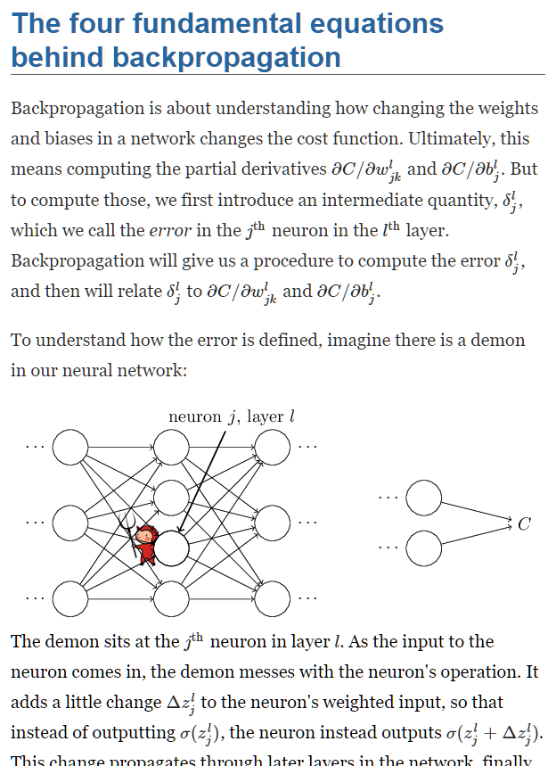
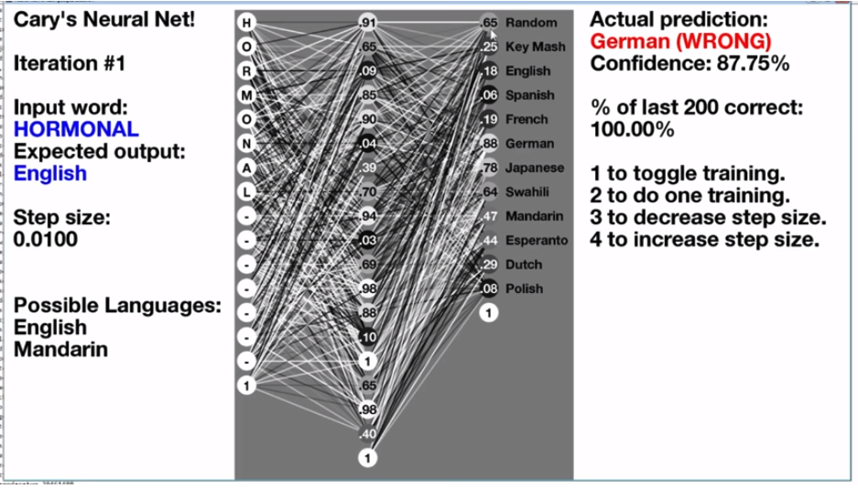
"Predicting Languages with Racist Neural Networks"
- Cary K. Huang, November 2016
“Neural Networks and Deep Learning” – Chapter 2
- Michael A. Nielson, 2015
Research
Notes:
These sources

Slide 3
Height (cm)
162
0.02
Chance of X
Weight (kg)
76.4
0.01
Chance of Y
Age (yr)
19
Design Principles: Functions

Slide 4
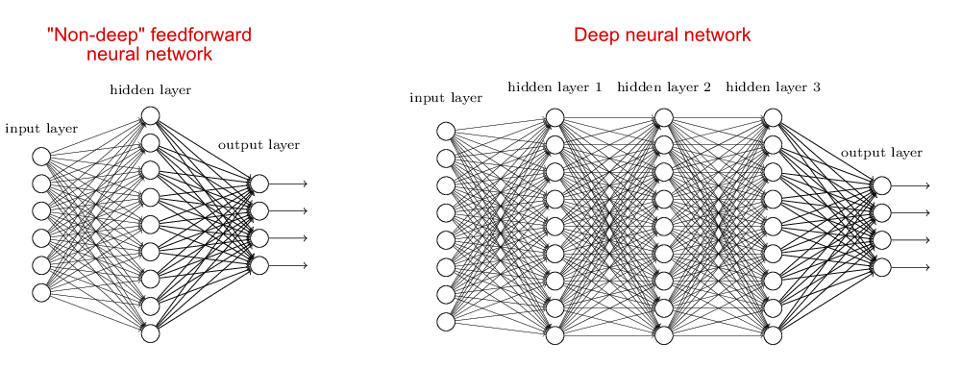
Function numbers
Input word
Language predictions
Design Principles: My function
Notes:
Network structure

Slide 5
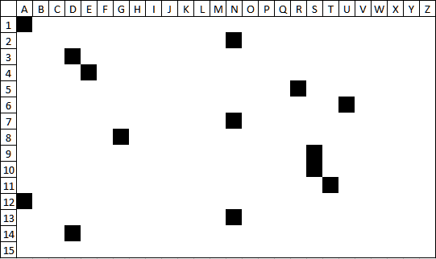
ANDERUNGSSTAND
ANDERUNGSSTAND
Design Principles: Input (One-hot encoding)
Notes:
Word to picture

Slide 6
Our actual word
Example
0 | 1 | 0 | 0 | 1 | 0 | 0 | 0 | 1 | 1 | 0 | 0 | 0 | 1 | 0 | 0 | 0 | 1 | 0 | 1 | 0 | 0 | 0 | 0 | 0 | 0 | 0 | 0 | 1 | 0
Design Principles: Input (One-hot encoding)
Notes:
Picture to numbers

Slide 7
Backpropagation
Forward propagation
0.17
0.81
0.37
0
0.02
0.23
0.86
1
Useless outputs
Real outputs
0.71
0.04
0.60
0
0.81
0
0.63
0.78
0.64
0
0.29
1
0.38
0.64
0.03
1
0.65
0
0.92
0.93
0.99
1
0.45
0
0.85
0.89
0.75
0
0.19
0.41
0.33
1
0.09
0.32
0.29
Design Principles: Training a network
Notes:
improvements

Slide 8
Forward propagation
0.17
0.81
0.37
0
0.02
0.23
0.86
1
0.71
0.04
0.60
0
0.01
0.63
0.78
0.64
Input word
0
0.03
0.38
0.64
0.03
Language predictions
1
0.93
0.92
0.93
0.99
1
0.02
0.85
0.89
0.75
0
0.19
0.41
0.33
1
0.09
0.32
0.29
Design Principles: The trained network
Notes:
predictions

Slide 9

French
German
Greek
Italian
Japanese
Latin
My program’s output

Slide 10
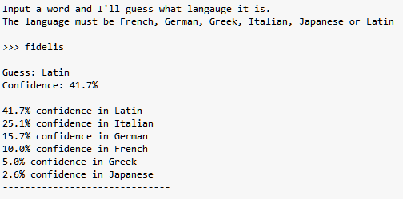
Running the program

Slide 11
Results

Slide 12
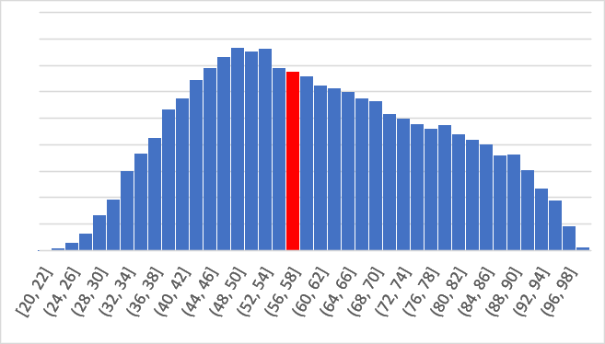
Evaluation
69% accuracy out of these 6 languages
Tried different styles of network
Analysed confidences
Network Confidence
Notes:
Nodes pL - 40, 80, 120, 160, 200
Hidden layers – 1,2,3
1/3 confidences below 50%
Actually 32%

Slide 13
What I learnt
Programming
Matrix Calculus
Collecting data
Conclusions on data

Slide 14
What I could do better
A different network model
Activation functions
More iterations

