Slide 1
(Yet Another) Presentation on COVID-19 in the US
The impact of state government action on the severity of the COVID-19 pandemic in the United States
Matt A. Beck
IST 652
Notes:
With the continued COVID-19 outbreak changing the fundamental nature of our how we conduct our lives, there has been great interest in the development of new approaches to expanding citizen understanding of the crisis and what actions are being taken. One group, COVID ACT NOW, has harnessed the collaborative efforts of multiple data scientists and engineers to build simple, easily digestible views for topline information on COVID at the state and county level.

Slide 2
Data Sources
NYT Covid Tracker (State over time)
Available as CSV from Github
State_intervention
Derived dataset
Originally embedded HTML presented by AEI

Slide 3
Do government actions appear to be effective in reducing the rate of new cases and deaths?
Calculations:
New Case Rate
New Death Rate
Groups
No/Low Intervention
Medium Intervention
High Intervention
Notes:
To answer this question, I needed to create some new fields. First, I created calculated fields for “new cases” and “new deaths” for each state over time. I then used a similar approach from question 1 and calculated an “intervention score” for each state. This time however, I grouped the time series dataset by these scores to produce the following units of analysis in a field *intervention_level*:
No/Low Intervention (Score of 0 – 3)
Medium Intervention (4 – 8)
High Intervention (9 – 12)
Using a data frame of state and intervention level, I joined the time series data with new cases and deaths. This allowed me to create calculated fields for “new case rate” and “new death rate” for each intervention level, over time. With one more use of matplotlib, I finally produced two charts, one for new case rate by intervention level, and one for new death rate.

Slide 4
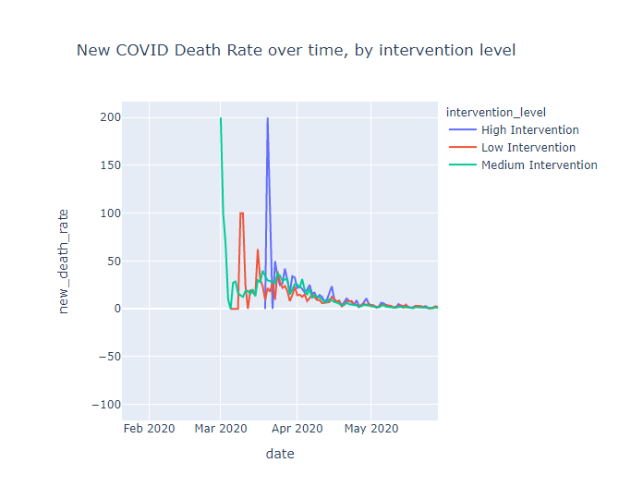
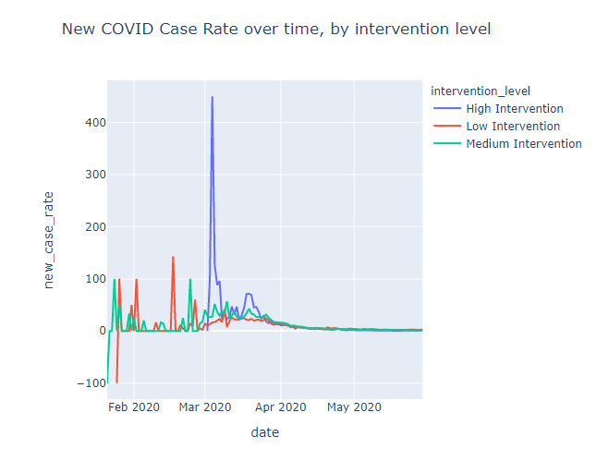
Do government actions appear to be effective in reducing the rate of new cases and deaths?
Notes:
We learned from these views over time that
There are some potential errors in the earliest collected data, showing dramatic decreases in new cases in the early stages—however these level out quickly as the volume of cases increases.
States with higher intervention saw the sharpest jumps in new cases, and the highest jumps in new deaths.
States with medium interventions initially saw large increases in new deaths, and remained higher than states with low intervention
States with low intervention saw the smallest variation in new cases, but saw more frequent jumps in new deaths, especially in March.

Slide 5
Conclusions
There was wide geographic variation in the severity of interventions taken at the state level to combat COVID-19
Of the interventions taken, School closures, restaurant/bar closures, and deployment of the national guard were taken by virtually all states.
Though the rate of new cases and deaths saw significant variation in the early stages of the crisis (especially among states with high levels of state action taken), at this stage the rate of new cases and deaths have largely converged.
Notes:
By analyzing these two datasets at various levels of analysis and different views, we were able to better understand the following about the COVID-19 crisis:

Slide 6
Next Steps
Calculate
Calculate true impact of intervention using cellphone “movement” data across the pandemic
Recalculate
Recalculate rates to capture how recent relaxation of interventions impacts new cases and deaths
Notes:
From these views alone, I don’t necessarily conclude that a lower level of state government action is associated strongly with a dramatic increase or decrease in cases and deaths when compared to states with more severe action. The next step in this analysis would be to quantify the true impact of these interventions, which could likely be done by including movement data provided by cellphone service providers and developing a measure for said impact. I also believe it’s still too early to determine how many deaths can be attributed to actions taken or lifted more recently--this initial analysis opens the door to a revisited look when CDC counts are updated in upcoming months.

Slide 7
Thank you for your time!
Matt A. Beck IST 652
Data Sources:
https://raw.githubusercontent.com/nytimes/covid-19-data/master/us-counties.csv
https://e.infogram.com/_/bo5pjUi7dprQAvs1l6oZ?src=embed

