Slide 1
Sticks Kebab Shop Segmentation
Team 1

Slide 2
How do people choose a fast food restaurant to visit?
What is important, location, price, assortment, or cuisine?
Who are Stick’s customers, and what are their motivations for visting sticks?
What does the survey data tell us about differences between customers and Noncustomers?
What survey questions would you use to identify the customer segments?

Slide 3
How many customer segments can you estimate from the survey data?
What are the profiles of the customer segments?
Which customer segments should Sticks target?
Bullet 3

Slide 4
Recommendation for the location of the next Sticks Kebob Shop
based on the segmentation analysis and the demographic profiles of the locations provided.
summary(cars)
## speed dist ## Min. : 4.0 Min. : 2.00 ## 1st Qu.:12.0 1st Qu.: 26.00 ## Median :15.0 Median : 36.00 ## Mean :15.4 Mean : 42.98 ## 3rd Qu.:19.0 3rd Qu.: 56.00 ## Max. :25.0 Max. :120.00

Slide 5
Determining the optimal number of clusters
## [1] 6261618.43 1452084.97 700340.88 404973.05 255682.06 178831.24 125858.85 ## [8] 97938.28

Slide 6
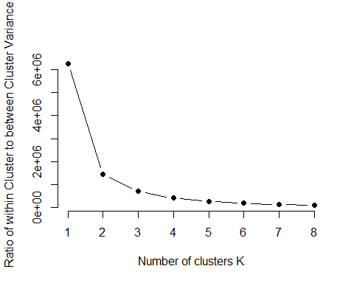

Slide 7
## K-means clustering with 3 clusters of sizes 34, 137, 170 ## ## Cluster means: ## careful_planner spender local_oriented health_oriented ## 1 2.235294 2.882353 3.705882 2.882353 ## 2 1.554745 3.751825 1.846715 1.474453 ## 3 1.976471 2.141176 1.782353 1.841176 ## ## Clustering vector: ## [1] 3 2 2 1 2 1 3 2 2 2 3 2 3 2 2 1 3 2 2 3 3 3 3 2 2 3 3 2 1 2 2 3 1 1 3 3 1 ## [38] 1 3 1 3 3 2 3 2 3 2 1 3 3 3 3 1 3 2 1 1 2 2 3 3 2 3 3 2 3 3 3 3 3 2 3 3 3 ## [75] 1 3 3 3 2 3 3 3 3 3 3 2 2 3 3 1 1 3 2 3 1 2 3 3 3 1 2 3 3 3 2 2 3 2 2 2 2 ## [112] 2 3 1 3 2 2 3 3 2 2 3 2 3 1 3 2 2 3 1 3 3 3 1 2 3 3 2 2 1 3 3 3 3 2 2 1 2 ## [149] 3 3 3 3 2 2 3 2 1 3 3 2 3 2 2 2 3 3 2 3 2 1 3 3 3 3 2 2 2 3 2 2 3 3 2 3 3 ## [186] 3 3 2 2 3 2 2 1 2 3 2 2 2 3 2 2 3 2 3 2 3 2 2 2 2 2 3 2 2 2 2 2 2 2 3 2 2 ## [223] 2 3 3 3 3 2 2 1 1 2 3 2 3 3 3 3 3 3 2 1 3 3 2 2 3 3 2 3 3 2 1 2 3 3 3 2 3 ## [260] 3 3 2 2 2 2 3 3 3 2 3 2 2 3 3 3 2 3 3 3 3 2 2 3 3 3 3 2 3 1 2 2 3 3 3 3 3 ## [297] 2 3 2 3 2 3 3 2 3 3 3 3 1 2 2 3 3 3 2 2 2 2 2 2 2 3 2 3 3 1 2 3 3 3 2 3 2 ## [334] 3 3 3 2 2 3 3 2 ## ## Within cluster sum of squares by cluster: ## [1] 116.2353 157.3431 274.1765 ## (between_SS / total_SS = 41.0 %) ## ## Available components: ## ## [1] "cluster" "centers" "totss" "withinss" "tot.withinss" ## [6] "betweenss" "size" "iter" "ifault"

