Slide 1
Process Improvement Project
Matthew Arlen Beck – MBC 638

Slide 2
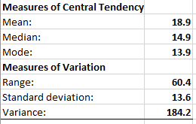
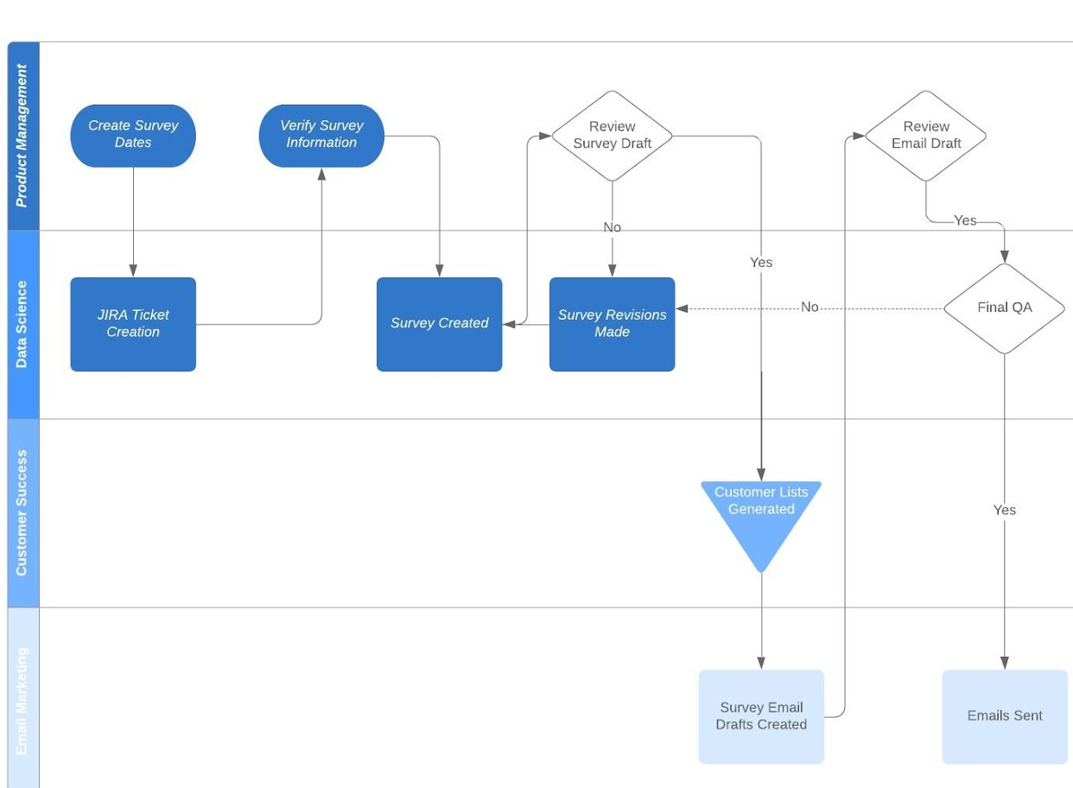
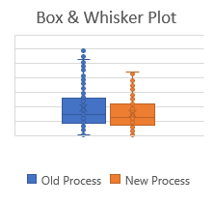
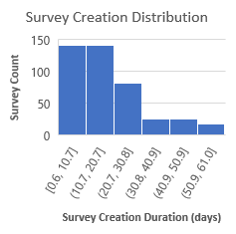
Process Improvement Project – Reducing Survey Creation Time
Define
Improve
Control
Measure
Analyze
Oct 7
- Oct 20
Oct 21
- Nov 3
Nov 4
- Nov 17
Nov 18
- Dec 1
Dec 2
- Dec 19
Our existing process for survey development and distribution has been identified as an issue with several potential points of failure, including:
Lack of measurement on distribution efficacy or quality
Decentralized documentation around survey/stakeholder responsibilities
Lack of standard distribution timeline
Manual quality assurance without a documented standard practice
I measured the existing process by collecting exported data from:
Ticketed requests for surveys in JIRA (project management software)
Survey team feedback on successful and defective surveys
I analyzed this process using the following approaches:
The team sought to improve this process by instituting the following ideas:
Set a team goal for 2 week (14 day) turnaround on all survey requests
Use data from JIRA to measure which tickets were at risk for failing to meet the goal to help prioritize work.
Requiring teams to include more information on the ticket itself, reducing time the survey team spent manually entering the information.
Since implementation, initial signs indicate the changes may be starting to work!
I ensured that the changes can improve the process over time by instituting a standard framework that determines whether the process is in control:
Distribution does not look ‘normal’
High variance indicates an inconsistent process!
This analysis helped me prioritize the areas where I could provide feedback on where to approve. Proposed changes needed to include:
A goal set significantly lower than the existing mean
Access to real-time data to help prioritize tickets during times of high volume (e.g. June)
Brainstorm of ways to reduce burden on the survey team
Drop in range, outliers
Cross-team collaboration in this process may be a factor in time required
Next Steps:
Calculate new SQL after 6 months of new process
Review Process Control Charts monthly
Calculate new measures of variation and central tendency after 6 month mark.
CURRENT PROCESS SQL:
2
As more data become available, a new SQL will be calculated.

Slide 3
Business Process & Problem Statement
Business Process
My company creates and distributes customer experience surveys on a regular cadence. These surveys are the backbone of our company’s ability to interpret the quality of our product offerings.
Problem Statement
This process is plagued with several potential points of failure, including:
Lack of measurement on distribution efficacy or quality
Decentralized documentation around survey/stakeholder responsibilities
Lack of standard distribution timeline
Manual quality assurance without a documented standard practice
Notes:
Consider talking about:
Critics

Slide 4
Business Impact, Measuring Success and Sigma Quality Level (SQL)
Business Impact
These points of failure create a risk to the company’s ability to measure not only customer satisfaction, but also to measure the impact of executive strategic decisions in response. Resolving these issues will decrease the required billable hours per survey and reduce the overall cost of the survey process.
Success Measure
Our goal was to improve the time from survey request to send by 16% (2 hours) by the end of the project period.
Initial data indicates we’re on track. 18.9 (old mean) – 16.8 (new mean) = savings of 2.1 hours
Data is continuous (hours).
SQL of Current Process: 2
Notes:
Consider talking about:
Critics

Slide 5
Data Stratification Tree
This tool guided the survey team through a discussion on what affected our output variable (survey creation time), and helped us know which data points I should be collecting. This method helped us determine a process change – an adjustment of who performs manual entry.
Notes:
Consider talking about:
Critics

Slide 6
Data Stratification Tree
Questions About Process
Stratification factors
X Variables
Measurements
Are certain teams associated with longer survey creation time?
Does the time of year impact the number of survey tickets?
Subtasks by Team
# of related subtasks by team
Duration of Survey creation by Month in year (1-12)
Month of Ticket Creation Date
Does the product type influence how long a given survey will take?
Product Offering Type
Duration of Survey creation by product type
Do surveys for new product offerings take longer to setup than for existing?
Days since Product Launch
# of days since product launch
Survey Creation
Time
Does the assigned individual survey creator impact survey creation time?
Survey Creator ID
Duration of survey creation by Creator ID
(Output Y)
Does time of month have an impact?
Day of Month
Count of Surveys by day of month (1-31)
Does # of concurrent surveys have an impact?
Concurrent Open Survey Count
Count of Active Surveys during survey creation period
Does ticket priority impact survey creation?
Priority Level
Priority Rating (1-3)
Do reported errors in QA impact time?
QA Errors Reported
# of reported errors in QA
Does the comment volume impact time?
Comment Volume
# of comments made on a survey ticket
Does the size of the group being surveyed impact survey creation time?
Survey Population Size
# of projected respondents

Slide 7
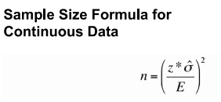
Determining Sample Size for Analysis
Acceptable parameters for sample size:
95% Confidence Level
Margin of Error = 2 Days A wide margin of measurement error is accounted for here, as we recognize there are circumstances out of the survey team’s control, and some room for delayed data entry.
Standard Deviation = 13.6
N (Desired Sample Size) = 177 ((1.96 * 13.6)/2)^2
Actual Available Sample Size = 429
Good to go!

Slide 8
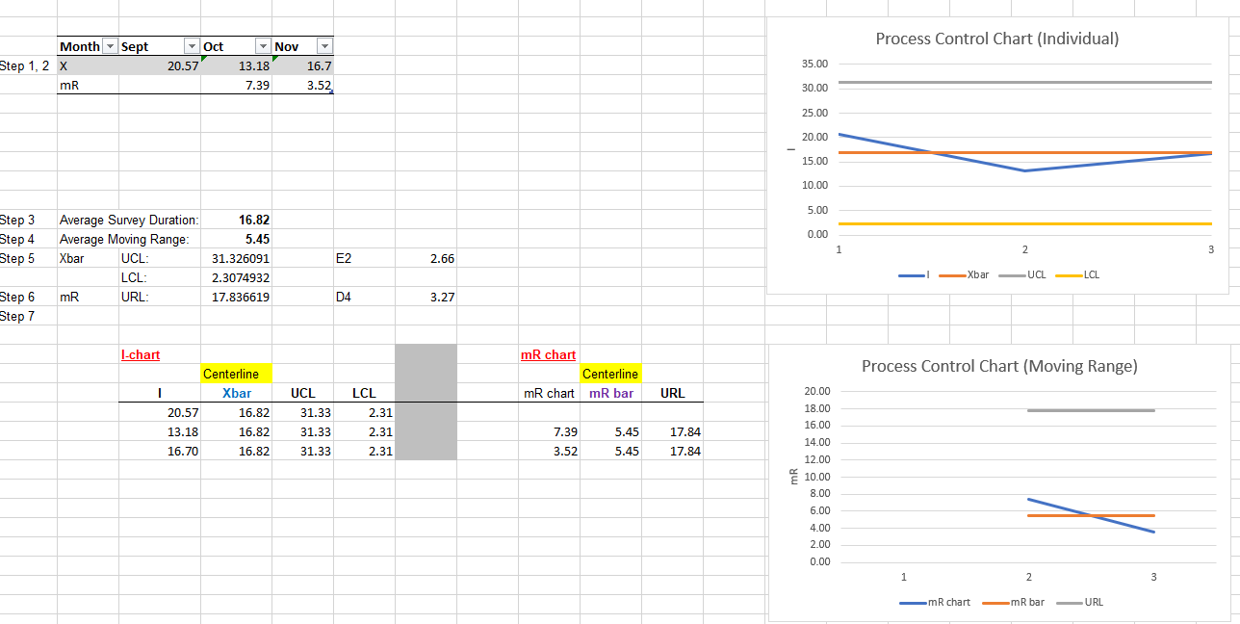
Controls – How I created them.

Slide 9
Tools Used
Histogram
Run Chart
Measures of Central Tendency + Measures of Variation
Process Map
Box and Whisker Plot
Control Chart

Slide 10
Appendix A: Measuring SQL (Sigma Quality Level)
Old Process
Surveys have two main types of defects:
Delayed Delivery (outside of 2 week turnaround)
Content Error (misspellings, etc.)
SQL Calculations:
Defect opportunities per unit: D = 2
Units produced per month: U = 56
Total possible defects per month: D U = 112
Total actual defects: A = 34
Defect-per-opportunity rate: A / DU = DPO = 30.3%
Defects per million opportunities (DPMO): DPO * 1,000,000 = 303,571
SQL value (from SQL table) ~2
NOT a great process!

