Slide 1
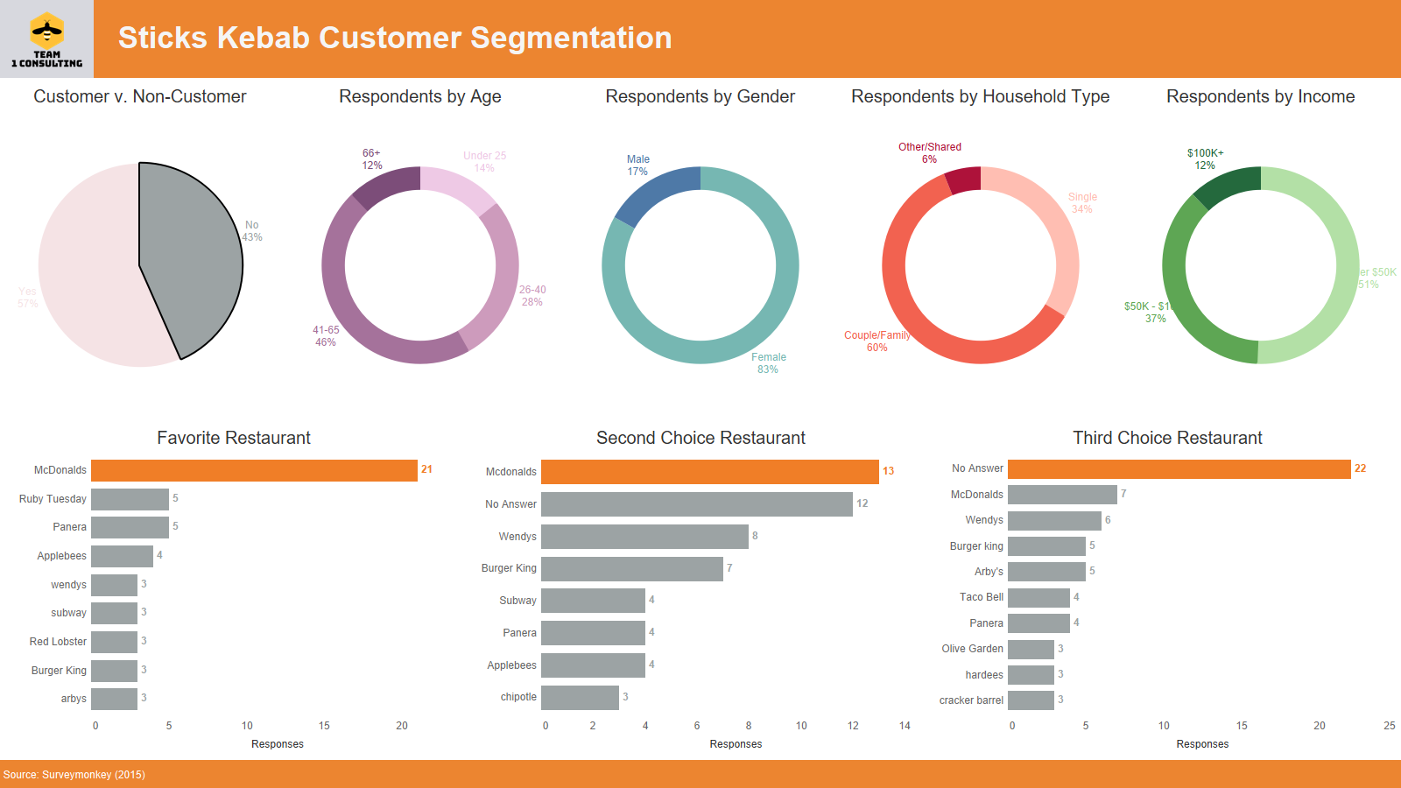
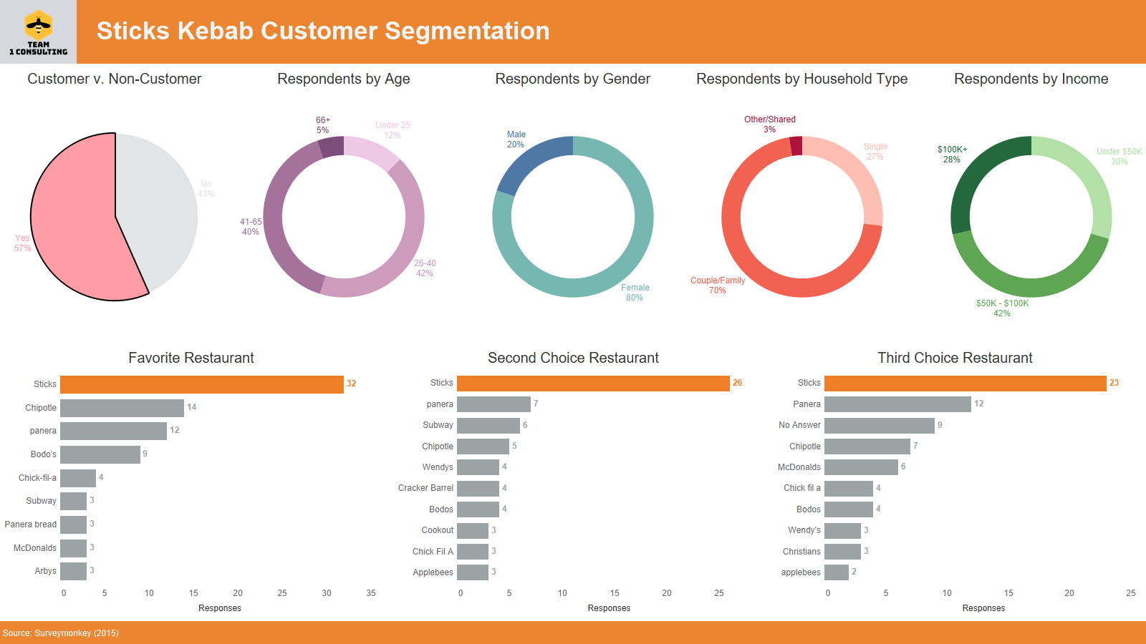
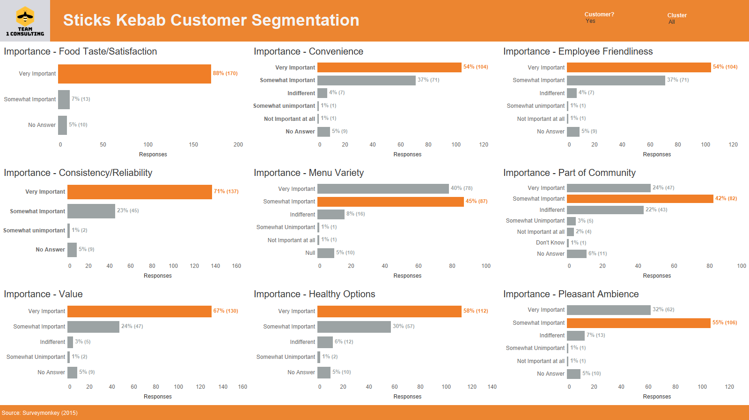
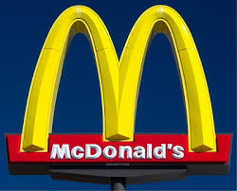
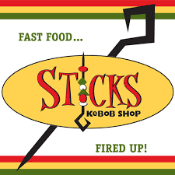
Problem Statement:
- We as the consulting company were hired by sticks to test their hypothesis of who the current customer base is.
Sticks Kebob Shop Segmentation
How do people choose fast food restaurants?
Taste and Satisfaction
Convenience
Employee Friendliness
Consistency / Reliability
Value
Health Options
Team 1
Matthew Beck, Heather Ford, Daniel Stafford, Carl West
Customer Fast Food Choice
Sticks Kabob Customers
1st (Sticks Kebob)
2nd (Sticks Kebob)
3rd (Sticks Kebob)
Non Sticks Customers
- 1st (McDonald’s)
- 2nd(McDonald’s)
- 3rd (No Answer)
Notes:
Sticks was relatively certain it had a good handle on its customer base- active people making choices for their families and working professionals looking for a quick, healthy lunch – but the team wanted to confirm that hypothesis. Management t worked with outside consultant to prepare and distribute a survey of both customers and noncustomers.

Slide 2
Who are Stick Kebob’s customers?
Primarily Female
Age 41-65
Couples or Families with a small child
Avg HH Income $50-$100K
What are their motivations for visiting Sticks Kebob?
Ambience
Food Variety
Friendly Staff
Customers vs Non-Customers?
Higher HH Income
Slightly Younger
More likely to have Children

Slide 3
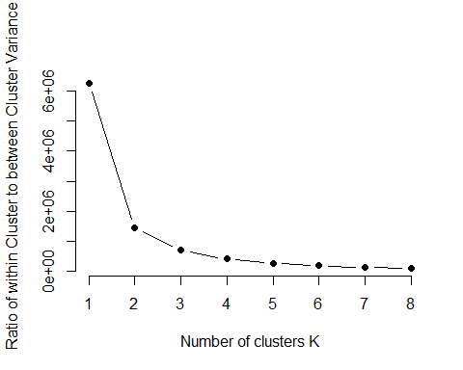
How many customer segments can you estimate from the survey data?
Cluster 1
Primarily existing Sticks customers
70% Couples/Family
Primary ages 41-65
Largest group made $50-100K
Strongly agreed health was important
Strongly disagreed that they struggled with spending
Cluster 2
Majority existing Sticks customers
Primary ages - 26-40
71% Couples/Family
Predominantly under $50K
Agree they struggle with spending
Cluster 3
Majority Non-customers
Predominantly under $50K
57% Couples/Family
Disagreed they struggled with spending
Survey topics used for segmentation
Careful Planner
Ability to Control Spending
Importance of locally produced products
Health Benefits

Slide 4
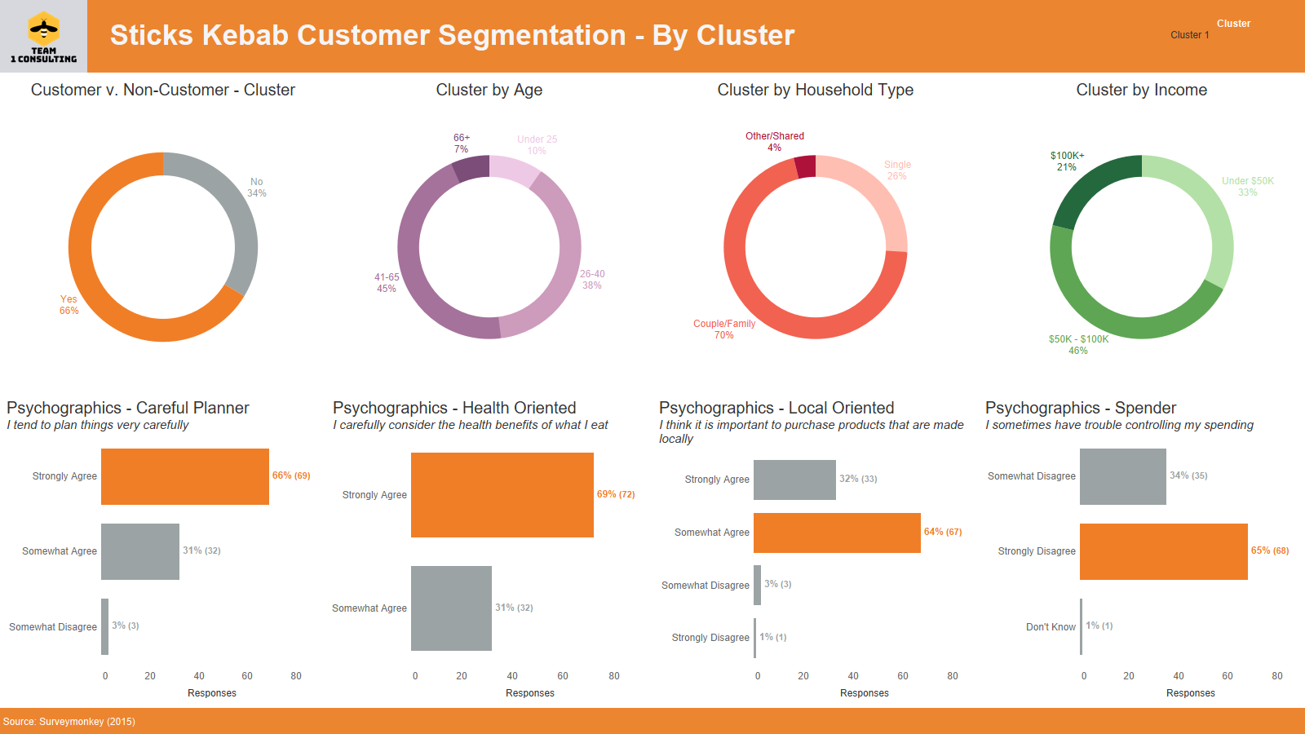
Which customer segments should Sticks target?

Slide 5
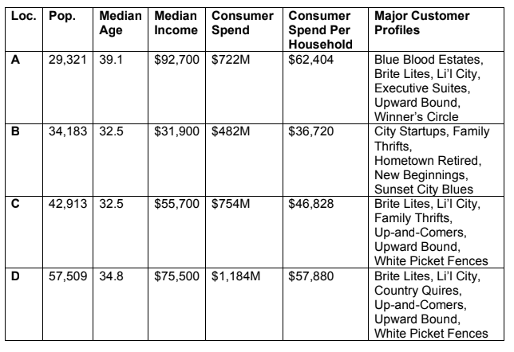
Recommended location for the next
Sticks Kebob
Problem Statement:
- We as the consulting company were hired by Sticks Kebob to test their hypothesis of who the current customer base is.
Methods:
- Based on the segmentation analysis and demographic analysis of the residential profiles in each area
Recommendation:
- In order to optimize sales and align with their growth revenue strategy, we recommend the prime location is Area “D.”

