Slide 1

Microsoft Azure Administrator: Implement Backup and Recovery
Working with Azure Backup Services
Michael Bender
Author evangelist - pluralsight
@michaelbender
Notes:
Servers fail.
Files get deleted.
Those are just facts of life in the world of information technology.
Having a solid backup and recovery plan strategy will mitigate many of the headaches that come with those events.
That’s what you’ll learn in this course, Microsoft Azure Administrator: Implement Backup and Recovery
I’m Michael Bender and I look forward to guiding you on your certification journey.

Slide 2
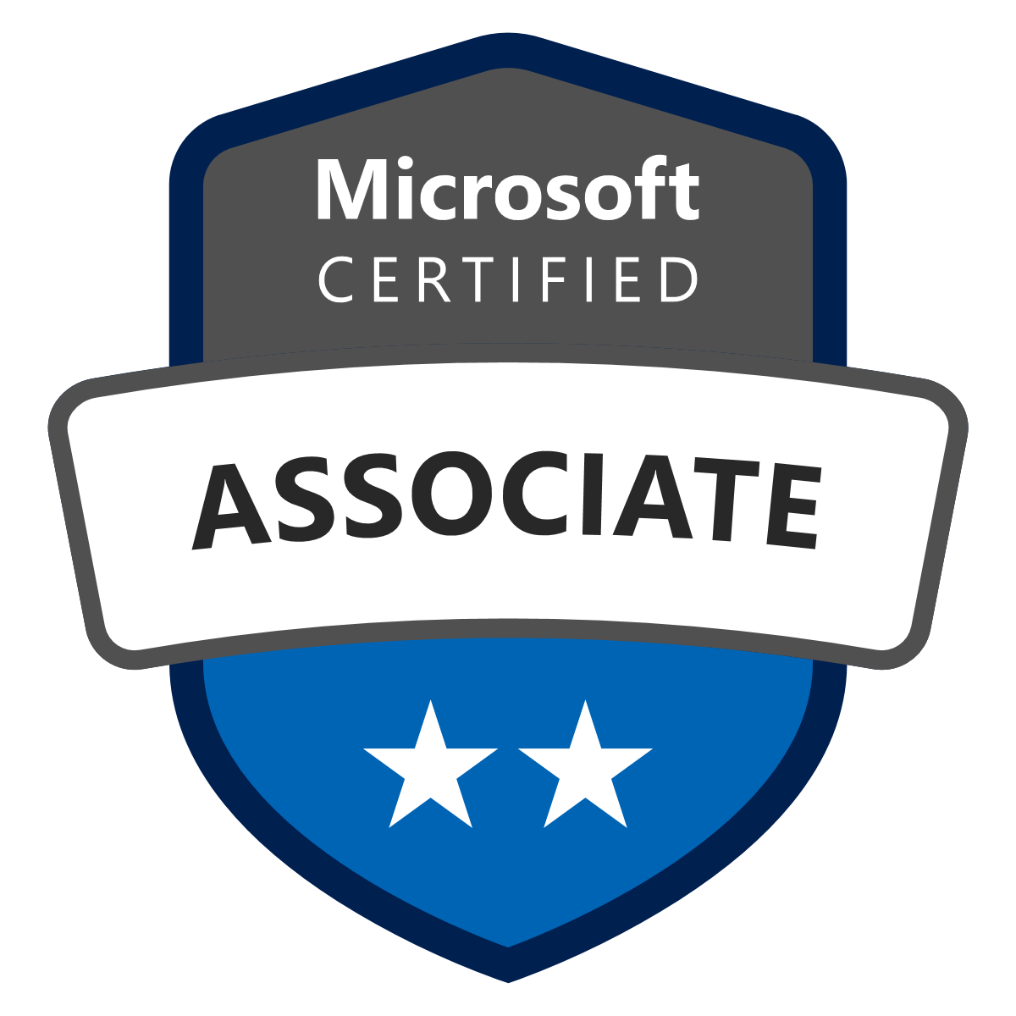
Course Coverage of Certification Objectives
Implement Backup and Recovery
Create a Recovery Services Vault
Create and configure backup policy
Perform backup and restore operations by using Azure Backup Service
Use soft delete to recover Azure VMs
Configure and review backup reports
Perform site-to-site recovery by using Azure Site Recovery
Full certification exam skills outline available at http://bit.ly/az104ms
Notes:
In this course, the focus is on managing backup and recovery, one of 2 functional groupings of knowledge in the Monitor and Backup Azure Resources objective domain for the Microsoft Azure Administrator - AZ-104 exam.
Since virtual machines and their contents (applications and file data) are the focus of the exam, you'll learn about the two major services in azure for business continuity and disaster recovery: Azure Backup and Azure Site Recovery.
You'll learn how to create a Recovery Services Vault for each of these services. And
Configure backup policies for use with backup and restore operations in Azure Backup.
Reporting will be covered so you can monitor your infrastructure
And finish the course with Azure Site Recovery and the knowledge needed to perform a site-to-site recovery of virtual machines.
Upon completion, you'll have all the knowledge you need for this area of the Az-104 certification exam AND to setup a bcdr strategy in Azure for your orginization.
> Before we jump in

Slide 3
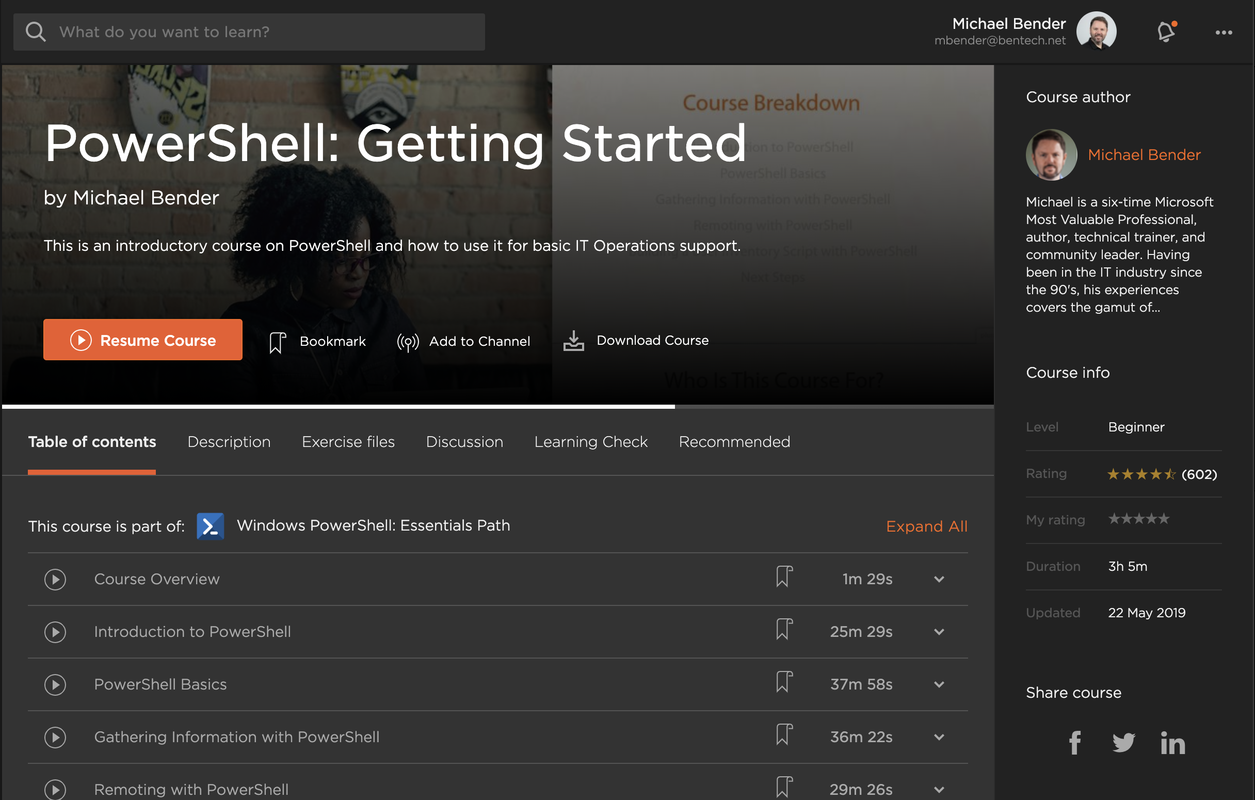
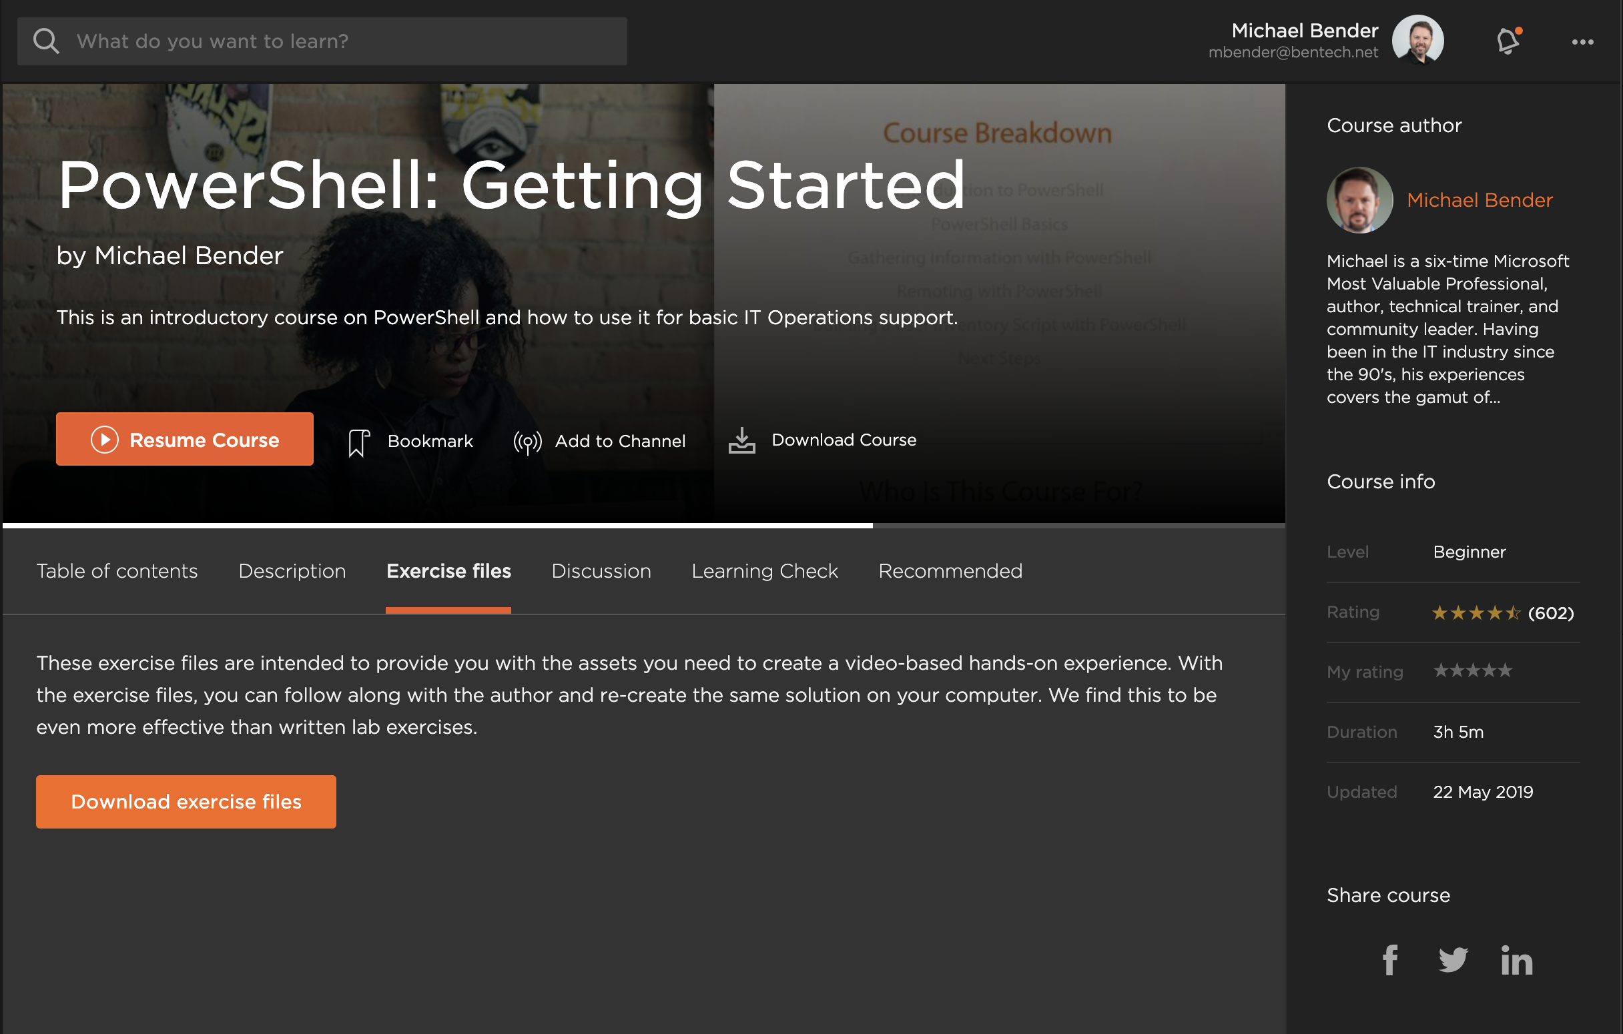
Exercise Files
Slides
Code
Links to Resources
Notes:
Before you jump,
I wanted to point out that this and every module has exercise files you can download from Pluralsight.com. This download will include a PDF copy of the slides, any code and/or file assets used during the course for demos, and links to resources for deeper learning about the topics covered. This will be especially helpful as you are preparing the AZ-104 exam.
From the course page at Pluralsight, Just choose the Exercise file tab
And click on the download button to get all of the resources from this module. You will get a compressed .zip file that you can extract on your local computer.
With that out of the way, let's get into Backup and Recovery!

Slide 4

Business Continuity and Disaster Recovery
File and folder recovery
Virtual machine recovery
Site-wide recovery
Recovery point objective (RPO)
Recovery time objective (RTO)
Notes:
When you are thinking about Backup and Recovery, there are a number of outcomes that come to mind. They include:
Recovering files and folders
Restoring a single or multiple virtual machines. This could be a physical server failure or a full OS corruption.
Recovering from a site wide disaster such as a datacenter fire or an azure region going down.
Along with those outcomes, you need to decide what tolerance your business has for data recovery. Do you need to recover to the minute or just last night. Do you have to have backups going back years for compliance, or just the last few quarters? This is referred to as the Recovery Point Objective, or at what point do you need to recover from.
How quickly your applications need to be back in service is important as well. This is the Recovery Time Objective, or the target for when services need to be back up and running.
How you plan for these is referred to as Business Continuity and Disaster Recovery planning, or BCDR. Having a good plan is critical for all organizations. While we won't go into how your organization decides it's needs in a BCDR plan, you'll learn how to use the tools in Azure to implement a BCDR plan for your organization.
>When implementing backup and recovery in Azure, the two main areas we’ll focus on for the exam as well as general azure administration are:

Slide 5
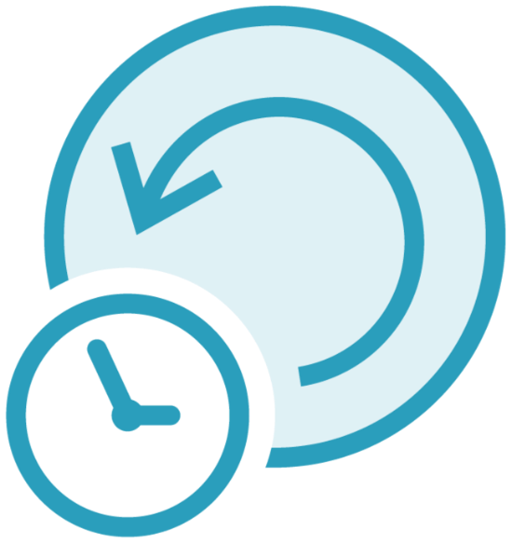
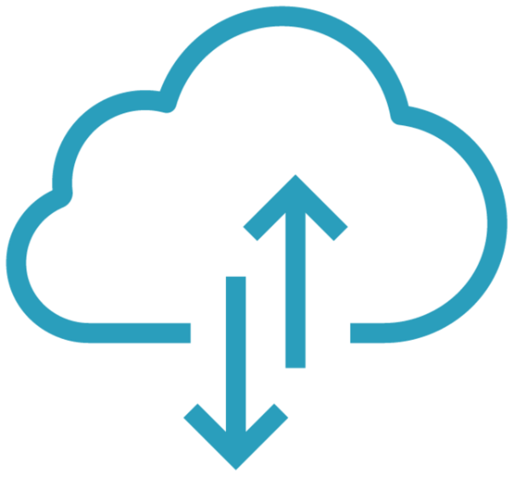
Backup and Disaster Recovery Options in Azure
Azure Backup
Azure Site Recovery
Notes:
When dealing with Backup and Disaster Recovery in Azure, the two main areas we’ll focus on for the exam as well as general azure administration are:
Azure Backup – This is a cloud-based enterprise backup and recovery service for VMs and Azure Files. Along with your cloud workloads, Azure Backup can backup your on-premises virtual machines using the Microsoft Azure Recovery Services, Or MARS, agent, workloads in AWS, and VMWare/Hyper-V infrastructures.
And
Azure Site Recovery, or ASR. – Through resource replication, Azure Site Recovery provides site-to-site replication and recovery of workloads in Azure, on-premises, and in other Clouds. It's designed for disaster recovery scenarios where you lose an entire site, and need to failover to a second site.
The exam is going to focus on Azure Backup with Azure Virtual Machines and Azure Files, and ASR with Azure-based resources. But there is a good chance you may need to use these with on-premises workloads running on virtualization hosts like Hyper-V or Vmware vSphere, or physical servers. You'll want to check out the docs on those scenarios. I've included a few links in the exercise files.
> To use both, you need a recovery services vault, or RSV.

Slide 6
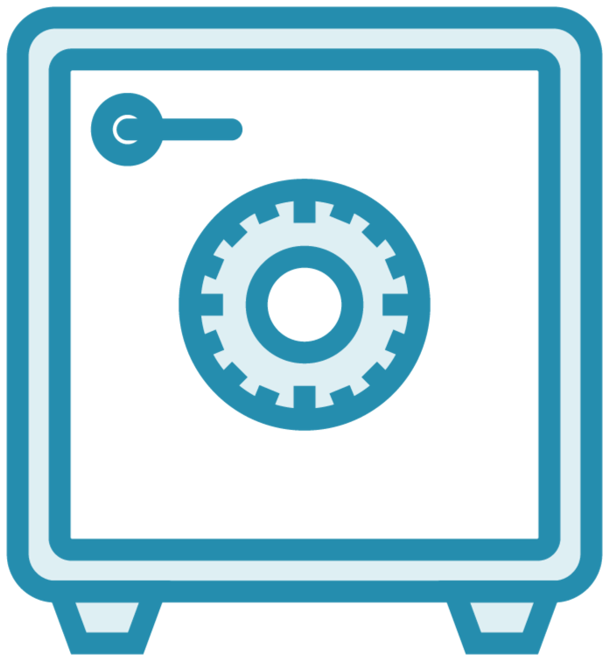
Recovery Service Vault
Storage Entity for backup and recovery resources
Centralized management
Work with on-premises and cloud-based workloads.
Backup resources in same region
Site recovery resources in different region
Notes:
> To use both, you need a recovery services vault, or RSV.
At the center of Azure backup and recovery is the recovery services vault. A Recovery Services vault (RSV) is a storage object in Azure designed for backup and recovery of Azure Resources. Linux and Windows Virtual machines, which this course focuses on, and Azure SQL Databases are common services.
RSVs provide a central place for organizing and managing your Backup Continuity and Disaster Recovery strategy (BCDR) using Azure Backup and Azure Site Recovery.
Backups, Restores, Site Replication, and management tasks like reporting are handled through the RSV.
While we'll focus on Azure virtual machines and Azure File shares, you should know that RSVs can service on-premises workloads along with workloads in AWS
When creating an RSV it is important to remember a Recovery Service Vault can only backup Azure data that is the same region as the RSV. So if you have resources distributed across multiple regions, you will need multiple Resource Vaults. Did I mention this was important?
When creating an RSV for Azure Site Recovery, it needs to be in a separate region than the source data. That's because the RSV will hold replicated data AND is designed for when a region goes down. This is an important distinction from Azure Backup.
Now, Let’s take a look at creating a recovery services vault in Azure.

Slide 7
Creating a Recovery Services Vault
Notes:
In this demo, you'll learn to create an Azure Recovery Services Vault in an existing resource group in the East US azure region. Then, we'll review the recovery services vault in Azure so you are familiar with its options and features, many of which you can customize to the needs of your organization.
Create an RSV in RG-backup-001

Slide 8

Azure Backup
Supports on-premises and Azure workloads
Scales with your organization
Centralized monitoring and management
App-consistent backups
Encrypted-at-rest by default
Require resources and vault in same region
Notes:
First stop in our Backup and Recovery journey is Azure Backup and Restore.
As mentioned, Azure Backup A enterprise backup and recovery service for VMs and Azure Files. It supports those workloads wherever they are: in Azure, On-premises (for hybrid scenarios), and even in AWS.
Because it's cloud-based, it easily scales to meet your organization's needs. No longer are you limited by media like tape or disks. Store as much as you want as long as you want, though you still have to pay the bill so don't get to carried away.
Through the recovery services vault, you have built-in monitoring and alerting capabilities, and they are available without any additional management infrastructure. You can also integrate with Azure Monitor for .
Azure Backup provides app-consistent backups: An application-consistent backup means a recovery point has all required data to restore the backup copy. Azure Backup provides application-consistent backups, which ensure additional fixes aren't required to restore the data. Restoring application-consistent data reduces the restoration time so you can achieve your recovery time objectives.
By default, all the disks in your VMs are automatically encrypted-at-rest using platform-managed keys (PMK) that use storage service encryption. You can back up these VMs using Azure Backup without any specific actions required to support encryption on your end.
As mentioned before, the resources you are backing up with Azure Backup need to be in the same region as the Resource Vault
Now let's take a look at how a backup of an Azure VM Works.

Slide 9

Backup Policy
Stored in Recovery Services Vault
Defines how a backup plan is implemented
Implements RPO and RTO
Policy for each resource type
Notes:
To get started with creating a backup, you need a backup policy.
This is created and stored inside of the Recovery Services Vault in the region with the source resources.
It defines what is backed up, when that backup runs and how long backup data is kept.
This will allow you to implement your RPO and RTO targets. When you choose to save backups over time, you will have various recovery points available for you to utilize should you need to go back further than the latest backup.
If you have a variety of sources like Azure Files and VMs, you will need a policy for each one of the resources.

Slide 10
Create and Configure Backup Policy
Notes:
Let’s take a look at creating and configuring a backup policy.
In this demo, you see the default policies created inside the Recovery Services vault. Then we’ll create a new recovery service vault that has defined retention settings. Last, you see how to modify an existing policy.
In RSV,
Show Default Policies
Create New Policies
Modify policy

Slide 11

Backup Agents
Manage recovery services between source and Recovery Services Vault
Azure Backup Extension
All Azure VMs
Installed on first backup
Microsoft Azure Recovery Services agent (Mars)
On-Premises and AWS Windows VMs
Supports various scenarios
Download from Recovery Services Vault
Notes:
In order to backup resources like VMs with Azure Backup, you need an agent. These agents manage the backup and recovery services between the source resources and the recovery services vault.
For Azure VMs, the Azure Backup extension is automatically installed during the first backup operation on a resource. No manual intervention is needed by administrators.
For On-Premises and non-Azure Windows VMs (say in AWS), administrators need to install and configure the Microsoft Azure Recovery Services Agent, or MARS agent, to work with a Recovery Services Vault.
Mars supports various scenarios for backup including:
Files and Folders: Selectively protect Windows files and folders.
Volume Level: Protect an entire Windows volume of your machine.
System Level: Protect an entire Windows system state.
The MARS agent and the required credential file for connecting to the Recovery Services Vault is downloaded from the RSV in the Azure Portal. As you saw in the RSV demo, it is located under properties

Slide 12


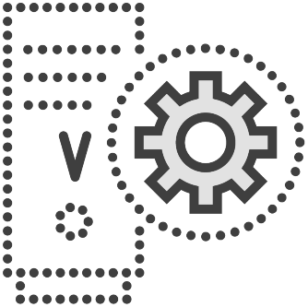
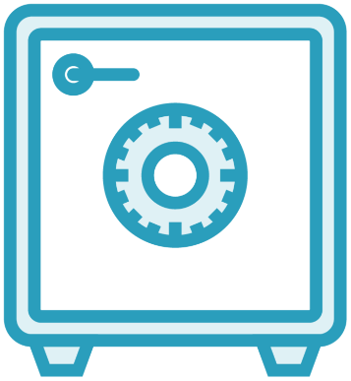
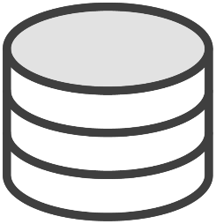

Azure VM Backup Architecture
Azure Backup Service
Azure VM
VM Disk
App-Consistent Snapshot
Recovery Services Vault
Notes:
When you enable backup for an Azure VM, a backup runs according to the schedule you specify in the backup policy.
During the first backup, a backup extension is installed on the Azure VM if the VM is running.
For Windows VMs, the VMSnapshot extension is installed.
For Linux VMs, the VMSnapshot Linux extension is installed.
To create the backup, the VM extension will take a storage-level snapshot.
For Windows VMs, the extension works with Windows Volume Shadow Copy Service (VSS) to take an app-consistent snapshot of the VM. By default, Backup takes full VSS backups. If Backup is unable to take an app-consistent snapshot, then it takes a file-consistent snapshot.
For Linux VMs, Backup takes a file-consistent snapshot. For app-consistent snapshots, you need to manually customize pre/post scripts.
If you have multiple disks, snapshots are taken in parallel.
After the snapshot is taken, the data is transferred to the vault. It works at the block level and only stores changed backup data, thus minimizing the backup time after initial backups occur.
During peak times, snapshot data may not be immediately copied to the RSV. It could take hours with total backup time being less than 24 hrs.
After the data is sent to the vault, a recovery point is created. 2 days of snapshots are retained (by default). This feature, called Instant Restore, allows you to restore from those snapshots. It reduces the time that's required to transform and copy data back from the vault.
Now it's time to setup up your first backup.

Slide 13
Backup an Azure VM
Create a Backup
Run Backup Manually
Notes:
In the first demo, you’ll see how to create a backup of a virtual machine in an existing Recovery Services Vault. We’ll start by creating a backup policy, which manages how backups are performed, then we’ll create a backup for an existing VM. Then we’ll kick off a manual backup.

Slide 14



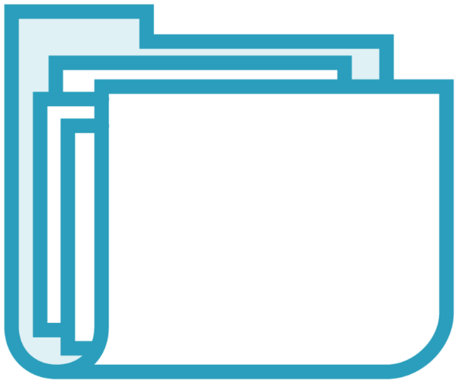
Azure VM Restore Options
VM
Create new or replace
Disk
Files
Cross-Region Restore
Notes:
Azure Backup gives a number of options for restore.
You can restore the entire VM as an Original Location Recovery OLR (if the source VM still exists and you wish to replace) or you can choose Alternate Location Recovery, or ALR, where the VM is restored to a different location. When restoring a VM, you are limited within the portal of the options for the new VM so customization requires the use of Azure PowerShell.
Next, you can restore just the disks that are attached to a VM.
If you want to restore specific files within a VM, you can choose a specific restore point, browse a mounted copy of the disks, select files, and restore them. To do this, you’ll download a script (for linux vms) or an executable (for windows VMs) that will auto-mount the restored data in azure for a default of 12 hrs.
The last option is Cross Region Restore (CRR). CRR allows you to restore Azure VMs in a secondary region, based on the azure list of paired regions. This was recently brought out of preview (as of the time of this recording) so it may or may not be on the exam when you take it. However, it is another option for VM recovery to add to your tool box.
>Along with these, there is one additional option turned on by default called Soft Delete.

Slide 15
Protects against unintended VM deletions
Stored for up to 14 days
Requires a backup to have been completed
Multiple tools for completing
Disabling not recommended
Virtual Machine Soft Delete
Notes:
>Along with these, there is one additional option turned on by default called Soft Delete.
Soft delete for VMs protects the backups of your VMs from unintended deletion. Even after the backups are deleted, they're preserved in soft-delete state for 14 additional days.
Soft delete only protects deleted backup data. If a VM is deleted without a backup, the soft-delete feature won't preserve the data. All resources should be protected with Azure Backup to ensure full resilience.
Like many operations in Azure, multiple tools can be used to recover soft-deleted VMs. This includes Azure PowerShell, Azure CLI, and REST API. The doc in the exercise file includes how to use all of them.
Disabling this feature isn't recommended. The only circumstance where you should consider disabling soft delete is if you're planning on moving your protected items to a new vault, and can't wait the 14 days required before deleting and re-protecting (such as in a test environment.)

Slide 16
Performing restores with Azure Backup
Restore a full VM
Restore files
Recover with soft delete
Notes:
Now that the backup is completed and we have some backup sets available, we’ll perform a few different types of restores. First will be the full restore of a Windows VM, then we’ll restore individual files from a backed up VM.
The last recovery option you’ll learn is using Soft Delete. This is a great option when VM backups have been deleted from Azure and you need to do a recovery.

Slide 17
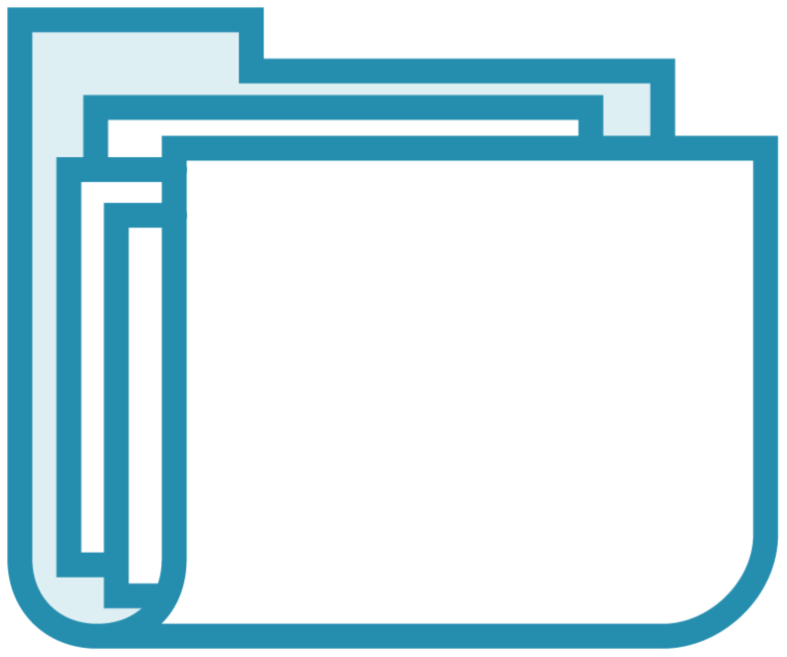
Azure Files Backup
Cloud-based backup for Azure Files
Integrates with Azure File Sync
Customized Retention
Instant Restore
Protection against accidently deletion with soft Delete
Snapshot-based
Notes:
Azure file share backup is a native, cloud based backup solution that protects your data in the cloud. With Azure Backup, there is no infrastructure like backup servers, disk storage units, or proprietary software that needs to be managed.
The Azure Backup service smoothly integrates with Azure File Sync, and allows you to centralize your file share data as well as your backups. This simple, reliable, and secure solution enables you to configure protection for your enterprise file shares in a few simple steps with an assurance that you can recover your data in any disaster scenario.
Like Azure VMs you can configure backups with daily/weekly/monthly/ and/or yearly retention to meet your orginizations. RTO/RPO requirements.
Azure file share backup uses file share snapshots, so you can select just the files you want to restore instantly. No waiting for a data restore. Note this is different than if you choose to restore files from an Azure VM backup. Make sure you know the difference between the two.
Azure Backup enables the soft delete feature on a storage account level with a retention period of 14 days. Even if a malicious actor deletes the file share, the file share’s contents and recovery points (snapshots) are retained for a configurable retention period, allowing the successful and complete recovery of source contents and snapshots with no data loss.
The file share data isn't transferred to the Backup service, since the Backup service creates and manages snapshots that are part of your storage account, and backups aren't transferred to the vault.

Slide 18
Azure File Share Backup and Restore
Notes:
In this demo, you’ll see the entire Azure File Backup and Restore process. First, we’ll create a policy for Azure File backup. Then the policy will be applied to an existing Azure File share. To finish, a restore of files will be done.

Slide 19
Configure Azure Backup Reports
Supports multiple source options
Requires a Log Analytics workspace
Configure through diagnostic settings
Notes:
I know in all of the orginizations I’ve worked in, tracking backup success has always been on the top of routine maintenance activity (RMA) lists.
With Azure Backup, reports are support for multiple sources including Azure VMs, SQL in Azure VMs, SAP HANA in Azure VMs, Microsoft Azure Recovery Services (MARS) agent, Microsoft Azure Backup Server (MABS), and System Center Data Protection Manager (DPM). For Azure File share backup, data is displayed for all records created on or after June 1, 2020, as it went in

Slide 20
Configuring Azure Backup Reports
Notes:
Create Log Analytics Workspace
Configure Azure Backup reports - Azure Backup | Microsoft Docs
Configure Diagnostics on Vault
Use diagnostics settings for Recovery Services vaults - Azure Backup | Microsoft Docs
RSV > Diagnostic Settings

Slide 21
Implementing Azure Site Recovery
Notes:
Now that you have an understanding of the Recovery Services Vault and Azure Backup,
It’s time to look at the other recovery tool in the Vault,
Azure Site Recovery.
In this module, you’ll learn the skills to perform a site-to-site recovery of Azure VMs

Slide 22
Implementing Azure Site Recovery
Michael Bender
Author evangelist - pluralsight
@michaelbender
Notes:
Now that you have an understanding of the Recovery Services Vault and Azure Backup,
It’s time to look at the other recovery tool in the Vault,
Azure Site Recovery.
In this module, you’ll learn the skills to perform a site-to-site recovery of Azure VMs

Slide 23
Designed for primary site outage
Replicates workloads
On-Premises servers and virtualization hosts
Azure Workloads
AWS Windows VMs
Azure Site Recovery
Notes:
Site Recovery helps ensure business continuity by keeping business apps and workloads running during outages. Site Recovery replicates workloads running on physical and virtual machines (VMs) from a primary site to a secondary location. When an outage occurs at your primary site, you fail over to secondary location, and access apps from there. After the primary location is running again, you can fail back to it.
Fail back is the term everyone uses, but what you are really doing is the same failover process, just returning to the original region
When setting up ASR you need to make sure you create the Recovery Service Vault in any region other than the source region. So if your VMs are located in East US, West US is a good chocie for your ASR vault. This is different than Azure Backup requirements.
ASR for the exam will focus on Site Recovery of Azure VMs. However, you should understand that you can use ASR with on-premises workloads. Like Azure Backup, On-premises workloads taking part in ASR will use the MARS agent and vault registration key
>It's important to understand what makes up Azure Site Recovery so let's take a look at it's general topology

Slide 24

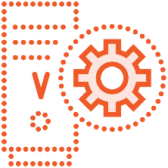


Azure Site Recovery Topology
Recovery
Recovery Services Vault
Managed disks
Cache data
Replica disks
vNet
vNet-ASR
Source Region
Target Region
Notes:
>It's important to understand what makes up Azure Site Recovery so let's take a look at it's general topology
When you enable replication for an Azure VM within a recovery services vault, the following happens:
The Site Recovery Mobility service extension is automatically installed on the VM.
The extension registers the VM with Site Recovery.
Continuous replication begins for the VM. Disk writes are immediately transferred to the cache storage account in the source location.
Site Recovery processes the data in the cache, and sends it to the target storage account, or to the replica managed disks.
After the data is processed, crash-consistent recovery points are generated every five minutes. App-consistent recovery points are generated according to the setting specified in the replication policy.
When a failover occurs, the recover service vault builds out the VMs using the replica disks, places them in the virtual network in the secondary region, and brings the vms online.
Depending on your network security and Domain Naming requirements, you may need to use a service like traffic manager to ensure custom domain names transfer automatically, otherwise it can be done manually.
> Now that you have an idea of how ASR works, let’s set it up!

Slide 25

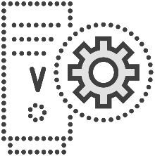
Azure Site Recovery Topology
Recovery Services Vault
Managed disks
Cache data
Replica disks
vNet
vNet-ASR
Source Region
Target Region
Notes:
>It's important to understand what makes up Azure Site Recovery so let's take a look at it's general topology
When you enable replication for an Azure VM within a recovery services vault, the following happens:
The Site Recovery Mobility service extension is automatically installed on the VM.
The extension registers the VM with Site Recovery.
Continuous replication begins for the VM. Disk writes are immediately transferred to the cache storage account in the source location.
Site Recovery processes the data in the cache, and sends it to the target storage account, or to the replica managed disks.
After the data is processed, crash-consistent recovery points are generated every five minutes. App-consistent recovery points are generated according to the setting specified in the replication policy.
When a failover occurs, the recover service vault builds out the VMs using the replica disks, places them in the virtual network in the secondary region, and brings the vms online.
Depending on your network security and Domain Naming requirements, you may need to use a service like traffic manager to ensure custom domain names transfer automatically, otherwise it can be done manually.
> Now that you have an idea of how ASR works, let’s set it up!

Slide 26
Setup up Azure Site Recovery for Azure VMs
Notes:
> Now that you have an idea of how ASR works, let’s set it up!
You can replicate a single or multiple VMs, depending on your orginizations needs.
In this demo, we'll implement ASR for a single Windows Server. This will be performed from the virtual machine blade in the Azure Portal to a Recover Services Vault.
Web001
Testfailback
Infrastructure view

Slide 27
Initiate Azure Site Recovery failover
Notes:
In our last demo

Slide 28
Recovery storage vaults only backup VMs in the same region
Place Recovery Storage Vaults in a different region for ASR
Use a different policy for each type of backup
Use the MARS agent for On-Prem and AWS VM backups
Review the CLI options
Get some hands-on experience
Summary
Notes:
And that wraps it up for Backup and Recovery.
As you continue on your AZ-104 journey, there are few key things you’ll need to know for the exam:
When creating recovery service vault for backing up Azure VMs, remember that the RSV neesds to reside in the same region as the source VMs.
For Azure Site Recovery, it is the opposite. Create your RSV in the target region. This should make sense since the RSV has all the information and data needed to failover your site. If you put it in the source region, it wouldn’t be available when needed.
When creating backup policies, make sure you create a different policy for each type of backup like Azure Files and Azure VMs.
While you are studying, make sure to check out the CLI options.
Depending on when you take the exam, you may or may not have hands on components. That said, you should make sure to run through all the demos on your own so you can actually perform the work.

Slide 29
For Further Learning
Azure Storage Accounts documentation at docs.microsoft.com https://docs.microsoft.com/en-us/azure/storage/common/storage-account-overview
Creating and Configuring Microsoft Azure Storage Accounts by Neil Morrissey https://www.pluralsight.com/courses/microsoft-azure-creating-configuring-storage-accounts
Remember the module exercise files
Questions? Join on the conversation at pluralsight.com or @Michaelbender on Twitter
Notes:
If you need further learning resources or information about the topics covered in this module, check out the Azure Storage Accounts documentation at docs.Microsoft.com. This is a great resource for Azure Administrators, and will allow you to go deeper on any topics related to Storage Accounts.
If you are looking for another pluralsight course to go deeper into Storage Accounts, check out Creating and Configuring Microsoft Azure Storage Accounts by Neil Morrissey. It 3+ hrs of everything you need to know about Storage Accounts.
You’ll also find curated list of specific links I think you find helpful in the module exercise files on pluralsight.com. Look for the ReadMe file for more information.
And if you have any questions about the course, please join the discussion on the discussion board for the course at pluralsight.com.
Now you should have all the knowledge you need to cover this area of the AZ-104 exam focused on backup and recover of Azure VMs and Azure Files.
I hope you enjoyed this course, as I enjoyed putting it together for you.
With that, thanks for watching and I'll see you in another course on Pluralsight.com.

