Slide 1
It’s PowerShell In the Cloud - Welcome to Azure Cloud Shell
Michael Bender
Author evangelist – Pluralsight.com

Slide 2
Session resources
http://bit.ly/azshell

Slide 3
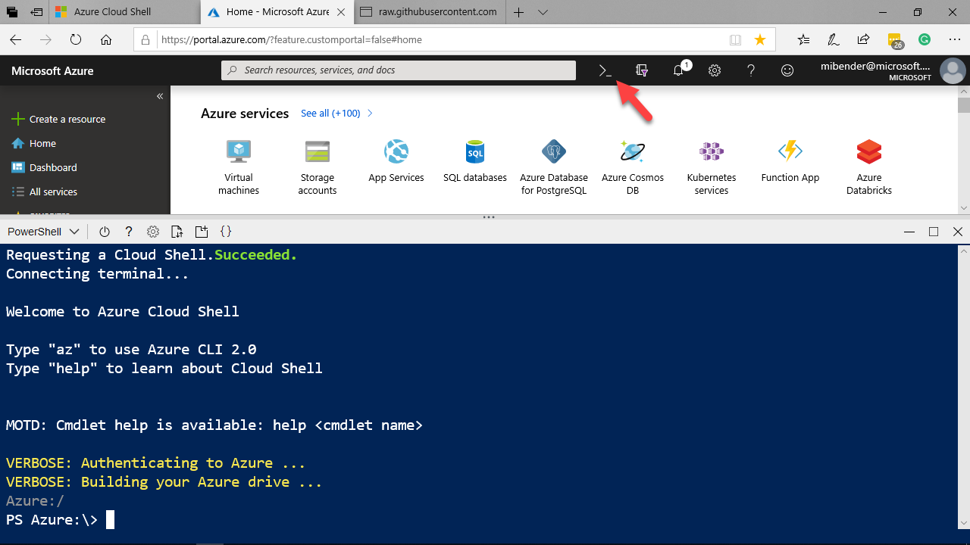
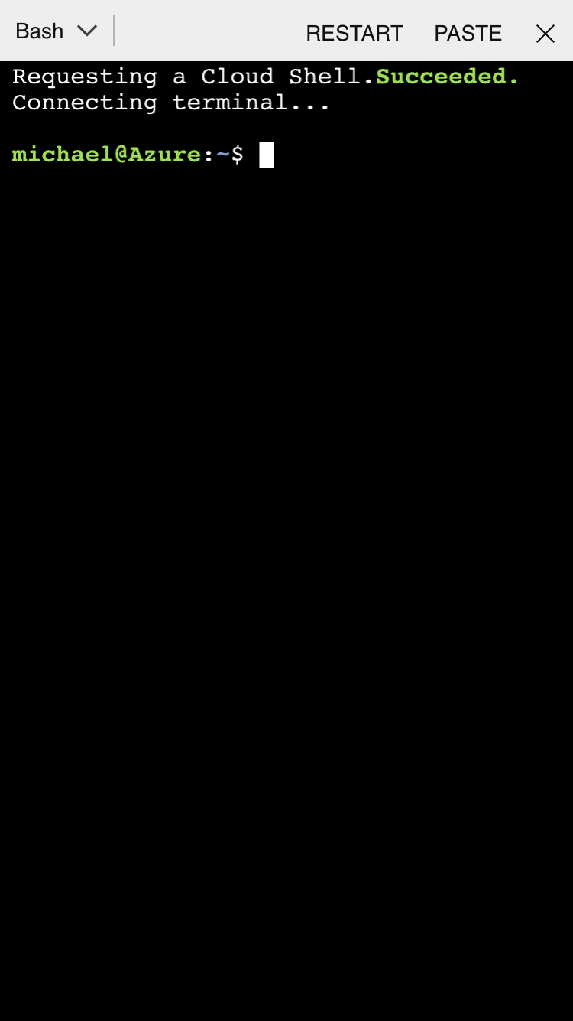
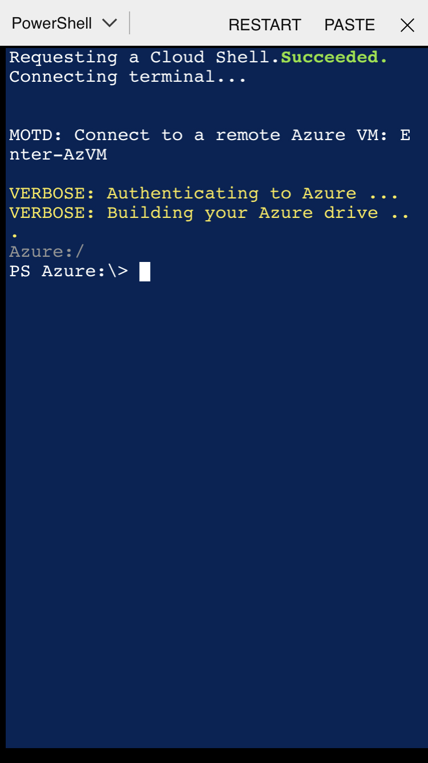
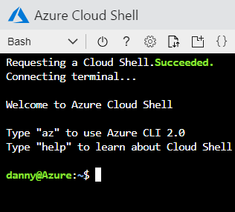
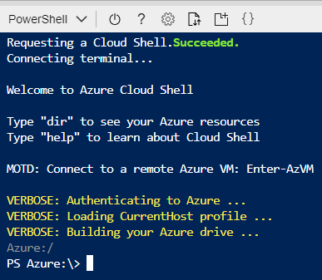
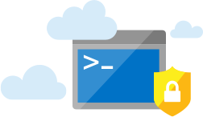
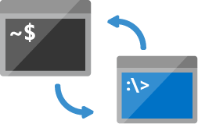
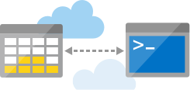
Azure Cloud Shell
Azure Cloud Shell
Browser-Accessible
Authenticated access
Bash & PowerShell
Private & secure environment
Multiple Points of Entry

Slide 4
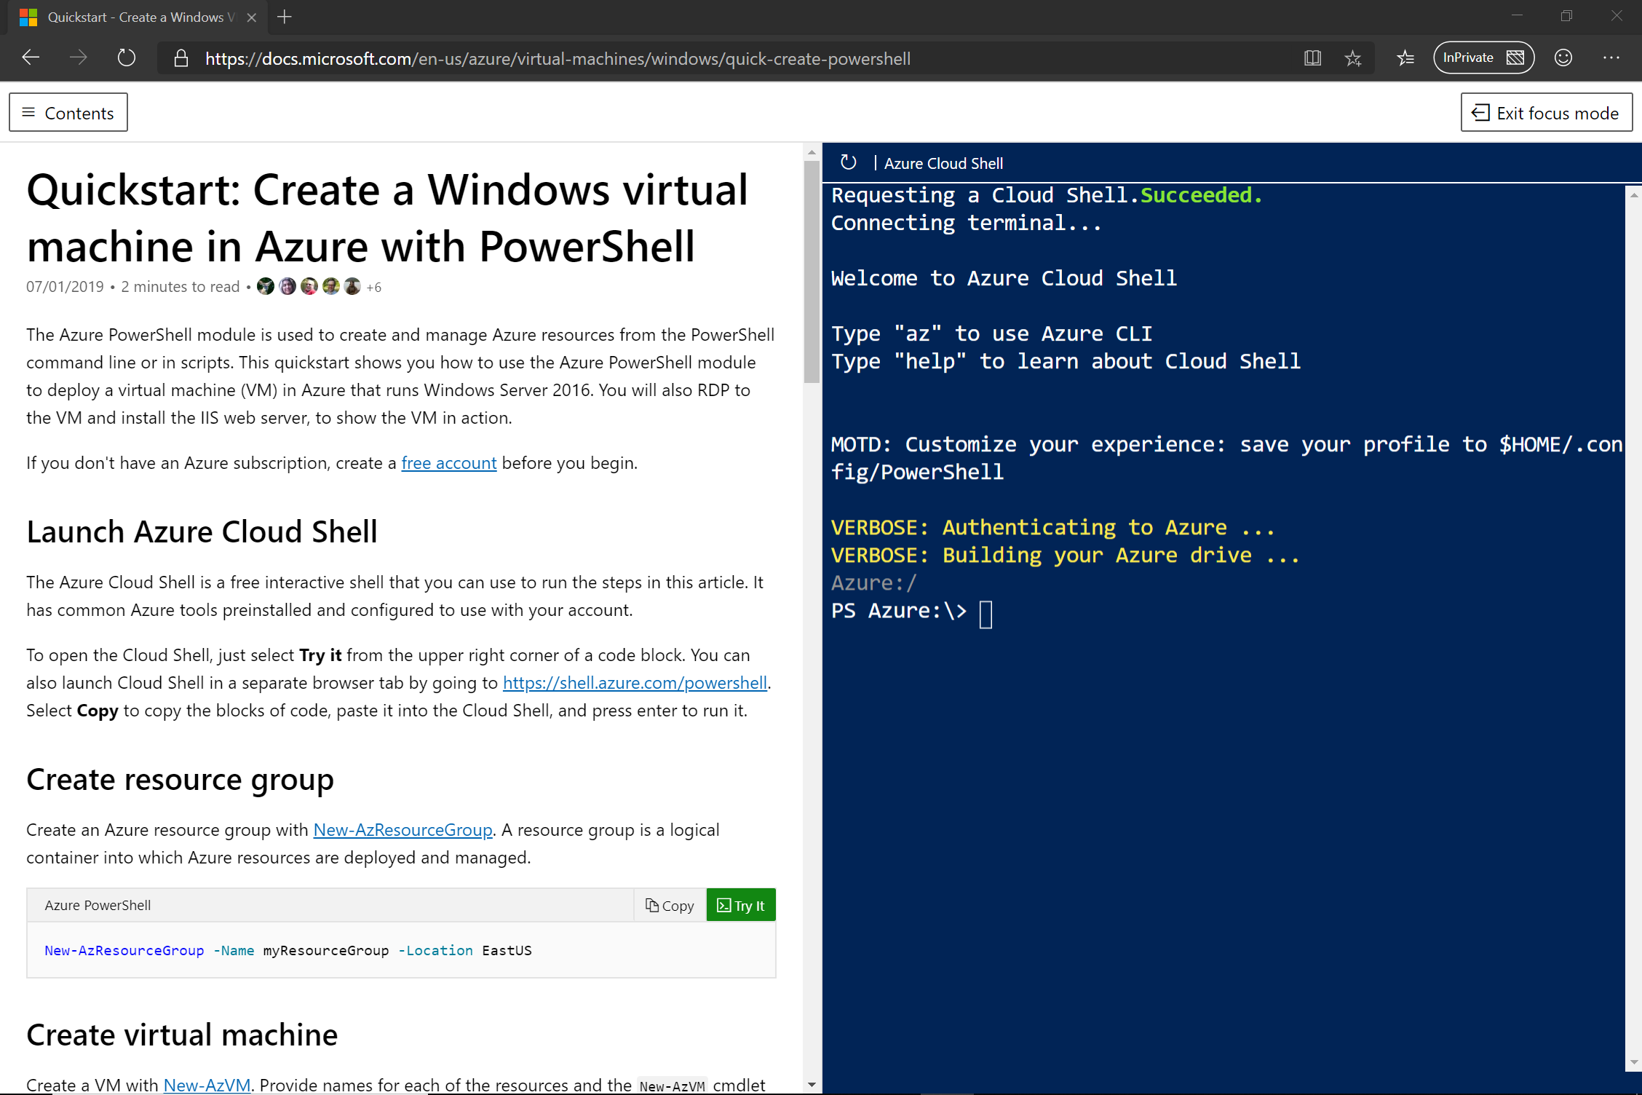
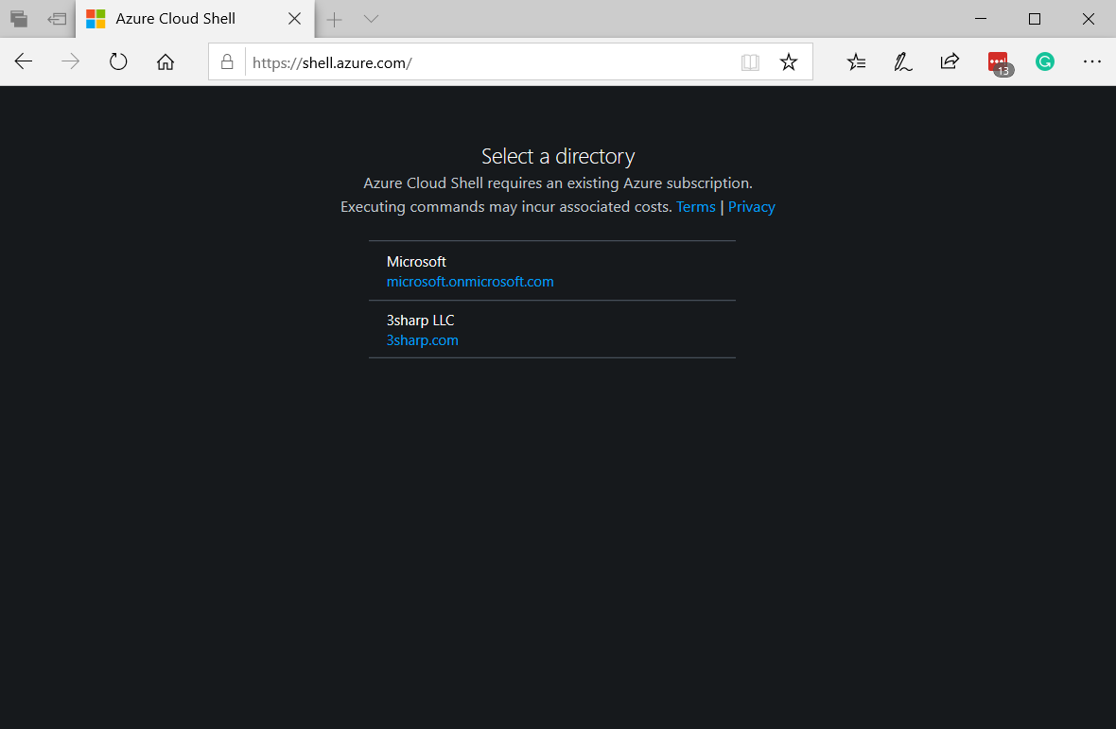
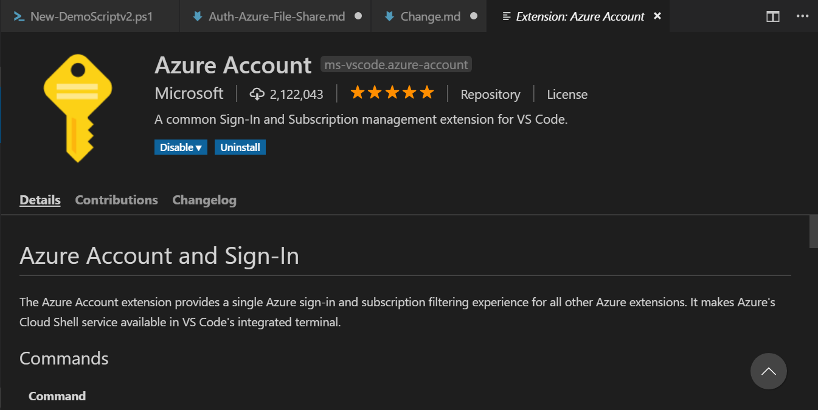
Multiple Experiences
Azure portal
Shell.azure.com
Azure Extension in Visual Studio Code
“Try It” integration in docs.microsoft.com
Azure Mobile App
Notes:
iPhone Video
Dir
Cd to scripts
Run Script
Get-AzVm
Switch to AzCloudshell

Slide 5
Exploring the Shell
Notes:
12 minutes

Slide 6
Cloud Shell Tools and VS Code Integration
Notes:
#7
Start in scripts directory
Get-command vi,nano,emacs
Get-command code
Code <Script> New-WinVm.ps1
Change subnet IP
Get-Module –listAvailable (azureAD>SQL & PS 6 modules)
Edit New-LinVM in code (local)
Show Azure Account extension
Show PowerShell Preview extension
Show code is connected to
Azure: Open Cloud Shell in Bash
Cd clouddrive
Cd Scripts
Uname –a
Exit
Azure: Open PowerShell in cloud Shell
Dir
Move back to shell
Webpage: Features and Tools of Cloud Shell (Review)
Login to Linux VM using Portal copy (SSH)
Get-command –module PSCloudShellUtility
Enable-AzVmPSRemoting into WindowsVM
Enter-AzVm
Cd c:
Dir
Cd ./windows
Cls
Get-service
Exit
Got to github repo & show stuff
Cd clouddrive
Mkdir github
Git clone <url to repo>
Dir
Cd <cloned directory>
Cd <directory of deploy> (101-Storage Account)

Slide 7
VM Remoting and Management
Notes:
Demos
Remoting into VMS
Resource Group Deployment from

Slide 8
Deploy Infrastructure as Code using Terraform from docs.Microsoft.com
Notes:
3:39
Open cloud Shell
Show Quickstart with VM PowerShell to show shell in docs & how to use Try it
Cd $Home
Cd CloudDrive (to show in your stuff)
Copy-Paste code
Show Learn Module > Browse to Create a Windows VM in Azure > Click till you get a shell (to show sandbox) Walk throughexercise

Slide 9
Working with Exchange Online cmdlets

Slide 10
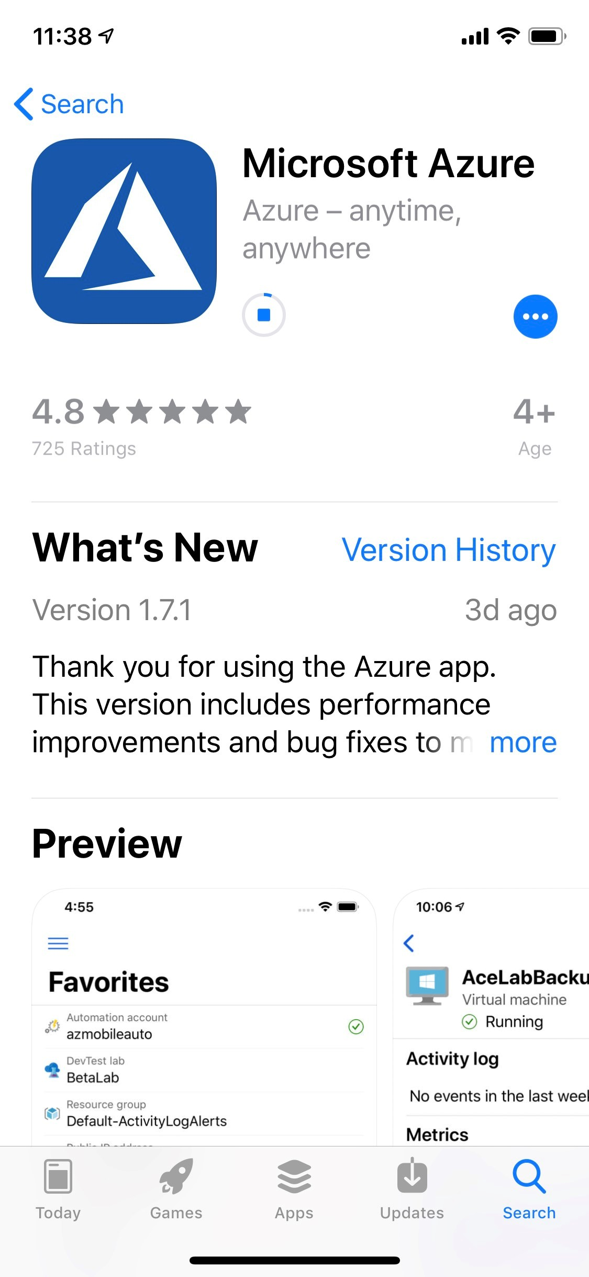
Access Cloud Shell using Microsoft Azure App
Notes:
3:39
Open cloud Shell
Show Quickstart with VM PowerShell to show shell in docs & how to use Try it
Cd $Home
Cd CloudDrive (to show in your stuff)
Copy-Paste code
Show Learn Module > Browse to Create a Windows VM in Azure > Click till you get a shell (to show sandbox) Walk throughexercise

Slide 11
Access Cloud Shell from everywhere
Notes:
3:39
Open cloud Shell
Show Quickstart with VM PowerShell to show shell in docs & how to use Try it
Cd $Home
Cd CloudDrive (to show in your stuff)
Copy-Paste code
Show Learn Module > Browse to Create a Windows VM in Azure > Click till you get a shell (to show sandbox) Walk throughexercise

Slide 12
In this session we learned how you can:
Setup Azure Cloud Shell to access your Azure Resources
Search for the tools you need in the Console
Using Visual Studio Code with Azure Cloud Shell
Remote management & deployment of Azure VMs
Discover new ways to access and use Azure Cloud Shell
Notes:
Add demo of Deploying Azure Samples

Slide 13
Session resources
http://bit.ly/azshell

Slide 14

Azure Cloud Shell docs https://aka.ms/AA4ras4
GitHub Repository for presentation http://bit.ly/azshell
Twitter @MichaelBender
Courses on Pluralsight - https://www.pluralsight.com/authors/michael-bender
Notes:
With that, I thank you for being a great audience, and remember ‘With Great Power Comes Great Responibility.’ Secure your environments wisely.

