Slide 1


No Computer Necessary
Managing Azure with Azure Cloud Shell
Michael Bender
Senior Content Developer
Microsoft

Slide 2
Session resources
http://bit.ly/azshell

Slide 3
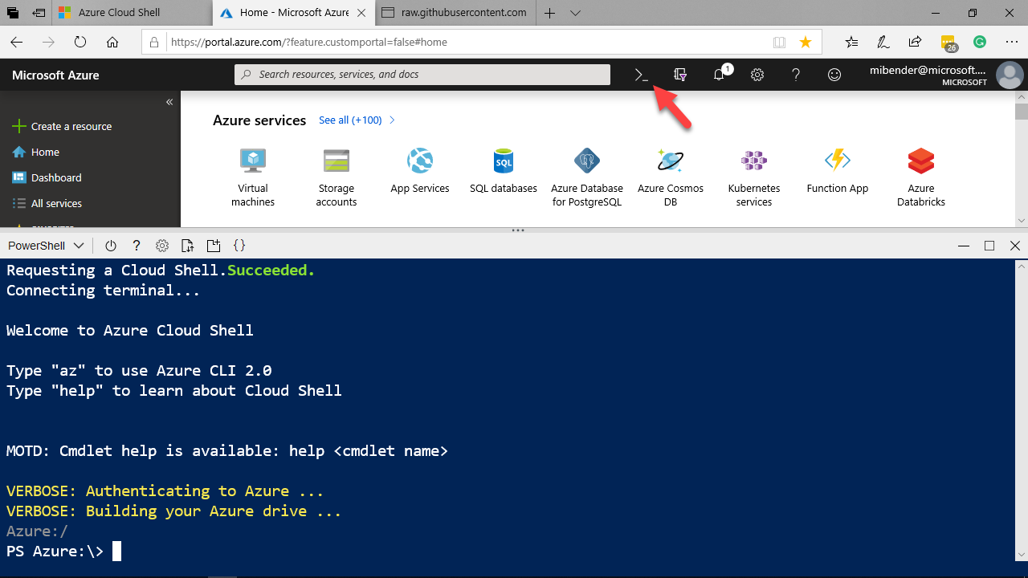
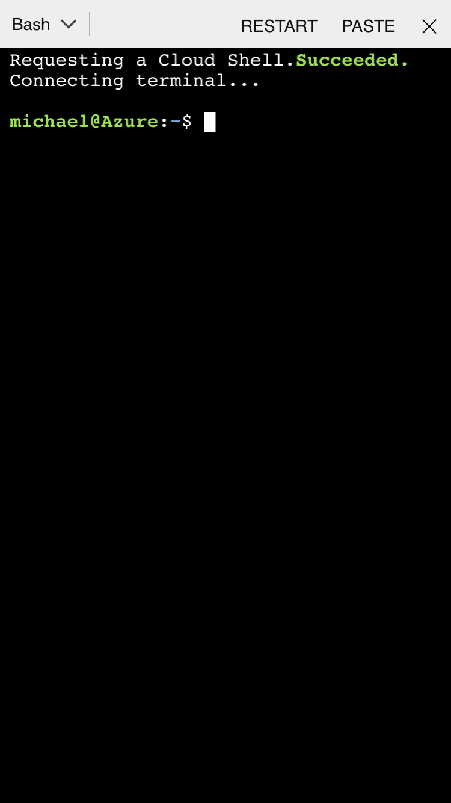
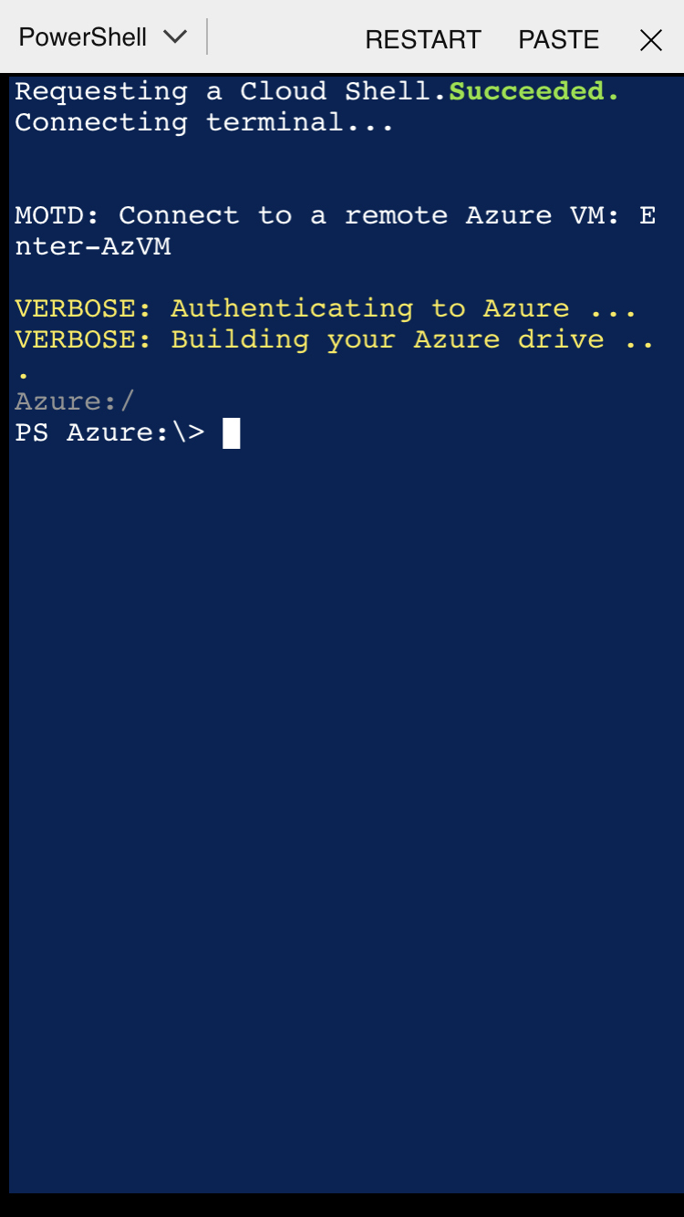
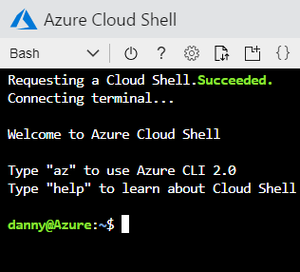
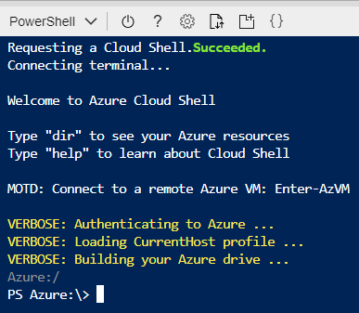
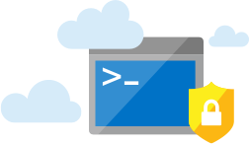
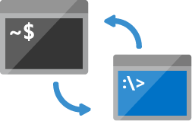
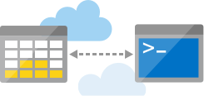
Azure Cloud Shell
Azure Cloud Shell
Browser-Accessible
Authenticated access
Bash & PowerShell
Private & secure environment
Multiple Points of Entry

Slide 4
Exploring the Shell
Notes:
12 minutes

Slide 5
Cloud Shell Tools and VS Code Integration
Notes:
#7
Start in scripts directory
Get-command vi,nano,emacs
Get-command code
Code <Script> New-WinVm.ps1
Change subnet IP
Get-Module –listAvailable (azureAD>SQL & PS 6 modules)
Edit New-LinVM in code (local)
Show Azure Account extension
Show PowerShell Preview extension
Show code is connected to
Azure: Open Cloud Shell in Bash
Cd clouddrive
Cd Scripts
Uname –a
Exit
Azure: Open PowerShell in cloud Shell
Dir
Move back to shell
Webpage: Features and Tools of Cloud Shell (Review)
Login to Linux VM using Portal copy (SSH)
Get-command –module PSCloudShellUtility
Enable-AzVmPSRemoting into WindowsVM
Enter-AzVm
Cd c:
Dir
Cd ./windows
Cls
Get-service
Exit
Got to github repo & show stuff
Cd clouddrive
Mkdir github
Git clone <url to repo>
Dir
Cd <cloned directory>
Cd <directory of deploy> (101-Storage Account)

Slide 6
VM Remoting and Management
Notes:
Demos
Remoting into VMS
Resource Group Deployment from

Slide 7
Deploy Cloud Shell into an Azure virtual network
Notes:
Cloud Shell in an Azure virtual network | Microsoft Learn

Slide 8
Deploy Infrastructure as Code using Terraform from docs.Microsoft.com
Notes:
3:39
Open cloud Shell
Show Quickstart with VM PowerShell to show shell in docs & how to use Try it
Cd $Home
Cd CloudDrive (to show in your stuff)
Copy-Paste code
Show Learn Module > Browse to Create a Windows VM in Azure > Click till you get a shell (to show sandbox) Walk throughexercise

Slide 9
Working with Exchange Online cmdlets

Slide 10
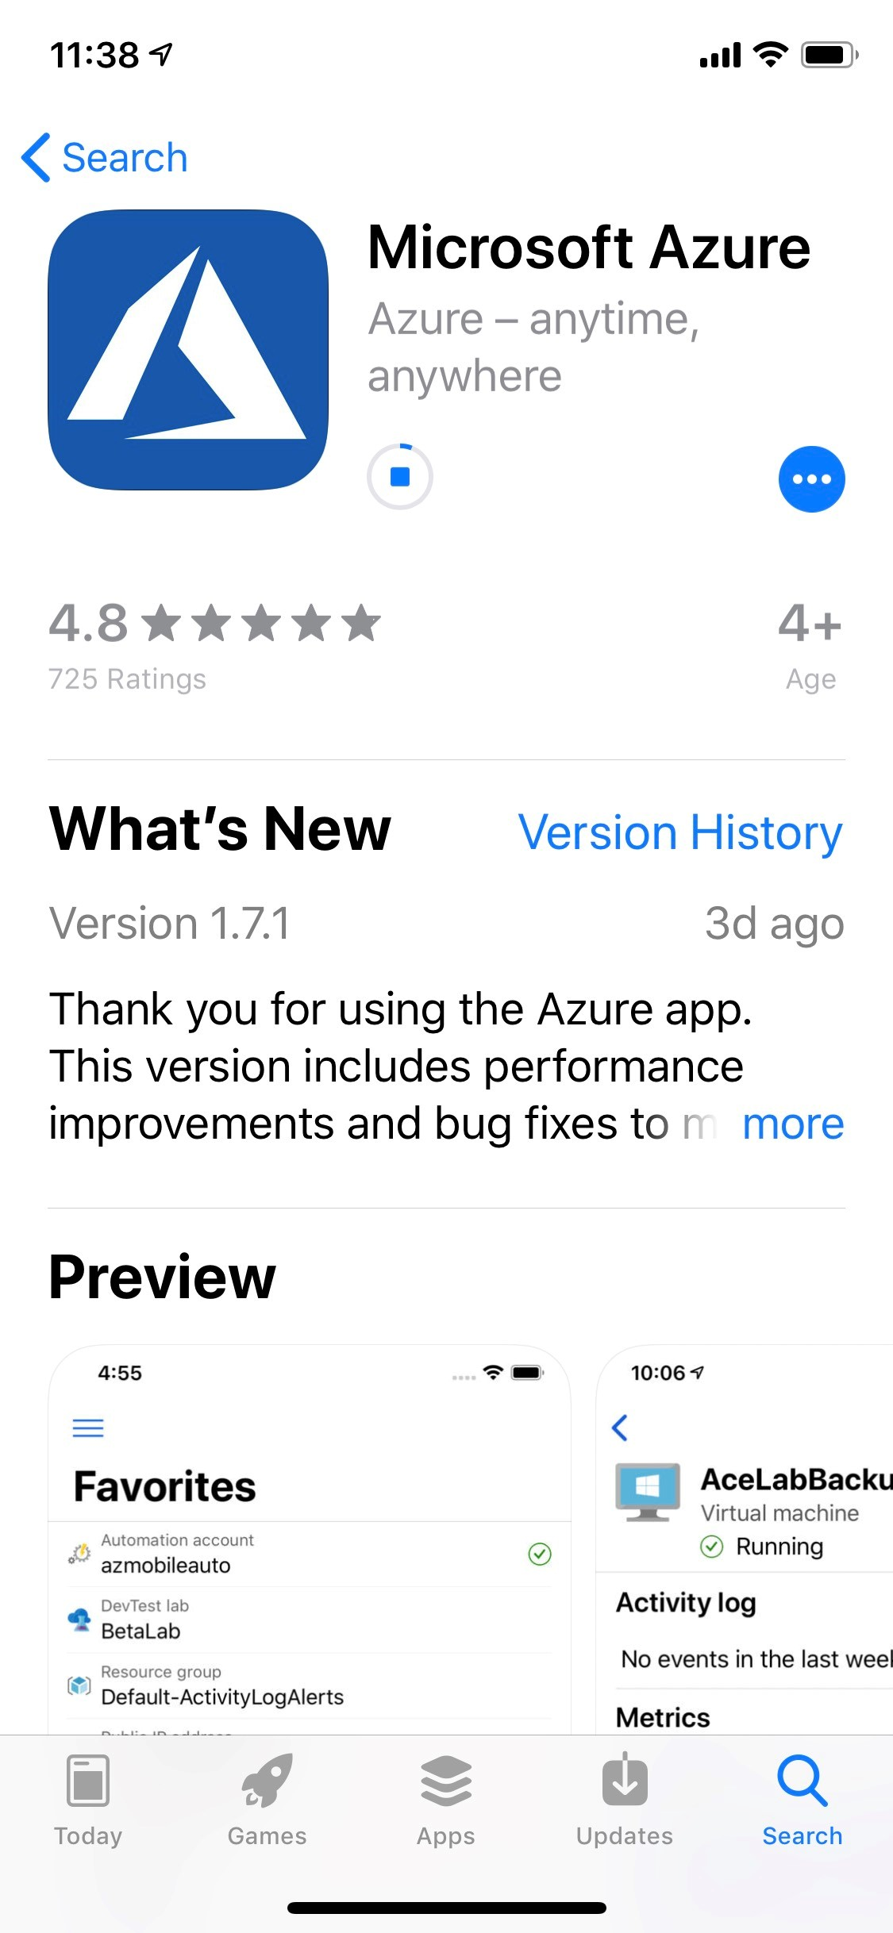
Access Cloud Shell using Microsoft Azure App
Notes:
3:39
Open cloud Shell
Show Quickstart with VM PowerShell to show shell in docs & how to use Try it
Cd $Home
Cd CloudDrive (to show in your stuff)
Copy-Paste code
Show Learn Module > Browse to Create a Windows VM in Azure > Click till you get a shell (to show sandbox) Walk throughexercise

Slide 11
Access Cloud Shell from everywhere
Notes:
3:39
Open cloud Shell
Show Quickstart with VM PowerShell to show shell in docs & how to use Try it
Cd $Home
Cd CloudDrive (to show in your stuff)
Copy-Paste code
Show Learn Module > Browse to Create a Windows VM in Azure > Click till you get a shell (to show sandbox) Walk throughexercise

Slide 12
Using Azure Cloud Shell in Microsoft Learn

Slide 13
Using ChatGPT in Azure Cloud Shell

Slide 14
In this session we learned how you can:
Setup Azure Cloud Shell to access your Azure Resources
Search for the tools you need in the Console
Using Visual Studio Code with Azure Cloud Shell
Remote management & deployment of Azure VMs
Discover new ways to access and use Azure Cloud Shell
Notes:
Add demo of Deploying Azure Samples

Slide 15
Session resources
http://bit.ly/azshell

Slide 16

Azure Cloud Shell docs https://aka.ms/AA4ras4
GitHub Repository for presentation http://bit.ly/azshell
Twitter @MichaelBender
Courses on Pluralsight - https://www.pluralsight.com/authors/michael-bender
Notes:
With that, I thank you for being a great audience, and remember ‘With Great Power Comes Great Responibility.’ Secure your environments wisely.

Slide 17
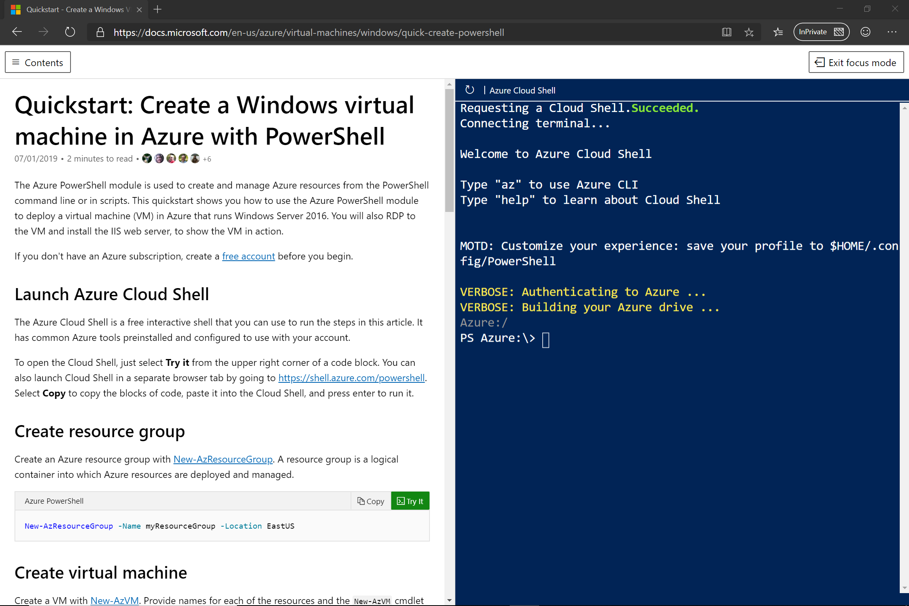
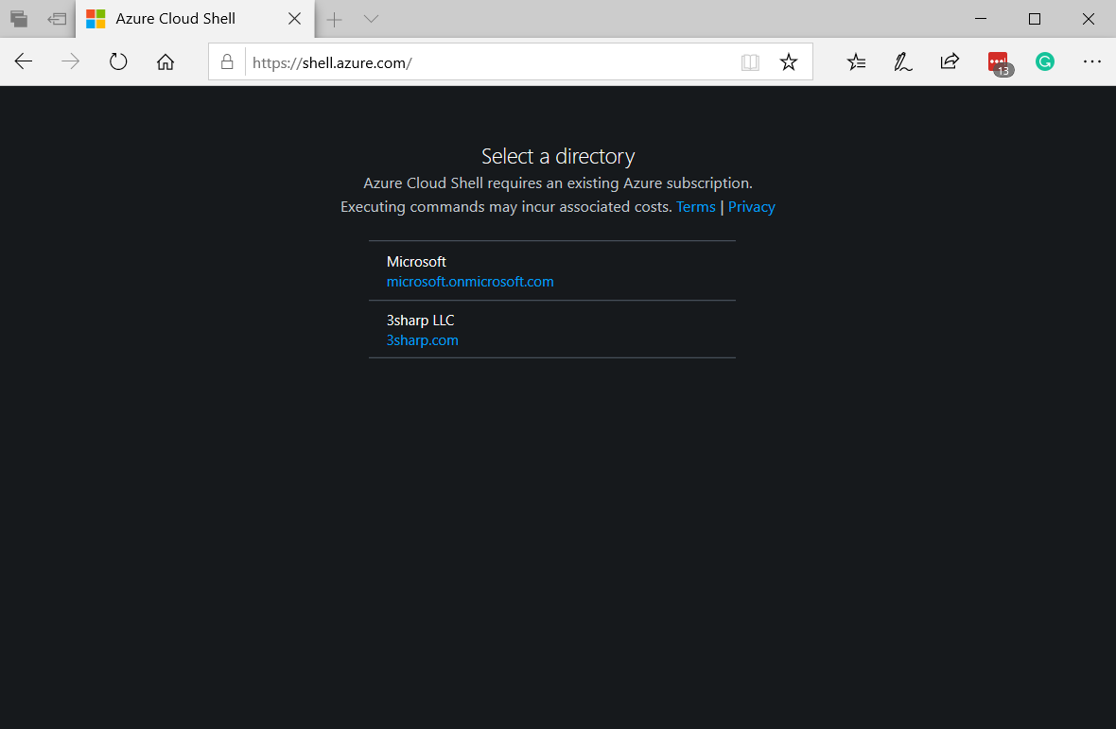
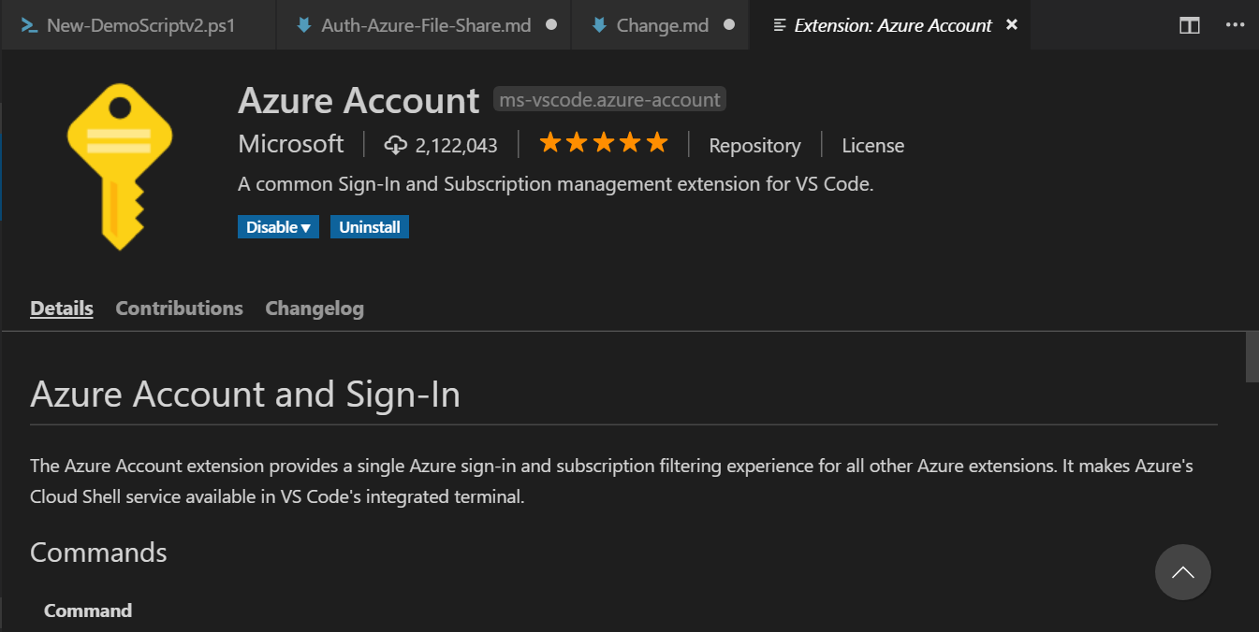
Multiple Experiences
Azure portal
Shell.azure.com
Azure Extension in Visual Studio Code
“Try It” integration in Learn.microsoft.com
Azure Mobile App
Notes:
iPhone Video
Dir
Cd to scripts
Run Script
Get-AzVm
Switch to AzCloudshell

Slide 19
Chat w/ Jason
Upcoming Changes
Ephemeral experience
No Storage Needed
UX Changes
TBA
Anywhere, Anytime, Anydevice
PS/Bash are equivalent
One-Click SSH
Feedback? Send to GitHub repo.

