Slide 1

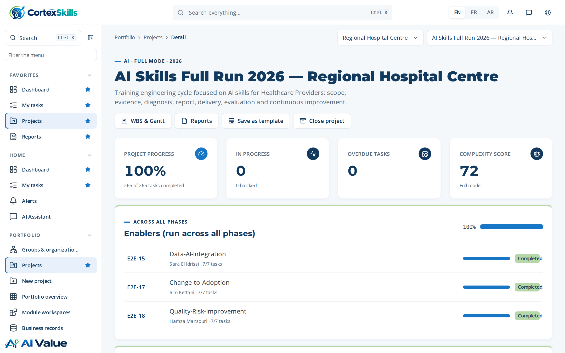
FULL CASE · HEALTHCARE · 2026
AI skills training engineering at a public hospital
Regional Hospital Centre: the project, the Training Engineering Report, the Training Plan and every document produced with CortexSkills
MEASURABLE · GOVERNED · SUSTAINABLE

Slide 2







AGENDA
How the case is presented
01
02
03
The hospital and the project
Diagnosis
Training Engineering Report
Context, charter, scope, method, schedule
Questionnaires, maturity, gaps, needs
Structure, findings, roadmap, risks
04
05
06
Training Plan
Delivery, evaluation and audit
Documents produced
Programs, agendas, design, budget
Sessions, Kirkpatrick, ROI, audit
37 published documents, traced
Agenda · Demonstration data — fictional organization
2

Slide 3







EXECUTIVE SUMMARY
A complete AI skills cycle, documented end to end
Regional Hospital Centre · 3,400 employees · AI Skills Full Run 2026 — Regional Hospital Centre
100 %
37 / 40
6
1,260,000
of the run completed — 35 end-to-end processes
people answered the questionnaires (93 %)
trainings in 2 programs, prioritized by impact
training budget; 1,192,662 spent
What the case shows
Diagnosis: “Information systems” is the weakest axis (2 / 5); the largest skill gap is “AI bed and staff capacity planning” (average gap 3.0).
10 training needs were validated and grouped into 6 themes, deployed in 4 roadmap initiatives over three waves.
Kirkpatrick results 86 % · 93 % · 84 %; training ROI 108 % (target ≥ 100%).
37 documents published, 1,060 pages; the Training Engineering Report alone has 198 pages.
Executive summary · Demonstration data — fictional organization
3

Slide 4
01
The hospital and the project
Context, charter, scope, method and schedule

Slide 5
CONTEXT
Regional Hospital Centre
Regional Hospital Centre operates in the Healthcare Providers sector, in Région, with 3400 employees.
Topic | Content
Vision | Become the reference of Healthcare Providers in the region, with teams trained to the best standards.
Mission | Deliver safe, compliant service through skilled people and controlled processes.
Values | Commitment · Excellence · Sharing
Context | Strong competition, stricter ISO 7101 audits and the arrival of AI triage and clinical decision support.
Products — existing | Core services of Clinical Care & Nursing
Products — new | Digital services supported by AI triage and clinical decision support
Market segments | Large accounts · Public sector · Individual customers
Organization and headcount
Function | People
Operations | 3
Quality & HSE | 3
Finance | 2
Human Resources | 2
Sales & Marketing | 2
Information Systems | 2
Clinical Care & Nursing | 2
The hospital and the project · Demonstration data — fictional organization
5

Slide 6




WHY THIS PROJECT
A public hospital under pressure: why skills come first
What the functional SWOTs and the strategic objectives say
External pressure
Opportunities to seize
• Stricter ISO 7101 audits
• Departure of key experts
• Demand for digital services
• Training contracts refunded by OFPPT
• AI bed and staff capacity planning
Weak points today
What the direction commits to
• Low use of AI triage and clinical decision support
• Reporting kept in spreadsheets
• Little versatility between roles
• Low use of AI bed and staff capacity planning
• Low use of AI medical imaging assistance
• SO-1: Adopt AI triage and clinical decision support across Clinical Care & Nursing by end 2027
• SO-2: Zero major findings in ISO 7101 audits
Source: SWOT of TER 1.4, functional SWOT records (E2E-25) and strategic objectives of the Scope of Work.
The hospital and the project · Demonstration data — fictional organization
6

Slide 7
HOSPITAL PROFILE
Key dates and SWOT of the hospital
2008
2014
2019
2025
Company founded
Second site opened
ISO 7101 certification
Digital transformation program launched
Strengths
Areas for improvement
Opportunities
Threats
• Experienced, committed team
• Good knowledge of the market
• Stable processes
• Low use of AI triage and clinical decision support
• Reporting kept in spreadsheets
• Little versatility between roles
• Low use of AI bed and staff capacity planning
• Low use of AI medical imaging assistance
• Demand for digital services
• Training contracts refunded by OFPPT
• Stricter ISO 7101 audits
• Departure of key experts
Source: TER sections 1.3 and 1.4.
The hospital and the project · Demonstration data — fictional organization
7

Slide 8




PROJECT CHARTER
AI Skills Full Run 2026 — Regional Hospital Centre
Training engineering cycle focused on AI skills for Healthcare Providers: scope, evidence, diagnosis, report, delivery, evaluation and continuous improvement.
72
40
17
MS · MO · OP
complexity score (out of 100): full run with gates
stakeholders registered and consulted
scope criteria approved in the Scope of Work
decision levels covered (strategic, middle, operational)
Strategic objectives
SO-1 — Adopt AI triage and clinical decision support across Clinical Care & Nursing by end 2027 (horizon 2027-12-31)
SO-2 — Zero major findings in ISO 7101 audits (horizon 2026-12-31)
The hospital and the project · Demonstration data — fictional organization
8

Slide 9
SCOPE OF THE MISSION
Functions and decision levels in scope
Focus: AI · Decision levels: MS, MO, OP · Approval: Approved (2026-04-30, Soukaina Ouazzani)
Function | MS — strategic | MO — middle | OP — operational
Operations | ● | ● | ●
Quality & HSE | ● | ● | —
Finance | ● | — | ●
Human Resources | — | ● | ●
Sales & Marketing | ● | ● | ●
Information Systems | ● | ● | —
Clinical Care & Nursing | ● | — | ●
How the scope is set
Each function × decision-level cell is a weighted criterion of the Scope of Work. 16 criteria were approved by the sponsor before any questionnaire was sent; every later table of the report is filtered by this scope.
Source: TER section 1.8.
The hospital and the project · Demonstration data — fictional organization
9

Slide 10
METHOD
Six phases, each closed by a gate with its deliverables
The training engineering mission follows the phases below, each closed by a gate with its deliverables.
Phase | End-to-end processes | Progress
1. Scope & evidence | E2E-32 · E2E-33 · E2E-19 · E2E-24 | 100%
2. Diagnosis | E2E-20 · E2E-25 · E2E-26 · E2E-27 · E2E-28 · E2E-29 · E2E-02 · E2E-21 | 100%
3. Training Engineering Report & plan | E2E-01 · E2E-03 · E2E-30 · E2E-22 · E2E-23 · E2E-16 · HCPR-E2E-02 | 100%
4. Design & delivery | E2E-04 · E2E-05 · E2E-06 · E2E-13 · E2E-14 | 100%
5. Evaluation, compliance & impact | E2E-07 · E2E-08 · E2E-09 · HCPR-E2E-01 | 100%
6. Talent, knowledge & continuous improvement | E2E-10 · E2E-11 · E2E-12 · E2E-31 | 100%
Source: Training Engineering Report, section 1.5 “The current mission”.
The hospital and the project · Demonstration data — fictional organization
10

Slide 11

THE RUN IN FIGURES
35 end-to-end processes, 265 tasks, all completed
Each process has an owner, its tasks, its dates and the document it produces
Phase | Processes | Tasks done | Start | End | Owners
Enablers (run across all phases) | 3 | 21 / 21 | 2026-04-10 | 2026-05-01 | 3
Scope & evidence | 4 | 37 / 37 | 2026-04-10 | 2026-05-16 | 4
Diagnosis | 8 | 62 / 62 | 2026-05-08 | 2026-06-07 | 3
Training Engineering Report & plan | 7 | 50 / 50 | 2026-06-05 | 2026-07-05 | 3
Design & delivery | 5 | 39 / 39 | 2026-07-03 | 2026-07-30 | 3
Evaluation, compliance & impact | 4 | 26 / 26 | 2026-07-31 | 2026-08-24 | 2
Talent, knowledge & continuous improvement | 4 | 30 / 30 | 2026-08-28 | 2026-09-21 | 4
265 / 265
tasks completed, none overdue or blocked
14
process owners from the project team
37
published documents, one per process and more
Source: project workspace (phases, processes, tasks).
The hospital and the project · Demonstration data — fictional organization
11

Slide 12
PROCESSES AND OWNERS
Who carried each process of the run
E2E | Process — document produced | Phase | Owner | Tasks
E2E-15 | Data, AI and integration governance | Enablers (run across all phas… | Sara El Idrissi | 7/7
E2E-17 | Change and adoption plan | Enablers (run across all phas… | Rim Kettani | 7/7
E2E-18 | Quality, risk and improvement report | Enablers (run across all phas… | Hamza Mansouri | 7/7
E2E-32 | Scope of work and stakeholder register | Scope & evidence | Leila Chraibi | 9/9
E2E-33 | Questionnaire campaign report | Scope & evidence | Asmae Fassi | 12/12
E2E-19 | Consulting engagement closure report | Scope & evidence | Hamza Benjelloun | 9/9
E2E-24 | Competitive intelligence note | Scope & evidence | Omar Benjelloun | 7/7
E2E-20 | Multi-axis diagnostic and maturity report | Diagnosis | Hamza Benjelloun | 10/10
E2E-25 | Job architecture and competency map | Diagnosis | Soukaina Ouazzani | 8/8
E2E-26 | Forward planning of jobs and skills (GPEC) | Diagnosis | Soukaina Ouazzani | 8/8
E2E-27 | Training demand consolidation | Diagnosis | Leila Chraibi | 7/7
E2E-28 | Performance assessment and RAG dashboard | Diagnosis | Leila Chraibi | 7/7
E2E-29 | Functional SWOT and improvement axes | Diagnosis | Leila Chraibi | 7/7
E2E-02 | Skills gap diagnosis | Diagnosis | Leila Chraibi | 7/7
E2E-21 | Previous plan impact evaluation | Diagnosis | Leila Chraibi | 8/8
E2E-01 | Annual L&D plan and budget | Training Engineering Report &… | Leila Chraibi | 8/8
E2E-03 | Training needs report and roadmap | Training Engineering Report &… | Leila Chraibi | 10/10
E2E-30 | Prioritized resource plan | Training Engineering Report &… | Leila Chraibi | 7/7
The hospital and the project · Demonstration data — fictional organization
12

Slide 13
PROCESSES AND OWNERS
The processes of the run (continued)
E2E | Process — document produced | Phase | Owner | Tasks
E2E-22 | Multi-site deployment plan | Training Engineering Report &… | Leila Chraibi | 8/8
E2E-23 | Regulatory submission file | Training Engineering Report &… | Kawtar Rami | 7/7
E2E-16 | Vendor management file | Training Engineering Report &… | Imane Naciri | 6/6
HCPR-E2E-02 | Healthcare-specific process (feeds the TER and the audit) | Training Engineering Report &… | Leila Chraibi | 4/4
E2E-04 | Curriculum design document | Design & delivery | Leila Chraibi | 8/8
E2E-05 | Training delivery report | Design & delivery | Leila Chraibi | 9/9
E2E-06 | Learner engagement report | Design & delivery | Leila Chraibi | 8/8
E2E-13 | Content catalogue and lifecycle | Design & delivery | Rim Mansouri | 7/7
E2E-14 | Extended enterprise training report | Design & delivery | Hajar Chraibi | 7/7
E2E-07 | Training evaluation report | Evaluation, compliance & impa… | Leila Chraibi | 8/8
E2E-08 | ROI and business impact report | Evaluation, compliance & impa… | Leila Chraibi | 7/7
E2E-09 | Compliance and certification register | Evaluation, compliance & impa… | Kawtar Rami | 7/7
HCPR-E2E-01 | Healthcare-specific process (feeds the TER and the audit) | Evaluation, compliance & impa… | Leila Chraibi | 4/4
E2E-10 | Internal mobility and career paths | Talent, knowledge & continuou… | Soukaina Ouazzani | 8/8
E2E-11 | Onboarding programme record | Talent, knowledge & continuou… | Hamza Lahlou | 7/7
E2E-12 | Knowledge capture and transfer record | Talent, knowledge & continuou… | Omar Alaoui | 7/7
E2E-31 | Post-engagement roadmap | Talent, knowledge & continuou… | Hamza Benjelloun | 8/8
The hospital and the project · Demonstration data — fictional organization
13

Slide 14
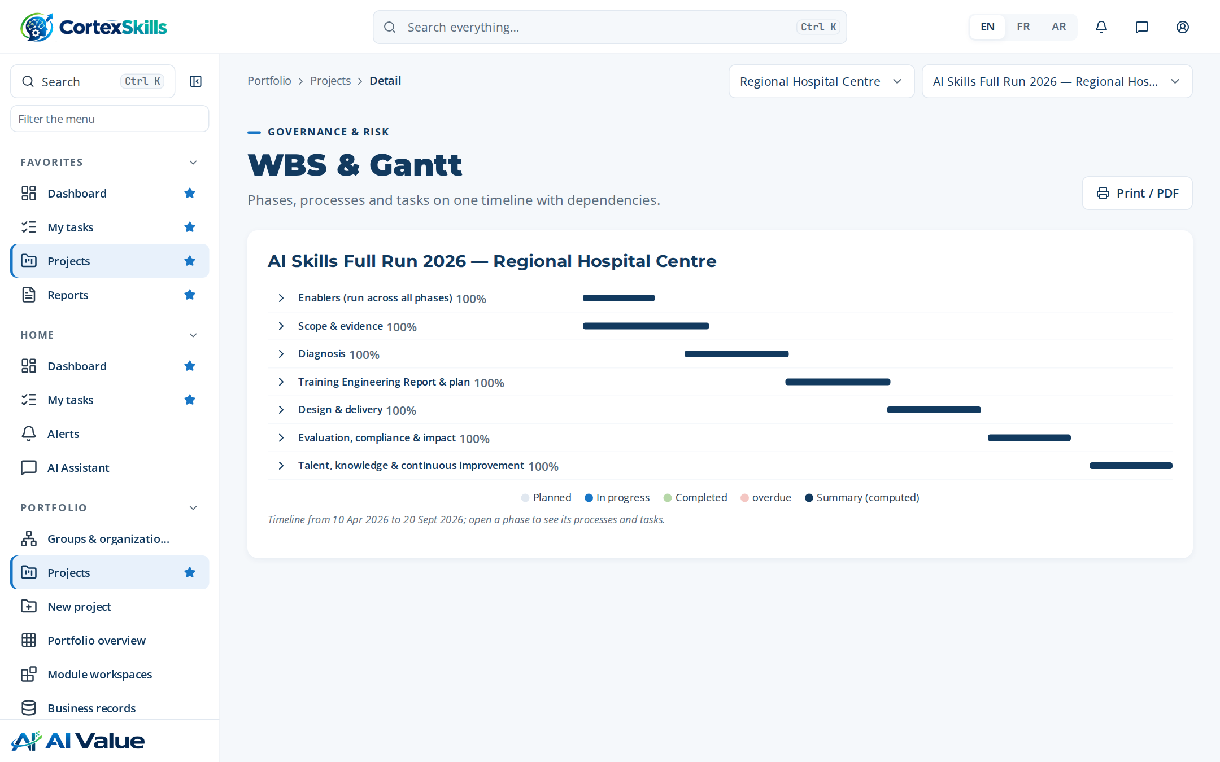
SCHEDULE
Work packages and the Gantt chart
Work package | Start | End | Progress
Scope & evidence | 2026-04-10 | 2026-05-07 | 100 %
Diagnosis | 2026-05-08 | 2026-06-04 | 100 %
Report & plan | 2026-06-05 | 2026-07-02 | 100 %
Sessions | Date
S-01 AI triage and clinical decision … | 2026-07-19
S-02 AI medical imaging assistance | 2026-07-26
S-03 AI triage and clinical decision … | 2026-08-02
S-04 AI medical imaging assistance | 2026-08-09
WBS and Gantt of the project in CortexSkills.
The hospital and the project · Demonstration data — fictional organization
14

Slide 15
STAKEHOLDERS
40 people consulted across every function
40 people were consulted: 1 from general management, 26 managers and 13 staff members.
Channel | People
Face-to-face | 1
Combination | 26
Email | 13
Consent recorded for 40 of 40 people before any answer was stored.
People consulted by function and population (TER 1.7).
The hospital and the project · Demonstration data — fictional organization
15

Slide 16
02
Diagnosis
Who answered, where the hospital stands, which skills are missing

Slide 17
QUESTIONNAIRE CAMPAIGN
37 of 40 people answered
40 people were invited to answer; 37 answered.
Function | General Manager | Management | Team member | Responded
Operations | 1 | 3 | 2 | 6
Quality & HSE | 0 | 4 | 2 | 5
Human Resources | 0 | 4 | 2 | 5
Sales & Marketing | 0 | 4 | 2 | 6
Information Systems | 0 | 3 | 2 | 5
Clinical Care & Nursing | 0 | 4 | 1 | 5
Finance | 0 | 4 | 2 | 5
Response rate by function.
Channel | Invited | Responded | Rate | Completeness
Face-to-face | 12 | 12 | 100 % | 95 %
Application | 23 | 23 | 100 % | 91 %
Email | 2 | 2 | 100 % | 77 %
Source: TER sections 1.6, 1.12 and 1.13.
Diagnosis · Demonstration data — fictional organization
17

Slide 18
THE PREVIOUS PLAN
What the teams said about the last training plan
What did you notice about the n-1 training plan?
What were the strengths of the n-1 plan?
What improvements did the n-1 plan bring?
• Trainings were chosen late in the year and with little link to our objectives.
• Good participation, but little follow-up after the sessions.
• Sessions held on site, close to the teams.
• Practical trainers who knew our sector.
• Supervisors use the new procedures.
• Fewer errors on ISO 7101 records.
What were the challenges of the n-1 plan?
What did you appreciate and like about the n-1 plan?
For a new training plan, what would you like to see done differently?
• Measuring the effect of the trainings.
• Releasing people from the job during peaks.
• The workshops on real cases.
• The exchange between sites.
• Shorter half-day formats with a workshop each time.
• A plan built from the needs of each function.
Source: TER chapter 2 — 59 trainings attended are listed in section 2.1.
Diagnosis · Demonstration data — fictional organization
18

Slide 19
DIAGNOSIS AND MATURITY
Five axes scored, maturity one level below target
Axis | Score | Reading
Strategy | 3.4 | Strength to build on
Organization | 2.8 | Partly in place
Processes | 2.6 | Partly in place
People and skills | 3.1 | Partly in place
Information systems | 2 | Priority for development
Model | Current | Target | Gap
CMM maturity (CMM) | 3 | 4 | 1
Leadership maturity (Leadership) | 3 | 4 | 1
Maturity models (TER 1.10).
Diagnostic score by axis against target level 4 (TER 1.9).
Diagnosis · Demonstration data — fictional organization
19

Slide 20
PERFORMANCE BY FUNCTION
Where each function stands at each decision level
Performance by decision level: MS strategic management, MO operational management, OP operational.
Function | MS | MO | OP | Main gaps
Operations | 75% Amber | 76% Amber | 68% Red | AI triage and clinical decision support · AI medical imaging assistance · AI bed and staff cap…
Quality & HSE | 90% Green | 56% Red | 65% Red | AI medical imaging assistance · AI bed and staff capacity planning · AI triage and clinical de…
Finance | 62% Red | 64% Red | 89% Amber | AI bed and staff capacity planning · AI triage and clinical decision support · AI medical imag…
Human Resources | 73% Amber | 70% Amber | 75% Amber | AI triage and clinical decision support · AI medical imaging assistance · AI bed and staff cap…
Sales & Marketing | 92% Green | 62% Red | 52% Red | AI medical imaging assistance · AI bed and staff capacity planning · AI triage and clinical de…
Information Systems | 65% Red | 55% Red | 84% Amber | AI bed and staff capacity planning · AI triage and clinical decision support · AI medical imag…
Clinical Care & Nursing | 59% Red | 56% Red | 64% Red | AI triage and clinical decision support · AI medical imaging assistance · AI bed and staff cap…
Maturity heatmap on the fixed red → green status scale (TER 3.2).
Diagnosis · Demonstration data — fictional organization
20

Slide 21
PERFORMANCE ASSESSMENT
21 cells scored: function × decision level
Score in % of the expected performance, from the assessment records (E2E-26)
Cell | % | Gap noted
Sales & Marketing — OP | 52 | AI triage and clinical decision support
Information Systems — MO | 55 | AI triage and clinical decision support
Quality & HSE — MO | 56 | AI bed and staff capacity planning
Clinical Care & Nursing — MO | 56 | AI medical imaging assistance
Clinical Care & Nursing — MS | 59 | AI triage and clinical decision support
Finance — MS | 62 | AI bed and staff capacity planning
Performance score by function and decision level (%).
The six weakest cells, with the gap noted.
Diagnosis · Demonstration data — fictional organization
21

Slide 22

FUNCTIONAL SWOT
Strengths and weaknesses, function by function
2 SWOTs validated with the function heads
Operations — Validated
Quality & HSE — Validated
Strengths
Weaknesses
Strengths
Weaknesses
• Experienced team
• stable processes
• Low use of AI triage and clinical decision support
• Experienced team
• stable processes
• Low use of AI triage and clinical decision support
Opportunities
Threats
Opportunities
Threats
• AI bed and staff capacity planning
• Stricter ISO 7101 audits
• AI bed and staff capacity planning
• Stricter ISO 7101 audits
Source: FunctionalSwot records (E2E-25), feeding the improvement axes.
Diagnosis · Demonstration data — fictional organization
22

Slide 23
COMPETENCES NAMED IN THE INTERVIEWS
The competences people asked for, by number of mentions
Consolidated from 32 responses.
Reading
The two AI clinical themes lead (108 and 103 mentions), followed by team communication and problem solving: the plan pairs each AI training with practical workshops on the hospital’s own cases.
Mentions across all answers (TER 3.3).
Diagnosis · Demonstration data — fictional organization
23

Slide 24
SOFT SKILLS AND LEADERSHIP
Self-assessment of the respondents, weakest first
Competence | Average (1–5) | n
Self-control and excellence | 3.2 | 31
Continuous quality improvement — conflict resolution and solutions | 3.2 | 29
Coaching others towards excellence | 3.3 | 29
Management by values | 3.3 | 30
Enterprise management: macro view of the company’s businesses and fun… | 3.3 | 20
Training and effectiveness | 3.3 | 30
Self-motivation and energy | 3.4 | 31
Communication with oneself | 3.4 | 31
Leadership levels reached (TER 3.7).
Diagnosis · Demonstration data — fictional organization
24

Slide 25
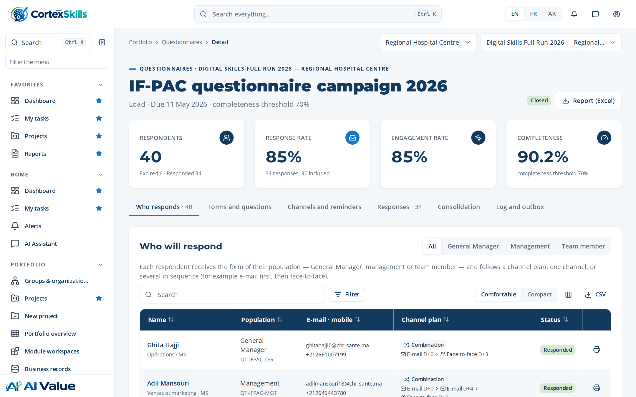
SKILL GAPS AND TRAINING NEEDS
From measured gaps to a validated needs register
Competency | People | Avg gap | Critical
AI medical imaging assistance | 3 | 2.0 | 0
AI bed and staff capacity planning | 2 | 3.0 | 2
AI triage and clinical decision support | 3 | 1.0 | 0
# | Theme | Source | Impact | Status
1 | AI bed and staff capacity planning | Diagnostic | 5 | Validated
2 | Responsible AI and data protection | Skills gap | 5 | Validated
3 | AI bed and staff capacity planning | GPEC | 5 | Validated
4 | AI medical imaging assistance | Demand | 4 | Validated
5 | Prompting and generative AI at work | SWOT | 4 | Validated
6 | AI medical imaging assistance | Diagnostic | 4 | Validated
7 | AI triage and clinical decision support | Skills gap | 3 | Validated
8 | AI literacy for all staff | GPEC | 3 | Validated
9 | AI triage and clinical decision support | Demand | 3 | Validated
10 | AI literacy for all staff | SWOT | 3 | Validated
Skill gaps by competency (TER 3.40).
Training needs register (TER 3.41): every need traced to its source.
Diagnosis · Demonstration data — fictional organization
25

Slide 26


SKILLS CAMPAIGN
Self-assessed and validated levels side by side
12 assessments of the campaign “Skills campaign 2026”, closed on 2026-05-20
2.0 → 2.0
average level, self-assessed → validated
12 · 0 · 0
confirmed · lowered · raised by the manager
Validation by the manager is what turns a self-assessment into a measured gap: only validated levels feed the skill gaps and the needs register.
Number of assessments at each level.
Diagnosis · Demonstration data — fictional organization
26

Slide 27
TRAINING REQUESTS
15 requests received, all traced to a theme
Individual and collective requests from managers and employees (E2E-27)
Status | Requests
Planned | 4
Validated | 7
Rejected | 4
Type | Requests
Individual | 11
Collective | 4
Requests by theme and priority.
Diagnosis · Demonstration data — fictional organization
27

Slide 28
FOCUS ON THE CORE FUNCTION
Clinical Care & Nursing
Needs, assessment and competences of the function that carries the strategic objective SO-1
Decision level | Score (%) | Status | Gap
MS | 59 % | Red | AI triage and clinical decision support
MO | 56 % | Red | AI medical imaging assistance
OP | 64 % | Red | AI bed and staff capacity planning
Respondent | Population | Strengths / Areas for improvement | Competences
Reda Naciri | Management | Soins cliniques et infirmiers — Good knowledge of the market — Little… | AI bed and staff capacity planning
Reda Naciri | Management | Clinical Care & Nursing — Good knowledge of the market — Reporting ke… | AI bed and staff capacity planning; Time management and priorities
Zineb Hajji | Team member | Experienced, committed team — Low use of AI medical imaging assistance | AI medical imaging assistance
Zineb Hajji | Team member | Stable processes — Low use of AI medical imaging assistance | ISO 7101 requirements; Dashboards
Ayoub Benjelloun | Management | Soins cliniques et infirmiers — Stable processes — Little versatility… | AI bed and staff capacity planning
Ayoub Benjelloun | Management | Clinical Care & Nursing — Good knowledge of the market — Reporting ke… | ISO 7101 requirements; Dashboards
Source: TER sections 3.36 to 3.39.
Diagnosis · Demonstration data — fictional organization
28

Slide 29


USE OF AI TODAY
How the teams use AI and what holds them back
Current use
Barriers
Risks to manage
Priorities
Preferred format
Daily, for triage and reports. (33)
Lack of training and unclear rules. (33)
Data protection and validation of results. (33)
AI bed and staff capacity planning; data quality (12)
AI medical imaging assistance; data quality (11)
Short workshops on the job, then coaching. (33)
Strategic planning practice | Yes | No
Is there a strategic plan with macro business plans at company level? | 1 | 0
Are this strategic plan and the macro business plans implemented? | 1 | 0
Are they monitored? | 0 | 1
Are they subject to continuous improvement? | 0 | 1
Most frequent answers of 37 respondents (TER 3.45, 3.46).
Diagnosis · Demonstration data — fictional organization
29

Slide 30
OBJECTIVES AND EXPECTED RESULTS
What the respondents want the training to change
Objective | SMART formulation | Mentions
Improve customer satisfaction | Satisfaction score ≥ 85% by end of year | 30
Reduce non-quality costs | -20% rework in 12 months | 30
Develop human capital | 80% of critical roles certified | 14
Expected results
• Teams able to use AI triage and clinical decision support safely.
• Better audit results and staff retention.
• Fewer errors and faster service.
• Teams able to use AI medical imaging assistance safely.
Source: TER 3.42 (74 objectives stated) and 3.9.
Diagnosis · Demonstration data — fictional organization
30

Slide 31
03
Training Engineering Report
134 sections, 198 pages, generated from the run data

Slide 32
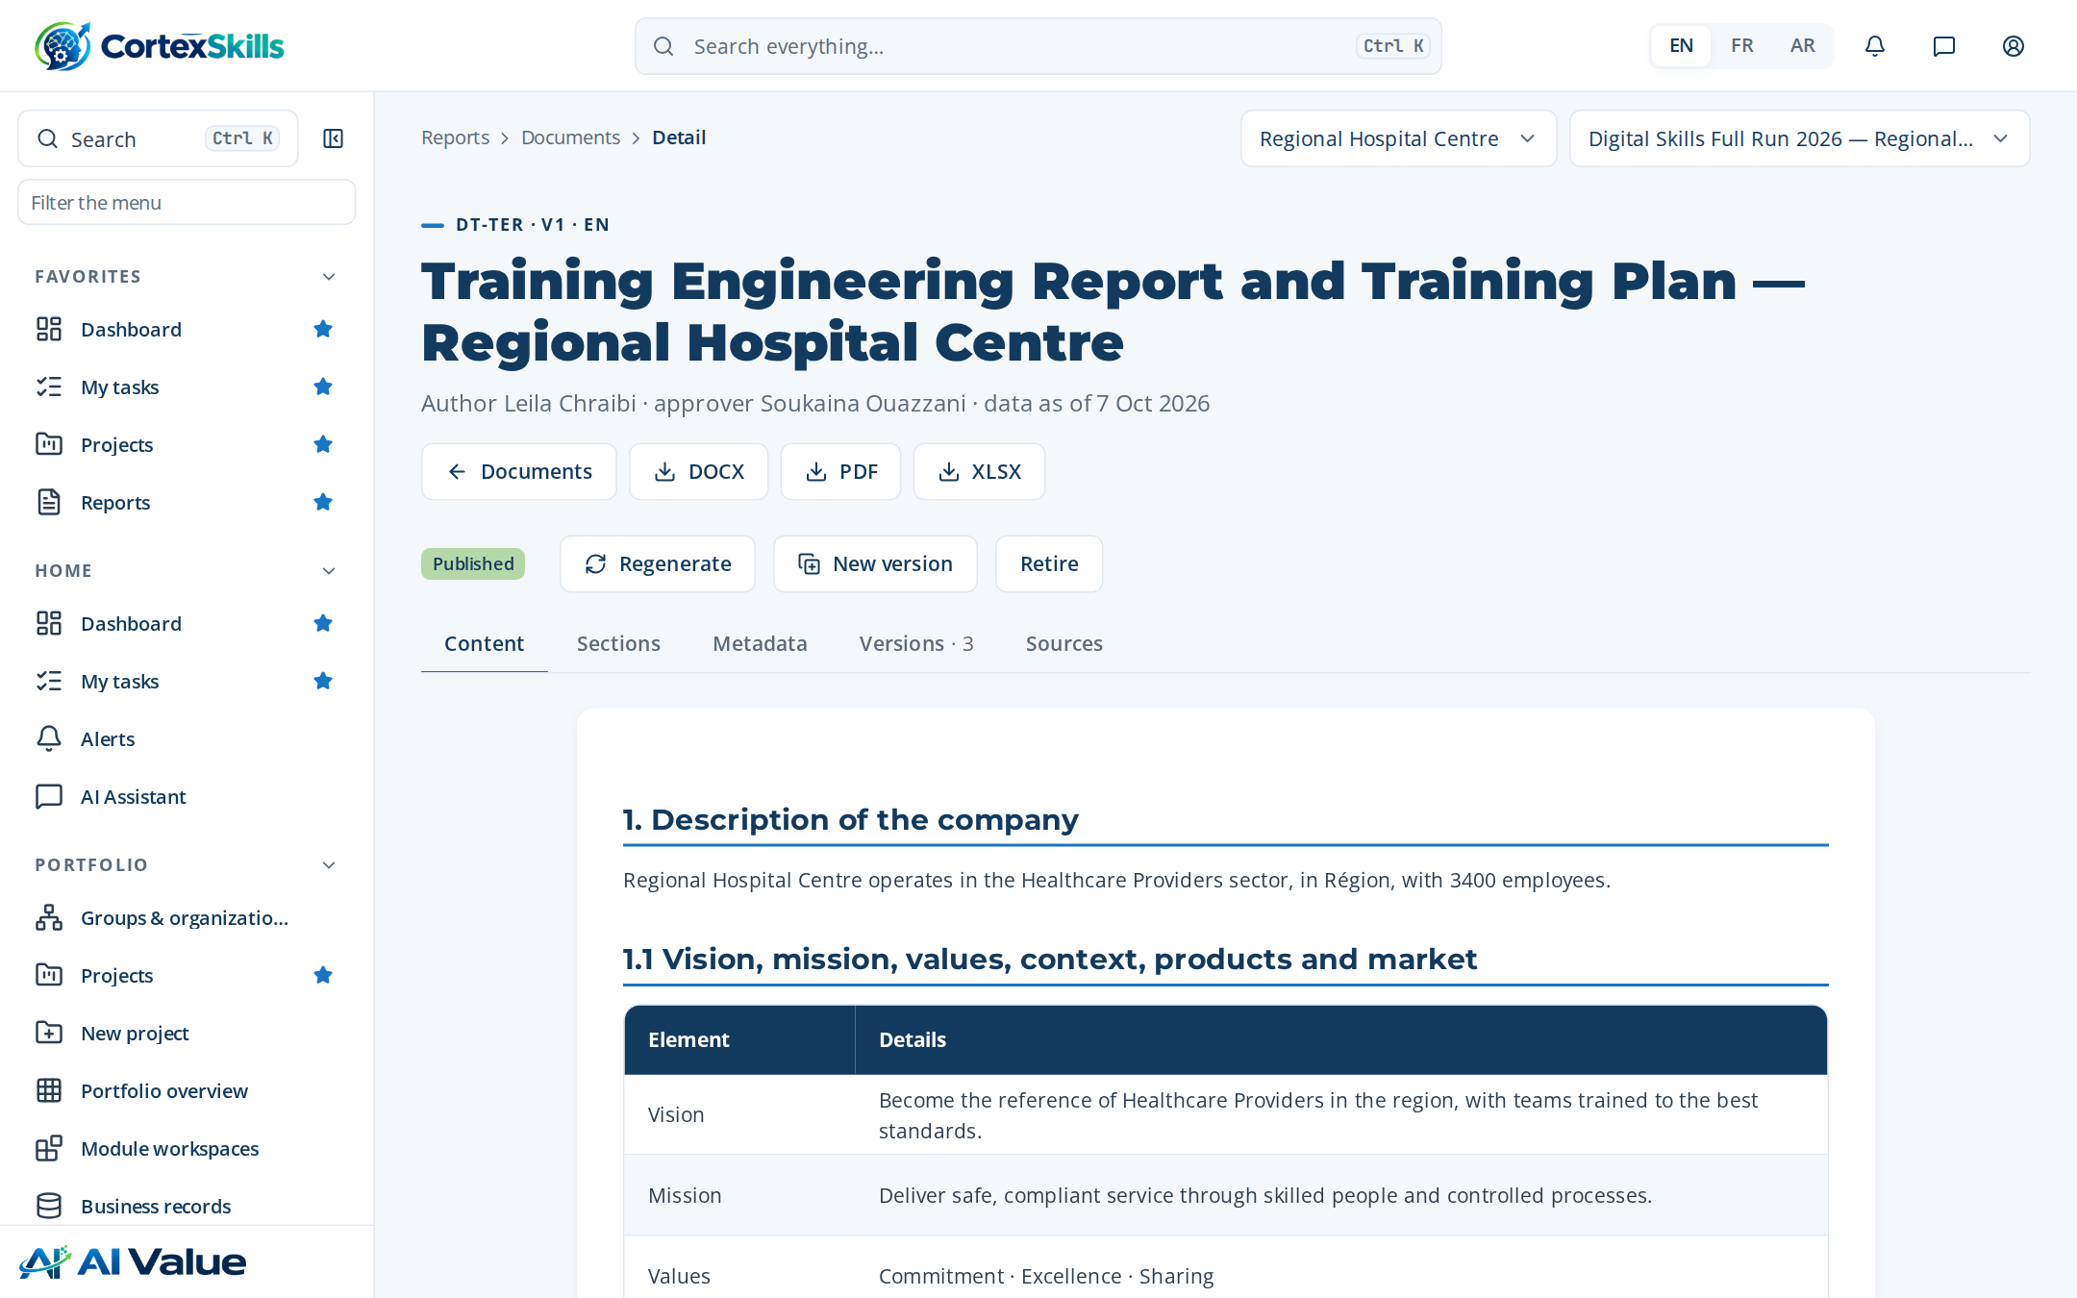
STRUCTURE OF THE REPORT
Training Engineering Report and Training Plan
Version 1 · author Leila Chraibi · approved by Soukaina Ouazzani
Chapter | Sections
1. Description of the company | 14
2. The previous training plan | 2
3. Competence needs | 50
4. Perspectives | 3
5. The prioritized training plan | 23
6. Risks, controls and indicators | 2
7. Annexes — interview forms | 38
Plus identification, data sources and approval.
The report in the document editor.
Training Engineering Report · Demonstration data — fictional organization
32

Slide 33
STRATEGIC ORIENTATIONS AND HR
Needs linked to the strategy and to the HR orientations
Priority axes named by the General Management: Leadership and performance · AI triage and clinical decision support · ISO 7101 compliance · Dashboards
ID | Objective | Horizon
SO-1 | Adopt AI triage and clinical decision support across Clinical Care & Nursing by end 2027 | 2027-12-31
SO-2 | Zero major findings in ISO 7101 audits | 2026-12-31
HR orientations
Change management
• Update job descriptions, individual objectives and the yearly assessment; build career paths.
1) Focus and prioritization · 2) Stay positive · 3) Persevere and follow up with short daily repetitions · Patience · Lead by example · Progressiveness.
Source: TER sections 3.1, 3.5 and 3.6.
Training Engineering Report · Demonstration data — fictional organization
33

Slide 34
PERSPECTIVES AND ROADMAP
Four initiatives deployed in three waves
The perspectives take into account the strategic orientations, the SWOT and improvement axes, the HR orientations and the recommendations made in the face-to-face meetin…
Wave 1
Wave 2
Wave 3
• AI triage and clinical decision support — impact 5
• AI literacy for all staff — impact 5
• AI medical imaging assistance — impact 4
• AI bed and staff capacity planning — impact 3
# | Improvement axis | Implemented | Wave
1 | AI triage and clinical decision support | 60% | 1
2 | AI medical imaging assistance | 65% | 2
3 | AI bed and staff capacity planning | 70% | 3
4 | AI literacy for all staff | 75% | 1
Source: TER chapter 4 and section 4.1.
Training Engineering Report · Demonstration data — fictional organization
34

Slide 35
IMPROVEMENT AXES
Each axis ranked, with its implementation progress
Improvement axes drawn from the SWOTs and followed in the roadmap
Roadmap initiative | Wave
AI triage and clinical decision support | 1
AI literacy for all staff | 1
AI medical imaging assistance | 2
AI bed and staff capacity planning | 3
Average implementation 68 %: wave 1 axes are deployed, the others are carried by waves 2 and 3.
Implementation of each improvement axis, by priority rank.
Training Engineering Report · Demonstration data — fictional organization
35

Slide 36
RISKS AND CONTROLS
Each risk reduced by named controls
ID | Risk or opportunity | Category | Inherent | Residual | Controls
RISK-014 | Low learner and user adoption | Adoption | 16 | 8 | CTRL-081
RISK-017 | Critical knowledge lost with expert departure | Operational | 16 | 8 | CTRL-070; CTRL-082
RISK-001 | Unauthorized access to tenant data | Security | 20 | 6 | CTRL-001; CTRL-002; CTRL-048; CTRL-011
RISK-005 | Training plan misaligned with strategy | Strategic | 16 | 6 | CTRL-049; CTRL-057; CTRL-076
RISK-006 | Inaccurate skills data leading to wrong needs | Data quality | 15 | 6 | CTRL-064; CTRL-045
RISK-030 | Position descriptions diverge from reality | Organizational | 12 | 6 | CTRL-066
RISK-007 | Unverified AI content in the Training Engineering Report | AI | 16 | 5 | CTRL-041; CTRL-056
RISK-009 | Expired mandatory certification | Compliance | 20 | 5 | CTRL-053; CTRL-054
RISK-031 | Site deployment deviates from group plan | Operational | 12 | 5 | CTRL-071
Top 9 of 35 risks by residual score (TER chapter 6).
Training Engineering Report · Demonstration data — fictional organization
36

Slide 37
PROJECT INDICATORS
Indicators followed every month during the run
ID | Indicator | Target | Latest value | Status
KPI-003 | Critical gap rate | ≤ 10% | 2026-10: 8.2 | Green
KPI-004 | Training Engineering Report cycle time | ≤ 30 days | 2026-10: 24.6 | Green
KPI-005 | Design approval lead time | ≤ 20 days | 2026-10: 16.4 | Green
KPI-007 | Content publication lead time | ≤ 15 days | 2026-10: 12.3 | Green
KPI-008 | Session fill rate | ≥ 85% | 2026-10: 91.8 | Green
KPI-009 | Plan realization rate | ≥ 90% | 2026-10: 97.2 | Green
KPI-010 | Learner completion rate | ≥ 80% | 2026-10: 86.4 | Green
KPI-012 | Average Level 1 satisfaction | ≥ 4.2 | 2026-10: 4.5 | Green
KPI-013 | Skill progression rate | ≥ 70% | 2026-10: 75.6 | Green
KPI-015 | Training record correction rate | ≤ 1% | 2026-10: 0.82 | Green
10 of the 61 indicators of TER section 6.1.
Training Engineering Report · Demonstration data — fictional organization
37

Slide 38
04
Training Plan
The plan 2026 holds 2 programs and 6 trainings, 12 days per group in total and 44 group-days to deliver, for a budget of 1,260,000.

Slide 39
PRIORITIZED PLAN
Six themes ranked by impact and urgency
Plan 2026 — status Locked — budget 1,260,000.
# | Theme | Days | Groups | Budget
1 | AI triage and clinical decision support | 3 | 6 | 360,000
2 | AI medical imaging assistance | 2 | 4 | 300,000
3 | AI bed and staff capacity planning | 2.5 | 3 | 240,000
4 | AI literacy for all staff | 1.5 | 3 | 180,000
5 | Prompting and generative AI at work | 1 | 2 | 120,000
6 | Responsible AI and data protection | 2 | 2 | 60,000
Budget by theme.
Training Plan · Demonstration data — fictional organization
39

Slide 40
PROGRAMS AND TRAININGS
Two programs, six trainings, clear prerequisites
Code | Program | Strategic axis | Trainings
PRG-1 | AI skills for Clinical Care & Nursing | Execution of the core function | TR-AI-01, TR-AI-02, TR-AI-03
PRG-2 | AI foundations for all staff | Leadership, performance and responsible use | TR-AI-04, TR-AI-05, TR-AI-06
ID | Training | Level | Duration | Prerequisites
TR-AI-01 | AI triage and clinical decision support | Intermediate | 3 day(s) | Basic digital literacy; the Foundation training is recommended
TR-AI-02 | AI medical imaging assistance | Intermediate | 2 day(s) | Basic digital literacy; the Foundation training is recommended
TR-AI-03 | AI bed and staff capacity planning | Advanced | 2.5 day(s) | TR-AI-01 or equivalent experience
TR-AI-04 | AI literacy for all staff | Foundation | 1.5 day(s) | None — open to all staff
TR-AI-05 | Prompting and generative AI at work | Foundation | 1 day(s) | None — open to all staff
TR-AI-06 | Responsible AI and data protection | Intermediate | 2 day(s) | Basic digital literacy; the Foundation training is recommended
Source: Training Plan “Programs” and TER section 5.1.
Training Plan · Demonstration data — fictional organization
40

Slide 41
TRAINING SHEET
TR-AI-01 — AI triage and clinical decision support
Level Intermediate · 3 day(s) · program PRG-1
Learning objectives
Prerequisites
• Explain the key concepts of AI triage and clinical decision support and how they apply to Clinical Care & Nursing
• Apply the methods and tools of AI triage and clinical decision support to a real case from Regional Hospital Centre
• Plan the deployment of AI triage and clinical decision support with its indicators and controls (ISO 7101)
Basic digital literacy; the Foundation training is recommended
Delivery
M1 AI triage and clinical decision support · E-learning · 2 h
M3 AI triage and clinical decision support · Virtual classroom · 3.5 h
Training Plan · Demonstration data — fictional organization
41

Slide 42
DETAILED AGENDA
AI triage and clinical decision support — half-day by half-day
22 activities over 3 day(s): lectures, quizzes and workshops on the hospital’s own cases.
Day 1 — morning
Day 1 — afternoon
Day 2 — morning
Lecture · Foundations of AI triage and clinical decision support: key c… (75 min)
Lecture · Why AI triage and clinical decision support matters for Clini… (45 min)
Quiz — key concepts of AI triage and clinical decision support (20 min)
Workshop — map today’s practices in Clinical Care & Nursing a… (75 min)
Lecture · Methods and tools of AI triage and clinical decision support (75 min)
Lecture · Worked example from the Healthcare Providers sector (40 min)
Quiz — choosing the right method (20 min)
Workshop — apply the method to a real case from Regional Hosp… (80 min)
Lecture · Governance, risks and ISO 7101 requirements (60 min)
Lecture · Data, quality and evidence to keep (45 min)
Quiz — compliance and risk scenarios (20 min)
Workshop — build the control checklist of your process (80 min)
Day 2 — afternoon
Day 3 — morning
Day 3 — afternoon
Lecture · Deploying AI triage and clinical decision support: roles, cha… (60 min)
Lecture · Indicators that measure the results (45 min)
Quiz — adoption and indicator cases (20 min)
Workshop — design the indicator dashboard of your team (80 min)
Lecture · Advanced practices and lessons learned in Clinical Care & Nur… (75 min)
Quiz — advanced cases (25 min)
Workshop — solve a critical incident scenario (100 min)
Lecture · Transfer to the workplace: the 30-60-90-day plan (60 min)
Quiz · Final assessment (Kirkpatrick level 2) (30 min)
Workshop — individual action plan and peer review (90 min)
Training Plan · Demonstration data — fictional organization
42

Slide 43

VALUE FOR EACH PERSONA
Why each audience should take the training
Training TR-AI-01 — behaviour, pain points and hopes of each persona
Executive sponsor — General Manager
Manager — director, head of department, process owner
Team member — Clinical Care & Nursing
Decides on facts presented in short steering meetings; delegates execution to the management team; follows a few indicators.
Training spend with no visible link to the strategic objectives; results of the previous plan hard to prove; ISO 7101 audits that expose competence gaps.
A prioritized plan that serves the strategy, a measurable return, and a management team able to lead the change.
Balances daily operations and improvement projects; prefers practical, short formats; relies on key people in the team.
Team absent from the job during long trainings; skills gaps on critical activities of Clinical Care & Nursing; processes not documented or without an owner.
Trainings that solve the function’s real problems, applied on the job the following week, with indicators the manager can follow.
Learns by doing and from peers; uses a phone more than a computer; wants to know what changes in daily work.
New tools introduced without explanation; theoretical trainings far from the tasks; fear of making mistakes with AI triage and clinical decision support.
Practical skills recognized by a certificate, less rework, and a clear path to the next position.
Training Plan · Demonstration data — fictional organization
43

Slide 44
TRAINING SHEET
TR-AI-02 — AI medical imaging assistance
Level Intermediate · 2 day(s) · program PRG-1 · 4 half-days, 15 activities, 14 h
Learning objectives
Half-day agenda
• Explain the key concepts of AI medical imaging assistance and how they apply to Clinical Care & Nursing
• Apply the methods and tools of AI medical imaging assistance to a real case from Regional Hospital Centre
• Plan the deployment of AI medical imaging assistance with its indicators and controls (ISO 7101)
Half-day | Activities | min
Day 1 — morning | Foundations of AI medical imaging assistance: key concepts and vocabulary · Why AI medical imaging assistance matters f… | 215
Day 1 — afternoon | Methods and tools of AI medical imaging assistance · Worked example from the Healthcare Providers sector · Quiz — choos… | 215
Day 2 — morning | Governance, risks and ISO 7101 requirements · Data, quality and evidence to keep · Quiz — compliance and risk scenarios… | 205
Day 2 — afternoon | Transfer to the workplace: the 30-60-90-day plan · Final assessment (Kirkpatrick level 2) · Workshop — individual actio… | 180
Prerequisites and activity mix
Basic digital literacy; the Foundation training is recommended
Lecture: 7 · Quiz: 4 · Workshop: 4
Personas: Executive sponsor — General Manager · Manager — director, head of department, process owner · Team member — Clinical Care & Nursing
Training Plan · Demonstration data — fictional organization
44

Slide 45
TRAINING SHEET
TR-AI-03 — AI bed and staff capacity planning
Level Advanced · 2.5 day(s) · program PRG-1 · 5 half-days, 19 activities, 17 h
Learning objectives
Half-day agenda
• Explain the key concepts of AI bed and staff capacity planning and how they apply to Clinical Care & Nursing
• Apply the methods and tools of AI bed and staff capacity planning to a real case from Regional Hospital Centre
• Plan the deployment of AI bed and staff capacity planning with its indicators and controls (ISO 7101)
Half-day | Activities | min
Day 1 — morning | Foundations of AI bed and staff capacity planning: key concepts and vocabulary · Why AI bed and staff capacity planning… | 215
Day 1 — afternoon | Methods and tools of AI bed and staff capacity planning · Worked example from the Healthcare Providers sector · Quiz — … | 215
Day 2 — morning | Governance, risks and ISO 7101 requirements · Data, quality and evidence to keep · Quiz — compliance and risk scenarios… | 205
Day 2 — afternoon | Deploying AI bed and staff capacity planning: roles, change and adoption · Indicators that measure the results · Quiz —… | 205
Day 3 — morning | Transfer to the workplace: the 30-60-90-day plan · Final assessment (Kirkpatrick level 2) · Workshop — individual actio… | 180
Prerequisites and activity mix
TR-AI-01 or equivalent experience
Lecture: 9 · Quiz: 5 · Workshop: 5
Personas: Executive sponsor — General Manager · Manager — director, head of department, process owner · Team member — Clinical Care & Nursing
Training Plan · Demonstration data — fictional organization
45

Slide 46
TRAINING SHEET
TR-AI-04 — AI literacy for all staff
Level Foundation · 1.5 day(s) · program PRG-2 · 3 half-days, 11 activities, 10 h
Learning objectives
Half-day agenda
• Explain the key concepts of AI literacy for all staff and how they apply to Clinical Care & Nursing
• Apply the methods and tools of AI literacy for all staff to a real case from Regional Hospital Centre
• Plan the deployment of AI literacy for all staff with its indicators and controls (ISO 7101)
Half-day | Activities | min
Day 1 — morning | Foundations of AI literacy for all staff: key concepts and vocabulary · Why AI literacy for all staff matters for Clini… | 215
Day 1 — afternoon | Methods and tools of AI literacy for all staff · Worked example from the Healthcare Providers sector · Quiz — choosing … | 215
Day 2 — morning | Transfer to the workplace: the 30-60-90-day plan · Final assessment (Kirkpatrick level 2) · Workshop — individual actio… | 180
Prerequisites and activity mix
None — open to all staff
Lecture: 5 · Quiz: 3 · Workshop: 3
Personas: Executive sponsor — General Manager · Manager — director, head of department, process owner · Team member — Clinical Care & Nursing
Training Plan · Demonstration data — fictional organization
46

Slide 47
TRAINING SHEET
TR-AI-05 — Prompting and generative AI at work
Level Foundation · 1 day(s) · program PRG-2 · 2 half-days, 7 activities, 7 h
Learning objectives
Half-day agenda
• Explain the key concepts of Prompting and generative AI at work and how they apply to Clinical Care & Nursing
• Apply the methods and tools of Prompting and generative AI at work to a real case from Regional Hospital Centre
• Plan the deployment of Prompting and generative AI at work with its indicators and controls (ISO 7101)
Half-day | Activities | min
Day 1 — morning | Foundations of Prompting and generative AI at work: key concepts and vocabulary · Why Prompting and generative AI at wo… | 215
Day 1 — afternoon | Transfer to the workplace: the 30-60-90-day plan · Final assessment (Kirkpatrick level 2) · Workshop — individual actio… | 180
Prerequisites and activity mix
None — open to all staff
Lecture: 3 · Quiz: 2 · Workshop: 2
Personas: Executive sponsor — General Manager · Manager — director, head of department, process owner · Team member — Clinical Care & Nursing
Training Plan · Demonstration data — fictional organization
47

Slide 48
TRAINING SHEET
TR-AI-06 — Responsible AI and data protection
Level Intermediate · 2 day(s) · program PRG-2 · 4 half-days, 15 activities, 14 h
Learning objectives
Half-day agenda
• Explain the key concepts of Responsible AI and data protection and how they apply to Clinical Care & Nursing
• Apply the methods and tools of Responsible AI and data protection to a real case from Regional Hospital Centre
• Plan the deployment of Responsible AI and data protection with its indicators and controls (ISO 7101)
Half-day | Activities | min
Day 1 — morning | Foundations of Responsible AI and data protection: key concepts and vocabulary · Why Responsible AI and data protection… | 215
Day 1 — afternoon | Methods and tools of Responsible AI and data protection · Worked example from the Healthcare Providers sector · Quiz — … | 215
Day 2 — morning | Governance, risks and ISO 7101 requirements · Data, quality and evidence to keep · Quiz — compliance and risk scenarios… | 205
Day 2 — afternoon | Transfer to the workplace: the 30-60-90-day plan · Final assessment (Kirkpatrick level 2) · Workshop — individual actio… | 180
Prerequisites and activity mix
Basic digital literacy; the Foundation training is recommended
Lecture: 7 · Quiz: 4 · Workshop: 4
Personas: Executive sponsor — General Manager · Manager — director, head of department, process owner · Team member — Clinical Care & Nursing
Training Plan · Demonstration data — fictional organization
48

Slide 49
LEARNING DESIGN
Paths, modules and content assets
Learning path | Days | Module | Modality | Hours | Design
AI triage and clinical decision support | 3 | M1 AI triage and clinical decision support | E-learning | 2 | Approved
 |  | M3 AI triage and clinical decision support | Virtual classroom | 3.5 | Approved
AI medical imaging assistance | 2 | M2 AI medical imaging assistance | Classroom | 7 | Approved
 |  | M4 AI medical imaging assistance | Classroom | 7 | Approved
Content | Format | Size (MB) | Review date | Status | Language
M1 material | SCORM | 42 | 2027-08-03 | Published | EN
M2 material | Video | 180 | 2027-04-05 | Published | FR
M3 material | PDF | 3.2 | 2026-12-06 | Published | AR
M4 material | Capsule | 12 | 2026-08-08 | Published | FR
Source: TER sections 5.3 and 5.4.
Training Plan · Demonstration data — fictional organization
49

Slide 50
BUDGET
Allocated, committed, spent and refunds expected
Allocated 1,260,000, committed 1,260,000 (100 %), spent 1,192,662 (95 % of planned); expected refunds 352,800.
Line | Actual | Refund
AI triage and clinical decisi… | 347,127 | 100,800
AI medical imaging assistance | 266,091 | 84,000
AI bed and staff capacity pla… | 243,800 | 67,200
AI literacy for all staff | 156,192 | 50,400
Prompting and generative AI a… | 118,913 | 33,600
Responsible AI and data prote… | 60,539 | 16,800
Total | 1,192,662 | 352,800
Provider | Accredited until | /5
Atlas Formation Conseil | 2027-04-25 | 4.2
Maghreb Learning Partners | 2027-08-03 | 3.8
Allocated (Muted) versus actual (Azure) by training, (TER 5.7).
Training Plan · Demonstration data — fictional organization
50

Slide 51
05
Delivery, evaluation and audit
Sessions, Kirkpatrick levels, ROI, internal audit and lessons learned

Slide 52

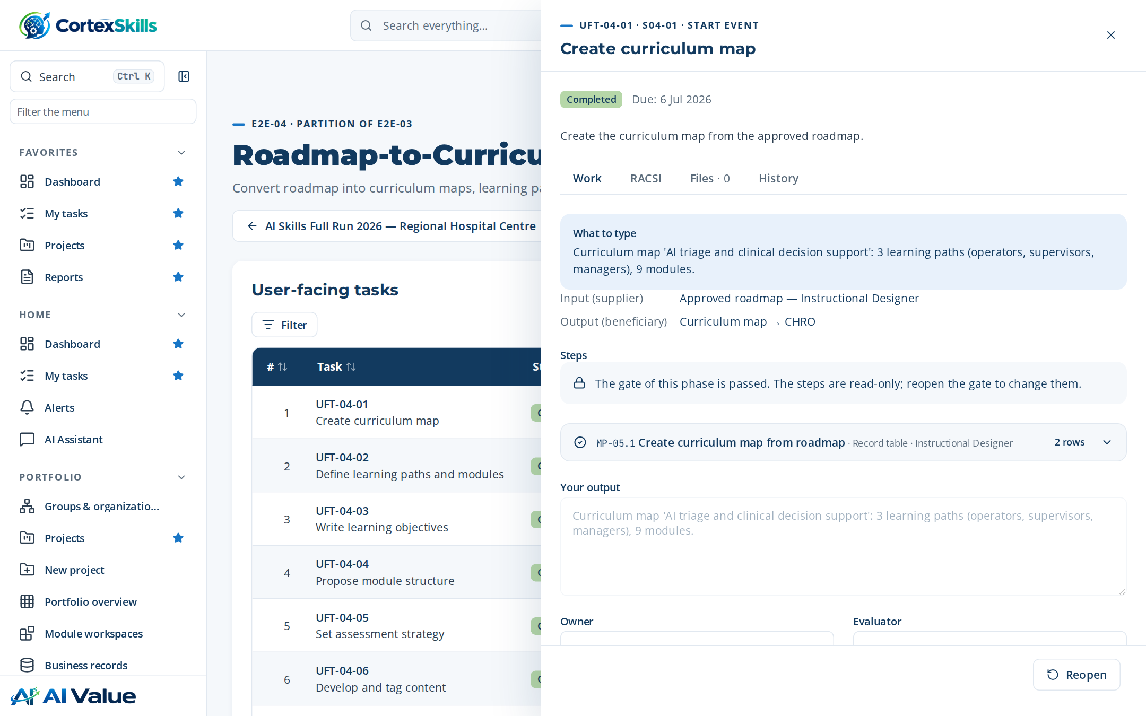
SESSIONS AND ATTENDANCE
Four sessions delivered with their enrolments
Session | Date | Capacity | Trainer | Enrolled
S-01 AI triage and clinical decision supp… | 2026-07-19 | 12 | Rachid Benjelloun | 3
S-02 AI medical imaging assistance | 2026-07-26 | 12 | Rachid Benjelloun | 3
S-03 AI triage and clinical decision supp… | 2026-08-02 | 12 | Rachid Benjelloun | 3
S-04 AI medical imaging assistance | 2026-08-09 | 12 | Rachid Benjelloun | 3
10 / 12
learners present at their session
10 / 12
enrolments completed
A task of the delivery process with its typed steps.
Delivery, evaluation and audit · Demonstration data — fictional organization
52

Slide 53



EVALUATION
Results measured at three Kirkpatrick levels
86 %
93 %
84 %
1 — Reaction
2 — Learning
3 — Behaviour
Level | What is measured | When | Instrument | Results
1 — Reaction | Satisfaction and perceived usefulness | End of each session | Satisfaction questionnaire | 2 × 86 %
2 — Learning | Knowledge and skills acquired | End of the training | Pre- and post-test, case study | 2 × 93 %
3 — Behaviour | Use of the skills at the workstation | Three months after | Manager observation grid | 2 × 84 %
4 — Results | Effect on the indicators of the function | Six to twelve months after | Indicators of the function (KPI) | —
Certifications (TER 5.10): 4 valid, 1 expiring, 1 expired — the expired one triggers an alert and a renewal session.
Delivery, evaluation and audit · Demonstration data — fictional organization
53

Slide 54
EVALUATION RESULTS
Each evaluation recorded with its score
6 evaluations linked to the enrolments of the sessions (E2E-07)
Evaluation | Level | Score
Kirkpatrick level 1 | 1 | 93 %
Kirkpatrick level 1 | 1 | 79 %
Kirkpatrick level 2 | 2 | 93 %
Kirkpatrick level 2 | 2 | 92 %
Kirkpatrick level 3 | 3 | 76 %
Kirkpatrick level 3 | 3 | 92 %
Average score by Kirkpatrick level.
Delivery, evaluation and audit · Demonstration data — fictional organization
54

Slide 55


CERTIFICATIONS
Certifications followed, renewals planned before expiry
Regulatory and accreditation requirements per employee (E2E-09)
4
1
1
valid certifications
expiring within 90 days: renewal session planned
expired: alert raised to the manager
Certification | Requirement | Valid until | Status
ISO 7101 awareness | ISO 7101 | 2026-08-18 | Valid
ISO 7101 awareness | ISO 7101 | 2026-11-16 | Expired
ISO 7101 awareness | ISO 7101 | 2027-02-14 | Valid
ISO 7101 awareness | ISO 7101 | 2027-05-15 | Expiring
ISO 7101 awareness | ISO 7101 | 2027-08-13 | Valid
ISO 7101 awareness | ISO 7101 | 2027-11-11 | Valid
Delivery, evaluation and audit · Demonstration data — fictional organization
55

Slide 56


ROI AND BUSINESS IMPACT
Phillips ROI and the indicators of the ROI study
ROI and business impact report — Regional Hospital Centre
108
4.5
75.6
4.1
Training ROI
Average Level 1 satisfaction
Skill progression rate
Budget execution variance
ID | Indicator | Formula | Target | Latest value | Status
KPI-037 | Training ROI | (Net programme benefits / programme costs) x 100 (Phillips) | ≥ 100% | 108 (2026-10) | Green
KPI-012 | Average Level 1 satisfaction | Mean reaction score across closed sessions (1-5) | ≥ 4.2 | 4.5 (2026-10) | Green
KPI-013 | Skill progression rate | Learners gaining at least one level within 6 months / learners traine… | ≥ 70% | 75.6 (2026-10) | Green
KPI-022 | Budget execution variance | |Actual - allocated| / allocated x 100 | ≤ 5% | 4.1 (2026-10) | Green
KPI-023 | OFPPT refund recovery rate | Refunds received / refunds forecast x 100 | ≥ 90% | 97.2 (2026-10) | Green
Source: ROI and business impact report (DT-E2E-08), indicators section.
Delivery, evaluation and audit · Demonstration data — fictional organization
56

Slide 57
INTERNAL AUDIT
Audit report — Regional Hospital Centre
Conforming with one minor nonconformity to correct within 60 days.
ID | Grade | Requirement | Statement
F-1 | Minor nonconformity | ISO 7101 7.2 | Two trainers have no evidence of competence on file.
F-2 | Observation | ISO 7101 9.1 | Level 3 evaluations are planned but not yet scheduled.
F-3 | Opportunity for improvement | ISO 7101 7.1.6 | Capture lessons learned at the end of each session.
F-4 | Strength | ISO 7101 7.2 | Needs analysis fully traced from strategic objectives.
Findings by grade.
Strengths: Clear needs analysis; strong management involvement; complete attendance records.
Follow-up: Verification of the corrective action at the next steering committee.
Delivery, evaluation and audit · Demonstration data — fictional organization
57

Slide 58
ACTION PLAN
Corrective actions owned, dated and evaluated
Actions raised by the audit and the indicators, each with an owner and an evaluator (governance)
Action | Due date | Status
Update 11 outdated position descriptions | 2026-07-09 | Open
Contract a second training vendor | 2026-06-09 | Done
How actions are governed
An owner carries the action, a different person evaluates its effectiveness.
Overdue actions raise an alert to the owner and the project manager.
Closure needs the evaluation: the audit finding is closed only then.
Delivery, evaluation and audit · Demonstration data — fictional organization
58

Slide 59



LESSONS LEARNED
REX — AI triage and clinical decision support
What went well
What did not
Root cause
What we will do next time
The stakeholder register and multi-channel distribution lifted the response rate.
SWOT inputs arrived late from one function.
No backup nominated for the function head.
Name a backup for every function head at kickoff.
Delivery, evaluation and audit · Demonstration data — fictional organization
59

Slide 60
06
Documents produced
37 documents published in English, each traced to its data

Slide 61
DOCUMENTS PRODUCED
Every end-to-end process leaves its document
All published, versioned and approved by a second person — 1,060 pages.
Code | Document | Pages
DT-E2E-01 | Annual L&D plan and budget | 28
DT-E2E-02 | Skills gap diagnosis | 23
DT-E2E-03 | Training needs report and roadmap | 28
DT-E2E-04 | Curriculum design document | 24
DT-E2E-05 | Training delivery report | 28
DT-E2E-06 | Learner engagement report | 30
DT-E2E-07 | Training evaluation report | 23
DT-E2E-08 | ROI and business impact report | 23
DT-E2E-09 | Compliance and certification register | 22
DT-E2E-10 | Internal mobility and career paths | 25
Code | Document | Pages
DT-E2E-11 | Onboarding programme record | 21
DT-E2E-12 | Knowledge capture and transfer record | 22
DT-E2E-13 | Content catalogue and lifecycle | 22
DT-E2E-14 | Extended enterprise training report | 22
DT-E2E-15 | Data, AI and integration governance | 24
DT-E2E-16 | Vendor management file | 20
DT-E2E-17 | Change and adoption plan | 23
DT-E2E-18 | Quality, risk and improvement report | 30
DT-E2E-19 | Consulting engagement closure report | 25
DT-E2E-20 | Multi-axis diagnostic and maturity report | 26
Documents produced · Demonstration data — fictional organization
61

Slide 62
DOCUMENTS PRODUCED
Documents produced (continued)
Code | Document | Pages
DT-E2E-21 | Previous plan impact evaluation | 25
DT-E2E-22 | Multi-site deployment plan | 24
DT-E2E-23 | Regulatory submission file | 22
DT-E2E-24 | Competitive intelligence note | 23
DT-E2E-25 | Job architecture and competency map | 23
DT-E2E-26 | Forward planning of jobs and skills (GPEC) | 24
DT-E2E-27 | Training demand consolidation | 21
DT-E2E-28 | Performance assessment and RAG dashboard | 22
DT-E2E-29 | Functional SWOT and improvement axes | 23
DT-E2E-30 | Prioritized resource plan | 24
Code | Document | Pages
DT-E2E-31 | Post-engagement roadmap | 24
DT-E2E-32 | Scope of work and stakeholder register | 31
DT-E2E-33 | Questionnaire campaign report | 29
DT-TER | Training Engineering Report and Training Plan | 198
DT-PLAN | Training plan with detailed agendas | 34
DT-AUDIT | Audit report | 5
DT-MASTER | Master list of documented information | 19
Documents produced · Demonstration data — fictional organization
62

Slide 63



INSIDE THE APPLICATION
How the teams entered and governed the data
CortexSkills 1.11 — Standard Application SRS v1.8
Typed step forms
Full-screen entry
Paste from Excel or Word
Each step asks for what it produces: records, matrices, decisions; rows are saved one by one, with Undo.
Any table opens over the whole screen with zoom (50–200 %), add, save and return to the same row.
Lists of staff or trainings are pasted in one step, checked cell by cell, saved and undone as one operation.
Amounts with their currency
Two-person publication
Audit trail
Budgets carry their currency; totals never mix currencies without a stated exchange rate and date.
A document is published only once a second person approves it; every version is kept.
Every change, paste and approval is recorded with its author, date and justification.
Documents produced · Demonstration data — fictional organization
63

Slide 64
TRACEABILITY
Every number of the report comes from a record
Every table of this document is drawn from the application’s records; data as of 07/10/2026, 15:28:07.
Source | Records | Process | Last change
Questionnaire responses | 32 | MP-54 | —
Stakeholder | 40 | MP-53 | 2026-10-07
ScopeCriterion | 17 | MP-52 | 2026-10-07
SkillAssessment | 12 | MP-16 | 2026-10-07
SkillGap | 8 | MP-16 | 2026-10-07
TrainingNeed | 10 | MP-03 | 2026-10-07
RoadmapInitiative | 4 | MP-04 | 2026-10-07
WbsNode | 3 | MP-49 | 2026-10-07
Session | 4 | MP-05 | 2026-10-07
TrainingPlan | 1 | MP-49 | 2026-10-07
Employee | 16 | MP-16 | 2026-10-07
StrategicObjective | 2 | MP-01 | 2026-10-07
Governance of the documents
Author Leila Chraibi, approver Soukaina Ouazzani: two different people.
Each version is kept; a change of the data marks the document as stale.
20 data sources listed with their record counts and process.
Documents produced · Demonstration data — fictional organization
64

Slide 65
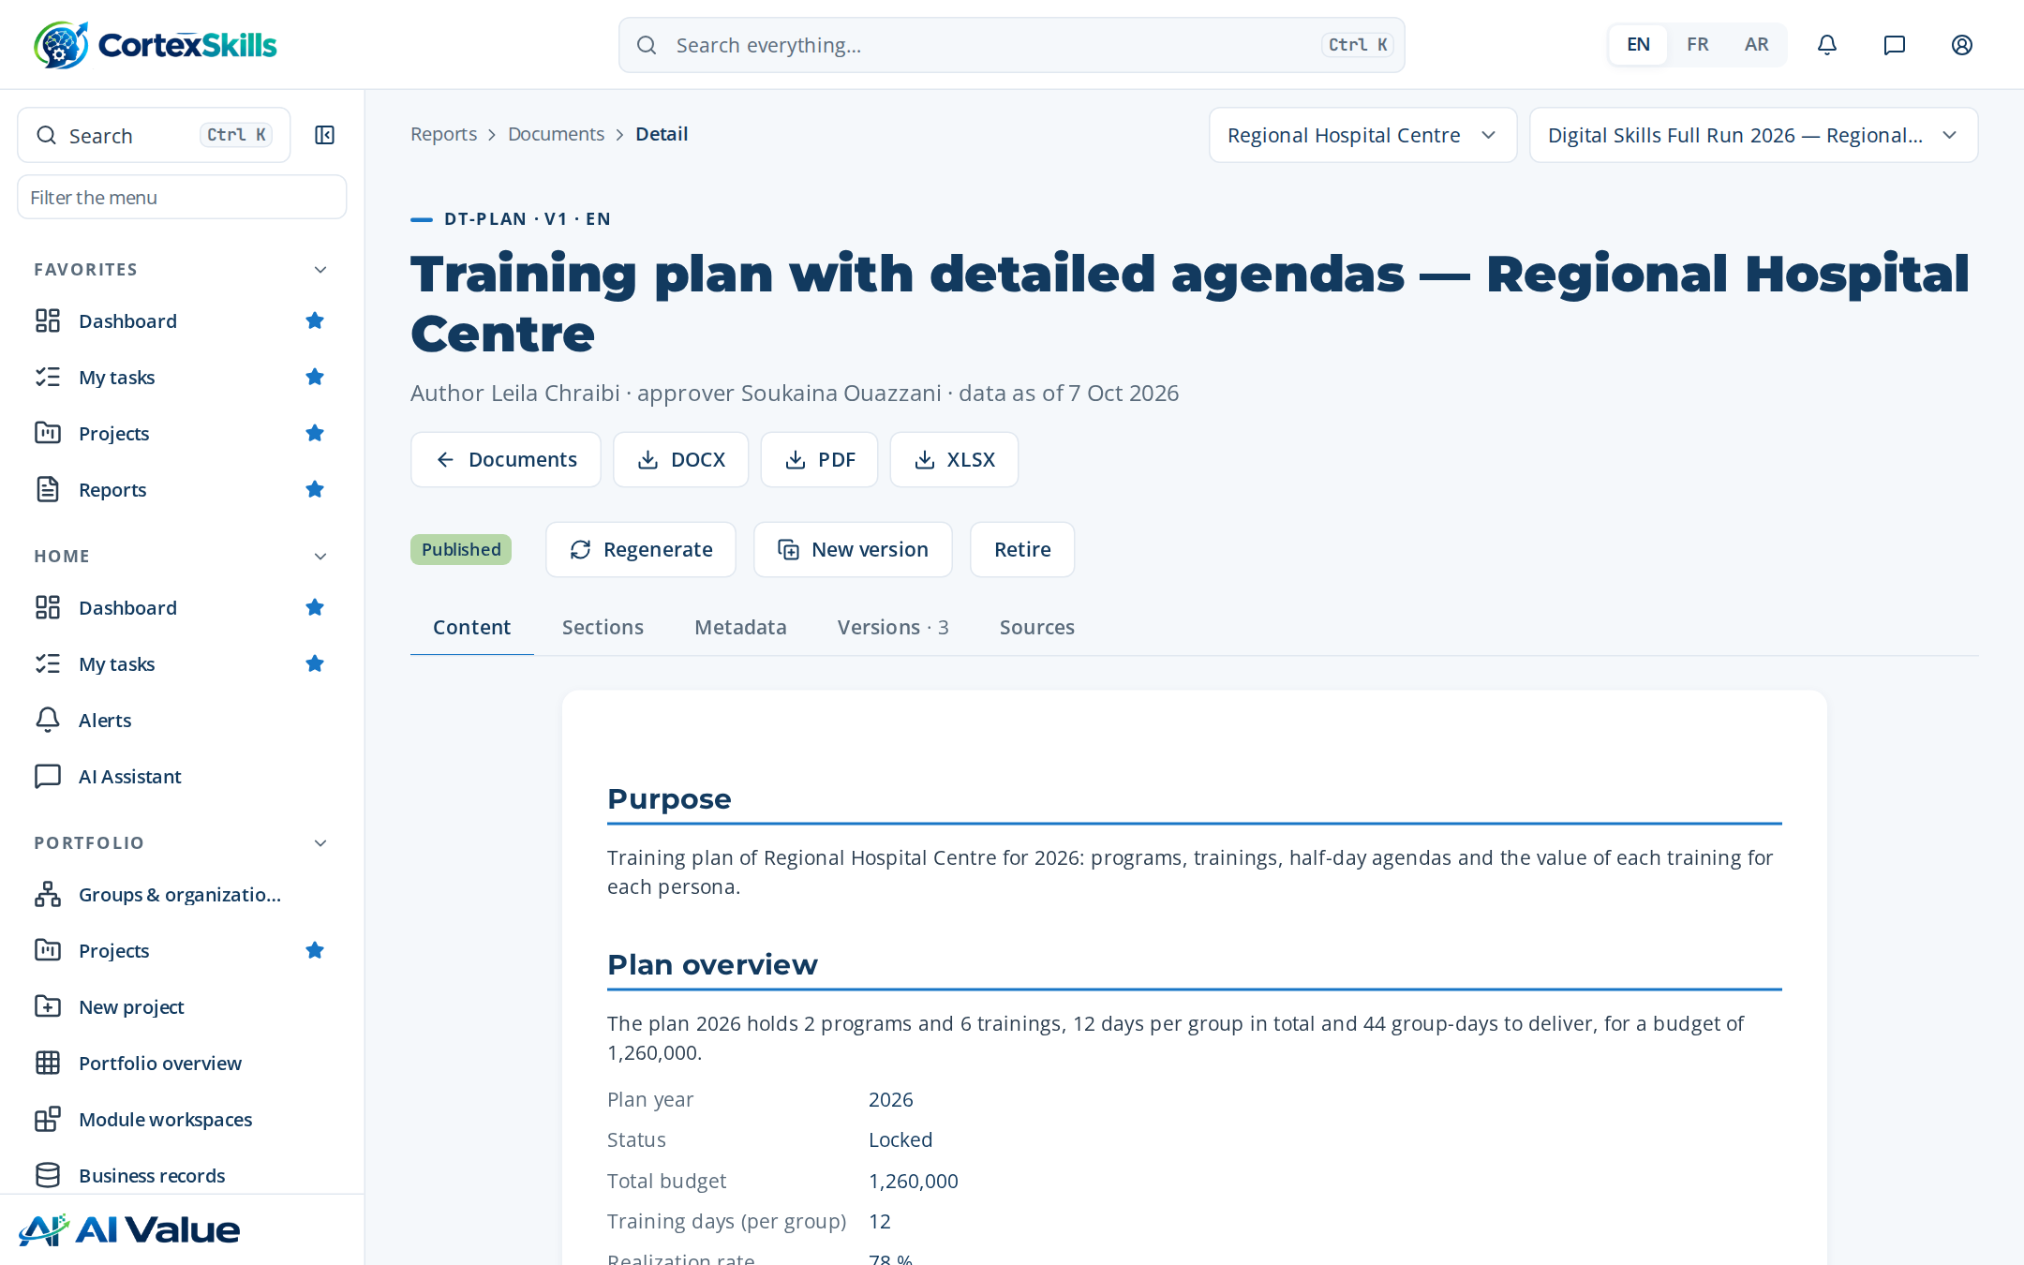
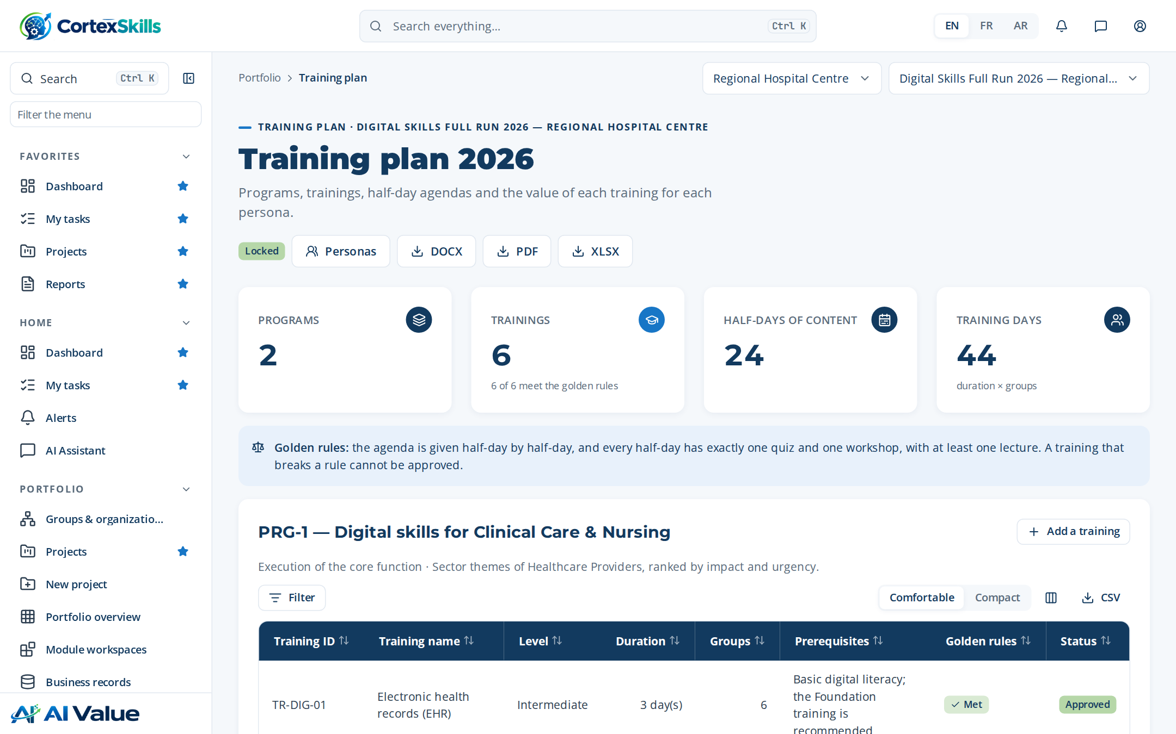
INSIDE THE APPLICATION
The Training Plan as the users see it
Training plan with detailed agendas — Regional Hospital Centre
Training plan screen: programs, trainings and sessions.
Documents produced · Demonstration data — fictional organization
65

Slide 66
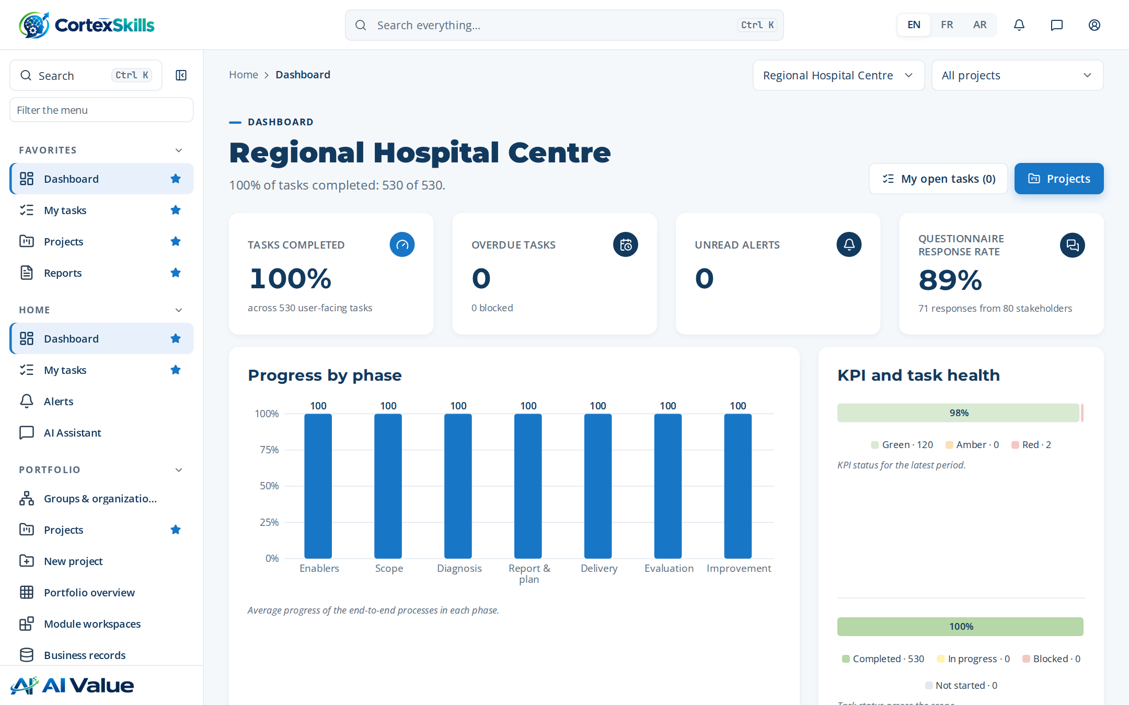
INSIDE THE APPLICATION
The project workspace and the dashboard
Project workspace: phases, processes and progress.
Dashboard of the hospital.
Documents produced · Demonstration data — fictional organization
66

Slide 67
CONCLUSION
What the hospital has at the end of the cycle
A Training Engineering Report of 198 pages, built from 37 answers, 40 stakeholders and the diagnosis of every function.
A locked Training Plan: 6 trainings, half-day agendas, a value proposition per persona and a budget of 1,260,000
Evaluation at three Kirkpatrick levels, an ROI study, followed certifications and an internal audit with one minor nonconformity to correct.
37 published documents ready for an accreditation audit (ISO 7101, JCI), each traced to the data and the step that produced it.
Next: waves 2 and 3 of the roadmap and the level-4 (results) evaluation six to twelve months after the trainings.
Conclusion · Demonstration data — fictional organization
67

Slide 68

Thank you
MEASURABLE · GOVERNED · SUSTAINABLE

