Slide 1

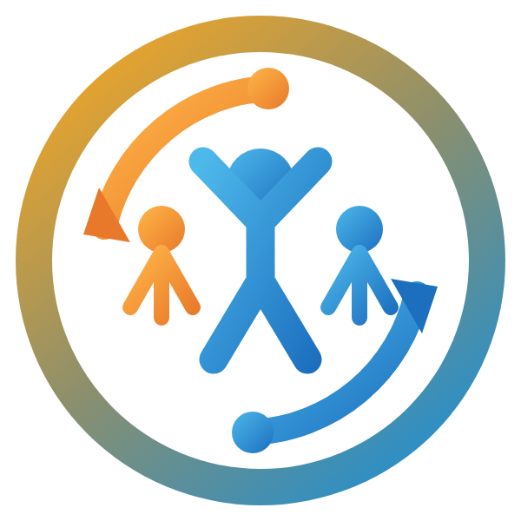
POWERACT CONSULTING PRESENTS
journi
The human side of change, mapped as a journey.
Change programs fail for human reasons, not technical ones — yet most organizations instrument the go-live and never the people. journi gives Change Managers, sponsors, and executives one governed, AI-assisted platform to measure readiness, diagnose resistance, and prove adoption — start to finish, scoped to exactly what each role should see.
22
4
9
modules — one lifecycle,
from tenant setup to sustainment
frameworks unified —
ADKAR, Lewin, Bridges, Kübler-Ross
RBAC roles — the right data,
for the right person, always
1

Slide 2





AI USE CASES
Built for the moments Change Managers actually face
Every use case is Assistive or Augmented — grounded in your own data, never autonomous.
Spot why someone’s stuck
Coach the coach
Reads open-text survey answers and flags the likely reason — e.g. “fear of losing their role” — for a Change Manager to confirm.
Turns a flagged team barrier into a ready-to-use coaching conversation, tailored for that manager and that team.
14
AI use cases across the change lifecycle
Catch change overload early
Report up in plain English
Warns when too many changes are about to hit the same population at once, and suggests a better rollout window.
Turns raw ADKAR scores into a short, readable narrative a sponsor can absorb in under a minute.
9 Assistive 5 Augmented
AI Use Cases
2

Slide 3



GOVERNANCE BY DESIGN
Two tiers. Always a human in the loop.
journi deliberately excludes Autonomous AI — no use case ever takes an irreversible action on its own.
Assistive
Augmented
The AI observes, analyzes, or suggests. A person still performs the task and makes the decision.
The AI drafts, classifies, or summarizes at scale — but a person must review, edit, and approve before it’s final.
Example: flagging a likely resistance pattern for a Change Manager to act on.
Example: drafting an executive readiness narrative for sign-off.
No Autonomous AI.
Every suggestion is labeled, logged, and reviewable — governance isn’t a setting, it’s the architecture.
journi doesn’t just track change. It proves it — safely, at scale, in every language your workforce speaks.
AI Governance & Tiers
3

