Slide 1
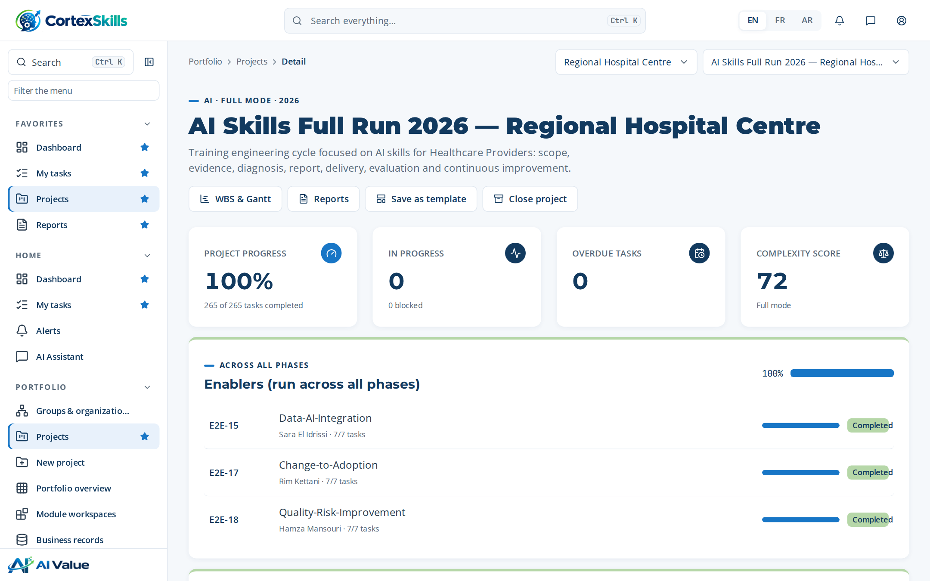
POWERACT
FULL CASE · HEALTHCARE · 2026
AI skills training engineering at a regional hospital
Regional Hospital Centre: from scope to evaluation — the project, the Training Engineering Report, the Training Plan and every document produced with CortexSkills
POWERACT Consulting

Slide 2






AGENDA
How the case is presented
01
02
03
The hospital and the project
Diagnosis
Training Engineering Report
Context, charter, scope, method, schedule
Questionnaires, maturity, skill gaps, needs
Structure, roadmap, risks
04
05
06
Training Plan
Delivery and evaluation
Documents produced
Programs, trainings, agendas, budget
Kirkpatrick, certifications, lessons
37 published documents
POWERACT
Agenda · Demonstration data — fictional organization
2

Slide 3







EXECUTIVE SUMMARY
A complete AI skills cycle, documented end to end
Regional Hospital Centre · 3,400 employees · AI Skills Full Run 2026 — Regional Hospital Centre
100 %
37 / 40
6
1,260,000
of the run completed — 35 end-to-end processes
people answered the questionnaires (93 %)
trainings in 2 programs, prioritized by impact
training budget; 1,192,662 spent
What the case shows
Diagnosis: “Information systems” is the weakest axis (2 / 5); the largest skill gap is “AI bed and staff capacity planning” (average gap 3.0).
10 training needs were validated and grouped into 6 themes, delivered in 4 roadmap initiatives over three waves.
Kirkpatrick results: 86 % · 93 % · 84 % for reaction, learning and behaviour.
37 documents published, 1,060 pages in total; the Training Engineering Report alone has 198 pages.
POWERACT
Executive summary · Demonstration data — fictional organization
3

Slide 4
01
The hospital and the project
Context, charter, scope, method and schedule
POWERACT

Slide 5
CONTEXT
Regional Hospital Centre
Regional Hospital Centre operates in the Healthcare Providers sector, in Région, with 3400 employees.
Topic | Content
Vision | Become the reference of Healthcare Providers in the region, with teams trained to the best standards.
Mission | Deliver safe, compliant service through skilled people and controlled processes.
Values | Commitment · Excellence · Sharing
Context | Strong competition, stricter ISO 7101 audits and the arrival of AI triage and clinical decision support.
Products — existing | Core services of Clinical Care & Nursing
Products — new | Digital services supported by AI triage and clinical decision support
Market segments | Large accounts · Public sector · Individual customers
Organization and headcount
Function | People
Operations | 3
Quality & HSE | 3
Finance | 2
Human Resources | 2
Sales & Marketing | 2
Information Systems | 2
Clinical Care & Nursing | 2
POWERACT
The hospital and the project · Demonstration data — fictional organization
5

Slide 6




PROJECT CHARTER
AI Skills Full Run 2026 — Regional Hospital Centre
Training engineering cycle focused on AI skills for Healthcare Providers: scope, evidence, diagnosis, report, delivery, evaluation and continuous improvement.
72
40
17
MS · MO · OP
complexity score (out of 100): full run with gates
stakeholders registered and consulted
scope criteria approved in the Scope of Work
decision levels covered (strategic, middle, operational)
Strategic objectives
SO-1 — Adopt AI triage and clinical decision support across Clinical Care & Nursing by end 2027 (horizon 2027-12-31)
SO-2 — Zero major findings in ISO 7101 audits (horizon 2026-12-31)
POWERACT
The hospital and the project · Demonstration data — fictional organization
6

Slide 7
METHOD
Six phases, each closed by a gate with its deliverables
The training engineering mission follows the phases below, each closed by a gate with its deliverables.
Phase | End-to-end processes | Progress
1. Scope & evidence | E2E-32 · E2E-33 · E2E-19 · E2E-24 | 100%
2. Diagnosis | E2E-20 · E2E-25 · E2E-26 · E2E-27 · E2E-28 · E2E-29 · E2E-02 · E2E-21 | 100%
3. Training Engineering Report & plan | E2E-01 · E2E-03 · E2E-30 · E2E-22 · E2E-23 · E2E-16 · HCPR-E2E-02 | 100%
4. Design & delivery | E2E-04 · E2E-05 · E2E-06 · E2E-13 · E2E-14 | 100%
5. Evaluation, compliance & impact | E2E-07 · E2E-08 · E2E-09 · HCPR-E2E-01 | 100%
6. Talent, knowledge & continuous improvement | E2E-10 · E2E-11 · E2E-12 · E2E-31 | 100%
Source: Training Engineering Report, section 1.5 “The current mission”.
POWERACT
The hospital and the project · Demonstration data — fictional organization
7

Slide 8
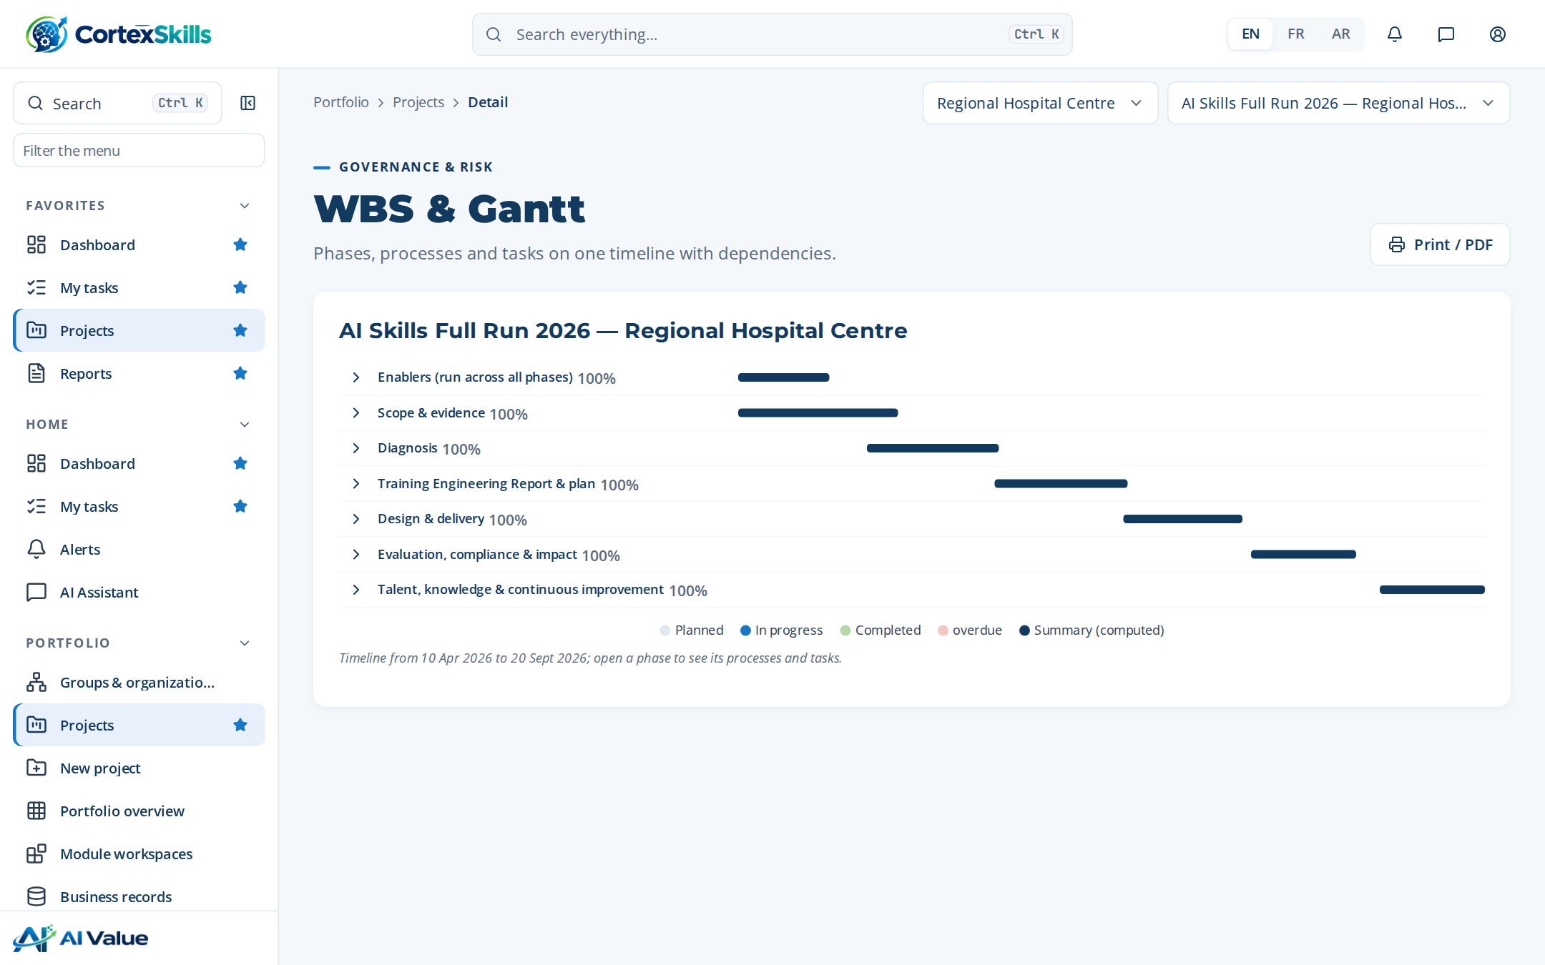
SCHEDULE
Work packages and the Gantt chart
Work package | Start | End | Progress
Scope & evidence | 2026-04-10 | 2026-05-07 | 100 %
Diagnosis | 2026-05-08 | 2026-06-04 | 100 %
Report & plan | 2026-06-05 | 2026-07-02 | 100 %
Sessions | Date
S-01 AI triage and clinical decision … | 2026-07-19
S-02 AI medical imaging assistance | 2026-07-26
S-03 AI triage and clinical decision … | 2026-08-02
S-04 AI medical imaging assistance | 2026-08-09
WBS and Gantt of the project in CortexSkills.
POWERACT
The hospital and the project · Demonstration data — fictional organization
8

Slide 9
02
Diagnosis
Who answered, where the hospital stands, which skills are missing
POWERACT

Slide 10
QUESTIONNAIRE CAMPAIGN
37 of 40 people answered
40 people were invited to answer; 37 answered.
Function | General Manager | Management | Team member | Responded
Operations | 1 | 3 | 2 | 6
Quality & HSE | 0 | 4 | 2 | 5
Human Resources | 0 | 4 | 2 | 5
Sales & Marketing | 0 | 4 | 2 | 6
Information Systems | 0 | 3 | 2 | 5
Clinical Care & Nursing | 0 | 4 | 1 | 5
Finance | 0 | 4 | 2 | 5
Response rate by function.
Channel | Invited | Responded | Rate | Completeness
Face-to-face | 12 | 12 | 100 % | 95 %
Application | 23 | 23 | 100 % | 91 %
Email | 2 | 2 | 100 % | 77 %
Source: TER sections 1.6, 1.12 and 1.13.
POWERACT
Diagnosis · Demonstration data — fictional organization
10

Slide 11
DIAGNOSIS AND MATURITY
Five axes scored, maturity one level below target
Axis | Score | Reading
Strategy | 3.4 | Strength to build on
Organization | 2.8 | Partly in place
Processes | 2.6 | Partly in place
People and skills | 3.1 | Partly in place
Information systems | 2 | Priority for development
Model | Current | Target | Gap
CMM maturity (CMM) | 3 | 4 | 1
Leadership maturity (Leadership) | 3 | 4 | 1
Maturity models (TER 1.10).
Diagnostic score by axis (TER 1.9).
POWERACT
Diagnosis · Demonstration data — fictional organization
11

Slide 12
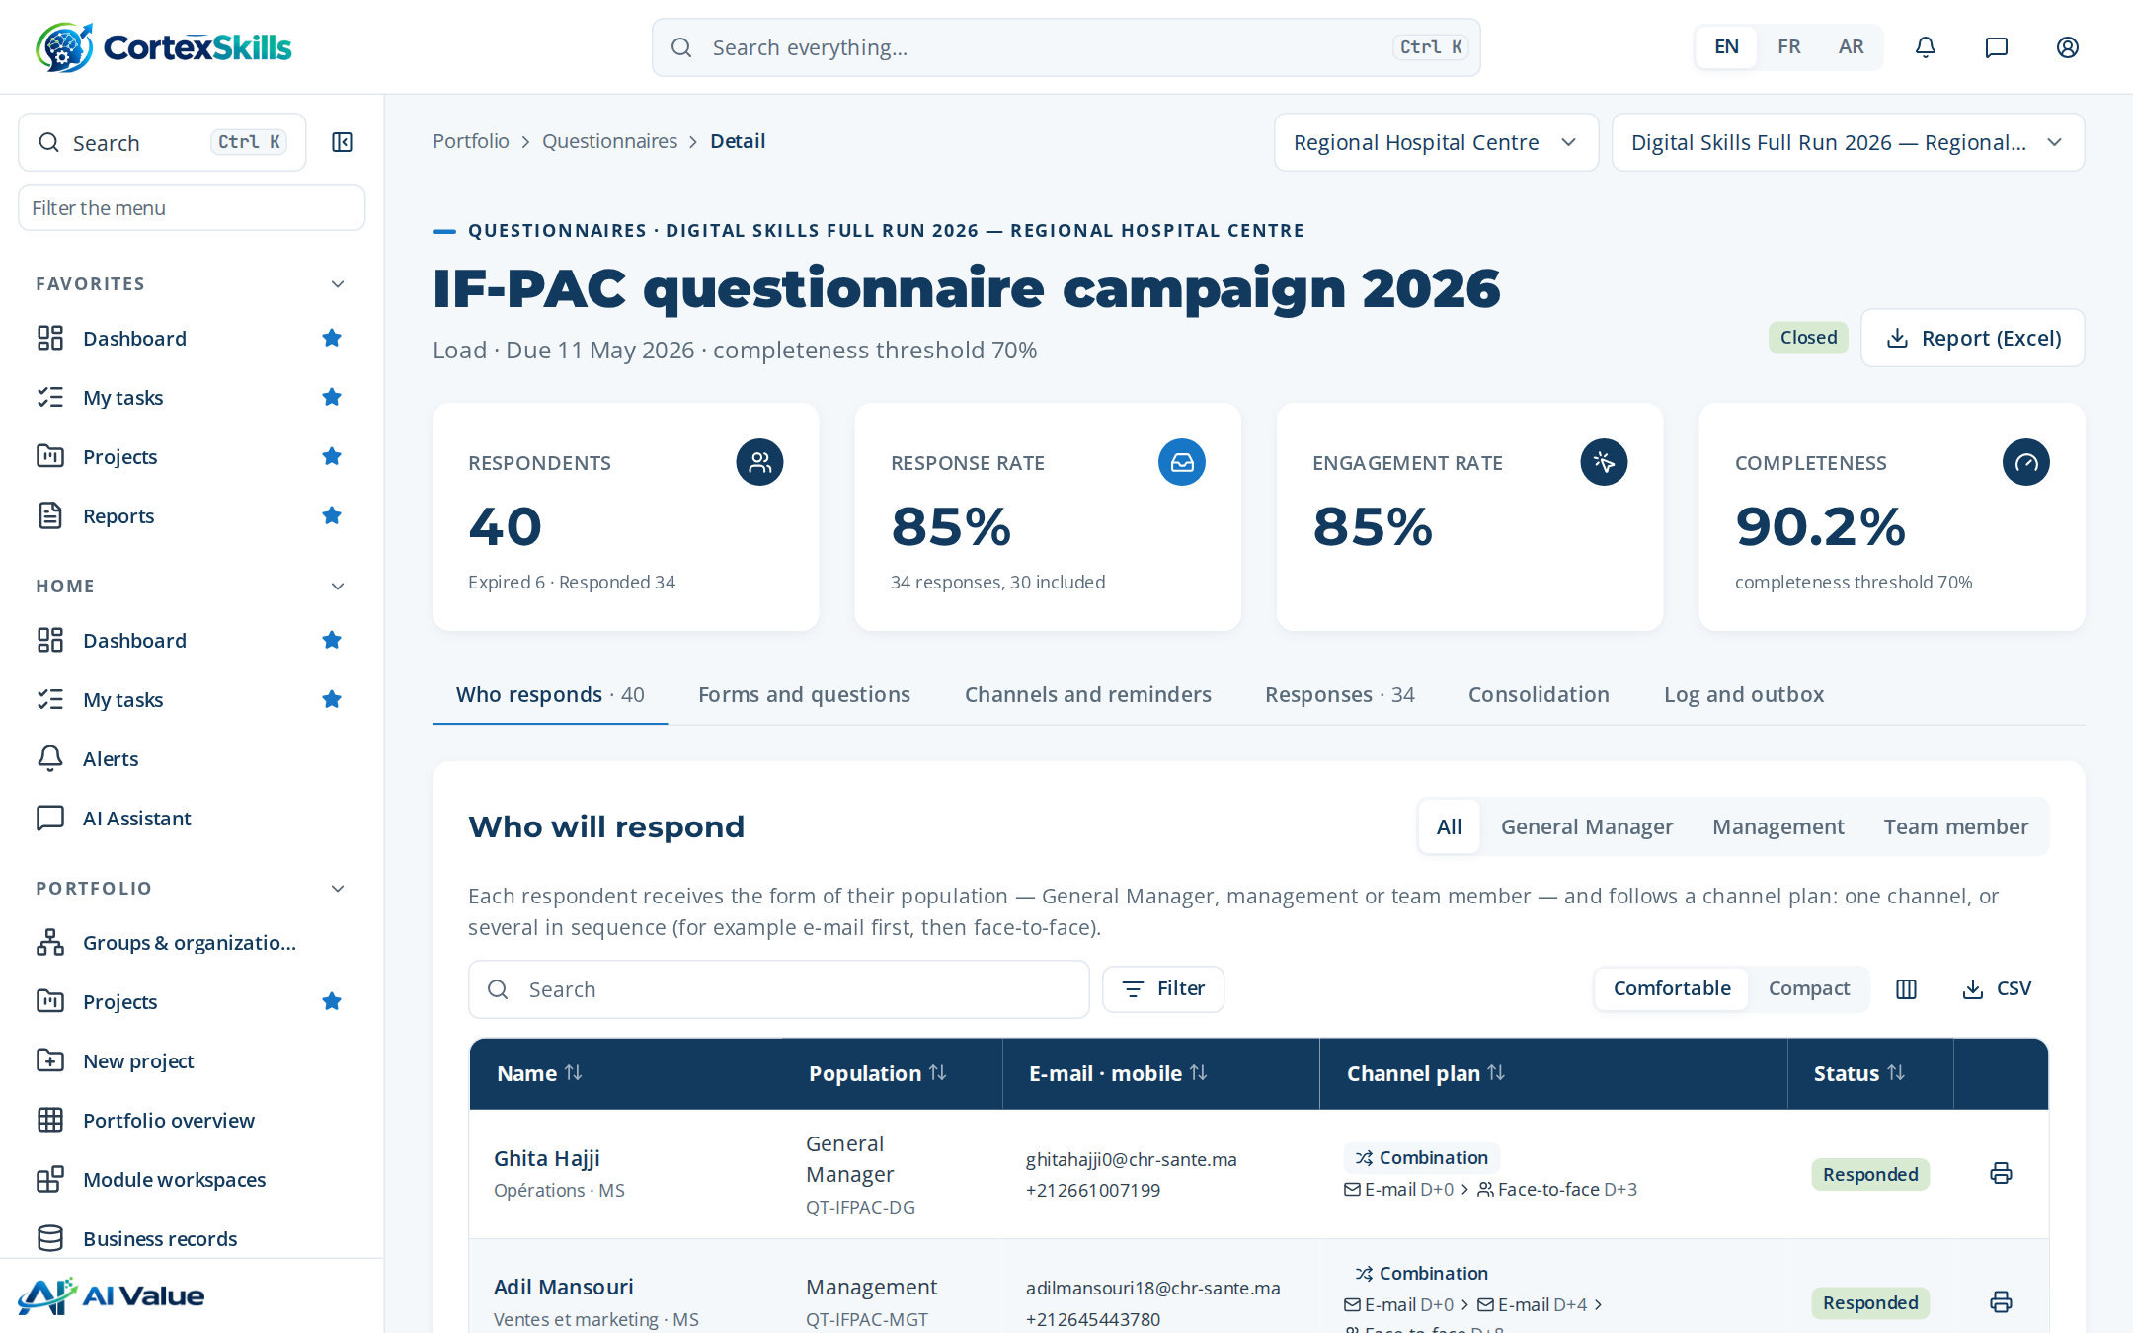
SKILL GAPS AND TRAINING NEEDS
From measured gaps to a validated needs register
Competency | People | Avg gap | Critical
AI medical imaging assistance | 3 | 2.0 | 0
AI bed and staff capacity planning | 2 | 3.0 | 2
AI triage and clinical decision support | 3 | 1.0 | 0
# | Theme | Source | Impact | Status
1 | AI bed and staff capacity planning | Diagnostic | 5 | Validated
2 | Responsible AI and data protection | Skills gap | 5 | Validated
3 | AI bed and staff capacity planning | GPEC | 5 | Validated
4 | AI medical imaging assistance | Demand | 4 | Validated
5 | Prompting and generative AI at work | SWOT | 4 | Validated
6 | AI medical imaging assistance | Diagnostic | 4 | Validated
7 | AI triage and clinical decision support | Skills gap | 3 | Validated
8 | AI literacy for all staff | GPEC | 3 | Validated
9 | AI triage and clinical decision support | Demand | 3 | Validated
10 | AI literacy for all staff | SWOT | 3 | Validated
Skill gaps by competency (TER 3.40).
Training needs register (TER 3.41): every need traced to its source.
POWERACT
Diagnosis · Demonstration data — fictional organization
12

Slide 13
03
Training Engineering Report
135 sections, 198 pages, generated from the run data
POWERACT

Slide 14
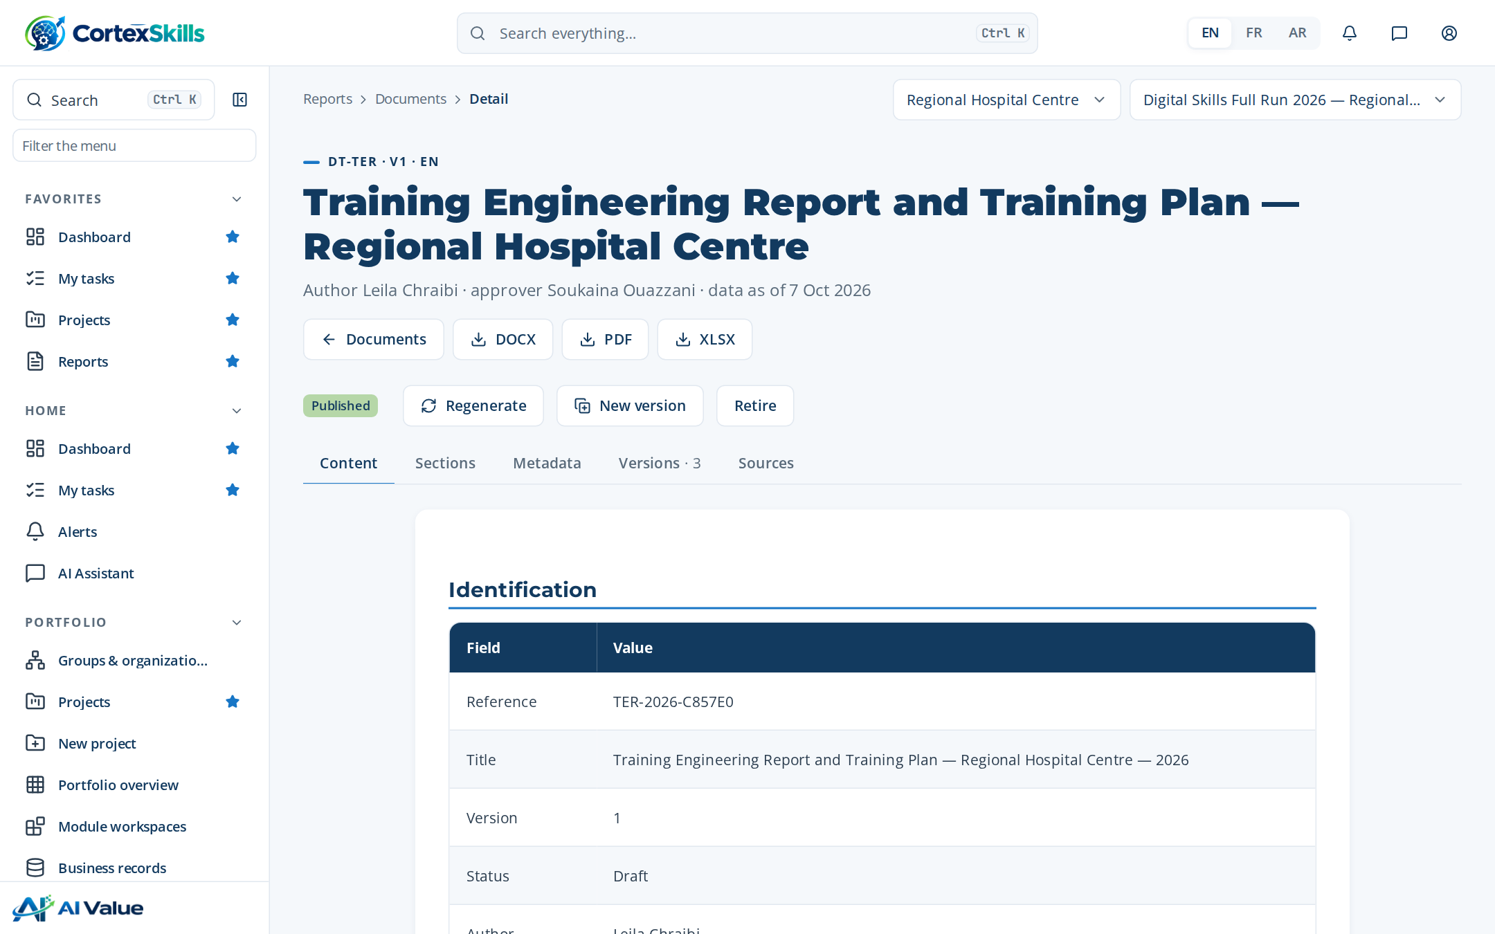
STRUCTURE OF THE REPORT
Training Engineering Report and Training Plan — Regional Hospital Centre
Version 1 · author Leila Chraibi · approved by Soukaina Ouazzani
Chapter | Sections
1. Description of the company | 14
2. The previous training plan | 2
3. Competence needs | 50
4. Perspectives | 3
5. The prioritized training plan | 23
6. Risks, controls and indicators | 2
7. Annexes — interview forms | 38
Plus identification, data sources and approval.
The report in the document editor.
POWERACT
Training Engineering Report · Demonstration data — fictional organization
14

Slide 15
PERSPECTIVES AND ROADMAP
Four initiatives deployed in three waves
The perspectives take into account the strategic orientations, the SWOT and improvement axes, the HR orientations and the recommendations made in the face-to-face meetin…
Wave 1
Wave 2
Wave 3
• AI triage and clinical decision support — impact 5
• AI literacy for all staff — impact 5
• AI medical imaging assistance — impact 4
• AI bed and staff capacity planning — impact 3
# | Improvement axis | Implemented | Wave
1 | AI triage and clinical decision support | 60% | 1
2 | AI medical imaging assistance | 65% | 2
3 | AI bed and staff capacity planning | 70% | 3
4 | AI literacy for all staff | 75% | 1
Source: TER chapter 4 and section 4.1.
POWERACT
Training Engineering Report · Demonstration data — fictional organization
15

Slide 16
RISKS, CONTROLS AND INDICATORS
Each risk reduced by named controls
ID | Risk or opportunity | Category | Inherent | Residual | Controls
RISK-014 | Low learner and user adoption | Adoption | 16 | 8 | CTRL-081
RISK-017 | Critical knowledge lost with expert departure | Operational | 16 | 8 | CTRL-070; CTRL-082
RISK-001 | Unauthorized access to tenant data | Security | 20 | 6 | CTRL-001; CTRL-002; CTRL-048; CTRL-011
RISK-005 | Training plan misaligned with strategy | Strategic | 16 | 6 | CTRL-049; CTRL-057; CTRL-076
RISK-006 | Inaccurate skills data leading to wrong needs | Data quality | 15 | 6 | CTRL-064; CTRL-045
RISK-030 | Position descriptions diverge from reality | Organizational | 12 | 6 | CTRL-066
RISK-007 | Unverified AI content in the Training Engineering Report | AI | 16 | 5 | CTRL-041; CTRL-056
RISK-009 | Expired mandatory certification | Compliance | 20 | 5 | CTRL-053; CTRL-054
RISK-031 | Site deployment deviates from group plan | Operational | 12 | 5 | CTRL-071
Top 9 of 35 risks by residual score (TER chapter 6); 61 project indicators follow in section 6.1.
POWERACT
Training Engineering Report · Demonstration data — fictional organization
16

Slide 17
04
Training Plan
The plan 2026 holds 2 programs and 6 trainings, 12 days per group in total and 44 group-days to deliver, for a budget of 1,260,000.
POWERACT

Slide 18
PRIORITIZED PLAN
Six themes ranked by impact and urgency
Plan 2026 — status Locked — budget 1,260,000.
# | Theme | Days | Groups | Budget
1 | AI triage and clinical decision support | 3 | 6 | 360,000
2 | AI medical imaging assistance | 2 | 4 | 300,000
3 | AI bed and staff capacity planning | 2.5 | 3 | 240,000
4 | AI literacy for all staff | 1.5 | 3 | 180,000
5 | Prompting and generative AI at work | 1 | 2 | 120,000
6 | Responsible AI and data protection | 2 | 2 | 60,000
Budget by theme.
POWERACT
Training Plan · Demonstration data — fictional organization
18

Slide 19
PROGRAMS AND TRAININGS
Two programs, six trainings, clear prerequisites
Code | Program | Strategic axis | Trainings
PRG-1 | AI skills for Clinical Care & Nursing | Execution of the core function | TR-AI-01, TR-AI-02, TR-AI-03
PRG-2 | AI foundations for all staff | Leadership, performance and responsible use | TR-AI-04, TR-AI-05, TR-AI-06
ID | Training | Level | Duration | Prerequisites
TR-AI-01 | AI triage and clinical decision support | Intermediate | 3 day(s) | Basic digital literacy; the Foundation training is recommended
TR-AI-02 | AI medical imaging assistance | Intermediate | 2 day(s) | Basic digital literacy; the Foundation training is recommended
TR-AI-03 | AI bed and staff capacity planning | Advanced | 2.5 day(s) | TR-AI-01 or equivalent experience
TR-AI-04 | AI literacy for all staff | Foundation | 1.5 day(s) | None — open to all staff
TR-AI-05 | Prompting and generative AI at work | Foundation | 1 day(s) | None — open to all staff
TR-AI-06 | Responsible AI and data protection | Intermediate | 2 day(s) | Basic digital literacy; the Foundation training is recommended
Source: Training Plan “Programs” and TER section 5.1.
POWERACT
Training Plan · Demonstration data — fictional organization
19

Slide 20
DETAILED AGENDA
AI triage and clinical decision support — half-day by half-day
22 activities over 3 day(s): lectures, quizzes and workshops on the hospital’s own cases.
Day 1 — morning
Day 1 — afternoon
Day 2 — morning
Lecture · Foundations of AI triage and clinical decision support: key c… (75 min)
Lecture · Why AI triage and clinical decision support matters for Clini… (45 min)
Quiz — key concepts of AI triage and clinical decision support (20 min)
Workshop — map today’s practices in Clinical Care & Nursing a… (75 min)
Lecture · Methods and tools of AI triage and clinical decision support (75 min)
Lecture · Worked example from the Healthcare Providers sector (40 min)
Quiz — choosing the right method (20 min)
Workshop — apply the method to a real case from Regional Hosp… (80 min)
Lecture · Governance, risks and ISO 7101 requirements (60 min)
Lecture · Data, quality and evidence to keep (45 min)
Quiz — compliance and risk scenarios (20 min)
Workshop — build the control checklist of your process (80 min)
Day 2 — afternoon
Day 3 — morning
Day 3 — afternoon
Lecture · Deploying AI triage and clinical decision support: roles, cha… (60 min)
Lecture · Indicators that measure the results (45 min)
Quiz — adoption and indicator cases (20 min)
Workshop — design the indicator dashboard of your team (80 min)
Lecture · Advanced practices and lessons learned in Clinical Care & Nur… (75 min)
Quiz — advanced cases (25 min)
Workshop — solve a critical incident scenario (100 min)
Lecture · Transfer to the workplace: the 30-60-90-day plan (60 min)
Quiz · Final assessment (Kirkpatrick level 2) (30 min)
Workshop — individual action plan and peer review (90 min)
POWERACT
Training Plan · Demonstration data — fictional organization
20

Slide 21

VALUE FOR EACH PERSONA
Why each audience should take the training
Training TR-AI-01 — behaviour, pain points and hopes of each persona
Executive sponsor — General Manager
Manager — director, head of department, process owner
Team member — Clinical Care & Nursing
Decides on facts presented in short steering meetings; delegates execution to the management team; follows a few indicators.
Training spend with no visible link to the strategic objectives; results of the previous plan hard to prove; ISO 7101 audits that expose competence gaps.
A prioritized plan that serves the strategy, a measurable return, and a management team able to lead the change.
Balances daily operations and improvement projects; prefers practical, short formats; relies on key people in the team.
Team absent from the job during long trainings; skills gaps on critical activities of Clinical Care & Nursing; processes not documented or without an owner.
Trainings that solve the function’s real problems, applied on the job the following week, with indicators the manager can follow.
Learns by doing and from peers; uses a phone more than a computer; wants to know what changes in daily work.
New tools introduced without explanation; theoretical trainings far from the tasks; fear of making mistakes with AI triage and clinical decision support.
Practical skills recognized by a certificate, less rework, and a clear path to the next position.
POWERACT
Training Plan · Demonstration data — fictional organization
21

Slide 22
BUDGET
Allocated, committed, spent and refunds expected
Allocated 1,260,000, committed 1,260,000 (100 %), spent 1,192,662 (95 % of planned); expected refunds 352,800.
Line | Actual | Refund
AI triage and clinical decisi… | 347,127 | 100,800
AI medical imaging assistance | 266,091 | 84,000
AI bed and staff capacity pla… | 243,800 | 67,200
AI literacy for all staff | 156,192 | 50,400
Prompting and generative AI a… | 118,913 | 33,600
Responsible AI and data prote… | 60,539 | 16,800
Total | 1,192,662 | 352,800
Provider | Accredited until | /5
Atlas Formation Conseil | 2027-04-25 | 4.2
Maghreb Learning Partners | 2027-08-03 | 3.8
Allocated versus actual by training (TER 5.7).
POWERACT
Training Plan · Demonstration data — fictional organization
22

Slide 23
05
Delivery and evaluation
Kirkpatrick levels, certifications and lessons learned
POWERACT

Slide 24



EVALUATION
Results measured at three Kirkpatrick levels
86 %
93 %
84 %
1 — Reaction
2 — Learning
3 — Behaviour
Level | What is measured | When | Instrument | Results
1 — Reaction | Satisfaction and perceived usefulness | End of each session | Satisfaction questionnaire | 2 × 86 %
2 — Learning | Knowledge and skills acquired | End of the training | Pre- and post-test, case study | 2 × 93 %
3 — Behaviour | Use of the skills at the workstation | Three months after | Manager observation grid | 2 × 84 %
4 — Results | Effect on the indicators of the function | Six to twelve months after | Indicators of the function (KPI) | —
Certifications (TER 5.10): 4 valid, 1 expiring, 1 expired — the expired one triggers an alert and a renewal session.
POWERACT
Delivery and evaluation · Demonstration data — fictional organization
24

Slide 25



LESSONS LEARNED
REX — AI triage and clinical decision support
What went well
What did not
What we will do next time
The stakeholder register and multi-channel distribution lifted the response rate.
SWOT inputs arrived late from one function.
Name a backup for every function head at kickoff.
POWERACT
Delivery and evaluation · Demonstration data — fictional organization
25

Slide 26
06
Documents produced
37 documents published in English, each traced to its data
POWERACT

Slide 27
DOCUMENTS PRODUCED
Every end-to-end process leaves its document
All published, versioned and approved by a second person — 1,060 pages.
Code | Document | Pages
DT-E2E-01 | Annual L&D plan and budget | 28
DT-E2E-02 | Skills gap diagnosis | 23
DT-E2E-03 | Training needs report and roadmap | 28
DT-E2E-04 | Curriculum design document | 24
DT-E2E-05 | Training delivery report | 28
DT-E2E-06 | Learner engagement report | 30
DT-E2E-07 | Training evaluation report | 23
DT-E2E-08 | ROI and business impact report | 23
DT-E2E-09 | Compliance and certification register | 22
DT-E2E-10 | Internal mobility and career paths | 25
Code | Document | Pages
DT-E2E-11 | Onboarding programme record | 21
DT-E2E-12 | Knowledge capture and transfer record | 22
DT-E2E-13 | Content catalogue and lifecycle | 22
DT-E2E-14 | Extended enterprise training report | 22
DT-E2E-15 | Data, AI and integration governance | 24
DT-E2E-16 | Vendor management file | 20
DT-E2E-17 | Change and adoption plan | 23
DT-E2E-18 | Quality, risk and improvement report | 30
DT-E2E-19 | Consulting engagement closure report | 25
POWERACT
Documents produced · Demonstration data — fictional organization
27

Slide 28
DOCUMENTS PRODUCED
Documents produced (continued)
Code | Document | Pages
DT-E2E-20 | Multi-axis diagnostic and maturity report | 26
DT-E2E-21 | Previous plan impact evaluation | 25
DT-E2E-22 | Multi-site deployment plan | 24
DT-E2E-23 | Regulatory submission file | 22
DT-E2E-24 | Competitive intelligence note | 23
DT-E2E-25 | Job architecture and competency map | 23
DT-E2E-26 | Forward planning of jobs and skills (GPEC) | 24
DT-E2E-27 | Training demand consolidation | 21
DT-E2E-28 | Performance assessment and RAG dashboard | 22
DT-E2E-29 | Functional SWOT and improvement axes | 23
Code | Document | Pages
DT-E2E-30 | Prioritized resource plan | 24
DT-E2E-31 | Post-engagement roadmap | 24
DT-E2E-32 | Scope of work and stakeholder register | 31
DT-E2E-33 | Questionnaire campaign report | 29
DT-TER | Training Engineering Report and Training Plan | 198
DT-PLAN | Training plan with detailed agendas | 34
DT-AUDIT | Audit report | 5
DT-MASTER | Master list of documented information | 19
POWERACT
Documents produced · Demonstration data — fictional organization
28

Slide 29
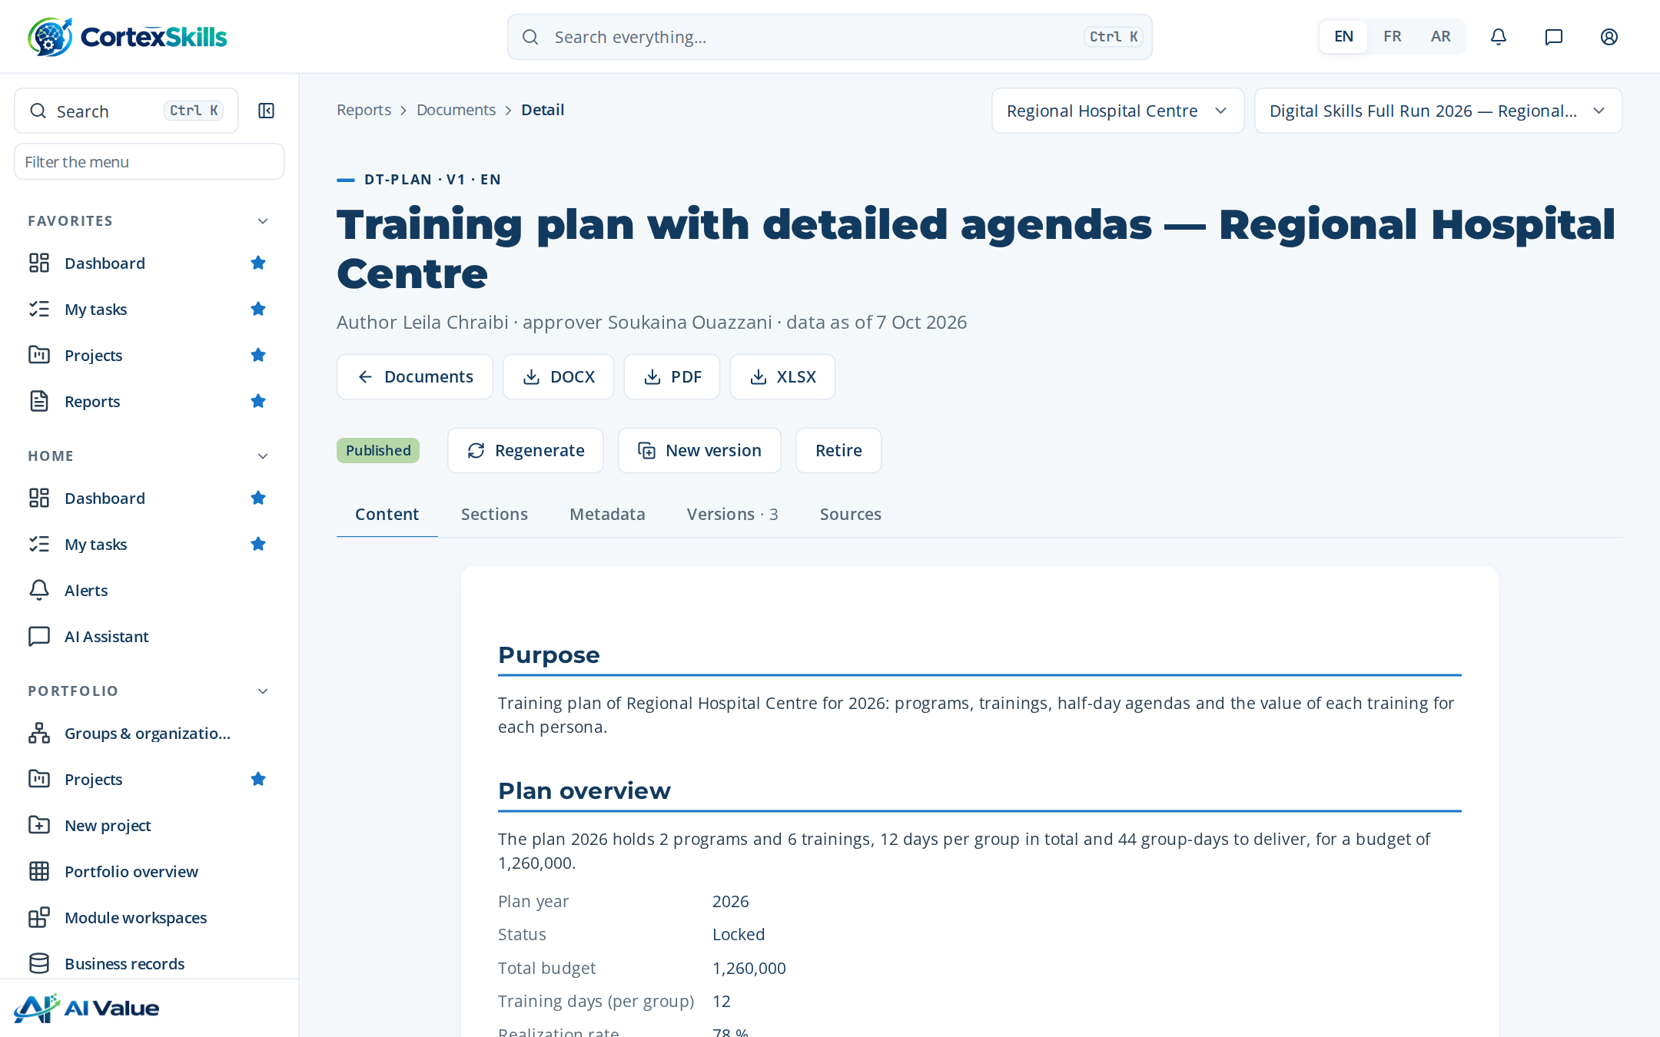
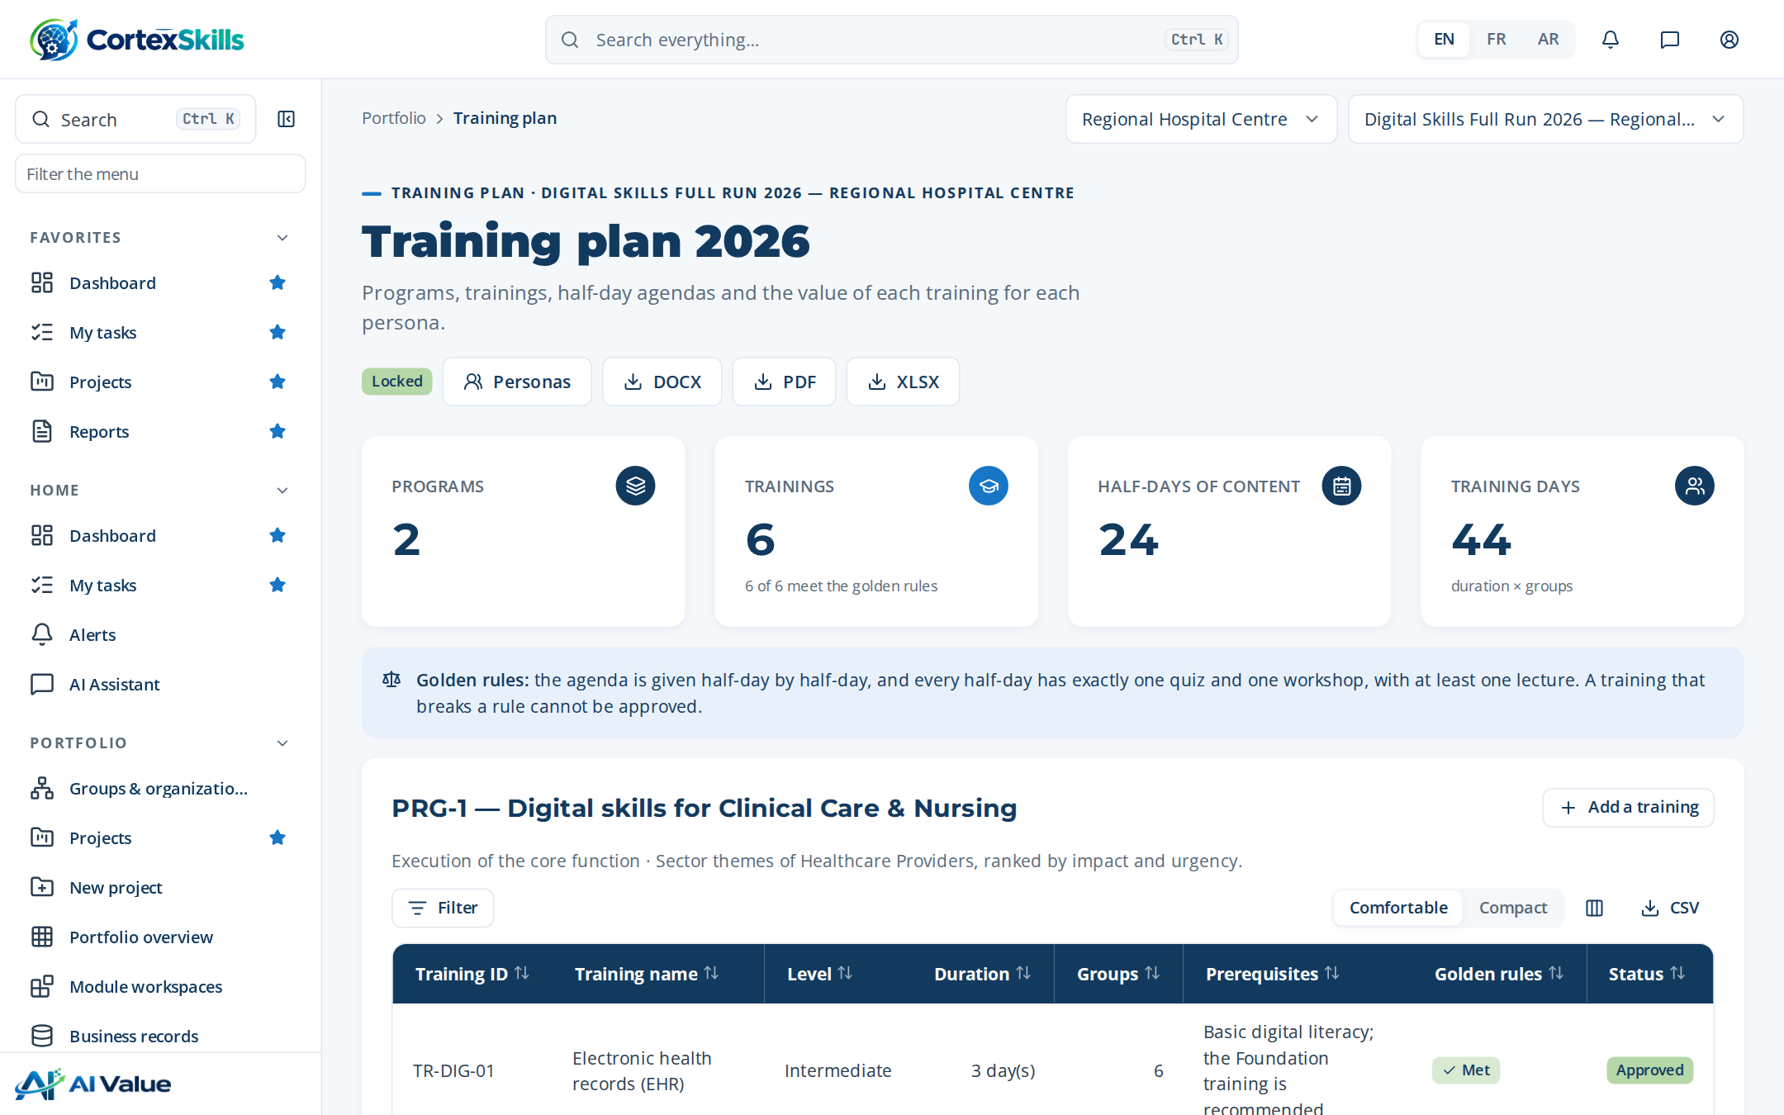
INSIDE THE APPLICATION
The Training Plan as the users see it
Training plan with detailed agendas — Regional Hospital Centre
Training plan screen: programs, trainings and sessions.
POWERACT
Documents produced · Demonstration data — fictional organization
29

Slide 30

CONCLUSION
What the hospital has at the end of the cycle
A Training Engineering Report of 198 pages, built from 37 answers, 40 stakeholders and the diagnosis of every function.
A locked Training Plan: 6 trainings, half-day agendas, a value proposition per persona and a budget of 1,260,000.
Evaluation at three Kirkpatrick levels, with certifications followed and alerts on expiry.
37 published documents ready for an accreditation audit (ISO 7101, JCI), each traced to the data and the step that produced it.
Next: waves 2 and 3 of the roadmap and the level-4 (results) evaluation six to twelve months after the trainings.
POWERACT
Conclusion · Demonstration data — fictional organization
30

