Slide 1
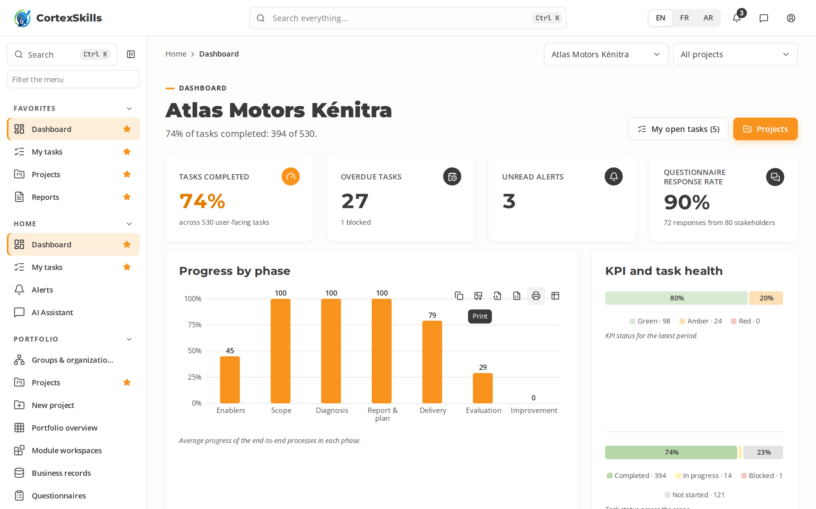
POWERACT
PRESENTATION · 2026
CortexSkills
Training engineering, end to end — the application in action, sector by sector
POWERACT Consulting

Slide 2




AGENDA
What this presentation covers
01
02
03
04
The lifecycle
The dynamics, step by step
SMEs
Sector by sector
Seven phases, 33 end-to-end processes, five gates
From the tenancy to the reports, on a large company
Lighter tracks for smaller organizations
29 sectors, each with its large company and its SME
POWERACT
Agenda
2

Slide 3

THE LIFECYCLE
One lifecycle, seven phases
Each phase groups end-to-end processes; a gate closes each main phase.
1
2
3
4
5
6
Scope & evidence
Diagnosis
Training Engineering Report & plan
Design & delivery
Evaluation, compliance & impact
Talent, knowledge & continuous improvement
4 processes
8 processes
6 processes
5 processes
3 processes
4 processes
G1
G2
G3
G4
G5
G6
Enablers run across all phases — E2E-15 · E2E-17 · E2E-18
POWERACT
The lifecycle
3

Slide 4




FOUR SEGMENTS
Every organization runs two full cycles
Digital skills and AI skills, for large companies and SMEs, in 29 sectors.
Large companies — Digital
Large companies — AI
68%
51%
average progress · 29 organizations
average progress · 29 organizations
SMEs — Digital
SMEs — AI
51%
31%
average progress · 29 organizations
average progress · 29 organizations
Average task completion by segment and run, across the 29 sectors (%)
POWERACT
Four segments
4

Slide 5
01
The dynamics, step by step
Example: Atlas Motors Kénitra, automotive, large company
POWERACT

Slide 6
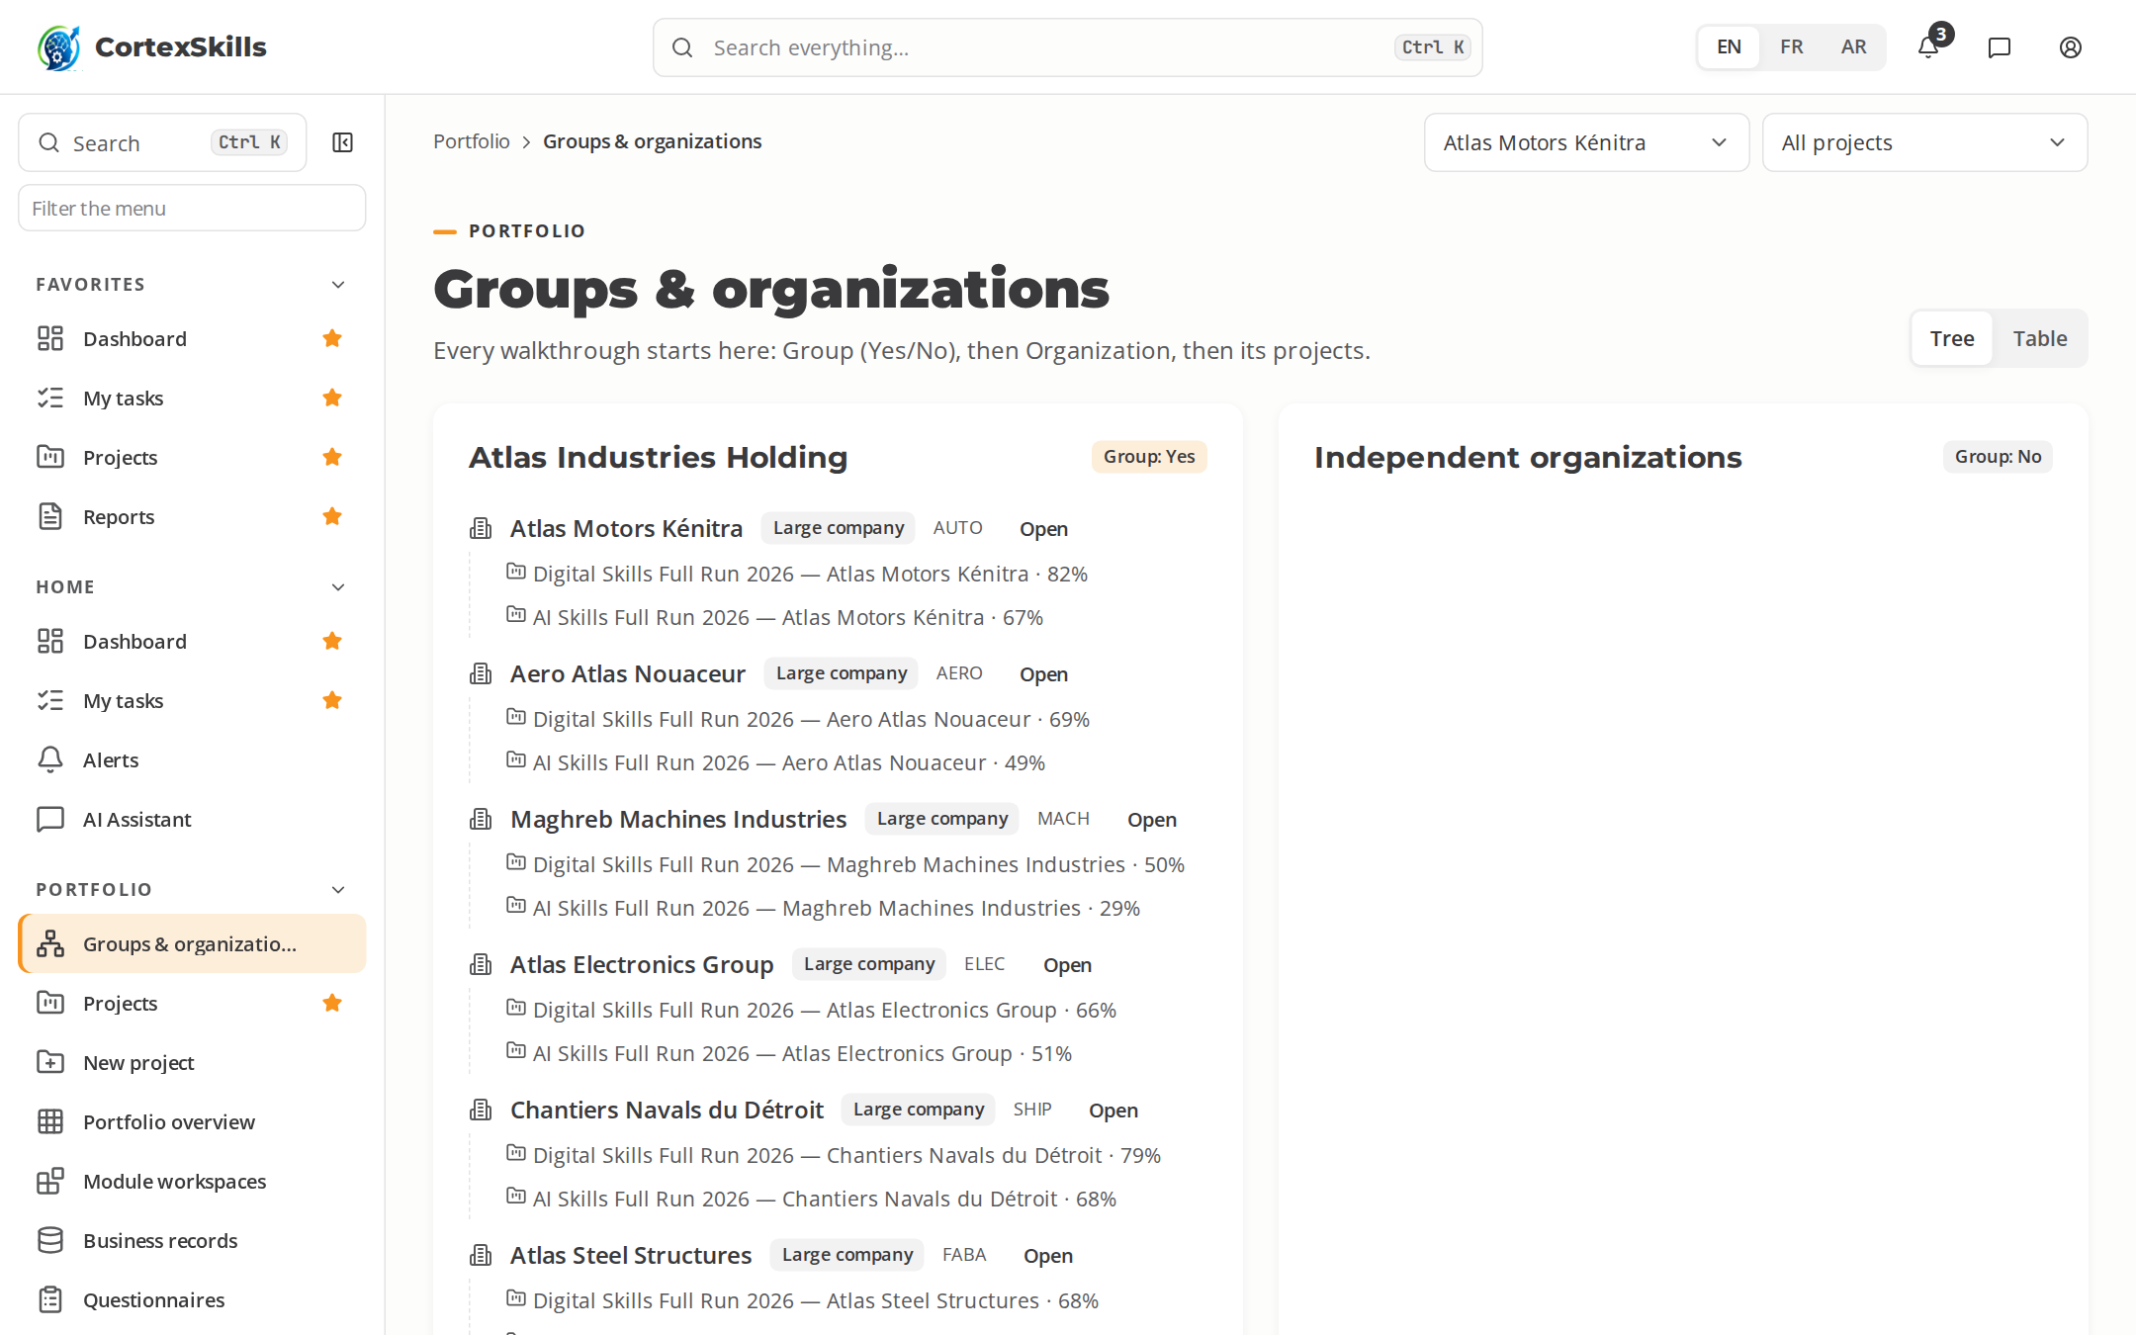



STEP 1 · TENANCY
Start from the Group and the Organization
Choose the Group (Yes or No), then the Organization.
Each organization is a closed tenant: its data is never visible to another.
Group members can read sister organizations; they cannot change them.
POWERACT
The dynamics, step by step
6

Slide 7
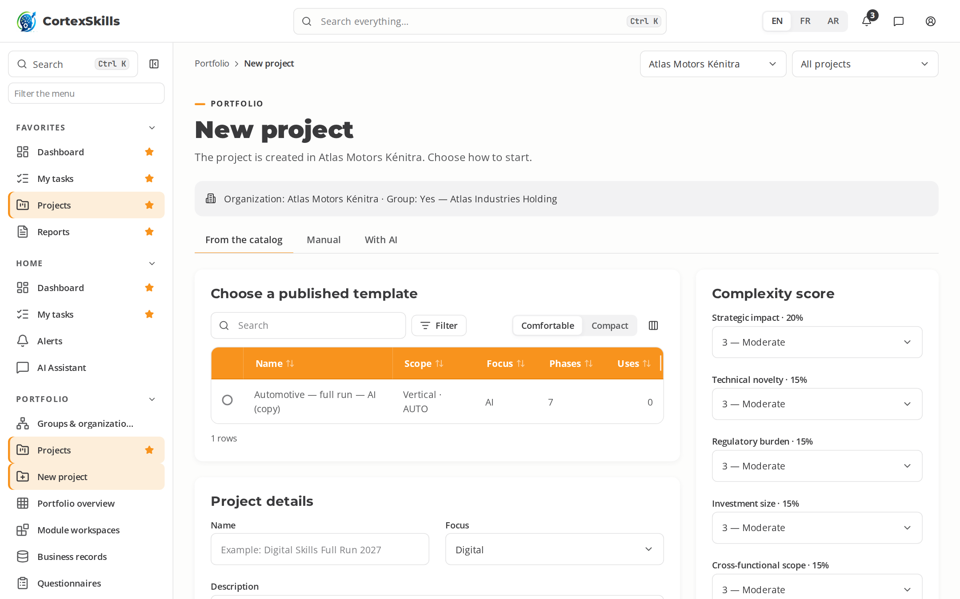
STEP 2 · NEW PROJECT
Create the run from the catalog, by hand or with AI
Rate seven weighted criteria: the score recommends Full mode or an SME track.
With AI: type a short description; accept, change or reject each proposed item.
Phases, gates, checklists and roles come from the chosen template.
POWERACT
The dynamics, step by step
7

Slide 8
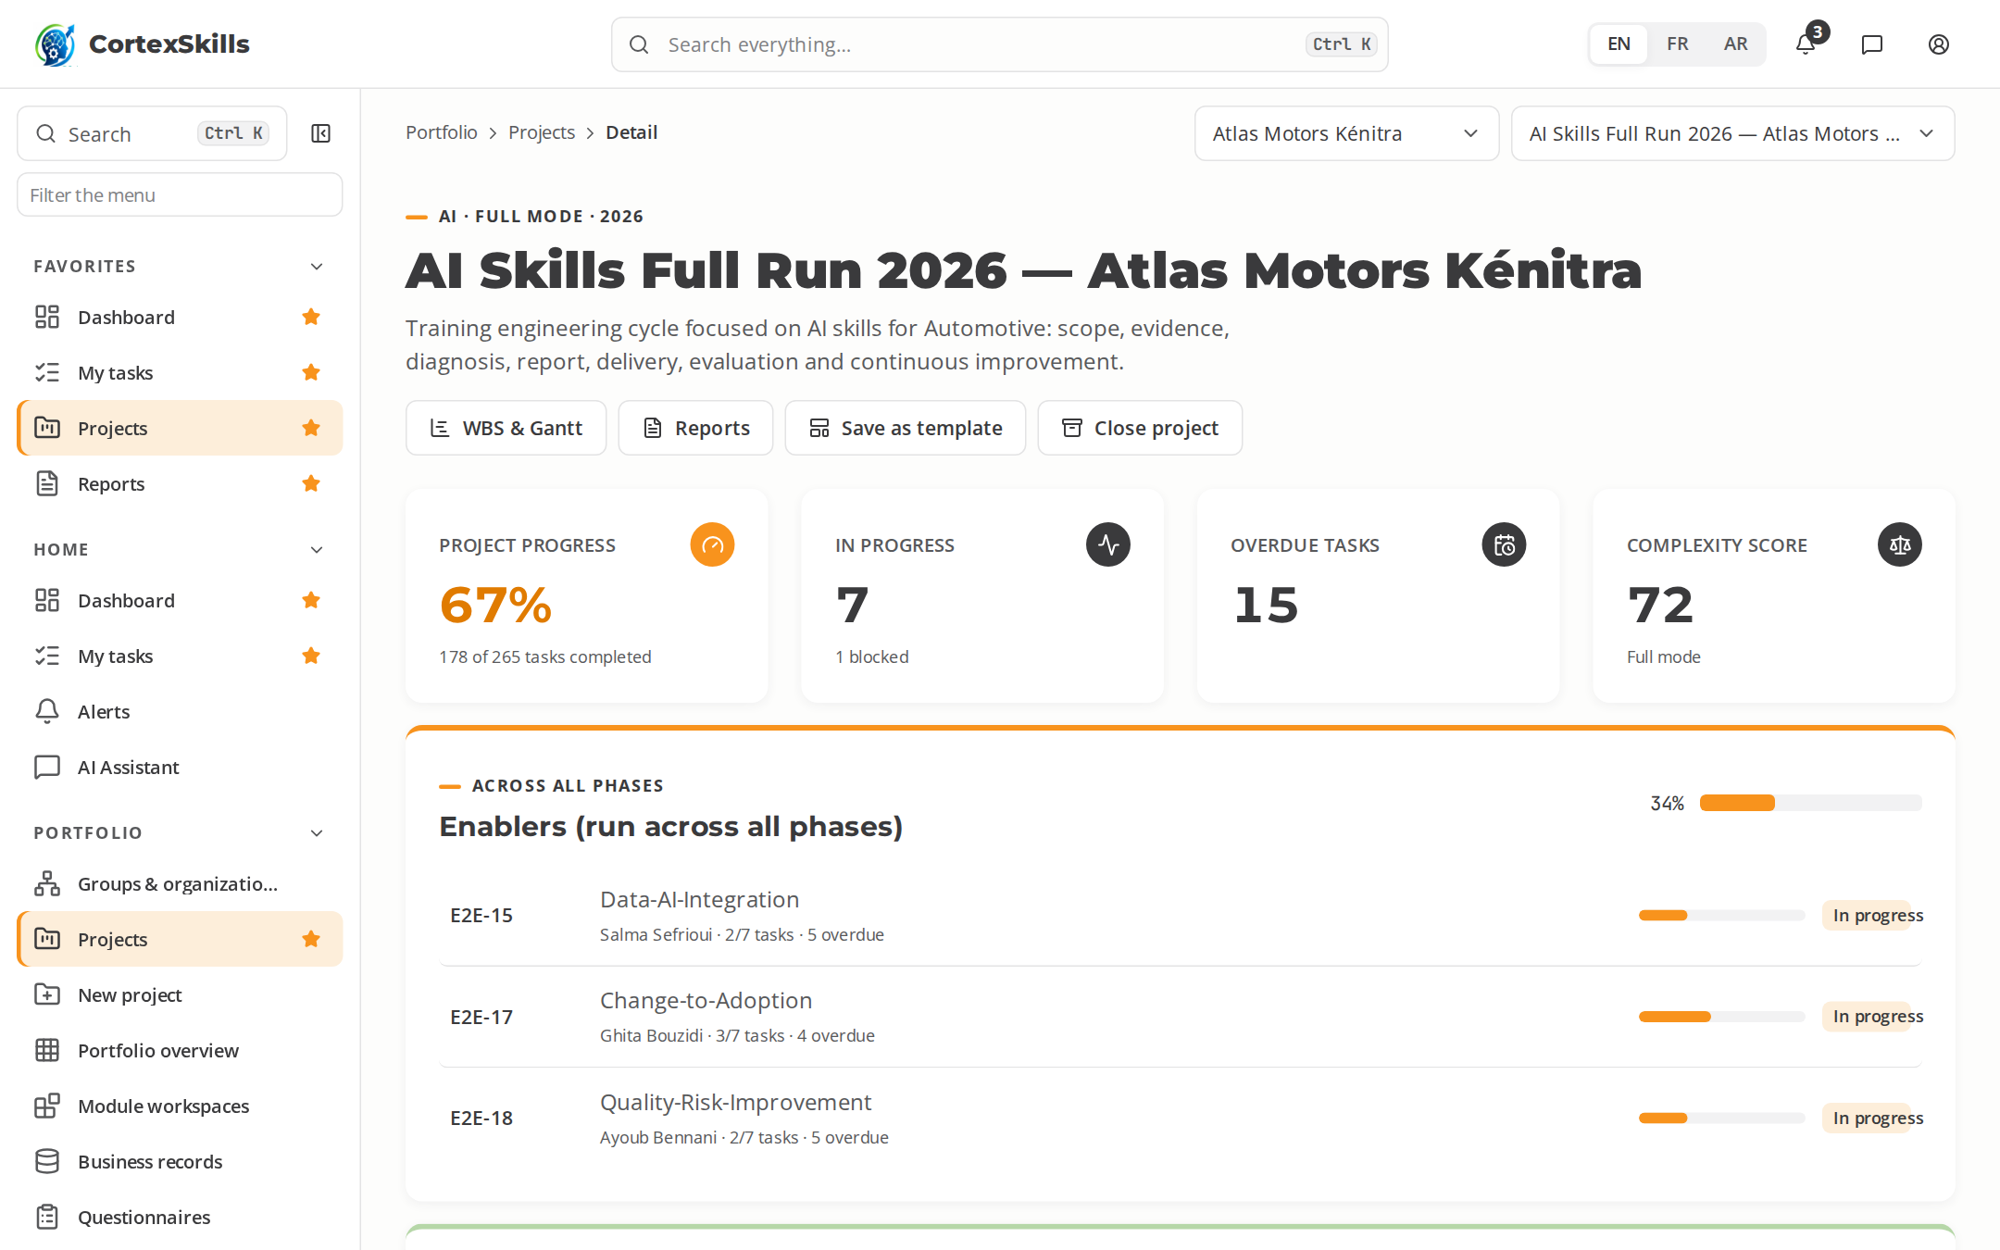
STEP 3 · WORKSPACE
Seven phases, processes and gates on one screen
Progress per phase and per process, overdue tasks, complexity score.
Enablers (data, change, quality) run across all phases.
A gate checklist must be complete before the next phase starts.
POWERACT
The dynamics, step by step
8

Slide 9
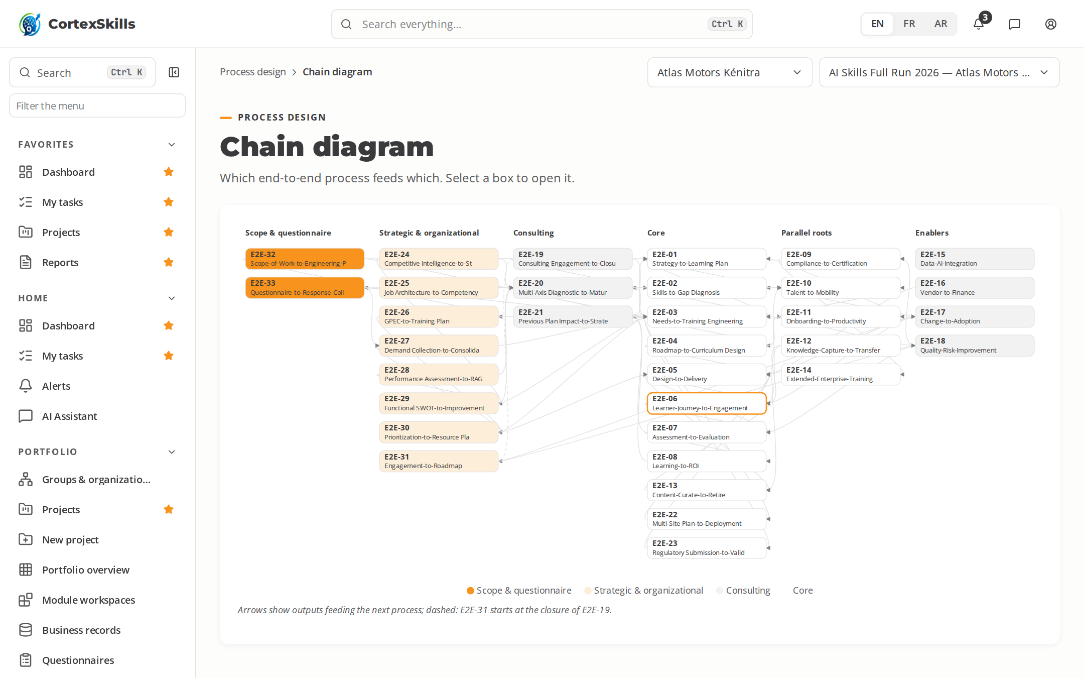
STEP 4 · PROCESS CHAIN
Processes feed each other
Each end-to-end process has a trigger, an end state and its inputs and outputs.
The chain shows which process consumes which output.
BPMN diagrams can be viewed, edited, imported and exported.
POWERACT
The dynamics, step by step
9

Slide 10
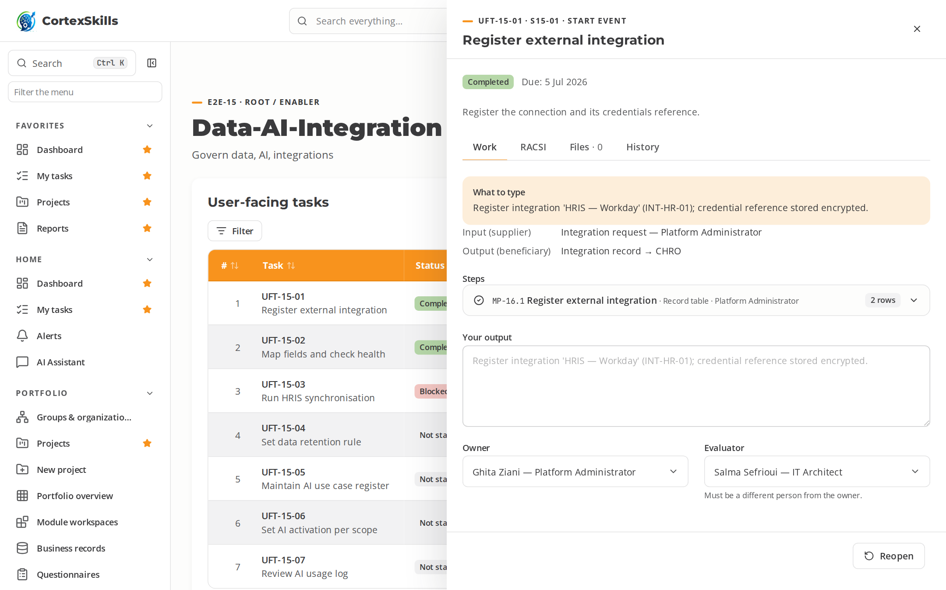
STEP 5 · TASK
“What to type” for every task
The task panel shows the expected answer for this organization and sector.
AI help proposes a draft, labelled with its confidence and sources.
Owner and evaluator are always two different people.
POWERACT
The dynamics, step by step
10

Slide 11
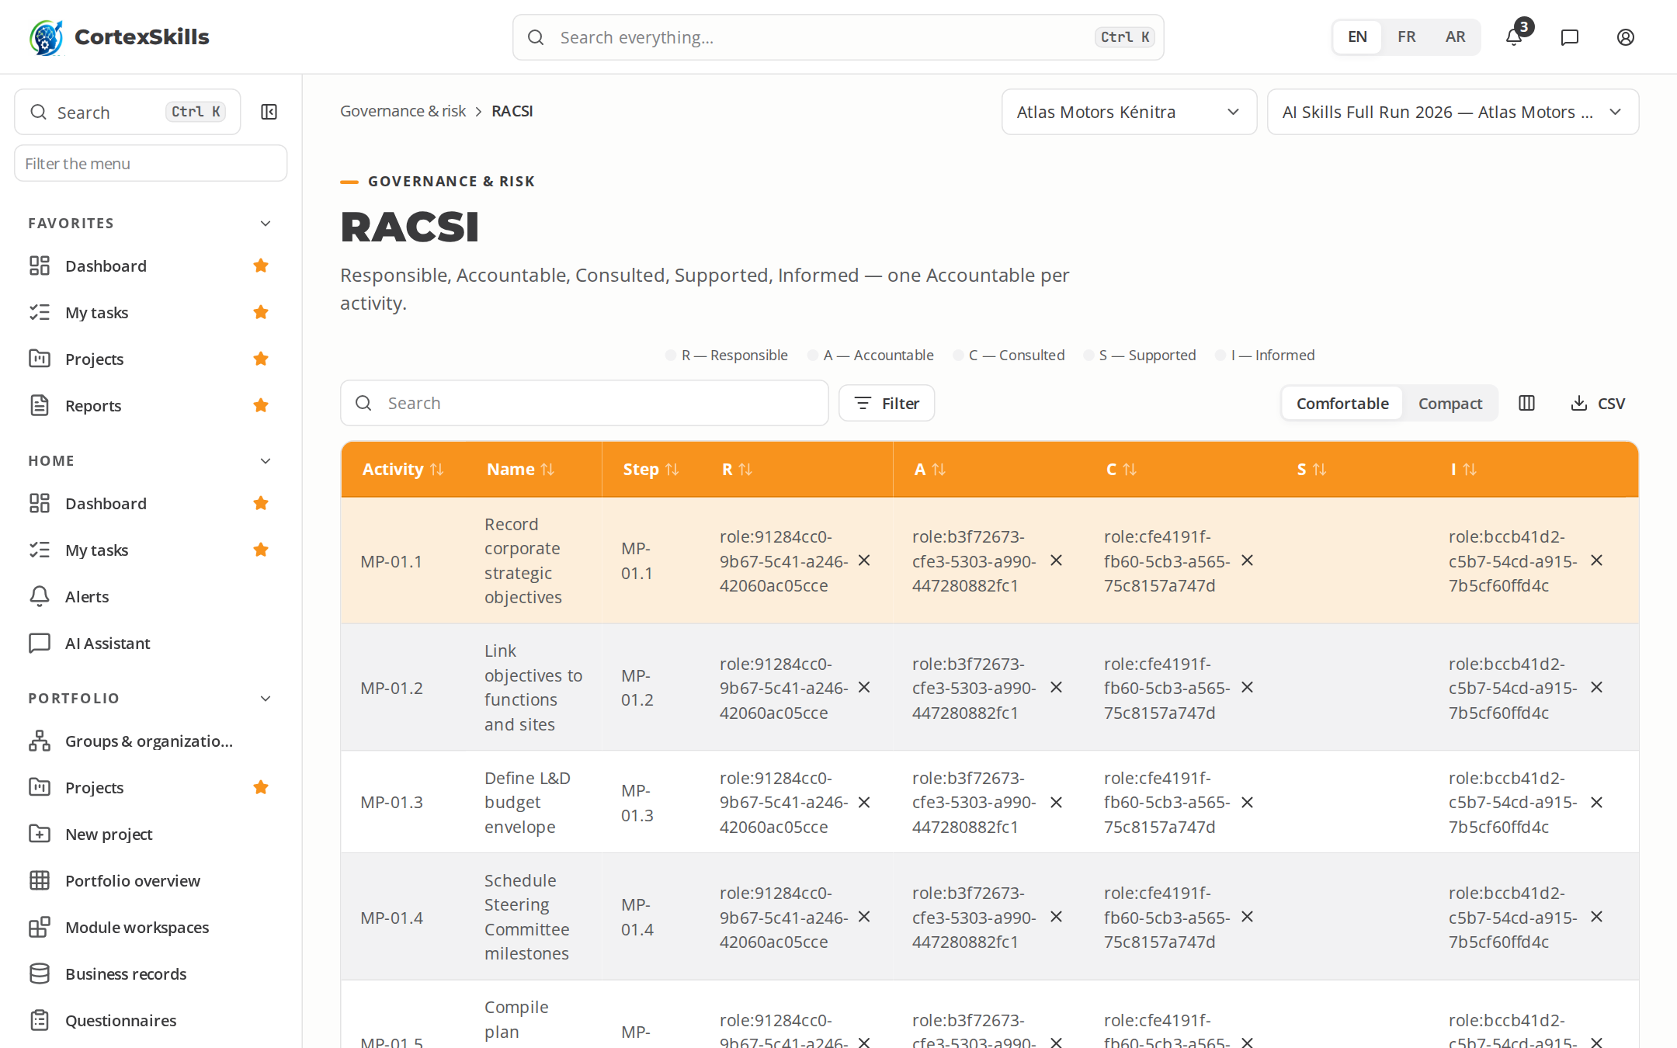
STEP 6 · GOVERNANCE
One Accountable per activity
RACSI roles are allocated per activity, with exactly one Accountable.
Risks, controls and business rules are tagged to the processes.
Every change to a governed field is justified and recorded.
POWERACT
The dynamics, step by step
11

Slide 12
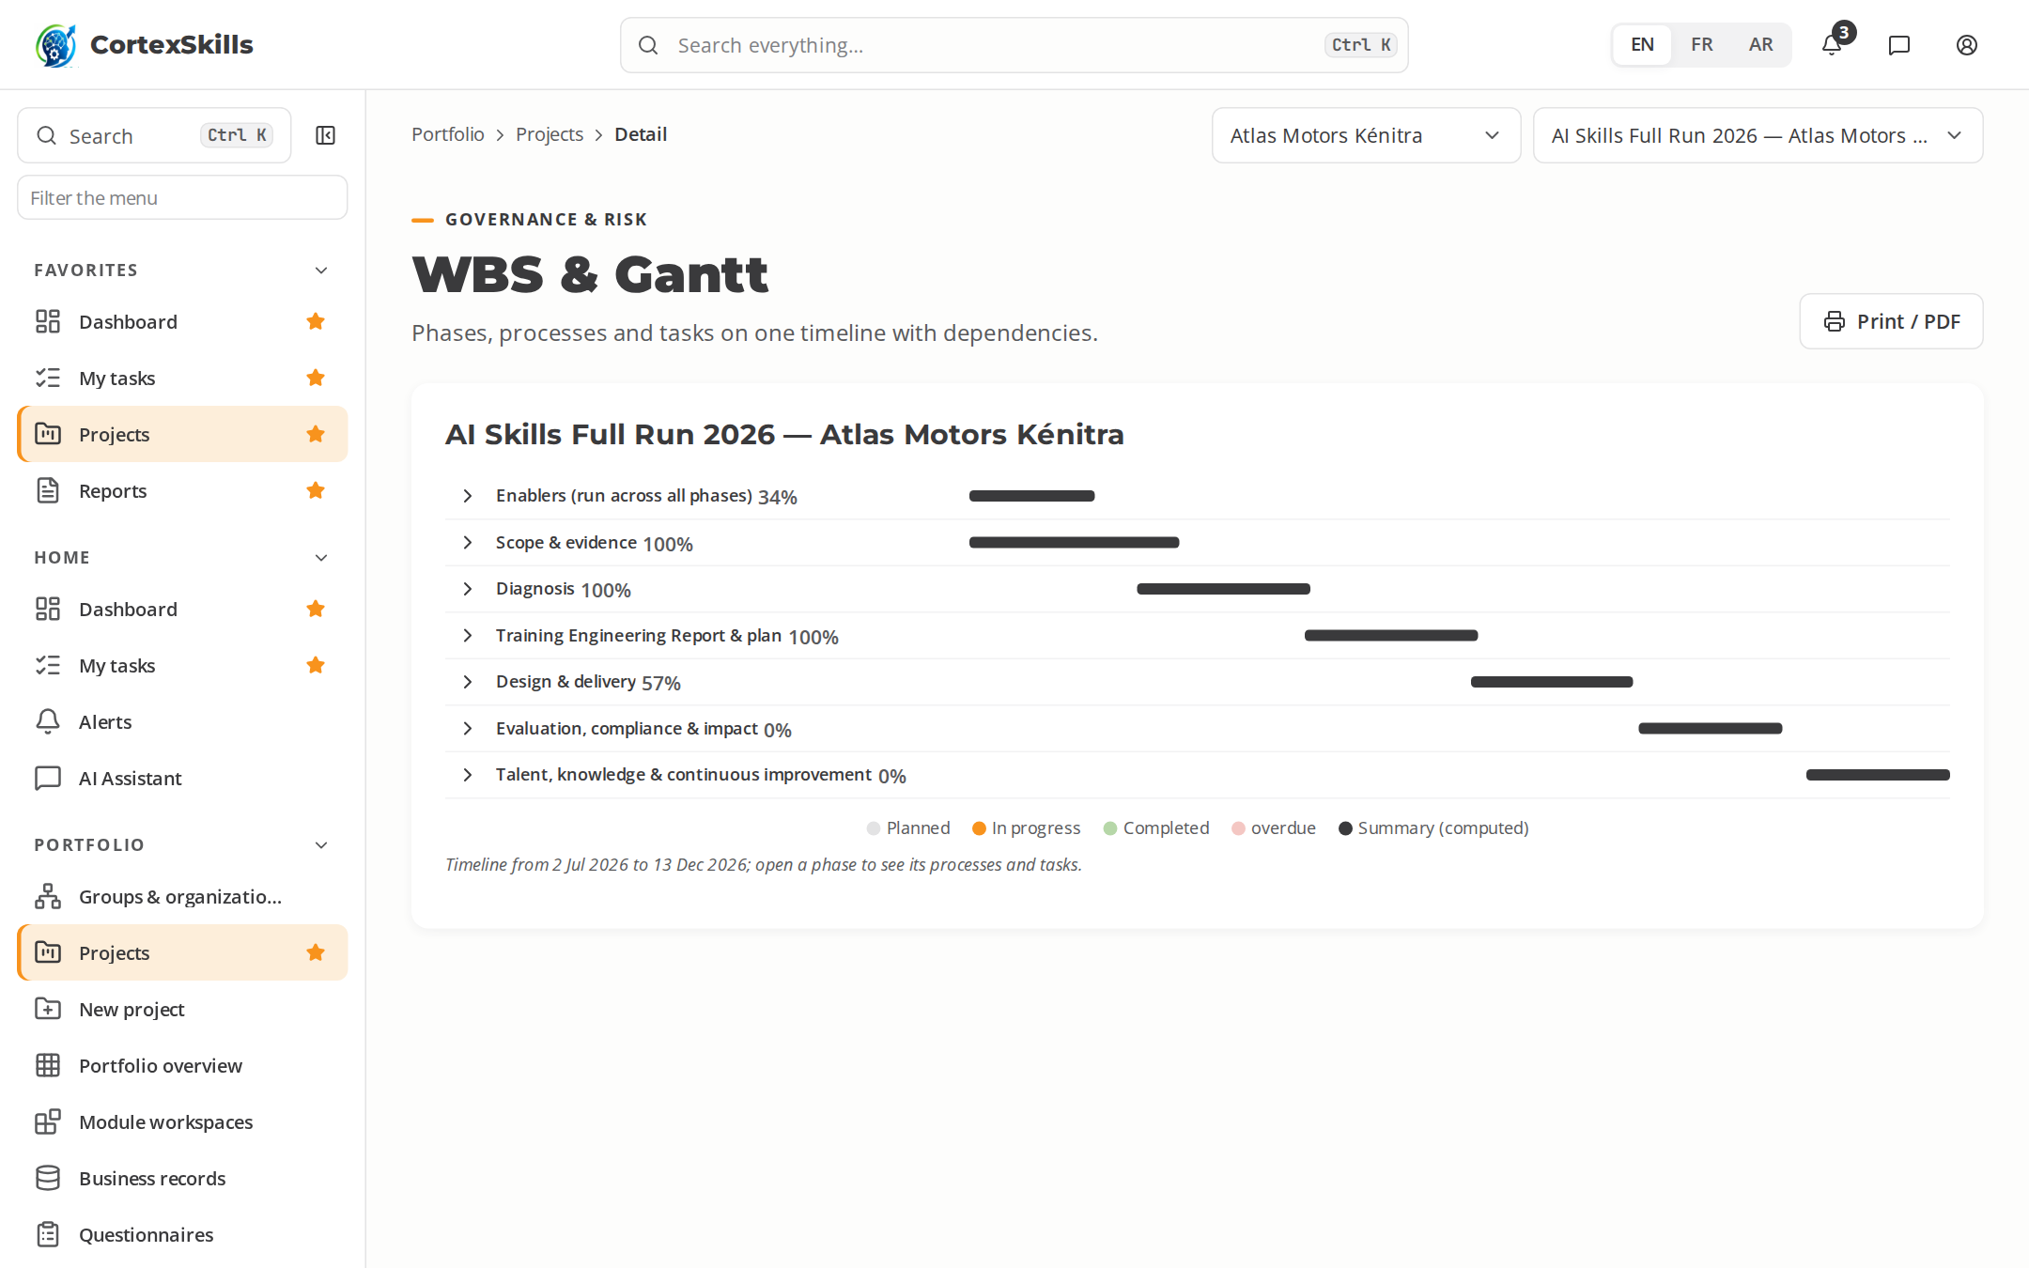
STEP 7 · PLANNING
The run on a timeline
Phases, processes and tasks on one Gantt, with dependencies.
Summary bars are computed from the tasks below them.
Print or save as PDF.
POWERACT
The dynamics, step by step
12

Slide 13
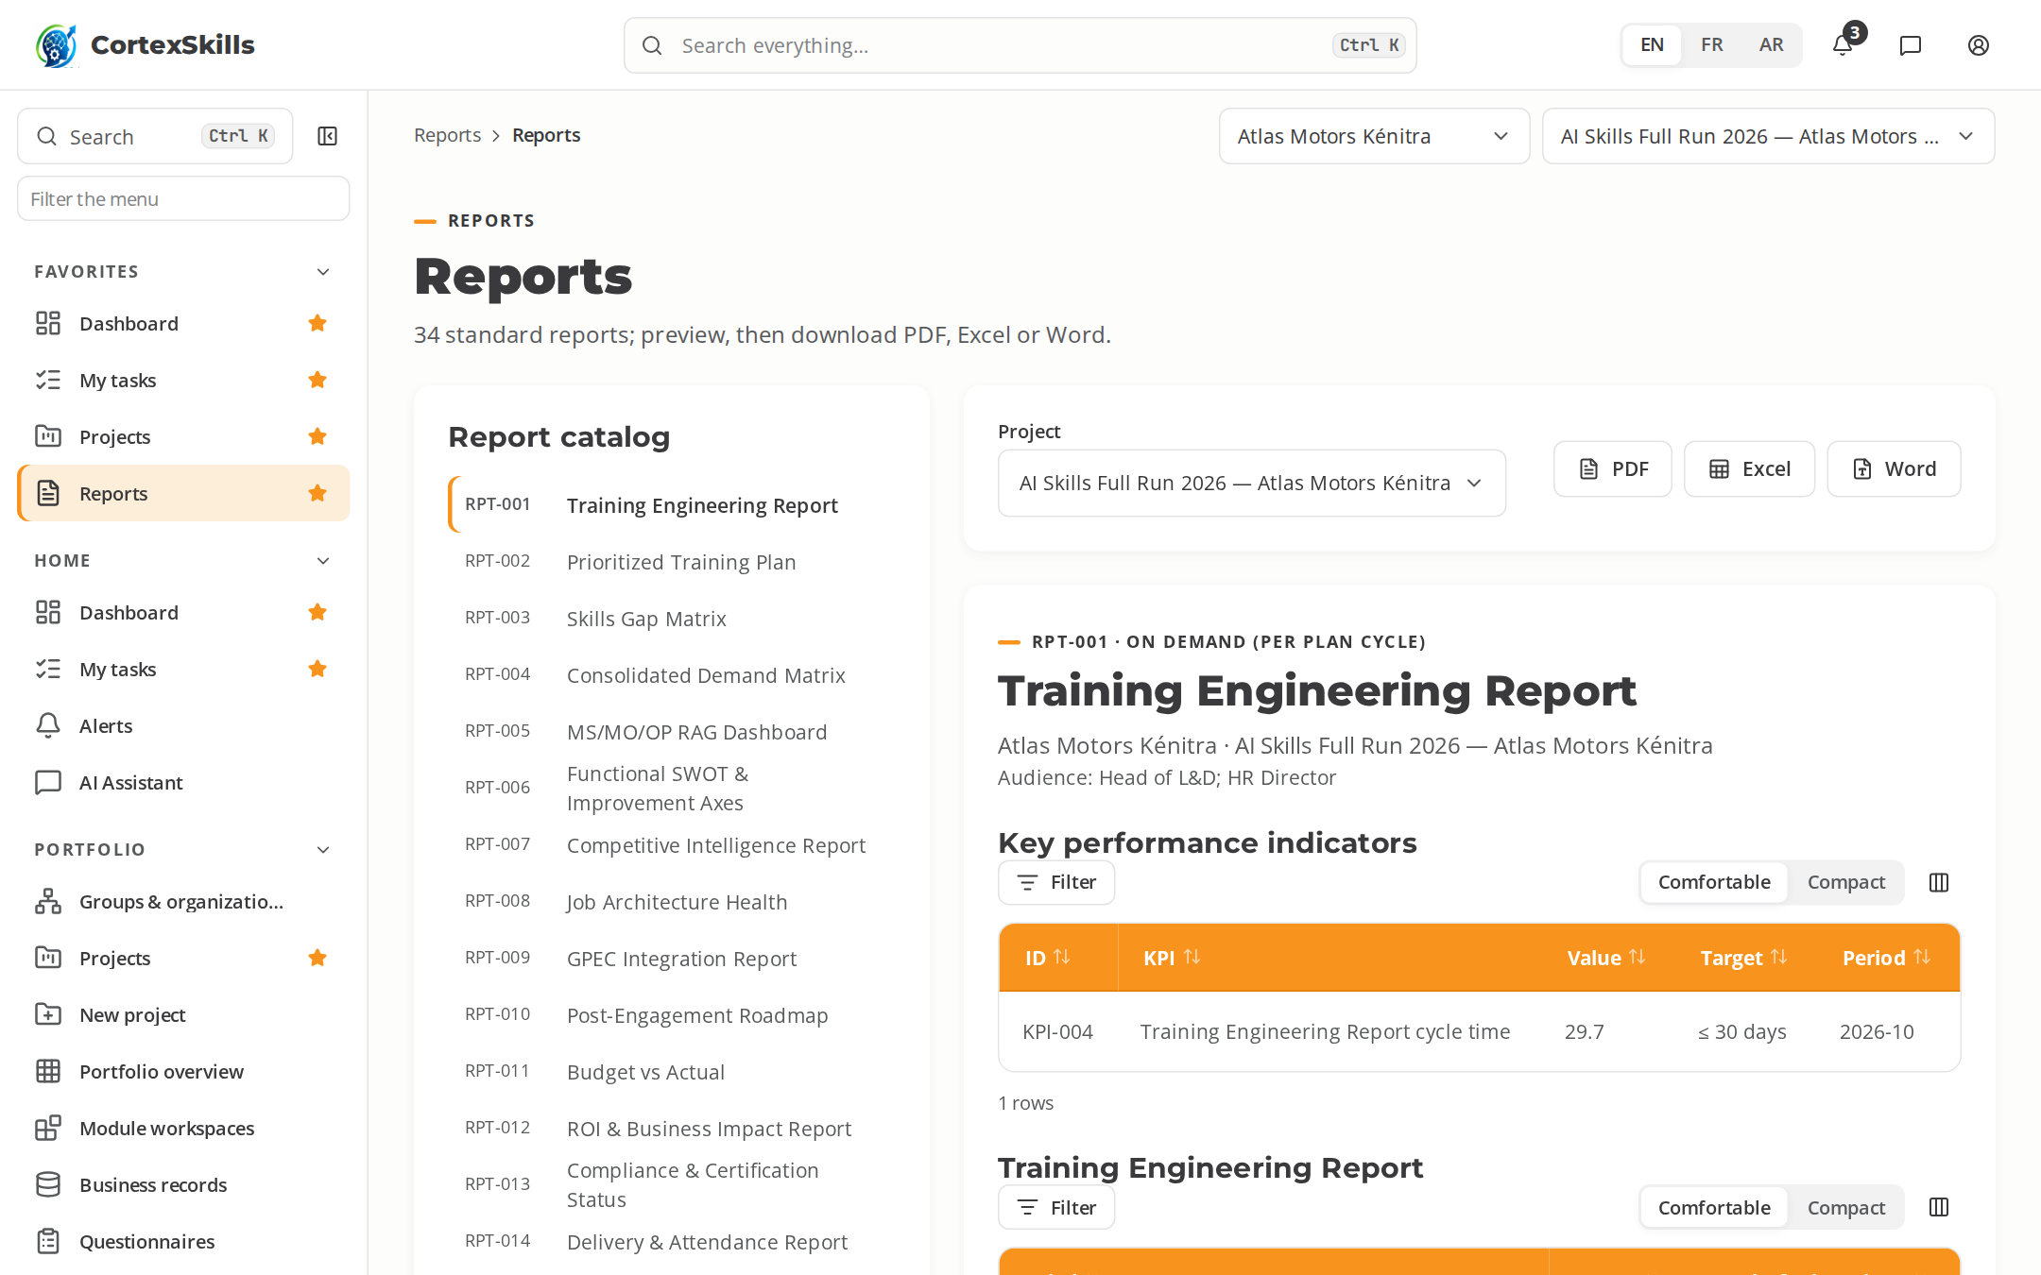
STEP 8 · RESULTS
Reports and questions in plain language
Standard reports exported to PDF, Excel and Word.
The AI Assistant answers from the organization’s own data, within the user’s permissions.
Alerts flag overdue steps and off-target KPIs.
POWERACT
The dynamics, step by step
13

Slide 14
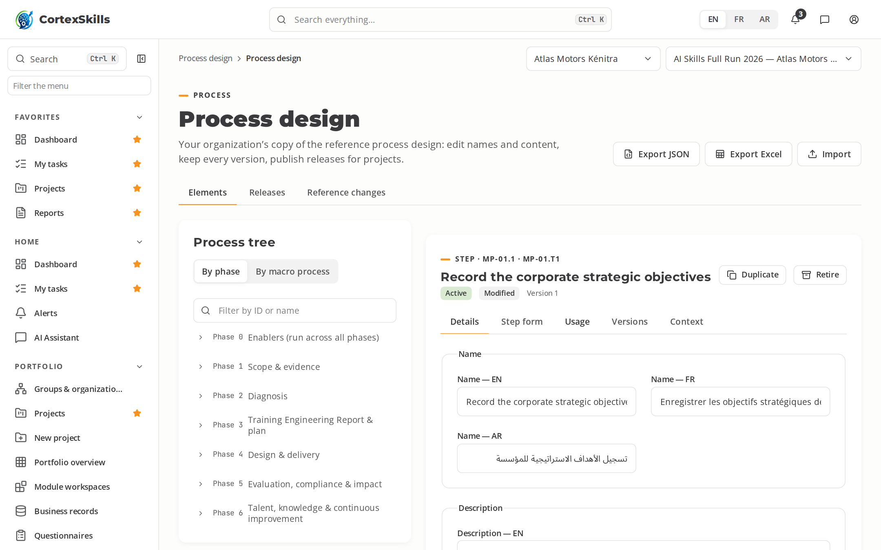
STEP 9 · PROCESS DESIGN
Your organization’s own process design
Rename, add, retire or move elements of the reference design; every change is a version.
Naming rules are checked before saving, in three languages.
A release is published by a second person; projects run on it.
POWERACT
The dynamics, step by step
14

Slide 15
STEP 10 · TYPED STEPS
Each step asks for what it produces
Tables of records, matrices, objectives and plans; forms for decisions and reviews.
Rows save as you go; Undo, paste from a spreadsheet, Row Editor.
Completed steps feed the registers of the project.
POWERACT
The dynamics, step by step
15

Slide 16
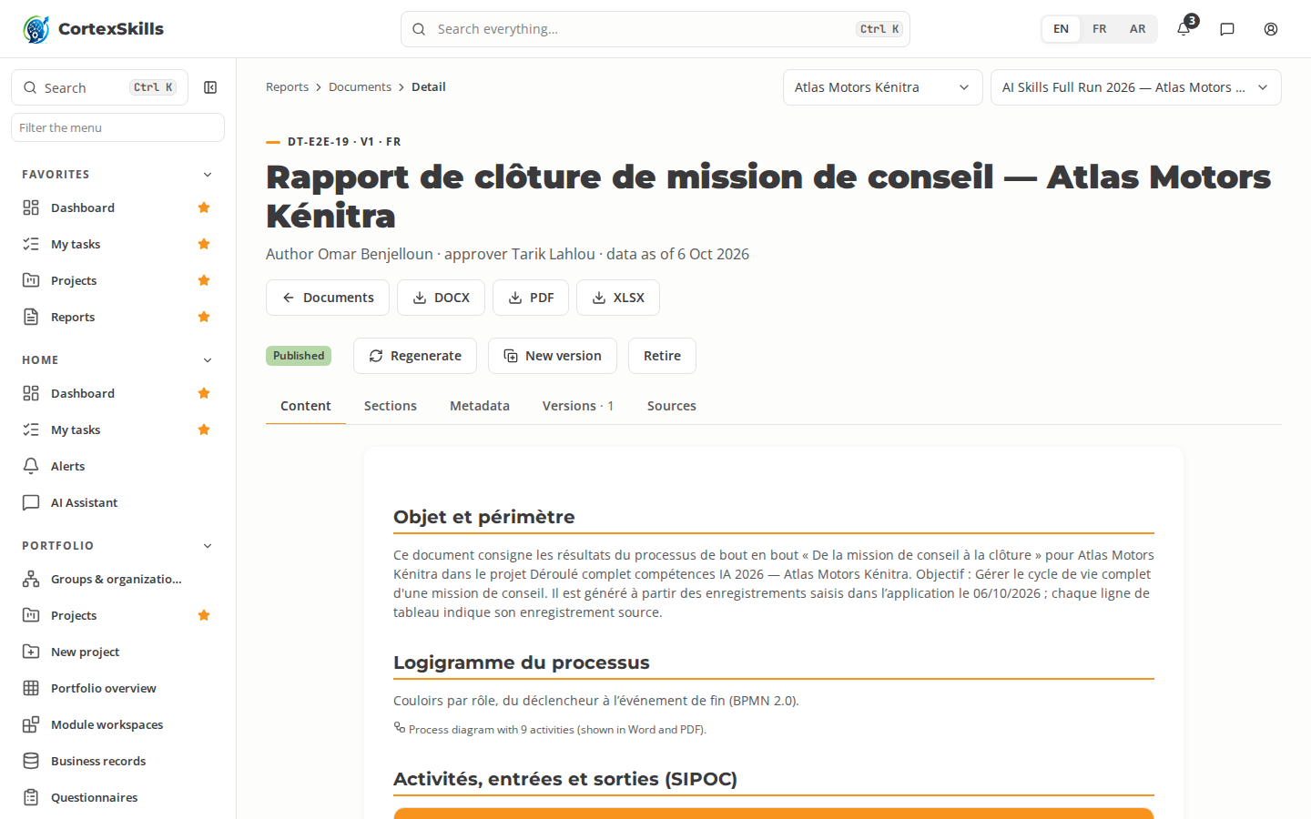
STEP 11 · DOCUMENTS
Documents written from the run’s data
37 templates: one per process deliverable, the report, the plan, the audit and the master list.
Overrides stay through regeneration; versions are compared and restored.
Published by a second person; Word, PDF and Excel.
POWERACT
The dynamics, step by step
16

Slide 17
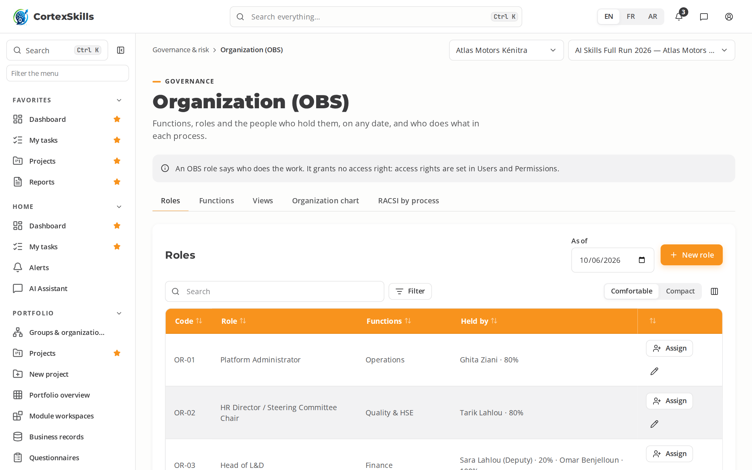
STEP 12 · ORGANIZATION
Roles, holders and RACSI
Functions group roles; each role has its holders, deputies and allocation.
The organization chart and vacant roles, on any date.
RACSI per step, by role, with exactly one Accountable.
POWERACT
The dynamics, step by step
17

Slide 18
02
SMEs: lighter tracks
Example: Clinique Al Amal, healthcare provider
POWERACT

Slide 19
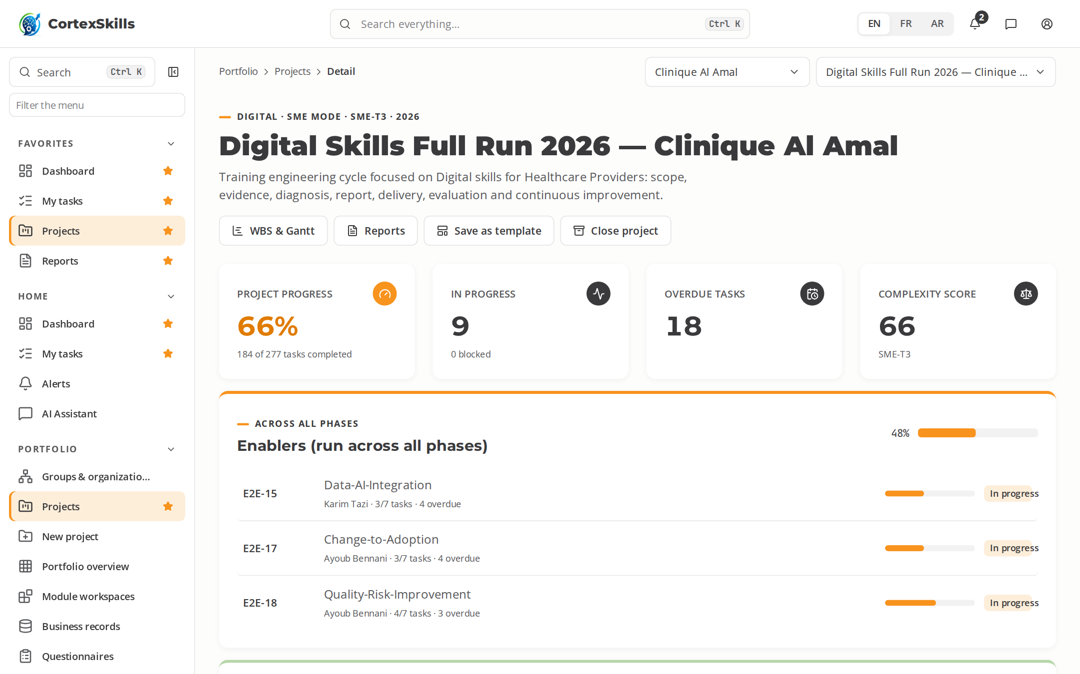
SMES
Three SME tracks, sized by complexity
The complexity score recommends the track; a different choice needs a justification.
T1 · Essential
Score 0–29
Fewer gates, short checklists, about 6 weeks
T2 · Standard
Score 30–49
Core processes with three gates
T3 · Extended
Score 50–69
Close to Full mode, lighter documentation
POWERACT
SMEs: lighter tracks
19

Slide 20
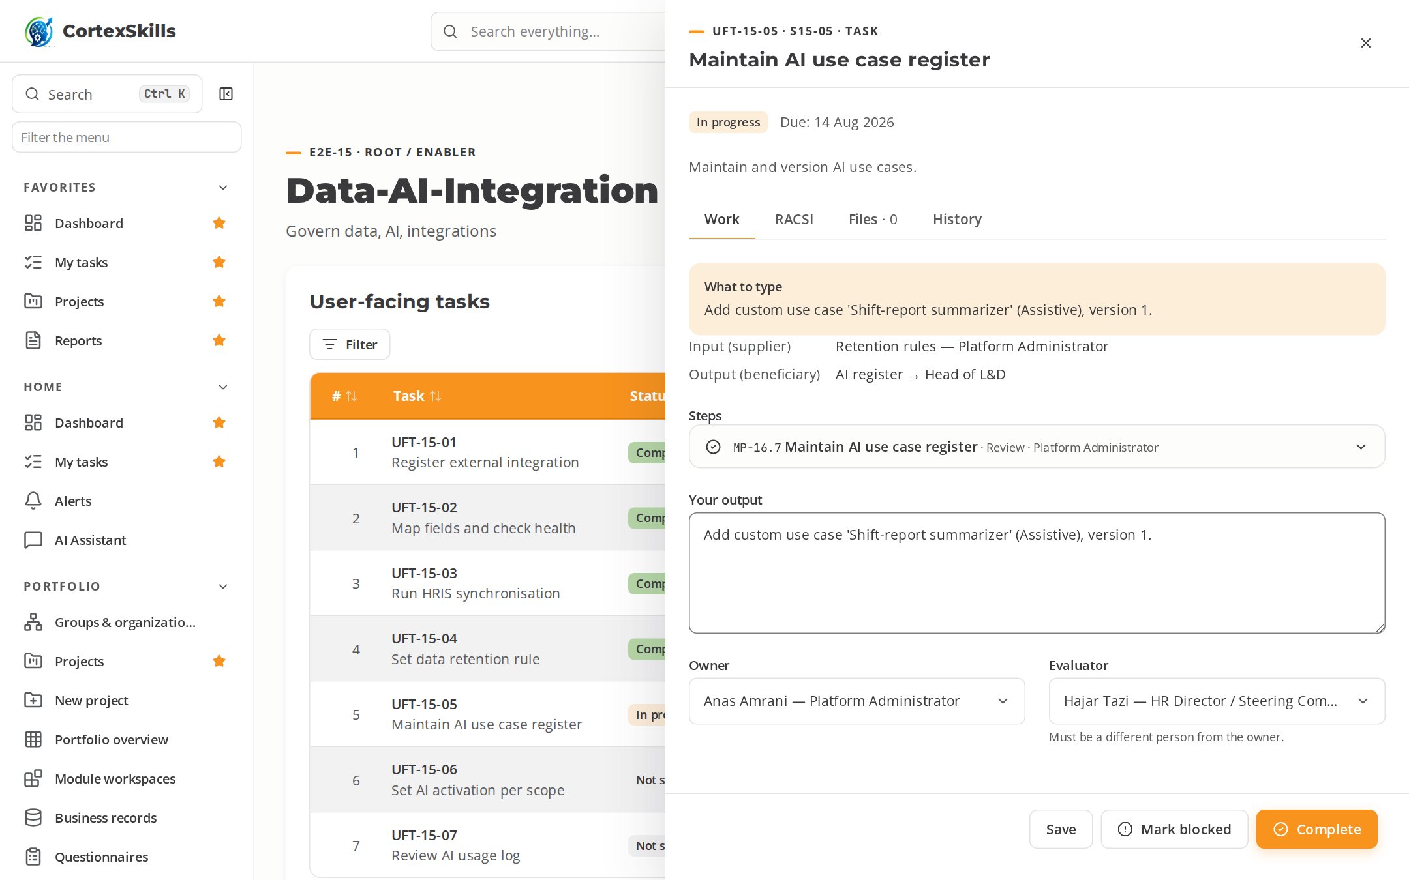
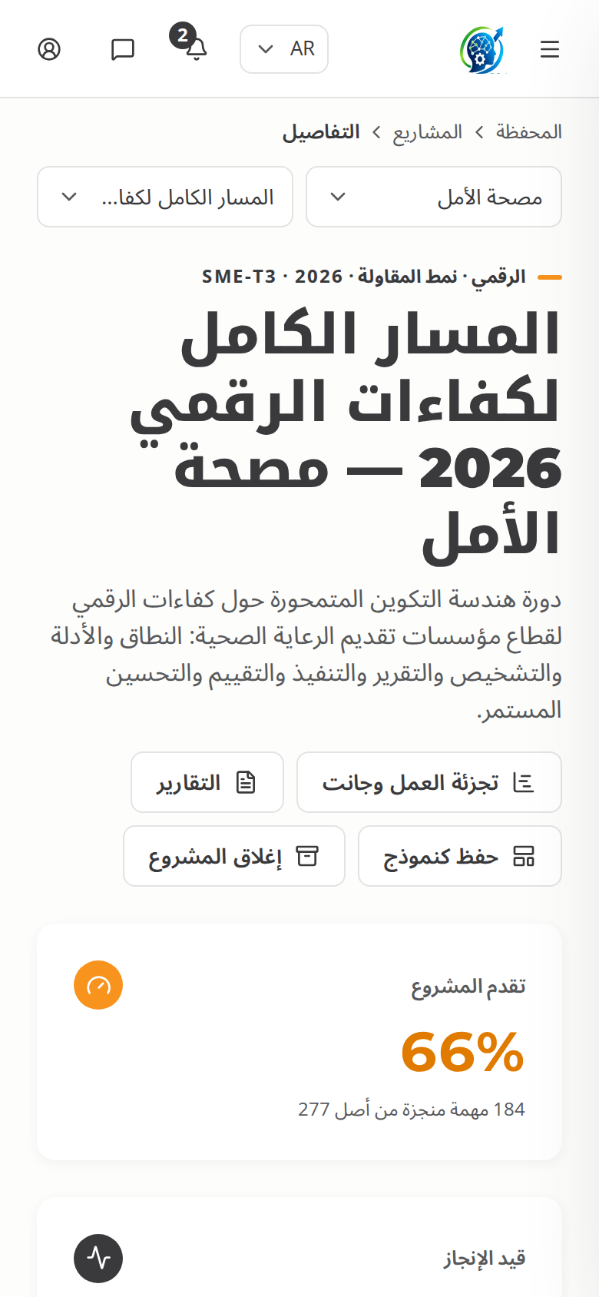
SMES
Same guidance, on any screen
Healthcare SME: the task panel in French, the workspace in Arabic on a phone.
POWERACT
SMEs: lighter tracks
20

Slide 21
03
Sector by sector
29 sectors · 58 organizations · 116 full runs
POWERACT

Slide 22
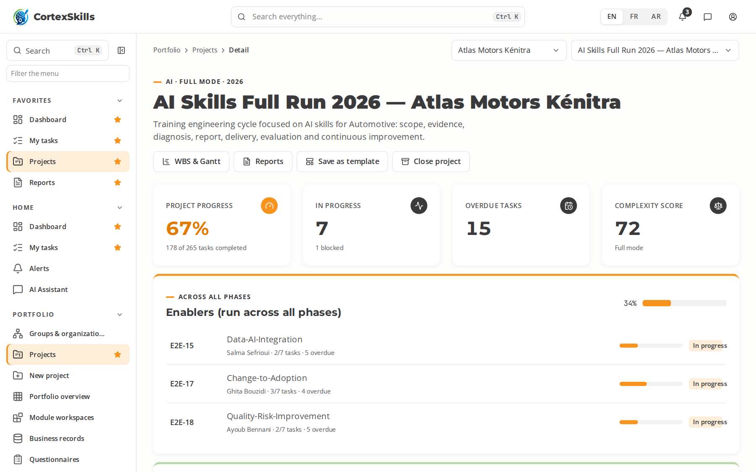

SECTOR · AUTO
Automotive
Manufacturing · Core function: Assembly & Production · IATF 16949, ISO 9001, ISO 45001
Large company — Atlas Motors Kénitra
SME — Tanger Auto Parts
Task completion by run (%)
Priority AI themes (large company)
AI visual inspection of welds and paint
Predictive maintenance of press lines
IATF 16949
Priority digital themes (SME)
MES and digital shop-floor tracking
PLM and digital engineering change
Supplier portal and EDI
POWERACT
Sector by sector
22

Slide 23
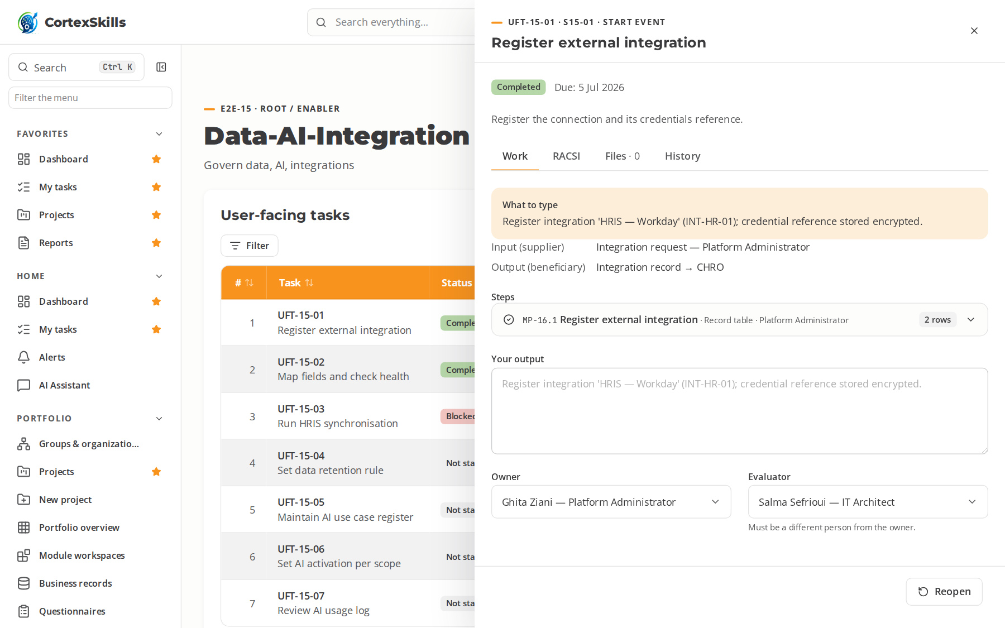
SECTOR · AUTO
Automotive — a process in progress
Atlas Motors Kénitra · AI run: the open task, its typed steps and what to type
POWERACT
Sector by sector
23

Slide 24
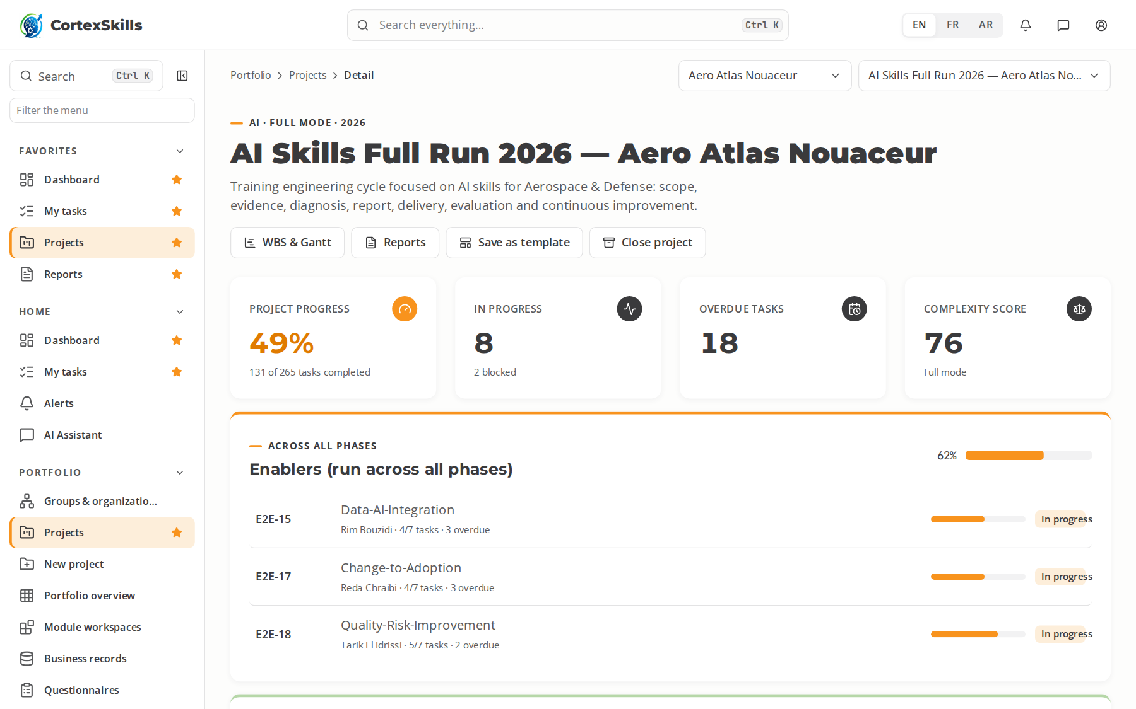
SECTOR · AERO
Aerospace & Defense
Manufacturing · Core function: Aerostructures & MRO · AS9100, EN 9110, ISO 9001
Large company — Aero Atlas Nouaceur
SME — Precision Aero Composites
Task completion by run (%)
Priority AI themes (large company)
AI-assisted non-destructive testing
Predictive MRO scheduling
AS9100
Priority digital themes (SME)
Digital work instructions and e-logbooks
Digital twin of assembly jigs
Configuration management in PLM
POWERACT
Sector by sector
24

Slide 25
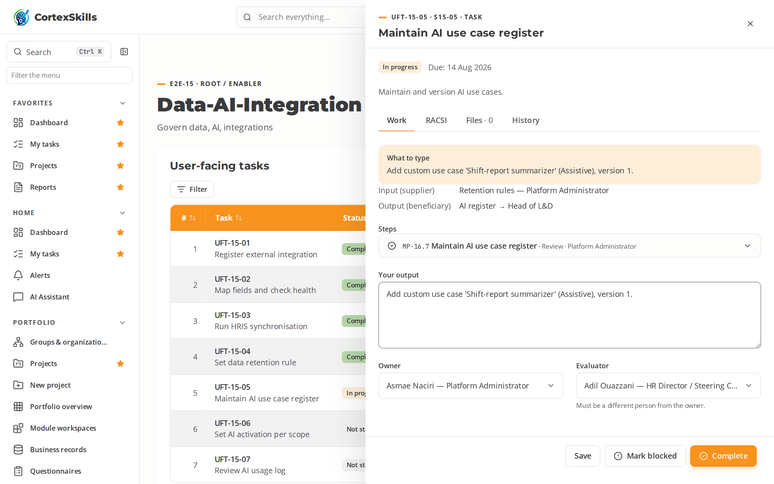
SECTOR · AERO
Aerospace & Defense — a process in progress
Aero Atlas Nouaceur · AI run: the open task, its typed steps and what to type
POWERACT
Sector by sector
25

Slide 26
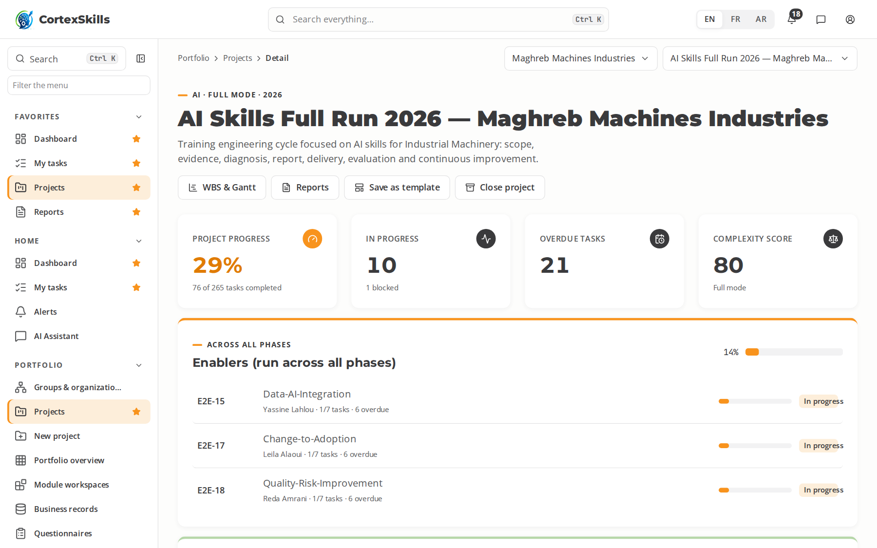
SECTOR · MACH
Industrial Machinery
Manufacturing · Core function: Machining & Assembly · ISO 9001, ISO 12100, CE Machinery Directive
Large company — Maghreb Machines Industries
SME — Fès Mécanique de Précision
Task completion by run (%)
Priority AI themes (large company)
AI-driven predictive maintenance
Machine-learning quality prediction
ISO 9001
Priority digital themes (SME)
CNC programming and CAM
IIoT machine connectivity
Digital after-sales service
POWERACT
Sector by sector
26

Slide 27
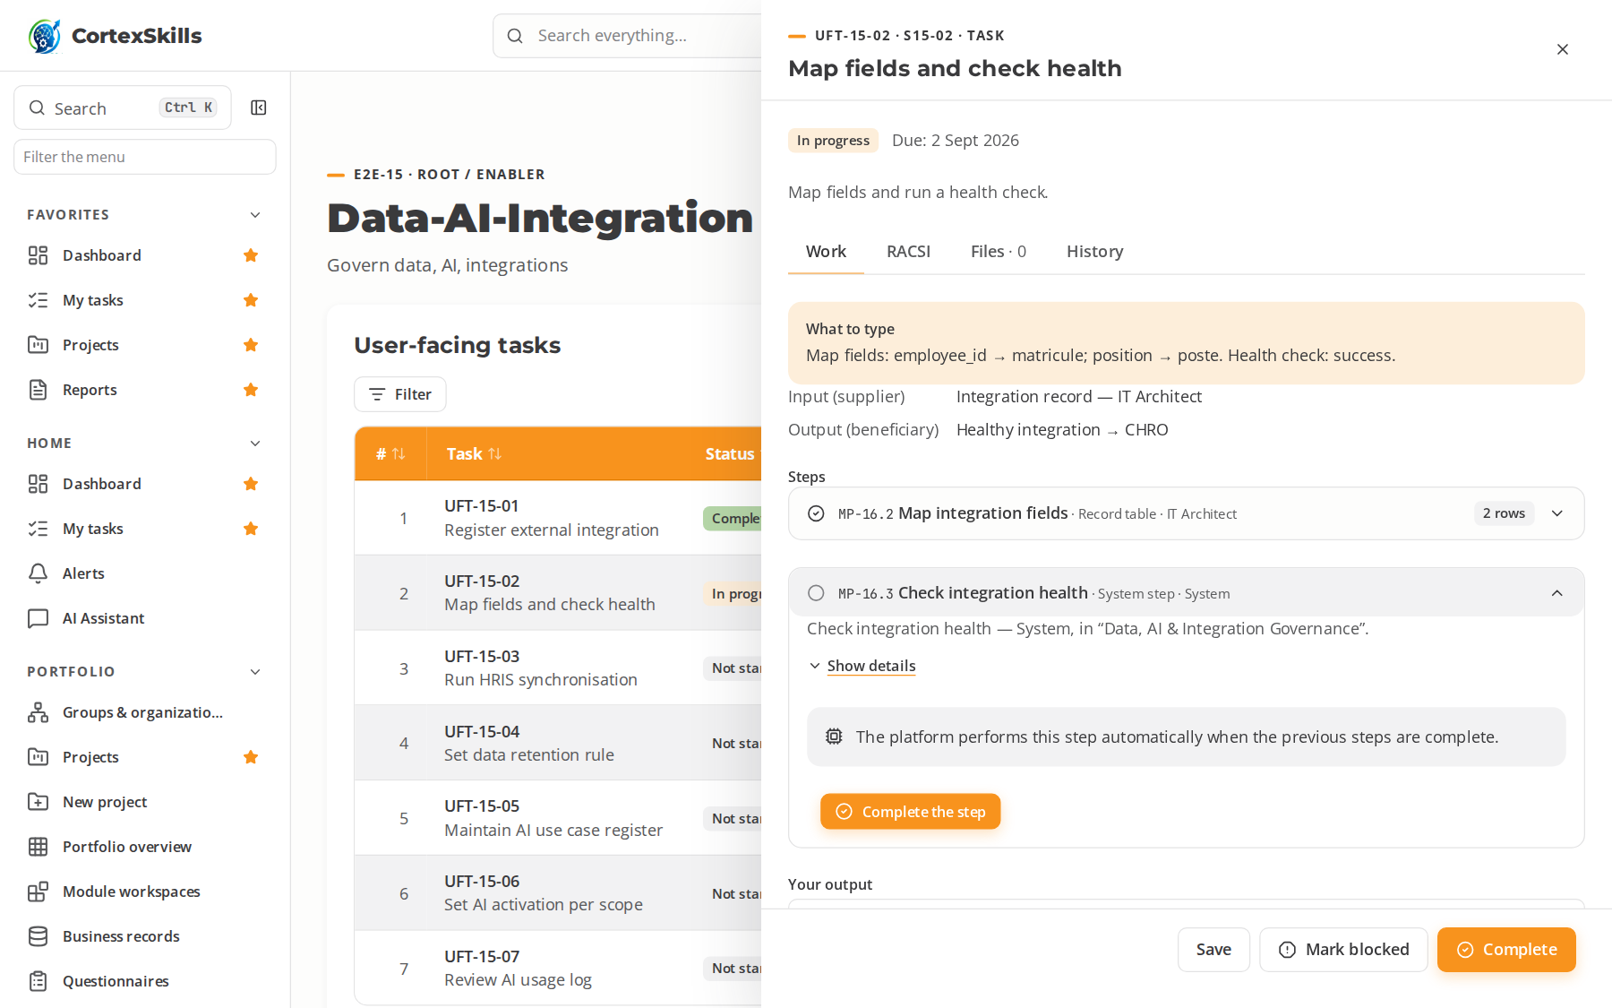
SECTOR · MACH
Industrial Machinery — a process in progress
Maghreb Machines Industries · AI run: the open task, its typed steps and what to type
POWERACT
Sector by sector
27

Slide 28
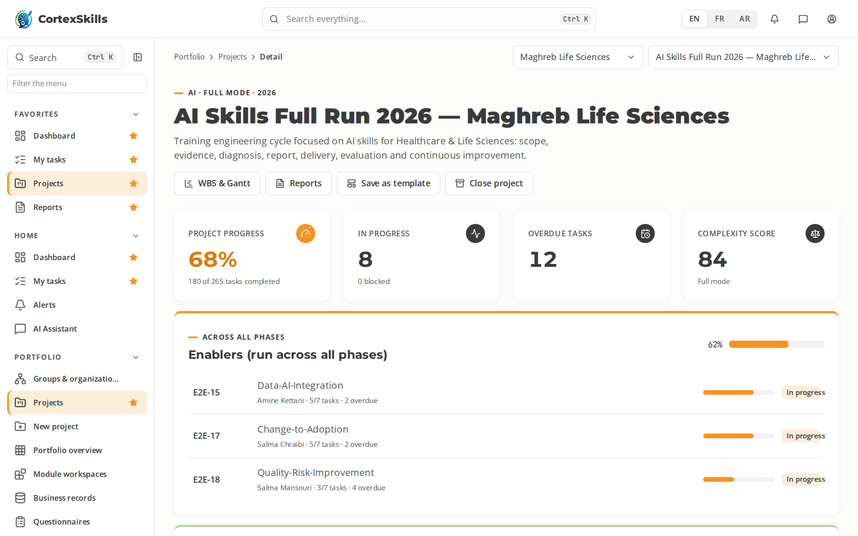
SECTOR · HLS
Healthcare & Life Sciences
Health · Core function: Clinical & Laboratory Operations · ISO 13485, EU MDR, ISO 15189
Large company — Maghreb Life Sciences
SME — BioLab Diagnostics Rabat
Task completion by run (%)
Priority AI themes (large company)
AI-assisted diagnostics validation
AI for pharmacovigilance signal detection
ISO 13485
Priority digital themes (SME)
Electronic lab notebooks and LIMS
Electronic quality management (eQMS)
Health data interoperability (HL7 FHIR)
POWERACT
Sector by sector
28

Slide 29
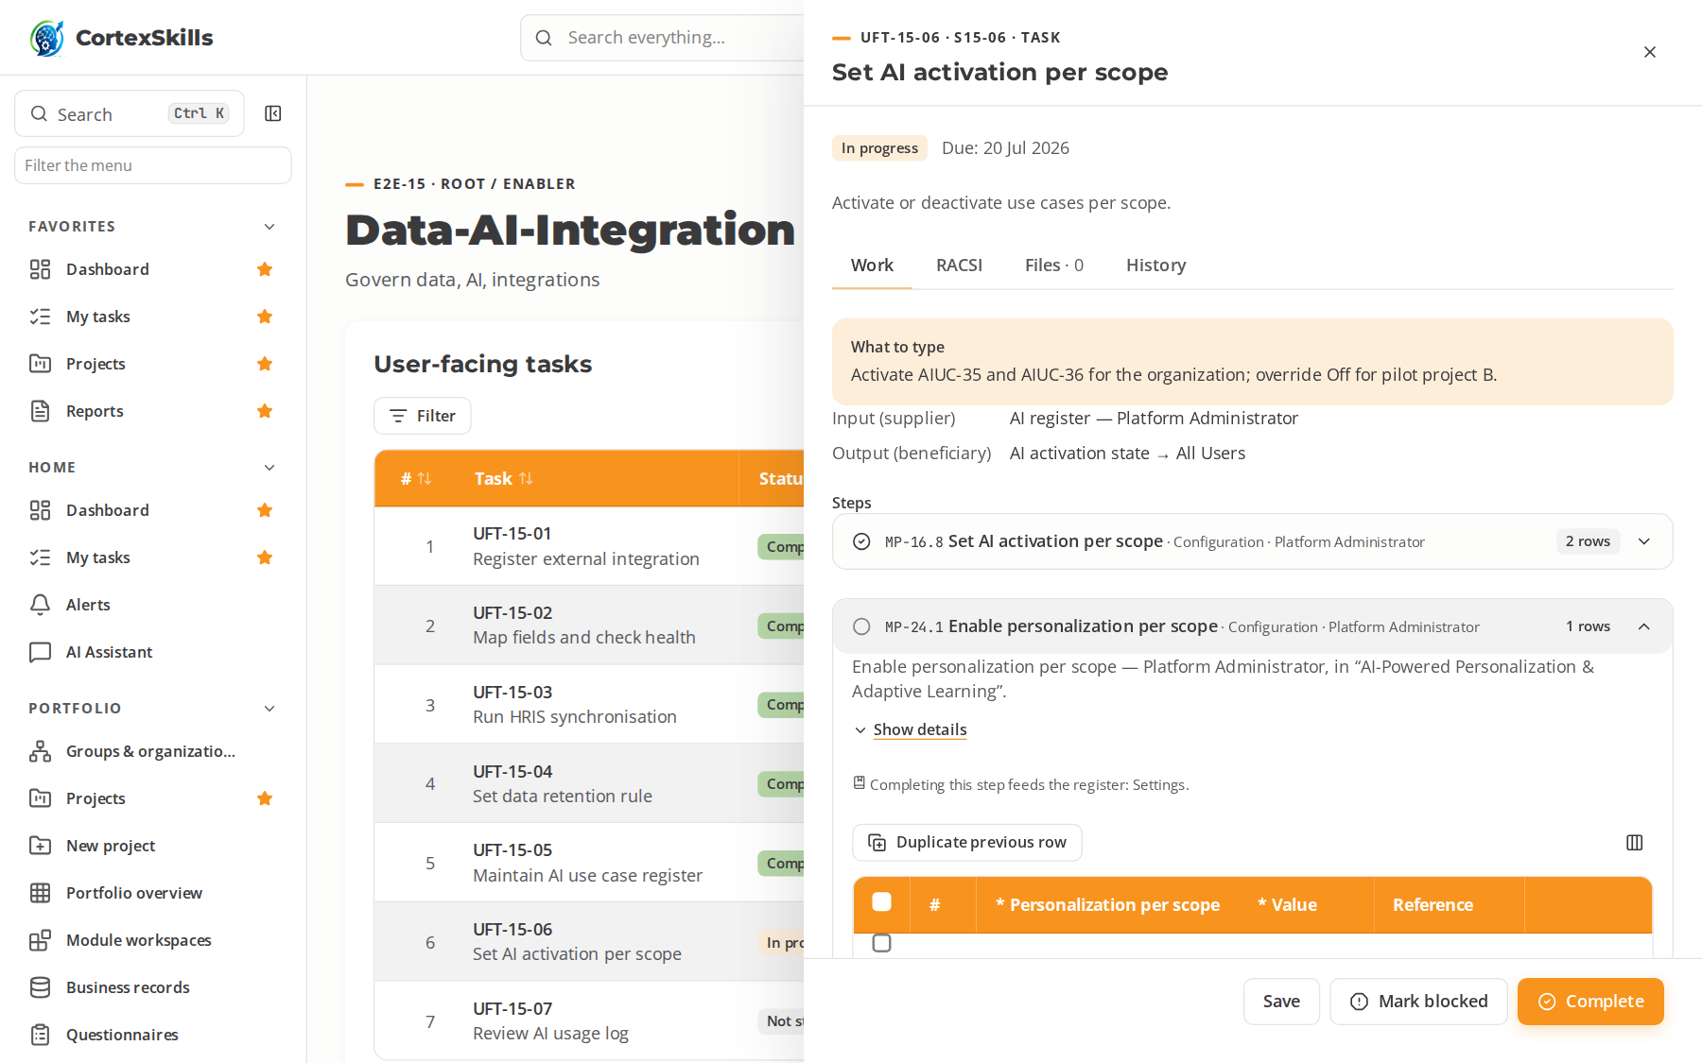
SECTOR · HLS
Healthcare & Life Sciences — a process in progress
Maghreb Life Sciences · AI run: the open task, its typed steps and what to type
POWERACT
Sector by sector
29

Slide 30
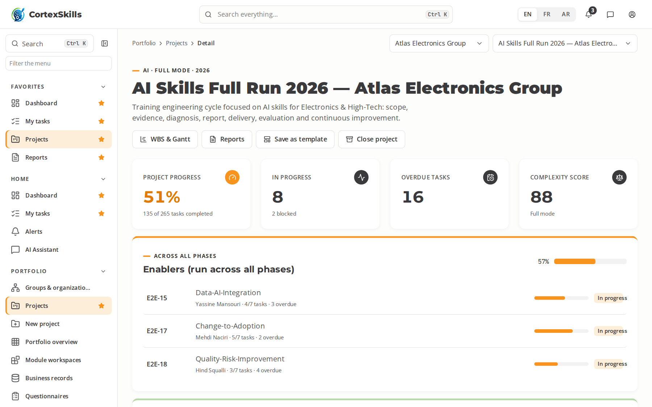
SECTOR · ELEC
Electronics & High-Tech
Manufacturing · Core function: SMT & Test · IPC-A-610, ISO 9001, ISO 14001
Large company — Atlas Electronics Group
SME — Circuitec Oujda
Task completion by run (%)
Priority AI themes (large company)
AI optical inspection (AOI) tuning
Yield prediction with machine learning
IPC-A-610
Priority digital themes (SME)
Traceability with MES and barcodes
Digital test benches and data capture
ERP-driven material planning
POWERACT
Sector by sector
30

Slide 31

SECTOR · ELEC
Electronics & High-Tech — a process in progress
Atlas Electronics Group · AI run: the open task, its typed steps and what to type
POWERACT
Sector by sector
31

Slide 32
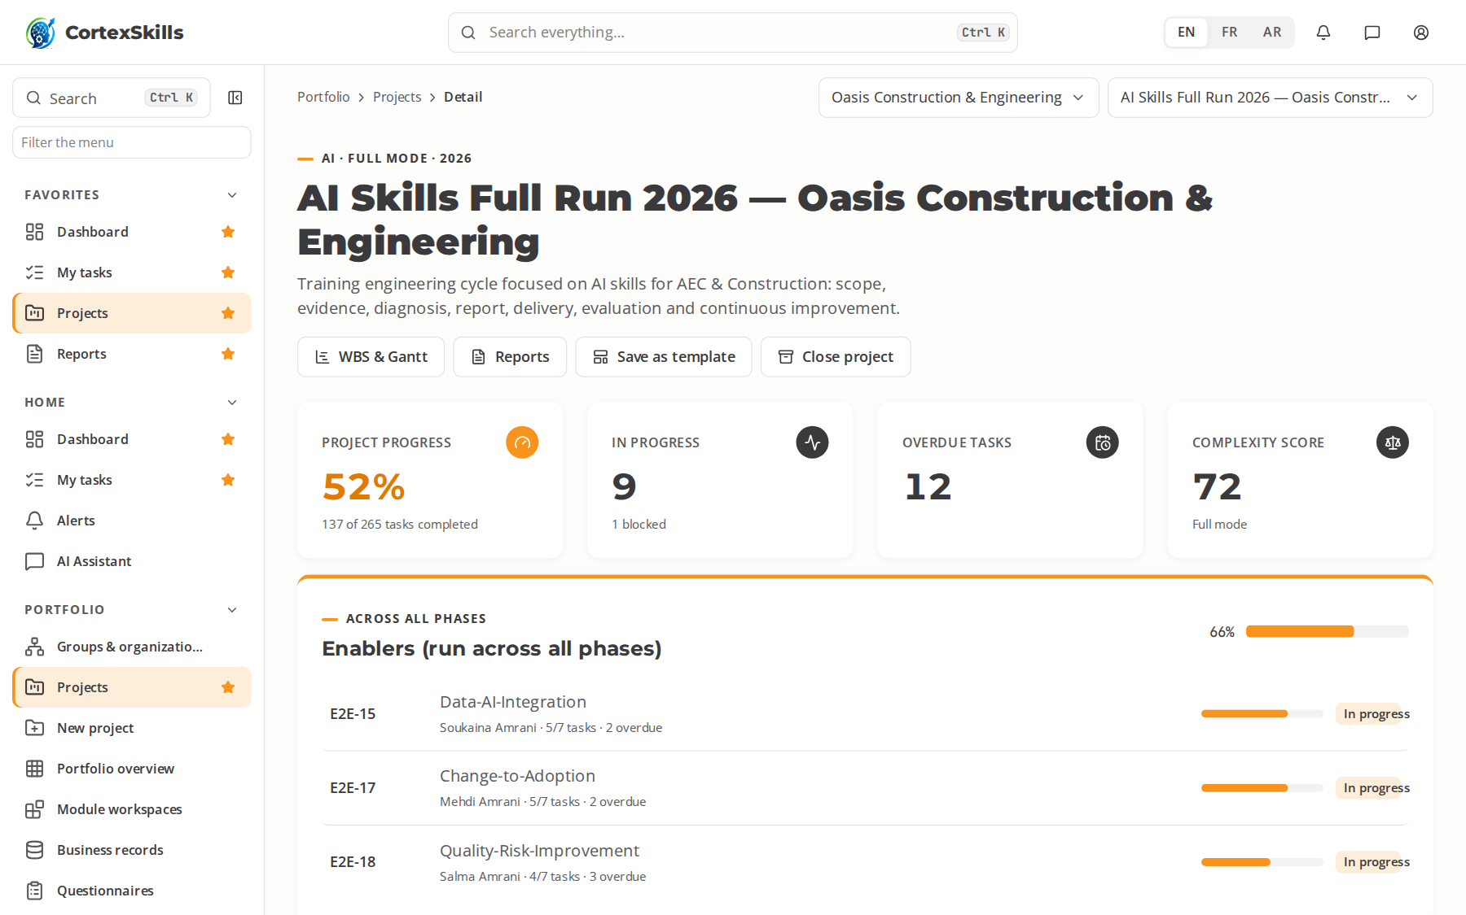
SECTOR · AEC
AEC & Construction
Infrastructure & energy · Core function: Site Works & Project Delivery · ISO 19650, ISO 45001, ISO 9001
Large company — Oasis Construction & Engineering
SME — Souss BTP Solutions
Task completion by run (%)
Priority AI themes (large company)
AI clash detection and model checking
AI safety monitoring with site cameras
ISO 19650
Priority digital themes (SME)
BIM modelling and ISO 19650 workflows
Digital site diary and field reporting
Drone surveying and 3D site scans
POWERACT
Sector by sector
32

Slide 33

SECTOR · AEC
AEC & Construction — a process in progress
Oasis Construction & Engineering · AI run: the open task, its typed steps and what to type
POWERACT
Sector by sector
33

Slide 34
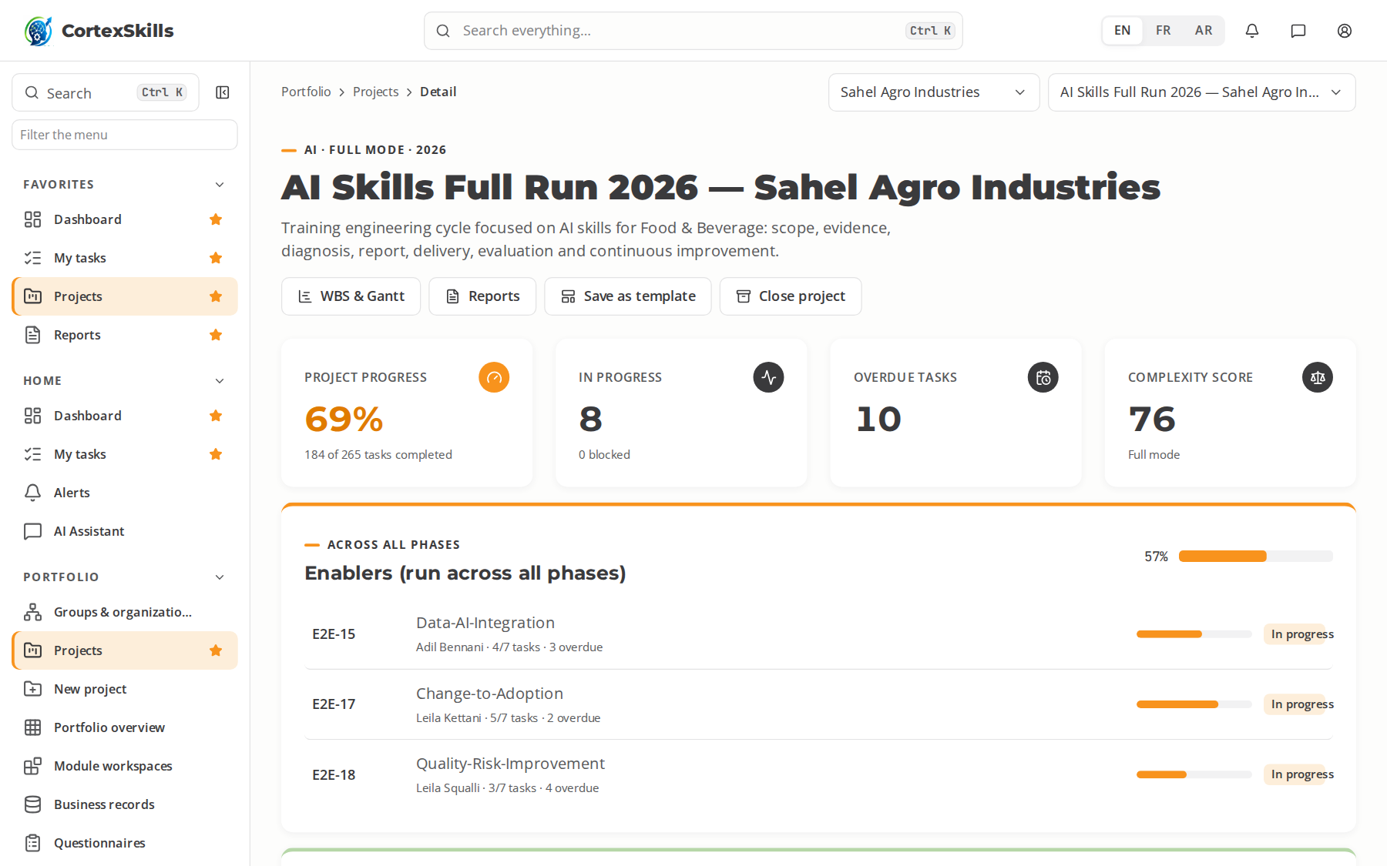
SECTOR · FNB
Food & Beverage
Consumer & retail · Core function: Production & Food Safety · HACCP, ISO 22000, FSSC 22000
Large company — Sahel Agro Industries
SME — Coopérative Laitière Al Baraka
Task completion by run (%)
Priority AI themes (large company)
AI shelf-life and spoilage prediction
Computer vision for foreign-body detection
HACCP
Priority digital themes (SME)
Digital HACCP records and traceability
Recipe and batch management in ERP
Connected cold-chain monitoring
POWERACT
Sector by sector
34

Slide 35

SECTOR · FNB
Food & Beverage — a process in progress
Sahel Agro Industries · AI run: the open task, its typed steps and what to type
POWERACT
Sector by sector
35

Slide 36
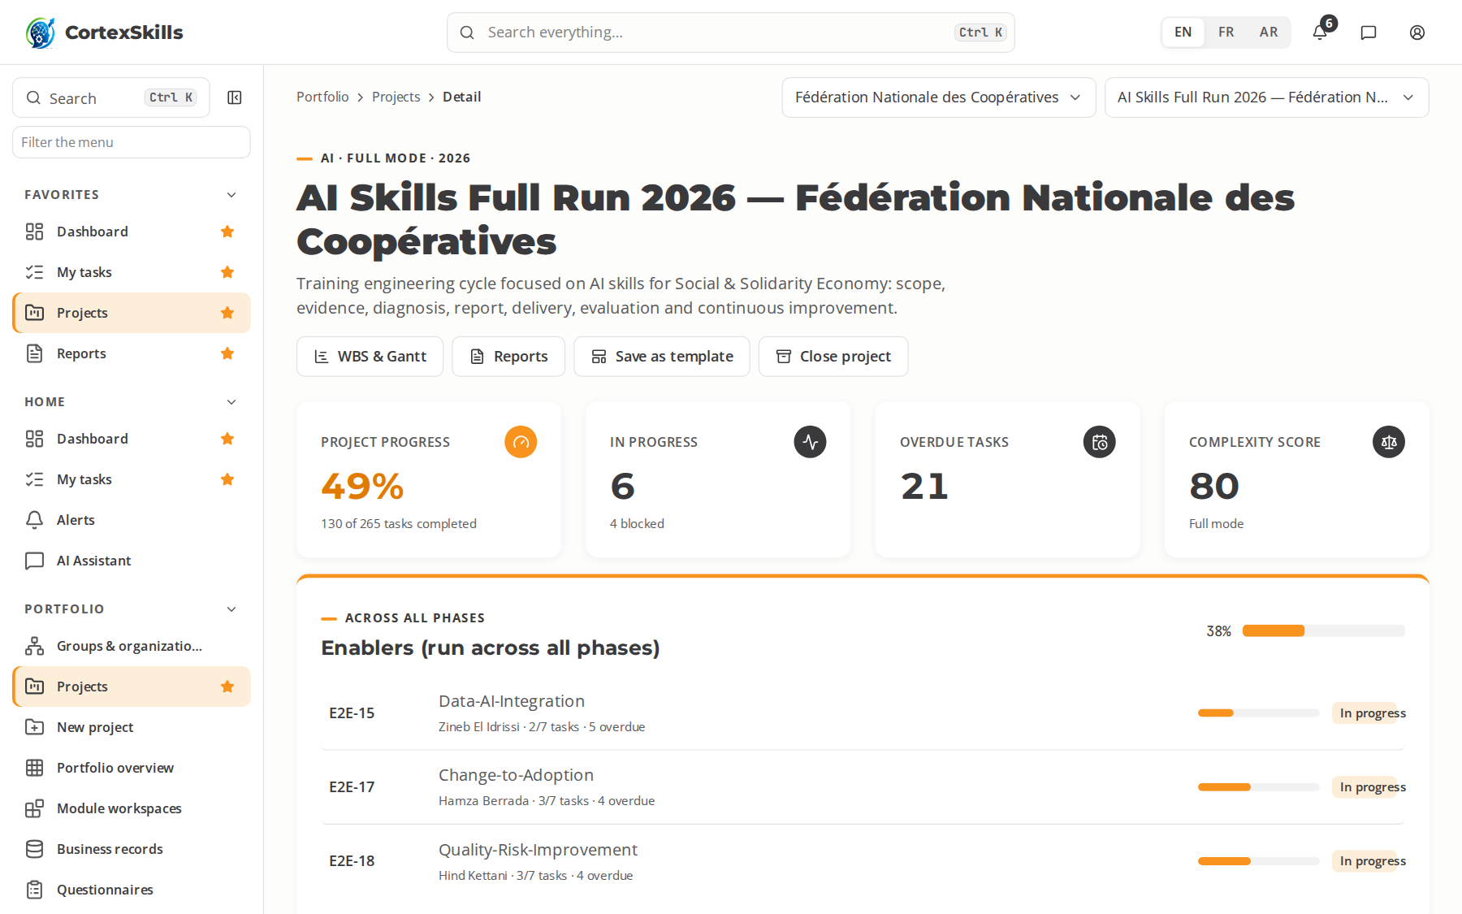
SECTOR · SSE
Social & Solidarity Economy
Public & social · Core function: Member Services & Cooperatives · ISO 26000, ISO 9001, Cooperative law 112-12
Large company — Fédération Nationale des Coopératives
SME — Coopérative Argan Tiznit
Task completion by run (%)
Priority AI themes (large company)
AI impact measurement for social programmes
AI translation for local-language outreach
ISO 26000
Priority digital themes (SME)
Digital membership and cooperative accounting
E-commerce for cooperative products
Mobile payment and micro-finance tools
POWERACT
Sector by sector
36

Slide 37

SECTOR · SSE
Social & Solidarity Economy — a process in progress
Fédération Nationale des Coopératives · AI run: the open task, its typed steps and what to type
POWERACT
Sector by sector
37

Slide 38
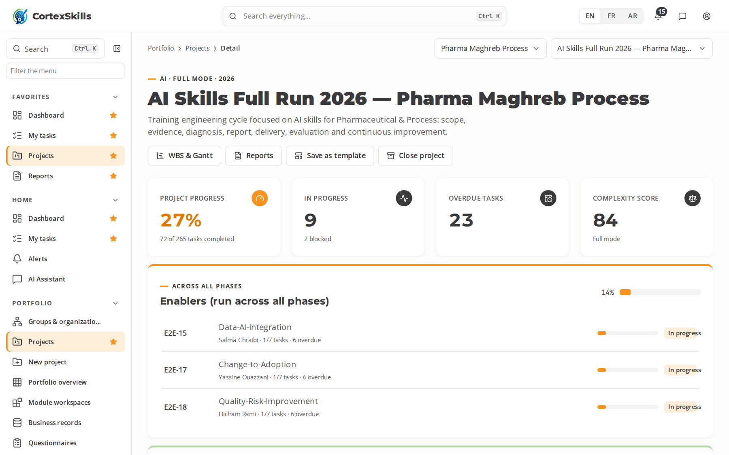
SECTOR · PHPR
Pharmaceutical & Process
Process industries · Core function: GMP Manufacturing · EU GMP, ICH Q10, FDA 21 CFR Part 11
Large company — Pharma Maghreb Process
SME — Galénix Laboratoires
Task completion by run (%)
Priority AI themes (large company)
AI process analytics for yield
AI deviation and CAPA triage
EU GMP
Priority digital themes (SME)
Electronic batch records (EBR)
Computer system validation (CSV)
Data integrity and ALCOA+ practices
POWERACT
Sector by sector
38

Slide 39

SECTOR · PHPR
Pharmaceutical & Process — a process in progress
Pharma Maghreb Process · AI run: the open task, its typed steps and what to type
POWERACT
Sector by sector
39

Slide 40
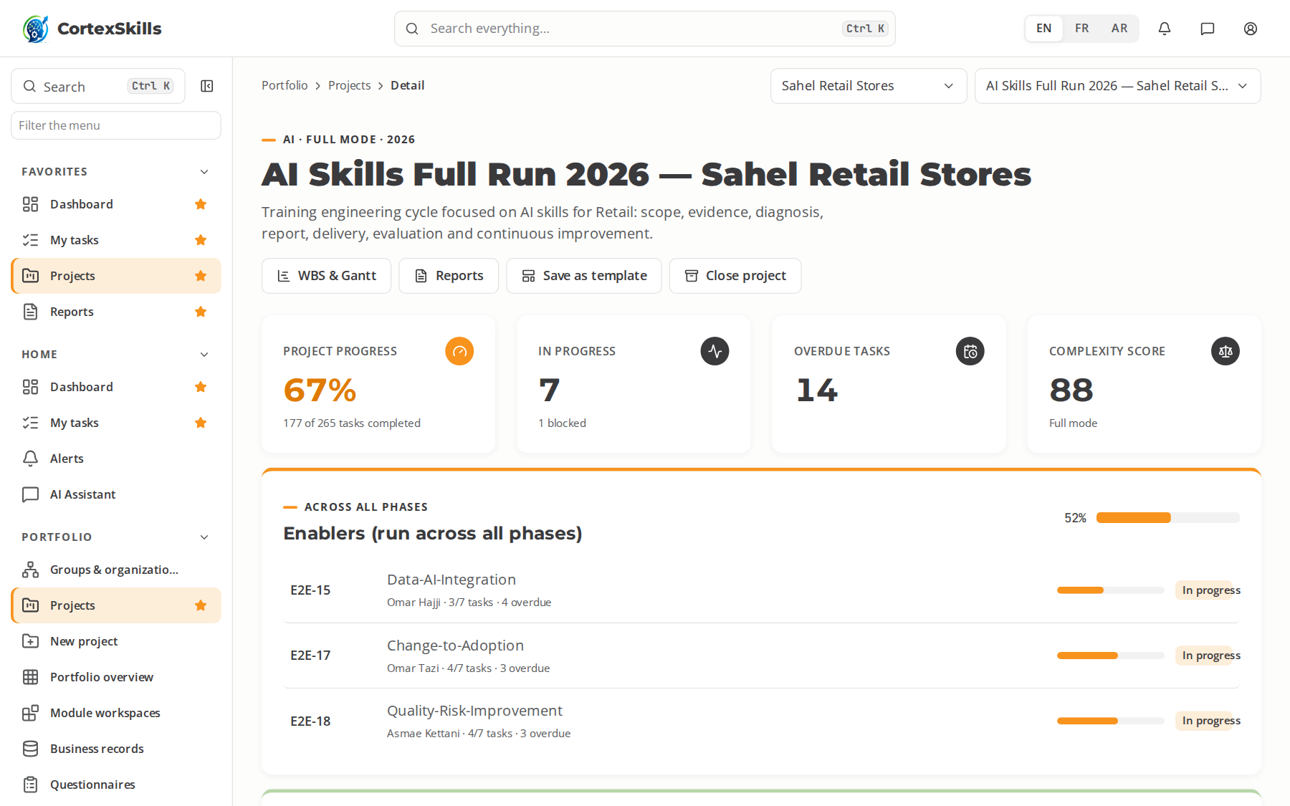
SECTOR · RETL
Retail
Consumer & retail · Core function: Store Operations · ISO 9001, PCI DSS, ISO 10002
Large company — Sahel Retail Stores
SME — Marrakech Concept Store
Task completion by run (%)
Priority AI themes (large company)
AI demand forecasting and replenishment
AI personalization of offers
ISO 9001
Priority digital themes (SME)
Omnichannel POS and click-and-collect
Digital merchandising and planograms
CRM and loyalty programmes
POWERACT
Sector by sector
40

Slide 41
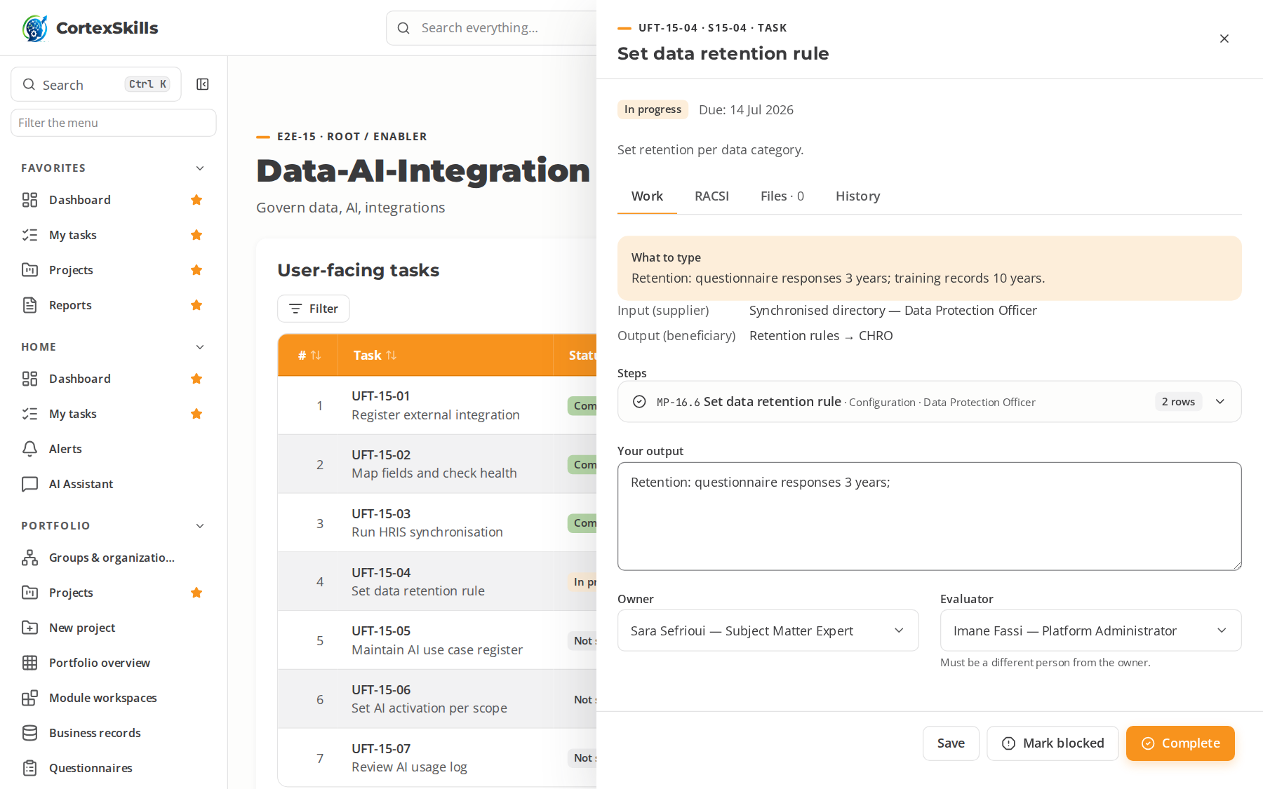
SECTOR · RETL
Retail — a process in progress
Sahel Retail Stores · AI run: the open task, its typed steps and what to type
POWERACT
Sector by sector
41

Slide 42
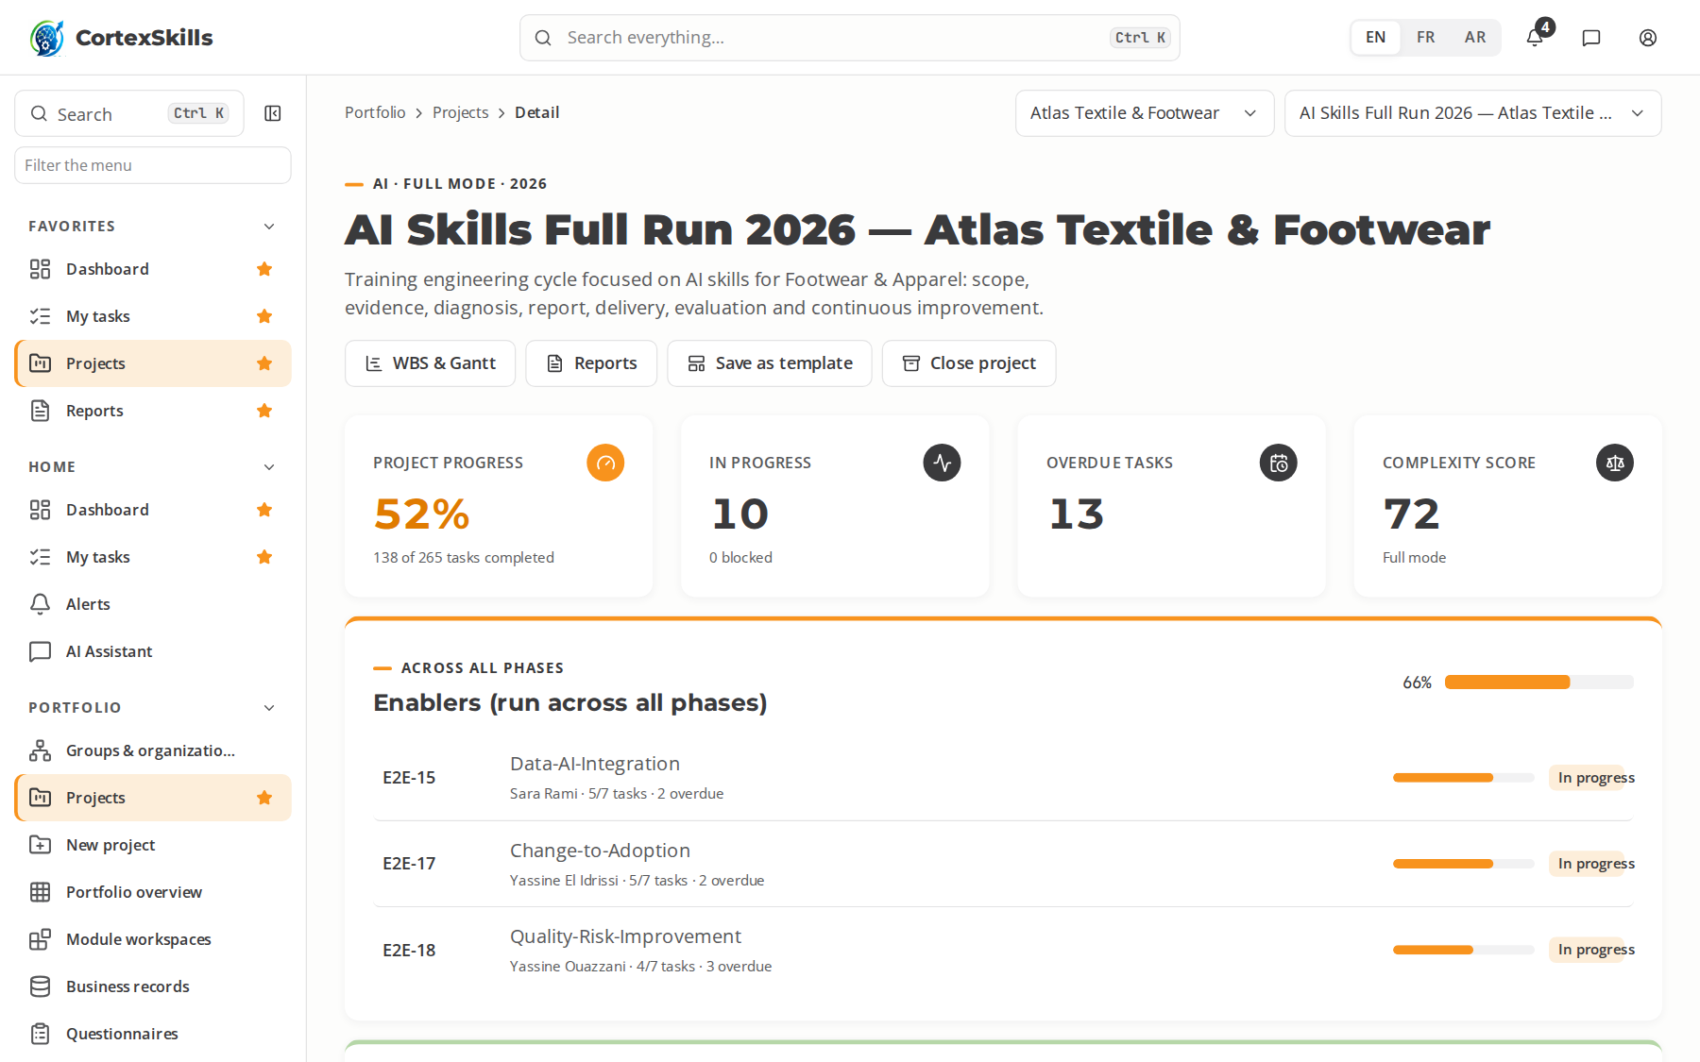
SECTOR · FTAP
Footwear & Apparel
Consumer & retail · Core function: Cutting, Sewing & Finishing · ISO 9001, OEKO-TEX, SA8000
Large company — Atlas Textile & Footwear
SME — Atelier Cuir Fès
Task completion by run (%)
Priority AI themes (large company)
AI defect detection on fabrics
AI line balancing
ISO 9001
Priority digital themes (SME)
Digital pattern making and 3D prototyping
Shop-floor data collection per operation
Digital compliance with buyer codes
POWERACT
Sector by sector
42

Slide 43

SECTOR · FTAP
Footwear & Apparel — a process in progress
Atlas Textile & Footwear · AI run: the open task, its typed steps and what to type
POWERACT
Sector by sector
43

Slide 44
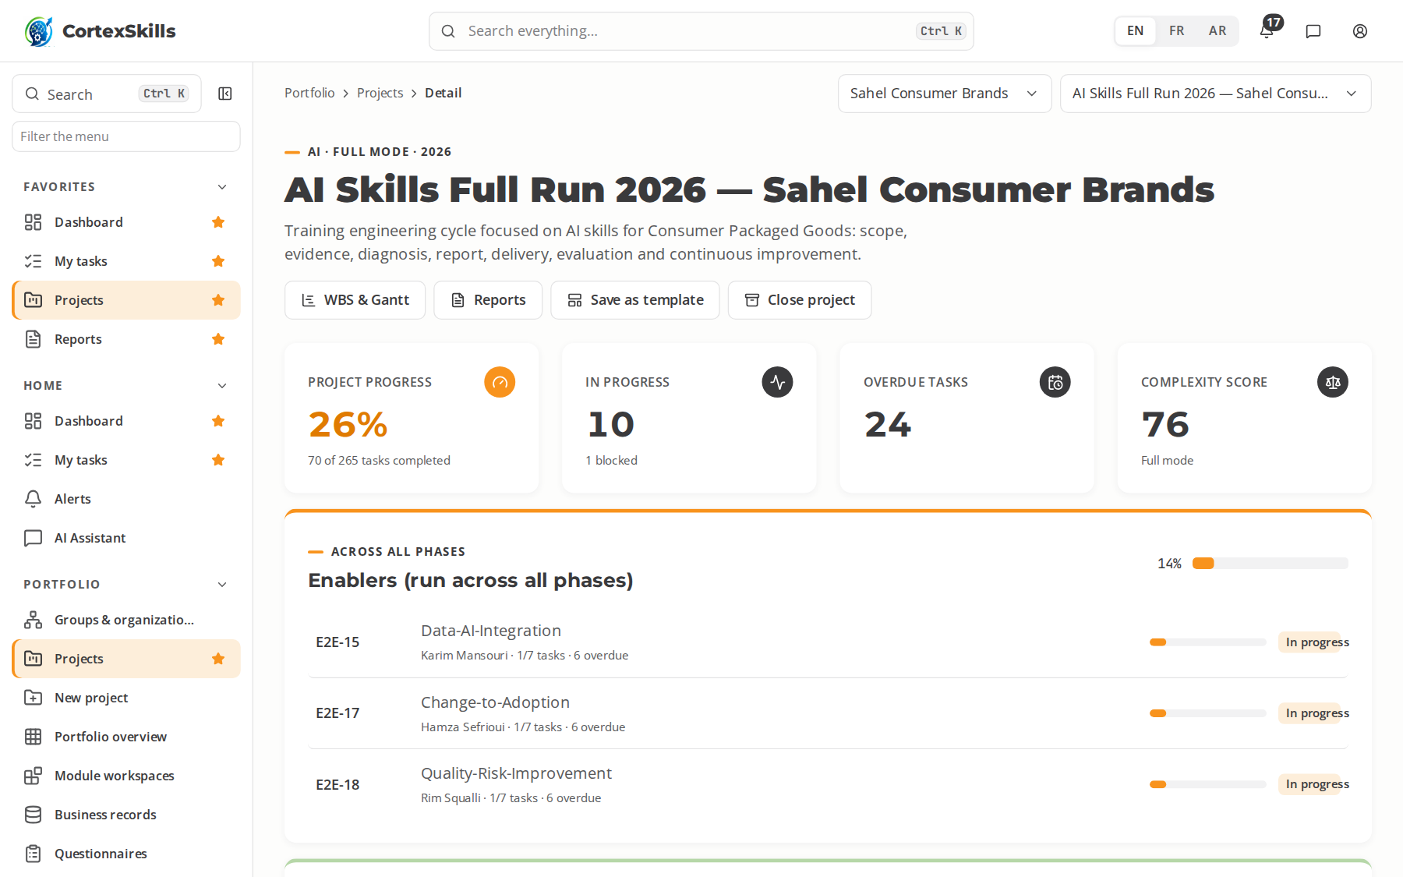
SECTOR · CPG
Consumer Packaged Goods
Consumer & retail · Core function: Packaging & Brand Operations · ISO 9001, ISO 22716, ISO 14001
Large company — Sahel Consumer Brands
SME — Savonnerie Beldi
Task completion by run (%)
Priority AI themes (large company)
AI promotion effectiveness modelling
AI consumer-insight mining
ISO 9001
Priority digital themes (SME)
Digital artwork and labelling workflow
Trade-marketing analytics
Line OEE digital dashboards
POWERACT
Sector by sector
44

Slide 45
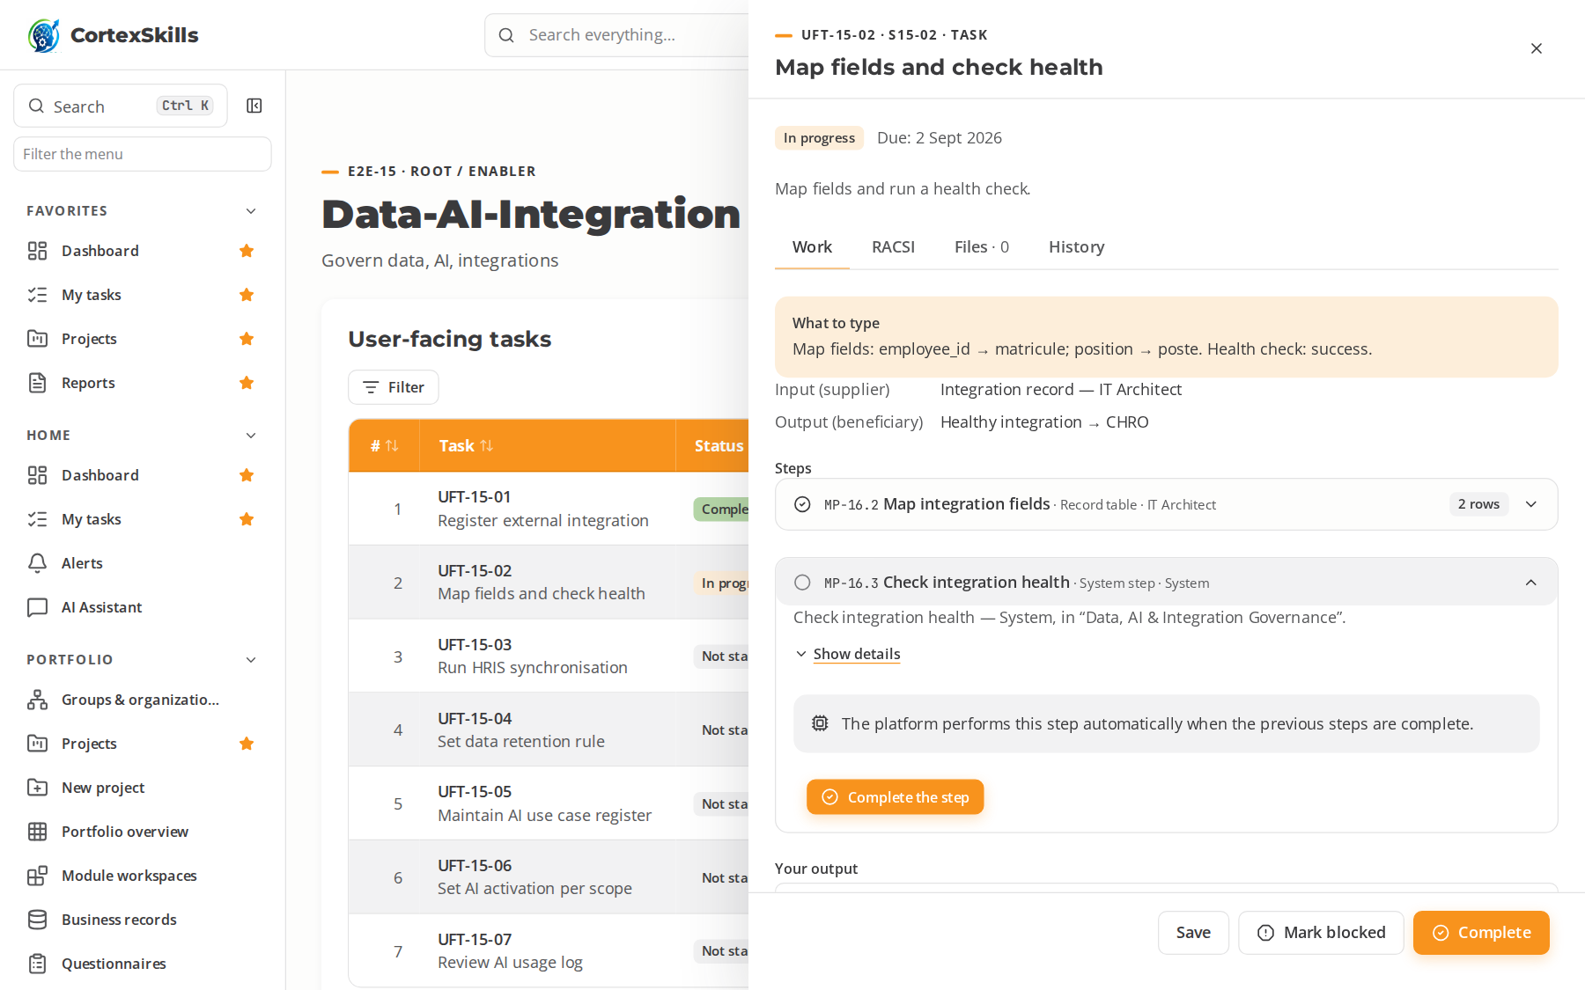
SECTOR · CPG
Consumer Packaged Goods — a process in progress
Sahel Consumer Brands · AI run: the open task, its typed steps and what to type
POWERACT
Sector by sector
45

Slide 46
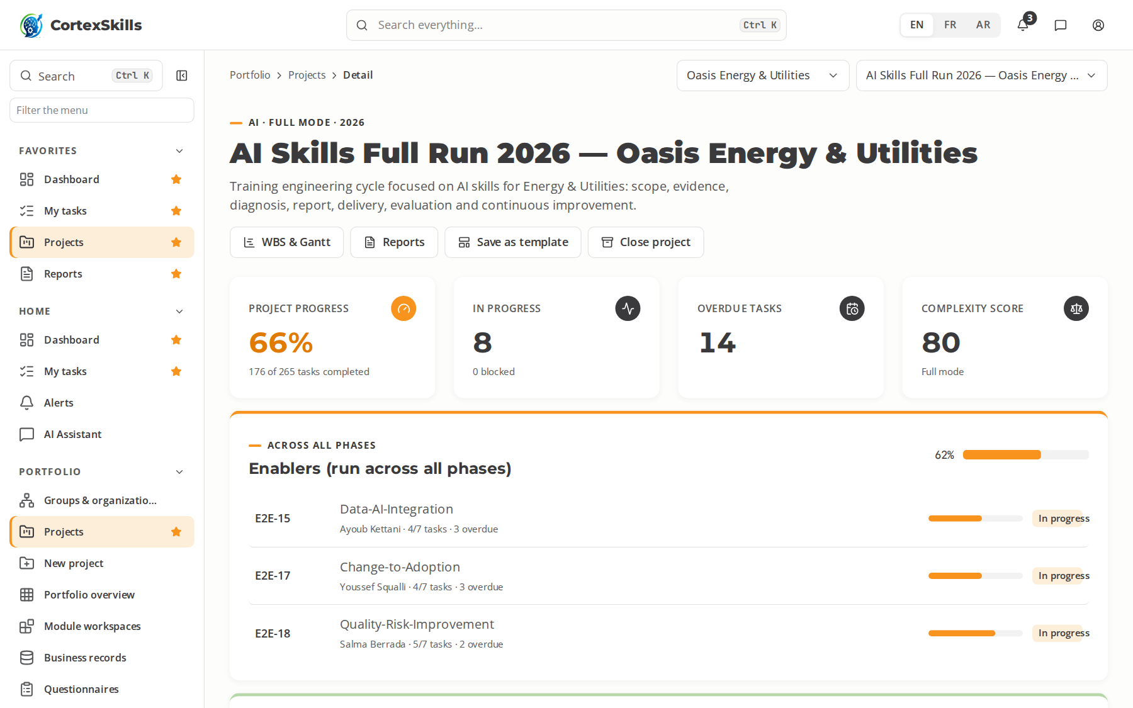
SECTOR · ENUT
Energy & Utilities
Infrastructure & energy · Core function: Network Operations & Field Maintenance · ISO 50001, ISO 55001, ISO 45001
Large company — Oasis Energy & Utilities
SME — Solaris Maintenance Services
Task completion by run (%)
Priority AI themes (large company)
AI load forecasting for grids
AI anomaly detection on assets
ISO 50001
Priority digital themes (SME)
SCADA and digital control rooms
Mobile work-order management
GIS asset mapping
POWERACT
Sector by sector
46

Slide 47

SECTOR · ENUT
Energy & Utilities — a process in progress
Oasis Energy & Utilities · AI run: the open task, its typed steps and what to type
POWERACT
Sector by sector
47

Slide 48
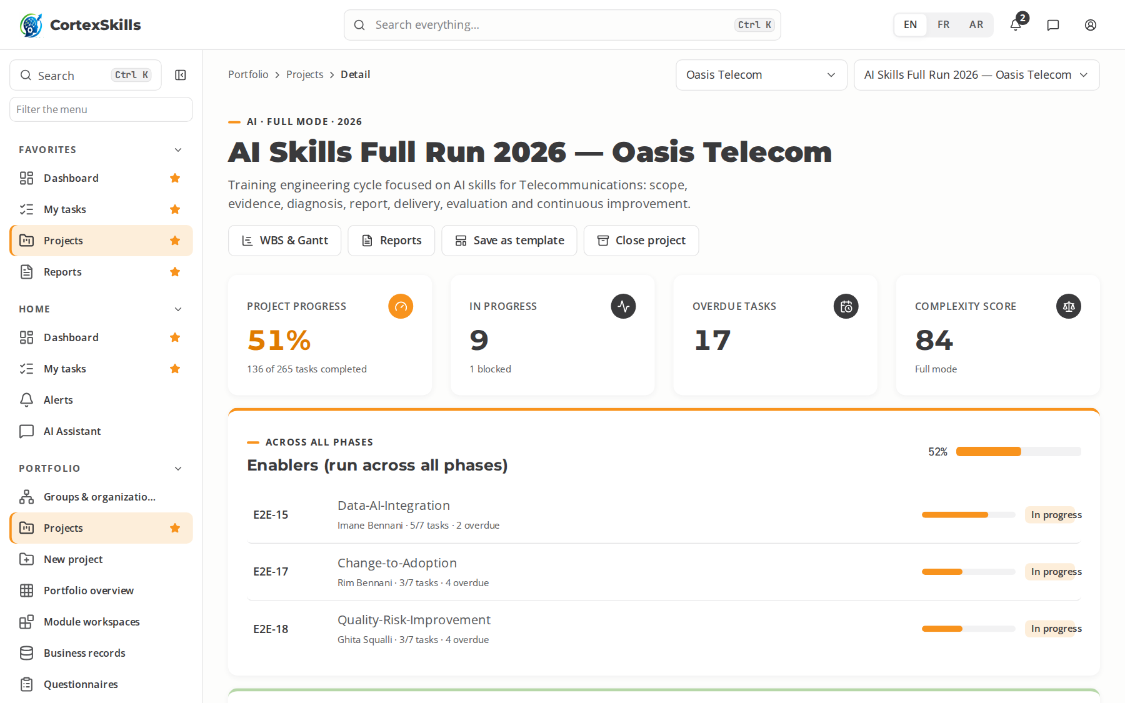
SECTOR · TELC
Telecommunications
Services · Core function: Network & Customer Operations · ISO/IEC 27001, ISO 9001, TM Forum eTOM
Large company — Oasis Telecom
SME — NetConnect Services
Task completion by run (%)
Priority AI themes (large company)
AI network fault prediction
AI churn prediction
ISO/IEC 27001
Priority digital themes (SME)
Network automation and SDN
Digital customer journeys and self-care
Cloud-native operations (DevOps)
POWERACT
Sector by sector
48

Slide 49

SECTOR · TELC
Telecommunications — a process in progress
Oasis Telecom · AI run: the open task, its typed steps and what to type
POWERACT
Sector by sector
49

Slide 50
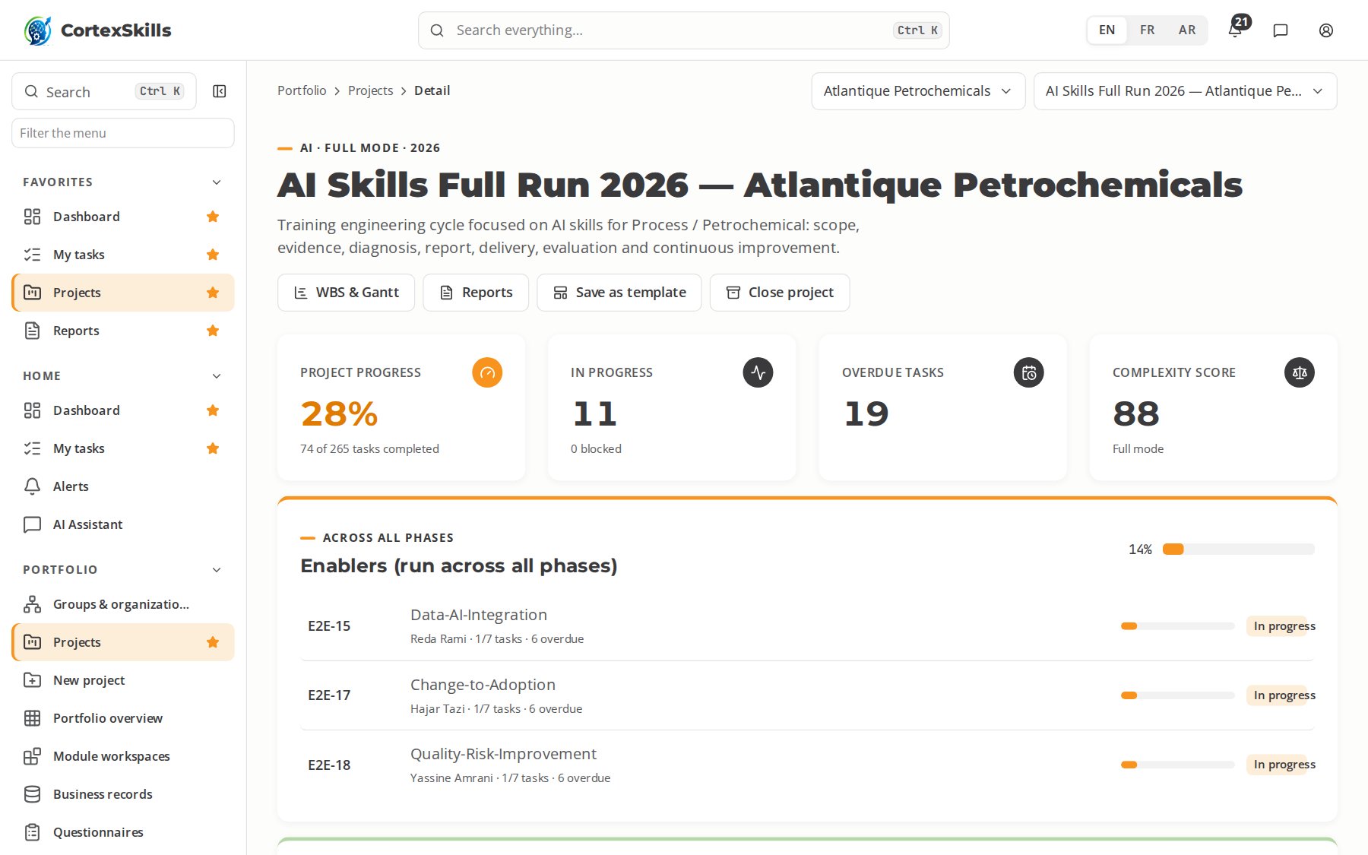
SECTOR · PETR
Process / Petrochemical
Process industries · Core function: Process Operations & Safety · ISO 45001, Seveso III, API RP 754
Large company — Atlantique Petrochemicals
SME — Chem Services Safi
Task completion by run (%)
Priority AI themes (large company)
AI process optimisation (APC)
AI corrosion and integrity prediction
ISO 45001
Priority digital themes (SME)
Digital permit-to-work
Operator training simulators (OTS)
Digital process safety management
POWERACT
Sector by sector
50

Slide 51

SECTOR · PETR
Process / Petrochemical — a process in progress
Atlantique Petrochemicals · AI run: the open task, its typed steps and what to type
POWERACT
Sector by sector
51

Slide 52
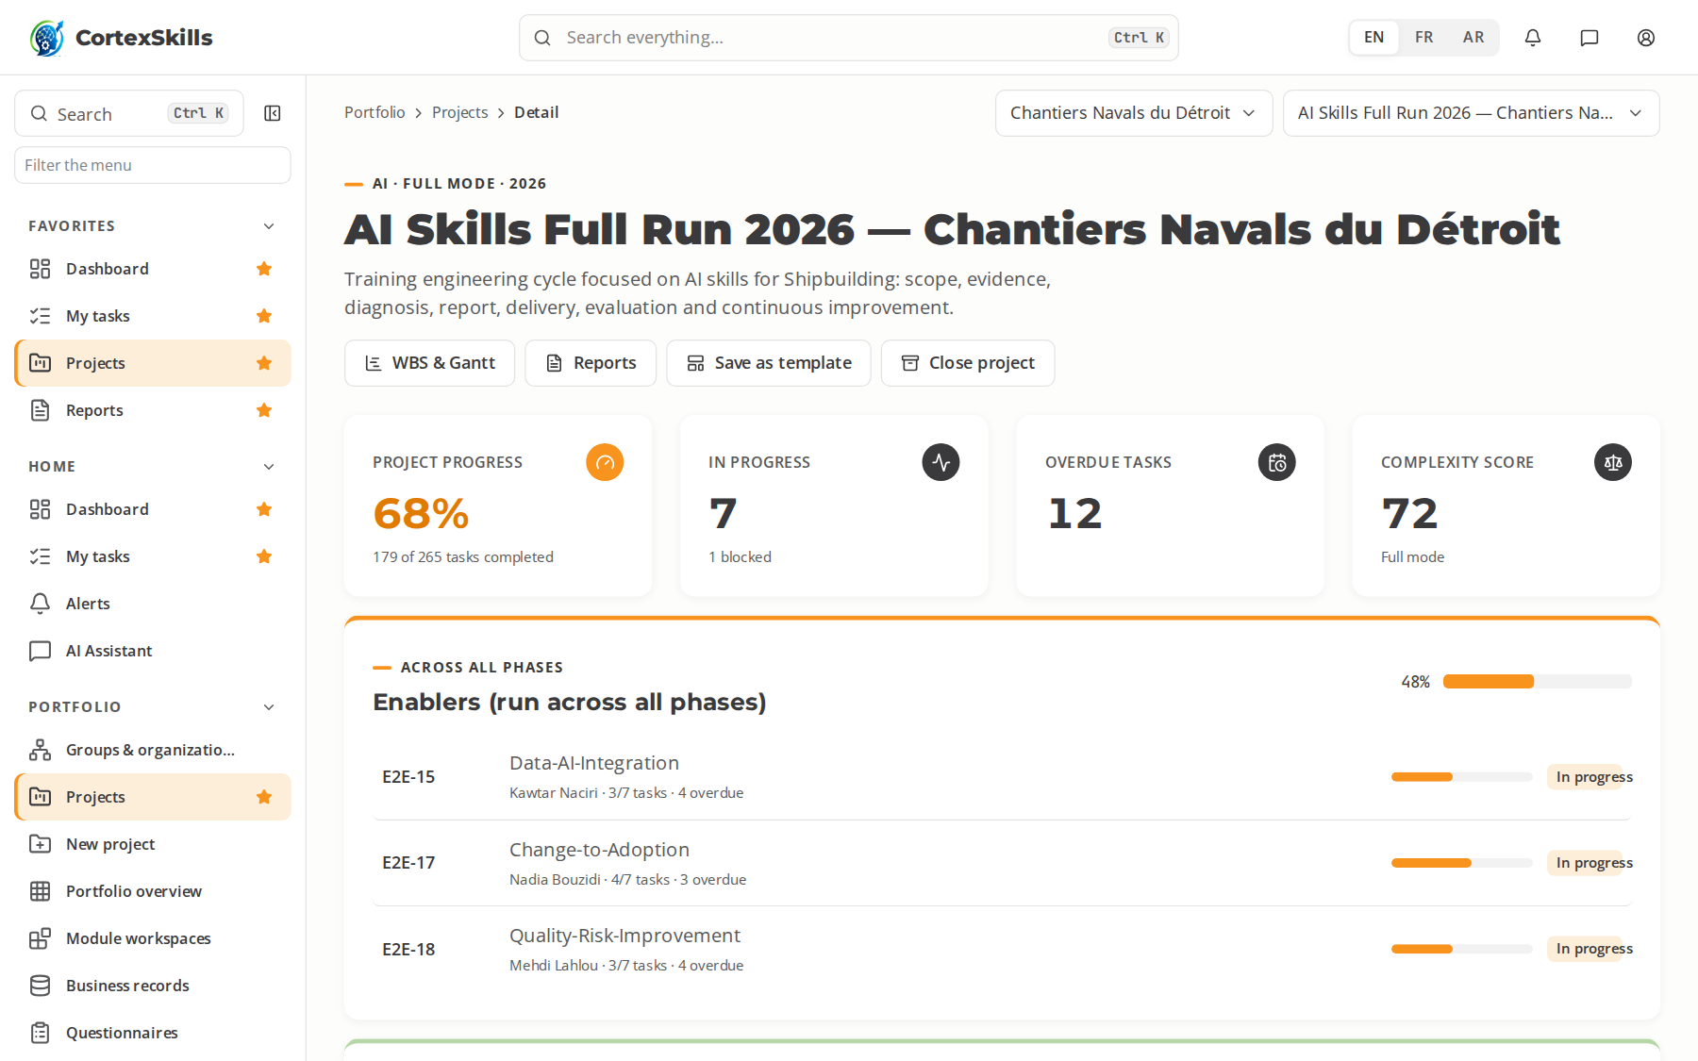
SECTOR · SHIP
Shipbuilding
Manufacturing · Core function: Hull Fabrication & Outfitting · ISO 9001, IACS UR, ISO 3834
Large company — Chantiers Navals du Détroit
SME — Marine Outfitting Agadir
Task completion by run (%)
Priority AI themes (large company)
AI weld-quality monitoring
AI nesting optimisation of steel plates
ISO 9001
Priority digital themes (SME)
3D ship design and production models
Digital welding qualification records
Block planning and digital scheduling
POWERACT
Sector by sector
52

Slide 53

SECTOR · SHIP
Shipbuilding — a process in progress
Chantiers Navals du Détroit · AI run: the open task, its typed steps and what to type
POWERACT
Sector by sector
53

Slide 54
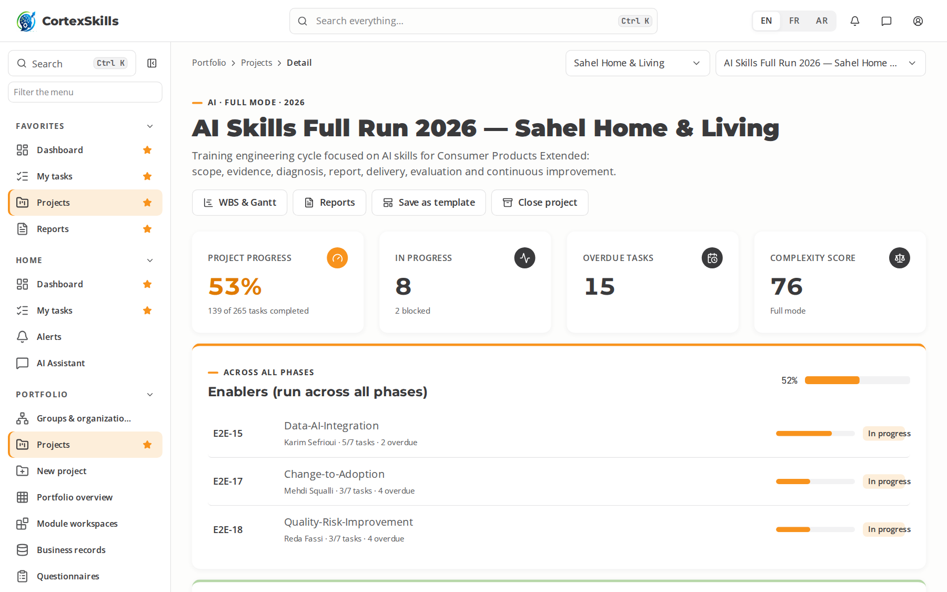
SECTOR · CPEX
Consumer Products Extended
Consumer & retail · Core function: Product Development & Sourcing · ISO 9001, ISO 10377, ISO 14001
Large company — Sahel Home & Living
SME — Poterie Safi Design
Task completion by run (%)
Priority AI themes (large company)
AI product-safety risk screening
AI review and sentiment analytics
ISO 9001
Priority digital themes (SME)
Digital product information management (PIM)
Supplier collaboration platforms
E-commerce marketplace operations
POWERACT
Sector by sector
54

Slide 55

SECTOR · CPEX
Consumer Products Extended — a process in progress
Sahel Home & Living · AI run: the open task, its typed steps and what to type
POWERACT
Sector by sector
55

Slide 56
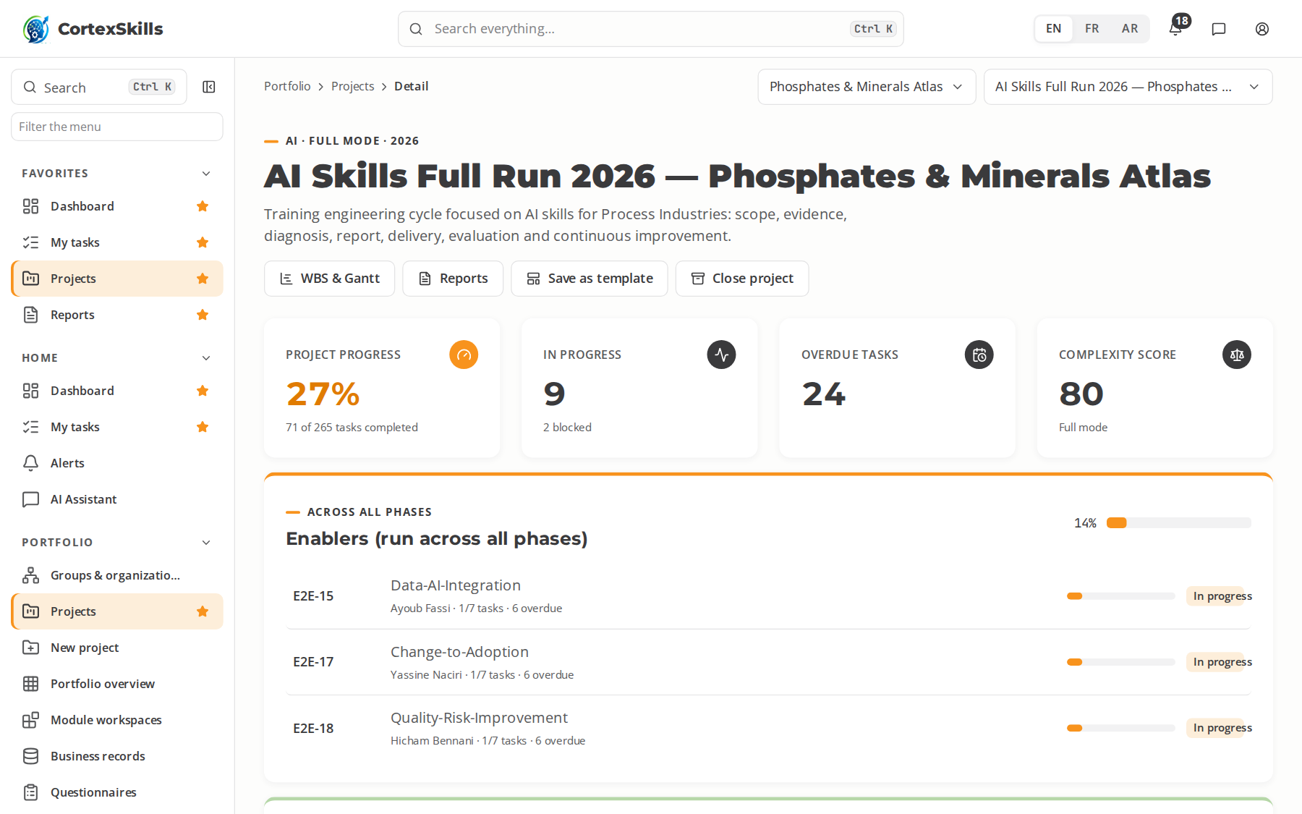
SECTOR · PROC
Process Industries
Process industries · Core function: Continuous Process Operations · ISO 9001, ISO 14001, ISO 45001
Large company — Phosphates & Minerals Atlas
SME — Minerals Lab Khouribga
Task completion by run (%)
Priority AI themes (large company)
AI soft sensors for quality
AI energy-efficiency optimisation
ISO 9001
Priority digital themes (SME)
DCS operation and digital logbooks
Laboratory information systems
Energy monitoring dashboards
POWERACT
Sector by sector
56

Slide 57

SECTOR · PROC
Process Industries — a process in progress
Phosphates & Minerals Atlas · AI run: the open task, its typed steps and what to type
POWERACT
Sector by sector
57

Slide 58
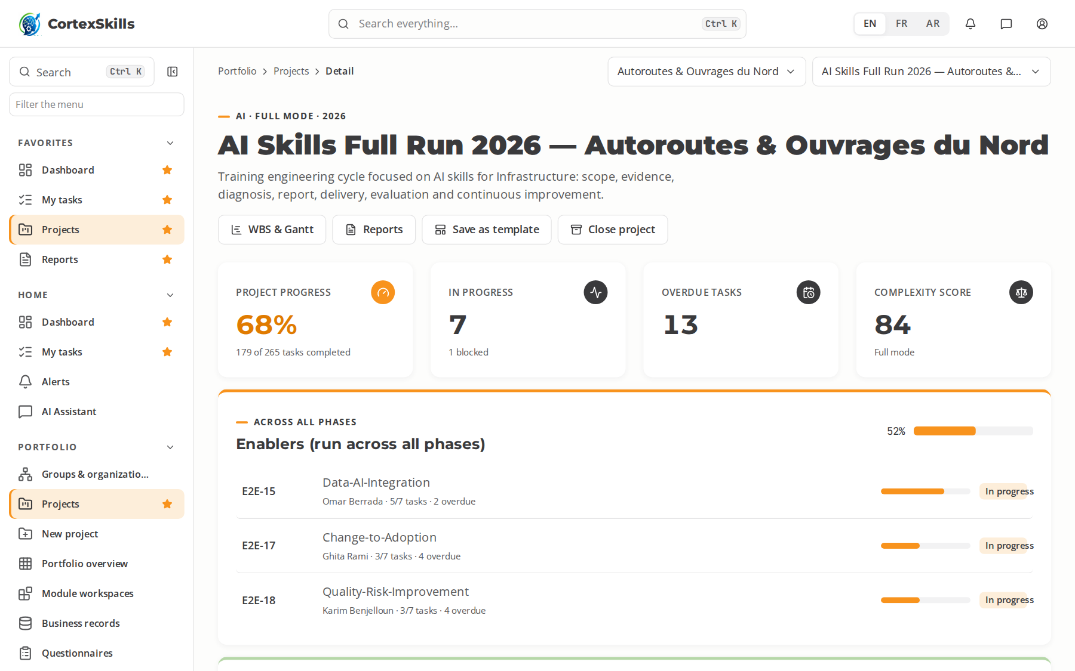
SECTOR · INFR
Infrastructure
Infrastructure & energy · Core function: Asset Management & Operations · ISO 55001, ISO 19650, ISO 45001
Large company — Autoroutes & Ouvrages du Nord
SME — Géo Inspect Maroc
Task completion by run (%)
Priority AI themes (large company)
AI structural health monitoring
AI traffic and demand modelling
ISO 55001
Priority digital themes (SME)
Digital asset registers and CMMS
Smart infrastructure sensors (IoT)
Digital inspection with tablets
POWERACT
Sector by sector
58

Slide 59
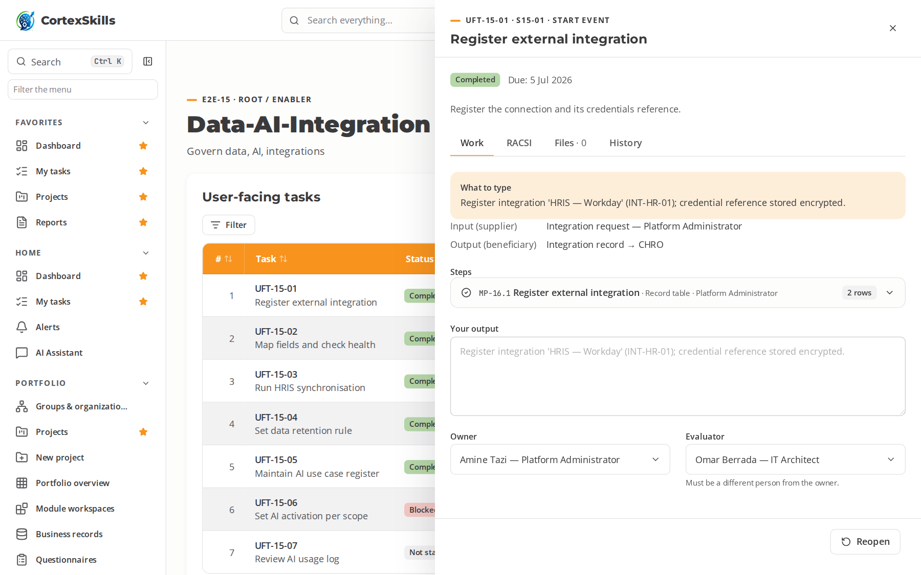
SECTOR · INFR
Infrastructure — a process in progress
Autoroutes & Ouvrages du Nord · AI run: the open task, its typed steps and what to type
POWERACT
Sector by sector
59

Slide 60
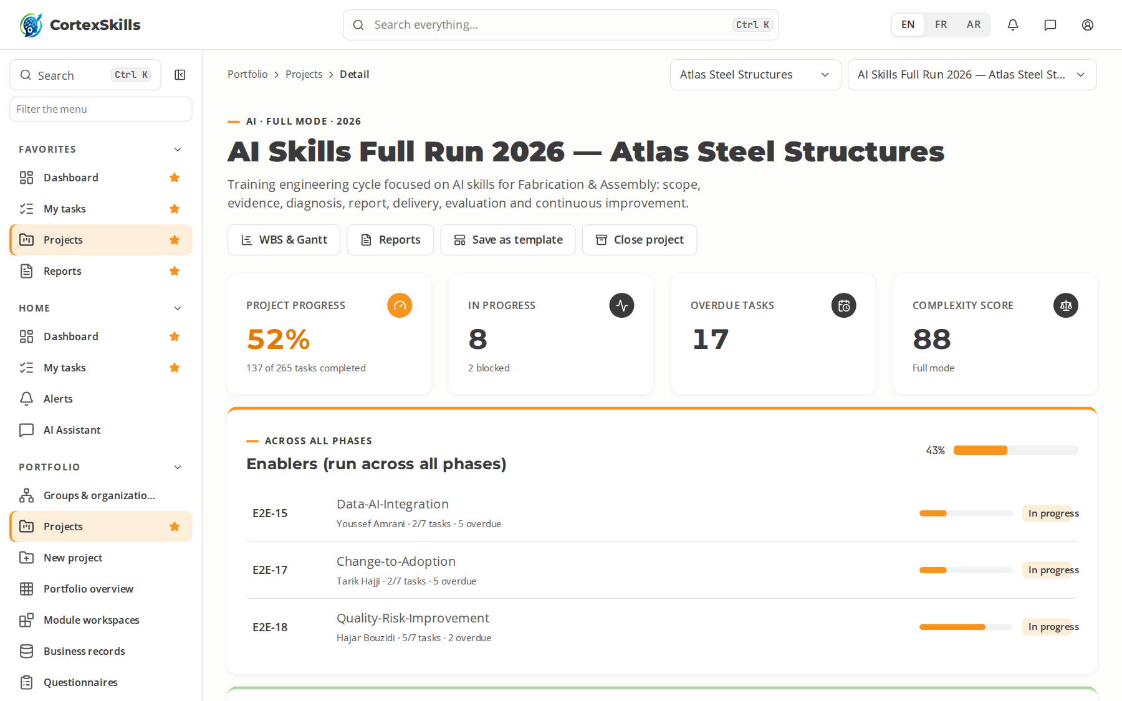
SECTOR · FABA
Fabrication & Assembly
Manufacturing · Core function: Metal Fabrication & Assembly · ISO 9001, ISO 3834, EN 1090
Large company — Atlas Steel Structures
SME — Atelier Métal Berrechid
Task completion by run (%)
Priority AI themes (large company)
AI cutting-plan optimisation
AI robot programming assistance
ISO 9001
Priority digital themes (SME)
Digital job cards and routing
CAD/CAM for sheet metal
Digital quality inspection records
POWERACT
Sector by sector
60

Slide 61
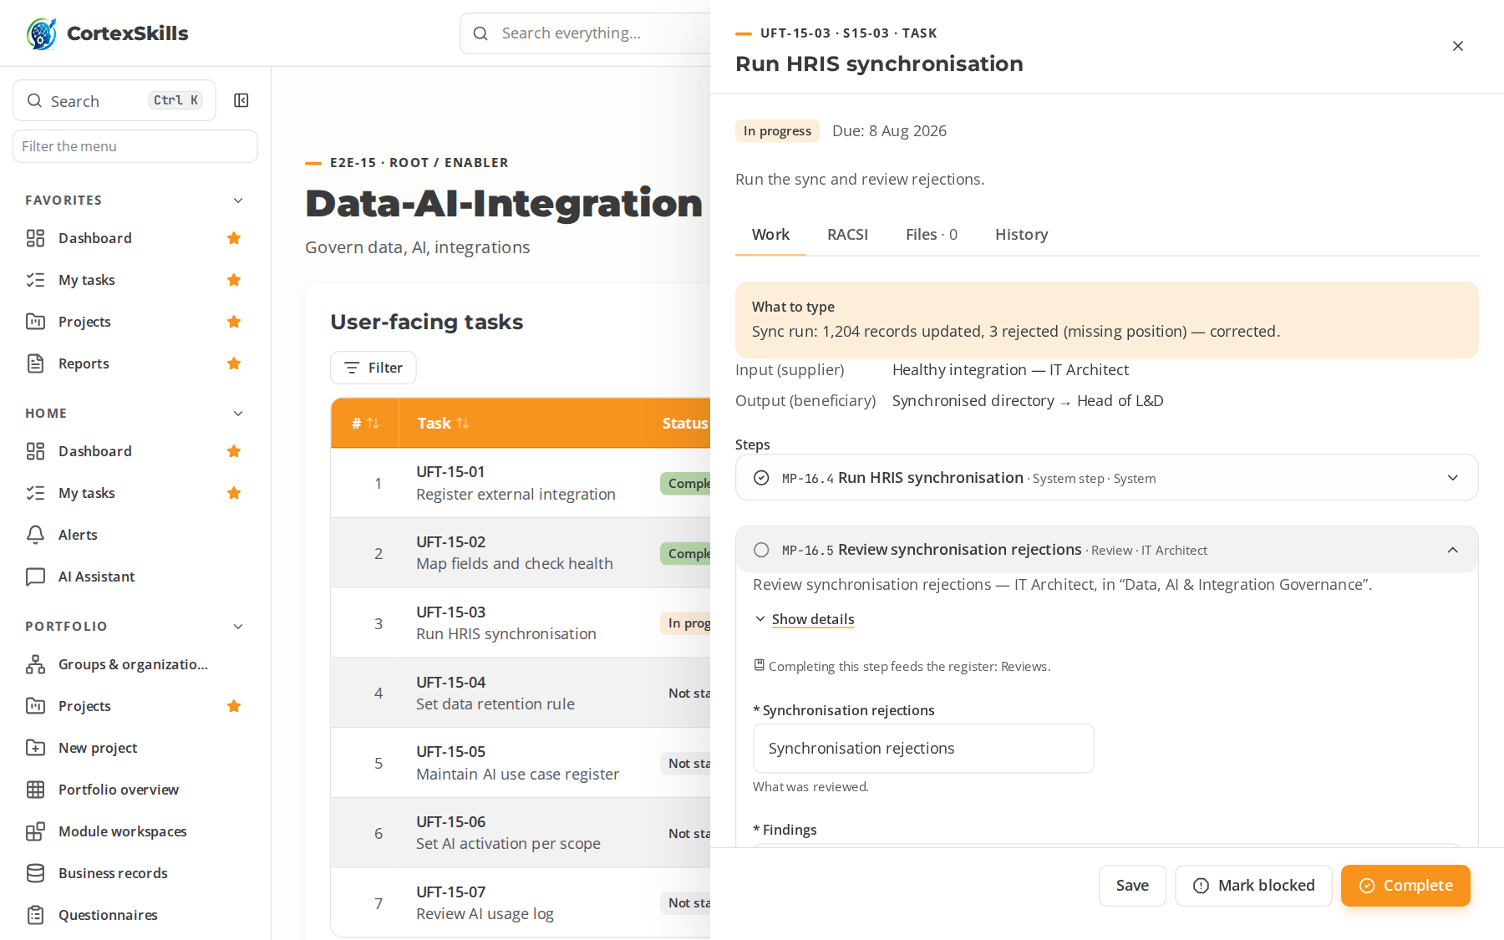
SECTOR · FABA
Fabrication & Assembly — a process in progress
Atlas Steel Structures · AI run: the open task, its typed steps and what to type
POWERACT
Sector by sector
61

Slide 62
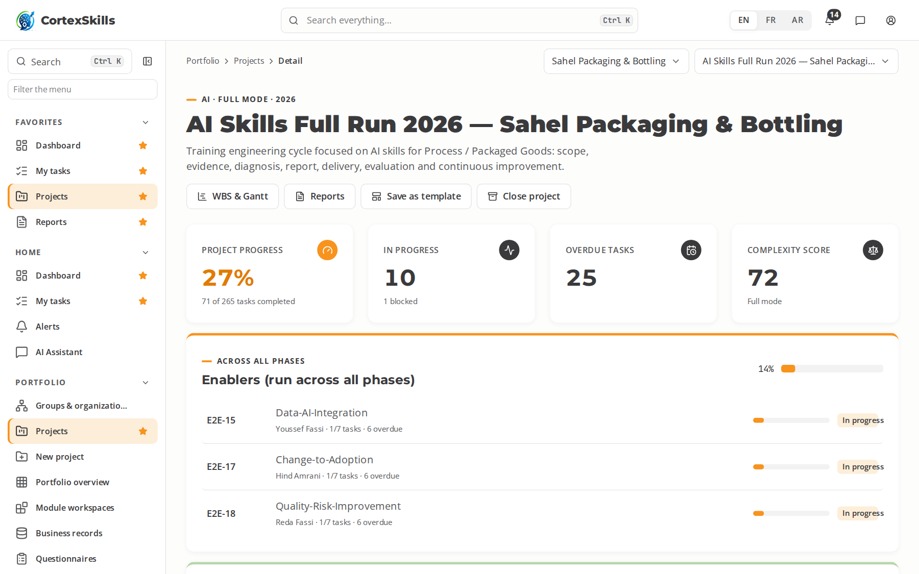
SECTOR · PKGD
Process / Packaged Goods
Process industries · Core function: Filling & Packaging Lines · ISO 22000, ISO 9001, BRCGS Packaging
Large company — Sahel Packaging & Bottling
SME — Emballages Kénitra
Task completion by run (%)
Priority AI themes (large company)
AI OEE loss analysis
AI vision for seal and label checks
ISO 22000
Priority digital themes (SME)
Line changeover digital checklists
Digital weight and fill control
Warehouse management system (WMS)
POWERACT
Sector by sector
62

Slide 63

SECTOR · PKGD
Process / Packaged Goods — a process in progress
Sahel Packaging & Bottling · AI run: the open task, its typed steps and what to type
POWERACT
Sector by sector
63

Slide 64
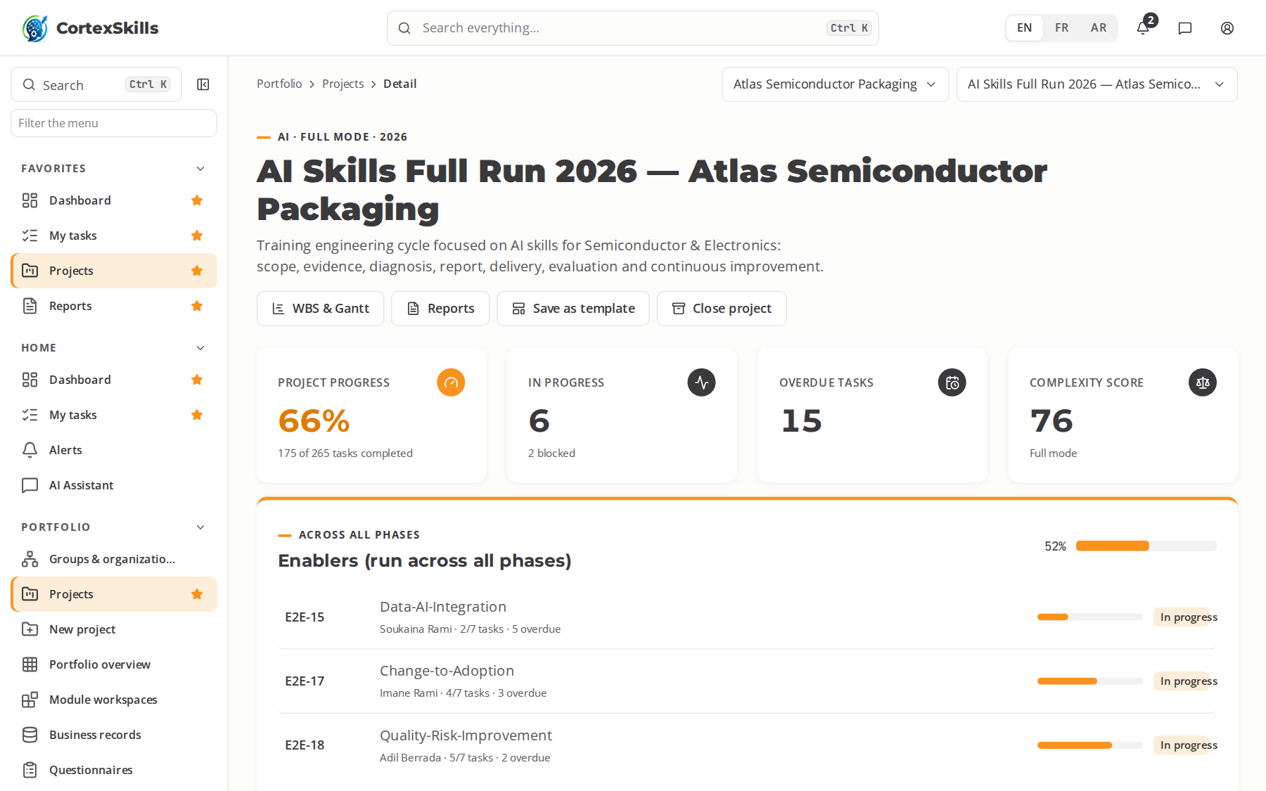
SECTOR · SEMI
Semiconductor & Electronics
Manufacturing · Core function: Cleanroom & Back-end Operations · ISO 9001, IATF 16949, ISO 14644
Large company — Atlas Semiconductor Packaging
SME — MicroTest Engineering
Task completion by run (%)
Priority AI themes (large company)
AI wafer-map defect classification
AI virtual metrology
ISO 9001
Priority digital themes (SME)
Cleanroom protocol digital training
Equipment automation (SECS/GEM)
Statistical process control (SPC) dashboards
POWERACT
Sector by sector
64

Slide 65

SECTOR · SEMI
Semiconductor & Electronics — a process in progress
Atlas Semiconductor Packaging · AI run: the open task, its typed steps and what to type
POWERACT
Sector by sector
65

Slide 66
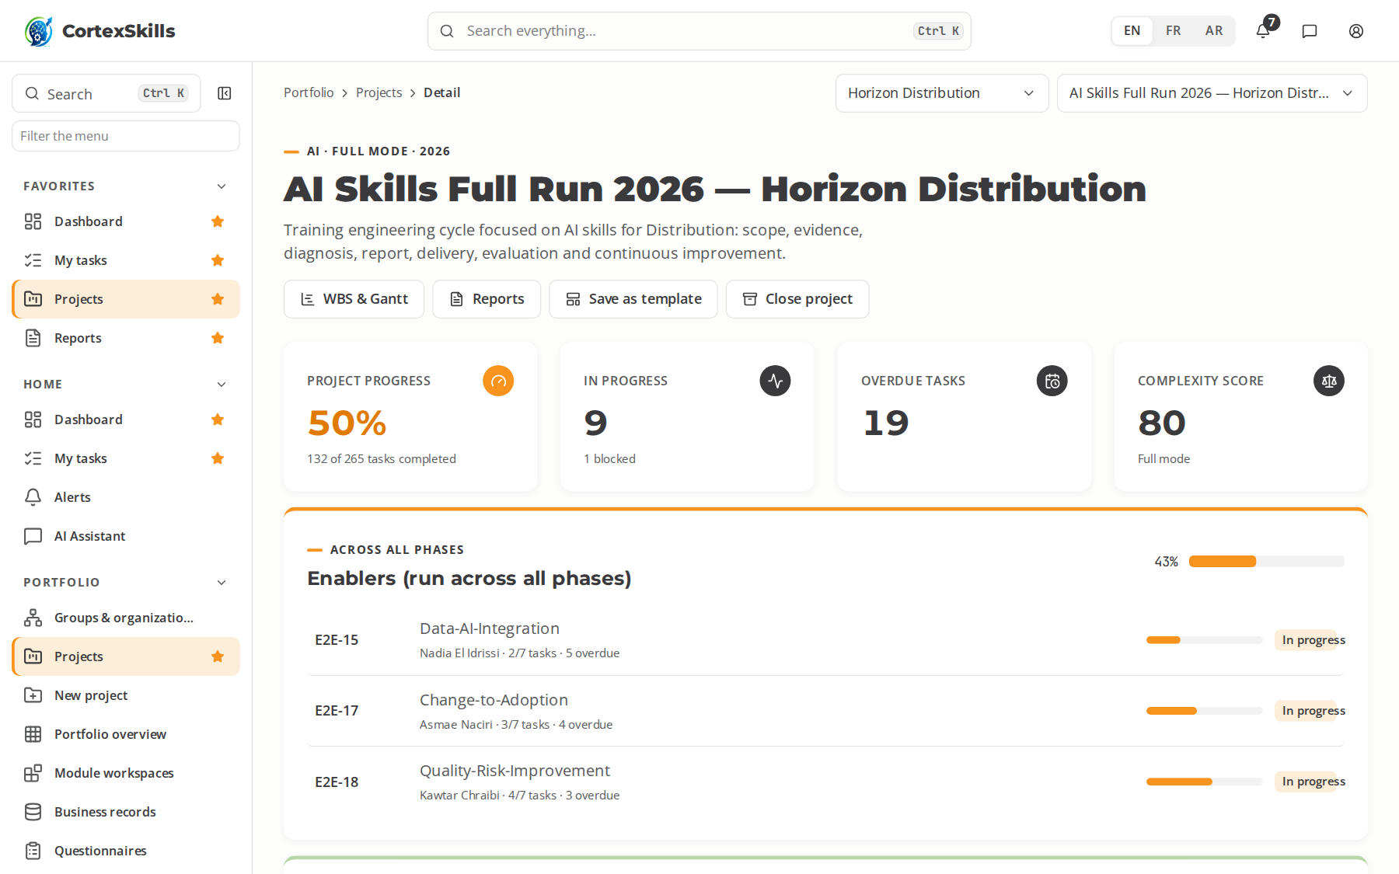
SECTOR · DIST
Distribution
Services · Core function: Sales & Distribution Network · ISO 9001, ISO 28000, ISO 39001
Large company — Horizon Distribution
SME — Distri Oriental
Task completion by run (%)
Priority AI themes (large company)
AI next-best-offer for sales reps
AI credit-risk scoring of customers
ISO 9001
Priority digital themes (SME)
Sales-force automation on mobile
B2B e-ordering portals
Route planning and telematics
POWERACT
Sector by sector
66

Slide 67

SECTOR · DIST
Distribution — a process in progress
Horizon Distribution · AI run: the open task, its typed steps and what to type
POWERACT
Sector by sector
67

Slide 68
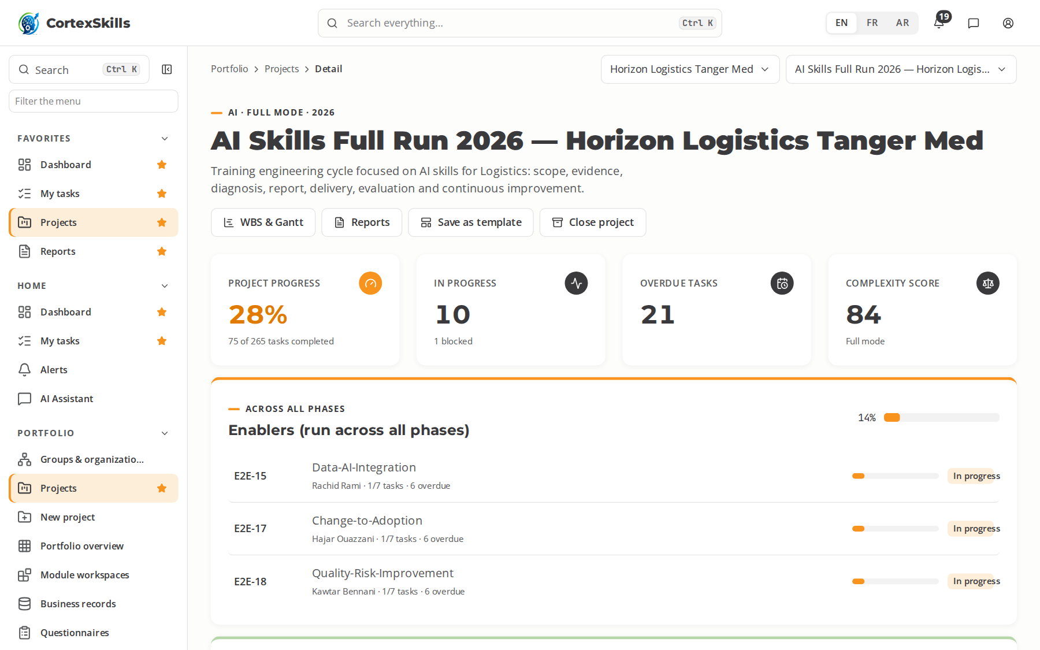
SECTOR · LOGI
Logistics
Services · Core function: Warehousing & Transport · ISO 9001, ISO 28000, TAPA FSR
Large company — Horizon Logistics Tanger Med
SME — Trans Atlas Express
Task completion by run (%)
Priority AI themes (large company)
AI warehouse slotting
AI ETA prediction
ISO 9001
Priority digital themes (SME)
WMS and RF scanning
Transport management system (TMS)
Digital customs and port community systems
POWERACT
Sector by sector
68

Slide 69
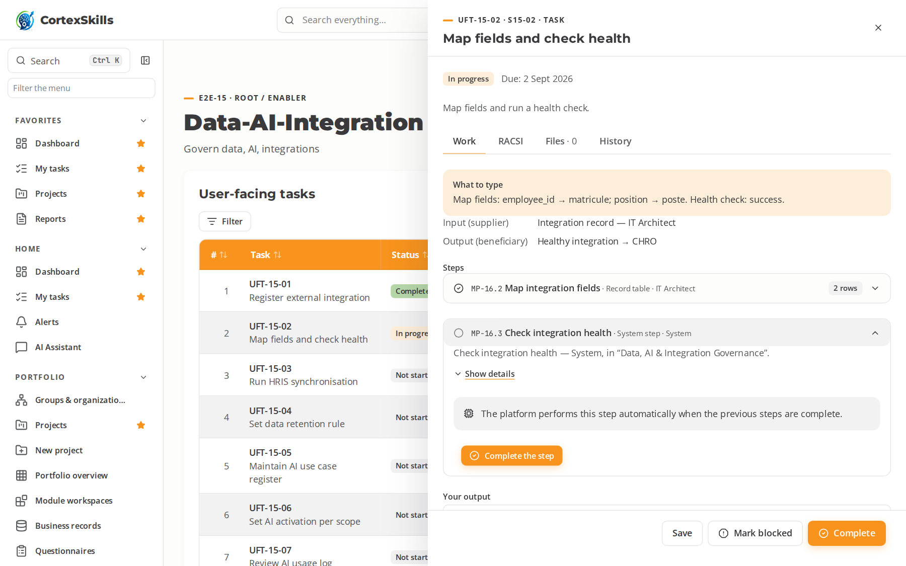
SECTOR · LOGI
Logistics — a process in progress
Horizon Logistics Tanger Med · AI run: the open task, its typed steps and what to type
POWERACT
Sector by sector
69

Slide 70
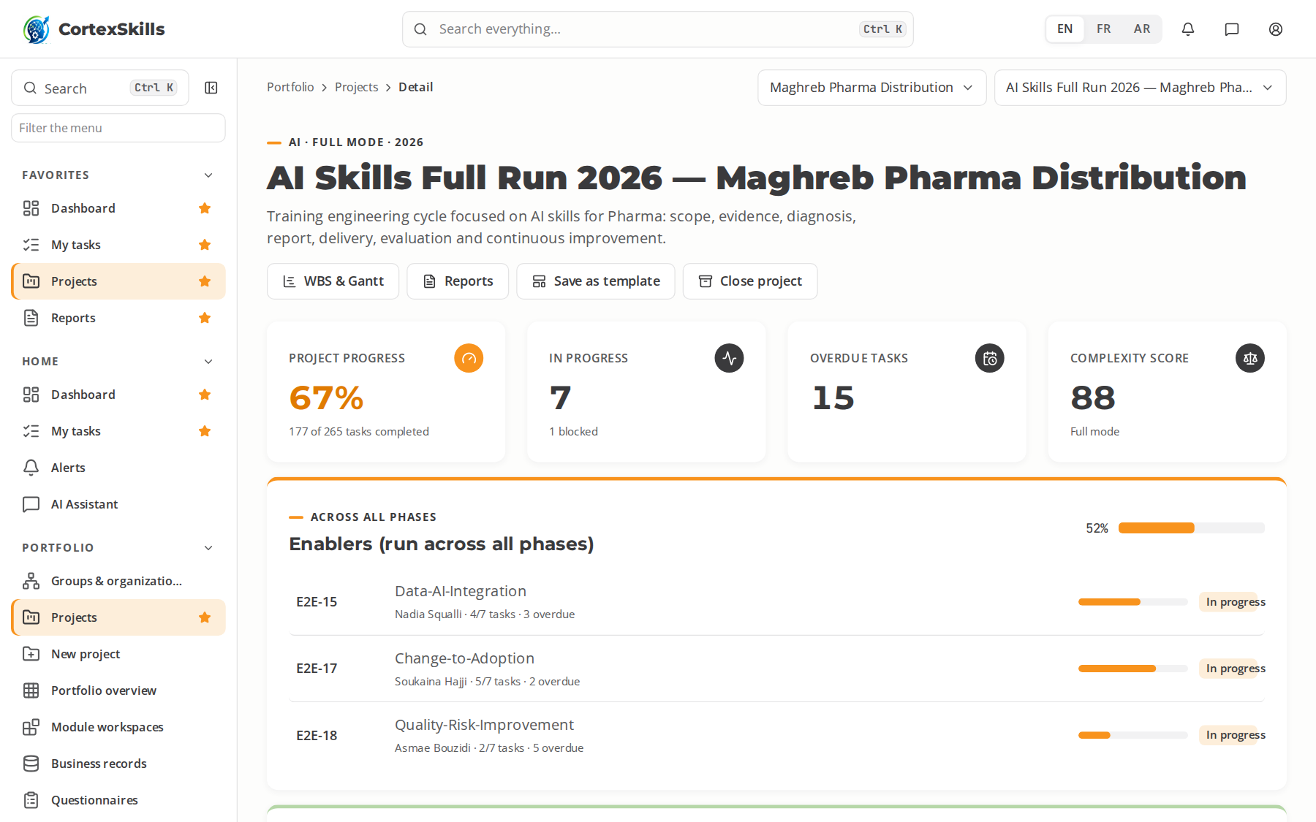
SECTOR · PHAR
Pharma
Health · Core function: Pharmaceutical Quality & Distribution · EU GMP, GDP, ICH Q9
Large company — Maghreb Pharma Distribution
SME — PharmaLog Services
Task completion by run (%)
Priority AI themes (large company)
AI regulatory-dossier drafting assistance
AI demand sensing for medicines
EU GMP
Priority digital themes (SME)
Serialization and track-and-trace
Digital GDP temperature monitoring
Regulatory information management (RIM)
POWERACT
Sector by sector
70

Slide 71
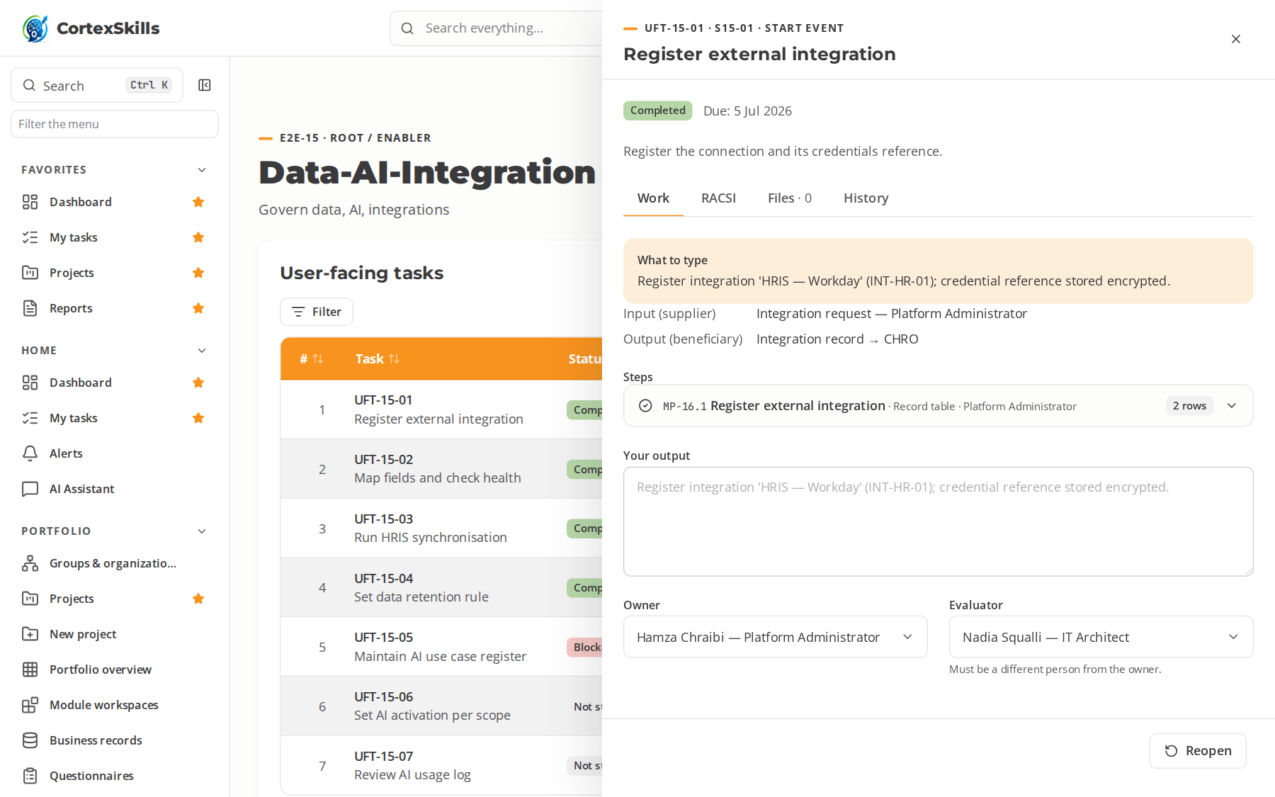
SECTOR · PHAR
Pharma — a process in progress
Maghreb Pharma Distribution · AI run: the open task, its typed steps and what to type
POWERACT
Sector by sector
71

Slide 72

SECTOR · MFGG
Manufacturing (Generic)
Manufacturing · Core function: Production & Maintenance · ISO 9001, ISO 45001, ISO 14001
Large company — Atlas Manufacturing Group
SME — Plasti Meknès
Task completion by run (%)
Priority AI themes (large company)
AI for continuous improvement (Kaizen)
AI visual quality control
ISO 9001
Priority digital themes (SME)
Lean digital (e-Kanban, digital 5S)
ERP and MRP fundamentals
Digital maintenance (CMMS)
POWERACT
Sector by sector
72

Slide 73

SECTOR · MFGG
Manufacturing (Generic) — a process in progress
Atlas Manufacturing Group · AI run: the open task, its typed steps and what to type
POWERACT
Sector by sector
73

Slide 74

SECTOR · PRED
Private Education
Public & social · Core function: Teaching & Academic Affairs · ISO 21001, ISO 9001, ISO/IEC 27001
Large company — Horizon Private Universities
SME — École Al Manar
Task completion by run (%)
Priority AI themes (large company)
AI tutoring and adaptive learning
Academic integrity with generative AI
ISO 21001
Priority digital themes (SME)
Learning management systems for teachers
Digital assessment and e-portfolios
Student information systems
POWERACT
Sector by sector
74

Slide 75

SECTOR · PRED
Private Education — a process in progress
Horizon Private Universities · AI run: the open task, its typed steps and what to type
POWERACT
Sector by sector
75

Slide 76

SECTOR · PUED
Public Education
Public & social · Core function: Schools & Teaching Staff · ISO 21001, ISO 9001, Public accessibility standards
Large company — Académie Régionale Rabat-Salé
SME — Lycée Pilote Ibn Sina
Task completion by run (%)
Priority AI themes (large company)
AI-assisted lesson planning
AI for inclusive and special-needs education
ISO 21001
Priority digital themes (SME)
Digital classroom tools
School management information systems
Digital citizenship and online safety
POWERACT
Sector by sector
76

Slide 77

SECTOR · PUED
Public Education — a process in progress
Académie Régionale Rabat-Salé · AI run: the open task, its typed steps and what to type
POWERACT
Sector by sector
77

Slide 78

SECTOR · HCPR
Healthcare Providers
Health · Core function: Clinical Care & Nursing · ISO 7101, JCI Standards, ISO 15189
Large company — Maghreb Hospitals Group
SME — Clinique Al Amal
Task completion by run (%)
Priority AI themes (large company)
AI triage and clinical decision support
AI medical imaging assistance
ISO 7101
Priority digital themes (SME)
Electronic health records (EHR)
Telemedicine and remote consultation
Digital patient scheduling and billing
POWERACT
Sector by sector
78

Slide 79

SECTOR · HCPR
Healthcare Providers — a process in progress
Maghreb Hospitals Group · AI run: the open task, its typed steps and what to type
POWERACT
Sector by sector
79

Slide 80
WHAT THE DATA SHOWS
Progress of the AI runs, by sector
Large companies, share of tasks completed in the AI skills run.
Share of tasks completed in the AI run of each large company (%)
POWERACT
What the data shows
80

Slide 81



NEXT STEPS
Start your own run
Install: two folders, three commands each (Installation Guide).
Sign in with a demonstration account and follow the User Guide.
Replace the demonstration organization with yours: Group, Organization, then Project.
POWERACT
Next steps
81

