Slide 1
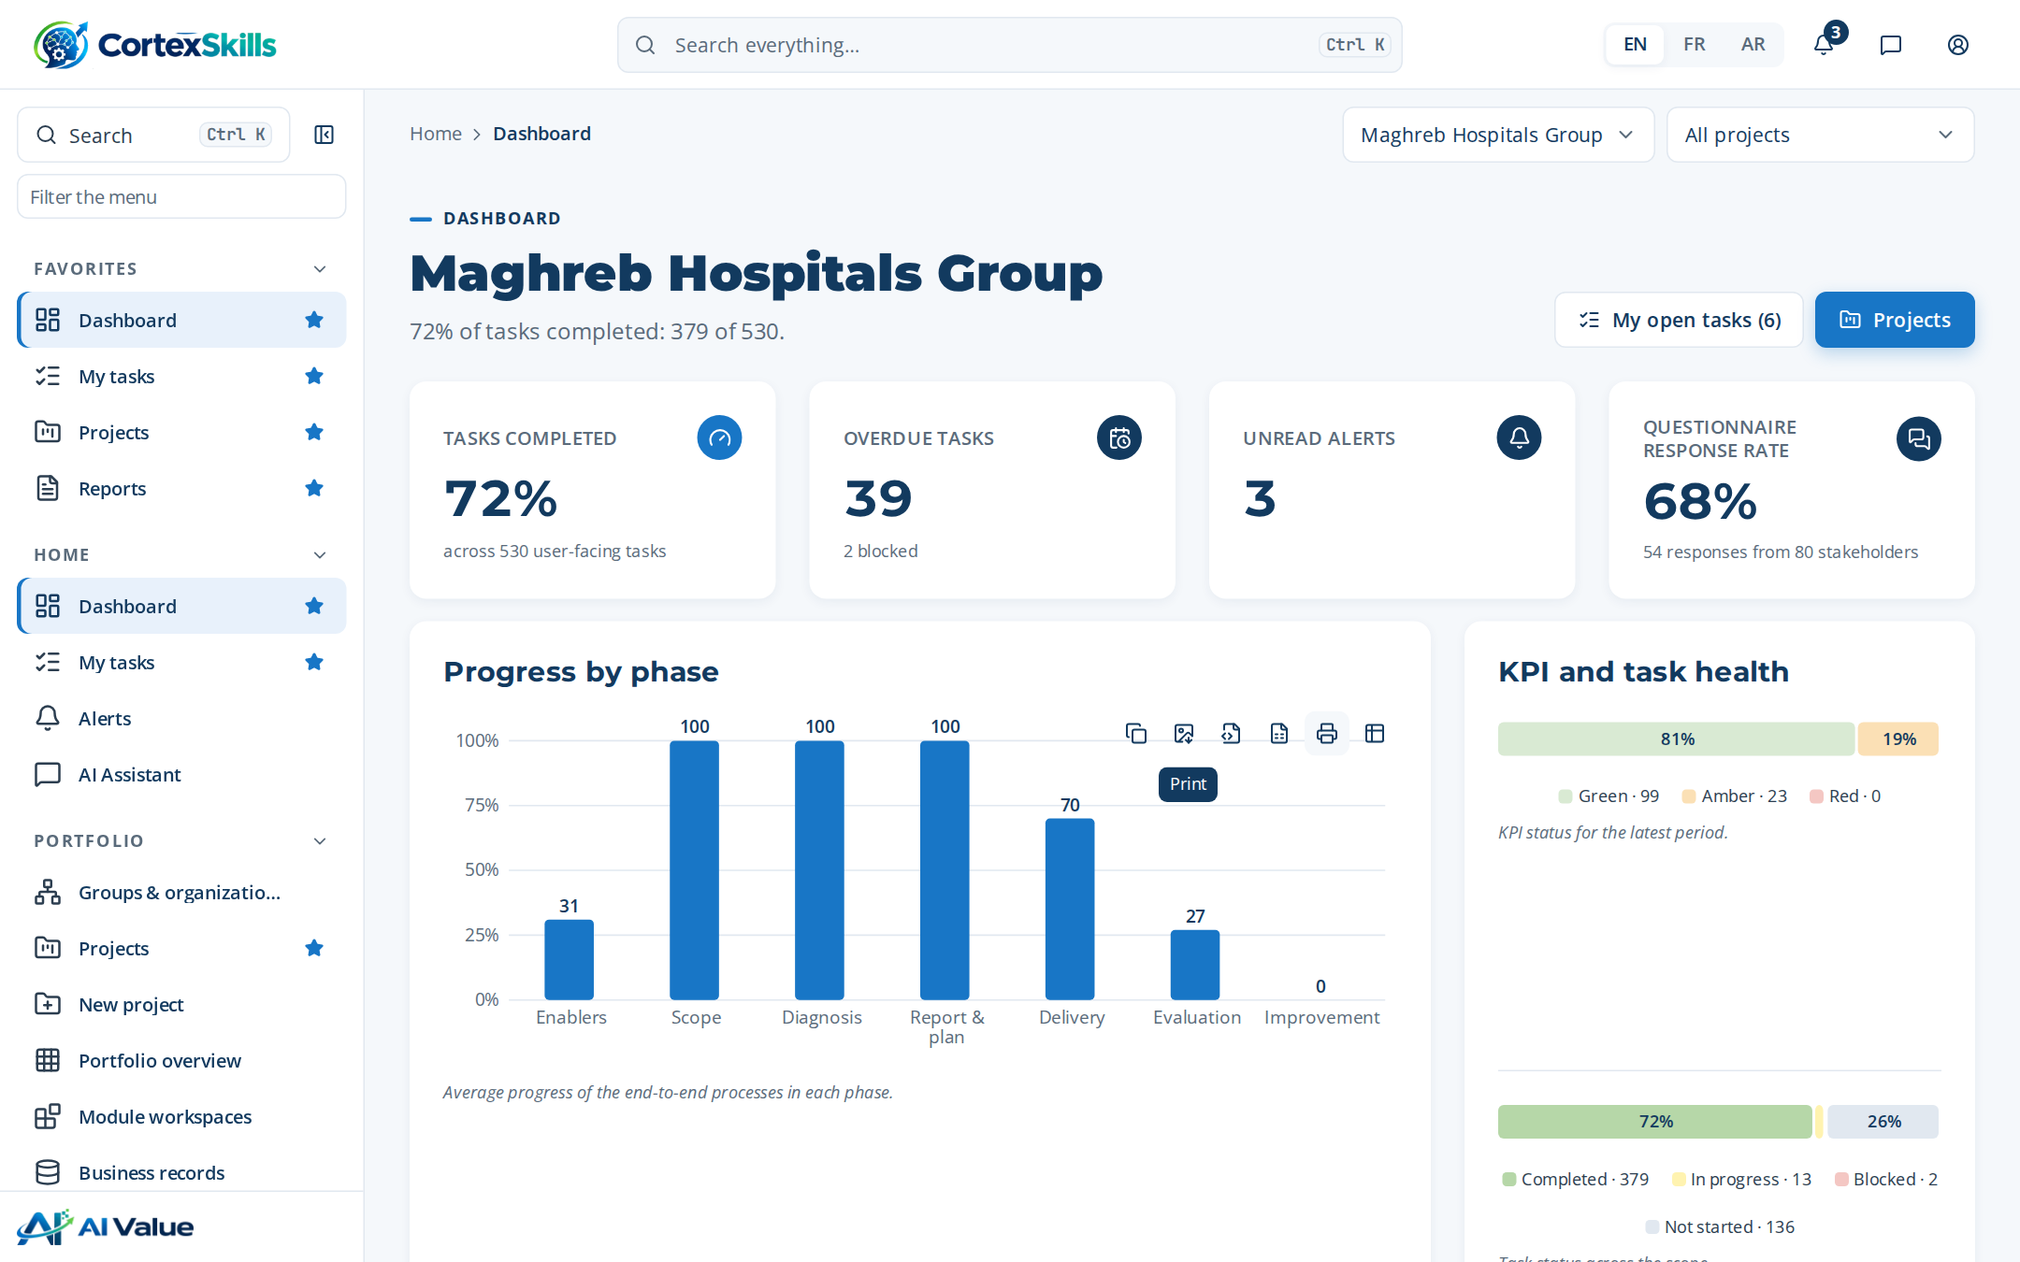
POWERACT
CUSTOMER PRESENTATION · HEALTHCARE · 2026
CortexSkills for Healthcare
Training engineering for hospitals and clinics — from accreditation requirements to certified, evaluated staff
POWERACT Consulting

Slide 2






AGENDA
What this presentation covers
01
02
03
The healthcare challenge
The solution
Case study: hospital group
Accreditation, patient safety and new skills
Lifecycle, gates, healthcare processes
A full AI skills run, phase by phase
04
05
06
Case study: a clinic
The health ecosystem
Trust and next steps
The same method on an SME track
Life sciences and pharma
Security, deployment, packs, plan
POWERACT
Agenda
2

Slide 3







EXECUTIVE SUMMARY
One hospital group, one AI skills run, measured end to end
Maghreb Hospitals Group · 4,700 employees · Casablanca · figures from the seeded demonstration run
65%
3 of 6
28
1,260,000
of 265 tasks completed in the AI skills run
phase gates signed off with a “Go” decision
questionnaire responses, 91% average completeness
training budget in the locked 2026 plan
What the run shows
Diagnosis flagged 5 of 21 function × decision-level cells as Red; Clinical Care & Nursing is Red at strategic and operational levels.
Six AI themes were prioritized by impact and urgency; “AI triage and clinical decision support” ranks first (impact 5, urgency 4).
Kirkpatrick evaluations range from 74% to 93%; one ISO 7101 awareness certificate has expired and one is expiring.
Every one of the 279 RACSI activities has exactly one Accountable; 385 audit entries trace the changes.
POWERACT
Executive summary · Demonstration data — fictional organization
3

Slide 4
01
The healthcare challenge
Accreditation, patient safety and the shift to digital and AI
POWERACT

Slide 5


HEALTHCARE PROVIDERS
Patient safety depends on proven competence
The accreditation bodies ask for evidence that each role is trained, assessed and current.
ISO 7101
JCI Standards
ISO 15189
Healthcare quality management: competence determined per role, training records kept, effectiveness evaluated.
Accreditation surveys check staff qualification and education, with evidence at the level of each practitioner.
Medical laboratories: competence of laboratory personnel, assessed and recorded.
SECTOR DRIVER
SECTOR RISK
Patient-safety accreditation burden
Adverse clinical event linked to a training gap
Every accreditation cycle requires competence evidence for regulated roles.
Reviewed at each gate through the healthcare readiness checklist.
POWERACT
The healthcare challenge
5

Slide 6



FOUR CHALLENGES
What Learning & Development teams in hospitals must solve
Clinical competence
Audit-ready evidence
Digital and AI adoption
Multi-site, multilingual
Map every Clinical Care & Nursing position to its obligations and keep certificates valid.
Attendance, results and manager observations kept per step, retrievable for a survey.
Electronic records, telemedicine, AI triage and imaging change daily practice.
Several sites and three working languages — English, French and Arabic.
POWERACT
The healthcare challenge
6

Slide 7
THE HEALTH ECOSYSTEM
Four healthcare verticals, each with its own standards
Each vertical brings its macro processes, end-to-end processes and readiness checklist.
HCPR
HLS
PHAR
PHPR
Healthcare Providers
Healthcare & Life Sciences
Pharma
Pharmaceutical & Process
Standards
Standards
Standards
Standards
ISO 7101
JCI Standards
ISO 15189
ISO 13485
EU MDR
ISO 15189
EU GMP
GDP
ICH Q9
EU GMP
ICH Q10
FDA 21 CFR Part 11
Core function
Core function
Core function
Core function
Clinical Care & Nursing
Clinical & Laboratory Operations
Pharmaceutical Quality & Distribution
GMP Manufacturing
Demo: Maghreb Hospitals Group
Demo: Maghreb Life Sciences
Demo: Maghreb Pharma Distribution
Demo: Pharma Maghreb Process
POWERACT
The healthcare challenge
7

Slide 8

HEALTHCARE PROVIDERS
Priority skills themes, digital and AI
Seeded for the Healthcare Providers vertical; each organization adjusts them during diagnosis.
Digital skills
AI skills
1
Electronic health records (EHR)
1
AI triage and clinical decision support
2
Telemedicine and remote consultation
2
AI medical imaging assistance
3
Digital patient scheduling and billing
3
AI bed and staff capacity planning
POWERACT
The healthcare challenge
8

Slide 9
02
The solution
One lifecycle, seven phases, gates, and healthcare-specific processes
POWERACT

Slide 10

THE LIFECYCLE
One lifecycle, seven phases
Each phase groups end-to-end processes; a gate closes each main phase.
1
2
3
4
5
6
Scope & evidence
Diagnosis
Training Engineering Report & plan
Design & delivery
Evaluation, compliance & impact
Talent, knowledge & continuous improvement
4 processes
8 processes
6 processes
5 processes
3 processes
4 processes
G1
G2
G3
G4
G5
G6
Enablers run across all phases — data, AI and integration · change and adoption · quality, risk and improvement
POWERACT
The solution
10

Slide 11
GATES
Six gates, each with a checklist and named approvers
A phase closes only when the mandatory items are met and the decision is recorded.
Gate | Purpose | Approvers
G1 — Scope & evidence approved | Confirm the approved Scope of Work and a consolidated questionnaire dataset. | HR Director, Consultant PM
G2 — Diagnostic validated | Validate diagnostic findings, gaps, demands, RAG and SWOT. | Head of L&D, HR Director
G3 — Report & roadmap approved | Approve the Training Engineering Report, prioritized plan and budget. | HR Director, Steering Committee
G4 — Delivery readiness | Confirm designs, content, trainers and logistics before delivery. | Head of L&D
G5 — Evaluation & impact validated | Validate effectiveness, ROI and compliance status. | Head of L&D, Finance Manager
G6 — Closure & continuous improvement | Close the cycle with REX and the post-engagement roadmap. | HR Director, Partner
POWERACT
The solution
11

Slide 12

HEALTHCARE PROCESSES
Three healthcare macro processes on top of the core model
Added automatically when the organization’s sector is Healthcare Providers.
HCPR-MP-01
HCPR-MP-02
HCPR-MP-03
Regulatory & Safety Training Compliance
Critical Skills & Certification Framework
Digital & AI Skills Transformation
Keep every regulated role in Healthcare Providers trained and certified against ISO 7101.
Define the critical Clinical Care & Nursing skills and their certification paths.
Plan the digital and AI skills that Healthcare Providers operations will need.
Owner: Compliance Officer
Owner: Head of L&D
Owner: L&D Strategist
POWERACT
The solution
12

Slide 13
HEALTHCARE PROCESSES
Two healthcare end-to-end processes
Each has a trigger, an end state, the macro processes it crosses and its user-facing tasks.
HCPR-E2E-01
HCPR-E2E-02
Compliance-to-Certification Readiness
Critical-Skills-to-Transformation Plan
Goal
Keep Healthcare Providers regulated roles certified against ISO 7101.
Goal
Turn critical-skill gaps and digital and AI use cases into a transformation plan.
Trigger
New ISO 7101 requirement or certification expiry.
Trigger
Annual plan cycle or technology change in Healthcare Providers.
End state
Sector compliance extract issued with every critical role certified.
End state
Transformation learning paths approved.
Crosses
MP-01 · MP-02 · MP-14 · HCPR-MP-01
Crosses
MP-02 · MP-03 · MP-05 · HCPR-MP-02
Tasks
4 user-facing tasks
Tasks
4 user-facing tasks
POWERACT
The solution
13

Slide 14
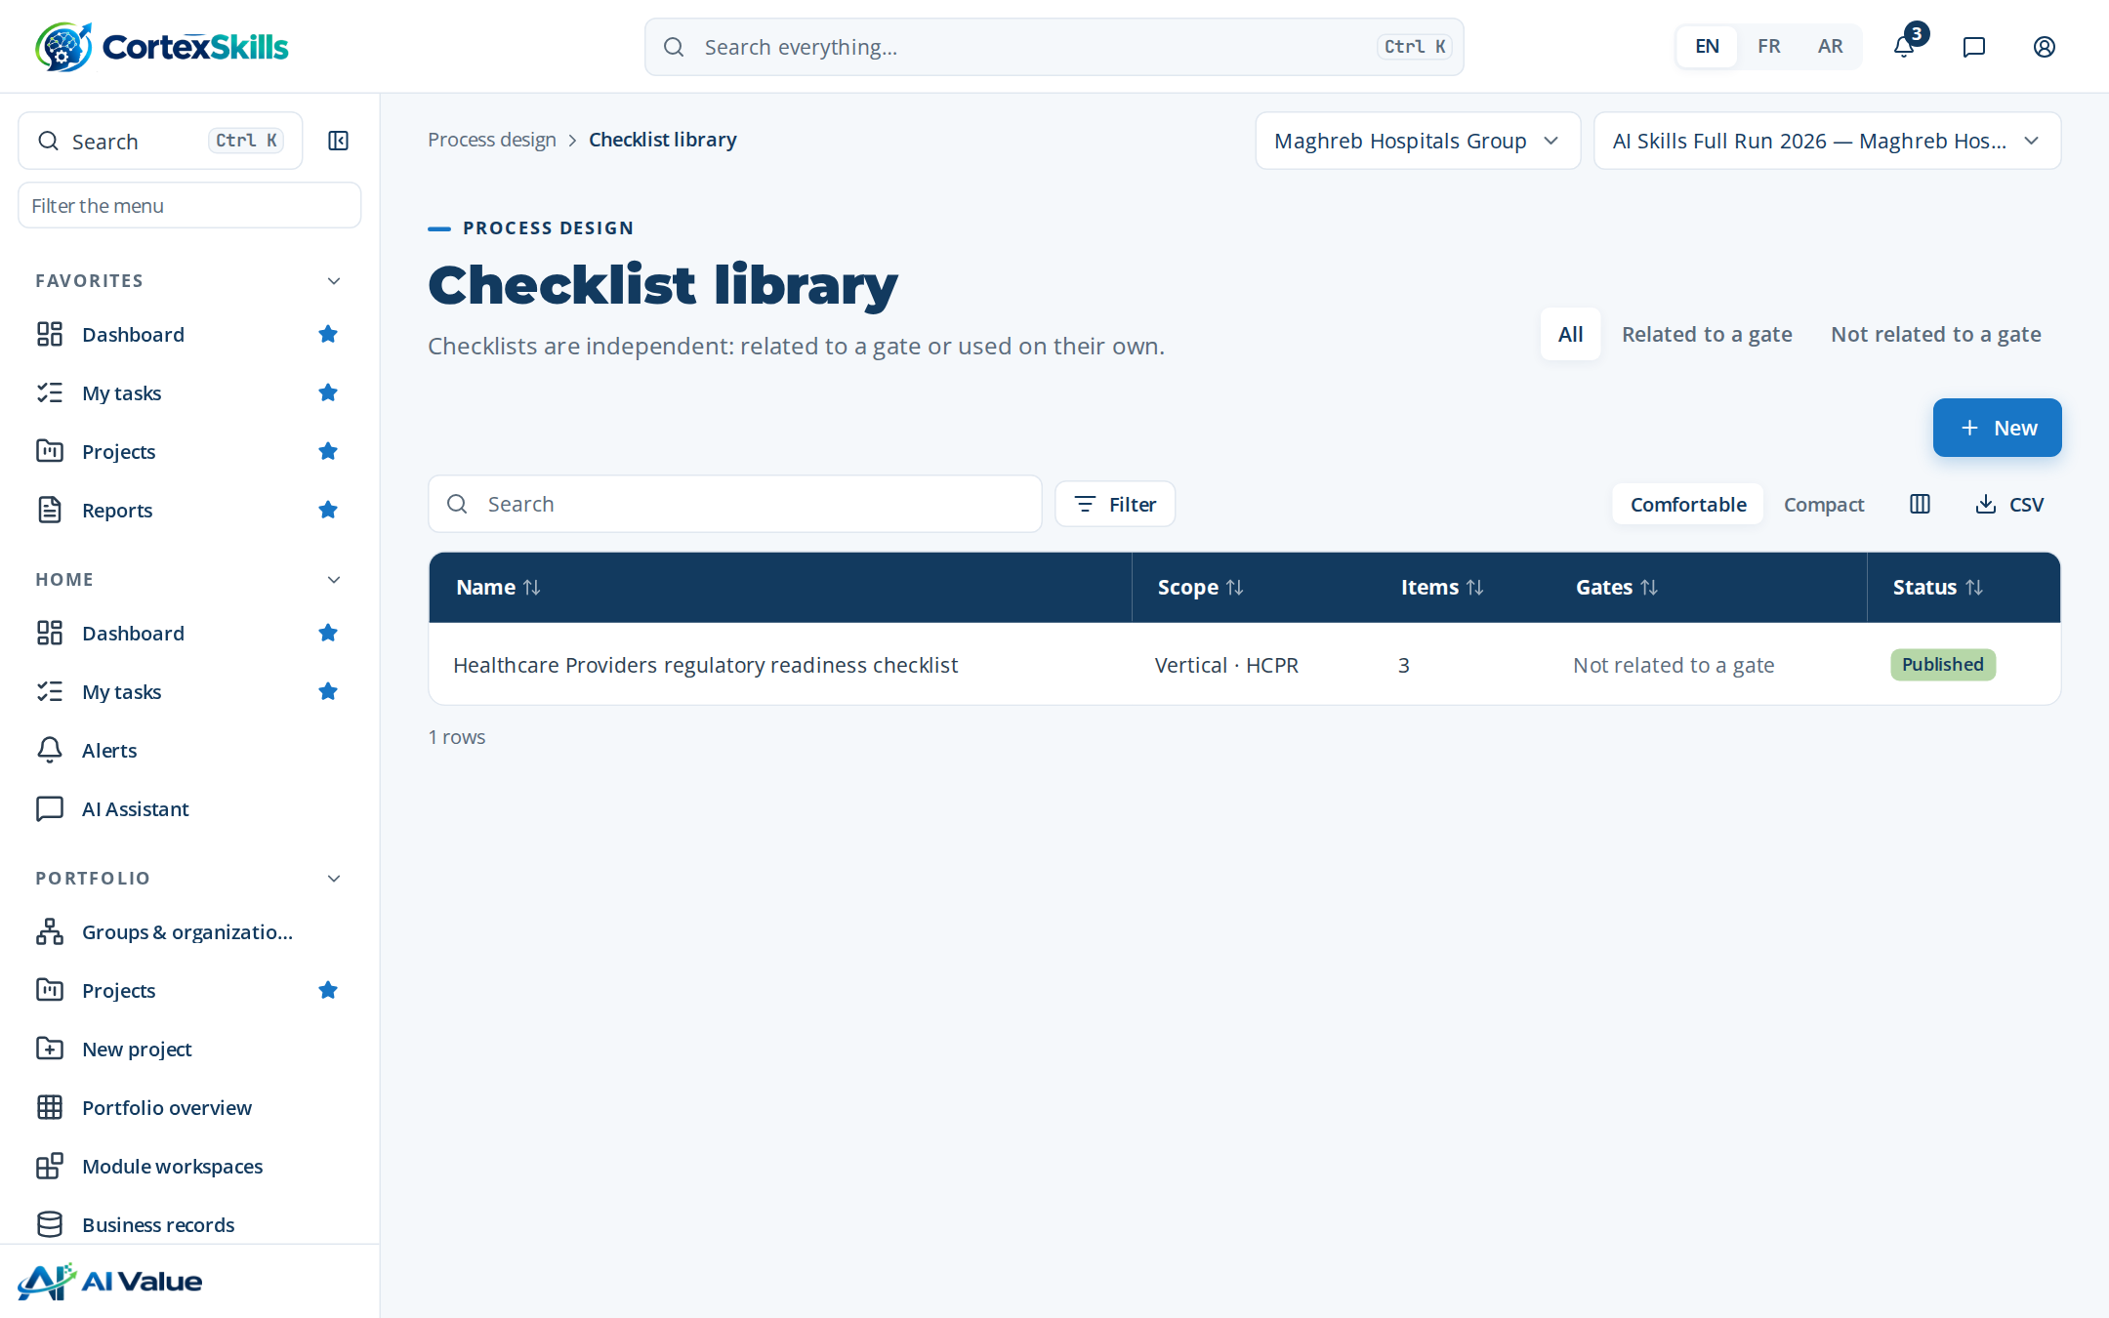

COMPLIANCE SCAFFOLDING
A readiness checklist for Healthcare Providers
Published once for the vertical; used at the gates and in the compliance extract.
Checklist item | Mandatory | Evidence
ISO 7101 training requirements mapped to positions | Yes | Required
Critical Clinical Care & Nursing roles certified | Yes | Required
Sector risk reviewed: Adverse clinical event linked to a training gap | Yes | —
Readiness support, not certification
The application organizes evidence and checks readiness against ISO 7101, JCI and ISO 15189. The certification decision stays with the accreditation body.
POWERACT
The solution
14

Slide 15
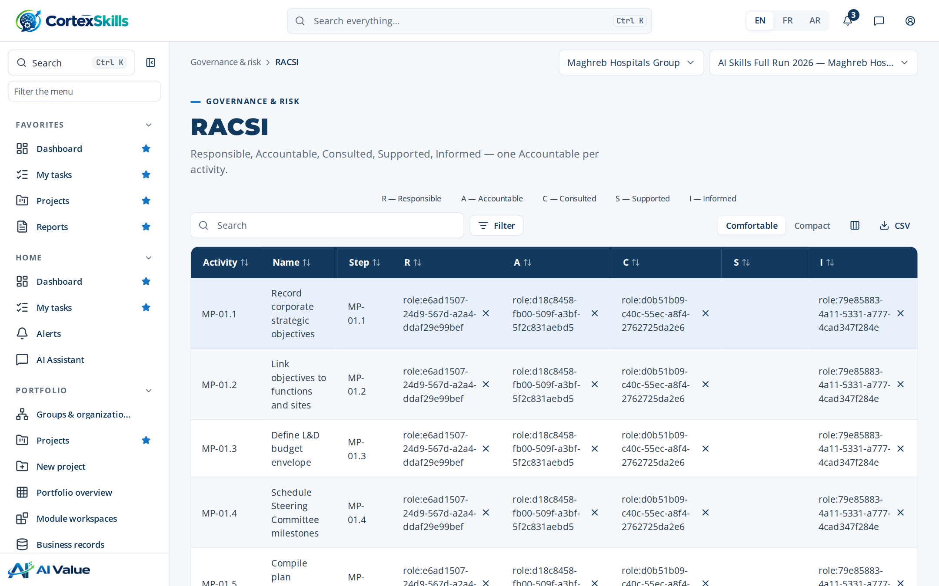

ROLES AND ACCOUNTABILITY
29 roles, one Accountable per activity
RACSI: Responsible, Accountable, Consulted, Supported, Informed — allocated for every activity of the run.
Examples of roles
HR Director / Steering Committee Chair
Head of L&D
L&D Analyst
L&D Strategist
L&D Business Partner
L&D Planner
Instructional Designer
Training Administrator
279
activities in the hospital run, each with exactly one Accountable
POWERACT
The solution
15

Slide 16
AI WITH A HUMAN CHECKPOINT
36 AI use cases, each reviewed by a person
AI drafts; a named role accepts, edits or rejects. Every suggestion is logged with its outcome.
Use case | Risk | Human checkpoint
Training Engineering Report drafting | High | L&D Strategist edits every section; Quality Manager reviews before approval.
Diagnostic findings drafting | High | Consultant PM validates findings with the client sponsor.
Theme prioritization scoring | High | L&D Strategist confirms the ranking; Steering Committee validates the plan.
Skill gap forecasting (6-18 months) | High | Head of L&D accepts or rejects each prediction before any action.
Content translation draft (FR/AR) | Medium | Subject Matter Expert validates terminology before publication.
Number of catalog AI use cases by risk level
POWERACT
The solution
16

Slide 17
03
Case study: a hospital group
Maghreb Hospitals Group — 4,700 employees, Casablanca. Demonstration data, fictional organization.
POWERACT

Slide 18


CASE STUDY · PROFILE
Maghreb Hospitals Group
Member of Maghreb Health & Life Group · Healthcare Providers · large company
4,700
7
29
2
employees
functions in the organization structure
named users, one per role
full runs in 2026: Digital and AI
Setting | Value
Functions | Operations, Quality & HSE, Finance, Human Resources, Sales & Marketing, Information Systems, Clinical Care & Nursing
Solution | BND-05 Full Suite (PK-01 to PK-08)
Add-ons | Multi-Site / Multi-Entity Deployment; Questionnaire Library & Multi-Channel Distribution
Data protection frameworks | GDPR, Law 09-08 (CNDP, Morocco), ISO 9001
Deployment · seats | SaaS · 600 seats
Justification on governed changes | Required
POWERACT
Case study: a hospital group · Demonstration data — fictional organization
18

Slide 19
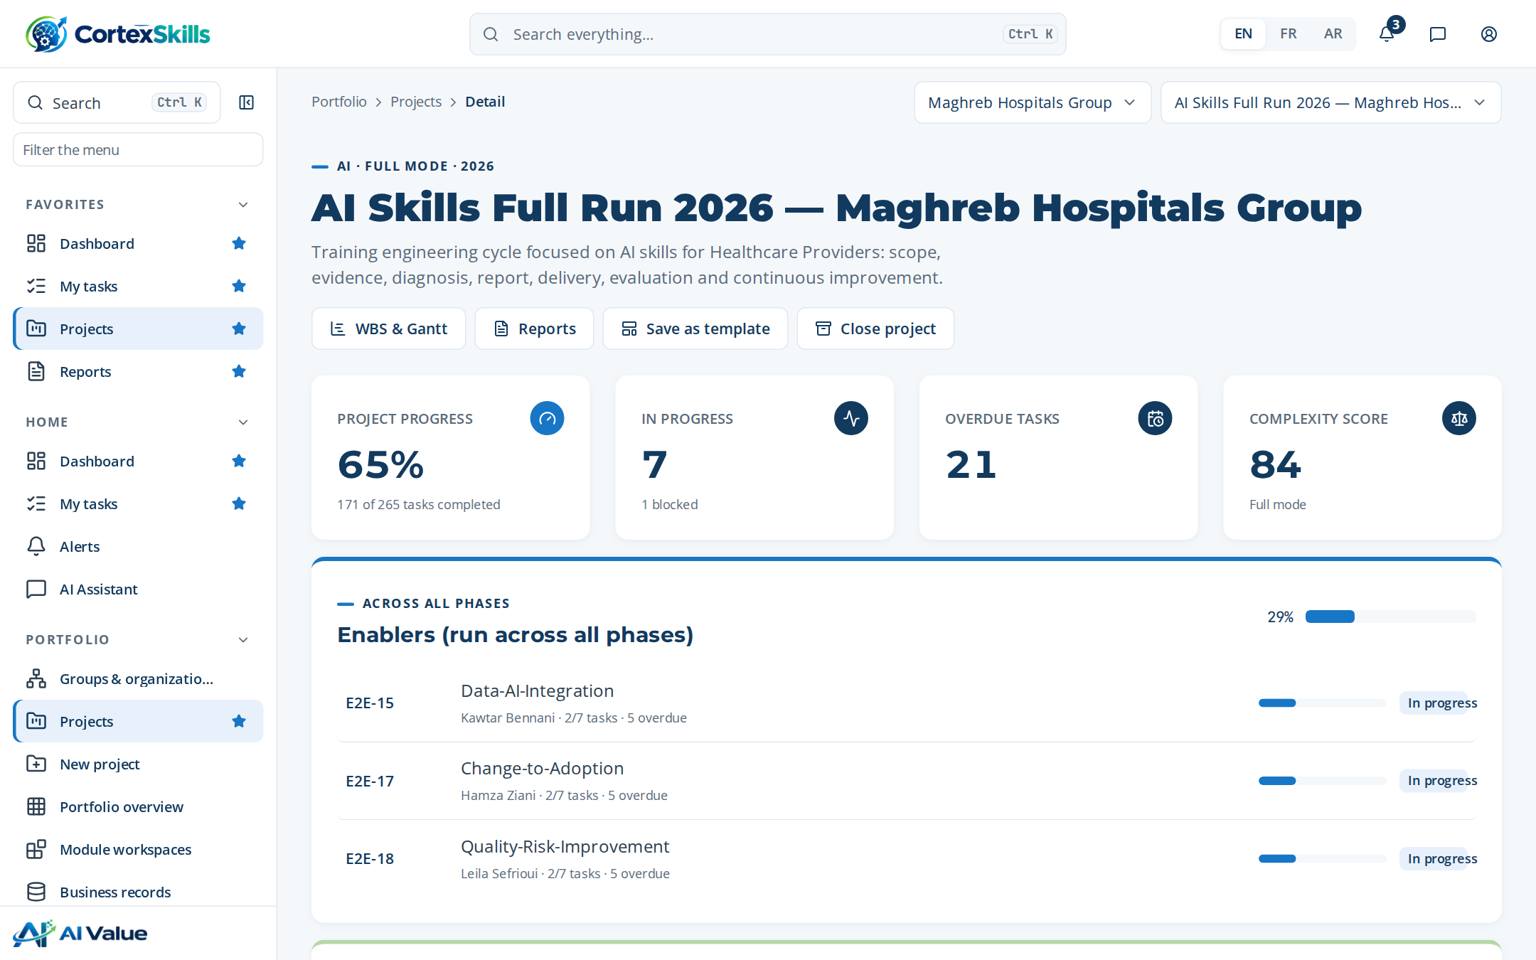
CASE STUDY · WORKSPACE
The AI skills run on one screen
AI Skills Full Run 2026 — Maghreb Hospitals Group
65% of 265 tasks completed; 7 in progress, 1 blocked.
21 tasks overdue — each raises an alert with an escalation chain.
Complexity score 84: Full mode, all seven phases and six gates.
POWERACT
Case study: a hospital group · Demonstration data — fictional organization
19

Slide 20
CASE STUDY · TWO RUNS
Two runs: the Digital run leads on delivery and evaluation
Share of tasks completed per phase, same organization, same template.
208 / 265
tasks completed in the Digital run
171 / 265
tasks completed in the AI run
Scope, diagnosis and the report are complete in both runs; the gap opens in delivery and evaluation.
Tasks completed / tasks planned in each phase (%)
POWERACT
Case study: a hospital group · Demonstration data — fictional organization
20

Slide 21
PHASE 0 · COMPLEXITY
Complexity score 84 out of 100: Full mode
Seven weighted criteria rated 1–5 when the project is created; the score recommends the mode.
84
Full mode: score of 70 or more
Below 70, the score recommends SME mode and one of three tracks (T1, T2, T3). Choosing a different track requires a written justification.
Rating of each complexity criterion (1 = low, 5 = high)
POWERACT
Case study: a hospital group · Demonstration data — fictional organization
21

Slide 22

PHASE 1 · SCOPE OF WORK
A scope approved before any data is collected
Approved on 22 Jul 2026 · focus AI · decision levels MS / MO / OP
17
40
40/40
v1
scope criteria: function × decision level
stakeholders in the register
stakeholders with consent recorded
approved version of the Scope of Work
Stakeholders by decision level
Stakeholders by preferred channel
POWERACT
Case study: a hospital group · Demonstration data — fictional organization
22

Slide 23
PHASE 1 · EVIDENCE
28 questionnaire responses, 91% complete on average
Questions drafted by AI from the Scope of Work, validated by a person, sent through each stakeholder’s channel.
Questionnaire responses by channel used
Responses by completeness of the answers
POWERACT
Case study: a hospital group · Demonstration data — fictional organization
23

Slide 24
GATE G1
G1 — Scope & evidence approved: “Go”
Decided on 30 Jul 2026 · All mandatory items met; evidence attached.
Checklist item | Mandatory | Evidence | Status
Scope frame recorded (Group Yes/No, Organization, sector) | Yes | — | Done
Decision levels and functions mapped in the criteria matrix | Yes | — | Done
Stakeholder register complete with channels | Yes | Attached | Done
Every AI-generated question validated by a person | Yes | — | Done
Consent confirmed for every stored response | Yes | Attached | Done
A gate cannot be signed off while a mandatory item is open; the approvers are HR Director and Consultant PM.
POWERACT
Case study: a hospital group · Demonstration data — fictional organization
24

Slide 25
PHASE 2 · DIAGNOSIS
Five-axis diagnostic: information systems score lowest
Findings validated with the sponsor · scores on a 0–5 scale
CMM maturity
3 → 4
current level → target level (1–5)
Leadership maturity
3 → 4
current level → target level (1–5)
Lowest axis: information systems (2). Highest: strategy (3.4).
Score of each diagnostic axis (0–5)
POWERACT
Case study: a hospital group · Demonstration data — fictional organization
25

Slide 26
PHASE 2 · PERFORMANCE
5 of 21 cells are Red
Performance by function and decision level: MS strategic, MO managerial, OP operational.
Function | MS | MO | OP
Operations | 79% | 55% | 71%
Quality & HSE | 81% | 88% | 73%
Finance | 85% | 54% | 76%
Human Resources | 92% | 68% | 79%
Sales & Marketing | 88% | 71% | 83%
Information Systems | 62% | 73% | 69%
Clinical Care & Nursing | 84% | 70% | 84%
Clinical Care & Nursing
MS
84% · Amber
Gap: AI triage and clinical decision support
MO
70% · Amber
Gap: AI medical imaging assistance
OP
84% · Amber
Gap: AI bed and staff capacity planning
Score per cell; fill shows the RAG status (red, amber, green)
POWERACT
Case study: a hospital group · Demonstration data — fictional organization
26

Slide 27
PHASE 2 · SWOT AND IMPROVEMENT AXES
Four improvement axes, ranked
Functional SWOT validated for Operations and Quality & HSE.
Strengths
Weaknesses
Experienced team; stable processes
Low use of AI triage and clinical decision support
Opportunities
Threats
AI bed and staff capacity planning
Stricter ISO 7101 audits
Implementation progress of each improvement axis, by priority rank (%)
POWERACT
Case study: a hospital group · Demonstration data — fictional organization
27

Slide 28




PHASE 2 · SKILLS GAPS AND NEEDS
From individual gaps to validated training demands
Gaps come from skills assessments; needs and demands are validated before prioritization.
12
8
10
15
skills assessments recorded
skill gaps, 2 critical
training needs, 10 validated
training demands from managers and staff
Training demands by priority
Priority | Demands
High | 5
Medium | 5
Low | 5
Skill gaps by competency: average gap in proficiency levels and number of gaps
POWERACT
Case study: a hospital group · Demonstration data — fictional organization
28

Slide 29
PHASE 3 · PRIORITIZATION
Six AI themes, ranked by impact and urgency
AI proposes a priority score; the L&D Strategist accepts or changes it with a justification.
# | Theme | Impact | Urgency | Days × groups | Trainer | Budget
1 | AI triage and clinical decision support | 5 | 4 | 3 × 6 | Internal | 360,000
2 | AI medical imaging assistance | 4 | 3 | 2 × 4 | Vendor A | 300,000
3 | AI bed and staff capacity planning | 3 | 4 | 2.5 × 3 | Internal | 240,000
4 | AI literacy for all staff | 5 | 3 | 1.5 × 3 | Vendor A | 180,000
5 | Prompting and generative AI at work | 4 | 4 | 1 × 2 | Internal | 120,000
6 | Responsible AI and data protection | 3 | 3 | 2 × 2 | Vendor A | 60,000
Impact and urgency on a 1–5 scale; cell fill follows the status scale (red = 1, dark green = 5). Budget as recorded in the plan.
POWERACT
Case study: a hospital group · Demonstration data — fictional organization
29

Slide 30
PHASE 3 · REPORT AND ROADMAP
The Training Engineering Report, published and versioned
Status Published · version 2 · 4 sections drafted by AI and reviewed by the Quality Manager
Wave 1
Wave 2
Wave 3
Strategic objectives
AI triage and clinical decision support
SO-1
by 31 Dec 2027
Adopt AI triage and clinical decision support across Clinical Care & Nursing by end 2027
AI medical imaging assistance
AI bed and staff capacity planning
SO-2
by 31 Dec 2026
Zero major findings in ISO 7101 audits
AI literacy for all staff
Roadmap initiatives by wave
Input: Healthcare Providers competitive intelligence 2026, updated 1 Oct 2026.
POWERACT
Case study: a hospital group · Demonstration data — fictional organization
30

Slide 31



PHASE 3 · PLAN AND BUDGET
2026 plan locked: 1,260,000 budgeted, 35% realized
Planned, committed and actual amounts per theme, as recorded (currency set per organization).
945,000
committed (75% of planned)
737,197
actual spend (59% of planned)
352,800
refund forecast from training contracts
Planned, committed and actual spend per theme
POWERACT
Case study: a hospital group · Demonstration data — fictional organization
31

Slide 32

PHASE 3 · FUNDING AND REGULATION
Training contract refunds, tracked to the deadline
OFPPT special training contracts file · regulator OFPPT · deadline 30 Oct 2026 · status Approved
Theme | Planned | Actual | Refund forecast | Refund / planned
AI triage and clinical decision support | 360,000 | 217,250 | 100,800 | 28%
AI medical imaging assistance | 300,000 | 171,599 | 84,000 | 28%
AI bed and staff capacity planning | 240,000 | 142,133 | 67,200 | 28%
AI literacy for all staff | 180,000 | 112,764 | 50,400 | 28%
Prompting and generative AI at work | 120,000 | 61,149 | 33,600 | 28%
Responsible AI and data protection | 60,000 | 32,302 | 16,800 | 28%
Deadline alerts
A missed submission deadline means a lost refund. The run records the file, its deadline and its status, and the risk register tracks “Missed regulatory submission deadline and lost refund”.
POWERACT
Case study: a hospital group · Demonstration data — fictional organization
32

Slide 33


PHASE 4 · DESIGN AND DELIVERY
Learning paths, modules and sessions
2 learning paths · 4 modules · 4 sessions · 12 enrollments
Module | Modality | Hours | Design status
M1 AI triage and clinical decision support | E-learning | 2 | Approved
M2 AI medical imaging assistance | Classroom | 7 | Approved
M3 AI triage and clinical decision support | Virtual | 3.5 | Draft
M4 AI medical imaging assistance | Classroom | 7 | Draft
4
content assets tagged to competencies
48
seats scheduled across the sessions
Session | Starts | Capacity
S-01 AI triage and clinical decision support | 10 Oct 2026 | 12
S-02 AI medical imaging assistance | 17 Oct 2026 | 12
S-03 AI triage and clinical decision support | 24 Oct 2026 | 12
S-04 AI medical imaging assistance | 31 Oct 2026 | 12
Attendance is recorded per session; a missing attendance record raises an alert to the Training Administrator.
POWERACT
Case study: a hospital group · Demonstration data — fictional organization
33

Slide 34
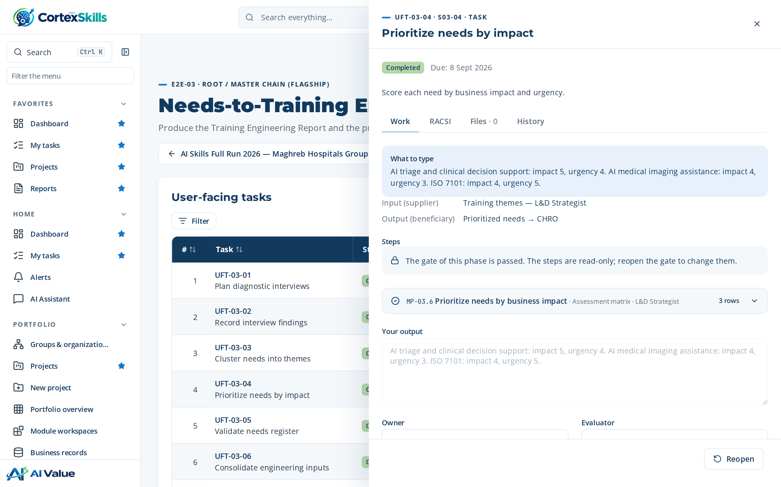
EVERY TASK · WHAT TO TYPE
Guidance written for this hospital and this sector
The task panel shows the expected answer, the inputs and outputs, the owner and the evaluator.
“What to type” is specific to the organization, its sector and the focus of the run.
AI help proposes a draft, labelled with its confidence and sources.
Owner and evaluator are two different people: segregation of duties is enforced.
POWERACT
Case study: a hospital group · Demonstration data — fictional organization
34

Slide 35
PHASE 5 · EVALUATION AND CERTIFICATION
Kirkpatrick levels 1 to 3, and certificate validity
Evaluation results per enrollment; certificates tracked against their expiry date.
Certificate | Valid until | Status
ISO 7101 awareness | 17 Aug 2026 | Valid
ISO 7101 awareness | 15 Nov 2026 | Expired
ISO 7101 awareness | 13 Feb 2027 | Valid
ISO 7101 awareness | 14 May 2027 | Expiring
ISO 7101 awareness | 12 Aug 2027 | Valid
ISO 7101 awareness | 10 Nov 2027 | Valid
4 valid · 1 expiring · 1 expired. Expiry raises an alert before the date.
Evaluation score by Kirkpatrick level: 1 reaction, 2 learning, 3 behaviour (%)
POWERACT
Case study: a hospital group · Demonstration data — fictional organization
35

Slide 36
GATES
3 gates signed off, 3 open
Where the run stands: mandatory items completed at each gate.
G1
G2
G3
G4
G5
G6
Scope & evidence approved
Diagnostic validated
Report & roadmap approved
Delivery readiness
Evaluation & impact validated
Closure & continuous improvement
5 / 5
5 / 5
4 / 4
2 / 4
0 / 3
0 / 3
items completed
items completed
items completed
items completed
items completed
items completed
Go · signed off
Go · signed off
Go · signed off
Open
Open
Open
Each gate has its own checklist; the sign-off records the decision, the approver and the date.
POWERACT
Case study: a hospital group · Demonstration data — fictional organization
36

Slide 37
GOVERNANCE · RISKS
35 risks scored by likelihood and impact
Each risk is linked to its controls, a key risk indicator and an owner.
Likelihood ↓
Code | Risk | Category | Score
RISK-014 | Low learner and user adoption | Adoption | 9
RISK-017 | Critical knowledge lost with expert departure | Operational | 9
RISK-001 | Unauthorized access to tenant data | Security | 6
RISK-005 | Training plan misaligned with strategy | Strategic | 6
RISK-006 | Inaccurate skills data leading to wrong needs | Data quality | 6
RISK-007 | Unverified AI content in the Training Engineering Report | AI | 6
RISK-009 | Expired mandatory certification | Compliance | 6
5
4
3
9
2
2
3
21
1
1
2
3
4
5
Impact →
Number of risks per likelihood × impact cell
POWERACT
Case study: a hospital group · Demonstration data — fictional organization
37

Slide 38
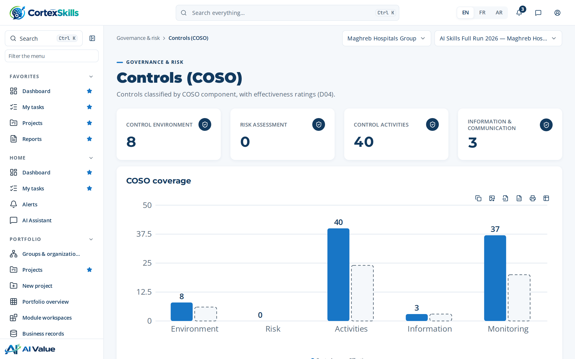
GOVERNANCE · CONTROLS
88 controls mapped to the COSO components
53 rated effective · 89 business rules enforce them in the workflow
Controls and effective controls per COSO component
POWERACT
Case study: a hospital group · Demonstration data — fictional organization
38

Slide 39
GOVERNANCE · KPIS
61 standard KPIs, measured monthly
Plus 2 custom KPIs, e.g. “Share of Clinical Care & Nursing supervisors certified”.
KPI | Latest | Target | Status
KPI-001 · Strategic objective coverage | 97.2 | 100% | Amber
KPI-002 · Skills inventory validation rate | 94.7 | ≥ 95% | Amber
KPI-003 · Critical gap rate | 8.9 | ≤ 10% | Green
KPI-010 · Learner completion rate | 82.9 | ≥ 80% | Green
KPI-020 · Integration synchronisation success rate | 104.6 | ≥ 99.5% | Green
KPI-061 · Stakeholder engagement rate | 72.9 | ≥ 75% | Amber
Strategic objective coverage: monthly value against target
POWERACT
Case study: a hospital group · Demonstration data — fictional organization
39

Slide 40
GOVERNANCE · ALERTS
15 open alerts, each with an escalation chain
Alerts come from process rules; overdue steps escalate by role and by delay.
Alert | Step | Severity | Open | Escalation
ALR-006 · Record attendance | MP-07.5 | Medium | 1 | Trainer → Training Administrator (24 h) → Head of L&D (72 h)
ALR-007 · Trigger re-engagement nudge | MP-08.6 | Low | 2 | Learner → Manager (after second nudge)
ALR-008 · Review evaluation results | MP-09.7 | Medium | 2 | L&D Analyst → Instructional Designer → Head of L&D
ALR-014 · Run HRIS synchronisation | MP-16.4 | Medium | 2 | IT Architect → Platform Administrator
ALR-016 · Enforce login rate limit | MP-17.6 | High | 2 | Platform Administrator → IT Architect
ALR-018 · Track adoption usage | MP-19.4 | Medium | 2 | Change Manager → Head of L&D
ALR-020 · Execute improvement action | MP-20.3 | High | 2 | Action Owner → Quality Manager (7 days) → Head of L&D
ALR-039 · Review access violation log | MP-17.4 | Medium | 2 | IT Architect → Platform Administrator
Alerts, approvals and task notices are sent in the application and by e-mail (11 dispatches in the demonstration run).
POWERACT
Case study: a hospital group · Demonstration data — fictional organization
40

Slide 41
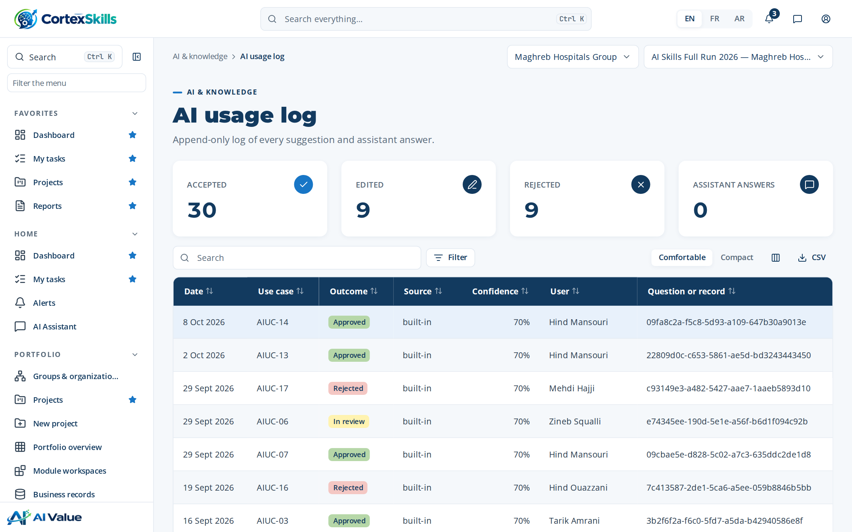
AI GOVERNANCE · USAGE LOG
48 AI suggestions logged: 30 accepted, 9 edited, 9 rejected
The usage log is append-only; each line keeps the use case, the user, the confidence and the decision.
AI suggestions by outcome of the human review
POWERACT
Case study: a hospital group · Demonstration data — fictional organization
41

Slide 42
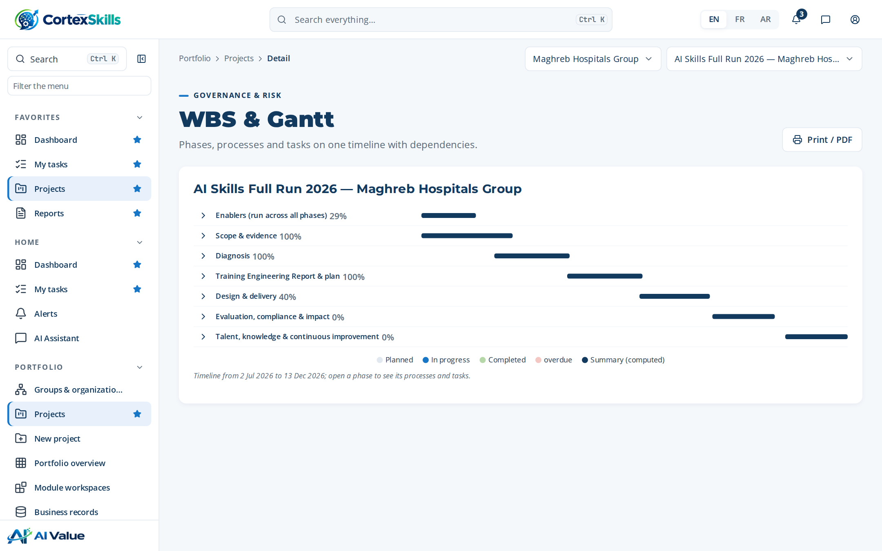
PLANNING
The whole run on one timeline
Phases, processes and tasks with dependencies; summary bars are computed from the tasks.
POWERACT
Case study: a hospital group · Demonstration data — fictional organization
42

Slide 43
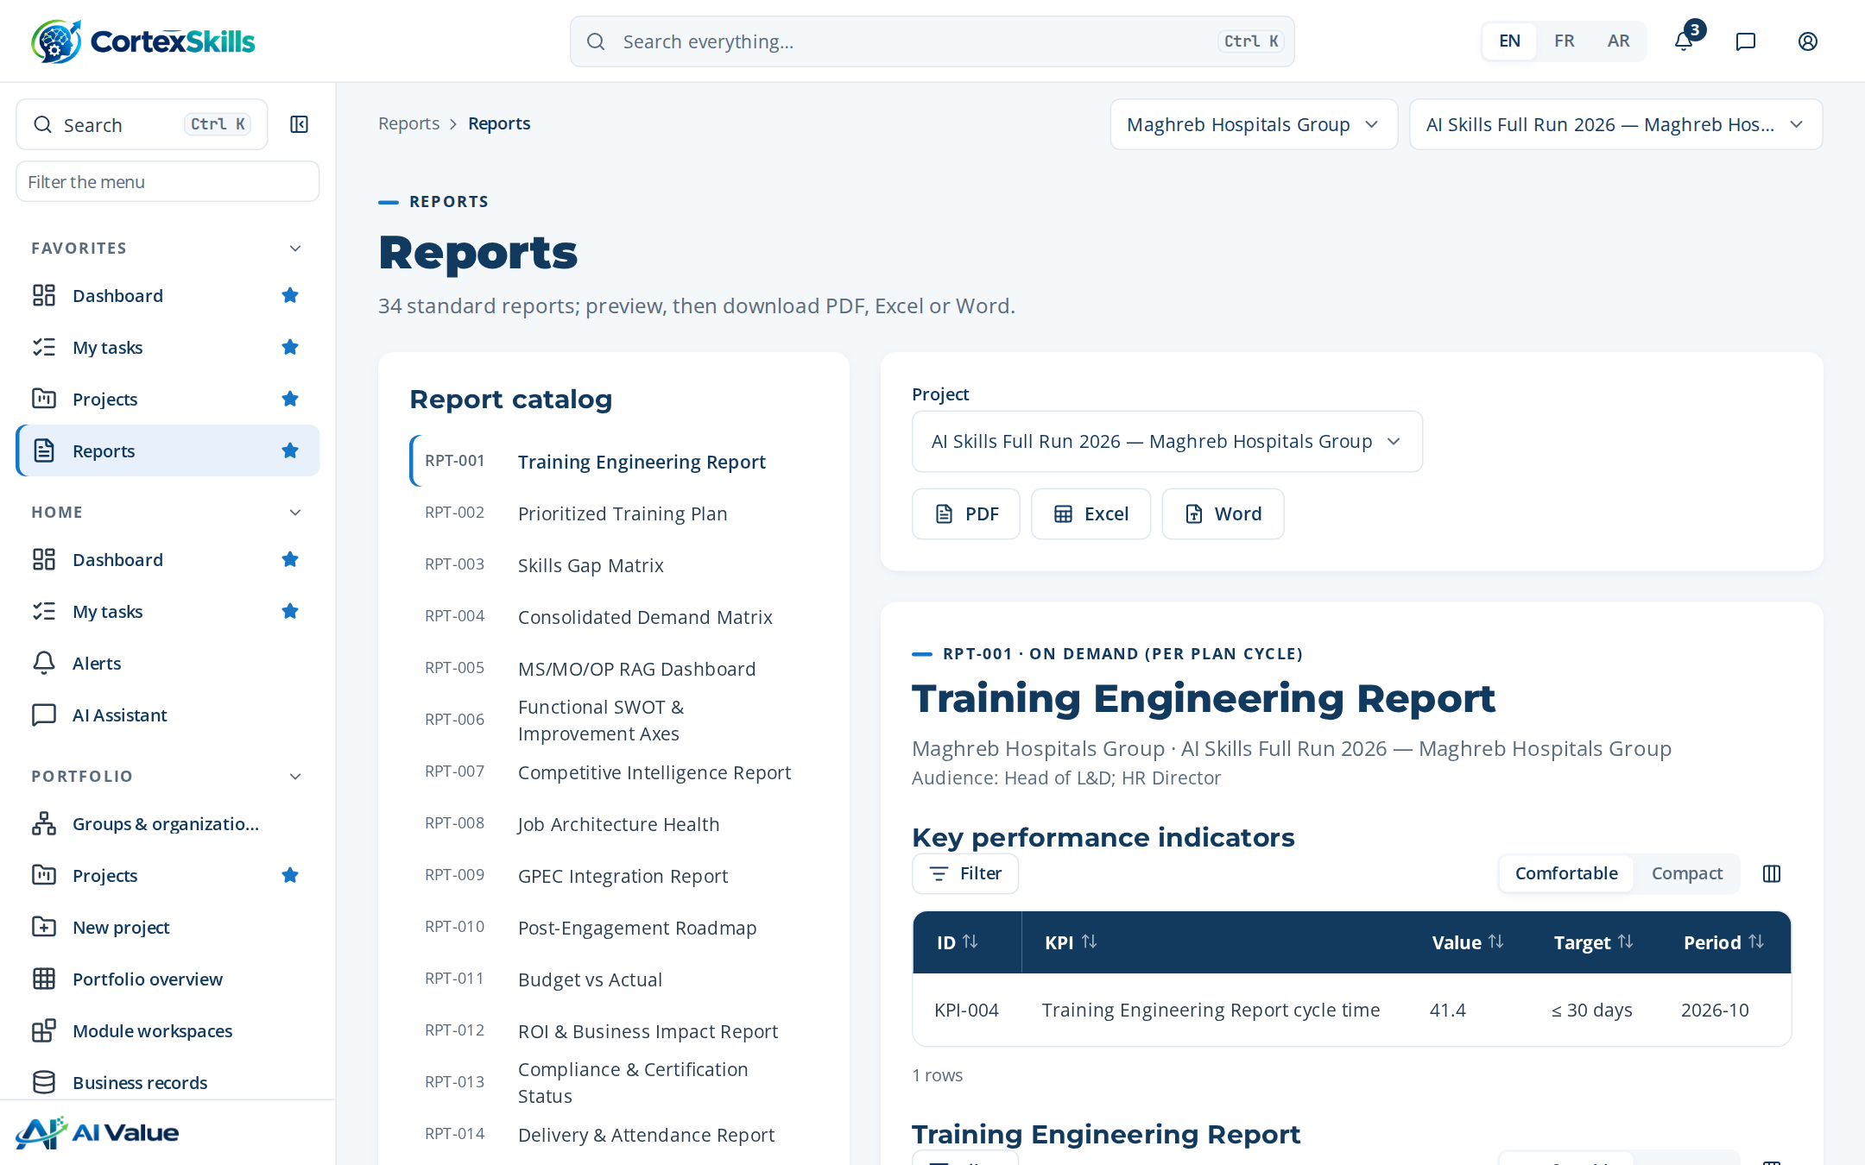
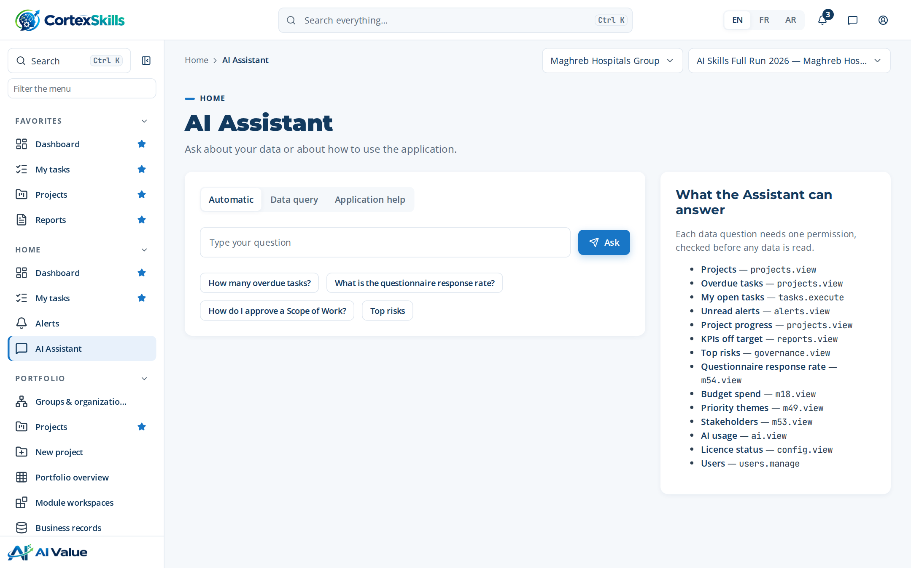
REPORTS AND QUESTIONS
34 standard reports and a data-aware assistant
Reports export to PDF, Excel and Word. The assistant answers within the user’s permissions.
POWERACT
Case study: a hospital group · Demonstration data — fictional organization
43

Slide 44
PHASE 6 · KNOWLEDGE AND IMPROVEMENT
Lessons learned feed the next cycle
Return on experience rated 4/5 · 4 knowledge base articles for the sector standards
What went well
The stakeholder register and multi-channel distribution lifted the response rate.
Knowledge base
ISO 7101 — training and competence requirements
What did not
SWOT inputs arrived late from one function.
JCI Standards — practitioner notes
Root cause
No backup nominated for the function head.
GPEC — Forward Planning of Jobs and Skills
Recommendation
Name a backup for every function head at kickoff.
Law 09-08 — personal data in questionnaires
POWERACT
Case study: a hospital group · Demonstration data — fictional organization
44

Slide 45
04
Case study: a clinic
Clinique Al Amal — 95 employees, Marrakech. The same method on a lighter track.
POWERACT

Slide 46
SME · TRACK
Complexity score 66: SME track T3
Clinique Al Amal · 95 employees · 11 users · Law 09-08 data protection
Track | For | Gates | Items per gate | Duration | Score
SME-T1 · Essential track | Micro | G1 · G3 · G6 | 3 | about 30 days | 0–35
SME-T2 · Standard track | Small | G1 · G3 · G5 · G6 | 4 | about 60 days | 35–60
SME-T3 · Advanced track | Medium | G1 · G2 · G3 · G4 · G5 · G6 | 5 | about 90 days | 60–100
Complexity ratings (1–5), clinic compared with the hospital group: investment and scope drive the difference
POWERACT
Case study: a clinic · Demonstration data — fictional organization
46

Slide 47
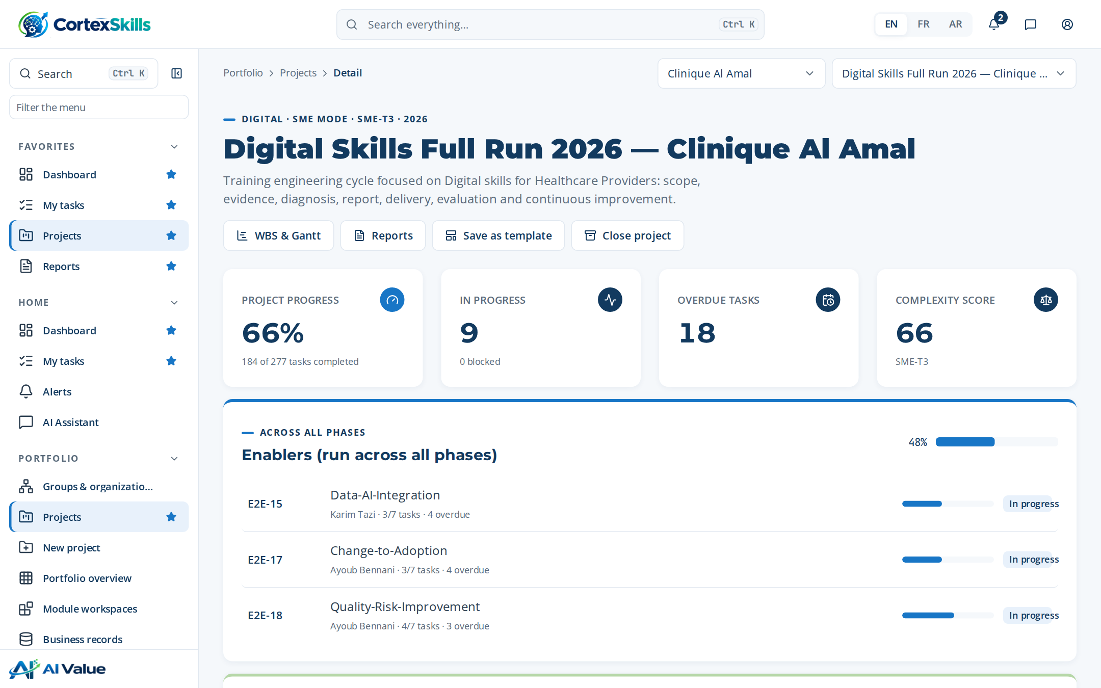
SME · WORKSPACE
Same lifecycle, fewer items to complete
AI Skills Full Run 2026 — Clinique Al Amal · 50% of 277 tasks completed
Digital run: 66% of 277 tasks completed; AI run: 50%.
Six gates with five items each on track T3, instead of the Full-mode checklists.
The recommended track is kept; another choice needs a written justification.
POWERACT
Case study: a clinic · Demonstration data — fictional organization
47

Slide 48
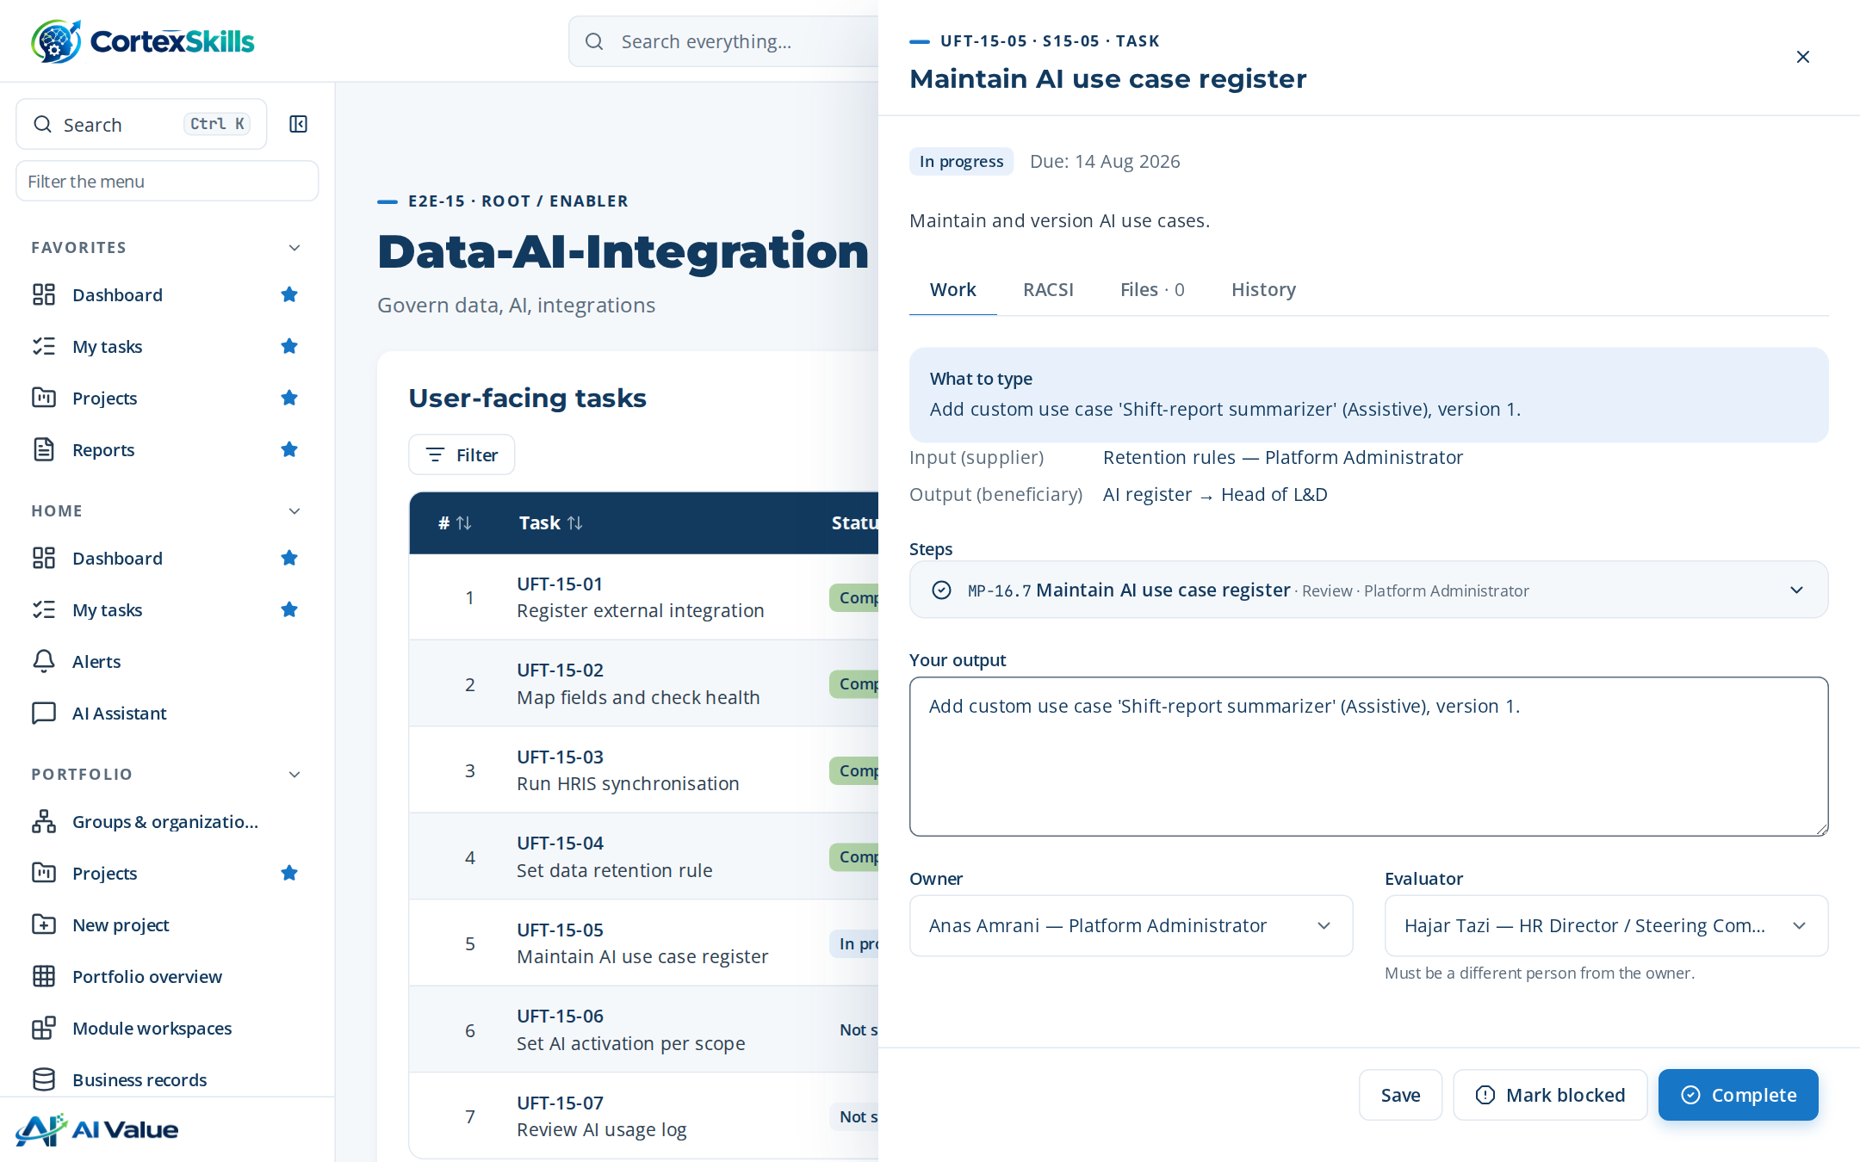
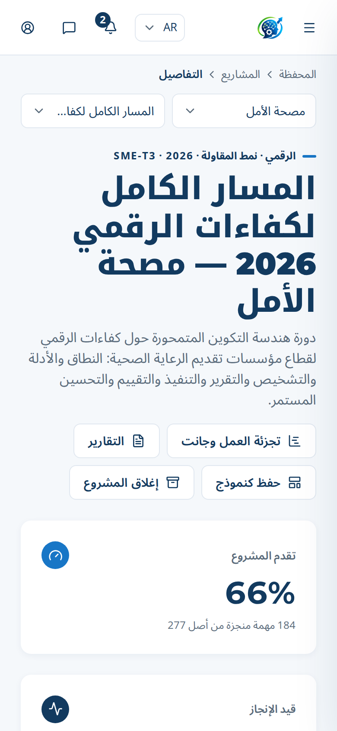
SME · ANY SCREEN, ANY LANGUAGE
The same guidance in English, French and Arabic
The task panel on a desktop, the workspace in Arabic on a phone (right-to-left layout).
POWERACT
Case study: a clinic · Demonstration data — fictional organization
48

Slide 49
LARGE VS SME
One method, sized to the organization
Comparison of the two healthcare providers in the demonstration instance.
 | Maghreb Hospitals Group | Clinique Al Amal
Employees · city | 4,700 · Casablanca | 95 · Marrakech
Complexity score · mode | 84 · Full mode | 66 · SME track T3
Tasks per run | 265 | 277
AI run completed | 65% | 50%
Digital run completed | 78% | 66%
Users | 29 | 11
Solution | BND-05 · 600 seats | SME-CMP · 100 seats
Data protection | GDPR, LAW0908, ISO9001 | LAW0908
POWERACT
Case study: a clinic · Demonstration data — fictional organization
49

Slide 50
05
The health ecosystem
Life sciences, pharma distribution and pharmaceutical manufacturing
POWERACT

Slide 51
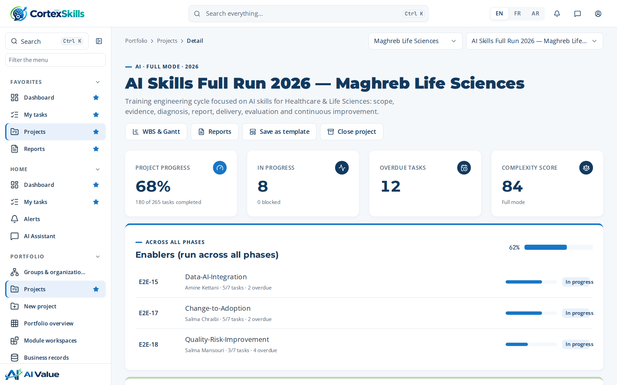
SECTOR · HLS
Healthcare & Life Sciences
Core function: Clinical & Laboratory Operations · ISO 13485, EU MDR, ISO 15189
Large company — Maghreb Life Sciences (3100)
SME — BioLab Diagnostics Rabat (60)
Task completion by run (%)
Priority AI themes
AI-assisted diagnostics validation
AI for pharmacovigilance signal detection
Responsible AI and patient-data ethics
Priority digital themes
Electronic lab notebooks and LIMS
Electronic quality management (eQMS)
Health data interoperability (HL7 FHIR)
POWERACT
The health ecosystem · Demonstration data — fictional organization
51

Slide 52
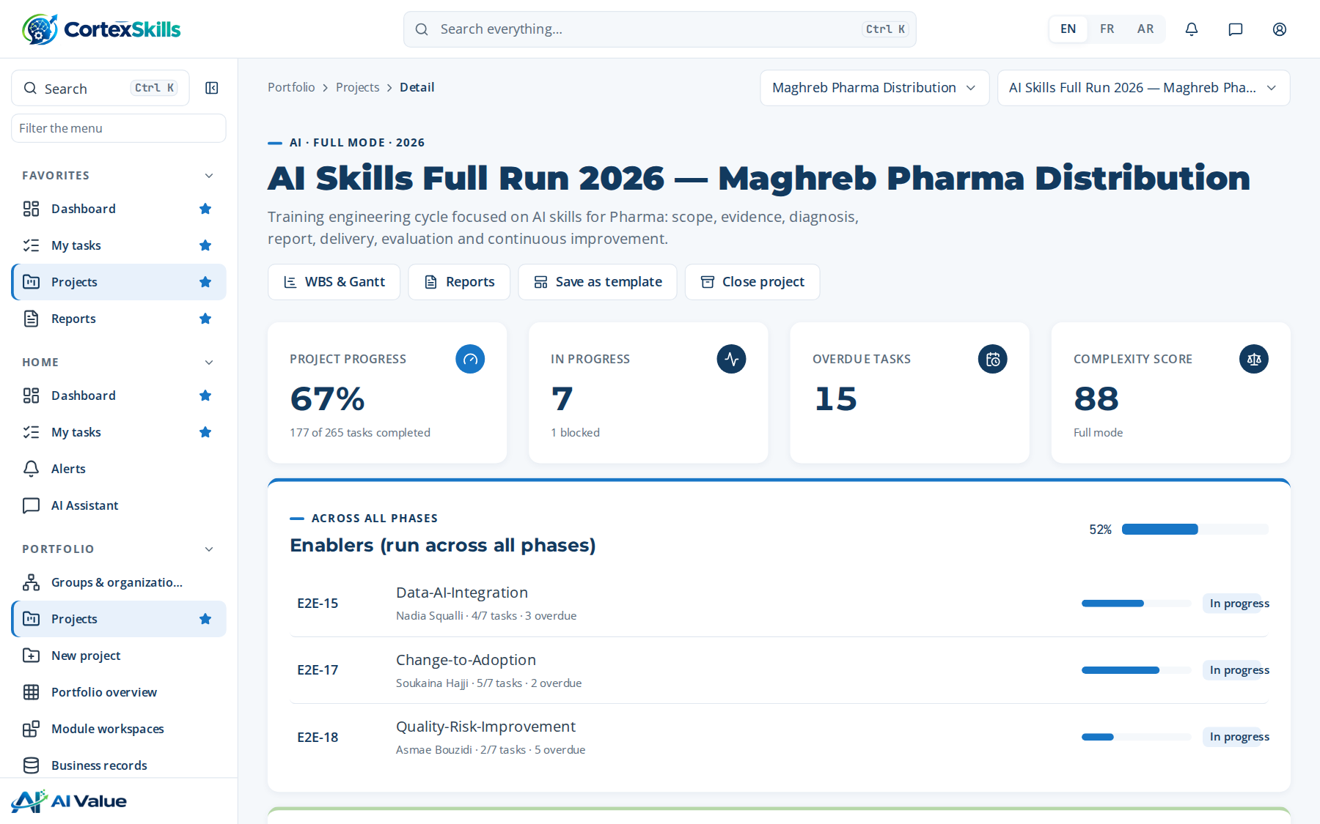
SECTOR · PHAR
Pharma
Core function: Pharmaceutical Quality & Distribution · EU GMP, GDP, ICH Q9
Large company — Maghreb Pharma Distribution (1400)
SME — PharmaLog Services (44)
Task completion by run (%)
Priority AI themes
AI regulatory-dossier drafting assistance
AI demand sensing for medicines
AI quality-risk management (ICH Q9)
Priority digital themes
Serialization and track-and-trace
Digital GDP temperature monitoring
Regulatory information management (RIM)
POWERACT
The health ecosystem · Demonstration data — fictional organization
52

Slide 53
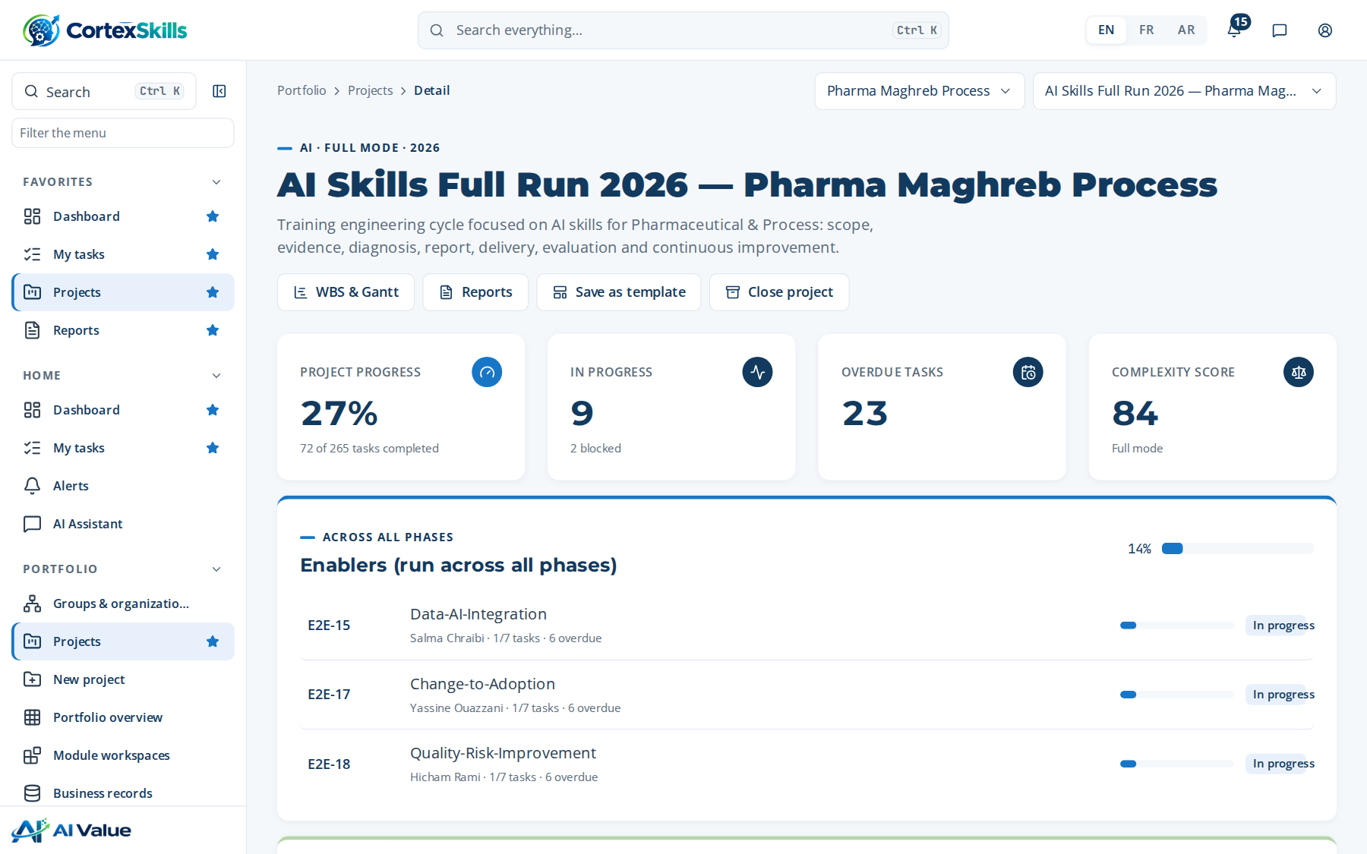
SECTOR · PHPR
Pharmaceutical & Process
Core function: GMP Manufacturing · EU GMP, ICH Q10, FDA 21 CFR Part 11
Large company — Pharma Maghreb Process (2200)
SME — Galénix Laboratoires (90)
Task completion by run (%)
Priority AI themes
AI process analytics for yield
AI deviation and CAPA triage
Validation of AI models in GxP
Priority digital themes
Electronic batch records (EBR)
Computer system validation (CSV)
Data integrity and ALCOA+ practices
POWERACT
The health ecosystem · Demonstration data — fictional organization
53

Slide 54
HEALTH ECOSYSTEM · BENCHMARK
Eight health organizations, two runs each
Share of tasks completed in the Digital and AI runs of each demonstration organization.
Tasks completed in each run (%). Group members see these aggregates; records of sister organizations stay read-only.
POWERACT
The health ecosystem · Demonstration data — fictional organization
54

Slide 55
06
Trust and next steps
Security, data protection, deployment and how to start
POWERACT

Slide 56






SECURITY AND DATA PROTECTION
Patient-adjacent data, handled with strict boundaries
Staff data and training records stay inside the organization’s tenant.
Tenant isolation
Role-based access
Audit trail
Each organization is a closed tenant; group members read sister organizations but cannot change them.
Permissions checked on the server for each of the 29 roles; pack entitlements enforced.
Every change to a governed field is justified and recorded in an append-only log.
Data-protection frameworks
Governed AI
Consent
GDPR, ISO/IEC 27001, SOC 2, ISO/IEC 27701, ISO 9001, Law 09-08 (CNDP, Morocco).
Each AI use case names its human checkpoint; the usage log keeps every outcome.
Consent recorded for every stored questionnaire response before gate G1.
POWERACT
Trust and next steps
56

Slide 57
INTEGRATIONS
18 integrations in the catalog
Three connections at the hospital group, each health-checked; the single sign-on check currently reports a failure.
Family | Integrations
Enterprise Systems | 3
Talent & Performance Management | 4
Learning Content & Ecosystem | 4
Learning in the Flow of Work | 2
Data & Analytics | 2
Core Platform & Security | 2
Survey & Feedback | 1
Connected at the hospital group | Code | Last health check
HRIS / HCM | INT-HR-01 | Success
Survey platform | INT-SUR-01 | Success
SSO (Microsoft Entra ID) | INT-SSO-01 | Auth failure
HRIS / HCM examples: Workday, SAP SuccessFactors, Oracle HCM, ADP, BambooHR, Personio, DarwinBox
POWERACT
Trust and next steps
57

Slide 58


DEPLOYMENT
SaaS or on-premises, same application
One licensing interface with two implementations, chosen when the server starts.
SaaS
On-premises
Hosted and updated centrally.
Licence checked online per organization.
Suited to clinics and groups without a local IT team.
Installed in the hospital’s data centre.
Signed licence file bound to the server, with expiry date and seat limit.
Suited to strict data-residency policies.
Demonstration licence of the hospital group: plan BND-05, up to 600 users, features analytics, export, api, valid until 10 Nov 2027.
POWERACT
Trust and next steps
58

Slide 59
PACKS FOR HEALTHCARE
Recommended packs for a hospital or clinic
Catalog prices per month, in USD; each pack includes a number of users, with a per-user price beyond.
PK-01
PK-04
PK-03
PK-02
Core Training Engineering Pack
Compliance & Certification Pack
Assessment, Analytics & ROI Pack
Learning Delivery & Experience Pack
$99
$99
$129
$149
per month · 100 users included · $0.75 per extra user
per month · 300 users included · $0.55 per extra user
per month · 500 users included · $0.5 per extra user
per month · 250 users included · $0.6 per extra user
Scope, evidence, diagnosis, the Training Engineering Report and the roadmap.
Certificate tracking and readiness evidence for ISO 7101, JCI and ISO 15189.
Kirkpatrick evaluation, KPIs and return on investment.
Paths, modules, sessions and learner engagement.
POWERACT
Trust and next steps
59

Slide 60
ADD-ONS AND BUNDLES
Add-ons that fit hospital groups
Catalog prices per month, in USD.
Add-on | Price | What it adds
AD-08 · Multi-Site / Multi-Entity Deployment | $55 | Adapt and deploy training plans across multiple sites, entities, or business units, ensuring local relevance while maintaining strategic alignment.
AD-09 · External Training Plan Validation (Regulatory) | $45 | Manage external validation and regulatory compliance for training plans, including submission to regulatory bodies (e.g., OFPPT, GIAC-Agro).
AD-11 · Questionnaire Library & Multi-Channel Distribution | $49 | Provide pre-built questionnaire templates tailored to Focus (All training needs, Digital, AI, Custom) and sector, with multi-channel distribution (Face-to-Face, Email, Hybrid, Custom), RACSI allocation per section and structured response collection.
AD-01 · Immersive Learning (VR/AR/Simulation) | $49 | Create experiential, safe-to-fail learning environments using VR, AR, and simulation technologies.
AD-07 · Expert Knowledge Capture & Transfer | $45 | Preserve institutional knowledge before it walks out the door.
Bundle | Packs | Price
Starter Bundle | PK-01 + PK-02 | $223.2 (−10%)
Growth Bundle | PK-01 + PK-02 + PK-03 | $320.45 (−15%)
Enterprise Bundle | PK-01 to PK-05 | $476 (−20%)
Strategic Bundle | PK-01 to PK-06 + PK-08 | $677.25 (−25%)
Full Suite | PK-01 to PK-08 | $806.4 (−30%)
POWERACT
Trust and next steps
60

Slide 61



IMPLEMENTATION
A first run in four steps
Sized by the complexity score: about 30, 60 or 90 days on an SME track; a full run for a hospital group.
01
02
03
04
Set up
Scope and evidence
Diagnose and plan
Deliver and evaluate
Group, organization, functions, users and roles; connect the HR system.
Approve the Scope of Work, send questionnaires, pass gate G1.
Five-axis diagnostic, gaps, prioritized themes, report, budget; gates G2 and G3.
Sessions, Kirkpatrick evaluation, certificates, return on experience; gates G4 to G6.
POWERACT supports each step: set-up, method coaching and the first gate reviews.
POWERACT
Trust and next steps
61

Slide 62



NEXT STEPS
Start with one hospital, one run
Book a working session with POWERACT: your accreditation calendar, sites and priority roles.
POWERACT Consulting
www.poweract.ma
See the demonstration: sign in to the healthcare tenant and follow a task from scope to certificate.
Figures in this presentation come from the demonstration instance. Organizations and people are fictional.
Run a pilot: one site or one clinic, Digital or AI focus, measured with the same KPIs.
POWERACT
Next steps
62

