Slide 1
POWERACT
C O N S U L T I N G
DYNAMICMS 1.0
Universal Case Study — One Full Run of DynamicMS
Twelve end-to-end processes, their macro processes, tasks and steps, as recorded in the application — prepared for healthcare organizations
POWERACT Consulting · October 2026

Slide 2
DYNAMICMS
Agenda
01
The case: one organization, one full run
02
What it means for a healthcare organization
03
The twelve end-to-end processes, phase by phase
04
Evidence, measurement, documents and AI
05
Next steps for your organization
POWERACT Consulting · Agenda
2

Slide 3
THE CASE
Horizon Universal Holdings: a full QMS run from context to innovation
Project HZ-UNI-QMS · ISO 9001 · 2025-10-01 to 2026-12-30 · 9,167 employees · universal profile
12
111
346
end-to-end processes, run as phases
macro processes activated
tasks
1,057
90%
19
workflow steps with their recorded values
of the run completed; 11 gates passed (Go)
people, each in a named role
All values come from the demonstration database of DynamicMS; names and figures are fictional.
Licence of the case: DMS-ENT with DMS-AI, DMS-CERT, DMS-ESG and add-ons ADD-01, ADD-04, ADD-06, ADD-07.
POWERACT Consulting · The case
3

Slide 4
FOR HEALTHCARE
The same twelve processes run a hospital’s management system
The universal run is the common core. For a healthcare provider (segment V-29), DynamicMS activates the following on top of it.
STANDARDS
79 MACRO PROCESSES, INCLUDING
RECOMMENDED LICENCE
JCI
ISO 9001
ISO/IEC 27001
HIPAA · GDPR
National Health Authority
HL7 FHIR
Medical Laboratory Management
Facility Management
IT Service Management
Cloud Security and Privacy
Anti-Bribery and Corruption
DMS-PRO
+ DMS-LSCI Life Sciences & Healthcare
+ DMS-CERT Certification
+ DMS-AI Intelligence & Assurance
Source: DynamicMS catalog (segment V-29 Healthcare Providers, Packs catalog 2.5).
POWERACT Consulting · Healthcare
4

Slide 5
FOR HEALTHCARE
How the run reads in a hospital
E2E | In the universal run | In a hospital (illustration)
E2E-01 | Interested parties, context issues | Patients and families, regulator, medical staff, insurers
E2E-03 | Risk and opportunity register | Patient safety risks, infection control, continuity of care
E2E-05 | Competence, documents, measuring equipment | Clinical competences, care protocols, calibrated medical devices
E2E-08 | Requirements to delivery | Care pathways from admission to discharge
E2E-09 | Nonconformity, root cause, corrective action | Adverse events and near misses, analysis, lessons learned
E2E-10 | KPIs, process and management reviews | Quality and safety indicators, accreditation readiness
E2E-11 | Audits and assurance | Internal audits against JCI and ISO 9001, mock surveys
Illustration of how the same steps are used; the healthcare macro processes add their own steps.
POWERACT Consulting · Healthcare
5

Slide 6
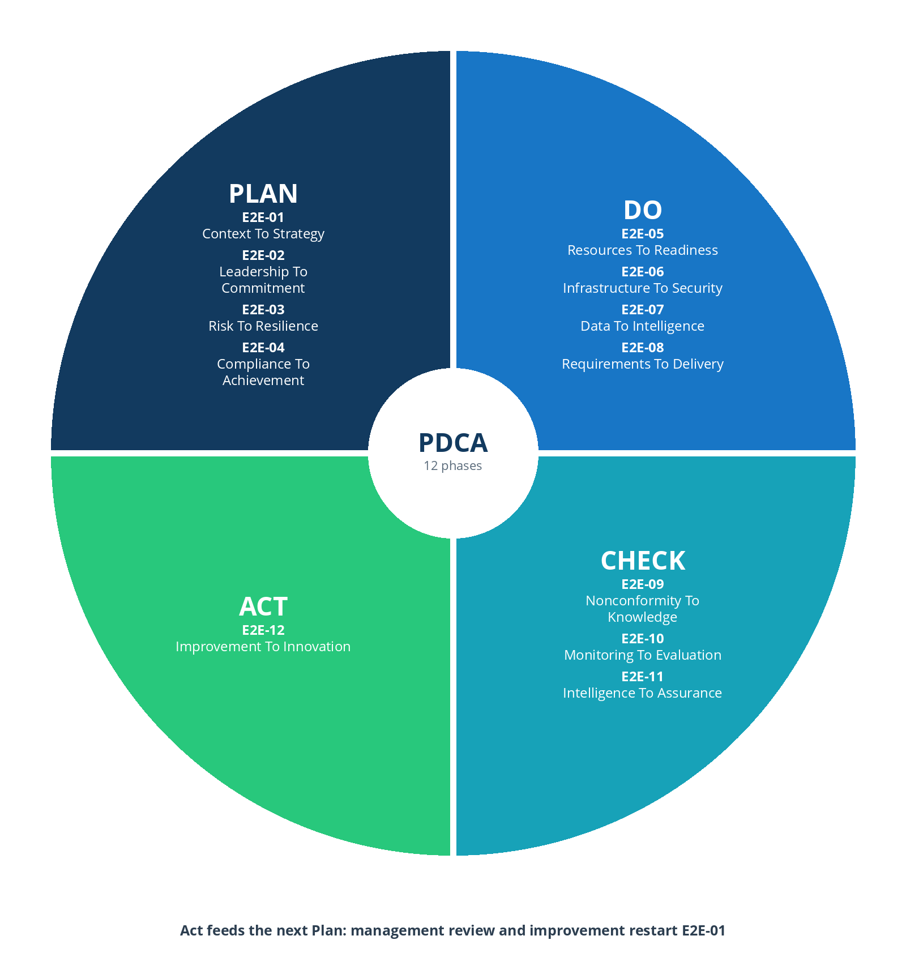
PDCA
Twelve phases on one Plan-Do-Check-Act cycle
E2E | Name | PDCA | MP | Steps | Gate
E2E-01 | Context To Strategy | Plan | 13 | 136 | Go
E2E-02 | Leadership To Commitment | Plan | 5 | 52 | Go
E2E-03 | Risk To Resilience | Plan | 6 | 58 | Go
E2E-04 | Compliance To Achievement | Plan | 5 | 50 | Go
E2E-05 | Resources To Readiness | Do | 4 | 50 | Go
E2E-06 | Infrastructure To Security | Do | 11 | 102 | Go
E2E-07 | Data To Intelligence | Do | 4 | 34 | Go
E2E-08 | Requirements To Delivery | Do | 8 | 73 | Go
E2E-09 | Nonconformity To Knowledge | Check | 12 | 109 | Go
E2E-10 | Monitoring To Evaluation | Check | 17 | 163 | Go
E2E-11 | Intelligence To Assurance | Check | 11 | 95 | Go
E2E-12 | Improvement To Innovation | Act | 15 | 135 | Active
POWERACT Consulting · The run
6

Slide 7
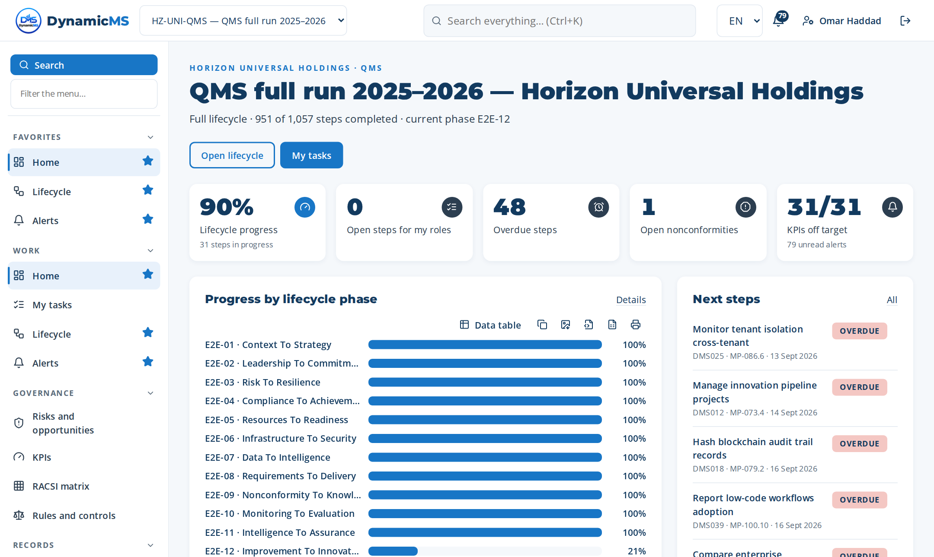
SCREENS
The project home: progress, next steps, KPIs
Home of project HZ-UNI-QMS.
POWERACT Consulting · The run
7

Slide 8
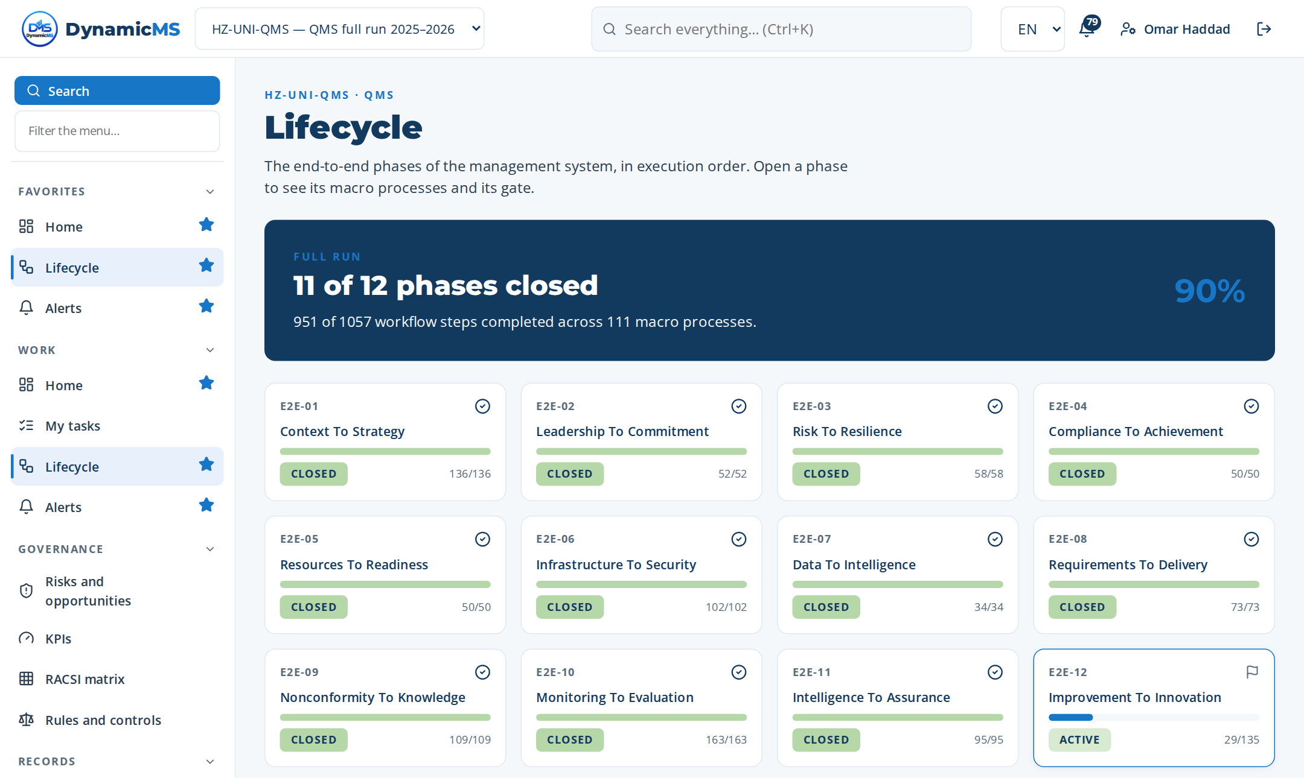
SCREENS
The lifecycle: twelve phases and their gates
Lifecycle screen: each card is an end-to-end process with its progress and gate.
POWERACT Consulting · The run
8

Slide 9
The full run, phase by phase
For each end-to-end process: its macro processes, one macro process down to its steps, and the screens.
POWERACT Consulting · The full run, phase by phase
9

Slide 10
PHASE 01 · PLAN
E2E-01 — Context To Strategy
Define context, policy, strategy, objectives, compliance, governance.
MACRO PROCESSES OF THIS PHASE
MP-001 Context Analysis and Stakeholder Mapping
MP-002 Quality Policy and Strategic Direction Defi…
MP-003 Quality Objectives and Targets Deployment
MP-004 Process Architecture Mapping
MP-005 SIPOC and Value Stream Mapping
MP-012 Operational Risk and Opportunity Management
MP-027 Unified Requirements Harmonization
MP-028 Regulatory and Compliance Obligations Mappi…
MP-036 Policy and Procedure Governance
MP-037 Enterprise Risk Universe and Assessment
MP-038 Risk Treatment and Mitigation Planning
MP-095 Industry-Specific Compliance Pack Management
MP-105 Compliance Calendar and Obligation Scheduler
13
42
136
macro processes
tasks
steps
FROM TRIGGER TO RESULT
Trigger: Strategic planning cycle, management review output, or significant context change
Result: Approved policy, strategy, objectives, risk register, compliance framework in place
Gate: G1 — Strategy baseline approved — Go
POWERACT Consulting · E2E-01 — Context To Strategy
10

Slide 11
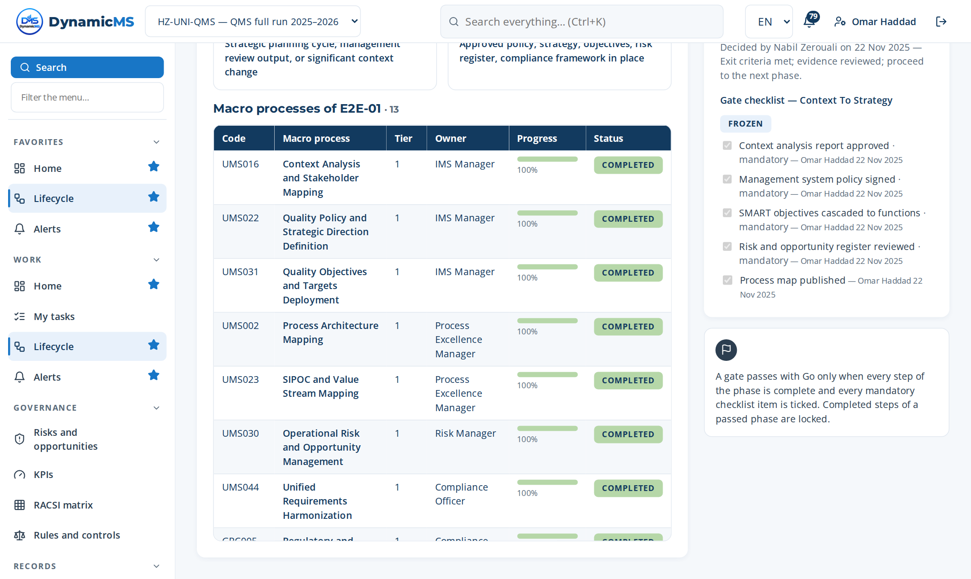
E2E-01 · SCREEN
Context To Strategy: the phase in the application
DELIVERS
Context, interested parties, scope, policy, SMART objectives, process map.
FEEDS
E2E-02 (commitment), E2E-03 (risks), E2E-10 (objective KPIs).
Lifecycle › E2E-01: macro processes of the phase with their progress and gate.
POWERACT Consulting · E2E-01 — Context To Strategy
11

Slide 12
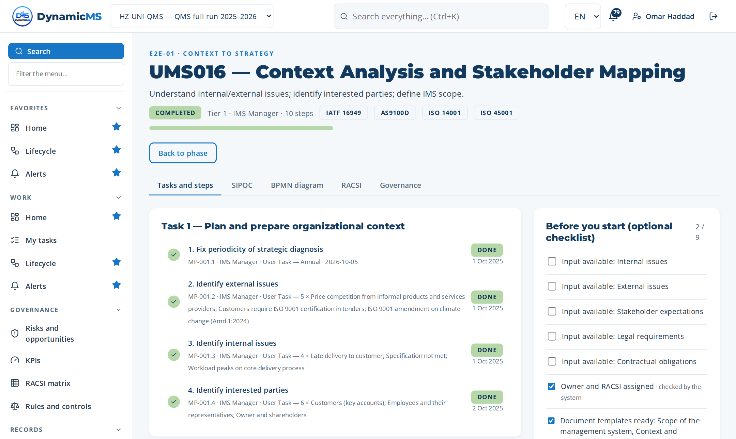
MACRO PROCESS · MP-001 (UMS016)
Context Analysis and Stakeholder Mapping
Understand internal/external issues; identify interested parties; define IMS scope. · Owner: IMS Manager · ISO 9001 §4.1, §4.2, §4.3
Step | Name | Role | What was recorded
MP-001.1 | Fix periodicity of strategic diagnosis | IMS Manager | Frequency: Annual
MP-001.2 | Identify external issues | IMS Manager | 5 rows in “External issues identified” — Price competition from infor…
MP-001.3 | Identify internal issues | IMS Manager | 4 rows in “Internal issues identified” — Late delivery to customer
MP-001.4 | Identify interested parties | IMS Manager | 6 rows in “Interested parties identified” — Customers (key accounts)
MP-001.5 | Determine needs and expectations of int… | IMS Manager | 8 rows in “Needs and expectations of the interested parties” — Servic…
MP-001.6 | Validate and cascade stakeholder requir… | IMS Manager | 3 rows in “Decision criteria checked” — Issues reviewed with top mana…
MP-001.7 | Identify interactions between processes | IMS Manager | 5 rows in “Interactions between macro processes” — Sales and quotation
MP-001.8 | Define or review the management system… | IMS Manager | 4 rows in “Management system scope identified” — Design and delivery…
MP-001.9 | Document and communicate the context an… | IMS Manager | Document template: TPL-SCOPE — Scope of the management system
MP-001.10 | Review organizational context periodica… | IMS Manager | 3 rows in “Inputs reviewed” — External and internal issues
3 tasks · 10 steps
T1 Plan and prepare organizational context
T2 Execute organizational context activities
T3 Verify, record and close organizational c…
POWERACT Consulting · E2E-01 — Context To Strategy
12

Slide 13
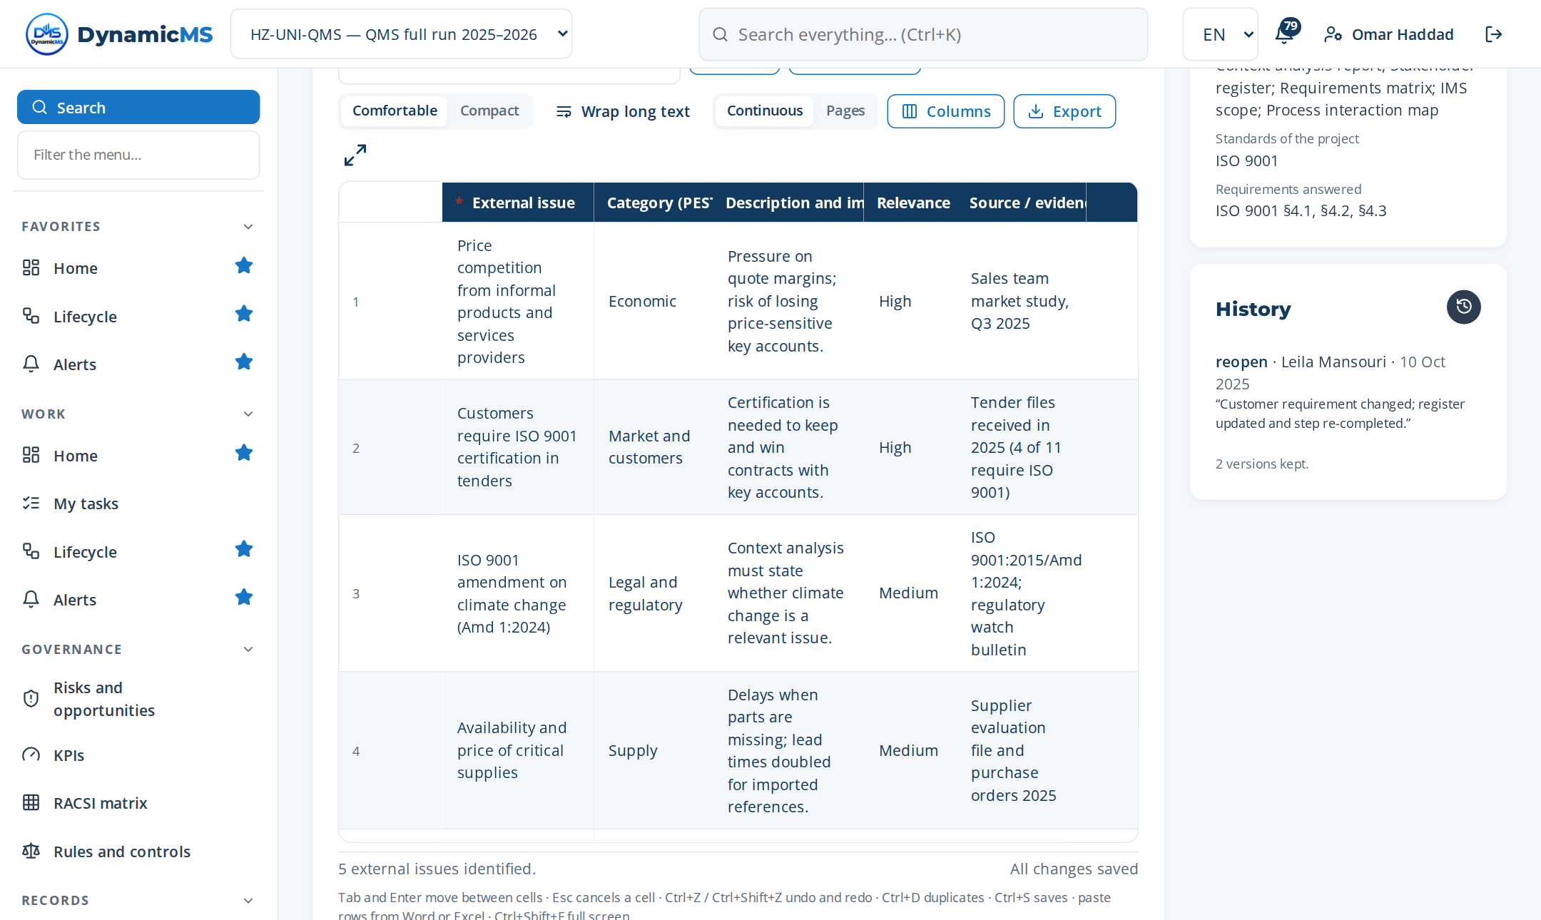
STEP · MP-001.2 · IMS MANAGER
Identify external issues
WHAT WAS RECORDED
External issues identified
• Price competition from informal p… — Economic
• Customers require ISO 9001 certif… — Market and customers
• ISO 9001 amendment on climate cha… — Legal and regulatory
• Availability and price of critica… — Supply
• Customers send requests through p… — Technological
Step MP-001.2 (Register items): rows typed, pasted or imported, saved as they are entered.
POWERACT Consulting · E2E-01 — Context To Strategy
13

Slide 14
PHASE 02 · PLAN
E2E-02 — Leadership To Commitment
Establish leadership, competence, communication, audit capability.
MACRO PROCESSES OF THIS PHASE
MP-013 Competence and Training Orchestration
MP-014 Management System Communication Plan Development
MP-026 Internal Auditor Qualification and Certification
MP-104 AI-Generated Microlearning and Training Content
MP-138 Collaborative Business Relationship Management
5
16
52
macro processes
tasks
steps
FROM TRIGGER TO RESULT
Trigger: E2E-01 completion or leadership change
Result: Competent personnel, communication plan, qualified auditors in place
Gate: G2 — People and communication ready — Go
POWERACT Consulting · E2E-02 — Leadership To Commitment
14

Slide 15
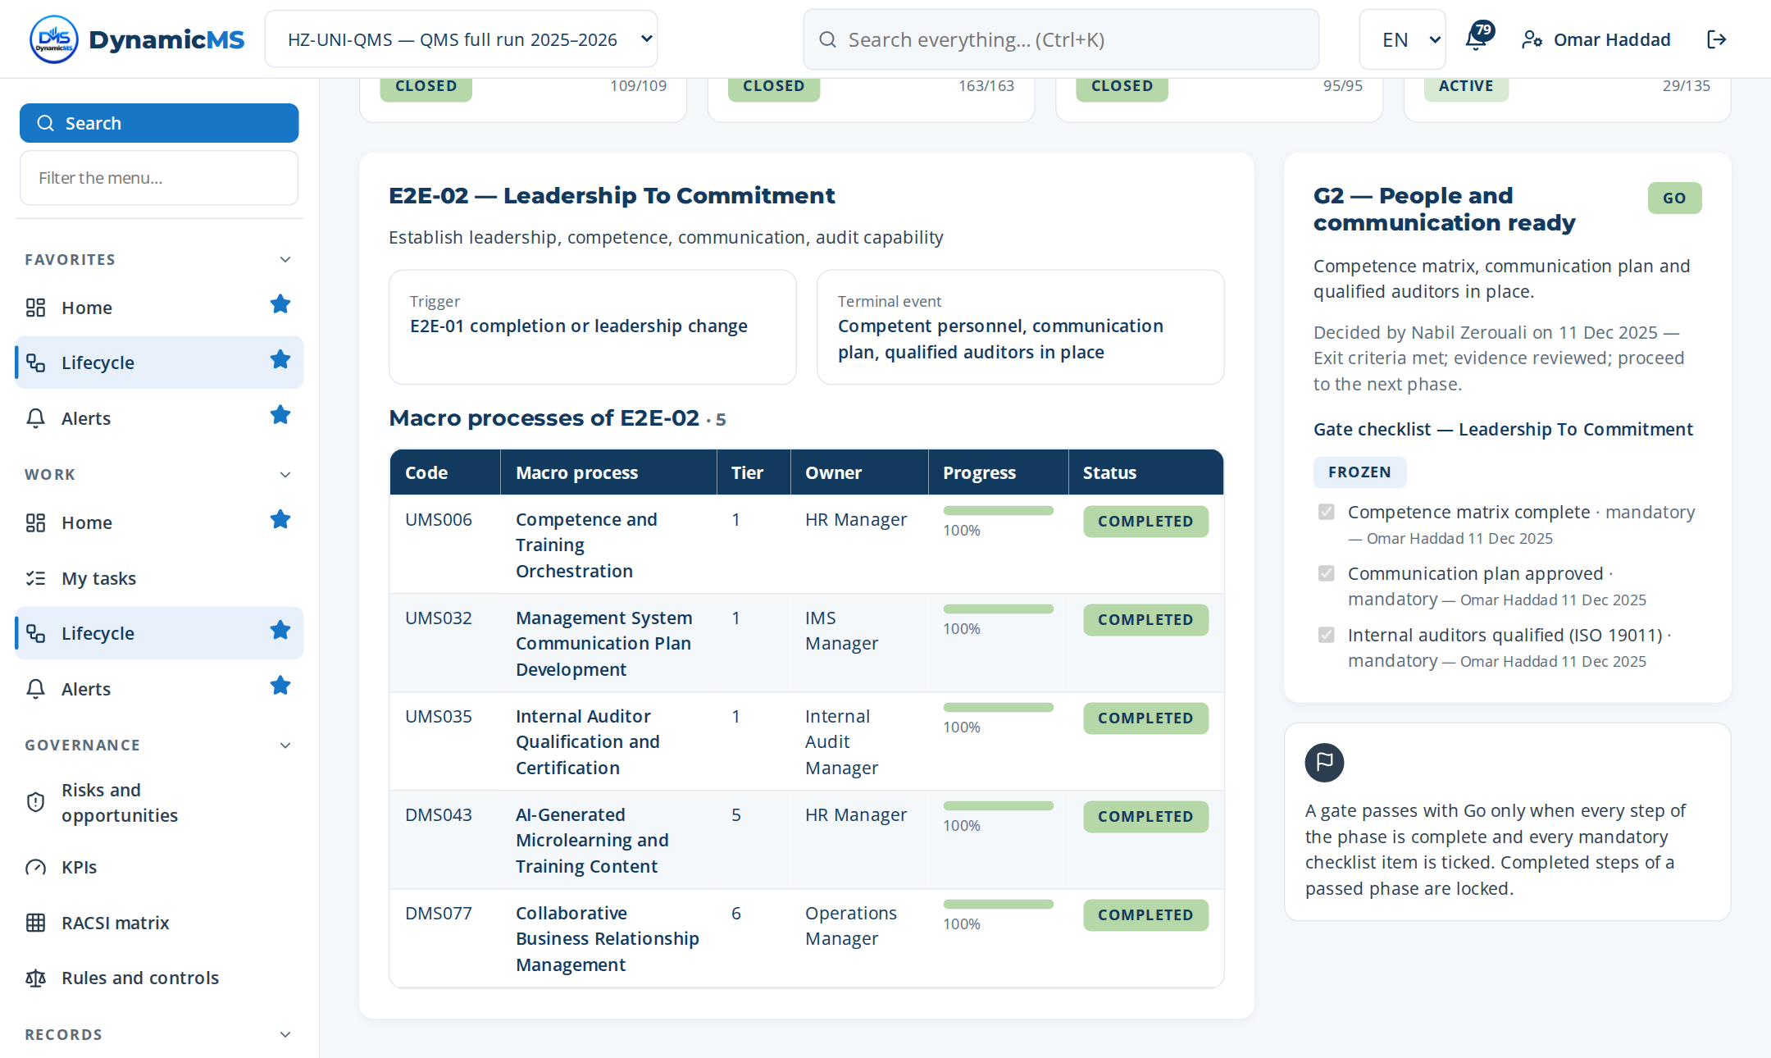
E2E-02 · SCREEN
Leadership To Commitment: the phase in the application
DELIVERS
Roles, RACSI, governance bodies, leadership commitments and communication.
FEEDS
Every phase (owners and approvers); E2E-10 (management review).
Lifecycle › E2E-02: macro processes of the phase with their progress and gate.
POWERACT Consulting · E2E-02 — Leadership To Commitment
15

Slide 16
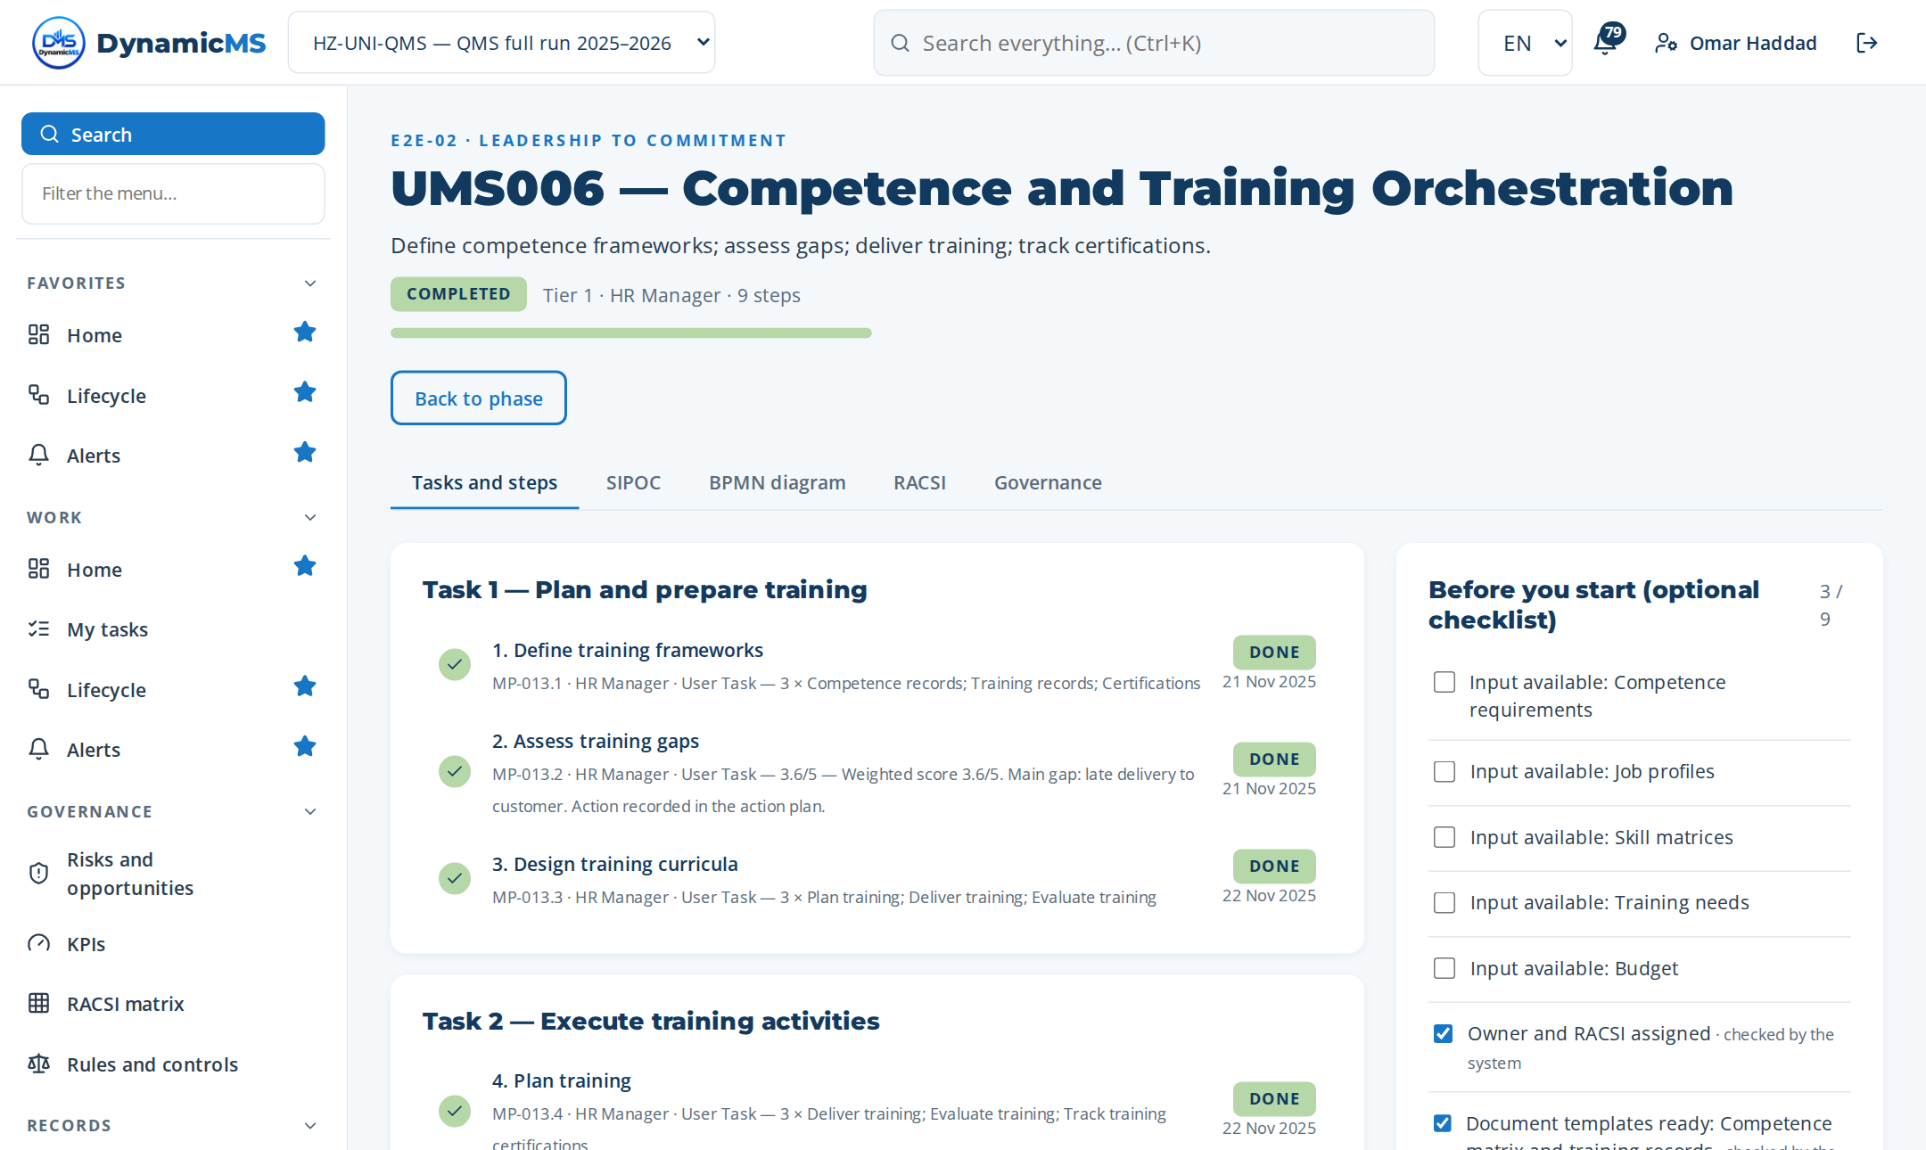
MACRO PROCESS · MP-013 (UMS006)
Competence and Training Orchestration
Define competence frameworks; assess gaps; deliver training; track certifications. · Owner: HR Manager · ISO 9001 §7.2, §7.3
Step | Name | Role | What was recorded
MP-013.1 | Define training frameworks | HR Manager | 3 rows in “Training frameworks identified” — Competence records
MP-013.2 | Assess training gaps | HR Manager | 4 rows in “Decision matrix” — Competence records complete and up to…
MP-013.3 | Design training curricula | HR Manager | 3 rows in “Planned activities (become actions)” — Plan training
MP-013.4 | Plan training | HR Manager | 3 rows in “Planned activities (become actions)” — Deliver training
MP-013.5 | Deliver training | HR Manager | Session / module: Deliver training — practice session
MP-013.6 | Evaluate training | HR Manager | 4 rows in “Decision matrix” — Competence records complete and up to…
MP-013.7 | Track training certifications | HR Manager | 1 rows in “Indicators measured” — KPI-04 — Competence gap closure rate
MP-013.8 | Certify training | HR Manager | 3 rows in “Decision criteria checked” — Competence records complete
MP-013.9 | Update training | HR Manager | Change made: Competence records updated: Use of an obsolete document…
3 tasks · 9 steps
T1 Plan and prepare training
T2 Execute training activities
T3 Verify, record and close training
POWERACT Consulting · E2E-02 — Leadership To Commitment
16

Slide 17
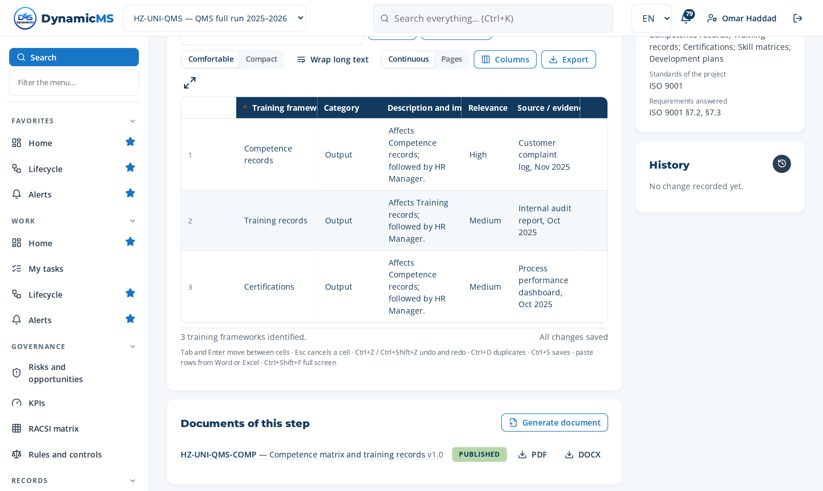
STEP · MP-013.1 · HR MANAGER
Define training frameworks
WHAT WAS RECORDED
Training frameworks identified
• Competence records — Output
• Training records — Output
• Certifications — Output
Step MP-013.1 (Register items): rows typed, pasted or imported, saved as they are entered.
POWERACT Consulting · E2E-02 — Leadership To Commitment
17

Slide 18
PHASE 03 · PLAN
E2E-03 — Risk To Resilience
Manage controls, third-party risk, continuity, functional safety, process safety, crisis.
MACRO PROCESSES OF THIS PHASE
MP-049 Internal Controls and SOX Certification
MP-050 Third-Party and Supplier Risk Monitoring
MP-051 Whistleblowing and Incident Investigation
MP-052 Business Continuity and Crisis Preparedness
MP-098 Continuous Controls Monitoring and Automated Testing
MP-108 Crisis Communication and Reputation Management
6
18
58
macro processes
tasks
steps
FROM TRIGGER TO RESULT
Trigger: Risk assessment cycle, incident, regulatory change, or functional safety requirement
Result: Controls, third-party risk managed, continuity tested, functional/process safety assured, crisis ready
Gate: G3 — Risk controls effective — Go
POWERACT Consulting · E2E-03 — Risk To Resilience
18

Slide 19
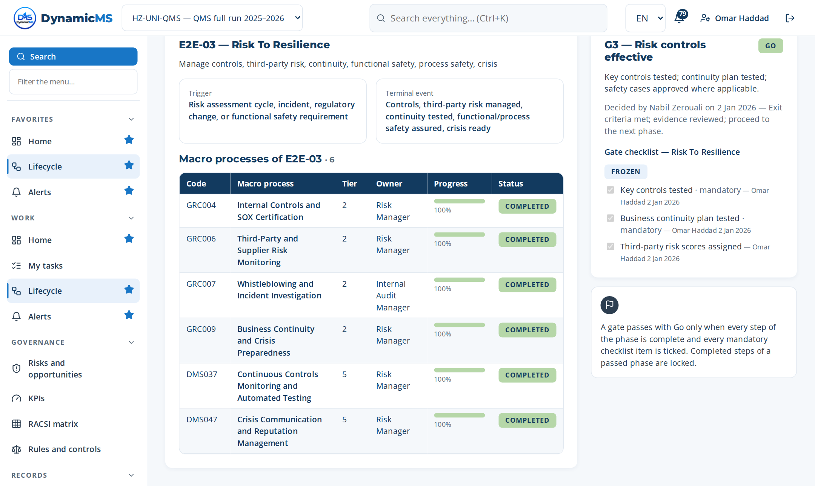
E2E-03 · SCREEN
Risk To Resilience: the phase in the application
DELIVERS
Risk and opportunity register, treatments, business continuity.
FEEDS
E2E-05 to E2E-08 (controls in operations); E2E-11 (audit universe).
Lifecycle › E2E-03: macro processes of the phase with their progress and gate.
POWERACT Consulting · E2E-03 — Risk To Resilience
19

Slide 20
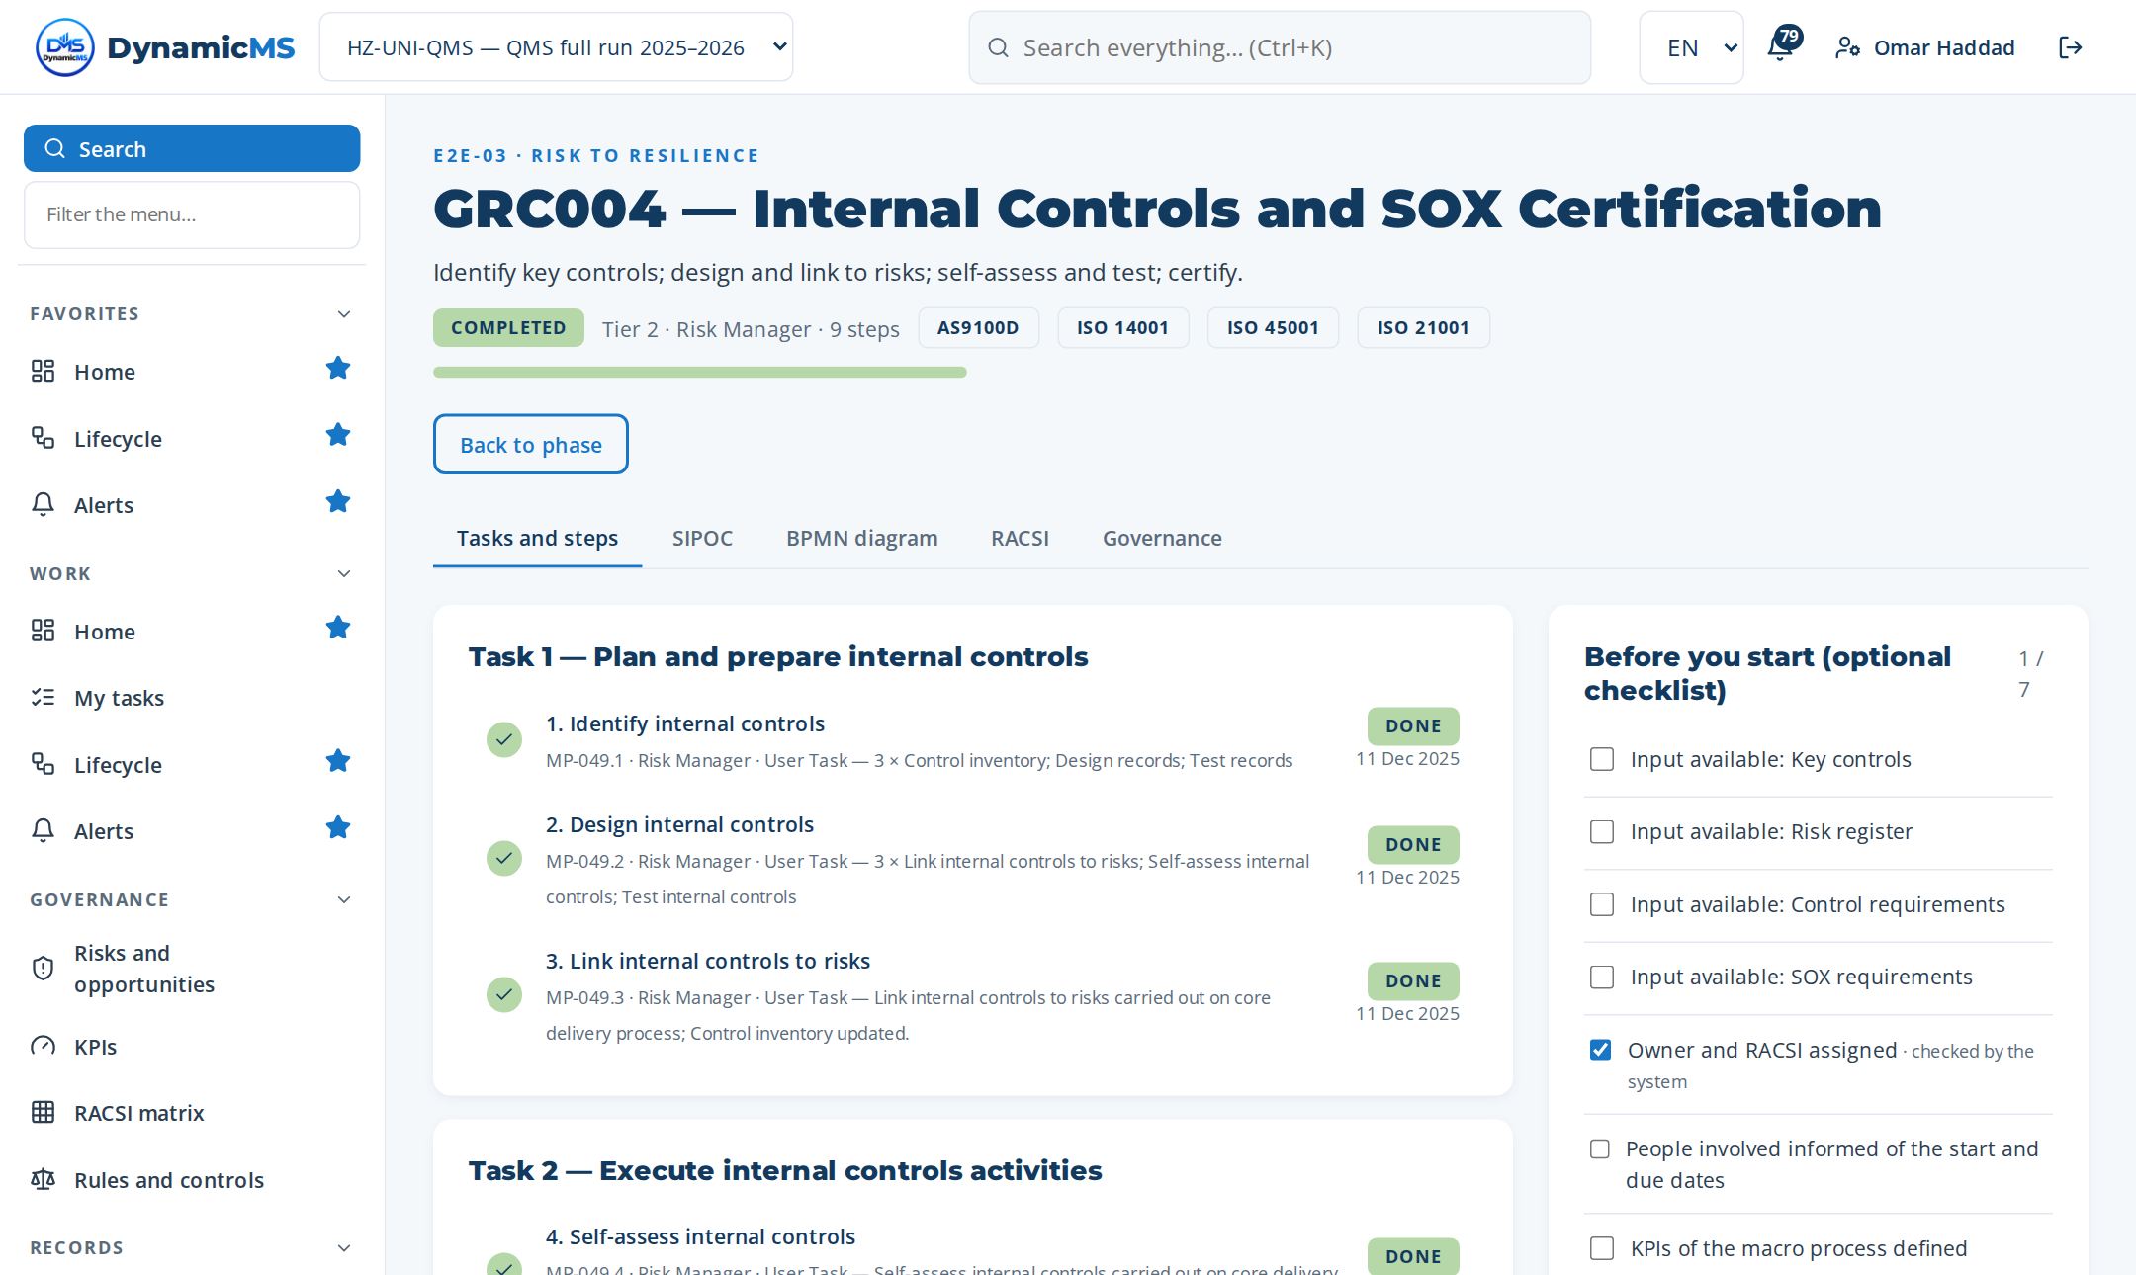
MACRO PROCESS · MP-049 (GRC004)
Internal Controls and SOX Certification
Identify key controls; design and link to risks; self-assess and test; certify. · Owner: Risk Manager
Step | Name | Role | What was recorded
MP-049.1 | Identify internal controls | Risk Manager | 3 rows in “Internal controls identified” — Control inventory
MP-049.2 | Design internal controls | Risk Manager | 3 rows in “Planned activities (become actions)” — Link internal contr…
MP-049.3 | Link internal controls to risks | Risk Manager | What was done: Link internal controls to risks carried out on core de…
MP-049.4 | Self-assess internal controls | Risk Manager | What was done: Self-assess internal controls carried out on core deli…
MP-049.5 | Test internal controls | Risk Manager | 4 rows in “Decision matrix” — Control inventory complete and up to…
MP-049.6 | Document internal controls deficiencies | Risk Manager | Document template: TPL-PROC — Procedure
MP-049.7 | Remediate internal controls | Risk Manager | Change made: Control inventory updated: Use of an obsolete document v…
MP-049.8 | Certify internal controls | Risk Manager | 3 rows in “Decision criteria checked” — Control inventory complete
MP-049.9 | Maintain internal controls repository | Risk Manager | Document template: TPL-PROC — Procedure
3 tasks · 9 steps
T1 Plan and prepare internal controls
T2 Execute internal controls activities
T3 Verify, record and close internal controls
POWERACT Consulting · E2E-03 — Risk To Resilience
20

Slide 21
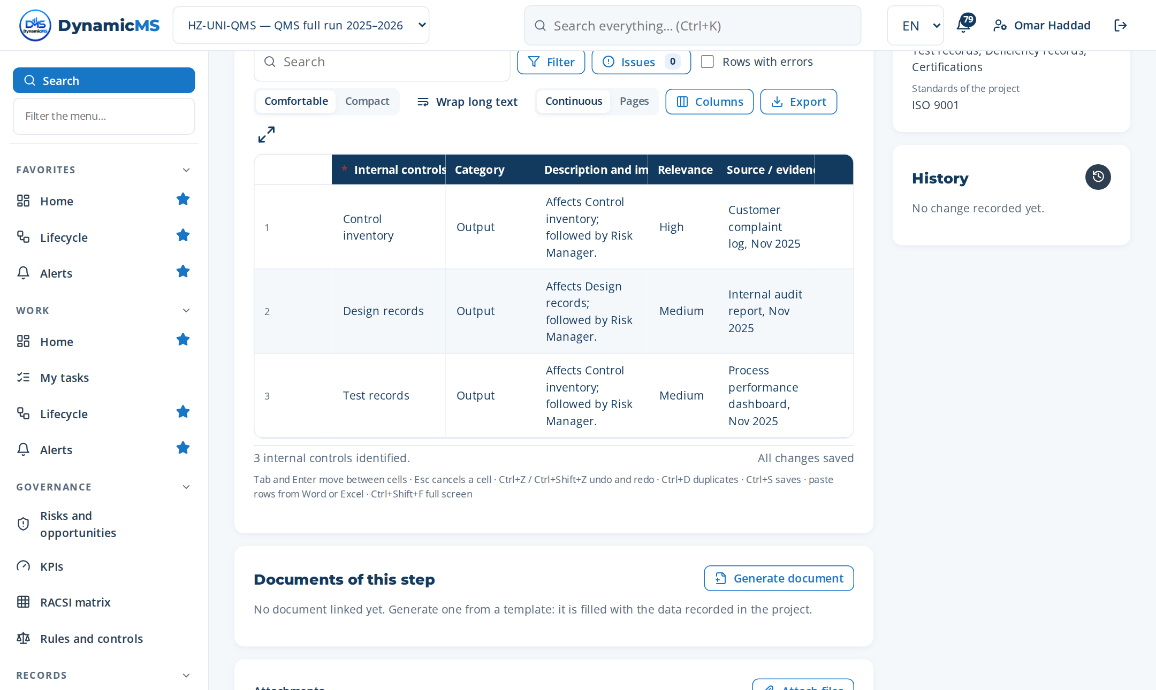
STEP · MP-049.1 · RISK MANAGER
Identify internal controls
WHAT WAS RECORDED
Internal controls identified
• Control inventory — Output
• Design records — Output
• Test records — Output
Step MP-049.1 (Register items): rows typed, pasted or imported, saved as they are entered.
POWERACT Consulting · E2E-03 — Risk To Resilience
21

Slide 22
PHASE 04 · PLAN
E2E-04 — Compliance To Achievement
Deploy, audit, certify, maintain the management system.
MACRO PROCESSES OF THIS PHASE
MP-015 Management System Deployment and Implementation
MP-016 Mock Audit, Pre-Certification, and Gap Diagnosis
MP-017 Certification Audit Preparation and Coordination
MP-096 Multi-Standard Certification Portfolio Management
MP-130 Anti-Bribery and Corruption Management
5
15
50
macro processes
tasks
steps
FROM TRIGGER TO RESULT
Trigger: Readiness for certification, surveillance audit due, or new compliance obligation
Result: Certification achieved or maintained; findings closed; compliance obligations met
Gate: G4 — Ready for certification — Go
POWERACT Consulting · E2E-04 — Compliance To Achievement
22

Slide 23
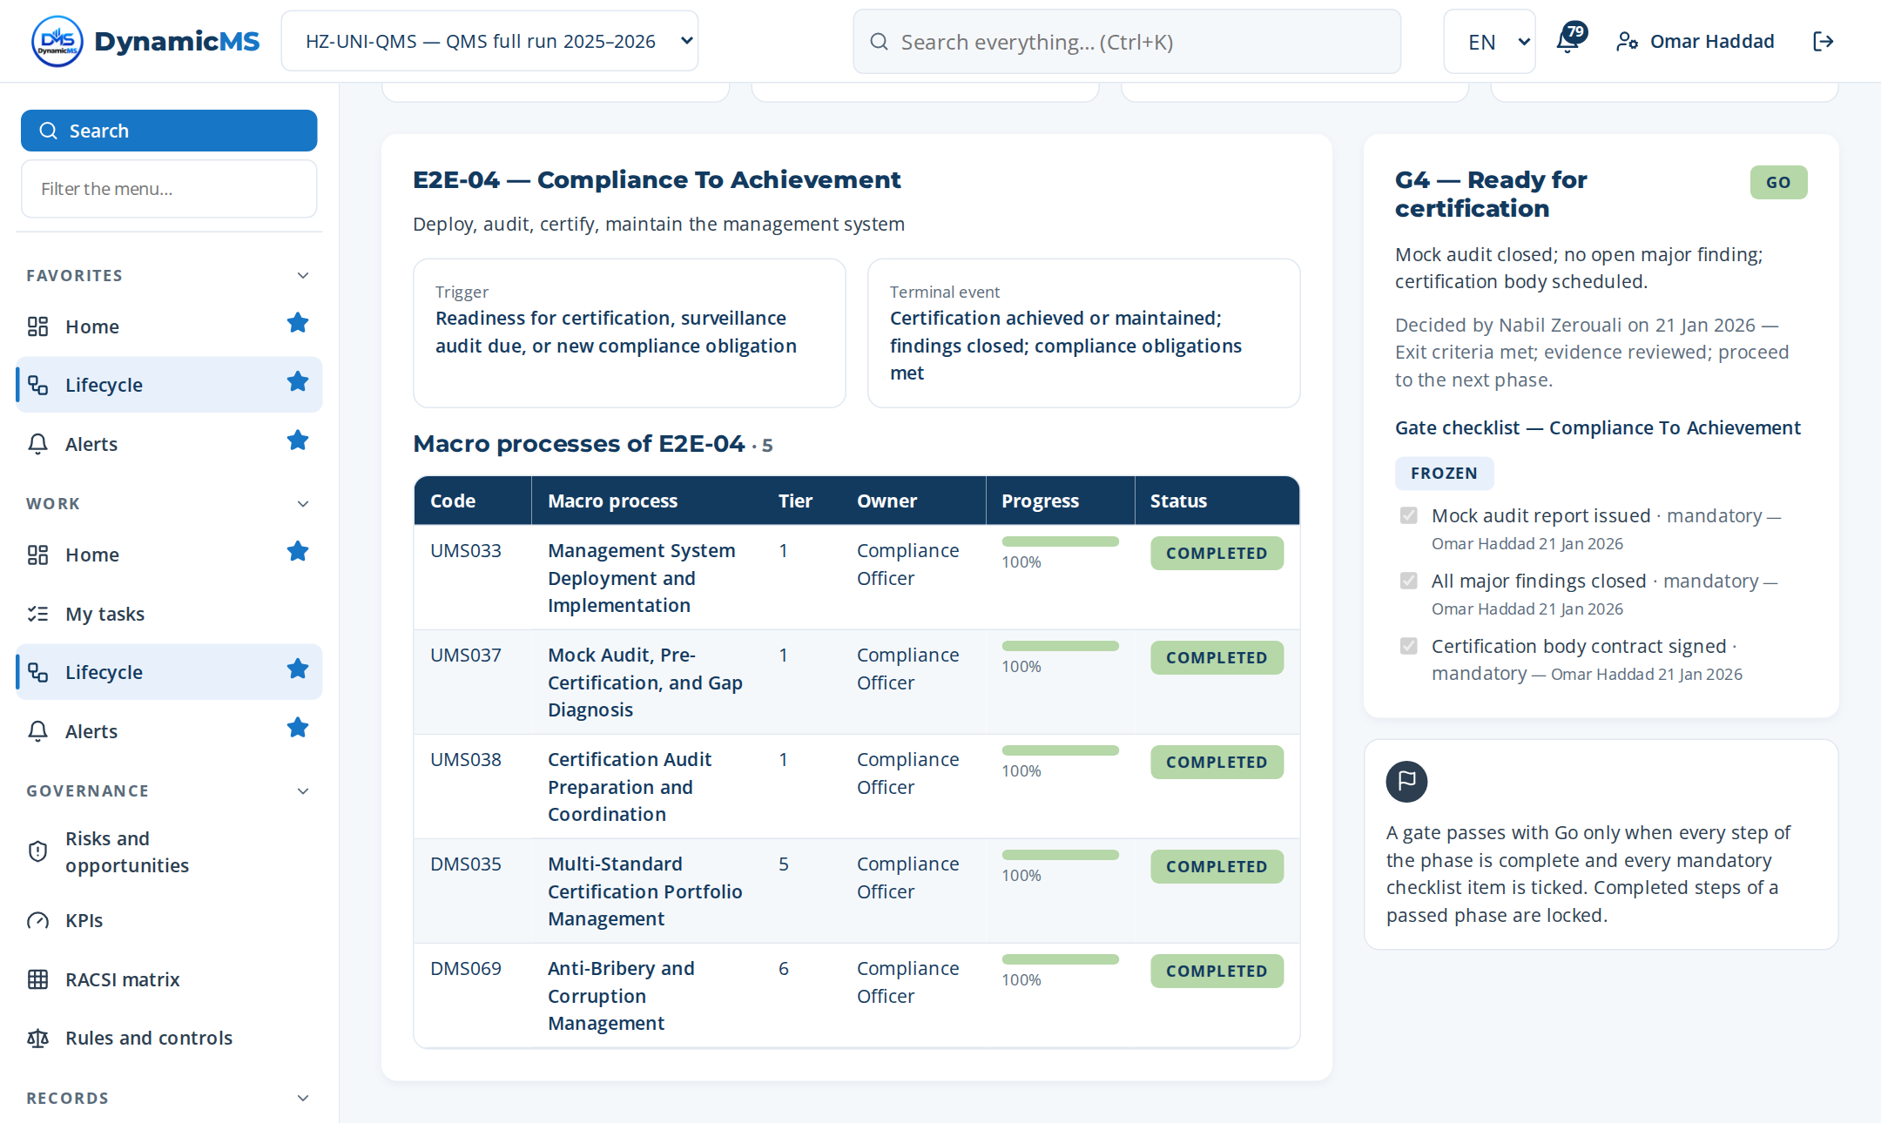
E2E-04 · SCREEN
Compliance To Achievement: the phase in the application
DELIVERS
Compliance obligations register, evaluation of compliance, certification plan.
FEEDS
E2E-08 (requirements), E2E-11 (assurance), E2E-10 (review inputs).
Lifecycle › E2E-04: macro processes of the phase with their progress and gate.
POWERACT Consulting · E2E-04 — Compliance To Achievement
23

Slide 24
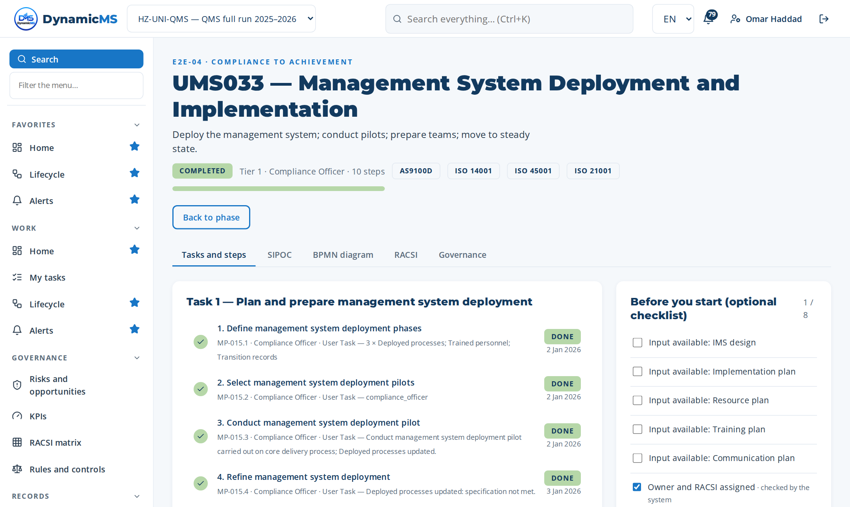
MACRO PROCESS · MP-015 (UMS033)
Management System Deployment and Implementation
Deploy the management system; conduct pilots; prepare teams; move to steady state. · Owner: Compliance Officer · ISO 9001 §8.1
Step | Name | Role | What was recorded
MP-015.1 | Define management system deployment pha… | Compliance Officer | 3 rows in “Management system deployment phases identified” — Deployed…
MP-015.2 | Select management system deployment pil… | Compliance Officer | 1 rows in “RACSI of the macro process” — Compliance Officer
MP-015.3 | Conduct management system deployment pi… | Compliance Officer | What was done: Conduct management system deployment pilot carried out…
MP-015.4 | Refine management system deployment | Compliance Officer | Change made: Deployed processes updated: specification not met.
MP-015.5 | Prepare management system deployment te… | Compliance Officer | Document template: TPL-PROC — Procedure
MP-015.6 | Validate management system deployment s… | Compliance Officer | 3 rows in “Decision criteria checked” — Deployed processes complete
MP-015.7 | Verify management system deployment rea… | Compliance Officer | 4 rows in “Decision matrix” — Deployed processes complete and up to…
MP-015.8 | Execute management system deployment tr… | Compliance Officer | What was done: Execute management system deployment transition carrie…
MP-015.9 | Support management system deployment us… | Compliance Officer | What was done: Support management system deployment users carried out…
MP-015.10 | Move to steady state | Compliance Officer | What was done: Move to steady state carried out on core delivery proc…
3 tasks · 10 steps
T1 Plan and prepare management system deploy…
T2 Execute management system deployment acti…
T3 Verify, record and close management syste…
POWERACT Consulting · E2E-04 — Compliance To Achievement
24

Slide 25
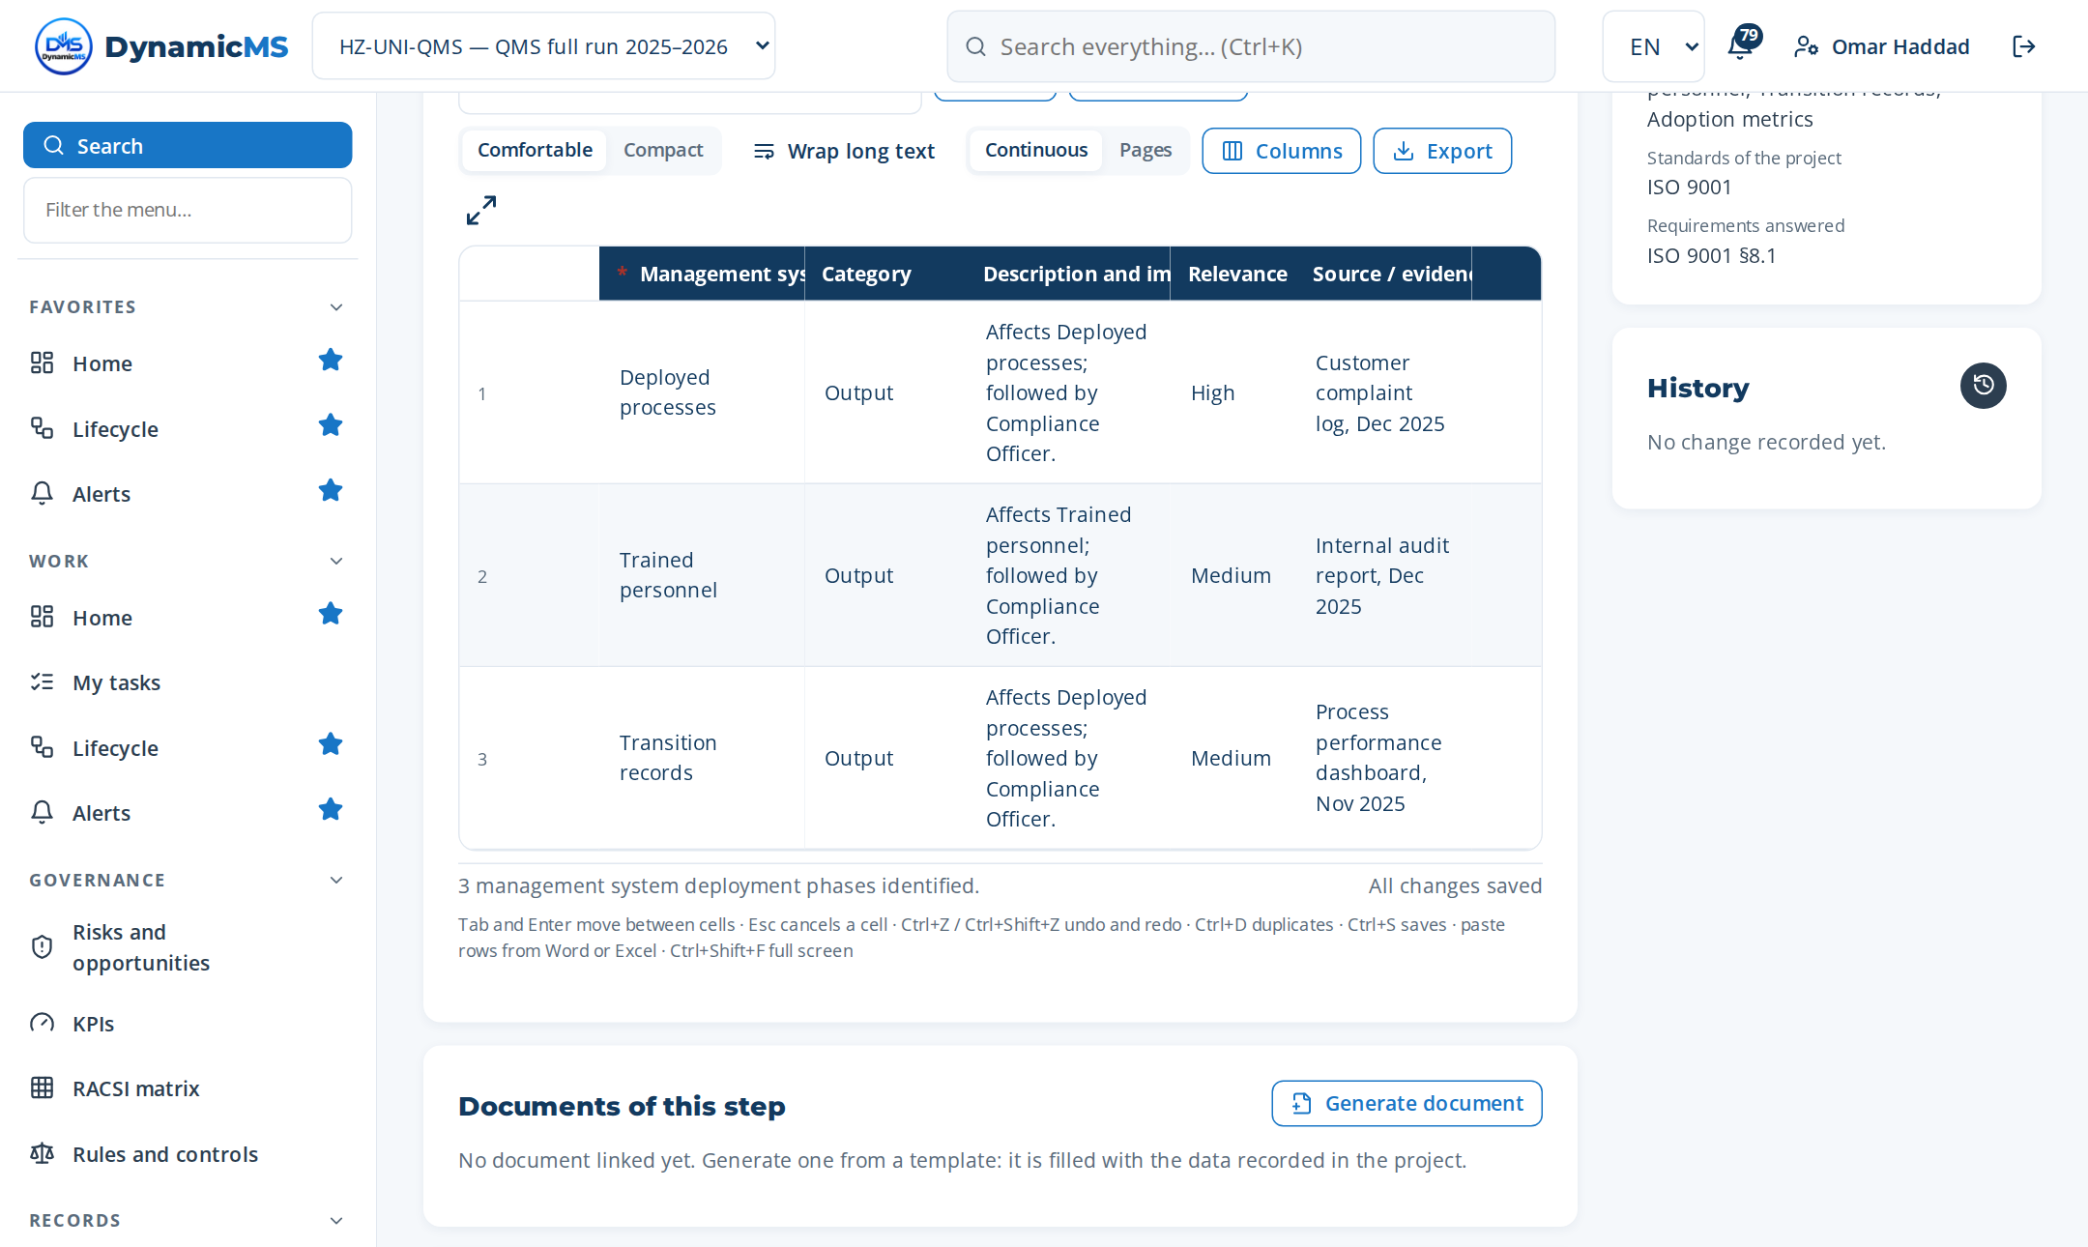
STEP · MP-015.1 · COMPLIANCE OFFICER
Define management system deployment phases
WHAT WAS RECORDED
Management system deployment phases identified
• Deployed processes — Output
• Trained personnel — Output
• Transition records — Output
Step MP-015.1 (Register items): rows typed, pasted or imported, saved as they are entered.
POWERACT Consulting · E2E-04 — Compliance To Achievement
25

Slide 26
PHASE 05 · DO
E2E-05 — Resources To Readiness
Provide people, competence, documentation, records, measurement, health.
MACRO PROCESSES OF THIS PHASE
MP-006 Procedures and Work Instructions Development
MP-025 Monitoring and Measurement Resources Control
MP-029 Documentary Lifecycle Control
MP-030 Records Lifecycle, Retention, and Evidence Governance
4
15
50
macro processes
tasks
steps
FROM TRIGGER TO RESULT
Trigger: IMS deployment, new hire, documentation change, or medical surveillance requirement
Result: Competent people, controlled documentation, calibrated equipment, health records
Gate: G5 — Documented information controlled — Go
POWERACT Consulting · E2E-05 — Resources To Readiness
26

Slide 27
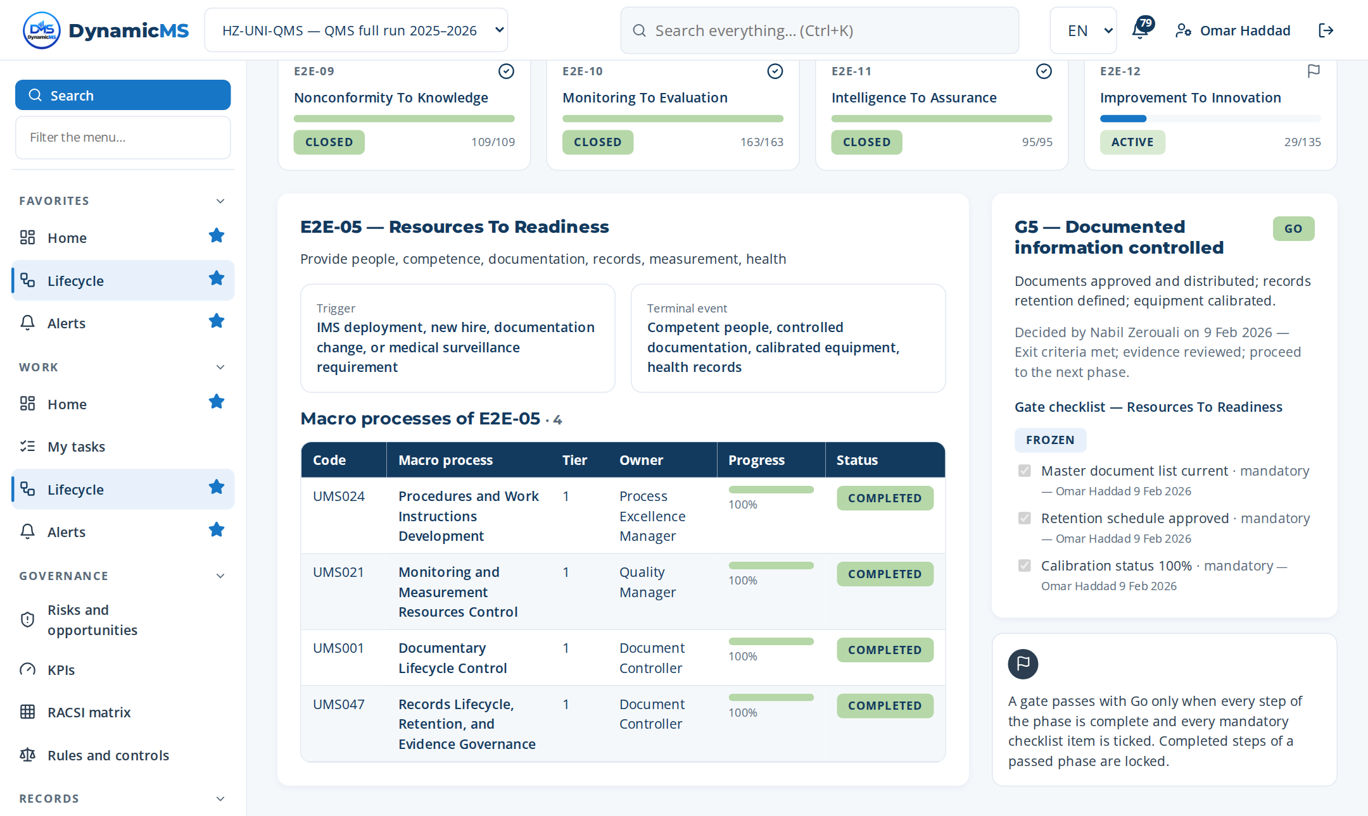
E2E-05 · SCREEN
Resources To Readiness: the phase in the application
DELIVERS
Competent people, documented information, measuring resources ready for operation.
FEEDS
E2E-08 (delivery); E2E-09 (calibration and competence nonconformities).
Lifecycle › E2E-05: macro processes of the phase with their progress and gate.
POWERACT Consulting · E2E-05 — Resources To Readiness
27

Slide 28
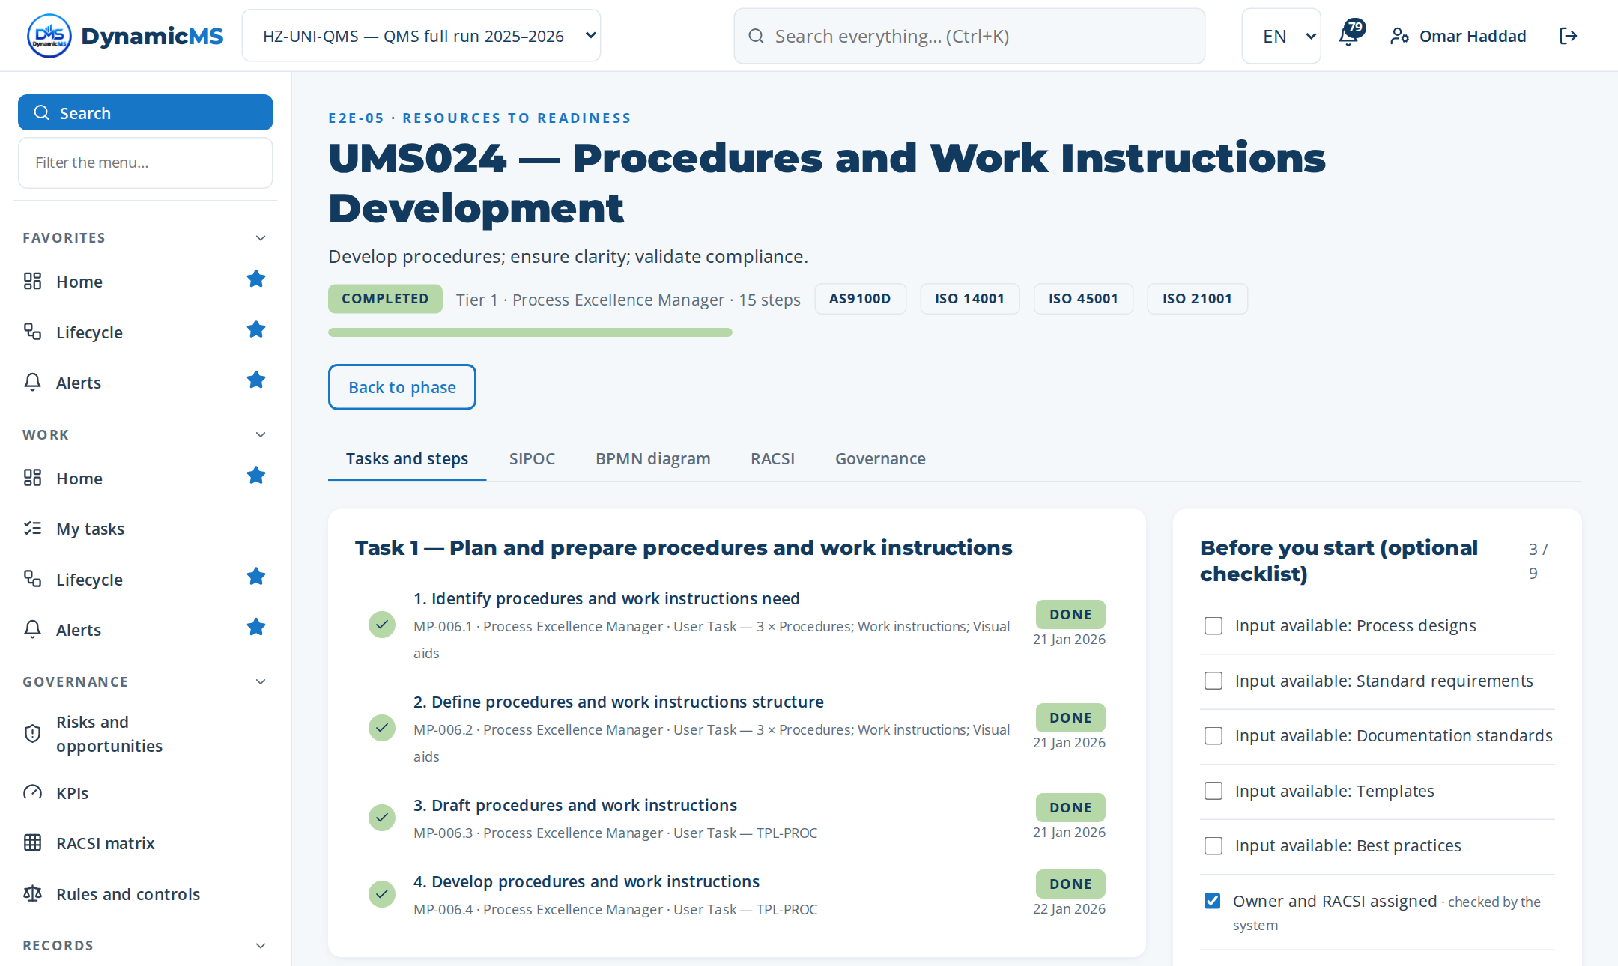
MACRO PROCESS · MP-006 (UMS024)
Procedures and Work Instructions Development
Develop procedures; ensure clarity; validate compliance. · Owner: Process Excellence Manager · ISO 9001 §7.5, §8.1
Step | Name | Role | What was recorded
MP-006.1 | Identify procedures and work instructio… | Process Excellence Ma… | 3 rows in “Procedures and work instructions need identified” — Proced…
MP-006.2 | Define procedures and work instructions… | Process Excellence Ma… | 3 rows in “Procedures and work instructions structure identified” — P…
MP-006.3 | Draft procedures and work instructions | Process Excellence Ma… | Document template: TPL-PROC — Procedure
MP-006.4 | Develop procedures and work instructions | Process Excellence Ma… | Document template: TPL-PROC — Procedure
MP-006.5 | Integrate visual supports | Process Excellence Ma… | 2 rows in “Settings” — Integrate visual supports
MP-006.6 | Validate procedures and work instructio… | Process Excellence Ma… | 3 rows in “Decision criteria checked” — Procedures complete
MP-006.7 | Verify procedures and work instructions… | Process Excellence Ma… | 4 rows in “Decision matrix” — Procedures complete and up to date
MP-006.8 | Submit procedures and work instructions… | Process Excellence Ma… | What was done: Submit procedures and work instructions for approval c…
MP-006.9 | Publish procedures and work instructions | Process Excellence Ma… | Document template: TPL-PROC — Procedure
MP-006.10 | Train staff on procedures and work inst… | Process Excellence Ma… | Session / module: Train staff on procedures and work instructions — p…
MP-006.11 | Plan procedures and work instructions r… | Process Excellence Ma… | 3 rows in “Inputs reviewed” — Process designs
MP-006.12 | Create procedure header | Process Excellence Ma… | Document template: TPL-PROC — Procedure
… | 3 more steps
4 tasks · 15 steps
T1 Plan and prepare procedures and work inst…
T2 Execute procedures and work instructions…
T3 Verify, record and close procedures and w…
T4 Author Task Procedures (Use Cases)
POWERACT Consulting · E2E-05 — Resources To Readiness
28

Slide 29
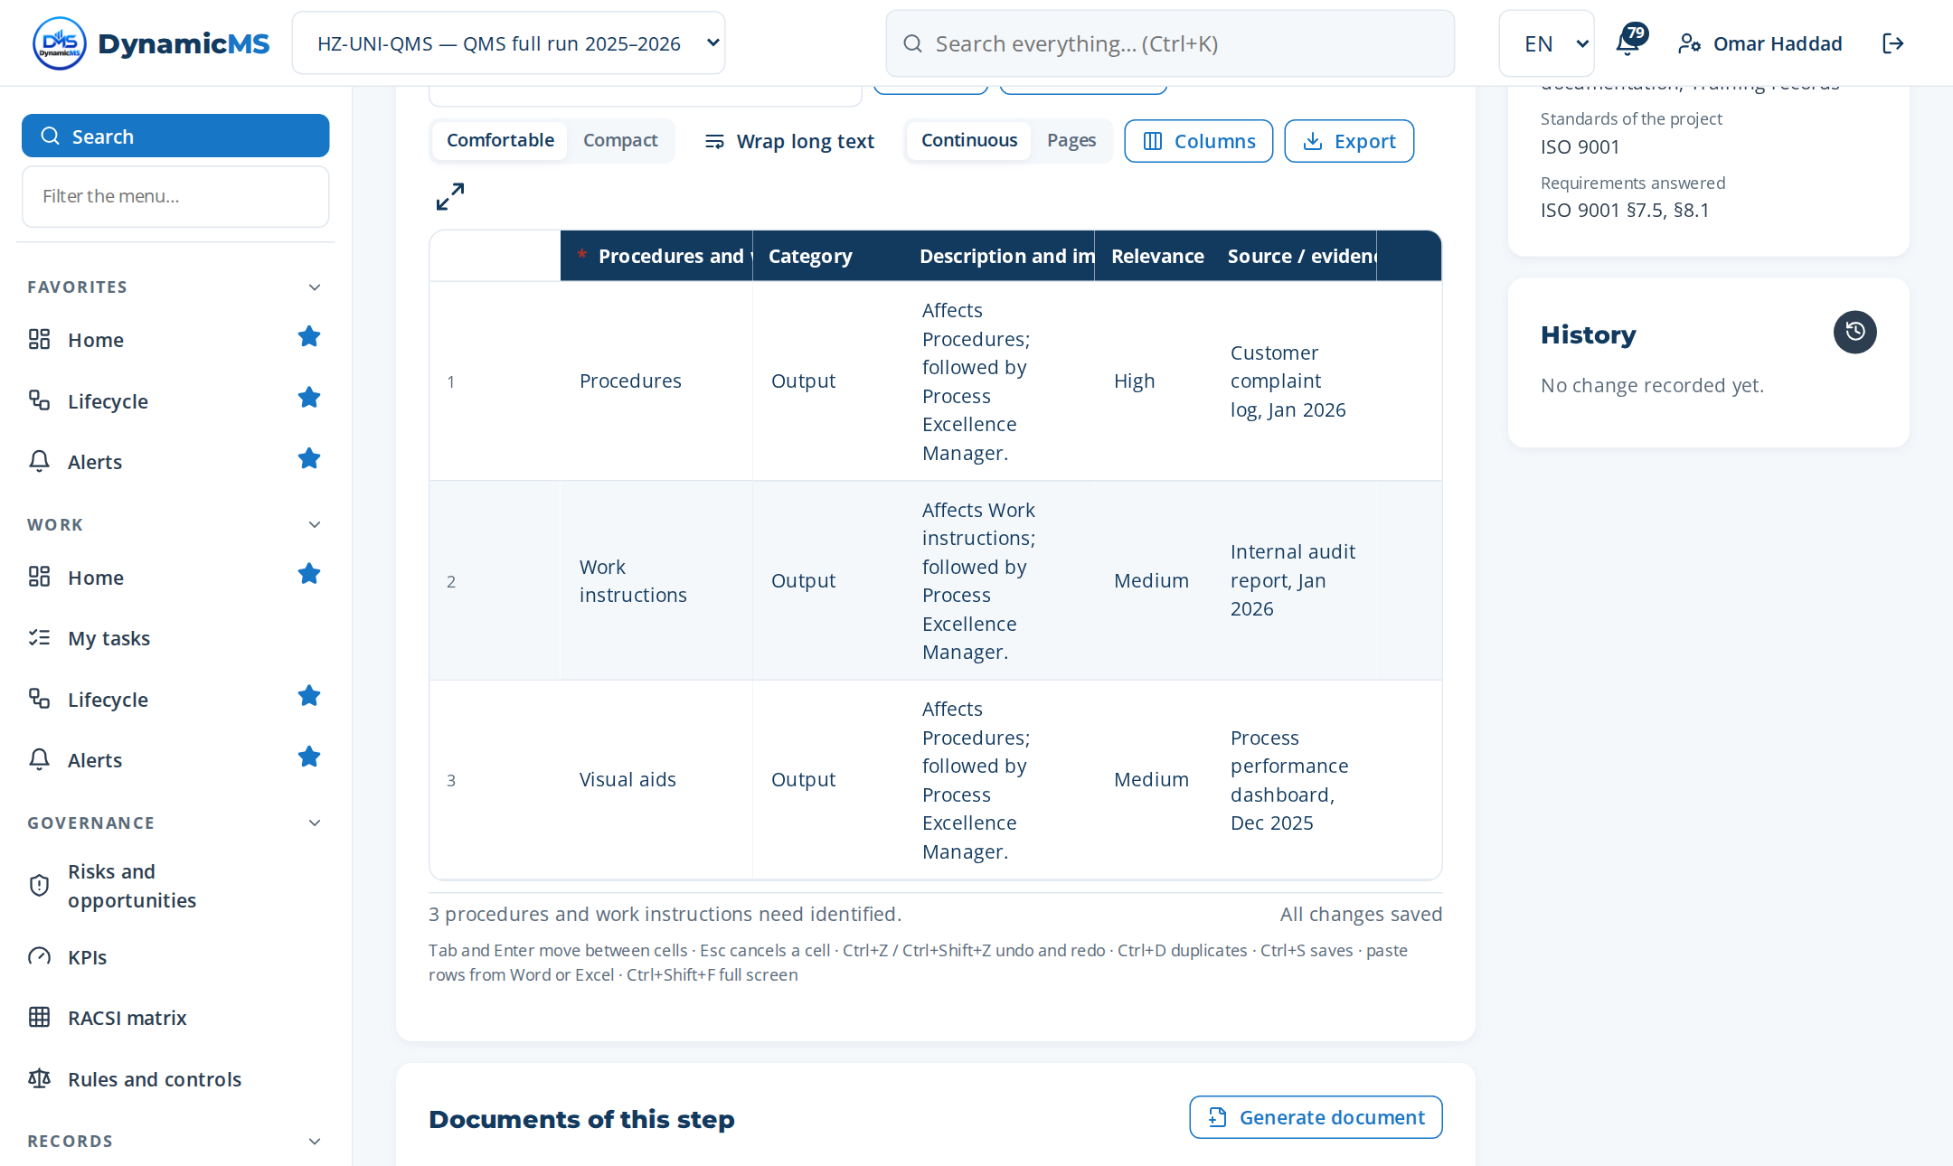
STEP · MP-006.1 · PROCESS EXCELLENCE MANAGER
Identify procedures and work instructions need
WHAT WAS RECORDED
Procedures and work instructions need identified
• Procedures — Output
• Work instructions — Output
• Visual aids — Output
Step MP-006.1 (Register items): rows typed, pasted or imported, saved as they are entered.
POWERACT Consulting · E2E-05 — Resources To Readiness
29

Slide 30
PHASE 06 · DO
E2E-06 — Infrastructure To Security
Provide IT, security, data, technology, environmental infrastructure.
MACRO PROCESSES OF THIS PHASE
MP-042 Cyber GRC and IT Control
MP-043 Personal Data Protection Management
MP-045 Access, Security, and Role Governance
MP-046 Application and Interface Repository
MP-047 Technology and Architecture Lifecycle
MP-048 Tenant Sovereignty and Security Governance
MP-059 Configuration and Parameter Governance
MP-119 Asset Reliability and Maintenance Management
MP-133 Facility Management
MP-134 IT Service Management
MP-135 Cloud Security and Privacy Management
11
35
102
macro processes
tasks
steps
FROM TRIGGER TO RESULT
Trigger: IT infrastructure change, security threat, data protection requirement, environmental requirement, or facilit…
Result: Secure compliant IT; data protection; cleanrooms monitored; facilities managed; asset reliability; water effi…
Gate: G6 — Infrastructure secured — Go
POWERACT Consulting · E2E-06 — Infrastructure To Security
30

Slide 31
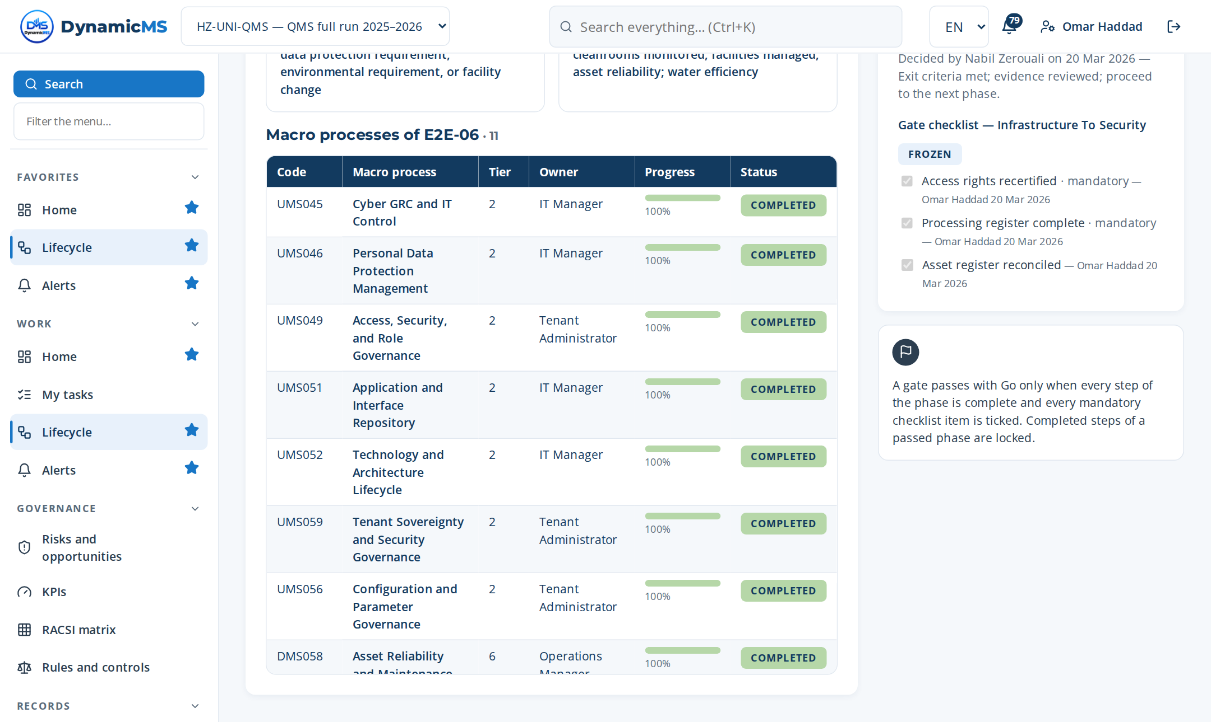
E2E-06 · SCREEN
Infrastructure To Security: the phase in the application
DELIVERS
Facilities, IT services and information security in a controlled state.
FEEDS
E2E-07 (data platform); E2E-08 (operations); E2E-09 (incidents).
Lifecycle › E2E-06: macro processes of the phase with their progress and gate.
POWERACT Consulting · E2E-06 — Infrastructure To Security
31

Slide 32
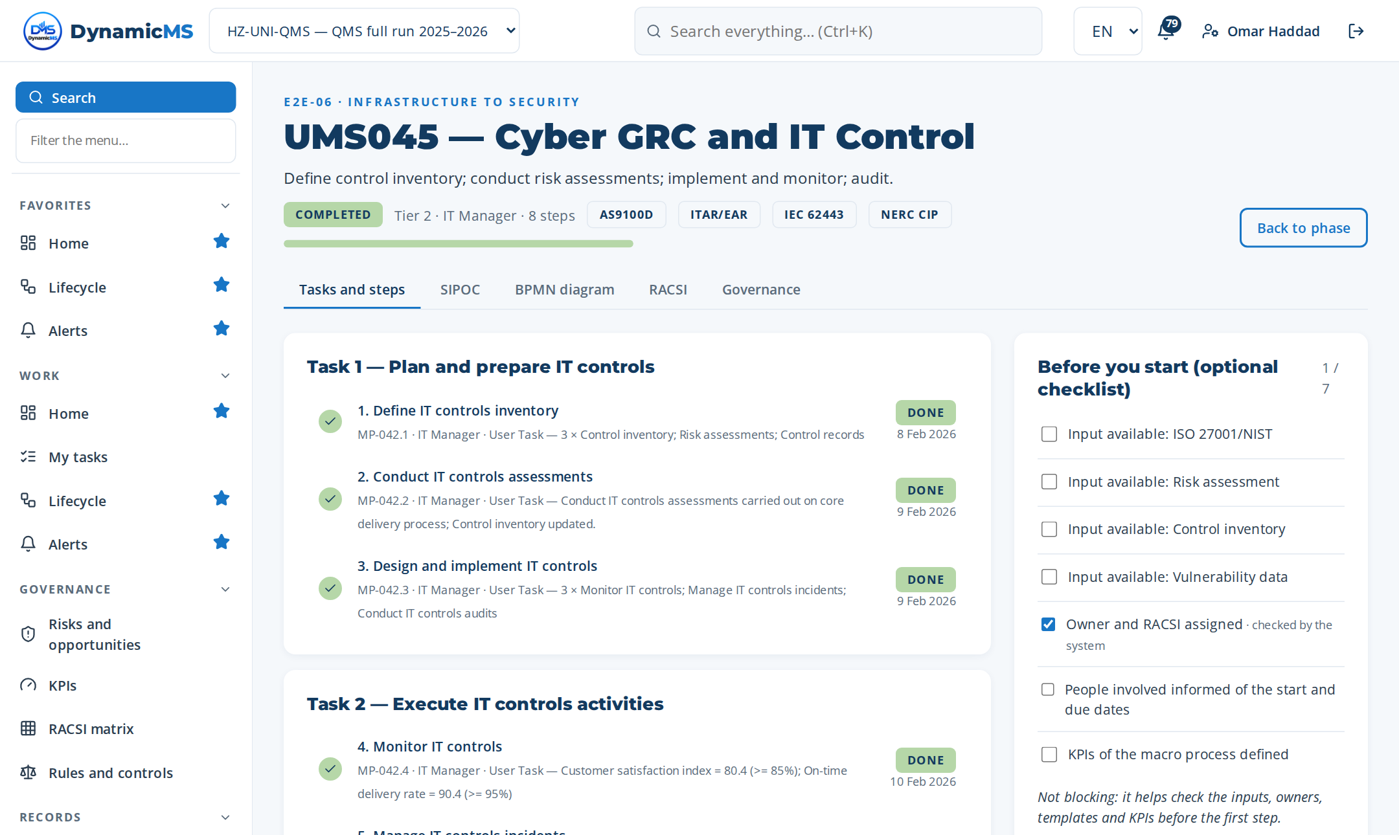
MACRO PROCESS · MP-042 (UMS045)
Cyber GRC and IT Control
Define control inventory; conduct risk assessments; implement and monitor; audit. · Owner: IT Manager
Step | Name | Role | What was recorded
MP-042.1 | Define IT controls inventory | IT Manager | 3 rows in “IT controls inventory identified” — Control inventory
MP-042.2 | Conduct IT controls assessments | IT Manager | What was done: Conduct IT controls assessments carried out on core de…
MP-042.3 | Design and implement IT controls | IT Manager | 3 rows in “Planned activities (become actions)” — Monitor IT controls
MP-042.4 | Monitor IT controls | IT Manager | 2 rows in “Indicators measured” — Q-KPI-01 — Customer satisfaction in…
MP-042.5 | Manage IT controls incidents | IT Manager | What was done: Manage IT controls incidents carried out on core deliv…
MP-042.6 | Conduct IT controls audits | IT Manager | What was done: Conduct IT controls audits carried out on core deliver…
MP-042.7 | Remediate IT controls | IT Manager | Change made: Control inventory updated: specification not met.
MP-042.8 | Report on IT controls status | IT Manager | 2 rows in “Communication records” — Top mgmt
3 tasks · 8 steps
T1 Plan and prepare IT controls
T2 Execute IT controls activities
T3 Verify, record and close IT controls
POWERACT Consulting · E2E-06 — Infrastructure To Security
32

Slide 33
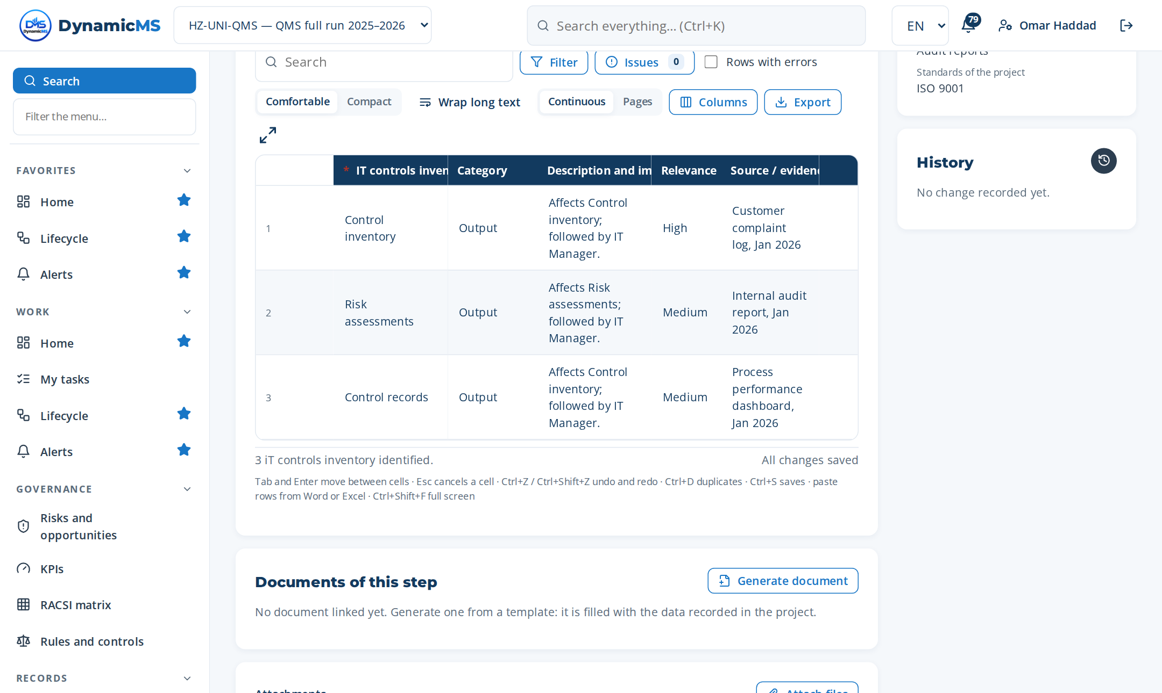
STEP · MP-042.1 · IT MANAGER
Define IT controls inventory
WHAT WAS RECORDED
IT controls inventory identified
• Control inventory — Output
• Risk assessments — Output
• Control records — Output
Step MP-042.1 (Register items): rows typed, pasted or imported, saved as they are entered.
POWERACT Consulting · E2E-06 — Infrastructure To Security
33

Slide 34
PHASE 07 · DO
E2E-07 — Data To Intelligence
Govern data, formulas, calculations, knowledge.
MACRO PROCESSES OF THIS PHASE
MP-044 Data Governance and Master Data Quality
MP-057 Formula Repository and Variable Governance
MP-058 Formula Execution and Traceability Orchestration
MP-074 Knowledge Graph and Semantic Search
4
13
34
macro processes
tasks
steps
FROM TRIGGER TO RESULT
Trigger: Data governance requirement, formula change, or knowledge gap
Result: Governed data, formulas, calculations, knowledge graph
Gate: G7 — Data and formulas governed — Go
POWERACT Consulting · E2E-07 — Data To Intelligence
34

Slide 35
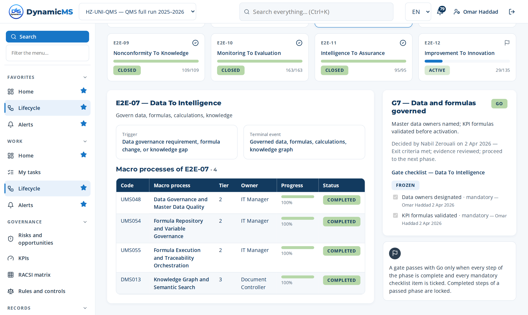
E2E-07 · SCREEN
Data To Intelligence: the phase in the application
DELIVERS
Governed data, formulas and knowledge; KPI data pipeline; data sources configured.
FEEDS
E2E-10 (measurement and dashboards); E2E-11 (intelligence for assurance).
Lifecycle › E2E-07: macro processes of the phase with their progress and gate.
POWERACT Consulting · E2E-07 — Data To Intelligence
35

Slide 36
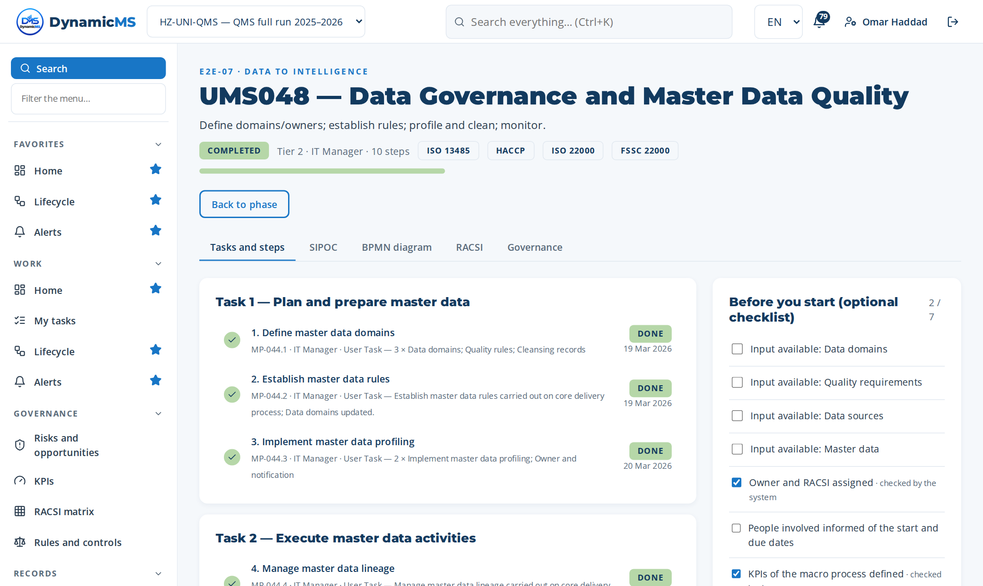
MACRO PROCESS · MP-044 (UMS048)
Data Governance and Master Data Quality
Define domains/owners; establish rules; profile and clean; monitor. · Owner: IT Manager
Step | Name | Role | What was recorded
MP-044.1 | Define master data domains | IT Manager | 3 rows in “Master data domains identified” — Data domains
MP-044.2 | Establish master data rules | IT Manager | What was done: Establish master data rules carried out on core delive…
MP-044.3 | Implement master data profiling | IT Manager | 2 rows in “Settings” — Implement master data profiling
MP-044.4 | Manage master data lineage | IT Manager | What was done: Manage master data lineage carried out on core deliver…
MP-044.5 | Operate master data MDM | IT Manager | 2 rows in “Settings” — Operate master data MDM
MP-044.6 | Monitor master data dashboards | IT Manager | 1 rows in “Indicators measured” — KPI-14 — Master data quality score
MP-044.7 | Resolve master data incidents | IT Manager | What was done: Resolve master data incidents carried out on core deli…
MP-044.8 | Report master data scores | IT Manager | 2 rows in “Communication records” — Top mgmt
MP-044.9 | Maintain customizable value lists | IT Manager | What was done: Maintain customizable value lists carried out on core…
MP-044.10 | Retire unused custom values | IT Manager | Closure evidence: Data domains closed; effectiveness verified on the…
4 tasks · 10 steps
T1 Plan and prepare master data
T2 Execute master data activities
T3 Verify, record and close master data
T4 Govern Custom Value Lists
POWERACT Consulting · E2E-07 — Data To Intelligence
36

Slide 37
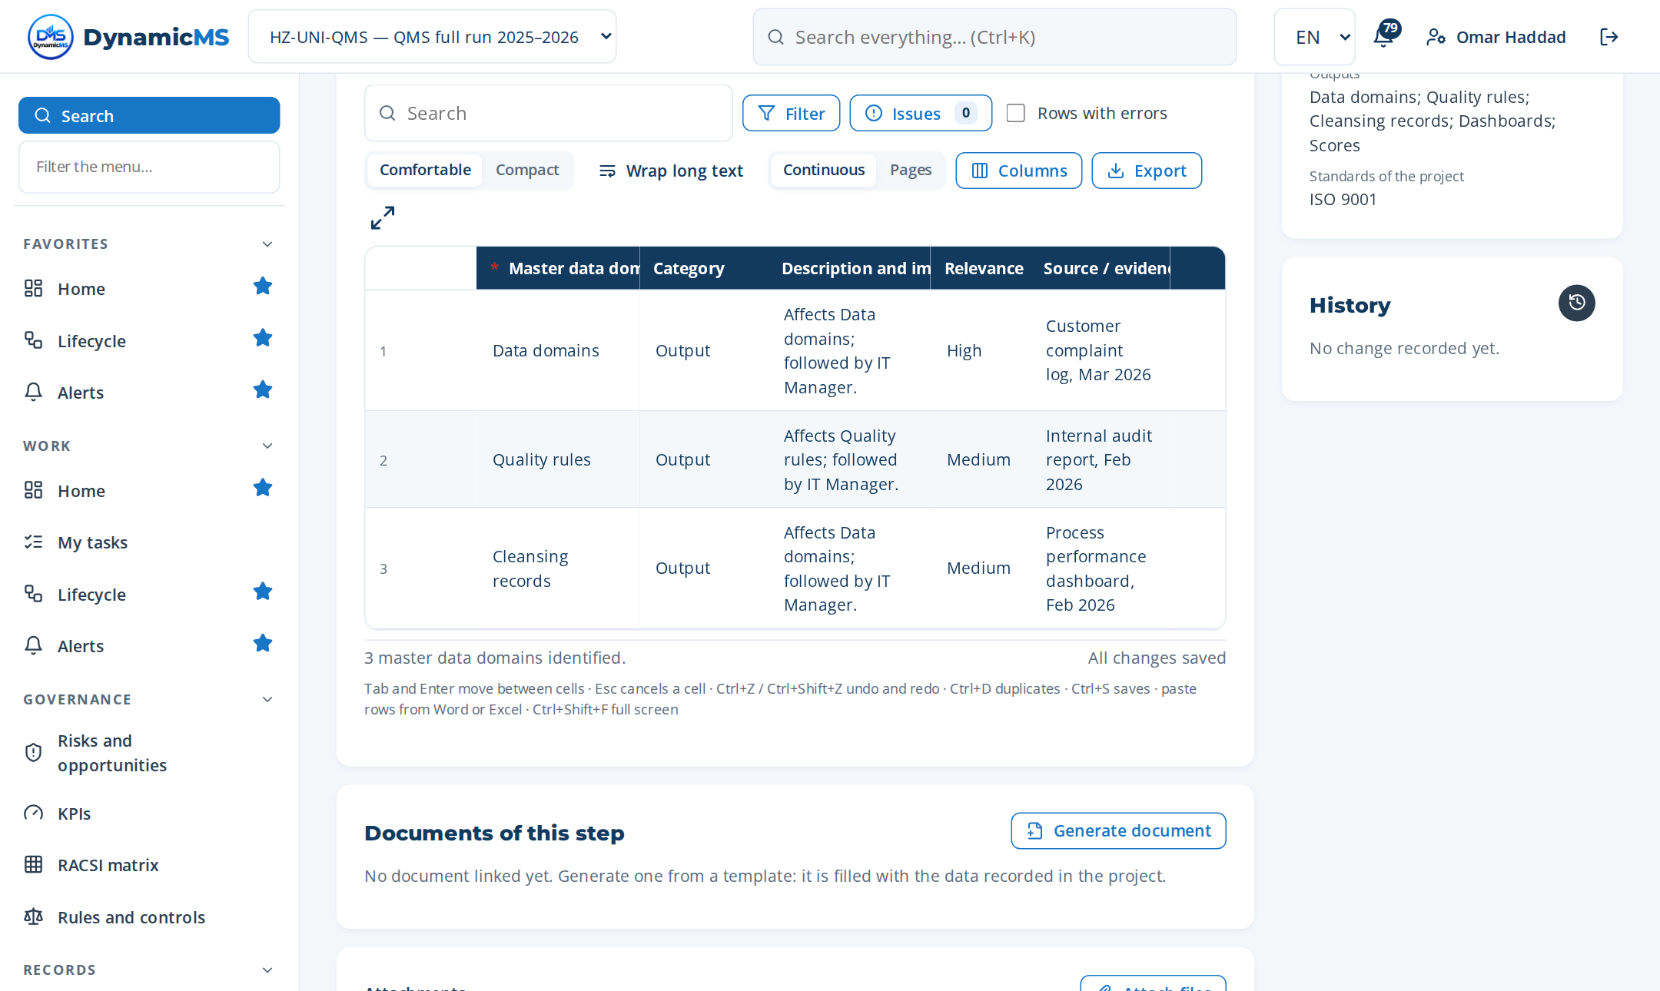
STEP · MP-044.1 · IT MANAGER
Define master data domains
WHAT WAS RECORDED
Master data domains identified
• Data domains — Output
• Quality rules — Output
• Cleansing records — Output
Step MP-044.1 (Register items): rows typed, pasted or imported, saved as they are entered.
POWERACT Consulting · E2E-07 — Data To Intelligence
37

Slide 38
PHASE 08 · DO
E2E-08 — Requirements To Delivery
Transform requirements into delivered products/services.
MACRO PROCESSES OF THIS PHASE
MP-007 Process Control Plan Management
MP-008 Business Rules and Process Logic Management
MP-024 Supplier Quality Performance
MP-069 Supply Chain Resilience and Traceability
MP-070 Supplier Ecosystem Intelligence
MP-090 Mobile-First Field Operations and Offline Capture
MP-102 Supplier Collaboration Portal
MP-107 Product Traceability and Recall Management
8
24
73
macro processes
tasks
steps
FROM TRIGGER TO RESULT
Trigger: Customer order, production plan, supplier onboarding, welding requirement, laboratory test, or eco-design
Result: Products/services delivered; suppliers controlled; traceability ensured; quality validated; LCA completed
Gate: G8 — Operations under control — Go
POWERACT Consulting · E2E-08 — Requirements To Delivery
38

Slide 39
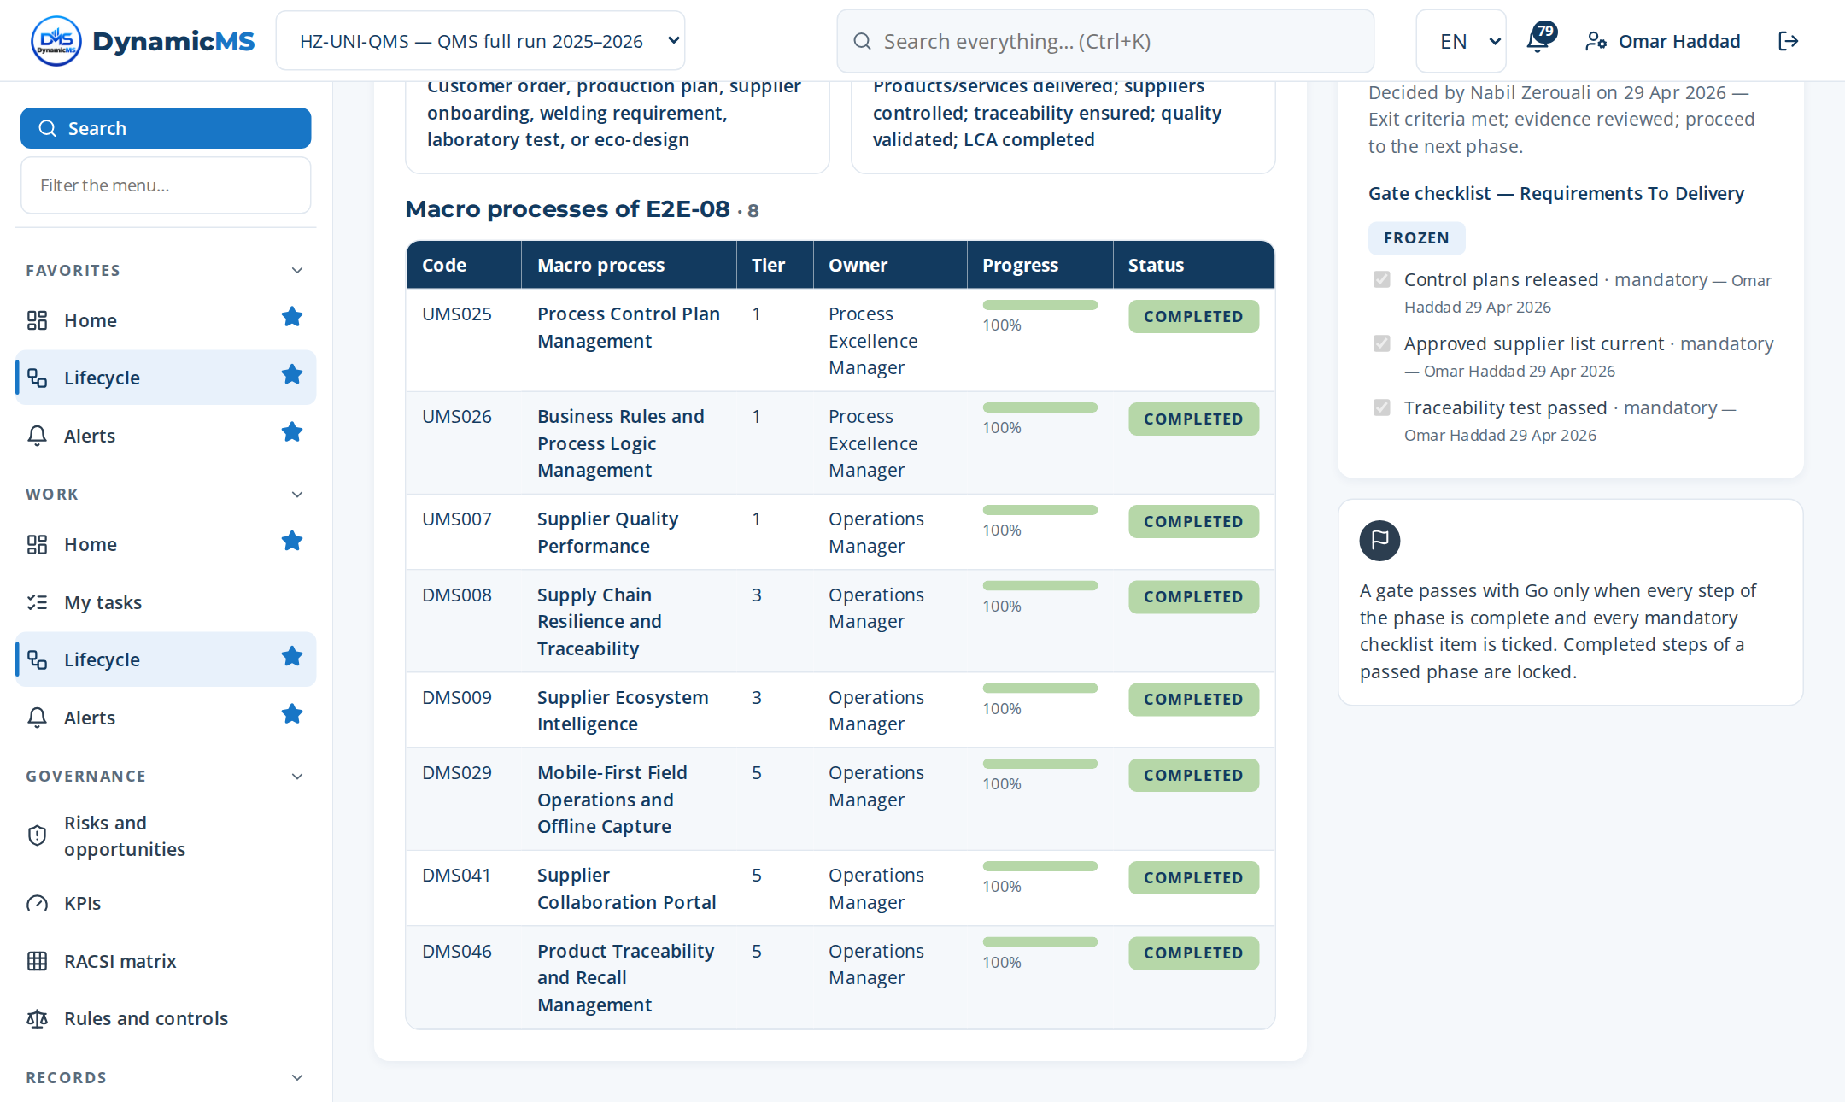
E2E-08 · SCREEN
Requirements To Delivery: the phase in the application
DELIVERS
Customer requirements reviewed, products and services delivered and released.
FEEDS
E2E-09 (nonconforming outputs); E2E-10 (customer satisfaction).
Lifecycle › E2E-08: macro processes of the phase with their progress and gate.
POWERACT Consulting · E2E-08 — Requirements To Delivery
39

Slide 40
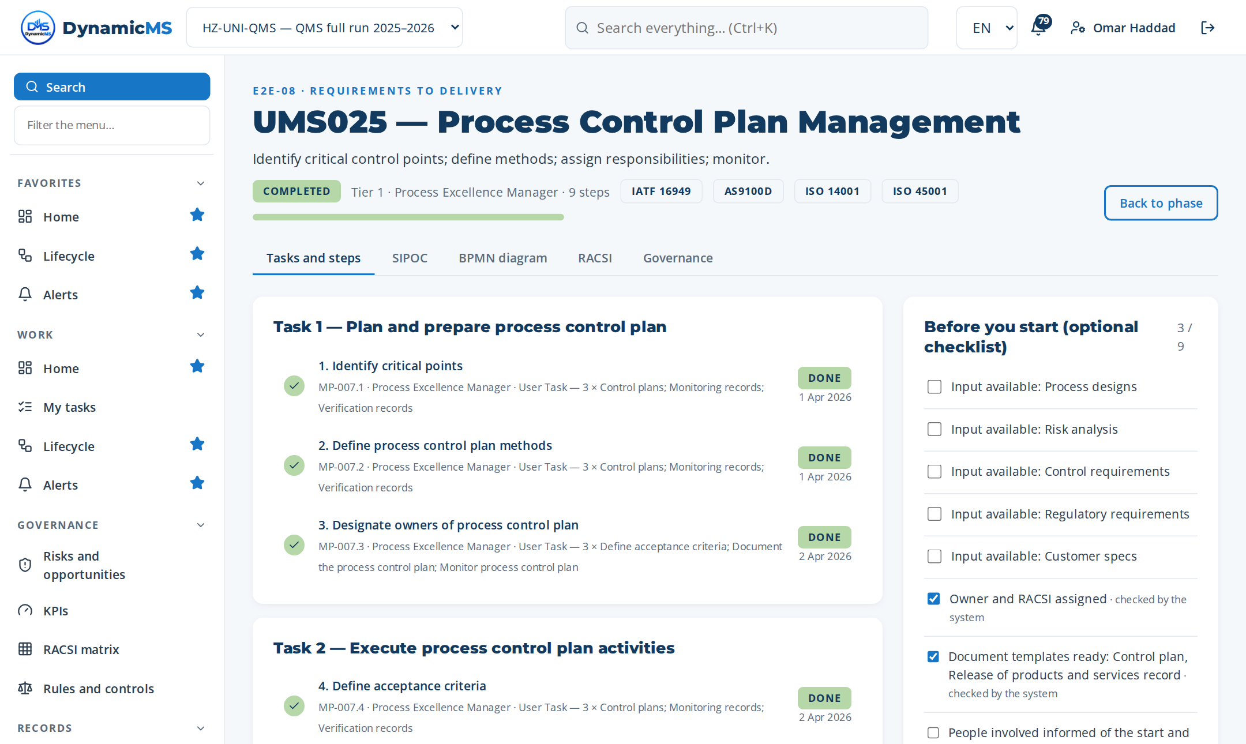
MACRO PROCESS · MP-007 (UMS025)
Process Control Plan Management
Identify critical control points; define methods; assign responsibilities; monitor. · Owner: Process Excellence Manager · ISO 9001 §8.5.1, §9.1.1
Step | Name | Role | What was recorded
MP-007.1 | Identify critical points | Process Excellence Ma… | 3 rows in “Critical points identified” — Control plans
MP-007.2 | Define process control plan methods | Process Excellence Ma… | 3 rows in “Process control plan methods identified” — Control plans
MP-007.3 | Designate owners of process control plan | Process Excellence Ma… | 3 rows in “Planned activities (become actions)” — Define acceptance c…
MP-007.4 | Define acceptance criteria | Process Excellence Ma… | 3 rows in “Acceptance criteria identified” — Control plans
MP-007.5 | Document the process control plan | Process Excellence Ma… | Document template: TPL-CTRL — Control plan
MP-007.6 | Monitor process control plan | Process Excellence Ma… | 1 rows in “Indicators measured” — Q-KPI-03 — First pass yield
MP-007.7 | Verify process control plan | Process Excellence Ma… | 4 rows in “Decision matrix” — Control plans complete and up to date
MP-007.8 | Adjust process control plan | Process Excellence Ma… | Change made: Control plans updated: specification not met.
MP-007.9 | Archive process control plan | Process Excellence Ma… | Closure evidence: Control plans closed; effectiveness verified on the…
3 tasks · 9 steps
T1 Plan and prepare process control plan
T2 Execute process control plan activities
T3 Verify, record and close process control…
POWERACT Consulting · E2E-08 — Requirements To Delivery
40

Slide 41
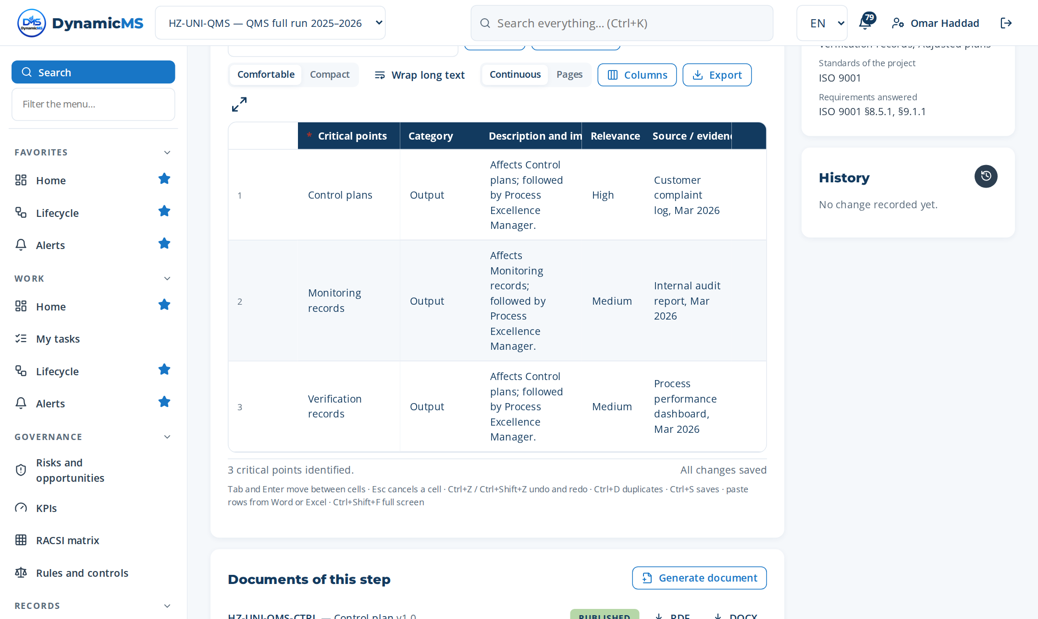
STEP · MP-007.1 · PROCESS EXCELLENCE MANAGER
Identify critical points
WHAT WAS RECORDED
Critical points identified
• Control plans — Output
• Monitoring records — Output
• Verification records — Output
Step MP-007.1 (Register items): rows typed, pasted or imported, saved as they are entered.
POWERACT Consulting · E2E-08 — Requirements To Delivery
41

Slide 42
PHASE 09 · CHECK
E2E-09 — Nonconformity To Knowledge
Detect, contain, resolve, capitalize nonconformities and problems.
MACRO PROCESSES OF THIS PHASE
MP-018 Problem Capture and Definition
MP-019 Immediate Action Management
MP-020 Root Cause Resolution
MP-021 Corrective Action Execution and Follow-Up
MP-022 Nonconformity Capitalization and Closure
MP-076 Automated Root Cause Intelligence
MP-081 Automated CAPA Recommendation Engine
MP-082 NCP Knowledge Base and RAG Management
MP-083 AI Agent Orchestration for Problem Solving
MP-084 Smart Alert and Escalation Engine
MP-087 REX Capitalization and Generalization
MP-091 Voice-to-Text Incident and Audit Reporting
12
36
109
macro processes
tasks
steps
FROM TRIGGER TO RESULT
Trigger: Nonconformity detected, incident reported, or problem identified
Result: Problem resolved; REX capitalized; KB updated
Gate: G9 — Problem solving effective — Go
POWERACT Consulting · E2E-09 — Nonconformity To Knowledge
42

Slide 43
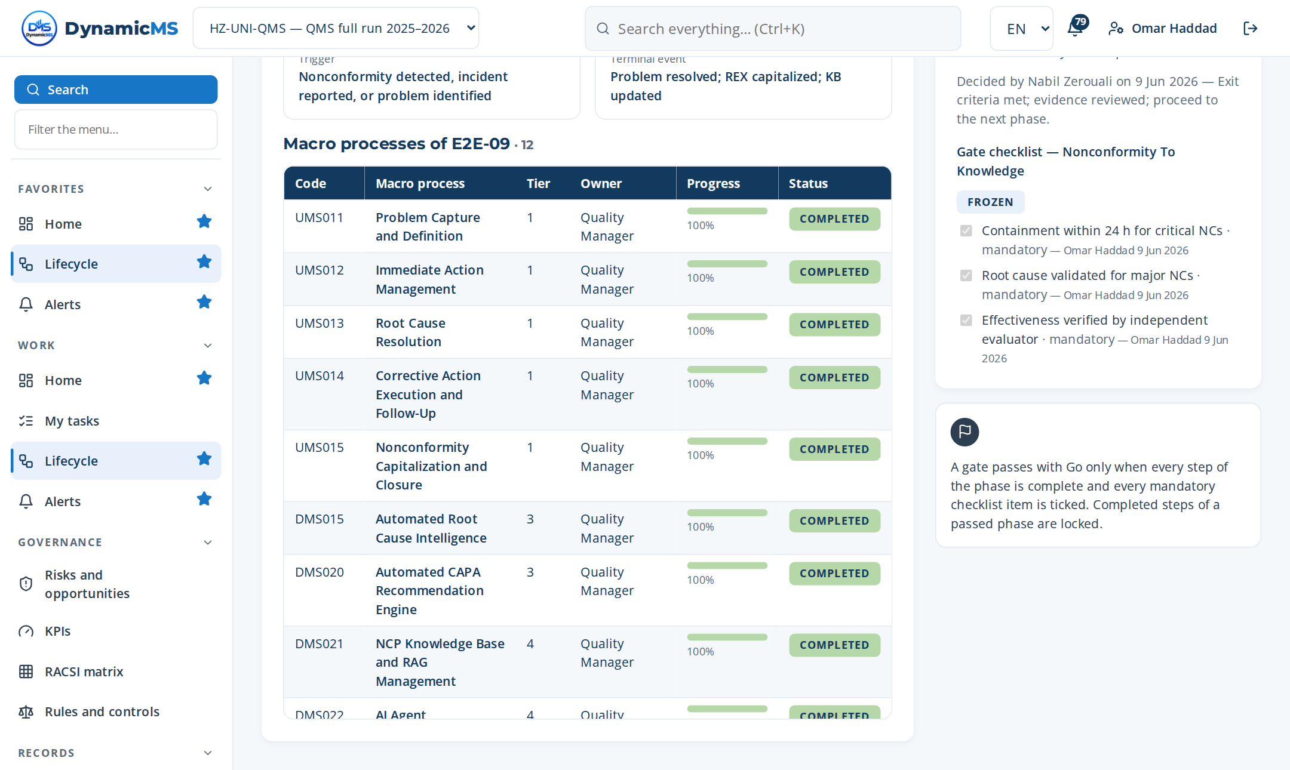
E2E-09 · SCREEN
Nonconformity To Knowledge: the phase in the application
DELIVERS
Nonconformities contained, root causes analysed, corrective actions, lessons learned (REX).
FEEDS
E2E-10 (NC KPIs); E2E-12 (improvement); E2E-05 (knowledge).
Lifecycle › E2E-09: macro processes of the phase with their progress and gate.
POWERACT Consulting · E2E-09 — Nonconformity To Knowledge
43

Slide 44
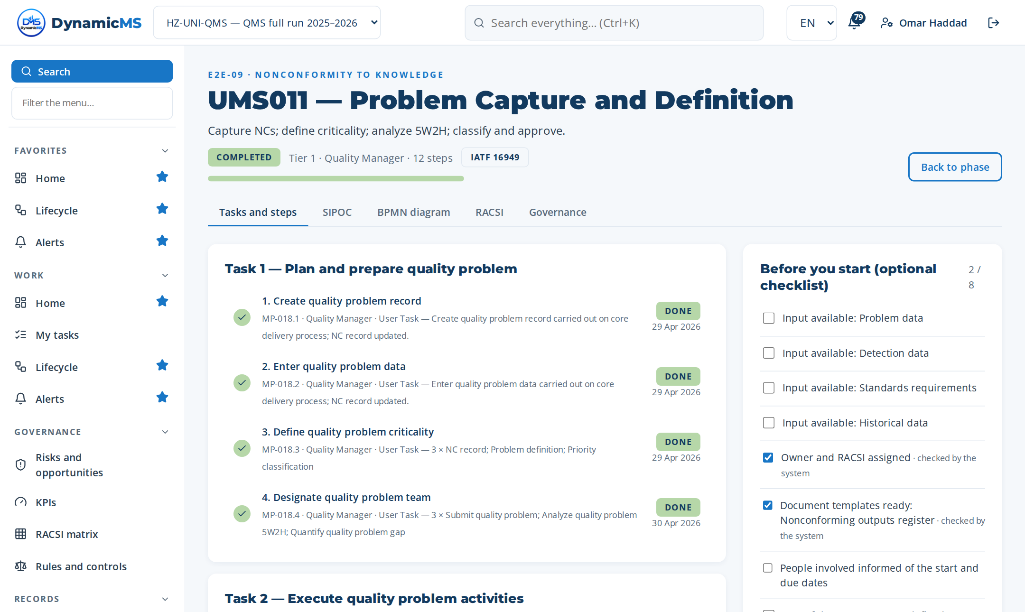
MACRO PROCESS · MP-018 (UMS011)
Problem Capture and Definition
Capture NCs; define criticality; analyze 5W2H; classify and approve. · Owner: Quality Manager · ISO 9001 §10.2.1
Step | Name | Role | What was recorded
MP-018.1 | Create quality problem record | Quality Manager | What was done: Create quality problem record carried out on core deli…
MP-018.2 | Enter quality problem data | Quality Manager | What was done: Enter quality problem data carried out on core deliver…
MP-018.3 | Define quality problem criticality | Quality Manager | 3 rows in “Quality problem criticality identified” — NC record
MP-018.4 | Designate quality problem team | Quality Manager | 3 rows in “Planned activities (become actions)” — Submit quality prob…
MP-018.5 | Submit quality problem | Quality Manager | What was done: Submit quality problem carried out on core delivery pr…
MP-018.6 | Analyze quality problem 5W2H | Quality Manager | 4 rows in “Decision matrix” — NC record complete and up to date
MP-018.7 | Quantify quality problem gap | Quality Manager | 4 rows in “Decision matrix” — NC record complete and up to date
MP-018.8 | Identify quality problem standards | Quality Manager | 1 rows in “Quality problem standards identified” — ISO 9001
MP-018.9 | Classify quality problem polarity | Quality Manager | 4 rows in “Decision matrix” — NC record complete and up to date
MP-018.10 | Review quality problem | Quality Manager | 3 rows in “Inputs reviewed” — Problem data
MP-018.11 | Approve quality problem | Quality Manager | 3 rows in “Decision criteria checked” — NC record complete
MP-018.12 | Transmit quality problem | Quality Manager | 2 rows in “Communication records” — Quality team
3 tasks · 12 steps
T1 Plan and prepare quality problem
T2 Execute quality problem activities
T3 Verify, record and close quality problem
POWERACT Consulting · E2E-09 — Nonconformity To Knowledge
44

Slide 45
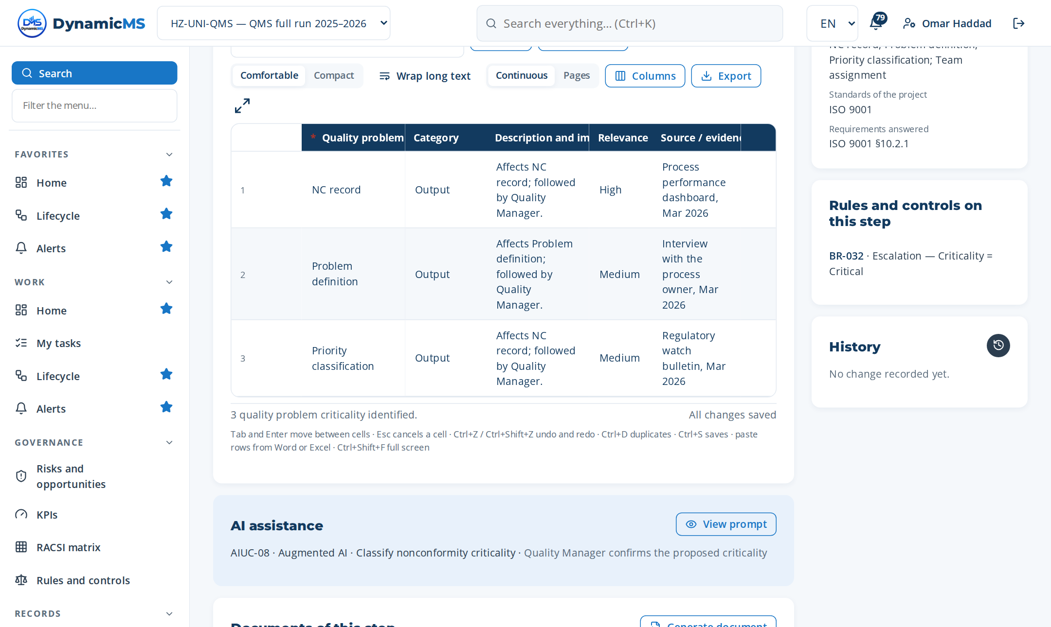
STEP · MP-018.3 · QUALITY MANAGER
Define quality problem criticality
WHAT WAS RECORDED
Quality problem criticality identified
• NC record — Output
• Problem definition — Output
• Priority classification — Output
Step MP-018.3 (Register items): rows typed, pasted or imported, saved as they are entered.
POWERACT Consulting · E2E-09 — Nonconformity To Knowledge
45

Slide 46
PHASE 10 · CHECK
E2E-10 — Monitoring To Evaluation
Monitor performance, evaluate results, steer the organization.
MACRO PROCESSES OF THIS PHASE
MP-009 Process Indicators and KPI Management
MP-010 Process Alert and Escalation Thresholds
MP-011 Real-Time Dashboard and Process Steering
MP-023 Continual Improvement Pipeline Steering
MP-031 Performance Indicator Consolidation and Rev…
MP-032 Management System Performance Monitoring
MP-033 Operational Process Performance Review
MP-034 Governance Bodies and Reviews Orchestration
MP-035 Customer Satisfaction Barometer Management
MP-039 Internal Audit and Assurance Cycle
MP-040 Executive GRC Reporting and Dashboards
MP-071 Customer Experience Intelligence
MP-072 Voice-of-Customer Analytics
MP-077 Cross-Site Benchmarking
MP-093 Augmented Reality Guided Audits and Inspect…
MP-097 Remote and Virtual Audit Capability
MP-103 Customer Complaint and Feedback Portal
17
53
163
macro processes
tasks
steps
FROM TRIGGER TO RESULT
Trigger: Monitoring periodicity, performance deviation, or governance review
Result: Performance evaluated; governance decisions made; improvements identified
Gate: G10 — Performance reviewed — Go
POWERACT Consulting · E2E-10 — Monitoring To Evaluation
46

Slide 47
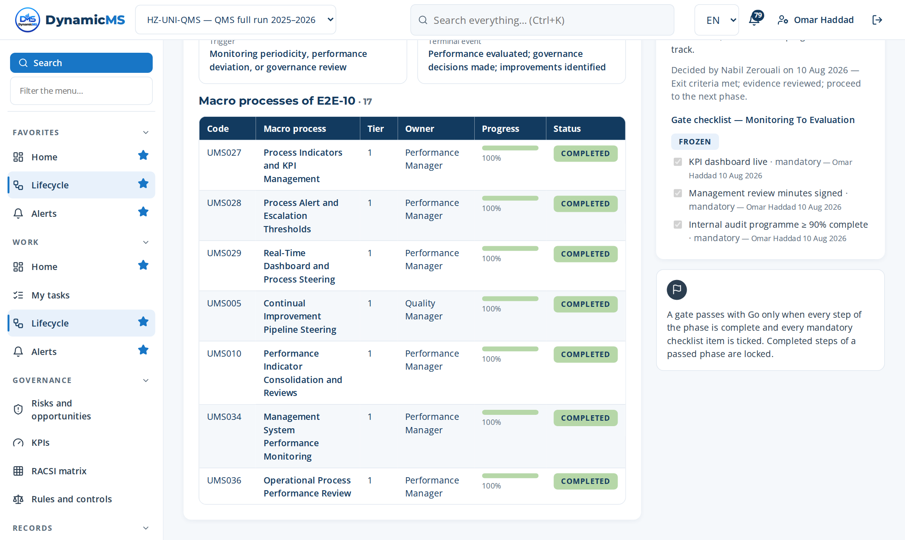
E2E-10 · SCREEN
Monitoring To Evaluation: the phase in the application
DELIVERS
KPI results, process reviews, management review decisions and actions.
FEEDS
E2E-11 (audit focus); E2E-12 (improvement); E2E-01 (next cycle).
Lifecycle › E2E-10: macro processes of the phase with their progress and gate.
POWERACT Consulting · E2E-10 — Monitoring To Evaluation
47

Slide 48
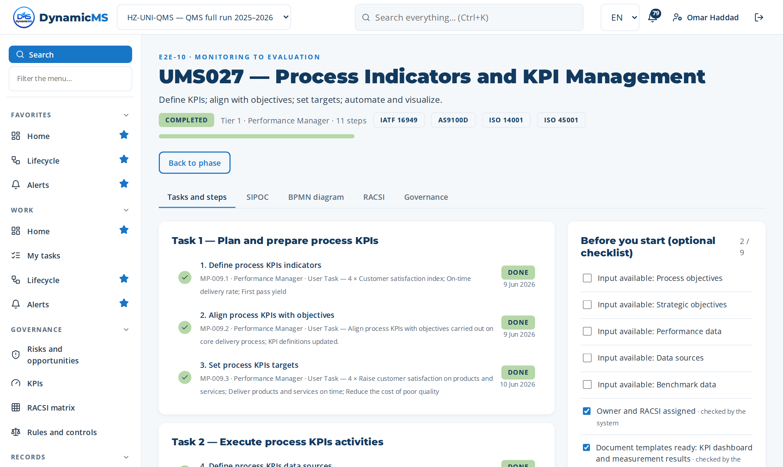
MACRO PROCESS · MP-009 (UMS027)
Process Indicators and KPI Management
Define KPIs; align with objectives; set targets; automate and visualize. · Owner: Performance Manager · ISO 9001 §9.1.1
Step | Name | Role | What was recorded
MP-009.1 | Define process KPIs indicators | Performance Manager | 4 rows in “Process KPIs indicators identified” — Customer satisfactio…
MP-009.2 | Align process KPIs with objectives | Performance Manager | What was done: Align process KPIs with objectives carried out on core…
MP-009.3 | Set process KPIs targets | Performance Manager | 4 rows in “Objectives (become entries of the objectives register)” —…
MP-009.4 | Define process KPIs data sources | Performance Manager | 3 rows in “Process KPIs data sources identified” — KPI definitions
MP-009.5 | Establish process KPIs frequency | Performance Manager | Frequency: Monthly
MP-009.6 | Designate owners of process KPIs | Performance Manager | 3 rows in “Planned activities (become actions)” — Review process KPIs…
MP-009.7 | Review process KPIs relevance | Performance Manager | 3 rows in “Inputs reviewed” — Process objectives
MP-009.8 | Automate process KPIs | DynamicMS Engine | System result confirmed: Automate process KPIs: done by the DynamicMS…
MP-009.9 | Visualize process KPIs | Performance Manager | What was done: Visualize process KPIs carried out on core delivery pr…
MP-009.10 | Set KPI measurement and analysis freque… | Performance Manager | What was done: Set KPI measurement and analysis frequencies carried o…
MP-009.11 | Assign KPI RACSI | Performance Manager | 1 rows in “RACSI of the macro process” — Performance Manager
4 tasks · 11 steps
T1 Plan and prepare process KPIs
T2 Execute process KPIs activities
T3 Verify, record and close process KPIs
T4 Govern KPI Frequencies & RACSI
POWERACT Consulting · E2E-10 — Monitoring To Evaluation
48

Slide 49
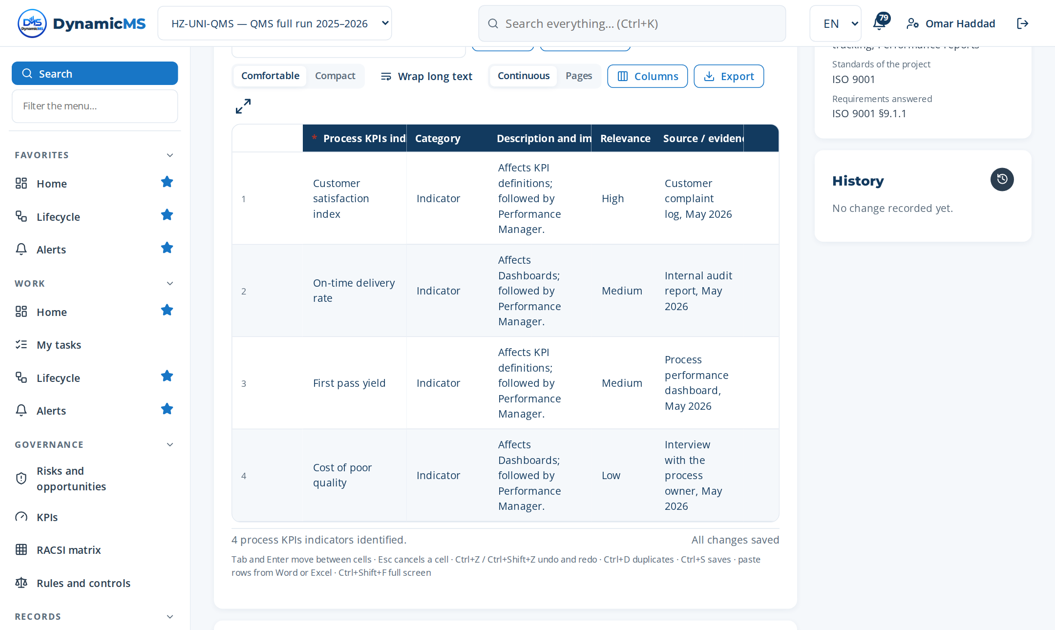
STEP · MP-009.1 · PERFORMANCE MANAGER
Define process KPIs indicators
WHAT WAS RECORDED
Process KPIs indicators identified
• Customer satisfaction index — Indicator
• On-time delivery rate — Indicator
• First pass yield — Indicator
• Cost of poor quality — Indicator
Step MP-009.1 (Register items): rows typed, pasted or imported, saved as they are entered.
POWERACT Consulting · E2E-10 — Monitoring To Evaluation
49

Slide 50
PHASE 11 · CHECK
E2E-11 — Intelligence To Assurance
Provide assurance through AI, foresight, IoT, ESG, analytics.
MACRO PROCESSES OF THIS PHASE
MP-062 AI Predictive Risk Intelligence
MP-063 Automated Regulatory Horizon Scanning
MP-064 Multi-Standard Automated Cross-Mapping
MP-065 Intelligent Document Generation
MP-066 Digital Twin Process Simulation
MP-075 Natural Language Process Mining
MP-078 Predictive Compliance Intelligence
MP-080 Real-Time Regulatory Change Impact
MP-088 AI Explainability and Confidence Scoring
MP-092 IoT and Sensor Data Integration
MP-099 Task Mining and Process Discovery Automation
11
33
95
macro processes
tasks
steps
FROM TRIGGER TO RESULT
Trigger: Predictive analytics alert, regulatory change, or assurance requirement
Result: Risks predicted; compliance assured; ESG and carbon reported
Gate: G11 — Assurance in place — Go
POWERACT Consulting · E2E-11 — Intelligence To Assurance
50

Slide 51
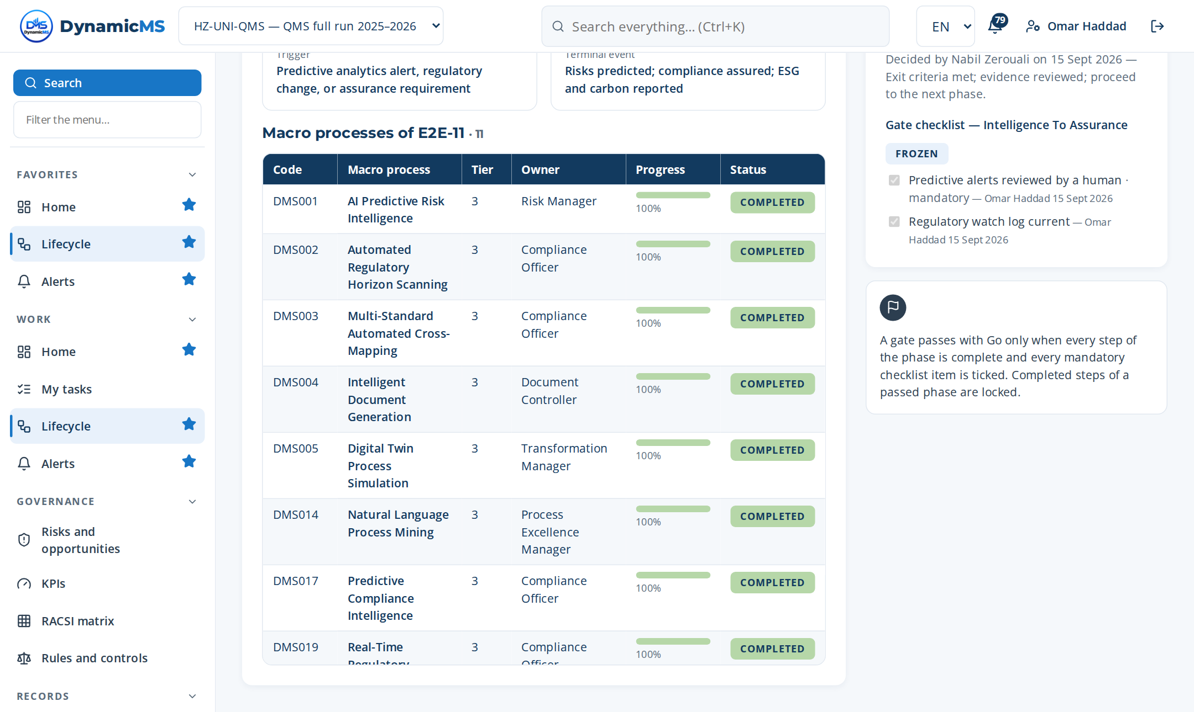
E2E-11 · SCREEN
Intelligence To Assurance: the phase in the application
DELIVERS
Audit programme, audit reports, findings and assurance opinion.
FEEDS
E2E-09 (findings as nonconformities); E2E-10 (review inputs).
Lifecycle › E2E-11: macro processes of the phase with their progress and gate.
POWERACT Consulting · E2E-11 — Intelligence To Assurance
51

Slide 52
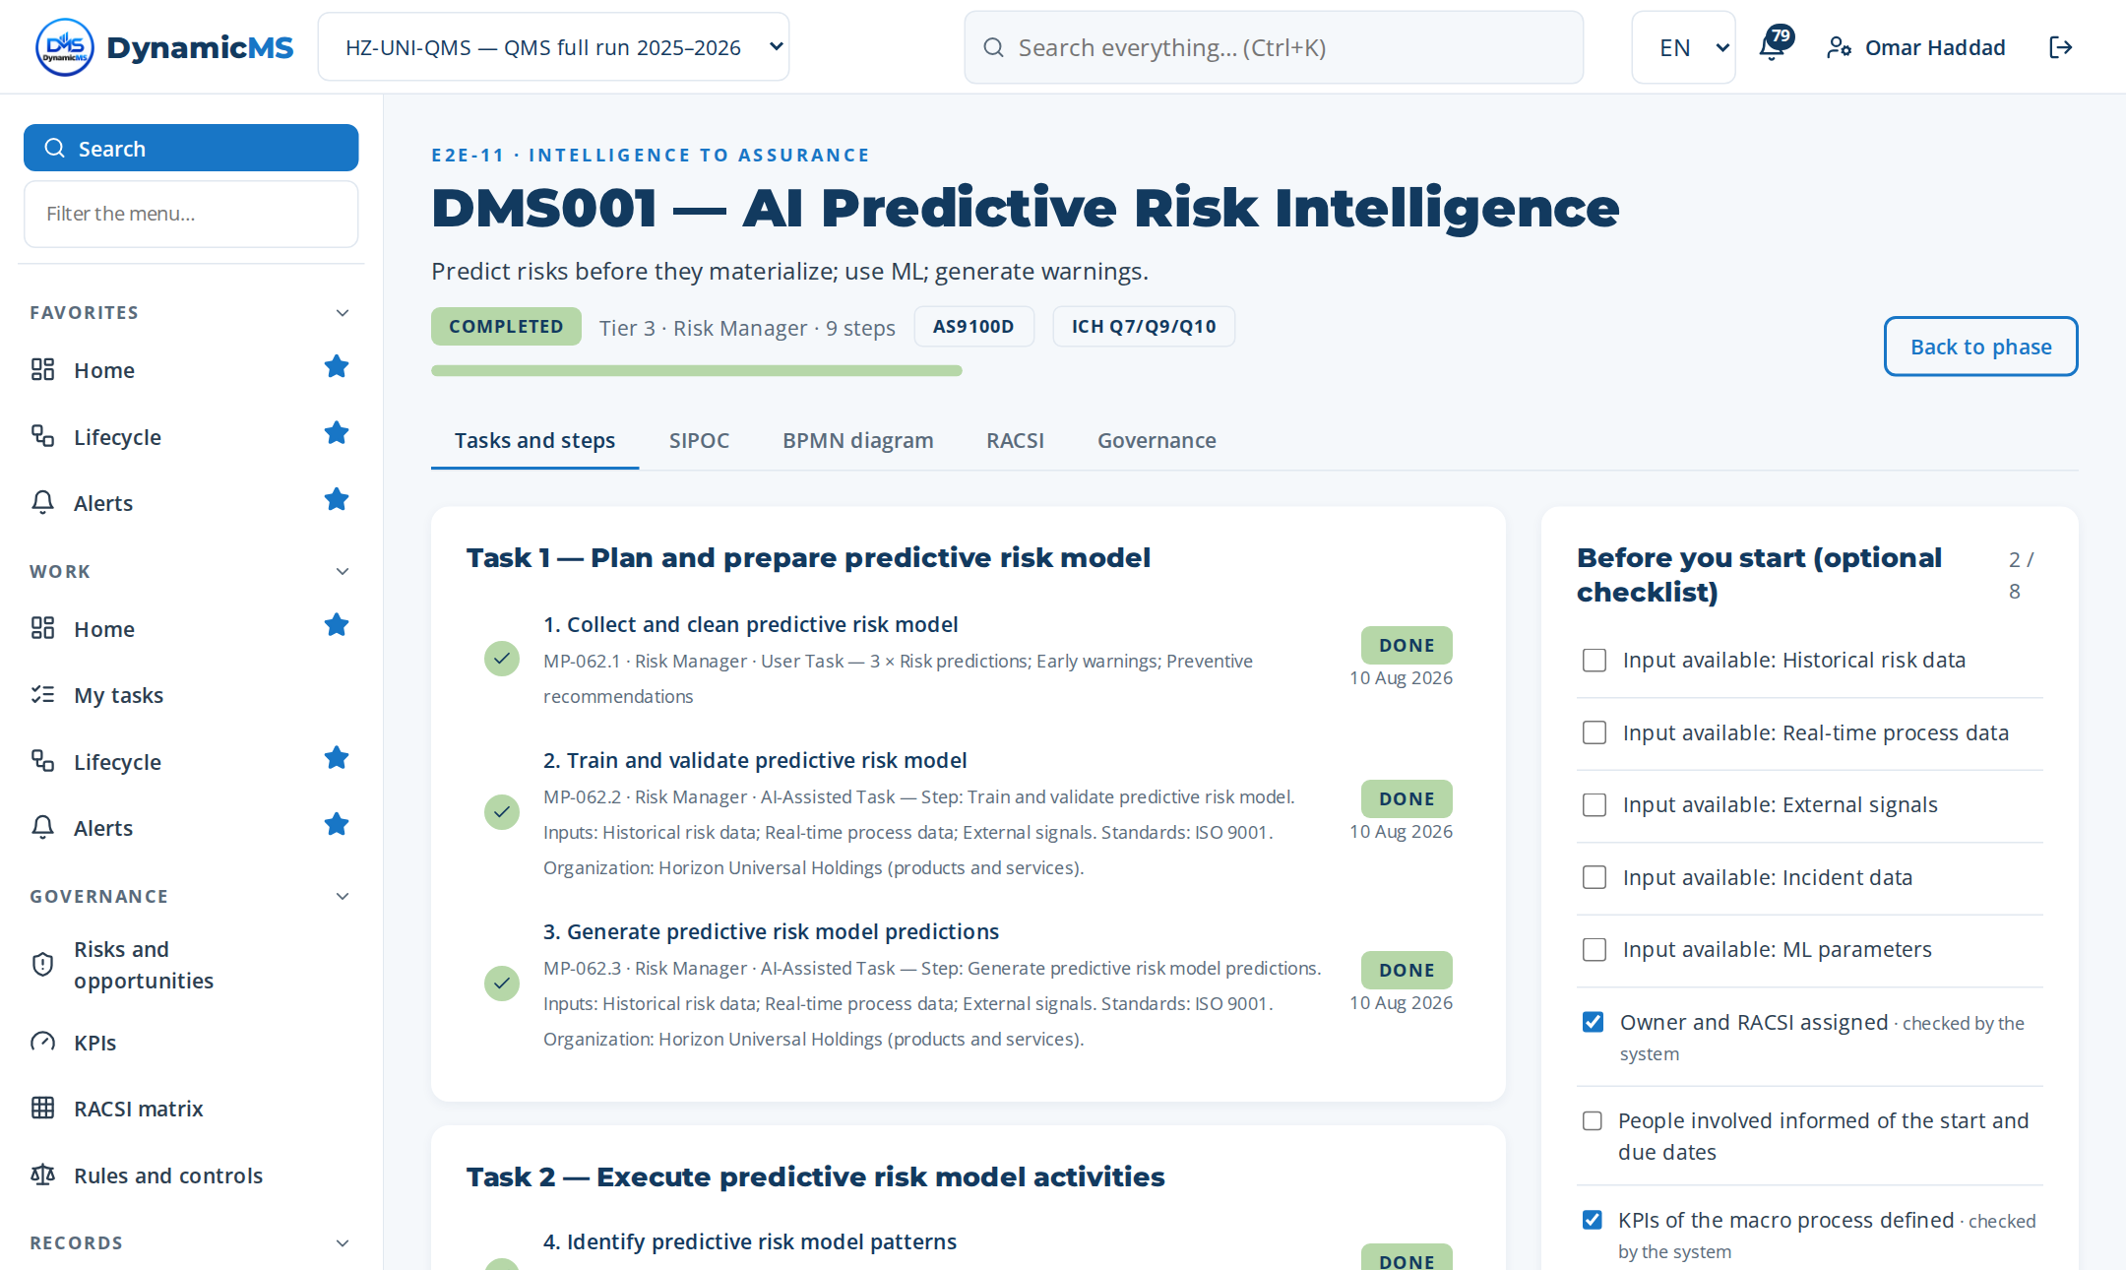
MACRO PROCESS · MP-062 (DMS001)
AI Predictive Risk Intelligence
Predict risks before they materialize; use ML; generate warnings. · Owner: Risk Manager
Step | Name | Role | What was recorded
MP-062.1 | Collect and clean predictive risk model | Risk Manager | 3 rows in “And clean predictive risk model identified” — Risk predict…
MP-062.2 | Train and validate predictive risk model | Risk Manager | Context given to the assistant: Step: Train and validate predictive r…
MP-062.3 | Generate predictive risk model predicti… | Risk Manager | Context given to the assistant: Step: Generate predictive risk model…
MP-062.4 | Identify predictive risk model patterns | Risk Manager | 3 rows in “Predictive risk model patterns identified” — Risk predicti…
MP-062.5 | Trigger predictive risk model warnings | Risk Manager | What was done: Trigger predictive risk model warnings carried out on…
MP-062.6 | Recommend predictive risk model actions | Risk Manager | What was done: Recommend predictive risk model actions carried out on…
MP-062.7 | Track predictive risk model accuracy | Risk Manager | 1 rows in “Indicators measured” — KPI-23 — Predictive alert precision
MP-062.8 | Retrain predictive risk model | Risk Manager | Change made: Risk predictions updated: Use of an obsolete document ve…
MP-062.9 | Report on predictive risk model status | Risk Manager | 2 rows in “Communication records” — Top mgmt
3 tasks · 9 steps
T1 Plan and prepare predictive risk model
T2 Execute predictive risk model activities
T3 Verify, record and close predictive risk…
POWERACT Consulting · E2E-11 — Intelligence To Assurance
52

Slide 53
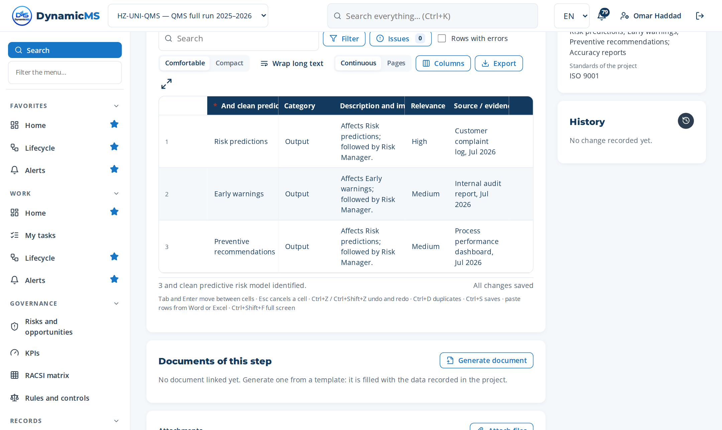
STEP · MP-062.1 · RISK MANAGER
Collect and clean predictive risk model
WHAT WAS RECORDED
And clean predictive risk model identified
• Risk predictions — Output
• Early warnings — Output
• Preventive recommendations — Output
Step MP-062.1 (Register items): rows typed, pasted or imported, saved as they are entered.
POWERACT Consulting · E2E-11 — Intelligence To Assurance
53

Slide 54
PHASE 12 · ACT
E2E-12 — Improvement To Innovation
Drive continual improvement, innovation, automation, ecosystem.
MACRO PROCESSES OF THIS PHASE
MP-041 AI Management System Supervision
MP-053 Optimization and Automation Project Managem…
MP-054 Macro Process Discovery and Prioritization
MP-055 Enterprise Simulation and Digital Twin
MP-056 Process Element Automation Scoring
MP-060 ROI Lifecycle Management
MP-061 VOI Lifecycle Management
MP-073 Innovation Pipeline Management
MP-079 Blockchain Audit Trail
MP-085 Composable Module Governance
MP-086 Multi-Tenant Isolation and Governance
MP-089 Real-Time Collaborative Editing and Co-Auth…
MP-094 Digital Signature and E-Signature Workflow
MP-100 Low-Code Process Builder and Workflow Desig…
MP-101 Marketplace for Templates, Connectors, and…
15
46
135
macro processes
tasks
steps
FROM TRIGGER TO RESULT
Trigger: Improvement opportunity, innovation idea, or automation candidate
Result: Improvements implemented; innovations deployed; ecosystem expanded
Gate: G12 — Improvement cycle closed — active
POWERACT Consulting · E2E-12 — Improvement To Innovation
54

Slide 55
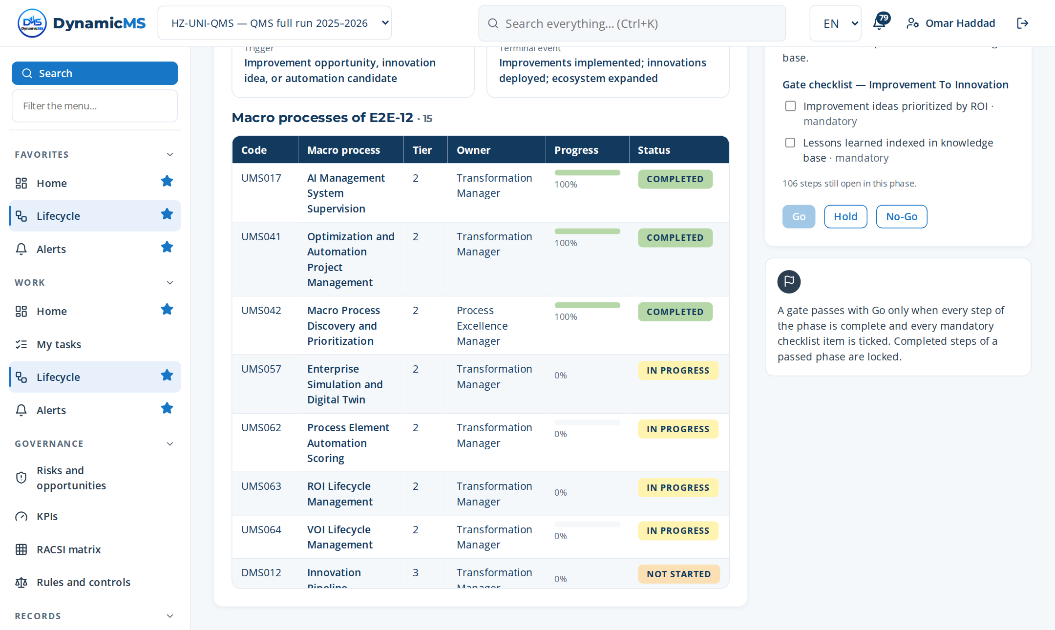
E2E-12 · SCREEN
Improvement To Innovation: the phase in the application
DELIVERS
Improvement portfolio, innovations, return on investment, updated objectives.
FEEDS
E2E-01 of the next cycle (context, policy and objectives are reviewed again).
Lifecycle › E2E-12: macro processes of the phase with their progress and gate.
POWERACT Consulting · E2E-12 — Improvement To Innovation
55

Slide 56
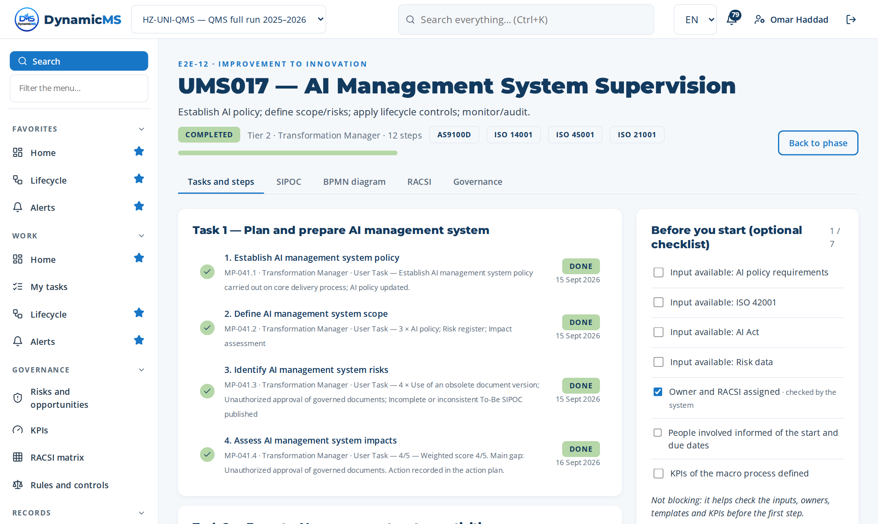
MACRO PROCESS · MP-041 (UMS017)
AI Management System Supervision
Establish AI policy; define scope/risks; apply lifecycle controls; monitor/audit. · Owner: Transformation Manager
Step | Name | Role | What was recorded
MP-041.1 | Establish AI management system policy | Transformation Manager | What was done: Establish AI management system policy carried out on c…
MP-041.2 | Define AI management system scope | Transformation Manager | 3 rows in “AI management system scope identified” — AI policy
MP-041.3 | Identify AI management system risks | Transformation Manager | 4 rows in “AI management system risks identified” — Use of an obsolet…
MP-041.4 | Assess AI management system impacts | Transformation Manager | 4 rows in “Decision matrix” — AI policy complete and up to date
MP-041.5 | Define AI management system roles | Transformation Manager | 3 rows in “AI management system roles identified” — AI policy
MP-041.6 | Apply AI management system controls | Transformation Manager | 2 rows in “Settings” — Apply AI management system controls
MP-041.7 | Monitor AI management system | Transformation Manager | 2 rows in “Indicators measured” — Q-KPI-01 — Customer satisfaction in…
MP-041.8 | Audit AI management system | Transformation Manager | 2 rows in “Indicators measured” — Q-KPI-01 — Customer satisfaction in…
MP-041.9 | Correct AI management system | Transformation Manager | Change made: AI policy updated: specification not met.
MP-041.10 | Update AI management system | Transformation Manager | Change made: AI policy updated: Use of an obsolete document version.
MP-041.11 | Activate AI use cases by scope | Transformation Manager | 2 rows in “Settings” — Activate AI use cases by scope
MP-041.12 | Approve custom AI use cases | Transformation Manager | 3 rows in “Decision criteria checked” — AI policy complete
4 tasks · 12 steps
T1 Plan and prepare AI management system
T2 Execute AI management system activities
T3 Verify, record and close AI management sy…
T4 Administer AI Use Cases
POWERACT Consulting · E2E-12 — Improvement To Innovation
56

Slide 57
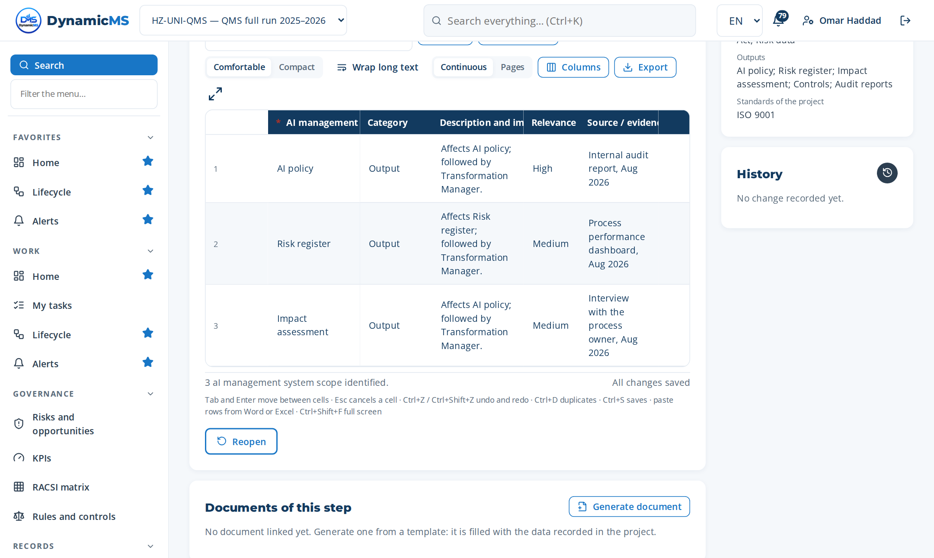
STEP · MP-041.2 · TRANSFORMATION MANAGER
Define AI management system scope
WHAT WAS RECORDED
AI management system scope identified
• AI policy — Output
• Risk register — Output
• Impact assessment — Output
Step MP-041.2 (Register items): rows typed, pasted or imported, saved as they are entered.
POWERACT Consulting · E2E-12 — Improvement To Innovation
57

Slide 58
Evidence, measurement and AI
What the run produces for audits, reviews and accreditation.
POWERACT Consulting · Evidence, measurement and AI
58

Slide 59
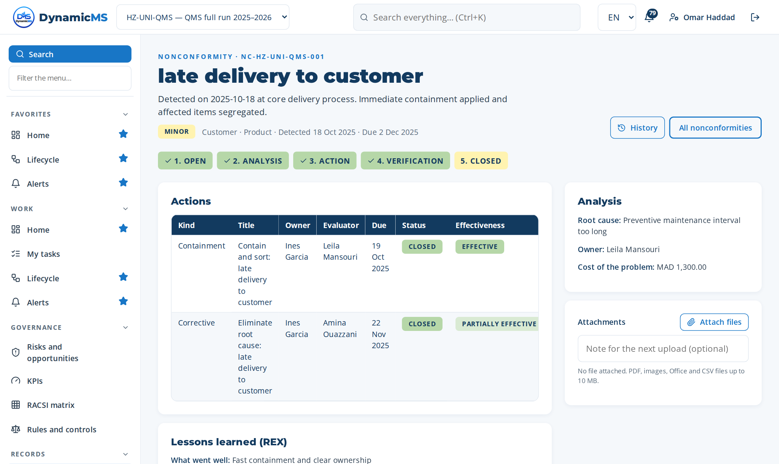
NONCONFORMITY
From detection to lessons learned
Containment, root cause, corrective actions
Effectiveness checked by another person
Cost recorded with its currency
POWERACT Consulting · Evidence
59

Slide 60
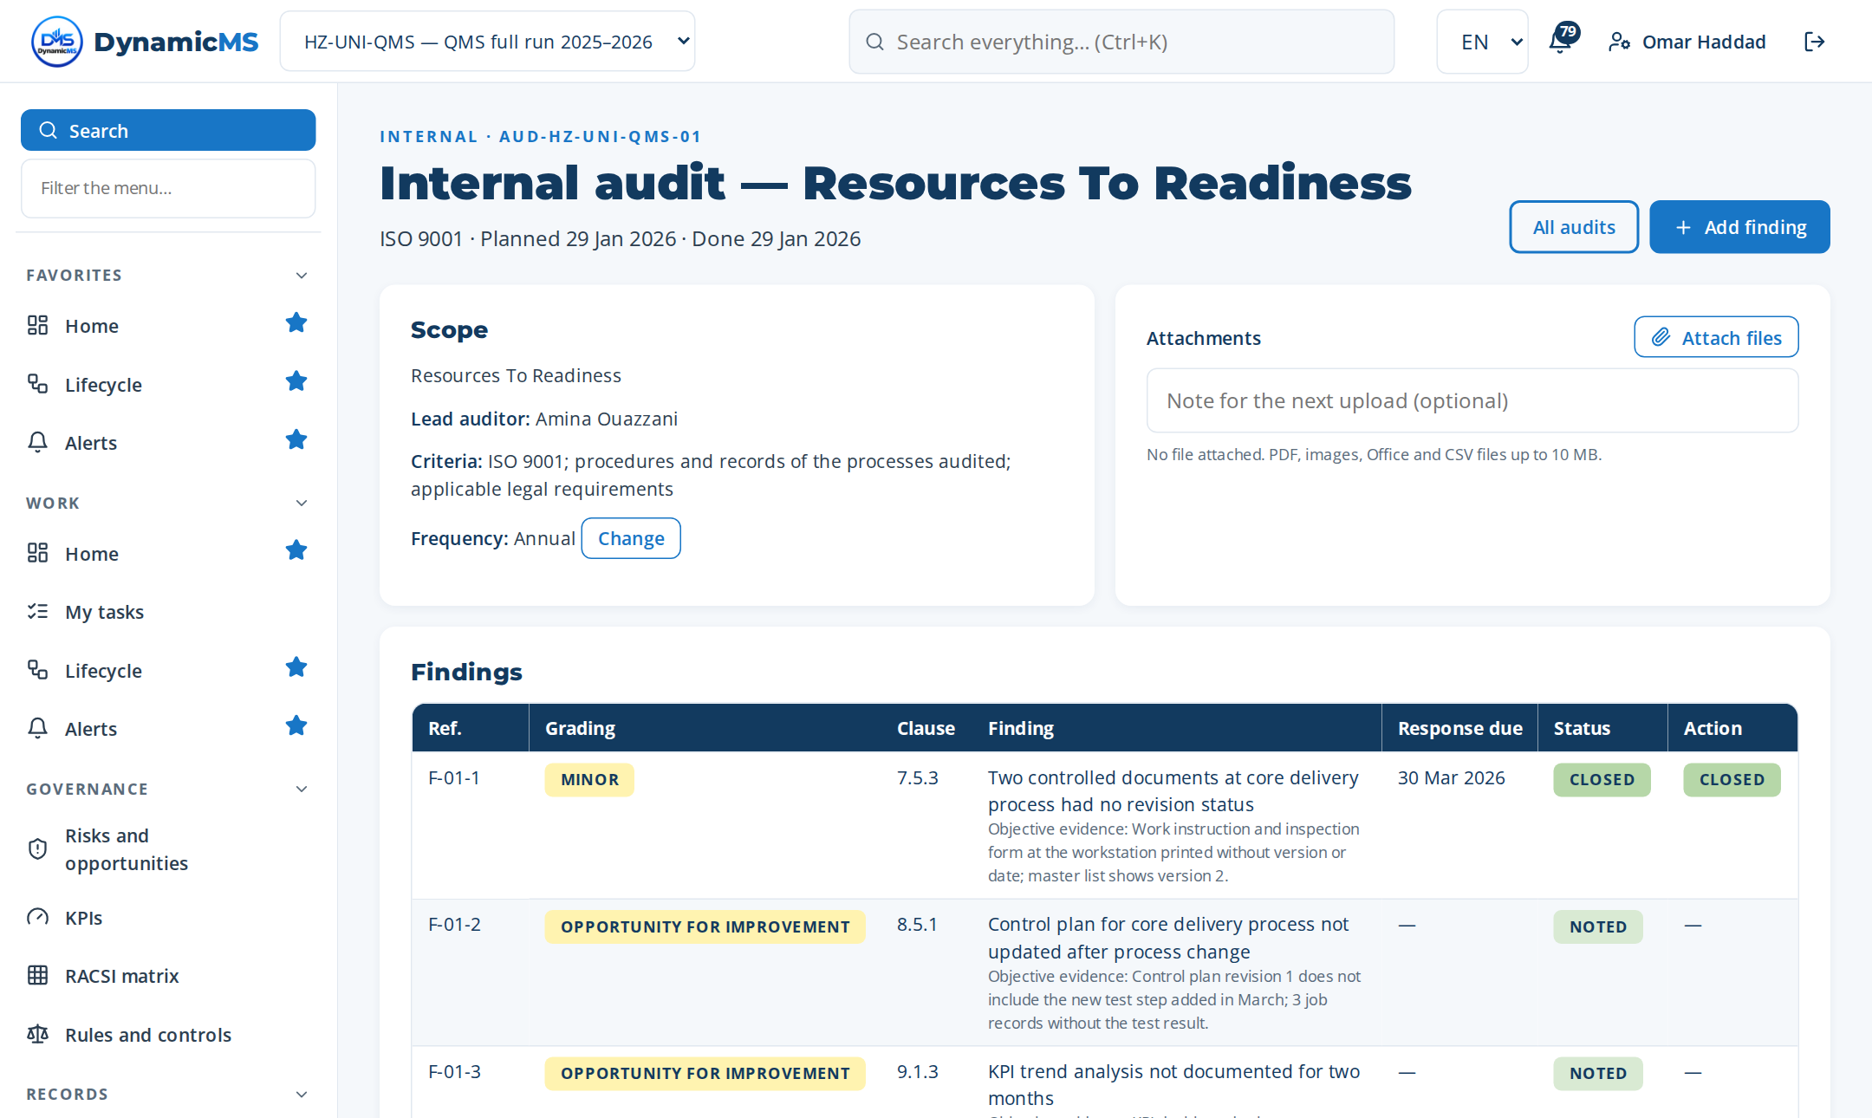
AUDIT
Audits with findings and conclusions
Programme, checklist, findings
Findings become nonconformities
Ready for JCI and ISO surveys
POWERACT Consulting · Evidence
60

Slide 61
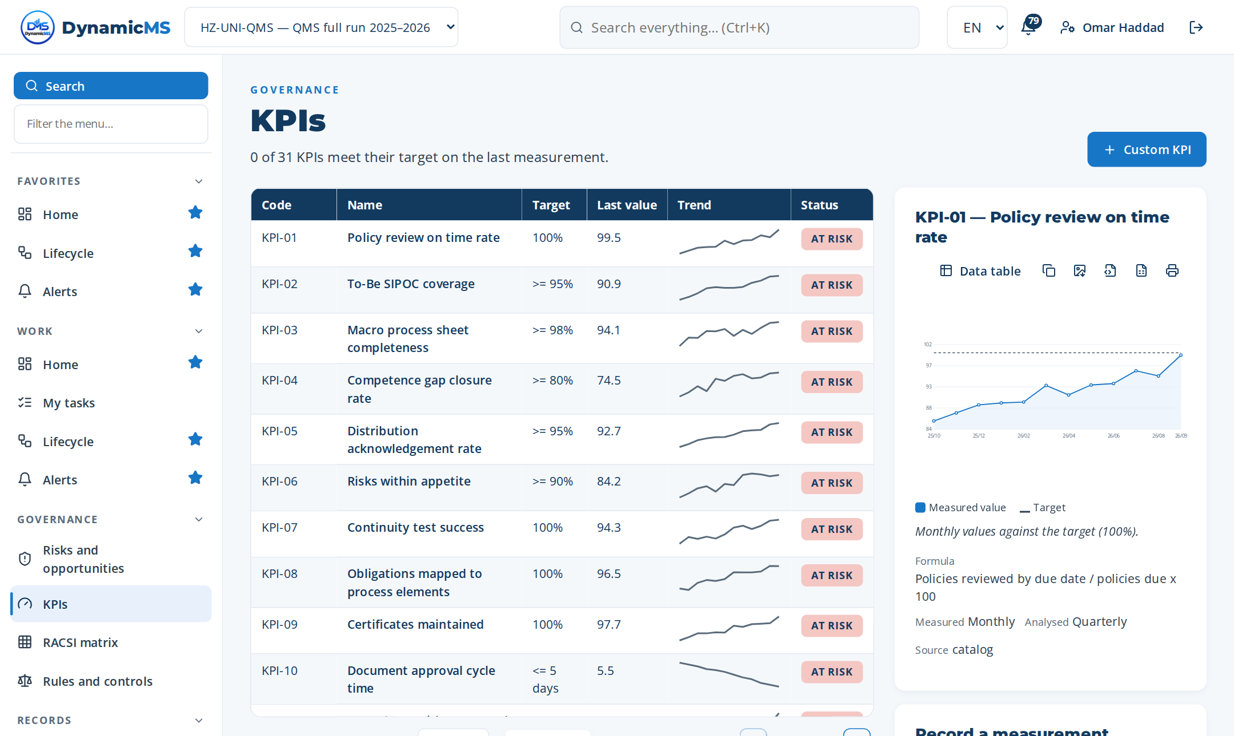
KPI
Indicators against their targets
Monthly values and trend
Data table, CSV and image export
Feed the management review
POWERACT Consulting · Evidence
61

Slide 62
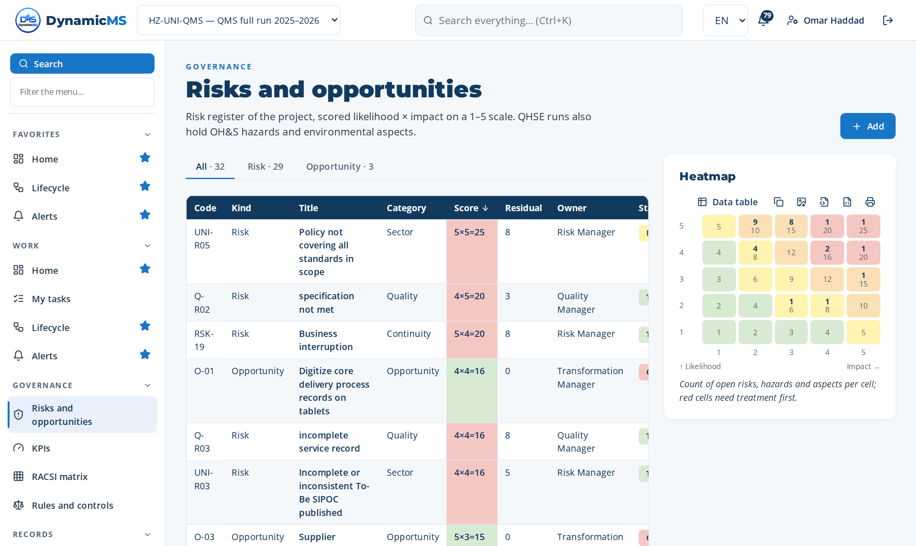
RISKS
Risks and opportunities by score
Likelihood × impact heatmap
Treatment and owner
Linked to the steps they govern
POWERACT Consulting · Evidence
62

Slide 63
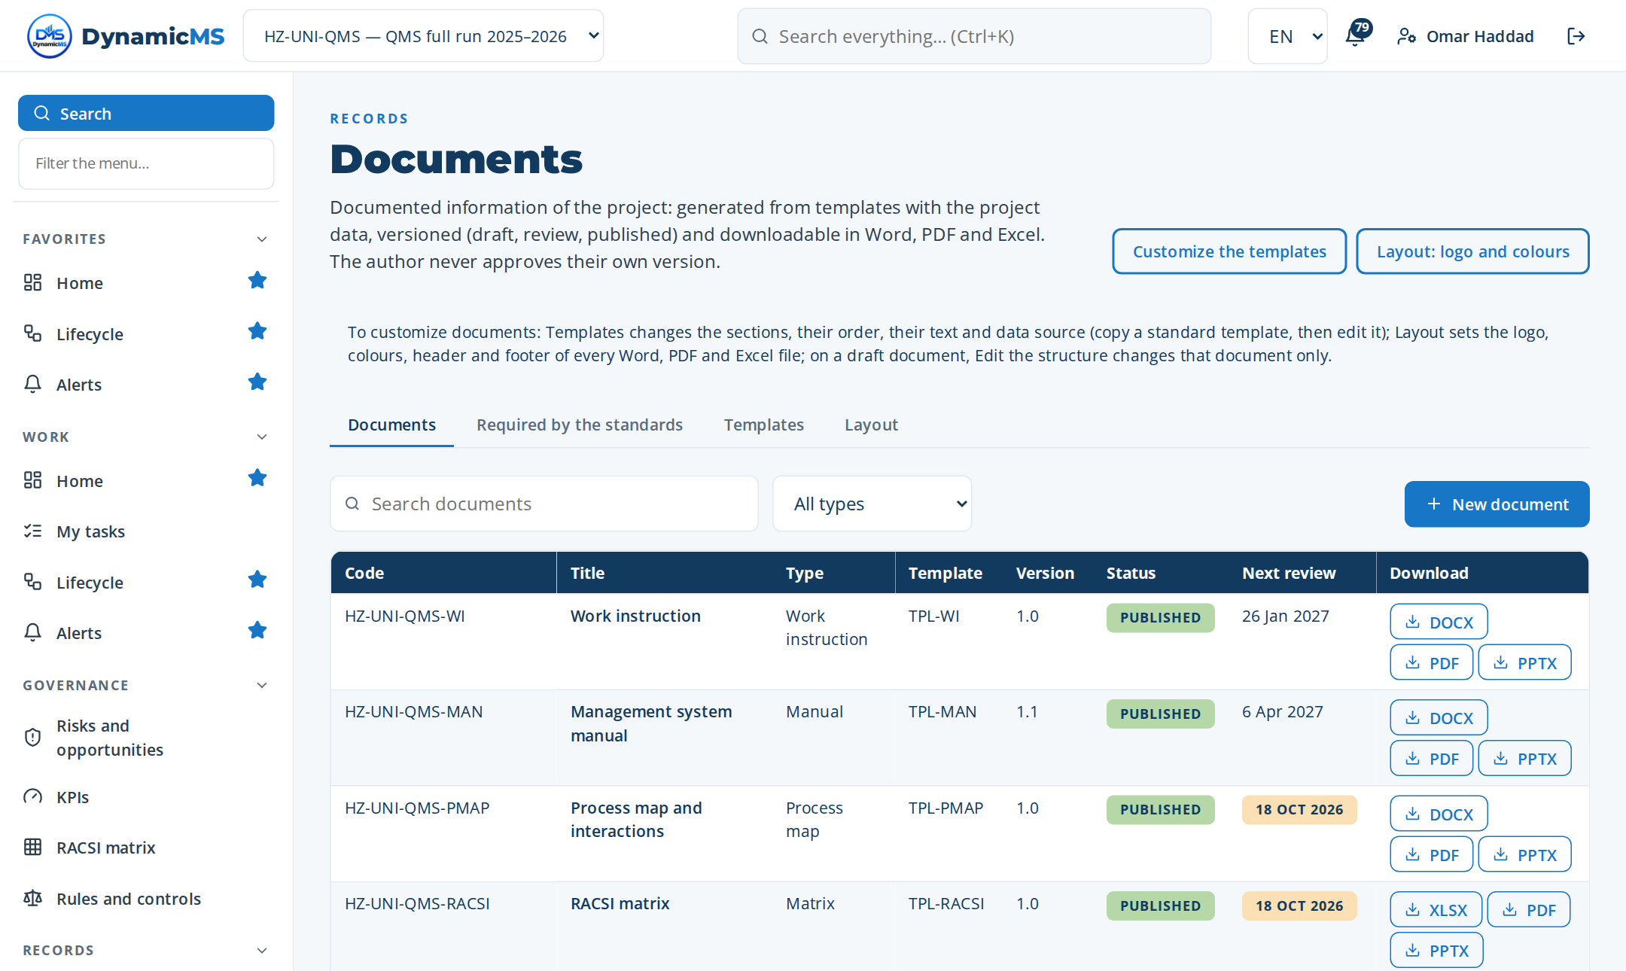
DOCUMENTS
Controlled documents generated from the data
37 IMS templates
Versions, review and approval
PDF, Word, Excel, PowerPoint
POWERACT Consulting · Evidence
63

Slide 64
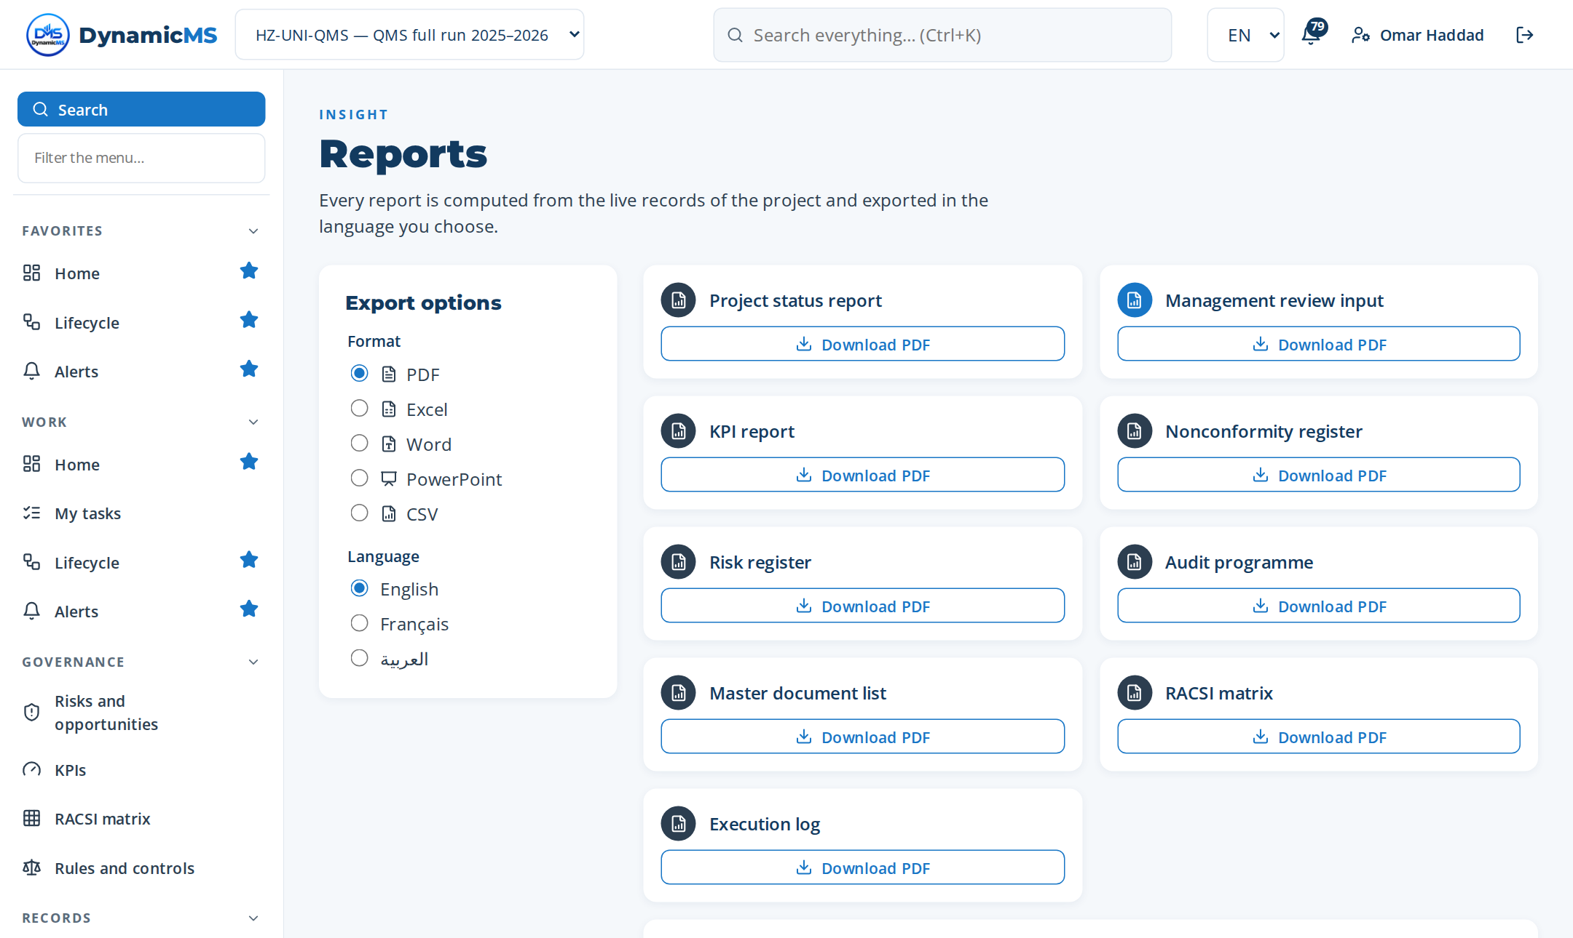
REPORTS
Reports for every review
Management review inputs (ISO 9001 §9.3.2)
English, French, Arabic
PDF, Excel, Word, PowerPoint, CSV
POWERACT Consulting · Evidence
64

Slide 65
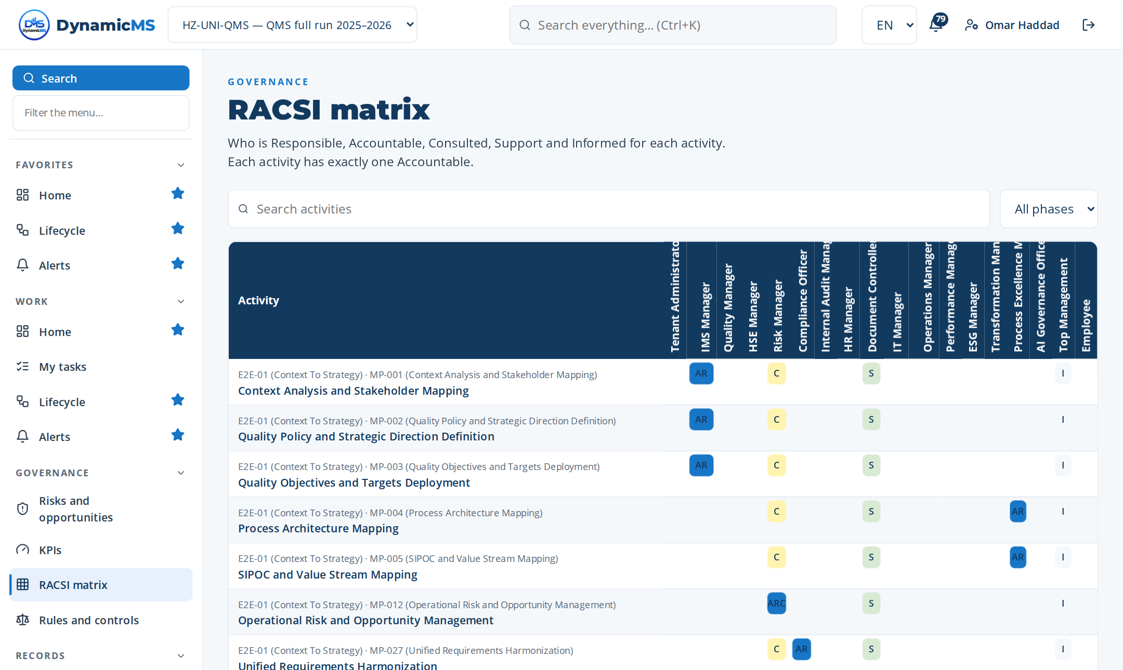
RACSI
Who is responsible for each step
Responsible, Accountable, Support, Consulted, Informed
Linked to the organization chart
Exported for audits
POWERACT Consulting · Evidence
65

Slide 66
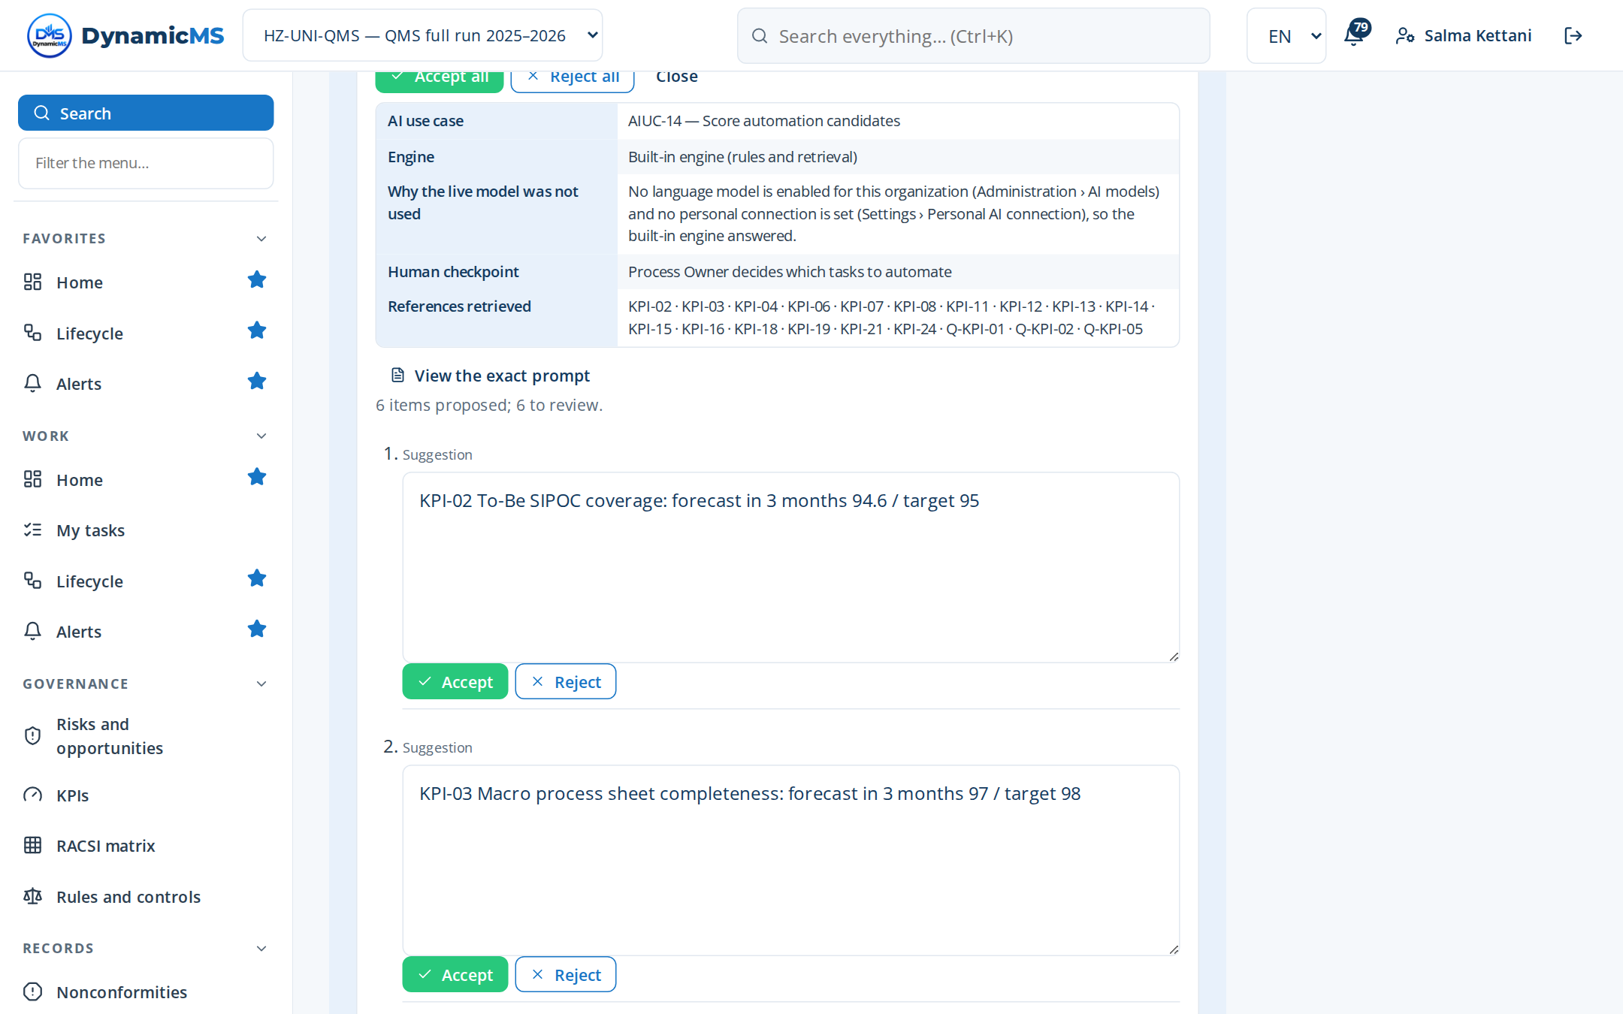
GOVERNED AI
AI proposes, a person decides
Each suggestion comes from an approved AI use case
Each item accepted, edited or rejected
Every decision kept in an append-only log
POWERACT Consulting · Evidence
66

Slide 67
NEXT STEPS
From this case to your organization
01
Scoping workshop: your sites, services, standards (JCI, ISO 9001, ISO 15189 for the laboratory) and priorities.
02
Configuration: healthcare segment V-29, licence, organization chart, roles and users.
03
Pilot: run E2E-01 to E2E-04 on one site with your data; first gate decision.
04
Deployment: the twelve phases across services, with reviews and reports in French and English.
The full step-by-step values of this run are in the DynamicMS user guide (full real run).
POWERACT Consulting · Next steps
67

