Slide 1

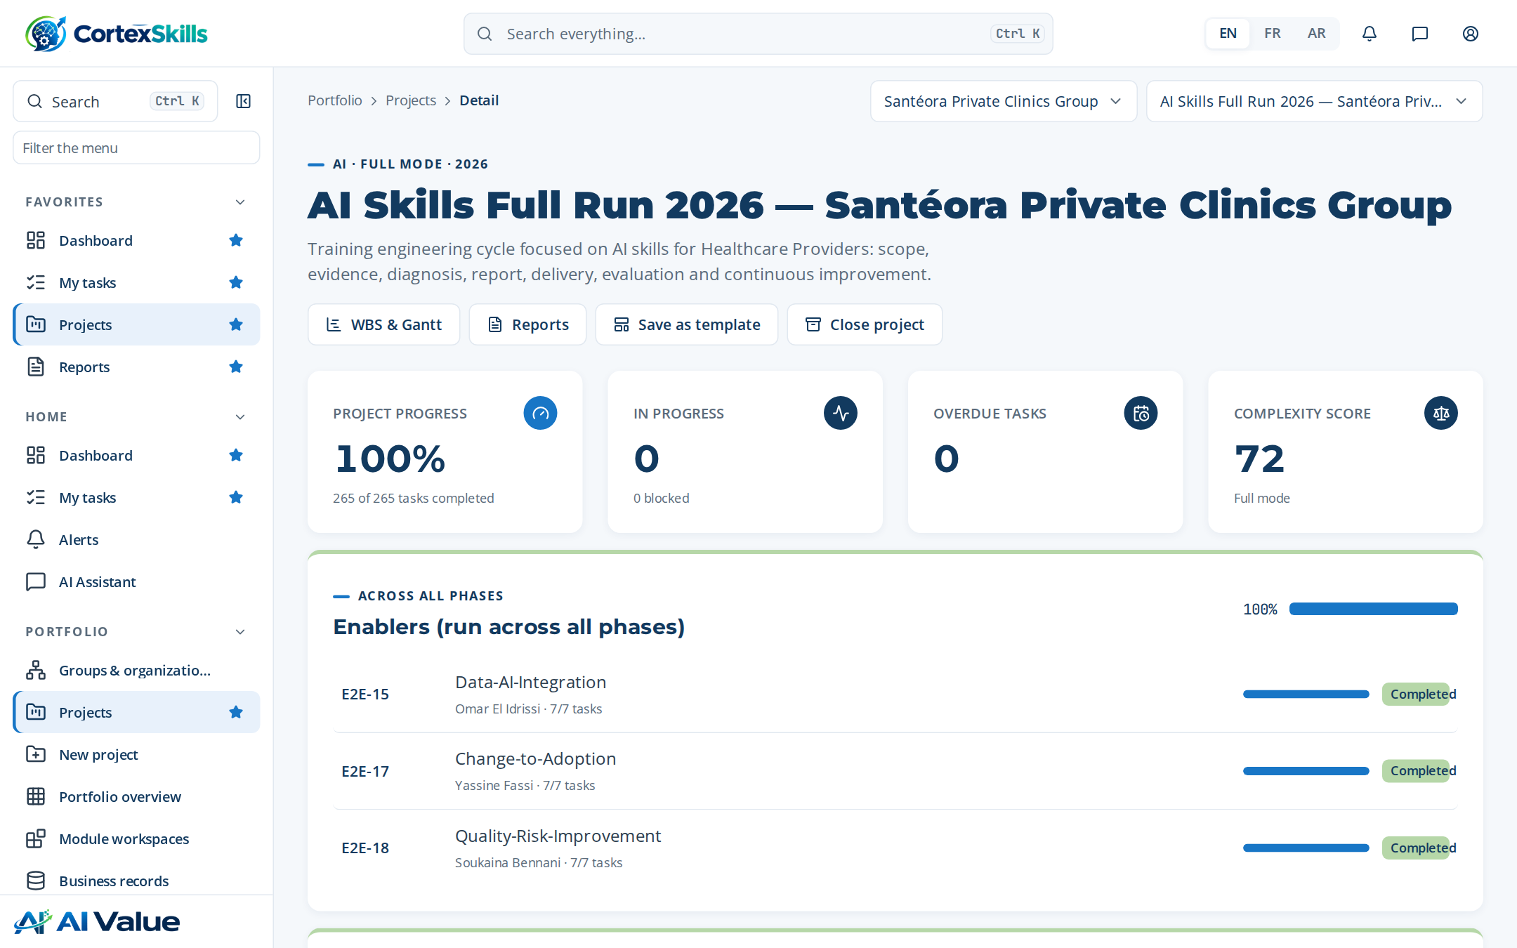
FULL CASE · HEALTHCARE · 2026
AI skills training engineering at a private clinic group
Santéora Private Clinics Group: the project, the Training Engineering Report, the Training Plan and every document produced with CortexSkills
MEASURABLE · GOVERNED · SUSTAINABLE

Slide 2







AGENDA
How the case is presented
01
02
03
The clinic group and the project
Diagnosis
Training Engineering Report
Context, charter, scope, method, schedule
Questionnaires, maturity, gaps, needs
Structure, findings, roadmap, risks
04
05
06
Training Plan
Delivery, evaluation and audit
Documents produced
Programs, agendas, design, budget
Sessions, Kirkpatrick, ROI, audit
37 published documents, traced
Agenda · Demonstration data — fictional organization
2

Slide 3







EXECUTIVE SUMMARY
A complete AI skills cycle, documented end to end
Santéora Private Clinics Group · 2,600 employees · AI Skills Full Run 2026 — Santéora Private Clinics Group
100 %
35 / 40
6
1,260,000
of the run completed — 35 end-to-end processes
people answered the questionnaires (88 %)
trainings in 2 programs, prioritized by impact
training budget; 1,238,497 spent
What the case shows
Diagnosis: “Information systems” is the weakest axis (2 / 5); the largest skill gap is “AI bed and staff capacity planning” (average gap 3.0).
10 training needs were validated and grouped into 6 themes, deployed in 4 roadmap initiatives over three waves.
Kirkpatrick results 77 % · 74 % · 75 %; training ROI 108 % (target ≥ 100%).
37 documents published, 1,077 pages; the Training Engineering Report alone has 193 pages.
Executive summary · Demonstration data — fictional organization
3

Slide 4
01
The clinic group and the project
Context, charter, scope, method and schedule

Slide 5
CONTEXT
Santéora Private Clinics Group
Santéora Private Clinics Group operates in the Healthcare Providers sector, in Casablanca, with 2600 employees.
Topic | Content
Vision | Become the reference of Healthcare Providers in the region, with teams trained to the best standards.
Mission | Deliver safe, compliant service through skilled people and controlled processes.
Values | Commitment · Excellence · Sharing
Context | Strong competition, stricter ISO 7101 audits and the arrival of AI triage and clinical decision support.
Products — existing | Core services of Clinical Care & Nursing
Products — new | Digital services supported by AI triage and clinical decision support
Market segments | Large accounts · Public sector · Individual customers
Organization and headcount
Function | People
Operations | 3
Quality & HSE | 3
Finance | 2
Human Resources | 2
Sales & Marketing | 2
Information Systems | 2
Clinical Care & Nursing | 2
The clinic group and the project · Demonstration data — fictional organization
5

Slide 6
GROUP PROFILE
Key dates and SWOT of the clinic group
2008
2014
2019
2025
Company founded
Second site opened
ISO 7101 certification
Digital transformation program launched
Strengths
Areas for improvement
Opportunities
Threats
• Experienced, committed team
• Good knowledge of the market
• Stable processes
• Low use of AI triage and clinical decision support
• Reporting kept in spreadsheets
• Low use of AI medical imaging assistance
• Little versatility between roles
• Low use of AI bed and staff capacity planning
• Demand for digital services
• Training contracts refunded by OFPPT
• Stricter ISO 7101 audits
• Departure of key experts
Source: TER sections 1.3 and 1.4.
The clinic group and the project · Demonstration data — fictional organization
6

Slide 7




PROJECT CHARTER
AI Skills Full Run 2026 — Santéora Private Clinics Group
Training engineering cycle focused on AI skills for Healthcare Providers: scope, evidence, diagnosis, report, delivery, evaluation and continuous improvement.
72
40
17
MS · MO · OP
complexity score (out of 100): full run with gates
stakeholders registered and consulted
scope criteria approved in the Scope of Work
decision levels covered (strategic, middle, operational)
Strategic objectives
SO-1 — Adopt AI triage and clinical decision support across Clinical Care & Nursing by end 2027 (horizon 2027-12-31)
SO-2 — Zero major findings in ISO 7101 audits (horizon 2026-12-31)
The clinic group and the project · Demonstration data — fictional organization
7

Slide 8
SCOPE OF THE MISSION
Functions and decision levels in scope
Focus: AI · Decision levels: MS, MO, OP · Approval: Approved (2026-04-30, Mehdi Lahlou)
Function | MS — strategic | MO — middle | OP — operational
Operations | ● | ● | ●
Quality & HSE | ● | ● | —
Finance | ● | — | ●
Human Resources | — | ● | ●
Sales & Marketing | ● | ● | ●
Information Systems | ● | ● | —
Clinical Care & Nursing | ● | — | ●
How the scope is set
Each function × decision-level cell is a weighted criterion of the Scope of Work. 16 criteria were approved by the sponsor before any questionnaire was sent; every later table of the report is filtered by this scope.
Source: TER section 1.8.
The clinic group and the project · Demonstration data — fictional organization
8

Slide 9
METHOD
Six phases, each closed by a gate with its deliverables
The training engineering mission follows the phases below, each closed by a gate with its deliverables.
Phase | End-to-end processes | Progress
1. Scope & evidence | E2E-32 · E2E-33 · E2E-19 · E2E-24 | 100%
2. Diagnosis | E2E-20 · E2E-25 · E2E-26 · E2E-27 · E2E-28 · E2E-29 · E2E-02 · E2E-21 | 100%
3. Training Engineering Report & plan | E2E-01 · E2E-03 · E2E-30 · E2E-22 · E2E-23 · E2E-16 · HCPR-E2E-02 | 100%
4. Design & delivery | E2E-04 · E2E-05 · E2E-06 · E2E-13 · E2E-14 | 100%
5. Evaluation, compliance & impact | E2E-07 · E2E-08 · E2E-09 · HCPR-E2E-01 | 100%
6. Talent, knowledge & continuous improvement | E2E-10 · E2E-11 · E2E-12 · E2E-31 | 100%
Source: Training Engineering Report, section 1.5 “The current mission”.
The clinic group and the project · Demonstration data — fictional organization
9

Slide 10
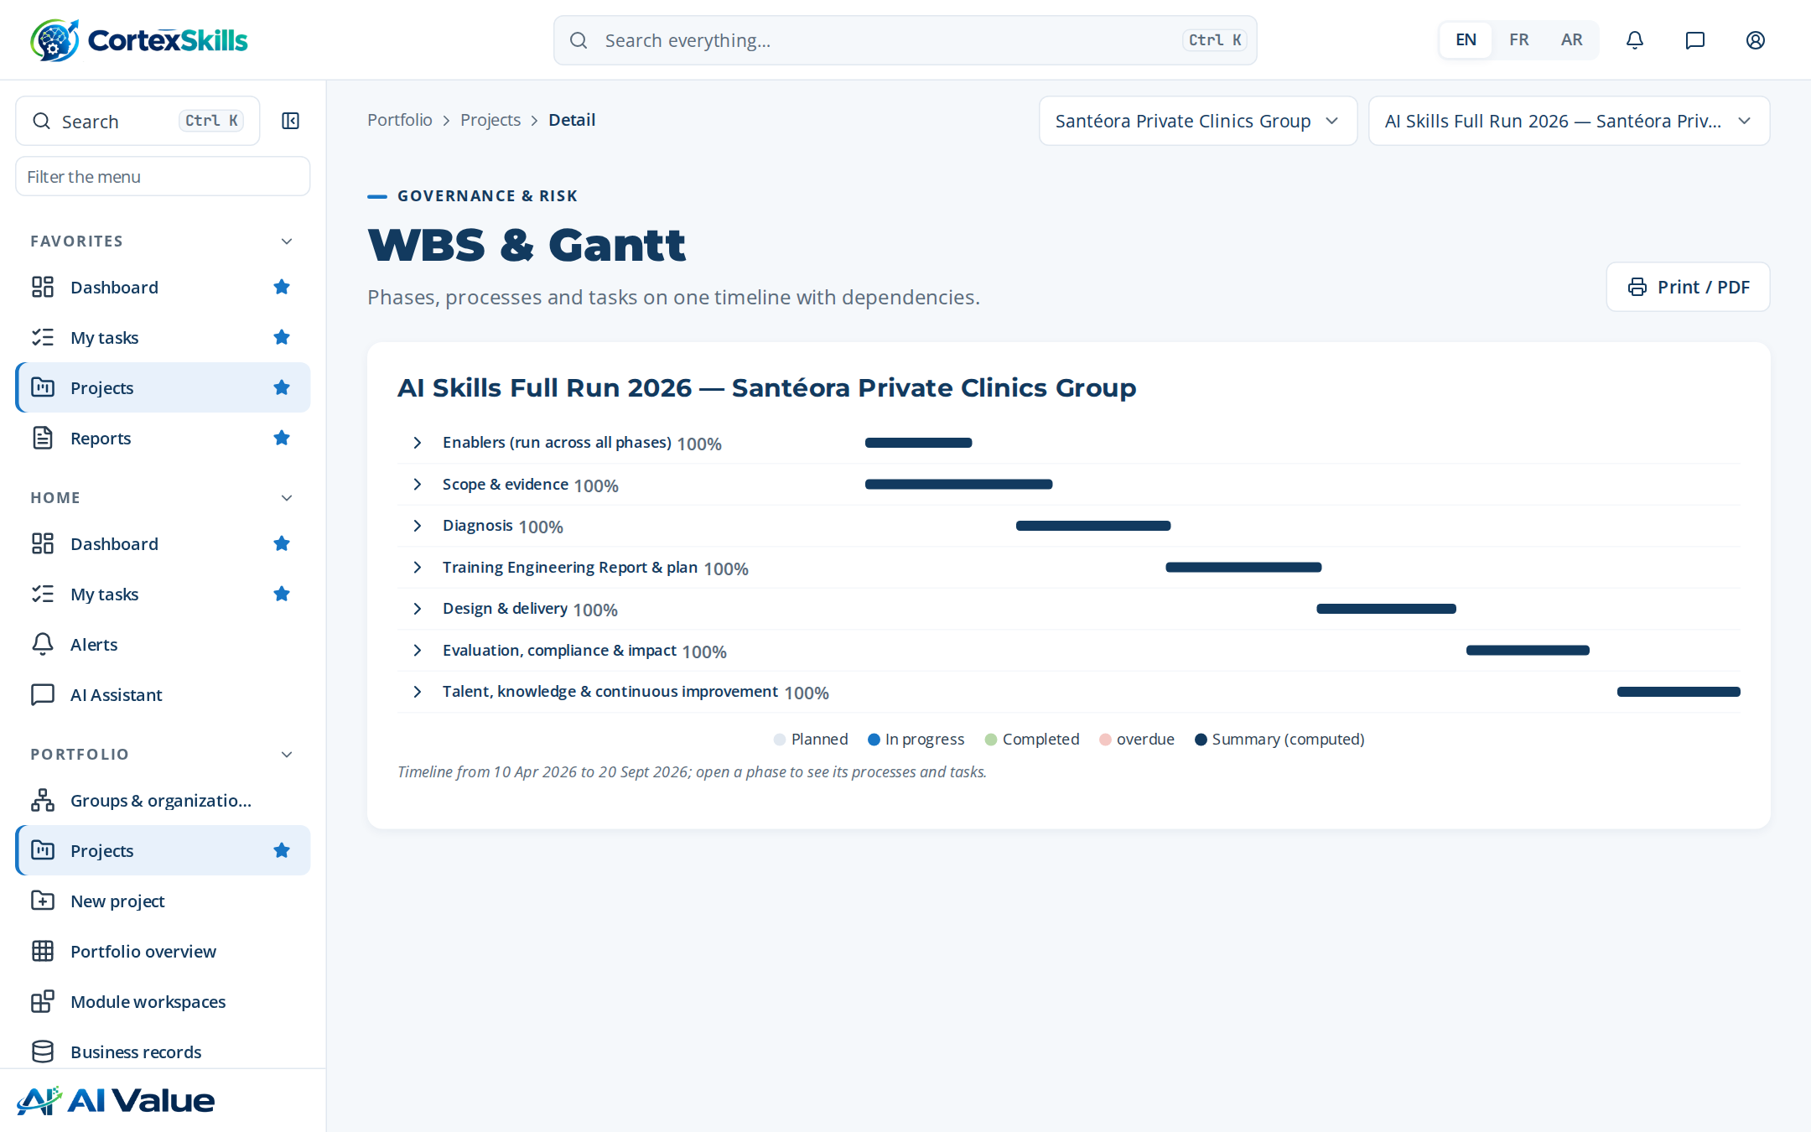
SCHEDULE
Work packages and the Gantt chart
Work package | Start | End | Progress
Scope & evidence | 2026-04-10 | 2026-05-07 | 100 %
Diagnosis | 2026-05-08 | 2026-06-04 | 100 %
Report & plan | 2026-06-05 | 2026-07-02 | 100 %
Sessions | Date
S-01 AI triage and clinical decision … | 2026-07-19
S-02 AI medical imaging assistance | 2026-07-26
S-03 AI triage and clinical decision … | 2026-08-02
S-04 AI medical imaging assistance | 2026-08-09
WBS and Gantt of the project in CortexSkills.
The clinic group and the project · Demonstration data — fictional organization
10

Slide 11
STAKEHOLDERS
40 people consulted across every function
40 people were consulted: 1 from general management, 26 managers and 13 staff members.
Channel | People
Face-to-face | 1
Combination | 26
Email | 13
Consent recorded for 40 of 40 people before any answer was stored.
People consulted by function and population (TER 1.7).
The clinic group and the project · Demonstration data — fictional organization
11

Slide 12
02
Diagnosis
Who answered, where the clinic group stands, which skills are missing

Slide 13
QUESTIONNAIRE CAMPAIGN
35 of 40 people answered
40 people were invited to answer; 35 answered.
Function | General Manager | Management | Team member | Responded
Operations | 1 | 3 | 2 | 5
Quality & HSE | 0 | 4 | 2 | 5
Human Resources | 0 | 4 | 2 | 5
Sales & Marketing | 0 | 4 | 2 | 5
Information Systems | 0 | 3 | 2 | 5
Clinical Care & Nursing | 0 | 4 | 1 | 5
Finance | 0 | 4 | 2 | 5
Response rate by function.
Channel | Invited | Responded | Rate | Completeness
Application | 18 | 18 | 100 % | 95 %
Face-to-face | 13 | 13 | 100 % | 89 %
Email | 4 | 4 | 100 % | 89 %
Source: TER sections 1.6, 1.12 and 1.13.
Diagnosis · Demonstration data — fictional organization
13

Slide 14
THE PREVIOUS PLAN
What the teams said about the last training plan
What did you notice about the n-1 training plan?
What were the strengths of the n-1 plan?
What improvements did the n-1 plan bring?
• Good participation, but little follow-up after the sessions.
• Trainings were chosen late in the year and with little link to our objectives.
• Sessions held on site, close to the teams.
• Practical trainers who knew our sector.
• Supervisors use the new procedures.
• Fewer errors on ISO 7101 records.
What were the challenges of the n-1 plan?
What did you appreciate and like about the n-1 plan?
For a new training plan, what would you like to see done differently?
• Measuring the effect of the trainings.
• Releasing people from the job during peaks.
• The workshops on real cases.
• The exchange between sites.
• Shorter half-day formats with a workshop each time.
• A plan built from the needs of each function.
Source: TER chapter 2 — 62 trainings attended are listed in section 2.1.
Diagnosis · Demonstration data — fictional organization
14

Slide 15
DIAGNOSIS AND MATURITY
Five axes scored, maturity one level below target
Axis | Score | Reading
Strategy | 3.4 | Strength to build on
Organization | 2.8 | Partly in place
Processes | 2.6 | Partly in place
People and skills | 3.1 | Partly in place
Information systems | 2 | Priority for development
Model | Current | Target | Gap
CMM maturity (CMM) | 3 | 4 | 1
Leadership maturity (Leadership) | 3 | 4 | 1
Maturity models (TER 1.10).
Diagnostic score by axis against target level 4 (TER 1.9).
Diagnosis · Demonstration data — fictional organization
15

Slide 16
PERFORMANCE BY FUNCTION
Where each function stands at each decision level
Performance by decision level: MS strategic management, MO operational management, OP operational.
Function | MS | MO | OP | Main gaps
Operations | 88% Amber | 83% Amber | 76% Amber | AI triage and clinical decision support · AI medical imaging assistance · AI bed and staff cap…
Quality & HSE | 76% Amber | 52% Red | 86% Amber | AI medical imaging assistance · AI bed and staff capacity planning · AI triage and clinical de…
Finance | 81% Amber | 58% Red | 77% Amber | AI bed and staff capacity planning · AI triage and clinical decision support · AI medical imag…
Human Resources | 79% Amber | 54% Red | 63% Red | AI triage and clinical decision support · AI medical imaging assistance · AI bed and staff cap…
Sales & Marketing | 88% Amber | 82% Amber | 59% Red | AI medical imaging assistance · AI bed and staff capacity planning · AI triage and clinical de…
Information Systems | 78% Amber | 64% Red | 71% Amber | AI bed and staff capacity planning · AI triage and clinical decision support · AI medical imag…
Clinical Care & Nursing | 88% Amber | 73% Amber | 53% Red | AI triage and clinical decision support · AI medical imaging assistance · AI bed and staff cap…
Maturity heatmap on the fixed red → green status scale (TER 3.2).
Diagnosis · Demonstration data — fictional organization
16

Slide 17
COMPETENCES NAMED IN THE INTERVIEWS
The competences people asked for, by number of mentions
Consolidated from 30 responses.
Reading
The two AI clinical themes lead (94 and 94 mentions), followed by team communication and problem solving: the plan pairs each AI training with practical workshops on the clinics’ own cases.
Mentions across all answers (TER 3.3).
Diagnosis · Demonstration data — fictional organization
17

Slide 18
SOFT SKILLS AND LEADERSHIP
Self-assessment of the respondents, weakest first
Competence | Average (1–5) | n
Rewards and motivation | 3.2 | 30
Training and effectiveness | 3.2 | 30
Positive thinking and positive results (focus on solutions, break a b… | 3.3 | 30
Management by objectives and strategic vision applied to oneself | 3.3 | 30
Communication with oneself | 3.3 | 29
Communication with the team | 3.3 | 29
Managing with flexibility | 3.3 | 28
Management by objectives and strategic vision applied to others | 3.4 | 29
Leadership levels reached (TER 3.7).
Diagnosis · Demonstration data — fictional organization
18

Slide 19
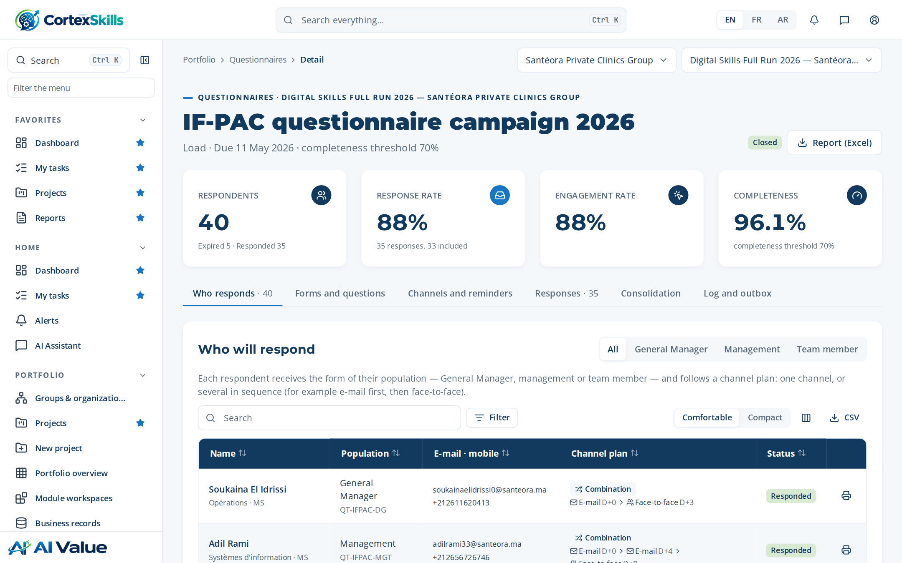
SKILL GAPS AND TRAINING NEEDS
From measured gaps to a validated needs register
Competency | People | Avg gap | Critical
AI medical imaging assistance | 3 | 2.0 | 0
AI bed and staff capacity planning | 2 | 3.0 | 2
AI triage and clinical decision support | 3 | 1.0 | 0
# | Theme | Source | Impact | Status
1 | AI bed and staff capacity planning | Diagnostic | 5 | Validated
2 | Responsible AI and data protection | Skills gap | 5 | Validated
3 | AI bed and staff capacity planning | GPEC | 5 | Validated
4 | AI medical imaging assistance | Demand | 4 | Validated
5 | Prompting and generative AI at work | SWOT | 4 | Validated
6 | AI medical imaging assistance | Diagnostic | 4 | Validated
7 | AI triage and clinical decision support | Skills gap | 3 | Validated
8 | AI literacy for all staff | GPEC | 3 | Validated
9 | AI triage and clinical decision support | Demand | 3 | Validated
10 | AI literacy for all staff | SWOT | 3 | Validated
Skill gaps by competency (TER 3.40).
Training needs register (TER 3.41): every need traced to its source.
Diagnosis · Demonstration data — fictional organization
19

Slide 20
FOCUS ON THE CORE FUNCTION
Clinical Care & Nursing
Needs, assessment and competences of the function that carries the strategic objective SO-1
Decision level | Score (%) | Status | Gap
MS | 88 % | Amber | AI triage and clinical decision support
MO | 73 % | Amber | AI medical imaging assistance
OP | 53 % | Red | AI bed and staff capacity planning
Respondent | Population | Strengths / Areas for improvement | Competences
Anas Berrada | Management | Soins cliniques et infirmiers — Experienced, committed team — Low use… | AI bed and staff capacity planning
Anas Berrada | Management | Clinical Care & Nursing — Experienced, committed team — Little versat… | AI bed and staff capacity planning; Time management and priorities
Imane Bennani | Team member | Experienced, committed team — Reporting kept in spreadsheets | AI medical imaging assistance
Imane Bennani | Team member | Experienced, committed team — Little versatility between roles | AI medical imaging assistance; Time management and priorities
Hajar Mansouri | Management | Soins cliniques et infirmiers — Good knowledge of the market — Report… | AI bed and staff capacity planning
Hajar Mansouri | Management | Clinical Care & Nursing — Stable processes — Little versatility betwe… | AI bed and staff capacity planning; Time management and priorities
Source: TER sections 3.36 to 3.39.
Diagnosis · Demonstration data — fictional organization
20

Slide 21




USE OF AI TODAY
How the teams use AI and what holds them back
Current use
Barriers
Risks to manage
Priorities
Preferred format
Daily, for triage and reports. (31)
Lack of training and unclear rules. (31)
Data protection and validation of results. (31)
AI medical imaging assistance; data quality (11)
AI triage and clinical decision support; data quality (10)
Short workshops on the job, then coaching. (31)
Strategic planning practice | Yes | No
Is there a strategic plan with macro business plans at company level? | 1 | 0
Are this strategic plan and the macro business plans implemented? | 1 | 0
Are they monitored? | 1 | 0
Are they subject to continuous improvement? | 1 | 0
Most frequent answers of 35 respondents (TER 3.45, 3.46).
Diagnosis · Demonstration data — fictional organization
21

Slide 22
OBJECTIVES AND EXPECTED RESULTS
What the respondents want the training to change
Objective | SMART formulation | Mentions
Improve customer satisfaction | Satisfaction score ≥ 85% by end of year | 28
Reduce non-quality costs | -20% rework in 12 months | 28
Develop human capital | 80% of critical roles certified | 8
Expected results
• Fewer errors and faster service.
• Teams able to use AI medical imaging assistance safely.
• Better audit results and staff retention.
• Teams able to use AI bed and staff capacity planning safely.
• Teams able to use AI triage and clinical decision support safely.
Source: TER 3.42 (64 objectives stated) and 3.9.
Diagnosis · Demonstration data — fictional organization
22

Slide 23
03
Training Engineering Report
132 sections, 193 pages, generated from the run data

Slide 24
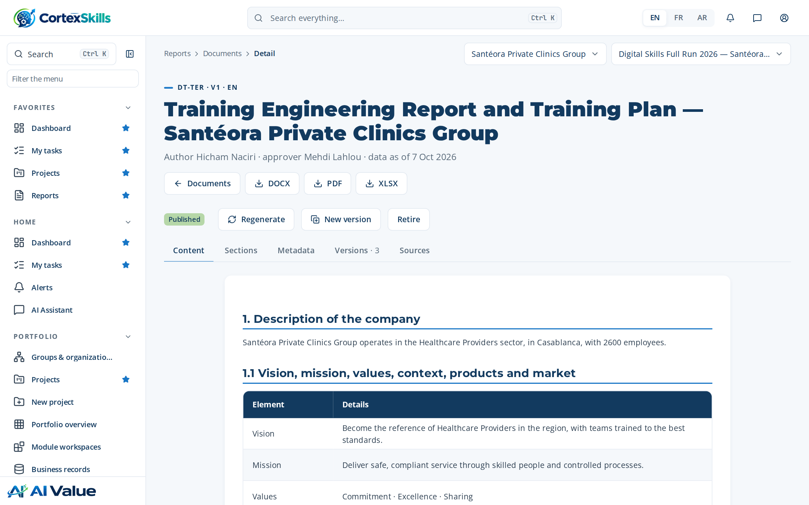
STRUCTURE OF THE REPORT
Training Engineering Report and Training Plan
Version 1 · author Hicham Naciri · approved by Mehdi Lahlou
Chapter | Sections
1. Description of the company | 14
2. The previous training plan | 2
3. Competence needs | 50
4. Perspectives | 3
5. The prioritized training plan | 23
6. Risks, controls and indicators | 2
7. Annexes — interview forms | 36
Plus identification, data sources and approval.
The report in the document editor.
Training Engineering Report · Demonstration data — fictional organization
24

Slide 25
STRATEGIC ORIENTATIONS AND HR
Needs linked to the strategy and to the HR orientations
Priority axes named by the General Management: Leadership and performance · AI triage and clinical decision support · ISO 7101 compliance · Dashboards
ID | Objective | Horizon
SO-1 | Adopt AI triage and clinical decision support across Clinical Care & Nursing by end 2027 | 2027-12-31
SO-2 | Zero major findings in ISO 7101 audits | 2026-12-31
HR orientations
Change management
• Update job descriptions, individual objectives and the yearly assessment; build career paths.
1) Focus and prioritization · 2) Stay positive · 3) Persevere and follow up with short daily repetitions · Patience · Lead by example · Progressiveness.
Source: TER sections 3.1, 3.5 and 3.6.
Training Engineering Report · Demonstration data — fictional organization
25

Slide 26
PERSPECTIVES AND ROADMAP
Four initiatives deployed in three waves
The perspectives take into account the strategic orientations, the SWOT and improvement axes, the HR orientations and the recommendations made in the face-to-face meetin…
Wave 1
Wave 2
Wave 3
• AI triage and clinical decision support — impact 5
• AI literacy for all staff — impact 5
• AI medical imaging assistance — impact 4
• AI bed and staff capacity planning — impact 3
# | Improvement axis | Implemented | Wave
1 | AI triage and clinical decision support | 60% | 1
2 | AI medical imaging assistance | 65% | 2
3 | AI bed and staff capacity planning | 70% | 3
4 | AI literacy for all staff | 75% | 1
Source: TER chapter 4 and section 4.1.
Training Engineering Report · Demonstration data — fictional organization
26

Slide 27
RISKS AND CONTROLS
Each risk reduced by named controls
ID | Risk or opportunity | Category | Inherent | Residual | Controls
RISK-014 | Low learner and user adoption | Adoption | 16 | 8 | CTRL-081
RISK-017 | Critical knowledge lost with expert departure | Operational | 16 | 8 | CTRL-070; CTRL-082
RISK-001 | Unauthorized access to tenant data | Security | 20 | 6 | CTRL-001; CTRL-002; CTRL-048; CTRL-011
RISK-005 | Training plan misaligned with strategy | Strategic | 16 | 6 | CTRL-049; CTRL-057; CTRL-076
RISK-006 | Inaccurate skills data leading to wrong needs | Data quality | 15 | 6 | CTRL-064; CTRL-045
RISK-030 | Position descriptions diverge from reality | Organizational | 12 | 6 | CTRL-066
RISK-007 | Unverified AI content in the Training Engineering Report | AI | 16 | 5 | CTRL-041; CTRL-056
RISK-009 | Expired mandatory certification | Compliance | 20 | 5 | CTRL-053; CTRL-054
RISK-031 | Site deployment deviates from group plan | Operational | 12 | 5 | CTRL-071
Top 9 of 35 risks by residual score (TER chapter 6).
Training Engineering Report · Demonstration data — fictional organization
27

Slide 28
PROJECT INDICATORS
Indicators followed every month during the run
ID | Indicator | Target | Latest value | Status
KPI-003 | Critical gap rate | ≤ 10% | 2026-10: 8.2 | Green
KPI-004 | Training Engineering Report cycle time | ≤ 30 days | 2026-10: 24.6 | Green
KPI-005 | Design approval lead time | ≤ 20 days | 2026-10: 16.4 | Green
KPI-007 | Content publication lead time | ≤ 15 days | 2026-10: 12.3 | Green
KPI-008 | Session fill rate | ≥ 85% | 2026-10: 91.8 | Green
KPI-009 | Plan realization rate | ≥ 90% | 2026-10: 97.2 | Green
KPI-010 | Learner completion rate | ≥ 80% | 2026-10: 86.4 | Green
KPI-012 | Average Level 1 satisfaction | ≥ 4.2 | 2026-10: 4.5 | Green
KPI-013 | Skill progression rate | ≥ 70% | 2026-10: 75.6 | Green
KPI-015 | Training record correction rate | ≤ 1% | 2026-10: 0.82 | Green
10 of the 61 indicators of TER section 6.1.
Training Engineering Report · Demonstration data — fictional organization
28

Slide 29
04
Training Plan
The plan 2026 holds 2 programs and 6 trainings, 12 days per group in total and 44 group-days to deliver, for a budget of 1,260,000.

Slide 30
PRIORITIZED PLAN
Six themes ranked by impact and urgency
Plan 2026 — status Locked — budget 1,260,000.
# | Theme | Days | Groups | Budget
1 | AI triage and clinical decision support | 3 | 6 | 360,000
2 | AI medical imaging assistance | 2 | 4 | 300,000
3 | AI bed and staff capacity planning | 2.5 | 3 | 240,000
4 | AI literacy for all staff | 1.5 | 3 | 180,000
5 | Prompting and generative AI at work | 1 | 2 | 120,000
6 | Responsible AI and data protection | 2 | 2 | 60,000
Budget by theme.
Training Plan · Demonstration data — fictional organization
30

Slide 31
PROGRAMS AND TRAININGS
Two programs, six trainings, clear prerequisites
Code | Program | Strategic axis | Trainings
PRG-1 | AI skills for Clinical Care & Nursing | Execution of the core function | TR-AI-01, TR-AI-02, TR-AI-03
PRG-2 | AI foundations for all staff | Leadership, performance and responsible use | TR-AI-04, TR-AI-05, TR-AI-06
ID | Training | Level | Duration | Prerequisites
TR-AI-01 | AI triage and clinical decision support | Intermediate | 3 day(s) | Basic digital literacy; the Foundation training is recommended
TR-AI-02 | AI medical imaging assistance | Intermediate | 2 day(s) | Basic digital literacy; the Foundation training is recommended
TR-AI-03 | AI bed and staff capacity planning | Advanced | 2.5 day(s) | TR-AI-01 or equivalent experience
TR-AI-04 | AI literacy for all staff | Foundation | 1.5 day(s) | None — open to all staff
TR-AI-05 | Prompting and generative AI at work | Foundation | 1 day(s) | None — open to all staff
TR-AI-06 | Responsible AI and data protection | Intermediate | 2 day(s) | Basic digital literacy; the Foundation training is recommended
Source: Training Plan “Programs” and TER section 5.1.
Training Plan · Demonstration data — fictional organization
31

Slide 32
TRAINING SHEET
TR-AI-01 — AI triage and clinical decision support
Level Intermediate · 3 day(s) · program PRG-1
Learning objectives
Prerequisites
• Explain the key concepts of AI triage and clinical decision support and how they apply to Clinical Care & Nursing
• Apply the methods and tools of AI triage and clinical decision support to a real case from Santéora Private Clinics Group
• Plan the deployment of AI triage and clinical decision support with its indicators and controls (ISO 7101)
Basic digital literacy; the Foundation training is recommended
Delivery
M1 AI triage and clinical decision support · E-learning · 2 h
M3 AI triage and clinical decision support · Virtual classroom · 3.5 h
Training Plan · Demonstration data — fictional organization
32

Slide 33
DETAILED AGENDA
AI triage and clinical decision support — half-day by half-day
22 activities over 3 day(s): lectures, quizzes and workshops on the clinics’ own cases.
Day 1 — morning
Day 1 — afternoon
Day 2 — morning
Lecture · Foundations of AI triage and clinical decision support: key c… (75 min)
Lecture · Why AI triage and clinical decision support matters for Clini… (45 min)
Quiz — key concepts of AI triage and clinical decision support (20 min)
Workshop — map today’s practices in Clinical Care & Nursing a… (75 min)
Lecture · Methods and tools of AI triage and clinical decision support (75 min)
Lecture · Worked example from the Healthcare Providers sector (40 min)
Quiz — choosing the right method (20 min)
Workshop — apply the method to a real case from Santéora Priv… (80 min)
Lecture · Governance, risks and ISO 7101 requirements (60 min)
Lecture · Data, quality and evidence to keep (45 min)
Quiz — compliance and risk scenarios (20 min)
Workshop — build the control checklist of your process (80 min)
Day 2 — afternoon
Day 3 — morning
Day 3 — afternoon
Lecture · Deploying AI triage and clinical decision support: roles, cha… (60 min)
Lecture · Indicators that measure the results (45 min)
Quiz — adoption and indicator cases (20 min)
Workshop — design the indicator dashboard of your team (80 min)
Lecture · Advanced practices and lessons learned in Clinical Care & Nur… (75 min)
Quiz — advanced cases (25 min)
Workshop — solve a critical incident scenario (100 min)
Lecture · Transfer to the workplace: the 30-60-90-day plan (60 min)
Quiz · Final assessment (Kirkpatrick level 2) (30 min)
Workshop — individual action plan and peer review (90 min)
Training Plan · Demonstration data — fictional organization
33

Slide 34

VALUE FOR EACH PERSONA
Why each audience should take the training
Training TR-AI-01 — behaviour, pain points and hopes of each persona
Executive sponsor — General Manager
Manager — director, head of department, process owner
Team member — Clinical Care & Nursing
Decides on facts presented in short steering meetings; delegates execution to the management team; follows a few indicators.
Training spend with no visible link to the strategic objectives; results of the previous plan hard to prove; ISO 7101 audits that expose competence gaps.
A prioritized plan that serves the strategy, a measurable return, and a management team able to lead the change.
Balances daily operations and improvement projects; prefers practical, short formats; relies on key people in the team.
Team absent from the job during long trainings; skills gaps on critical activities of Clinical Care & Nursing; processes not documented or without an owner.
Trainings that solve the function’s real problems, applied on the job the following week, with indicators the manager can follow.
Learns by doing and from peers; uses a phone more than a computer; wants to know what changes in daily work.
New tools introduced without explanation; theoretical trainings far from the tasks; fear of making mistakes with AI triage and clinical decision support.
Practical skills recognized by a certificate, less rework, and a clear path to the next position.
Training Plan · Demonstration data — fictional organization
34

Slide 35
LEARNING DESIGN
Paths, modules and content assets
Learning path | Days | Module | Modality | Hours | Design
AI triage and clinical decision support | 3 | M1 AI triage and clinical decision support | E-learning | 2 | Approved
 |  | M3 AI triage and clinical decision support | Virtual classroom | 3.5 | Approved
AI medical imaging assistance | 2 | M2 AI medical imaging assistance | Classroom | 7 | Approved
 |  | M4 AI medical imaging assistance | Classroom | 7 | Approved
Content | Format | Size (MB) | Review date | Status | Language
M1 material | SCORM | 42 | 2027-08-03 | Published | EN
M2 material | Video | 180 | 2027-04-05 | Published | FR
M3 material | PDF | 3.2 | 2026-12-06 | Published | AR
M4 material | Capsule | 12 | 2026-08-08 | Published | FR
Source: TER sections 5.3 and 5.4.
Training Plan · Demonstration data — fictional organization
35

Slide 36
BUDGET
Allocated, committed, spent and refunds expected
Allocated 1,260,000, committed 1,260,000 (100 %), spent 1,238,497 (98 % of planned); expected refunds 352,800.
Line | Actual | Refund
AI triage and clinical decisi… | 354,598 | 100,800
AI medical imaging assistance | 295,234 | 84,000
AI bed and staff capacity pla… | 244,886 | 67,200
AI literacy for all staff | 159,533 | 50,400
Prompting and generative AI a… | 123,413 | 33,600
Responsible AI and data prote… | 60,833 | 16,800
Total | 1,238,497 | 352,800
Provider | Accredited until | /5
Atlas Formation Conseil | 2027-04-25 | 4.2
Maghreb Learning Partners | 2027-08-03 | 3.8
Allocated (Muted) versus actual (Azure) by training, (TER 5.7).
Training Plan · Demonstration data — fictional organization
36

Slide 37
05
Delivery, evaluation and audit
Sessions, Kirkpatrick levels, ROI, internal audit and lessons learned

Slide 38


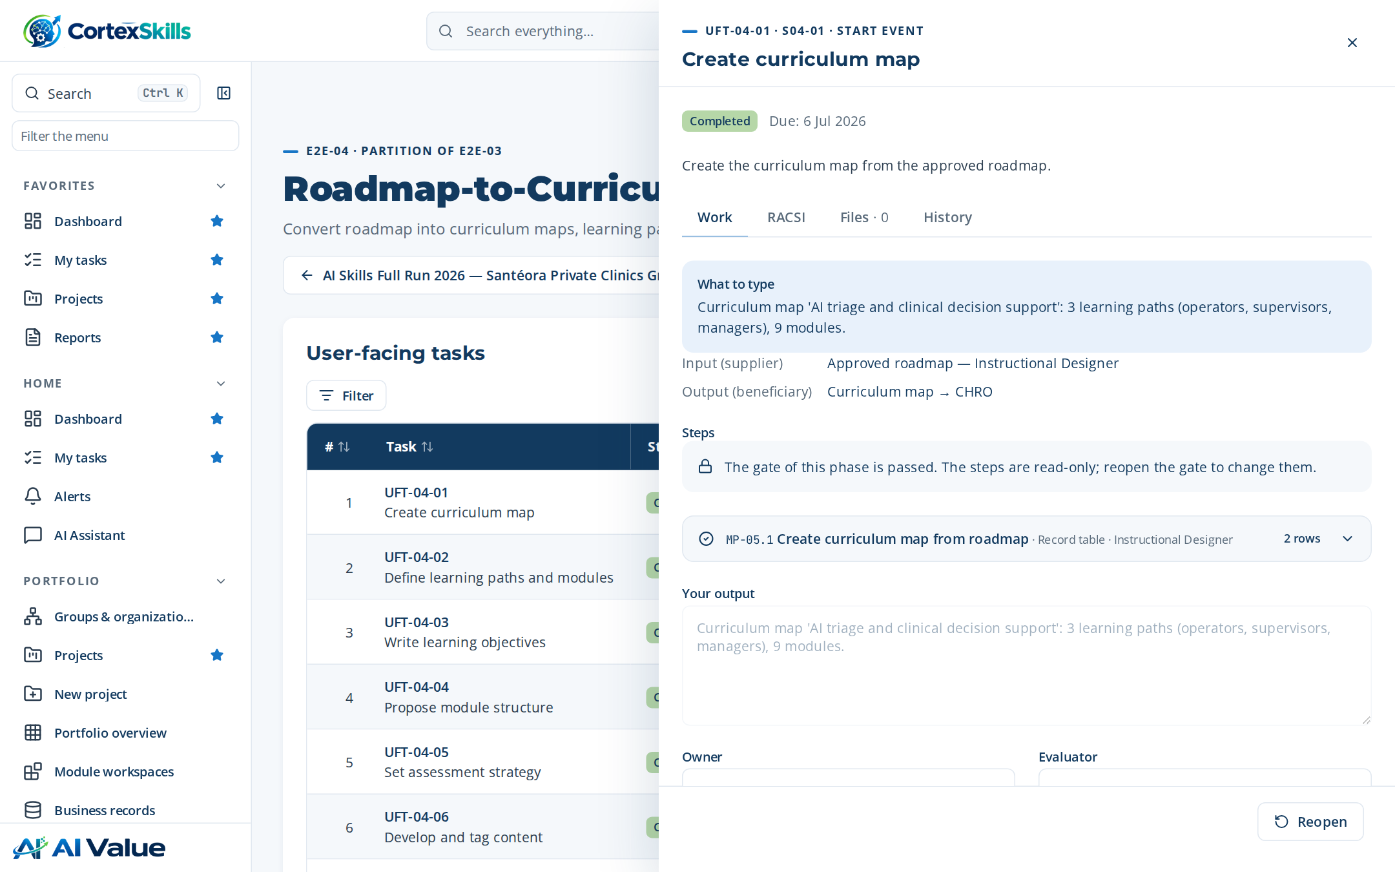
SESSIONS AND ATTENDANCE
Four sessions delivered with their enrolments
Session | Date | Capacity | Trainer | Enrolled
S-01 AI triage and clinical decision support | 2026-07-19 | 12 | Zineb Kettani | 3
S-02 AI medical imaging assistance | 2026-07-26 | 12 | Zineb Kettani | 3
S-03 AI triage and clinical decision support | 2026-08-02 | 12 | Zineb Kettani | 3
S-04 AI medical imaging assistance | 2026-08-09 | 12 | Zineb Kettani | 3
10 / 12
learners present at their session
10 / 12
enrolments completed
A task of the delivery process with its typed steps.
Delivery, evaluation and audit · Demonstration data — fictional organization
38

Slide 39



EVALUATION
Results measured at three Kirkpatrick levels
77 %
74 %
75 %
1 — Reaction
2 — Learning
3 — Behaviour
Level | What is measured | When | Instrument | Results
1 — Reaction | Satisfaction and perceived usefulness | End of each session | Satisfaction questionnaire | 2 × 77 %
2 — Learning | Knowledge and skills acquired | End of the training | Pre- and post-test, case study | 2 × 74 %
3 — Behaviour | Use of the skills at the workstation | Three months after | Manager observation grid | 2 × 75 %
4 — Results | Effect on the indicators of the function | Six to twelve months after | Indicators of the function (KPI) | —
Certifications (TER 5.10): 4 valid, 1 expiring, 1 expired — the expired one triggers an alert and a renewal session.
Delivery, evaluation and audit · Demonstration data — fictional organization
39

Slide 40



ROI AND BUSINESS IMPACT
Phillips ROI and the indicators of the ROI study
ROI and business impact report — Santéora Private Clinics Group
108
4.5
75.6
4.1
Training ROI
Average Level 1 satisfaction
Skill progression rate
Budget execution variance
ID | Indicator | Formula | Target | Latest value | Status
KPI-037 | Training ROI | (Net programme benefits / programme costs) x 100 (Phillips) | ≥ 100% | 108 (2026-10) | Green
KPI-012 | Average Level 1 satisfaction | Mean reaction score across closed sessions (1-5) | ≥ 4.2 | 4.5 (2026-10) | Green
KPI-013 | Skill progression rate | Learners gaining at least one level within 6 months / learners traine… | ≥ 70% | 75.6 (2026-10) | Green
KPI-022 | Budget execution variance | |Actual - allocated| / allocated x 100 | ≤ 5% | 4.1 (2026-10) | Green
KPI-023 | OFPPT refund recovery rate | Refunds received / refunds forecast x 100 | ≥ 90% | 97.2 (2026-10) | Green
Source: ROI and business impact report (DT-E2E-08), indicators section.
Delivery, evaluation and audit · Demonstration data — fictional organization
40

Slide 41
INTERNAL AUDIT
Audit report — Santéora Private Clinics Group
Conforming with one minor nonconformity to correct within 60 days.
ID | Grade | Requirement | Statement
F-1 | Minor nonconformity | ISO 7101 7.2 | Two trainers have no evidence of competence on file.
F-2 | Observation | ISO 7101 9.1 | Level 3 evaluations are planned but not yet scheduled.
F-3 | Opportunity for improvement | ISO 7101 7.1.6 | Capture lessons learned at the end of each session.
F-4 | Strength | ISO 7101 7.2 | Needs analysis fully traced from strategic objectives.
Findings by grade.
Strengths: Clear needs analysis; strong management involvement; complete attendance records.
Follow-up: Verification of the corrective action at the next steering committee.
Delivery, evaluation and audit · Demonstration data — fictional organization
41

Slide 42




LESSONS LEARNED
REX — AI triage and clinical decision support
What went well
What did not
Root cause
What we will do next time
The stakeholder register and multi-channel distribution lifted the response rate.
SWOT inputs arrived late from one function.
No backup nominated for the function head.
Name a backup for every function head at kickoff.
Delivery, evaluation and audit · Demonstration data — fictional organization
42

Slide 43
06
Documents produced
37 documents published in English, each traced to its data

Slide 44
DOCUMENTS PRODUCED
Every end-to-end process leaves its document
All published, versioned and approved by a second person — 1,077 pages.
Code | Document | Pages
DT-E2E-01 | Annual L&D plan and budget | 29
DT-E2E-02 | Skills gap diagnosis | 23
DT-E2E-03 | Training needs report and roadmap | 29
DT-E2E-04 | Curriculum design document | 25
DT-E2E-05 | Training delivery report | 29
DT-E2E-06 | Learner engagement report | 30
DT-E2E-07 | Training evaluation report | 24
DT-E2E-08 | ROI and business impact report | 24
DT-E2E-09 | Compliance and certification register | 22
DT-E2E-10 | Internal mobility and career paths | 26
Code | Document | Pages
DT-E2E-11 | Onboarding programme record | 22
DT-E2E-12 | Knowledge capture and transfer record | 23
DT-E2E-13 | Content catalogue and lifecycle | 23
DT-E2E-14 | Extended enterprise training report | 23
DT-E2E-15 | Data, AI and integration governance | 24
DT-E2E-16 | Vendor management file | 22
DT-E2E-17 | Change and adoption plan | 23
DT-E2E-18 | Quality, risk and improvement report | 30
DT-E2E-19 | Consulting engagement closure report | 26
DT-E2E-20 | Multi-axis diagnostic and maturity report | 27
Documents produced · Demonstration data — fictional organization
44

Slide 45
DOCUMENTS PRODUCED
Documents produced (continued)
Code | Document | Pages
DT-E2E-21 | Previous plan impact evaluation | 25
DT-E2E-22 | Multi-site deployment plan | 24
DT-E2E-23 | Regulatory submission file | 22
DT-E2E-24 | Competitive intelligence note | 23
DT-E2E-25 | Job architecture and competency map | 23
DT-E2E-26 | Forward planning of jobs and skills (GPEC) | 25
DT-E2E-27 | Training demand consolidation | 22
DT-E2E-28 | Performance assessment and RAG dashboard | 22
DT-E2E-29 | Functional SWOT and improvement axes | 23
DT-E2E-30 | Prioritized resource plan | 24
Code | Document | Pages
DT-E2E-31 | Post-engagement roadmap | 24
DT-E2E-32 | Scope of work and stakeholder register | 31
DT-E2E-33 | Questionnaire campaign report | 30
DT-TER | Training Engineering Report and Training Plan | 193
DT-PLAN | Training plan with detailed agendas | 35
DT-AUDIT | Audit report | 5
DT-MASTER | Master list of documented information | 22
Documents produced · Demonstration data — fictional organization
45

Slide 46
TRACEABILITY
Every number of the report comes from a record
Every table of this document is drawn from the application’s records; data as of 07/10/2026, 15:27:56.
Source | Records | Process | Last change
Questionnaire responses | 30 | MP-54 | —
Stakeholder | 40 | MP-53 | 2026-10-07
ScopeCriterion | 17 | MP-52 | 2026-10-07
SkillAssessment | 12 | MP-16 | 2026-10-07
SkillGap | 8 | MP-16 | 2026-10-07
TrainingNeed | 10 | MP-03 | 2026-10-07
RoadmapInitiative | 4 | MP-04 | 2026-10-07
WbsNode | 3 | MP-49 | 2026-10-07
Session | 4 | MP-05 | 2026-10-07
TrainingPlan | 1 | MP-49 | 2026-10-07
Employee | 16 | MP-16 | 2026-10-07
StrategicObjective | 2 | MP-01 | 2026-10-07
Governance of the documents
Author Hicham Naciri, approver Mehdi Lahlou: two different people.
Each version is kept; a change of the data marks the document as stale.
20 data sources listed with their record counts and process.
Documents produced · Demonstration data — fictional organization
46

Slide 47
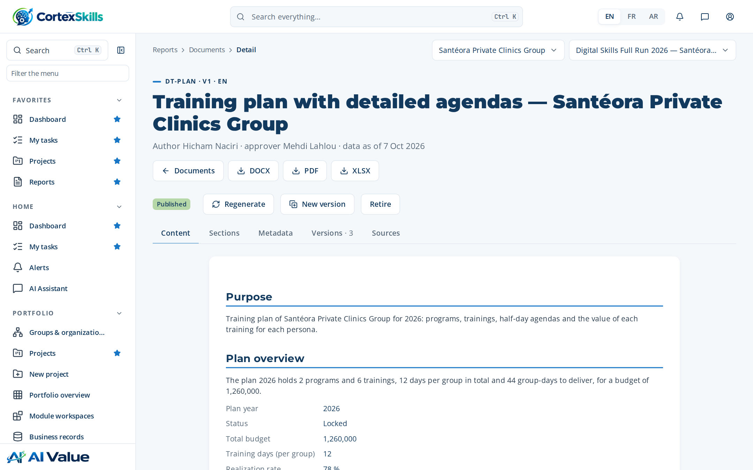
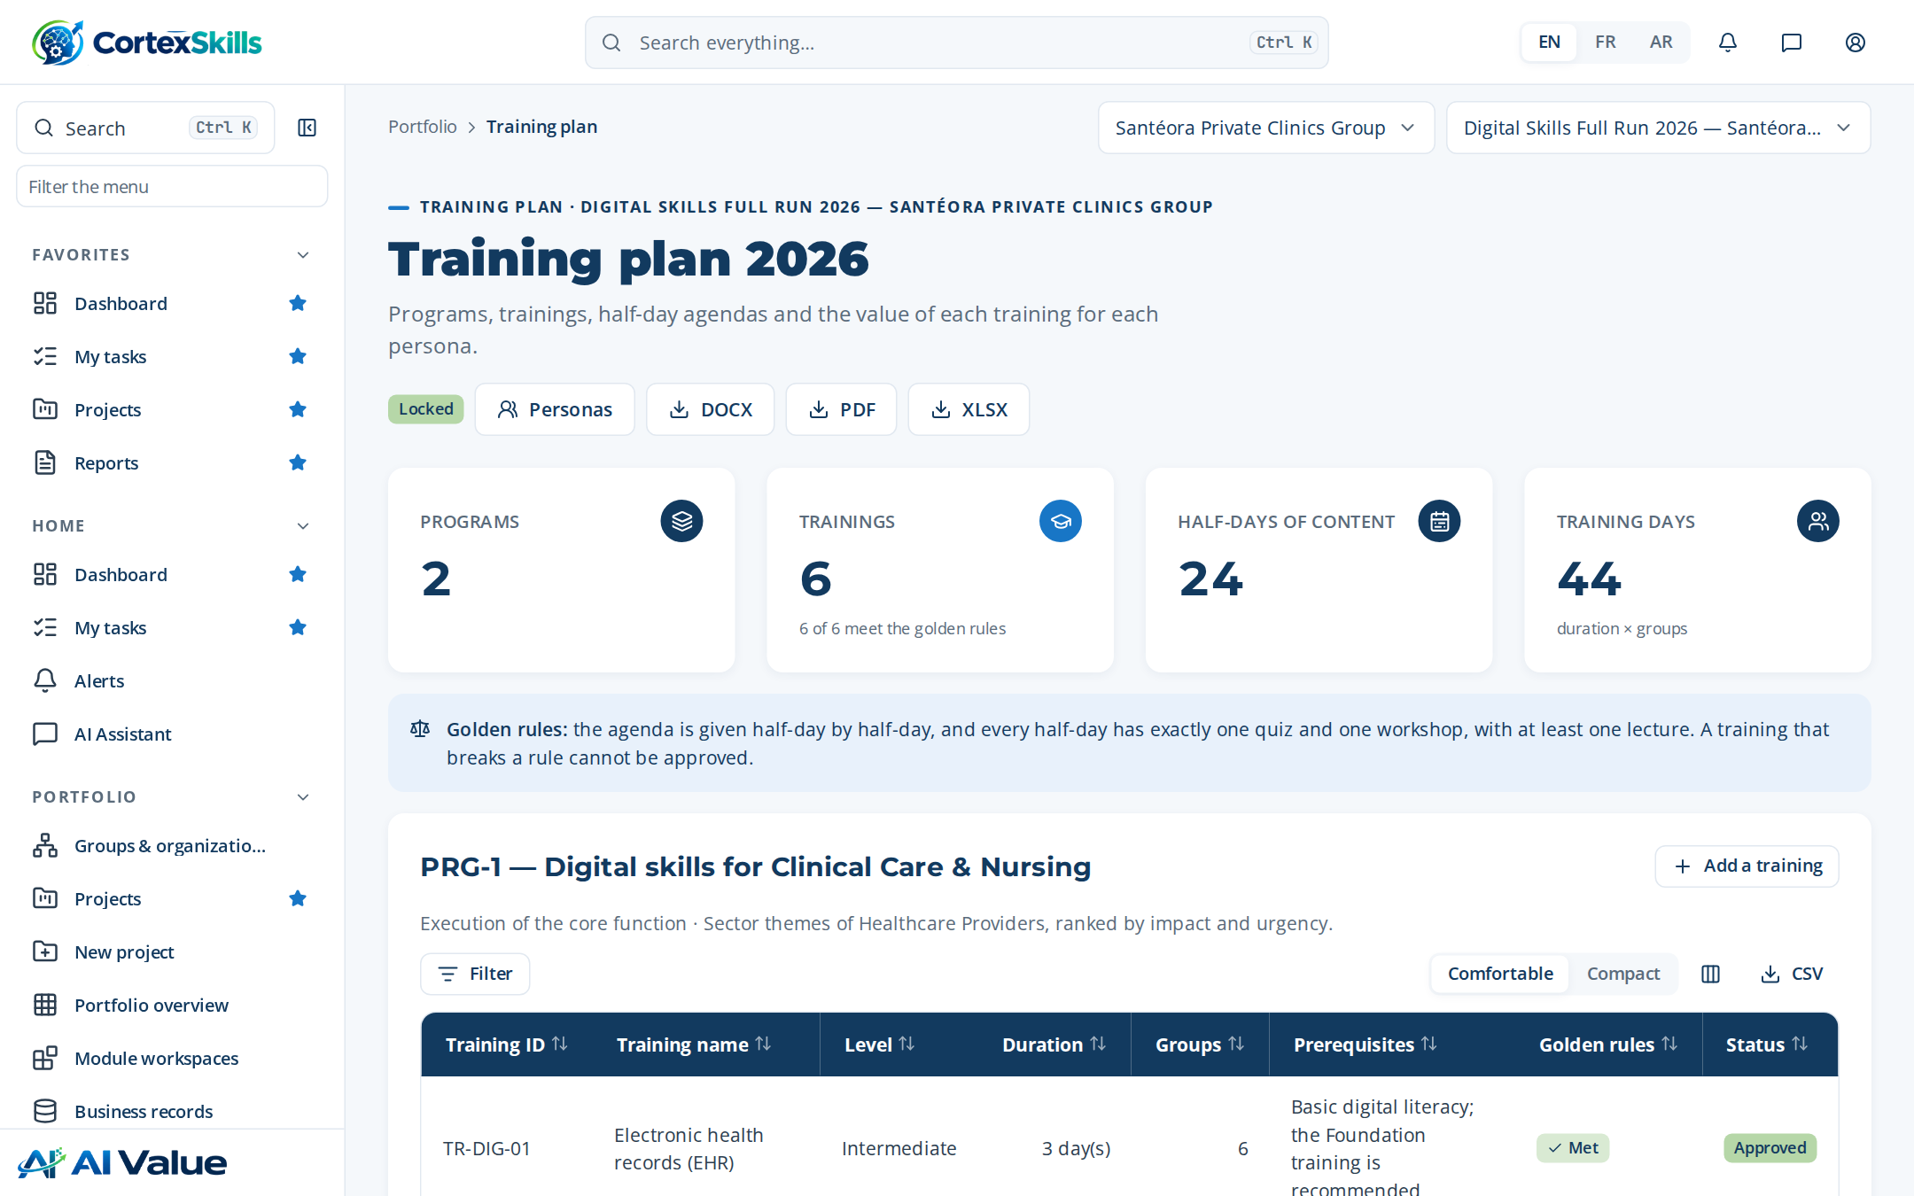
INSIDE THE APPLICATION
The Training Plan as the users see it
Training plan with detailed agendas — Santéora Private Clinics Group
Training plan screen: programs, trainings and sessions.
Documents produced · Demonstration data — fictional organization
47

Slide 48
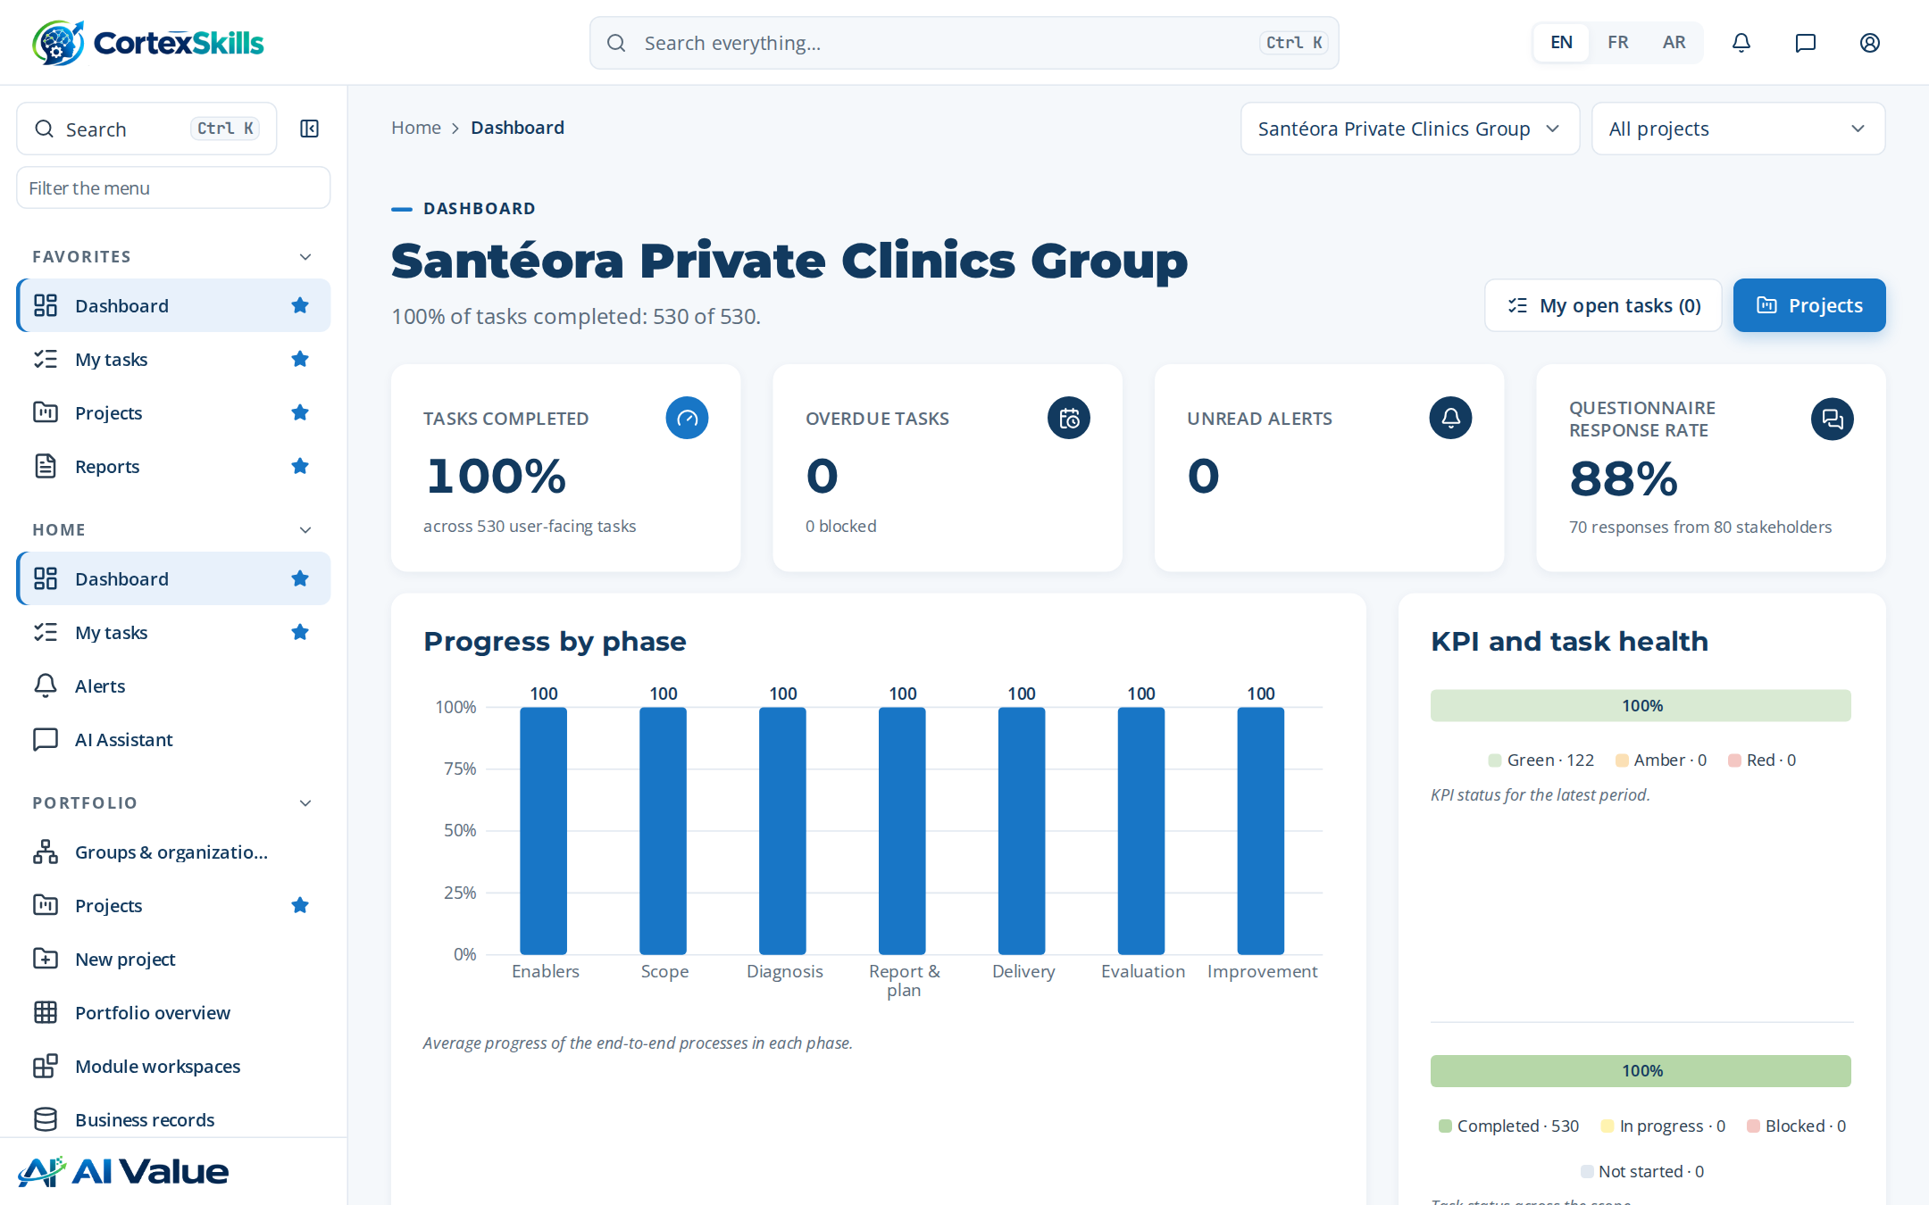
INSIDE THE APPLICATION
The project workspace and the dashboard
Project workspace: phases, processes and progress.
Dashboard of the clinic group.
Documents produced · Demonstration data — fictional organization
48

Slide 49
CONCLUSION
What the clinic group has at the end of the cycle
A Training Engineering Report of 193 pages, built from 35 answers, 40 stakeholders and the diagnosis of every function.
A locked Training Plan: 6 trainings, half-day agendas, a value proposition per persona and a budget of 1,260,000
Evaluation at three Kirkpatrick levels, an ROI study, followed certifications and an internal audit with one minor nonconformity to correct.
37 published documents ready for an accreditation audit (ISO 7101, JCI), each traced to the data and the step that produced it.
Next: waves 2 and 3 of the roadmap and the level-4 (results) evaluation six to twelve months after the trainings.
Conclusion · Demonstration data — fictional organization
49

Slide 50

Thank you
MEASURABLE · GOVERNED · SUSTAINABLE

