Slide 1


POWERACT CONSULTING PRESENTS
journi across sectors
The same AI-governed change-management engine — seven sectors, one end-to-end journey.
Public Sector
Manufacturing in Construction
Healthcare
Agro-Business — Dairy Products
Transportation
Oil / Gas / Energy
Construction
journi — Human Change Management Platform
1

Slide 2
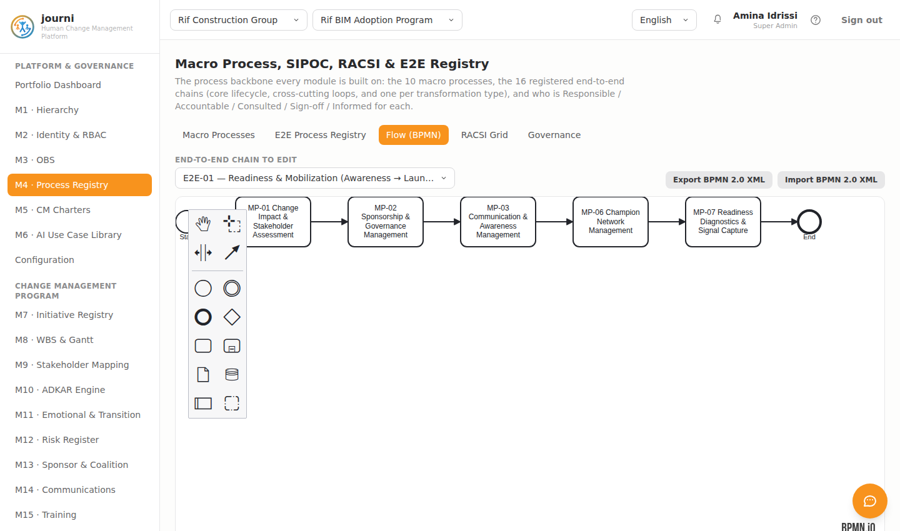
SEVEN SECTORS, ONE ENGINE
The end-to-end change journey
Every sector below advances along the same E2E-01 "Readiness & Mobilization" chain — from impact and stakeholder assessment through readiness diagnostics — modeled as native BPMN 2.0 in the Process Registry (M4), with an editing palette kept structurally separate from the canvas.
journi — Human Change Management Platform
2

Slide 3
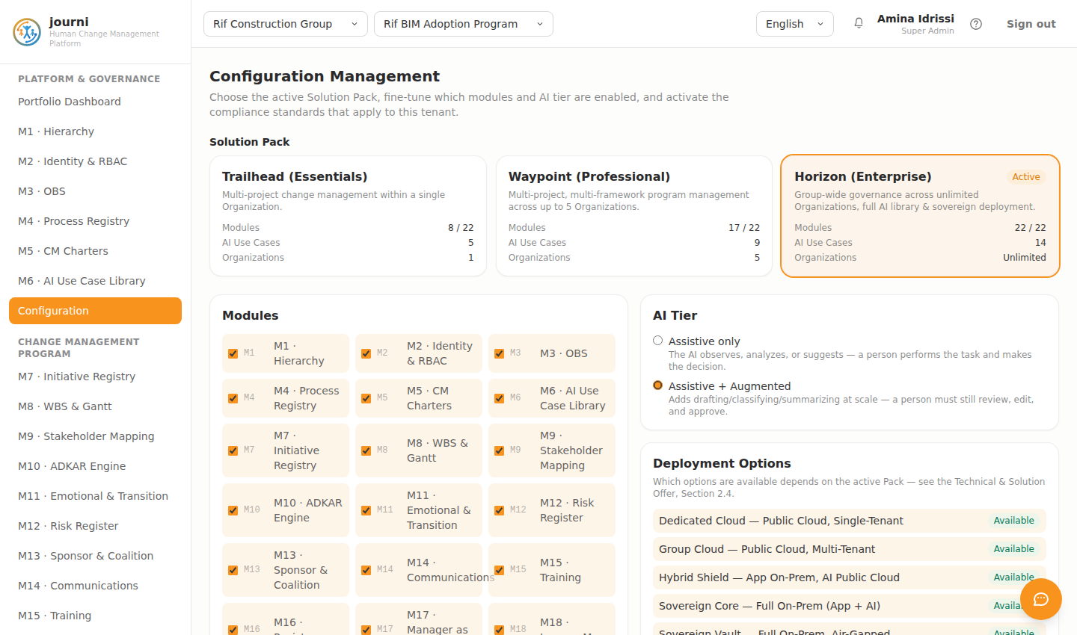
SEVEN SECTORS, ONE ENGINE
One engine, configured per sector
The Configuration module determines which modules and AI tier are active per Pack, and which compliance standards apply — the same journi engine serves the public sector and energy alike, with no change of platform.
journi — Human Change Management Platform
3

Slide 4
SEVEN SECTORS, ONE ENGINE
Public Sector
Sahara Public Services Authority
Citizen e-Services Adoption Program — replacing in-person queues with digital self-service across 6 regional centers.
LEWIN PHASE
AVERAGE ADKAR SCORE
TARGET POPULATION
Unfreeze
1.4 / 5
~450 front-desk staff, 6 regional centers
journi — Human Change Management Platform
4

Slide 5
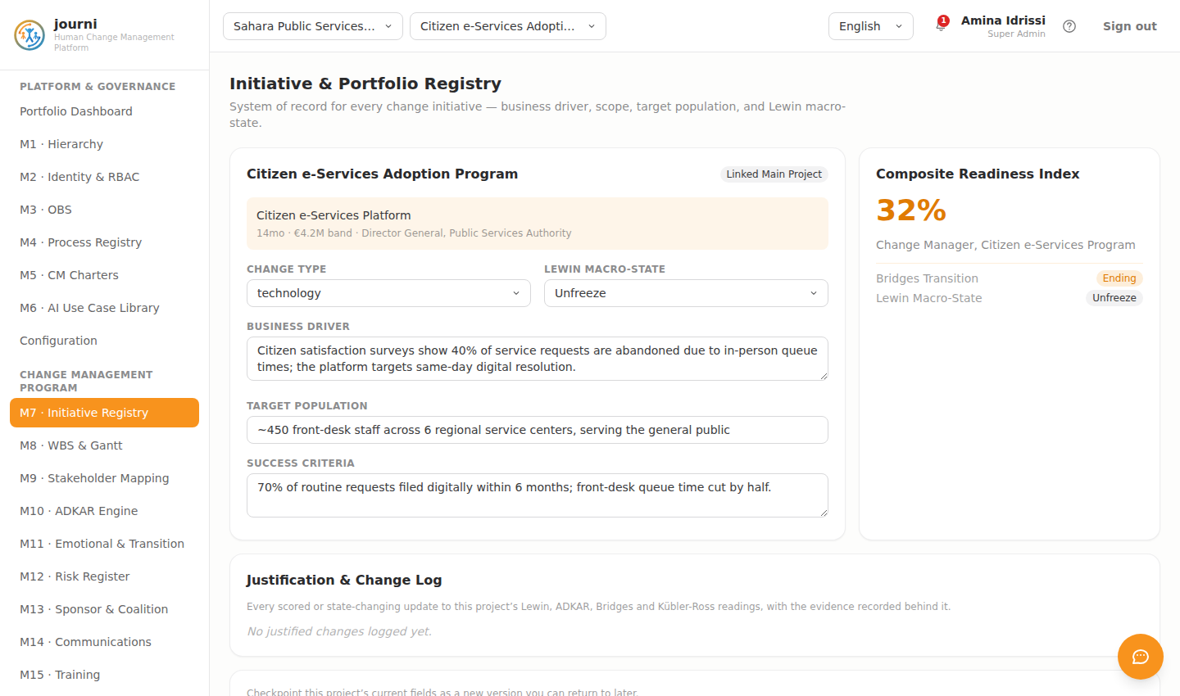
PUBLIC SECTOR
M7 · Initiative Registry
journi — Human Change Management Platform
5

Slide 6
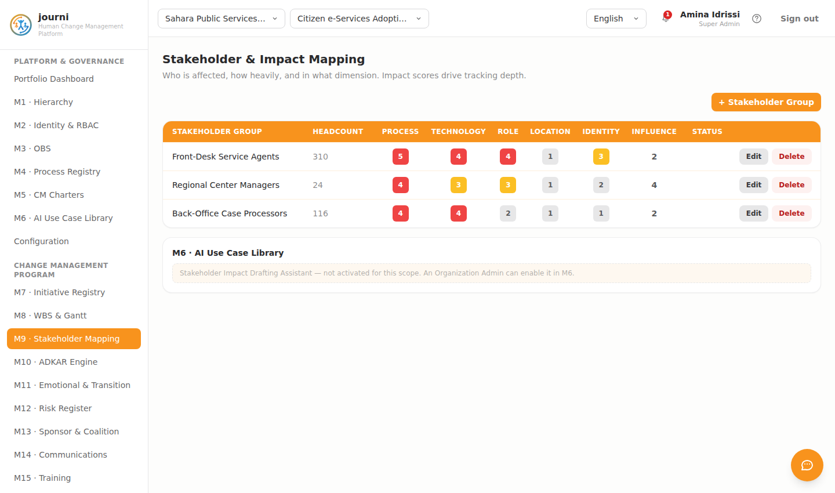
PUBLIC SECTOR
M9 · Stakeholder Mapping
journi — Human Change Management Platform
6

Slide 7
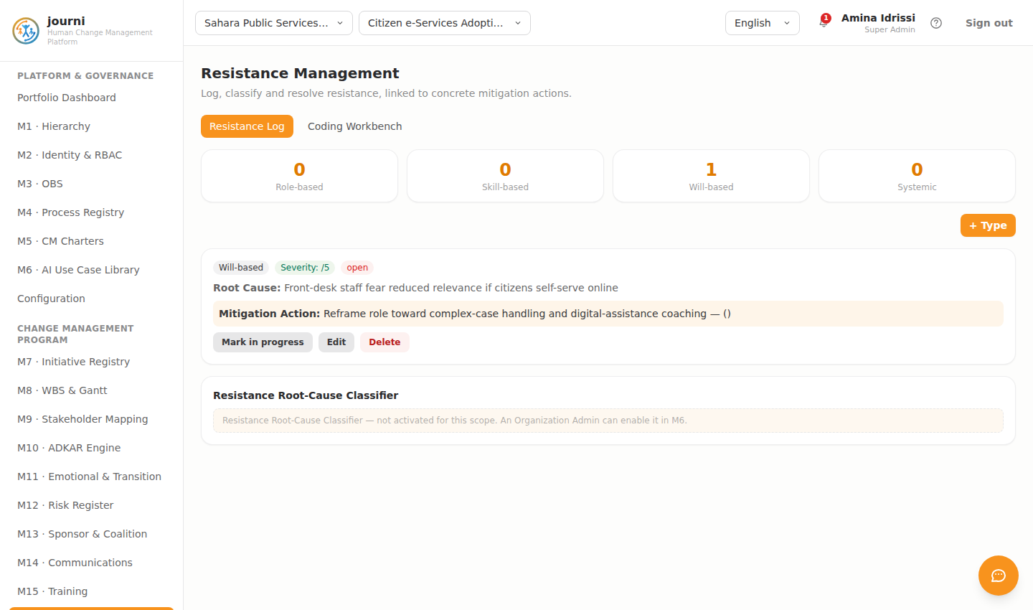
PUBLIC SECTOR
M16 · Resistance Management
journi — Human Change Management Platform
7

Slide 8
SEVEN SECTORS, ONE ENGINE
Manufacturing in Construction
Atlas BuildTech Materials Group
Plant Digital Production Control — automating batch tracking on the precast and aggregates lines.
LEWIN PHASE
AVERAGE ADKAR SCORE
TARGET POPULATION
Change
2.8 / 5
~340 plant operators, 2 sites
journi — Human Change Management Platform
8

Slide 9
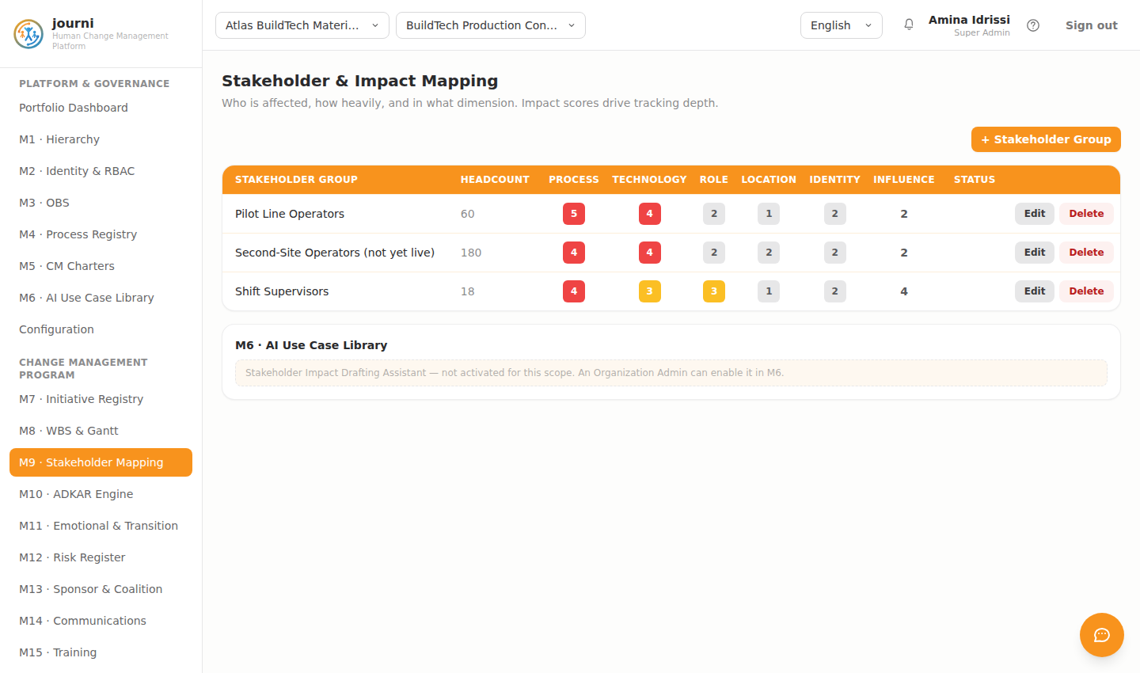
MANUFACTURING IN CONSTRUCTION
M9 · Stakeholder Mapping
journi — Human Change Management Platform
9

Slide 10
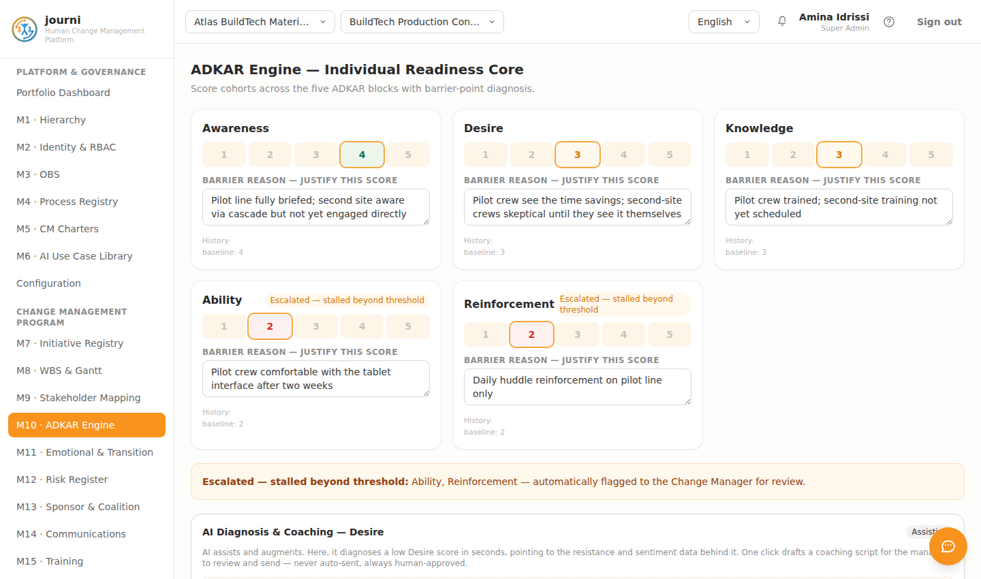
MANUFACTURING IN CONSTRUCTION
M10 · ADKAR Engine
journi — Human Change Management Platform
10

Slide 11
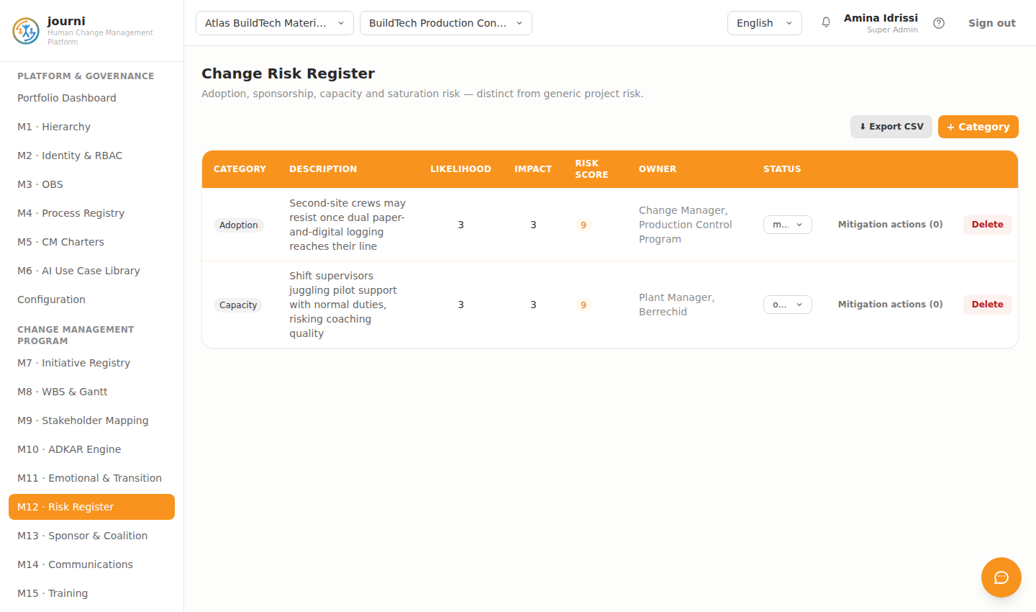
MANUFACTURING IN CONSTRUCTION
M12 · Risk Register
journi — Human Change Management Platform
11

Slide 12
SEVEN SECTORS, ONE ENGINE
Healthcare
Meridia Health Network
Health-sector ERP adoption program — governed change management across clinical and administrative staff.
LEWIN PHASE
AVERAGE ADKAR SCORE
TARGET POPULATION
Unfreeze
1.8 / 5
~2,000 clinical & admin staff, 3 hospitals
journi — Human Change Management Platform
12

Slide 13
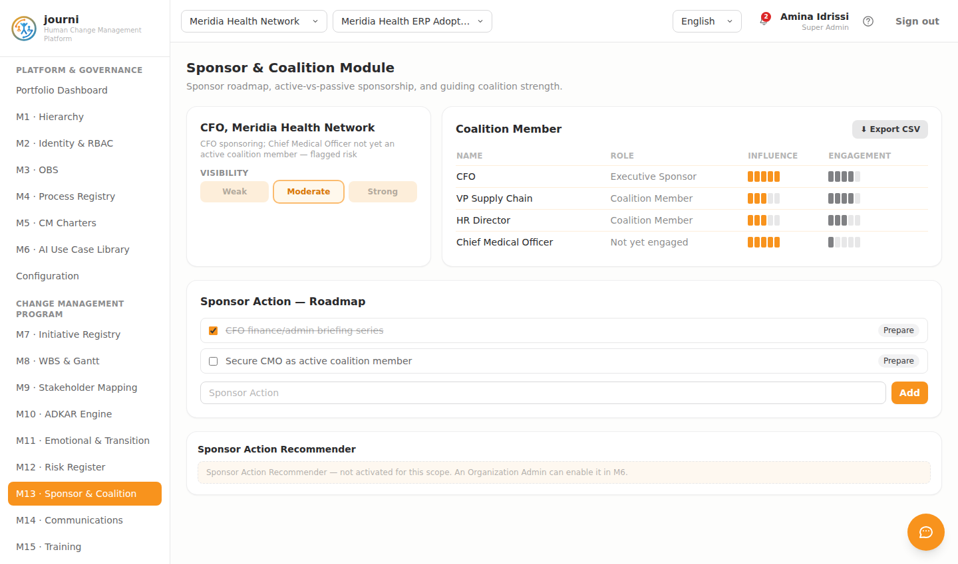
HEALTHCARE
M13 · Sponsor & Coalition
journi — Human Change Management Platform
13

Slide 14
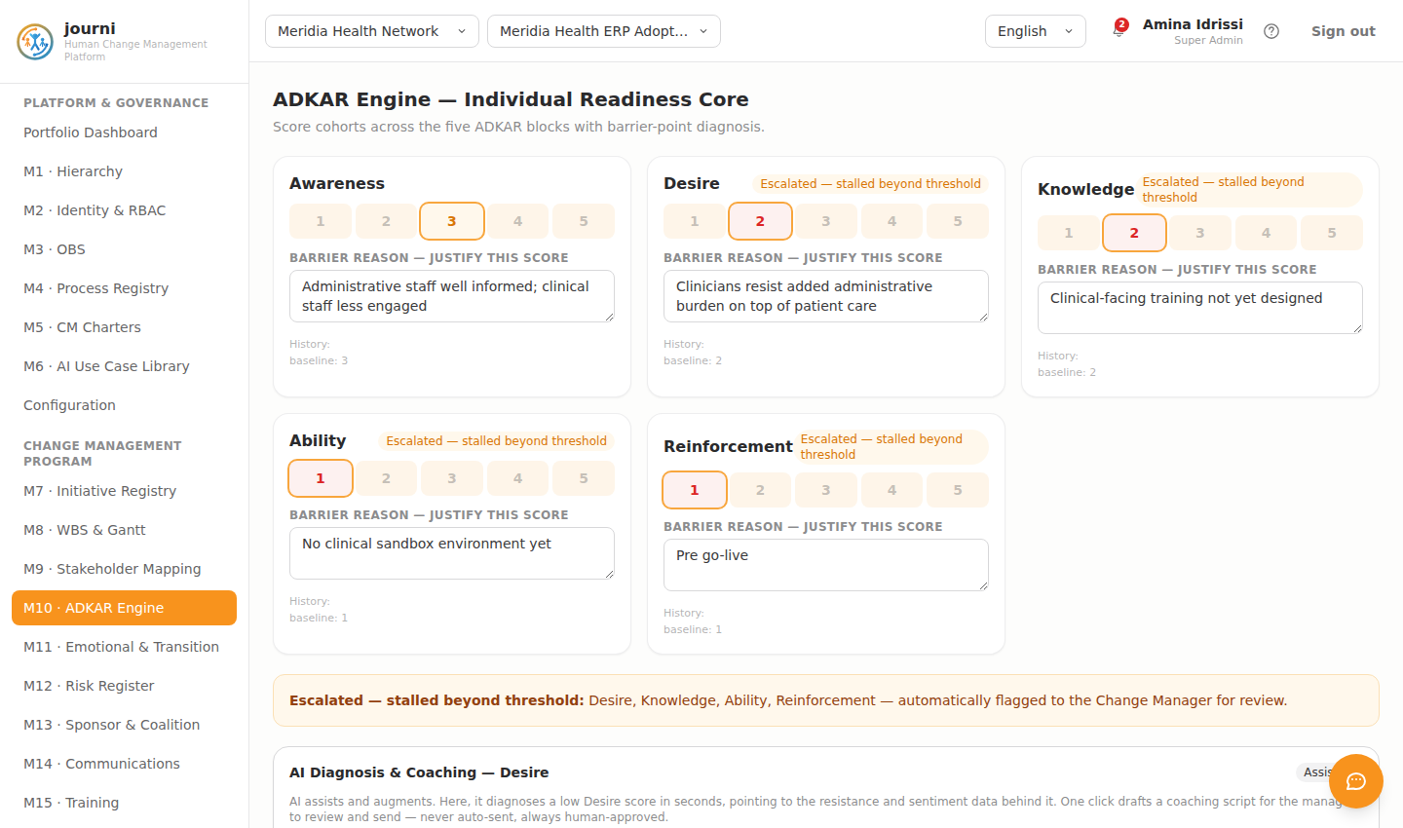
HEALTHCARE
M10 · ADKAR Engine
journi — Human Change Management Platform
14

Slide 15
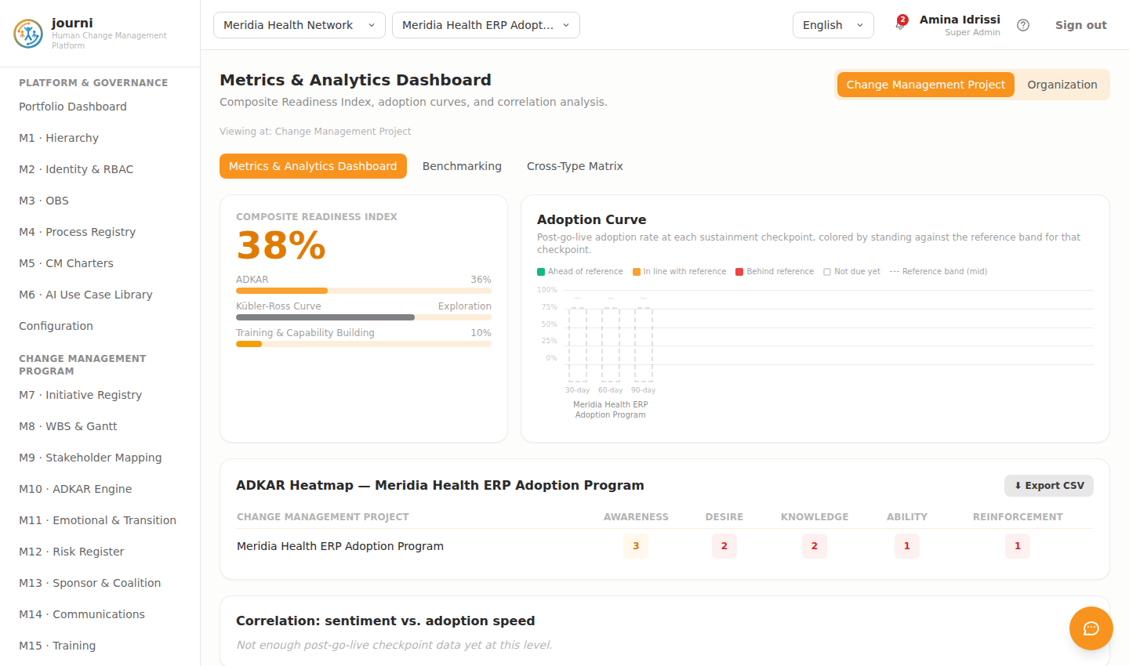
HEALTHCARE
M20 · Analytics
journi — Human Change Management Platform
15

Slide 16
SEVEN SECTORS, ONE ENGINE
Agro-Business — Dairy Products
Meknes Dairy Cooperative
Cold-Chain Traceability Program — meeting export-market food-safety requirements farm to shelf.
LEWIN PHASE
AVERAGE ADKAR SCORE
TARGET POPULATION
Unfreeze
1.8 / 5
~210 plant & collection-center staff
journi — Human Change Management Platform
16

Slide 17
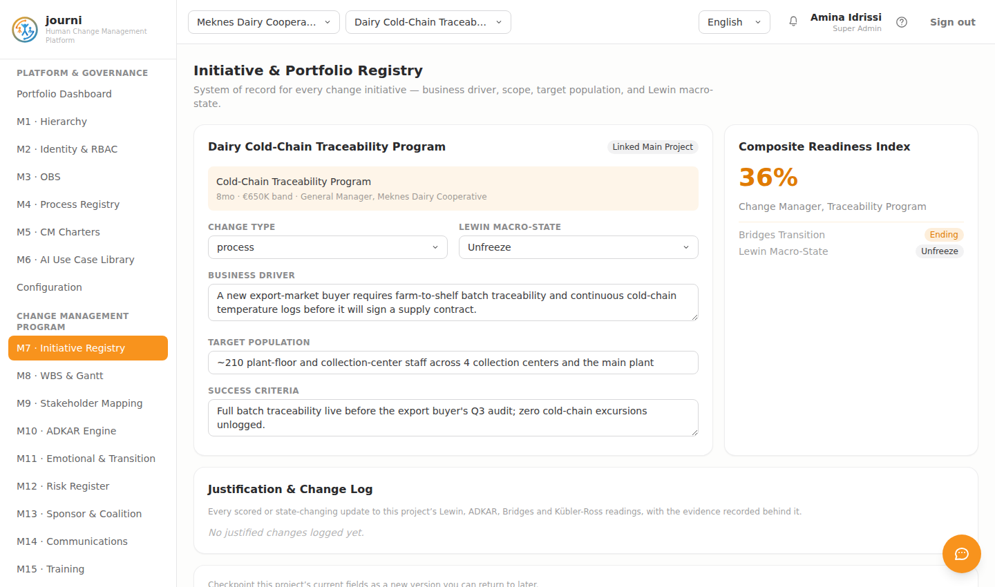
AGRO-BUSINESS — DAIRY PRODUCTS
M7 · Initiative Registry
journi — Human Change Management Platform
17

Slide 18
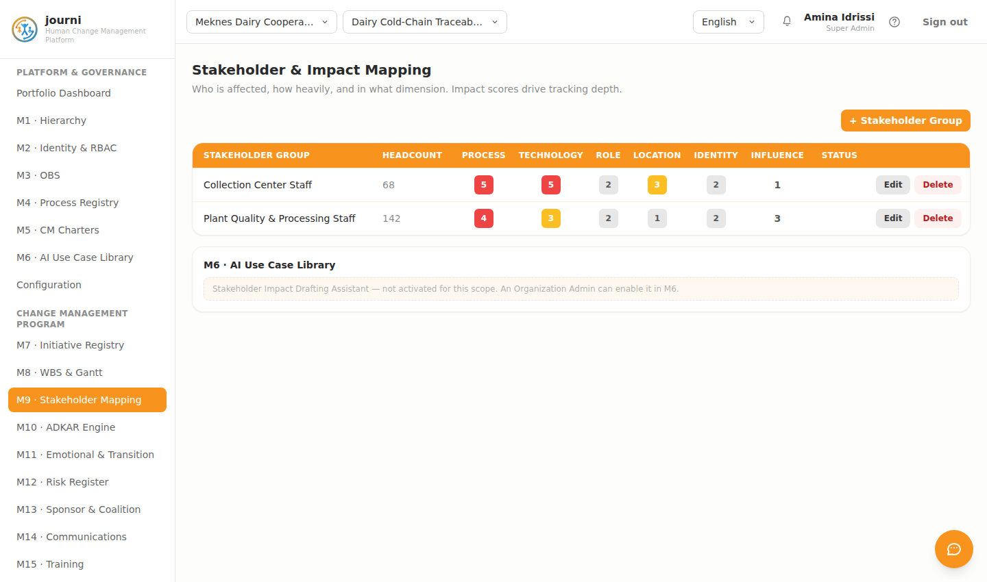
AGRO-BUSINESS — DAIRY PRODUCTS
M9 · Stakeholder Mapping
journi — Human Change Management Platform
18

Slide 19
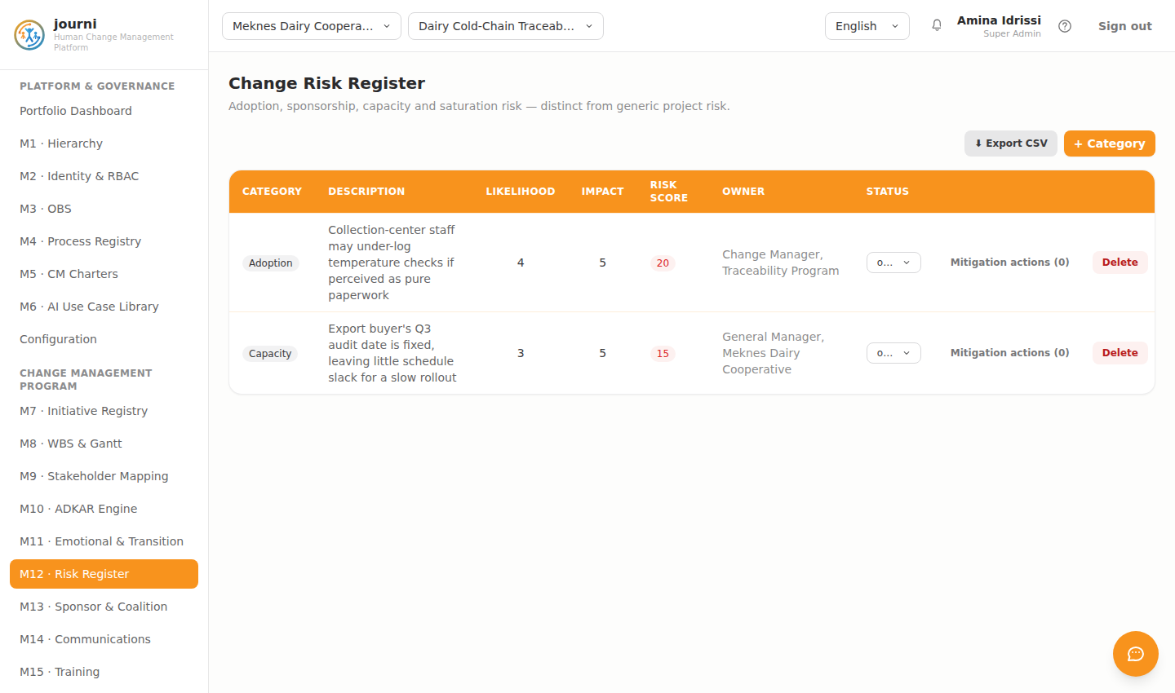
AGRO-BUSINESS — DAIRY PRODUCTS
M12 · Risk Register
journi — Human Change Management Platform
19

Slide 20
SEVEN SECTORS, ONE ENGINE
Transportation
Maghreb Logistics Hub
Logistics-sector ERP adoption — coordinating change across a multi-site transportation network.
LEWIN PHASE
AVERAGE ADKAR SCORE
TARGET POPULATION
Unfreeze
2.2 / 5
~650 dispatch, warehouse & finance staff, 5 hubs
journi — Human Change Management Platform
20

Slide 21
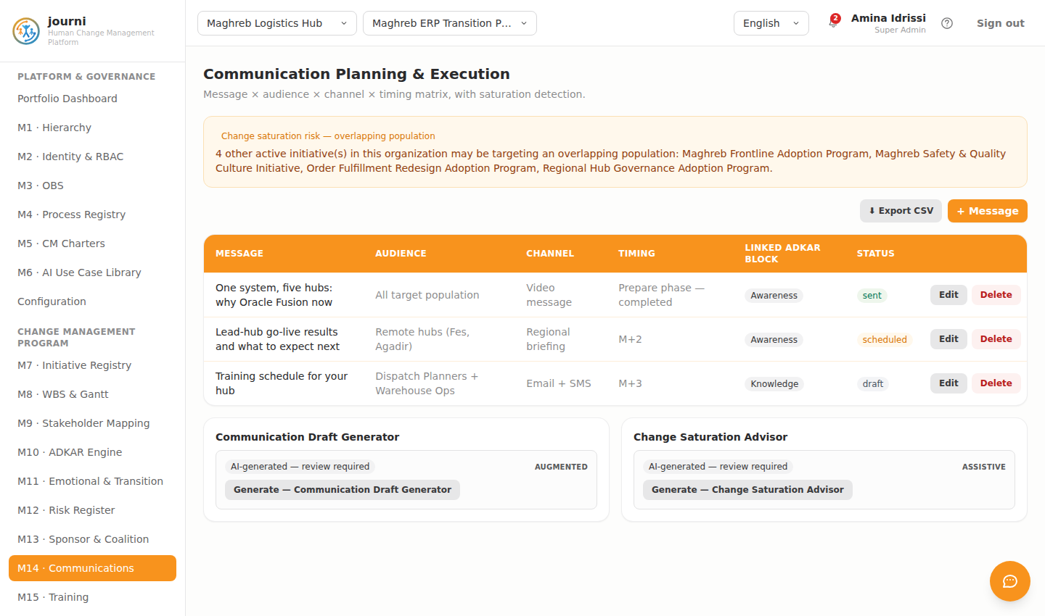
TRANSPORTATION
M14 · Communications
journi — Human Change Management Platform
21

Slide 22
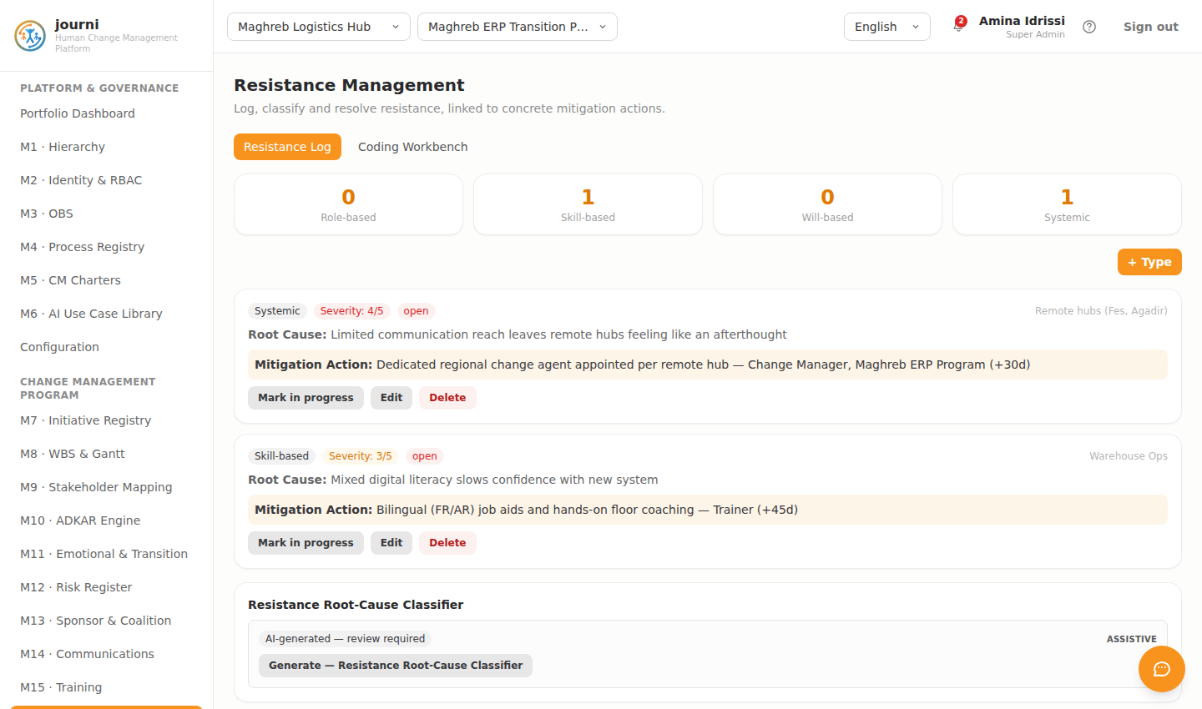
TRANSPORTATION
M16 · Resistance Management
journi — Human Change Management Platform
22

Slide 23
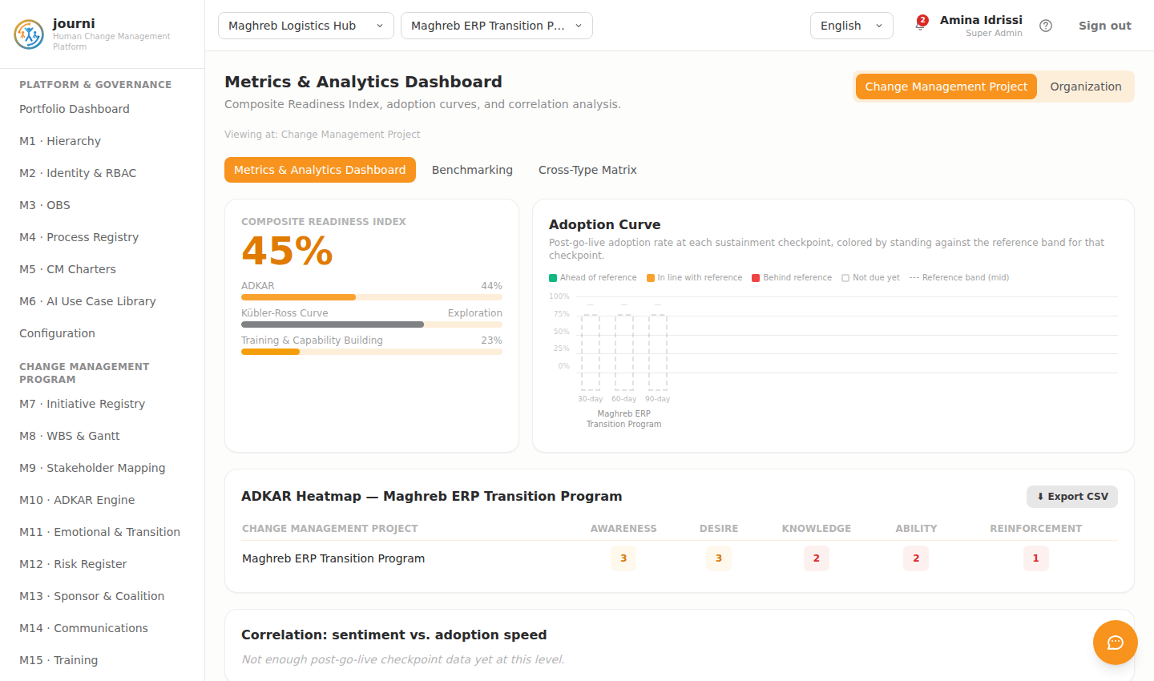
TRANSPORTATION
M20 · Analytics
journi — Human Change Management Platform
23

Slide 24
SEVEN SECTORS, ONE ENGINE
Oil / Gas / Energy
Sahara Energy Holding
Digital Safety & Operations Program — modernizing permit-to-work across refinery and field sites.
LEWIN PHASE
AVERAGE ADKAR SCORE
TARGET POPULATION
Change
3.8 / 5
~640 refinery & field operations staff
journi — Human Change Management Platform
24

Slide 25
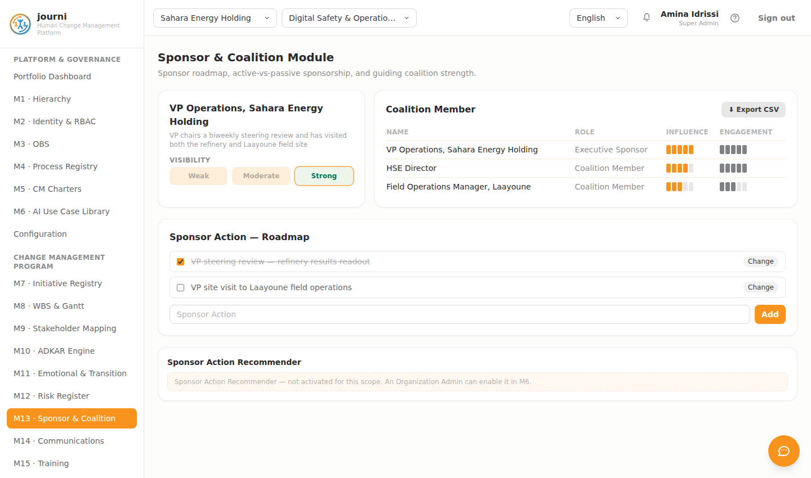
OIL / GAS / ENERGY
M13 · Sponsor & Coalition
journi — Human Change Management Platform
25

Slide 26
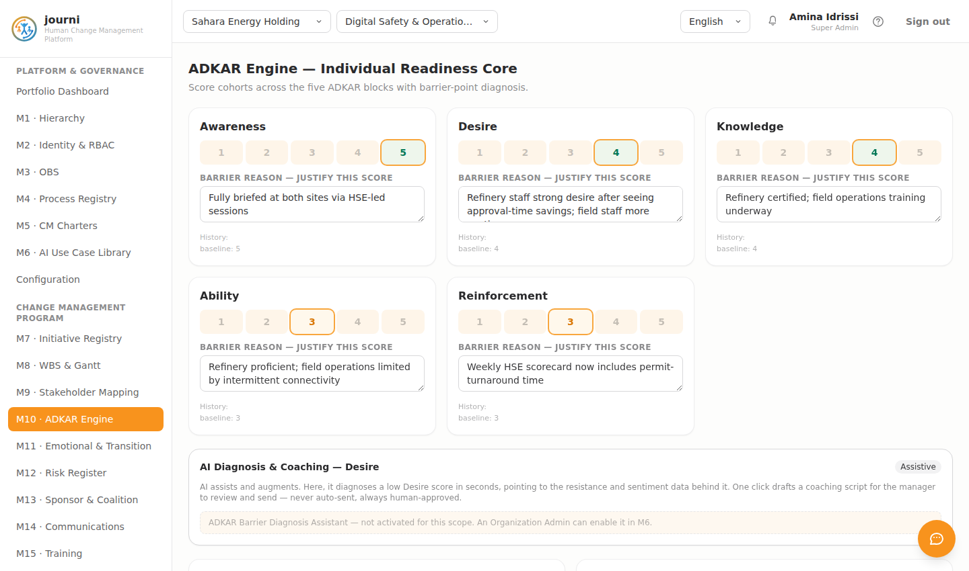
OIL / GAS / ENERGY
M10 · ADKAR Engine
journi — Human Change Management Platform
26

Slide 27
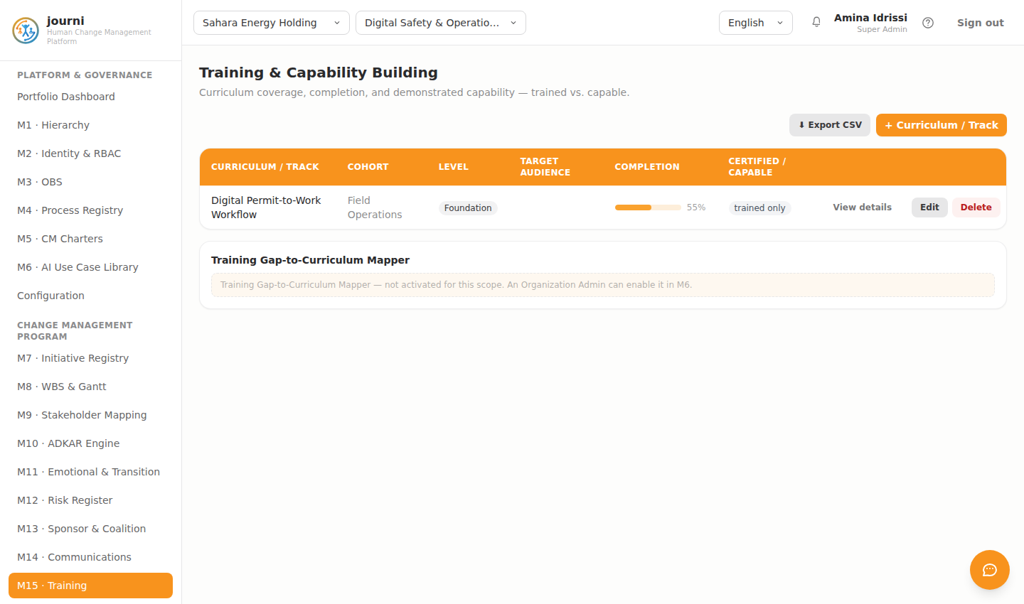
OIL / GAS / ENERGY
M15 · Training
journi — Human Change Management Platform
27

Slide 28
SEVEN SECTORS, ONE ENGINE
Construction
Rif Construction Group
BIM & Project Controls Adoption — now in sustainment, 85% adoption at day 90.
LEWIN PHASE
AVERAGE ADKAR SCORE
TARGET POPULATION
Refreeze
4.2 / 5
~280 site engineers & project controllers
journi — Human Change Management Platform
28

Slide 29
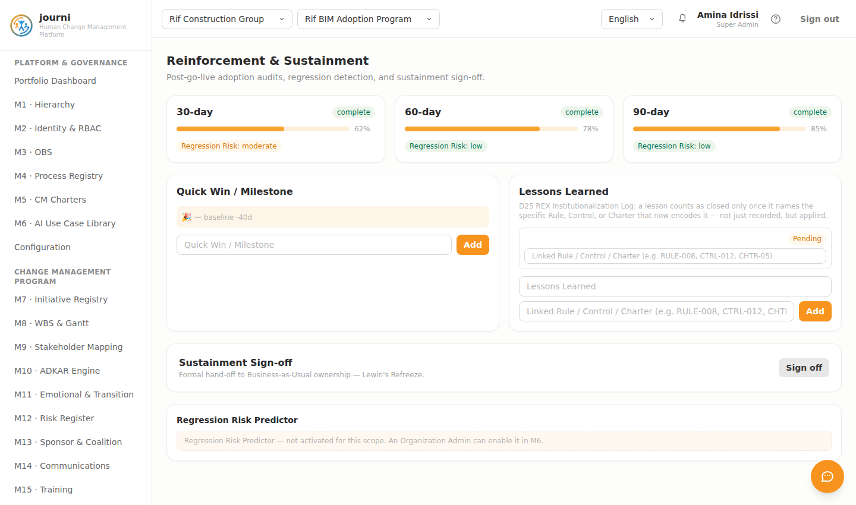
CONSTRUCTION
M21 · Sustainment
journi — Human Change Management Platform
29

Slide 30
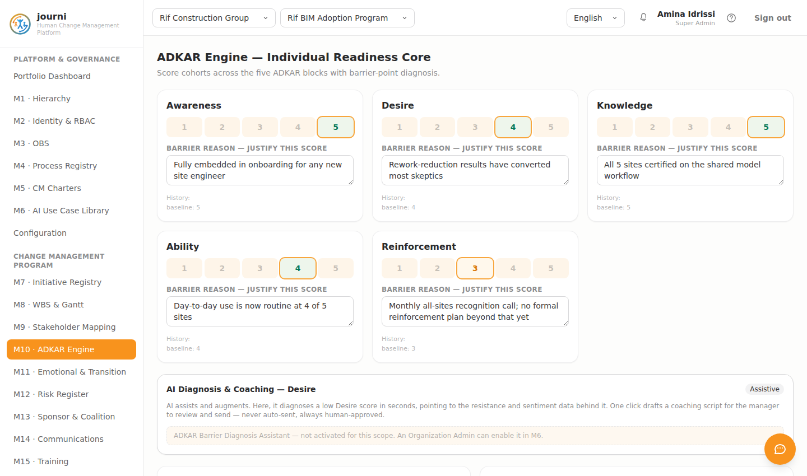
CONSTRUCTION
M10 · ADKAR Engine
journi — Human Change Management Platform
30

Slide 31
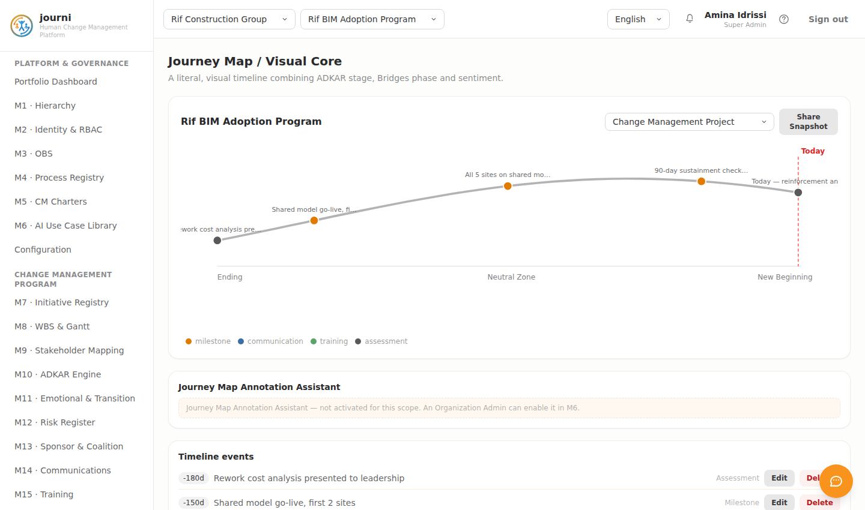
CONSTRUCTION
M18 · Journey Map
journi — Human Change Management Platform
31

Slide 32
SEVEN SECTORS, ONE ENGINE
One system of record, not seven
Public sector, manufacturing, healthcare, agro-business, transportation, energy, construction — every change program shares the same governed data model, the same audit trail, and the same assistive AI engine. No change of platform required to grow from a single pilot to a multi-sector rollout.
Public Sector
Manufacturing in Construction
Healthcare
Agro-Business — Dairy Products
Transportation
Oil / Gas / Energy
Construction
journi — Human Change Management Platform
32

