Slide 1

POWERACT
C O N S U L T I N G
CASE STUDY · HEALTHCARE · PRIVATE CLINICS
Training engineering for AI skills, end to end
Santéora Private Clinics Group: the real flow of the 35 end-to-end processes run in CortexSkills — macro processes, tasks and steps
Prepared by POWERACT Consulting · 16 Oct 2026
Notes:
Case study of a private clinic group run end to end in CortexSkills. Every figure and every screen comes from the application.

Slide 2










AGENDA
What this case study covers
The client and the project
Phase 4 — Design & delivery
How CortexSkills structures the work
Phase 5 — Evaluation, compliance & impact
Phase 1 — Scope & evidence
Phase 6 — Talent, knowledge & continuous improvement
Phase 2 — Diagnosis
Phase 0 — Enablers (run across all phases)
Phase 3 — Training Engineering Report & plan
Results and next steps

Slide 3



EXECUTIVE SUMMARY
35 processes run end to end, 100 % of tasks completed
18 Apr 2026 – 28 Sept 2026 · 27 people involved · every figure below is read from the application
35
53
265
463
end-to-end processes (33 standard + 2 healthcare)
macro processes involved
tasks completed, none overdue
steps executed
Scope and evidence first
A plan approved on facts
Delivery measured up to impact
40 stakeholders registered, 24 AI-generated questions validated, 187 responses collected before any decision.
23 needs grouped into 6 themes; net budget 1,330,000 MAD approved by the Steering Committee.
Test scores from 48 % to 81 %; 9 of 11 supervisors apply the routine at day 30; ROI 22 %.
Notes:
Three messages: the evidence comes first, the plan is approved on facts, and delivery is measured up to business impact.

Slide 4
THE CLIENT
Santéora Private Clinics Group
Training engineering cycle focused on AI skills for Healthcare Providers: scope, evidence, diagnosis, report, delivery, evaluation and continuous improvement.
Fact | Value
Sector | Healthcare providers — private clinics
Size | 2,600 employees, large organization
Headquarters | Casablanca, Morocco
Project | AI Skills Full Run 2026 — Santéora Private Clinics Group
Focus | AI skills
Period | 18 Apr 2026 – 28 Sept 2026
Languages | French, English, Arabic
Strategic objectives entered in the application
SO-1: AI triage and clinical decision support used by 80% of Clinical Care & Nursing staff by end 2026 (owner: Operations Director, measured quarterly).
SO-2: zero major audit findings on ISO 7101.
Priority competency families: AI triage and clinical decision support; AI medical imaging assistance; ISO 7101 compliance. Target level 3 (Autonomous) for supervisors.
Notes:
The client and what it wanted: the two strategic objectives typed in step MP-01.1 and the priority competency families.

Slide 5




HOW CORTEXSKILLS STRUCTURES THE WORK
Four levels, from the value stream down to the step that is typed
End-to-end process
Macro process
Task
Step
E2E-33 · Questionnaire-to-Response-Collection
MP-54 · Questionnaire Design, Distribution & Response Collection
UFT-33-04 · Allocate RACSI
MP-54.4 · Allocate RACSI per section
35 run in this case
53 involved
265 completed
463 executed
What was entered at this step
Each step is filled in one of three ways: typed or pasted, loaded from a template, or proposed by AI and validated by a person.
Section 'Digital practices': R L&D Analyst, A Head of L&D, C Consultant PM, S IT, I CHRO (one Accountable only).
Notes:
Read the process slides with this grid: a process groups tasks; each task executes one or more steps of a macro process.

Slide 6
THE PROJECT PATH
Six phases closed by approval gates, with enablers running throughout
1
2
3
4
5
6
Scope & evidence
Diagnosis
Training Engineering Report & plan
Design & delivery
Evaluation, compliance & impact
Talent, knowledge & continuous improvement
E2E-32 · E2E-33 · E2E-19 · E2E-24
E2E-20 · E2E-25 · E2E-26 · E2E-27 · E2E-28 · E2E-29 · E2E-02 · E2E-21
E2E-01 · E2E-03 · E2E-30 · E2E-22 · E2E-23 · E2E-16 · HCPR-E2E-02
E2E-04 · E2E-05 · E2E-06 · E2E-13 · E2E-14
E2E-07 · E2E-08 · E2E-09 · HCPR-E2E-01
E2E-10 · E2E-11 · E2E-12 · E2E-31
4 processes · 37 tasks
8 processes · 62 tasks
7 processes · 50 tasks
5 processes · 39 tasks
4 processes · 26 tasks
4 processes · 30 tasks
G1 — Scope & evidence approved
G2 — Diagnostic validated
G3 — Report & roadmap approved
G4 — Delivery readiness
G5 — Evaluation & impact validated
G6 — Closure & continuous improvement
Phase 0 — Enablers, across all phases: E2E-15 Data-AI-Integration · E2E-17 Change-to-Adoption · E2E-18 Quality-Risk-Improvement

Slide 7
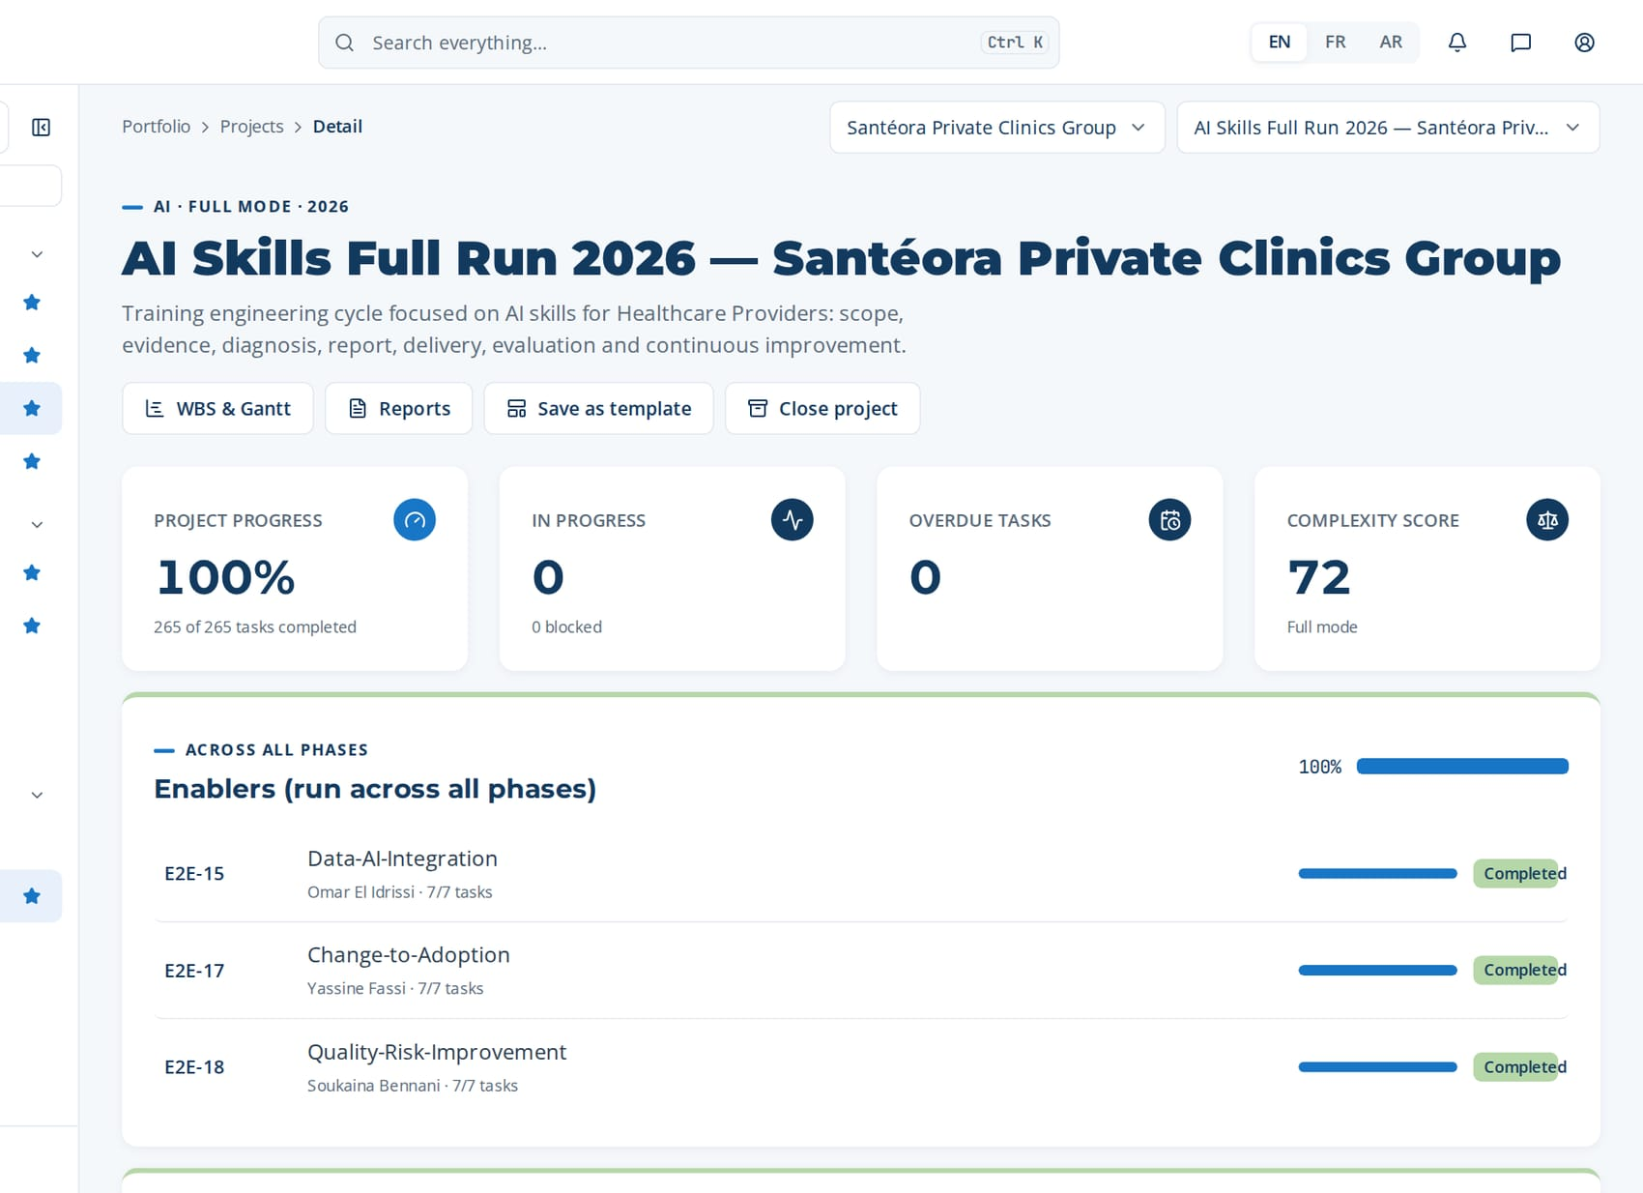


IN THE APPLICATION
The project cockpit: 265 of 265 tasks completed
Progress per phase
Each phase lists its processes, owners and task counts.
No overdue task
Due dates, owners and evaluators are set per task.
Complexity score 72
Full mode chosen from the scoring of the project.

Slide 8
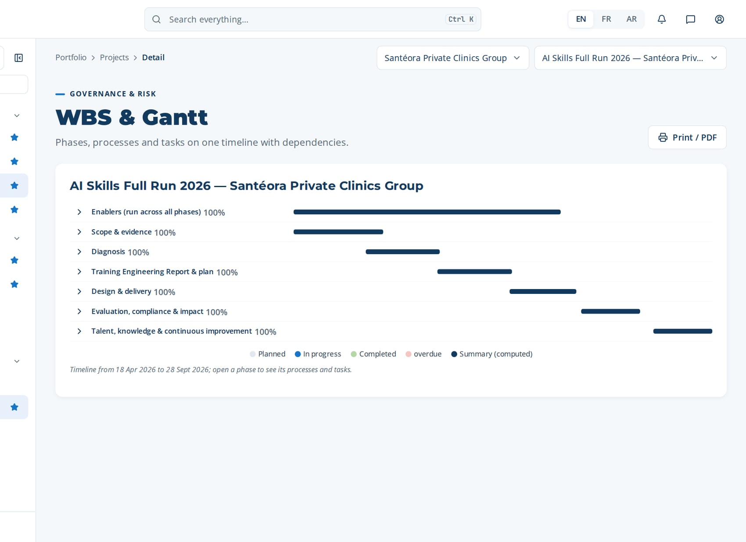
IN THE APPLICATION
Work breakdown and Gantt chart of the run
Phases, processes and tasks on one timeline, with their dependencies.

Slide 9
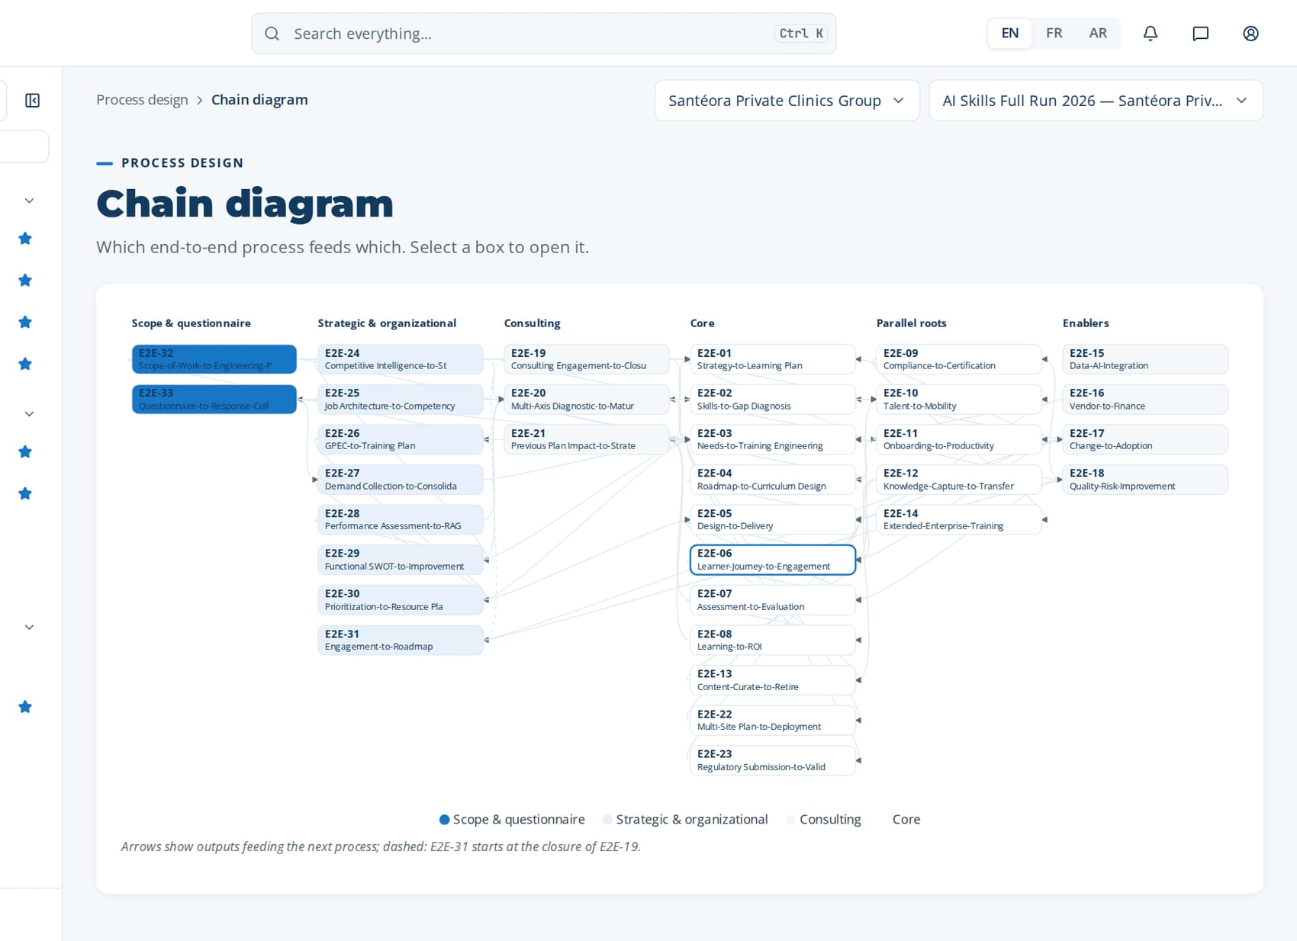
IN THE APPLICATION
How the processes feed each other
Chain diagram: the output of each process is an input of the next ones.

Slide 10
01
E2E-32 Scope-of-Work-to-Engineering-Plan
E2E-33 Questionnaire-to-Response-Collection
E2E-19 Consulting Engagement-to-Closure
E2E-24 Competitive Intelligence-to-Strategy
PHASE 1
Scope & evidence
4 processes · 37 tasks · 52 steps
18 Apr 2026 – 23 May 2026
Closed by G1 — Scope & evidence approved
Notes:
Scope & evidence

Slide 11
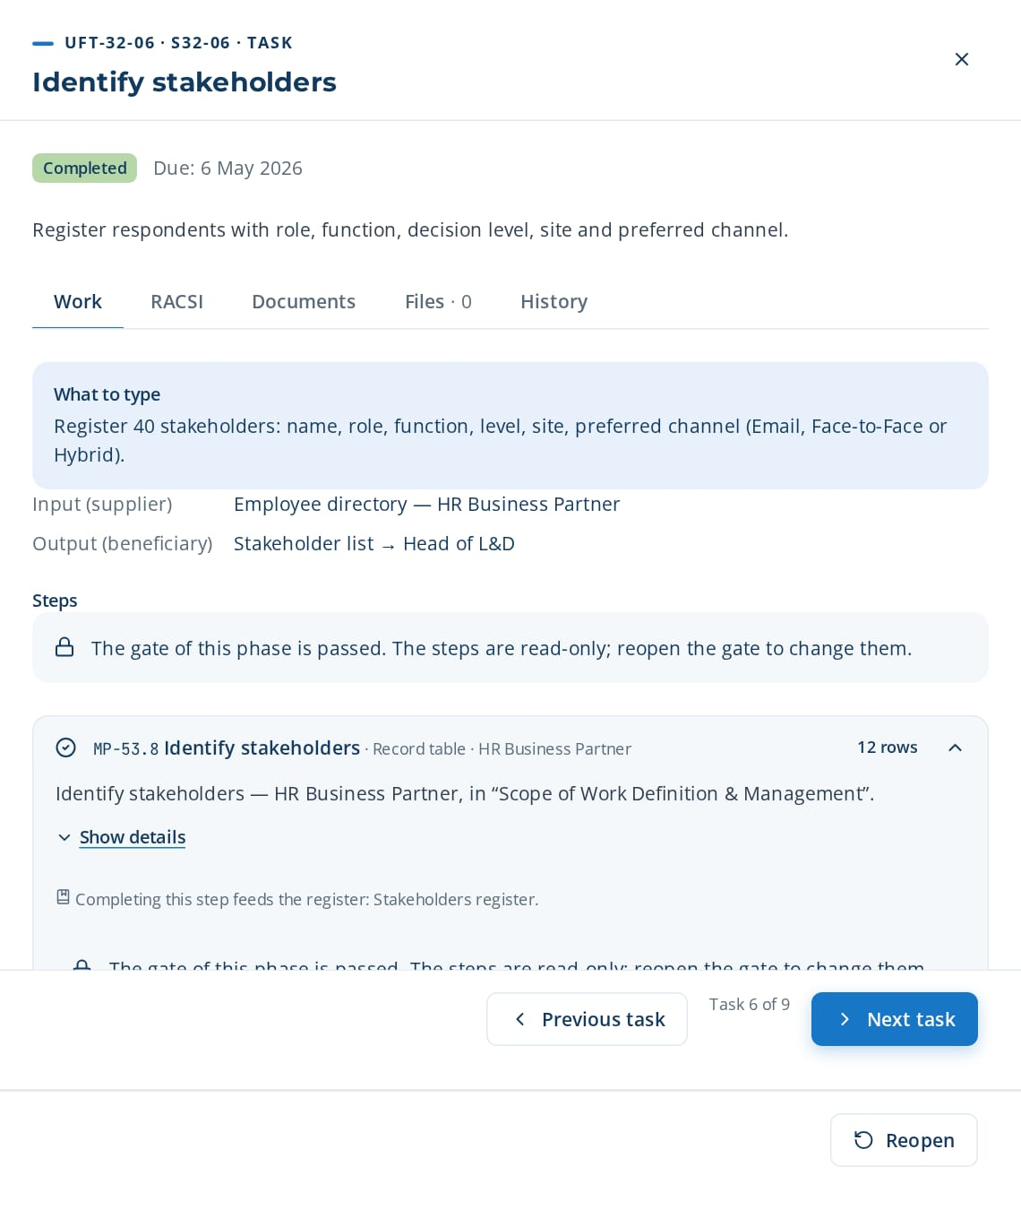
PHASE 1 · E2E-32 · ROOT — STRATEGIC
Scope-of-Work-to-Engineering-Plan
Define and approve the structured scope of work and stakeholder register
TRIGGER
New training engineering engagement, annual plan cycle, or executive request.
END STATE
Approved Scope of Work with criteria matrix and stakeholder register released to questionnaire design (E2E-33) and needs analysis (E2E-03).
9 tasks · 12 steps
26 days · 4 owners · 100 %
Macro processes: MP-53 Scope of Work Definition & Management · MP-01 Strategy & Governance Alignment · MP-44 Job Architecture & Position Description Management · MP-45 GPEC & HR Strategic Integration (Forward Planning of Jobs and Skills) · MP-03 Needs Analysis & Diagnosis
Task | Steps executed | Owner · done | What was entered
UFT-32-01 Define scope frame | MP-53.1 Define scope frame (Group Yes/No) MP-53.2 Select Organization | Hicham Naciri 20 Apr 2026 | Group scope: No. Organization: Santéora Private Clinics Group.
UFT-32-02 Select sector | MP-53.3 Select sector | Yassine Berrada 23 Apr 2026 | Sector: Healthcare Providers.
UFT-32-03 Select decision levels | MP-53.4 Select decision level (MS/MO/OP/Custom) | Yassine Berrada 26 Apr 2026 | Decision levels: MS, MO, OP (no custom level).
UFT-32-04 Map functions × decision levels | MP-53.5 Map functions × decision level | Yassine Berrada 29 Apr 2026 | Matrix: Clinical Care & Nursing × MS/MO/OP; Quality × MO/OP; Finance × MS/MO; HR × MS/MO.
UFT-32-05 Select focus and add custom criteria | MP-53.6 Select focus (All/Digital/AI/Custom) MP-53.7 Add custom criteria | Hicham Naciri 2 May 2026 | Focus: AI. Custom criterion: 'Readiness for AI triage and clinical decision support' (weight 2.00).
UFT-32-06 Identify stakeholders | MP-53.8 Identify stakeholders | Karim Chraibi 5 May 2026 | Register 40 stakeholders: name, role, function, level, site, preferred channel (Email, Face-to-Face or Hybrid).
UFT-32-06 opened in CortexSkills: what to enter, its steps and its result.
Continued on the next slide
Notes:
E2E-32 Scope-of-Work-to-Engineering-Plan — This root chain frames a training engineering engagement before any data is collected. It records whether the scope covers a Group or a single Organization, the sector, the decision levels (Strategic Management — MS, Operational Management — MO, Operational Level — OP, or a custom level), the functions in scope, the focus (all training needs, Digital, AI or custom) and any custom criteria. It then identifies the stakeholders who will respond, has the scope validated by the Head of L&D and approved by the HR Director or the Consultant PM, and publishes it to questionnaire design and needs analysis. Any change after approval requires re-validation.
Trigger: New training engineering engagement, annual plan cycle, or executive request.
End state: Approved Scope of Work with criteria matrix and stakeholder register released to questionnaire design (E2E-33) and needs analysis (E2E-03).

Slide 12
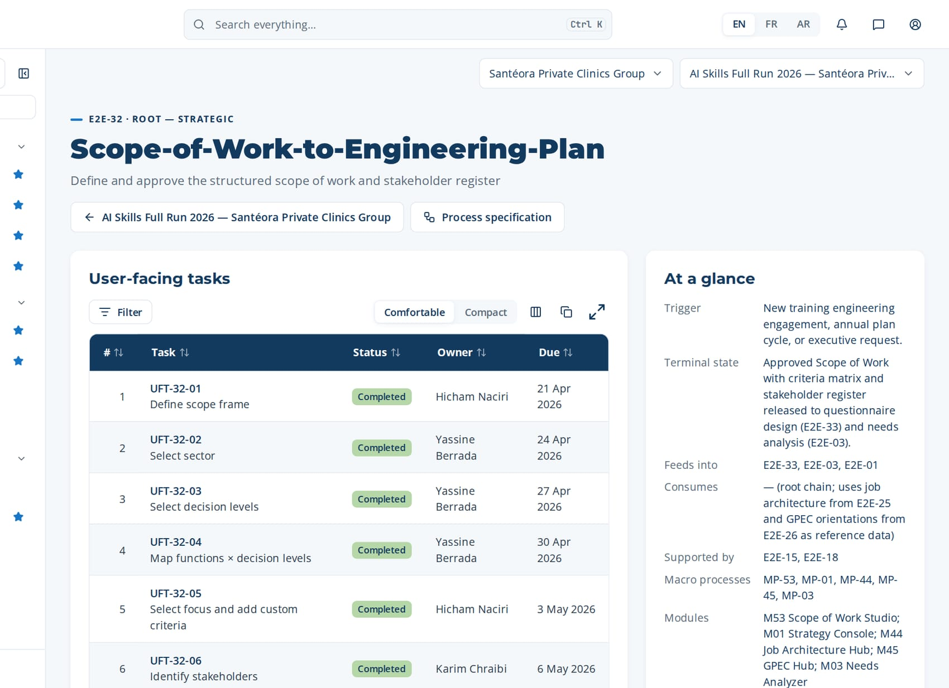
PHASE 1 · E2E-32 · ROOT — STRATEGIC
Scope-of-Work-to-Engineering-Plan (continued)
Task | Steps executed | Owner · done | What was entered
UFT-32-07 Validate scope | MP-53.9 Validate and approve scope | Hicham Naciri 8 May 2026 | Validation: every function in scope has at least 3 stakeholders; completeness 100%.
UFT-32-08 Approve scope | MP-53.9 Validate and approve scope MP-53.10 Publish scope and register stakeholders | Mehdi Lahlou 11 May 2026 | Approval status: Approved (version 1). Justification: scope aligned with SO-1 and SO-2.
UFT-32-09 Publish scope and register stakeholders | MP-53.10 Publish scope and register stakeholders | Yassine Berrada 14 May 2026 | Generate the SOW document (RPT-033) and release scope and stakeholders to the questionnaire studio.
Macro processes
MP-53 Scope of Work Definition & Management
MP-01 Strategy & Governance Alignment
MP-44 Job Architecture & Position Description Management
MP-45 GPEC & HR Strategic Integration (Forward Planning of Jobs and Skills)
MP-03 Needs Analysis & Diagnosis
Feeds into
E2E-33, E2E-03, E2E-01
Supported by
E2E-15, E2E-18
The page of E2E-32 in CortexSkills: its tasks, owners and due dates, and the process card.
Notes:
E2E-32 — remaining tasks

Slide 13
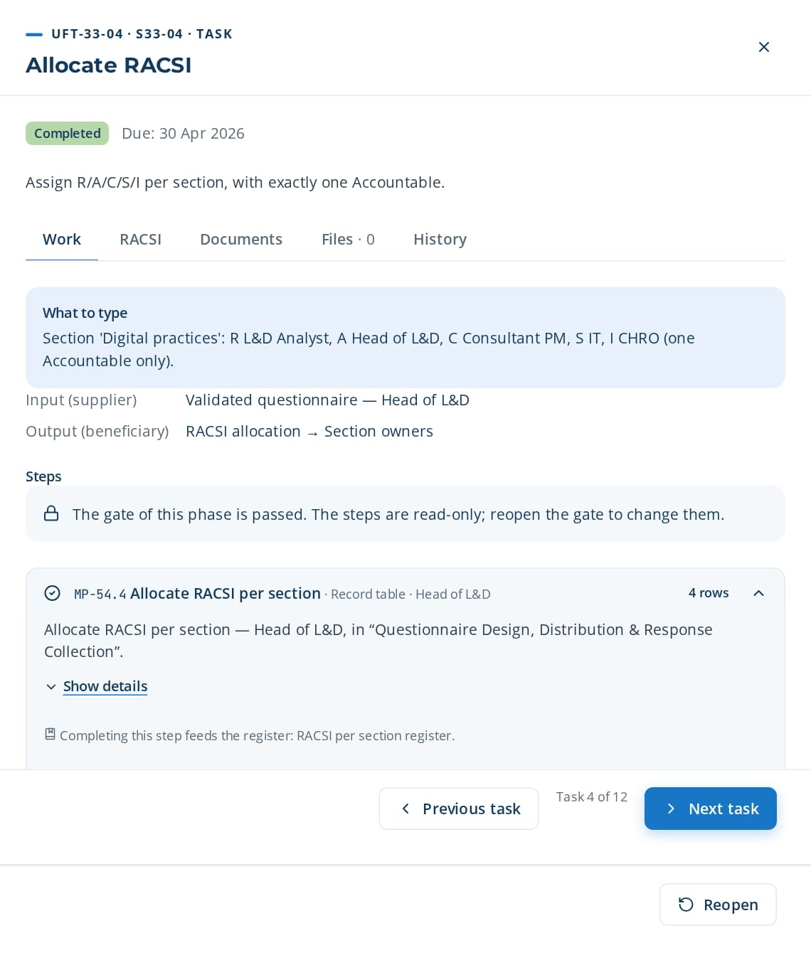
PHASE 1 · E2E-33 · ROOT — DIAGNOSTIC
Questionnaire-to-Response-Collection
Design, distribute and collect questionnaire responses across channels
TRIGGER
An approved Scope of Work becomes available (end of E2E-32).
END STATE
Consolidated, validated questionnaire response dataset feeding needs analysis (E2E-03), diagnostic (E2E-20) and demand collection (E2E-27).
12 tasks · 13 steps
35 days · 3 owners · 100 %
Macro processes: MP-54 Questionnaire Design, Distribution & Response Collection · MP-03 Needs Analysis & Diagnosis · MP-37 Multi-Axis Organizational Diagnostic · MP-46 Training Demand Collection & Consolidation
Task | Steps executed | Owner · done | What was entered
UFT-33-01 Select questionnaire template | MP-54.1 Select questionnaire template by focus | Yassine Berrada 20 Apr 2026 | Template: 'AI needs — Healthcare Providers' in the user's language, 5 sections.
UFT-33-02 Elaborate questionnaire | MP-54.2 Elaborate questionnaire (Load/AI/Manual) | Yassine Berrada 23 Apr 2026 | Elaboration mode: AI. 24 questions generated from the approved Scope of Work.
UFT-33-03 Tailor and validate content | MP-54.3 Tailor to sector and focus | Yassine Berrada 26 Apr 2026 | Validate each question; reword 5 with Clinical Care & Nursing vocabulary; delete 2 duplicates.
UFT-33-04 Allocate RACSI | MP-54.4 Allocate RACSI per section | Hicham Naciri 29 Apr 2026 | Section 'Digital practices': R L&D Analyst, A Head of L&D, C Consultant PM, S IT, I CHRO (one Accountable only).
UFT-33-05 Select distribution channels | MP-54.5 Select distribution channels | Hicham Naciri 2 May 2026 | Channels: MS and MO by Email; OP Face-to-Face with tablets; night shift Hybrid.
UFT-33-06 Distribute questionnaire | MP-54.6 Distribute to stakeholders | Hicham Naciri 5 May 2026 | Distribute to 40 stakeholders; 40 dispatches logged.
UFT-33-04 opened in CortexSkills: what to enter, its steps and its result.
Continued on the next slide
Notes:
E2E-33 Questionnaire-to-Response-Collection — This root chain turns the approved Scope of Work into evidence. The L&D Analyst selects a template by focus and sector and elaborates the questionnaire by loading a template, generating questions with AI, or writing them manually; every AI-generated or AI-tailored question is validated by a human before distribution. RACSI roles are allocated to each section, with exactly one Accountable. The questionnaire is then distributed through the channels each stakeholder uses (Face-to-Face, Email, Hybrid or Custom), reminders follow a per-channel cadence, and responses are collected — offline for Face-to-Face, with later synchronisation. No response is stored without consent. Complete responses are consolidated into a tenant-scoped dataset that feeds the needs analysis, the diagnostic and the Training Engineering Report.
Trigger: An approved Scope of Work becomes available (end of E2E-32).
End state: Consolidated, validated questionnaire response dataset feeding needs analysis (E2E-03), diagnostic (E2E-20) and demand collection (E2E-27).

Slide 14
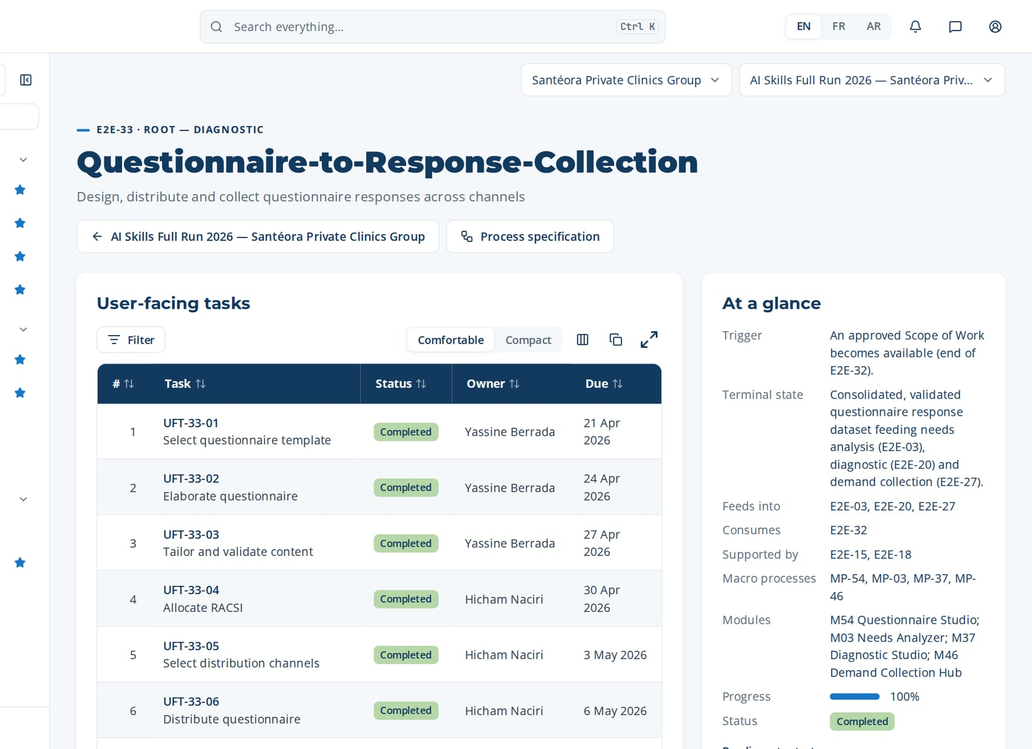
PHASE 1 · E2E-33 · ROOT — DIAGNOSTIC
Questionnaire-to-Response-Collection (continued)
Task | Steps executed | Owner · done | What was entered
UFT-33-07 Send reminders | MP-54.7 Send reminders on cadence | Hicham Naciri 8 May 2026 | Reminder 1 on day 5 to 17 non-respondents; reminder 2 on day 10 to 8.
UFT-33-08 Collect responses | MP-54.8 Collect responses | Soukaina Bennani 11 May 2026 | Responses: 34 collected (22 online, 12 offline synchronised).
UFT-33-09 Validate completeness | MP-54.9 Validate completeness and consent | Yassine Berrada 14 May 2026 | Completeness: 31 complete, 3 incomplete flagged.
UFT-33-10 Consolidate responses | MP-54.10 Consolidate responses | Yassine Berrada 17 May 2026 | Consolidated dataset: 31 responses, 24 questions, by function and level.
UFT-33-11 Check consent and release dataset | MP-54.11 Feed responses to needs analysis and diagnostic MP-54.12 Report on response rate and engagement | Yassine Berrada 20 May 2026 | Consent given for 31 of 31 stored responses; release to needs analysis, diagnostic and demand collection.
UFT-33-12 Report on response and engagement | MP-54.12 Report on response rate and engagement | Yassine Berrada 23 May 2026 | Response rate 85%; engagement rate 78%; completeness 91% (RPT-034).
The page of E2E-33 in CortexSkills: its tasks, owners and due dates, and the process card.
Feeds into
E2E-03, E2E-20, E2E-27
Supported by
E2E-15, E2E-18
Notes:
E2E-33 — remaining tasks

Slide 15
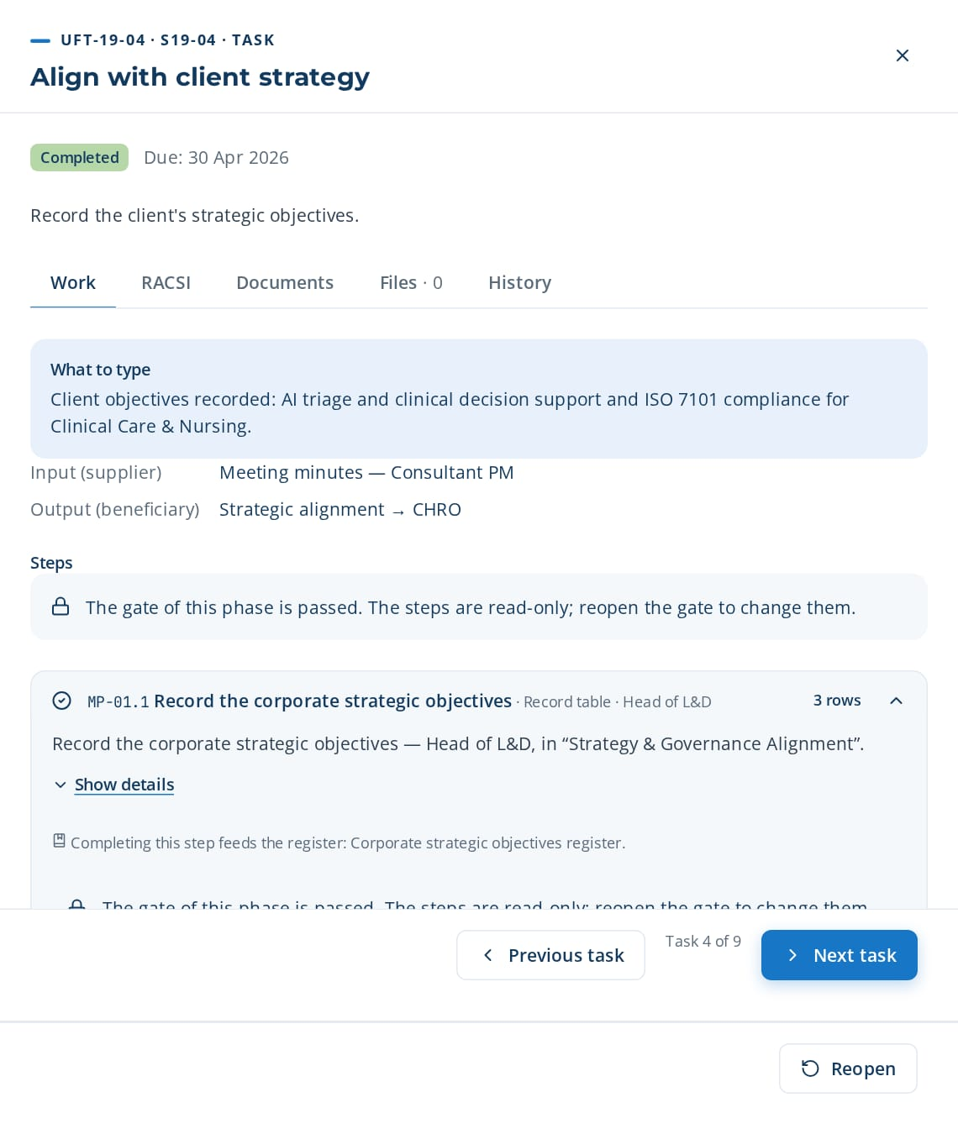
PHASE 1 · E2E-19 · ROOT (CONSULTING)
Consulting Engagement-to-Closure
Manage full consulting engagement lifecycle
TRIGGER
Client purchase order or engagement request received.
END STATE
Engagement closed with client acceptance and REX recorded.
9 tasks · 15 steps
26 days · 2 owners · 100 %
Macro processes: MP-36 Consulting Engagement Management · MP-01 Strategy & Governance Alignment · MP-19 Change Management & Adoption · MP-20 Quality, Risk & Continuous Improvement
Task | Steps executed | Owner · done | What was entered
UFT-19-01 Register engagement and purchase order | MP-36.1 Register engagement and purchase order | Nadia Lahlou 20 Apr 2026 | Engagement 'Training engineering 2026 — Santéora Private Clinics Group', PO-CL-221, 45 consulting days.
UFT-19-02 Hold kickoff meeting | MP-36.2 Hold kickoff meeting | Nadia Lahlou 23 Apr 2026 | Kickoff held on 10 February with HR Director, Head of L&D and 4 function heads.
UFT-19-03 Draft meeting minutes | MP-36.3 Draft meeting minutes | Nadia Lahlou 26 Apr 2026 | Review the AI minutes: 6 decisions, 9 actions, RACSI extracted; correct 1 owner name.
UFT-19-04 Align with client strategy | MP-01.1 Record corporate strategic objectives MP-01.2 Link objectives to functions and sites | Nadia Lahlou 29 Apr 2026 | Client objectives recorded: AI triage and clinical decision support and ISO 7101 compliance for Clinical Care & Nursing.
UFT-19-05 Plan engagement work breakdown | MP-36.4 Plan engagement work breakdown | Nadia Lahlou 2 May 2026 | WBS: 6 phases, 14 deliverables, Gantt from February to November.
UFT-19-04 opened in CortexSkills: what to enter, its steps and its result.
Continued on the next slide
Notes:
E2E-19 Consulting Engagement-to-Closure — This consulting root chain registers the engagement and purchase order, holds the kickoff with AI-drafted minutes, plans the work breakdown, tracks deliverables and closes with acceptance and REX.
Trigger: Client purchase order or engagement request received.
End state: Engagement closed with client acceptance and REX recorded.

Slide 16
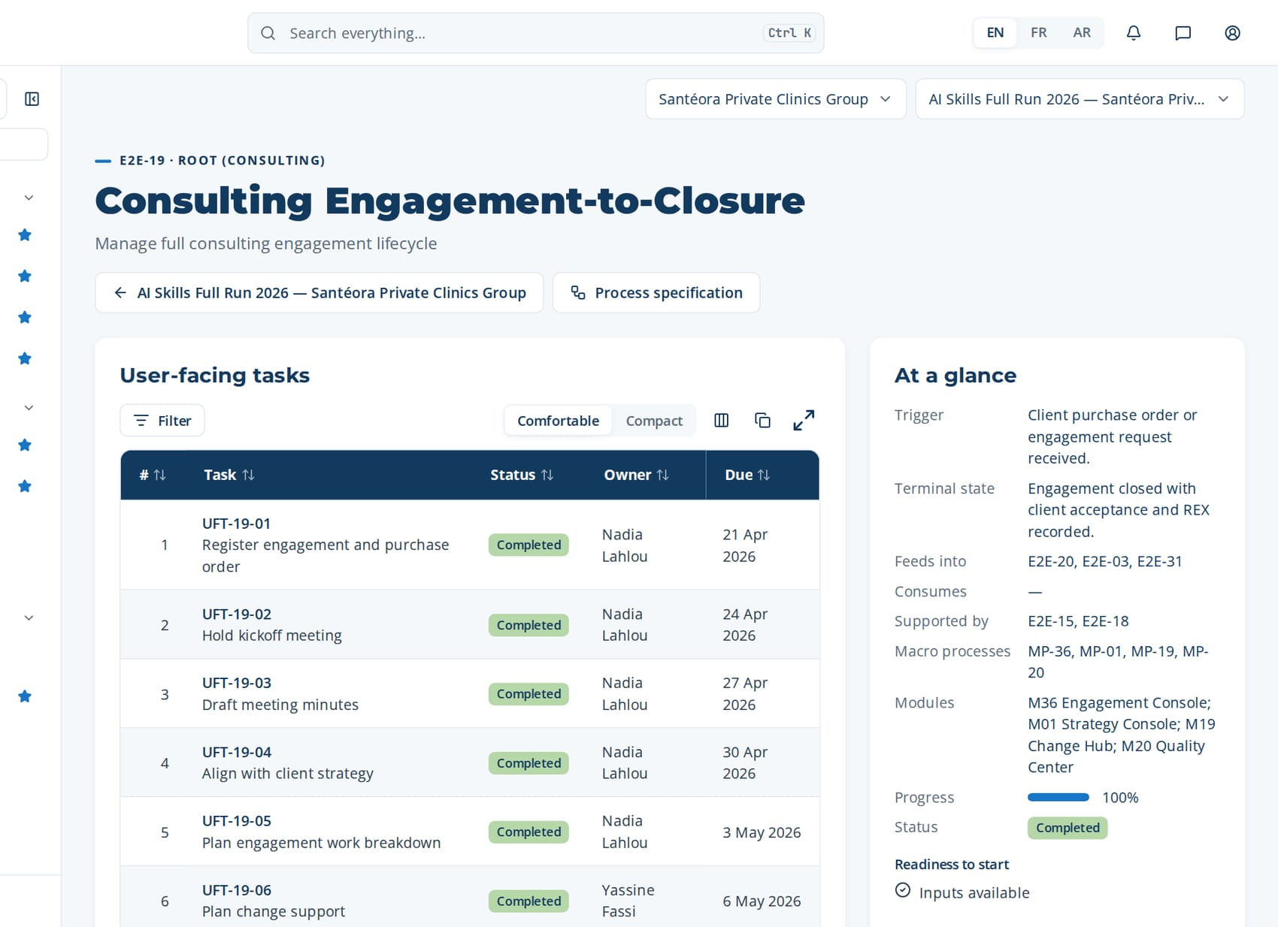
PHASE 1 · E2E-19 · ROOT (CONSULTING)
Consulting Engagement-to-Closure (continued)
Task | Steps executed | Owner · done | What was entered
UFT-19-06 Plan change support | MP-19.1 Assess change impact MP-19.2 Build adoption plan | Yassine Fassi 5 May 2026 | Change plan: 3 sponsor messages, champion network, 2 town-halls.
UFT-19-07 Track engagement deliverables | MP-36.5 Track engagement deliverables MP-20.5 Run periodic quality review | Nadia Lahlou 8 May 2026 | Deliverables: 9 of 14 delivered on time, 1 late (SWOT), 4 planned.
UFT-19-08 Deliver final report and obtain acceptance | MP-36.6 Deliver final report MP-36.7 Obtain client acceptance | Nadia Lahlou 11 May 2026 | Final report delivered; acceptance signed by the HR Director on 28 November.
UFT-19-09 Record engagement REX | MP-36.8 Record engagement REX MP-12.6 Record REX entry MP-12.5 Prompt REX at closure | Nadia Lahlou 14 May 2026 | REX: went well — stakeholder register; did not — late SWOT inputs; root cause — no function-head backup; rating 4/5.
Macro processes
MP-36 Consulting Engagement Management
MP-01 Strategy & Governance Alignment
MP-19 Change Management & Adoption
MP-20 Quality, Risk & Continuous Improvement
Feeds into
E2E-20, E2E-03, E2E-31
Supported by
E2E-15, E2E-18
The page of E2E-19 in CortexSkills: its tasks, owners and due dates, and the process card.
Notes:
E2E-19 — remaining tasks

Slide 17
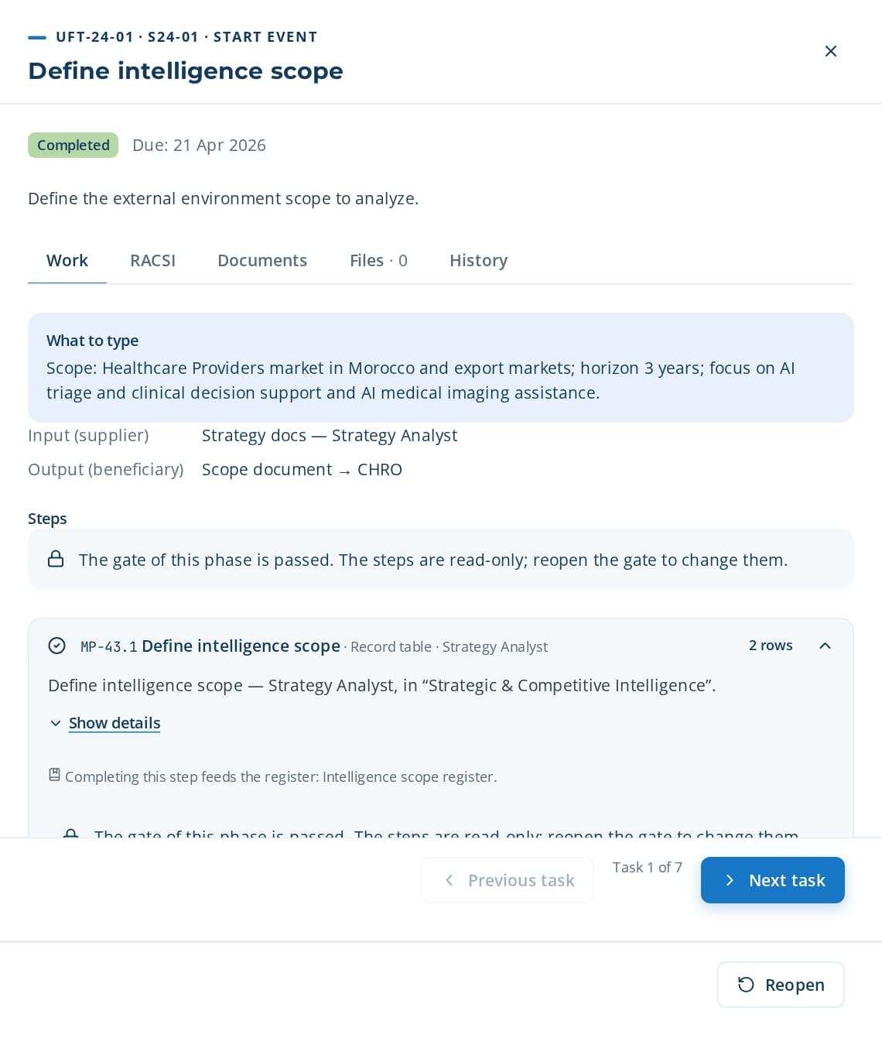
PHASE 1 · E2E-24 · ROOT (STRATEGIC)
Competitive Intelligence-to-Strategy
Analyze external environment and feed L&D strategy
TRIGGER
Annual strategy cycle or executive request for market positioning analysis.
END STATE
Validated competitive intelligence report feeding into L&D strategy and organizational diagnostic.
7 tasks · 12 steps
20 days · 2 owners · 100 %
Macro processes: MP-43 Strategic & Competitive Intelligence · MP-01 Strategy & Governance Alignment · MP-37 Multi-Axis Organizational Diagnostic · MP-04 Training Engineering Report & Roadmap Elaboration
Task | Steps executed | Owner · done | What was entered
UFT-24-01 Define intelligence scope | MP-43.1 Define intelligence scope | Rim Ziani 20 Apr 2026 | Scope: Healthcare Providers market in Morocco and export markets; horizon 3 years; focus on AI triage and clinical decision support and AI medical imaging assistance.
UFT-24-02 Conduct Porter's Five Forces | MP-43.2 Conduct Porter's Five Forces analysis | Rim Ziani 23 Apr 2026 | Rivalry 4/5; new entrants 3/5; substitutes 2/5; supplier power 3/5; buyer power 4/5.
UFT-24-03 Map market segments | MP-43.3 Map market segments | Rim Ziani 26 Apr 2026 | Segments: key accounts (55% revenue), resellers (30%), direct small customers (15%).
UFT-24-04 Analyze competitor positioning | MP-43.4 Analyze competitor positioning | Rim Ziani 29 Apr 2026 | Competitor A leads on AI triage and clinical decision support; competitor B cheaper but weaker on ISO 7101.
UFT-24-05 Monitor regulatory and technology trends | MP-43.5 Monitor regulatory changes MP-43.6 Track technology trends MP-43.7 Benchmark against industry | Rim Ziani 2 May 2026 | Trends: revision of ISO 7101 expected next year; fast growth of AI bed and staff capacity planning.
UFT-24-01 opened in CortexSkills: what to enter, its steps and its result.
Continued on the next slide
Notes:
E2E-24 Competitive Intelligence-to-Strategy — This root chain analyzes the external business environment using Porter's Five Forces, market segmentation, and competitor benchmarking. It produces strategic implications for L&D and feeds into the strategy, diagnostic, and functional SWOT processes.
Trigger: Annual strategy cycle or executive request for market positioning analysis.
End state: Validated competitive intelligence report feeding into L&D strategy and organizational diagnostic.

Slide 18

PHASE 1 · E2E-24 · ROOT (STRATEGIC)
Competitive Intelligence-to-Strategy (continued)
Task | Steps executed | Owner · done | What was entered
UFT-24-06 Identify L&D implications | MP-43.8 Identify strategic implications for L&D | Amine Lahlou 5 May 2026 | L&D implication: build AI triage and clinical decision support skills for key-account teams before competitor A scales.
UFT-24-07 Publish intelligence report | MP-43.9 Produce intelligence report MP-43.10 Feed intelligence into strategy and diagnostic MP-43.11 Update intelligence continuously + 1 more steps | Rim Ziani 8 May 2026 | Publish RPT-007 Competitive Intelligence Report to the executive committee.
Macro processes
MP-43 Strategic & Competitive Intelligence
MP-01 Strategy & Governance Alignment
MP-37 Multi-Axis Organizational Diagnostic
MP-04 Training Engineering Report & Roadmap Elaboration
Feeds into
E2E-01, E2E-20, E2E-29
Supported by
E2E-15, E2E-18
The page of E2E-24 in CortexSkills: its tasks, owners and due dates, and the process card.
Notes:
E2E-24 — remaining tasks

Slide 19
02
E2E-20 Multi-Axis Diagnostic-to-Maturity Report
E2E-25 Job Architecture-to-Competency Map
E2E-26 GPEC-to-Training Plan
E2E-27 Demand Collection-to-Consolidation
E2E-28 Performance Assessment-to-RAG Dashboard
E2E-29 Functional SWOT-to-Improvement Axes
E2E-02 Skills-to-Gap Diagnosis
E2E-21 Previous Plan Impact-to-Strategy Update
PHASE 2
Diagnosis
8 processes · 62 tasks · 100 steps
16 May 2026 – 14 Jun 2026
Closed by G2 — Diagnostic validated
Notes:
Diagnosis

Slide 20
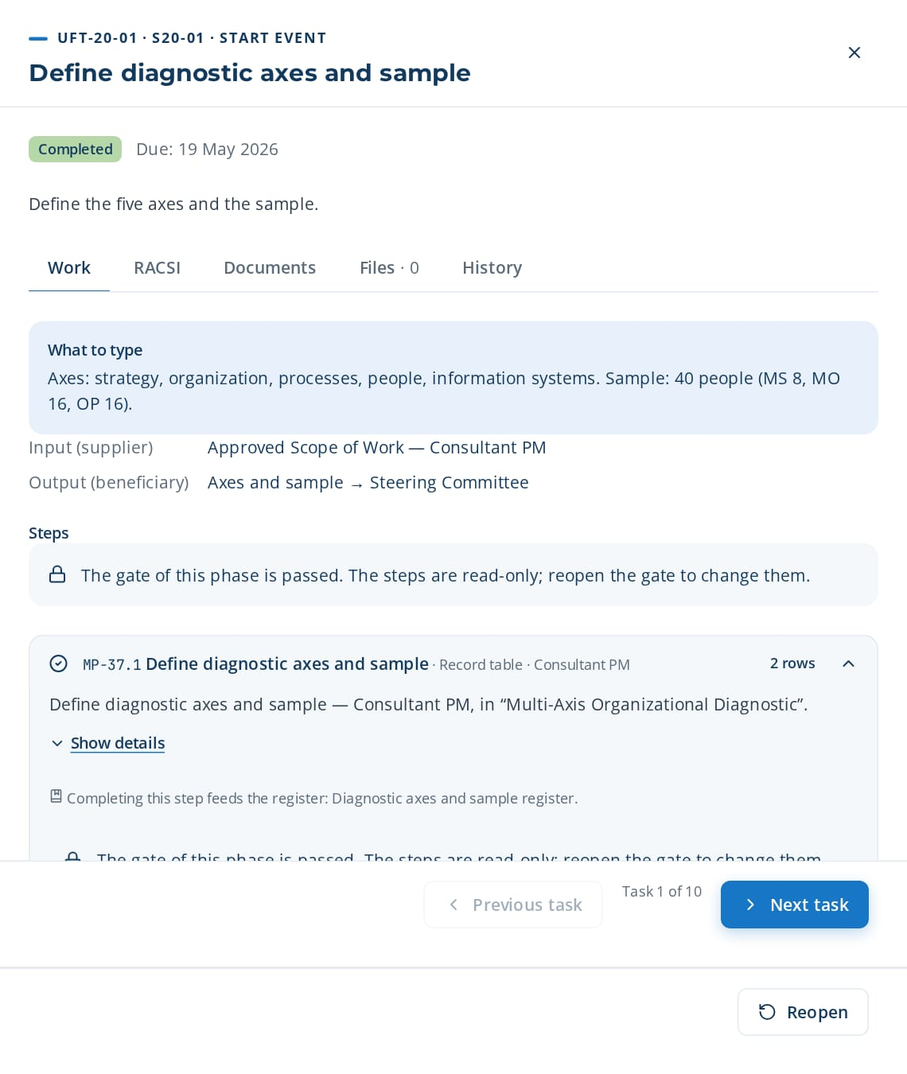
PHASE 2 · E2E-20 · ROOT (DIAGNOSTIC)
Multi-Axis Diagnostic-to-Maturity Report
Conduct 5-axis diagnostic + CMM maturity + leadership assessment
TRIGGER
Engagement kickoff or approved Scope of Work requesting a diagnostic.
END STATE
5-axis diagnostic, CMM maturity and leadership maturity report validated with the sponsor.
10 tasks · 17 steps
29 days · 4 owners · 100 %
Macro processes: MP-37 Multi-Axis Organizational Diagnostic · MP-38 Organizational Maturity Assessment (CMM-Based) · MP-42 Leadership Maturity Assessment & Development · MP-02 Skills & Competency Management · MP-03 Needs Analysis & Diagnosis
Task | Steps executed | Owner · done | What was entered
UFT-20-01 Define diagnostic axes and sample | MP-37.1 Define diagnostic axes and sample | Nadia Lahlou 18 May 2026 | Axes: strategy, organization, processes, people, information systems. Sample: 40 people (MS 8, MO 16, OP 16).
UFT-20-02 Deploy diagnostic questionnaire | MP-37.2 Deploy diagnostic questionnaire MP-37.4 Collect questionnaire responses | Nadia Lahlou 21 May 2026 | Diagnostic questionnaire deployed to 40 people; 34 responses (85%).
UFT-20-03 Conduct semi-structured interviews | MP-37.3 Conduct semi-structured interviews | Soukaina El Idrissi 24 May 2026 | Interview notes (OP, Clinical Care & Nursing): 'Procedures exist but are not updated since 2023.'
UFT-20-04 Score diagnostic axes | MP-37.5 Score diagnostic axes | Soukaina El Idrissi 27 May 2026 | Axis scores (1-5): strategy 3.4, organization 2.8, processes 2.6, people 3.1, IS 2.2.
UFT-20-05 Select maturity model | MP-38.1 Select maturity model levels MP-38.2 Define evidence criteria per level | Soukaina El Idrissi 30 May 2026 | Maturity model: CMM 5 levels; evidence for level 3 = documented and applied process.
UFT-20-01 opened in CortexSkills: what to enter, its steps and its result.
Continued on the next slide
Notes:
E2E-20 Multi-Axis Diagnostic-to-Maturity Report — This diagnostic root chain defines the axes and sample, collects interview and questionnaire evidence, scores the axes, assesses CMM and leadership maturity, and validates the findings with the sponsor.
Trigger: Engagement kickoff or approved Scope of Work requesting a diagnostic.
End state: 5-axis diagnostic, CMM maturity and leadership maturity report validated with the sponsor.

Slide 21
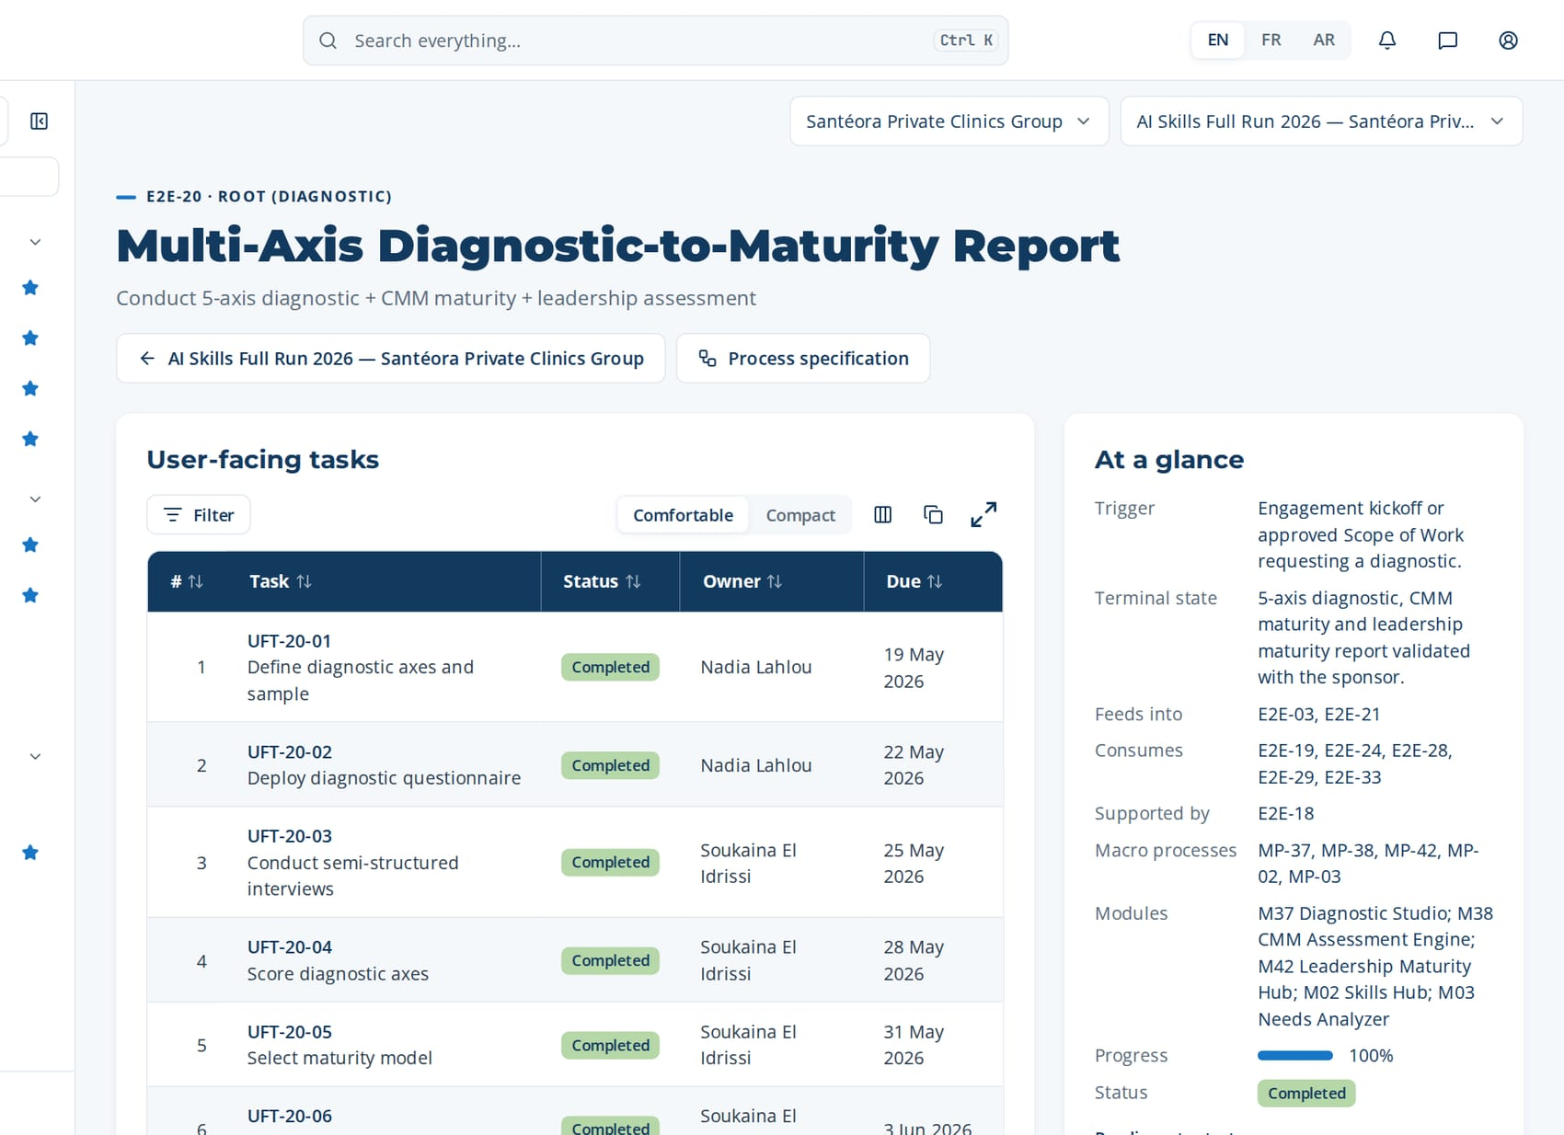
PHASE 2 · E2E-20 · ROOT (DIAGNOSTIC)
Multi-Axis Diagnostic-to-Maturity Report (continued)
Task | Steps executed | Owner · done | What was entered
UFT-20-06 Rate process maturity | MP-38.3 Rate maturity per process area MP-38.4 Compute maturity profile | Soukaina El Idrissi 2 Jun 2026 | Maturity: training management level 2; Clinical Care & Nursing processes level 3.
UFT-20-07 Assess leadership maturity | MP-42.1 Launch leadership 360 assessment MP-42.2 Compute leadership maturity level | Karim Chraibi 5 Jun 2026 | Leadership 360: average level 3 (Team Leadership) across 18 managers.
UFT-20-08 Cross-check skills and needs | MP-02.7 Validate skills inventory MP-03.2 Review gap matrix by site and function | Yassine Berrada 8 Jun 2026 | Cross-check: IS axis weakness confirmed by the AI triage and clinical decision support gap (-1.4).
UFT-20-09 Draft diagnostic findings | MP-37.6 Draft diagnostic findings MP-38.5 Produce maturity report | Soukaina El Idrissi 11 Jun 2026 | Edit AI findings: keep 5, merge 2, add one on ISO 7101 documentation.
UFT-20-10 Validate findings with sponsor | MP-37.7 Validate findings with sponsor MP-38.6 Agree target maturity | Nadia Lahlou 14 Jun 2026 | Findings validated with the sponsor; target maturity level 3 by 2026+1.
The page of E2E-20 in CortexSkills: its tasks, owners and due dates, and the process card.
Feeds into
E2E-03, E2E-21
Supported by
E2E-18
Notes:
E2E-20 — remaining tasks

Slide 22
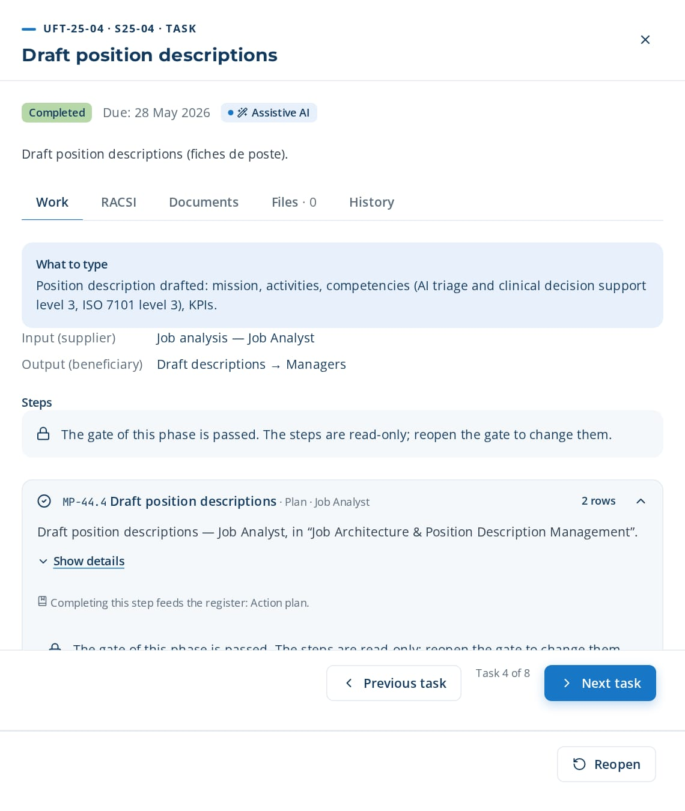
PHASE 2 · E2E-25 · ROOT (ORGANIZATIONAL)
Job Architecture-to-Competency Map
Manage organizational charts, position descriptions, gap analysis
TRIGGER
Organizational change, new role creation, or annual job architecture review.
END STATE
Approved organizational charts, position descriptions, and competency maps with gap analysis.
8 tasks · 12 steps
23 days · 2 owners · 100 %
Macro processes: MP-44 Job Architecture & Position Description Management · MP-02 Skills & Competency Management · MP-13 Talent & Career Development · MP-37 Multi-Axis Organizational Diagnostic
Task | Steps executed | Owner · done | What was entered
UFT-25-01 Map organizational structure | MP-44.1 Map organizational structure | Mehdi Lahlou 18 May 2026 | Structure: 6 functions, 14 departments, 3 sites; 212 positions.
UFT-25-02 Design organizational charts | MP-44.2 Design organizational charts | Mehdi Lahlou 21 May 2026 | Org chart 'Clinical Care & Nursing': director → 3 managers → 9 supervisors → operators.
UFT-25-03 Conduct job analysis | MP-44.3 Conduct job analysis | Karim Chraibi 24 May 2026 | Job analysis 'Clinical Care & Nursing supervisor': 8 main activities, 2 of them now supported by AI triage and clinical decision support.
UFT-25-04 Draft position descriptions | MP-44.4 Draft position descriptions | Karim Chraibi 27 May 2026 | Position description drafted: mission, activities, competencies (AI triage and clinical decision support level 3, ISO 7101 level 3), KPIs.
UFT-25-05 Validate with managers | MP-44.5 Validate descriptions with managers | Karim Chraibi 30 May 2026 | Validated by the Clinical Care & Nursing manager with 2 changes on activities.
UFT-25-04 opened in CortexSkills: what to enter, its steps and its result.
Continued on the next slide
Notes:
E2E-25 Job Architecture-to-Competency Map — This root chain manages the organization's job architecture (organizational charts, position descriptions, role profiles), conducts gap analysis between existing descriptions and reality, and aligns the architecture with the competency framework.
Trigger: Organizational change, new role creation, or annual job architecture review.
End state: Approved organizational charts, position descriptions, and competency maps with gap analysis.

Slide 23

PHASE 2 · E2E-25 · ROOT (ORGANIZATIONAL)
Job Architecture-to-Competency Map (continued)
Task | Steps executed | Owner · done | What was entered
UFT-25-06 Conduct gap analysis | MP-44.6 Conduct gap analysis existing versus real | Karim Chraibi 2 Jun 2026 | Gap existing vs real: 11 descriptions outdated; 4 roles with new AI triage and clinical decision support tasks.
UFT-25-07 Identify roles to develop | MP-44.7 Identify roles to develop MP-44.8 Update job architecture MP-44.9 Align with competency framework | Karim Chraibi 5 Jun 2026 | Roles 'To develop': data-literate supervisor, maintenance technician 4.0.
UFT-25-08 Publish approved architecture | MP-44.10 Publish approved position descriptions MP-44.11 Track job architecture changes MP-44.12 Report on architecture health | Mehdi Lahlou 8 Jun 2026 | Publish 212 approved descriptions and the architecture map to all employees.
Macro processes
MP-44 Job Architecture & Position Description Management
MP-02 Skills & Competency Management
MP-13 Talent & Career Development
MP-37 Multi-Axis Organizational Diagnostic
Feeds into
E2E-02, E2E-10, E2E-26
Supported by
E2E-15, E2E-18
The page of E2E-25 in CortexSkills: its tasks, owners and due dates, and the process card.
Notes:
E2E-25 — remaining tasks

Slide 24
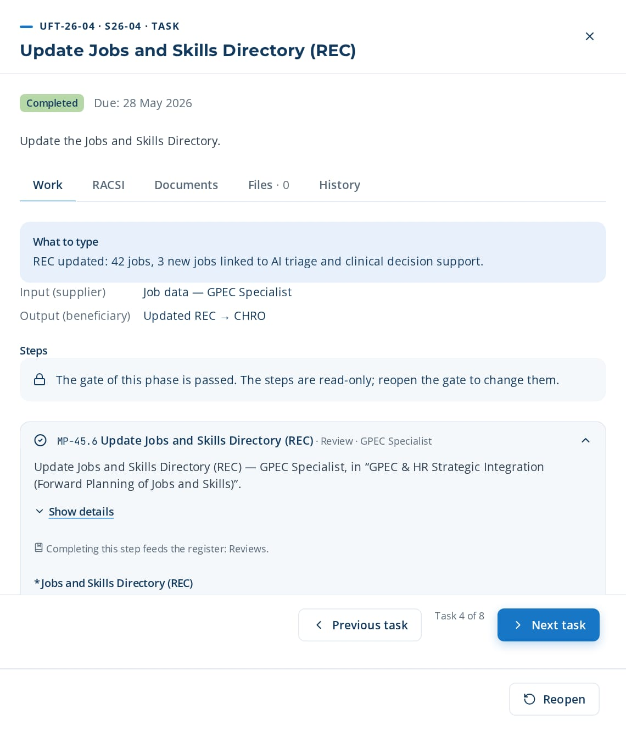
PHASE 2 · E2E-26 · ROOT (HR INTEGRATION)
GPEC-to-Training Plan
Integrate Forward Planning of Jobs and Skills into L&D
TRIGGER
Annual HR strategic planning cycle or GPEC (Forward Planning of Jobs and Skills) review.
END STATE
Training plan aligned with GPEC and HR strategic orientations.
8 tasks · 12 steps
23 days · 4 owners · 100 %
Macro processes: MP-45 GPEC & HR Strategic Integration (Forward Planning of Jobs and Skills) · MP-13 Talent & Career Development · MP-04 Training Engineering Report & Roadmap Elaboration · MP-03 Needs Analysis & Diagnosis · MP-18 Financial & Budget Management
Task | Steps executed | Owner · done | What was entered
UFT-26-01 Define GPEC scope | MP-45.1 Define GPEC scope | Nadia Tazi 18 May 2026 | GPEC scope: Clinical Care & Nursing and Information Systems jobs; horizon 3 years.
UFT-26-02 Map HR strategic orientations | MP-45.2 Map HR strategic orientations MP-45.3 Align training with GPEC | Mehdi Lahlou 21 May 2026 | HR orientations: internal mobility first; 30% of promotions from internal talent.
UFT-26-03 Update development foundation | MP-45.4 Update development foundation MP-45.5 Support human capital development | Karim Chraibi 24 May 2026 | Development foundation updated: descriptions, annual objectives, evaluation grid.
UFT-26-04 Update Jobs and Skills Directory (REC) | MP-45.6 Update Jobs and Skills Directory (REC) | Nadia Tazi 27 May 2026 | REC updated: 42 jobs, 3 new jobs linked to AI triage and clinical decision support.
UFT-26-05 Redynamize periodic evaluations | MP-45.7 Redynamize periodic evaluations | Karim Chraibi 30 May 2026 | Periodic evaluation redesigned: 2 reviews per year, competency section added.
UFT-26-06 Design career paths | MP-45.8 Design career paths | Mehdi Lahlou 2 Jun 2026 | Career path: operator → team leader → supervisor → Clinical Care & Nursing manager.
UFT-26-04 opened in CortexSkills: what to enter, its steps and its result.
Continued on the next slide
Notes:
E2E-26 GPEC-to-Training Plan — This root chain integrates GPEC (Gestion Prévisionnelle des Emplois et des Compétences — Forward Planning of Jobs and Skills) and HR strategic orientations into the training engineering process. It ensures L&D supports workforce planning, career paths, and HR strategy.
Trigger: Annual HR strategic planning cycle or GPEC (Forward Planning of Jobs and Skills) review.
End state: Training plan aligned with GPEC and HR strategic orientations.

Slide 25
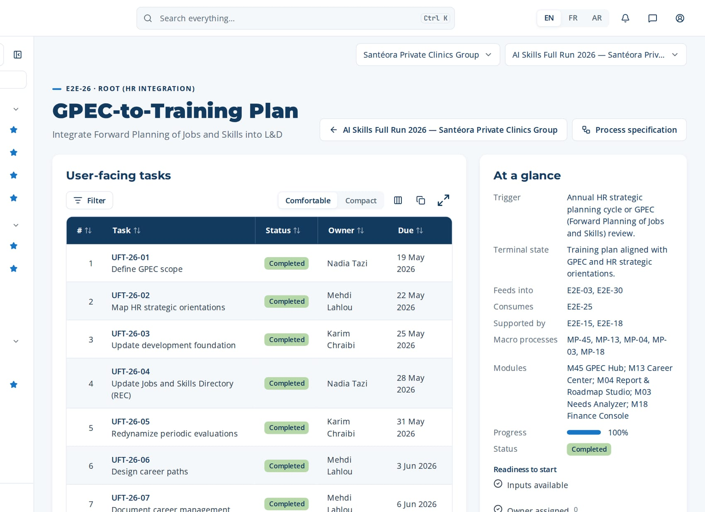
PHASE 2 · E2E-26 · ROOT (HR INTEGRATION)
GPEC-to-Training Plan (continued)
Task | Steps executed | Owner · done | What was entered
UFT-26-07 Document career management | MP-45.9 Document career management process MP-45.10 Implement collective compensation | Mehdi Lahlou 5 Jun 2026 | Career management procedure documented (v1): eligibility, committee, calendar.
UFT-26-08 Align training with GPEC | MP-45.11 Feed GPEC into training needs MP-45.12 Report on GPEC integration | Amine Lahlou 8 Jun 2026 | Training aligned with GPEC: 4 themes cover the 3 new jobs; 2 themes removed.
Macro processes
MP-45 GPEC & HR Strategic Integration (Forward Planning of Jobs and Skills)
MP-13 Talent & Career Development
MP-04 Training Engineering Report & Roadmap Elaboration
MP-03 Needs Analysis & Diagnosis
MP-18 Financial & Budget Management
Feeds into
E2E-03, E2E-30
Supported by
E2E-15, E2E-18
The page of E2E-26 in CortexSkills: its tasks, owners and due dates, and the process card.
Notes:
E2E-26 — remaining tasks

Slide 26
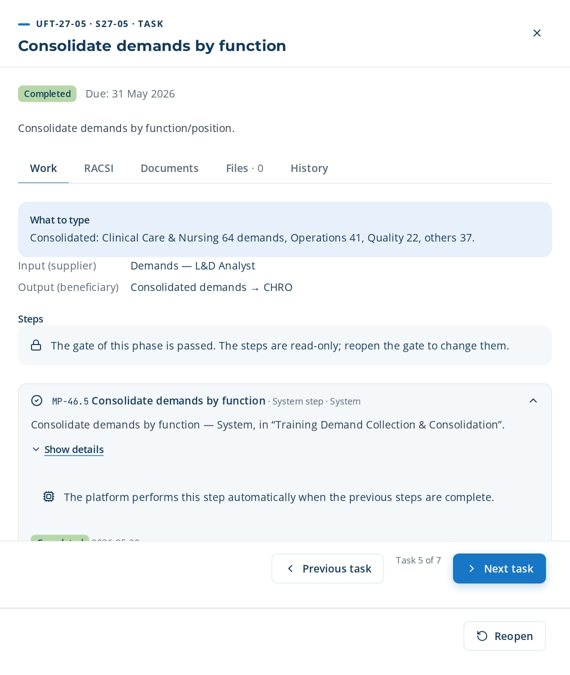
PHASE 2 · E2E-27 · ROOT (DEMAND)
Demand Collection-to-Consolidation
Collect individual and collective training demands
TRIGGER
Annual training plan cycle or ad-hoc demand collection request.
END STATE
Consolidated and prioritized demand repository integrated into the training needs analysis.
7 tasks · 12 steps
20 days · 2 owners · 100 %
Macro processes: MP-46 Training Demand Collection & Consolidation · MP-03 Needs Analysis & Diagnosis · MP-04 Training Engineering Report & Roadmap Elaboration · MP-08 Learner Experience & Engagement
Task | Steps executed | Owner · done | What was entered
UFT-27-01 Design demand collection forms | MP-46.1 Design demand collection forms | Yassine Berrada 18 May 2026 | Forms: individual form (5 questions) and collective form per team (3 questions).
UFT-27-02 Deploy individual demand collection | MP-46.2 Deploy individual demand collection | Yassine Berrada 21 May 2026 | Individual collection open 1-20 March; 146 demands received.
UFT-27-03 Deploy collective demand collection | MP-46.3 Deploy collective demand collection | Yassine Berrada 24 May 2026 | Collective collection: 18 team demands received.
UFT-27-04 Collect manager recommendations | MP-46.4 Collect manager recommendations | Nadia Lahlou 27 May 2026 | Manager recommendations: 24 received, 9 flagged as priority.
UFT-27-05 Consolidate demands by function | MP-46.5 Consolidate demands by function | Yassine Berrada 30 May 2026 | Consolidated: Clinical Care & Nursing 64 demands, Operations 41, Quality 22, others 37.
UFT-27-05 opened in CortexSkills: what to enter, its steps and its result.
Continued on the next slide
Notes:
E2E-27 Demand Collection-to-Consolidation — This root chain collects individual and collective training demands from all levels of the organization and consolidates them into a structured demand repository. It is the bottom-up complement to the top-down needs analysis.
Trigger: Annual training plan cycle or ad-hoc demand collection request.
End state: Consolidated and prioritized demand repository integrated into the training needs analysis.

Slide 27
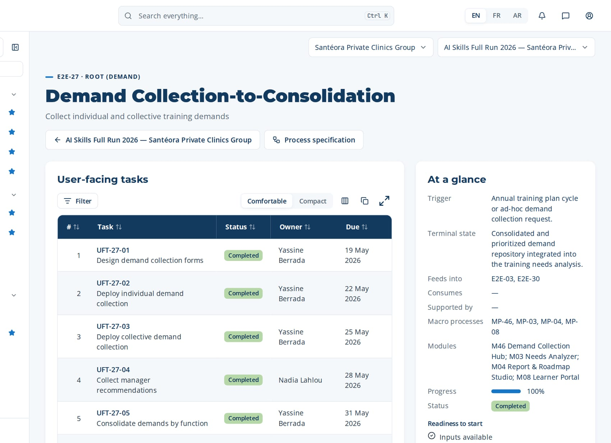
PHASE 2 · E2E-27 · ROOT (DEMAND)
Demand Collection-to-Consolidation (continued)
Task | Steps executed | Owner · done | What was entered
UFT-27-06 Map demands to competencies | MP-46.6 Map demands to competencies MP-46.7 Prioritize demands | Yassine Berrada 2 Jun 2026 | Accept AI mapping for 139 demands; map 7 manually to 'AI medical imaging assistance'.
UFT-27-07 Prioritize and validate demands | MP-46.8 Validate demands with managers MP-46.9 Integrate demands into needs analysis MP-46.10 Report on demand patterns + 2 more steps | Nadia Lahlou 5 Jun 2026 | Validated: 112 demands (High 38, Medium 51, Low 23); 34 rejected with reason.
Macro processes
MP-46 Training Demand Collection & Consolidation
MP-03 Needs Analysis & Diagnosis
MP-04 Training Engineering Report & Roadmap Elaboration
MP-08 Learner Experience & Engagement
Feeds into
E2E-03, E2E-30
Supported by
—
The page of E2E-27 in CortexSkills: its tasks, owners and due dates, and the process card.
Notes:
E2E-27 — remaining tasks

Slide 28
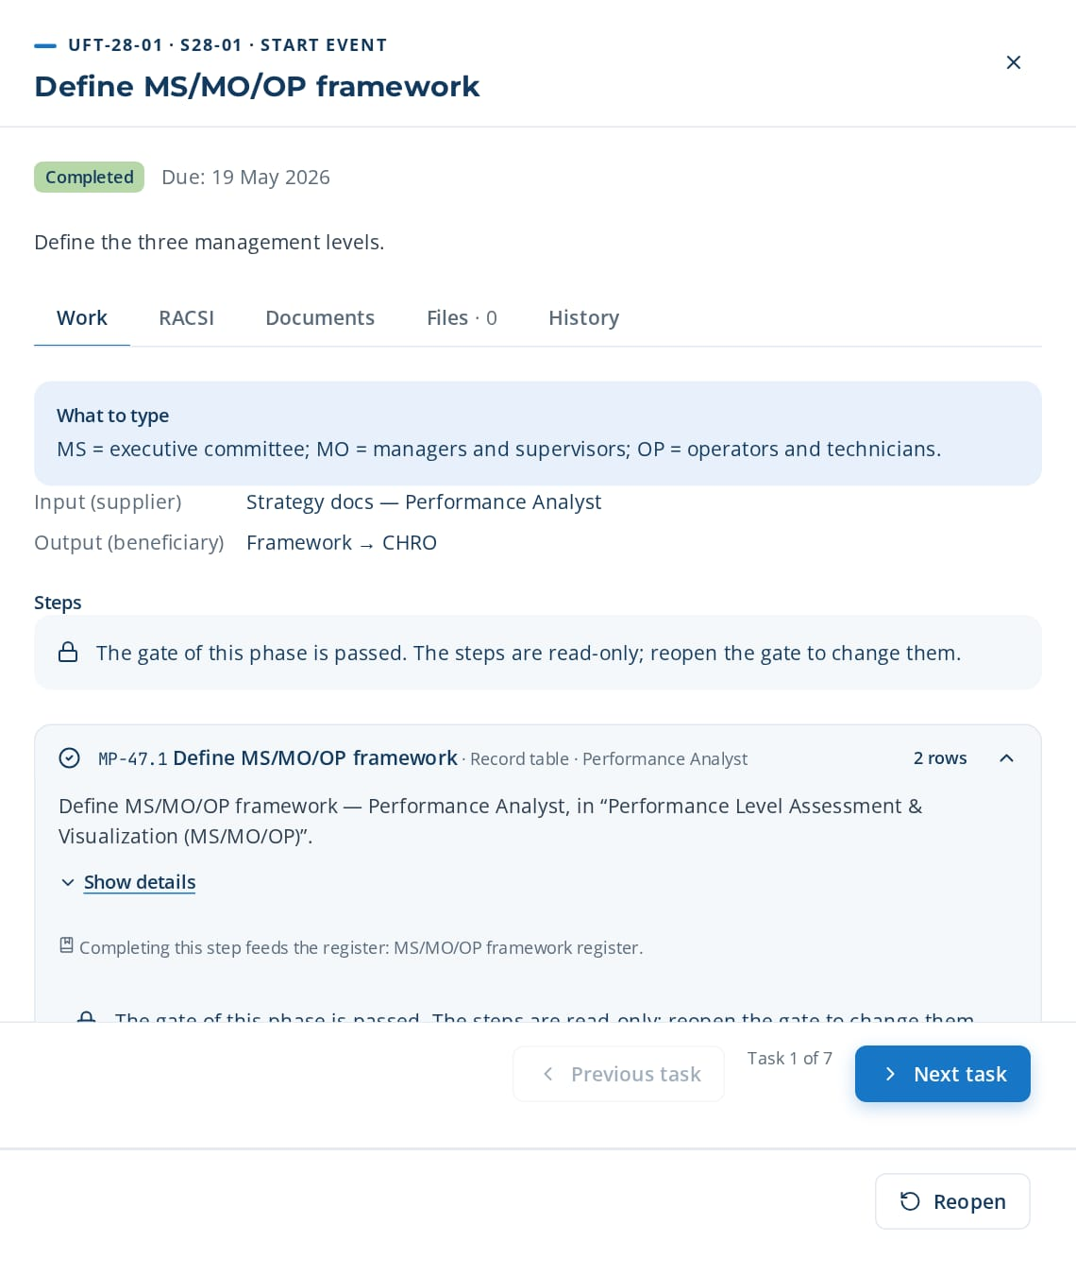
PHASE 2 · E2E-28 · ROOT (PERFORMANCE)
Performance Assessment-to-RAG Dashboard
Assess MS/MO/OP performance with RAG ratings
TRIGGER
Annual performance cycle or management request for performance visualization.
END STATE
Validated MS/MO/OP (Strategic Management / Operational Management / Operational Level) performance assessment with RAG (Green/Amber/Red) dashboards.
7 tasks · 12 steps
20 days · 1 owners · 100 %
Macro processes: MP-47 Performance Level Assessment & Visualization (MS/MO/OP) · MP-10 Reporting & Analytics · MP-37 Multi-Axis Organizational Diagnostic · MP-04 Training Engineering Report & Roadmap Elaboration
Task | Steps executed | Owner · done | What was entered
UFT-28-01 Define MS/MO/OP framework | MP-47.1 Define MS/MO/OP framework | Anas Hajji 18 May 2026 | MS = executive committee; MO = managers and supervisors; OP = operators and technicians.
UFT-28-02 Define RAG criteria | MP-47.2 Define RAG criteria | Anas Hajji 21 May 2026 | Green ≥ 90% of target; Amber 70-89%; Red < 70%.
UFT-28-03 Collect performance data by function | MP-47.3 Collect performance data by function | Anas Hajji 24 May 2026 | Data collected for 6 functions: 18 KPIs, last 12 months.
UFT-28-04 Assess MS performance | MP-47.4 Assess MS performance | Anas Hajji 27 May 2026 | MS: strategy deployment Amber (78%); governance Green (92%).
UFT-28-05 Assess MO performance | MP-47.5 Assess MO performance | Anas Hajji 30 May 2026 | MO: Clinical Care & Nursing team management Red (64%); planning Amber (81%).
UFT-28-06 Assess OP performance | MP-47.6 Assess OP performance MP-47.7 Apply RAG ratings | Anas Hajji 2 Jun 2026 | OP: ISO 7101 compliance Amber (85%); productivity Green (93%).
UFT-28-01 opened in CortexSkills: what to enter, its steps and its result.
Continued on the next slide
Notes:
E2E-28 Performance Assessment-to-RAG Dashboard — This root chain assesses and visualizes organizational performance across three management levels — Strategic Management (MS), Operational Management (MO), and Operational Level (OP) — using a Green/Amber/Red (RAG) rating system. It feeds into the multi-axis diagnostic and functional SWOT.
Trigger: Annual performance cycle or management request for performance visualization.
End state: Validated MS/MO/OP (Strategic Management / Operational Management / Operational Level) performance assessment with RAG (Green/Amber/Red) dashboards.

Slide 29
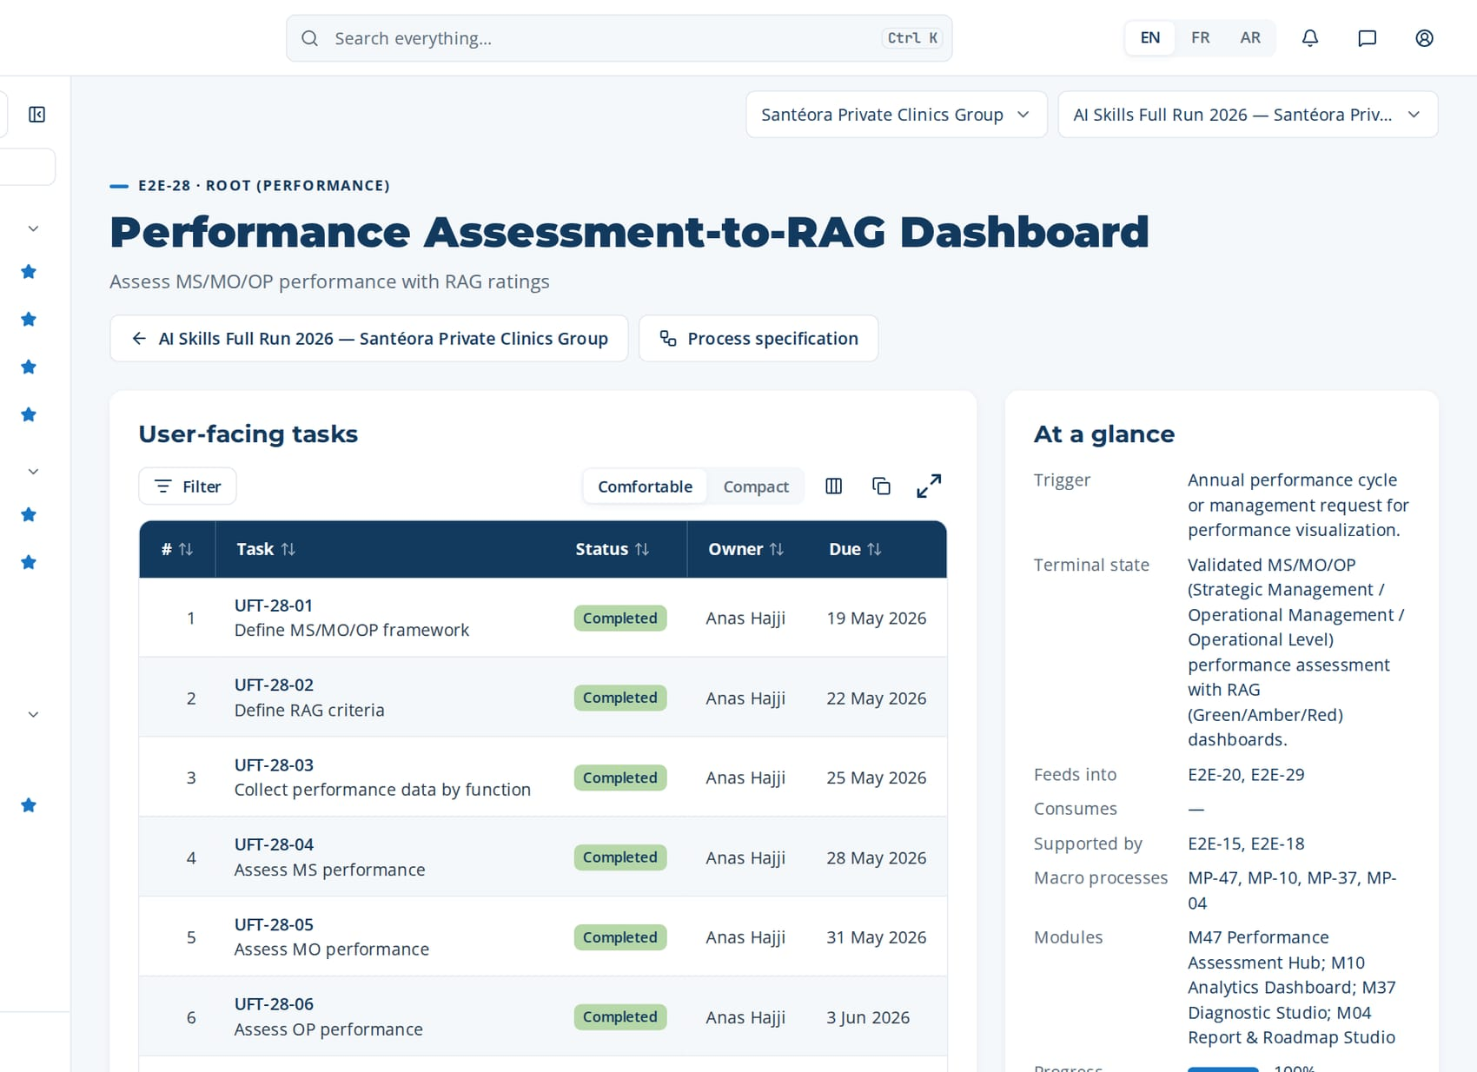
PHASE 2 · E2E-28 · ROOT (PERFORMANCE)
Performance Assessment-to-RAG Dashboard (continued)
Task | Steps executed | Owner · done | What was entered
UFT-28-07 Publish RAG dashboard | MP-47.8 Visualize performance dashboards MP-47.9 Identify performance gaps MP-47.10 Feed performance into diagnostic report + 2 more steps | Anas Hajji 5 Jun 2026 | Publish RPT-005 MS/MO/OP RAG dashboard to the executive committee.
Macro processes
MP-47 Performance Level Assessment & Visualization (MS/MO/OP)
MP-10 Reporting & Analytics
MP-37 Multi-Axis Organizational Diagnostic
MP-04 Training Engineering Report & Roadmap Elaboration
Feeds into
E2E-20, E2E-29
Supported by
E2E-15, E2E-18
The page of E2E-28 in CortexSkills: its tasks, owners and due dates, and the process card.
Notes:
E2E-28 — remaining tasks

Slide 30
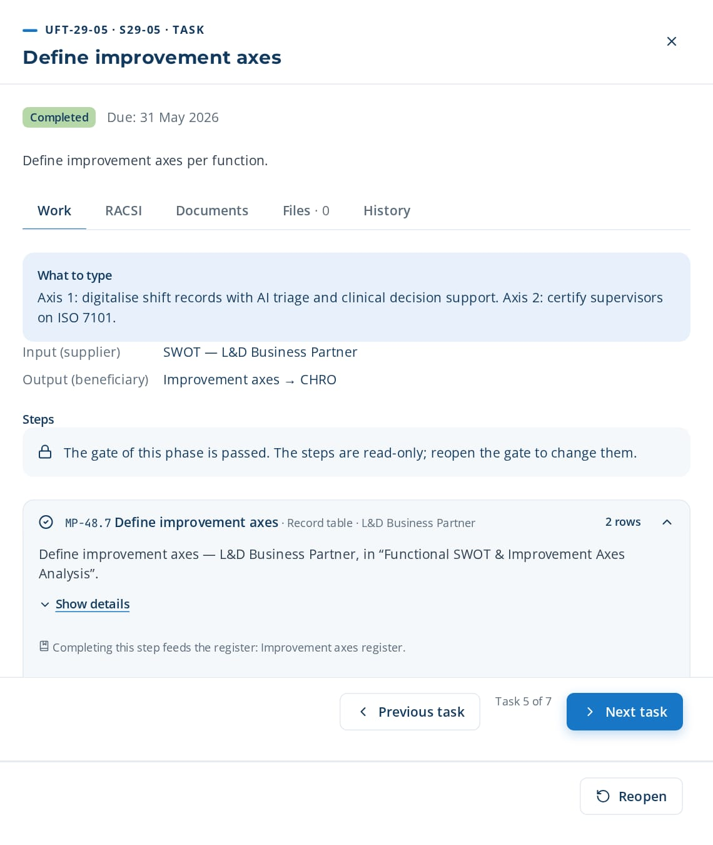
PHASE 2 · E2E-29 · ROOT (DIAGNOSTIC)
Functional SWOT-to-Improvement Axes
Conduct function-level SWOT and define improvement axes
TRIGGER
Diagnostic phase of a training engineering engagement or annual functional review.
END STATE
Validated functional SWOT reports with prioritized improvement axes per function.
7 tasks · 12 steps
20 days · 3 owners · 100 %
Macro processes: MP-48 Functional SWOT & Improvement Axes Analysis · MP-37 Multi-Axis Organizational Diagnostic · MP-04 Training Engineering Report & Roadmap Elaboration · MP-20 Quality, Risk & Continuous Improvement
Task | Steps executed | Owner · done | What was entered
UFT-29-01 Define function scope | MP-48.1 Define function scope | Yassine Berrada 18 May 2026 | Function in scope: Clinical Care & Nursing (3 sites, 96 people).
UFT-29-02 Conduct function SWOT | MP-48.2 Conduct function SWOT | Yassine Berrada 21 May 2026 | SWOT workshop held with the function head and 6 supervisors.
UFT-29-03 Identify strengths and weaknesses | MP-48.3 Identify strengths MP-48.4 Identify weaknesses | Yassine Berrada 24 May 2026 | Strength: experienced team. Weakness: low AI triage and clinical decision support usage, paper records.
UFT-29-04 Identify opportunities and threats | MP-48.5 Identify opportunities MP-48.6 Identify threats | Yassine Berrada 27 May 2026 | Opportunity: AI bed and staff capacity planning. Threat: stricter ISO 7101 audits.
UFT-29-05 Define improvement axes | MP-48.7 Define improvement axes | Nadia Lahlou 30 May 2026 | Axis 1: digitalise shift records with AI triage and clinical decision support. Axis 2: certify supervisors on ISO 7101.
UFT-29-06 Validate with function heads | MP-48.8 Validate axes with function heads | Nadia Lahlou 2 Jun 2026 | Validated by the function head on 18 April; axis 2 deadline moved to Q3.
UFT-29-05 opened in CortexSkills: what to enter, its steps and its result.
Continued on the next slide
Notes:
E2E-29 Functional SWOT-to-Improvement Axes — This root chain conducts SWOT (Strengths, Weaknesses, Opportunities, Threats) analysis at the function/department level and defines improvement axes for each function. It feeds into the multi-axis diagnostic and the Training Engineering Report.
Trigger: Diagnostic phase of a training engineering engagement or annual functional review.
End state: Validated functional SWOT reports with prioritized improvement axes per function.

Slide 31
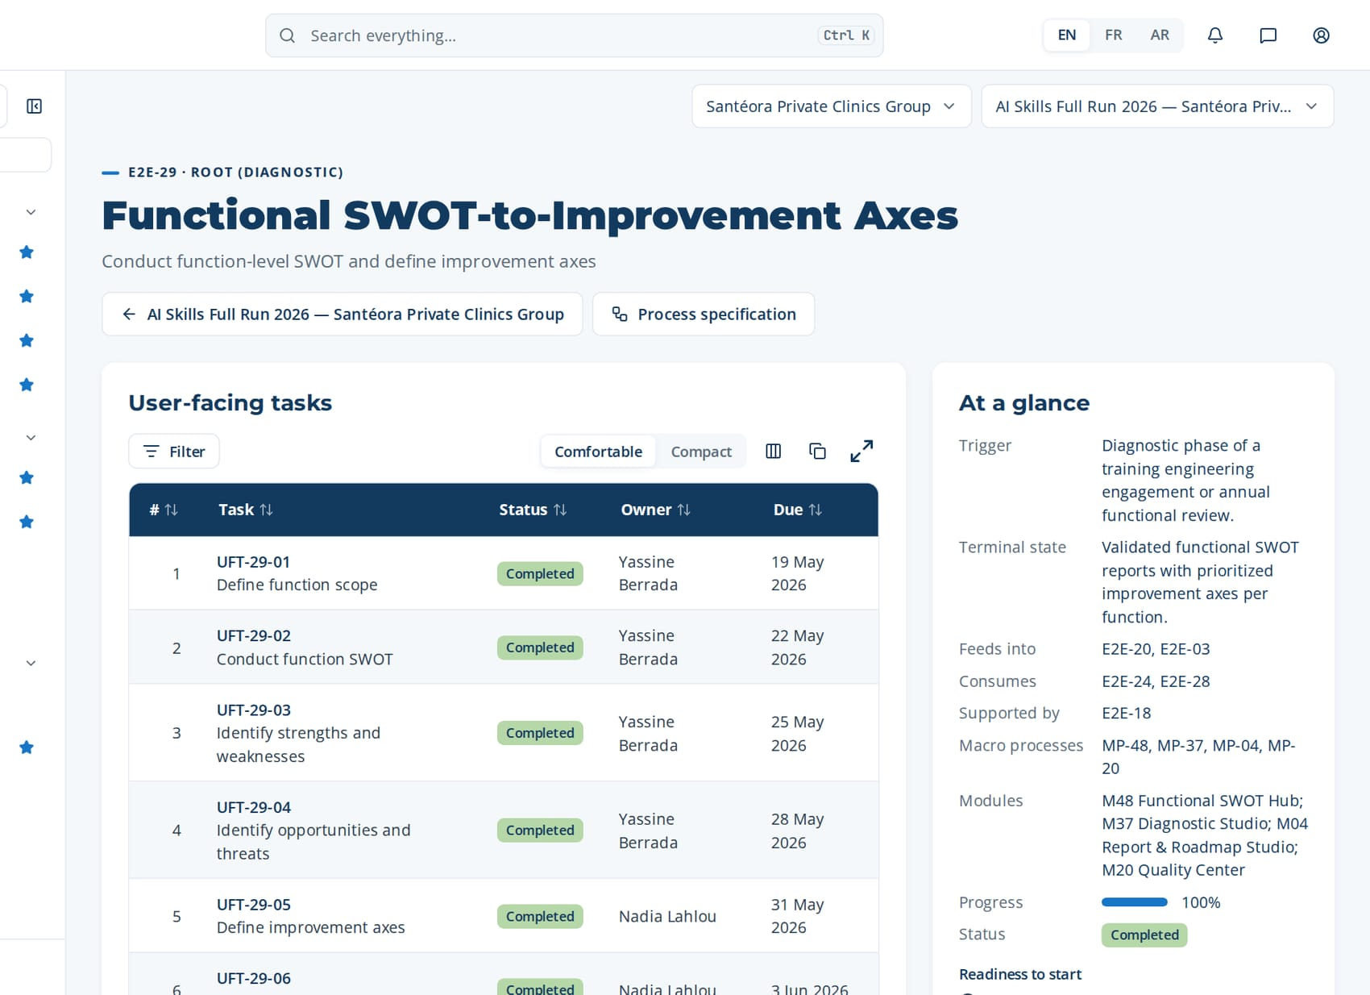
PHASE 2 · E2E-29 · ROOT (DIAGNOSTIC)
Functional SWOT-to-Improvement Axes (continued)
Task | Steps executed | Owner · done | What was entered
UFT-29-07 Prioritize improvement axes | MP-48.9 Prioritize improvement axes MP-48.10 Feed SWOT into diagnostic report MP-48.11 Track improvement implementation + 1 more steps | Amine Lahlou 5 Jun 2026 | Priority: axis 1 (impact 5), axis 2 (impact 4).
Macro processes
MP-48 Functional SWOT & Improvement Axes Analysis
MP-37 Multi-Axis Organizational Diagnostic
MP-04 Training Engineering Report & Roadmap Elaboration
MP-20 Quality, Risk & Continuous Improvement
Feeds into
E2E-20, E2E-03
Supported by
E2E-18
The page of E2E-29 in CortexSkills: its tasks, owners and due dates, and the process card.
Notes:
E2E-29 — remaining tasks

Slide 32
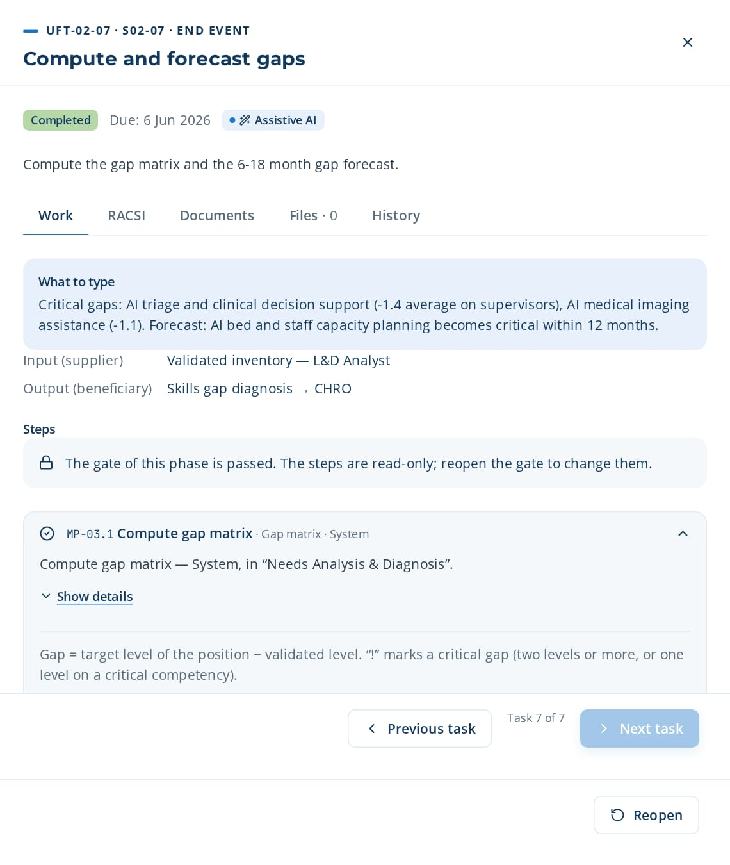
PHASE 2 · E2E-02 · PARTITION OF E2E-01
Skills-to-Gap Diagnosis
Produce a validated skills gap diagnosis
TRIGGER
Approved annual L&D plan or a scheduled skills assessment campaign.
END STATE
Validated skills gap diagnosis released to needs analysis.
7 tasks · 11 steps
20 days · 4 owners · 100 %
Macro processes: MP-02 Skills & Competency Management · MP-03 Needs Analysis & Diagnosis · MP-28 Predictive Learning Analytics & Intelligence
Task | Steps executed | Owner · done | What was entered
UFT-02-01 Maintain competency framework | MP-02.1 Define competency families and levels | Yassine Berrada 18 May 2026 | Family 'AI triage and clinical decision support': 4 competencies on the 1-4 scale (Aware, Practitioner, Autonomous, Expert).
UFT-02-02 Set target levels per position | MP-02.2 Set target levels per position | Karim Chraibi 21 May 2026 | Clinical Care & Nursing supervisor: AI triage and clinical decision support = 3; ISO 7101 = 3. Clinical Care & Nursing operator: AI triage and clinical decision support = 2.
UFT-02-03 Launch assessment campaign | MP-02.3 Launch assessment campaign | Yassine Berrada 24 May 2026 | Campaign 'Skills 2026': population Clinical Care & Nursing and Operations (212 people), 12 competencies, close date 30 April.
UFT-02-04 Collect self and manager assessments | MP-02.4 Submit self and manager assessments MP-02.5 Consolidate assessment results | Karim El Idrissi 27 May 2026 | Self-assessment AI triage and clinical decision support: 2; manager validation: 2 with comment 'needs practice on live cases'.
UFT-02-07 opened in CortexSkills: what to enter, its steps and its result.
Continued on the next slide
Notes:
E2E-02 Skills-to-Gap Diagnosis — This partition of E2E-01 maintains the competency framework, runs the skills assessment campaign, validates the inventory and computes the gap matrix that feeds the flagship report.
Trigger: Approved annual L&D plan or a scheduled skills assessment campaign.
End state: Validated skills gap diagnosis released to needs analysis.

Slide 33
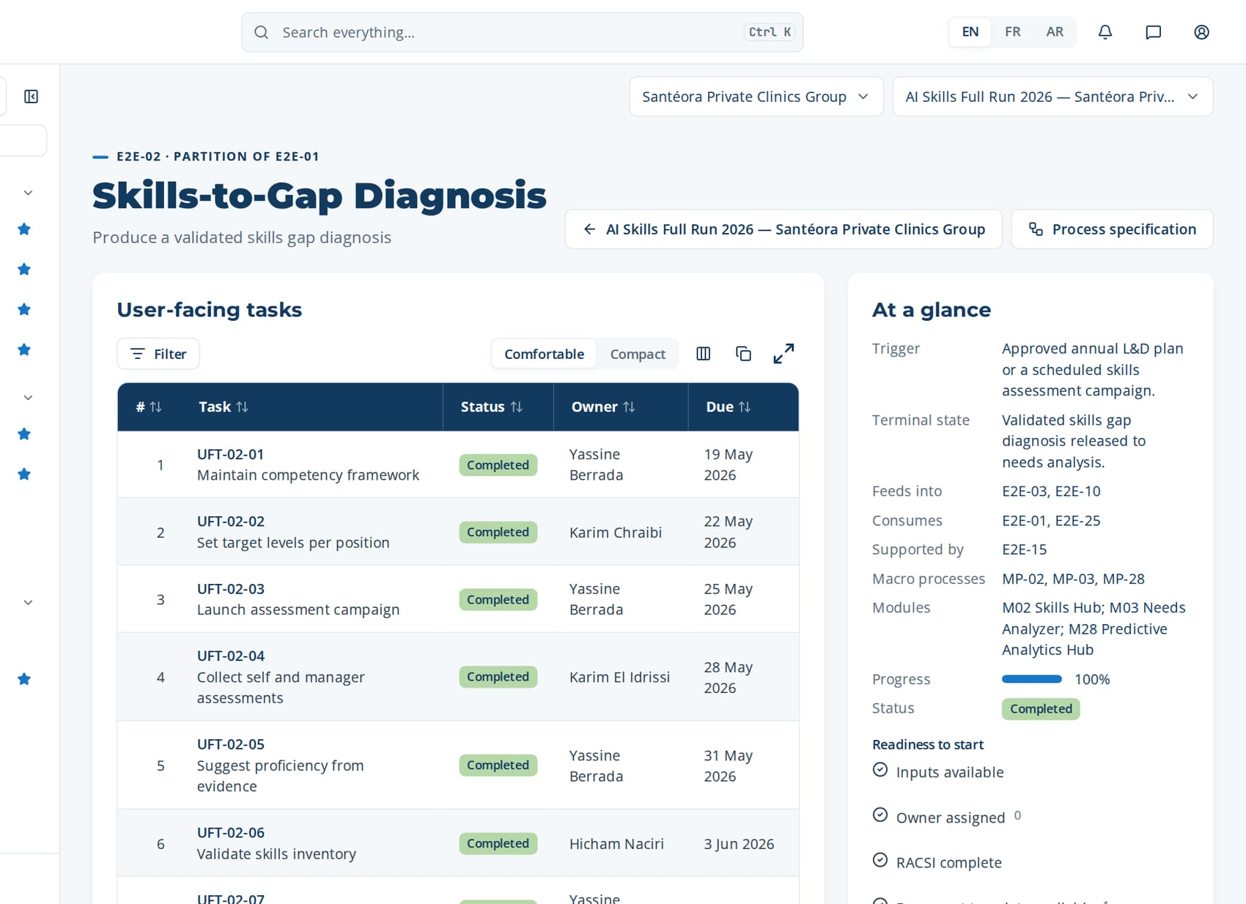
PHASE 2 · E2E-02 · PARTITION OF E2E-01
Skills-to-Gap Diagnosis (continued)
Task | Steps executed | Owner · done | What was entered
UFT-02-05 Suggest proficiency from evidence | MP-02.6 Suggest proficiency from evidence | Yassine Berrada 30 May 2026 | Accept 38 suggested levels, edit 4 (evidence too old), reject 1. Every change carries a note.
UFT-02-06 Validate skills inventory | MP-02.7 Validate skills inventory | Hicham Naciri 2 Jun 2026 | Inventory validated: 212 employees, 96% assessments complete. Justification: sample checked by site.
UFT-02-07 Compute and forecast gaps | MP-03.1 Compute gap matrix MP-03.2 Review gap matrix by site and function MP-28.3 Forecast skill gaps + 1 more steps | Yassine Berrada 5 Jun 2026 | Critical gaps: AI triage and clinical decision support (-1.4 average on supervisors), AI medical imaging assistance (-1.1). Forecast: AI bed and staff capacity planning becomes critical within 12 months.
Macro processes
MP-02 Skills & Competency Management
MP-03 Needs Analysis & Diagnosis
MP-28 Predictive Learning Analytics & Intelligence
Feeds into
E2E-03, E2E-10
Supported by
E2E-15
The page of E2E-02 in CortexSkills: its tasks, owners and due dates, and the process card.
Notes:
E2E-02 — remaining tasks

Slide 34
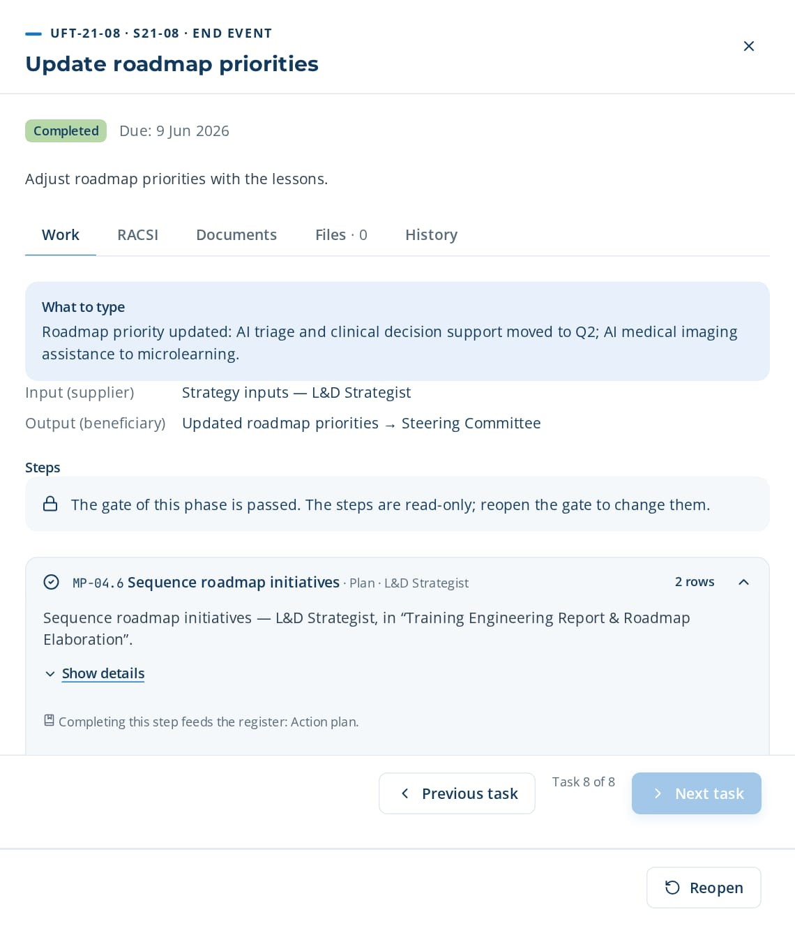
PHASE 2 · E2E-21 · ROOT
Previous Plan Impact-to-Strategy Update
Evaluate N-1 plan impact and update strategy
TRIGGER
Start of a new plan cycle with N-1 execution data available.
END STATE
N-1 impact conclusions fed into the strategy update.
8 tasks · 12 steps
23 days · 4 owners · 100 %
Macro processes: MP-39 Training Plan Impact Study (N-1) · MP-09 Assessment & Evaluation · MP-32 Learning ROI & Business Impact Measurement · MP-01 Strategy & Governance Alignment · MP-04 Training Engineering Report & Roadmap Elaboration
Task | Steps executed | Owner · done | What was entered
UFT-21-01 Load N-1 plan execution data | MP-39.1 Load N-1 plan execution data | Yassine Berrada 18 May 2026 | Load N-1 plan: 28 sessions planned, 23 delivered, 1,410,000 MAD spent.
UFT-21-02 Define impact criteria | MP-39.2 Define impact criteria | Yassine Berrada 21 May 2026 | Impact criteria: application on the job, KPI change, satisfaction, cost per learner.
UFT-21-03 Survey participants and managers | MP-39.3 Survey participants and managers MP-09.5 Record on-the-job observation (Level 3) | Yassine Berrada 24 May 2026 | Survey sent to 190 participants and 34 managers; 61% responded.
UFT-21-04 Compare planned against realized | MP-39.4 Compare planned against realized MP-32.3 Isolate training effect | Yassine Berrada 27 May 2026 | Planned vs realized: 82% of sessions, 94% of budget; 2 themes not delivered.
UFT-21-05 Review N-1 ROI | MP-32.4 Compute Phillips ROI MP-32.5 Review ROI with finance | Anas Hajji 30 May 2026 | N-1 ROI: AI medical imaging assistance 18%; safety theme 35%.
UFT-21-06 Draft impact conclusions | MP-39.5 Draft impact study conclusions | Yassine Berrada 2 Jun 2026 | Accept AI conclusions 1-3; rewrite conclusion 4 (sample too small).
UFT-21-08 opened in CortexSkills: what to enter, its steps and its result.
Continued on the next slide
Notes:
E2E-21 Previous Plan Impact-to-Strategy Update — This root chain loads N-1 plan execution data, defines impact criteria, surveys participants and managers, compares planned against realized, drafts conclusions and feeds them into the strategy update.
Trigger: Start of a new plan cycle with N-1 execution data available.
End state: N-1 impact conclusions fed into the strategy update.

Slide 35
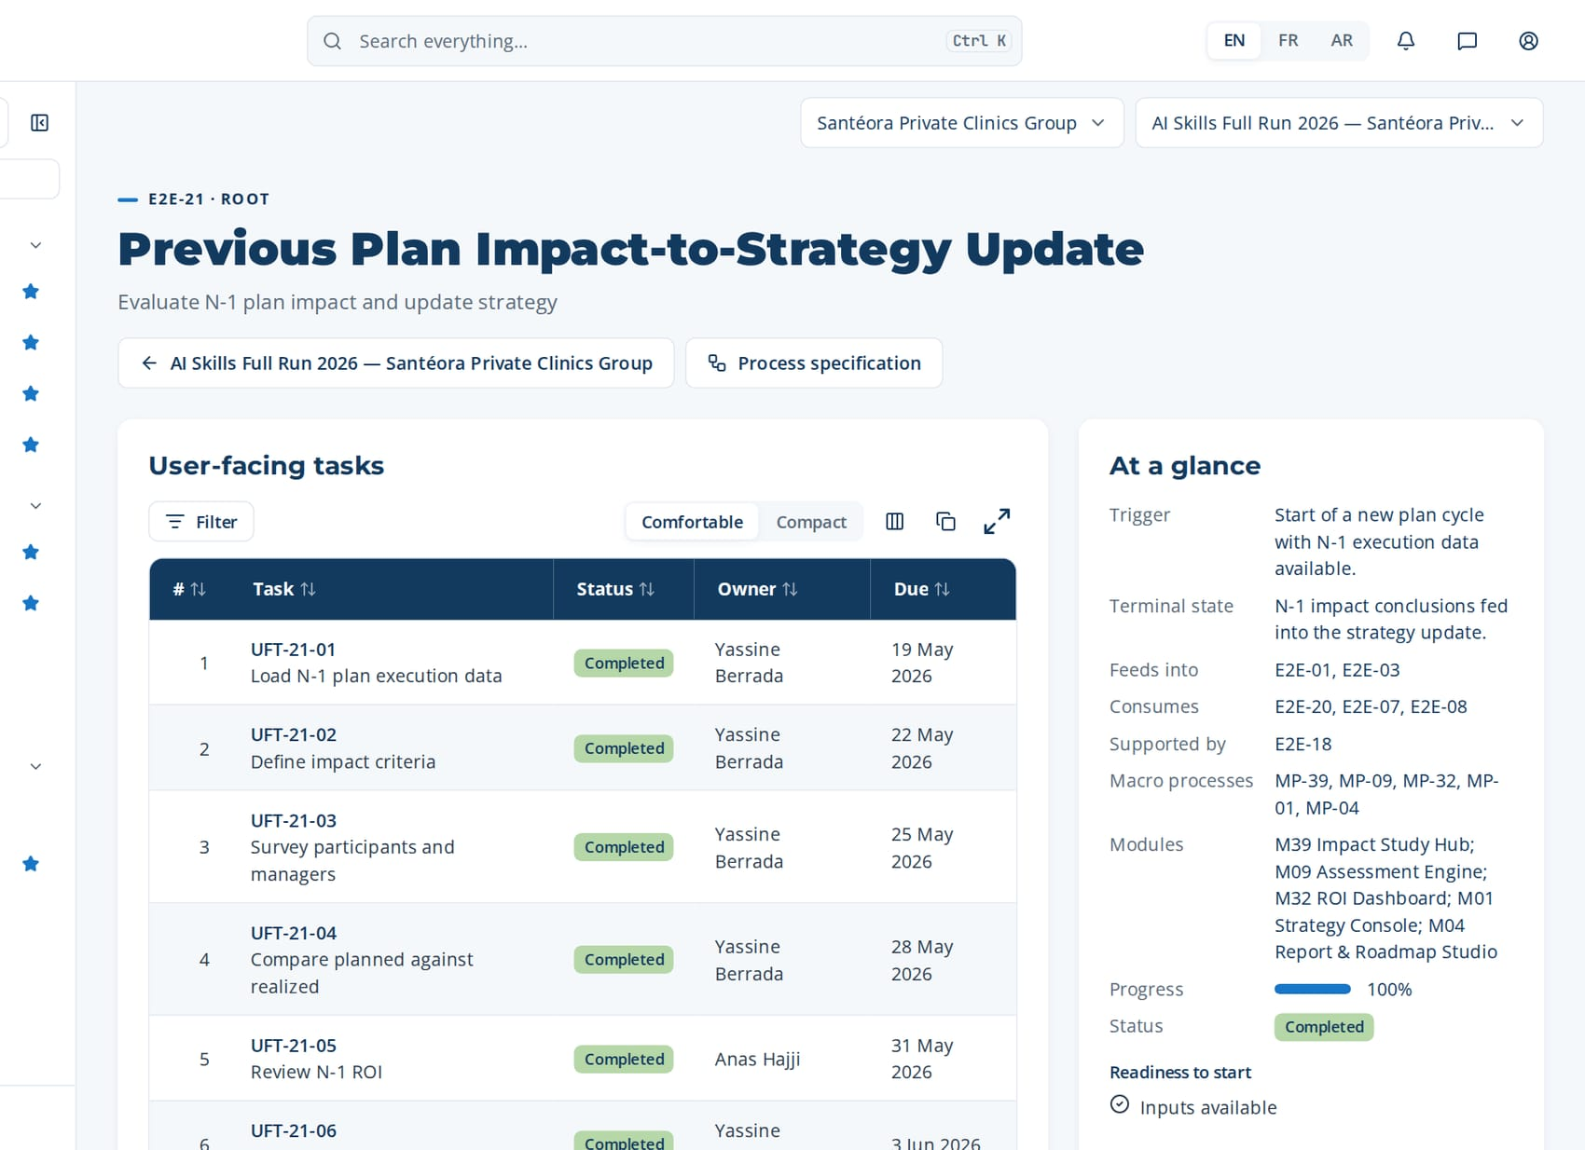
PHASE 2 · E2E-21 · ROOT
Previous Plan Impact-to-Strategy Update (continued)
Task | Steps executed | Owner · done | What was entered
UFT-21-07 Feed conclusions to strategy | MP-39.6 Feed conclusions to strategy update MP-01.1 Record corporate strategic objectives | Hicham Naciri 5 Jun 2026 | Feed to strategy: keep blended format; stop long classroom courses on AI medical imaging assistance.
UFT-21-08 Update roadmap priorities | MP-04.6 Sequence roadmap initiatives | Amine Lahlou 8 Jun 2026 | Roadmap priority updated: AI triage and clinical decision support moved to Q2; AI medical imaging assistance to microlearning.
Macro processes
MP-39 Training Plan Impact Study (N-1)
MP-09 Assessment & Evaluation
MP-32 Learning ROI & Business Impact Measurement
MP-01 Strategy & Governance Alignment
MP-04 Training Engineering Report & Roadmap Elaboration
Feeds into
E2E-01, E2E-03
Supported by
E2E-18
The page of E2E-21 in CortexSkills: its tasks, owners and due dates, and the process card.
Notes:
E2E-21 — remaining tasks

Slide 36
03
E2E-01 Strategy-to-Learning Plan
E2E-03 Needs-to-Training Engineering Report & Roadmap
E2E-30 Prioritization-to-Resource Plan
E2E-22 Multi-Site Plan-to-Deployment
E2E-23 Regulatory Submission-to-Validation
E2E-16 Vendor-to-Finance
HCPR-E2E-02 Healthcare Providers Critical-Skills-to-Transformation Plan
PHASE 3
Training Engineering Report & plan
7 processes · 50 tasks · 84 steps
13 Jun 2026 – 12 Jul 2026
Closed by G3 — Report & roadmap approved
Notes:
Training Engineering Report & plan

Slide 37
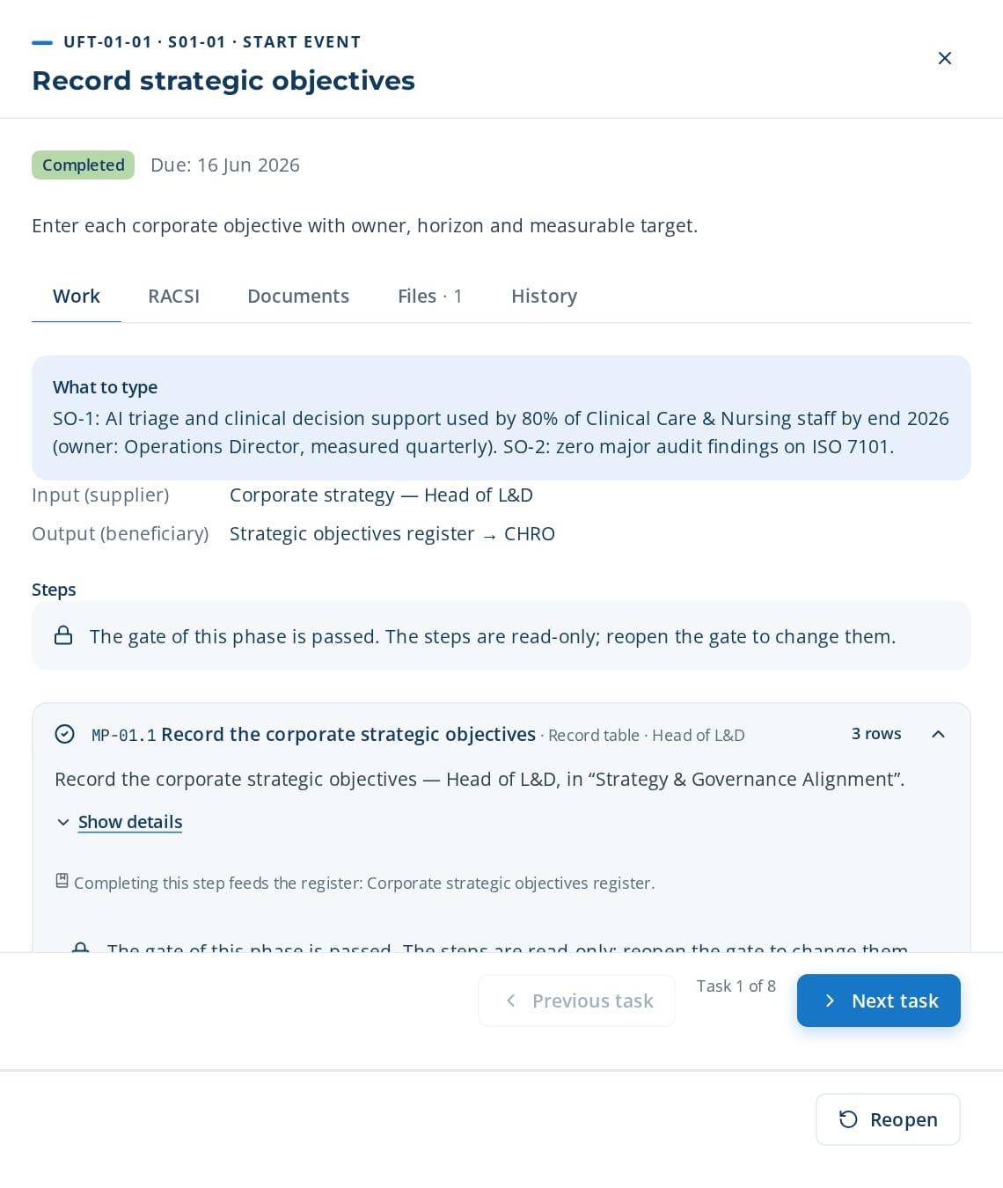
PHASE 3 · E2E-01 · ROOT / MASTER CHAIN
Strategy-to-Learning Plan
Translate corporate strategy into an approved annual L&D plan and budget
TRIGGER
Annual strategy cycle opened or revised corporate objectives published by the board.
END STATE
Annual L&D plan and budget envelope approved by the Steering Committee and locked.
8 tasks · 16 steps
23 days · 6 owners · 100 %
Macro processes: MP-01 Strategy & Governance Alignment · MP-02 Skills & Competency Management · MP-03 Needs Analysis & Diagnosis · MP-04 Training Engineering Report & Roadmap Elaboration · MP-18 Financial & Budget Management · MP-19 Change Management & Adoption
Task | Steps executed | Owner · done | What was entered
UFT-01-01 Record strategic objectives | MP-01.1 Record corporate strategic objectives | Hicham Naciri 15 Jun 2026 | SO-1: AI triage and clinical decision support used by 80% of Clinical Care & Nursing staff by end 2026 (owner: Operations Director, measured quarterly). SO-2: zero major audit findings on ISO 7101.
UFT-01-02 Link objectives to functions and sites | MP-01.2 Link objectives to functions and sites | Amine Lahlou 18 Jun 2026 | SO-1 → Clinical Care & Nursing, Operations, Information Systems (all sites). SO-2 → Quality & HSE, Clinical Care & Nursing.
UFT-01-03 Frame skills priorities | MP-02.1 Define competency families and levels MP-02.2 Set target levels per position | Yassine Berrada 21 Jun 2026 | Priority competency families: AI triage and clinical decision support; AI medical imaging assistance; ISO 7101 compliance. Target level 3 (Autonomous) for supervisors.
UFT-01-01 opened in CortexSkills: what to enter, its steps and its result.
Continued on the next slide
Notes:
E2E-01 Strategy-to-Learning Plan — This root chain translates corporate strategy into an approved annual L&D plan. It records strategic objectives, links them to functions and sites, sets the budget envelope and the governance calendar, and ends with a Steering Committee decision that locks the plan.
Trigger: Annual strategy cycle opened or revised corporate objectives published by the board.
End state: Annual L&D plan and budget envelope approved by the Steering Committee and locked.

Slide 38
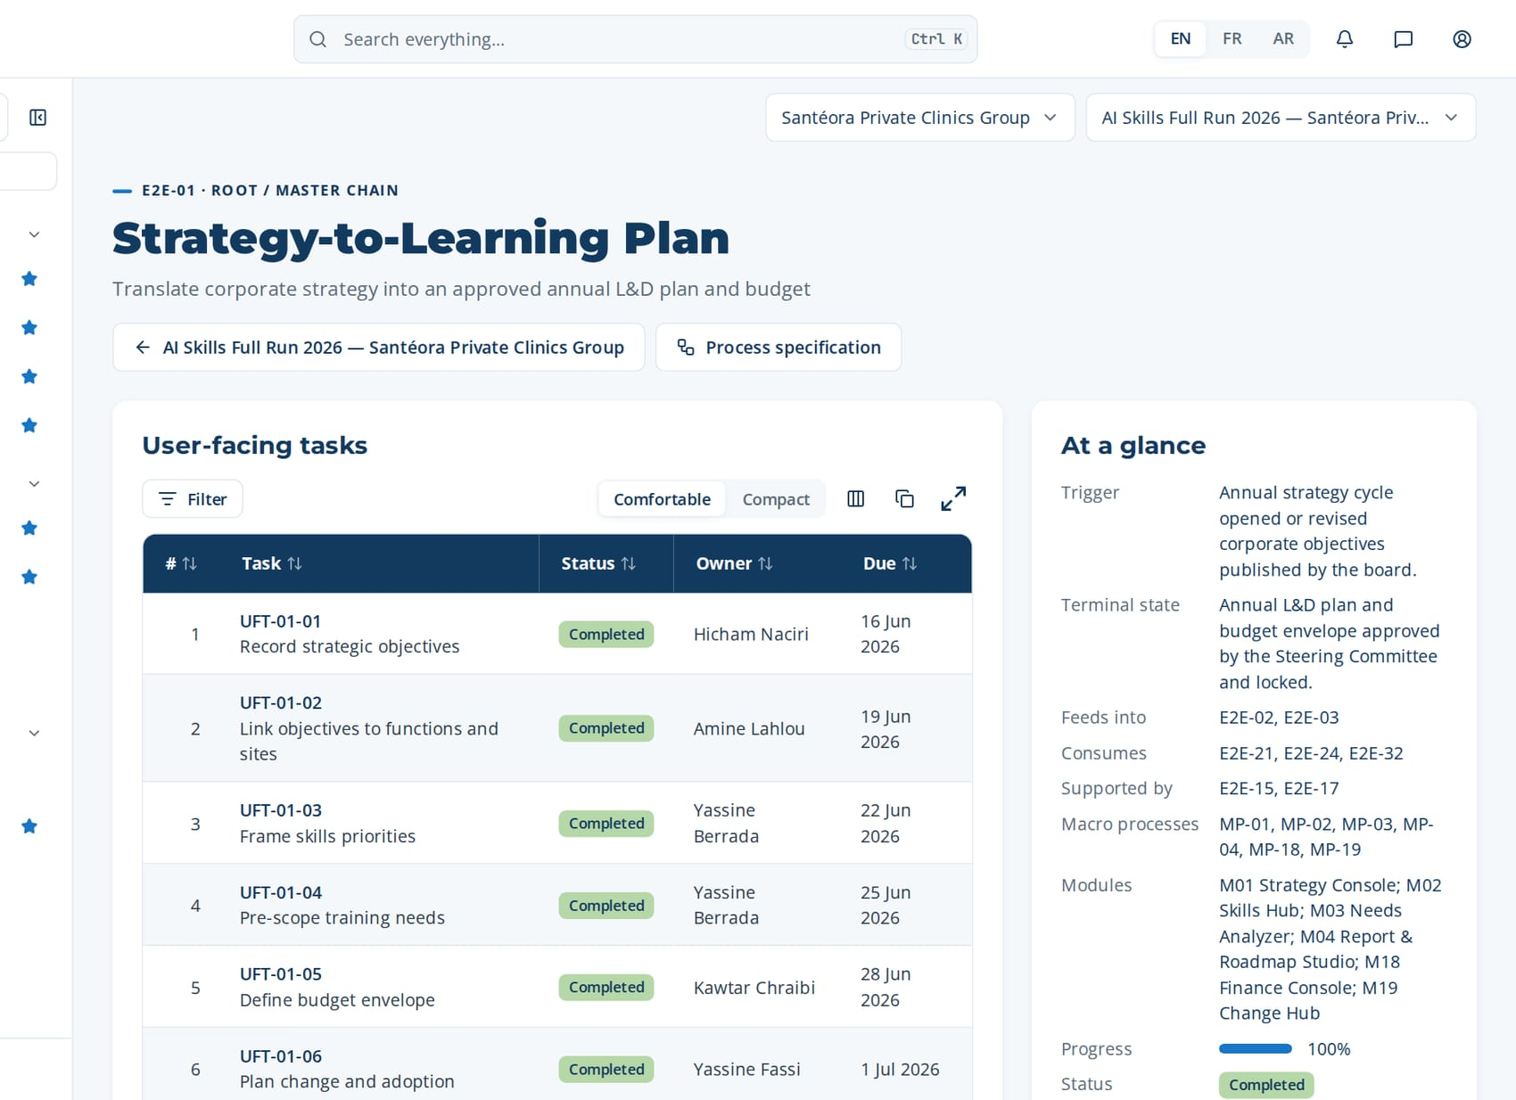
PHASE 3 · E2E-01 · ROOT / MASTER CHAIN
Strategy-to-Learning Plan (continued)
Task | Steps executed | Owner · done | What was entered
UFT-01-04 Pre-scope training needs | MP-03.1 Compute gap matrix MP-03.2 Review gap matrix by site and function | Yassine Berrada 24 Jun 2026 | Pre-scoped needs: 42% of Clinical Care & Nursing supervisors below target on AI triage and clinical decision support; 18 employees below target on ISO 7101.
UFT-01-05 Define budget envelope | MP-01.3 Define L&D budget envelope MP-18.1 Allocate budget by theme and site MP-18.2 Forecast OFPPT refunds | Kawtar Chraibi 27 Jun 2026 | Gross L&D budget 2026: 1,850,000 MAD; forecast refund (OFPPT/CSF): 520,000 MAD; net envelope: 1,330,000 MAD.
UFT-01-06 Plan change and adoption | MP-19.1 Assess change impact MP-19.2 Build adoption plan | Yassine Fassi 30 Jun 2026 | Change impact: high for Clinical Care & Nursing supervisors (new AI triage and clinical decision support routines). Sponsors: Operations Director. Champions: one per site.
UFT-01-07 Compile plan approval pack | MP-01.4 Schedule Steering Committee milestones MP-01.5 Compile plan approval pack MP-04.1 Consolidate feeder outputs | Hicham Naciri 3 Jul 2026 | Approval pack: 2 objectives, net budget 1,330,000 MAD, 6 priority themes, committee date 15 March 2026.
UFT-01-08 Approve and lock annual L&D plan | MP-01.6 Record Steering Committee decision MP-01.7 Lock and distribute approved plan | Mehdi Lahlou 6 Jul 2026 | Decision: Approve. Justification: aligned with SO-1 and SO-2; budget within envelope. Plan locked as version 1.
The page of E2E-01 in CortexSkills: its tasks, owners and due dates, and the process card.
Feeds into
E2E-02, E2E-03
Supported by
E2E-15, E2E-17
Notes:
E2E-01 — remaining tasks

Slide 39
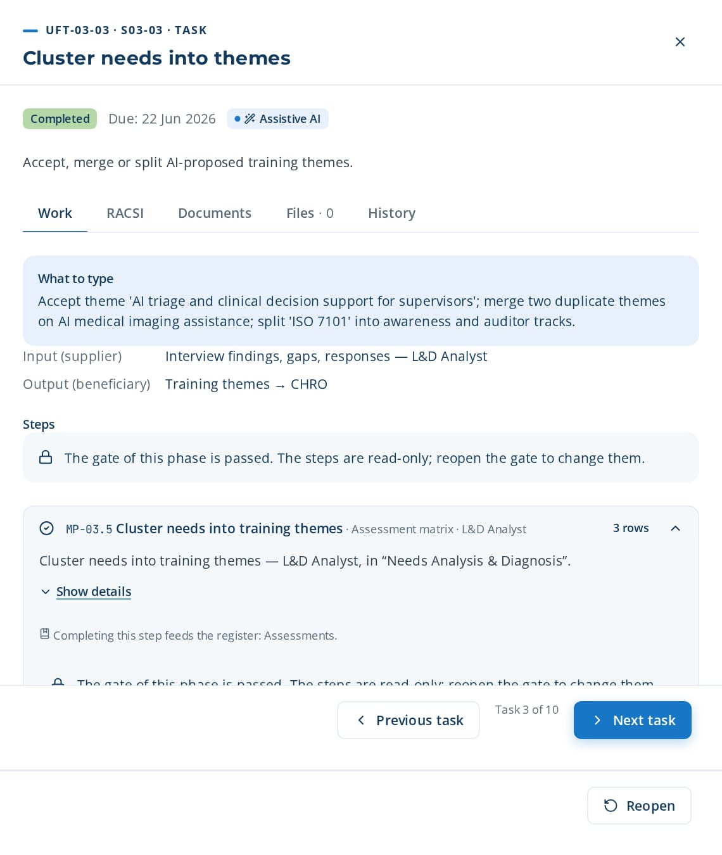
PHASE 3 · E2E-03 · ROOT / MASTER CHAIN (FLAGSHIP)
Needs-to-Training Engineering Report & Roadmap
Produce the Training Engineering Report and the prioritized training roadmap
TRIGGER
Validated skills gap diagnosis, consolidated demands, approved Scope of Work or diagnostic findings available.
END STATE
Training Engineering Report and prioritized roadmap approved and published.
10 tasks · 17 steps
29 days · 4 owners · 100 %
Macro processes: MP-01 Strategy & Governance Alignment · MP-03 Needs Analysis & Diagnosis · MP-04 Training Engineering Report & Roadmap Elaboration · MP-18 Financial & Budget Management · MP-20 Quality, Risk & Continuous Improvement
Task | Steps executed | Owner · done | What was entered
UFT-03-01 Plan diagnostic interviews | MP-03.3 Plan diagnostic interviews | Yassine Berrada 15 Jun 2026 | Interview plan: 14 semi-structured interviews (4 MS, 6 MO, 4 OP), 45 minutes each, weeks 10-11.
UFT-03-02 Record interview findings | MP-03.4 Record interview findings | Yassine Berrada 18 Jun 2026 | Finding (MO, Clinical Care & Nursing): 'Supervisors do not trust AI triage and clinical decision support data; they re-enter figures on paper.'
UFT-03-03 Cluster needs into themes | MP-03.5 Cluster needs into training themes | Yassine Berrada 21 Jun 2026 | Accept theme 'AI triage and clinical decision support for supervisors'; merge two duplicate themes on AI medical imaging assistance; split 'ISO 7101' into awareness and auditor tracks.
UFT-03-04 Prioritize needs by impact | MP-03.6 Prioritize needs by business impact | Amine Lahlou 24 Jun 2026 | AI triage and clinical decision support: impact 5, urgency 4. AI medical imaging assistance: impact 4, urgency 3. ISO 7101: impact 4, urgency 5.
UFT-03-03 opened in CortexSkills: what to enter, its steps and its result.
Continued on the next slide
Notes:
E2E-03 Needs-to-Training Engineering Report & Roadmap — The flagship chain. It turns gaps, demands, questionnaire evidence and diagnostic findings into a validated needs register, drafts the Training Engineering Report with AI assistance, runs a quality review, and sequences and approves the roadmap.
Trigger: Validated skills gap diagnosis, consolidated demands, approved Scope of Work or diagnostic findings available.
End state: Training Engineering Report and prioritized roadmap approved and published.

Slide 40
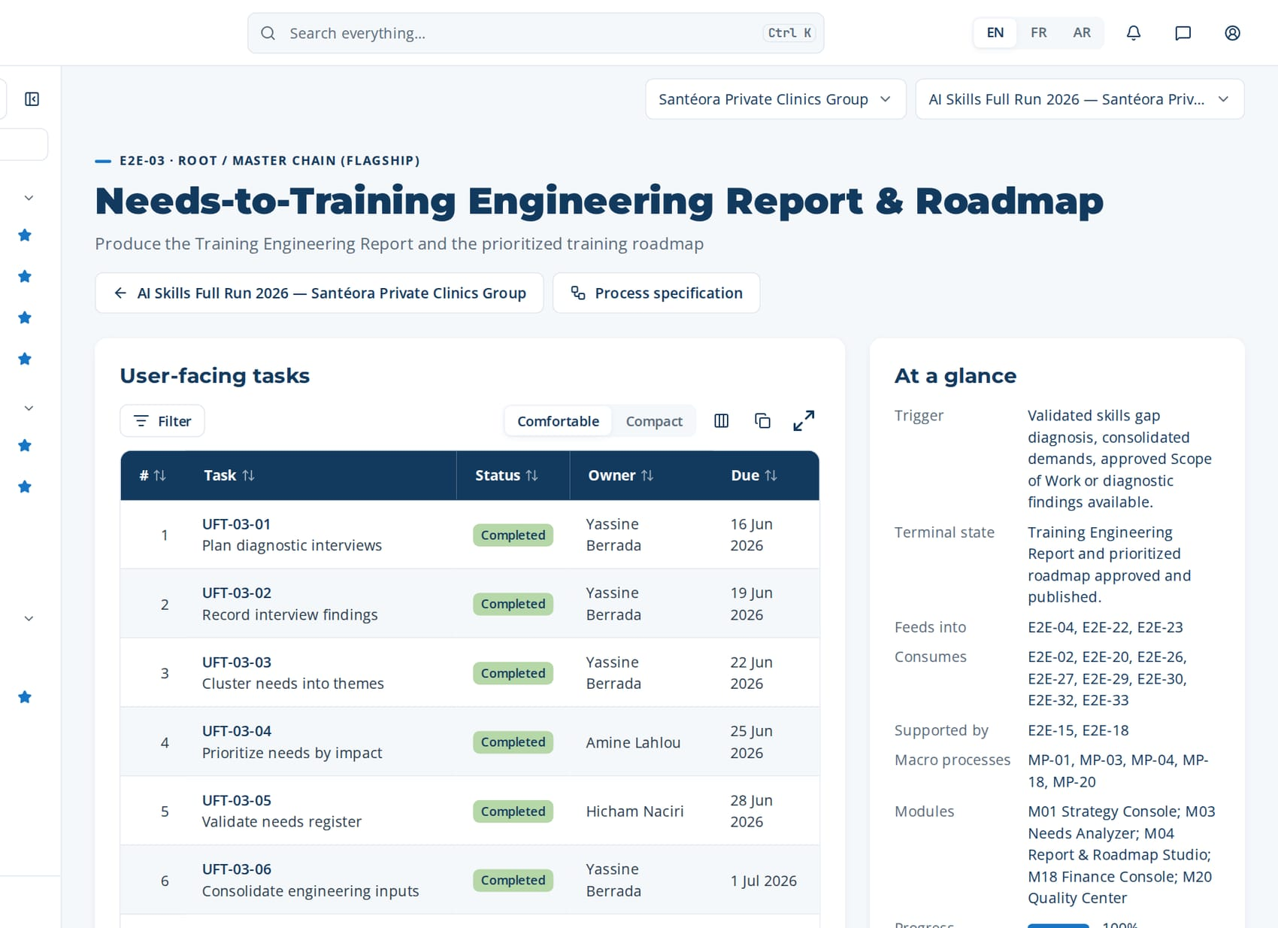
PHASE 3 · E2E-03 · ROOT / MASTER CHAIN (FLAGSHIP)
Needs-to-Training Engineering Report & Roadmap (continued)
Task | Steps executed | Owner · done | What was entered
UFT-03-05 Validate needs register | MP-03.7 Validate needs register | Hicham Naciri 27 Jun 2026 | Needs register validated: 23 needs, 6 themes. Justification: covers SO-1 and SO-2; sponsor reviewed.
UFT-03-06 Consolidate engineering inputs | MP-04.1 Consolidate feeder outputs MP-04.2 Check input completeness | Yassine Berrada 30 Jun 2026 | Inputs complete: Scope of Work, 187 responses, gap matrix, RAG dashboard, SWOT, demands. Missing: none.
UFT-03-07 Draft Training Engineering Report | MP-04.3 Generate report draft MP-04.4 Edit and complete report sections | Amine Lahlou 3 Jul 2026 | Section 3 'Diagnostic': edit the AI draft, add the interview quote on AI triage and clinical decision support, keep the RAG table.
UFT-03-08 Run quality review | MP-04.5 Run quality review of report MP-20.5 Run periodic quality review | Soukaina Bennani 6 Jul 2026 | Quality review: 11/12 checklist items met; fix item 'sources cited for every figure'. Result: pass after correction.
UFT-03-09 Sequence and budget roadmap | MP-04.6 Sequence roadmap initiatives MP-18.1 Allocate budget by theme and site | Amine Lahlou 9 Jul 2026 | Roadmap: Q2 AI triage and clinical decision support (6 groups); Q3 ISO 7101 (4 groups); Q4 AI medical imaging assistance (3 groups). Total 1,240,000 MAD.
UFT-03-10 Approve and publish report and roadmap | MP-04.7 Submit roadmap for approval MP-04.8 Record roadmap approval MP-04.9 Publish approved report and roadmap + 1 more steps | Hicham Naciri 12 Jul 2026 | Decision: Approve report and roadmap v1. Justification: within budget, linked to SO-1/SO-2. Publish to all stakeholders.
The page of E2E-03 in CortexSkills: its tasks, owners and due dates, and the process card.
Feeds into
E2E-04, E2E-22, E2E-23
Supported by
E2E-15, E2E-18
Notes:
E2E-03 — remaining tasks

Slide 41
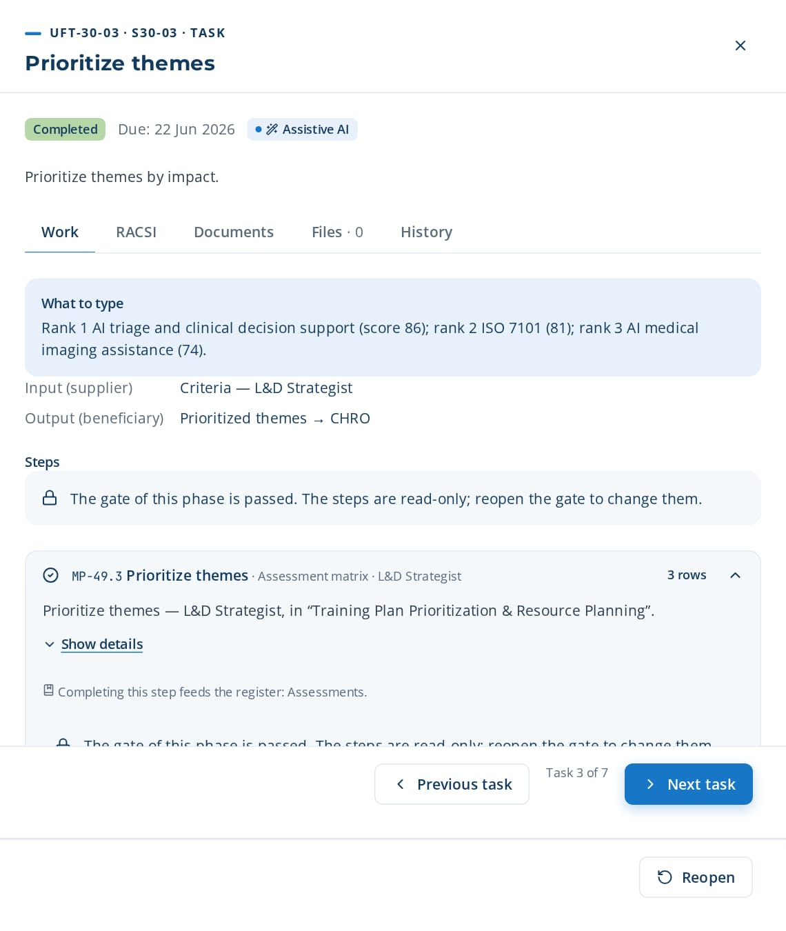
PHASE 3 · E2E-30 · ROOT (PLANNING)
Prioritization-to-Resource Plan
Prioritize themes and plan days, groups, trainers, budget
TRIGGER
Consolidated training themes requiring prioritization and resource planning.
END STATE
Approved prioritized training plan with days per theme, group planning, trainer allocation, and budget.
7 tasks · 12 steps
20 days · 5 owners · 100 %
Macro processes: MP-49 Training Plan Prioritization & Resource Planning · MP-04 Training Engineering Report & Roadmap Elaboration · MP-18 Financial & Budget Management · MP-11 Administration & Operations · MP-07 Learning Delivery & Implementation
Task | Steps executed | Owner · done | What was entered
UFT-30-01 Consolidate training themes | MP-49.1 Consolidate training themes | Yassine Berrada 15 Jun 2026 | Consolidated list: 9 themes from needs, demands, GPEC and SWOT.
UFT-30-02 Define prioritization criteria | MP-49.2 Define prioritization criteria | Amine Lahlou 18 Jun 2026 | Criteria: strategic impact 40%, urgency 30%, number of learners 20%, cost 10%.
UFT-30-03 Prioritize themes | MP-49.3 Prioritize themes | Amine Lahlou 21 Jun 2026 | Rank 1 AI triage and clinical decision support (score 86); rank 2 ISO 7101 (81); rank 3 AI medical imaging assistance (74).
UFT-30-04 Estimate days per theme | MP-49.4 Estimate days per theme | Hamza Sefrioui 24 Jun 2026 | AI triage and clinical decision support: 3 days per group; ISO 7101: 2 days; AI medical imaging assistance: 1.5 days.
UFT-30-05 Define groups per theme | MP-49.5 Define number of groups per theme MP-49.6 Allocate trainers | Hamza Sefrioui 27 Jun 2026 | AI triage and clinical decision support: 6 groups of 12; ISO 7101: 4 groups; AI medical imaging assistance: 3 groups.
UFT-30-06 Allocate trainers and budget | MP-49.7 Estimate plan budget MP-49.8 Sequence delivery MP-49.9 Validate plan with governance | Kawtar Chraibi 30 Jun 2026 | Trainers: 2 internal, vendor A; budget 1,240,000 MAD (within envelope).
UFT-30-03 opened in CortexSkills: what to enter, its steps and its result.
Continued on the next slide
Notes:
E2E-30 Prioritization-to-Resource Plan — This root chain prioritizes training themes and plans resources (days per theme, number of groups, trainers, budget) for the training plan. It produces the "Plan de Formation Priorisé" (Prioritized Training Plan).
Trigger: Consolidated training themes requiring prioritization and resource planning.
End state: Approved prioritized training plan with days per theme, group planning, trainer allocation, and budget.

Slide 42
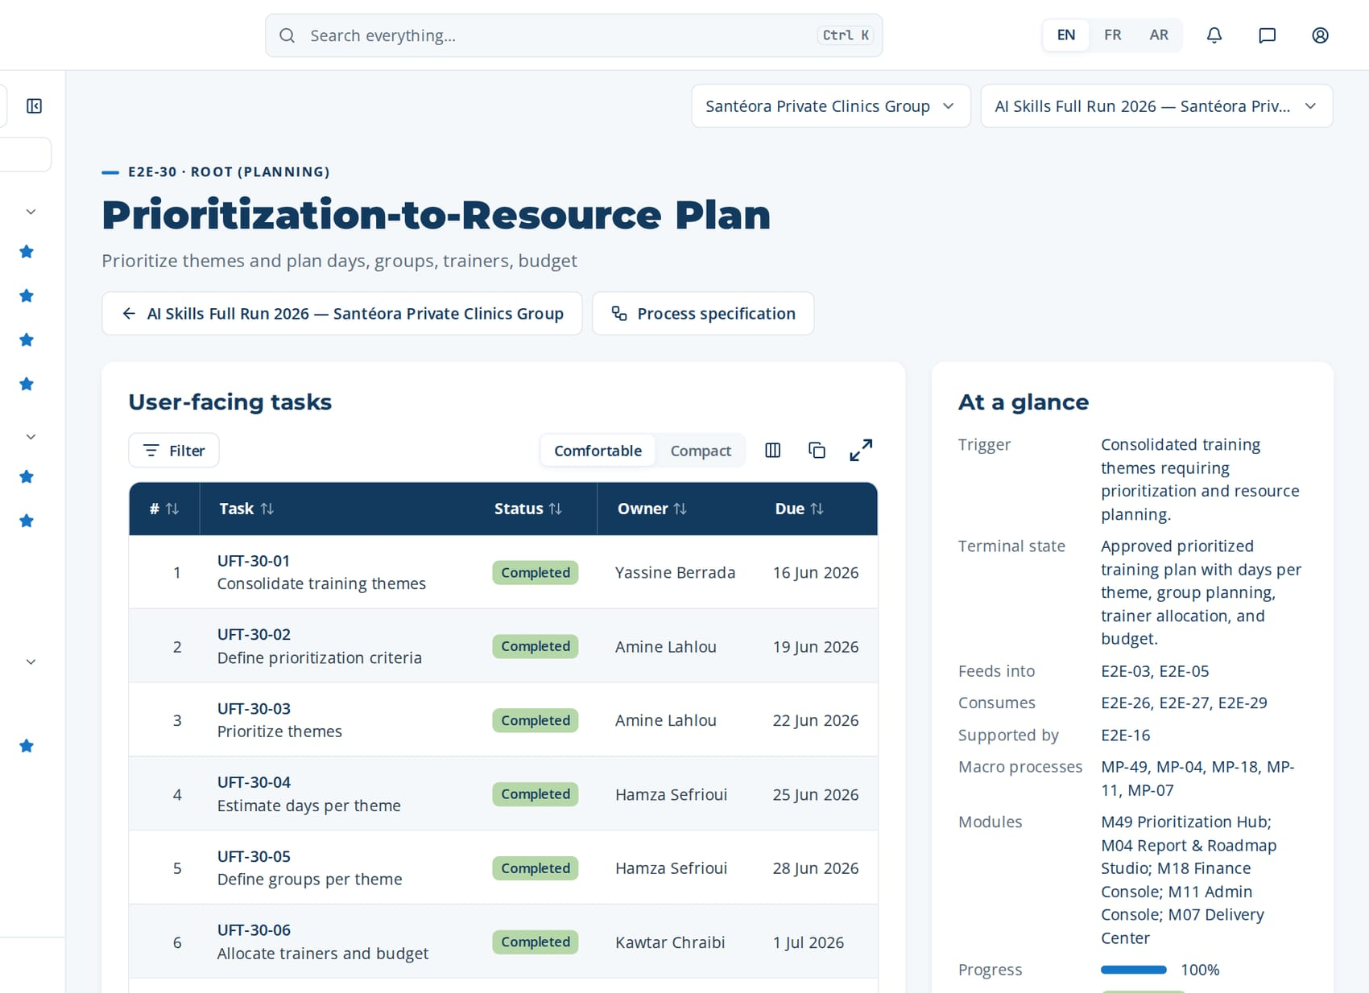
PHASE 3 · E2E-30 · ROOT (PLANNING)
Prioritization-to-Resource Plan (continued)
Task | Steps executed | Owner · done | What was entered
UFT-30-07 Publish prioritized training plan | MP-49.10 Publish prioritized plan MP-49.11 Track plan execution MP-49.12 Report on resource utilization | Hicham Naciri 3 Jul 2026 | Publish RPT-002 Prioritized Training Plan 2026 to all stakeholders.
Macro processes
MP-49 Training Plan Prioritization & Resource Planning
MP-04 Training Engineering Report & Roadmap Elaboration
MP-18 Financial & Budget Management
MP-11 Administration & Operations
MP-07 Learning Delivery & Implementation
Feeds into
E2E-03, E2E-05
Supported by
E2E-16
The page of E2E-30 in CortexSkills: its tasks, owners and due dates, and the process card.
Notes:
E2E-30 — remaining tasks

Slide 43
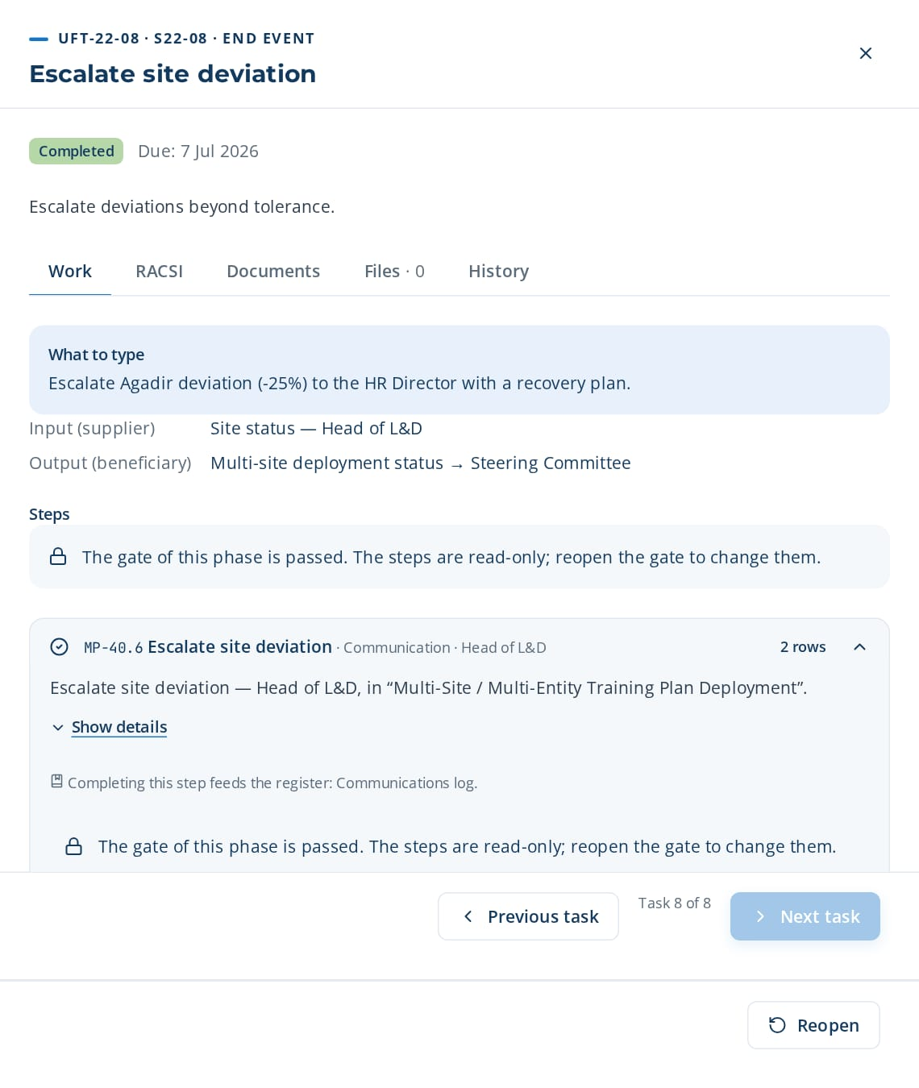
PHASE 3 · E2E-22 · PARTITION OF E2E-03
Multi-Site Plan-to-Deployment
Adapt and deploy plans across sites
TRIGGER
Approved roadmap for an organization with several sites or entities.
END STATE
Site plans adapted, validated and deployed, with deviations escalated.
8 tasks · 12 steps
23 days · 4 owners · 100 %
Macro processes: MP-40 Multi-Site / Multi-Entity Training Plan Deployment · MP-04 Training Engineering Report & Roadmap Elaboration · MP-07 Learning Delivery & Implementation · MP-11 Administration & Operations · MP-23 Localization, Accessibility & Inclusion
Task | Steps executed | Owner · done | What was entered
UFT-22-01 Split plan by site | MP-40.1 Split plan by site | Hicham Naciri 15 Jun 2026 | Split plan into 3 sites: Casablanca 55%, Tanger 30%, Agadir 15%.
UFT-22-02 Adapt site plan to local constraints | MP-40.2 Adapt site plan to local constraints | Imane Hajji 18 Jun 2026 | Tanger: shift constraints → sessions of 4 hours instead of full days.
UFT-22-03 Localize site materials | MP-23.1 Request translation MP-23.3 Validate translation MP-23.6 Review participation equity + 1 more steps | Ghita Bouzidi 21 Jun 2026 | Agadir materials translated to AR; validated by the site expert.
UFT-22-04 Validate site plan | MP-40.3 Validate site plan | Hicham Naciri 24 Jun 2026 | Site plans validated centrally; budget deviation within ±5%.
UFT-22-05 Schedule site sessions | MP-07.1 Create training session MP-11.1 Book rooms and equipment | Reda Hajji 27 Jun 2026 | Tanger schedule: 8 sessions, rooms booked, 2 trainers.
UFT-22-06 Deploy site schedule | MP-40.4 Deploy site schedule | Imane Hajji 30 Jun 2026 | Schedules deployed and communicated to site managers.
UFT-22-07 Consolidate site status | MP-40.5 Consolidate site status | Hicham Naciri 3 Jul 2026 | Status: Casablanca 70%, Tanger 45%, Agadir 20% delivered.
UFT-22-08 opened in CortexSkills: what to enter, its steps and its result.
Continued on the next slide
Notes:
E2E-22 Multi-Site Plan-to-Deployment — This partition of E2E-03 splits the plan by site, adapts it to local constraints and languages, validates and deploys each site schedule and consolidates status with escalation of deviations.
Trigger: Approved roadmap for an organization with several sites or entities.
End state: Site plans adapted, validated and deployed, with deviations escalated.

Slide 44
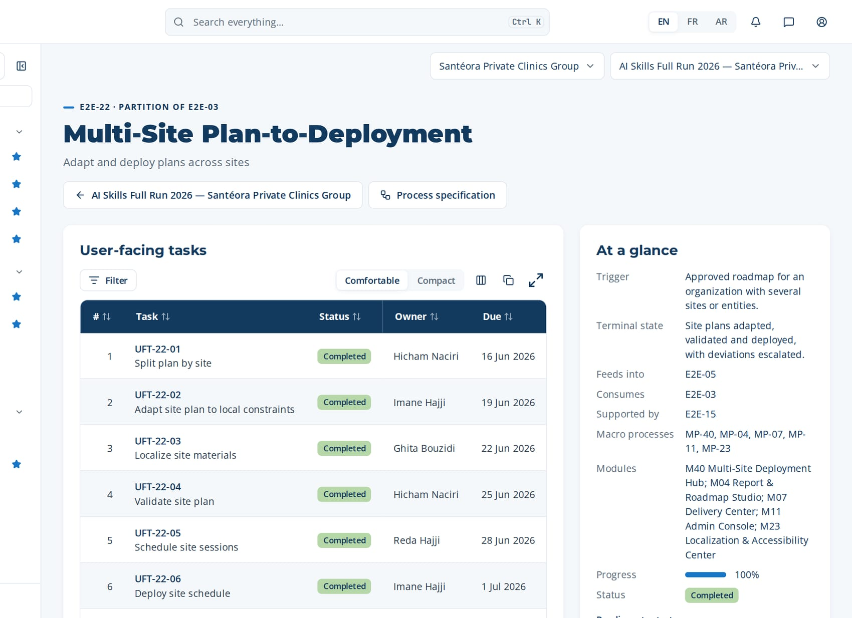
PHASE 3 · E2E-22 · PARTITION OF E2E-03
Multi-Site Plan-to-Deployment (continued)
Task | Steps executed | Owner · done | What was entered
UFT-22-08 Escalate site deviation | MP-40.6 Escalate site deviation | Hicham Naciri 6 Jul 2026 | Escalate Agadir deviation (-25%) to the HR Director with a recovery plan.
Macro processes
MP-40 Multi-Site / Multi-Entity Training Plan Deployment
MP-04 Training Engineering Report & Roadmap Elaboration
MP-07 Learning Delivery & Implementation
MP-11 Administration & Operations
MP-23 Localization, Accessibility & Inclusion
Feeds into
E2E-05
Supported by
E2E-15
The page of E2E-22 in CortexSkills: its tasks, owners and due dates, and the process card.
Notes:
E2E-22 — remaining tasks

Slide 45
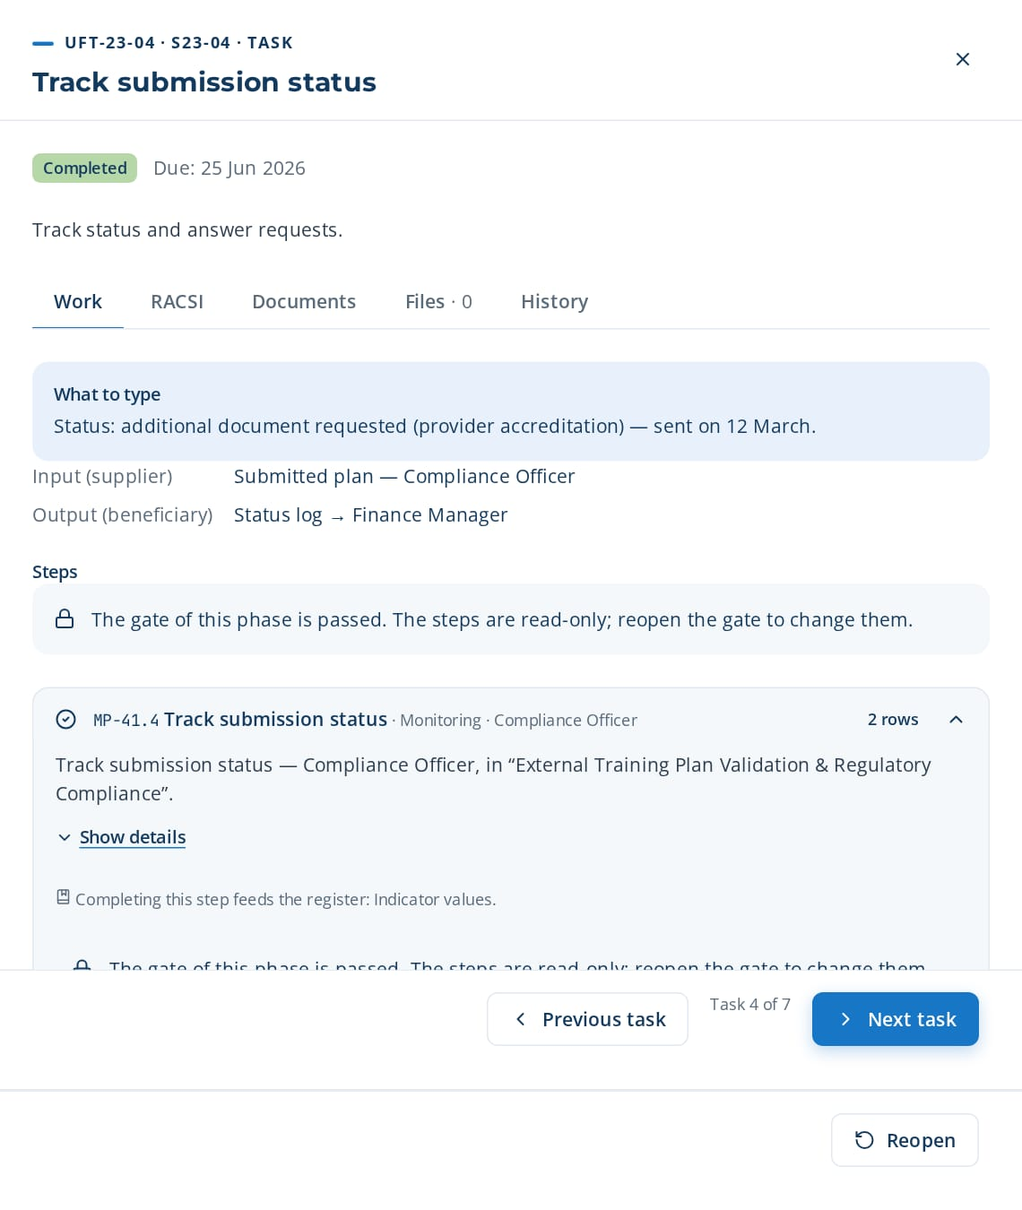
PHASE 3 · E2E-23 · ROOT
Regulatory Submission-to-Validation
Submit and validate training plans with regulatory bodies
TRIGGER
Approved plan requiring external validation or funding (e.g. OFPPT, GIAC-Agro).
END STATE
Plan validated by the regulatory body and evidence archived.
7 tasks · 10 steps
20 days · 2 owners · 100 %
Macro processes: MP-41 External Training Plan Validation & Regulatory Compliance · MP-14 Compliance & Certification Management · MP-18 Financial & Budget Management · MP-20 Quality, Risk & Continuous Improvement
Task | Steps executed | Owner · done | What was entered
UFT-23-01 Select regulatory template | MP-41.1 Select regulatory template | Rachid Kettani 15 Jun 2026 | Template: OFPPT special training contracts (CSF) — plan file.
UFT-23-02 Generate submission file | MP-41.2 Generate submission file MP-20.5 Run periodic quality review | Rachid Kettani 18 Jun 2026 | Submission file generated: plan, themes, providers, costs; quality check passed.
UFT-23-03 Submit plan to regulatory body | MP-41.3 Submit plan to regulatory body | Rachid Kettani 21 Jun 2026 | Submitted to the regional funding committee on 5 March; reference GSF-2026-118.
UFT-23-04 Track submission status | MP-41.4 Track submission status | Rachid Kettani 24 Jun 2026 | Status: additional document requested (provider accreditation) — sent on 12 March.
UFT-23-05 Record regulator decision | MP-41.5 Record regulator decision MP-14.1 Register regulatory requirement | Rachid Kettani 27 Jun 2026 | Decision: approved with a cap of 520,000 MAD.
UFT-23-06 Submit refund claims | MP-18.5 Submit refund claims | Kawtar Chraibi 30 Jun 2026 | Refund claims submitted for 12 delivered actions: 318,000 MAD.
UFT-23-07 Archive submission evidence | MP-41.6 Archive submission evidence MP-18.6 Close budget period | Rachid Kettani 3 Jul 2026 | Archive file, decision and claims; retention 10 years.
UFT-23-04 opened in CortexSkills: what to enter, its steps and its result.
Notes:
E2E-23 Regulatory Submission-to-Validation — This root chain selects the regulatory template, generates the submission file, submits it, tracks its status, records the decision, files refund claims and archives the evidence.
Trigger: Approved plan requiring external validation or funding (e.g. OFPPT, GIAC-Agro).
End state: Plan validated by the regulatory body and evidence archived.

Slide 46
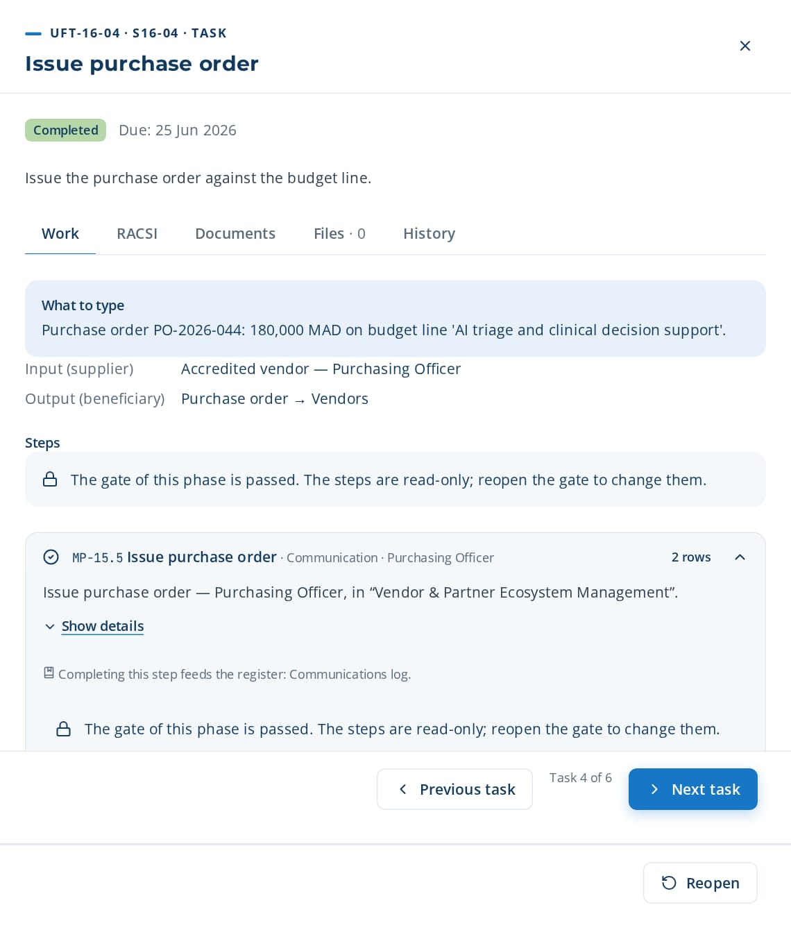
PHASE 3 · E2E-16 · PARTITION OF E2E-15
Vendor-to-Finance
Manage vendors from selection to payment
TRIGGER
Training need requiring an external provider.
END STATE
Vendor selected, order issued and payment approved against attendance.
6 tasks · 10 steps
17 days · 3 owners · 100 %
Macro processes: MP-15 Vendor & Partner Ecosystem Management · MP-18 Financial & Budget Management · MP-11 Administration & Operations
Task | Steps executed | Owner · done | What was entered
UFT-16-01 Issue request for proposal | MP-15.1 Issue request for proposal | Youssef Hajji 15 Jun 2026 | RFP 'Training on AI triage and clinical decision support' sent to 4 vendors, answers due 15 May.
UFT-16-02 Score vendor proposals | MP-15.2 Score vendor proposals | Youssef Hajji 18 Jun 2026 | Scores: vendor A 82, vendor B 76, vendor C 64 (price 40%, expertise 40%, references 20%).
UFT-16-03 Register and verify vendor | MP-15.3 Register vendor record MP-15.4 Verify vendor accreditation | Youssef Hajji 21 Jun 2026 | Register vendor A; accreditation OFPPT verified, valid until December.
UFT-16-04 Issue purchase order | MP-15.5 Issue purchase order MP-18.3 Record committed and actual costs | Youssef Hajji 24 Jun 2026 | Purchase order PO-2026-044: 180,000 MAD on budget line 'AI triage and clinical decision support'.
UFT-16-05 Match invoice to order and attendance | MP-15.6 Match invoice to order and attendance MP-11.5 Reconcile attendance with invoices | Reda Hajji 27 Jun 2026 | Invoice matched with PO and attendance (3 days × 12 learners): OK.
UFT-16-04 opened in CortexSkills: what to enter, its steps and its result.
Continued on the next slide
Notes:
E2E-16 Vendor-to-Finance — This partition of E2E-15 runs vendor selection, onboarding and accreditation, issues the purchase order and approves payment after matching invoice to order and attendance.
Trigger: Training need requiring an external provider.
End state: Vendor selected, order issued and payment approved against attendance.

Slide 47

PHASE 3 · E2E-16 · PARTITION OF E2E-15
Vendor-to-Finance (continued)
Task | Steps executed | Owner · done | What was entered
UFT-16-06 Approve vendor payment | MP-15.7 Approve vendor payment MP-18.4 Compare spend against budget | Kawtar Chraibi 30 Jun 2026 | Approve payment 180,000 MAD; vendor performance rating 4/5.
Macro processes
MP-15 Vendor & Partner Ecosystem Management
MP-18 Financial & Budget Management
MP-11 Administration & Operations
Feeds into
E2E-05
Supported by
E2E-15
The page of E2E-16 in CortexSkills: its tasks, owners and due dates, and the process card.
Notes:
E2E-16 — remaining tasks

Slide 48
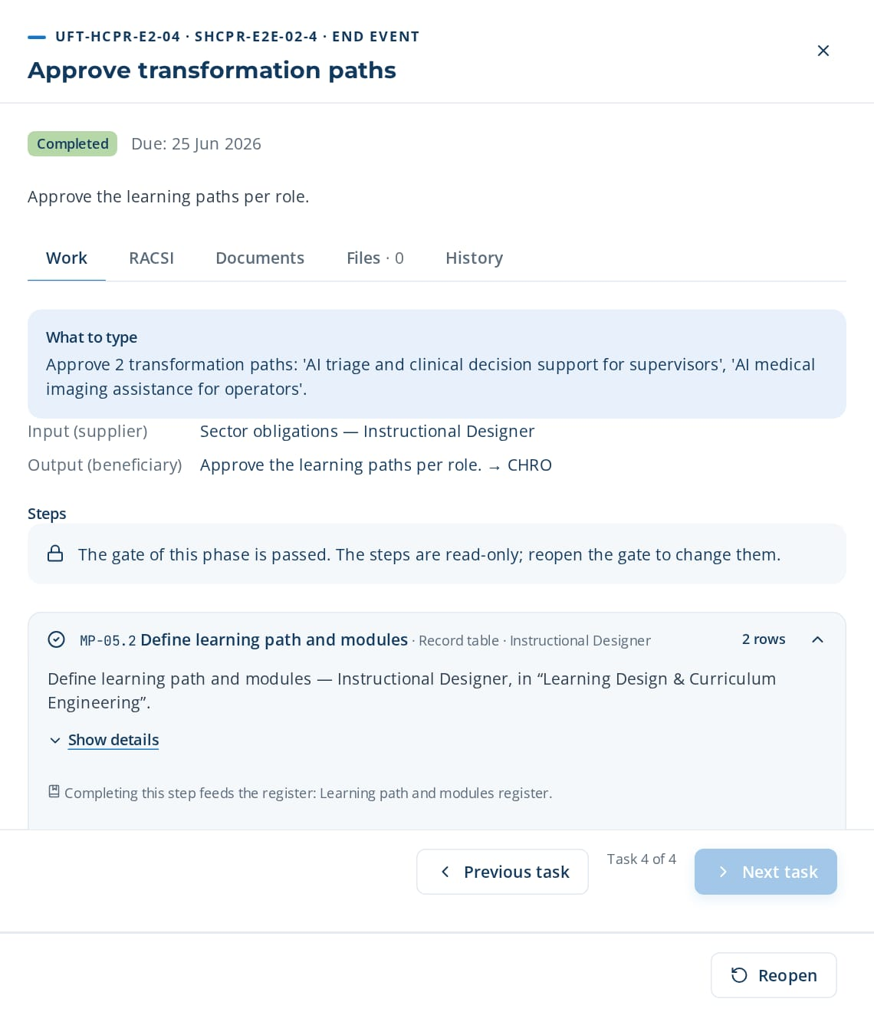
PHASE 3 · HCPR-E2E-02 · VERTICAL
Healthcare Providers Critical-Skills-to-Transformation Plan
Turn critical-skill gaps and digital and AI use cases into a transformation plan.
TRIGGER
Annual plan cycle or technology change in Healthcare Providers.
END STATE
Transformation learning paths approved.
4 tasks · 7 steps
11 days · 4 owners · 100 %
Macro processes: MP-02 Skills & Competency Management · MP-03 Needs Analysis & Diagnosis · MP-05 Learning Design & Curriculum Engineering · HCPR-MP-02 HCPR-MP-02
Task | Steps executed | Owner · done | What was entered
UFT-HCPR-E2-01 List critical Clinical Care & Nursing skills | MP-02.1 Define competency families and levels MP-03.1 Compute gap matrix | Yassine Berrada 15 Jun 2026 | Critical skills: 6 for Clinical Care & Nursing, each with target level 3.
UFT-HCPR-E2-02 List digital and AI use cases | MP-03.3 Plan diagnostic interviews | Amine Lahlou 18 Jun 2026 | Use cases: AI triage and clinical decision support; AI medical imaging assistance; AI bed and staff capacity planning.
UFT-HCPR-E2-03 Forecast impacted roles | MP-03.5 Cluster needs into training themes MP-28.3 Forecast skill gaps | Anas Hajji 21 Jun 2026 | Impacted roles: supervisors (high), operators (medium); accept the AI forecast.
UFT-HCPR-E2-04 Approve transformation paths | MP-05.2 Define learning path and modules MP-05.7 Approve design document | Ghita Bouzidi 24 Jun 2026 | Approve 2 transformation paths: 'AI triage and clinical decision support for supervisors', 'AI medical imaging assistance for operators'.
UFT-HCPR-E2-04 opened in CortexSkills: what to enter, its steps and its result.
Notes:
HCPR-E2E-02 Healthcare Providers Critical-Skills-to-Transformation Plan — Turn critical-skill gaps and digital and AI use cases into a transformation plan.
Trigger: Annual plan cycle or technology change in Healthcare Providers.
End state: Transformation learning paths approved.

Slide 49
04
E2E-04 Roadmap-to-Curriculum Design
E2E-05 Design-to-Delivery
E2E-06 Learner-Journey-to-Engagement
E2E-13 Content-Curate-to-Retire
E2E-14 Extended-Enterprise-Training
PHASE 4
Design & delivery
5 processes · 39 tasks · 99 steps
11 Jul 2026 – 6 Aug 2026
Closed by G4 — Delivery readiness
Notes:
Design & delivery

Slide 50
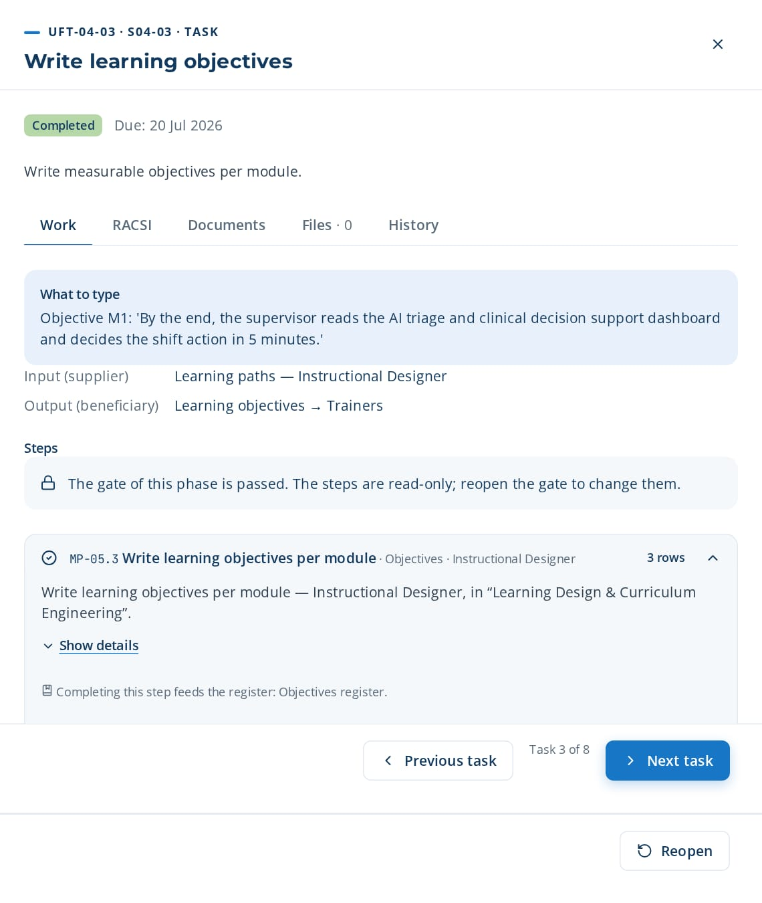
PHASE 4 · E2E-04 · PARTITION OF E2E-03
Roadmap-to-Curriculum Design
Convert roadmap into curriculum maps, learning paths, design documents
TRIGGER
Approved Training Engineering Report and roadmap published.
END STATE
Approved curriculum maps, learning paths and design documents.
8 tasks · 15 steps
23 days · 3 owners · 100 %
Macro processes: MP-04 Training Engineering Report & Roadmap Elaboration · MP-05 Learning Design & Curriculum Engineering · MP-06 Content & Resource Management · MP-23 Localization, Accessibility & Inclusion
Task | Steps executed | Owner · done | What was entered
UFT-04-01 Create curriculum map | MP-05.1 Create curriculum map from roadmap | Ghita Bouzidi 13 Jul 2026 | Curriculum map 'AI triage and clinical decision support': 3 learning paths (operators, supervisors, managers), 9 modules.
UFT-04-02 Define learning paths and modules | MP-05.2 Define learning path and modules | Ghita Bouzidi 16 Jul 2026 | Path 'Supervisors — AI triage and clinical decision support': 4 modules, 3 days blended (1 day e-learning, 2 days workshop).
UFT-04-03 Write learning objectives | MP-05.3 Write learning objectives per module | Ghita Bouzidi 19 Jul 2026 | Objective M1: 'By the end, the supervisor reads the AI triage and clinical decision support dashboard and decides the shift action in 5 minutes.'
UFT-04-04 Propose module structure | MP-05.4 Propose module structure | Ghita Bouzidi 22 Jul 2026 | Accept the proposed structure (intro, demo, practice, quiz); replace the quiz by a live case from Clinical Care & Nursing.
UFT-04-03 opened in CortexSkills: what to enter, its steps and its result.
Continued on the next slide
Notes:
E2E-04 Roadmap-to-Curriculum Design — This partition of E2E-03 converts the roadmap into curriculum maps and learning paths, writes the design specification, localizes it and gets it approved.
Trigger: Approved Training Engineering Report and roadmap published.
End state: Approved curriculum maps, learning paths and design documents.

Slide 51
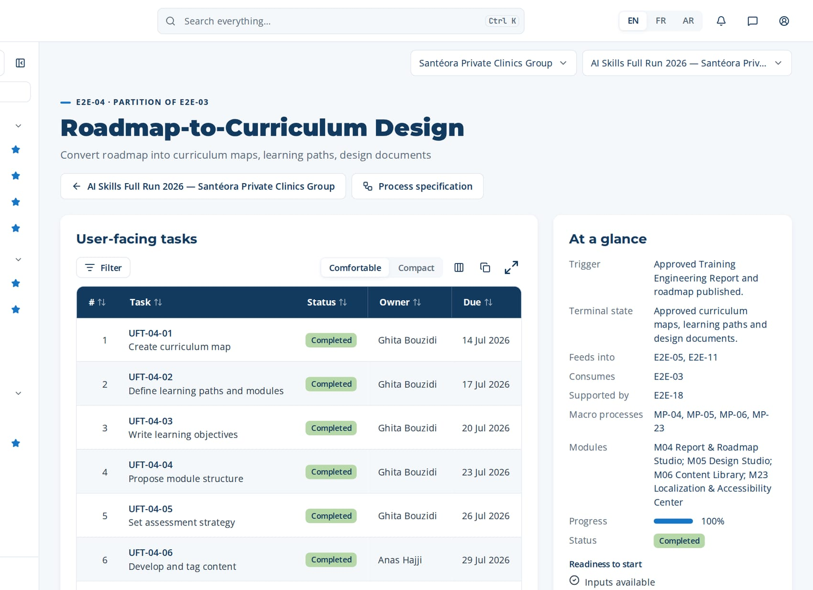
PHASE 4 · E2E-04 · PARTITION OF E2E-03
Roadmap-to-Curriculum Design (continued)
Task | Steps executed | Owner · done | What was entered
UFT-04-05 Set assessment strategy | MP-05.5 Set assessment strategy | Ghita Bouzidi 25 Jul 2026 | Assessment: pre/post test (Level 2) and manager observation after 30 days (Level 3).
UFT-04-06 Develop and tag content | MP-06.1 Upload content assets MP-06.2 Validate package format MP-06.5 Tag content with competencies | Anas Hajji 28 Jul 2026 | Upload 'M1_AI triage and clinical decision support.pptx' and 'M1_video.mp4'; tag competency 'AI triage and clinical decision support' level 3.
UFT-04-07 Localize and check accessibility | MP-23.1 Request translation MP-23.2 Draft machine translation MP-23.3 Validate translation + 2 more steps | Ghita Bouzidi 31 Jul 2026 | Request FR and AR versions; validate the AI draft translation; accessibility check: 0 blocking issues.
UFT-04-08 Approve design document | MP-05.6 Review design with subject matter expert MP-05.7 Approve design document | Hicham Naciri 3 Aug 2026 | Decision: design approved. Comment: SME review done on 12 May; ready for delivery.
Macro processes
MP-04 Training Engineering Report & Roadmap Elaboration
MP-05 Learning Design & Curriculum Engineering
MP-06 Content & Resource Management
MP-23 Localization, Accessibility & Inclusion
Feeds into
E2E-05, E2E-11
Supported by
E2E-18
The page of E2E-04 in CortexSkills: its tasks, owners and due dates, and the process card.
Notes:
E2E-04 — remaining tasks

Slide 52
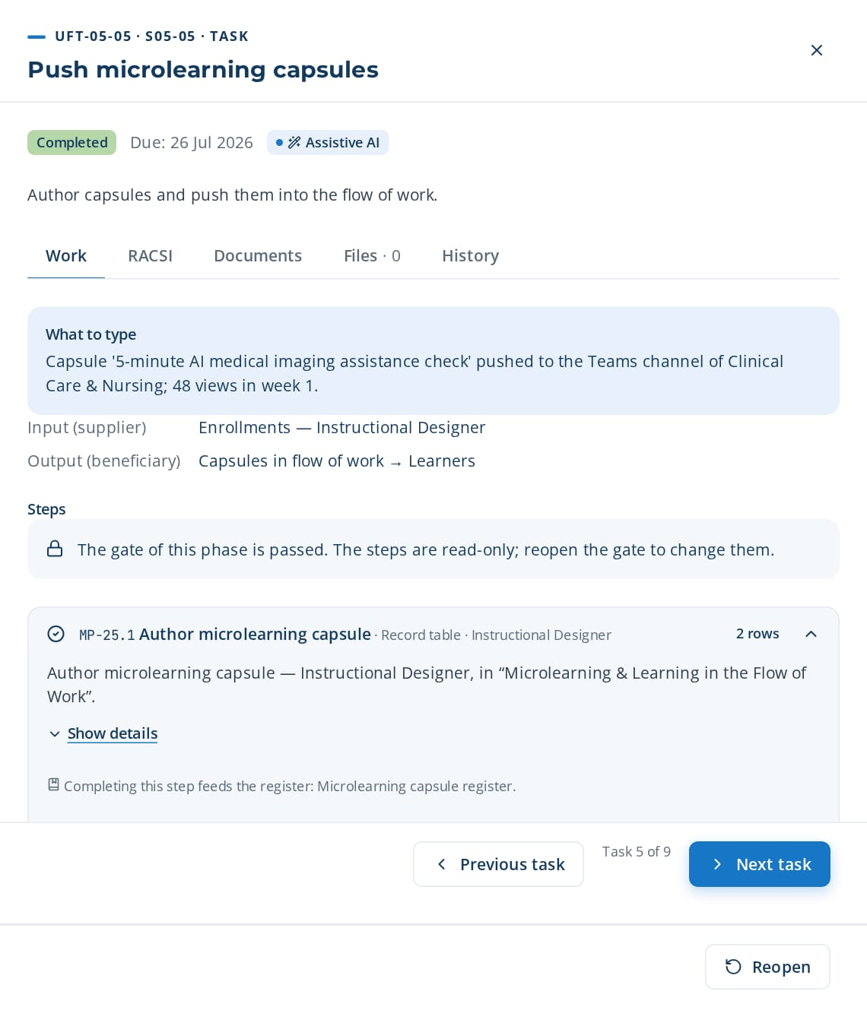
PHASE 4 · E2E-05 · ROOT / MASTER CHAIN
Design-to-Delivery
Deliver training across all modalities
TRIGGER
Approved design document and prioritized training plan.
END STATE
Training delivered across all modalities with attendance and completion recorded.
9 tasks · 27 steps
26 days · 4 owners · 100 %
Macro processes: MP-05 Learning Design & Curriculum Engineering · MP-06 Content & Resource Management · MP-07 Learning Delivery & Implementation · MP-11 Administration & Operations · MP-17 Identity, Access & Security Management · MP-25 Microlearning & Learning in the Flow of Work · MP-30 Immersive Learning (VR/AR/Simulation)
Task | Steps executed | Owner · done | What was entered
UFT-05-01 Publish content to catalog | MP-06.3 Route content for expert review MP-06.4 Record review decision MP-06.6 Publish content to catalog | Anas Hajji 13 Jul 2026 | Publish module 'M1 AI triage and clinical decision support' to the catalog; audience: supervisors; languages EN/FR/AR.
UFT-05-02 Book logistics | MP-11.1 Book rooms and equipment MP-11.2 Manage trainer calendars | Reda Hajji 16 Jul 2026 | Room 'Training A' (20 seats) 3-5 June; projector; trainer calendar blocked.
UFT-05-03 Schedule sessions | MP-07.1 Create training session MP-07.2 Check scheduling conflicts | Reda Hajji 19 Jul 2026 | Session S-01 'AI triage and clinical decision support — supervisors', 3-5 June, 12 seats, no conflict reported.
UFT-05-04 Enroll learners and send convocations | MP-07.3 Enroll learners into session MP-07.4 Send convocations MP-17.1 Provision users via SSO | Reda Hajji 22 Jul 2026 | Enroll 12 supervisors; convocations sent by e-mail and SMS in each learner's language.
UFT-05-05 Push microlearning capsules | MP-25.1 Author microlearning capsule MP-25.2 Generate capsule draft from source MP-25.3 Push capsule to collaboration channel + 2 more steps | Ghita Bouzidi 25 Jul 2026 | Capsule '5-minute AI medical imaging assistance check' pushed to the Teams channel of Clinical Care & Nursing; 48 views in week 1.
UFT-05-05 opened in CortexSkills: what to enter, its steps and its result.
Continued on the next slide
Notes:
E2E-05 Design-to-Delivery — This root chain delivers training in class, virtual, microlearning and immersive modes: it publishes content, schedules sessions, enrolls learners, runs sessions and closes them with attendance and completion.
Trigger: Approved design document and prioritized training plan.
End state: Training delivered across all modalities with attendance and completion recorded.

Slide 53
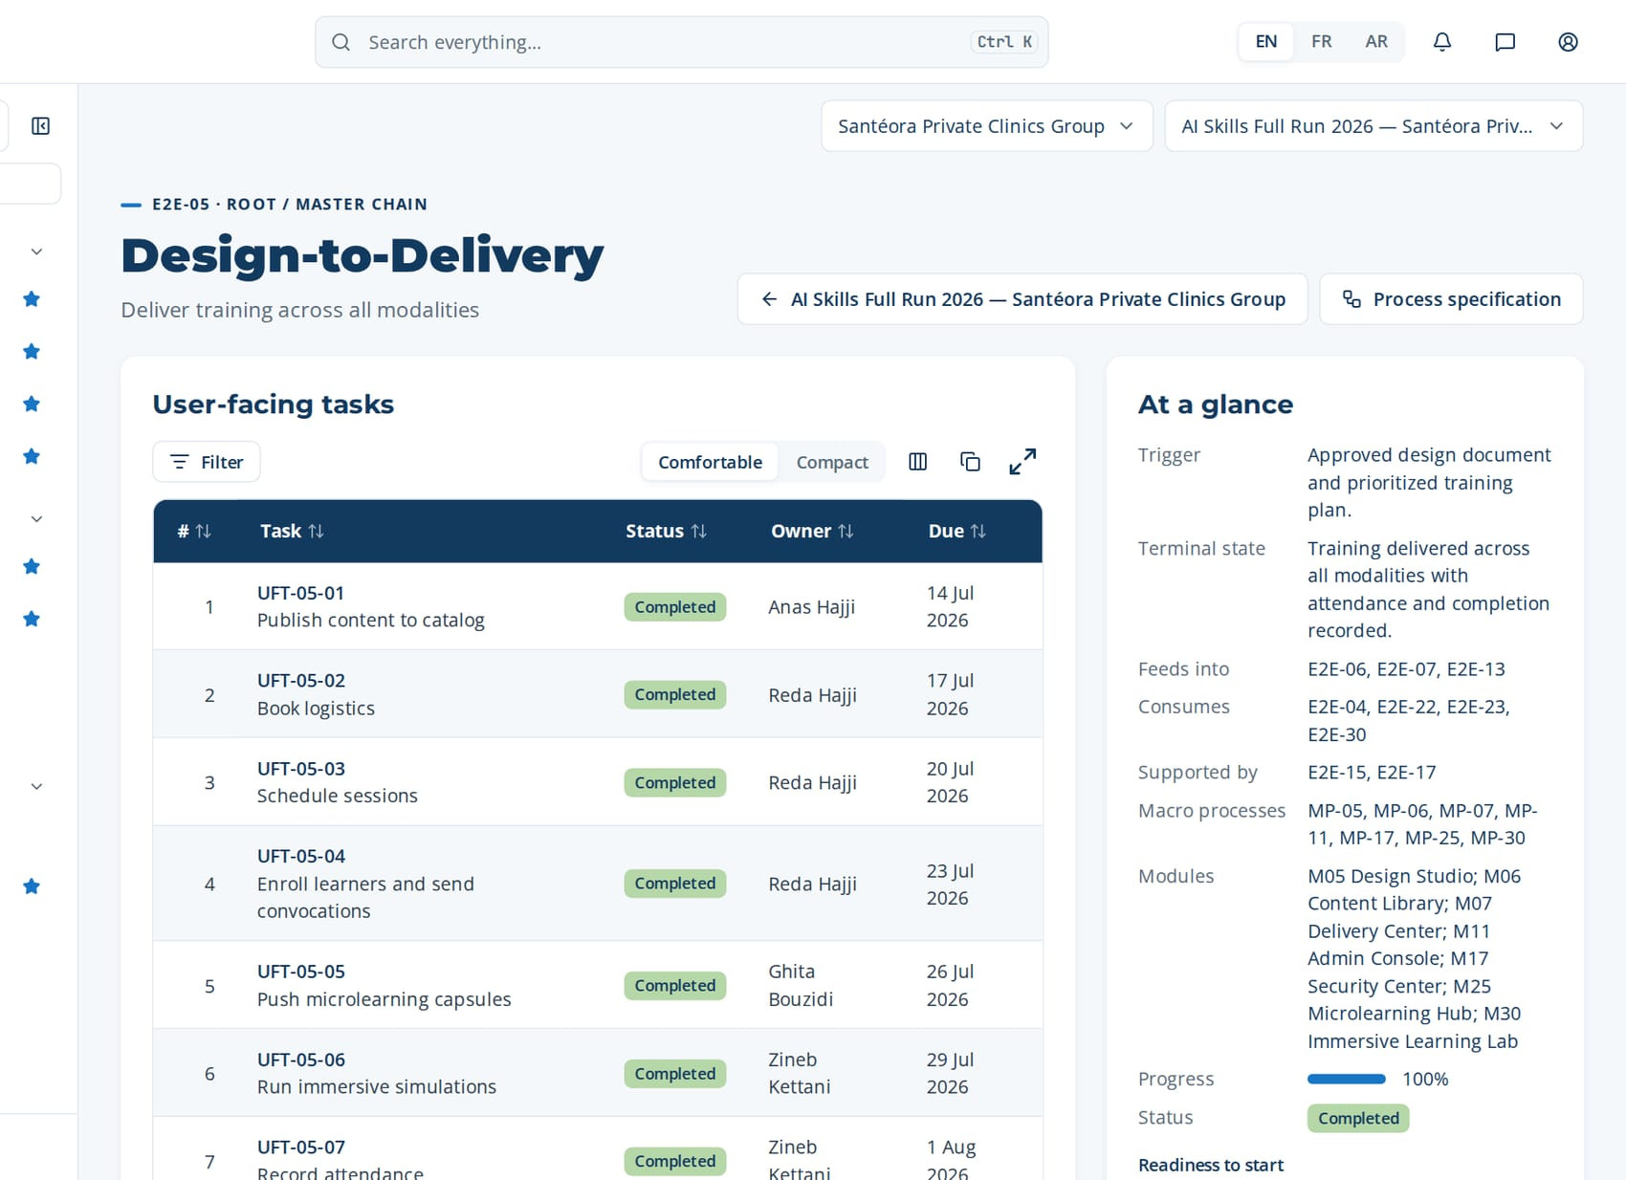
PHASE 4 · E2E-05 · ROOT / MASTER CHAIN
Design-to-Delivery (continued)
Task | Steps executed | Owner · done | What was entered
UFT-05-06 Run immersive simulations | MP-30.1 Define simulation scenario MP-30.2 Configure simulation scoring MP-30.3 Launch simulation session + 3 more steps | Zineb Kettani 28 Jul 2026 | Simulation 'Clinical Care & Nursing incident': score 78/100; debrief notes recorded; evidence saved.
UFT-05-07 Record attendance | MP-07.5 Record attendance | Zineb Kettani 31 Jul 2026 | Attendance S-01: 11 present, 1 absent (justified). Signature sheet attached.
UFT-05-08 Close sessions | MP-07.6 Close session and record completion | Reda Hajji 3 Aug 2026 | Close S-01: 11 completions recorded; certificate issued to each participant.
UFT-05-09 Reconcile and archive period | MP-11.5 Reconcile attendance with invoices MP-11.6 Archive period records MP-11.3 Import external training records + 1 more steps | Reda Hajji 6 Aug 2026 | Reconcile invoice INV-2026-118 (3 days × 12 learners) with attendance; archive period Q2.
The page of E2E-05 in CortexSkills: its tasks, owners and due dates, and the process card.
Feeds into
E2E-06, E2E-07, E2E-13
Supported by
E2E-15, E2E-17
Notes:
E2E-05 — remaining tasks

Slide 54
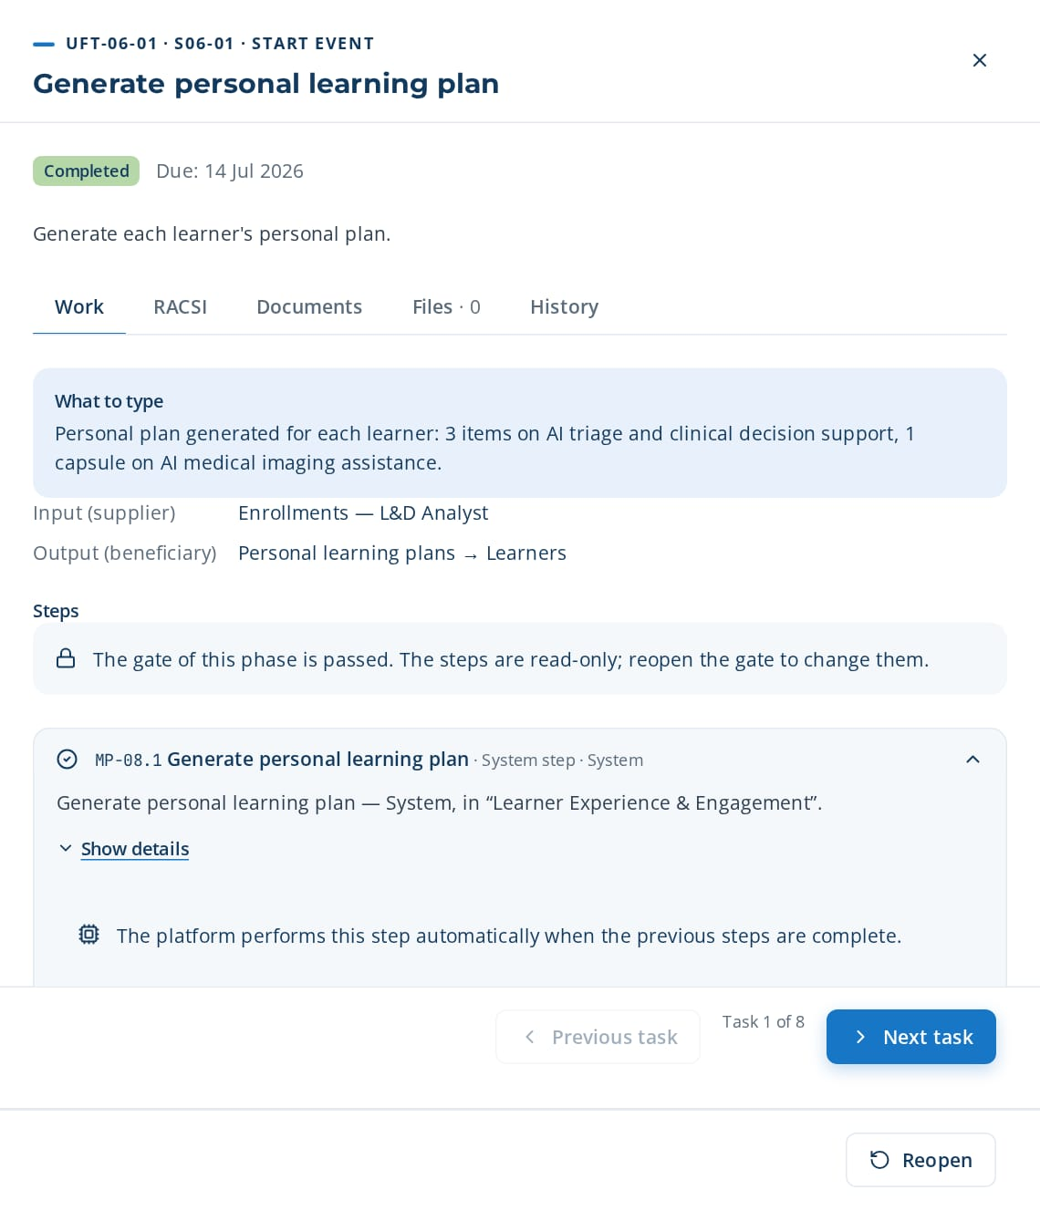
PHASE 4 · E2E-06 · PARTITION OF E2E-05
Learner-Journey-to-Engagement
Deliver personalized, engaging learning experience
TRIGGER
Learner enrolled in a learning path or session.
END STATE
Personalized learning journey completed with engagement measured.
8 tasks · 33 steps
23 days · 5 owners · 100 %
Macro processes: MP-08 Learner Experience & Engagement · MP-24 AI-Powered Personalization & Adaptive Learning · MP-25 Microlearning & Learning in the Flow of Work · MP-26 Social & Collaborative Learning Networks · MP-27 Gamification & Engagement Mechanics
Task | Steps executed | Owner · done | What was entered
UFT-06-01 Generate personal learning plan | MP-08.1 Generate personal learning plan | Yassine Berrada 13 Jul 2026 | Personal plan generated for each learner: 3 items on AI triage and clinical decision support, 1 capsule on AI medical imaging assistance.
UFT-06-02 Recommend learning items | MP-08.2 Recommend learning items MP-24.1 Enable personalization per scope | Reda Sefrioui 16 Jul 2026 | Accept 2 recommendations, reject 1 ('already mastered'). The outcome is logged.
UFT-06-03 Adapt path to performance | MP-24.2 Set adaptation rules MP-24.3 Adapt path to learner performance MP-24.4 Record learner response to adaptation | Ghita Bouzidi 19 Jul 2026 | Rule: if the quiz score < 60%, add the remedial capsule 'AI triage and clinical decision support basics'.
UFT-06-04 Animate social learning | MP-26.1 Create learning cohort group MP-26.2 Invite group members MP-26.3 Post question or answer + 3 more steps | Asmae Ziani 22 Jul 2026 | Create cohort 'AI triage and clinical decision support supervisors 2026' and invite 12 members; first question posted.
UFT-06-01 opened in CortexSkills: what to enter, its steps and its result.
Continued on the next slide
Notes:
E2E-06 Learner-Journey-to-Engagement — This partition of E2E-05 delivers a personalized, engaging experience: personal plans and recommendations, adaptive paths, social learning, gamification, coaching and engagement monitoring.
Trigger: Learner enrolled in a learning path or session.
End state: Personalized learning journey completed with engagement measured.

Slide 55
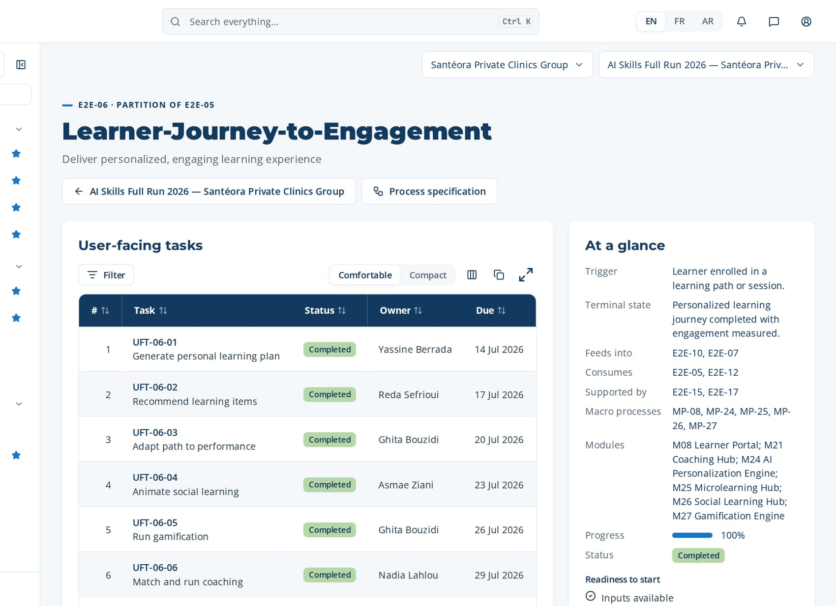
PHASE 4 · E2E-06 · PARTITION OF E2E-05
Learner-Journey-to-Engagement (continued)
Task | Steps executed | Owner · done | What was entered
UFT-06-05 Run gamification | MP-27.1 Define points and badge rules MP-27.2 Configure leaderboard scope MP-27.3 Award points on completion + 2 more steps | Ghita Bouzidi 25 Jul 2026 | Badge 'AI triage and clinical decision support Practitioner' for completing 3 modules; 10 points per capsule.
UFT-06-06 Match and run coaching | MP-21.1 Request coaching MP-21.2 Match coach to learner MP-21.3 Schedule coaching sessions + 3 more steps | Nadia Lahlou 28 Jul 2026 | Match coach 'Senior Clinical Care & Nursing supervisor' to 3 learners; 4 sessions of 1 hour.
UFT-06-07 Collect learner feedback | MP-08.3 Enroll in recommended item MP-08.4 Submit learning feedback | Reda Sefrioui 31 Jul 2026 | Feedback: 4.4/5; comment 'more real cases from Clinical Care & Nursing'.
UFT-06-08 Monitor engagement and nudge | MP-08.5 Monitor engagement indicators MP-08.6 Trigger re-engagement nudge MP-24.5 Review recommendation acceptance + 5 more steps | Yassine Berrada 3 Aug 2026 | Engagement 81%; nudge sent to 9 inactive learners; drop-out risk high for 2 learners.
The page of E2E-06 in CortexSkills: its tasks, owners and due dates, and the process card.
Feeds into
E2E-10, E2E-07
Supported by
E2E-15, E2E-17
Notes:
E2E-06 — remaining tasks

Slide 56
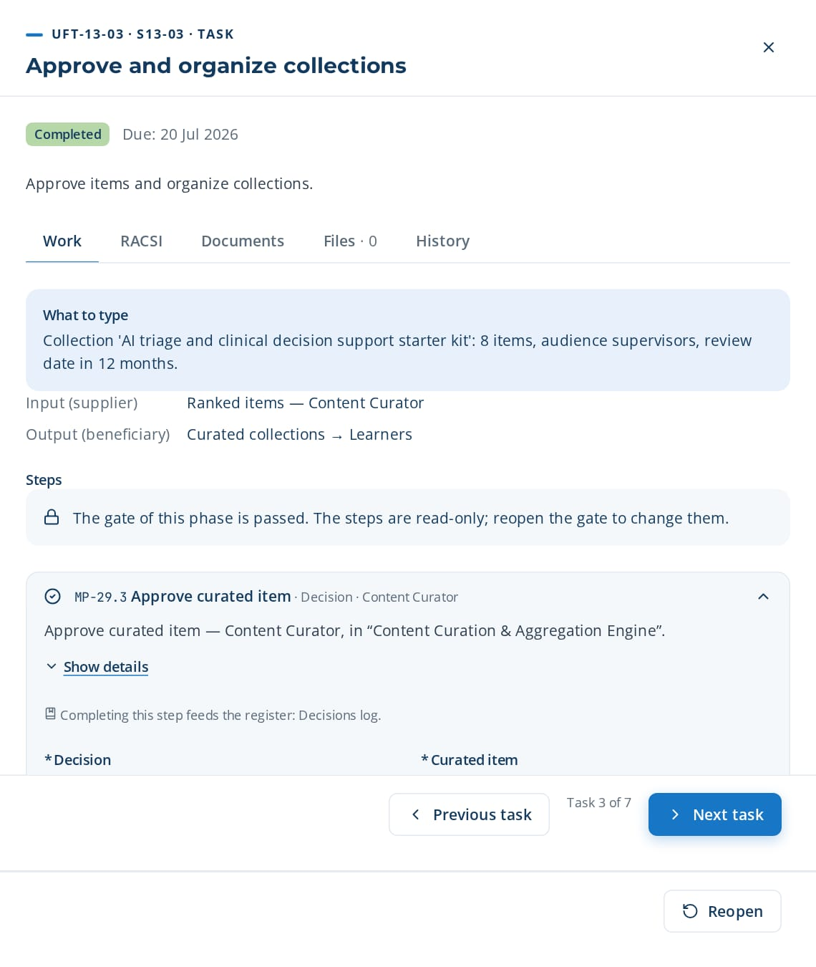
PHASE 4 · E2E-13 · PARTITION OF E2E-05
Content-Curate-to-Retire
Publish, maintain, retire content
TRIGGER
New content published or content past its review date.
END STATE
Catalog curated, maintained and outdated content retired.
7 tasks · 12 steps
20 days · 3 owners · 100 %
Macro processes: MP-06 Content & Resource Management · MP-29 Content Curation & Aggregation Engine · MP-33 User-Generated Content & Peer Knowledge Sharing
Task | Steps executed | Owner · done | What was entered
UFT-13-01 Aggregate provider catalogs | MP-29.1 Aggregate provider catalogs | Hicham Naciri 13 Jul 2026 | Aggregate 2 provider catalogs (LinkedIn Learning, Coursera): 1,240 items imported.
UFT-13-02 Recommend curated items | MP-29.2 Recommend curated items | Hicham Naciri 16 Jul 2026 | Keep the 15 top-ranked items on AI triage and clinical decision support; reject 3 items older than 3 years.
UFT-13-03 Approve and organize collections | MP-29.3 Approve curated item MP-29.4 Organize curated collection | Hicham Naciri 19 Jul 2026 | Collection 'AI triage and clinical decision support starter kit': 8 items, audience supervisors, review date in 12 months.
UFT-13-04 Review peer content | MP-33.1 Submit user-generated content MP-33.2 Check content against policy MP-33.3 Peer review content | Hamza Lahlou 22 Jul 2026 | Peer video 'How we use AI medical imaging assistance on shift' reviewed by an expert: approved with 1 correction.
UFT-13-05 Promote and rate content | MP-33.5 Send approved content to curation MP-33.6 Rate user-generated item | Asmae Ziani 25 Jul 2026 | Send approved peer content to curation; average learner rating 4.5/5.
UFT-13-06 Flag content past review date | MP-29.5 Flag content past review date | Hicham Naciri 28 Jul 2026 | 14 items past review date flagged; owners notified.
UFT-13-03 opened in CortexSkills: what to enter, its steps and its result.
Continued on the next slide
Notes:
E2E-13 Content-Curate-to-Retire — This partition of E2E-05 aggregates provider catalogs, curates and organizes items, promotes peer content, flags content past review and retires what is outdated.
Trigger: New content published or content past its review date.
End state: Catalog curated, maintained and outdated content retired.

Slide 57
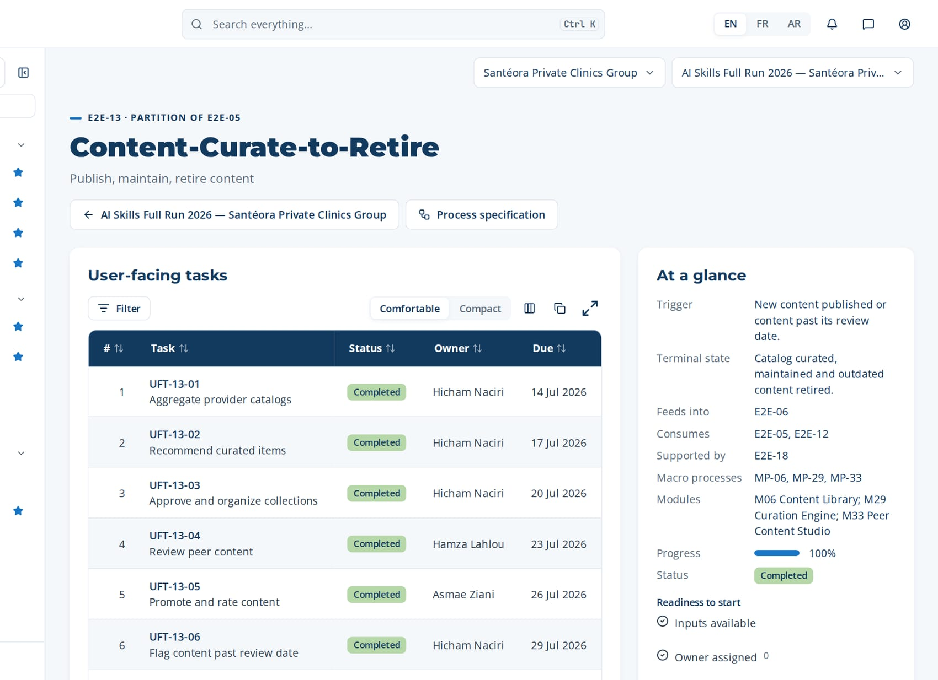
PHASE 4 · E2E-13 · PARTITION OF E2E-05
Content-Curate-to-Retire (continued)
Task | Steps executed | Owner · done | What was entered
UFT-13-07 Retire outdated content | MP-29.6 Retire outdated content MP-25.6 Retire low-value capsule | Hicham Naciri 31 Jul 2026 | Retire 6 outdated items and 2 low-value capsules; library health 92%.
Macro processes
MP-06 Content & Resource Management
MP-29 Content Curation & Aggregation Engine
MP-33 User-Generated Content & Peer Knowledge Sharing
Feeds into
E2E-06
Supported by
E2E-18
The page of E2E-13 in CortexSkills: its tasks, owners and due dates, and the process card.
Notes:
E2E-13 — remaining tasks

Slide 58
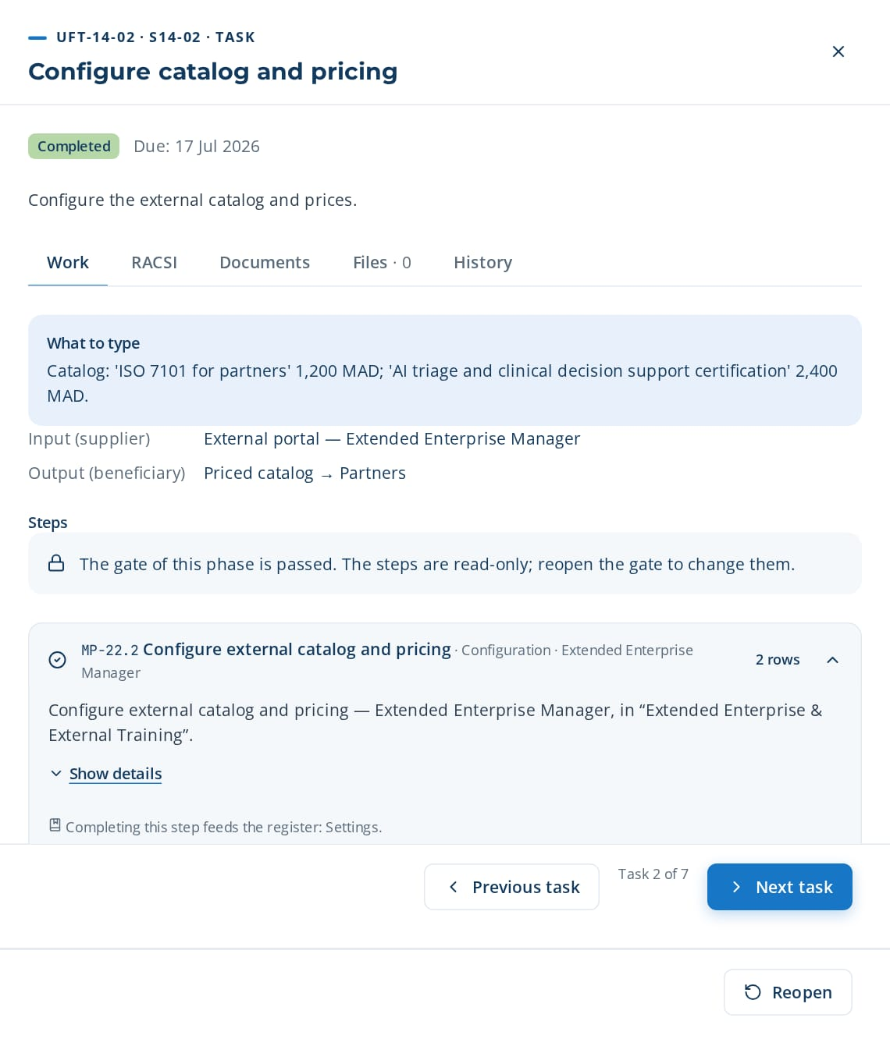
PHASE 4 · E2E-14 · ROOT / MASTER CHAIN
Extended-Enterprise-Training
Certify partners and train customers
TRIGGER
Partner, reseller or customer training program launched.
END STATE
External learners trained, paid and certified.
7 tasks · 12 steps
20 days · 3 owners · 100 %
Macro processes: MP-22 Extended Enterprise & External Training · MP-07 Learning Delivery & Implementation · MP-14 Compliance & Certification Management · MP-18 Financial & Budget Management
Task | Steps executed | Owner · done | What was entered
UFT-14-01 Create external sub-portal | MP-22.1 Create external sub-portal | Yassine Naciri 13 Jul 2026 | Sub-portal 'Partners Academy — Santéora Private Clinics Group' created for distributors and installers.
UFT-14-02 Configure catalog and pricing | MP-22.2 Configure external catalog and pricing MP-18.1 Allocate budget by theme and site | Yassine Naciri 16 Jul 2026 | Catalog: 'ISO 7101 for partners' 1,200 MAD; 'AI triage and clinical decision support certification' 2,400 MAD.
UFT-14-03 Process payment and enroll | MP-22.3 Process online payment MP-22.4 Enroll external learner | Yassine Naciri 19 Jul 2026 | 18 online payments processed; 18 external learners enrolled.
UFT-14-04 Deliver external sessions | MP-07.1 Create training session MP-07.5 Record attendance | Reda Hajji 22 Jul 2026 | Session P-01 (virtual), 18 invited, 16 present.
UFT-14-05 Track external completion | MP-22.5 Track external completion | Yassine Naciri 25 Jul 2026 | Completion: 15 of 16 passed the final quiz.
UFT-14-06 Issue partner certification | MP-22.6 Issue partner certification MP-14.4 Issue certificate on completion | Yassine Naciri 28 Jul 2026 | Issue 15 partner certificates valid 2 years.
UFT-14-02 opened in CortexSkills: what to enter, its steps and its result.
Continued on the next slide
Notes:
E2E-14 Extended-Enterprise-Training — This root chain sets up an external sub-portal and catalog, processes payment and enrollment, tracks completion and issues partner certifications.
Trigger: Partner, reseller or customer training program launched.
End state: External learners trained, paid and certified.

Slide 59
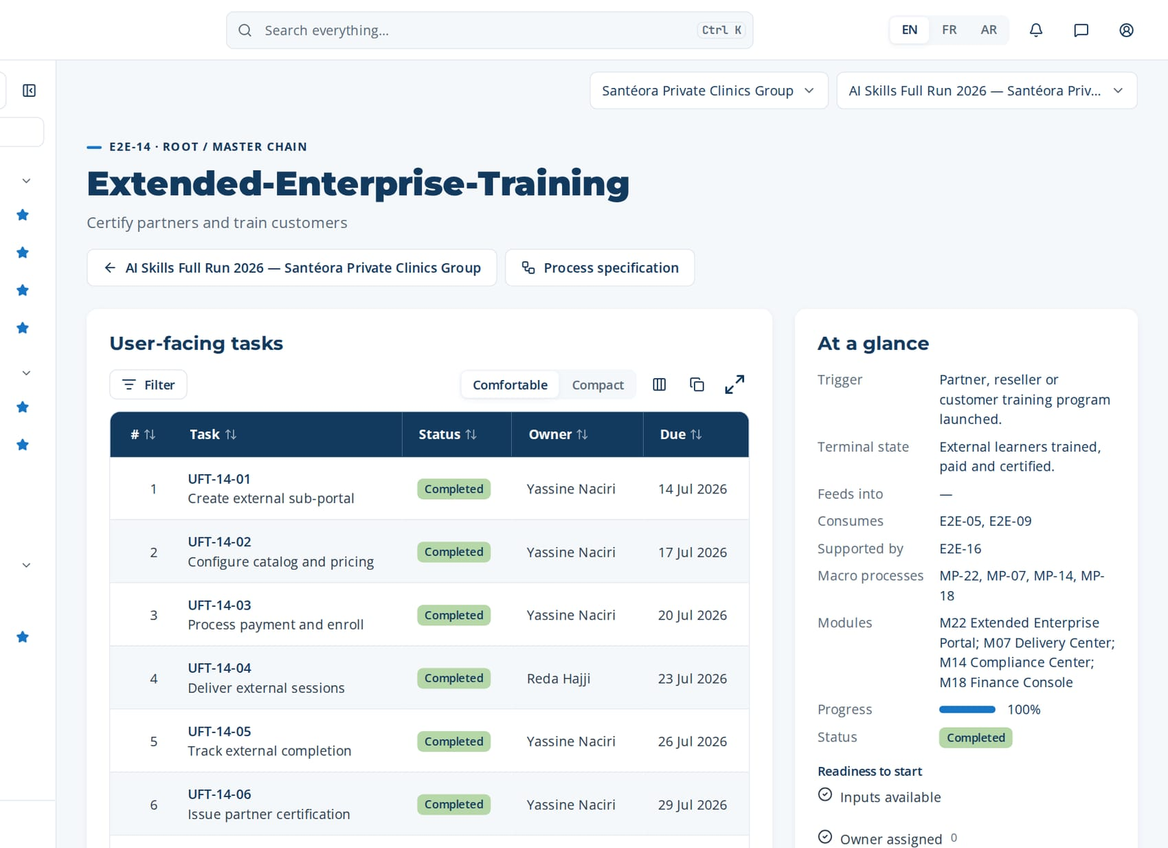
PHASE 4 · E2E-14 · ROOT / MASTER CHAIN
Extended-Enterprise-Training (continued)
Task | Steps executed | Owner · done | What was entered
UFT-14-07 Reconcile external revenue | MP-18.3 Record committed and actual costs MP-18.4 Compare spend against budget | Kawtar Chraibi 31 Jul 2026 | Revenue 43,200 MAD reconciled with the ERP; 0 unpaid.
Macro processes
MP-22 Extended Enterprise & External Training
MP-07 Learning Delivery & Implementation
MP-14 Compliance & Certification Management
MP-18 Financial & Budget Management
Feeds into
—
Supported by
E2E-16
The page of E2E-14 in CortexSkills: its tasks, owners and due dates, and the process card.
Notes:
E2E-14 — remaining tasks

Slide 60
05
E2E-07 Assessment-to-Evaluation
E2E-08 Learning-to-ROI
E2E-09 Compliance-to-Certification
HCPR-E2E-01 Healthcare Providers Compliance-to-Certification Readiness
PHASE 5
Evaluation, compliance & impact
4 processes · 26 tasks · 43 steps
8 Aug 2026 – 31 Aug 2026
Closed by G5 — Evaluation & impact validated
Notes:
Evaluation, compliance & impact

Slide 61
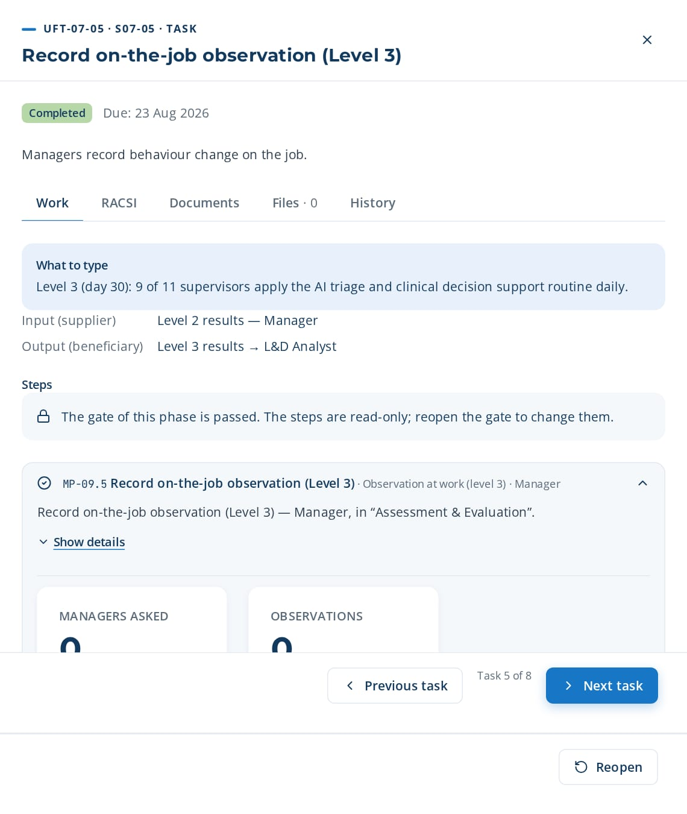
PHASE 5 · E2E-07 · ROOT / MASTER CHAIN
Assessment-to-Evaluation
Measure training effectiveness and skill progression
TRIGGER
Training session or path completed.
END STATE
Effectiveness measured on Kirkpatrick levels 1-3 and skill progression computed.
8 tasks · 12 steps
23 days · 4 owners · 100 %
Macro processes: MP-09 Assessment & Evaluation · MP-10 Reporting & Analytics · MP-20 Quality, Risk & Continuous Improvement
Task | Steps executed | Owner · done | What was entered
UFT-07-01 Create assessment instrument | MP-09.1 Create assessment instrument | Ghita Bouzidi 10 Aug 2026 | Instrument 'Test AI triage and clinical decision support M1': 15 questions, pass mark 70%.
UFT-07-02 Draft question bank | MP-09.2 Generate question bank draft | Ghita Bouzidi 13 Aug 2026 | Keep 12 AI-drafted questions, rewrite 3 with Clinical Care & Nursing vocabulary; validate each one.
UFT-07-03 Collect reaction survey (Level 1) | MP-09.3 Collect reaction survey (Level 1) | Yassine Berrada 16 Aug 2026 | Reaction survey S-01: 11 responses, satisfaction 4.3/5.
UFT-07-04 Record learning results (Level 2) | MP-09.4 Record learning results (Level 2) | Zineb Kettani 19 Aug 2026 | Level 2: average pre-test 48%, post-test 81% (+33 points).
UFT-07-05 Record on-the-job observation (Level 3) | MP-09.5 Record on-the-job observation (Level 3) | Karim El Idrissi 22 Aug 2026 | Level 3 (day 30): 9 of 11 supervisors apply the AI triage and clinical decision support routine daily.
UFT-07-05 opened in CortexSkills: what to enter, its steps and its result.
Continued on the next slide
Notes:
E2E-07 Assessment-to-Evaluation — This root chain builds assessment instruments, runs reaction, learning and behaviour evaluations, computes skill progression and reviews the results.
Trigger: Training session or path completed.
End state: Effectiveness measured on Kirkpatrick levels 1-3 and skill progression computed.

Slide 62
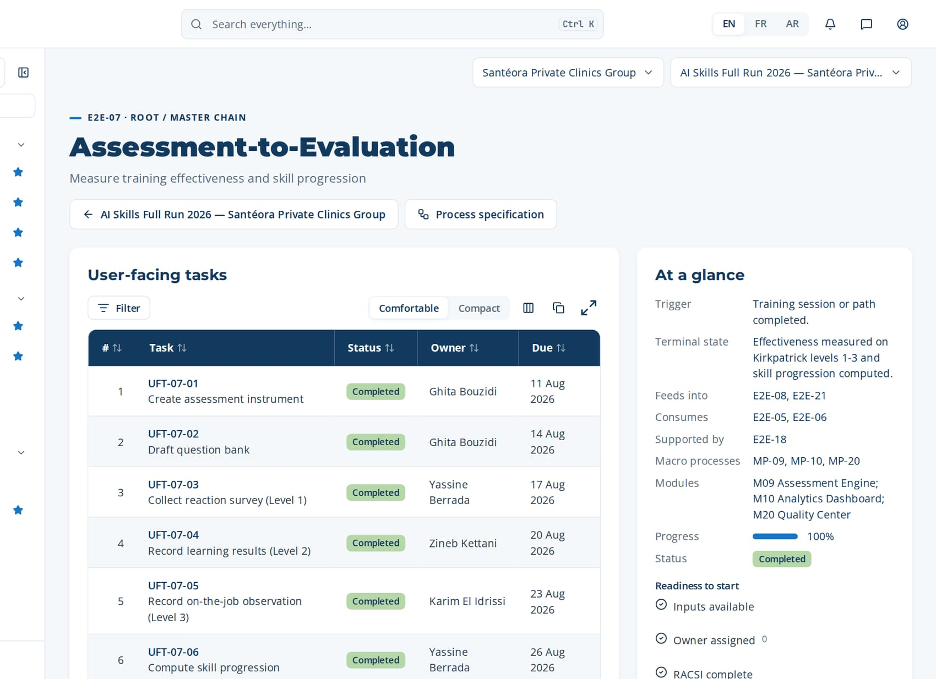
PHASE 5 · E2E-07 · ROOT / MASTER CHAIN
Assessment-to-Evaluation (continued)
Task | Steps executed | Owner · done | What was entered
UFT-07-06 Compute skill progression | MP-09.6 Compute skill progression MP-10.3 Refresh KPI computation | Yassine Berrada 25 Aug 2026 | Skill progression: AI triage and clinical decision support from 1.8 to 2.7 (target 3).
UFT-07-07 Review evaluation results | MP-09.7 Review evaluation results MP-20.5 Run periodic quality review | Yassine Berrada 28 Aug 2026 | Review: module M3 below 70% pass rate → improvement action assigned to the designer.
UFT-07-08 Publish evaluation report | MP-10.4 Export report MP-10.6 Share insight with stakeholders MP-10.2 Configure dashboard widgets | Yassine Berrada 31 Aug 2026 | Export RPT-016 Kirkpatrick report (PDF) and share with the Steering Committee.
Macro processes
MP-09 Assessment & Evaluation
MP-10 Reporting & Analytics
MP-20 Quality, Risk & Continuous Improvement
Feeds into
E2E-08, E2E-21
Supported by
E2E-18
The page of E2E-07 in CortexSkills: its tasks, owners and due dates, and the process card.
Notes:
E2E-07 — remaining tasks

Slide 63

PHASE 5 · E2E-08 · PARTITION OF E2E-07
Learning-to-ROI
Validate ROI and business impact
TRIGGER
Evaluation results available for a theme selected for an ROI study.
END STATE
Phillips ROI validated with finance and business impact report published.
7 tasks · 12 steps
20 days · 3 owners · 100 %
Macro processes: MP-09 Assessment & Evaluation · MP-10 Reporting & Analytics · MP-18 Financial & Budget Management · MP-32 Learning ROI & Business Impact Measurement
Task | Steps executed | Owner · done | What was entered
UFT-08-01 Select theme for ROI study | MP-32.1 Select theme for ROI study | Anas Hajji 10 Aug 2026 | ROI study on theme 'AI triage and clinical decision support' — population: 36 supervisors, 3 sites.
UFT-08-02 Define business indicators | MP-32.2 Define business indicators MP-10.1 Define KPI set per audience | Anas Hajji 13 Aug 2026 | Indicators: rework rate, downtime minutes per shift, data re-entry hours.
UFT-08-03 Collect cost data | MP-18.3 Record committed and actual costs MP-18.4 Compare spend against budget | Kawtar Chraibi 16 Aug 2026 | Costs: design 60,000 MAD; delivery 180,000 MAD; participants' time 95,000 MAD.
UFT-08-04 Isolate training effect | MP-32.3 Isolate training effect MP-09.6 Compute skill progression | Anas Hajji 19 Aug 2026 | Control group: site B (not trained). Isolated benefit: 410,000 MAD per year.
UFT-08-05 Compute Phillips ROI | MP-32.4 Compute Phillips ROI | Anas Hajji 22 Aug 2026 | ROI = (410,000 − 335,000) / 335,000 = 22%; benefit-cost ratio 1.22.
UFT-08-06 Review ROI with finance | MP-32.5 Review ROI with finance | Kawtar Chraibi 25 Aug 2026 | Finance review: assumptions accepted; downtime valued at 180 MAD per minute.
UFT-08-01 opened in CortexSkills: what to enter, its steps and its result.
Continued on the next slide
Notes:
E2E-08 Learning-to-ROI — This partition of E2E-07 selects a theme, defines business indicators, isolates the training effect, computes the Phillips ROI and publishes the business impact report.
Trigger: Evaluation results available for a theme selected for an ROI study.
End state: Phillips ROI validated with finance and business impact report published.

Slide 64
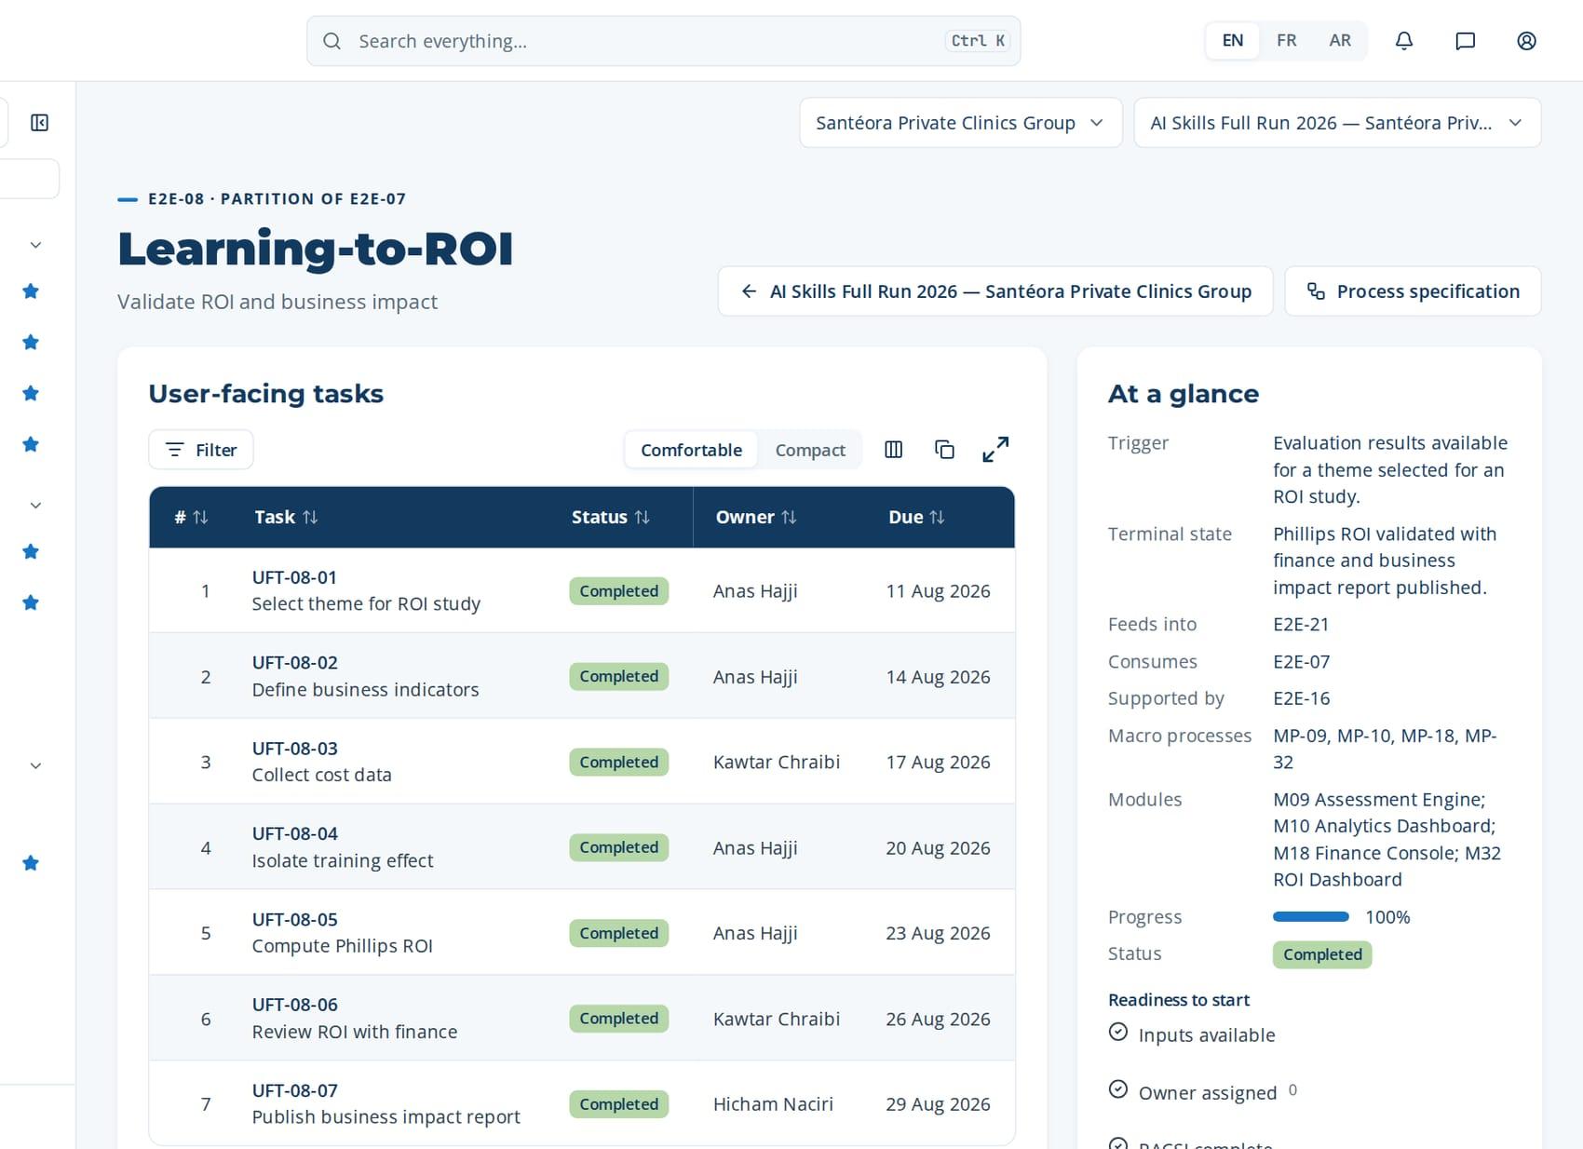
PHASE 5 · E2E-08 · PARTITION OF E2E-07
Learning-to-ROI (continued)
Task | Steps executed | Owner · done | What was entered
UFT-08-07 Publish business impact report | MP-32.6 Publish business impact report MP-10.4 Export report MP-10.5 Query data via AI Assistant | Hicham Naciri 28 Aug 2026 | Publish RPT-012 ROI & Business Impact Report to executive leadership.
Macro processes
MP-09 Assessment & Evaluation
MP-10 Reporting & Analytics
MP-18 Financial & Budget Management
MP-32 Learning ROI & Business Impact Measurement
Feeds into
E2E-21
Supported by
E2E-16
The page of E2E-08 in CortexSkills: its tasks, owners and due dates, and the process card.
Notes:
E2E-08 — remaining tasks

Slide 65
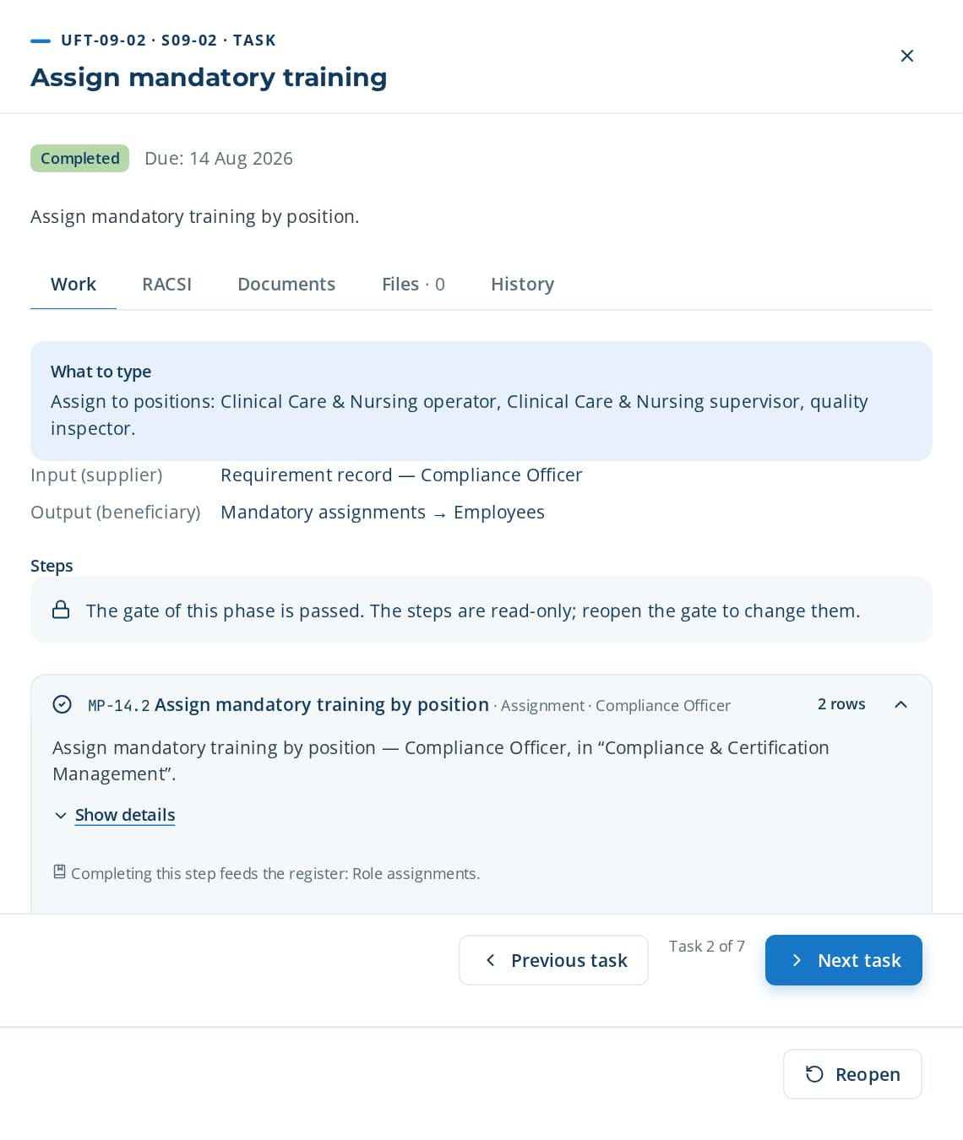
PHASE 5 · E2E-09 · ROOT / MASTER CHAIN
Compliance-to-Certification
Ensure compliant workforce with valid certifications
TRIGGER
New regulatory requirement or certification nearing expiry.
END STATE
Compliant workforce with valid certifications and an audit extract available.
7 tasks · 11 steps
20 days · 3 owners · 100 %
Macro processes: MP-14 Compliance & Certification Management · MP-07 Learning Delivery & Implementation · MP-09 Assessment & Evaluation · MP-10 Reporting & Analytics
Task | Steps executed | Owner · done | What was entered
UFT-09-01 Register regulatory requirement | MP-14.1 Register regulatory requirement | Rachid Kettani 10 Aug 2026 | Requirement 'ISO 7101 awareness', every 24 months, source: ISO 7101 clause on competence.
UFT-09-02 Assign mandatory training | MP-14.2 Assign mandatory training by position | Rachid Kettani 13 Aug 2026 | Assign to positions: Clinical Care & Nursing operator, Clinical Care & Nursing supervisor, quality inspector.
UFT-09-03 Deliver mandatory sessions | MP-07.3 Enroll learners into session MP-07.5 Record attendance | Reda Hajji 16 Aug 2026 | Enroll 24 employees in session 'ISO 7101 awareness'; attendance recorded.
UFT-09-04 Assess and certify | MP-09.4 Record learning results (Level 2) MP-14.4 Issue certificate on completion | Zineb Kettani 19 Aug 2026 | Result 86%; certificate 'ISO 7101 awareness' issued, valid until 2026+2.
UFT-09-05 Compute certification validity | MP-14.3 Compute certification validity | Rachid Kettani 22 Aug 2026 | Validity: 212 valid, 9 expire within 60 days, 3 expired.
UFT-09-06 Manage renewals | MP-14.5 Launch renewal enrollment MP-14.6 Confirm renewal completion | Rachid Kettani 25 Aug 2026 | Launch renewal for the 12 employees; confirm 10 completions, 2 rescheduled.
UFT-09-02 opened in CortexSkills: what to enter, its steps and its result.
Continued on the next slide
Notes:
E2E-09 Compliance-to-Certification — This root chain registers regulatory requirements, assigns mandatory training by position, tracks certification validity, launches renewals and produces the compliance audit extract.
Trigger: New regulatory requirement or certification nearing expiry.
End state: Compliant workforce with valid certifications and an audit extract available.

Slide 66

PHASE 5 · E2E-09 · ROOT / MASTER CHAIN
Compliance-to-Certification (continued)
Task | Steps executed | Owner · done | What was entered
UFT-09-07 Produce compliance audit extract | MP-14.7 Produce compliance audit extract MP-10.4 Export report | Rachid Kettani 28 Aug 2026 | Export compliance audit extract for ISO 7101 (XLSX) for the external auditor.
Macro processes
MP-14 Compliance & Certification Management
MP-07 Learning Delivery & Implementation
MP-09 Assessment & Evaluation
MP-10 Reporting & Analytics
Feeds into
E2E-14
Supported by
E2E-18
The page of E2E-09 in CortexSkills: its tasks, owners and due dates, and the process card.
Notes:
E2E-09 — remaining tasks

Slide 67

PHASE 5 · HCPR-E2E-01 · VERTICAL
Healthcare Providers Compliance-to-Certification Readiness
Keep Healthcare Providers regulated roles certified against ISO 7101.
TRIGGER
New ISO 7101 requirement or certification expiry.
END STATE
Sector compliance extract issued with every critical role certified.
4 tasks · 8 steps
11 days · 2 owners · 100 %
Macro processes: MP-01 Strategy & Governance Alignment · MP-02 Skills & Competency Management · MP-14 Compliance & Certification Management · HCPR-MP-01 HCPR-MP-01
Task | Steps executed | Owner · done | What was entered
UFT-HCPR-E1-01 Register ISO 7101 obligations | MP-01.1 Record corporate strategic objectives MP-14.1 Register regulatory requirement | Rachid Kettani 10 Aug 2026 | Obligation 'ISO 7101 training', every 12 months, owner Compliance Officer.
UFT-HCPR-E1-02 Link obligations to positions | MP-01.2 Link objectives to functions and sites MP-14.2 Assign mandatory training by position | Karim Chraibi 13 Aug 2026 | Linked to 5 Clinical Care & Nursing positions (38 employees).
UFT-HCPR-E1-03 Track certification validity | MP-02.1 Define competency families and levels MP-14.3 Compute certification validity | Rachid Kettani 16 Aug 2026 | Validity: 33 valid, 5 expire within 60 days.
UFT-HCPR-E1-04 Issue sector compliance extract | MP-02.2 Set target levels per position MP-14.7 Produce compliance audit extract | Rachid Kettani 19 Aug 2026 | Extract issued for the ISO 7101 audit on 15 October.
UFT-HCPR-E1-01 opened in CortexSkills: what to enter, its steps and its result.
Notes:
HCPR-E2E-01 Healthcare Providers Compliance-to-Certification Readiness — Keep Healthcare Providers regulated roles certified against ISO 7101.
Trigger: New ISO 7101 requirement or certification expiry.
End state: Sector compliance extract issued with every critical role certified.

Slide 68
06
E2E-10 Talent-to-Mobility
E2E-11 Onboarding-to-Productivity
E2E-12 Knowledge-Capture-to-Transfer
E2E-31 Engagement-to-Roadmap
PHASE 6
Talent, knowledge & continuous improvement
4 processes · 30 tasks · 51 steps
5 Sept 2026 – 28 Sept 2026
Closed by G6 — Closure & continuous improvement
Notes:
Talent, knowledge & continuous improvement

Slide 69

PHASE 6 · E2E-10 · ROOT / MASTER CHAIN
Talent-to-Mobility
Enable internal mobility and career progression
TRIGGER
Internal opening published or annual career review.
END STATE
Internal move decided with a reskilling plan assigned.
8 tasks · 18 steps
23 days · 4 owners · 100 %
Macro processes: MP-13 Talent & Career Development · MP-31 Skills-Based Talent Marketplace & Internal Mobility · MP-02 Skills & Competency Management · MP-08 Learner Experience & Engagement
Task | Steps executed | Owner · done | What was entered
UFT-10-01 Model career paths | MP-13.1 Model career path MP-13.2 Link path steps to competency targets | Mehdi Lahlou 7 Sept 2026 | Career path: Clinical Care & Nursing operator → team leader → supervisor, with competency targets per step.
UFT-10-02 Publish internal opening | MP-31.1 Publish internal opening MP-31.2 Define required skills | Karim Chraibi 10 Sept 2026 | Opening 'Clinical Care & Nursing team leader', required skills: AI triage and clinical decision support level 3, leadership level 2.
UFT-10-03 Match employees to opening | MP-31.3 Match employees to opening MP-02.7 Validate skills inventory | Karim Chraibi 13 Sept 2026 | Review 6 AI matches; keep 4 candidates with match score above 75%.
UFT-10-04 Apply to internal opening | MP-31.4 Apply to internal opening | Reda Sefrioui 16 Sept 2026 | Application with motivation note and consent of the current manager.
UFT-10-05 Shortlist candidates | MP-31.5 Shortlist candidates | Karim El Idrissi 19 Sept 2026 | Shortlist: 2 candidates; interviews on 20 and 21 June.
UFT-10-02 opened in CortexSkills: what to enter, its steps and its result.
Continued on the next slide
Notes:
E2E-10 Talent-to-Mobility — This root chain models career paths, publishes internal openings, matches employees to openings, shortlists candidates and assigns reskilling plans.
Trigger: Internal opening published or annual career review.
End state: Internal move decided with a reskilling plan assigned.

Slide 70

PHASE 6 · E2E-10 · ROOT / MASTER CHAIN
Talent-to-Mobility (continued)
Task | Steps executed | Owner · done | What was entered
UFT-10-06 Plan individual development | MP-13.3 Create individual development plan MP-13.4 Suggest development actions MP-42.3 Build leadership development plan + 1 more steps | Karim El Idrissi 22 Sept 2026 | Development plan: 2 modules AI triage and clinical decision support, 1 leadership workshop, 3 months mentoring.
UFT-10-07 Assign reskilling plan | MP-31.6 Assign reskilling plan MP-08.1 Generate personal learning plan | Karim Chraibi 25 Sept 2026 | Assign reskilling path 'AI triage and clinical decision support for team leaders' to the selected candidate.
UFT-10-08 Review career and succession | MP-13.5 Run career review MP-13.6 Update succession readiness MP-42.5 Review leadership pipeline + 1 more steps | Mehdi Lahlou 28 Sept 2026 | Succession readiness updated: 2 ready now, 3 ready within 12 months.
Macro processes
MP-13 Talent & Career Development
MP-31 Skills-Based Talent Marketplace & Internal Mobility
MP-02 Skills & Competency Management
MP-08 Learner Experience & Engagement
Feeds into
E2E-11
Supported by
E2E-15
The page of E2E-10 in CortexSkills: its tasks, owners and due dates, and the process card.
Notes:
E2E-10 — remaining tasks

Slide 71

PHASE 6 · E2E-11 · ROOT / MASTER CHAIN
Onboarding-to-Productivity
Accelerate time-to-productivity
TRIGGER
New hire or internal mover confirmed.
END STATE
Employee productive within target time and onboarding closed.
7 tasks · 11 steps
20 days · 4 owners · 100 %
Macro processes: MP-35 Onboarding & Rapid Upskilling · MP-07 Learning Delivery & Implementation · MP-08 Learner Experience & Engagement · MP-13 Talent & Career Development
Task | Steps executed | Owner · done | What was entered
UFT-11-01 Create onboarding record | MP-35.1 Create onboarding record | Karim El Idrissi 7 Sept 2026 | Onboarding record for the new Clinical Care & Nursing technician, start date 1 July, buddy assigned.
UFT-11-02 Generate 30-60-90 day path | MP-35.2 Generate 30-60-90 day path MP-08.1 Generate personal learning plan | Karim Chraibi 10 Sept 2026 | 30-60-90 path: day 30 safety and ISO 7101; day 60 AI triage and clinical decision support; day 90 autonomy on shift.
UFT-11-03 Enroll in onboarding sessions | MP-07.3 Enroll learners into session MP-07.4 Send convocations | Reda Hajji 13 Sept 2026 | Enroll in the induction session of 2 July; convocation sent.
UFT-11-04 Complete onboarding tasks | MP-35.3 Complete onboarding tasks | Reda Sefrioui 16 Sept 2026 | Tasks done: badge, IT account, safety tour, meeting with the team.
UFT-11-05 Hold milestone check-ins | MP-35.4 Hold milestone check-in MP-21.3 Schedule coaching sessions | Karim El Idrissi 19 Sept 2026 | Day-30 check-in: on track; coaching needed on AI triage and clinical decision support data entry.
UFT-11-06 Assess time to productivity | MP-35.5 Assess time to productivity | Karim El Idrissi 22 Sept 2026 | Time to productivity: 74 days (target 90).
UFT-11-02 opened in CortexSkills: what to enter, its steps and its result.
Continued on the next slide
Notes:
E2E-11 Onboarding-to-Productivity — This root chain prepares the onboarding record, generates the 30-60-90 day path, runs check-ins with coaching support and confirms time to productivity.
Trigger: New hire or internal mover confirmed.
End state: Employee productive within target time and onboarding closed.

Slide 72

PHASE 6 · E2E-11 · ROOT / MASTER CHAIN
Onboarding-to-Productivity (continued)
Task | Steps executed | Owner · done | What was entered
UFT-11-07 Close onboarding | MP-35.6 Close onboarding MP-13.3 Create individual development plan | Karim Chraibi 25 Sept 2026 | Close onboarding; link the individual development plan for year 1.
Macro processes
MP-35 Onboarding & Rapid Upskilling
MP-07 Learning Delivery & Implementation
MP-08 Learner Experience & Engagement
MP-13 Talent & Career Development
Feeds into
E2E-10
Supported by
E2E-17
The page of E2E-11 in CortexSkills: its tasks, owners and due dates, and the process card.
Notes:
E2E-11 — remaining tasks

Slide 73

PHASE 6 · E2E-12 · ROOT / MASTER CHAIN
Knowledge-Capture-to-Transfer
Capture and transfer institutional knowledge
TRIGGER
Critical expert identified as leaving, retiring or holding at-risk knowledge.
END STATE
Knowledge captured, published and transferred to a validated successor.
7 tasks · 10 steps
20 days · 4 owners · 100 %
Macro processes: MP-34 Expert Knowledge Capture & Transfer · MP-12 Learning Culture & Knowledge Management · MP-33 User-Generated Content & Peer Knowledge Sharing · MP-06 Content & Resource Management
Task | Steps executed | Owner · done | What was entered
UFT-12-01 Identify critical experts | MP-34.1 Identify critical experts | Karim Chraibi 7 Sept 2026 | Critical expert: senior Clinical Care & Nursing engineer retiring in 8 months; knowledge risk: high.
UFT-12-02 Plan capture sessions | MP-34.2 Plan capture sessions | Asmae Ziani 10 Sept 2026 | Capture plan: 4 sessions of 90 minutes on troubleshooting and ISO 7101 practices.
UFT-12-03 Record expert interview | MP-34.3 Record expert interview | Asmae Ziani 13 Sept 2026 | Interview 1 recorded (82 minutes); transcript attached.
UFT-12-04 Structure knowledge | MP-34.4 Structure knowledge from transcript | Asmae Ziani 16 Sept 2026 | Accept the AI structure: 5 failure modes, 12 checks, 3 decision rules; correct 2 technical terms.
UFT-12-05 Publish knowledge article | MP-12.1 Publish knowledge article MP-12.2 Index article for retrieval MP-33.4 Approve publication | Asmae Ziani 19 Sept 2026 | Publish article 'Troubleshooting guide — Clinical Care & Nursing' in EN/FR/AR; indexed for search.
UFT-12-06 Assign successor learning path | MP-34.5 Assign successor learning path MP-06.6 Publish content to catalog | Karim El Idrissi 22 Sept 2026 | Assign the successor path: article + 3 shadowing sessions with the expert.
UFT-12-01 opened in CortexSkills: what to enter, its steps and its result.
Continued on the next slide
Notes:
E2E-12 Knowledge-Capture-to-Transfer — This root chain identifies critical experts, records and structures their knowledge, publishes it and validates its transfer to successors.
Trigger: Critical expert identified as leaving, retiring or holding at-risk knowledge.
End state: Knowledge captured, published and transferred to a validated successor.

Slide 74

PHASE 6 · E2E-12 · ROOT / MASTER CHAIN
Knowledge-Capture-to-Transfer (continued)
Task | Steps executed | Owner · done | What was entered
UFT-12-07 Validate transfer completion | MP-34.6 Validate transfer completion | Hamza Lahlou 25 Sept 2026 | Transfer validated: successor solved 4 of 5 test cases alone.
Macro processes
MP-34 Expert Knowledge Capture & Transfer
MP-12 Learning Culture & Knowledge Management
MP-33 User-Generated Content & Peer Knowledge Sharing
MP-06 Content & Resource Management
Feeds into
E2E-13, E2E-06
Supported by
E2E-17
The page of E2E-12 in CortexSkills: its tasks, owners and due dates, and the process card.
Notes:
E2E-12 — remaining tasks

Slide 75

PHASE 6 · E2E-31 · ROOT (ROADMAP)
Engagement-to-Roadmap
Define post-engagement roadmap and continuous improvement
TRIGGER
Closure of the current training engineering engagement (E2E-19).
END STATE
Approved post-engagement roadmap with future missions and continuous improvement plan.
8 tasks · 12 steps
23 days · 5 owners · 100 %
Macro processes: MP-50 Post-Engagement Roadmap & Continuous Improvement · MP-36 Consulting Engagement Management · MP-19 Change Management & Adoption · MP-12 Learning Culture & Knowledge Management · MP-16 Data, AI & Integration Governance
Task | Steps executed | Owner · done | What was entered
UFT-31-01 Consolidate engagement findings | MP-50.1 Consolidate engagement findings | Nadia Lahlou 7 Sept 2026 | Findings: 6 deliverables, 3 lessons learned, 2 open topics (IS, org design).
UFT-31-02 Define future perspectives | MP-50.2 Define future perspectives | Nadia Lahlou 10 Sept 2026 | Perspectives: AI bed and staff capacity planning programme, second wave for OP level.
UFT-31-03 Plan One-to-One coaching | MP-50.3 Plan One-to-One coaching | Amine Lahlou 13 Sept 2026 | One-to-One coaching: 6 managers, 6 sessions each over 6 months.
UFT-31-04 Plan organizational optimization | MP-50.4 Plan organizational optimization | Mehdi Lahlou 16 Sept 2026 | Organizational optimization: merge 2 planning cells; update 11 descriptions.
UFT-31-05 Plan IS rehabilitation | MP-50.5 Plan IS rehabilitation | Omar El Idrissi 19 Sept 2026 | IS rehabilitation: connect HRIS and training platform; retire 2 spreadsheets.
UFT-31-06 Define KPIs and dashboards | MP-50.6 Define KPIs and dashboards | Anas Hajji 22 Sept 2026 | KPIs: training coverage, time to competency, ROI per theme; monthly dashboard.
UFT-31-02 opened in CortexSkills: what to enter, its steps and its result.
Continued on the next slide
Notes:
E2E-31 Engagement-to-Roadmap — This root chain defines the long-term roadmap beyond the current training engineering engagement, including future missions (One-to-One coaching, organizational optimization, IS rehabilitation/reengineering), KPIs, and dashboards.
Trigger: Closure of the current training engineering engagement (E2E-19).
End state: Approved post-engagement roadmap with future missions and continuous improvement plan.

Slide 76

PHASE 6 · E2E-31 · ROOT (ROADMAP)
Engagement-to-Roadmap (continued)
Task | Steps executed | Owner · done | What was entered
UFT-31-07 Prioritize future missions | MP-50.7 Prioritize future missions MP-50.8 Validate roadmap with leadership | Nadia Lahlou 25 Sept 2026 | Priority missions: 1 IS rehabilitation, 2 coaching, 3 org optimization.
UFT-31-08 Publish roadmap | MP-50.9 Publish post-engagement roadmap MP-50.10 Track roadmap execution MP-50.11 Improve roadmap continuously + 1 more steps | Nadia Lahlou 28 Sept 2026 | Publish RPT-010 Post-Engagement Roadmap to the executive committee.
Macro processes
MP-50 Post-Engagement Roadmap & Continuous Improvement
MP-36 Consulting Engagement Management
MP-19 Change Management & Adoption
MP-12 Learning Culture & Knowledge Management
MP-16 Data, AI & Integration Governance
Feeds into
E2E-17, E2E-18
Supported by
—
The page of E2E-31 in CortexSkills: its tasks, owners and due dates, and the process card.
Notes:
E2E-31 — remaining tasks

Slide 77
00
E2E-15 Data-AI-Integration
E2E-17 Change-to-Adoption
E2E-18 Quality-Risk-Improvement
PHASE 0
Enablers (run across all phases)
3 processes · 21 tasks · 34 steps
18 Apr 2026 – 31 Jul 2026
Runs across all phases
Notes:
Enablers (run across all phases)

Slide 78

PHASE 0 · E2E-15 · ROOT / ENABLER
Data-AI-Integration
Govern data, AI, integrations
TRIGGER
New integration, data source or AI use case to govern.
END STATE
Integrations, data and AI governed with health, retention and usage reviewed.
7 tasks · 11 steps
20 days · 3 owners · 100 %
Macro processes: MP-16 Data, AI & Integration Governance · MP-17 Identity, Access & Security Management · MP-10 Reporting & Analytics · MP-24 AI-Powered Personalization & Adaptive Learning · MP-28 Predictive Learning Analytics & Intelligence
Task | Steps executed | Owner · done | What was entered
UFT-15-01 Register external integration | MP-16.1 Register external integration | Loubna Mansouri 20 Apr 2026 | Register integration 'HRIS — Workday' (INT-HR-01); credential reference stored encrypted.
UFT-15-02 Map fields and check health | MP-16.2 Map integration fields MP-16.3 Check integration health | Omar El Idrissi 23 Apr 2026 | Map fields: employee_id → matricule; position → poste. Health check: success.
UFT-15-03 Run HRIS synchronisation | MP-16.4 Run HRIS synchronisation MP-16.5 Review synchronisation rejections | Omar El Idrissi 26 Apr 2026 | Sync run: 1,204 records updated, 3 rejected (missing position) — corrected.
UFT-15-04 Set data retention rule | MP-16.6 Set data retention rule | Yassine Berrada 29 Apr 2026 | Retention: questionnaire responses 3 years; training records 10 years.
UFT-15-05 Maintain AI use case register | MP-16.7 Maintain AI use case register | Loubna Mansouri 2 May 2026 | Add custom use case 'Shift-report summarizer' (Assistive), version 1.
UFT-15-06 Set AI activation per scope | MP-16.8 Set AI activation per scope MP-24.1 Enable personalization per scope | Loubna Mansouri 5 May 2026 | Activate AIUC-35 and AIUC-36 for the organization; override Off for pilot project B.
UFT-15-01 opened in CortexSkills: what to enter, its steps and its result.
Continued on the next slide
Notes:
E2E-15 Data-AI-Integration — This enabler registers integrations and maps fields, runs HRIS synchronisation, sets retention rules, maintains the AI Use Case register and its activation, and reviews AI usage.
Trigger: New integration, data source or AI use case to govern.
End state: Integrations, data and AI governed with health, retention and usage reviewed.

Slide 79

PHASE 0 · E2E-15 · ROOT / ENABLER
Data-AI-Integration (continued)
Task | Steps executed | Owner · done | What was entered
UFT-15-07 Review AI usage log | MP-16.9 Review AI usage log MP-28.2 Validate dataset quality | Omar El Idrissi 8 May 2026 | Usage review: 412 suggestions — 71% accepted, 20% edited, 9% rejected.
Macro processes
MP-16 Data, AI & Integration Governance
MP-17 Identity, Access & Security Management
MP-10 Reporting & Analytics
MP-24 AI-Powered Personalization & Adaptive Learning
MP-28 Predictive Learning Analytics & Intelligence
Feeds into
All E2E processes
Supported by
—
The page of E2E-15 in CortexSkills: its tasks, owners and due dates, and the process card.
Notes:
E2E-15 — remaining tasks

Slide 80

PHASE 0 · E2E-17 · ROOT / ENABLER
Change-to-Adoption
Drive sustained adoption and culture change
TRIGGER
Approved plan or new platform capability requiring adoption.
END STATE
Sustained adoption reached with low-adoption groups reinforced.
7 tasks · 11 steps
20 days · 3 owners · 100 %
Macro processes: MP-19 Change Management & Adoption · MP-12 Learning Culture & Knowledge Management · MP-08 Learner Experience & Engagement · MP-26 Social & Collaborative Learning Networks
Task | Steps executed | Owner · done | What was entered
UFT-17-01 Assess change impact | MP-19.1 Assess change impact | Yassine Fassi 13 Jul 2026 | Impact: Clinical Care & Nursing supervisors high, operators medium, support functions low.
UFT-17-02 Build adoption plan | MP-19.2 Build adoption plan | Yassine Fassi 16 Jul 2026 | Adoption plan: sponsor message, 6 champions, weekly 15-minute huddles for 8 weeks.
UFT-17-03 Launch communication campaign | MP-19.3 Launch communication campaign | Yassine Fassi 19 Jul 2026 | Campaign 'AI triage and clinical decision support — why it matters' on e-mail, intranet and screens.
UFT-17-04 Open community space | MP-12.3 Create community space MP-12.4 Moderate community posts MP-26.1 Create learning cohort group | Asmae Ziani 22 Jul 2026 | Community space 'AI triage and clinical decision support Q&A' opened; moderation rules published.
UFT-17-05 Track adoption usage | MP-19.4 Track adoption usage MP-08.5 Monitor engagement indicators | Yassine Berrada 25 Jul 2026 | Weekly active users: 64% of the target population.
UFT-17-06 Identify low-adoption groups | MP-19.5 Identify low-adoption groups | Yassine Fassi 28 Jul 2026 | Low adoption confirmed for night shift (31%); one group rejected as false positive.
UFT-17-03 opened in CortexSkills: what to enter, its steps and its result.
Continued on the next slide
Notes:
E2E-17 Change-to-Adoption — This enabler assesses change impact, builds the adoption plan, runs the communication campaign, tracks usage, detects low-adoption groups and runs reinforcement actions.
Trigger: Approved plan or new platform capability requiring adoption.
End state: Sustained adoption reached with low-adoption groups reinforced.

Slide 81

PHASE 0 · E2E-17 · ROOT / ENABLER
Change-to-Adoption (continued)
Task | Steps executed | Owner · done | What was entered
UFT-17-07 Run reinforcement actions | MP-19.6 Run reinforcement actions MP-08.6 Trigger re-engagement nudge | Yassine Fassi 31 Jul 2026 | Reinforcement: night-shift coaching sessions; adoption reached 58% after 4 weeks.
Macro processes
MP-19 Change Management & Adoption
MP-12 Learning Culture & Knowledge Management
MP-08 Learner Experience & Engagement
MP-26 Social & Collaborative Learning Networks
Feeds into
E2E-01, E2E-05, E2E-06
Supported by
E2E-15
The page of E2E-17 in CortexSkills: its tasks, owners and due dates, and the process card.
Notes:
E2E-17 — remaining tasks

Slide 82

PHASE 0 · E2E-18 · ROOT / ENABLER
Quality-Risk-Improvement
Improve processes and mitigate risk
TRIGGER
Risk logged, periodic quality review due or control test scheduled.
END STATE
Risks mitigated, actions evaluated by a different person, controls rated.
7 tasks · 12 steps
20 days · 2 owners · 100 %
Macro processes: MP-20 Quality, Risk & Continuous Improvement · MP-16 Data, AI & Integration Governance · MP-17 Identity, Access & Security Management · MP-09 Assessment & Evaluation
Task | Steps executed | Owner · done | What was entered
UFT-18-01 Log risk or opportunity | MP-20.1 Log risk or opportunity | Soukaina Bennani 20 Apr 2026 | Risk 'Trainers unavailable in Q3': likelihood 3, impact 4, score 12.
UFT-18-02 Assign mitigation action | MP-20.2 Assign mitigation action | Soukaina Bennani 23 Apr 2026 | Action: contract a second vendor; owner Purchasing Officer; evaluator Quality Manager.
UFT-18-03 Execute improvement action | MP-20.3 Execute improvement action | Soukaina Bennani 26 Apr 2026 | Action done: framework contract signed with vendor B; evidence attached.
UFT-18-04 Evaluate action effectiveness | MP-20.4 Evaluate action effectiveness | Soukaina Bennani 29 Apr 2026 | Verdict: effective. The evaluator is a different user from the owner.
UFT-18-05 Review access and security | MP-17.4 Review access violation log MP-17.6 Enforce login rate limit MP-17.2 Assign roles to user + 2 more steps | Omar El Idrissi 2 May 2026 | Access review: 2 dormant accounts disabled; 0 cross-tenant attempts.
UFT-18-06 Run periodic quality review | MP-20.5 Run periodic quality review MP-09.7 Review evaluation results | Soukaina Bennani 5 May 2026 | Quality review minutes: 3 KPIs red, 2 actions opened, next review in 30 days.
UFT-18-02 opened in CortexSkills: what to enter, its steps and its result.
Continued on the next slide
Notes:
E2E-18 Quality-Risk-Improvement — This enabler logs risks and opportunities, assigns and executes mitigation actions, has each action evaluated by a different user, runs periodic quality reviews and updates control effectiveness.
Trigger: Risk logged, periodic quality review due or control test scheduled.
End state: Risks mitigated, actions evaluated by a different person, controls rated.

Slide 83

PHASE 0 · E2E-18 · ROOT / ENABLER
Quality-Risk-Improvement (continued)
Task | Steps executed | Owner · done | What was entered
UFT-18-07 Update control effectiveness | MP-20.6 Update control effectiveness rating | Soukaina Bennani 8 May 2026 | Control CTRL-002 effectiveness: Effective; CTRL-031: Partially effective.
Macro processes
MP-20 Quality, Risk & Continuous Improvement
MP-16 Data, AI & Integration Governance
MP-17 Identity, Access & Security Management
MP-09 Assessment & Evaluation
Feeds into
E2E-03, E2E-07, E2E-09
Supported by
—
The page of E2E-18 in CortexSkills: its tasks, owners and due dates, and the process card.
Notes:
E2E-18 — remaining tasks

Slide 84
RESULTS
What the run produced, in figures
Each figure is the value entered or computed at the step shown under it
187
6
1.33 M
questionnaire responses consolidated
themes built from 23 validated needs
MAD net L&D budget approved
UFT-03-06
UFT-03-05
UFT-01-05
+33 pts
9 / 11
22 %
test score, 48 % to 81 % (level 2)
supervisors apply the routine at day 30
ROI, benefit-cost ratio 1.22
UFT-07-04
UFT-07-05
UFT-08-05

Slide 85




RESULTS
Training measured at every Kirkpatrick level
Session S-01, AI triage and clinical decision support for supervisors
Level 1 — Reaction
Reaction survey S-01: 11 responses, satisfaction 4.3/5.
Level 2 — Learning
Level 2: average pre-test 48%, post-test 81% (+33 points).
Level 3 — Behaviour
Level 3 (day 30): 9 of 11 supervisors apply the AI triage and clinical decision support routine daily.
Level 4 — ROI
ROI = (410,000 − 335,000) / 335,000 = 22%; benefit-cost ratio 1.22.
Satisfaction 4.3/5 shown as 86 %; 9 of 11 participants shown as 82 %. Source: tasks UFT-07-03 to UFT-07-05.

Slide 86

RESULTS
Every KPI of the project on target
61 of 61 KPIs green — the first ten
ID | KPI | Value | Target | Status
KPI-001 | Strategic objective coverage | 108 | 100 | On target
KPI-002 | Skills inventory validation rate | 102.6 | 95 | On target
KPI-003 | Critical gap rate | 8.2 | 10 | On target
KPI-004 | Training Engineering Report cycle time | 24.6 | 30 | On target
KPI-005 | Design approval lead time | 16.4 | 20 | On target
KPI-006 | License Compliance % | 108 | 100 | On target
KPI-007 | Content publication lead time | 12.3 | 15 | On target
KPI-008 | Session fill rate | 91.8 | 85 | On target
KPI-009 | Plan realization rate | 97.2 | 90 | On target
KPI-010 | Learner completion rate | 86.4 | 80 | On target
KPI page of the project in CortexSkills.

Slide 87

DELIVERABLES
The questionnaire campaign
Campaign with three forms (top management, management, staff), channels, response rate and completeness.

Slide 88

DELIVERABLES
The 2026 training plan
Programmes, trainings, half-day agendas and the golden rules checked on every training.

Slide 89

DELIVERABLES
37 documents published, versioned and approved
Training Engineering Report, training plan, audit, ROI report and the other documents, each with an author, an approver and a review date.

Slide 90

DELIVERABLES
Standard reports, ready to export
34 standard reports, previewed and downloaded as PDF, Excel or Word.

Slide 91


NEXT STEPS
Proposed path for your clinics
Durations are indicative and set with you during the scoping workshop
1
2
3
Scoping workshop
Pilot on one clinic
Deployment to all clinics
Half a day: sites, functions, decision levels, focus and stakeholders — Phase 1 in the application.
Questionnaires, diagnosis and Training Engineering Report on your data — Phases 1 to 3.
Delivery, evaluation up to ROI and continuous improvement — Phases 4 to 6.
Deployment on your private cloud or on site, under a licence; interface and documents in French, English and Arabic.

Slide 92
Thank you
POWERACT Consulting · CortexSkills, training engineering for healthcare
Questions and discussion

