Slide 1
POWERACT
C O N S U L T I N G
DYNAMICMS 1.0
DynamicMS — Integrated Management System
Full QMS and QHSE runs for every sector, large companies and SMEs
POWERACT Consulting · September 2026

Slide 2
DYNAMICMS
Agenda
01
What the application does
02
The lifecycle of a management system
03
The main screens
04
One full run per sector
05
Installation and next steps
POWERACT Consulting · Agenda
2

Slide 3



OVERVIEW
One application runs the whole lifecycle of a management system
From context analysis to continual improvement, every step is assigned, recorded and traced.
Lifecycle
Governance
Evidence
12 end-to-end phases, 162 macro processes and 1,572 workflow steps, each with its own input form.
Business rules, COSO controls, risks, RACSI and KPIs linked to the steps they govern.
Nonconformities, audits, documents and registers, with versions and an audit trail.
POWERACT Consulting · Overview
3

Slide 4
DEMONSTRATION DATA
The seeded database holds 120 complete runs
60
120
84,603
organizations in 2 groups and 1 independent SME
full-run projects: QMS and QHSE for each
workflow steps with their recorded values
1,141
3
30
users across 19 roles
languages: English, French, Arabic (right-to-left)
sectors: 29 verticals plus universal
Counts after running npm run seed; every value is fictional demonstration data.
POWERACT Consulting · Demonstration data
4

Slide 5
The lifecycle
Twelve end-to-end processes run in order; gates close the phases.
POWERACT Consulting · The lifecycle
5

Slide 6
END-TO-END PROCESSES
A run moves through twelve phases
Each phase groups the macro processes activated for the organization; a gate with a checklist closes it.
E2E-01
E2E-02
E2E-03
E2E-04
E2E-05
E2E-06
Context To Strategy
Leadership To Commitment
Risk To Resilience
Compliance To Achievement
People To Capability
Infrastructure To Wellbeing
E2E-07
E2E-08
E2E-09
E2E-10
E2E-11
E2E-12
Knowledge To Control
Requirements To Delivery
Verification To Preparedness
Monitoring To Evaluation
Audit To Assurance
Correction To Innovation
Tinted cards: phases with a gate in every SME track (E2E-01, E2E-09, E2E-10).
POWERACT Consulting · The lifecycle
6

Slide 7
The main screens
Screens captured on the Horizon Universal Holdings QMS run.
POWERACT Consulting · The main screens
7

Slide 8
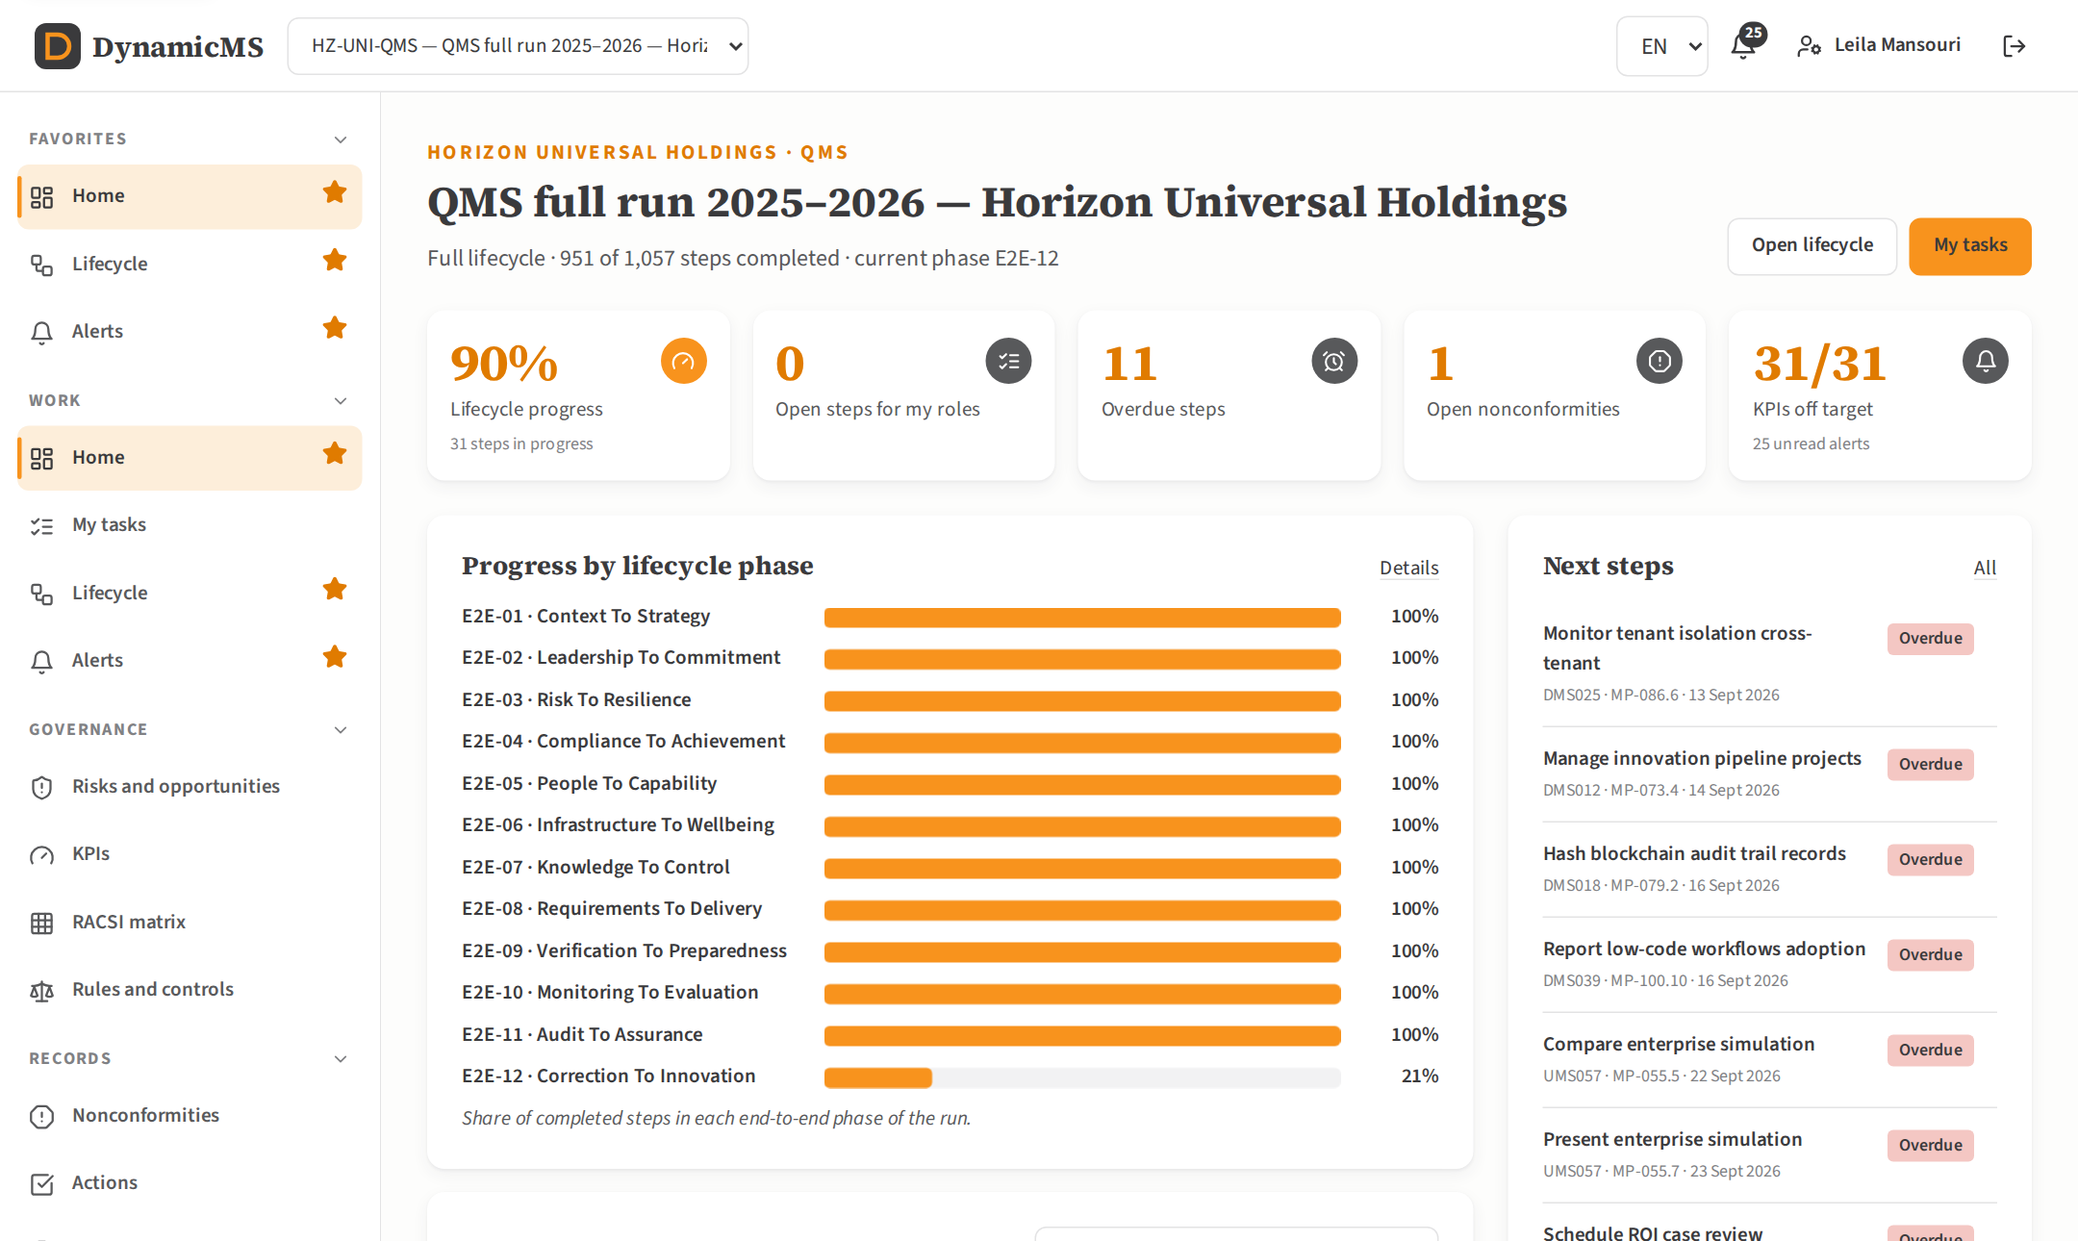
HOME
Where the run stands, at a glance
Progress by end-to-end phase
KPI trend against its target
Next steps due for my roles
POWERACT Consulting · The main screens
8

Slide 9
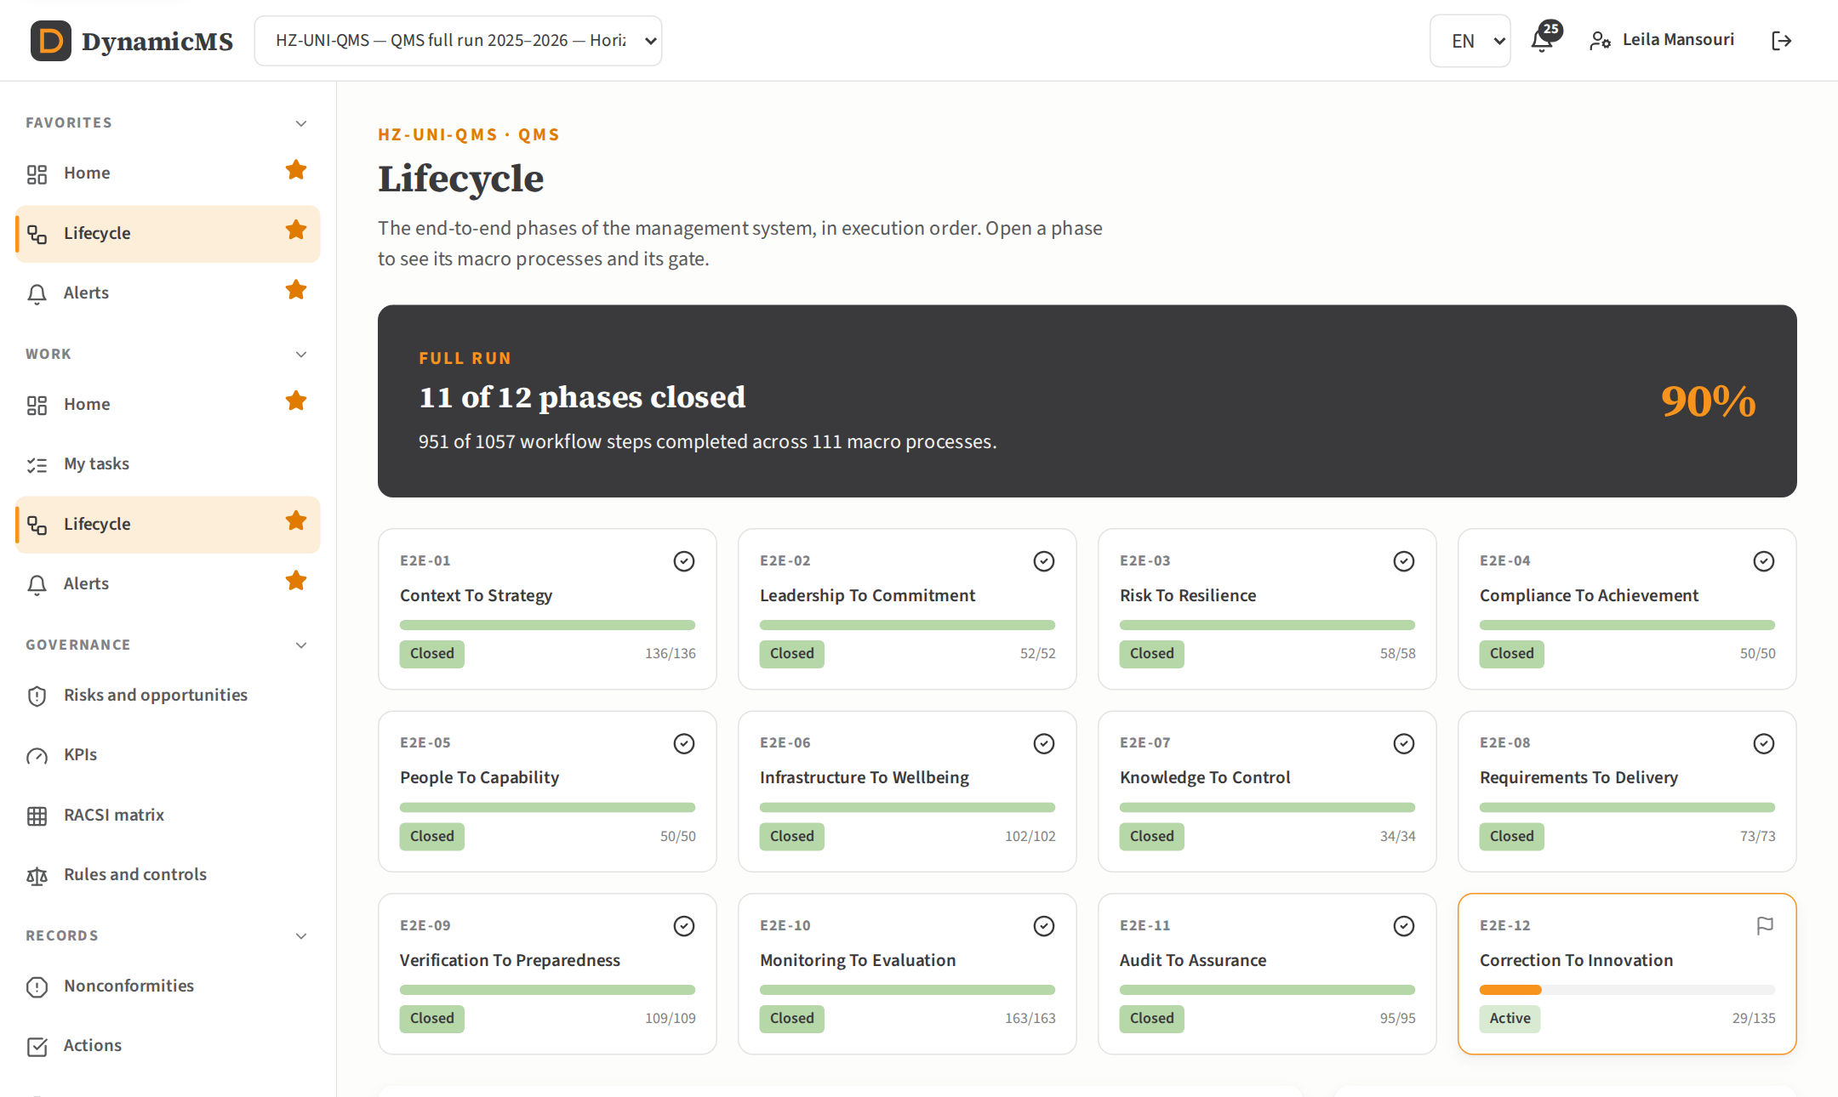
LIFECYCLE
Twelve phases, run in order
A card per phase with completed steps
Gate status and decision on each card
Macro processes of the selected phase
POWERACT Consulting · The main screens
9

Slide 10
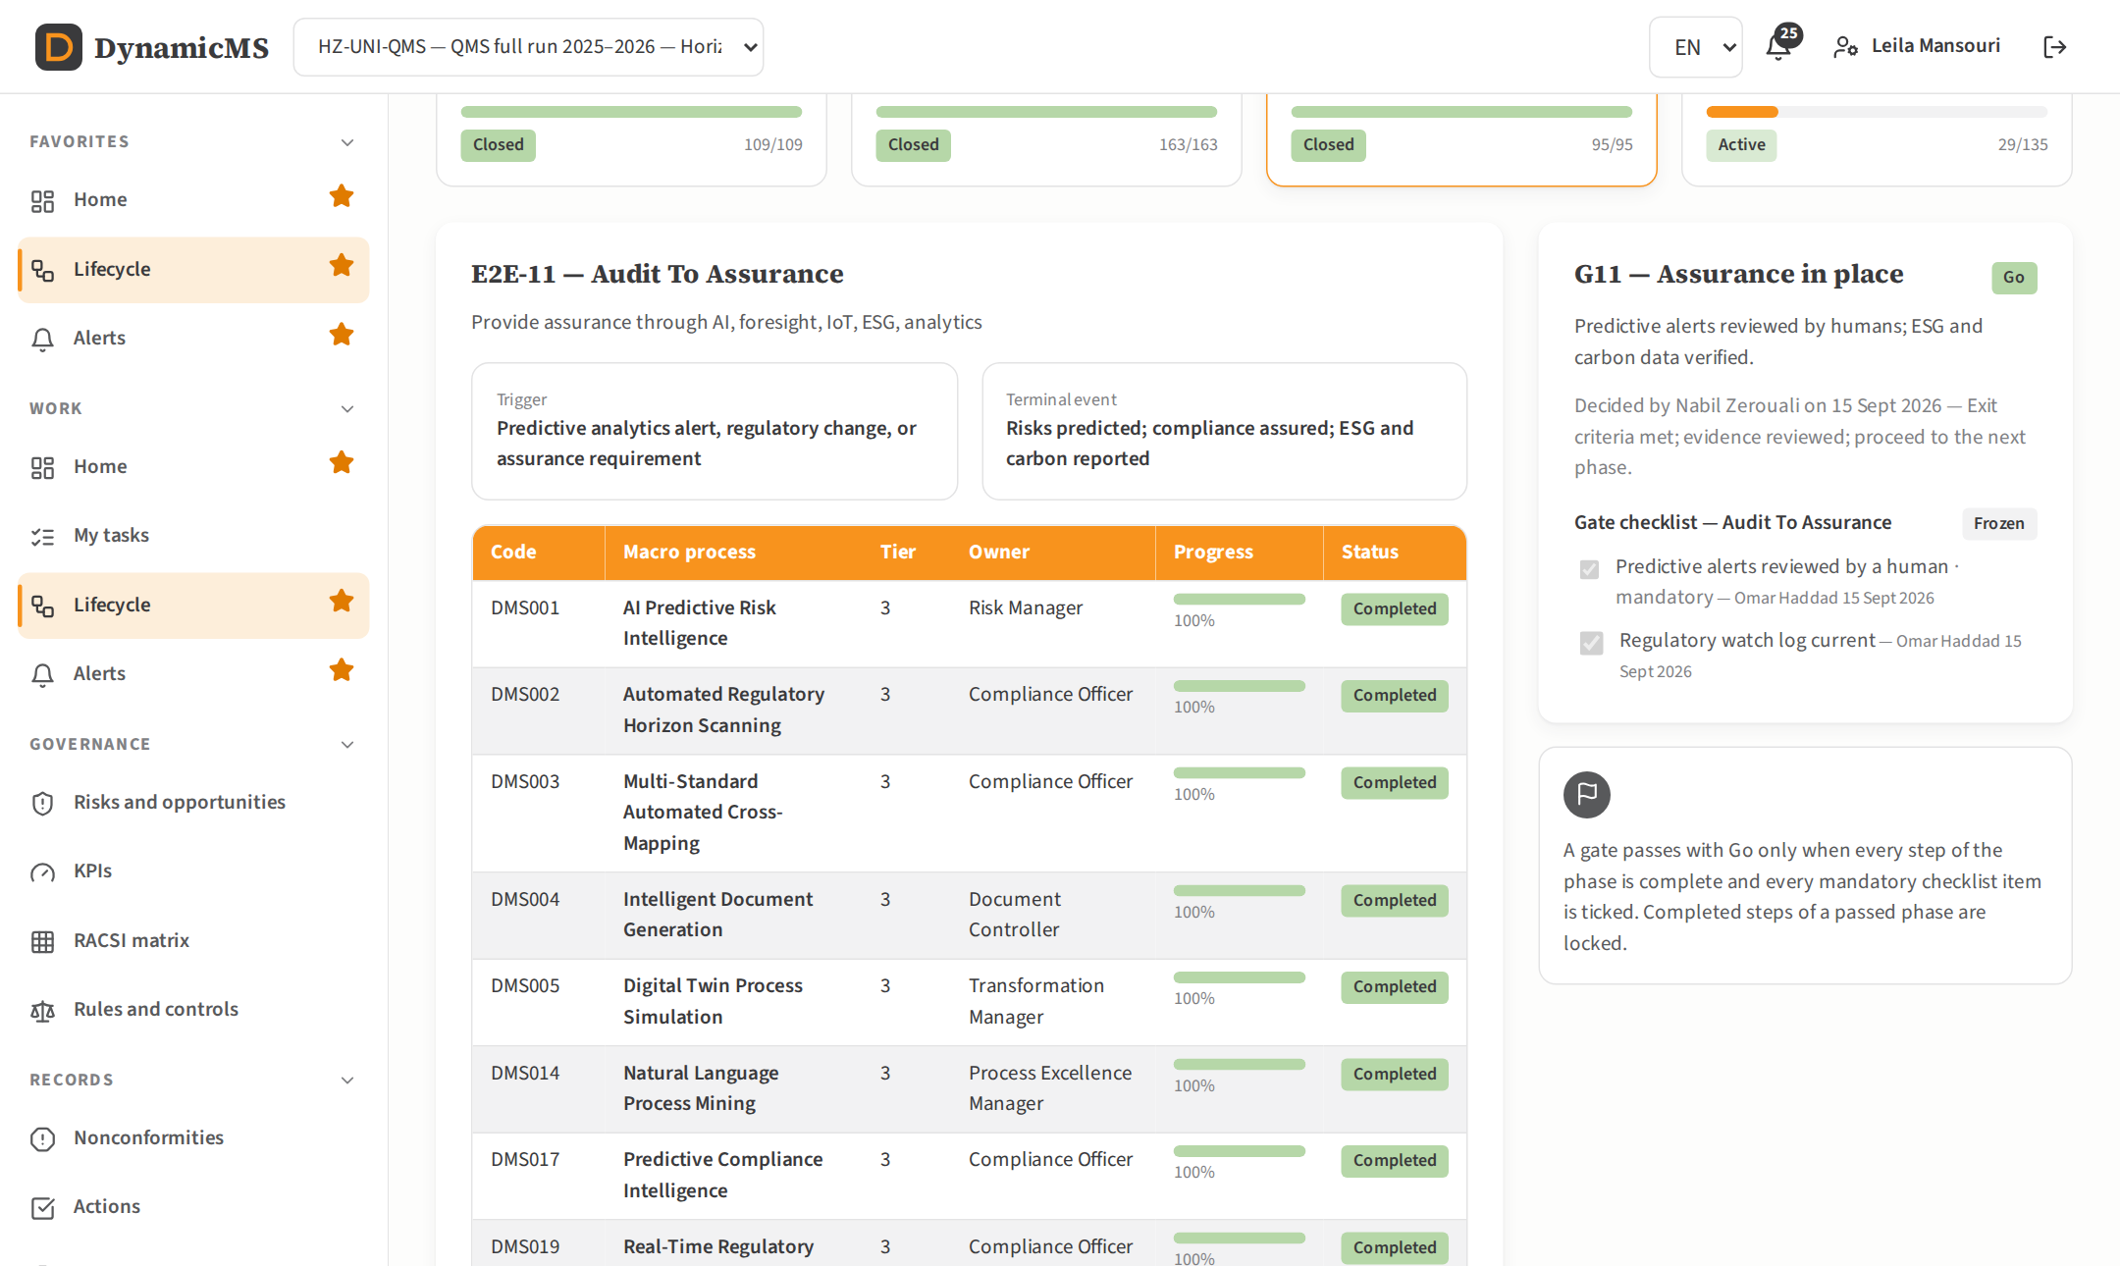
GATES
A gate closes each phase
Exit criteria and checklist items
Go only when every step is complete
Hold and No-Go require a comment
POWERACT Consulting · The main screens
10

Slide 11
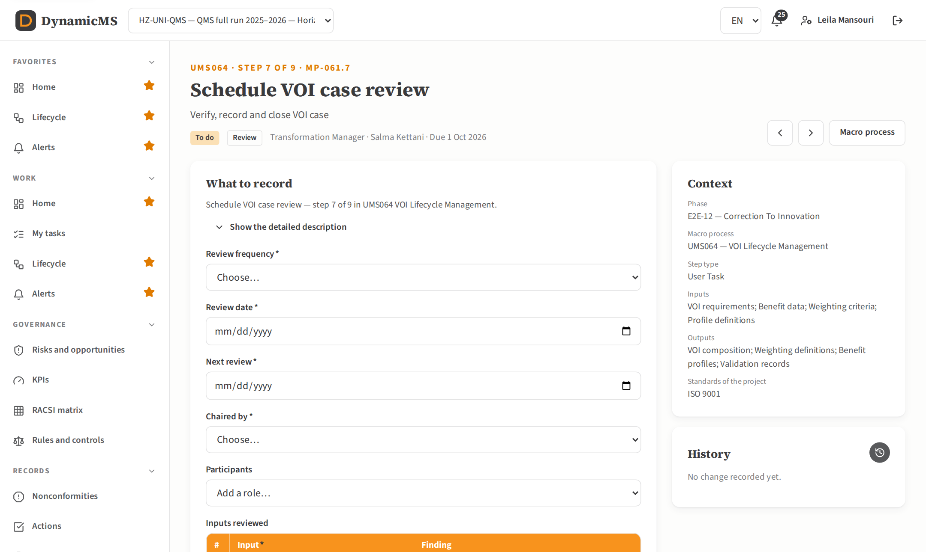
WORKFLOW STEP
Every step has its own input form
20 form kinds cover the 1,572 steps
Explicit names, brief and detailed description
Generate a document, attach files with history
POWERACT Consulting · The main screens
11

Slide 12
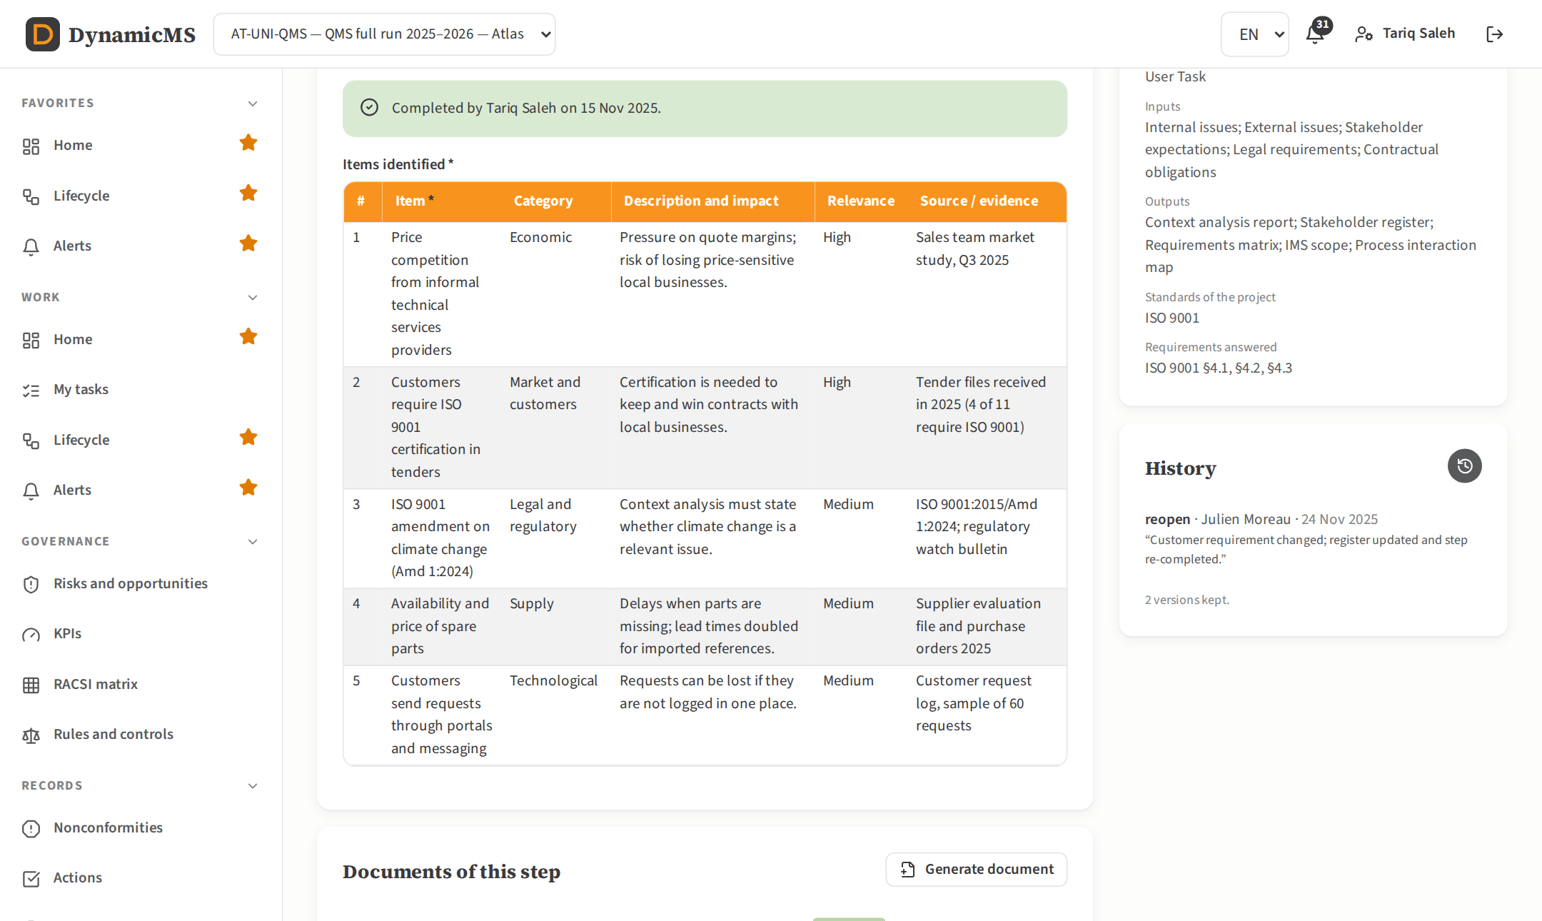
RECORD TABLES
One row per item, each with its source
Add, edit or delete rows
People and units picked from the OBS
Plans become actions, objectives a register
POWERACT Consulting · The main screens
12

Slide 13
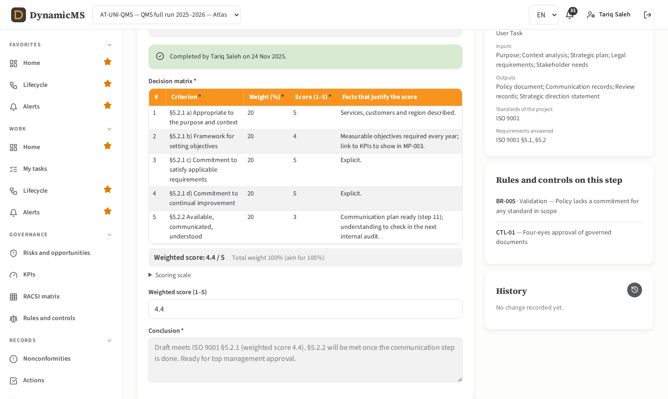
DECISION MATRIX
Scores explained criterion by criterion
Weights and 1–5 scores with the facts
Weighted score computed
Scoring scale shown on the step
POWERACT Consulting · The main screens
13

Slide 14
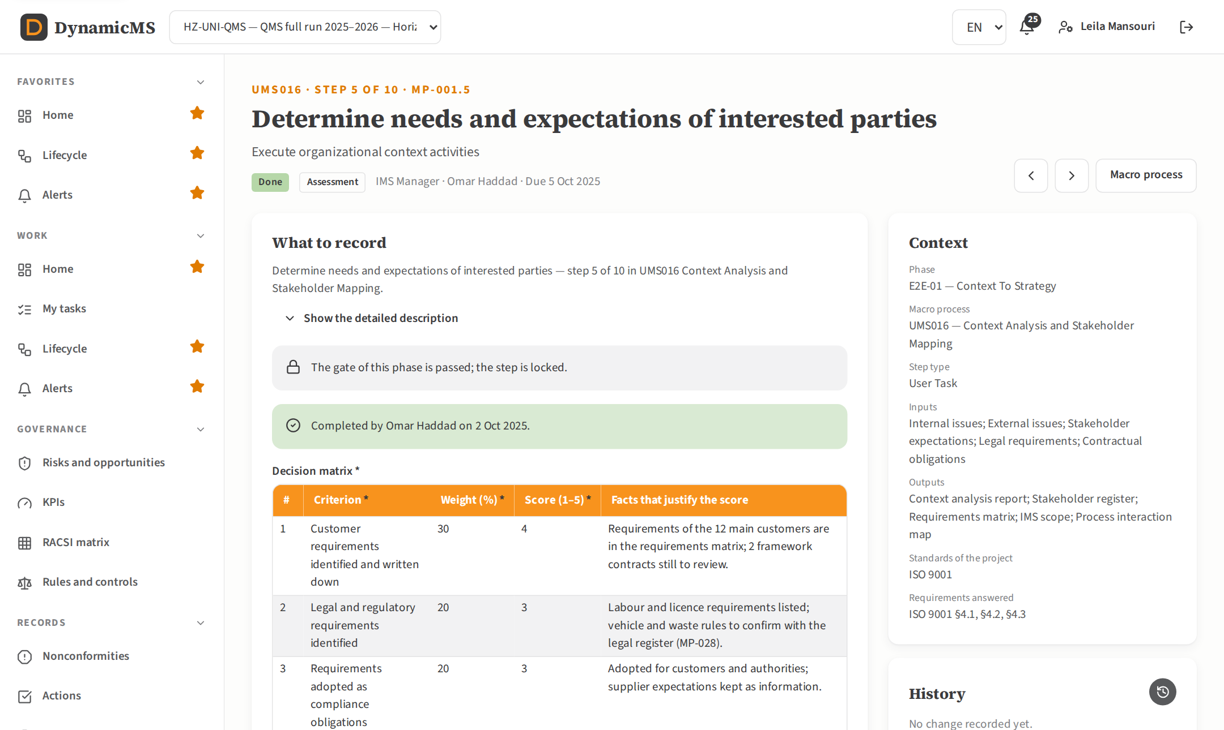
TRACEABILITY
Completed steps keep their evidence
Who completed the step and when
Reopen needs a written justification
A passed gate locks the phase
POWERACT Consulting · The main screens
14

Slide 15
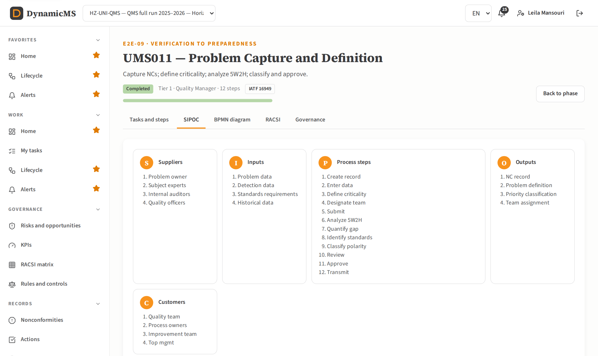
MACRO PROCESS
SIPOC of each macro process
Suppliers, inputs, process, outputs, customers
Tasks and steps in execution order
KPIs, rules and AI use cases of the process
POWERACT Consulting · The main screens
15

Slide 16
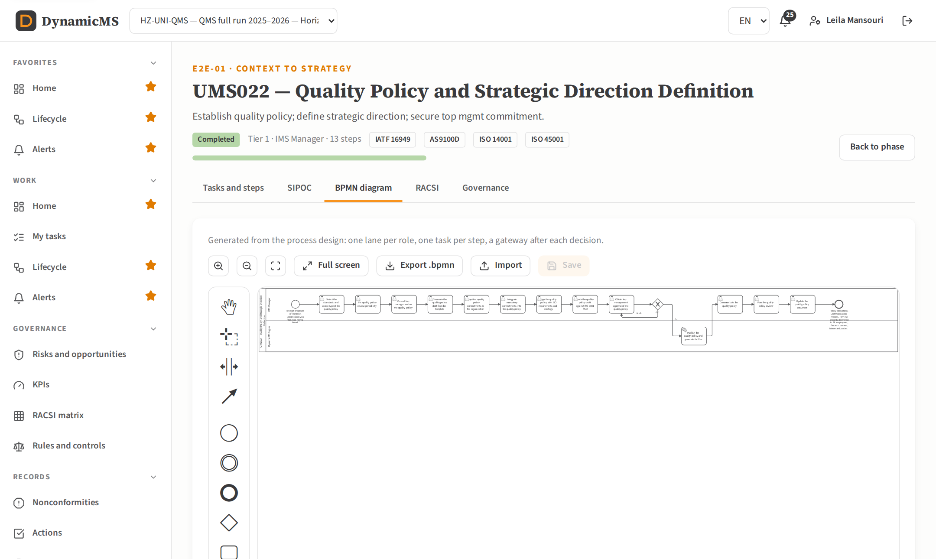
BPMN 2.0
Diagrams generated from the process design
One lane per role, one task per step
Palette in its own panel beside the canvas
Export and import .bpmn files
POWERACT Consulting · The main screens
16

Slide 17
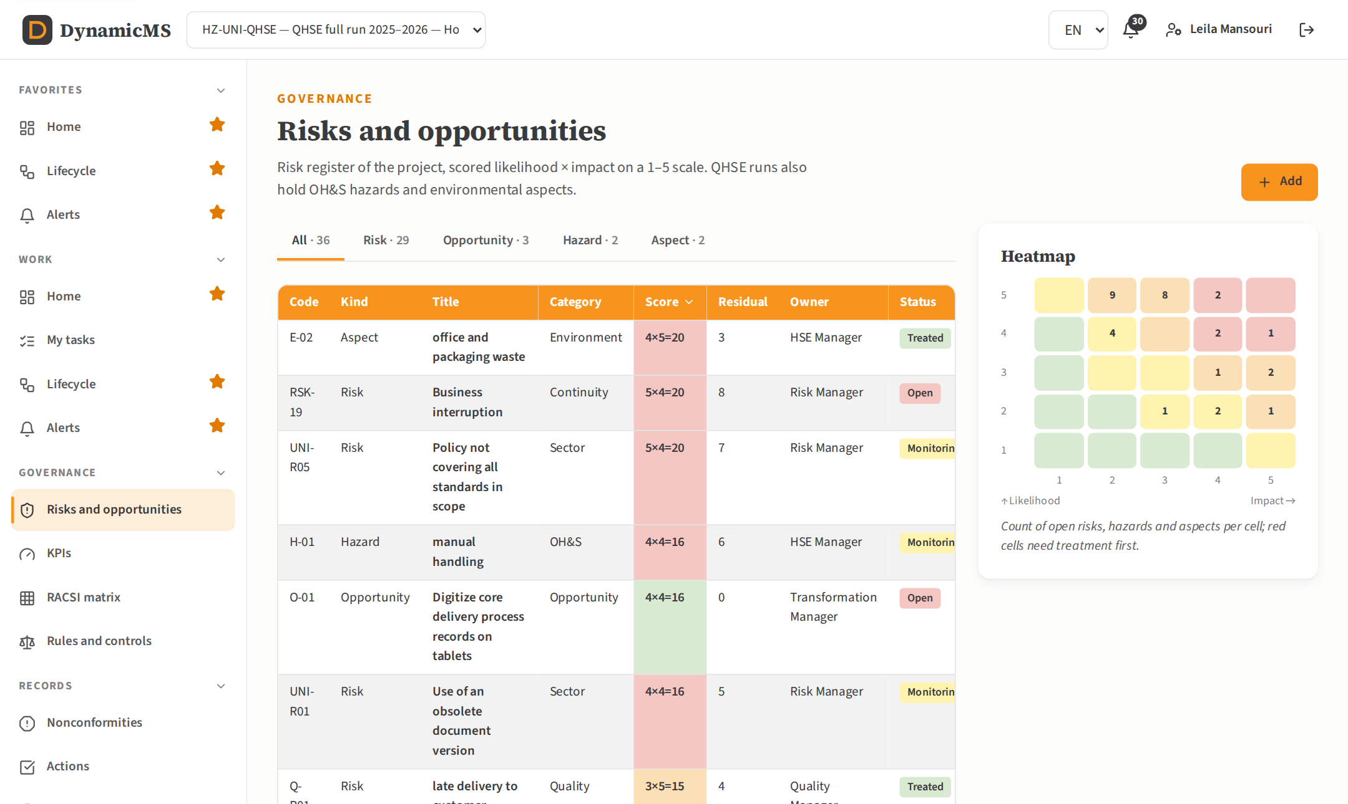
RISKS
Risks, hazards and aspects on one heatmap
Likelihood × impact on a 1–5 scale
QHSE runs add OH&S hazards and environmental aspects
Treatment and residual score per entry
POWERACT Consulting · The main screens
17

Slide 18
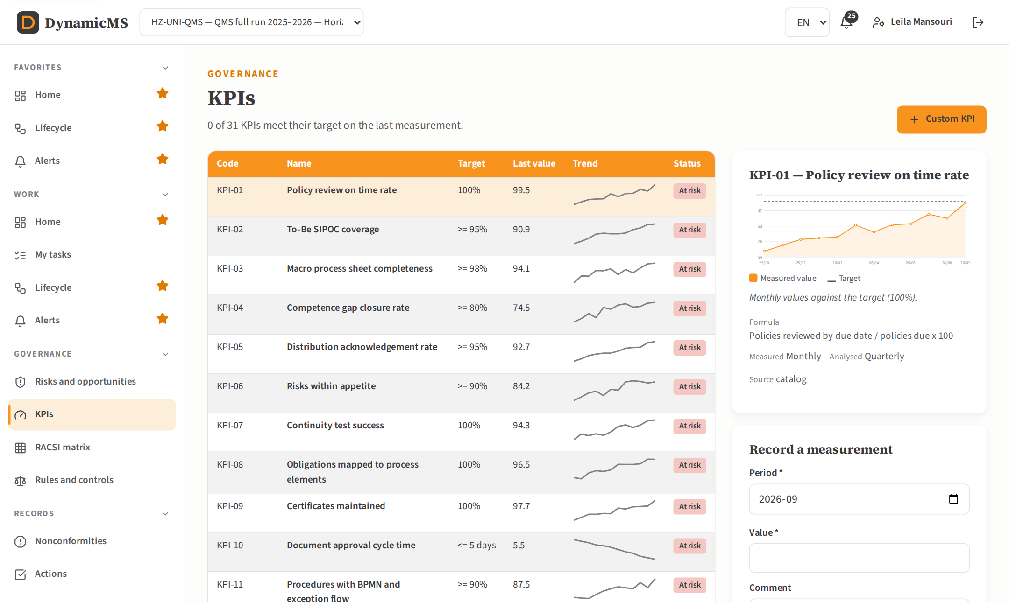
KPIS
KPIs measured every month against target
Catalog, sector and core KPIs
A value off target raises an alert
Custom KPIs with measurement rules
POWERACT Consulting · The main screens
18

Slide 19
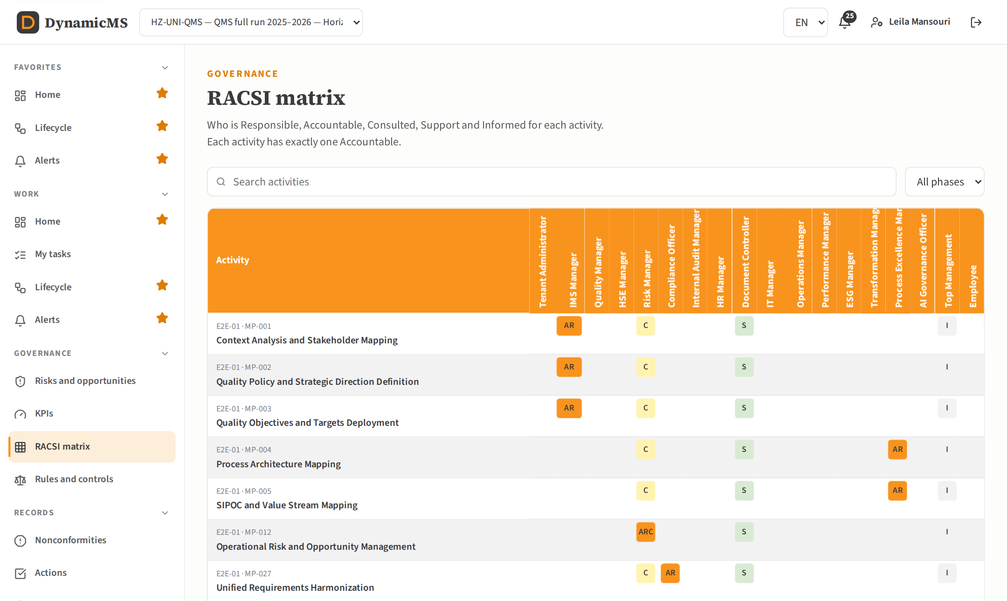
RACSI
Exactly one Accountable per activity
Activities of each phase and macro process
Responsible, Consulted, Support, Informed
The rule is enforced by the database
POWERACT Consulting · The main screens
19

Slide 20
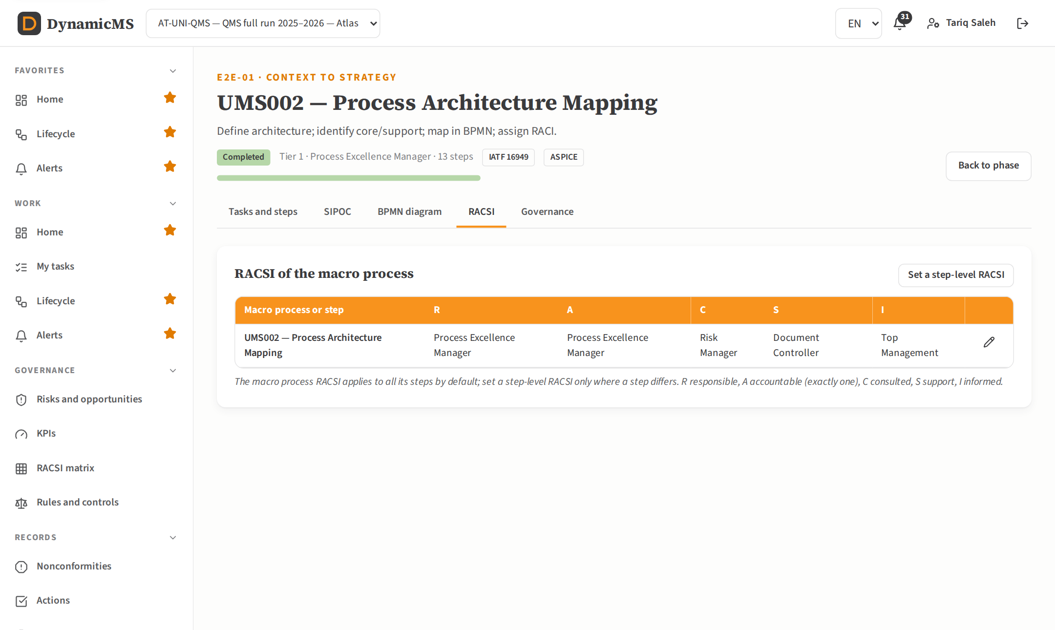
RACSI PER MACRO PROCESS
Five columns, by default for all steps
Edited on the macro process page
A step-level RACSI only where a step differs
Checked before starting (readiness list)
POWERACT Consulting · The main screens
20

Slide 21
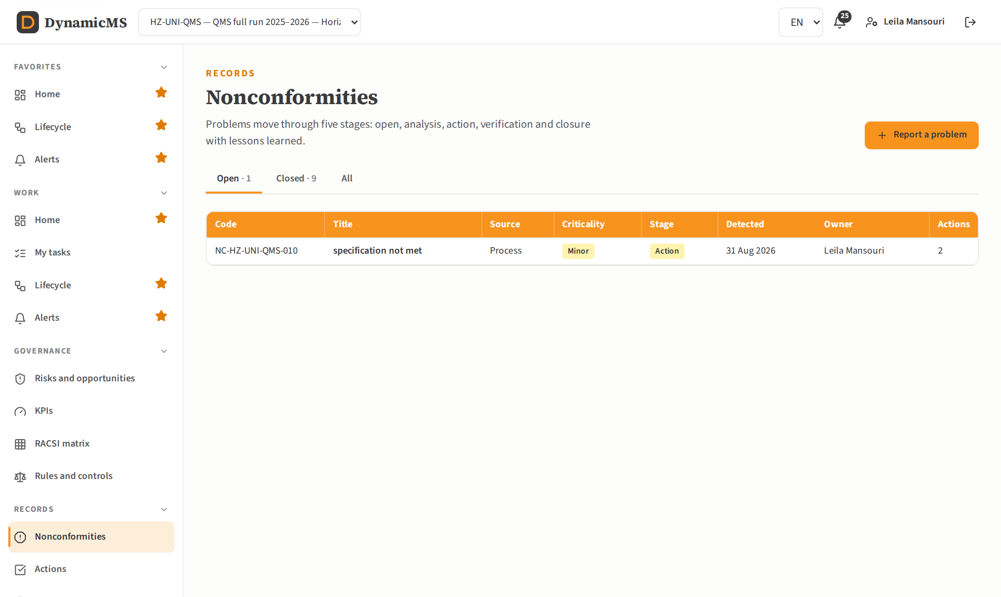
NONCONFORMITIES
From detection to lessons learned
Five stages, one at a time
Owner and evaluator are different people
Closure requires the lessons learned
POWERACT Consulting · The main screens
21

Slide 22
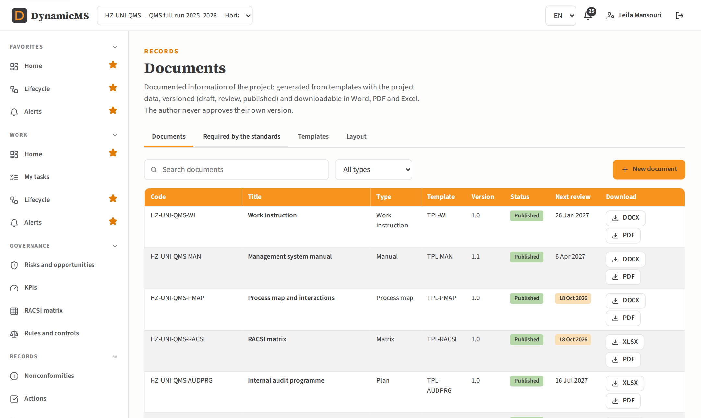
DOCUMENTS
Documents generated from the project data
Word, PDF and Excel, cover and table of contents
Draft, review, published, superseded
Structure editing, layout, CRUD by role
POWERACT Consulting · The main screens
22

Slide 23
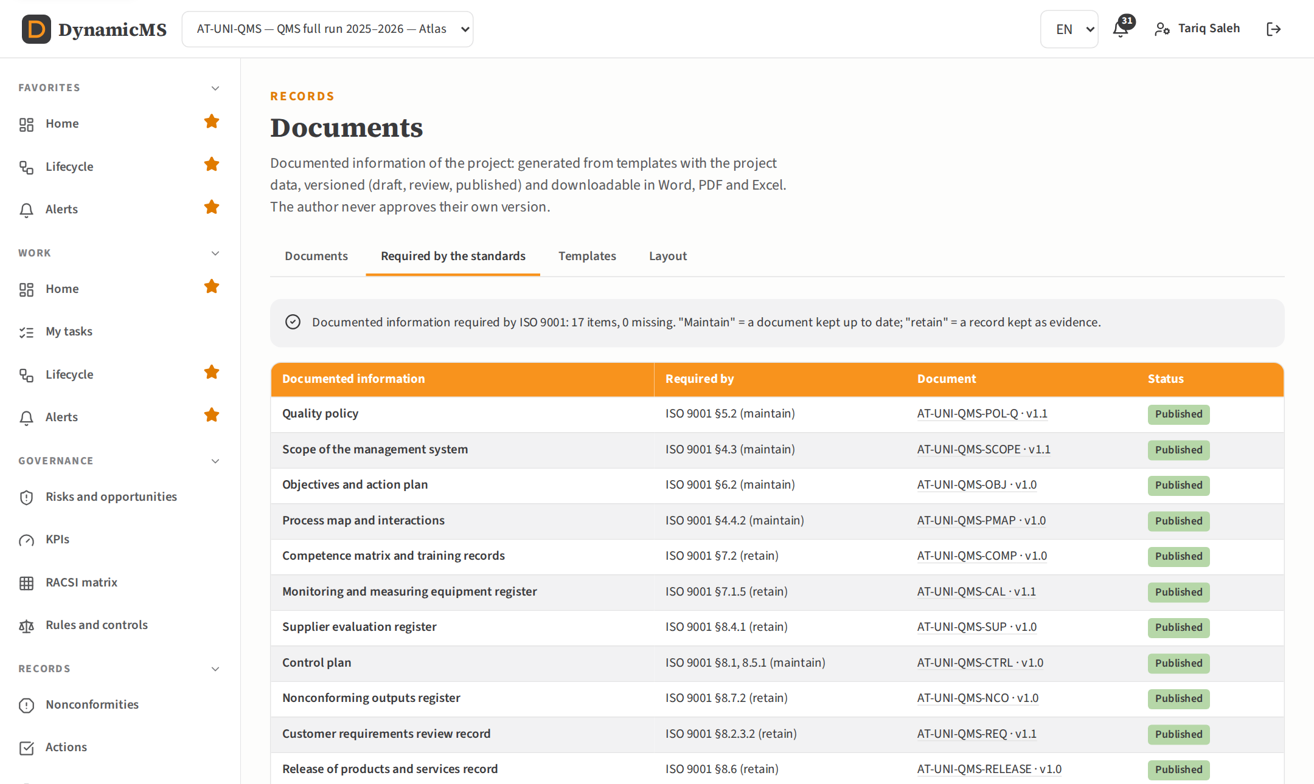
REQUIRED DOCUMENTS
What ISO 9001, 14001 and 45001 require
Maintain (document) or retain (record)
The document answering each requirement
Create a missing one in one click
POWERACT Consulting · The main screens
23

Slide 24
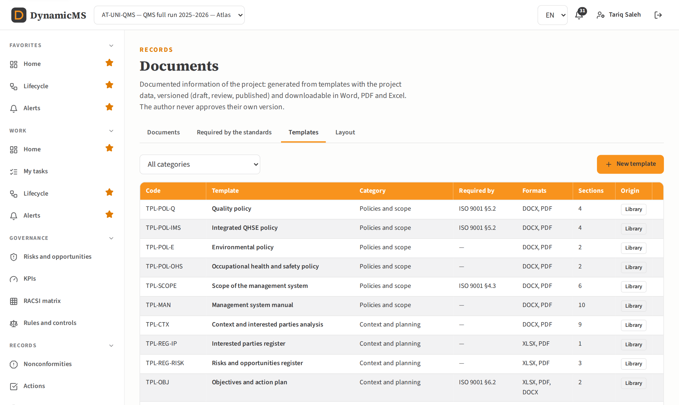
IMS TEMPLATES
37 templates, filled with the project data
Policies, scope, manual, registers, procedures
Sections with their data source
Copy and adapt, or create new templates
POWERACT Consulting · The main screens
24

Slide 25
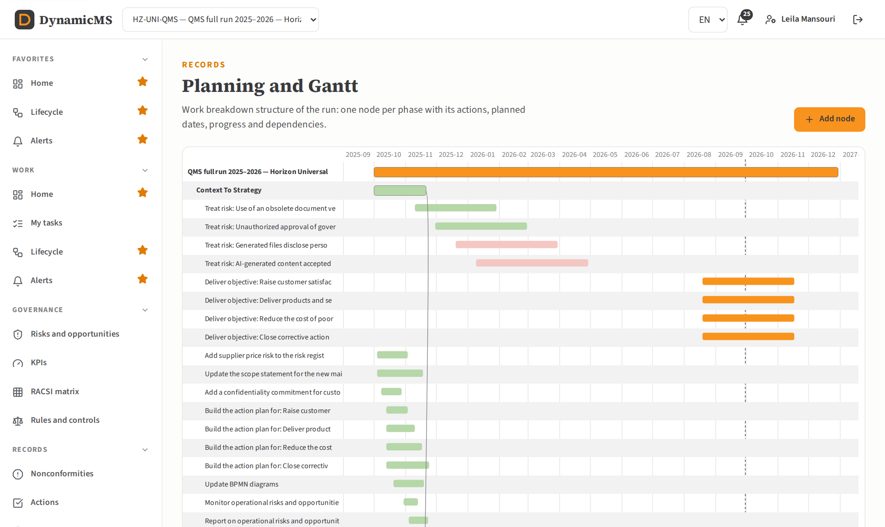
PLANNING
Work breakdown structure and Gantt chart
One node per phase with its actions
Dependencies drawn between phases
Overdue items in red
POWERACT Consulting · The main screens
25

Slide 26
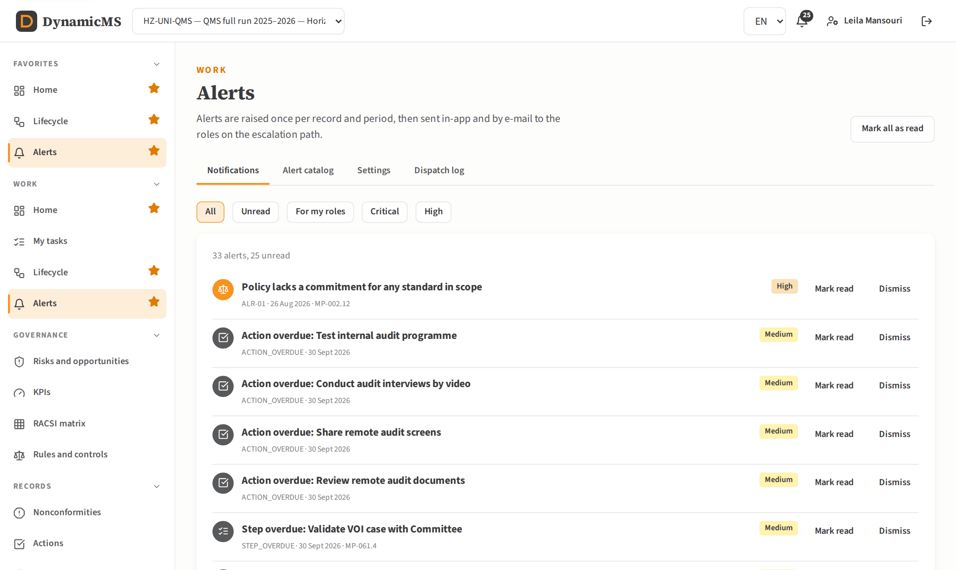
ALERTS
Raised once, sent along the escalation path
Deduplicated per record and period
In-app and e-mail dispatch log
Alert types enabled per organization
POWERACT Consulting · The main screens
26

Slide 27
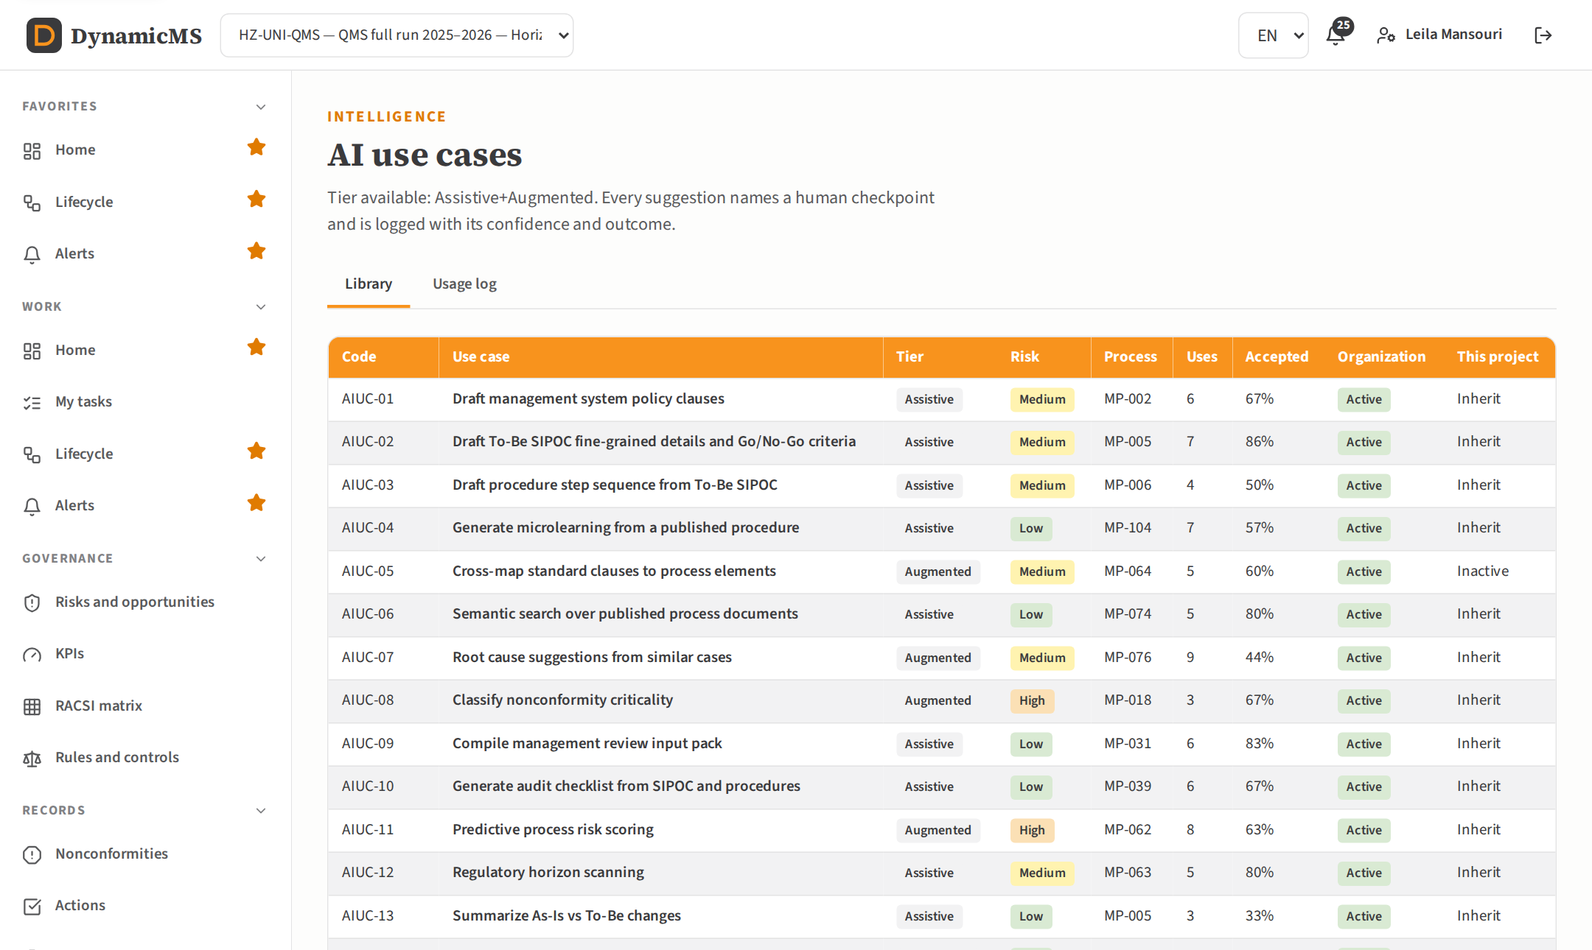
AI USE CASES
AI suggestions with a human checkpoint
Each use case mapped to its step
Prompt built from the step, visible to the user
Accepted, edited or rejected, and logged
POWERACT Consulting · The main screens
27

Slide 28
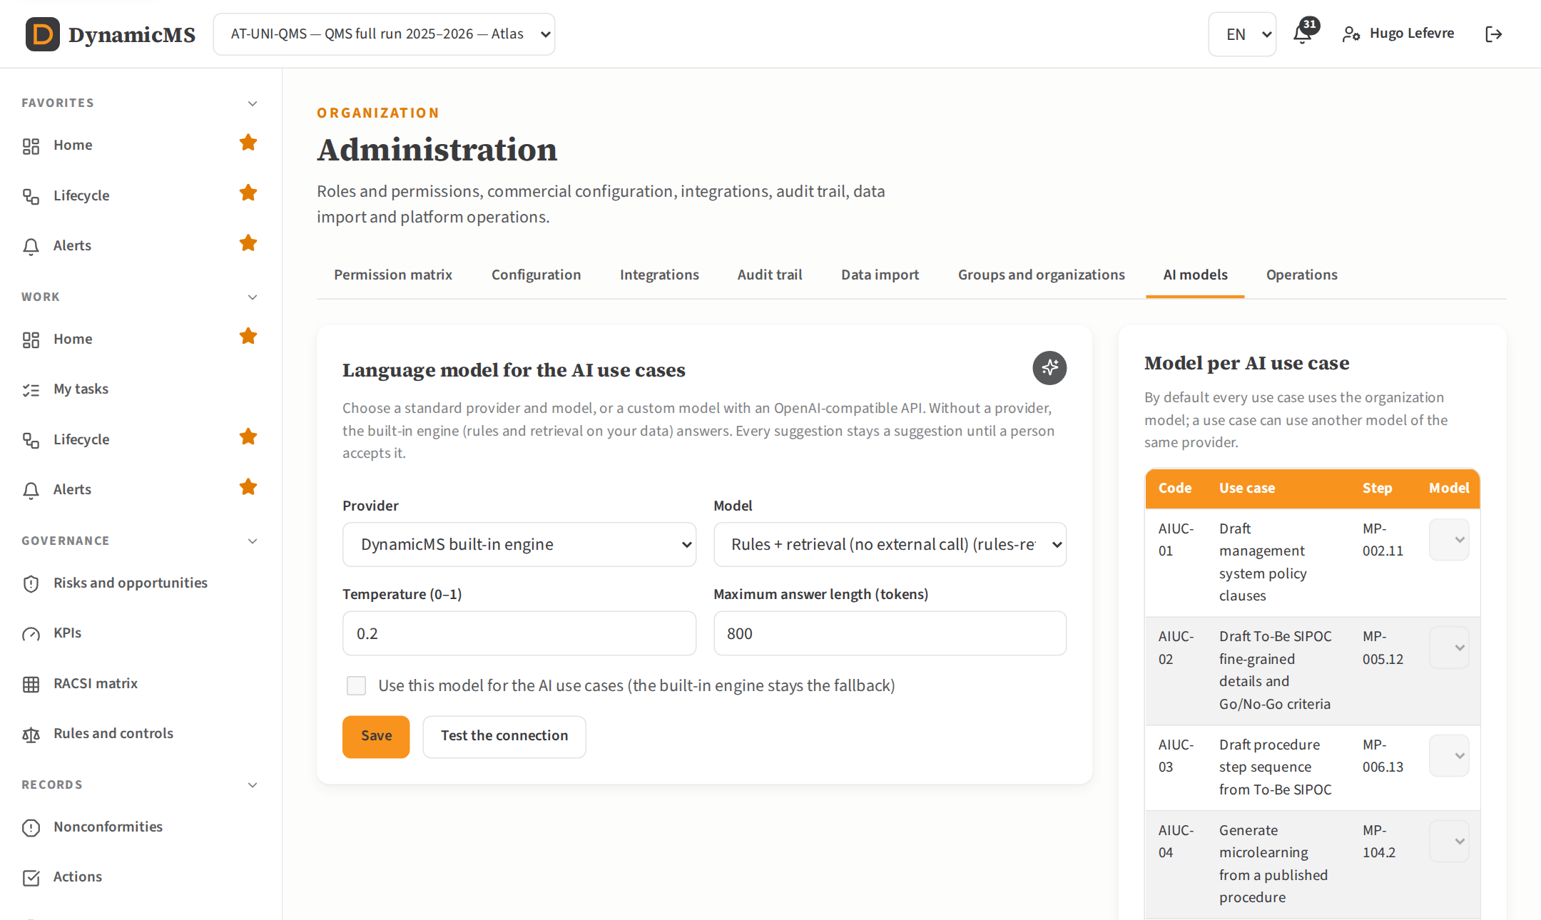
AI MODELS
Standard or custom language models
Claude, OpenAI, Azure, Gemini, Mistral or custom
Keys encrypted, connection test
Built-in engine as fallback
POWERACT Consulting · The main screens
28

Slide 29
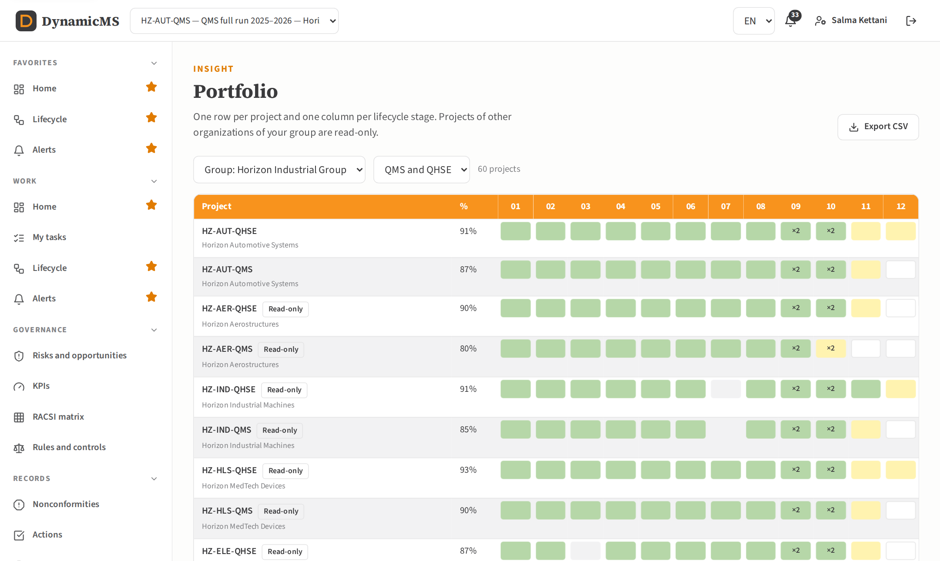
PORTFOLIO
Every project of the group, stage by stage
One row per project, one column per phase
Other organizations are read-only
Export to CSV
POWERACT Consulting · The main screens
29

Slide 30
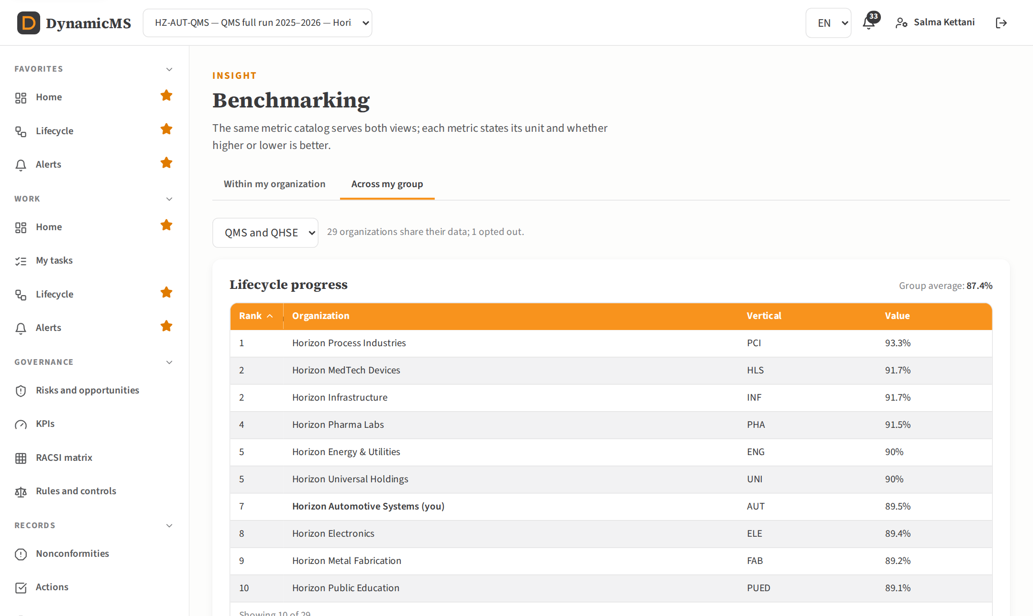
BENCHMARKING
Organizations ranked on shared metrics
Same metric catalog for all views
Only organizations that share data
Hidden below three participants
POWERACT Consulting · The main screens
30

Slide 31
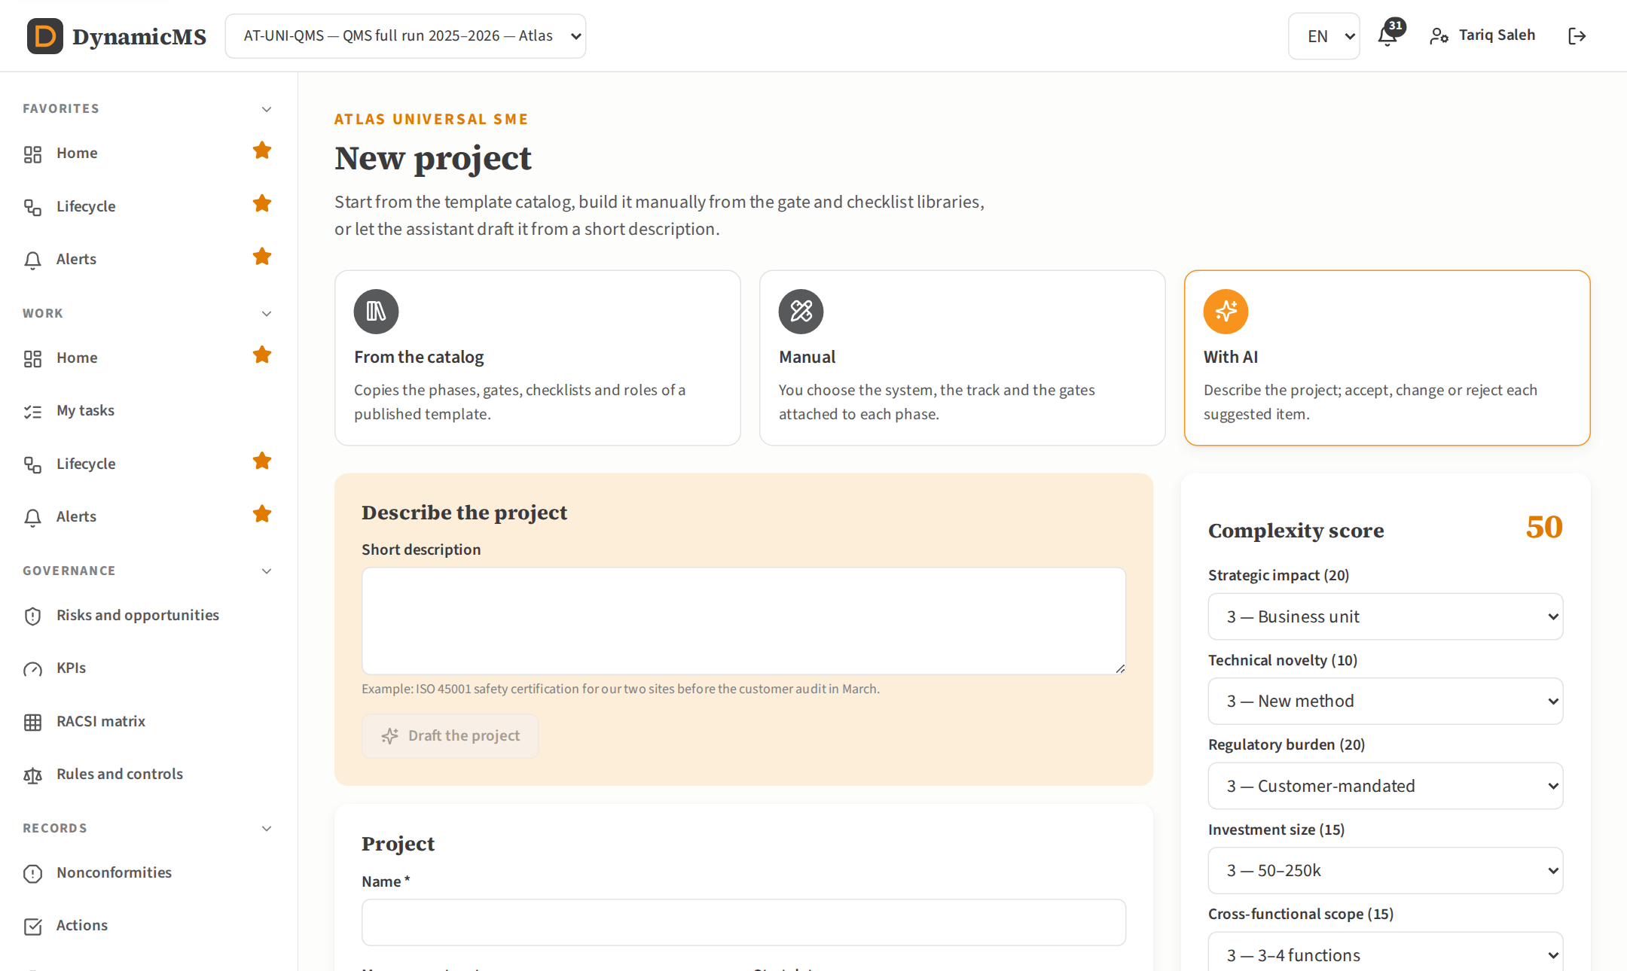
NEW PROJECT
Catalog, manual or with AI
Templates by vertical, mode and track
Complexity score recommends the track
Each AI item accepted or rejected
POWERACT Consulting · The main screens
31

Slide 32
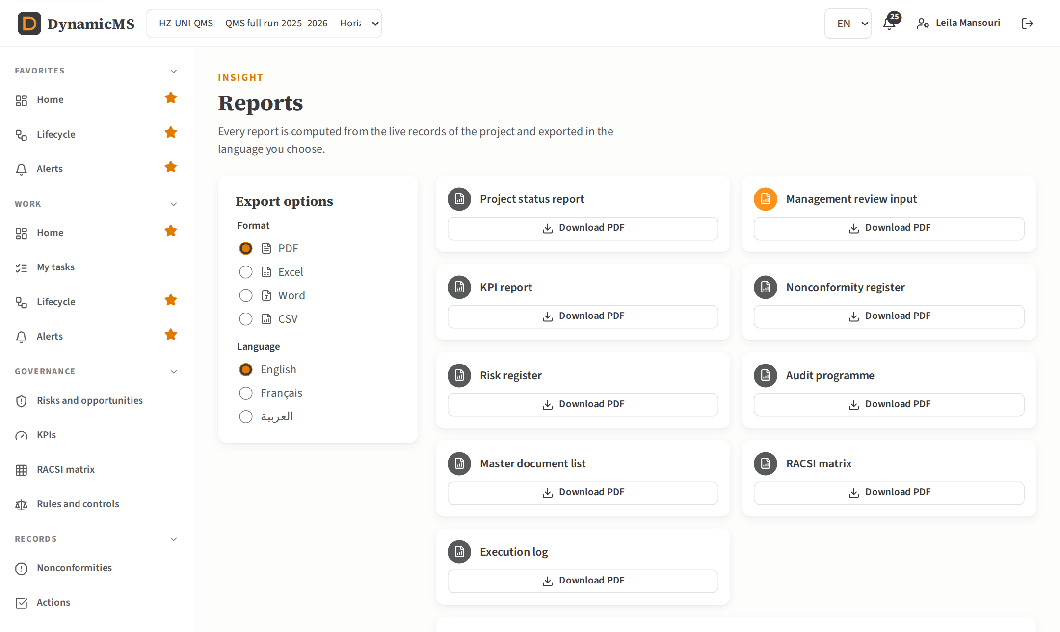
REPORTS
Reports in three languages and four formats
PDF, Excel, Word and CSV
Management review input per ISO 9001 9.3.2
Arabic reports laid out right to left
POWERACT Consulting · The main screens
32

Slide 33
One full run per sector
For each vertical: the lifecycle of the large company and the figures of its SME counterpart.
POWERACT Consulting · One full run per sector
33

Slide 34
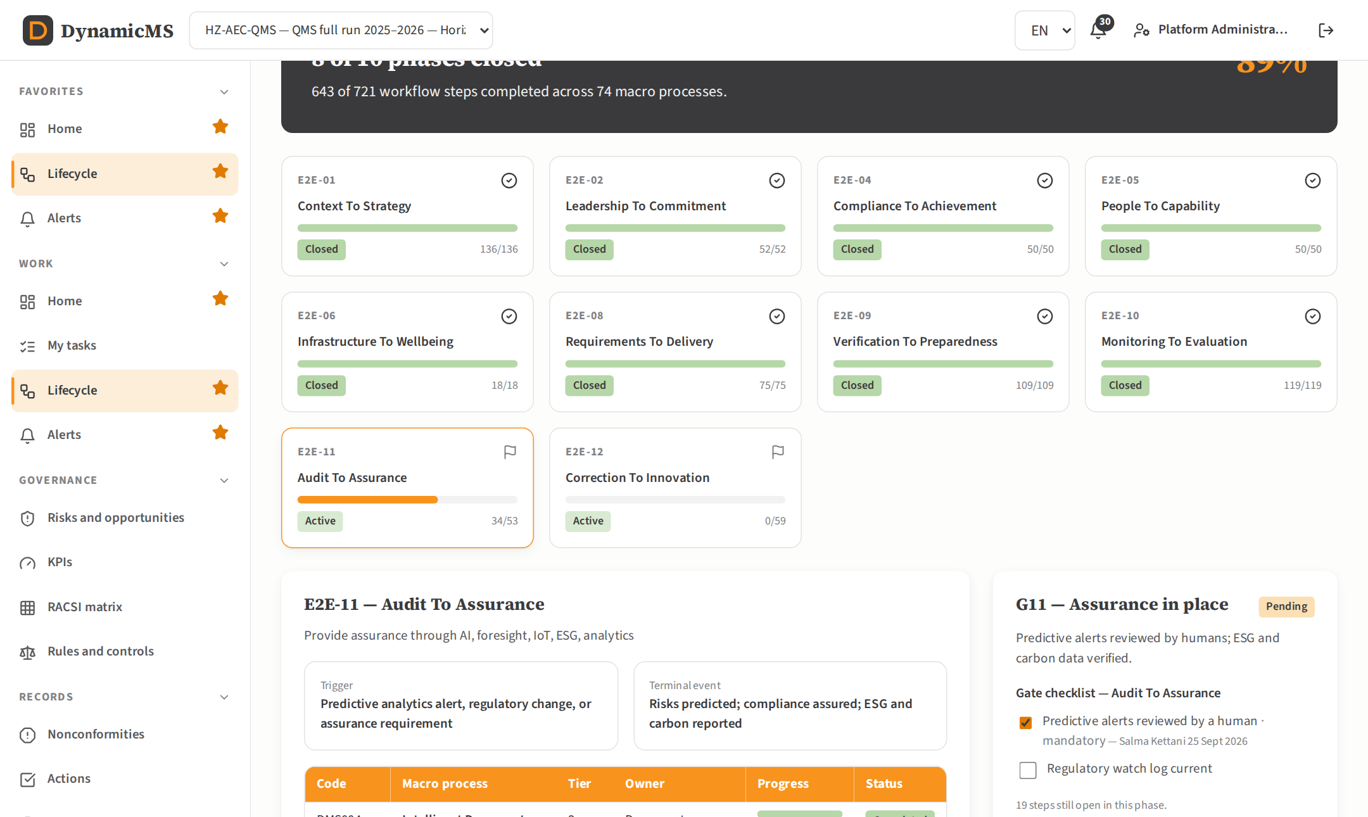
SECTOR · AEC
AEC & Construction
Horizon Build & Construct · Nova Build & Construct
Large company
SME
Macro processes QMS
74
65
Macro processes QHSE
75
66
Steps QMS
721
660
Steps QHSE
731
670
Progress QMS
89%
90%
SME track
—
Standard
Must-have standards
ISO 19650, EN 1090, CE Marking (CPR) · Industry pack: none
Lifecycle screen of the QMS run: phase cards with completed steps and gate status.
POWERACT Consulting · One full run per sector
34

Slide 35
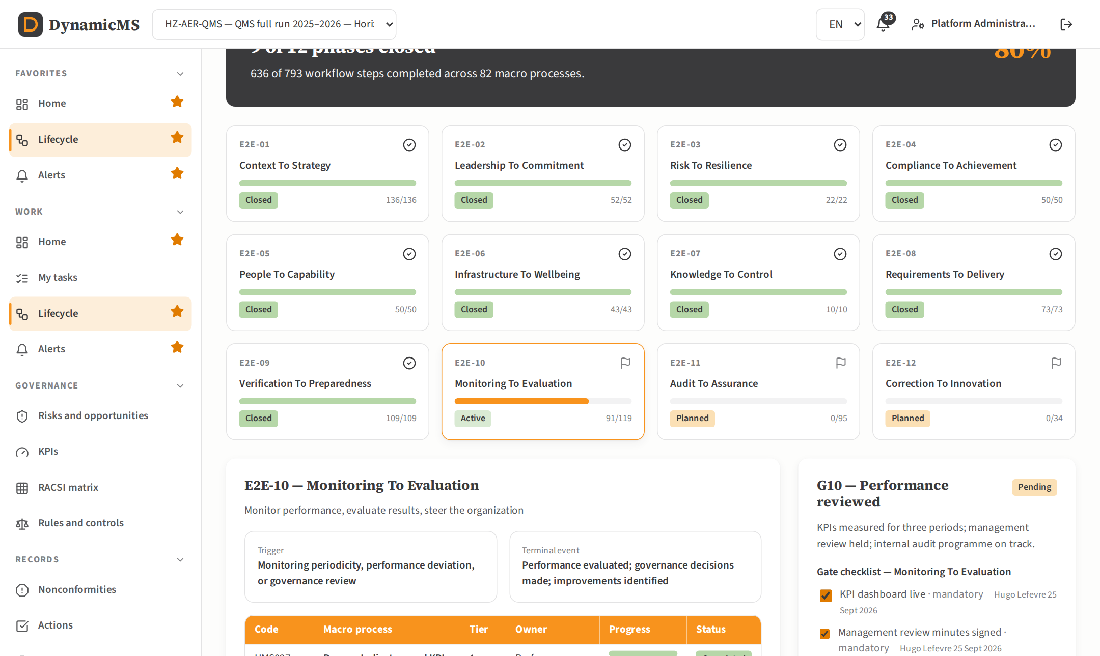
SECTOR · AER
Aerospace & Defense
Horizon Aerostructures · Nova Aerostructures
Large company
SME
Macro processes QMS
82
65
Macro processes QHSE
83
66
Steps QMS
793
662
Steps QHSE
803
672
Progress QMS
80%
77%
SME track
—
Standard
Must-have standards
AS9100D, NADCAP, ITAR/EAR, AS9120B, EASA/FAA · Industry pack: DMS-AERO
Lifecycle screen of the QMS run: phase cards with completed steps and gate status.
POWERACT Consulting · One full run per sector
35

Slide 36
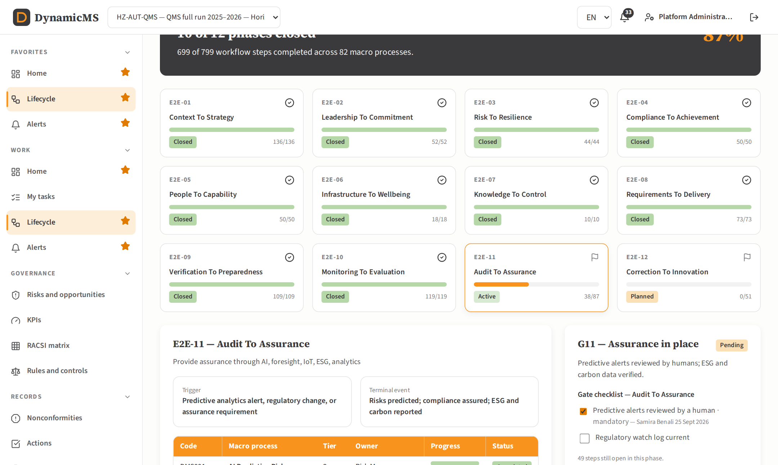
SECTOR · AUT
Automotive & Transportation
Horizon Automotive Systems · Nova Automotive Systems
Large company
SME
Macro processes QMS
82
67
Macro processes QHSE
86
71
Steps QMS
799
684
Steps QHSE
839
724
Progress QMS
87%
92%
SME track
—
Light
Must-have standards
IATF 16949, ISO 26262, ISO/SAE 21434, ASPICE, AEC-Q · Industry pack: DMS-AUTO
Lifecycle screen of the QMS run: phase cards with completed steps and gate status.
POWERACT Consulting · One full run per sector
36

Slide 37
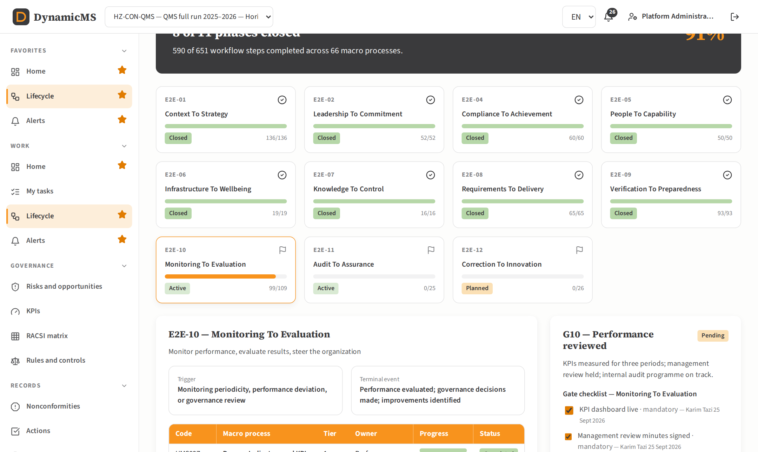
SECTOR · CON
Consumer Products Extended
Horizon Consumer Products · Nova Consumer Products
Large company
SME
Macro processes QMS
66
65
Macro processes QHSE
75
73
Steps QMS
651
660
Steps QHSE
740
740
Progress QMS
91%
86%
SME track
—
Standard
Must-have standards
ISO 9001, ISO 22716, FDA CGMP, ISO 13485 · Industry pack: none
Lifecycle screen of the QMS run: phase cards with completed steps and gate status.
POWERACT Consulting · One full run per sector
37

Slide 38

SECTOR · CPG
Consumer Packaged Goods
Horizon Consumer Goods · Nova Consumer Goods
Large company
SME
Macro processes QMS
71
64
Macro processes QHSE
76
66
Steps QMS
694
650
Steps QHSE
742
670
Progress QMS
91%
90%
SME track
—
Standard
Must-have standards
ISO 22000, FDA 21 CFR 110, FSSC 22000, HACCP · Industry pack: DMS-FOOD
Lifecycle screen of the QMS run: phase cards with completed steps and gate status.
POWERACT Consulting · One full run per sector
38

Slide 39
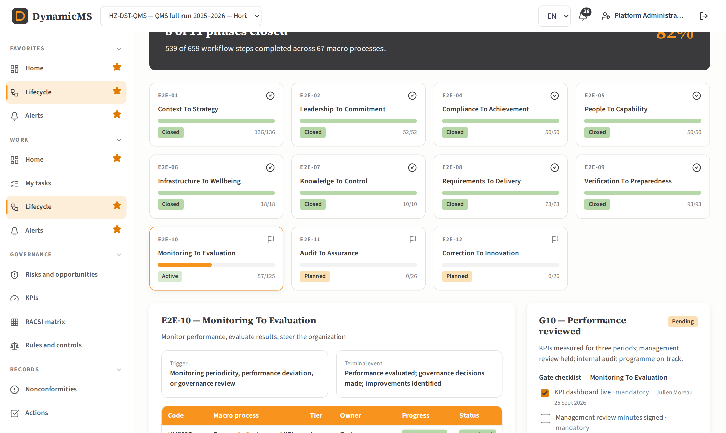
SECTOR · DST
Distribution
Horizon Distribution · Nova Distribution
Large company
SME
Macro processes QMS
67
64
Macro processes QHSE
69
66
Steps QMS
659
650
Steps QHSE
679
670
Progress QMS
82%
88%
SME track
—
Standard
Must-have standards
ISO 9001, GDP, IFS Logistic · Industry pack: none
Lifecycle screen of the QMS run: phase cards with completed steps and gate status.
POWERACT Consulting · One full run per sector
39

Slide 40

SECTOR · ELE
Electronics & High-Tech
Horizon Electronics · Nova Electronics
Large company
SME
Macro processes QMS
76
65
Macro processes QHSE
80
69
Steps QMS
736
660
Steps QHSE
776
700
Progress QMS
91%
79%
SME track
—
Standard
Must-have standards
IPC-A-610, IPC-J-STD-001, ISO 9001, RoHS, REACH · Industry pack: DMS-AUTO
Lifecycle screen of the QMS run: phase cards with completed steps and gate status.
POWERACT Consulting · One full run per sector
40

Slide 41

SECTOR · ENG
Energy & Utilities
Horizon Energy & Utilities · Nova Energy & Utilities
Large company
SME
Macro processes QMS
74
67
Macro processes QHSE
80
71
Steps QMS
723
680
Steps QHSE
782
721
Progress QMS
88%
76%
SME track
—
Light
Must-have standards
ISO 55001, IEC 62443, NERC CIP, IEC 62351 · Industry pack: DMS-PROC
Lifecycle screen of the QMS run: phase cards with completed steps and gate status.
POWERACT Consulting · One full run per sector
41

Slide 42
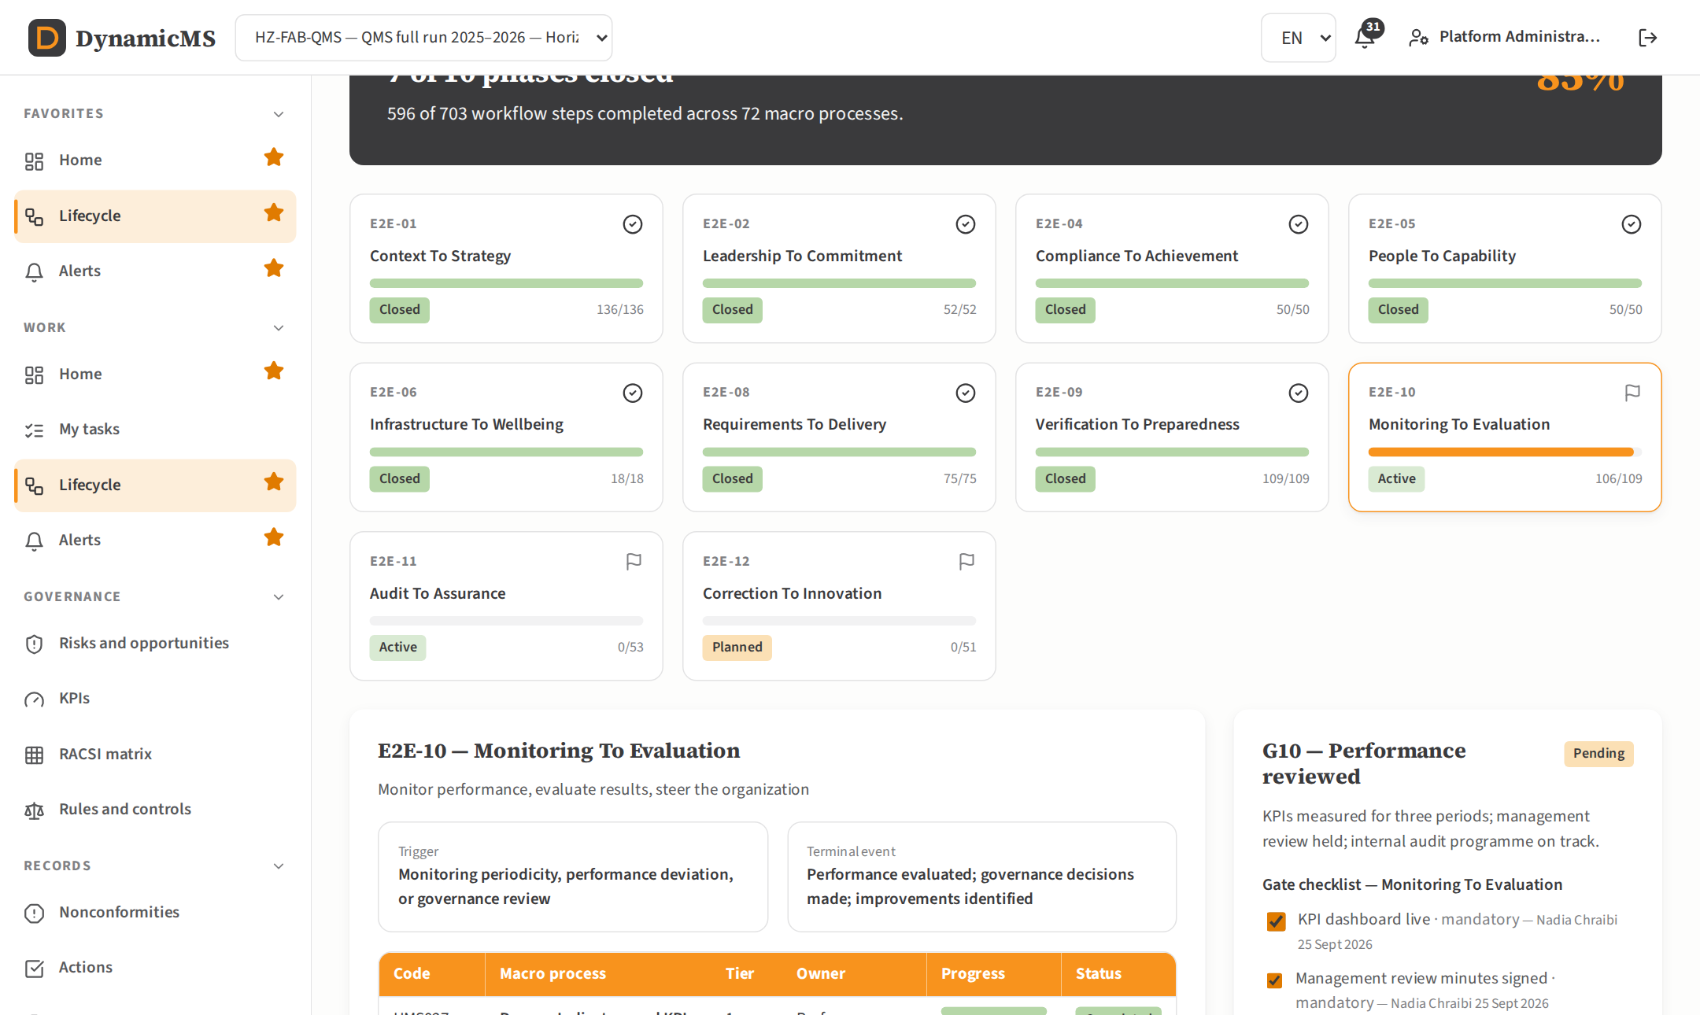
SECTOR · FAB
Fabrication & Assembly
Horizon Metal Fabrication · Nova Metal Fabrication
Large company
SME
Macro processes QMS
72
65
Macro processes QHSE
73
66
Steps QMS
703
660
Steps QHSE
713
670
Progress QMS
85%
84%
SME track
—
Light
Must-have standards
EN 1090, ISO 3834, ISO 14554, DIN EN 1090-2 · Industry pack: DMS-AUTO
Lifecycle screen of the QMS run: phase cards with completed steps and gate status.
POWERACT Consulting · One full run per sector
42

Slide 43

SECTOR · FNB
Food & Beverage
Horizon Food & Beverages · Nova Food & Beverages
Large company
SME
Macro processes QMS
72
65
Macro processes QHSE
79
69
Steps QMS
704
660
Steps QHSE
772
700
Progress QMS
83%
91%
SME track
—
Standard
Must-have standards
HACCP, ISO 22000, FSSC 22000, BRCGS, IFS Food · Industry pack: DMS-FOOD
Lifecycle screen of the QMS run: phase cards with completed steps and gate status.
POWERACT Consulting · One full run per sector
43

Slide 44

SECTOR · HCA
Healthcare (Providers)
Horizon Health Clinics · Nova Health Clinics
Large company
SME
Macro processes QMS
78
67
Macro processes QHSE
79
68
Steps QMS
760
680
Steps QHSE
770
690
Progress QMS
82%
91%
SME track
—
Standard
Must-have standards
JCI, ISO 9001, HIPAA, GDPR, NHA · Industry pack: DMS-LSCI
Lifecycle screen of the QMS run: phase cards with completed steps and gate status.
POWERACT Consulting · One full run per sector
44

Slide 45

SECTOR · HLS
Healthcare & Life Sciences
Horizon MedTech Devices · Nova MedTech Devices
Large company
SME
Macro processes QMS
82
67
Macro processes QHSE
84
68
Steps QMS
792
680
Steps QHSE
811
690
Progress QMS
90%
89%
SME track
—
Light
Must-have standards
ISO 13485, FDA 21 CFR Part 820, EU MDR 2017/745 · Industry pack: DMS-LSCI
Lifecycle screen of the QMS run: phase cards with completed steps and gate status.
POWERACT Consulting · One full run per sector
45

Slide 46

SECTOR · IND
Industrial Machinery
Horizon Industrial Machines · Nova Industrial Machines
Large company
SME
Macro processes QMS
71
66
Macro processes QHSE
72
67
Steps QMS
697
672
Steps QHSE
707
682
Progress QMS
85%
77%
SME track
—
Light
Must-have standards
EN ISO 12100, EN ISO 13849-1, EN 62061, CE Marking · Industry pack: DMS-AUTO
Lifecycle screen of the QMS run: phase cards with completed steps and gate status.
POWERACT Consulting · One full run per sector
46

Slide 47

SECTOR · INF
Infrastructure
Horizon Infrastructure · Nova Infrastructure
Large company
SME
Macro processes QMS
67
65
Macro processes QHSE
68
66
Steps QMS
661
660
Steps QHSE
671
670
Progress QMS
93%
90%
SME track
—
Light
Must-have standards
ISO 55001, EN 1090, EN 1990, CE Marking · Industry pack: DMS-PROC
Lifecycle screen of the QMS run: phase cards with completed steps and gate status.
POWERACT Consulting · One full run per sector
47

Slide 48
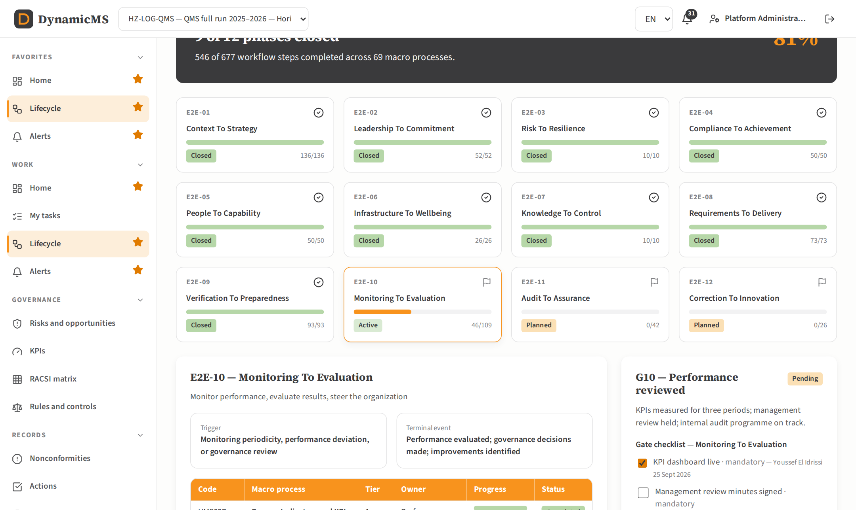
SECTOR · LOG
Logistics
Horizon Logistics · Nova Logistics
Large company
SME
Macro processes QMS
69
64
Macro processes QHSE
71
66
Steps QMS
677
650
Steps QHSE
697
670
Progress QMS
81%
81%
SME track
—
Standard
Must-have standards
ISO 9001, TAPA FSR/TSR, IFS Logistics, GDP, AEO · Industry pack: none
Lifecycle screen of the QMS run: phase cards with completed steps and gate status.
POWERACT Consulting · One full run per sector
48

Slide 49

SECTOR · MFG
Manufacturing (Generic)
Horizon Manufacturing · Nova Manufacturing
Large company
SME
Macro processes QMS
72
65
Macro processes QHSE
80
73
Steps QMS
703
660
Steps QHSE
783
740
Progress QMS
82%
89%
SME track
—
Light
Must-have standards
ISO 9001, ISO 14001, ISO 45001, CE Marking · Industry pack: DMS-AUTO
Lifecycle screen of the QMS run: phase cards with completed steps and gate status.
POWERACT Consulting · One full run per sector
49

Slide 50

SECTOR · PCH
Process/Petrochemical
Horizon Petrochemicals · Nova Petrochemicals
Large company
SME
Macro processes QMS
73
66
Macro processes QHSE
85
75
Steps QMS
713
670
Steps QHSE
832
761
Progress QMS
89%
76%
SME track
—
Light
Must-have standards
API 510, API 570, ASME VIII, NBIC, ISO 14644 · Industry pack: DMS-PROC
Lifecycle screen of the QMS run: phase cards with completed steps and gate status.
POWERACT Consulting · One full run per sector
50

Slide 51

SECTOR · PCI
Process Industries
Horizon Process Industries · Nova Process Industries
Large company
SME
Macro processes QMS
70
64
Macro processes QHSE
73
66
Steps QMS
683
650
Steps QHSE
712
670
Progress QMS
93%
89%
SME track
—
Standard
Must-have standards
ISO 22000, FDA FSMA, HACCP, GMP · Industry pack: DMS-FOOD
Lifecycle screen of the QMS run: phase cards with completed steps and gate status.
POWERACT Consulting · One full run per sector
51

Slide 52

SECTOR · PED
Private Education
Horizon Private Schools · Nova Private Schools
Large company
SME
Macro processes QMS
59
64
Macro processes QHSE
60
65
Steps QMS
589
650
Steps QHSE
599
660
Progress QMS
81%
84%
SME track
—
Light
Must-have standards
National Accreditation, ISO 21001, Reg. Educ. Authority · Industry pack: none
Lifecycle screen of the QMS run: phase cards with completed steps and gate status.
POWERACT Consulting · One full run per sector
52

Slide 53

SECTOR · PHA
Pharma
Horizon Pharma Labs · Nova Pharma Labs
Large company
SME
Macro processes QMS
77
66
Macro processes QHSE
81
69
Steps QMS
744
670
Steps QHSE
783
700
Progress QMS
90%
85%
SME track
—
Standard
Must-have standards
GMP, ICH Q7/Q9/Q10, ISO 14644 · Industry pack: DMS-LSCI
Lifecycle screen of the QMS run: phase cards with completed steps and gate status.
POWERACT Consulting · One full run per sector
53

Slide 54

SECTOR · PHM
Pharmaceutical & Process
Horizon Pharma Process · Nova Pharma Process
Large company
SME
Macro processes QMS
81
66
Macro processes QHSE
87
69
Steps QMS
782
670
Steps QHSE
840
700
Progress QMS
83%
90%
SME track
—
Light
Must-have standards
GMP (EU Annex 1), ICH Q7/Q9/Q10, ISO 14644, WHO TRS 961 · Industry pack: DMS-LSCI
Lifecycle screen of the QMS run: phase cards with completed steps and gate status.
POWERACT Consulting · One full run per sector
54

Slide 55

SECTOR · PPG
Process/Packaged Goods
Horizon Packaged Foods · Nova Packaged Foods
Large company
SME
Macro processes QMS
71
64
Macro processes QHSE
73
65
Steps QMS
692
650
Steps QHSE
711
660
Progress QMS
86%
86%
SME track
—
Light
Must-have standards
ISO 22000, FDA FSVP, HACCP, Codex Alim., GFSI · Industry pack: DMS-FOOD
Lifecycle screen of the QMS run: phase cards with completed steps and gate status.
POWERACT Consulting · One full run per sector
55

Slide 56

SECTOR · PUED
Public Education
Horizon Public Education · Nova Public Education
Large company
SME
Macro processes QMS
59
64
Macro processes QHSE
60
65
Steps QMS
589
650
Steps QHSE
599
660
Progress QMS
87%
79%
SME track
—
Standard
Must-have standards
Ministry of Education, National Curriculum, ISO 21001 · Industry pack: none
Lifecycle screen of the QMS run: phase cards with completed steps and gate status.
POWERACT Consulting · One full run per sector
56

Slide 57

SECTOR · RET
Retail
Horizon Retail Stores · Nova Retail Stores
Large company
SME
Macro processes QMS
73
66
Macro processes QHSE
74
67
Steps QMS
713
670
Steps QHSE
723
680
Progress QMS
82%
83%
SME track
—
Standard
Must-have standards
ISO 9001, PCI DSS 4.0, GDPR, ISO 27001, ISO 45001 · Industry pack: none
Lifecycle screen of the QMS run: phase cards with completed steps and gate status.
POWERACT Consulting · One full run per sector
57

Slide 58

SECTOR · RFA
Retail, Footwear & Apparel
Horizon Fashion & Footwear · Nova Fashion & Footwear
Large company
SME
Macro processes QMS
65
64
Macro processes QHSE
72
68
Steps QMS
639
650
Steps QHSE
707
690
Progress QMS
87%
88%
SME track
—
Standard
Must-have standards
ISO 9001, GOTS, OEKO-TEX 100, SA8000 · Industry pack: none
Lifecycle screen of the QMS run: phase cards with completed steps and gate status.
POWERACT Consulting · One full run per sector
58

Slide 59

SECTOR · SEM
Semiconductor & Electronics Mfg
Horizon Semiconductors · Nova Semiconductors
Large company
SME
Macro processes QMS
83
67
Macro processes QHSE
85
69
Steps QMS
801
682
Steps QHSE
821
702
Progress QMS
89%
81%
SME track
—
Standard
Must-have standards
ISO 9001, IATF 16949, AEC-Q100, IEC 61508, ISO 14001 · Industry pack: DMS-AUTO
Lifecycle screen of the QMS run: phase cards with completed steps and gate status.
POWERACT Consulting · One full run per sector
59

Slide 60

SECTOR · SHB
Shipbuilding
Horizon Shipyards · Nova Shipyards
Large company
SME
Macro processes QMS
70
65
Macro processes QHSE
76
68
Steps QMS
686
660
Steps QHSE
744
690
Progress QMS
86%
82%
SME track
—
Standard
Must-have standards
SOLAS, MARPOL, IMO GBS, IACS · Industry pack: DMS-MARI
Lifecycle screen of the QMS run: phase cards with completed steps and gate status.
POWERACT Consulting · One full run per sector
60

Slide 61

SECTOR · SSE
Social & Solidarity Economy
Horizon Fair Cooperatives · Nova Fair Cooperatives
Large company
SME
Macro processes QMS
60
64
Macro processes QHSE
66
67
Steps QMS
593
650
Steps QHSE
651
680
Progress QMS
82%
78%
SME track
—
Light
Must-have standards
Fairtrade, WFTO, SA8000, ISO 26000 · Industry pack: none
Lifecycle screen of the QMS run: phase cards with completed steps and gate status.
POWERACT Consulting · One full run per sector
61

Slide 62

SECTOR · TEL
Telecommunications
Horizon Telecom Networks · Nova Telecom Networks
Large company
SME
Macro processes QMS
76
66
Macro processes QHSE
77
67
Steps QMS
737
670
Steps QHSE
747
680
Progress QMS
82%
89%
SME track
—
Light
Must-have standards
TL 9000, ISO 9001, ISO 27001, ISO 22301 · Industry pack: none
Lifecycle screen of the QMS run: phase cards with completed steps and gate status.
POWERACT Consulting · One full run per sector
62

Slide 63

SECTOR · UNI
Universal (all sectors)
Horizon Universal Holdings · Atlas Universal SME
Large company
SME
Macro processes QMS
111
61
Macro processes QHSE
121
61
Steps QMS
1057
620
Steps QHSE
1155
620
Progress QMS
90%
90%
SME track
—
Standard
Must-have standards
ISO 9001, ISO 14001, ISO 45001 · Industry pack: none
Lifecycle screen of the QMS run: phase cards with completed steps and gate status.
POWERACT Consulting · One full run per sector
63

Slide 64



NEXT STEPS
Install, seed and run in three commands per folder
server: npm install · npm run seed · npm run dev
web: npm install · npm run dev
Open http://localhost:5173 and sign in with a demonstration account (password Demo@2026)
The user guides list, for every step of the five scenarios, the values to type.
POWERACT Consulting · Next steps
64

