Slide 1

APPLICATION SCREENSHOTS
CortexSkills
Horizon Services Group
70 screens · English · 1440 × 900
MEASURABLE · GOVERNED · SUSTAINABLE

Slide 2

CONTENTS
The screens of the application, by menu
As seen by the users of Horizon Services Group. Administration screens are taken with the organization administrator; Backups & health with the platform administrator.
01
02
03
04
Sign-in and home
Portfolio and projects
Process design
Governance
7 screens
15 screens
12 screens
11 screens
05
06
07
08
Artificial intelligence
Reports and documents
Administration
Settings, help and profile
5 screens
8 screens
10 screens
2 screens
Contents · Horizon Services Group · Demonstration data — fictional organization
2

Slide 3
01
Sign-in and home
Sign in · Horizon Services Group · My tasks · Alerts · AI Assistant · Profile menu · Change password

Slide 4
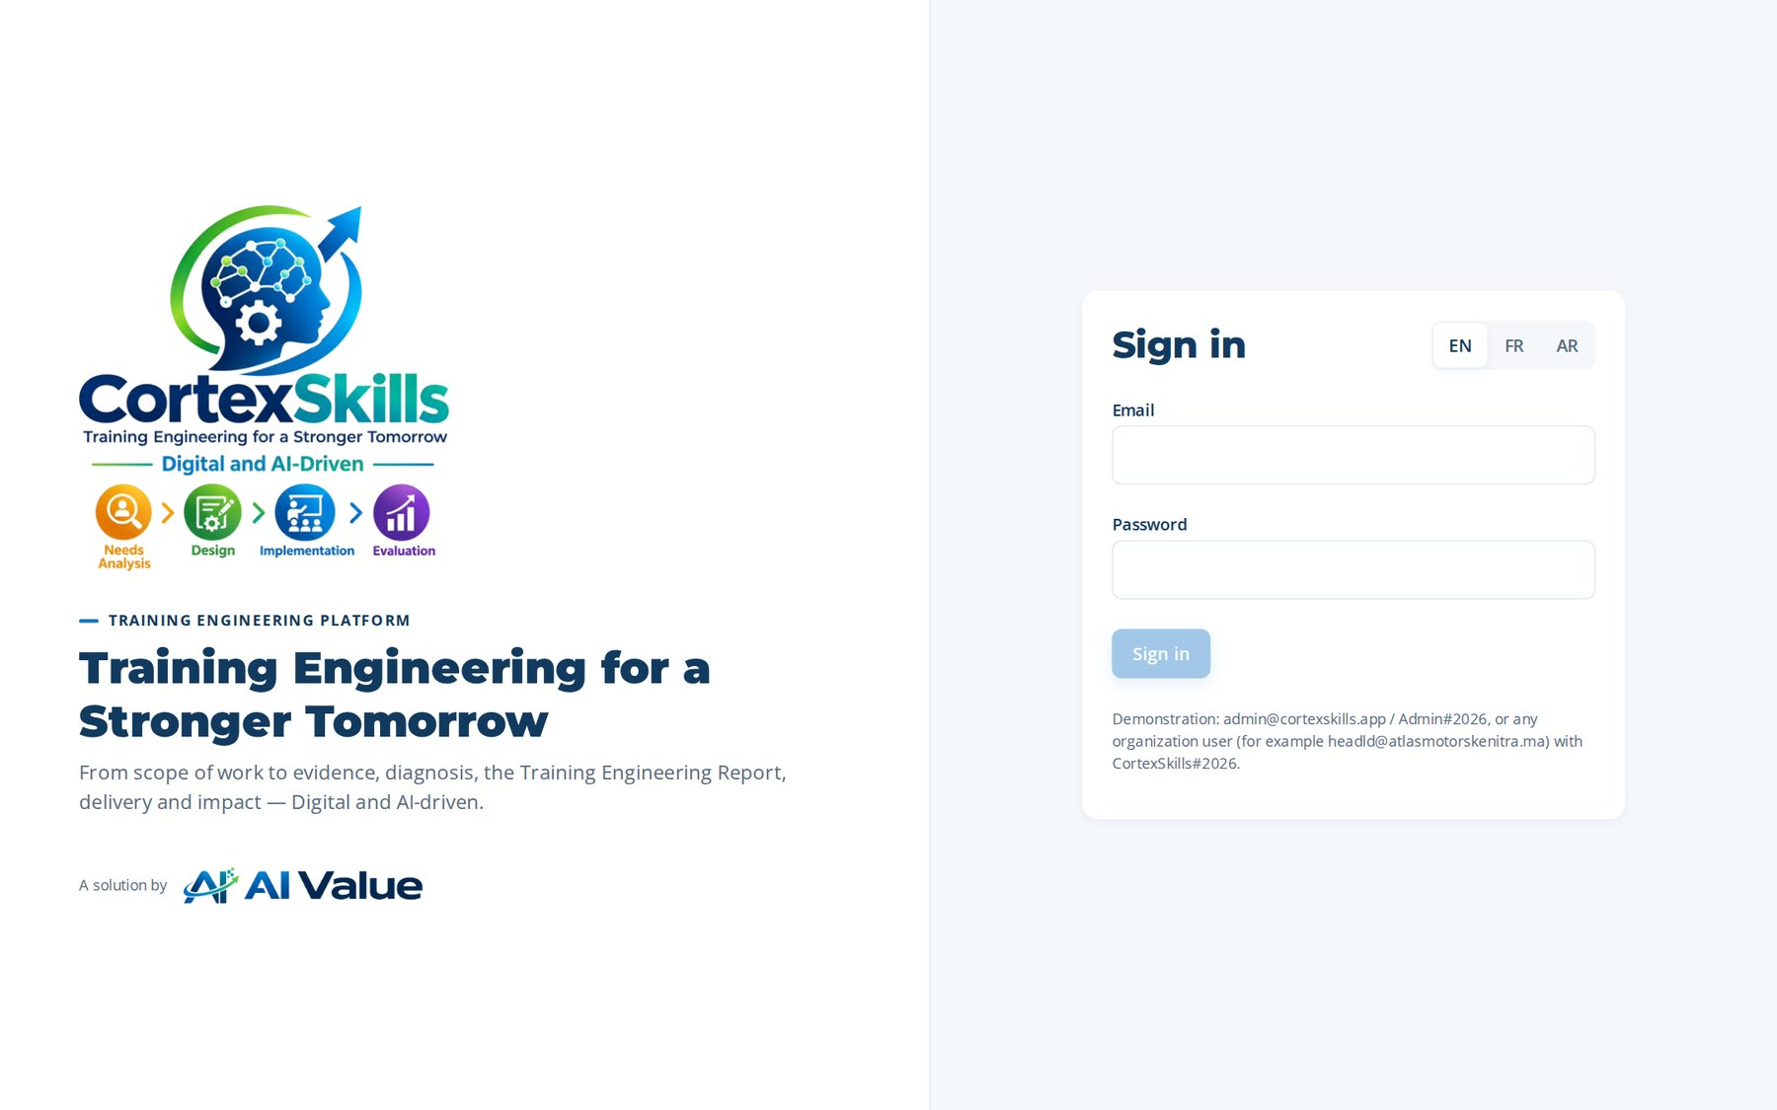
SIGN-IN AND HOME
Sign in
Address: /login
Sign-in and home · Horizon Services Group · Demonstration data — fictional organization
4

Slide 5
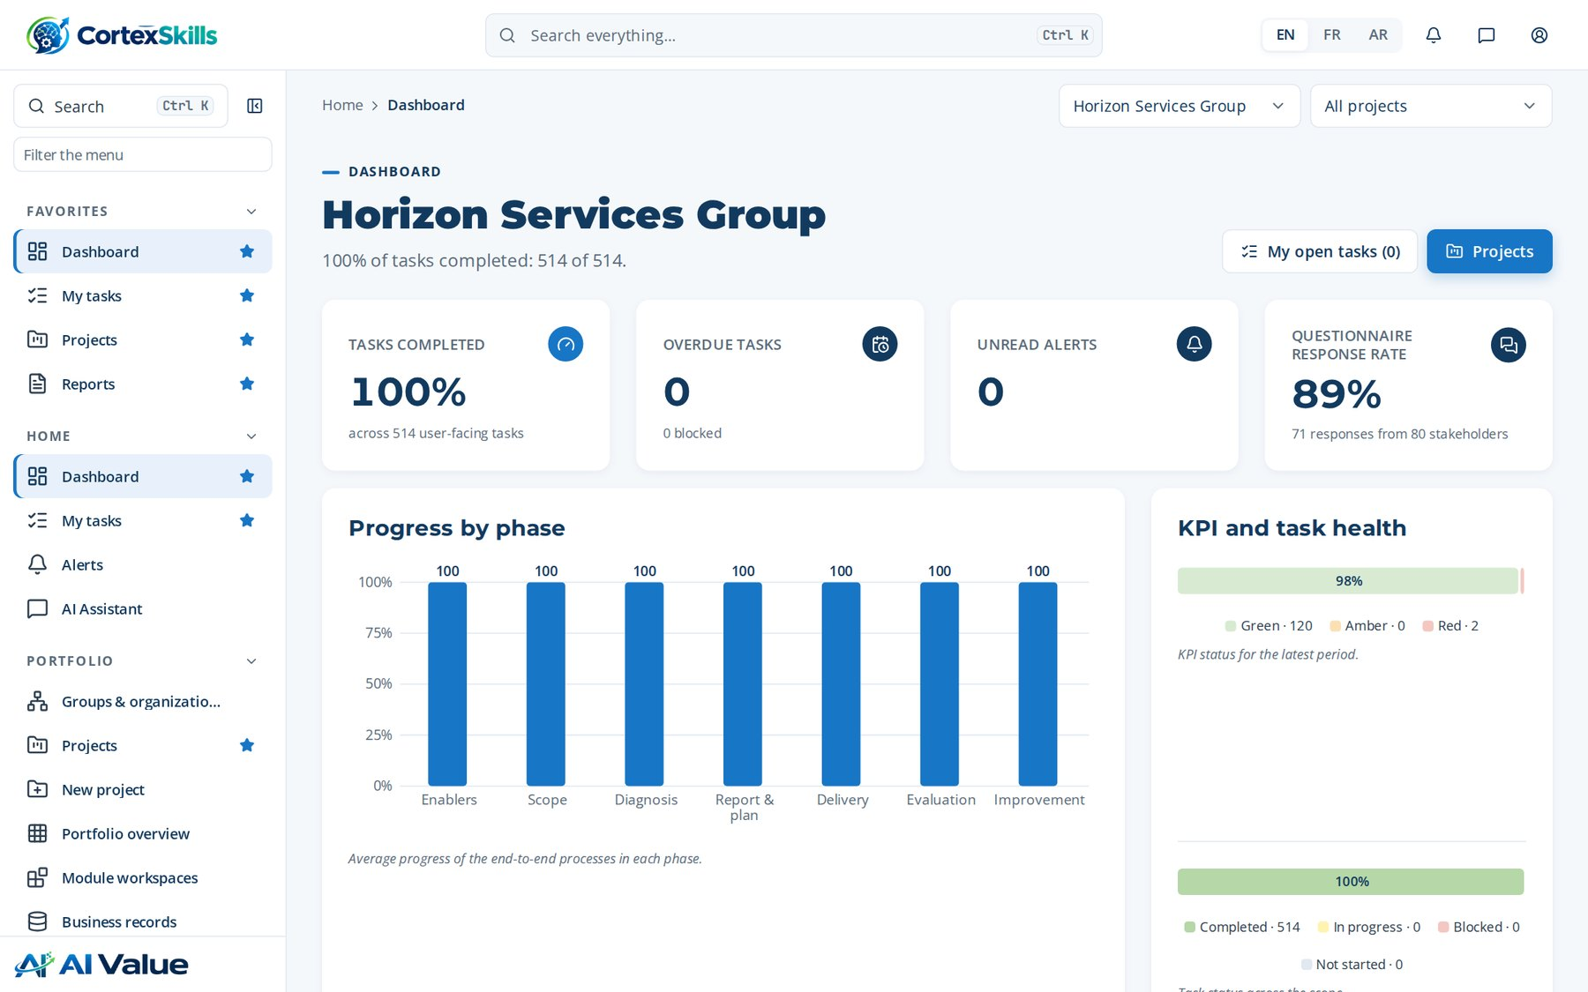
SIGN-IN AND HOME
Horizon Services Group
Address: /
Sign-in and home · Horizon Services Group · Demonstration data — fictional organization
5

Slide 6
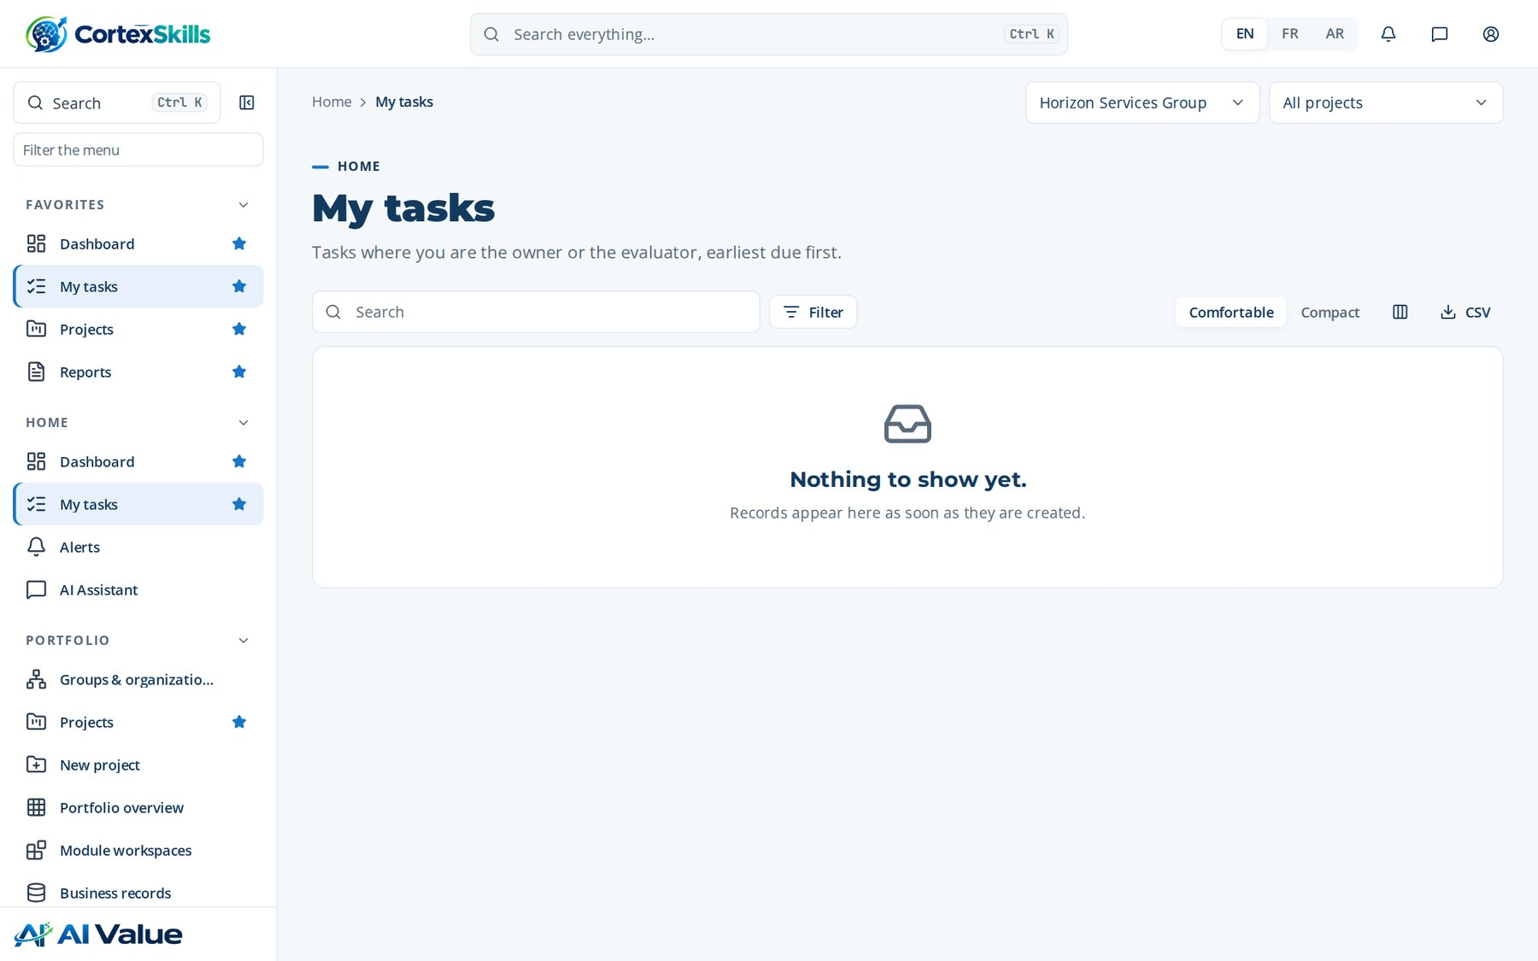
SIGN-IN AND HOME
My tasks
Address: /my-tasks
Sign-in and home · Horizon Services Group · Demonstration data — fictional organization
6

Slide 7
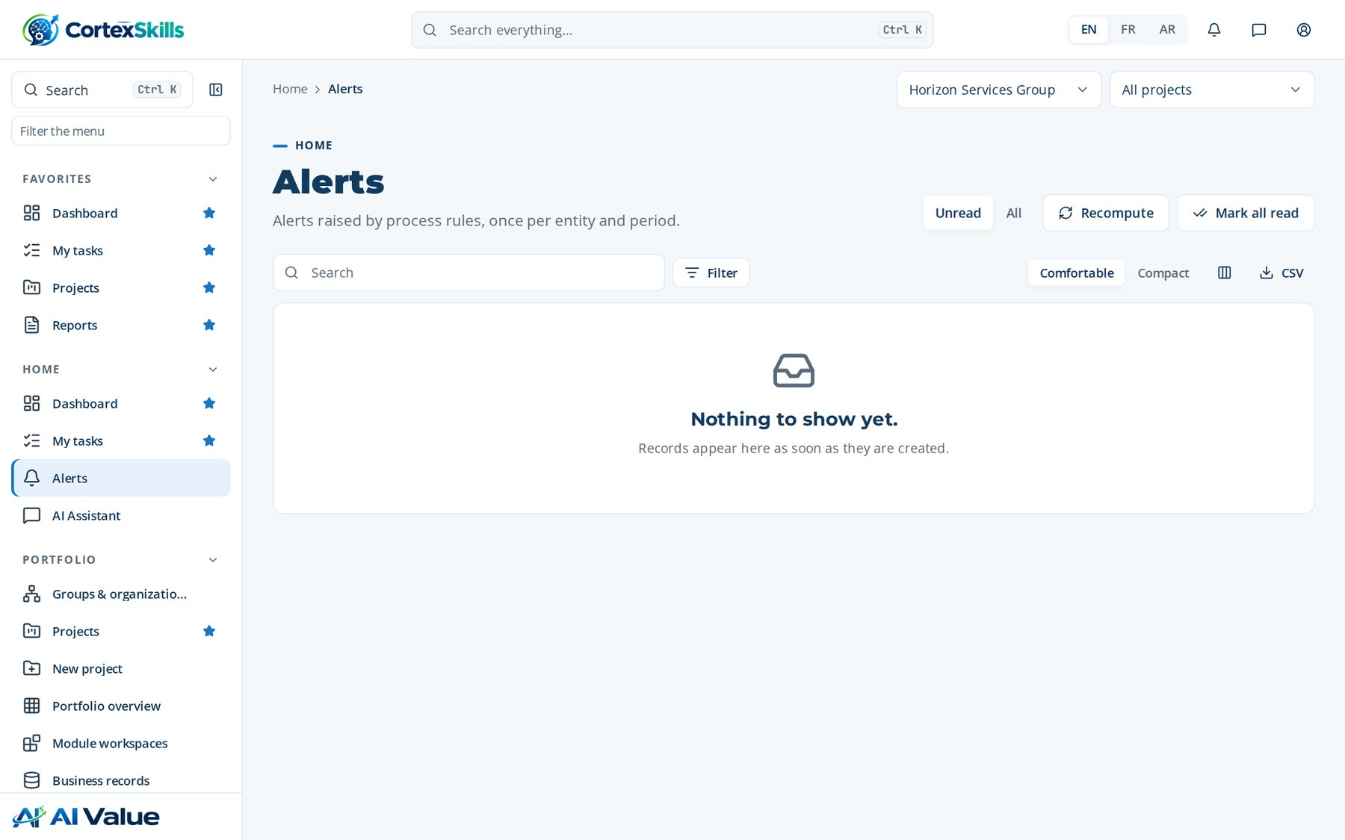
SIGN-IN AND HOME
Alerts
Address: /alerts
Sign-in and home · Horizon Services Group · Demonstration data — fictional organization
7

Slide 8
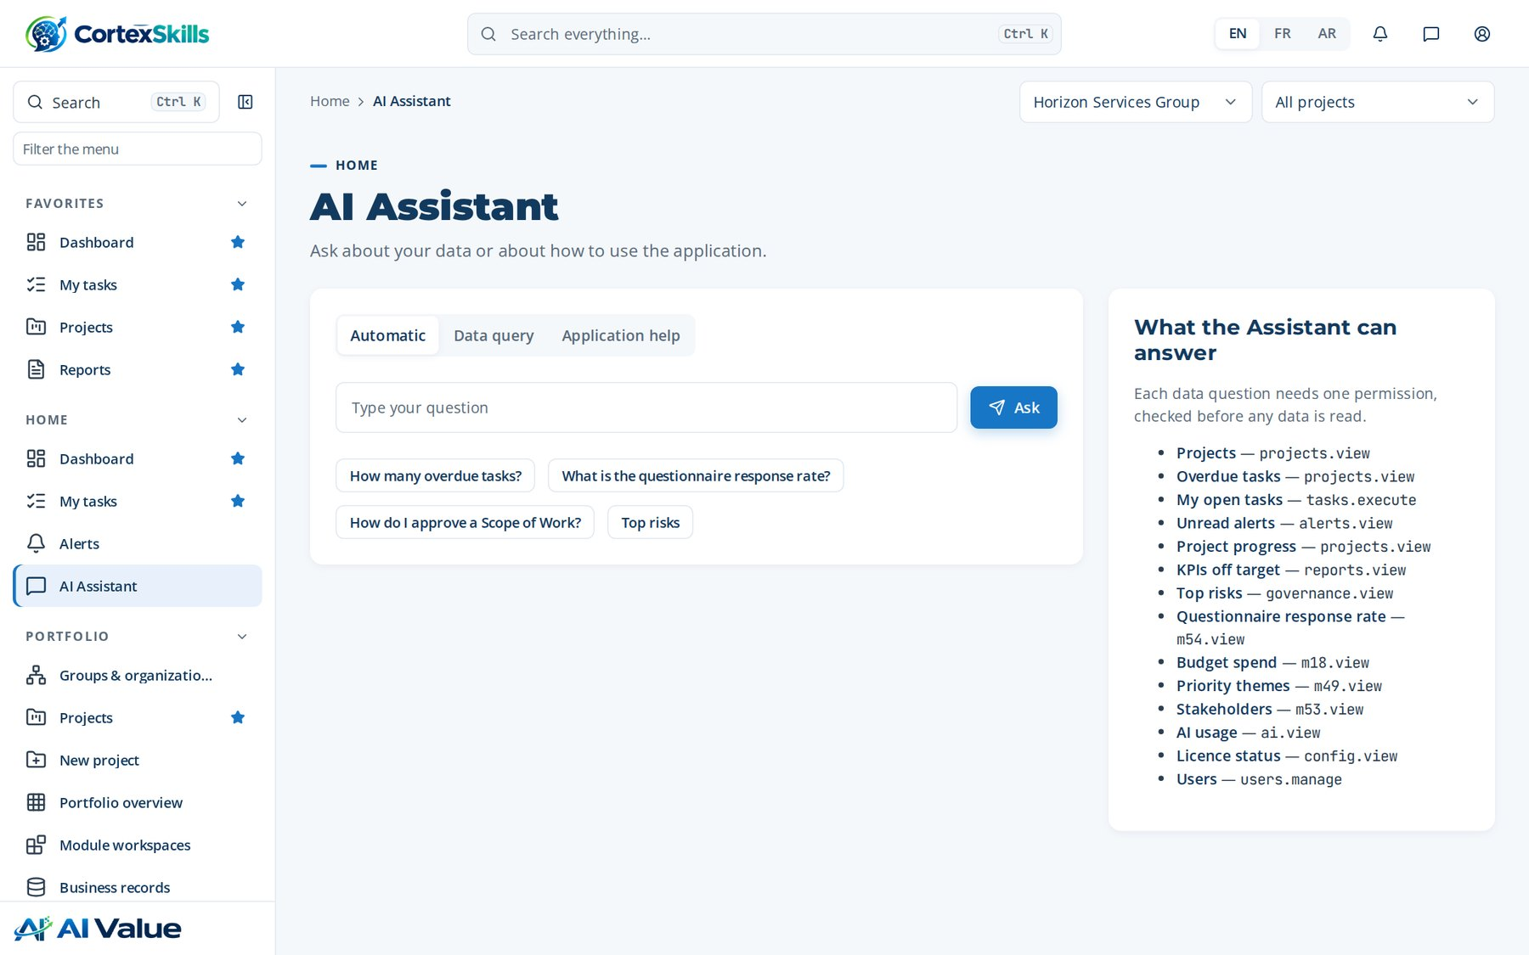
SIGN-IN AND HOME
AI Assistant
Address: /assistant
Sign-in and home · Horizon Services Group · Demonstration data — fictional organization
8

Slide 9
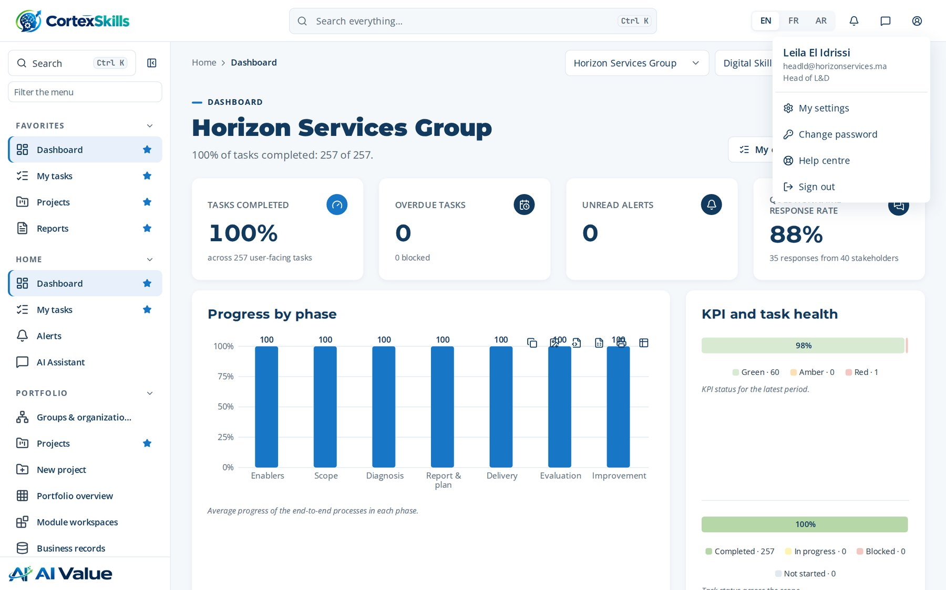
SIGN-IN AND HOME
Profile menu
Address: /
Sign-in and home · Horizon Services Group · Demonstration data — fictional organization
9

Slide 10
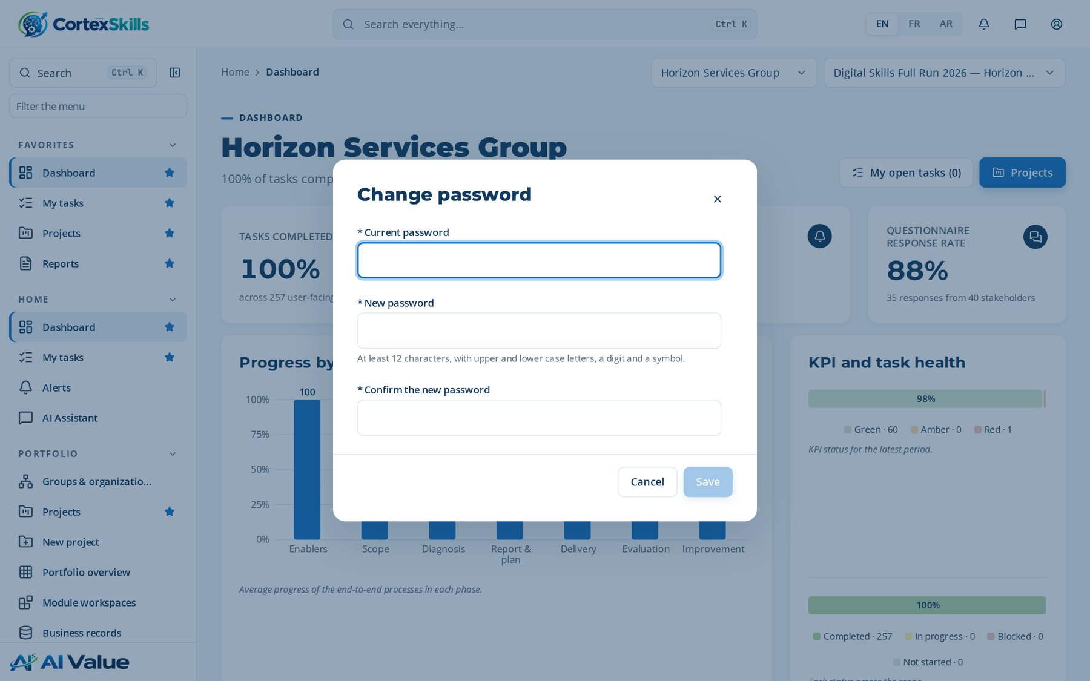
SIGN-IN AND HOME
Change password
Address: /
Sign-in and home · Horizon Services Group · Demonstration data — fictional organization
10

Slide 11
02
Portfolio and projects
Groups & organizations · Projects · New project · AI Skills Full Run 2026 — Horizon Services Group · WBS & Gantt · Roadmap-to-Curriculum Design · Roadmap-to-Curriculum Design · Portfolio overview · Module workspaces · Platform Shell & Common Services · Business records · Questionnaires

Slide 12
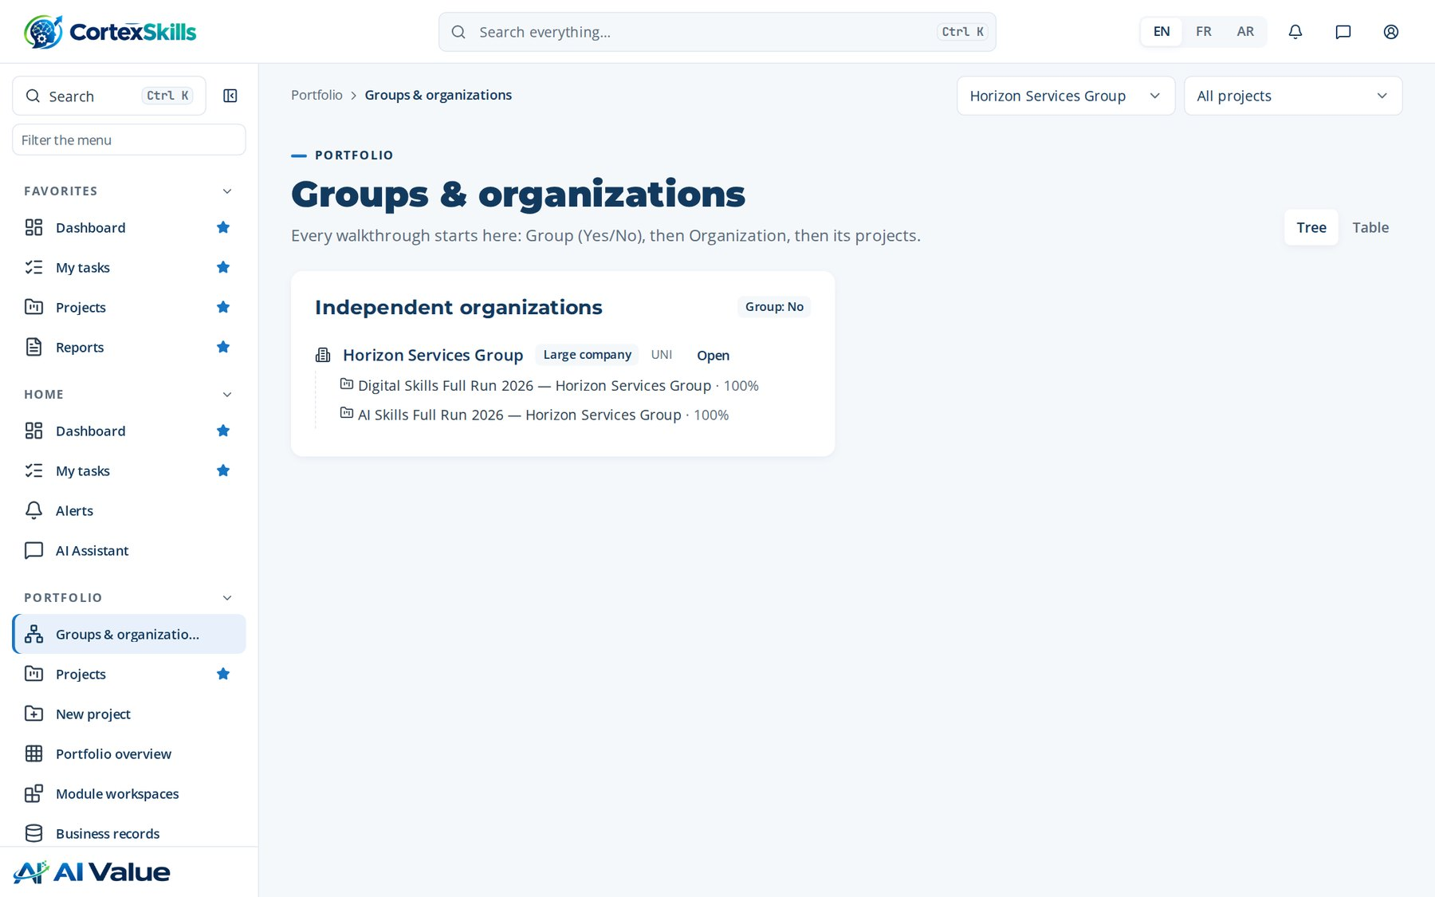
PORTFOLIO AND PROJECTS
Groups & organizations
Address: /tenancy
Portfolio and projects · Horizon Services Group · Demonstration data — fictional organization
12

Slide 13
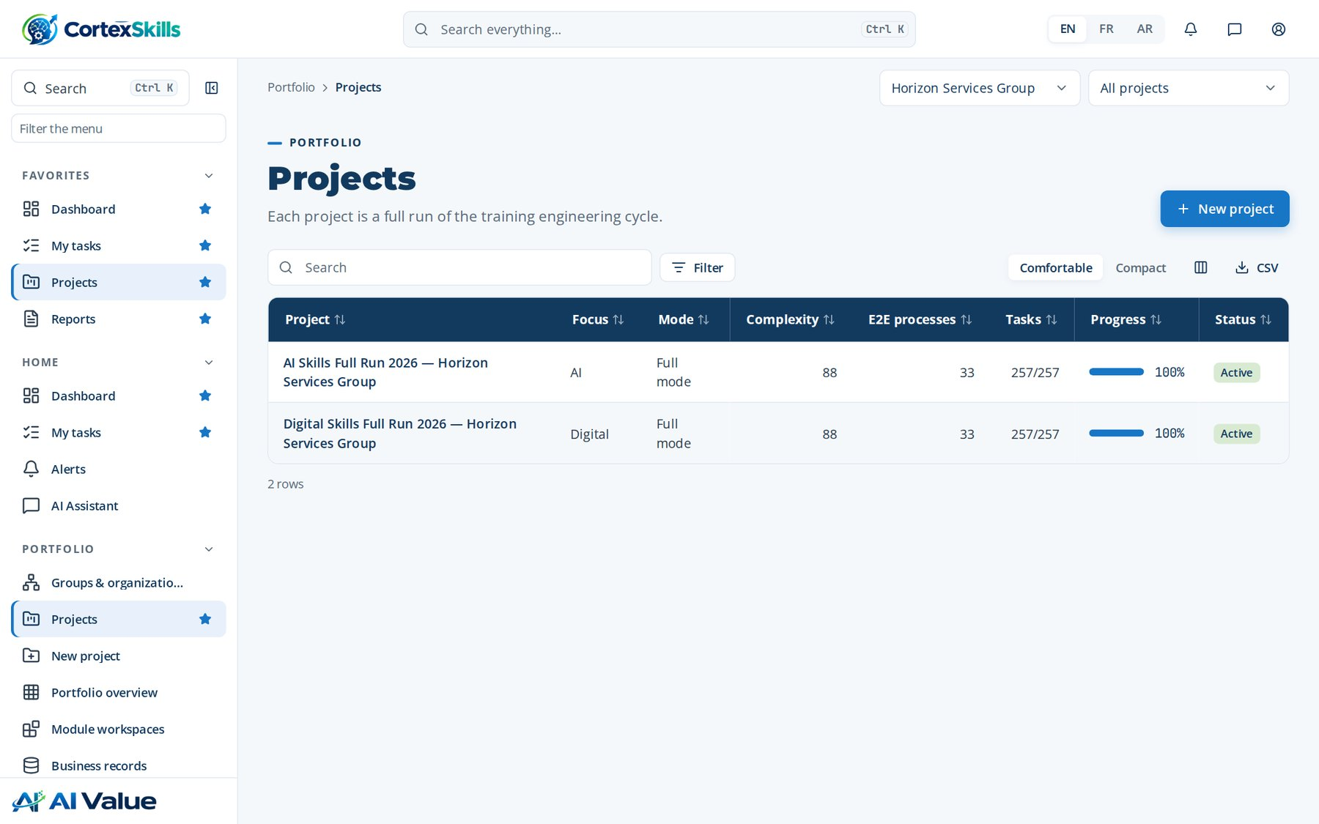
PORTFOLIO AND PROJECTS
Projects
Address: /projects
Portfolio and projects · Horizon Services Group · Demonstration data — fictional organization
13

Slide 14
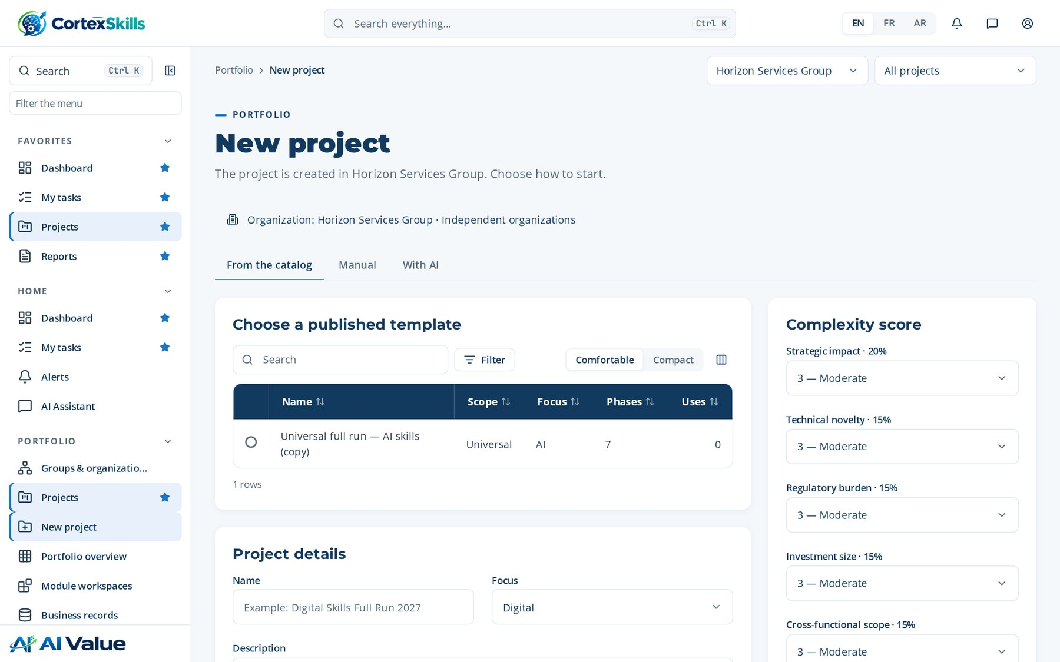
PORTFOLIO AND PROJECTS
New project
Address: /projects/new
Portfolio and projects · Horizon Services Group · Demonstration data — fictional organization
14

Slide 15
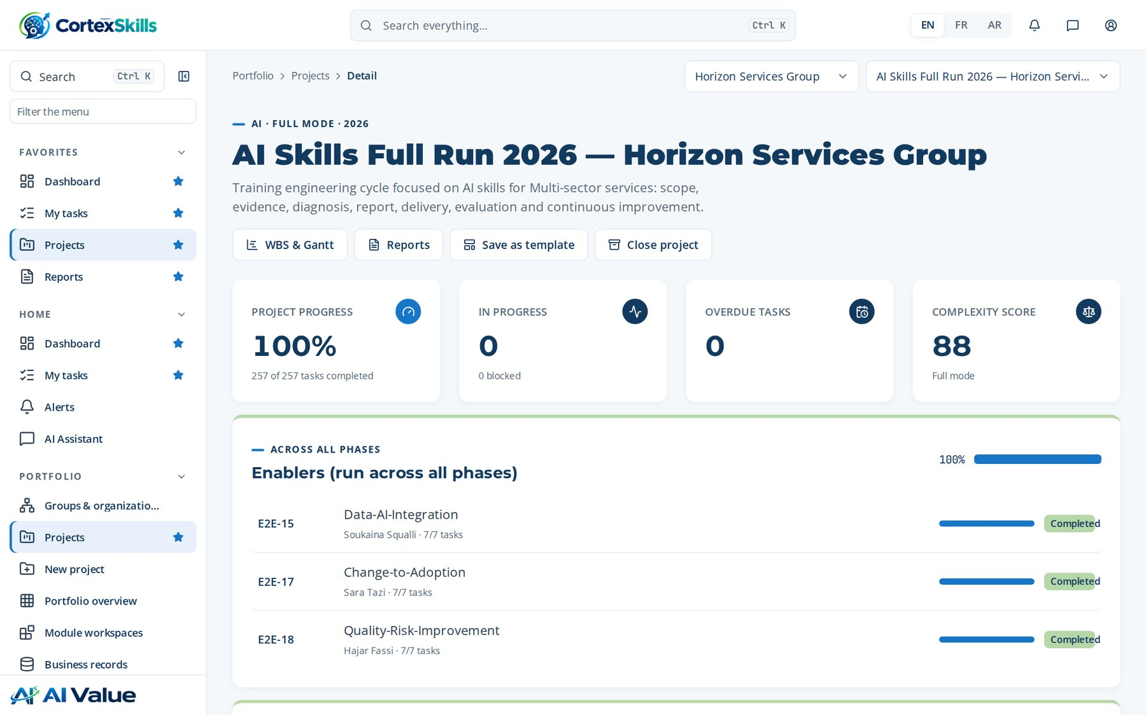
PORTFOLIO AND PROJECTS
AI Skills Full Run 2026 — Horizon Services Group
Address: /projects/:id
Portfolio and projects · Horizon Services Group · Demonstration data — fictional organization
15

Slide 16
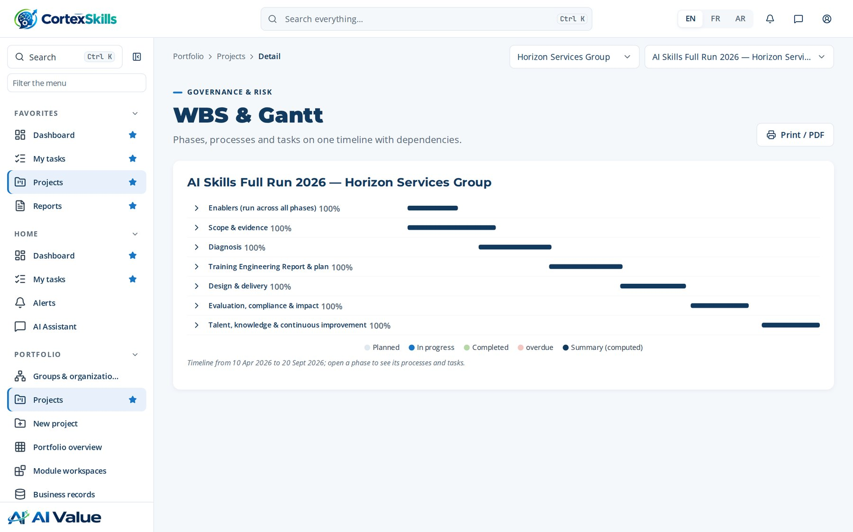
PORTFOLIO AND PROJECTS
WBS & Gantt
Address: /projects/:id/gantt
Portfolio and projects · Horizon Services Group · Demonstration data — fictional organization
16

Slide 17
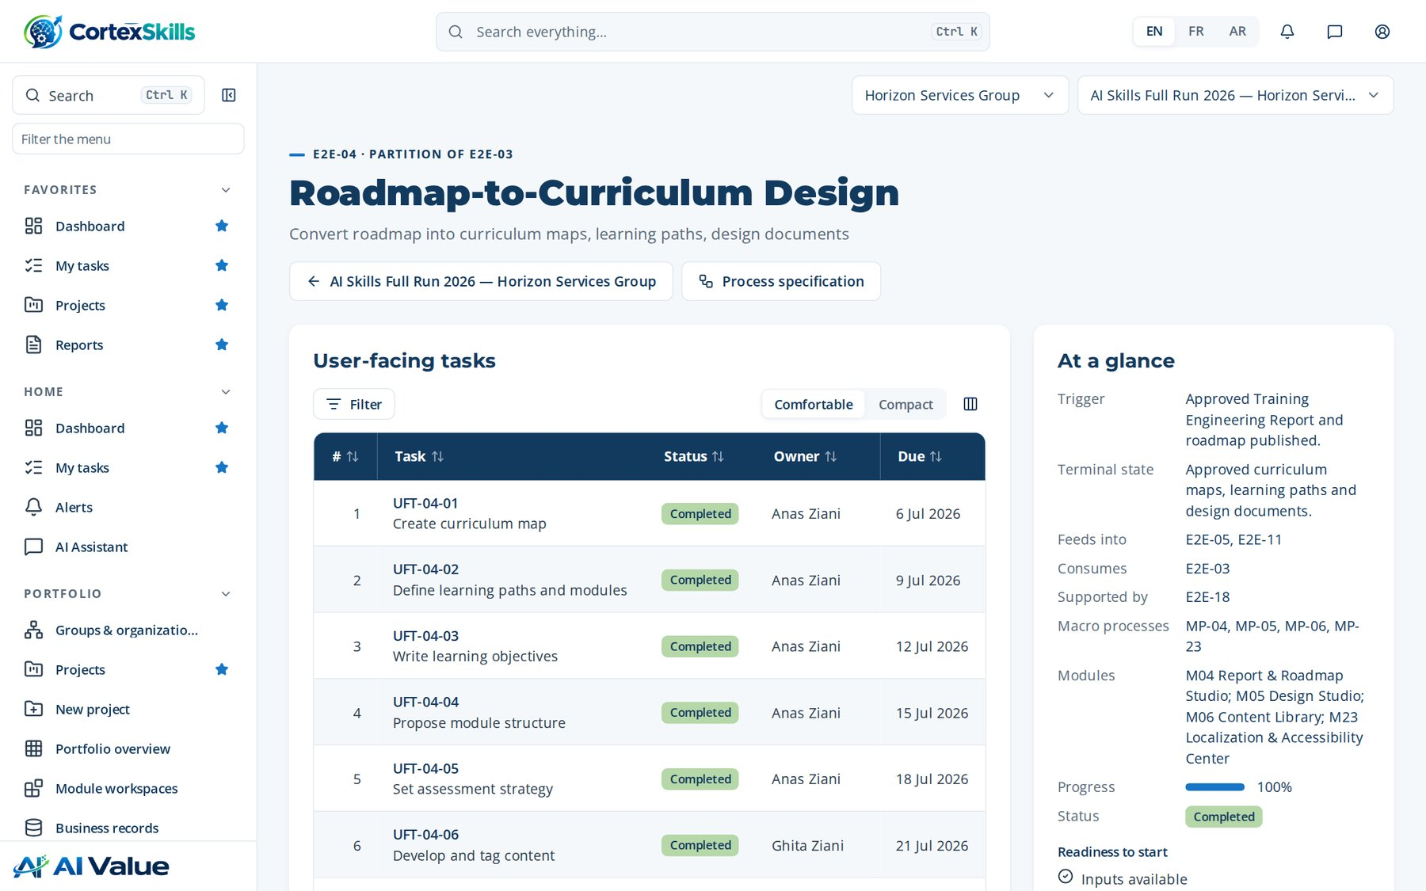
PORTFOLIO AND PROJECTS
Roadmap-to-Curriculum Design
Address: /runs/:id
Portfolio and projects · Horizon Services Group · Demonstration data — fictional organization
17

Slide 18
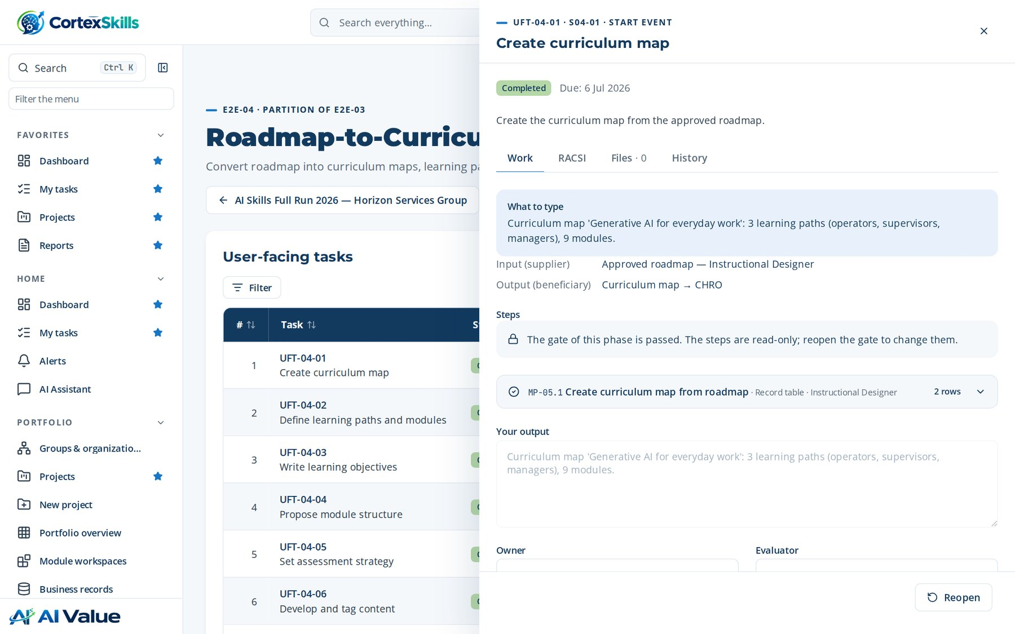
PORTFOLIO AND PROJECTS
Roadmap-to-Curriculum Design
Address: /runs/:id?task=:id
Portfolio and projects · Horizon Services Group · Demonstration data — fictional organization
18

Slide 19
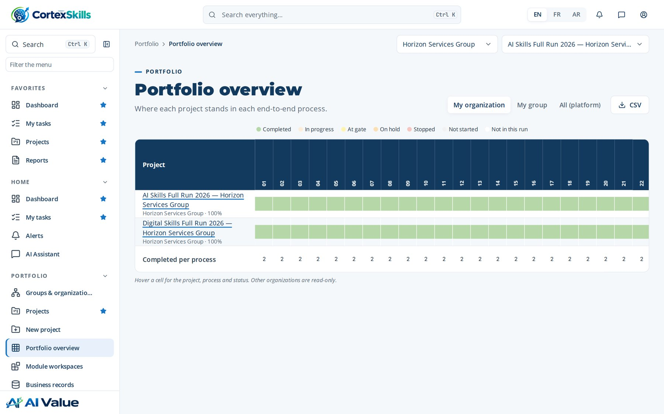
PORTFOLIO AND PROJECTS
Portfolio overview
Address: /portfolio
Portfolio and projects · Horizon Services Group · Demonstration data — fictional organization
19

Slide 20
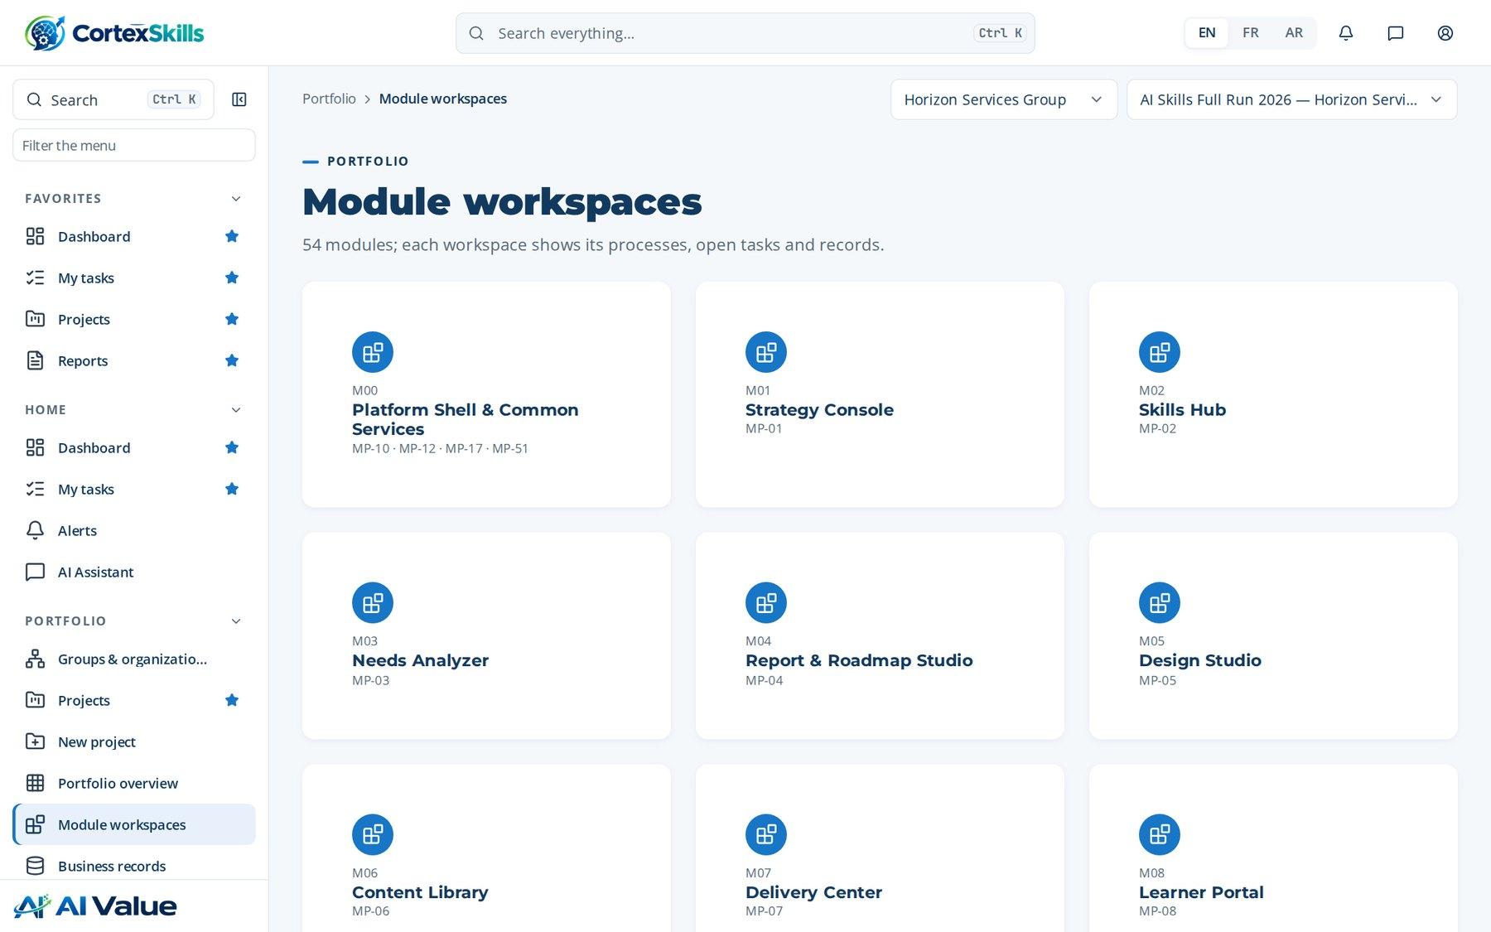
PORTFOLIO AND PROJECTS
Module workspaces
Address: /modules
Portfolio and projects · Horizon Services Group · Demonstration data — fictional organization
20

Slide 21
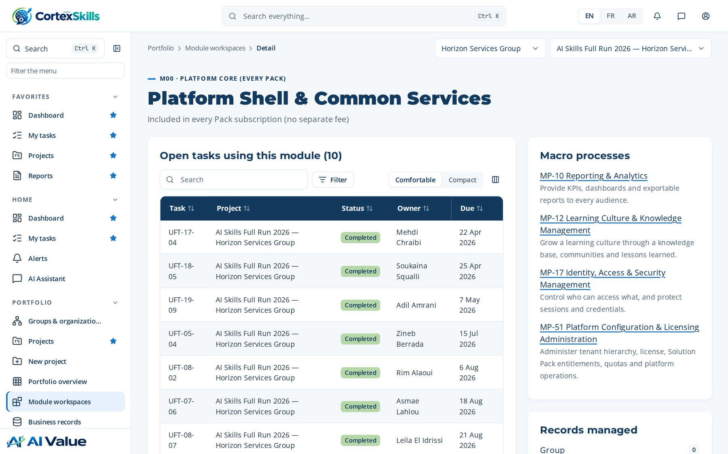
PORTFOLIO AND PROJECTS
Platform Shell & Common Services
Address: /modules/M00
Portfolio and projects · Horizon Services Group · Demonstration data — fictional organization
21

Slide 22
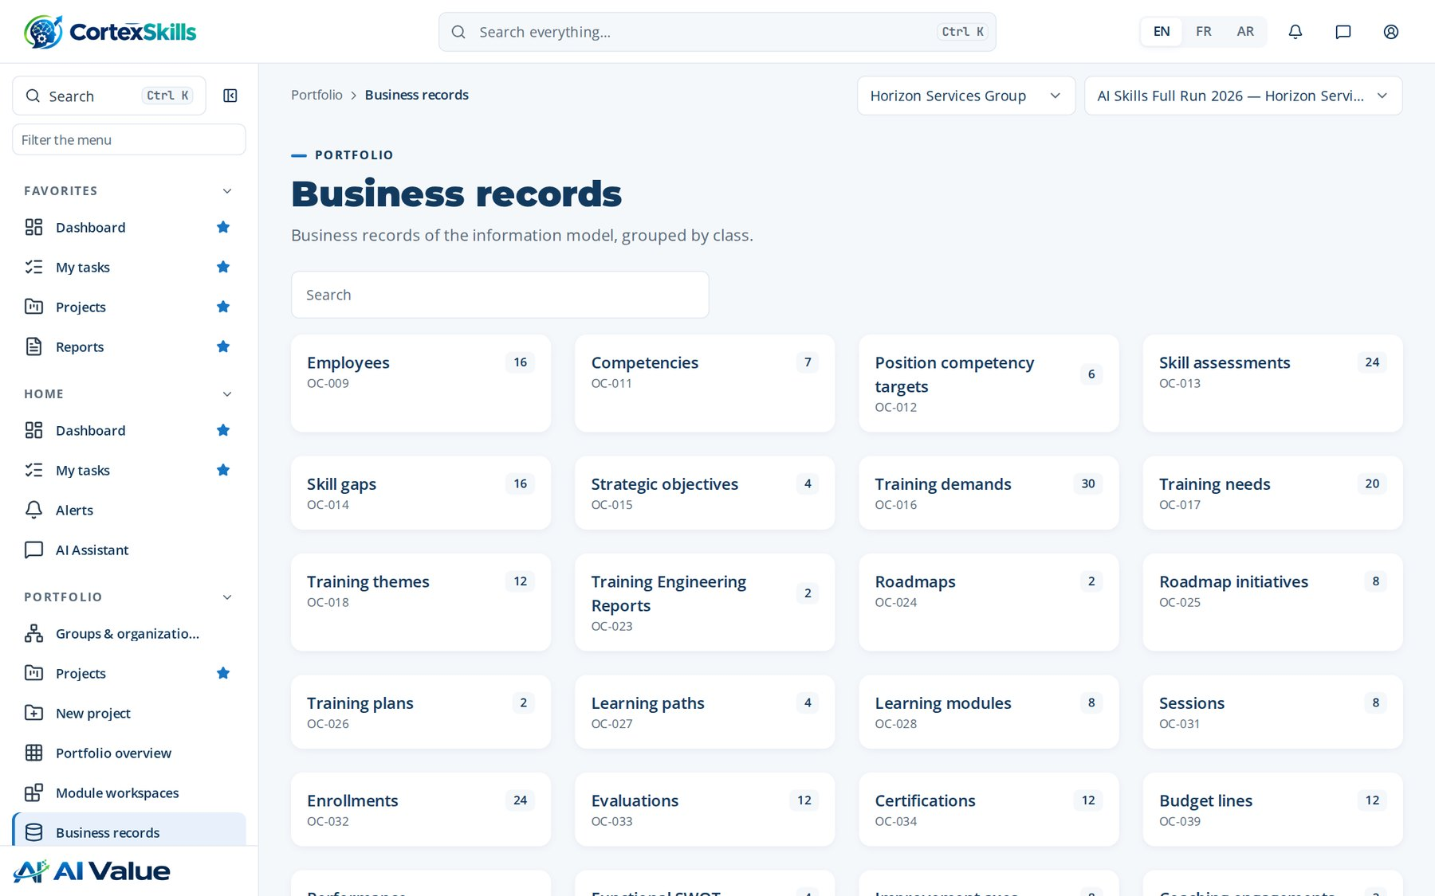
PORTFOLIO AND PROJECTS
Business records
Address: /records
Portfolio and projects · Horizon Services Group · Demonstration data — fictional organization
22

Slide 23
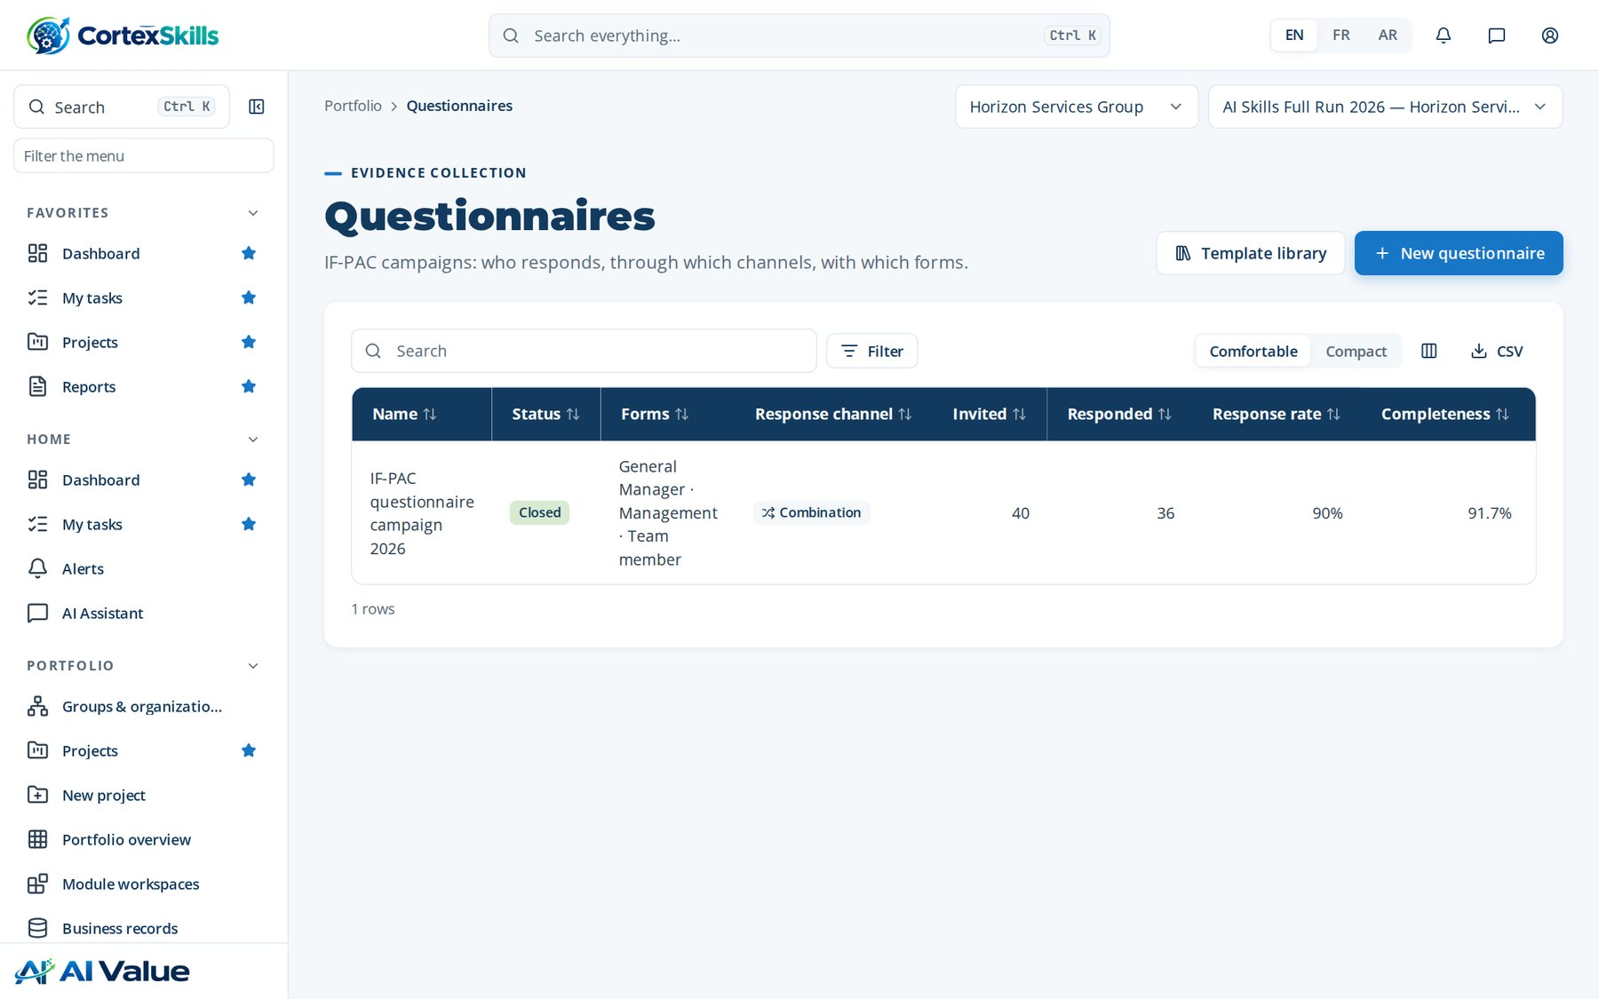
PORTFOLIO AND PROJECTS
Questionnaires
Address: /questionnaires
Portfolio and projects · Horizon Services Group · Demonstration data — fictional organization
23

Slide 24
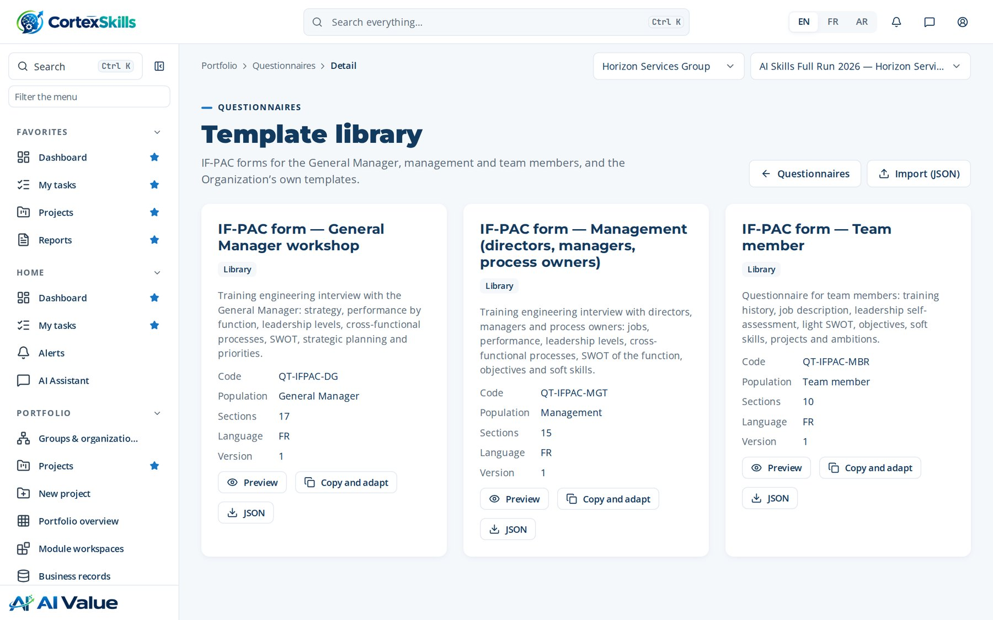
PORTFOLIO AND PROJECTS
Template library
Address: /questionnaires/templates
Portfolio and projects · Horizon Services Group · Demonstration data — fictional organization
24

Slide 25
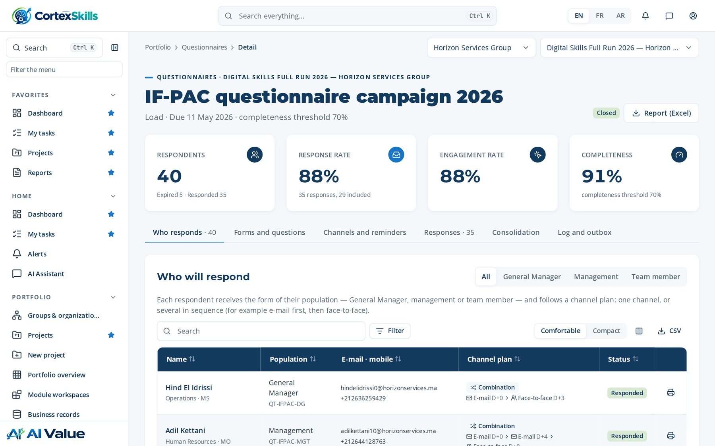
PORTFOLIO AND PROJECTS
IF-PAC questionnaire campaign 2026
Address: /questionnaires/:id
Portfolio and projects · Horizon Services Group · Demonstration data — fictional organization
25

Slide 26
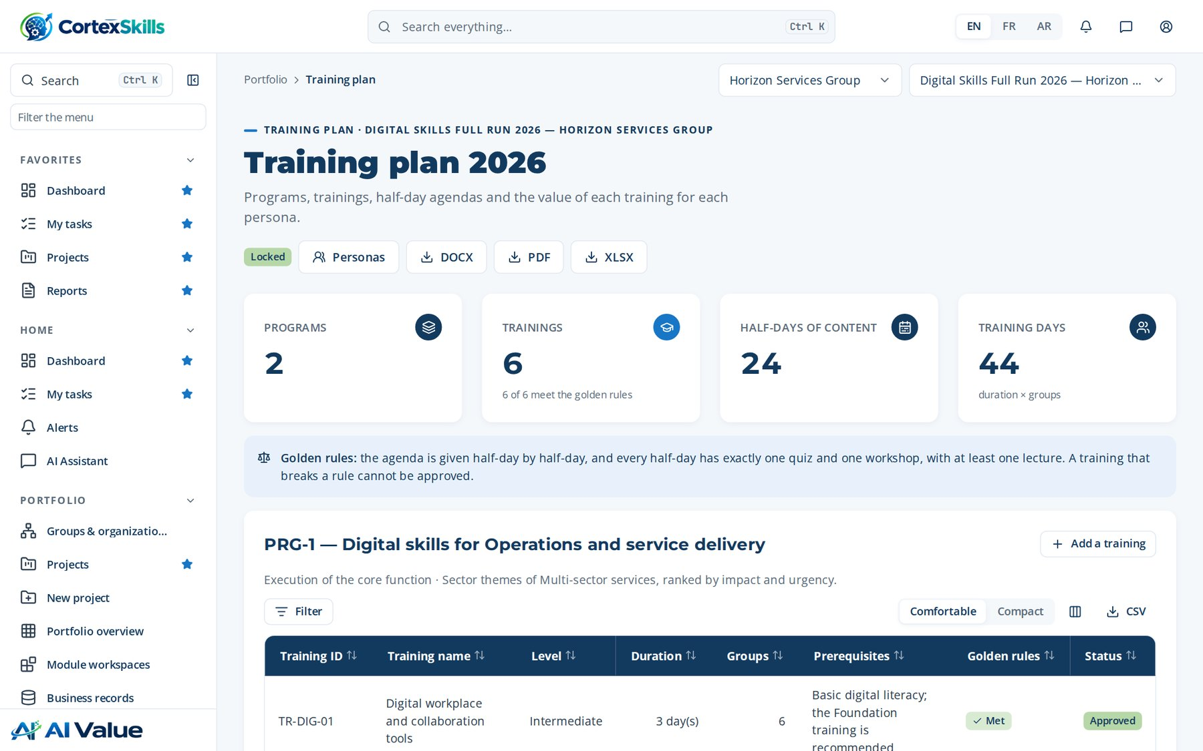
PORTFOLIO AND PROJECTS
Training plan 2026
Address: /training-plan
Portfolio and projects · Horizon Services Group · Demonstration data — fictional organization
26

Slide 27
03
Process design
Process design · Macro processes · End-to-end processes · Chain diagram · Coverage matrix · BPMN diagrams · Verticals · SME tracks & scoring · Project templates · Gate library · Checklist library · Information model

Slide 28
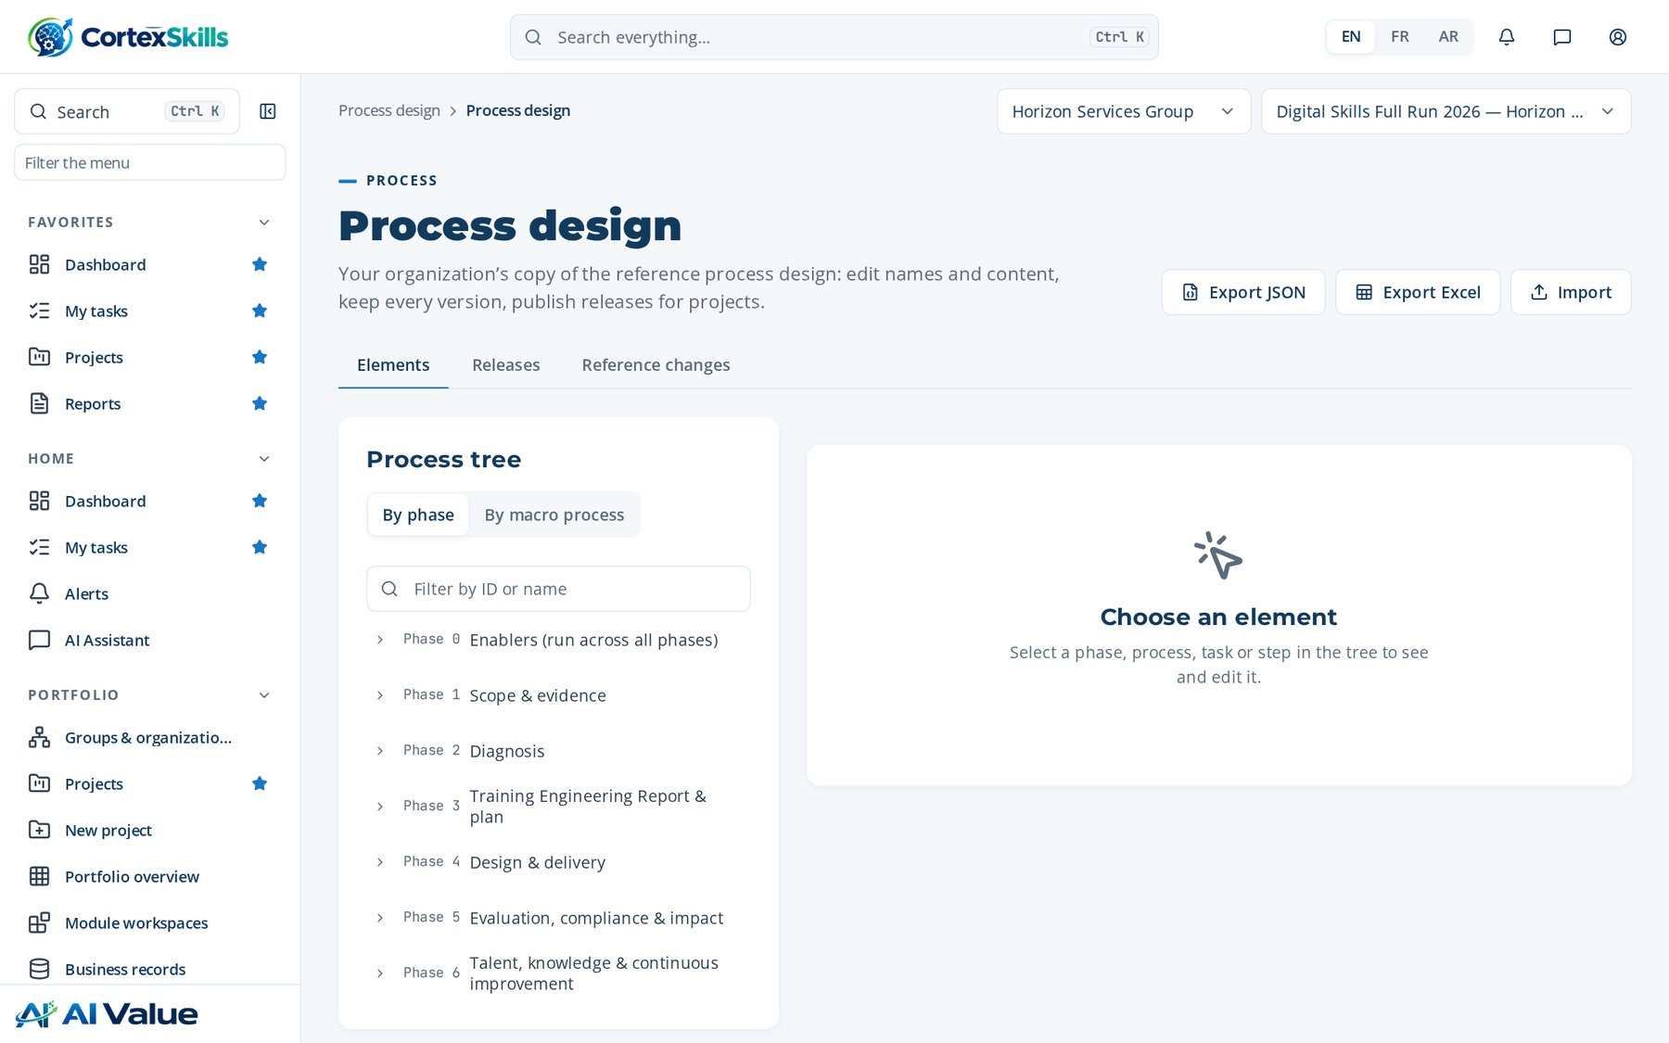
PROCESS DESIGN
Process design
Address: /process/design
Process design · Horizon Services Group · Demonstration data — fictional organization
28

Slide 29
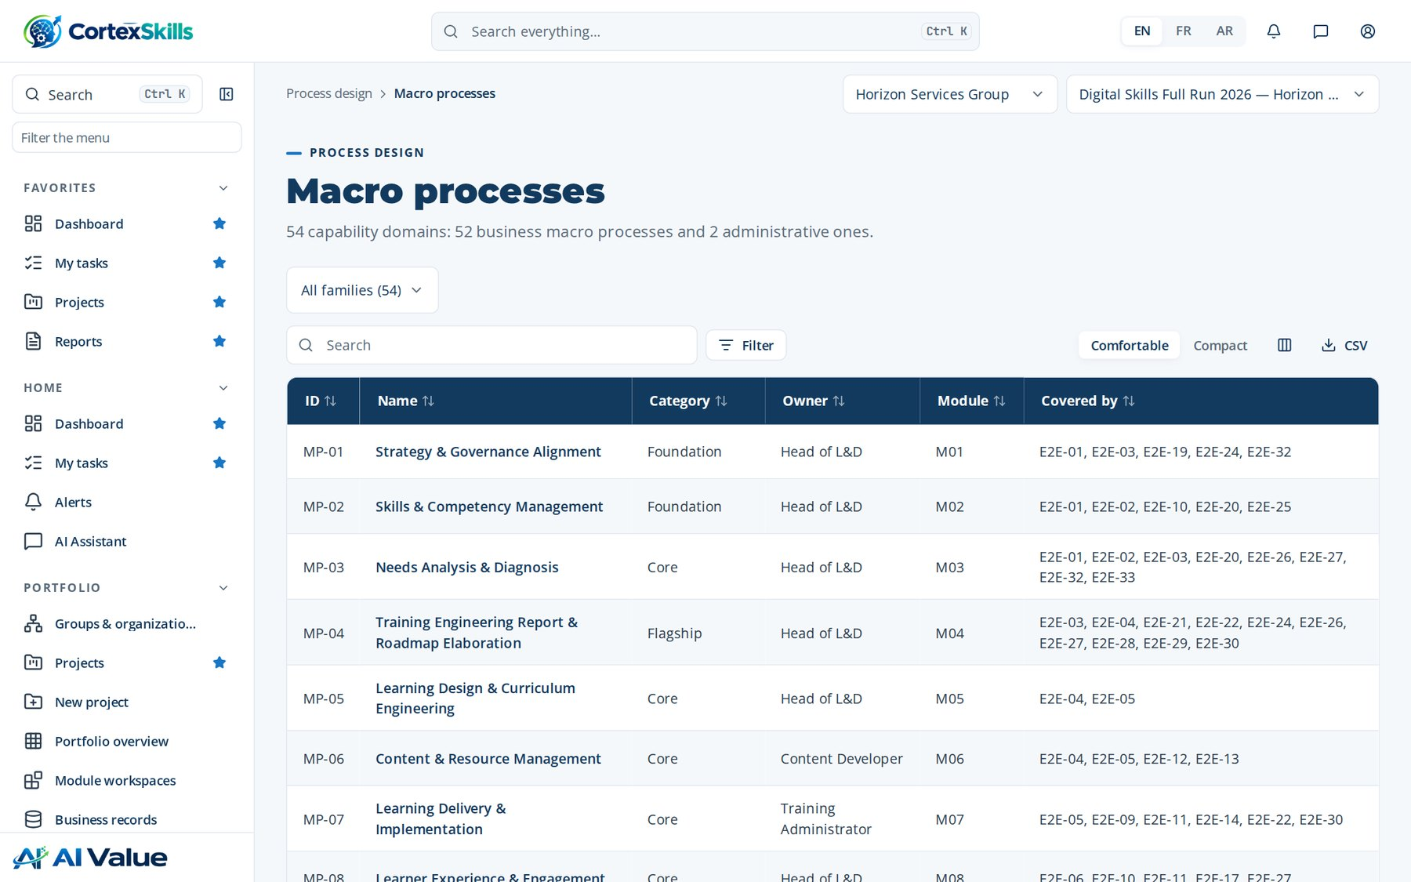
PROCESS DESIGN
Macro processes
Address: /process/mp
Process design · Horizon Services Group · Demonstration data — fictional organization
29

Slide 30
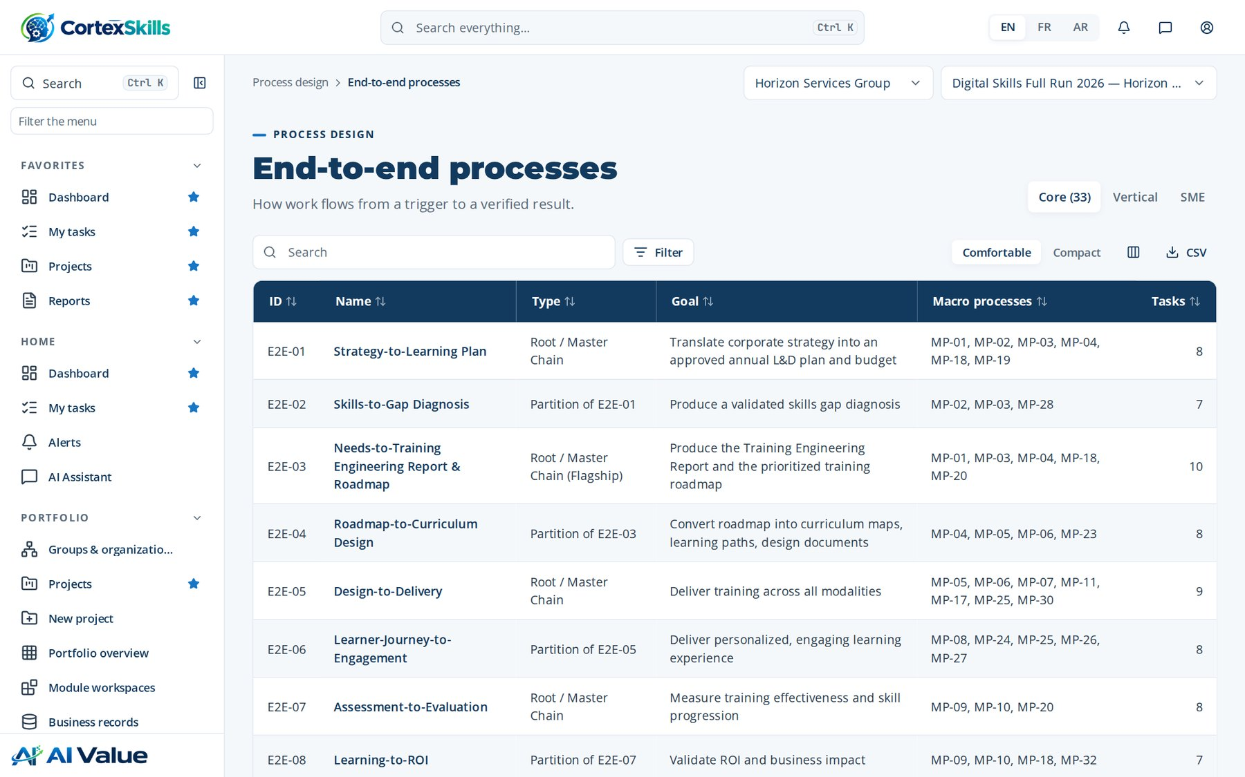
PROCESS DESIGN
End-to-end processes
Address: /process/e2e
Process design · Horizon Services Group · Demonstration data — fictional organization
30

Slide 31
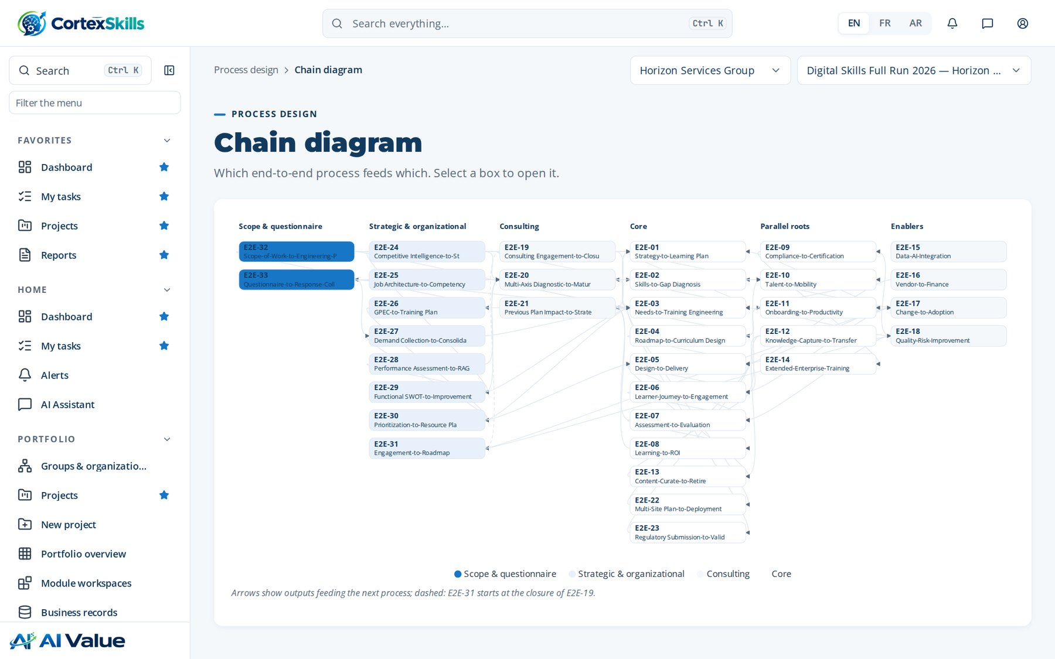
PROCESS DESIGN
Chain diagram
Address: /process/chain
Process design · Horizon Services Group · Demonstration data — fictional organization
31

Slide 32
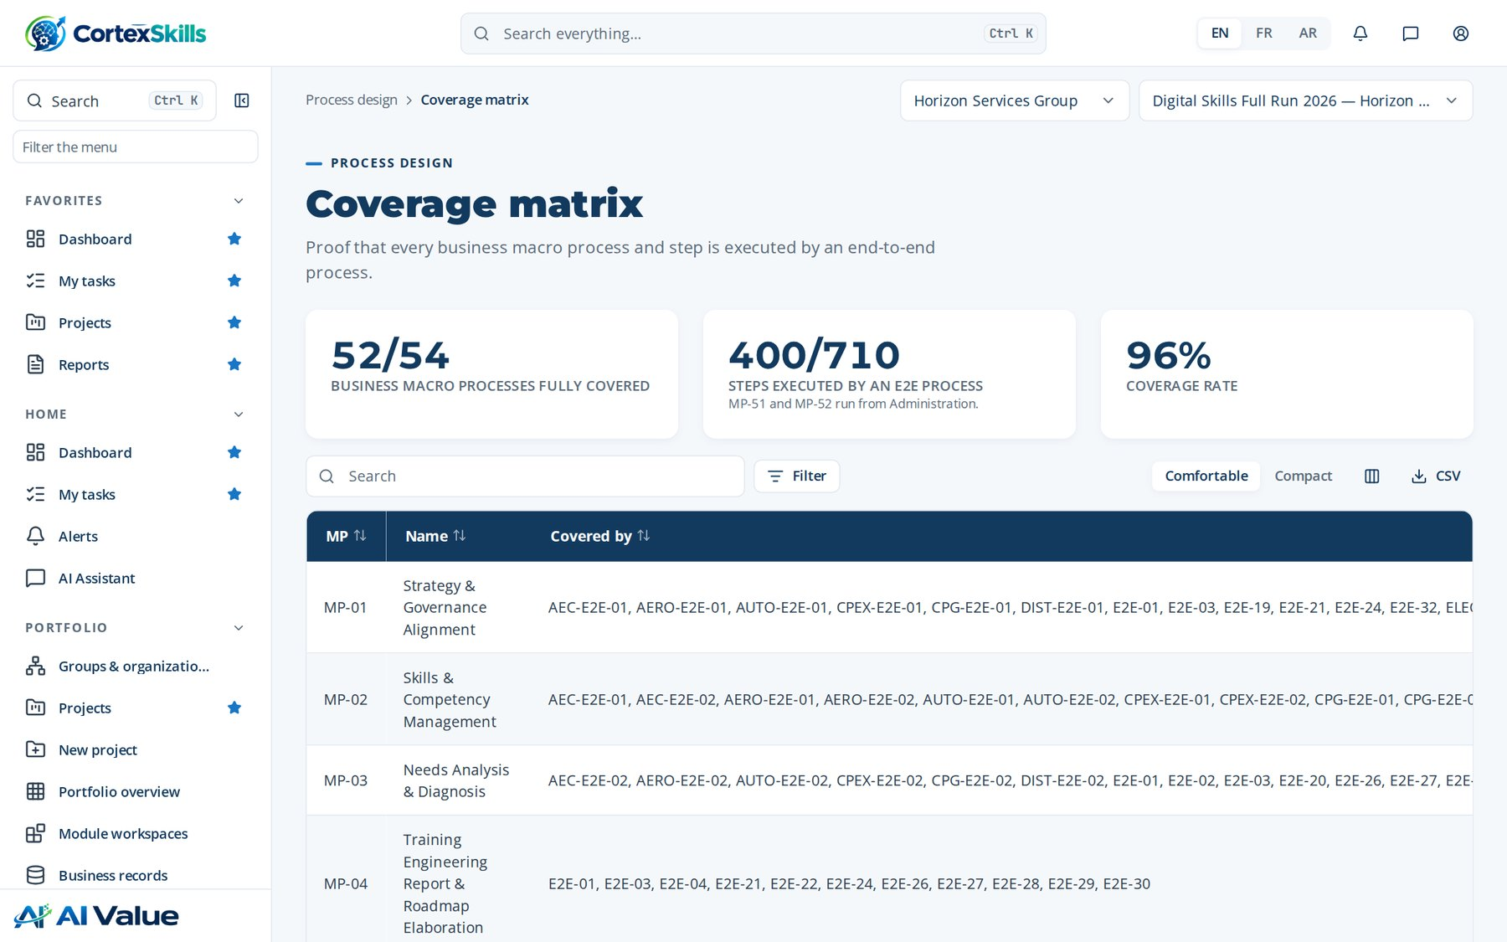
PROCESS DESIGN
Coverage matrix
Address: /process/coverage
Process design · Horizon Services Group · Demonstration data — fictional organization
32

Slide 33
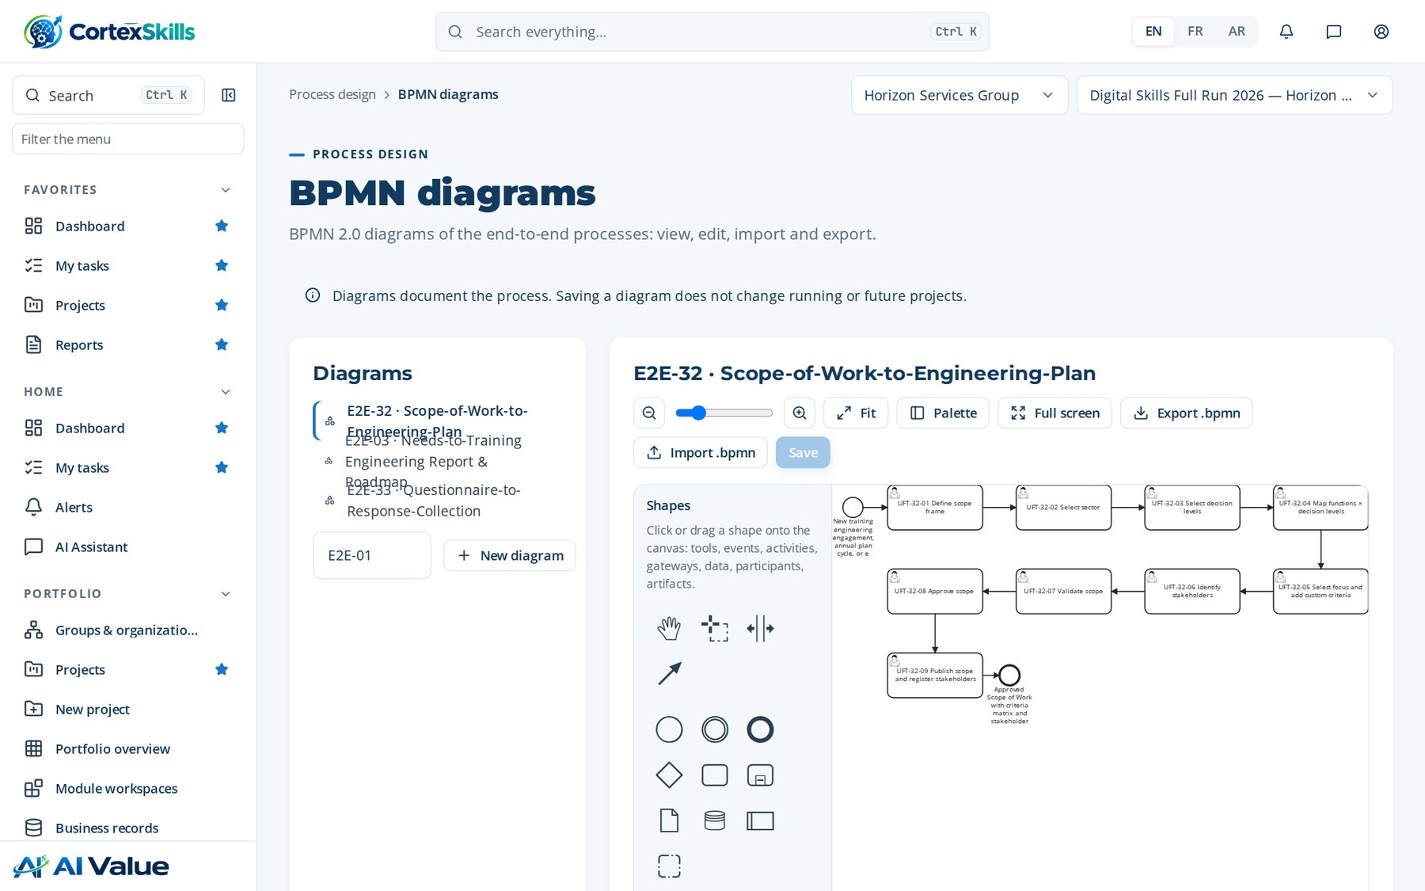
PROCESS DESIGN
BPMN diagrams
Address: /process/bpmn
Process design · Horizon Services Group · Demonstration data — fictional organization
33

Slide 34
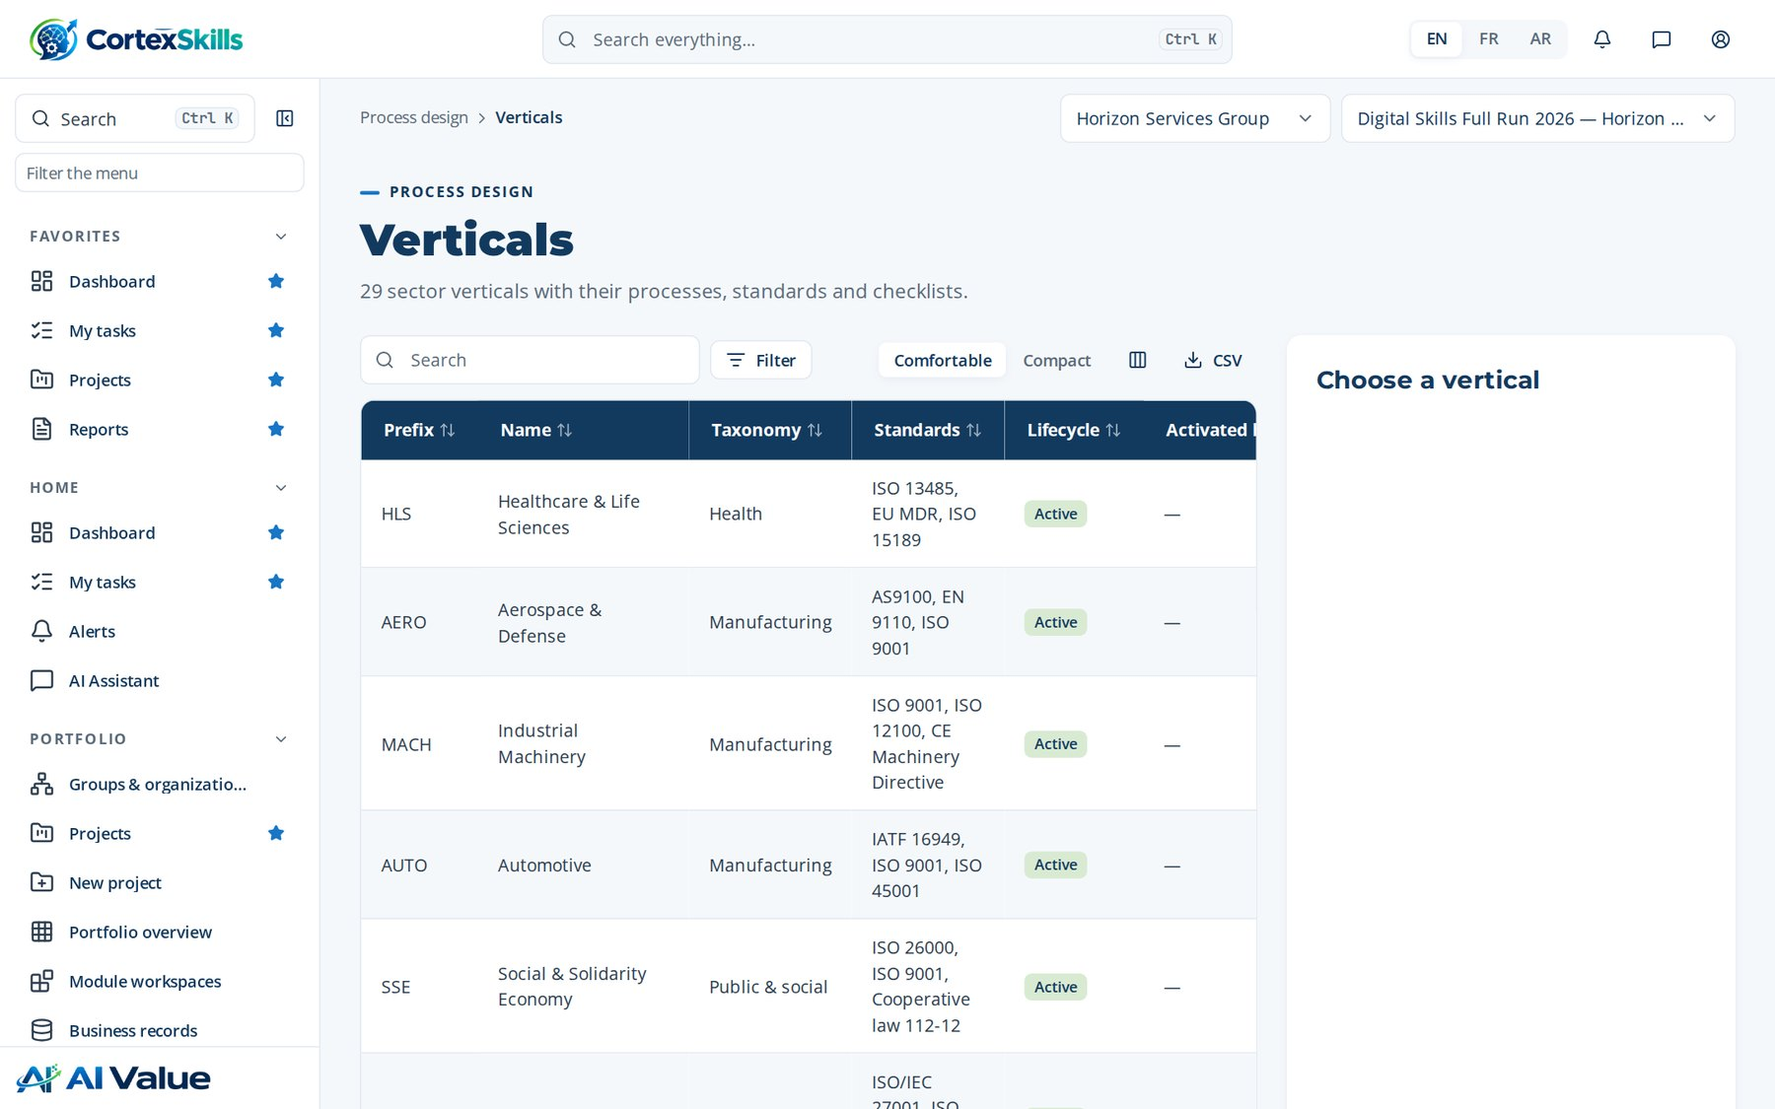
PROCESS DESIGN
Verticals
Address: /process/verticals
Process design · Horizon Services Group · Demonstration data — fictional organization
34

Slide 35
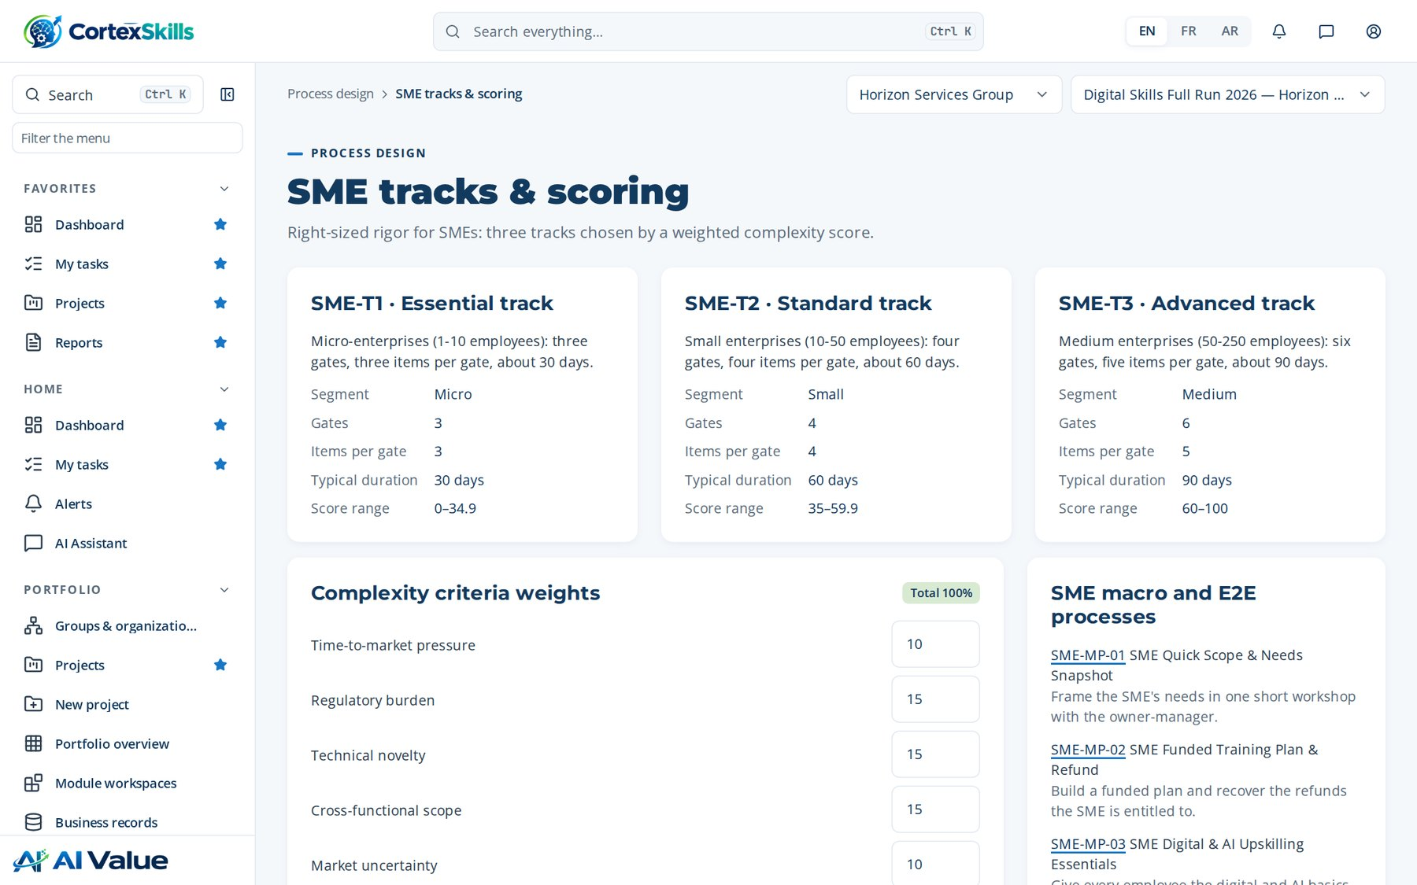
PROCESS DESIGN
SME tracks & scoring
Address: /process/sme
Process design · Horizon Services Group · Demonstration data — fictional organization
35

Slide 36
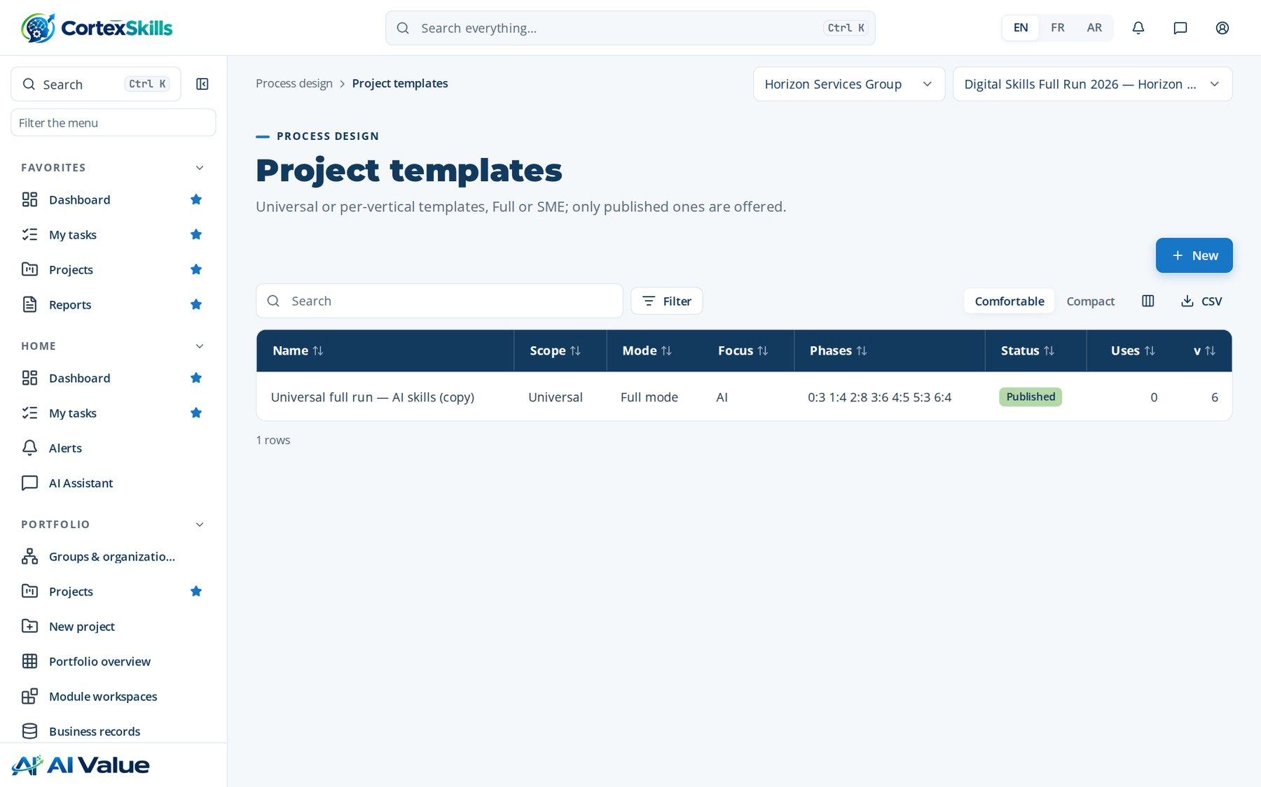
PROCESS DESIGN
Project templates
Address: /process/templates
Process design · Horizon Services Group · Demonstration data — fictional organization
36

Slide 37
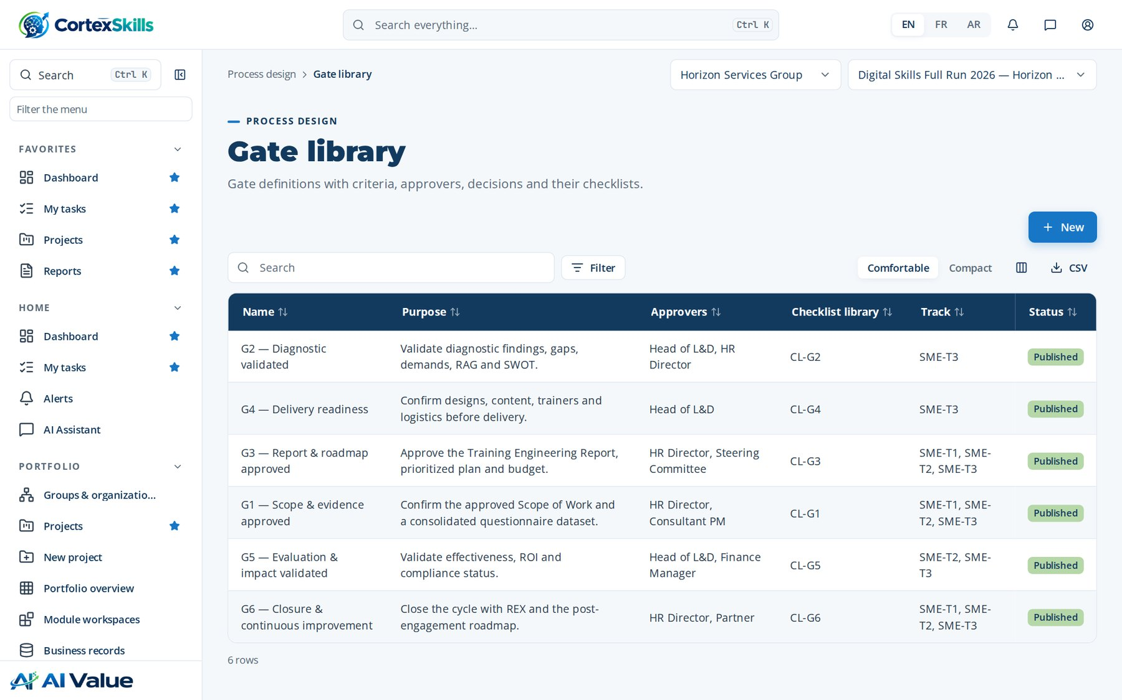
PROCESS DESIGN
Gate library
Address: /process/gates
Process design · Horizon Services Group · Demonstration data — fictional organization
37

Slide 38
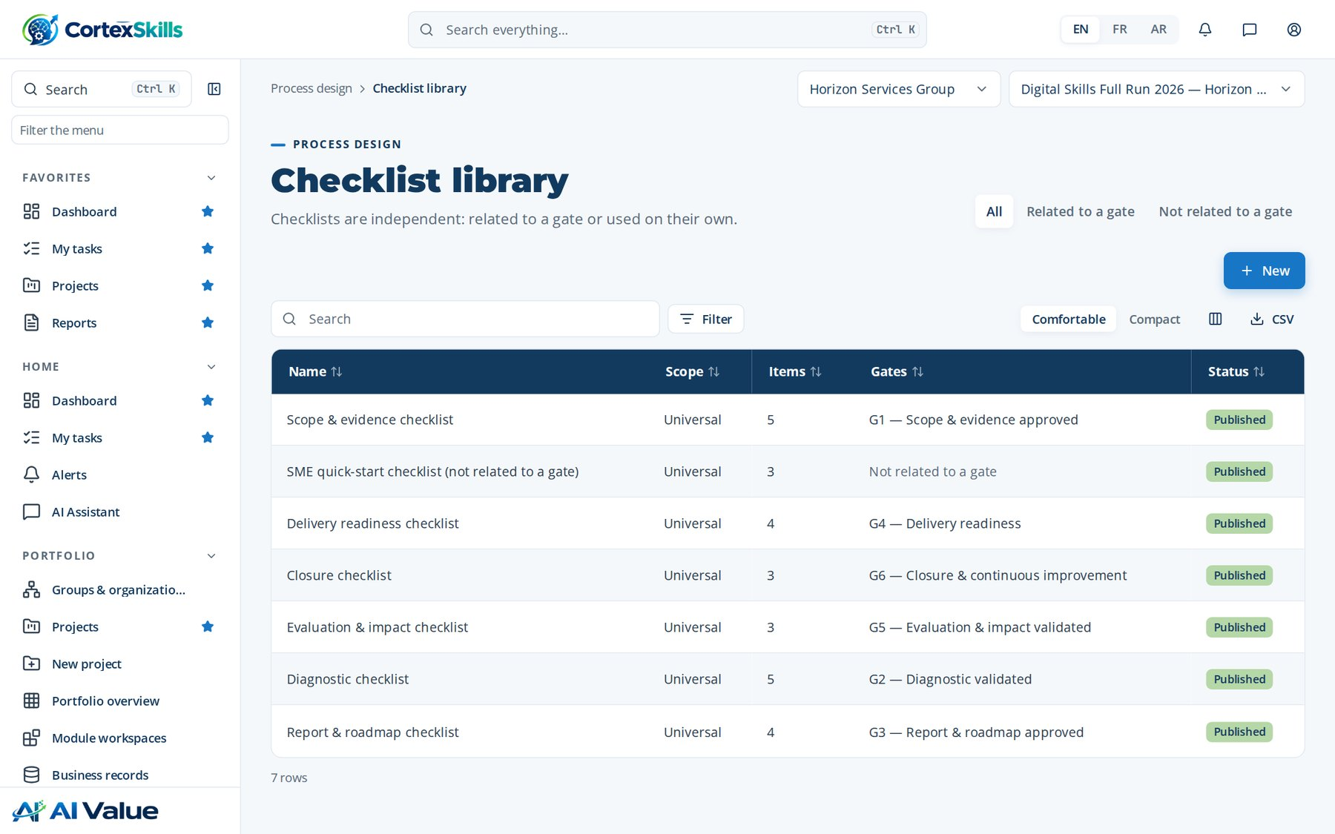
PROCESS DESIGN
Checklist library
Address: /process/checklists
Process design · Horizon Services Group · Demonstration data — fictional organization
38

Slide 39
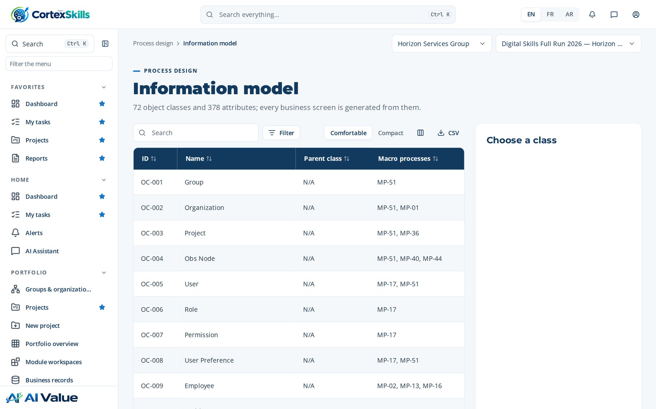
PROCESS DESIGN
Information model
Address: /process/model
Process design · Horizon Services Group · Demonstration data — fictional organization
39

Slide 40
04
Governance
Business rules · Controls (COSO) · Risks & opportunities · KPIs · Alert settings · RACSI · Organization (OBS) · Registers · Audits · Return on experience · WBS & Gantt

Slide 41
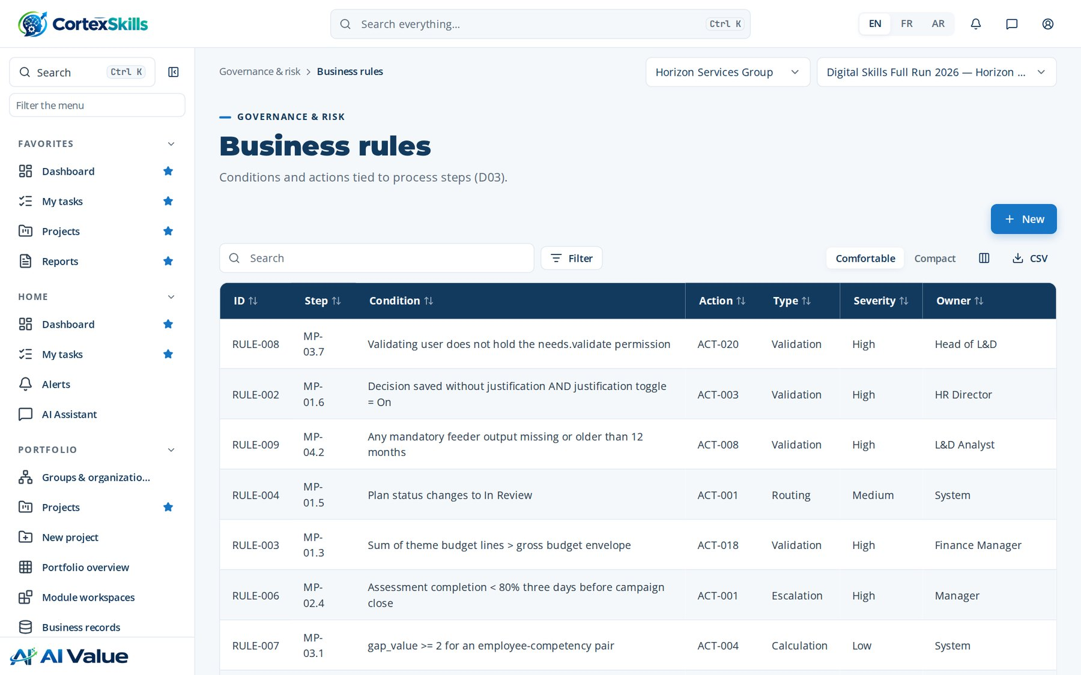
GOVERNANCE
Business rules
Address: /gov/rules
Governance · Horizon Services Group · Demonstration data — fictional organization
41

Slide 42
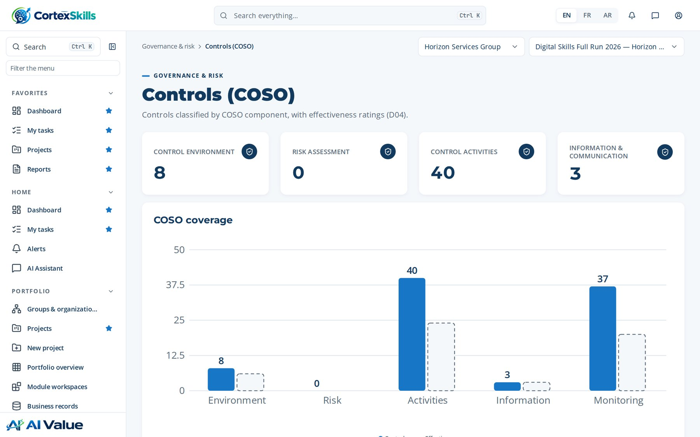
GOVERNANCE
Controls (COSO)
Address: /gov/controls
Governance · Horizon Services Group · Demonstration data — fictional organization
42

Slide 43
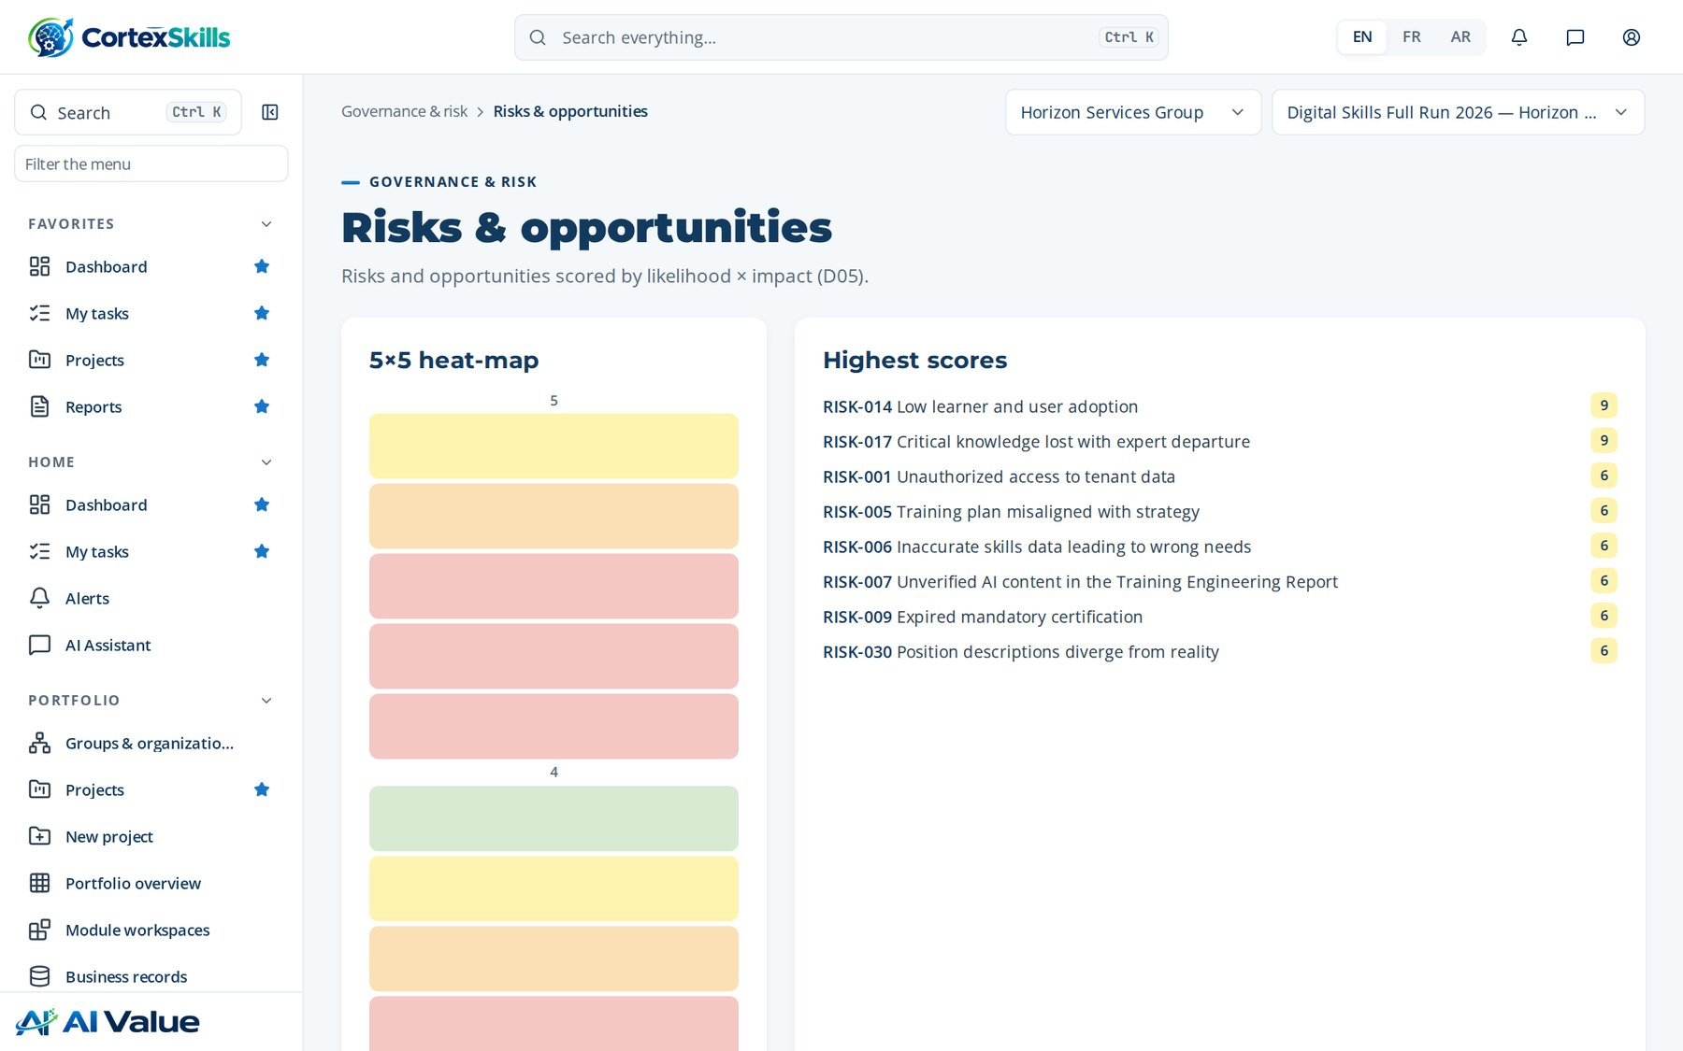
GOVERNANCE
Risks & opportunities
Address: /gov/risks
Governance · Horizon Services Group · Demonstration data — fictional organization
43

Slide 44
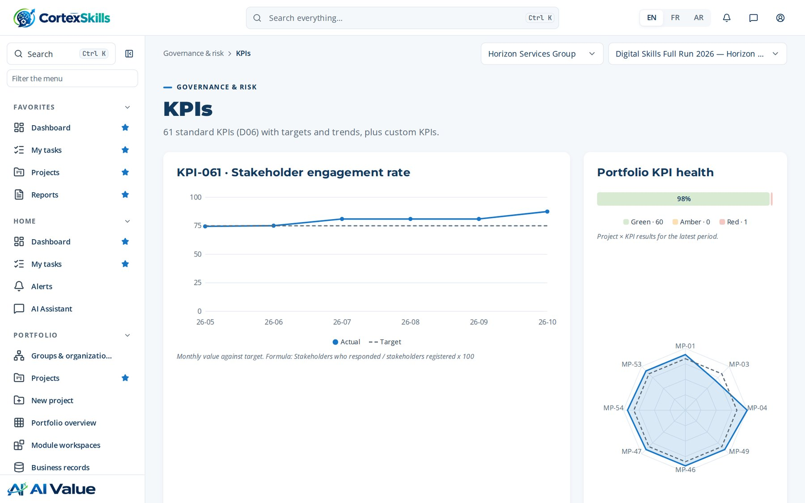
GOVERNANCE
KPIs
Address: /gov/kpis
Governance · Horizon Services Group · Demonstration data — fictional organization
44

Slide 45
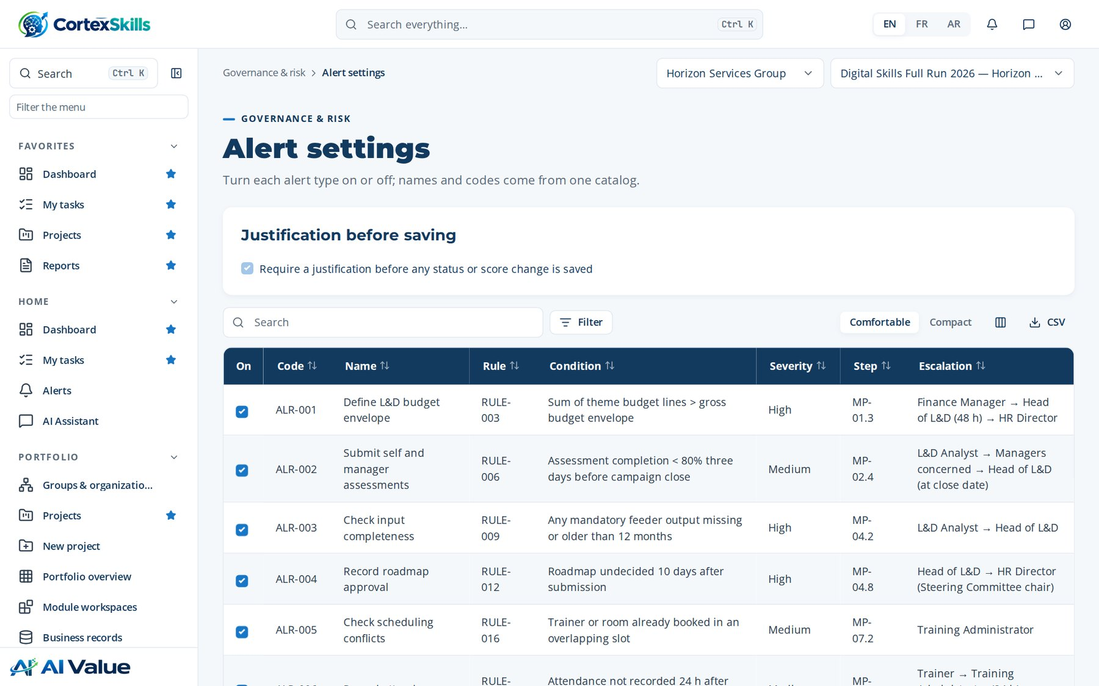
GOVERNANCE
Alert settings
Address: /gov/alert-settings
Governance · Horizon Services Group · Demonstration data — fictional organization
45

Slide 46
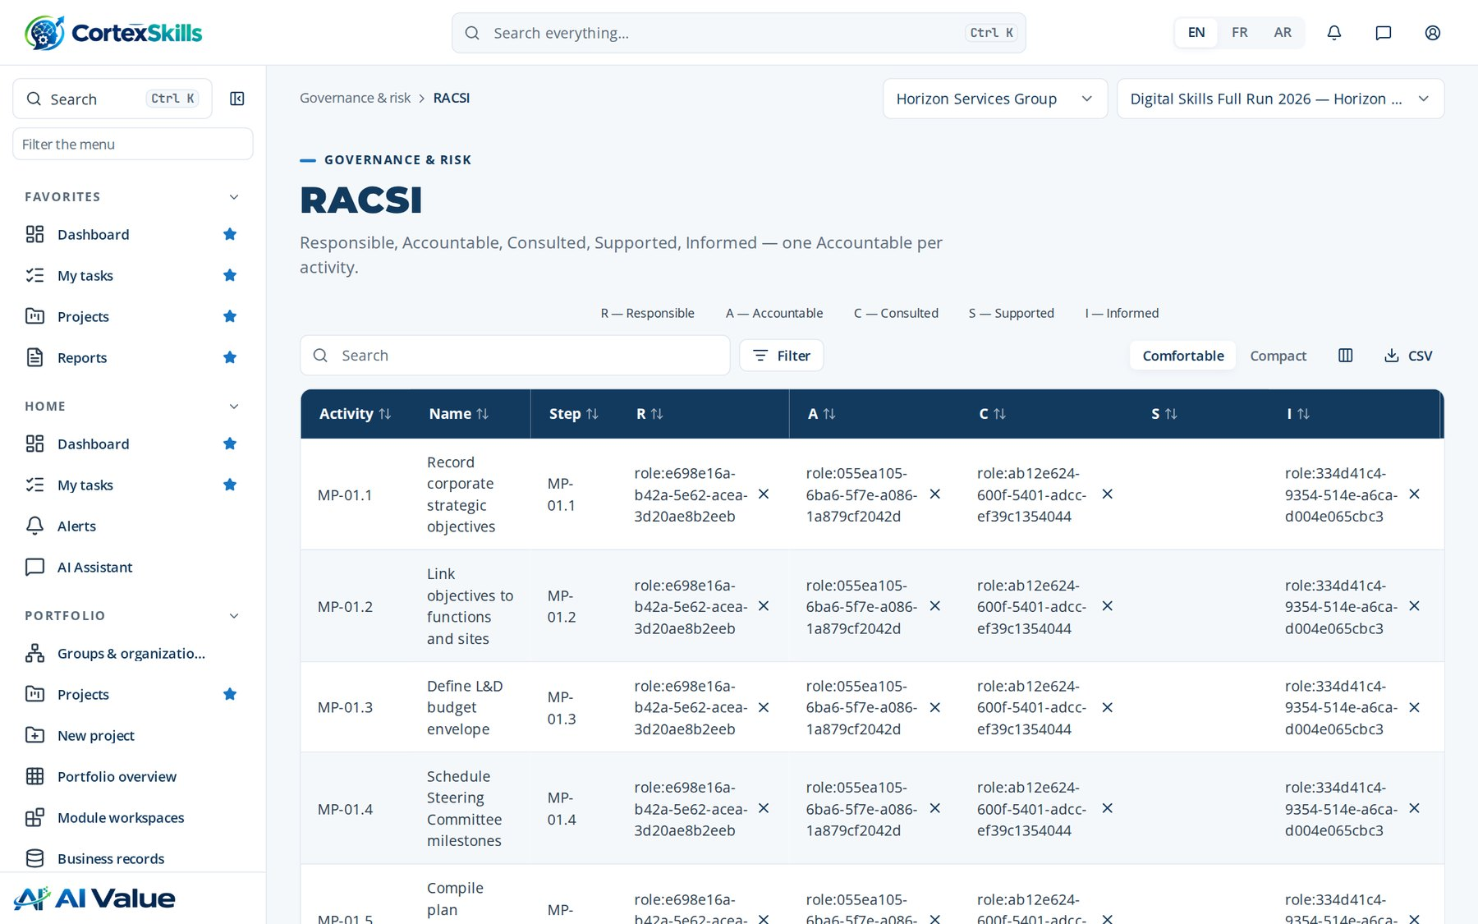
GOVERNANCE
RACSI
Address: /gov/racsi
Governance · Horizon Services Group · Demonstration data — fictional organization
46

Slide 47
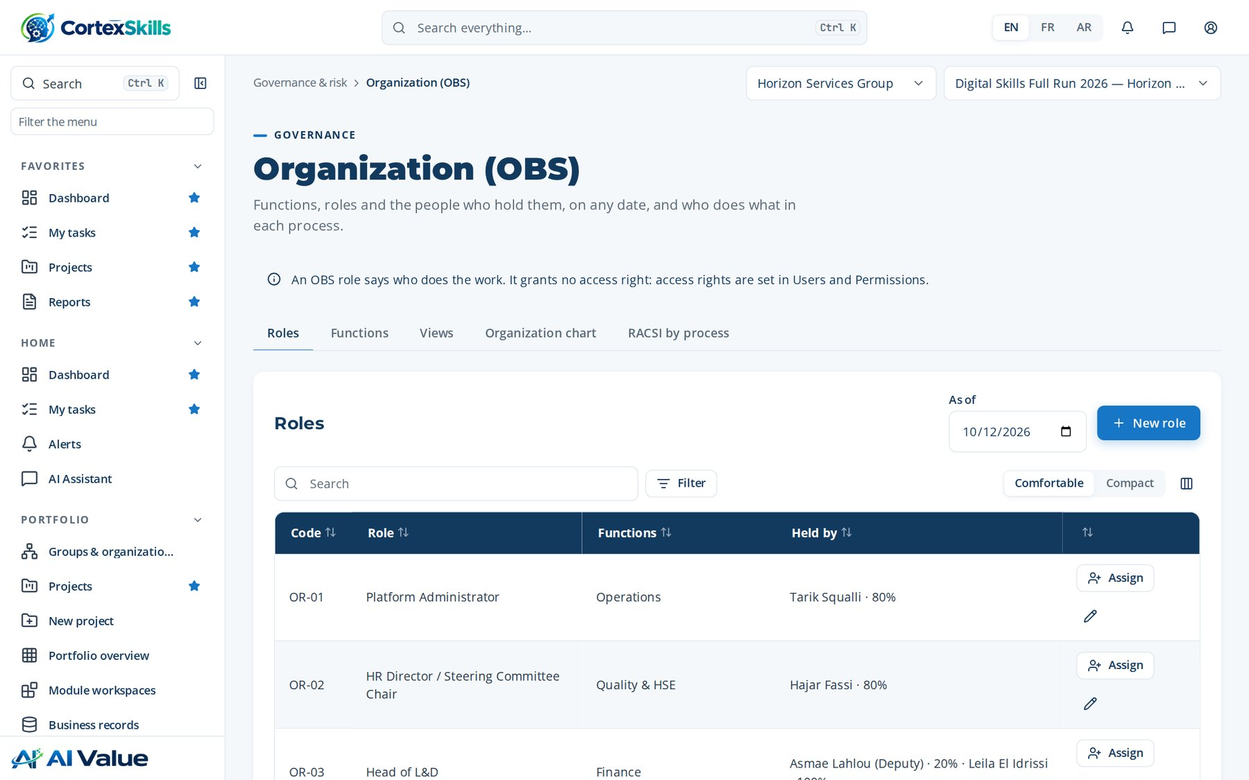
GOVERNANCE
Organization (OBS)
Address: /gov/obs
Governance · Horizon Services Group · Demonstration data — fictional organization
47

Slide 48
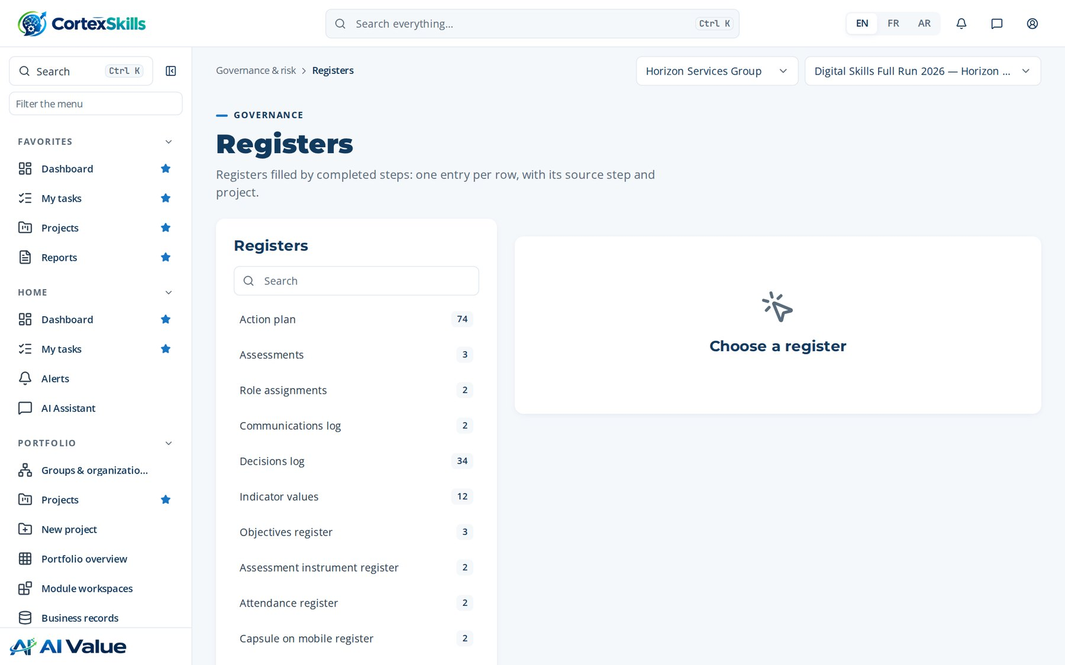
GOVERNANCE
Registers
Address: /registers
Governance · Horizon Services Group · Demonstration data — fictional organization
48

Slide 49
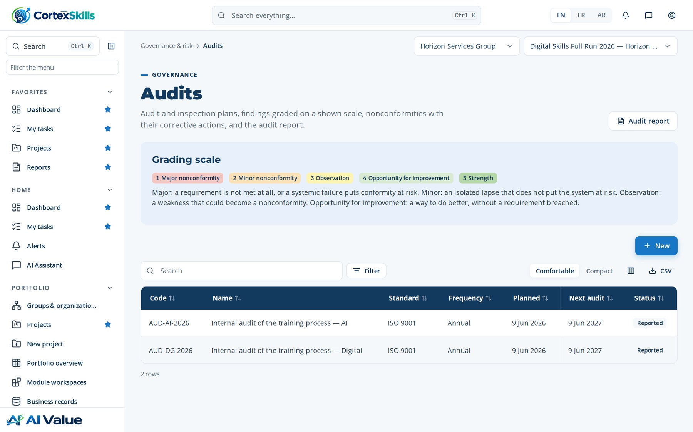
GOVERNANCE
Audits
Address: /gov/audits
Governance · Horizon Services Group · Demonstration data — fictional organization
49

Slide 50
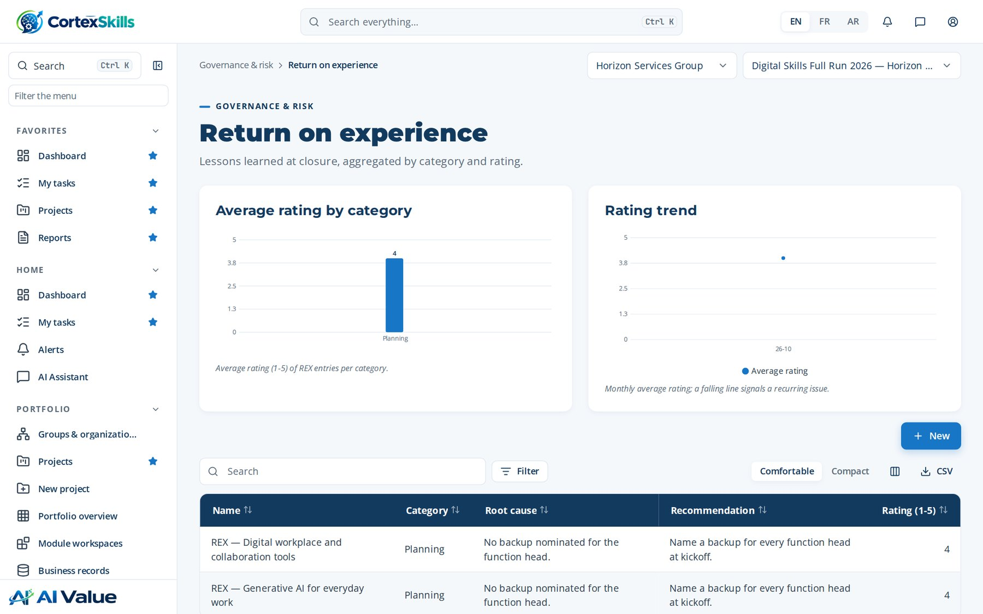
GOVERNANCE
Return on experience
Address: /gov/rex
Governance · Horizon Services Group · Demonstration data — fictional organization
50

Slide 51
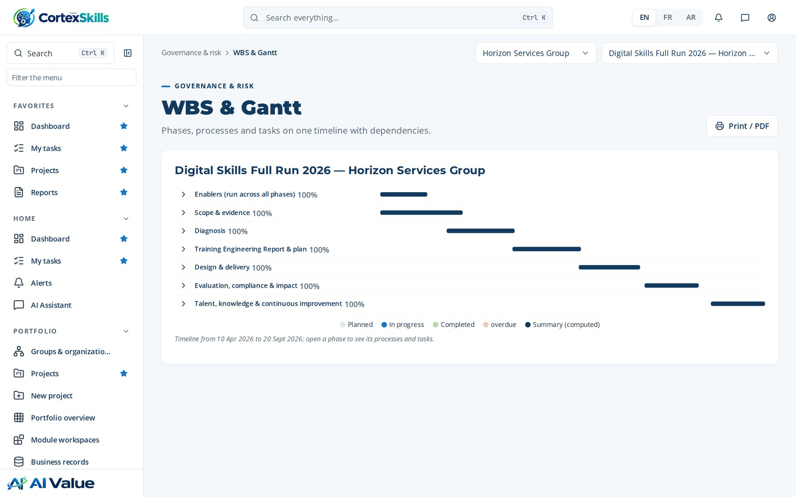
GOVERNANCE
WBS & Gantt
Address: /gov/gantt
Governance · Horizon Services Group · Demonstration data — fictional organization
51

Slide 52
05
Artificial intelligence
AI use cases · AI usage log · Knowledge base · Live AI model · AI settings

Slide 53
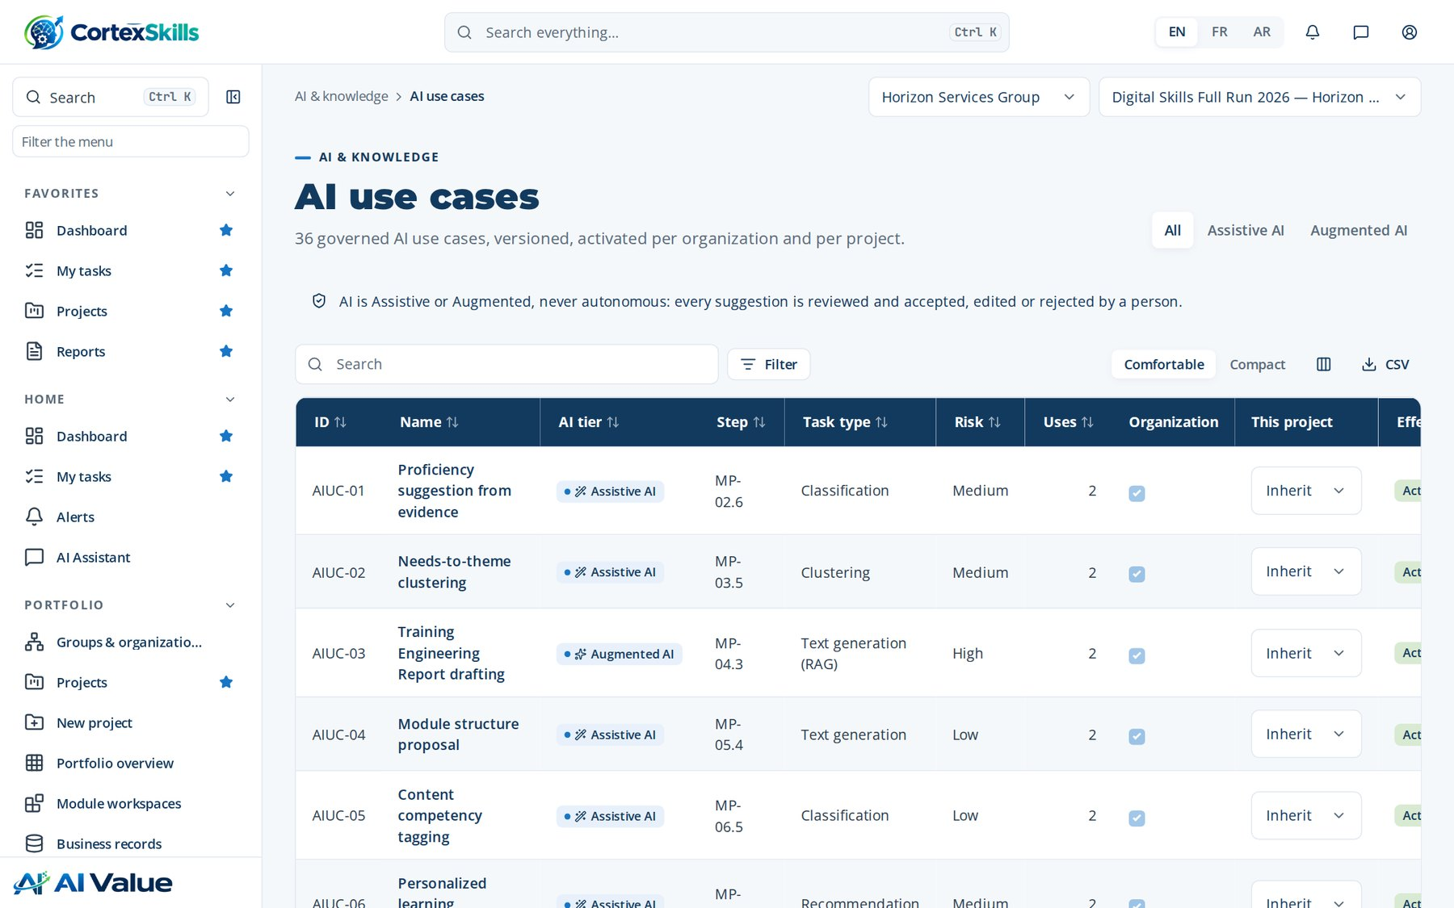
ARTIFICIAL INTELLIGENCE
AI use cases
Address: /ai/use-cases
Artificial intelligence · Horizon Services Group · Demonstration data — fictional organization
53

Slide 54
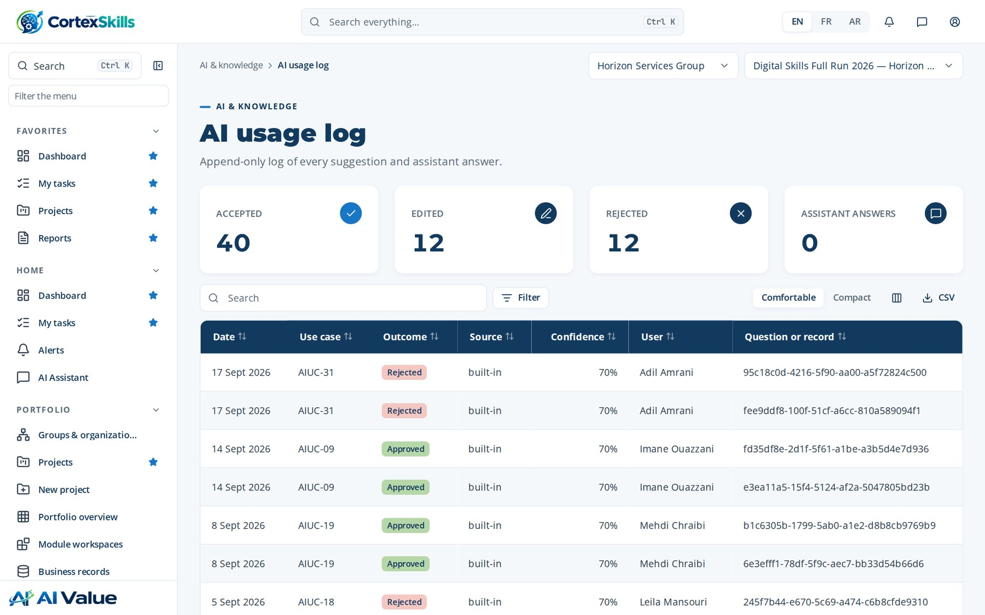
ARTIFICIAL INTELLIGENCE
AI usage log
Address: /ai/usage
Artificial intelligence · Horizon Services Group · Demonstration data — fictional organization
54

Slide 55
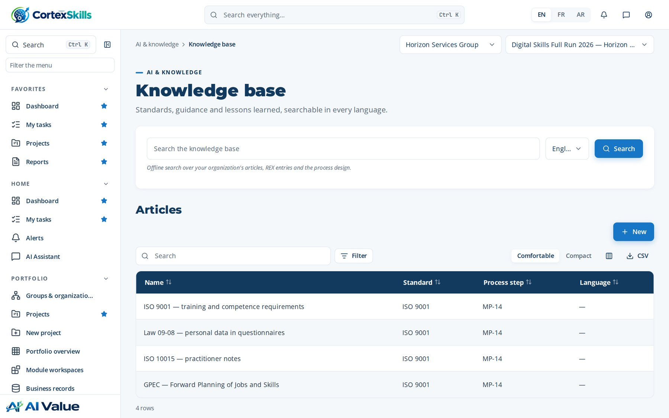
ARTIFICIAL INTELLIGENCE
Knowledge base
Address: /ai/kb
Artificial intelligence · Horizon Services Group · Demonstration data — fictional organization
55

Slide 56
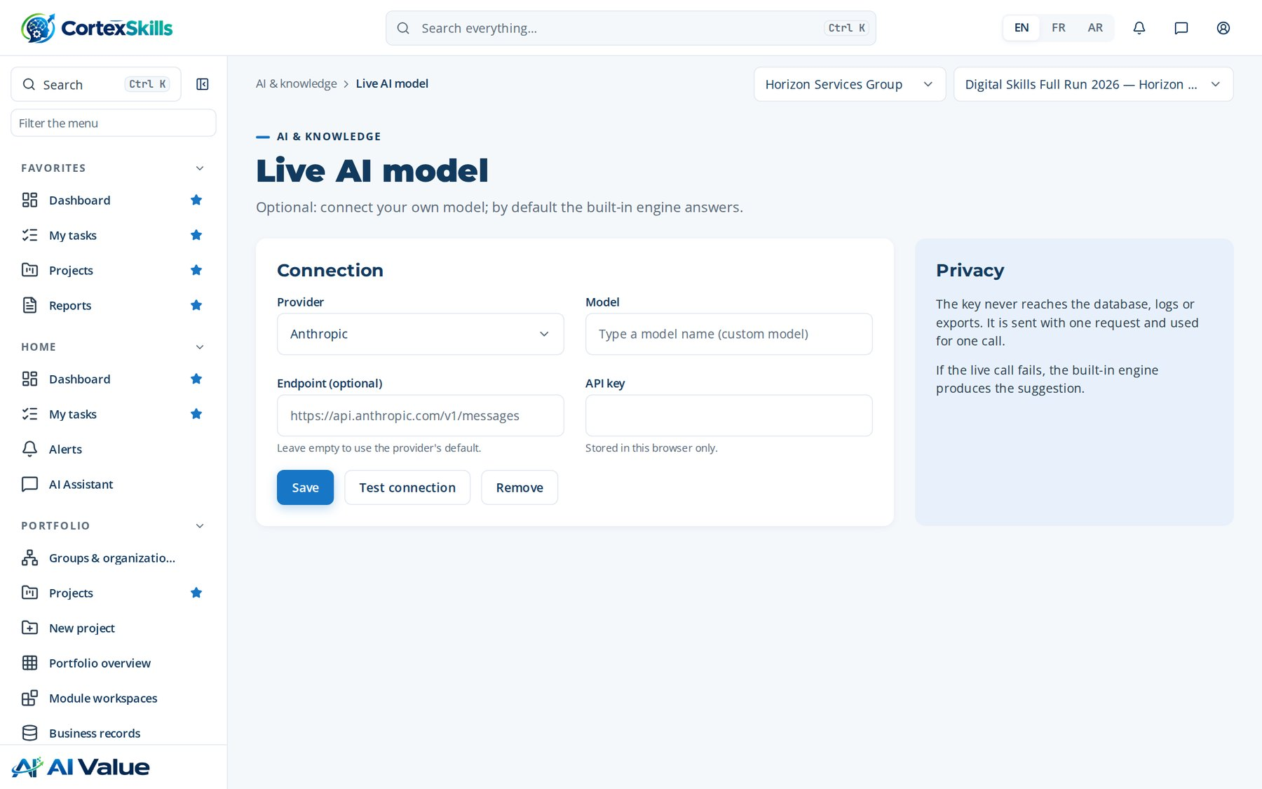
ARTIFICIAL INTELLIGENCE
Live AI model
Address: /ai/model
Artificial intelligence · Horizon Services Group · Demonstration data — fictional organization
56

Slide 57
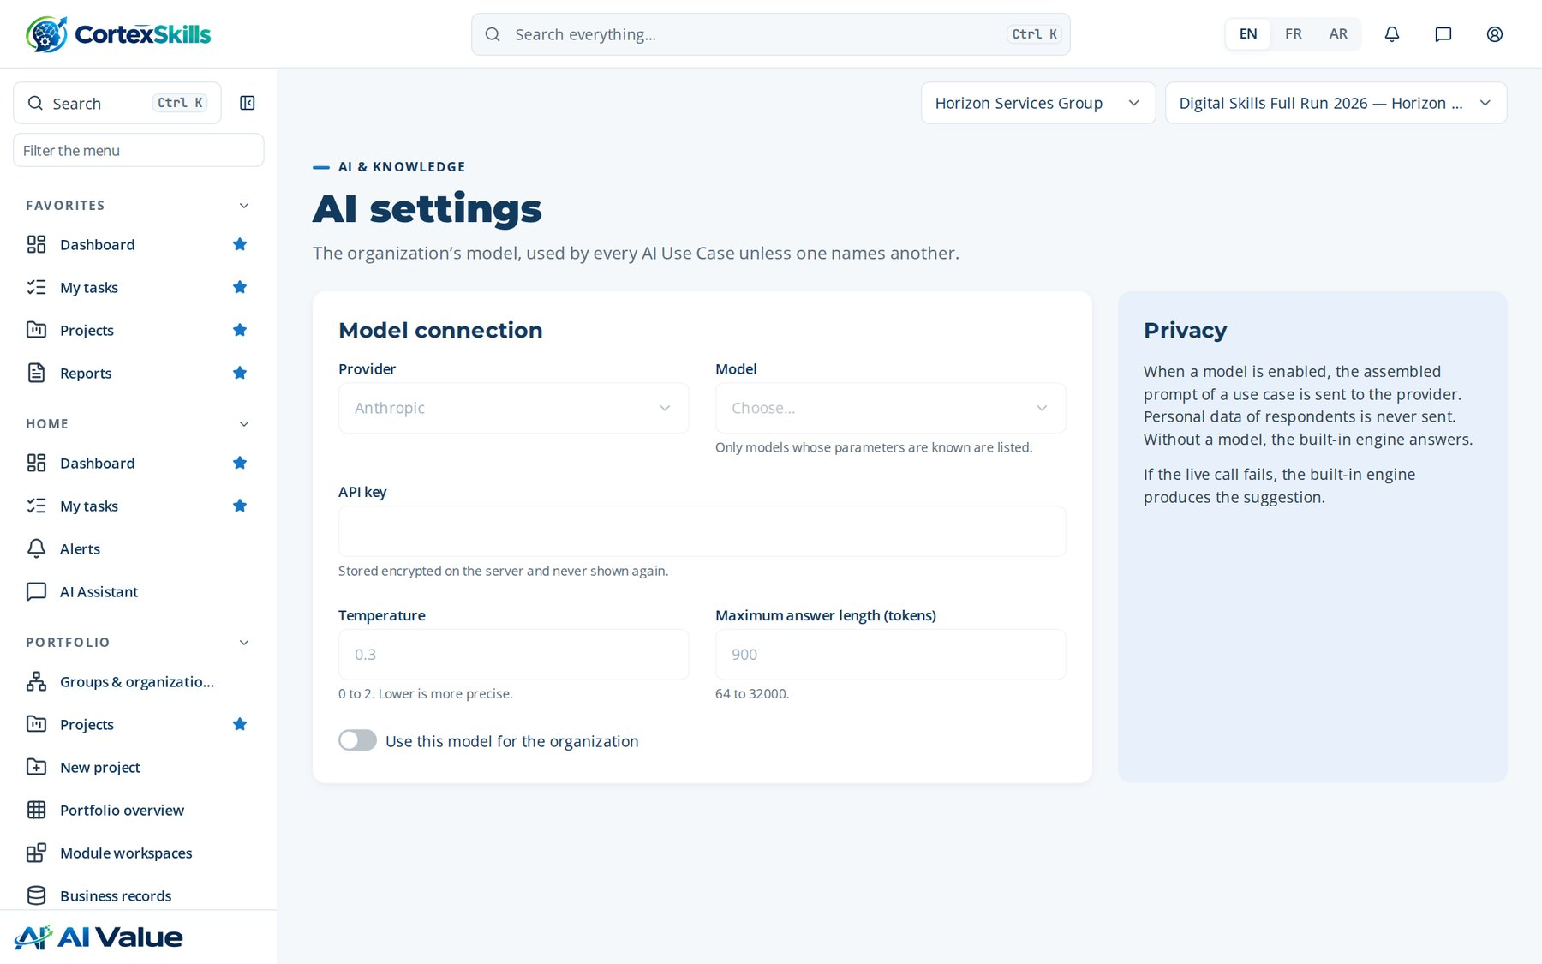
ARTIFICIAL INTELLIGENCE
AI settings
Address: /ai/settings
Artificial intelligence · Horizon Services Group · Demonstration data — fictional organization
57

Slide 58
06
Reports and documents
Reports · Documents · Training Engineering Report and Training Plan — Horizon Services Group · Training plan with detailed agendas — Horizon Services Group · Document templates · Document layout · Master list · Internal benchmarking

Slide 59

REPORTS AND DOCUMENTS
Reports
Address: /reports
Reports and documents · Horizon Services Group · Demonstration data — fictional organization
59

Slide 60

REPORTS AND DOCUMENTS
Documents
Address: /documents
Reports and documents · Horizon Services Group · Demonstration data — fictional organization
60

Slide 61

REPORTS AND DOCUMENTS
Training Engineering Report and Training Plan — Horizon Services Group
Address: /documents/:id
Reports and documents · Horizon Services Group · Demonstration data — fictional organization
61

Slide 62

REPORTS AND DOCUMENTS
Training plan with detailed agendas — Horizon Services Group
Address: /documents/:id
Reports and documents · Horizon Services Group · Demonstration data — fictional organization
62

Slide 63

REPORTS AND DOCUMENTS
Document templates
Address: /documents/templates
Reports and documents · Horizon Services Group · Demonstration data — fictional organization
63

Slide 64

REPORTS AND DOCUMENTS
Document layout
Address: /documents/layout
Reports and documents · Horizon Services Group · Demonstration data — fictional organization
64

Slide 65

REPORTS AND DOCUMENTS
Master list
Address: /documents/master-list
Reports and documents · Horizon Services Group · Demonstration data — fictional organization
65

Slide 66

REPORTS AND DOCUMENTS
Internal benchmarking
Address: /benchmark
Reports and documents · Horizon Services Group · Demonstration data — fictional organization
66

Slide 67
07
Administration
Users · Permission matrix · Configuration & licence · Packs & pricing · Integrations · Channels (e-mail, WhatsApp) · SME onboarding · Audit log · Backups & health · Requirement traceability

Slide 68

ADMINISTRATION
Users
Address: /admin/users
Administration · Horizon Services Group · Demonstration data — fictional organization
68

Slide 69

ADMINISTRATION
Permission matrix
Address: /admin/permissions
Administration · Horizon Services Group · Demonstration data — fictional organization
69

Slide 70

ADMINISTRATION
Configuration & licence
Address: /admin/config
Administration · Horizon Services Group · Demonstration data — fictional organization
70

Slide 71

ADMINISTRATION
Packs & pricing
Address: /admin/pricing
Administration · Horizon Services Group · Demonstration data — fictional organization
71

Slide 72

ADMINISTRATION
Integrations
Address: /admin/integrations
Administration · Horizon Services Group · Demonstration data — fictional organization
72

Slide 73

ADMINISTRATION
Channels (e-mail, WhatsApp)
Address: /admin/channels
Administration · Horizon Services Group · Demonstration data — fictional organization
73

Slide 74

ADMINISTRATION
SME onboarding
Address: /admin/onboarding
Administration · Horizon Services Group · Demonstration data — fictional organization
74

Slide 75

ADMINISTRATION
Audit log
Address: /admin/audit
Administration · Horizon Services Group · Demonstration data — fictional organization
75

Slide 76

ADMINISTRATION
Backups & health
Address: /admin/backups
Administration · Horizon Services Group · Demonstration data — fictional organization
76

Slide 77

ADMINISTRATION
Requirement traceability
Address: /admin/traceability
Administration · Horizon Services Group · Demonstration data — fictional organization
77

Slide 78
08
Settings, help and profile
My settings · Help centre

Slide 79

SETTINGS, HELP AND PROFILE
My settings
Address: /settings
Settings, help and profile · Horizon Services Group · Demonstration data — fictional organization
79

Slide 80

SETTINGS, HELP AND PROFILE
Help centre
Address: /help
Settings, help and profile · Horizon Services Group · Demonstration data — fictional organization
80

