Slide 1
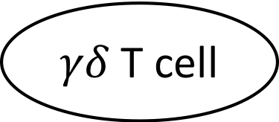
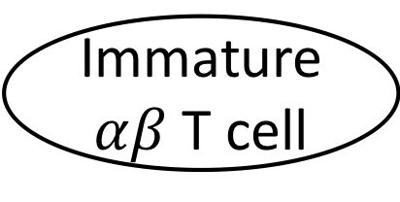
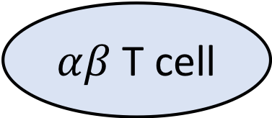
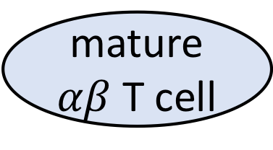
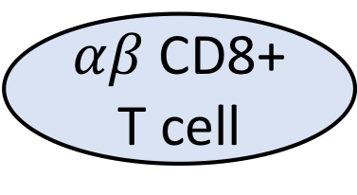
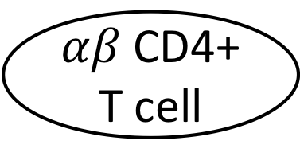
T cell
0.03
Machine
learning
$αβ$T cell
$γδ$T cell
0.2
0.3
mature$αβ$T cell
Immature $αβ$T cell
0.4
0.07
$αβ$CD4+ T cell
$αβ$CD8+ T cell
RNA-seq derived
feature vector
Cell Ontology

