Slide 1
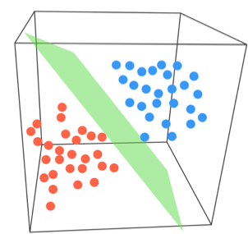
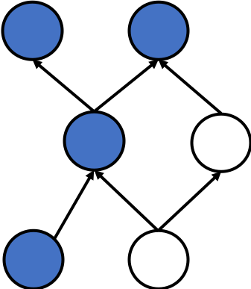
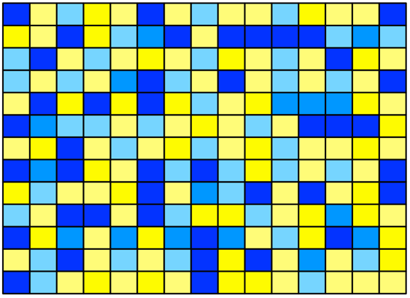

Raw Reads
RNA-seq derived
expression data
Cell type classifier
Ontology
Quantify
Training
Predict
Supervise
Phenotype terms
Raw Metadata
Normalize
Chapters 3 and 4
Chapter 2

