Slide 1
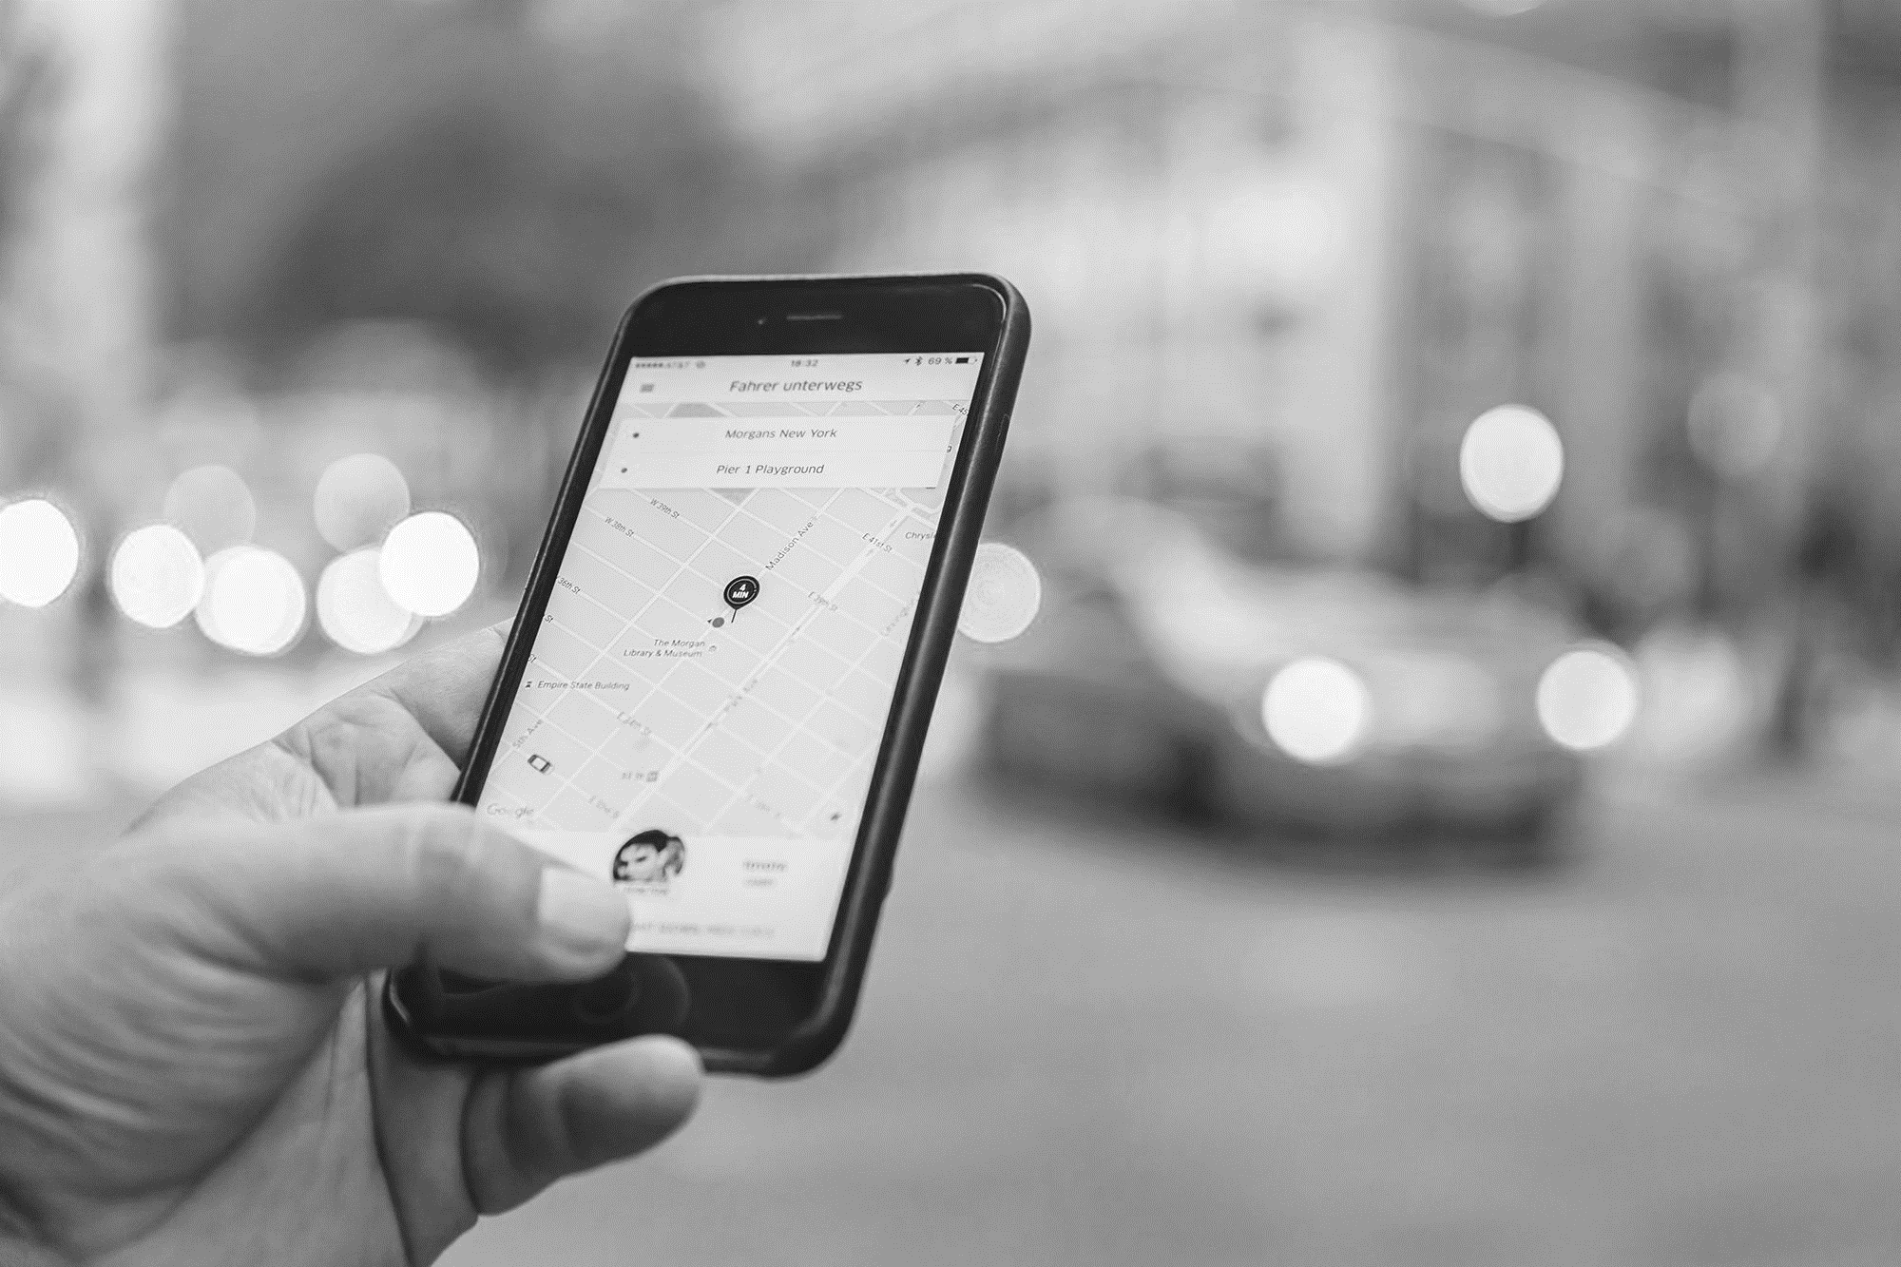
LEARNING ABOUT TAXI TRIPS TO HELP OUR SERVICE LAUNCH
New York City (USA)
Notes:
Good afternoon everyone and thank you for taking the time to come to this presentation about the features of our new riding app. As you know, we have been very successful in Europe with the launch of our ride sharing services and we are aiming to do the same un the USA, with New York as our starting point.
One of the main features we would like to include in our app is advising our customer on how much they should tip according to the features of their trip

Slide 2
Objective
Successfully introduce our ride sharing company in the city.
App optimization. Offer the customer different possibilities to reward the driver at the end of each trip.
Provide drivers with information about the most profitable trips.
Limitations
We do not have data on trips yet to make recommendations on tips.
Little knowledge on the city and its trips behaviour.
Notes:
So the objective of this Project is as follows:
We want to be sucessful
We want to optimise our app by creating a system to advice our customer on how much they should tip
We want to provide our drivers with information on how to obtain the best tips
We have some limitations to do this:
We do not know New York and the behaviour of customers
We do not have data yet on our product in order to use it to make predictions

Slide 3
Our solution
01
02
Generate basic information
Sector mobility and the city
NYC Open Data Portal
Use as sample data in order to build a tip recommendation model
DATASET
August 2019
6 Million trips
Notes:
As a solution, we have gathered data on yellow cab trips from the NYC Open Portal taking a dataset with 6 milion trips corresponding to August 2019. Since the speed of vaccinations is going well (almost 40% of all new yorkers will be vaccinated by June), we can expect to have a similar situation to 2019 soon.
We have used this data to generate insights about mobility
And to build a model able to recommend tip quantities to customers

Slide 4
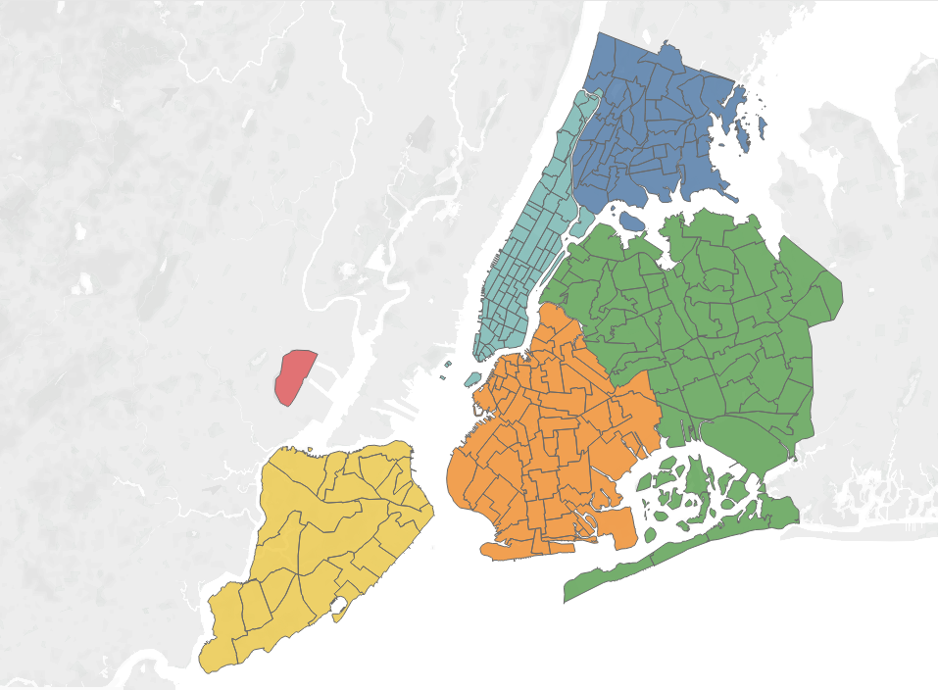
Intro to New York
BRONX
MANHATTAN
Area: 1,200 km2
Population: 8,419 million
Main business área: Manhattan
Three airports
Sample approximate distances
JFK – Manhattan – 30.7 km
Bronx – Manhattan – 14.7 km
Queens – Brooklyn – 16.8 km
Cross Manhattan – 3.9 km
QUEENS
BROOKLYN
STATEN ISLAND
Notes:
I know many of you are not from New York, so let’s start by contextualising the city.
The city where we want to make business has an área of 1200 km2 and a population of roughly 8.5 million.
The main business área and the heart of the city is Manhattan (here).
There are three airports connecting the city (which are here, here, and here). LaGuardia Airport (LGA) , Kennedy International Airport (JFK), Newark International Airport (EWR)
Some sample approximate distances are as follow:
If I land in JFK airport and I want to go to Manhattan (super usual trip) the distance I will travel is approximately 30 km.
If I then decide to go from Manhattan to the Bronx I will need to travel 14km to get there.
Queens to Brooklyn is almost 17 km and crossing Manhattan just takes 4 km.

Slide 5
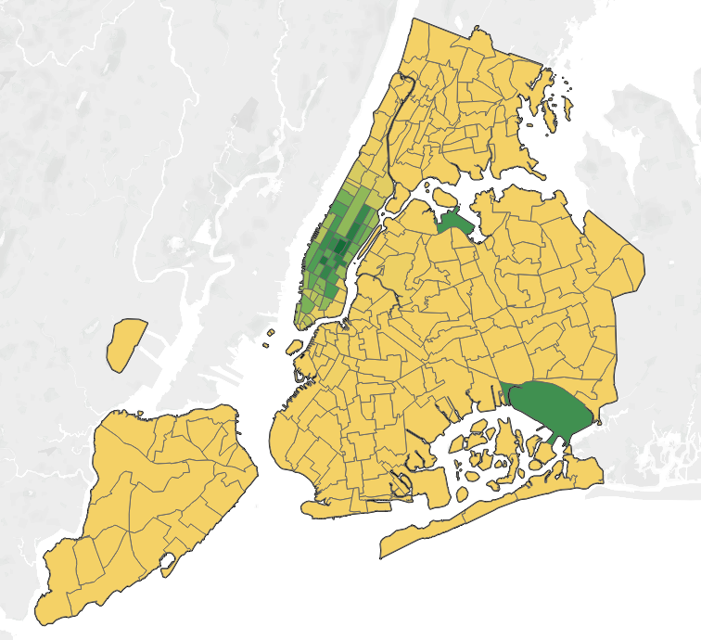
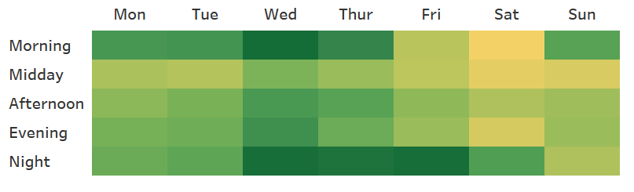
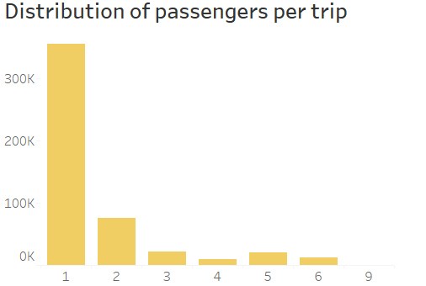

Trip distribution
Notes:
For the visualization of the data we have taken a smaller sample that is about 25% of our original data set.
When I see this map two things cme to my mind: tourism and business. The distribution of the trips cannot be more clear. People take cabs in Manhattan and the airport of JFK and LaGuardia Airport (LGA).
Most passengers travel alone and the times of the week were the demand is higher are mornings and nights. Wednesday is somehow the busiest day. While New York is a city that attract inmense amounts of tourism, if most passengers trave alone I would tend to think that business plays a key role in trips distribution.

Slide 6
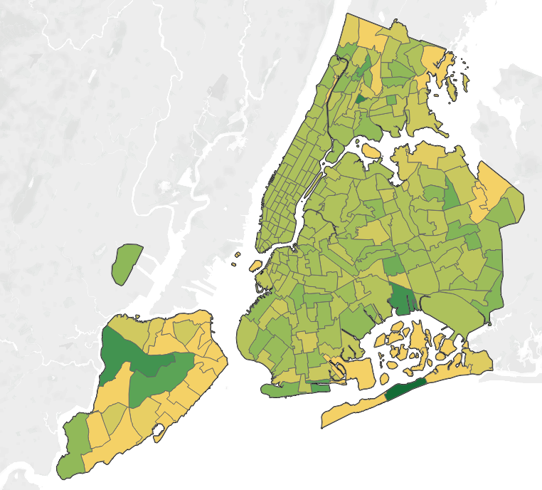

Tip distribution
Quite a lot of homogeneity
25% less than $2
75% less than $3.5
Main explanatory variables
Trip distance
Trip duration
Average speed
Fare amount
Notes:
So… we developed some maps to locate how tips are distributed, asking ourselves some questions:
Does location influence your generosity when tipping? Well, I guess that is a difficult question to answer since everybody seems to pay more or less the same. This maps shouldn’t be taken as definitive. I cannot really say that Manhanttan passengers are worse tippers. Huge number of passengers, huge numbers of tips → the area tends to concentrate the average tip.
However, it is a nice thought to say that Staten Island might be a good business! Big service areas, and one of the best average tip in the city
So what did we do? We used data transformation and modelling techniques (no need to explain this) to develop a system that can make realistic recommendations on tips. Let’s see it
Tip distribution repartida homogeneamente

Slide 7
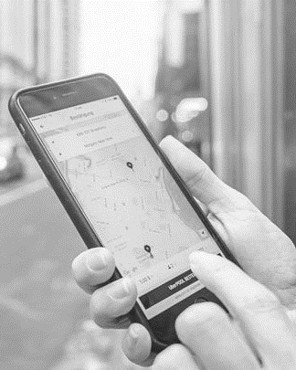
Demo
Venus has a beautiful name and is the second planet from the Sun. It’s terribly hot—even hotter than Mercury—and its atmosphere is extremely poisonous. It’s the second-brightest natural object in the night sky after the Moon
Tip prediction model
Notes:
Elena (Finance department) → Hey Elena I Heard you are travelling to New York, will you need to take a cab? → Yes I have meetings there right after I arrive
Ok tell me about your trip
Where are you going?
From JFK Airport to Manhattan → Distance 30 km
How long do you want to take?
Im always in a hurry, so 40 minutes max
Are travelling alone?
Yes
When do you need to travel?
Monday Morning
Joan (HR) I remeber you saying something about the Yankees. → yes, I will spend next week for work in New York but will stay for the weekend and go to see a game
Allright, tell me about your plans:
Where are you going?
I will go from the financial district to the northern part of Manhattan → ok, that’s a distance of 5 km
How long do you want to take?
25 minutes would be alright
Are travelling alone?
No, going with my brother
When do you need to travel?
Friday Evening

Slide 8
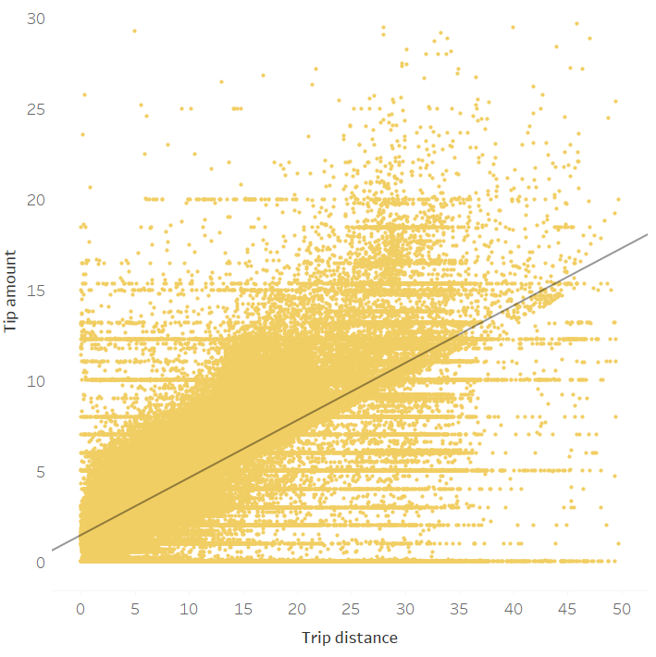
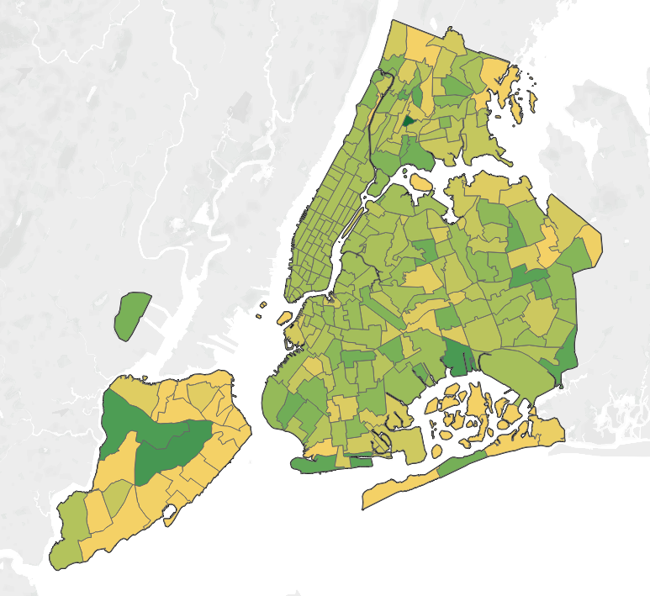

Trip distance
Tip amount
Trip distance
Notes:
Although it is still a prototype, seems like our model is able to predict accurate tips. Let’s look at the variables that are playing a big role in predicting tips.
First of all, distance seems to be key. The diagram on the left shows the relationship between those two variables. As we go further, the tip amount seems to increase, doesn’t it?
The map does not allow for a further interpretation. But if we go back to our Staten Island example, it all seems to make sense. Bigger average distance per trip and thus bigger tips can be found in the area.

Slide 9
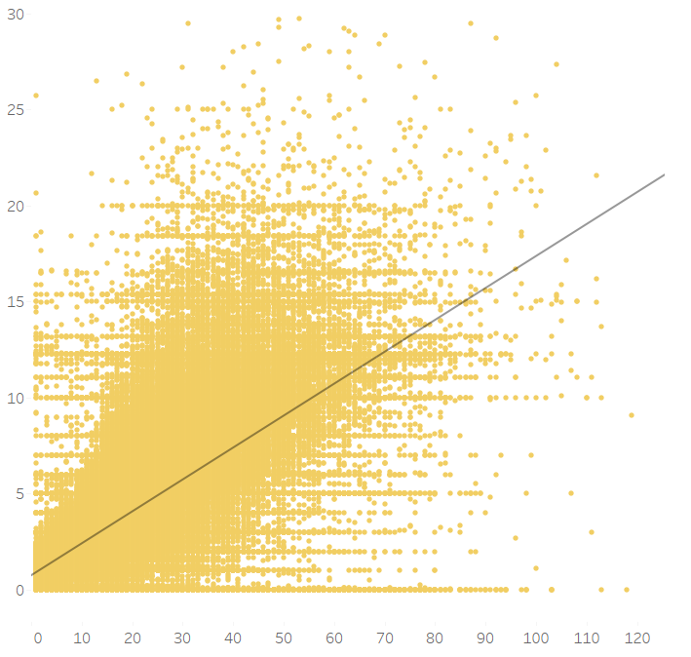
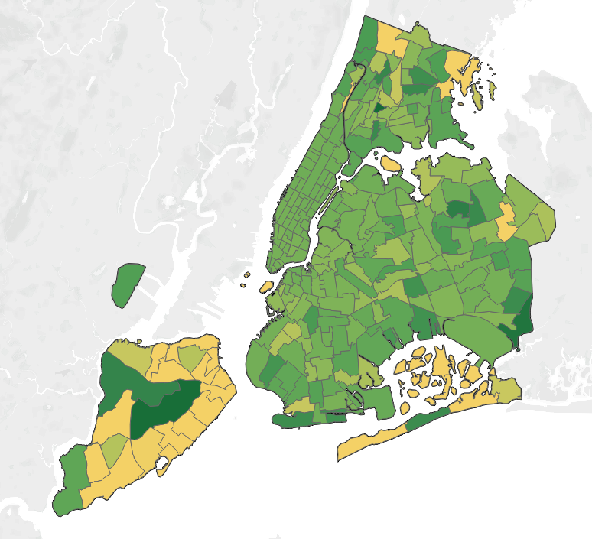

Trip duration
Tip amount
Trip duration
Notes:
What happened with the trip duration? Again, it seems to be a super good predictor of tip amount. Those darker areas (pretty common in many areas) correspond to areas that have an average duration of trip closer to the upper range. So apart from the upper areas of the Bronx and the east of Staten Island, I would tell my drivers that most of New York service areas are likely to yield high duration trips and thus larger tips.

Slide 10
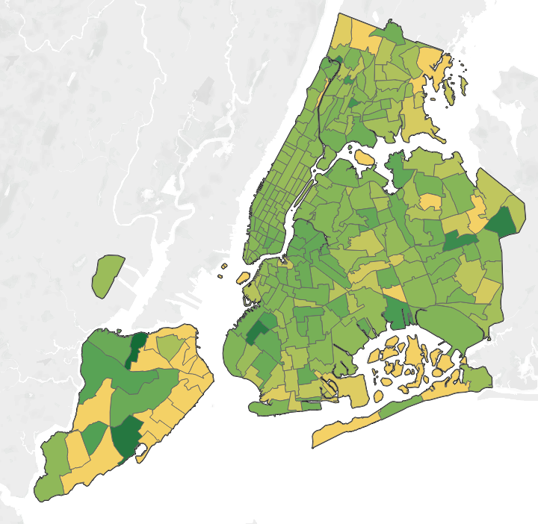
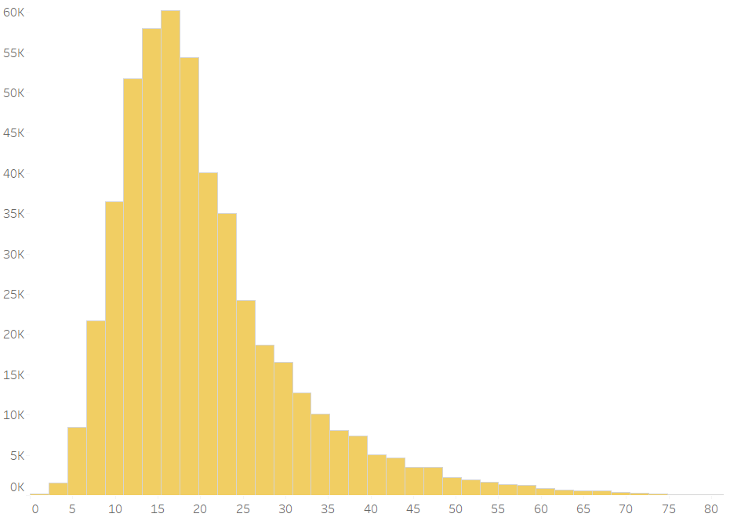

Trip average speed
Trip count
Trip average speed
Notes:
Fare amount and total amount are so related to the variables I just explained that I will skip talking about them, but something we wanted to look at how average speed in trips is actually distributed around the city. Mmmm Elena needs to go to Manhattan form JFK Airport…I hope you are finally not in a hurry because your average trip speed is very likely to be around 20km/h. Which is ok…but not very fast.

Slide 11
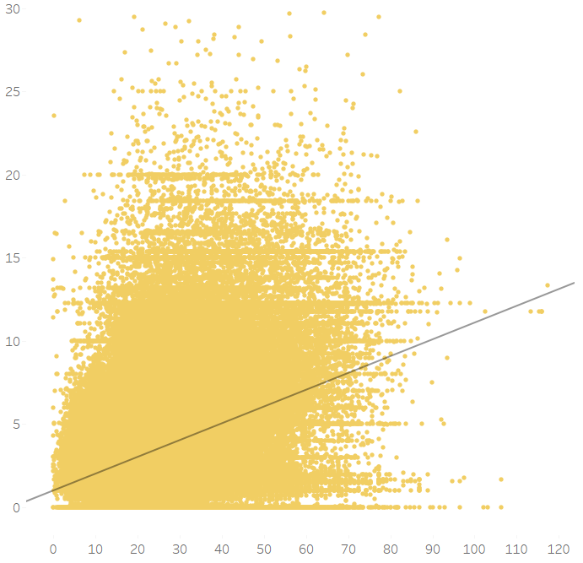
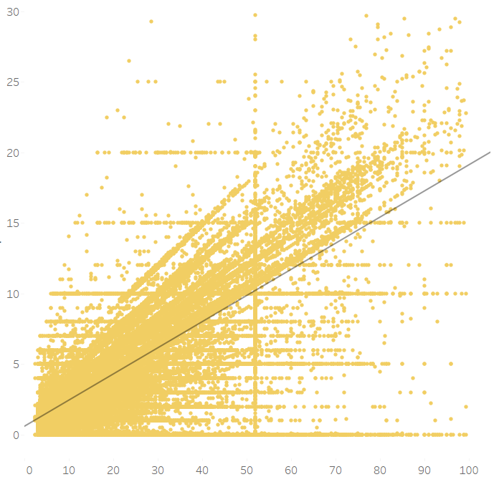
Maybe at this point you are already wondering… is this really so?
Tip amount
Tip amount
Tip amount
Tip amount
Trip average speed
Trip duration
Trip distance
Trip fare
Notes:
If we go back to check on trip distance, for example. We see a clear growth tendency fo the tip amount as the distance per trip grows.
However (and this happen with the rest of the variables as well) this strange lines are actually telling us a story by themselves. Can anybody guess?
Yes, those line are actually telling us that people tend to tip certain amounts independently of what their trip duration was. We see the 2,3,4 5, 10, fifthteens there… all those line are cases our model Will not be able to explain . And this happens with all the variables identified as great predictors.
Check duration, and fare, and speed…same exact issue

Slide 12
Does this mean we cannot trust our model?
Our model is smart, but it has an accuray of 65%
Limited predictive power
Can we increase the accuracy?
Yes and no. Aspects involving human emotions have generally no univeral consensus.
Notes:
Our model is smart, it has been trained on 6 million trips. Still, it has an accuray of 65%..
This means that the variance between our values can only be explained to a certain point. When the model gives us an tipping amount, what it is really telling us is that only 65% percent of the passengers taking that same trip agree that that should be the tip.
So…Can we predict the rest of the values? It probably difficult. We can add further data to increase the accuracy. Still, these type of problems, such as tipping (which is a very subjective issue, everybody tips differently) or liking a certain product, are things that can only be predicted up to a certain percentage because there is no universal consensus about it.

Slide 13
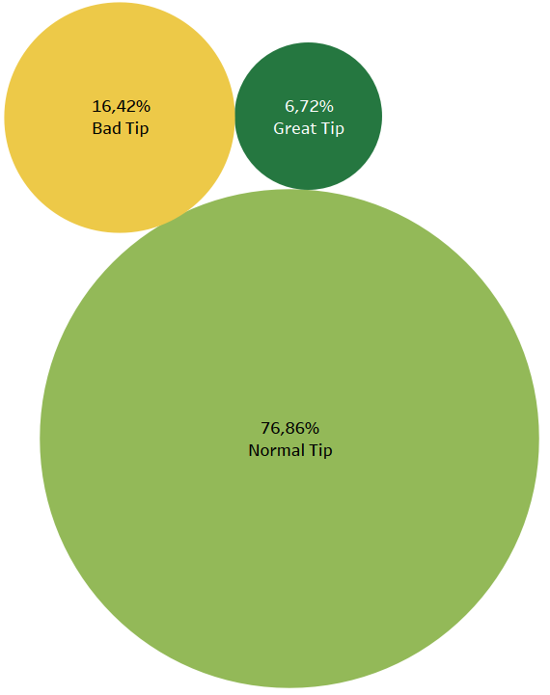

Oh...so you can’t tell me what makes a good tip?
—Some taxi driver
YES I CAN!!
YES I CAN!
Notes:
This does not leave us however, with empty hands.
Great tips only represent 6,7% of the total tips, can we know something for sure about them?
We cannot ace at predicting exact tips amounts but we can sure extract some useful insights by looking at our data in an exploratory manner.

Slide 14
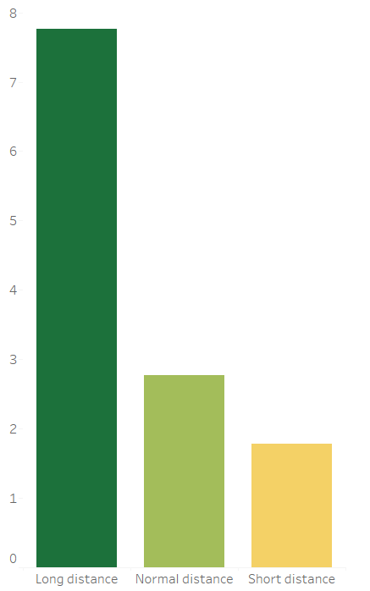
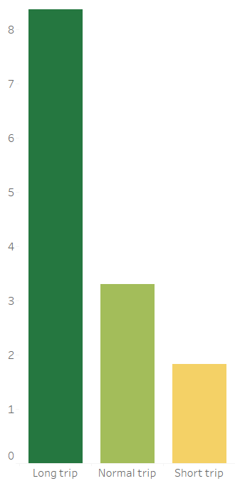
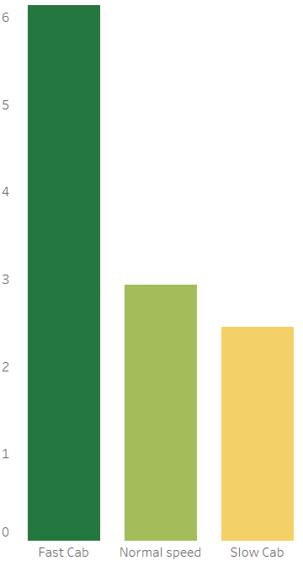
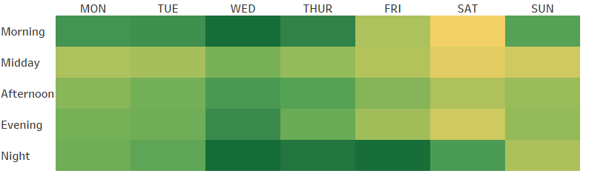
Our data is powerful !
Average tip amount
Average tip amount
Average tip amount
Trip distance
Trip duration
Trip speed
Notes:
Independently of our model, exploring the data can already provide us with clear and useful information
Clear things that we see just by looking at the numbers
More distance, more tips
More duration more tips
And something that can actually be used to motivate our drivers (but please respect the rules) → more average speed more tips!
We even know when the business is high!
With this data insights in front of us, we can definitely tell that customers in a hurry to catch a flight are probably a great opportunity to make a Good tip!

Slide 15
We can even identify bonus areas for best drivers
Trip distance
Trip duration
Notes:
Given the fact that there is a still a good relationship between distance, duration and tip amount, we can even identify bonus areas and and use them as a reward for our best drivers by sending them to work in those areas more often.

Slide 16
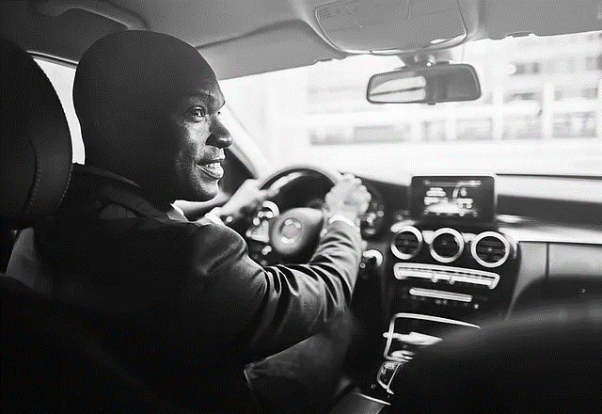
Final conclusions
THANK YOU!
Any questions?
We now have valuable information before launching our business in the city
Ways to improve the accuracy of the model
Alternative: suggest percentage
Driver loyalty schema
Notes:
We have extracted valuable insights about the business and how to make drivers stay with us before landing in New York
We could improve the accuracy of the model by including an option to rate trips and train the model again with this data
Alternative → suggest percentage over trip fare
We found a Smart way to create a driver loyalty schema

