Slide 2
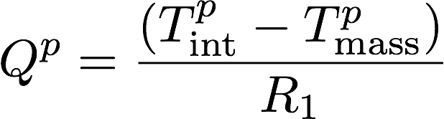
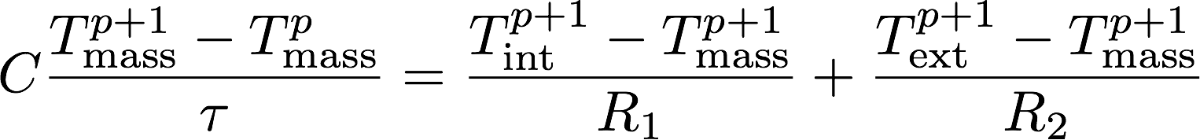
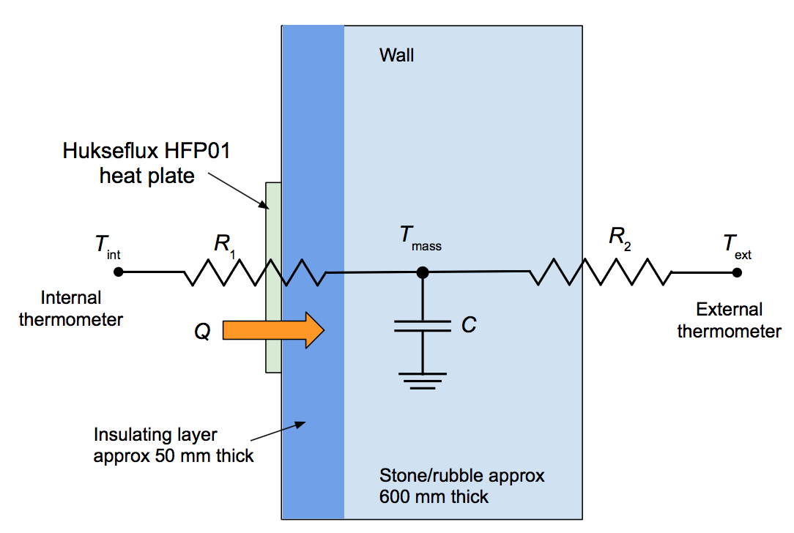
Rosewarne Stable Block Energy Monitoring: Dynamic Heat flow model
Does breathable internal insulation effectively increase thermal performance of solid walls, reduce damp problems and maintain good air quality?
To determine in-use energy and emissions:
Use dynamic single thermal mass model
How does the life cycle impact of a retrofitted historic building compare to demolishing and building new
A retrofitted building’s thermal performance will usually be worse than that of a new building leading to higher in-use energy and emissions.
Our analysis seeks to determine to what extent this is mitigated by the lower embodied energy and carbon of the retrofit and how this is affected by choice of materials.
After Biddulph et al.

Slide 3
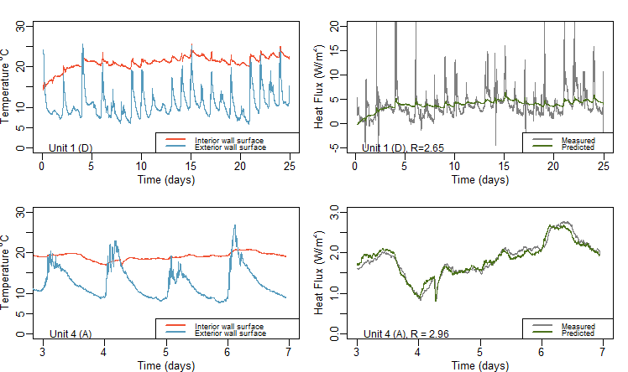
Rosewarne Stable Block Energy Monitoring Results: U-values
Use R to model time-variation of heat flow, using maximum likelihood estimation to find best fit values of R₁ and R₂.
Wall U-value (WK⁻¹m⁻²)
 | Estimate using Steady State Model | Measured , using Dynamic Model
A | 0.31 – 0.34 | 0.34
D | 0.74 to 0.94 | 0.39
Left panels show interior and exterior wall surface temperatures of the two retrofitted cottages.
Right panels show modelled (green) and measured (grey) heat fluxes through the walls of these units

Slide 4
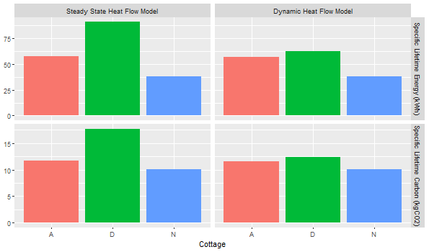
Rosewarne Stable Block Energy Monitoring: Results
Estimate of embodied and in-use carbon and energy.
Use simplified SAP and Bath Inventory of Carbon and Energy.
Compare cottages A (celotex), D (cork board) with new build.
Assume (Muncaster and Symons) demolition accounts for 21% embodied carbon and 5% embodied energy in new build.
When the dynamic nature of heat flow through the thick solid walls is taken into account, lifetime carbon emissions of the retrofitted cottages are comparable to those of the new build, even for cottage D where a less thermally insulating cork layer was used.
Using this dynamic treatment significantly reduces lifetime emissions estimates where low impact materials are used..

Slide 5
Rosewarne Stable Block Energy Monitoring: Conclusions
The dynamic nature of heat flow through the thick solid walls shows that lifetime carbon emissions of the retrofitted cottages are comparable to those of the new build, even for cottage D where a less thermally insulating cork layer was used. Using this dynamic treatment significantly reduces lifetime emissions estimates.
Further, the natural product retrofit has scope to achieve lower emissions than either the modern material or new build options if space and water heating were switched to an electrical form, as the carbon intensity of electricity in coming decades is expected to reduce.
U values of solid walls, used for SAP energy performance calculations and Building Regulations are often lower than anticipated making energy efficiency calculations of solid walls inaccurate. Breathable insulation is essential to a solid walled buildings long term survival and all breathable internal insulation monitored worked effectively.
Cork boards and plasters used in Cottage D, as well as all roofing slates were imported from Portugal and Spain. Carbon intensities supplied by DE- FRA show that the additional transport emissions due to this distance of travel are less than 1% of the lifetime building emissions, and thus not a major consideration.

