Slide 1

Faculty of Engineering and Technology
Department of Computer Science and Engineering
Pre-Project Presentation
DBARS: Demand Based Bus Allocation & Routing System
One BMTC timetable, three products: find the bus and vote for route or bus | plan the fleet | open the data
Project Batch No.: 26PB54
Team Details:
                M Bharath Kumar 23ETCS002066
                Nagendra S Jadav 23ETCS002077
                Pavan Panchal 23ETCS002086
                Vishrutha T 23ETCS002163
Guide:
Ms. Sheethal Raj T.G.
Asst. Professor
Dept. of CSE, MSRUAS, Bengaluru
Notes:
OPENING (30 seconds). Good morning. We are proposing DBARS, the Demand Based Bus Allocation and Routing System, for BMTC. In one line: one published timetable, three products. A journey planner for riders, a fleet and crew planner for depot managers, and open timetable data for other apps.
Before presenting: fill in the guide's designation (still highlighted).

Slide 2
Outline
1
Introduction
7
Sustainable Development Goals
2
Literature Survey
8
Expected Outcomes
3
Research Gaps
9
Gantt Chart for Work Plan
4
Problem Statement and What DBARS Adds
10
Conclusion
5
Objectives
11
References
6
Proposed Methodology
Notes:
OUTLINE (15 seconds). We follow the university's pre-project format. One addition: the problem statement slide also shows what existing apps already offer and what DBARS adds.

Slide 3
Introduction
1
The domain
2
Why it matters
Urban public transport: Bengaluru's BMTC city bus network.
Buses are the city's everyday mass transport. Riders and the operator both depend on good data.
3
The issue
4
Why now
Fixed bus schedules lead to overcrowding during peak hours and underutilization during off-peak periods, reducing overall transit efficiency.
The Shakti scheme (2023) changed ridership; digital tickets, tracking and AI now make demand-aware planning possible.
7,000+
6,737
4,883
44
BMTC buses
route-directions
bus stops
depots
DBARS: one BMTC timetable, three products
Find and vote for the bus (riders) | Plan the fleet (depots) | Open the data (other apps)
AI/ML inside: smart bus search, voice input and a grounded AI assistant
Notes:
INTRODUCTION (1 minute). Domain: BMTC, Bengaluru's city bus operator, with a fleet of over 7,000 buses. Why it matters: buses are the city's mass transport. The issue: rider apps and operator planning are disconnected. Why now: Shakti changed ridership, and tickets and tracking are going digital.
The numbers 6,737 route-directions, 4,883 stops and 44 depots describe the published BMTC timetable we will work from. The fleet figure is from Sustainable Bus (September 2025).
AI/ML in one sentence: DBARS uses machine-learning text search (TF-IDF and fuzzy matching) to find the right bus even from misspelt or spoken stop names, and a retrieval-augmented AI assistant that answers only from BMTC data.

Slide 4
Literature Survey
Ref. | Title and Year | Methodology | Dataset | Limitations | Observations
[1] | ULTRA: unlimited transfers for journey planning (Baum et al., 2023) | Transfer shortcuts; best trade-off journeys | City transit networks | Rider side only | Transfers decide journey quality
[2] | Analysing transit systems using GTFS (Liu et al., 2025) | GTFS to time-space network; shortest paths | Nashville GTFS, 2019-24 | One feed; no demand side | GTFS is the standard input
[3] | Visualising transit operation with GTFS, Calgary (Prommaharaj et al., 2020) | Interactive visuals; clustering | Calgary static GTFS | No real-time data | Analysis only; no trip search
[4] | Multi-depot vehicle scheduling on overlapped routes (Shang et al., 2023) | Bi-objective integer programming | Beijing, 6 bus lines | Small scale | Not tested city-wide
[5] | Exact multi-depot e-bus scheduling (Gkiotsalitis et al., 2023) | Mixed-integer linear programming | Benchmark sets | Up to 30 trips | Exact methods do not scale
[6] | GRASP for bus crew scheduling (Pardo-Pena et al., 2024) | GRASP heuristic with local search | 42-595 shifts; real operator | Depends on tuning | Crew planned apart from buses
[7] | Driver scheduling by set covering (Argilan & Bekesi, 2025) | Set covering; column generation | 200-400 trip benchmarks | Simplified driving rules | Crew rules are the hard part
[8] | Direct demand model for bus ridership, Bengaluru (Deepa et al., 2022) | Stop-route demand model | BMTC boardings | Needs fare-stage data | Allocate buses by demand
[9] | Headway variability and bus ridership, Bengaluru (Deepa et al., 2023) | Route and stop demand models | BMTC demand and supply | Single city | Irregular service loses riders
[10] | Bus arrival-time prediction with AI: a review (Singh & Kumar, 2022) | Systematic review | Published studies | Review only | Needs live data; label estimates
[11] | Survey of hallucination in natural language generation (Ji et al., 2023) | Survey of causes, metrics and fixes for AI hallucination | Summarisation, dialogue and QA studies | General text AI, not transport | AI answers must be grounded in real data
Notes:
LITERATURE SURVEY (1 minute 30 seconds). Eleven peer-reviewed journal papers, 2020 to 2025, in four themes: journey planning and open data [1-3], bus and crew scheduling [4-7], Bengaluru demand studies [8, 9], and AI for transport and text [10, 11].
The key contrast: [1] serves only the rider; [4] to [7] serve only the operator, and on small cases. [8] and [9] use BMTC's own data and show that frequency and regular service drive ridership. [10] reviews AI arrival-time prediction and stresses the need for live data. [11] shows that language-model AI can invent facts, which is why the DBARS assistant must answer only from retrieved BMTC data and cite it.

Slide 5
Literature Survey: Research Gaps
G1
Rider and operator sides are studied separately
Journey planners serve riders; scheduling work serves buses and crews. None does both from one dataset.
G2
Scheduling is tested only on small cases
Six lines, 30 trips or 595 shifts, not a full city timetable with 6,737 route-directions.
G3
Open data stops at static timetables
No live service alerts, and estimated values are not clearly labelled.
G4
Rider demand never reaches the depot
Demand studies are offline; riders cannot signal where they need more buses.
G5
AI assistants can invent answers
Language-model AI can hallucinate facts; no surveyed transit work grounds an assistant in the operator's own data.
Our bridge: DBARS connects riders and the operator using one BMTC dataset, with AI grounded in that data.
Notes:
RESEARCH GAPS (1 minute). A gap is what existing work has not addressed. G1: the two sides are studied separately [1] versus [4-7]. G2: scheduling papers use small cases [4-7]. G3: GTFS studies use static feeds [2, 3]. G4: BMTC demand studies are offline models [8, 9]. G5: language-model AI can hallucinate [11], and none of the surveyed transport work grounds an assistant in the operator's own data.
If challenged, say 'in the papers we surveyed', not 'in all research'.

Slide 6
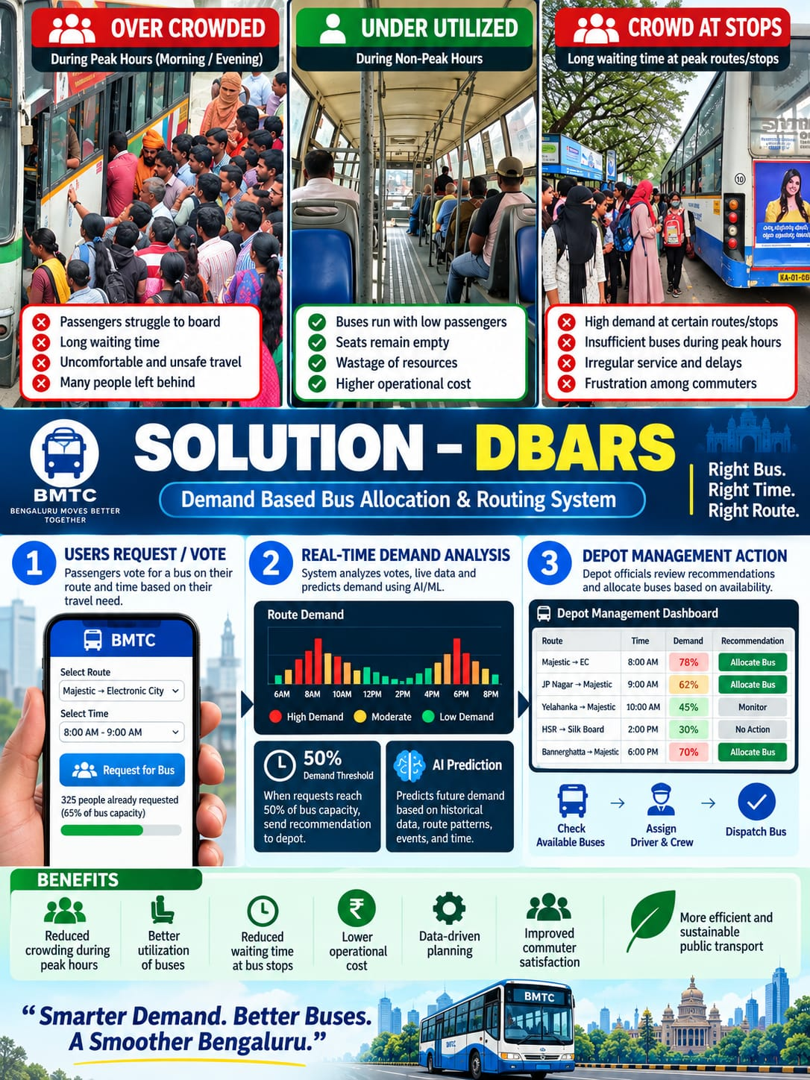
Proposed Work / Problem Statement
Bengaluru's bus network has 3,940 bus numbers and 4,883 stops. Existing apps help riders find a bus, but none links what riders need to how many buses and crew BMTC runs.
DBARS proposes one platform, built on BMTC's timetable, that serves riders and the operator together.
Current public bus transit systems operate on fixed schedules that fail to respond to real-time passenger demand, resulting in significant inefficiencies across urban transport networks.
Notes:
PROBLEM STATEMENT (1 minute). Read the statement. Then be fair to the competition: Namma BMTC 2.0 (launched September 2026), Moovit and Google Maps already do journey planning, tracking and tickets, and DBARS will match those. What makes DBARS different is the right-hand box: operator-side features that the public descriptions of those apps do not mention.
Wording: say 'not described in their public features', never 'they do not have it'. A static BMTC timetable feed is already listed publicly; DBARS extends it with alerts and clear labels. DBARS complements Namma BMTC 2.0; it does not replace it.

Slide 7
Objectives
To develop an ML-based journey planner for direct and connecting bus trips across 4,883 stops.
Existing apps already offer
Namma BMTC 2.0, Google Maps
1
Journey planning
Live bus tracking
Digital tickets and passes
To establish a planner for the minimum buses and crew a timetable needs.
2
What DBARS adds
Rider votes become depot recommendations
Minimum buses and crew for a timetable
Offline conductor waybill with cash check
Online ticket verification, with unique 6 digits alphanumeric code.
Shakti free rides counted for reimbursement
Open timetable data with live alerts
4 languages, voice search, AI assistant
To analyse rider demand and turn it into ranked recommendations for depot managers.
3
To publish the bus network as open data, add a grounded AI assistant, and evaluate the system honestly.
4
Notes:
OBJECTIVES (1 minute). Four objectives, each starting with an infinitive verb.
How each will be judged: 1) the ML-based planner ranks the best bus first in most test cases, and results come back fast; 2) the fleet number is compared with a proven minimum, and every result states its assumptions; 3) suspicious votes are filtered, every recommendation maps to a real bus route, and free Shakti rides keep their full fare value; 4) the timetable exports in the open GTFS format, the AI assistant answers only from BMTC data with sources, and accuracy is judged by a metric that can fail.

Slide 8
Methods / Proposed Methodology
Objective | How we will do it | Why this method
1 Journey planner (ML search) | Split stop names into words, word pairs and 3-letter chunks; TF-IDF vectors with cosine similarity; fuzzy matching; hybrid ranker (stop match, order, frequency, distance); voice input | Finds the right stop even when misspelt or spoken; needs no training labels
2 Fleet and crew planner | Chain trips into bus schedules; check against a lower bound; build legal crew duties | Shows how close to the minimum the fleet is
3 Demand and tickets | Rule-based anomaly checks on votes (repeats, vote rate, shared IP, spread) with a voter reliability score; rank for depots; QR tickets; offline sales | Fake votes are filtered before they reach a depot; works without signal
4 Open data and evaluation | Publish in GTFS; label estimates; compare 4 ranking models with 5-fold cross-validation and ranking metrics (nDCG@5, best-option rate) | The model is chosen on evidence; results stay honest
5 AI assistant (GenAI) | Retrieval-augmented generation: BM25 + vector-embedding hybrid search; LLM (Google Gemini) via LangChain agents for travel and operations; grounding checks, prompt-injection guardrails, offline fallback | Answers cite BMTC data and never invent a route; read-only, so it cannot change data
How it fits together
BMTC timetable
routes, stops, fares
DBARS (ML + AI)
find and vote for the bus | plan the fleet | open the data
Users
riders, depot managers, other apps
Rider votes flow back into depot planning
Notes:
METHODOLOGY (2 minutes). Read each row as objective, how, why.
1) ML search: every route is turned into a TF-IDF vector built from words, word pairs and 3-letter character chunks, so 'Majestik' still matches 'Majestic'. Cosine similarity and fuzzy matching find candidate stops; a weighted hybrid ranker then orders buses by stop match, correct direction, trip frequency and distance. Voice input uses the browser's speech recognition in English, Kannada, Hindi and Telugu.
2) Fleet and crew: trips are chained into bus schedules and checked against a hard lower bound; this part is optimisation, not ML.
3) Votes pass four rule-based anomaly checks (the same route repeated, more than 30 votes an hour, one IP voting across accounts, too many unrelated destinations) and feed a voter reliability score.
4) Evaluation: four candidate rankers (TF-IDF cosine, ordered fuzzy match, distance-aware ranker, live transfer search) are compared on the same test pairs with 5-fold cross-validation; the headline metric is ranking quality (nDCG@5, best-option rate), not coverage.
5) AI assistant: retrieval-augmented generation. BM25 keyword search and vector embeddings retrieve BMTC evidence; an LLM (Google Gemini, through LangChain agents) writes the answer; a grounding checker rejects invented routes and labels claims as confirmed, inferred or unknown; guardrails block prompt injection; an offline mode answers from retrieved evidence if the LLM is unavailable.
If asked 'is the route search deep learning?': no. It is a vector-space ML model plus a tuned ranker, chosen because the route data has no labels to train a deep model on.

Slide 9
Sustainable Development Goals Aligned to the Project
SDG 11
Sustainable Cities
Target : accessible public transport
SDG 9
Industry and Infrastructure
Target : reliable infrastructure
Easier bus trips in four languages, voice search, reduced dead kilometers, efficient resource usage.
Innovation: ML-ranked bus search, an AI assistant, and data-driven bus and crew planning.
SDG 5
Gender Equality
Target : technology for women
SDG 16
Strong Institutions
Target : transparent institutions
Shakti free travel supported digitally and counted in full.
Audit log and honest cash and data reporting.
Source: https://sdgs.un.org/goals
Notes:
SDGs (45 seconds). Main goal: SDG 11, target 11.2, accessible and affordable public transport. Supporting: SDG 9 (target 9.1, reliable infrastructure), SDG 5 (target 5.b, technology for women's empowerment, through Shakti-aware ticketing) and SDG 16 (target 16.6, transparent institutions).
Be modest on SDG 5: DBARS supports and counts the free-travel entitlement; it does not verify eligibility.

Slide 10
Expected Outcomes
A
Functional
B
Performance
ML-ranked journey search with voice input
Fleet and crew plans with what-if changes
Rider demand turned into depot recommendations
Open timetable data with alerts
Best bus ranked first in most test cases
Fast responses for real-time use
Fleet size compared with a proven minimum
Ranking scored with nDCG@5 and cross-validation
C
Practical impact
D
Extension
Riders: easier, clearer trips
Depots: see what a timetable change costs
BMTC finance: Shakti and cash clearly reported
Staff: ask the AI assistant in plain language
Connect BMTC's live bus-location feed
Pilot at one depot against real rosters
Payment gateway for tickets and Shakti
ML demand forecasting from vote and ticket history
Notes:
EXPECTED OUTCOMES (1 minute). Functional: what the system will do. Performance: how we will judge it. Practical impact: who benefits. Extension: what comes next, including a proposed pilot with BMTC: compare our fleet and crew plan with one depot's real rosters, connect a live bus-location feed, and trial the conductor waybill on a few routes.
Do not quote rupee savings; we have no measured figure yet.
AI/ML points: the journey search is ML-ranked and accepts voice input; ranking quality is scored with nDCG@5 and 5-fold cross-validation; depot staff can ask the grounded AI assistant questions in plain language. ML demand forecasting is an extension, not part of the 16-week plan.

Slide 11
Gantt Chart
Project Work (UG) 16 weeks
Week | 1 | 2 | 3 | 4 | 5 | 6 | 7 | 8 | 9 | 10 | 11 | 12 | 13 | 14 | 15 | 16
1 Requirements, data and literature survey
2 Journey planner: TF-IDF search, ML ranking
3 Backend services: logins, roles, storage
4 User interface, languages, voice search
5 Fleet and crew planner
6 Demand voting, tickets, Shakti, waybills
7 Open data export and alerts
8 Model evaluation and cross-validation
9 AI assistant: RAG, LLM, guardrails
10 Testing, final report and review
Review points: week 4 problem and literature | week 8 journey planner | week 12 full platform | week 16 final evaluation
Notes:
GANTT CHART (30 seconds). Ten activities over 16 weeks. The core (ML journey planner, then fleet and crew planner) comes first; model evaluation and the AI assistant come after the core is working. If time runs short, extras slip, not the core. Review points at weeks 4, 8, 12 and 16 let the guide track progress.

Slide 12
Conclusion
Problem
Riders and BMTC use separate tools; rider demand never reaches depot planning.
Relevance
7,000+ buses, ridership changed by Shakti, and tickets and tracking going digital.
Outcome
One AI-assisted platform: find the bus, plan the fleet, open the data.
Feasibility
Public BMTC data, proven ML and optimisation methods, standard tools and a 16-week phased plan.
DBARS answers both questions: which bus to take, and how many buses to run.
Notes:
CONCLUSION (45 seconds). Answer the template's four questions: problem, relevance, outcome, feasibility. Close with the ask: 'We request approval to proceed with DBARS as our final-year project.'

Slide 13
References (APA format)
[1] Baum, M., Buchhold, V., Sauer, J., Wagner, D., & Zündorf, T. (2023). ULTRA: Unlimited transfers for efficient multimodal journey planning. Transportation Science, 57(6), 1536-1559.
[2] Liu, D., Guo, J., Gu, Y., King, M., Han, L. D., & Brakewood, C. (2025). Analyzing transit systems using General Transit Feed Specification (GTFS) by generating spatiotemporal transit networks. Information, 16(1), 24.
[3] Prommaharaj, P., Phithakkitnukoon, S., Demissie, M. G., Kattan, L., & Ratti, C. (2020). Visualizing public transit system operation with GTFS data: A case study of Calgary, Canada. Heliyon, 6(4), e03729.
[4] Shang, H., Liu, Y., Wu, W., & Zhao, F. (2023). Multi-depot vehicle scheduling with multiple vehicle types on overlapped bus routes. Expert Systems with Applications, 228, 120352.
[5] Gkiotsalitis, K., Iliopoulou, C., & Kepaptsoglou, K. (2023). An exact approach for the multi-depot electric bus scheduling problem with time windows. European Journal of Operational Research, 306(1), 189-206.
[6] Pardo-Peña, D., Álvarez-Martínez, D., & Escobar, J. W. (2024). A GRASP algorithm for the bus crew scheduling problem. International Journal of Industrial Engineering Computations, 15, 443-456.
[7] Árgilán, V. S., & Békési, J. (2025). Optimizing bus driver scheduling: A set covering approach for reducing transportation costs. Applied System Innovation, 8(5), 122.
[8] Deepa, L., Pinjari, A. R., Nirmale, S. K., Srinivasan, K. K., & Rambha, T. (2022). A direct demand model for bus transit ridership in Bengaluru, India. Transportation Research Part A, 163, 126-147.
[9] Deepa, L., Pinjari, A. R., Nirmale, S. K., Biswas, M., & Srinivasan, K. K. (2023). The adverse impact of headway variability on bus transit ridership: Evidence from Bengaluru, India. Transport Policy, 141, 343-356.
[10] Singh, N., & Kumar, K. (2022). A review of bus arrival time prediction using artificial intelligence. WIREs Data Mining and Knowledge Discovery, 12(4), e1457.
[11] Ji, Z., Lee, N., Frieske, R., Yu, T., Su, D., Xu, Y., Ishii, E., Bang, Y. J., Madotto, A., & Fung, P. (2023). Survey of hallucination in natural language generation. ACM Computing Surveys, 55(12), 1-38.
[12] Halder, T., & Jayadev, A. (2025). Gender, welfare, and mobility: Impact of Shakti scheme on BMTC transport transformation [Report]. Azim Premji University.
[13] United Nations. (n.d.). The 17 Sustainable Development Goals. https://sdgs.un.org/goals
[14] Namma BMTC 2.0 [Mobile app]. (2026). Google Play. https://play.google.com/store/apps/details?id=com.bmtc.bmtcavls.two
[15] Asianet Newsable. (2026). BMTC launches Namma BMTC 2.0 app, one NCMC card for bus and Metro.
[16] Moovit. (n.d.). BMTC, Bengaluru: Bus schedules, routes & updates. https://moovitapp.com
[17] Mobility Database. (n.d.). BMTC GTFS Schedule feed (mdb-2595). https://mobilitydatabase.org/feeds/gtfs/mdb-2595
[18] Sustainable Bus. (2025, September 8). One in five buses in Bangalore now electric as BMTC fleet surpasses 7,000 units.
Notes:
REFERENCES. [1]-[11] are the peer-reviewed journal papers in the literature survey (2020-2025); [10] and [11] cover AI for transport and AI hallucination. [12] is the Shakti ridership report. [13] is the UN SDG site. [14]-[18] are the web sources behind the fleet size and the comparison with existing apps, accessed September 2026.

Slide 14
Thank You
Questions and Discussion
DBARS: Demand Based Bus Allocation & Routing System
Notes:
CLOSE (15 seconds). Thank the panel and invite questions. Likely questions and honest answers:
1) Where is the AI/ML? Three places. (a) ML search: TF-IDF vectors with word, word-pair and character 3-gram features, cosine similarity and fuzzy matching, followed by a weighted hybrid ranker; four rankers are compared with 5-fold cross-validation. (b) A retrieval-augmented AI assistant: BM25 plus vector search, an LLM (Google Gemini) through LangChain agents, grounding checks and prompt-injection guardrails. (c) Voice search through speech recognition in four languages. Vote fraud checks are rule-based, not ML; say so.
2) Why no deep learning for routes? The route data has no labels to learn from; a vector-space model with a tuned ranker is the right tool, and it is measured with ranking metrics.
3) Can the AI assistant give a wrong bus? It answers only from retrieved BMTC data, cites it, and a grounding checker rejects routes that do not exist; if evidence is missing it says so.
4) What is new versus Namma BMTC 2.0 or Google Maps? They serve riders; DBARS adds the operator side and open data, and complements them.
5) How much have you done already? Answer truthfully.

