Slide 1

KYC/AML Agentic AI System
Multi-Agent AI for Intelligent Compliance
Manisha Bhattacharjee | IBM

Slide 2
Overview & Problem Statement
OVERVIEW: The KYC/AML AI Agents system is a full-stack intelligent compliance platform that uses multiple AI agents to process KYC documents and analyze transactions for anti-money laundering compliance. The system features real-time processing feedback, risk assessment, and automated decision-making with human-in-the-loop capabilities.
THE CHALLENGE:
Manual KYC/AML processes are slow, error-prone, and costly
Traditional automation lacks reasoning capabilities
Compliance officers spend 70% time on verification
PROPOSED SOLUTION:
Multi-agent AI where agents collaborate and reason
Agents can loop back, re-verify, and escalate decisions
Real-time processing with live agent feedback (SSE)
Automated KYC + AML transaction monitoring
Explainable AI with complete audit trail
95% reduction in processing time, 90% accuracy

Slide 3
Full-Stack System Architecture
FRONTEND: React + TypeScript + Vite
Document upload, real-time feed, dashboard, audit history
BACKEND: FastAPI + Python 3.11+
RESTful API, SSE streaming, file management, audit logging
ORCHESTRATION: LangGraph State Machine
Workflow coordination, multi-agent routing, state management
AI AGENTS: 6 LLM-Powered Specialists (Multi-Model Support)
Extraction, Verification, Transaction, Reasoning, Assessment, Decision
DATA: SQLite + Mock Databases
Immutable Audit Trails, State Memory, & Mock External DBs (Gov/PEP/Sanctions)

Slide 4
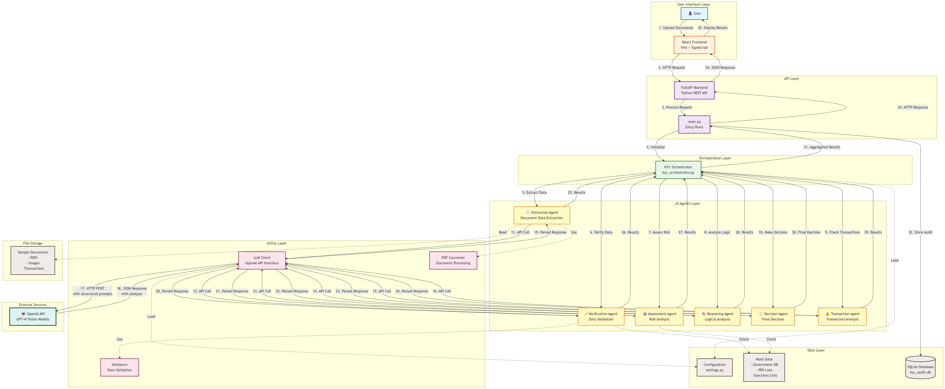

Slide 5
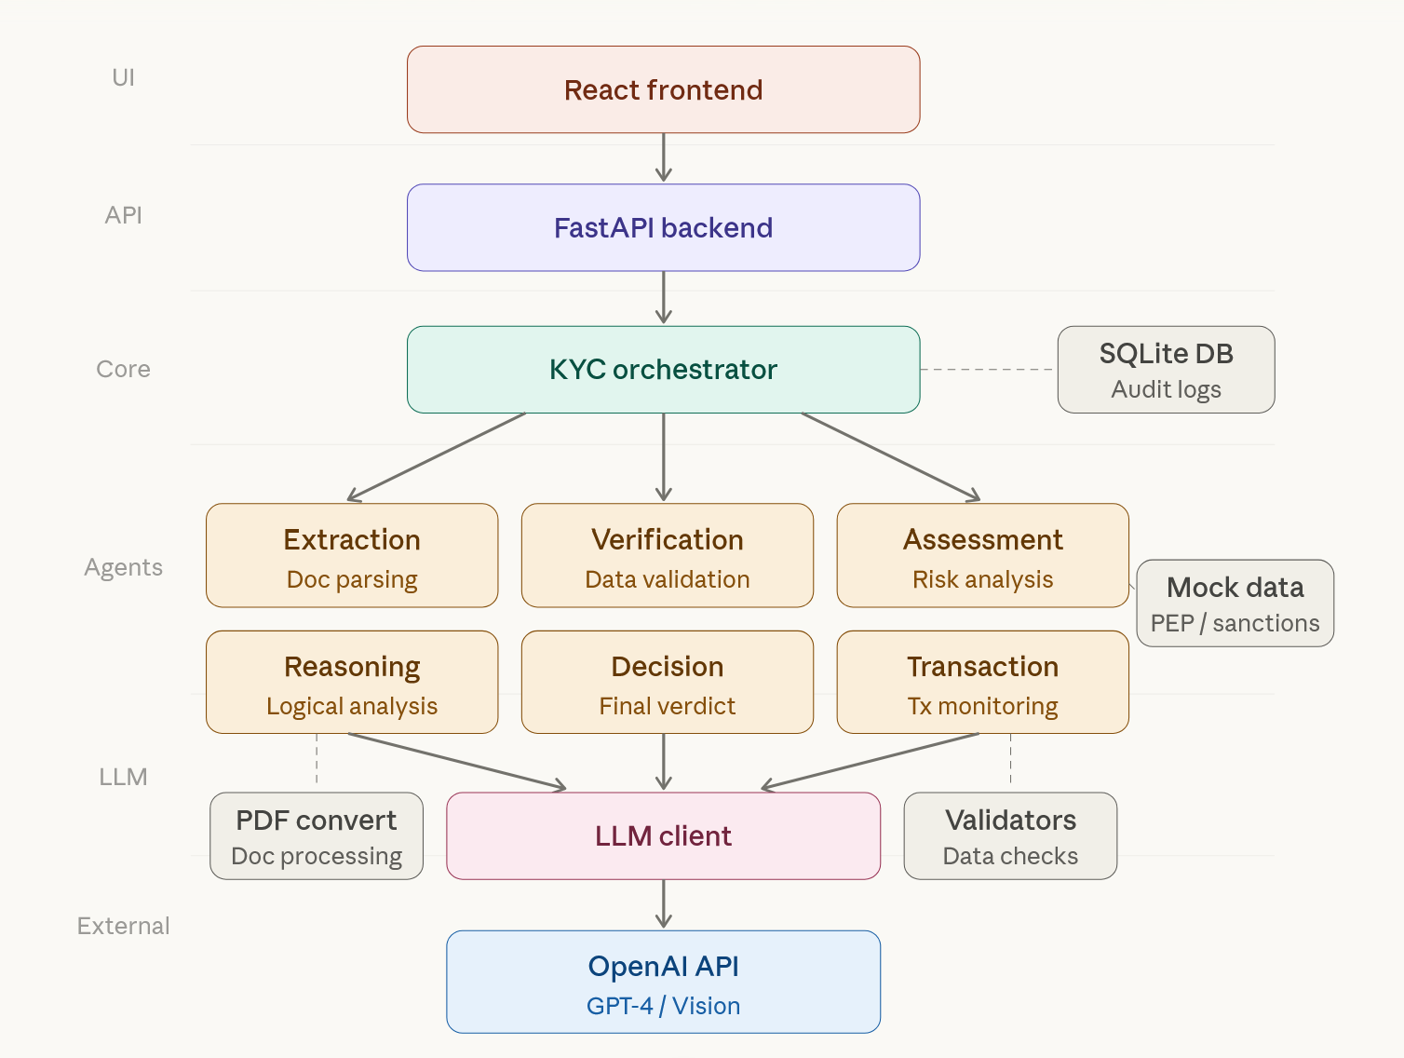

Slide 6
Multi-Agent AI Workflow
EXTRACTION AGENT - Extracts structured data from documents
→ Uses GPT-4o Vision for PDF/Image OCR
VERIFICATION AGENT - Validates against multiple databases
→ Government DB, Sanctions Lists, PEP screening
TRANSACTION AGENT - Analyzes AML patterns (optional)
→ Pattern detection, velocity checks, unusual activity
REASONING AGENT - Performs logical analysis
→ Identifies inconsistencies, patterns, relationships
ASSESSMENT AGENT - Calculates risk scores (1-10)
→ Categories: LOW, MEDIUM, HIGH, CRITICAL
DECISION AGENT - Makes final decision
→ APPROVE, REJECT, or ESCALATE to human review

Slide 7
Key Features & Capabilities
StateGraph Implementation - LangGraph orchestration
Real-time Agent Live Feed - Server-Sent Events (SSE)
OCR Capabilities - PDF and image document processing
Enhanced Due Diligence - Transaction monitoring & AML
Cyclic Reasoning - Agents loop back for re-verification
Intelligent Conflict Resolution - Handles typos, variations
Explainable AI - Complete audit trail for every decision
Dynamic Risk Scoring - Context-aware 1-10 scale
Human-in-the-Loop - Automated with escalation paths

Slide 8
Technology Stack
FRONTEND TECHNOLOGIES:
React 18.3.1, TypeScript 5.6.2, Vite 6.0.1
Tailwind CSS 3.4.17, Axios 1.7.9, EventSource (SSE)
BACKEND TECHNOLOGIES:
FastAPI (Python 3.11+), Uvicorn (ASGI)
SQLAlchemy, SQLite (Immutable Audit Trails)
Pydantic validation, Asynchronous SSE Streaming
Loguru logging
AI/ML TECHNOLOGIES:
Multi-Provider LLMs: OpenAI GPT-4o & Anthropic Claude
LangGraph (Agent Orchestration) & LangChain (Core AI Framework)
PyMuPDF (PDF processing), Pillow (Images)
Pandas (Financial Transaction Analysis)
ARCHITECTURE PATTERNS:
Multi-agent orchestration & State machine workflow
Repository pattern, Adapter pattern, Event-driven streaming

Slide 9
Results & Impact
BUSINESS IMPACT:
95% reduction in KYC processing time
90% accuracy in identity verification
80% reduction in false positives
Automated AML transaction monitoring
TECHNICAL ACHIEVEMENTS:
True agentic AI with reasoning loops
Real-time processing with live feedback
Scalable full-stack architecture
Production-ready with audit compliance
COMPLIANCE & SECURITY:
Complete audit trail for regulatory compliance
Explainable AI decisions
PII handling best practices (Zero Data Retention)
Multi-source verification for accuracy

Slide 10

Team Details
Team Members: ​
Manisha Bhattacharjee
Manisha.Bhattacharjee@ibm.com
​
GitHub Repository: ​
🔗https://github.ibm.com/Manisha-Bhattacharjee/KYC-AML-Multi-Agentic-AI-System.git

Slide 11


