Slide 1

GROUP 17
Requirement Gathering for Smart Vehicle Diagnostic System
CEF440
Instructor: Dr Nkemini Valery

Slide 2
Problem Statement
Hundreds of diagnostic signals genrated by modern vehicles
Less than 20% of drivers fully understand the warning lights in their cars.
This is 1 out of every 5 drivers in cameroon alone

Slide 3
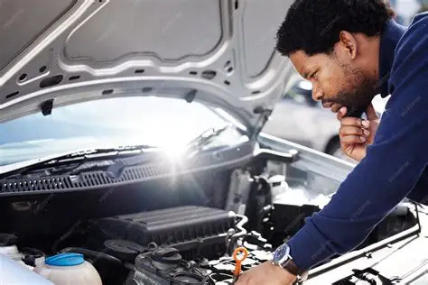
Objective of Requirement Gathering
The Requirements gathering aimed to:
Understand the diagnostic challenges faced by car owners.
Identify common types of vehicle faults experienced by users
Evaluate limitations of existing diagnostic solutions
Determine key features required for a user-friendly diagnostic system.

Slide 4
Key Stakeholders
Car parts dealers
Software developers
Vehicle owners
Automobile mechanics
Drivers who need accessible diagnostic information
Professionals responsible for diagnosing and repairing vehicles.
Responsible for designing and implementing the diagnostic system.
Provide insights on repair costs and parts availability.

Slide 5
Methods Used for Requirement Gathering
Informal interviews with Stake holders
Online surveys using Google Forms
Review of automotive diagnostic documentations
Review of automotive diagnostic documentation

Slide 6


Insights from User Interviews
26 informal interviews were conducted with car owners around:
Molyko
University of Buea Campus
21
Find difficulty interpreting dashboard warning signals.
5
Are able to properly interprete dashboard warning signals.
Many users indicated that:
Electrical faults occur frequently
Warning lights are confusing
Diagnosing problems early is difficult.
No source of authentic parts cost.

Slide 7
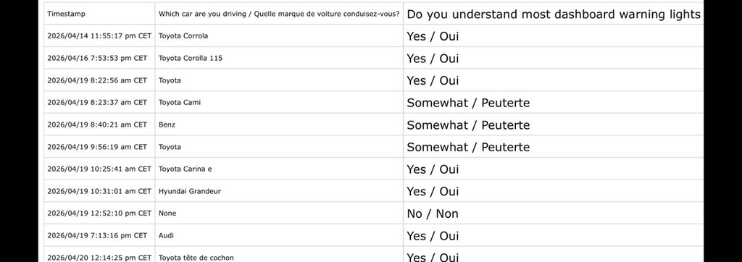
Online Survey Findings
Responses were collected from:
Car owners
Mechanics
The survey confirmed similar challenges identified during interviews:
Difficulty understanding fault indicators
Limited access to diagnostic information
Dependence on mechanics for interpretation
Mechanics worry about the rapid evolution of different models
Your paragraph text
Your paragraph text

Slide 8
Analysis of Existing Solutions
Features | Torque | CarMD | Car Scanner | Proposed System
Reads OBD2 Fault Codes | ✔ | ✔ | ✔ | ✔
Easy Interpretation for Drivers | ✖ | ✔ | x | ✔
Offline Diagnostics | x | x | x | ✔
Repair Cost Estimation | x | ✔ | x | ✔
Accessible Developer Integration | x | x | x | ✔

Slide 9
Diagnostic Data Collection
During the research phase we collected a large diagnostic dataset consisting of Over 18,000 diagnostic trouble codes
These codes belong to internationally recognized OBD2 families:
P (Powertrain)
B (Body)
C (Chassis)
U (Network).

Slide 10
Local Market Insights for Cost Estimation
Key Findings
Prices vary significantly by vehicle brand
Electrical components are frequently replaced
Lack of standardized pricing reference
Suggested System Integration
Use verified local pricing sources
Map fault codes → affected components
Generate estimated repair cost ranges

Slide 11
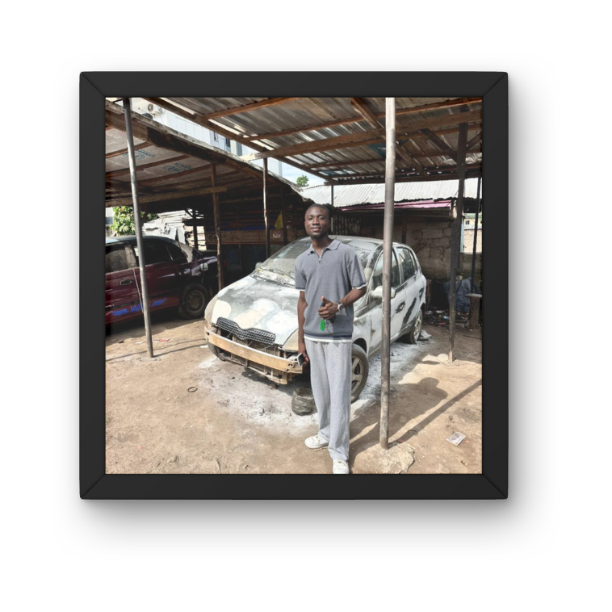
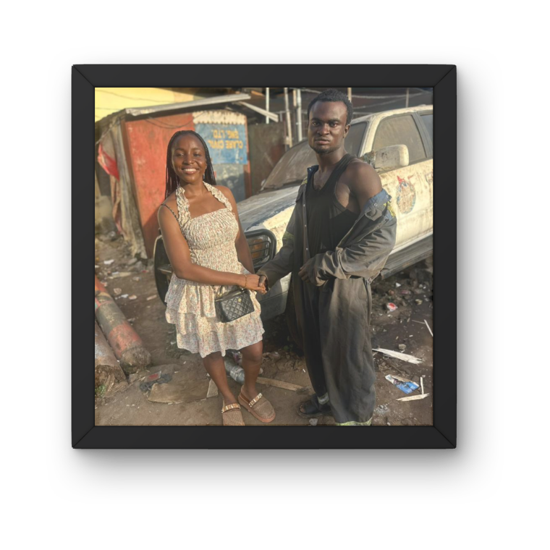
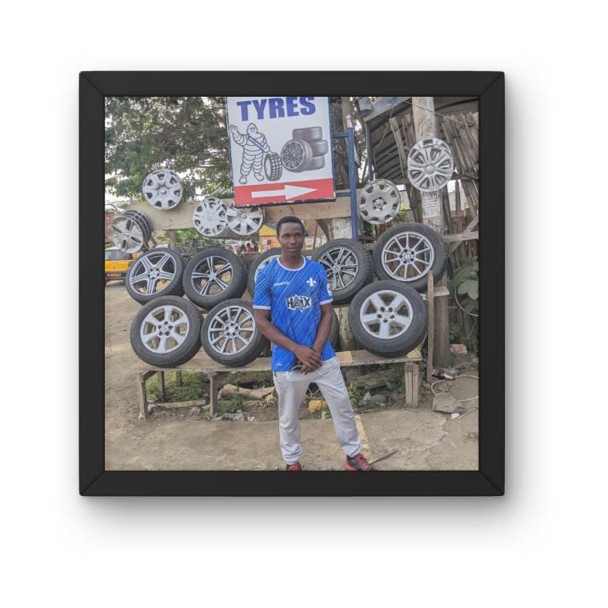
Team Fieldwork & Interviews
Mechanic Interviews – Molyko
Mechanic Interviews – Malingo
Spare Parts Dealers – Molyko

Slide 12
Challenges Encountered
Several challenges were experienced during the requirement gathering process:
Difficulty accessing car parts dealers for local pricing information
Limited access to commercial automotive APIs
Variations in diagnostic information across different vehicle brands.
Despite these challenges, valuable insights were obtained that shaped the direction of the project.

Slide 13

NEXT PHASE:
Requirement Analysis
Thank
you

