Slide 1
Mid-semester Presentation
Team H
By: Mark Biegel, Tim Yingling, Jenna Pasternak, Scott Boyd, Clement Onoja, Biruk, Yimer

Slide 2

Database
Used sqlite3 in python
Created File and Database classes for use in the back-end
Files are just containers that hold information received from VirusTotal
Database class has two functions: search and store
Still need to create tables in order to hold multiple engines and their results for each file hash

Slide 3
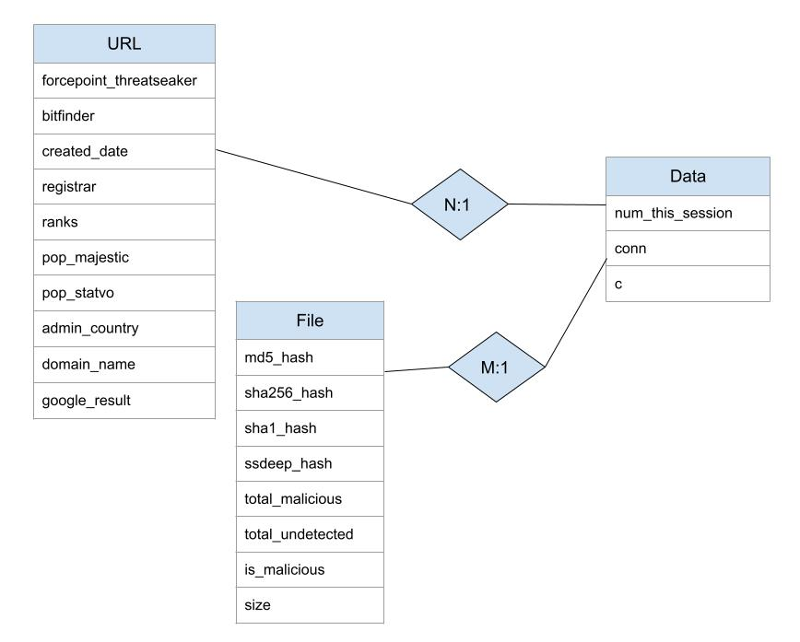
ER Diagram
Notes:
Text and integers
Size in bytes
Number of files touched during the session
c = cursor

Slide 4
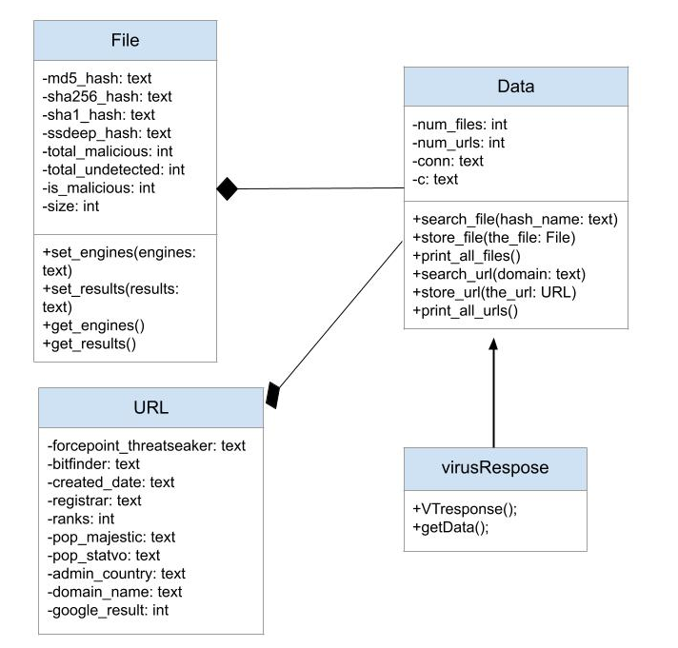
Class Diagram
Notes:
Black diamond: Composition association
Arrow: Dependency association

Slide 5

Back-End
Used Flask since we practiced with it in the homework
User can input the hash in the following formats:
MD5
SHA256
SHA1
SSDEEP
VirusTotal gets the following information:
Number of vendors that flagged it as malicious
Size of Hash

Slide 6

Front-End
Used Bootstrap Framework with CSS for its easy implementation.
Currently have 3 pages:
Homepage
Malicious Hash
Clean Hash
Future Plans:
Add “About” and “Documentation” Pages
Add more information about the hash to display to user

Slide 7
Demo

Slide 8
Questions?

