Slide 1
2.1 Training
July 2007

Slide 2
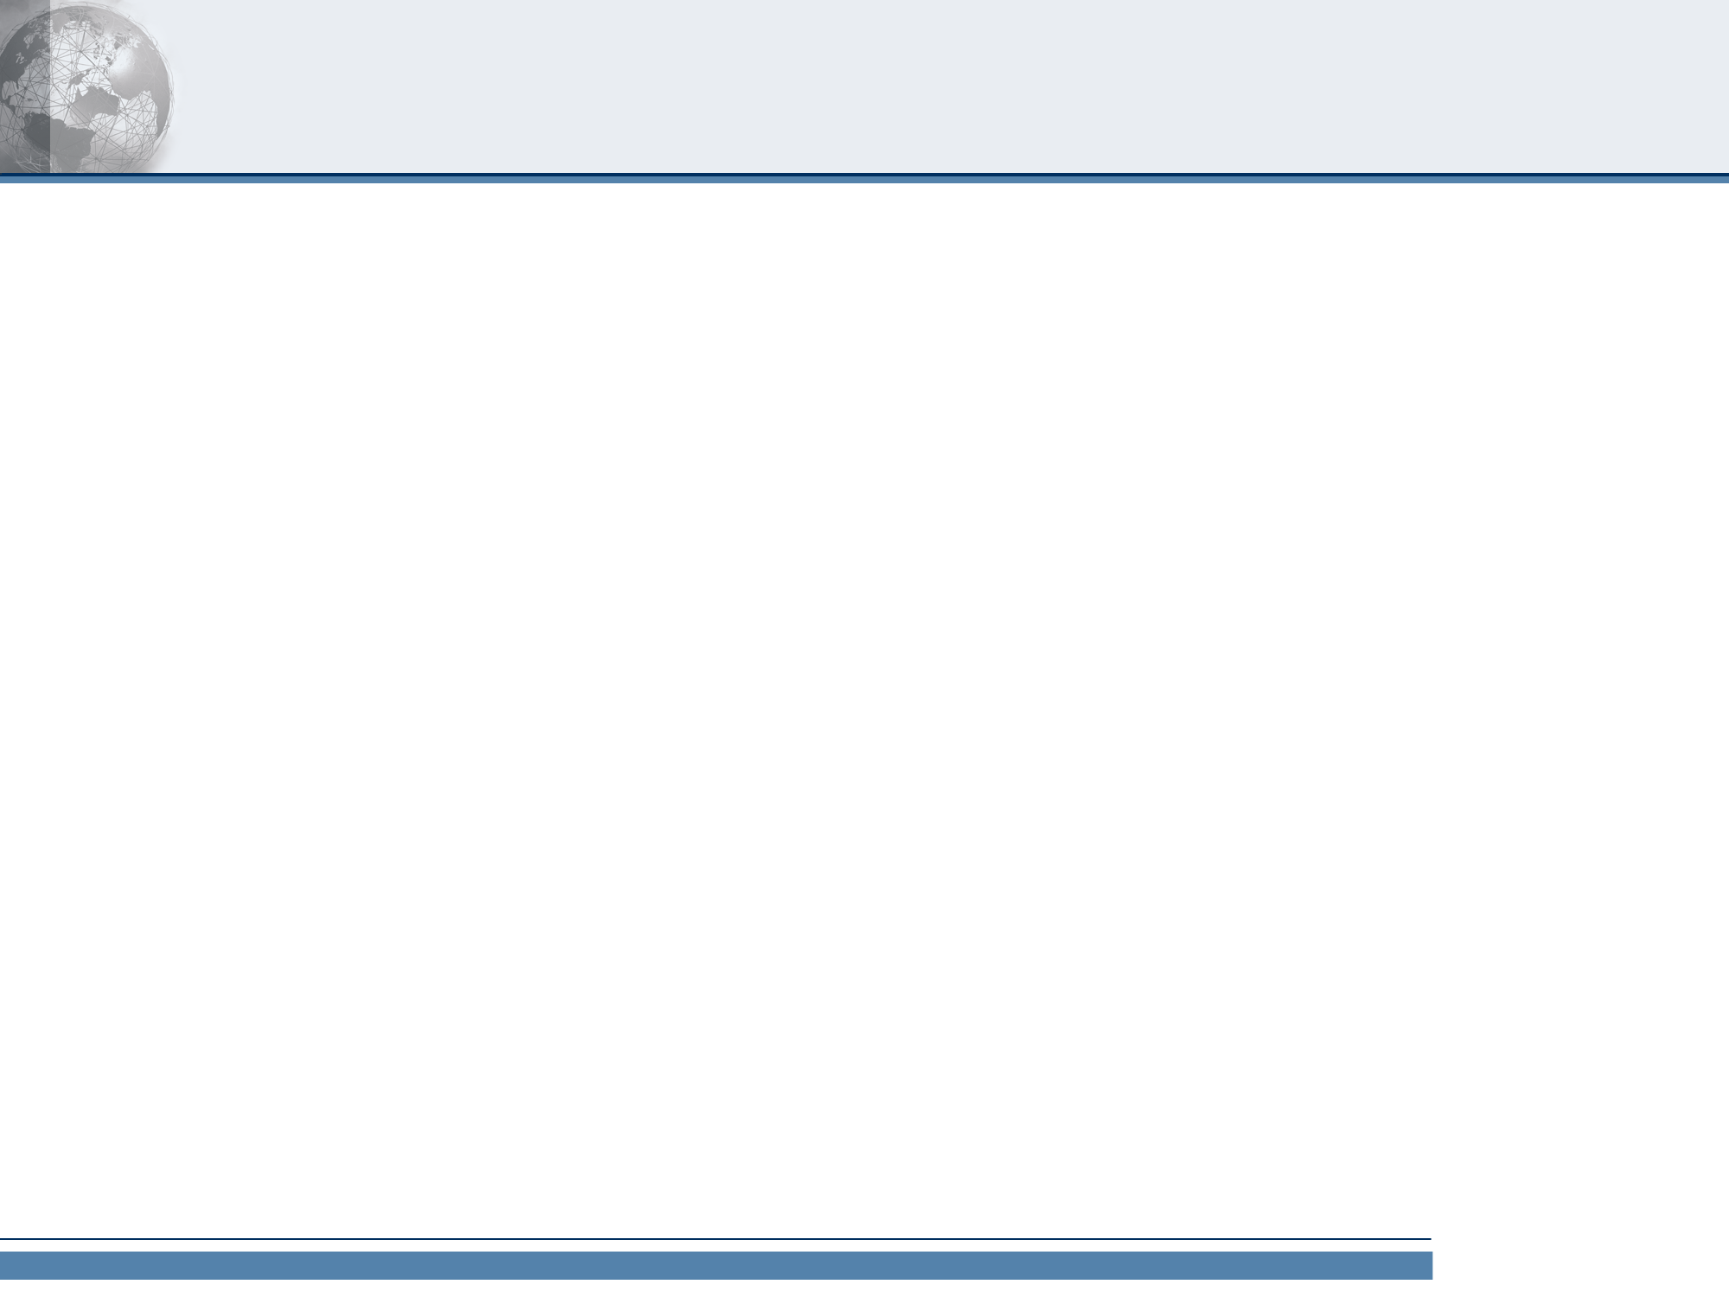
Product Positioning
Habeas Reputation Services provide:
Hard data
Timely analysis
Actionable, clearly presented information
to help senders improve delivery rates and protect their email reputations.
With our latest release, Habeas leads the industry with the richness and depth of the information made easily available to email senders.

Slide 3
New Product Summary
New Email Monitor features present leading-edge email delivery and reputation data as well as a new dynamic user interface that provides a window into a sender’s reach into the world’s largest email reputation network.

Slide 4
Positioning Support
World’s largest email reputation network
  Five million receiving networks…
  Spread over 190 countries…
  800+ million times daily…
  Use the Habeas SafeList to make delivery decisions.
  Because senders on the SafeList have been audited and exhibit exceptional email practices, they receive delivery uplift to B2C and B2B networks worldwide including leading Fortune 500 companies, ISPs, government agencies and universities worldwide.
Notes:
World’s largest email reputation network
Five million receiving networks…
Spread over 190 countries…
800+ million times daily…
Use the Habeas SafeList to make delivery decisions.
Because senders on the SafeList have been audited and exhibit exceptional email practices, they receive delivery uplift to B2C and B2B networks worldwide including leading Fortune 500 companies, ISPs, government agencies and universities worldwide.
Get actionable delivery data
Our latest Email Monitor release including the new SafeList Monitor, gives senders unprecedented insight into the entire lifecycle of their email programs.
Habeas provides you with specific information as to how your email will perform before it goes out, inbox delivery rates, complaint rates, and broader industry compliance.
Centralized portal with a more intuitive interface
Improved navigation makes reporting and tracking alerts easier and more intuitive. With the new SafeList Monitor, customers can geographically track the networks - and ultimately the customers - that are tracking their email reputations.
Habeas provides customers better marketing tools that can be combined with existing data to make decisions about where to pinpoint direct mail and radio campaigns.
Proactive alerts help you correct issues before delivery rates are affected
Once an email reputation is sullied by failure to comply with industry best-practices, delivery rates will suffer.
Corrective measures must be taken and a clean track record demonstrated in order to reinstate a good reputation - which takes time and effort.
Habeas Compliance Monitoring enhances delivery to any network by ensuring senders comply with a wide range of issues that receivers check before allowing mail to enter their systems. As a reputation services provider, we educate, monitor and alert our SafeList customers to key issues related to sending practices, email infrastructure, and identity and authentication configurations so that they can fix issues before delivery rates are affected.
Hard data demonstrates the value of being on the SafeList
The SafeList Monitor gives senders a customized window into the Habeas Network. SafeListed senders can now geographically pinpoint:
who is checking their email reputation
how many times
where they are around the globe.
SafeList senders have meaningful metrics for the benefits of Habeas’ expert consulting, education, and delivery mediation services.

Slide 5
Positioning Support
World’s largest email reputation network
Improve the entire lifecycle of your email programs
  Habeas provides you with specific information as to how your email will perform before it goes out, inbox delivery rates, complaint rates, and broader industry compliance.
Notes:
World’s largest email reputation network
Five million receiving networks…
Spread over 190 countries…
800+ million times daily…
Use the Habeas SafeList to make delivery decisions.
Because senders on the SafeList have been audited and exhibit exceptional email practices, they receive delivery uplift to B2C and B2B networks worldwide including leading Fortune 500 companies, ISPs, government agencies and universities worldwide.
An unprecedented view into the entire lifecycle of your email programs
Our latest Email Monitor release including the new SafeList Monitor, gives senders unprecedented insight into the entire lifecycle of their email programs.
Habeas provides you with specific information as to how your email will perform before it goes out, inbox delivery rates, complaint rates, and broader industry compliance.
Proactive alerts help you correct issues before delivery rates are affected
Once an email reputation is sullied by failure to comply with industry best-practices, delivery rates will suffer.
Corrective measures must be taken and a clean track record demonstrated in order to reinstate a good reputation - which takes time and effort.
Habeas Compliance Monitoring enhances delivery to any network by ensuring senders comply with a wide range of issues that receivers check before allowing mail to enter their systems. As a reputation services provider, we educate, monitor and alert our SafeList customers to key issues related to sending practices, email infrastructure, and identity and authentication configurations so that they can fix issues before delivery rates are affected.
Centralized portal with a more intuitive interface
Improved navigation makes reporting and tracking alerts easier and more intuitive. With the new SafeList Monitor, customers can geographically track the networks - and ultimately the customers - that are tracking their email reputations.
Habeas provides customers better marketing tools that can be combined with existing data to make decisions about where to pinpoint direct mail and radio campaigns.
Hard data demonstrates the value of being on the SafeList
The SafeList Monitor gives senders a customized window into the Habeas Network. SafeListed senders can now geographically pinpoint:
who is checking their email reputation
how many times
where they are around the globe.
SafeList senders have meaningful metrics for the benefits of Habeas’ expert consulting, education, and delivery mediation services.

Slide 6
Positioning Support
World’s largest email reputation network
Improve the entire lifecycle of your email programs
Proactive alerts help you correct issues before delivery rates are affected
  Once an email reputation is sullied by failure to comply with industry best-practices, delivery rates will suffer.
  Corrective measures must be taken and a clean track record demonstrated in order to reinstate a good reputation - which takes time and effort.
  Improved navigation makes reporting and tracking alerts easier and more intuitive.
Notes:
World’s largest email reputation network
Five million receiving networks…
Spread over 190 countries…
800+ million times daily…
Use the Habeas SafeList to make delivery decisions.
Because senders on the SafeList have been audited and exhibit exceptional email practices, they receive delivery uplift to B2C and B2B networks worldwide including leading Fortune 500 companies, ISPs, government agencies and universities worldwide.
An unprecedented view into the entire lifecycle of your email programs
Our latest Email Monitor release including the new SafeList Monitor, gives senders unprecedented insight into the entire lifecycle of their email programs.
Habeas provides you with specific information as to how your email will perform before it goes out, inbox delivery rates, complaint rates, and broader industry compliance.
Proactive alerts help you correct issues before delivery rates are affected
Once an email reputation is sullied by failure to comply with industry best-practices, delivery rates will suffer.
Corrective measures must be taken and a clean track record demonstrated in order to reinstate a good reputation - which takes time and effort.
Habeas Compliance Monitoring enhances delivery to any network by ensuring senders comply with a wide range of issues that receivers check before allowing mail to enter their systems. As a reputation services provider, we educate, monitor and alert our SafeList customers to key issues related to sending practices, email infrastructure, and identity and authentication configurations so that they can fix issues before delivery rates are affected.
Centralized portal with a more intuitive interface
Improved navigation makes reporting and tracking alerts easier and more intuitive. With the new SafeList Monitor, customers can geographically track the networks - and ultimately the customers - that are tracking their email reputations.
Habeas provides customers better marketing tools that can be combined with existing data to make decisions about where to pinpoint direct mail and radio campaigns.
Hard data demonstrates the value of being on the SafeList
The SafeList Monitor gives senders a customized window into the Habeas Network. SafeListed senders can now geographically pinpoint:
who is checking their email reputation
how many times
where they are around the globe.
SafeList senders have meaningful metrics for the benefits of Habeas’ expert consulting, education, and delivery mediation services.

Slide 7
Positioning Support
World’s largest email reputation network
Improve the entire lifecycle of your email programs
Proactive alerts help you correct issues before delivery rates are affected
Centralized portal with a more intuitive interface
  Habeas educates, monitors and alert our SafeList customers to key issues related to sending practices, email infrastructure, and identity and authentication configurations so that they can fix issues before delivery rates are affected.

Slide 8
Positioning Support
World’s largest email reputation network
Improve the entire lifecycle of your email programs
Proactive alerts help you correct issues before delivery rates are affected
Centralized portal with a more intuitive interface
Hard data demonstrates the value of being on the SafeList
  SafeList senders have meaningful metrics for the benefits of Habeas’ expert consulting, education, and delivery mediation services.
  SafeListed senders can now pinpoint who is checking their email reputation, how many times, where they are around the globe.
Notes:
With the new SafeList Monitor, customers can geographically track the networks - and ultimately the customers - that are tracking their email reputations.
Habeas provides customers better marketing tools that can be combined with existing data to make decisions about where to pinpoint direct mail and radio campaigns.

Slide 9
2.1 Schedule
Today, 7/9:
  Product Training – Sales, CS
Tomorrow, 7/10:
  email announcement to customers, prospects and recycled leads
  Process Training - CS
Friday, 7/13 (after hours through the weekend):
  Release!
Monday, 7/16:
  Corporate website update
  Knowledgebase updtae
  “change complete” email to customers
Tuesday, 7/24:
  Press release

Slide 10
2.1 Value Propositions
Service/Area | Features | Value to Senders
SafeList Monitor | Customer-centric view of the Habeas Network | Know who is querying, where, and when Understand impact of the SafeList New! marketing demographic data
Dashboard | Updated UI Information rich | “Executive Summary” provides a better snapshot of required actions, reputation and campaign lifecycles
Delivery Monitor | Updated UI Summary line Feedback integration | Better delivery prediction Better understanding of how Reputation impacts delivery
Content Check | Outlook 2003 and 2007 rendering | Extended coverage for B2B subscribers as well as B2C email to work addresses
(internal) Compliance Workflow Improvements | yahoo.de and yahoo.fr seed boxes New branding / UI | International seedbox coverage Updated look and feel

Slide 11
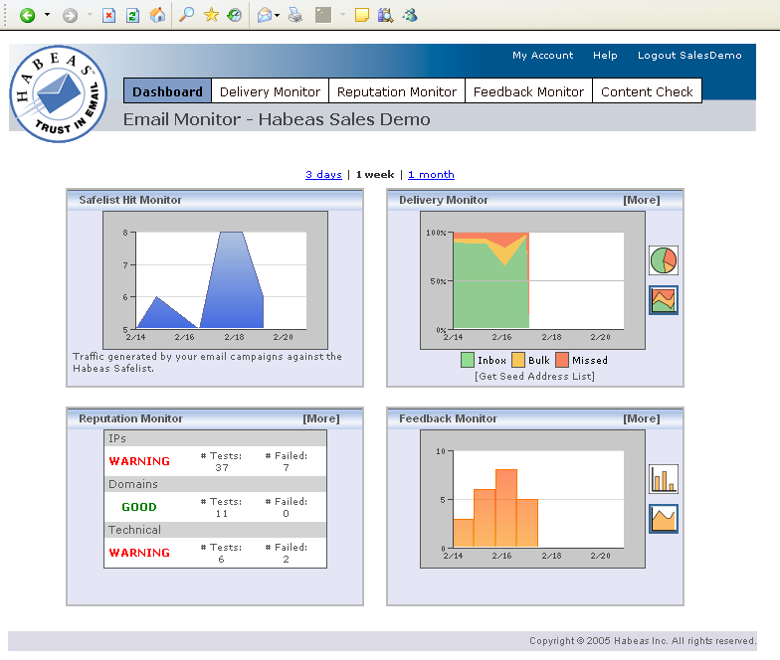
Email Monitor: New!

Slide 12
Email Monitor: Yesterday

Slide 13
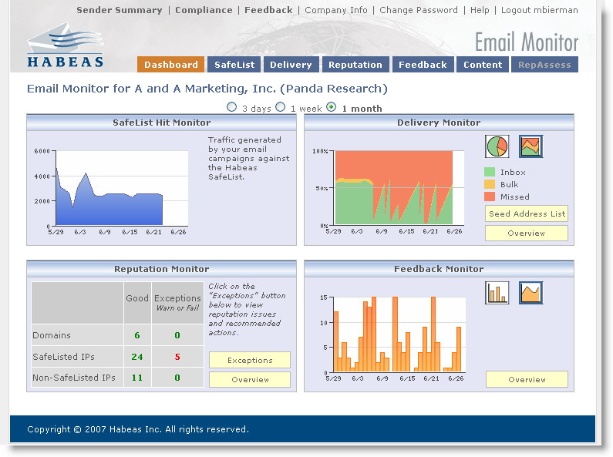
Email Monitor: Today

Slide 14
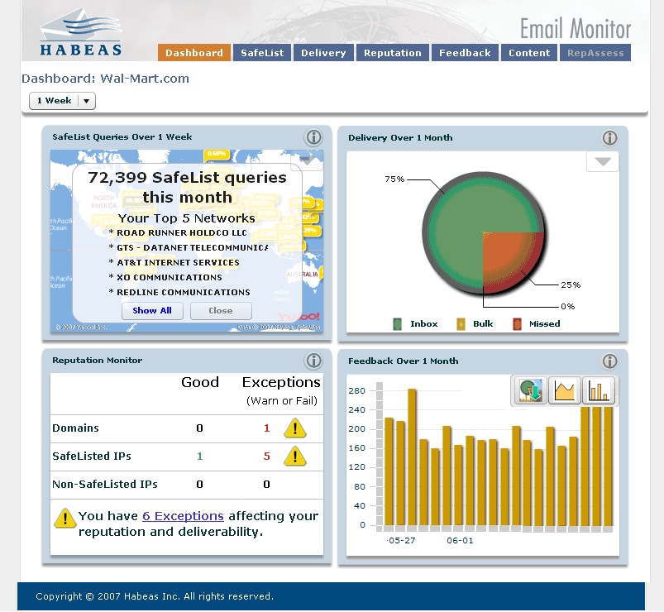
Email Monitor: New Dashboard!
SafeList Monitor
New application!
Delivery and Feedback
New graphs
Graph Export
Data Tooltips
Reputation
Improved User Interface

Slide 15
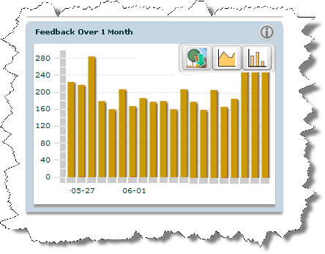
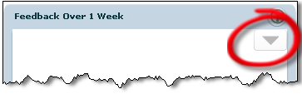
Dashboard Features
Graph
download
Additional
Information
Dashboard
Pallet
Notes:
CS only

Slide 16
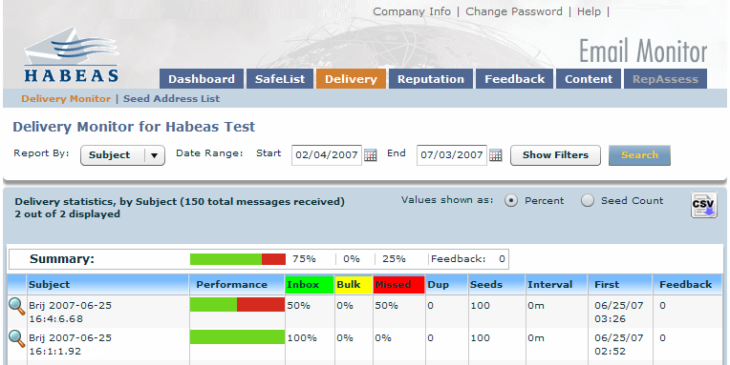
Delivery Monitor
Email reputation impacts delivery.
  Enhanced UI functionality
  Graphic summarizations for all reports
    We now have summarizations for reports by subject, campaign, sending email, IP, and ISP available in Delivery Monitor. Hovering over summary graphic by color will show you more information on the exact percentage/seed count for inbox, bulk, and missed delivery. There is also a total feedback count for the time period and report selected.
    We now have competitive parity with Return Path and Pivotal Veracity who also offer summaries.
  You can now select start and end dates for reporting with improved calendar options.
  The Inbox, Bulk, and Missed columns are sortable. These column also cannot be moved to another area on the results table.
  To export a report please use the CSV icon located on the top right of the results table next to Seed Count button.
  For CS Admins Only – Clicking on the Subject to view the message delivery will open the results in a new window.

Slide 17
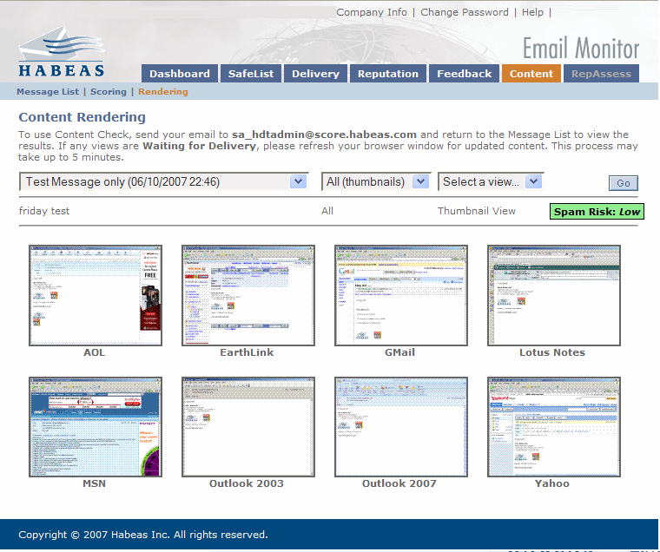
Content Check
New Content Rendering Clients
  Microsoft Outlook 2003 and 2007

Slide 18
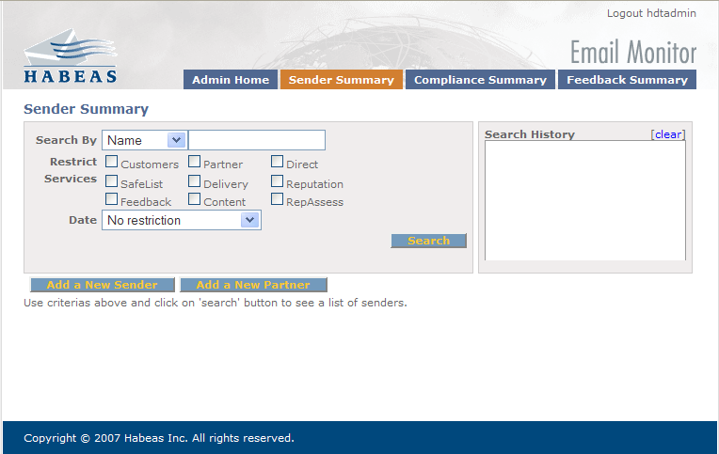
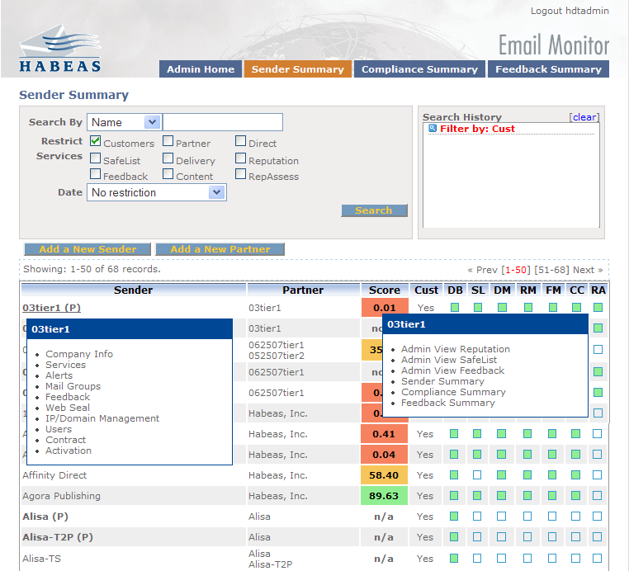
Sender Summary – New Navigation Options
Faster load time with no results
New hover functionality over the Sender name with quick links to Edit Sender pages:
  Company Info
  Services
  Alerts
  Mail Groups
  Feedback
  Web Seal
  IP/Domains Management
  Users
  Contract
  Activation
New hover functionality over the Score with quick links to:
  Admin View Reputation
  Admin View Safelist
  Admin View Feedback
  Sender Summary (filtered and only for partners)
  Compliance Summary (filtered)
  Feedback Summary (filtered)

Slide 19
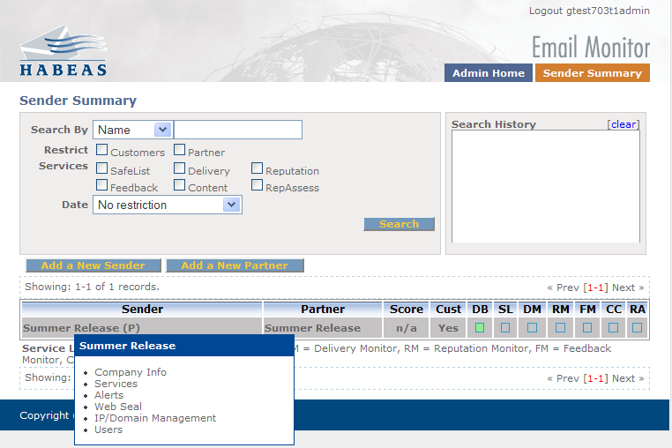
Partner Sender Summary
When Partners arrive on the Sender Summary results will be included
They also have the new hover functionality for pages they can access:
  Company Info
  Services
  Alerts
  Web Seal
  IP/Domains Management
  Users page

Slide 20
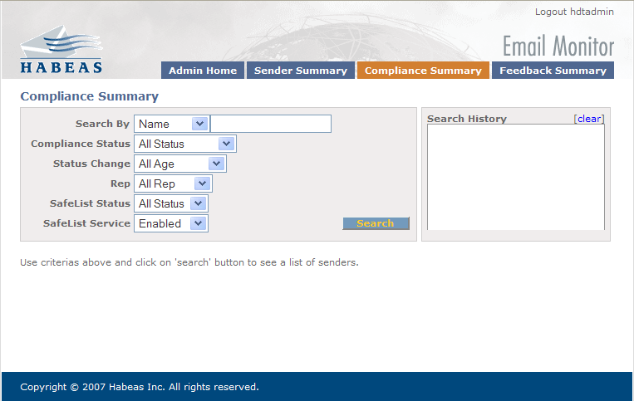
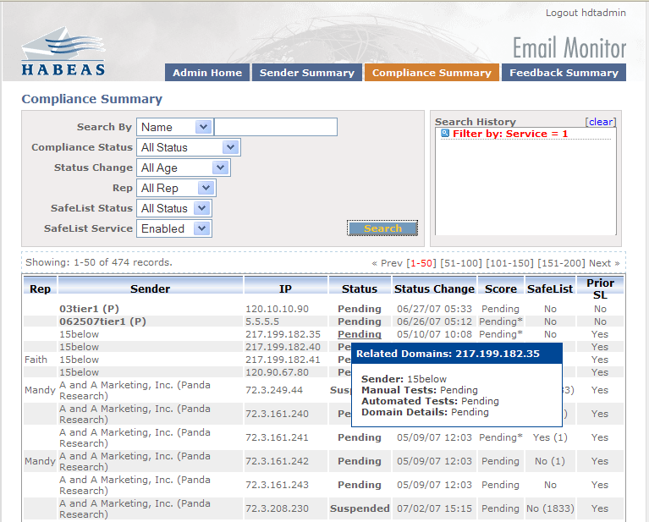
Compliance Summary
Faster load time with no results
New Search Criteria for:
  Safelist Status which indicates whether they are currently on the Safelist or not
  Safelist Service which indicated whether they have Safelist as a service enabled or not.
New quick links include:
  Sender name – links to IP/Domains Management
  IP – links to Compliance Admin
  Status – links to the Compliance Summary for related domains for that IP. This hover will also offer information for the status of Manual, Automated, and Domain Details.
  Score – links to the admin view of the Reputation Summary
  Safelist – links to admin view of the Safelist Summary
  Prior SL – A “Yes” indicates whether the sender has ever had an IP in the statuses of Non-Compliant, SafeListed, Suspended, and/or Deactivated. A “NO” indicates that the sender has only ever had IPs in the statuses of Pending, Review, Pass, Fail, and/or Eligible.

Slide 21
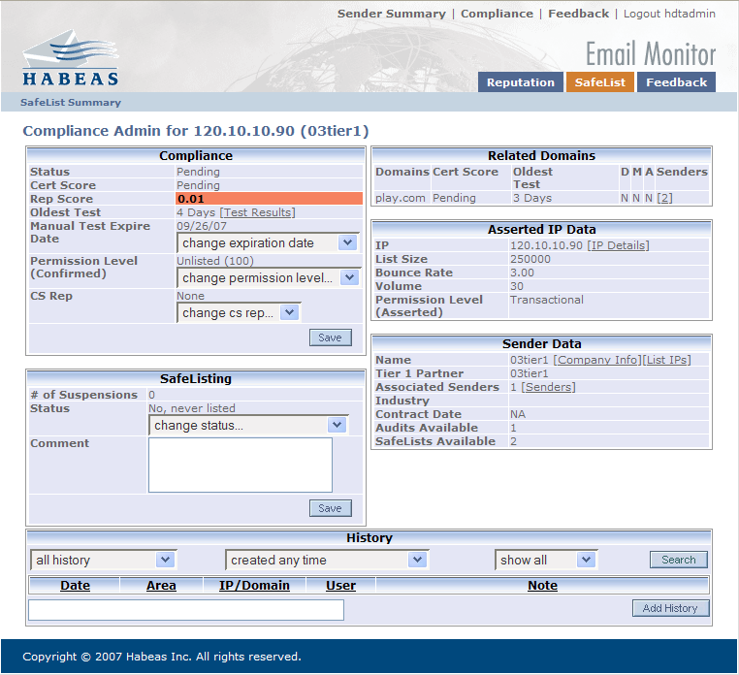
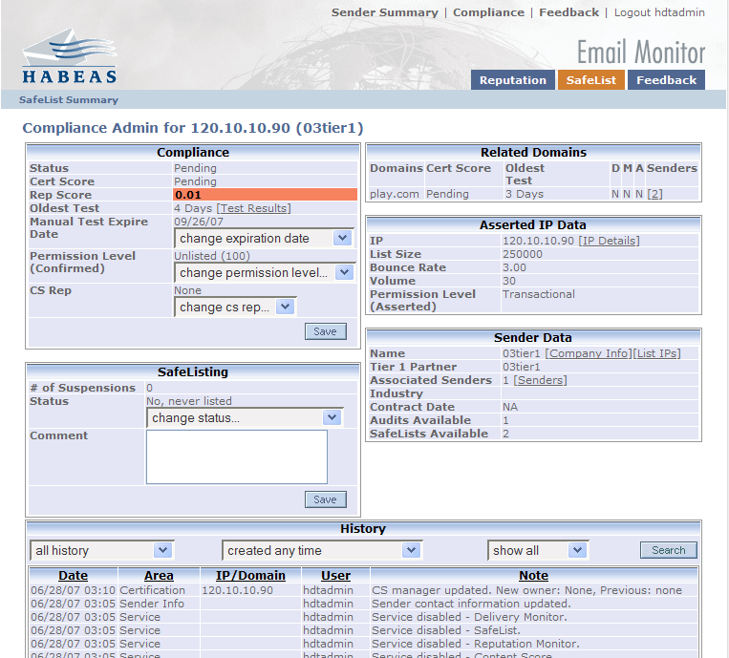
Compliance Admin
Faster load time with no results
  Search options default to all results with a new search button
New quick links include:
  Compliance
    Test results links to the Admin View of the Reputation Summary
  Related Domains
    D indicates whether the Domain Details have been completed
    M indicates whether the Manual tests have been completed
    A indicates whether the Asserted tests have been completed
    Senders links to all associated senders for that domain.
  Asserted IP Data
    IP details links to the Company Info > IP/Domains Management page
  Sender Data
    Company Info links to the Edit Sender > Company Info page
    List IPs > links to a filtered version of the Compliance Summary page
    Senders links to all associated senders by IP.

Slide 22
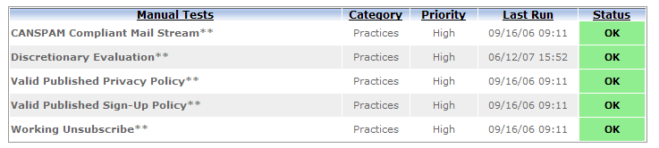
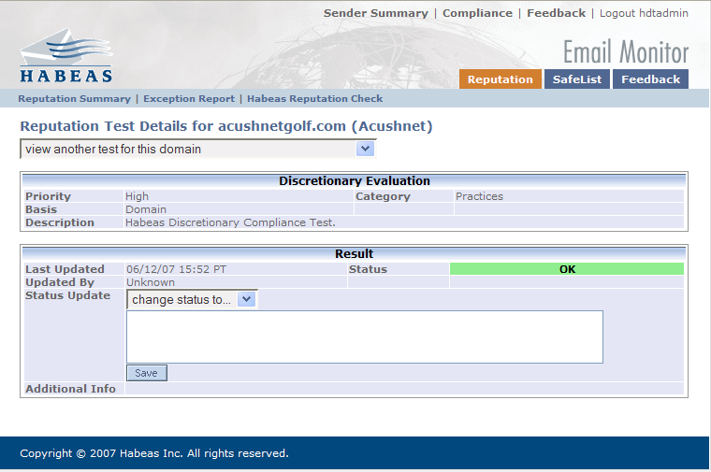
Discretionary Evaluation Reputation Test
This is a domain based reputation test for Senders who do not demonstrate an understanding of good email sending practices based on Habeas evaluation criteria.
This test does not have an override expiration date.

Slide 23
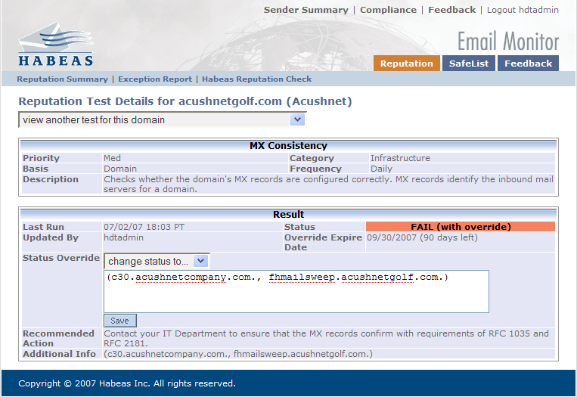
Override Expiration Dates
You can set an override expiration date to review test results in 90 days
There is also a countdown with how many days are remaining until the override expires.
This can be used for any of the Status Override statuses of Fail, Warn, Pass, and FYI.

Slide 24
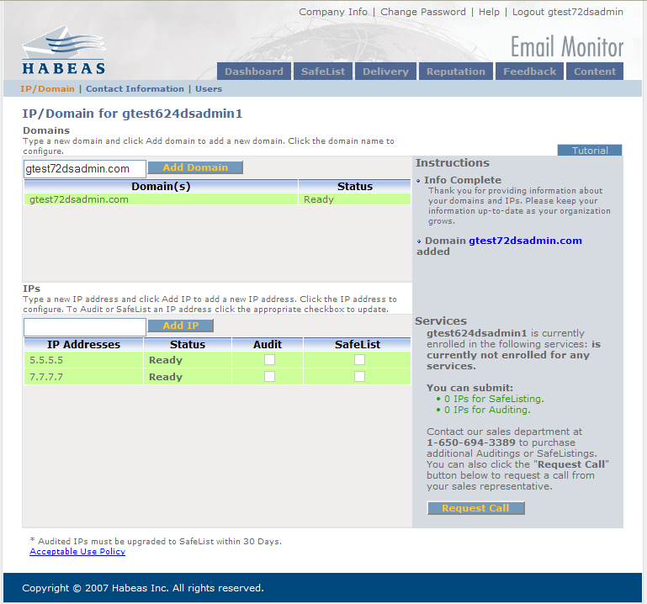
IP/Domains Management – Direct Senders Only
Direct Senders can not longer delete IPs and/or Domains.
You must be logged as a Direct Sender for this view

Slide 25
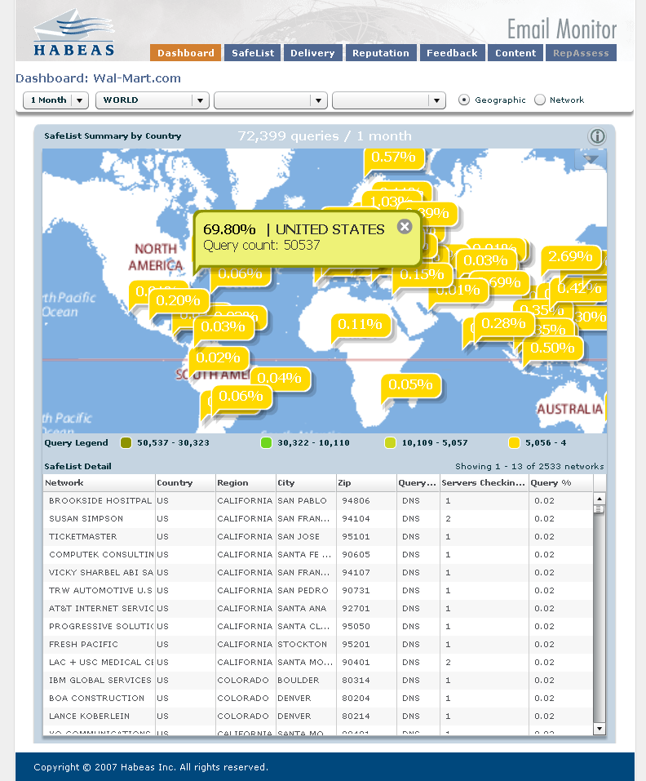
SafeList Monitor Overview
Detail Table
Network
Country
Region
City
Zip
Query type
Servers
Query %
Latitude
Longitude
Filters
Time
Country
Region
State
Markers
% of hits
Location
Query count
Geographic: Summary by location
Network: Summary by network & country
Query Types
DNS
ISP whitelist
Rsync
Notes:
Network
Query Count
Table % map markers
Network vs geographic
DNS, rsync, ISP whitelist

Slide 26
Definitions
Networks include:
  Receiving ISPs
    Comcast, Cox, BlueHost, DSL Extreeme, etc.
  Hosting providers
    Intermedia.com, XO Communications, etc.
  Corporate domains
    IBM.com, Polaroid.com, Novell.com, etc.
Views: Geographic vs Network
  Geographic view: Networks sorted by geography
  Network view: Networks sorted by Network
  (per country)
Notes:
Corporate domains

Slide 27
Definitions (cont)
Query Count: The number of queries for a specific country, region, city, or network.
Query Types
  DNS queries. Millions of MTAs all over the world check the SafeList multiple times daily in order to make delivery decisions. The SafeList Monitor will register each DNS query, which may represent multiple emails.
  Rsync. Some larger networks prefer to copy the Habeas SafeList to their own servers and periodically update the list rather than check Habeas servers over the Internet. This type of check will also be tracked in the SafeList Monitor. (Bizanga)
  ISP proprietary whitelists. Some networks rely on in-house whitelists based on their own sender reputation criteria to decide what email is delivered to the inbox. As part of the Habeas SafeList service, Habeas manages your placement on these whitelists for you, so you can rest assured that your email messages are reaching the widest audience possible. (AOL, Juno, NetZero, Outblaze (confirmed opt-in only), Yahoo!, Verizon)

Slide 28
Table vs Map
Map markers and table are filtered by the Filter UI
Map is a summary
Table is a detailed report
Map Makers:
  %s = query count of location/total queries for the time selected
Table data:
  %s = query count by Network/total queries for the time selected
Summary:
By country
Detail:
Every Network in the world

Slide 29
Other tidbits
Email Monitor now requires Flash 9
Email Monitor is WebEx ready!

Slide 30
More training
http://wiki/twiki/pub/Habeas/21ReleaseManagement/2.1SLQMUAT06.29.07v1.doc

Slide 31
SafeList Monitor FAQ

Slide 32
How big is the Habeas Network?
The Habeas Network consists of 5 million receiving mail servers in over 190 countries and grows larger every day.

Slide 33
Do the organizations and subscribers I email check the SafeList?
The SafeList Monitor gives you a clear window into who is checking your individual email reputation, and how often. Other email reputation services may tout relationships with a single ISP, Habeas tracks your market penetration to corporations, ISPs, government agencies, and universities around the globe and presents it in a clear, easy to use interactive map and downloadable data you can use for further analysis.

Slide 34
Why is Compliance Monitoring important? Can I just get on the Habeas SafeList?
Habeas Compliance Monitoring services are complementary to our SafeList services. Habeas Reputation Services are founded upon dozens of infrastructure and sending practices tests that have been empirically honed over years of development to create an email reputation rating. Habeas’ in-depth understanding of reputation factors is the foundation of our Compliance Monitoring recommendations. Following our Compliance Monitoring recommendations ensures that you maintain adherence to the latest industry best practices. In doing so, you not only head off any issues that may jeopardize your SafeList standing, you also increase the likelihood of delivery uplift to networks that may not yet be checking the Habeas SafeList.

Slide 35
Is every email I send verified by receiving networks?
Not necessarily.
There are also a few networks that will vary their inbound processing as a way to confuse spammers so the SafeList may or may not be referenced at any given moment at those networks.
There are some networks that don’t check the Habeas SafeList.

Slide 36
Does Habeas charge receiving networks for checking the Habeas SafeList?
There is no charge for a SafeList query. Habeas provides this as a free service which has contributed to wide-spread adoption.

Slide 37
How do email receivers check the Habeas SafeList?
Receivers use a variety of methods to check the SafeList. Delivery benefits are the same regardless of which method they choose.
  DNS queries. Millions of MTAs all over the world check the SafeList multiple times daily in order to make delivery decisions. The SafeList Monitor will register each DNS query, which may represent multiple emails.
  Rsync. Some larger networks prefer to copy the Habeas SafeList to their own servers and periodically update the list rather than check Habeas servers over the Internet. This type of check will also be tracked in the SafeList Monitor.
  ISP proprietary whitelists. Some networks rely on in-house whitelists based on their own sender reputation criteria to decide what email is delivered to the inbox. As part of the Habeas SafeList service, Habeas manages your placement on these whitelists for you, so you can rest assured that your email messages are reaching the widest audience possible.

Slide 38
If I have 1 million subscribers will I see 1 million queries in the SafeList Monitor?
Probably not. There are several reasons why:
  Network caching. Once a receiving server checks the Habeas SafeList for reputation information about a particular sender it may cache that answer for a few hours to maximize network performance and speed email delivery.
  Multiple subscribers within a single domain. If a sender emails 500 addresses to a single network within a fairly short period of time, the receiving network doesn’t need to check each address against the SafeList. This is because each message originates from the same sender using the same servers.
  Rsyncs of the Habeas SafeList. When a network rsyncs the Habeas SafeList they move a copy of the entire list to a local network, so Habeas doesn’t have specific information about how many times it is checked.
  ISP proprietary whitelists. Some networks rely on in-house whitelists based on their own sender reputation criteria to decide what email is delivered to the inbox. As part of the Habeas SafeList service, Habeas manages your placement on these whitelists for you, so you can rest assured that your email messages are reaching the widest audience possible.
  Bad addresses. Receiving network servers may discard email sent to addresses that no longer exist without checking the SafeList.

Slide 39
How many networks will check the mail I send?
The answer depends on the size of your list and the breadth of your demographic. Typical senders will see queries from thousands of networks over the course of a month including consumer email solutions (primarily B2C communication) and many businesses networks (primarily B2B communication). Though we believe that the thousands of networks are vastly more important than any one ISP, customers sometimes ask about specific networks.
Some of the more frequent are:
Earthlink Earlthink servers check the Habeas SafeList. See DNS queries above for details.
AOL Habeas lists SafeList subscribers on AOL’s proprietary whitelist. See ISP whitelist above.
Yahoo! Habeas lists SafeList subscribers with Yahoo!’s internal whitelist. See ISP whitelist above.
Google Google servers check the Habeas SafeList. See above for details.
Hotmail Hotmail does not use third party reputation data and relies solely automated filtering to manage their email delivery. However, following Habeas best practices, such as those required by the SafeList, most likely improves delivery to Hotmail as many of these criteria are the same.

Slide 40
Do small networks and domains, including those in other countries, check the Habeas SafeList?
Most small networks and domains will show up on the SafeList Monitor as their Internet hosting company. Small organizations typically host their Web and or email through an Internet Service Provider (ISP) or Email Service Provider (ESP).

Slide 41
How does the size of the Habeas Network compare with competitors?
To date, no one has demonstrated a more comprehensive network. The Habeas Network is the largest and most in-depth in the industry, and provides the information that is most relevant to your email deliverability.

Slide 42
How do I know Habeas helps my deliverability?
Habeas SafeList Monitor demonstrates who, where, when, and how often networks use the SafeList to make email delivery decisions.
Delivery Monitor predicts how a campaign will perform before you actually send it to your subscribers
Compliance Monitoring solutions keep you up-to-date when any change in your reputation occurs.

Slide 43
What else can I do with the Habeas SafeList Monitor?
In addition to providing rich visualization of world wide SafeList queries, the Habeas SafeList Monitor allows you to export the data in both XML and Excel formats so you can create detailed pivot table reports and charts to better understand the networks that check your reputation - and ultimately your customers.
The Habeas SafeList Monitor arms you with better deliverability tools that give you a clear direction for solving problems, and marketing tools you can combine with existing data to help you better target direct mail, radio campaigns, and other integrated marketing programs.

