Slide 1

Mass Spectroscopy using a Residual Gas Analyzer
Max Bigras

Slide 2
Overview
Experimental apparatus
More details about the RGA
Spectra analysis
Notes:
----- Meeting Notes (3/13/14 08:01) -----
1:20

Slide 3
Experimental Apparatus
Notes:
----- Meeting Notes (3/13/14 08:01) -----
2:40

Slide 4
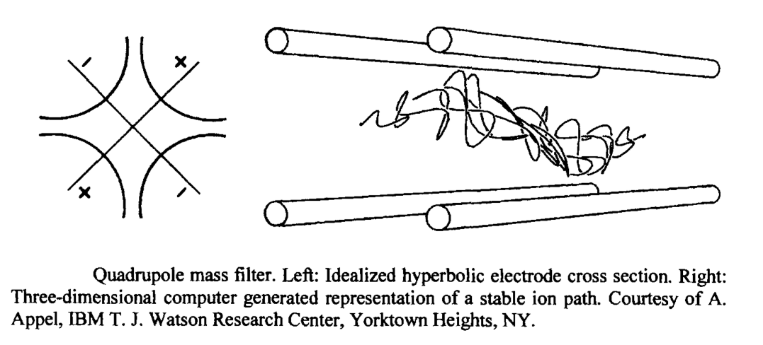
Principle operation
Notes:
----- Meeting Notes (3/13/14 08:01) -----
3:60

Slide 5
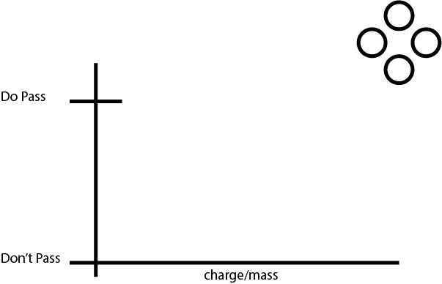
Scanning basics
Notes:
----- Meeting Notes (3/13/14 08:01) -----
5

Slide 6
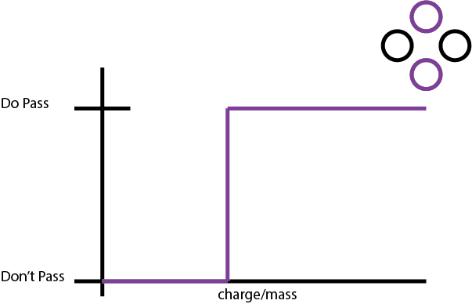
Scanning basics

Slide 7
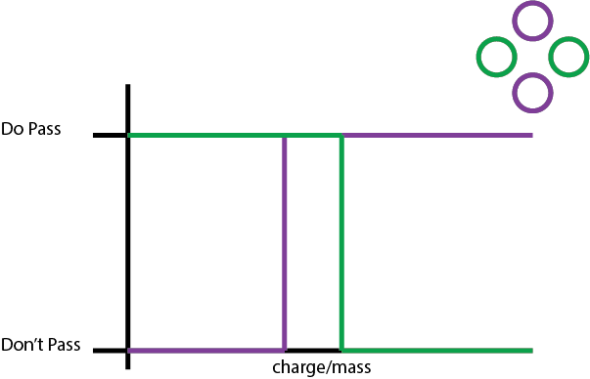
Scanning basics

Slide 8
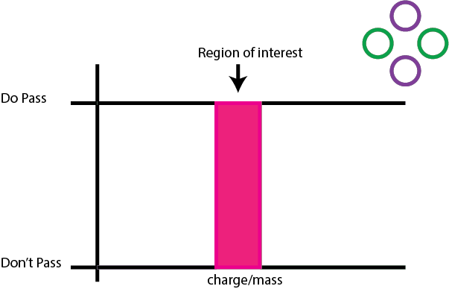
Scanning basics

Slide 9
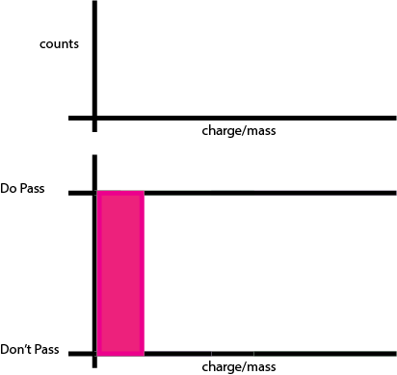
Scanning basics

Slide 10
Scanning basics

Slide 11
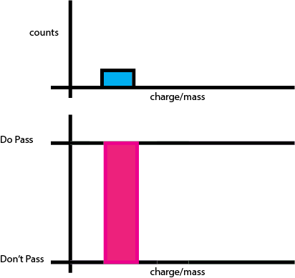
Scanning basics

Slide 12
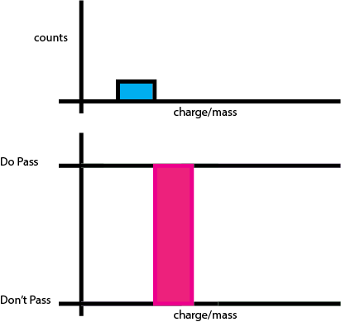
Scanning basics

Slide 13
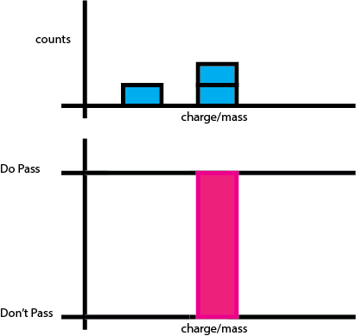
Scanning basics

Slide 14
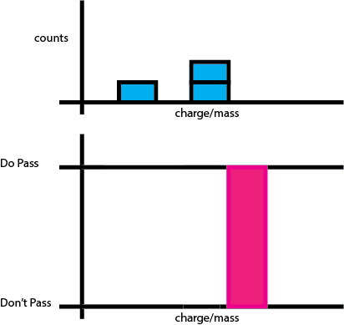
Scanning basics

Slide 15
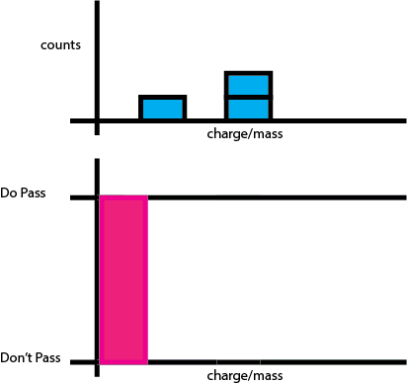
Scanning basics

Slide 16
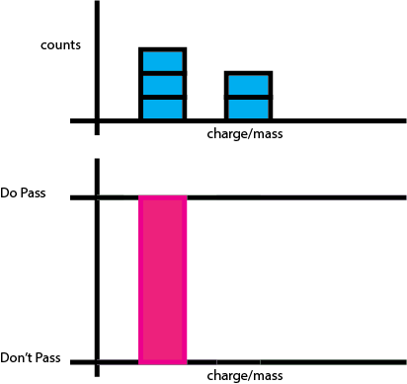
Scanning basics

Slide 17
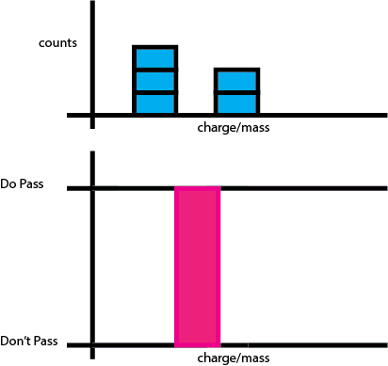
Scanning basics

Slide 18
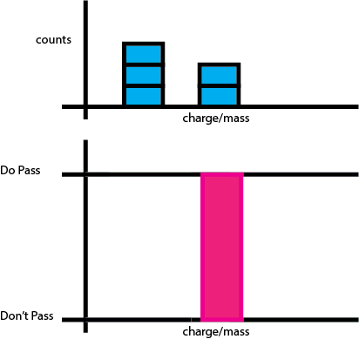
Scanning basics

Slide 19
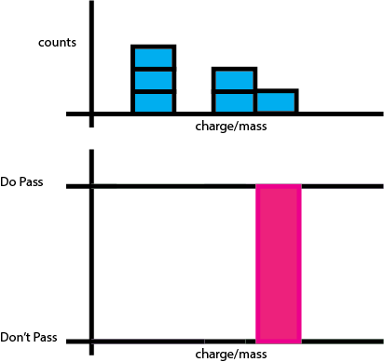
Scanning basics

Slide 20
Scanning basics

Slide 21
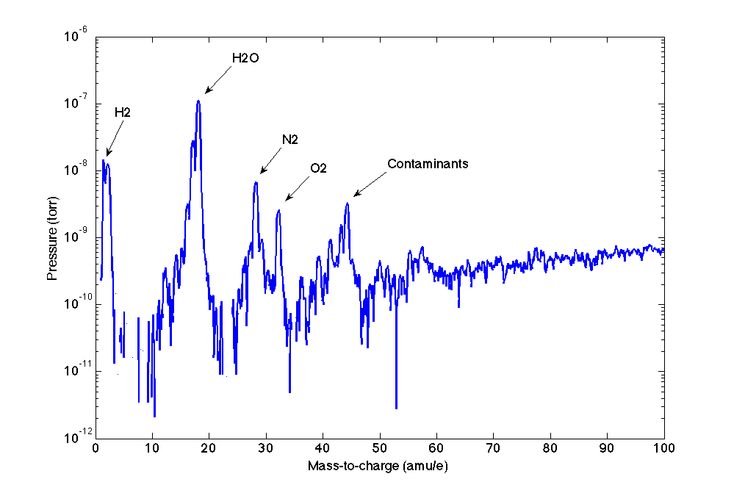
Background
Notes:
Log scale
O2 – 32
N2 – 28
H20 – 18

Slide 22
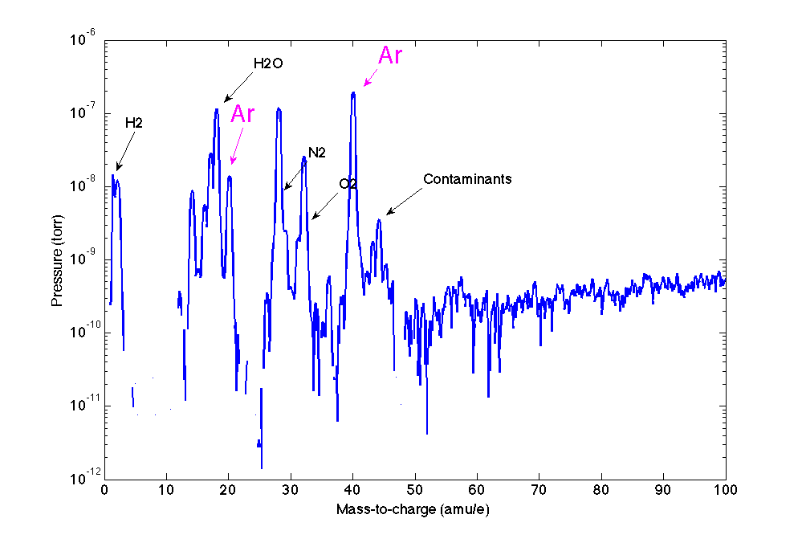
Argon

Slide 23
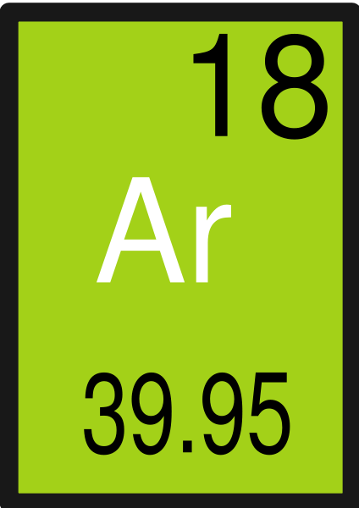
Argon

Slide 24
Argon

Slide 25
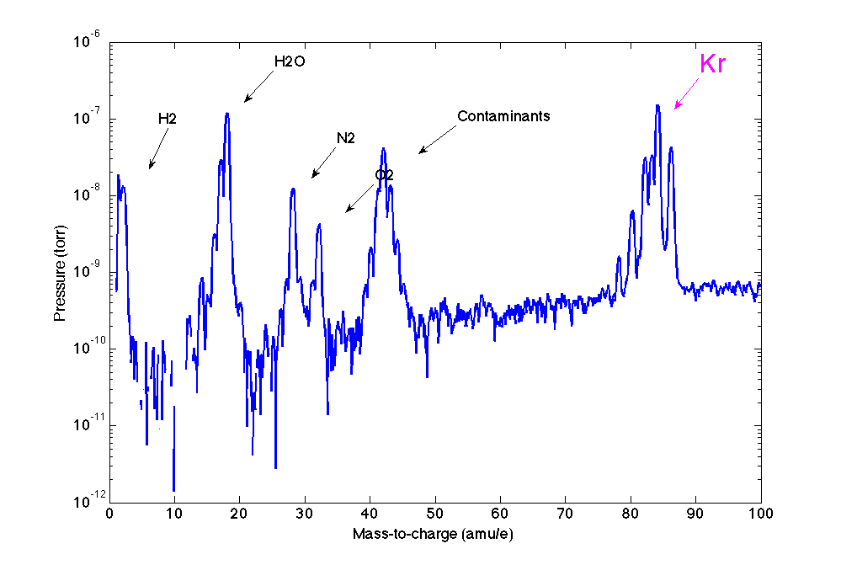
Krypton

Slide 26
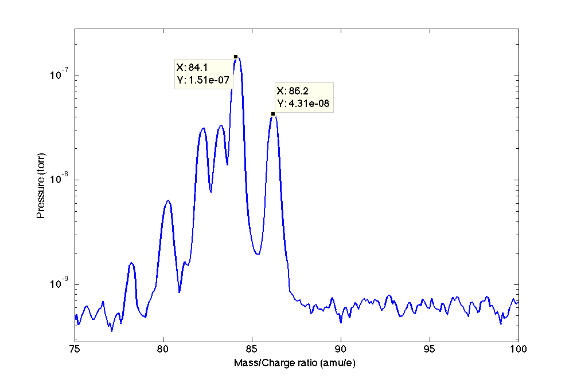
Krypton

Slide 27
Krypton
Isotope | Natural Abundance | Experimental
 | (%) | (%)
78Kr | 0.35
80Kr | 2.25
82Kr | 11.6
83Kr | 11.5
84Kr | 57
86Kr | 17.3

Slide 28
Krypton
Isotope | Natural Abundance | Experimental
 | (%) | (%)
78Kr | 0.35 | 0.63
80Kr | 2.25 | 2.28
82Kr | 11.6 | 11.21
83Kr | 11.5 | 12.88
84Kr | 57 | 56.42
86Kr | 17.3 | 16.58

Slide 29
Ethanol
Notes:
----- Meeting Notes (3/13/14 08:01) -----
about 8 minutes is fine

Slide 30
Ethanol

Slide 31
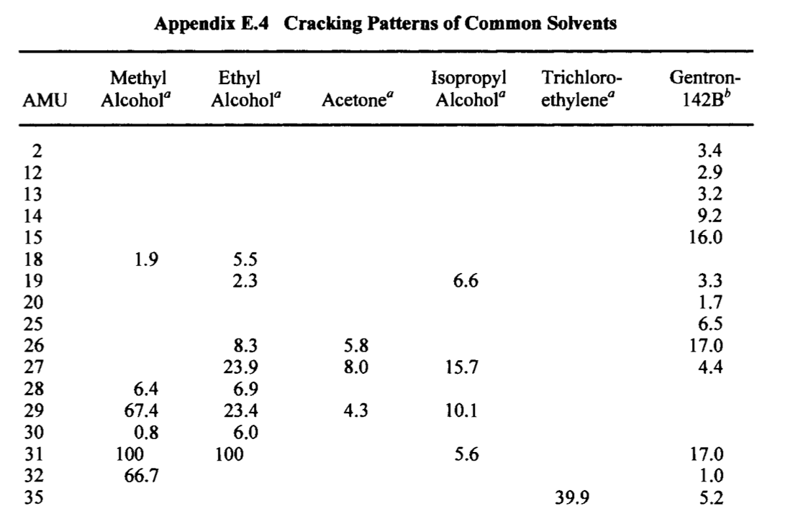
Ethanol

Slide 32
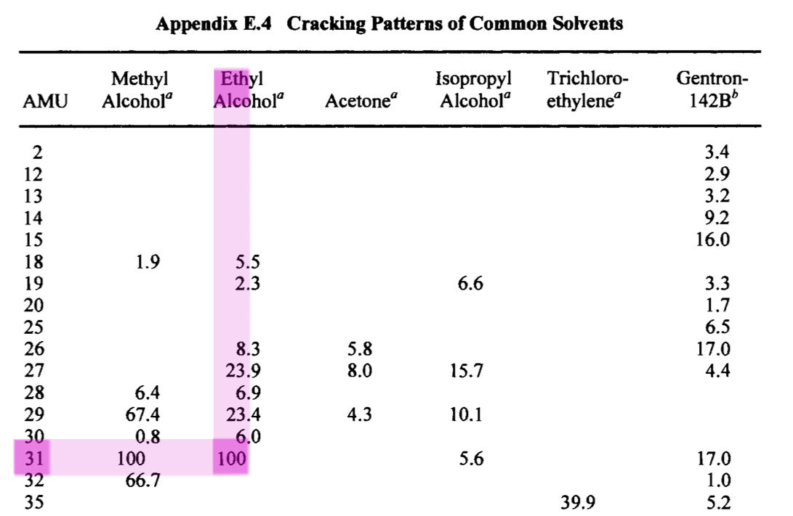
Ethanol

Slide 33
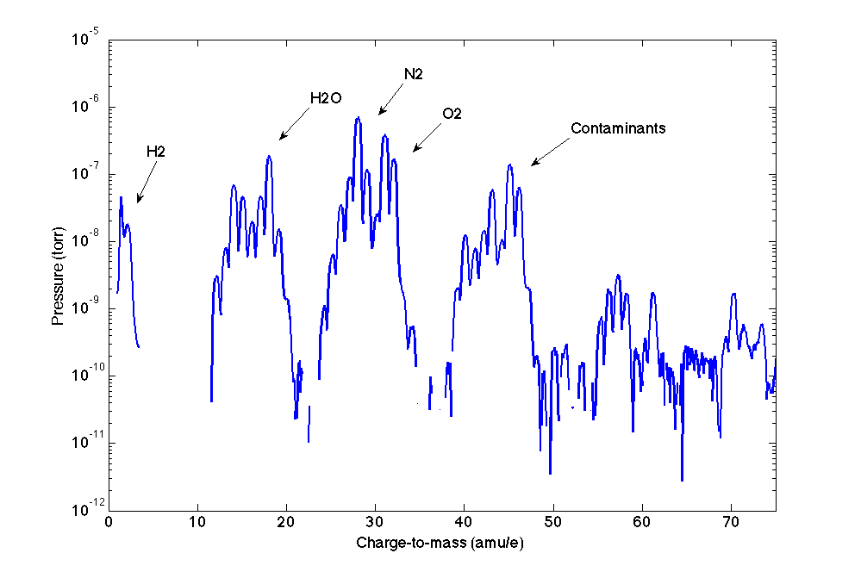
Ethanol

Slide 34
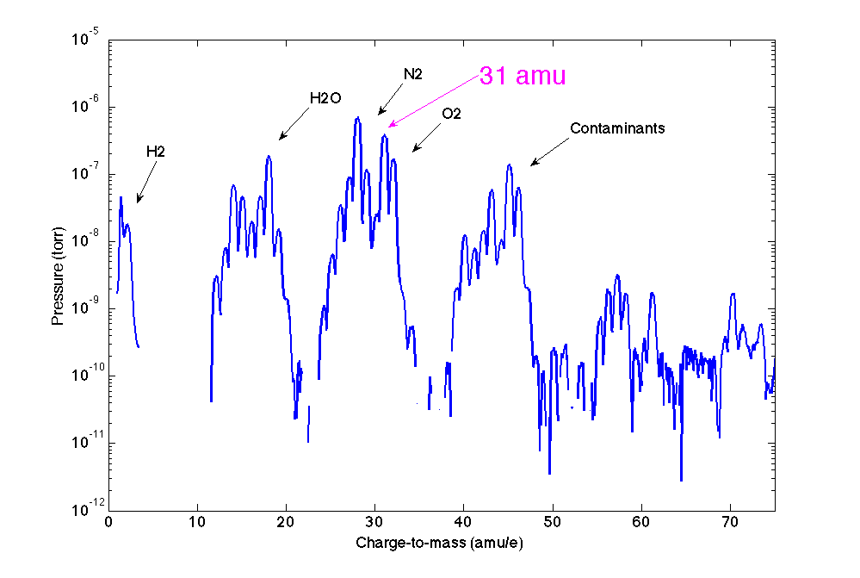
Ethanol

Slide 35
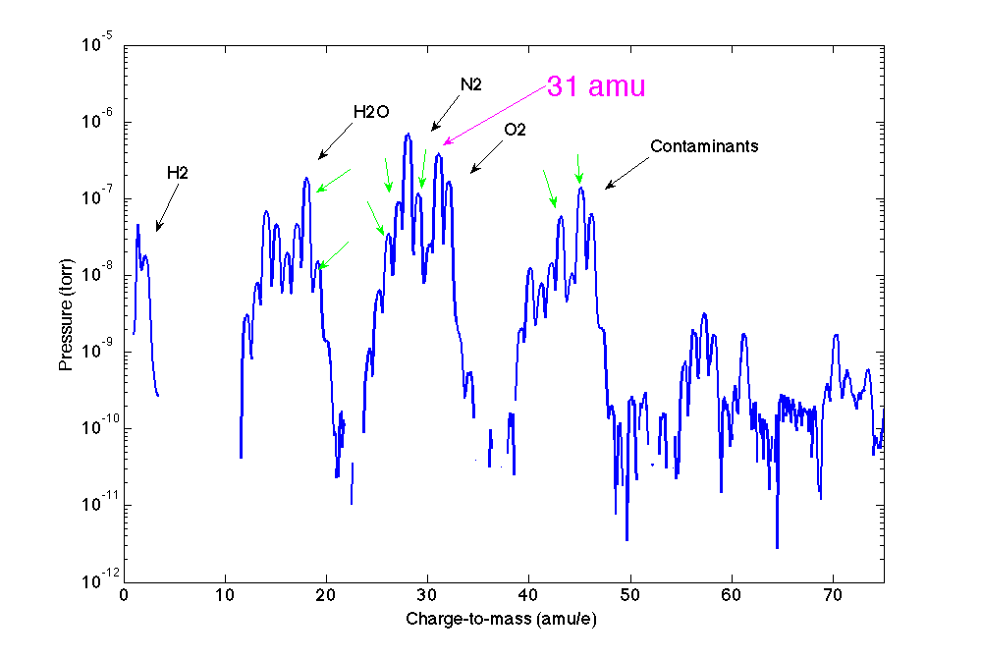
Ethanol

Slide 36
Conclusion
Vacuum technology
Notes:
Wide array of applications – we leveraged the power of vacuum technology to perform mass spectroscopy

Slide 37
Conclusion
Vacuum technology
RGA
Notes:
The residual gas analyser can be used to distinguish gases in air,
Our specific mass filter was a quadropole filter, electric fields, economical choice

Slide 38
Conclusion
Vacuum technology
RGA
Ar, Kr, Ethanol, ….
Notes:
Interesting properties, doubly ionized, different cracking patterns, reference material

Slide 39
fin

