Slide 1
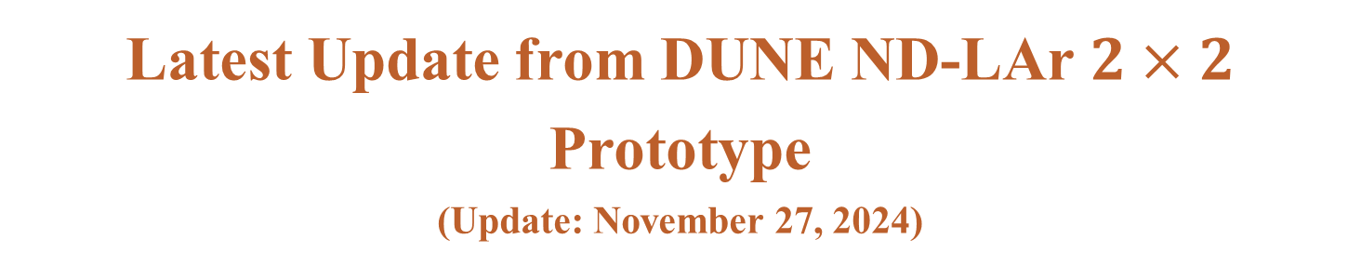
Latest Update from DUNE ND-LAr $2×2$ Prototype
(Update: November 27, 2024)
M. Bilal Azam, Zelimir Djurcic et. al.

Slide 2
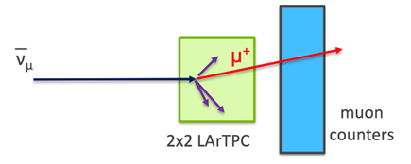

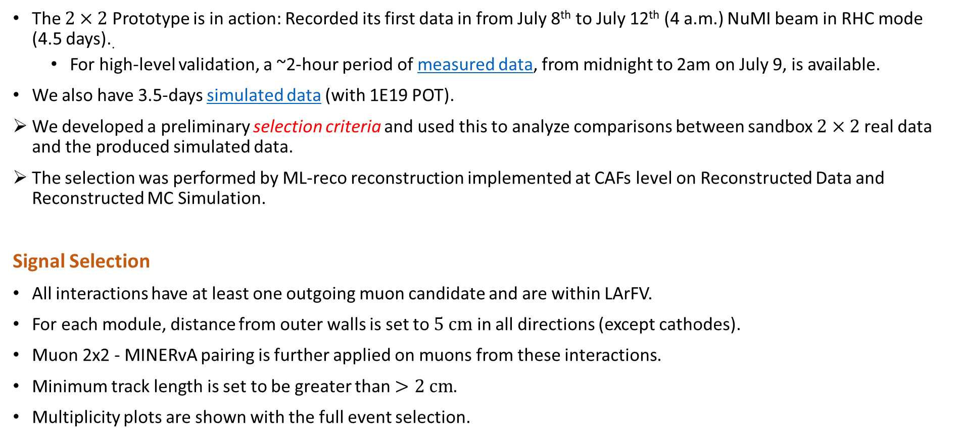
Current Status
The $2×2$ Prototype is in action: Recorded its first data in from July 8th to July 12th (4 a.m.) NuMI beam in RHC mode (4.5 days)..
For high-level validation, a ~2-hour period of measured data, from midnight to 2am on July 9, is available.
We also have 3.5-days simulated data (with 1E19 POT).
We developed a preliminary selection criteria and used this to analyze comparisons between sandbox $2×2$ real data and the produced simulated data.
The selection was performed by ML-reco reconstruction implemented at CAFs level on Reconstructed Data and Reconstructed MC Simulation.
Signal Selection
All interactions have at least one outgoing muon candidate and are within LArFV.
For each module, distance from outer walls is set to $5 cm$ in all directions (except cathodes).
Muon 2x2 - MINERvA pairing is further applied on muons from these interactions.
Minimum track length is set to be greater than $>2 cm$.
Multiplicity plots are shown with the full event selection.
FV Bounds are (in cm)
$$X (−63.931,+63.931)$$
$$Y (−62.076, +62.076)$$
$$Z (−64.538,+64.538)$$
2

Slide 3
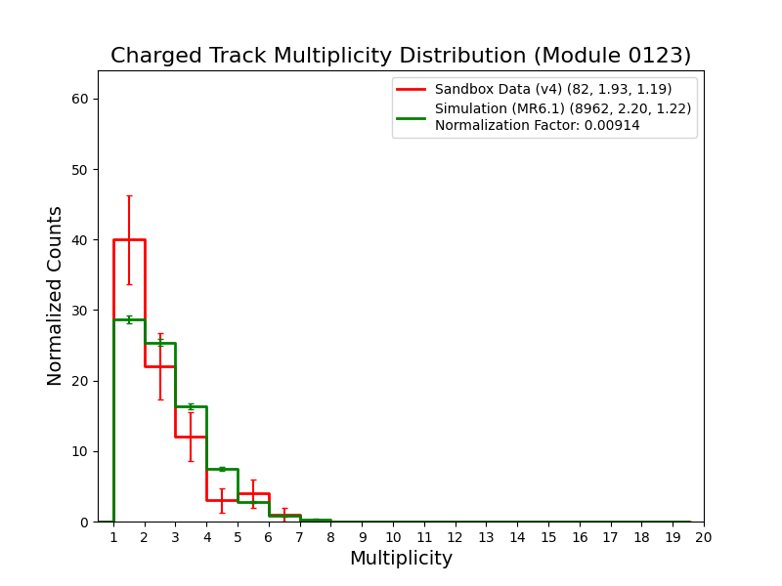
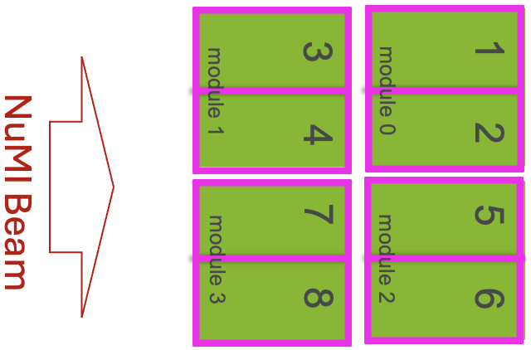
Charged Track Multiplicity Distribution (Module-by-Module Basis)
Multiplicity distribution for charged tracks (muons, protons, charged pions, charged kaons), with the full event selection, is shown.
Number of interactions in MC simulation is normalized to the number of interactions in data.
Same normalization factor is applied in the rest of the talk when MC and data are compared.

Slide 4
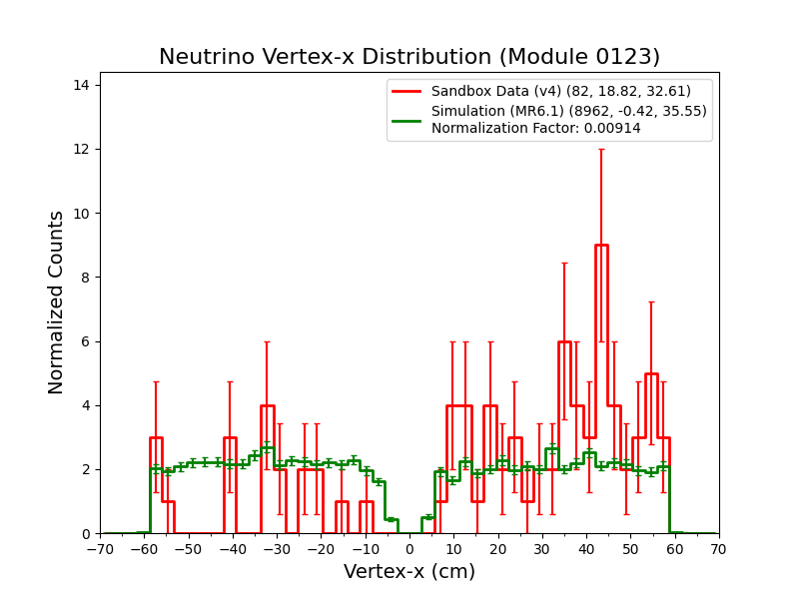
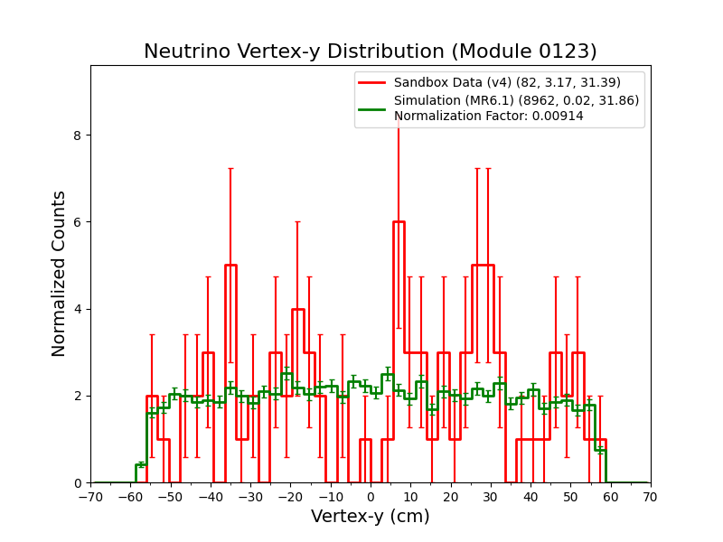
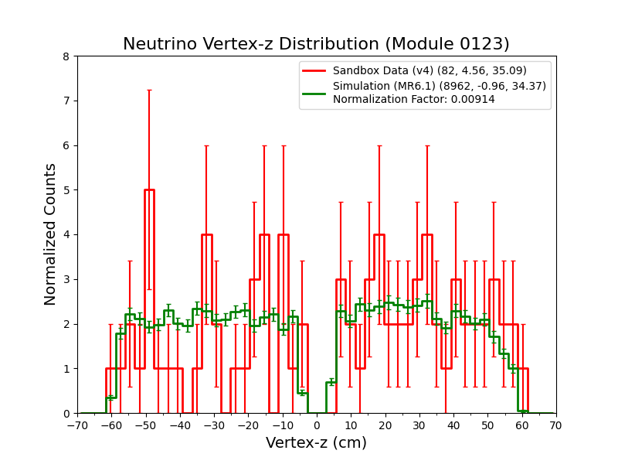
Neutrino Interaction Vertices
1D histograms of neutrino interaction vertices from data and MC simulation are shown, from full event selection.
MC simulation is normalized according to data and normalization factor is calculated from total number of interactions.
Vertex-x
Vertex-y
Vertex-z

Slide 5
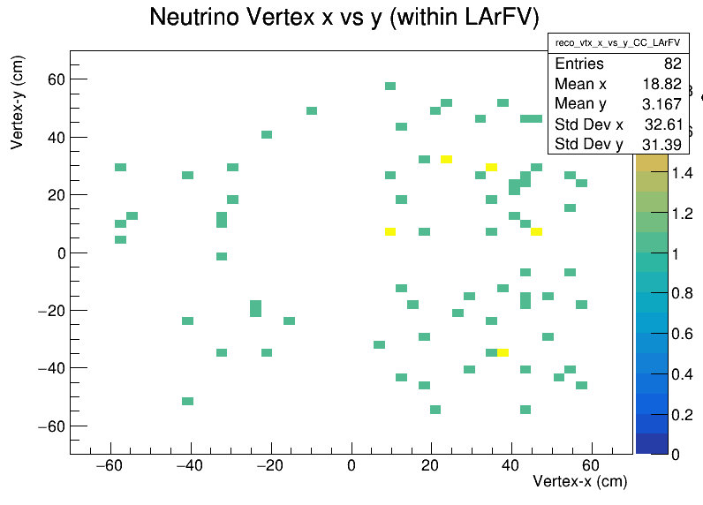
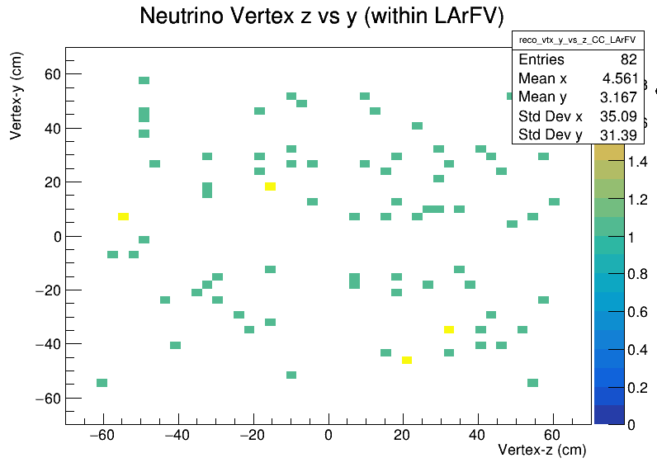
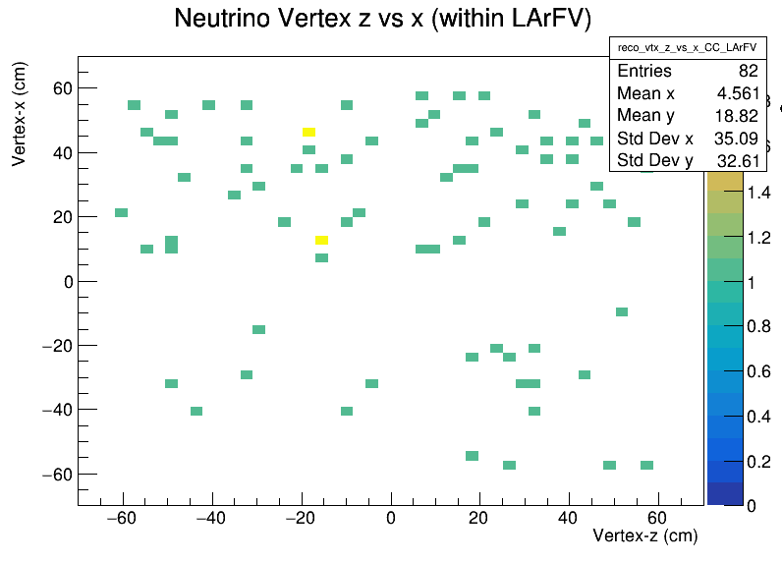
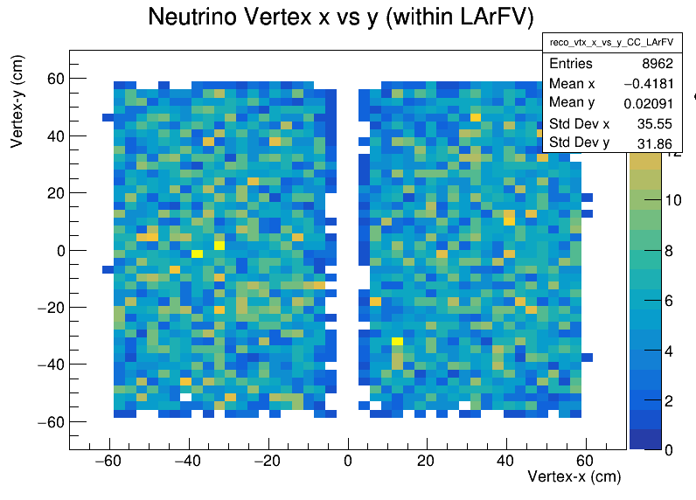
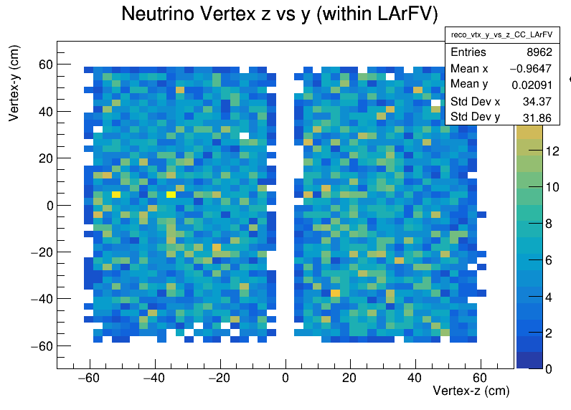
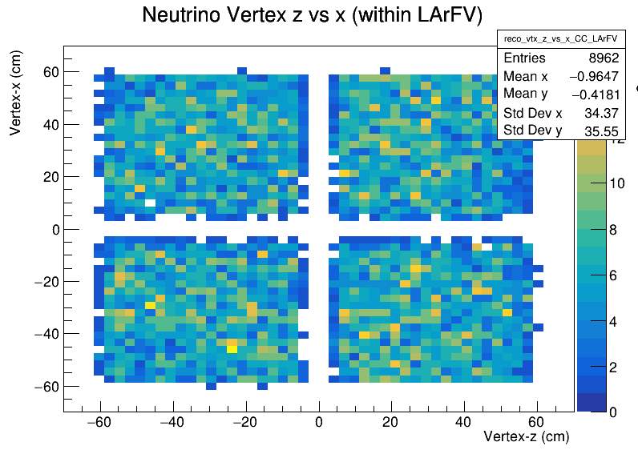
Neutrino Interaction Vertices
Neutrino interaction vertices, for reconstructed data and reconstructed MC simulation, are shown within LArFV.
Data-Reco ($x$ vs. $y$)
Data-Reco ($z$ vs. $y$)
Data-Reco ($z$ vs. $x$)
Sim-Reco ($x$ vs. $y$)
Sim-Reco ($z$ vs. $y$)
Sim-Reco ($z$ vs. $x$)

Slide 6
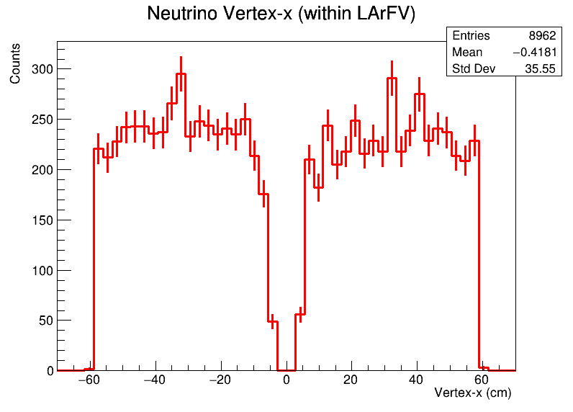
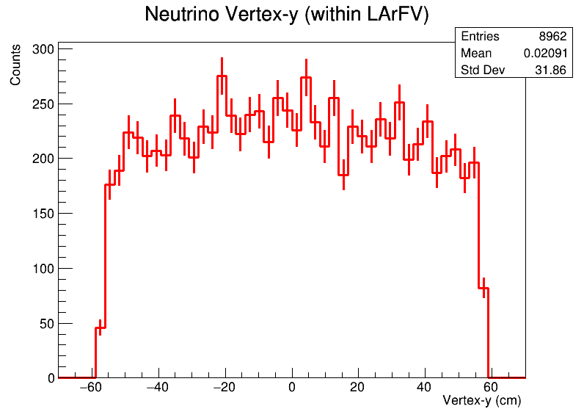
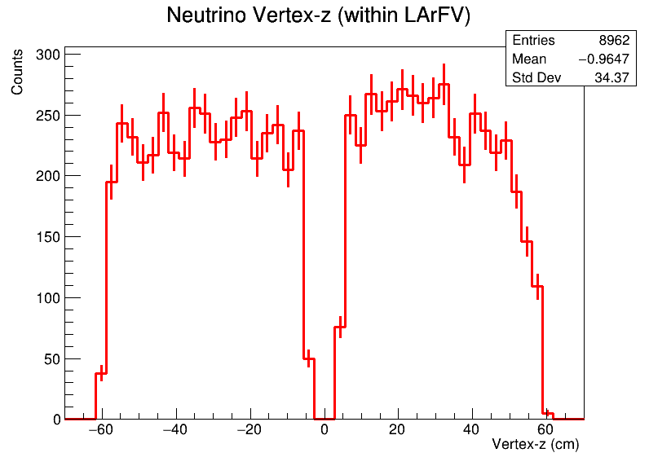
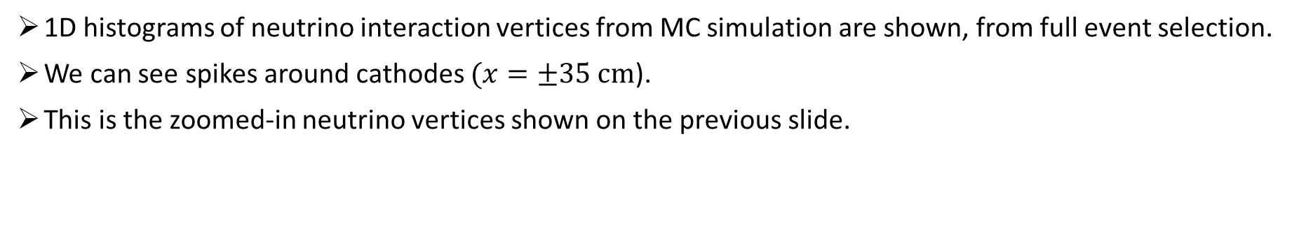
Neutrino Interaction Vertices
1D histograms of neutrino interaction vertices from MC simulation are shown, from full event selection.
We can see spikes around cathodes $(x=±35 cm$).
This is the zoomed-in neutrino vertices shown on the previous slide.
Vertex-x
Vertex-y
Vertex-z

Slide 7
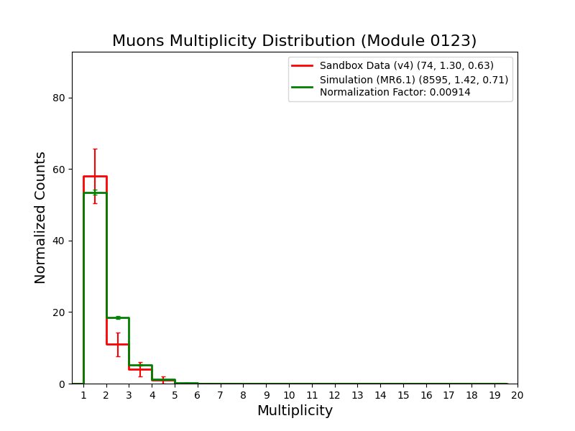
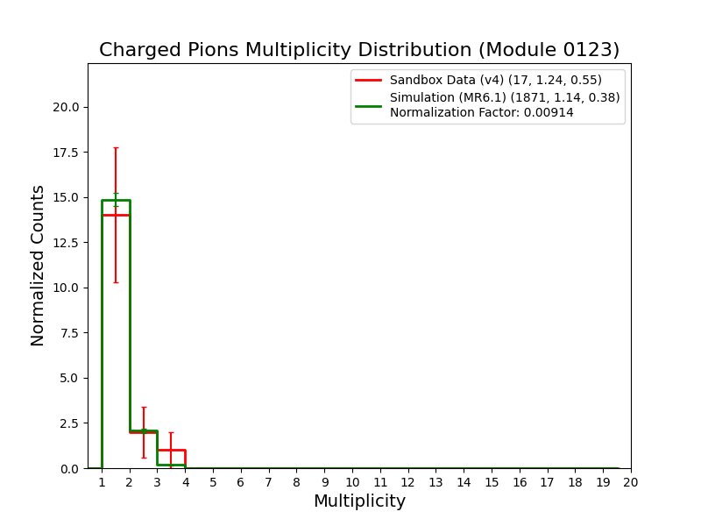
Individual Charged Track Multiplicity Distribution (All Modules)
Multiplicity distribution for muons, charged pions, protons, and kaons with the full event selection, is shown.
Normalization is applied based on the total charged track multiplicity.
There are multiple muon candidates can be seen in the muon distribution.
Muons
Charged Pions
Tracks
Data: 96
MC: 12244
Scaled MC: 112
Tracks
Data: 21
MC: 2138
Scaled MC: 20

Slide 8
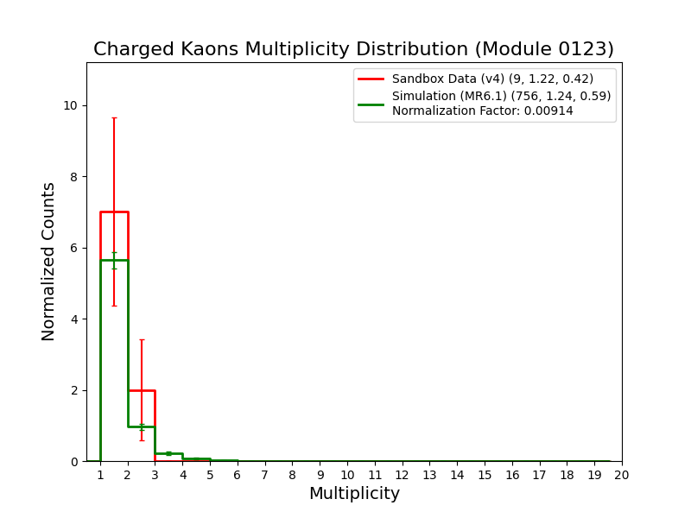
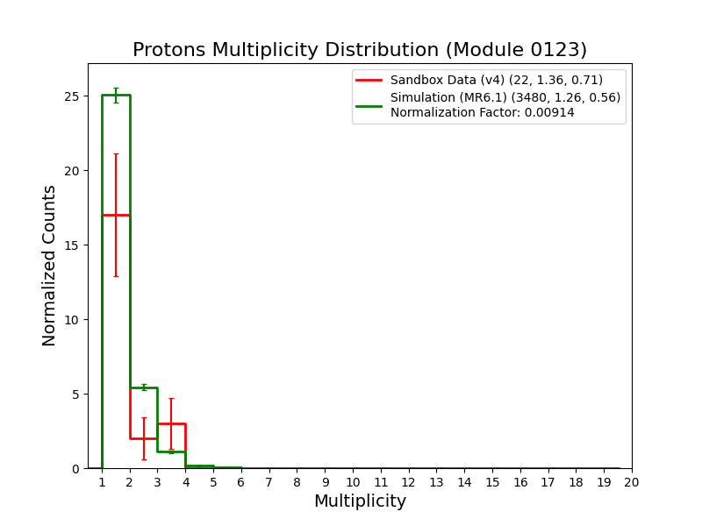
Individual Charged Track Multiplicity Distribution (All Modules) [contd.]
Multiplicity distribution for muons, charged pions, protons, and kaons with the full event selection, is shown.
Normalization is applied based on the total charged track multiplicity.
Charged Kaons
Protons
Tracks
Data: 11
MC: 941
Scaled MC: 9
Tracks
Data: 30
MC: 4388
Scaled MC: 40

Slide 9
Study of Some Features around Cathodes
We notices some potentially interesting features (spikes) at cathode locations, in the MC simulation.
We try to examine these features.

Slide 10
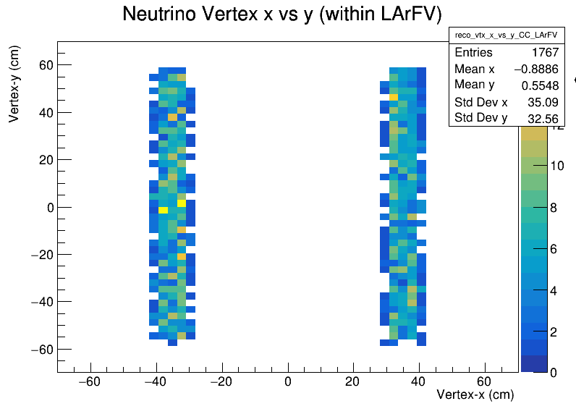
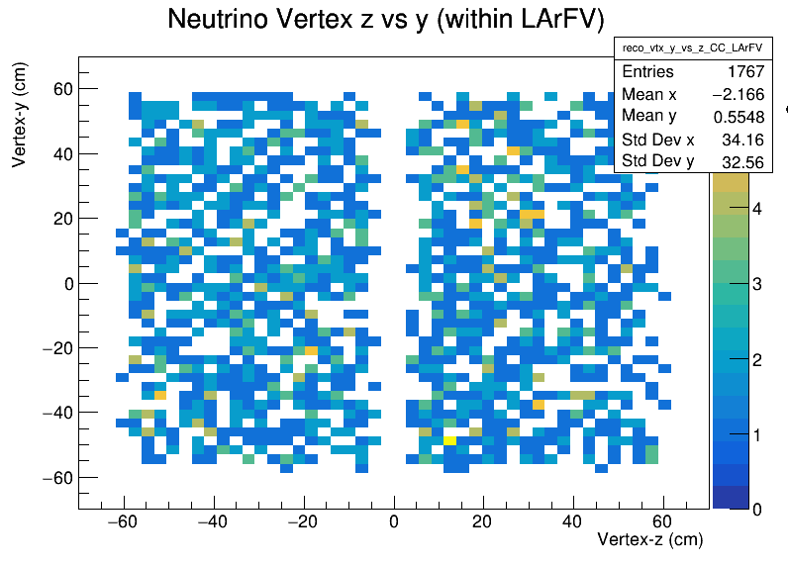
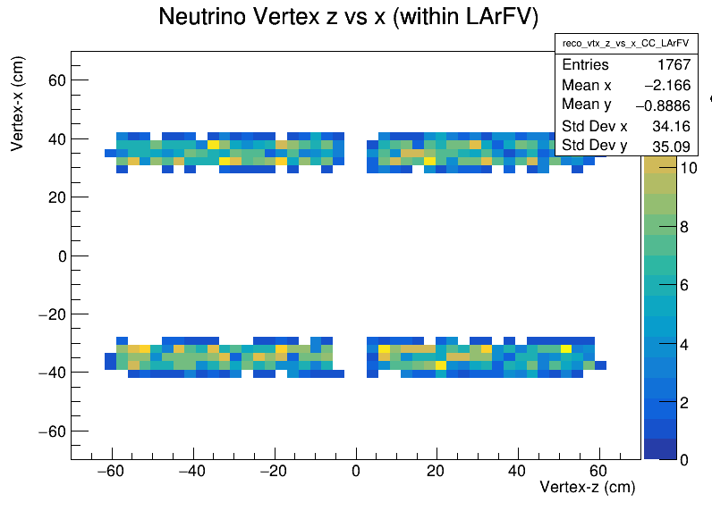



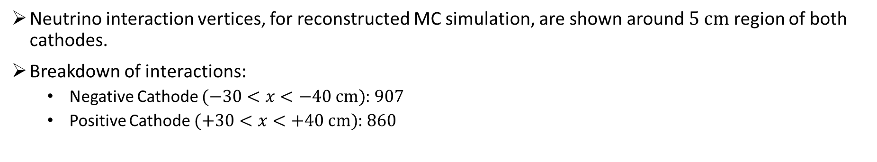
Neutrino Interaction Vertices around Cathodes
Neutrino interaction vertices, for reconstructed MC simulation, are shown around $5 cm$ region of both cathodes.
Breakdown of interactions:
Negative Cathode $(−30<x<−40 cm)$: $907$
Positive Cathode $(+30<x<+40 cm)$: $860$
Sim-Reco ($x$ vs. $y$)
Sim-Reco ($z$ vs. $y$)
Sim-Reco ($z$ vs. $x$)

Slide 11
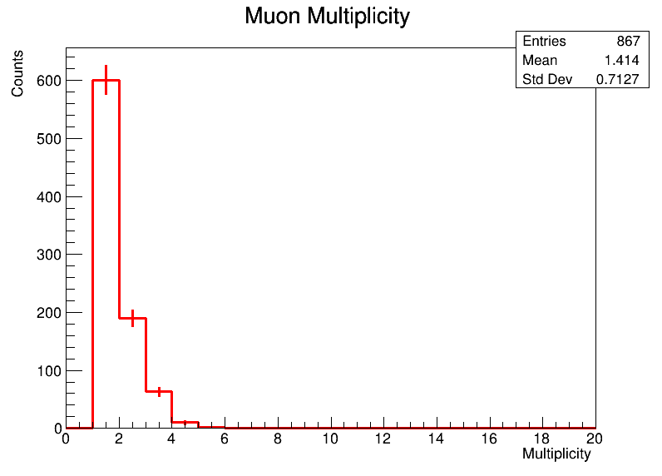
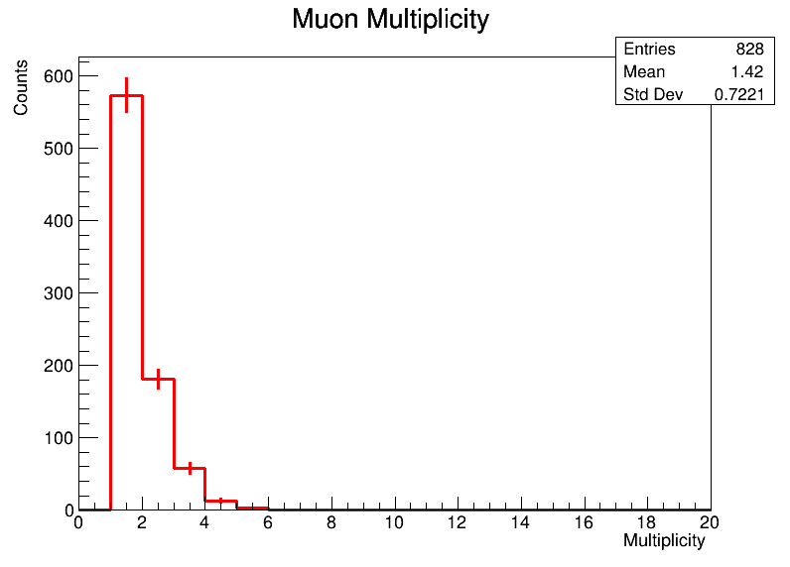
Muon Multiplicity Distribution around Cathodes
Multiplicity distribution for muons, with the full event selection, is shown around each cathode.
There are approximately equal number of multiple muon candidates around both cathodes.
We will repeat this study near anode walls between modules.
We further plan to look at the track length and angular distributions of each muon to better understand this multiple muon candidacy.
Negative Cathode
Positive Cathode
Tracks
MC: 1226
Tracks
MC: 1176

Slide 12

Summary
Studied the $2×2$ multiplicity events with the latest measured data and reconstructed simulation (MiniRun6.1) with the existing event selection.
Stats are low but presented reconstructed distributions provide a guidance on what to expect from next run of $2×2$ measured data.
Some interesting features are observed at cathode location, and we started to look at them.
Our plans are to:
Relax existing cuts and optimize the selection.
hand scan these events in the SPINE Flow files and traceback to their truth counterparts.

Slide 13
Backup Slides

