Slide 1
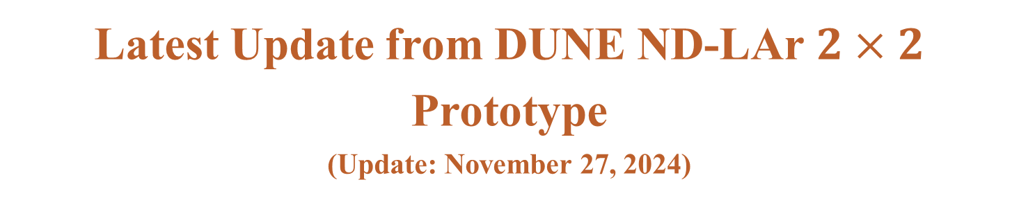
Latest Update from DUNE ND-LAr $2×2$ Prototype
(Update: November 27, 2024)
M. Bilal Azam, Zelimir Djurcic et. al.

Slide 2
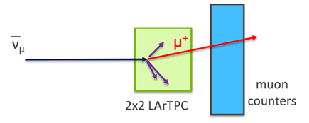

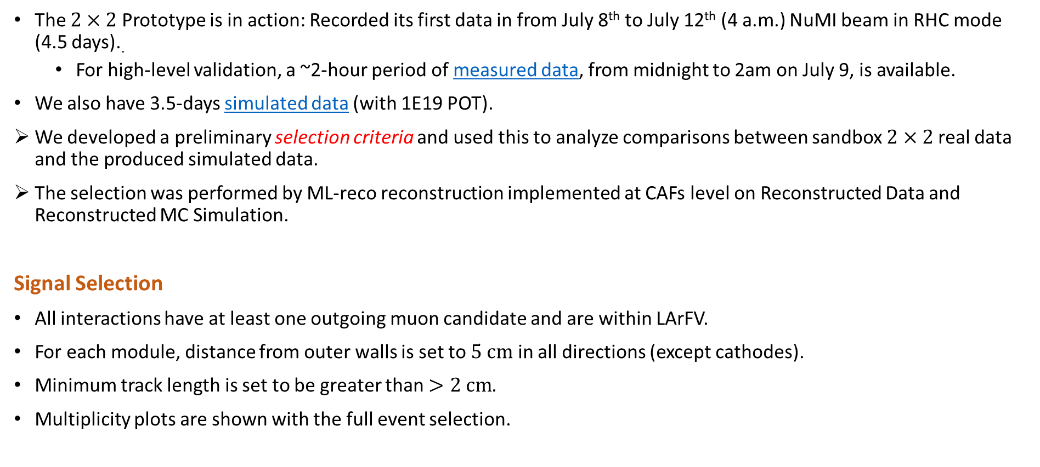
Current Status
The $2×2$ Prototype is in action: Recorded its first data in from July 8th to July 12th (4 a.m.) NuMI beam in RHC mode (4.5 days)..
For high-level validation, a ~2-hour period of measured data, from midnight to 2am on July 9, is available.
We also have 3.5-days simulated data (with 1E19 POT).
We developed a preliminary selection criteria and used this to analyze comparisons between sandbox $2×2$ real data and the produced simulated data.
The selection was performed by ML-reco reconstruction implemented at CAFs level on Reconstructed Data and Reconstructed MC Simulation.
Signal Selection
All interactions have at least one outgoing muon candidate and are within LArFV.
For each module, distance from outer walls is set to $5 cm$ in all directions (except cathodes).
Minimum track length is set to be greater than $>2 cm$.
Multiplicity plots are shown with the full event selection.
FV Bounds are (in cm)
$$X (−63.931,+63.931)$$
$$Y (−62.076, +62.076)$$
$$Z (−64.538,+64.538)$$
2

Slide 3
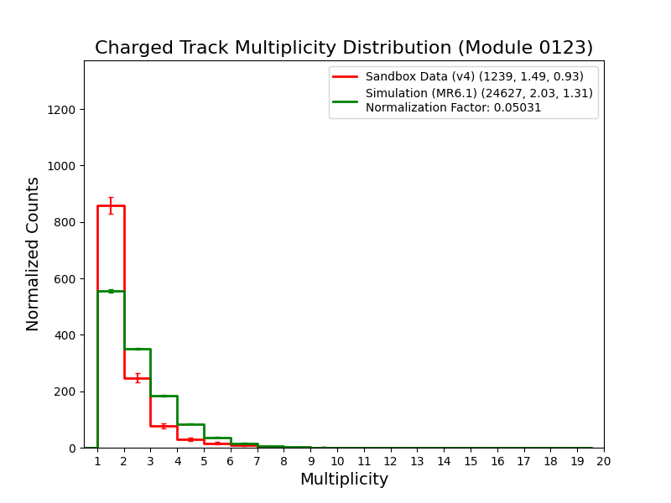
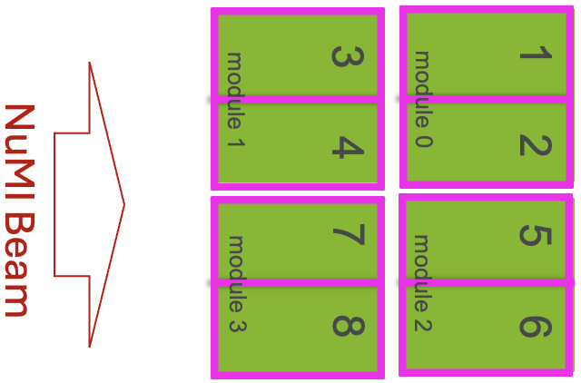
Charged Track Multiplicity Distribution (Module-by-Module Basis)
Multiplicity distribution for charged tracks (muons, protons, charged pions, charged kaons), with the full event selection, is shown.
Number of interactions in MC simulation is normalized to the number of interactions in data.
Same normalization factor is applied in the rest of the talk when MC and data are compared.

Slide 4
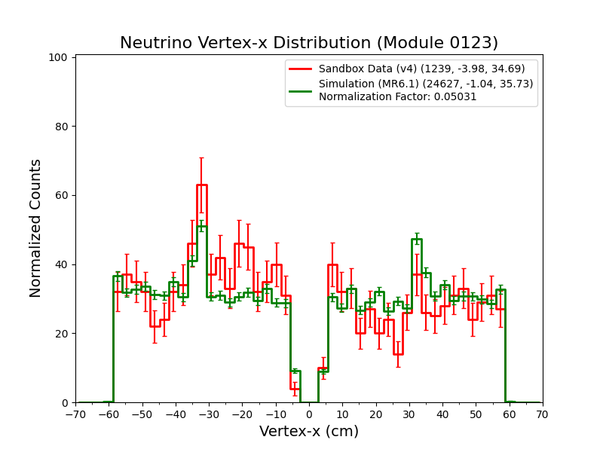
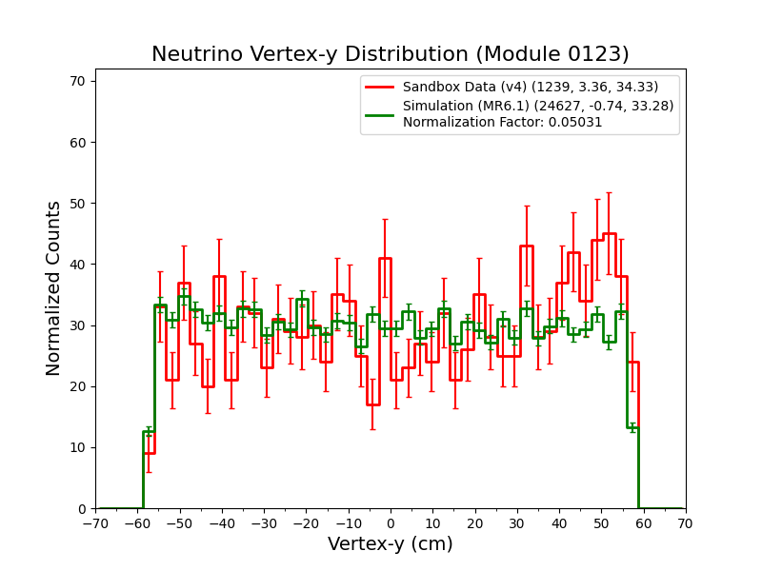
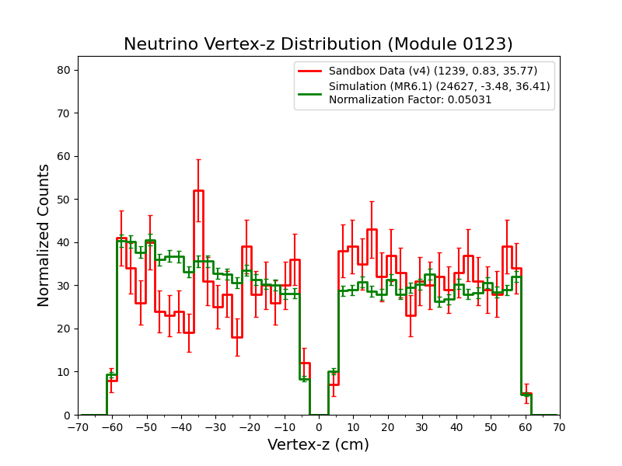
Neutrino Interaction Vertices
1D histograms of neutrino interaction vertices from data and MC simulation are shown, from full event selection.
MC simulation is normalized according to data and normalization factor is calculated from total number of interactions.
Vertex-x
Vertex-y
Vertex-z

Slide 5
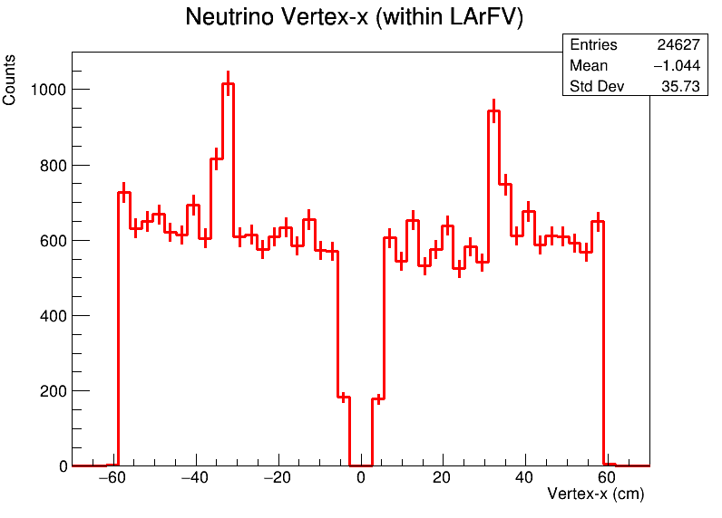
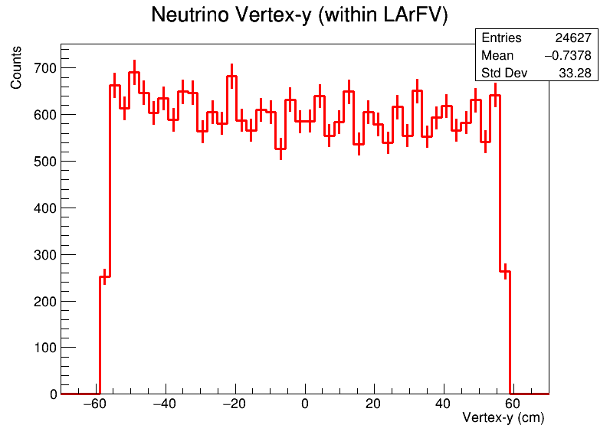
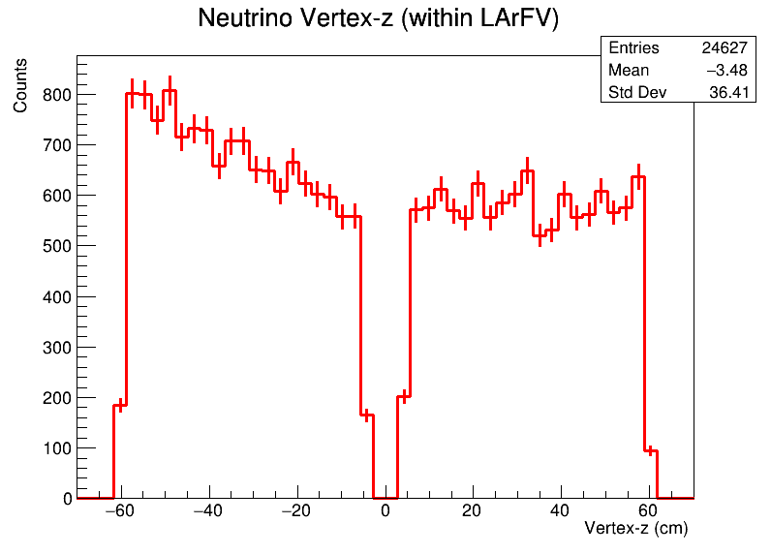
Neutrino Interaction Vertices
1D histograms of neutrino interaction vertices from MC simulation are shown, from full event selection.
We can see spikes around cathodes $(x=±35 cm$).
This is the zoomed-in neutrino vertices shown on the previous slide.
Vertex-x
Vertex-y
Vertex-z

Slide 6
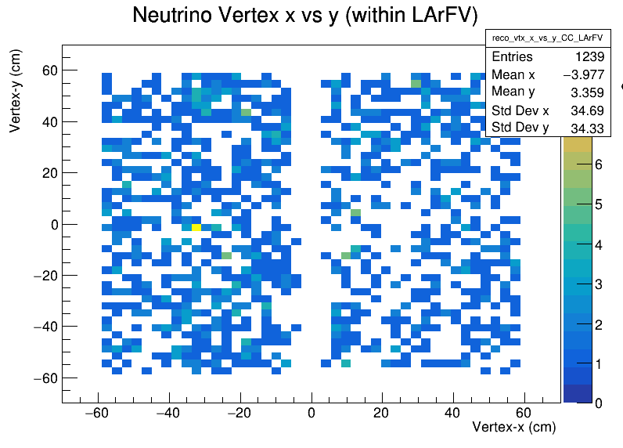
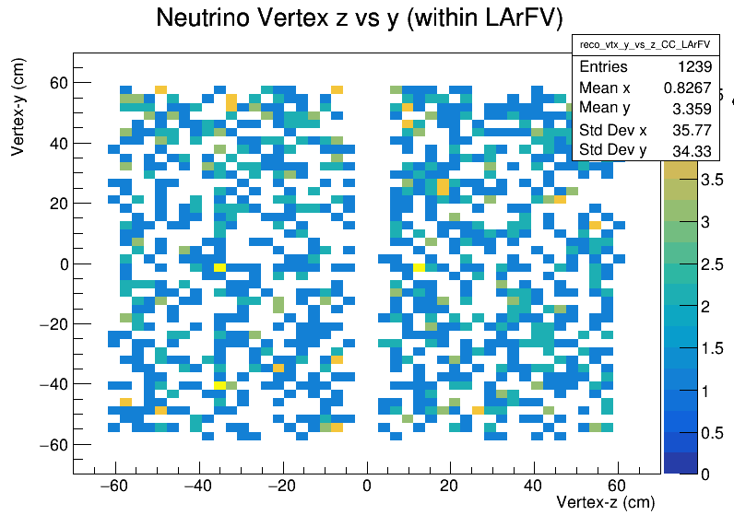
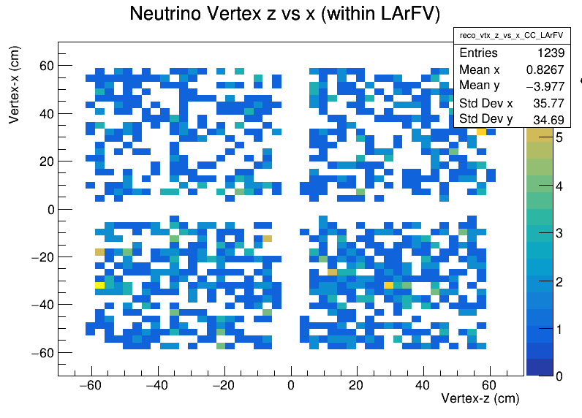
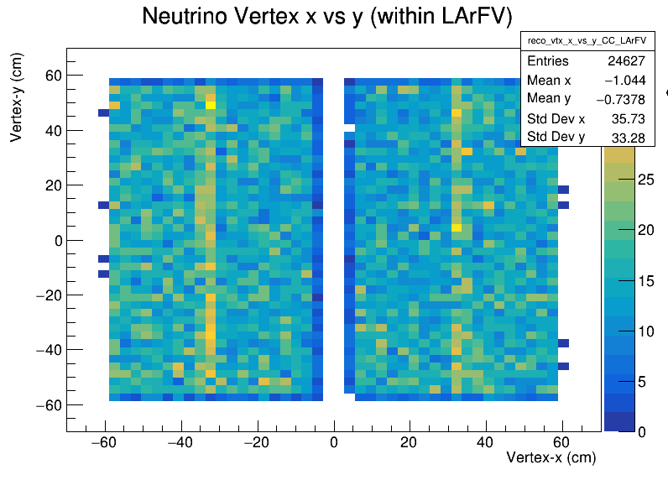
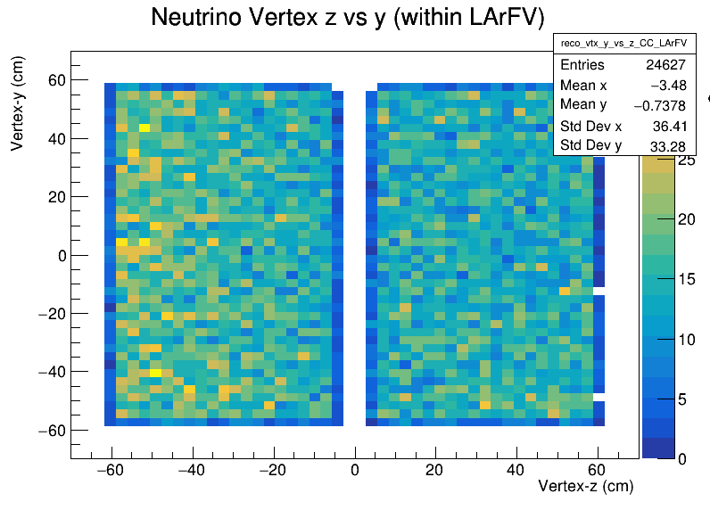
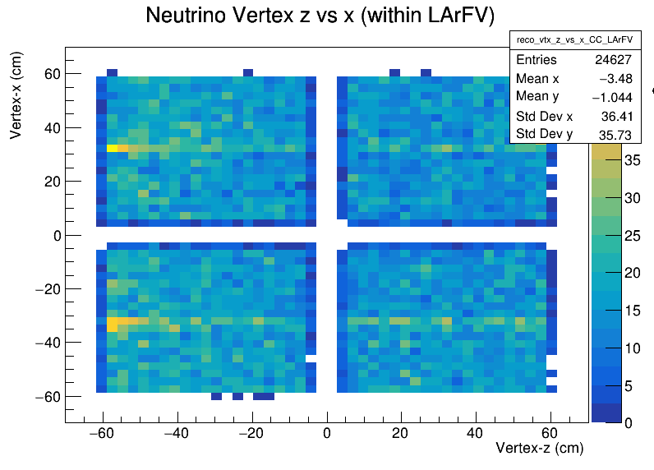
Neutrino Interaction Vertices
Neutrino interaction vertices, for reconstructed data and reconstructed MC simulation, are shown within LArFV.
Data-Reco ($x$ vs. $y$)
Data-Reco ($z$ vs. $y$)
Data-Reco ($z$ vs. $x$)
Sim-Reco ($x$ vs. $y$)
Sim-Reco ($z$ vs. $y$)
Sim-Reco ($z$ vs. $x$)

Slide 7
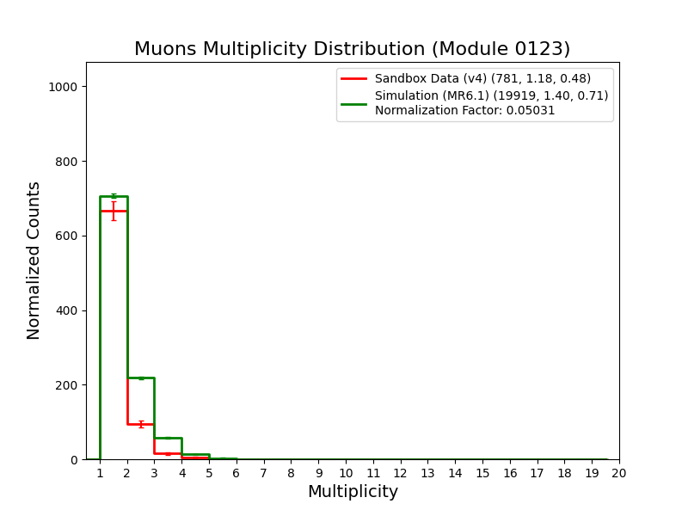
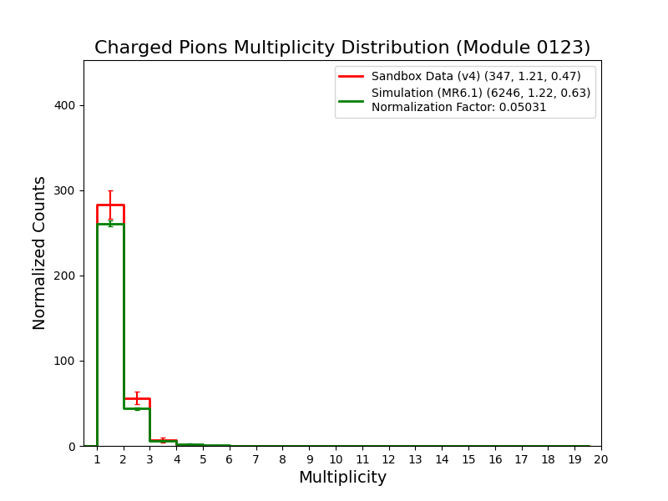
Individual Charged Track Multiplicity Distribution (All Modules)
Multiplicity distribution for muons, charged pions, protons, and kaons with the full event selection, is shown.
Normalization is applied based on the total charged track multiplicity.
There are multiple muon candidates can be seen in the muon distribution.
Muons
Charged Pions
Tracks
Data: 922
MC: 27790
Scaled MC: 1398
Tracks
Data: 420
MC: 7647
Scaled MC: 385

Slide 8
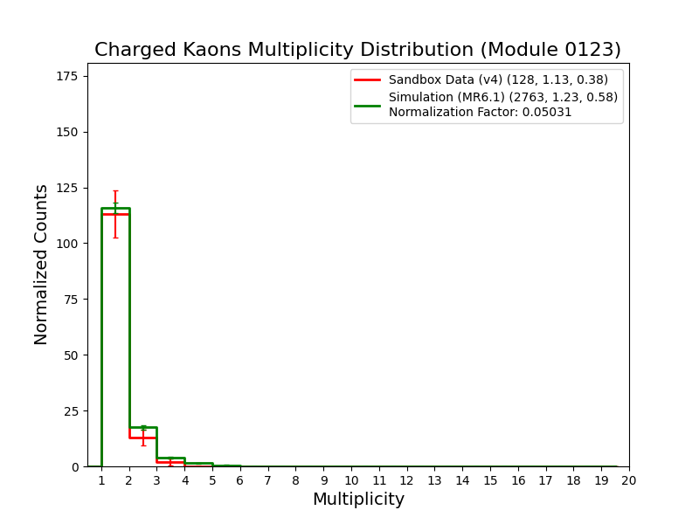
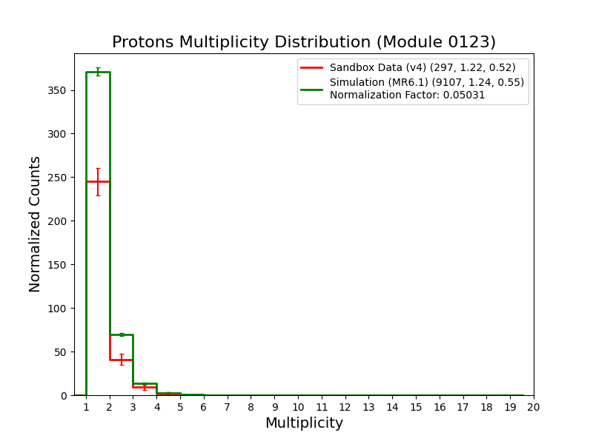
Individual Charged Track Multiplicity Distribution (All Modules) [contd.]
Multiplicity distribution for muons, charged pions, protons, and kaons with the full event selection, is shown.
Normalization is applied based on the total charged track multiplicity.
Charged Kaons
Protons
Tracks
Data: 145
MC: 3387
Scaled MC: 170
Tracks
Data: 362
MC: 11270
Scaled MC: 567

