Slide 1
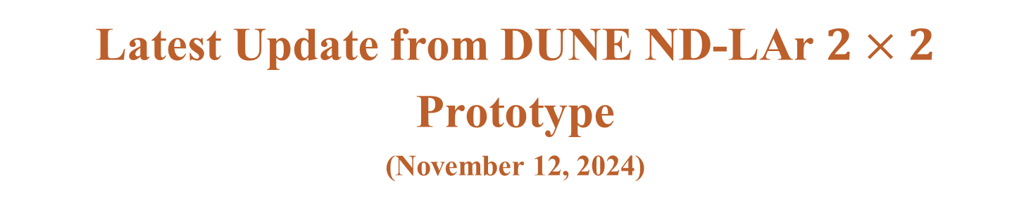
Latest Update from DUNE ND-LAr $2×2$ Prototype
(November 12, 2024)
M. Bilal Azam, Zelimir Djurcic et. al.

Slide 2
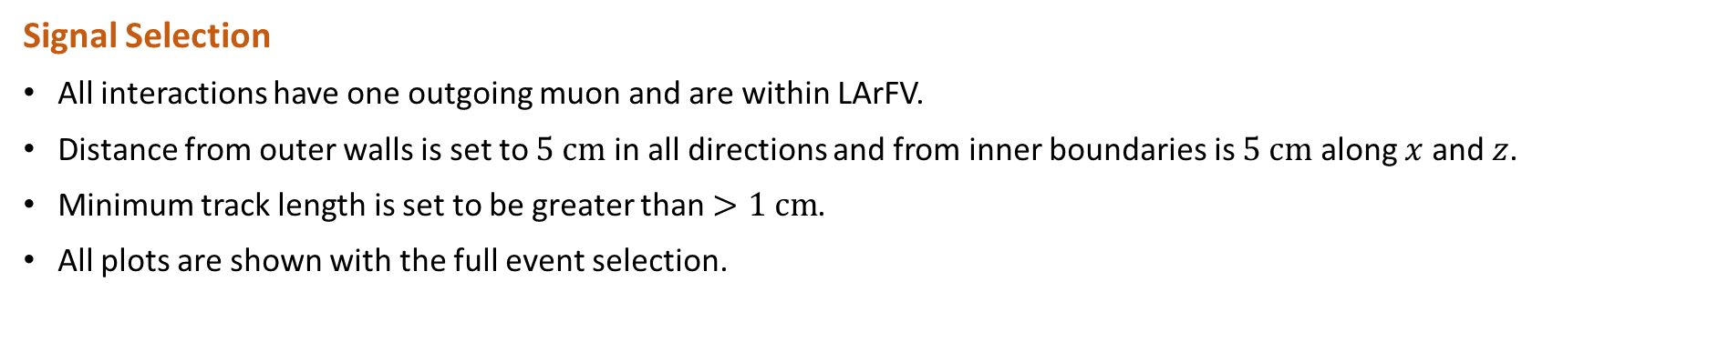
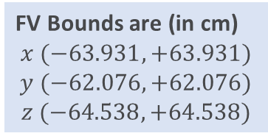
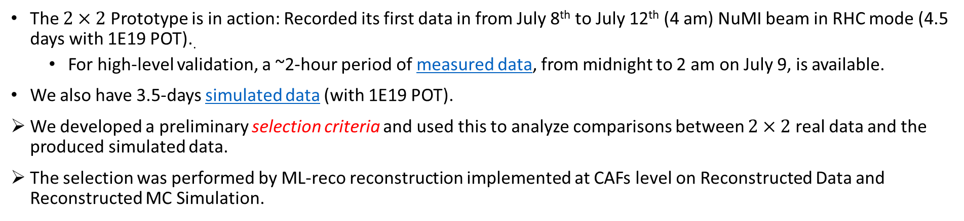
Current Status
The $2×2$ Prototype is in action: Recorded its first data in from July 8th to July 12th (4 am) NuMI beam in RHC mode (4.5 days with 1E19 POT)..
For high-level validation, a ~2-hour period of measured data, from midnight to 2 am on July 9, is available.
We also have 3.5-days simulated data (with 1E19 POT).
We developed a preliminary selection criteria and used this to analyze comparisons between $2×2$ real data and the produced simulated data.
The selection was performed by ML-reco reconstruction implemented at CAFs level on Reconstructed Data and Reconstructed MC Simulation.
Signal Selection
All interactions have one outgoing muon and are within LArFV.
Distance from outer walls is set to $5 cm$ in all directions and from inner boundaries is $5 cm$ along $x$ and $z$.
Minimum track length is set to be greater than $>1 cm$.
All plots are shown with the full event selection.
FV Bounds are (in cm)
$$x (−63.931,+63.931)$$
$$y (−62.076, +62.076)$$
$$z (−64.538,+64.538)$$
2

Slide 3
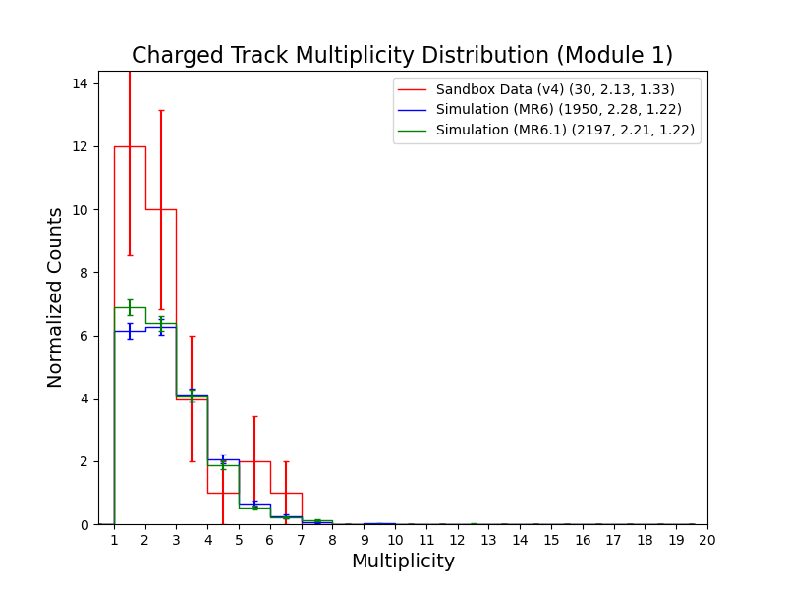
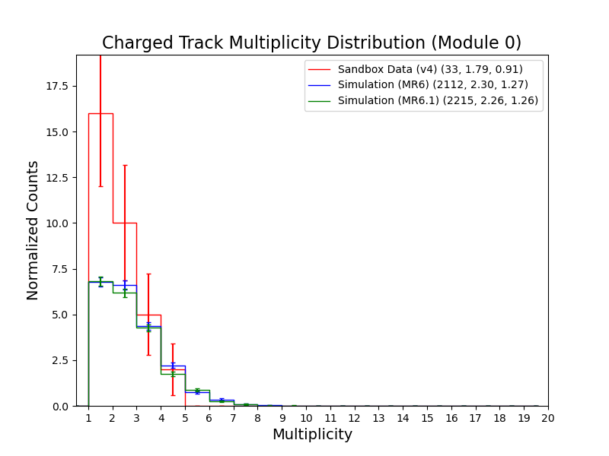
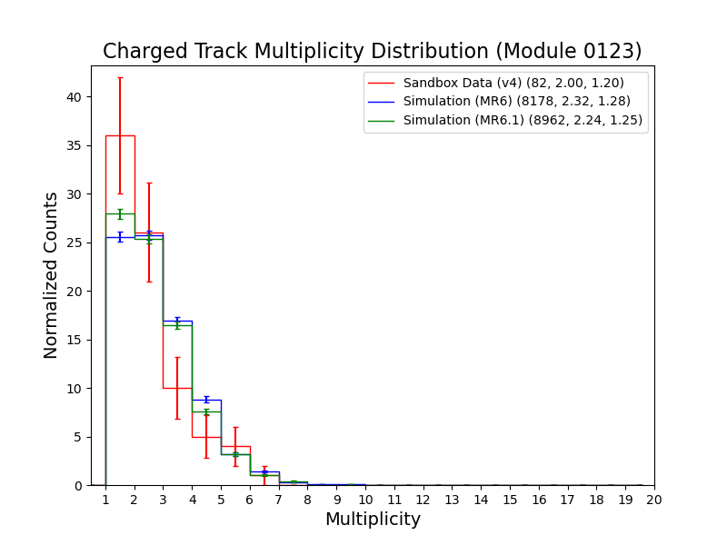
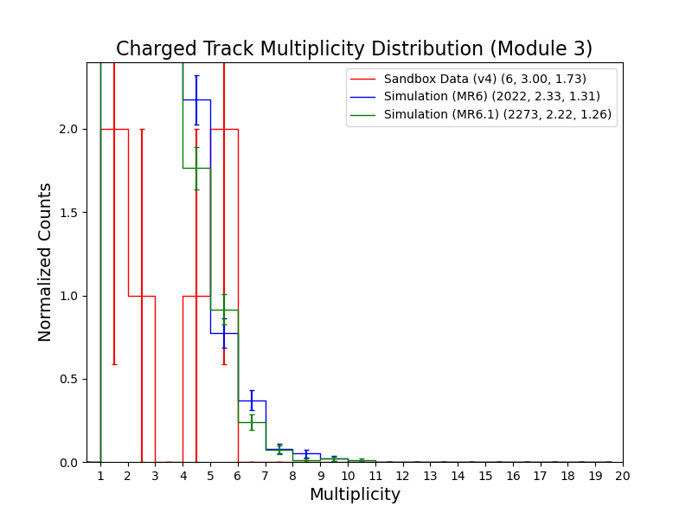
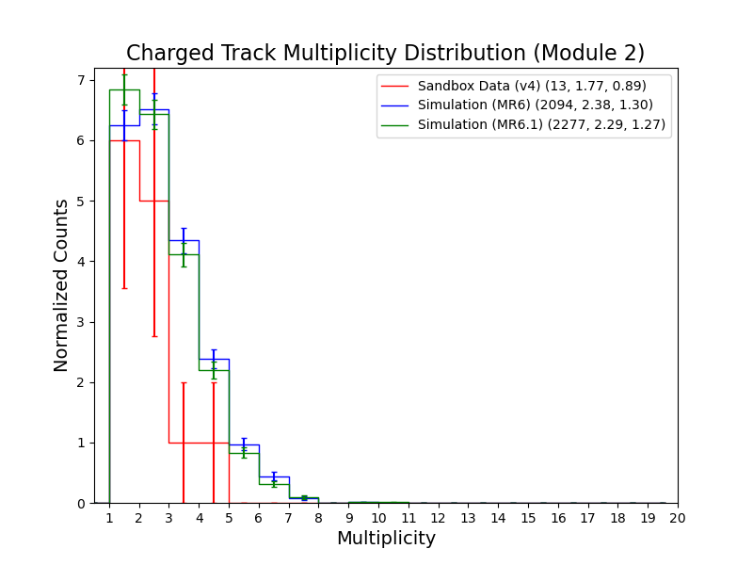
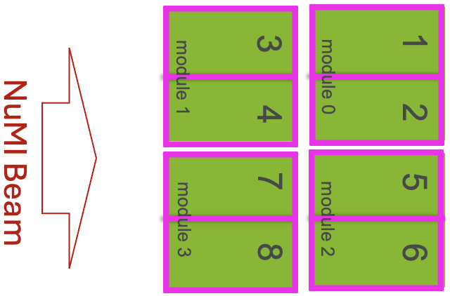
Charged Track Multiplicity Distribution (Module-by-Module Basis)
Multiplicity distribution for charged tracks (muons, protons, charged pions, kaons), with the full event selection, is shown on module-by-module basis.
Data
and
Simulation

Slide 4
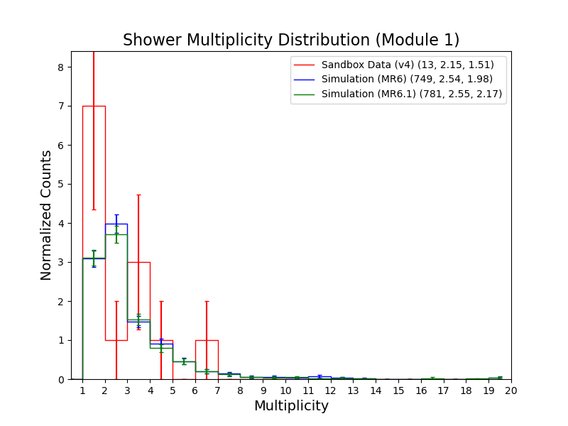
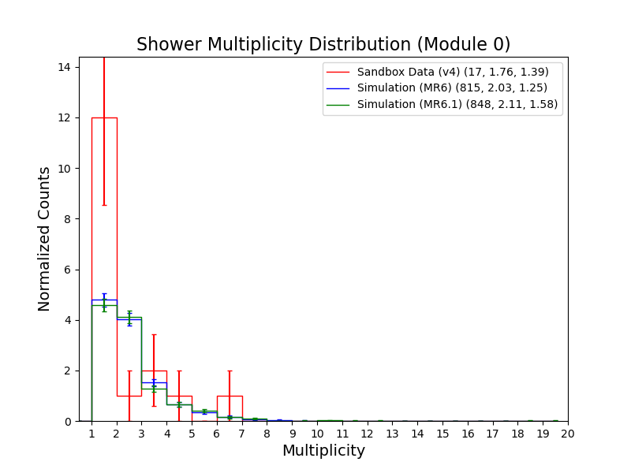
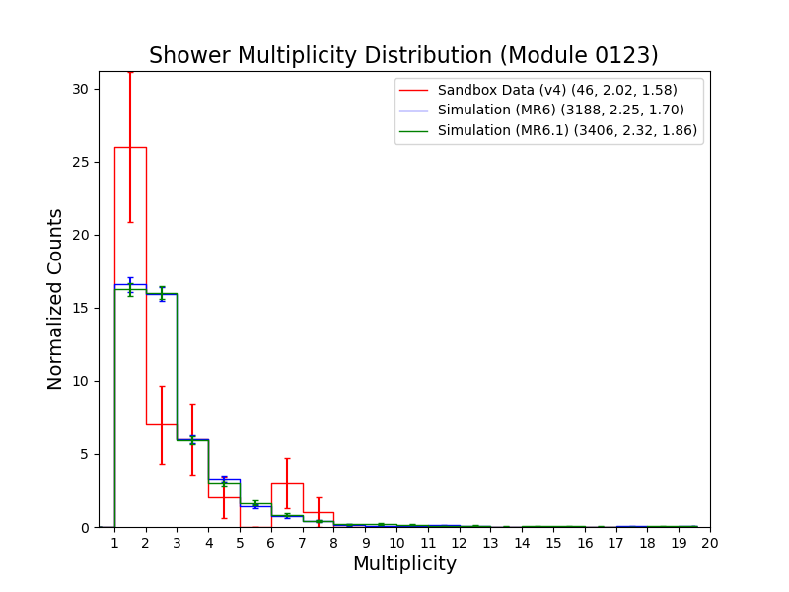
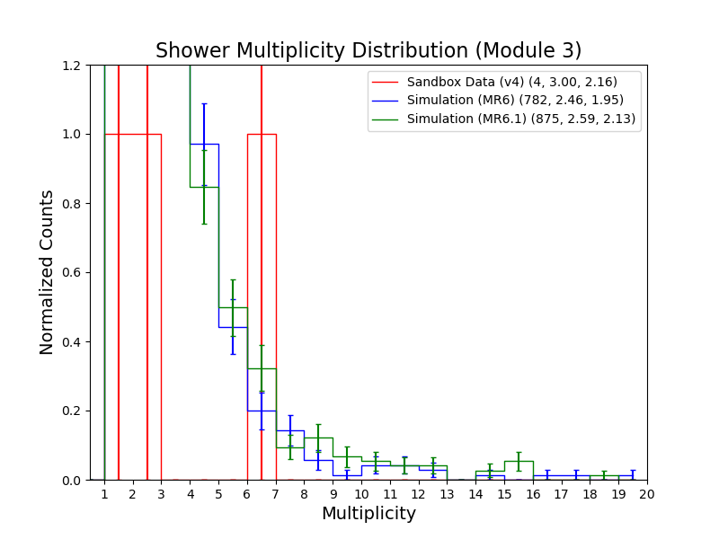
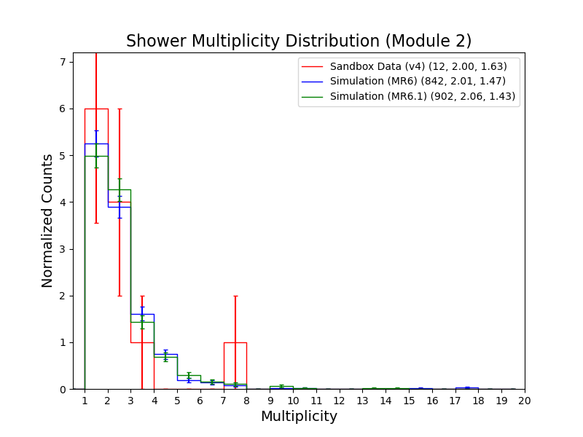
Shower Multiplicity Distribution (Module-by-Module Basis)
Multiplicity distribution for showers (electrons, photons), with the full event selection, is shown on module-by-module basis.
Data
and
Simulation
Track-shower separation need to be understood.

Slide 5
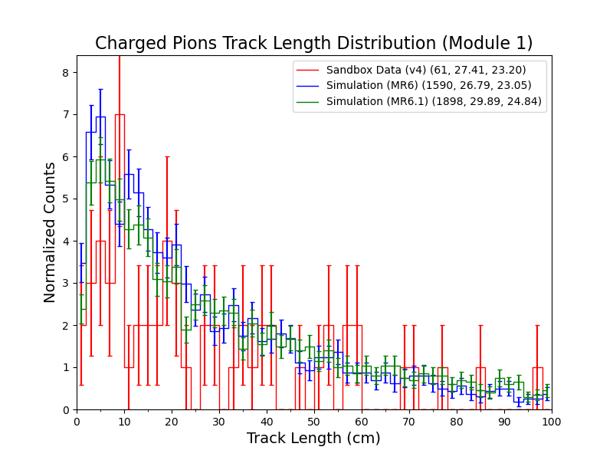
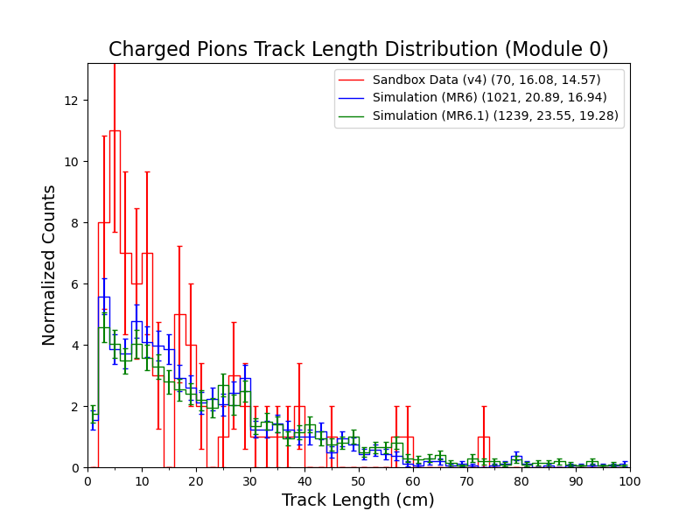
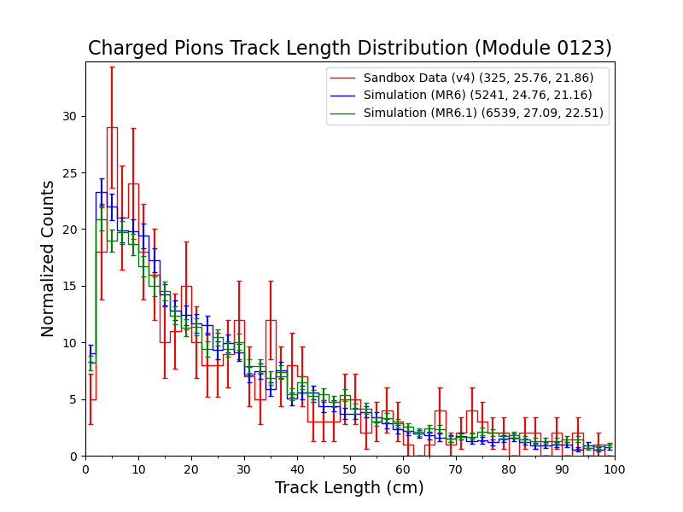
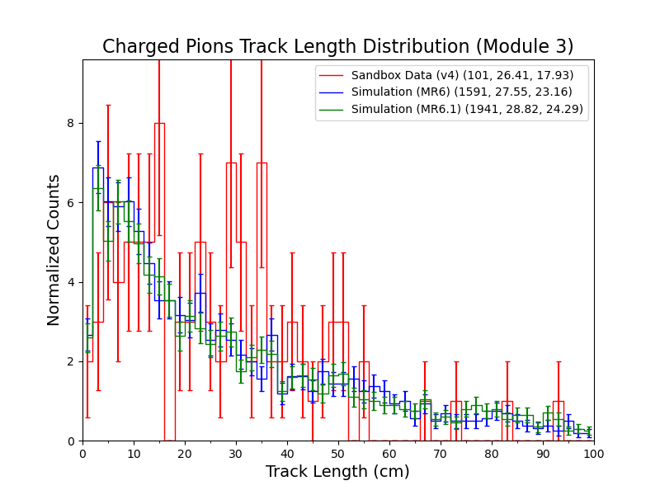
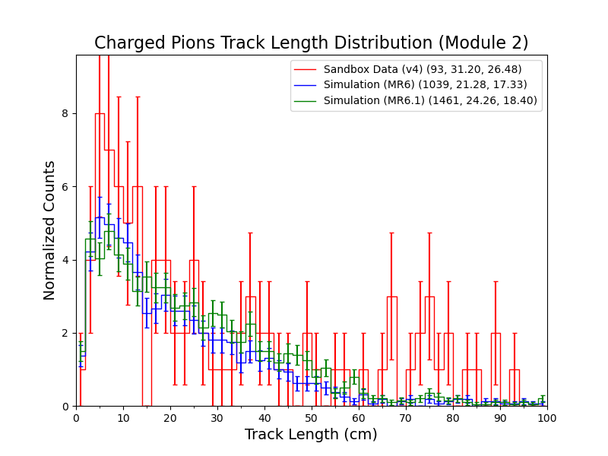
Track Length Distribution of Charged Pions (Module-by-Module Basis)
Track length distribution for charged pions, with the full event selection, is shown on module-by-module basis.
Data
and
Simulation

Slide 6
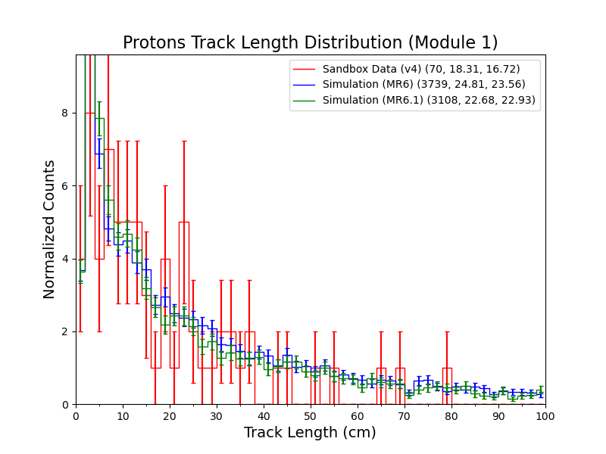
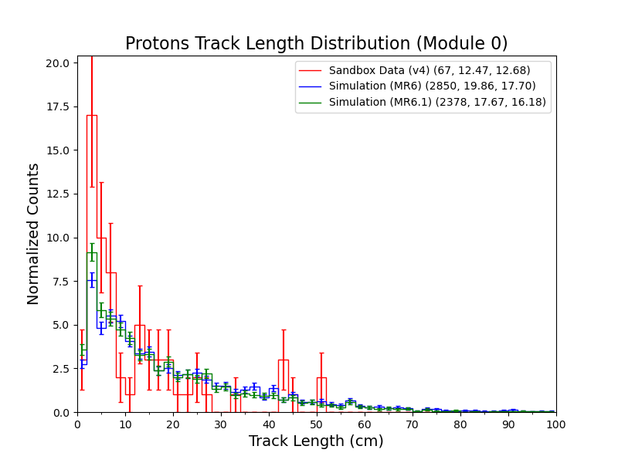
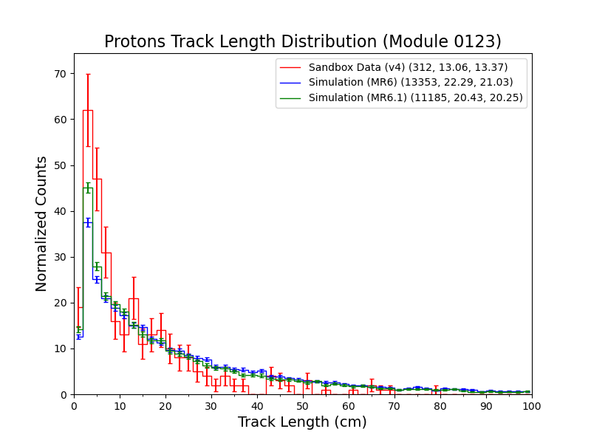
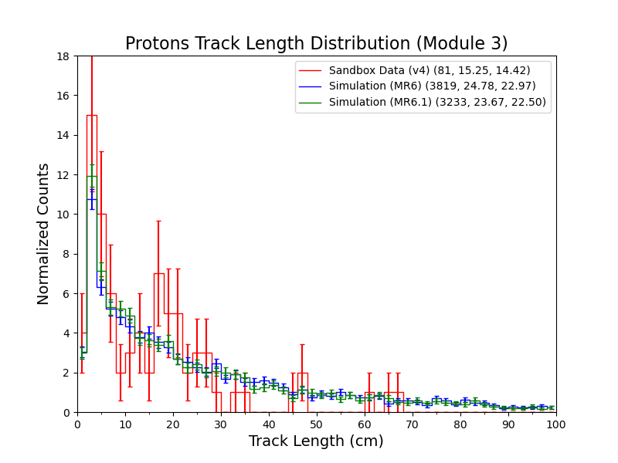
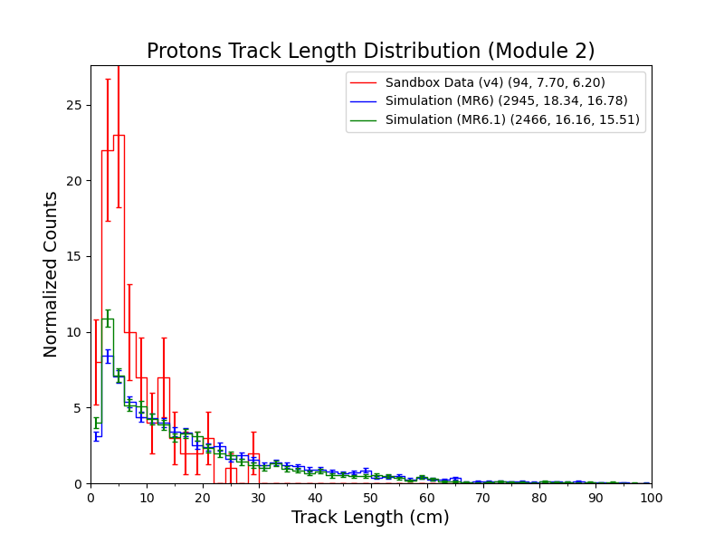
Track Length Distribution of Protons (Module-by-Module Basis)
Track length distribution for protons, with the full event selection, is shown on module-by-module basis.
Data
and
Simulation

Slide 7
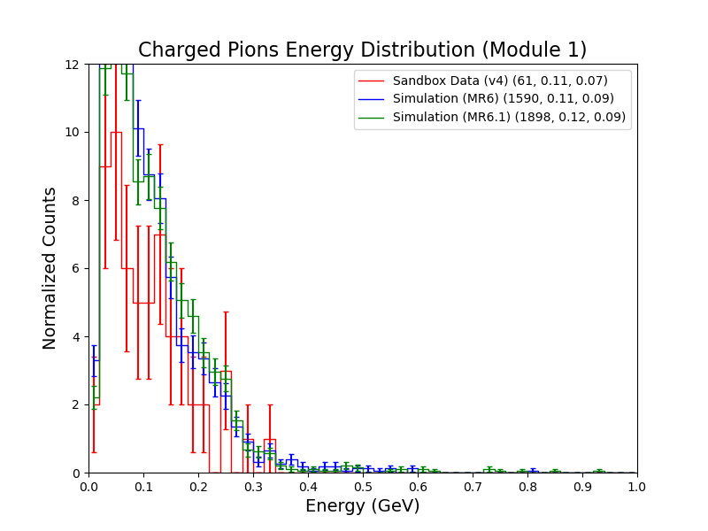
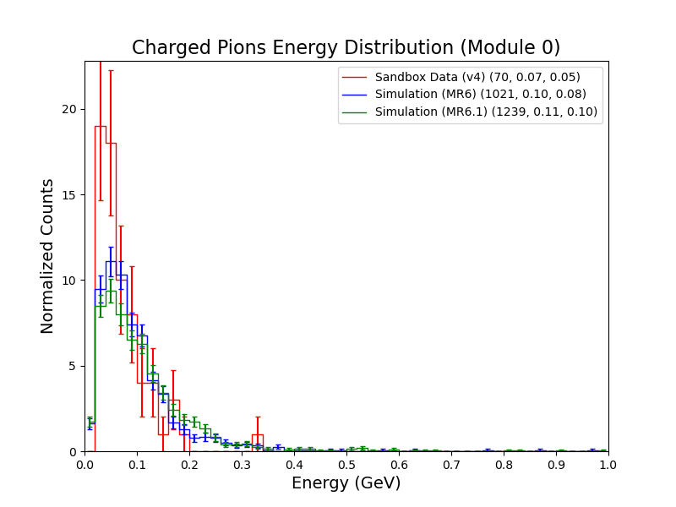
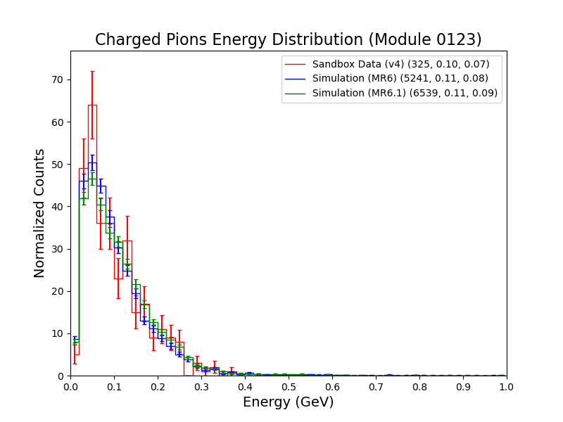
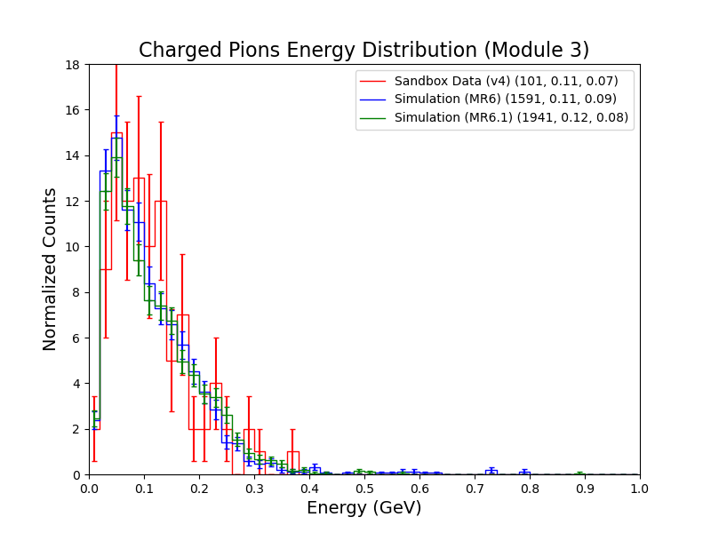
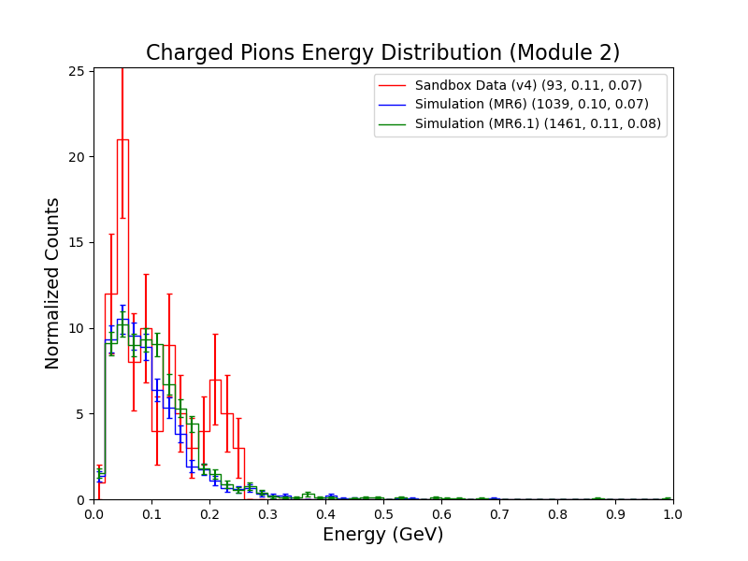
Energy Distribution of Charged Pions (Module-by-Module Basis)
Energy distribution for charged pions, with the full event selection, is shown on module-by-module basis.
Data
and
Simulation

Slide 8
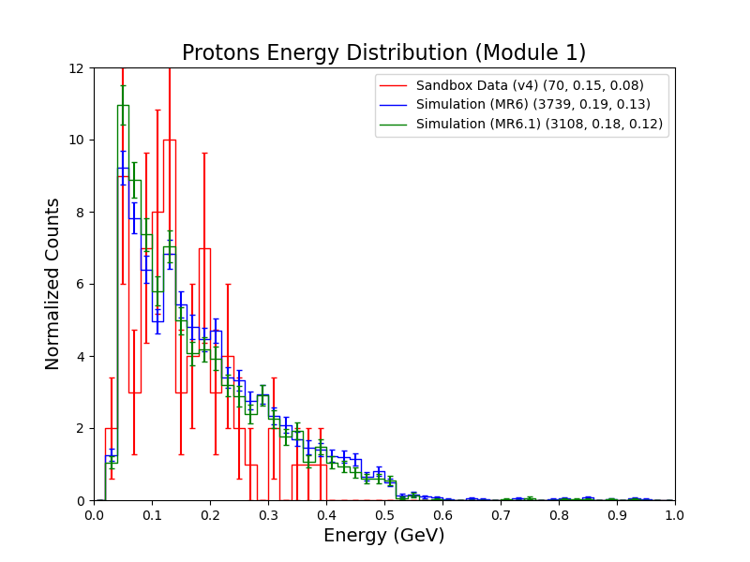
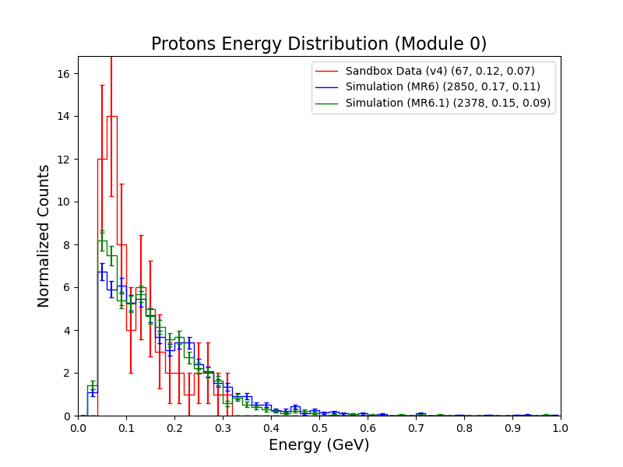
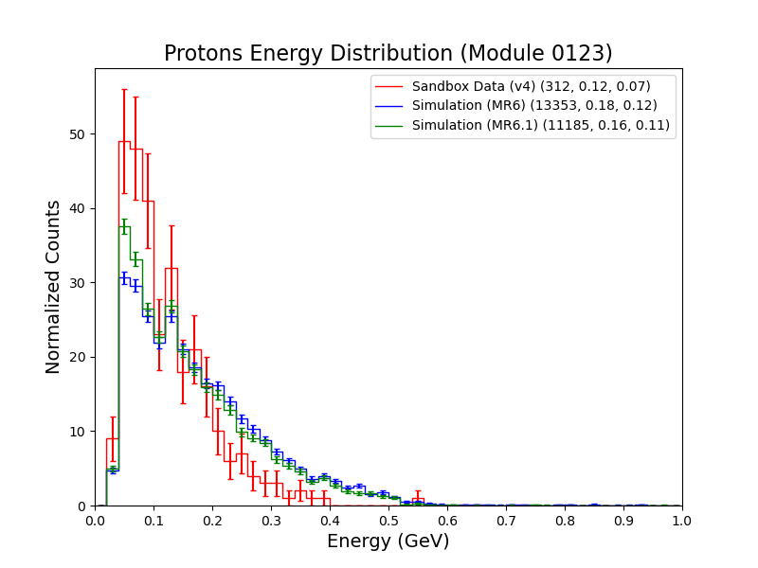
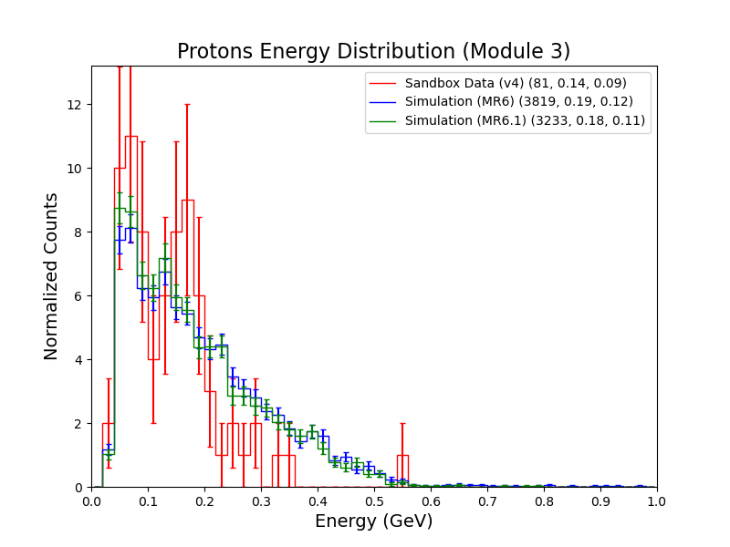
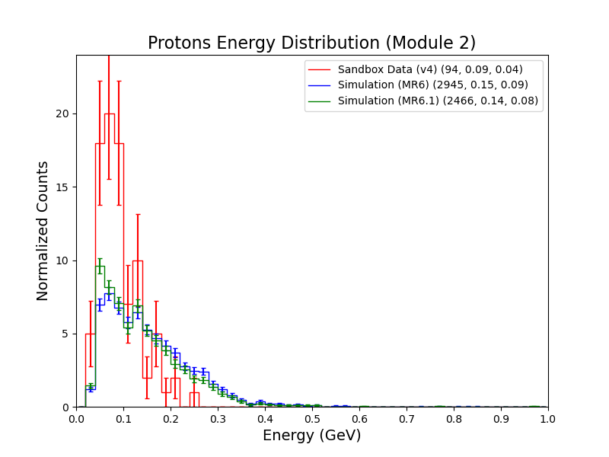
Energy Distribution of Protons (Module-by-Module Basis)
Energy distribution for protons, with the full event selection, is shown on module-by-module basis.
Data
and
Simulation

Slide 9
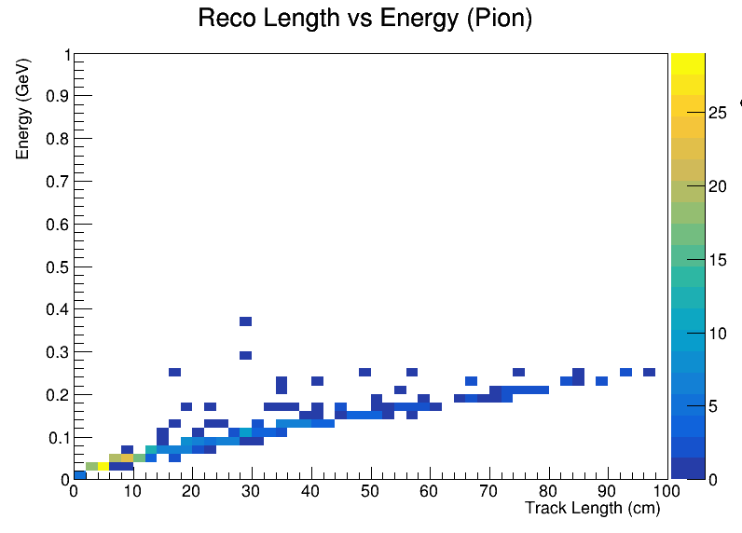
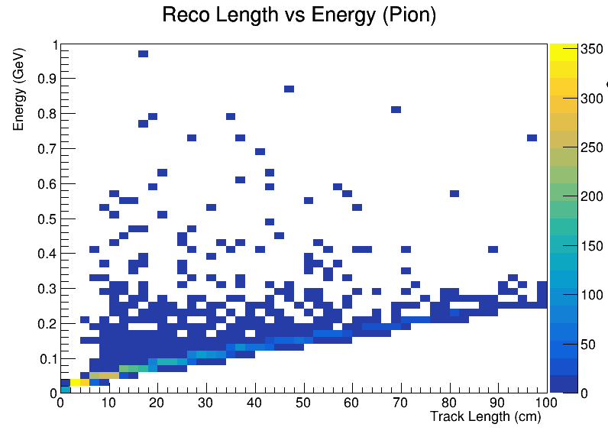
Track Length vs Energy Distribution of Charged Pions
This distribution is from all modules.
Data
Simulation (MR6)

Slide 10
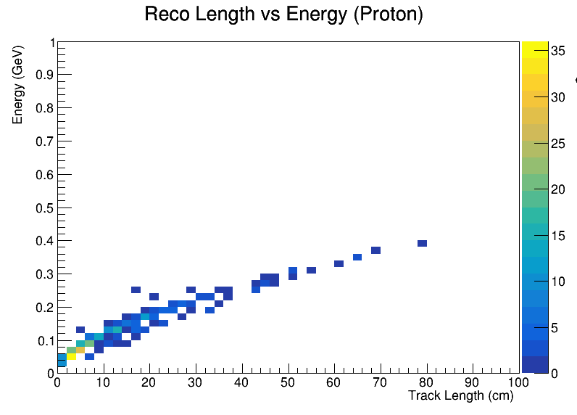
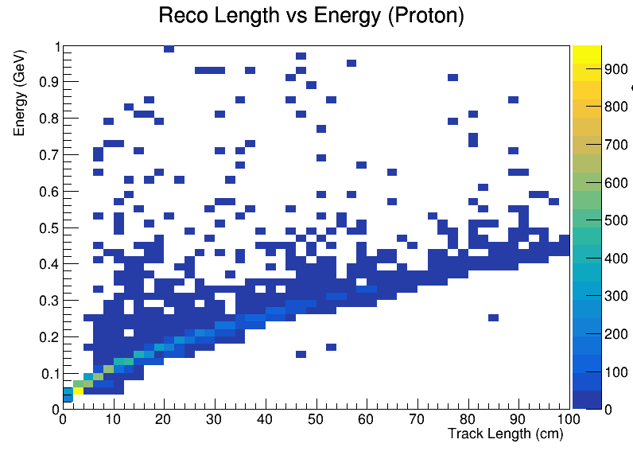
Track Length vs Energy Distribution of Protons
This distribution is from all modules.
Data
Simulation (MR6)

Slide 11
Our Next Task on ML-Reco
We are looking at the aggregation of tracks.
We have POLARIS setup with ML-Reco software, and by now we tested the training and inference on GPU using small files and official DUNE training files.

Slide 12
Backup Slides

Slide 13
Data/MC Comparisons of Kinematic Variables
In the next slides, we are presenting comparisons between some kinematic variables of charged hadrons, for low-level studies.
These distributions include track length, energy and angular variables. For now, I am showing track length and energy distributions in next slides.

