Slide 1
Selection Criteria for Incident Neutrino Beam Energy (MiniRun4_RHC)
Path: /pnfs/dune/tape_backed/users/mkramer/prod/MiniRun4/MiniRun4_1E19_RHC/MiniRun4_1E19_RHC.flow/FLOW
Files: MiniRun4_1E19_RHC.flow.{i:05}.FLOW.h5 (1024 files)
Dataset: /mc_truth/interactions/data
vertex: the position of the interaction vertex (x,y,z,t) in [cm]
target: the Z value of the struck nucleus
isCC: True if charged-current event, False if neutral-current event
isQES: quasi-elastic
isMEC: meson-exchange current (also known as multi-nucleon)
isRES: resonant pion production
isDIS: deep inelastic scattering
isCOH: coherent scattering
Enu: incident neutrino energy in [MeV]

Slide 2
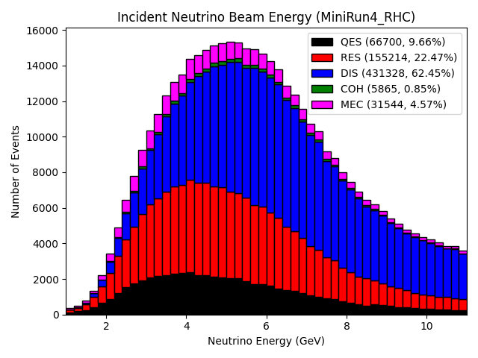

Incident Neutrino Beam Energy (MiniRun4_RHC)
All Events
All CC Events

Slide 3
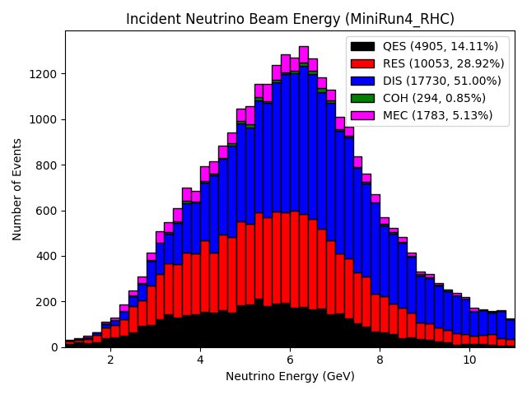
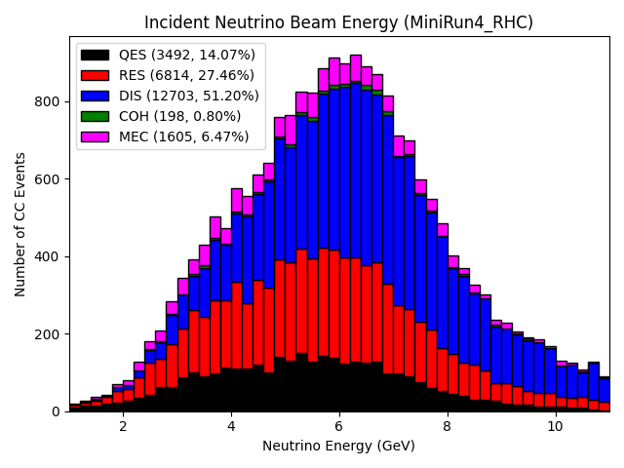
Incident Neutrino Beam Energy (MiniRun4_RHC)
The center of the 2x2 LArTPC is at (0, -268, 1300) cm in (x, y, z).
-67 < x < +67
-335 < y < -201
+1233 < z < +1367
All Events within FV
All CC Events within FV

Slide 4
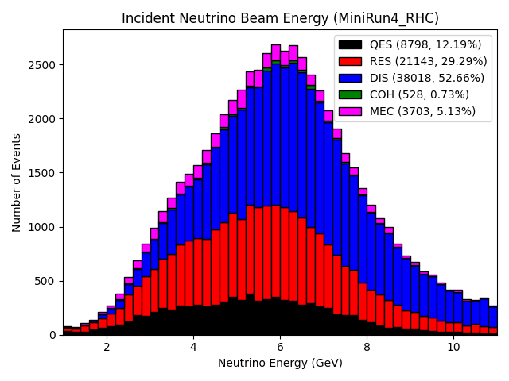
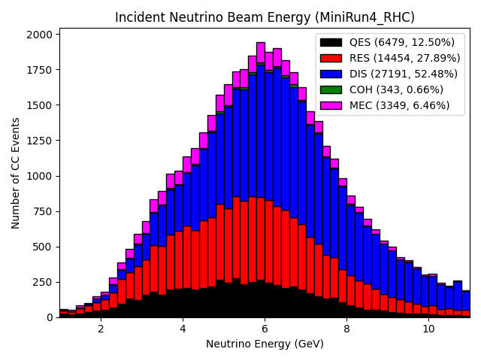
Incident Neutrino Beam Energy (MiniRun4_RHC)
All Events (for Z = 18)
All CC Events (for Z = 18)

Slide 5
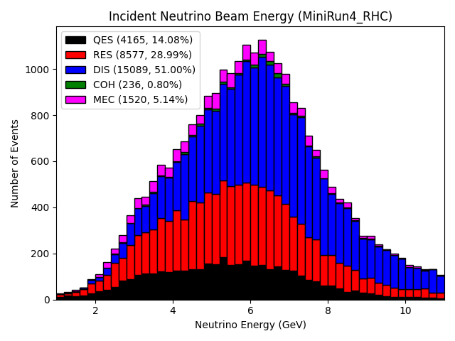
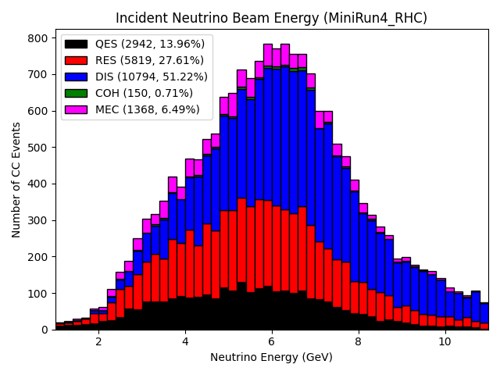
Incident Neutrino Beam Energy (MiniRun4_RHC)
The center of the 2x2 LArTPC is at (0, -268, 1300) cm in (x, y, z).
-67 < x < +67
-335 < y < -201
+1233 < z < +1367
All Events within FV (for Z = 18)
All CC Events within FV (for Z = 18)

Slide 6
Comparison (MiniRun4_RHC)
Number of Incident Neutrinos
Type | All Events | All CC Events | All Events within FV | All CC Events within FV
QES | 66700 | 60685 | 4905 | 3492
RES | 155214 | 125758 | 10053 | 6814
DIS | 431328 | 342593 | 17730 | 12703
COH | 5865 | 4922 | 294 | 198
MEC | 31544 | 30295 | 1783 | 1605
Total | 690651 | 564253 | 34765 | 24812
Number of Incident Neutrinos (target = 18)
Type | All Events | All CC Events | All Events within FV | All CC Events within FV
QES | 8798 | 6479 | 4165 | 2942
RES | 21143 | 14454 | 8577 | 5819
DIS | 38018 | 27191 | 15089 | 10794
COH | 528 | 343 | 236 | 150
MEC | 3703 | 3349 | 1520 | 1368
Total | 72190 | 51816 | 29587 | 21073

