Slide 1



Module 2: Machine Learning, Finding Patterns
Instructor: M Bilal Shaikh
Course : Data Mining
M.Phil (Information Technology) Spring 2017
IICT, University of Sindh
Courtesy : Gregory Piatetsky-Shapiro/KDnuggets

Slide 2
Outline
Machine learning and Classification
Examples
*Learning as Search
Bias
Weka
‹#›

Slide 3
Finding patterns
Goal: programs that detect patterns and regularities in the data
Strong patterns ⇒ good predictions
Problem 1: most patterns are not interesting
Problem 2: patterns may be inexact (or spurious)
Problem 3: data may be garbled or missing
‹#›

Slide 4
Machine learning techniques
Algorithms for acquiring structural descriptions from examples
Structural descriptions represent patterns explicitly
Can be used to predict outcome in new situation
Can be used to understand and explain how prediction is derived (may be even more important)
Methods originate from artificial intelligence, statistics, and research on databases
witten&eibe
‹#›

Slide 5
Can machines really learn?
Definitions of “learning” from dictionary:
To get knowledge of by study, experience, or being taught
To become aware by information or from observation
To commit to memory
To be informed of, ascertain(settle/fix); to receive instruction
Difficult to measure
Trivial(little value) for computers
Operational definition:
Things learn when they change their behavior in a way that makes them perform better in the future.
Does a slipper learn?
Does learning imply intention?
witten&eibe
‹#›

Slide 6
Classification
Learn a method for predicting the instance class from pre-labeled (classified) instances
Many approaches: Regression,
Decision Trees,
Bayesian,
Neural Networks,
...
Given a set of points from classes
what is the class of new point ?
‹#›

Slide 7
Classification: Linear Regression
Linear Regression
w₀ + w₁ x + w₂ y >= 0
Regression computes wi from data to minimize squared error to ‘fit’ the data
Not flexible enough
‹#›

Slide 8
Squared Erroror Mean squared error (MSE) or Mean Squared deviation (MSD)
In statistics, the mean squared error (MSE) or meansquared deviation (MSD) of an estimator (of a procedure for estimating an unobserved quantity) measures the average of the squares of the errors or deviations—that is, the difference between the estimator and what is estimated.
How to Calculate Squared Error
Find the regression line.
Insert your X values into the linear regression equation to find the new Y values (Y').
Subtract the new Y value from the original to get the error.
Square the errors.
Add up the errors.
Find the mean.

Slide 9
Classification: Decision Trees
if X > 5 then blue
else if Y > 3 then blue
else if X > 2 then green
else blue
Y
3
2
5
X
‹#›

Slide 10
Classification: Neural Networks
Can select more complex regions
Can be more accurate
Also can overfit the data – find patterns in random noise
‹#›

Slide 11
Noise and Overfitting
Noise is a random fluctuation in an electrical signal, a characteristic of all electronic circuits.
In overfitting, a statistical model describes random error or noise instead of the underlying relationship.Overfitting occurs when a model is excessively complex, such as having too many parameters relative to the number of observations.
Use of Overfitting & Underfitting
We don’t encounter underfitting very often. Data sets that are used for predictive modelling nowadays often come with too many predictors, not too few. Nonetheless, when building any model in machine learning for predictive modelling, use validation or cross-validation to assess predictive accuracy – whether you are trying to avoid overfitting or underfitting.

Slide 12
Overfitting vs Underfitting
Overfitting occurs when a statistical model or machine learning algorithm captures the noise of the data.
Intuitively, overfitting occurs when the model or the algorithm fits the data too well. Specifically, overfitting occurs if the model or algorithm shows low bias but high variance. Overfitting is often a result of an excessively complicated model, and it can be prevented by fitting multiple models and using validation or cross-validation to compare their predictive accuracies on test data.
Underfitting occurs when a statistical model or machine learning algorithm cannot capture the underlying trend of the data. Intuitively, underfitting occurs when the model or the algorithm does not fit the data well enough. Specifically, underfitting occurs if the model or algorithm shows low variance but high bias. Underfitting is often a result of an excessively simple model.
Both overfitting and underfitting lead to poor predictions on new data sets.
In my experience with statistics and machine learning

Slide 13
Outline
Machine learning and Classification
Examples
*Learning as Search
Bias
Weka
‹#›

Slide 14
The weather problem
Outlook | Temperature | Humidity | Windy | Play
sunny | hot | high | false | no
sunny | hot | high | true | no
overcast | hot | high | false | yes
rainy | mild | high | false | yes
rainy | mild | normal | false | yes
rainy | mild | normal | true | no
overcast | mild | normal | true | yes
sunny | mild | high | false | no
sunny | mild | normal | false | yes
rainy | mild | normal | false | yes
sunny | mild | normal | true | yes
overcast | mild | high | true | yes
overcast | hot | normal | false | yes
rainy | mild | high | true | no
Given past data,
Can you come up
with the rules for
Play/Not Play ?
What is the game?
‹#›

Slide 15

The weather problem
Given this data, what are the rules for play/not play?
Outlook | Temperature | Humidity | Windy | Play
Sunny | Hot | High | False | No
Sunny | Hot | High | True | No
Overcast | Hot | High | False | Yes
Rainy | Mild | Normal | False | Yes
… | … | … | … | …
‹#›

Slide 16
The weather problem
Conditions for playing
Outlook | Temperature | Humidity | Windy | Play
Sunny | Hot | High | False | No
Sunny | Hot | High | True | No
Overcast | Hot | High | False | Yes
Rainy | Mild | Normal | False | Yes
… | … | … | … | …
If outlook = sunny and humidity = high then play = no If outlook = rainy and windy = true then play = no If outlook = overcast then play = yes If humidity = normal then play = yes If none of the above then play = yes
witten&eibe
‹#›

Slide 17
Weather data with mixed attributes
Outlook | Temperature | Humidity | Windy | Play
sunny | 85 | 85 | false | no
sunny | 80 | 90 | true | no
overcast | 83 | 86 | false | yes
rainy | 70 | 96 | false | yes
rainy | 68 | 80 | false | yes
rainy | 65 | 70 | true | no
overcast | 64 | 65 | true | yes
sunny | 72 | 95 | false | no
sunny | 69 | 70 | false | yes
rainy | 75 | 80 | false | yes
sunny | 75 | 70 | true | yes
overcast | 72 | 90 | true | yes
overcast | 81 | 75 | false | yes
rainy | 71 | 91 | true | no
‹#›

Slide 18
Weather data with mixed attributes
How will the rules change when some attributes have numeric values?
Outlook | Temperature | Humidity | Windy | Play
Sunny | 85 | 85 | False | No
Sunny | 80 | 90 | True | No
Overcast | 83 | 86 | False | Yes
Rainy | 75 | 80 | False | Yes
… | … | … | … | …
‹#›

Slide 19
Weather data with mixed attributes
Rules with mixed attributes
Outlook | Temperature | Humidity | Windy | Play
Sunny | 85 | 85 | False | No
Sunny | 80 | 90 | True | No
Overcast | 83 | 86 | False | Yes
Rainy | 75 | 80 | False | Yes
… | … | … | … | …
If outlook = sunny and humidity > 83 then play = no If outlook = rainy and windy = true then play = no If outlook = overcast then play = yes If humidity < 85 then play = yes If none of the above then play = yes
witten&eibe
‹#›

Slide 20
The contact lenses data
Age | Spectacle prescription | Astigmatism | Tear production rate | Recommended lenses
Young | Myope | No | Reduced | None
Young | Myope | No | Normal | Soft
Young | Myope | Yes | Reduced | None
Young | Myope | Yes | Normal | Hard
Young | Hypermetrope | No | Reduced | None
Young | Hypermetrope | No | Normal | Soft
Young | Hypermetrope | Yes | Reduced | None
Young | Hypermetrope | Yes | Normal | hard
Pre-presbyopic | Myope | No | Reduced | None
Pre-presbyopic | Myope | No | Normal | Soft
Pre-presbyopic | Myope | Yes | Reduced | None
Pre-presbyopic | Myope | Yes | Normal | Hard
Pre-presbyopic | Hypermetrope | No | Reduced | None
Pre-presbyopic | Hypermetrope | No | Normal | Soft
Pre-presbyopic | Hypermetrope | Yes | Reduced | None
Pre-presbyopic | Hypermetrope | Yes | Normal | None
Presbyopic | Myope | No | Reduced | None
Presbyopic | Myope | No | Normal | None
Presbyopic | Myope | Yes | Reduced | None
Presbyopic | Myope | Yes | Normal | Hard
Presbyopic | Hypermetrope | No | Reduced | None
Presbyopic | Hypermetrope | No | Normal | Soft
Presbyopic | Hypermetrope | Yes | Reduced | None
Presbyopic | Hypermetrope | Yes | Normal | None
witten&eibe
‹#›

Slide 21
A complete and correct rule set
If tear production rate = reduced then recommendation = none If age = young and astigmatic = no and tear production rate = normal then recommendation = soft If age = pre-presbyopic and astigmatic = no and tear production rate = normal then recommendation = soft If age = presbyopic and spectacle prescription = myope and astigmatic = no then recommendation = none If spectacle prescription = hypermetrope and astigmatic = no and tear production rate = normal then recommendation = soft If spectacle prescription = myope and astigmatic = yes and tear production rate = normal then recommendation = hard If age young and astigmatic = yes and tear production rate = normal then recommendation = hard If age = pre-presbyopic and spectacle prescription = hypermetrope and astigmatic = yes then recommendation = none If age = presbyopic and spectacle prescription = hypermetrope and astigmatic = yes then recommendation = none
witten&eibe
‹#›

Slide 22
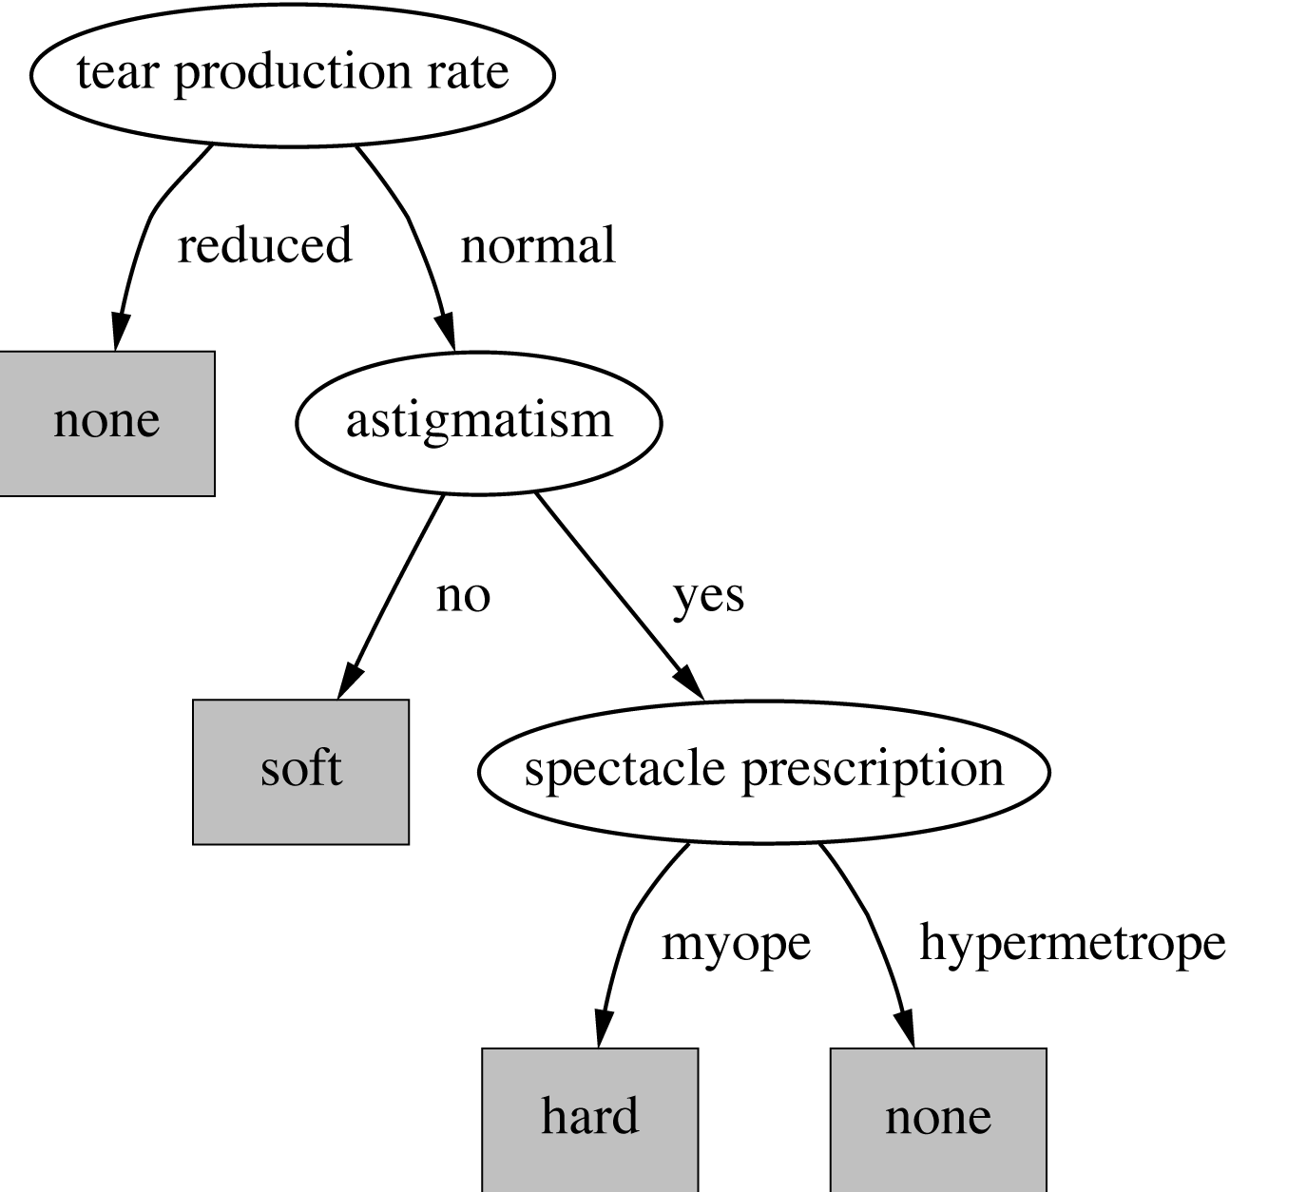
A decision tree for this problem
witten&eibe
‹#›

Slide 23

Classifying iris flowers
 | Sepal length | Sepal width | Petal length | Petal width | Type
1 | 5.1 | 3.5 | 1.4 | 0.2 | Iris setosa
2 | 4.9 | 3.0 | 1.4 | 0.2 | Iris setosa
…
51 | 7.0 | 3.2 | 4.7 | 1.4 | Iris versicolor
52 | 6.4 | 3.2 | 4.5 | 1.5 | Iris versicolor
…
101 | 6.3 | 3.3 | 6.0 | 2.5 | Iris virginica
102 | 5.8 | 2.7 | 5.1 | 1.9 | Iris virginica
…
If petal length < 2.45 then Iris setosa If sepal width < 2.10 then Iris versicolor ...
witten&eibe
‹#›

Slide 24
Predicting CPU performance
Example: 209 different computer configurations
Linear regression function
 | Cycle time (ns) | Main memory (Kb) |  | Cache (Kb) | Channels |  | Performance
 | MYCT | MMIN | MMAX | CACH | CHMIN | CHMAX | PRP
1 | 125 | 256 | 6000 | 256 | 16 | 128 | 198
2 | 29 | 8000 | 32000 | 32 | 8 | 32 | 269
…
208 | 480 | 512 | 8000 | 32 | 0 | 0 | 67
209 | 480 | 1000 | 4000 | 0 | 0 | 0 | 45
PRP = -55.9 + 0.0489 MYCT + 0.0153 MMIN + 0.0056 MMAX + 0.6410 CACH - 0.2700 CHMIN + 1.480 CHMAX
witten&eibe
‹#›

Slide 25
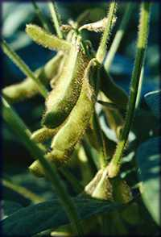
Soybean classification
 | Attribute | Number of values | Sample value
Environment | Time of occurrence | 7 | July
 | Precipitation | 3 | Above normal
…
Seed | Condition | 2 | Normal
 | Mold growth | 2 | Absent
…
Fruit | Condition of fruit pods | 4 | Normal
 | Fruit spots | 5 | ?
Leaves | Condition | 2 | Abnormal
 | Leaf spot size | 3 | ?
…
Stem | Condition | 2 | Abnormal
 | Stem lodging | 2 | Yes
…
Roots | Condition | 3 | Normal
Diagnosis |  | 19 | Diaporthe stem canker
witten&eibe
‹#›

Slide 26
The role of domain knowledge
If leaf condition is normal and stem condition is abnormal and stem cankers is below soil line and canker lesion color is brown then diagnosis is rhizoctonia root rot
If leaf malformation is absent and stem condition is abnormal and stem cankers is below soil line and canker lesion color is brown then diagnosis is rhizoctonia root rot
But in this domain, “leaf condition is normal” implies “leaf malformation is absent”!
witten&eibe
‹#›

Slide 27
Outline
Machine learning and Classification
Examples
*Learning as Search
Bias
Weka
‹#›

Slide 28
Learning as search
Inductive learning: find a concept description that fits the data
Example: rule sets as description language
Enormous, but finite, search space
Simple solution:
enumerate the concept space
eliminate descriptions that do not fit examples
surviving descriptions contain target concept
witten&eibe
‹#›

Slide 29
Enumerating the concept space
Search space for weather problem
4 x 4 x 3 x 3 x 2 = 288 possible combinations
With 14 rules ⇒ 2.7x10³⁴ possible rule sets
Solution: candidate-elimination algorithm
Other practical problems:
More than one description may survive
No description may survive
Language is unable to describe target concept
or data contains noise
witten&eibe
‹#›

Slide 30
The version space
Space of consistent concept descriptions
Completely determined by two sets
L: most specific descriptions that cover all positive examples and no negative ones
G: most general descriptions that do not cover any negative examples and all positive ones
Only L and G need be maintained and updated
But: still computationally very expensive
And: does not solve other practical problems
witten&eibe
‹#›

Slide 31
*Version space example, 1
Given: red or green cows or chicken
Start with: L={} G={<*, *>} First example: <green,cow>: positive How does this change L and G?
witten&eibe
‹#›

Slide 32
*Version space example, 2
Given: red or green cows or chicken
Result: L={<green, cow>} G={<*, *>} Second example: <red,chicken>: negative
witten&eibe
‹#›

Slide 33
*Version space example, 3
Given: red or green cows or chicken
Result: L={<green, cow>} G={<green,*>,<*,cow>} Final example: <green, chicken>: positive
witten&eibe
‹#›

Slide 34
*Version space example, 4
Given: red or green cows or chicken
Resultant version space: L={<green, *>} G={<green, *>}
witten&eibe
‹#›

Slide 35
*Version space example, 5
Given: red or green cows or chicken
L={} G={<*, *>} <green,cow>: positive L={<green, cow>} G={<*, *>} <red,chicken>: negative L={<green, cow>} G={<green,*>,<*,cow>} <green, chicken>: positive L={<green, *>} G={<green, *>}
witten&eibe
‹#›

Slide 36
*Candidate-elimination algorithm
Initialize L and G For each example e: If e is positive: Delete all elements from G that do not cover e For each element r in L that does not cover e: Replace r by all of its most specific generalizations that 1. cover e and 2. are more specific than some element in G Remove elements from L that are more general than some other element in L If e is negative: Delete all elements from L that cover e For each element r in G that covers e: Replace r by all of its most general specializations that 1. do not cover e and 2. are more general than some element in L Remove elements from G that are more specific than some other element in G
witten&eibe
‹#›

Slide 37
Outline
Machine learning and Classification
Examples
*Learning as Search
Bias
Weka
‹#›

Slide 38
Bias
Important decisions in learning systems:
Concept description language
Order in which the space is searched
Way that overfitting to the particular training data is avoided
These form the “bias” of the search:
Language bias
Search bias
Overfitting-avoidance bias
witten&eibe
‹#›

Slide 39
Language bias
Important question:
is language universal or does it restrict what can be learned?
Universal language can express arbitrary(random) subsets of examples
If language includes logical or (“disjunction”), it is universal
Example: rule sets
Domain knowledge can be used to exclude some concept descriptions a priori from the search
a priori : relating to or denoting reasoning or knowledge which proceeds from theoretical deduction rather than from observation or experience. Latin “from what is come before”
witten&eibe
‹#›

Slide 40
Search bias
Search heuristic
“Greedy” search: performing the best single step
“Beam search”: keeping several alternatives
…
Direction of search
General-to-specific
E.g. specializing a rule by adding conditions
Specific-to-general
E.g. generalizing an individual instance into a rule
witten&eibe
‹#›

Slide 41
Overfitting-avoidance bias
Can be seen as a form of search bias
Modified evaluation criterion
E.g. balancing simplicity and number of errors
Modified search strategy
E.g. pruning (simplifying a description)
Pre-pruning: stops at a simple description before search proceeds to an overly complex one
Post-pruning: generates a complex description first and simplifies it afterwards
witten&eibe
‹#›

Slide 42
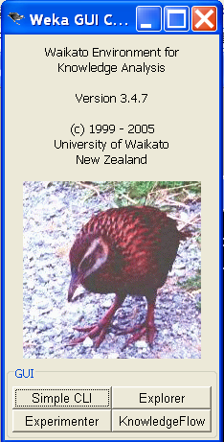
Weka ( Open Source ML Software)
New ML Areas
Wit.AI https://wit.ai/
Bigmo http://bigmo.com
Api.ai http://api.ai
‹#›

