Slide 1
RESTful (Web) Applications
In Practice
Nupul Kukreja
CS 578
7th November 2012

Slide 2
Agenda
REST – What/Why?
REST in Practice – How?
  Real life example ☺
Architectural styles commonly encountered when creating RESTful (web) systems
  Event Based
  MVC (Client/Server)
Data Abstraction Layers (patterns)
  Data Mapper
  Active Record

Slide 3
REST (REpresentational State Transfer)
The architectural style of the web
So what %&*@#$ does that even mean??
REST is a set of design criteria and not the physical structure (architecture) of the system
REST is not tied to the ‘Web’ i.e. doesn’t depend on the mechanics of HTTP
‘Web’ applications are the most prevalent – hence RESTful architectures run off of it
Notes:
Definition of rest in sync with 578 definition of software architecture ☺ - i.e. principal design decisions about a system

Slide 4
Understanding REST
Based on content from chapter #3 of:
RESTful Web Services (O’Reilly)
-Richardson & Ruby

Slide 5
Understanding REST – Resources
Anything that’s important enough to be referenced as a thing in itself
Something that can be stored on a computer and represented as a stream of bits:
  A document (e.g. information about USC)
  Row in DB (e.g. ‘User Profile’)
  Output of executing an algorithm (e.g. 100th Prime number or Google Search ☺)

Slide 6
URIs and Resources
URI is an ‘address’ of a resource
A resource must have at least one URI
No URI → Not a resource (i.e. it’s really not on the web, so to speak ☺)
URIs should be descriptive (human parseable) and have structure. For Example:
  http://www.ex.com/software/releases/latest.tar.gz
  http://www.ex.com/map/roads/USA/CA/17_mile_drive
  http://www.ex.com/search/cs578
  http://www.ex.com/sales/2012/Q1
  http://www.ex.com/relationships/Alice;Bob
Notes:
The forward slashes suggest a hierarchical breakdown

Slide 7
Resources and URIs (Cont’d)
Not so good URIs (everything as query parameters):
  http://www.ex.com?software=Prism&release=latest &filetype=tar&method=fetch
  http://www.ex.com?sessionId=123456789087654321234567876543234567865432345678876543&itemId=9AXFE5&method=addToCart
URIs need not have structure/predictability but are valuable (and easier) for the (human) clients to navigate through the application
May have multiple URIs to refer to same resource – convenient but confusing
Each URI must refer a unique resource – although they may point to the ‘same one’ at some point in time (Ex.: …/latest.tar.gz and …/v1.5.6.tar.gz)

Slide 8
Understanding REST - Addressability
An application is addressable if it exposes interesting aspects of its data set as resources
An addressable application exposes a URI for every piece of information it might conceivably serve (usually infinitely many ☺)
Most important from end-user perspective
Addressability allows one to bookmark URIs or embed them in presentations/books etc. Ex.:
  google.com/search?q=CS578+USC
  Instead of
    Go to www.google.com
    Enter ‘CS578 USC’ (without quotes in search box)
    Click ‘Search’ or hit the ‘Enter key’

Slide 9
REST Principle #1
The key abstraction of information is a resource, named by a URI. Any information that can be named can be a resource

Slide 10
Understanding REST - Statelessness
Every HTTP request happens in complete isolation
  Server NEVER relies on information from prior requests
  There is no specific ‘ordering’ of client requests (i.e. page 2 may be requested before page 1)
  If the server restarts a client can resend the request and continue from it left off
Possible states of a server are also resources and should be given their own URIs!
Notes:
Stateful examples: Disabled ‘back button’ in browser when filling a form etc. that needs to be filled in a specific order and the application disallows you to go to a previous ‘state’ in essence.
Statelessness: Assume that the client requests a document 100 pages long and the server only returns 1 page at a time. To request subsequent pages the client makes more HTTP requests. Each page is a distinct ‘state’ of the application and the URIs could (should) be designed as: www.ex.com/some-long-report?page=10 – this way you may bookmark the state or send it to someone or embed it in a document etc. The user is not forced to view a sequential order of the pages. The ‘state’ of the application (i.e. on page 10) has now been exposed as a resource.

Slide 11
REST Principle #2*
All interactions are context-free: each interaction contains all of the information necessary to understand the request, independent of any requests that may have preceded it.
*RP #3 as per 578 Lecture slides

Slide 12
Understanding REST - Representations
Resources are NOT data – they are an abstraction of how the information/data is split up for presentation/consumption
The web server must respond to a request by sending a series of bytes in a specific file format, in a specific language – i.e. a representation of the resource
  Formats: XML/JSON, HTML, PDF, PPT, DOCX...
  Languages: English, Spanish, Hindi, Portuguese…

Slide 13
Which Representation to Request?
Style 1: Distinct URI for each representation:
  ex.com/press-release/2012-11.en (English)
  ex.com/press-release/2012.11.fr (French)
  …and so on
Style 2: Content Negotiation
  Expose Platonic form URI:
    ex.com/press-release/2012-11
  Client sets specific HTTP request headers to signal what representations it’s willing to accept
    Accept: Acceptable file formats
    Accept-Language: Preferred language
Notes:
Both are RESTful and you can pick either one ☺
Style 1:
Pros – easy to know what is being requested and a distinct URI for each representation
Cons – too many URIs
Style 2:
Pros – single URI entry point and everything else part of request metadata i.e. HTTP headers
Cons – A default representation will be returned if the headers are not set properly. Client must know what options to set and what to request

Slide 14
REST Principle #3*
The representation of a resource is a sequence of bytes, plus representation metadata to describe those bytes. The particular form of the representation can be negotiated between REST components
*RP #2 as per 578 Lecture slides

Slide 15
Understanding REST – Uniform Interface
HTTP Provides 4 basic methods for CRUD (create, read, update, delete) operations:
  GET: Retrieve representation of resource
  PUT: Update/modify existing resource (or create a new resource)
  POST: Create a new resource
  DELETE: Delete an existing resource
Another 2 less commonly used methods:
  HEAD: Fetch meta-data of representation only (i.e. a metadata representation)
  OPTIONS: Check which HTTP methods a particular resource supports
Notes:
CRUD = Create, Read, Update, Delete

Slide 16
HTTP Request/Response
Method | Request Entity-Body/Representation | Response Entity-Body/Representation
GET | (Usually) Empty Representation/entity-body sent by client | Server returns representation of resource in HTTP Response
DELETE | (Usually) Empty Representation/entity-body sent by client | Server may return entity body with status message or nothing at all
PUT | (Usually) Client’s proposed representation of resource in entity-body | Server may respond back with status message or with copy of representation or nothing at all
POST | Client’s proposed representation of resource in entity-body | Server may respond back with status message or with copy of representation or nothing at all

Slide 17
PUT vs. POST
POST
  Commonly used for creating subordinate resources existing in relation to some ‘parent’ resource
    Parent: /weblogs/myweblog
    Children: /weblogs/myweblog/entries/1
    Parent: Table in DB; Child: Row in Table
PUT
  Usually used for modifying existing resources
  May also be used for creating resources
PUT vs. POST (for creation)
  PUT: Client is in charge of deciding which URI resource should have
  POST: Server is in charge of deciding which URI resource should have

Slide 18
PUT vs. POST (Cont’d)
What in case of partial updates or appending new data? PUT or POST?
  PUT states: Send completely new representation overwriting current one
  POST states: Create new resource
In practice:
  PUT for partial updates works fine. No evidence/claim for ‘why’ it can’t (or shouldn’t) be used as such (personal preference)
  POST may also be used and some purists prefer this

Slide 19
REST Principle #4
Components perform only a small set of well-defined methods on a resource producing a representation to capture the current or intended state of that resource and transfer that representation between components. These methods are global to the specific architectural instantiation of REST; for instance, all resources exposed via HTTP are expected to support each operation identically

Slide 20
Understanding REST – Safety & Idempotence
When correctly used GET and HEAD requests are safe and GET, HEAD, PUT, DELETE are idempotent. POST is neither safe nor idempotent
Safety: The request doesn’t change server state i.e. no side effects → no changing state of resource
  Making 10 requests is same as making one or none at all
Idempotence: Executing the same operation multiple times is the same as executing it once
  Deleting an already DELETE-ed resource is still deleted
  Updating an already updated resource with PUT has no effect

Slide 21
Safety and Idempotence
Why do they matter?
Lets a client make reliable HTTP requests over an unreliable connection
If no response then just reissue the request
Some common mistakes/misuses:
  GET https://some.api.com/item/delete
  (Overloaded )POST https://some.api.com/item
    Entity-body: Method=fetch
    Or setting different query parameters
    Basically using POST for everything ☺

Slide 22
REST Principle #5
Idempotent operations and representation metadata are encouraged in support of caching and representation reuse.

Slide 23
REST Principle #6
The presence of intermediaries is promoted. Filtering or redirection intermediaries may also use both the metadata and the representations within requests or responses to augment, restrict, or modify requests and responses in a manner that is transparent to both the user agent and the origin server.

Slide 24
Steps to a RESTful Architecture
Read the Requirements and turn them into resources ☺
Figure out the data set
Split the data set into resources
For each kind of resource:
Name resources with URIs
Expose a subset of uniform interface
Design representation(s) accepted from client (Form-data, JSON, XML to be sent to server)
Design representation(s) served to client (file-format, language and/or (which) status message to be sent)
Consider typical course of events: sunny-day scenarios
Consider alternative/error conditions: rainy-day scenarios

Slide 25
HTTP Status/Response Codes
HTTP is built in with a set of status codes for various types of scenarios:
  2xx Success (200 OK, 201 Created…)
  3xx Redirection (303 See other)
  4xx Client error (404 Not Found)
  5xx Server error (500 Internal Server Errror)
Leverage existing status codes to handle sunny/rainy-day scenarios in your application!

Slide 26
Points to Note
Authentication/Authorization data sent with every request
Sessions are NOT RESTful (i.e. sessions = state)
Cookies, if used appropriately (for storing client state) are RESTful
100% RESTful architecture is not practical and not valuable either
Need to be unRESTful at times (Eg.: Login/Logout)
  These are actions and not a resource per se
  Usually POST requests sent to some URI for logging in/out
  Advantages: Gives login page, provides ability of “Forgot your password” type functionalities etc.
  Benefits of UnRESTful-ness outweigh adherence to style
Some server frameworks only support GET/POST forcing one to overload POST requests for PUT/DELETE

Slide 27
Benefits of RESTful Design
Simpler and intuitive design – easier navigability
Server doesn’t have to worry about client timeout
Clients can easily survive a server restart (state controlled by client instead of server)
Easy distribution – since requests are independent they can be handled by different servers
Scalability: As simple as connecting more servers ☺
Stateless applications are easier to cache – applications can decide which response to cache without worrying about ‘state’ of a previous request
Bookmark-able URIs/Application States
HTTP is stateless by default – developing applications around it gets above benefits (unless you wish to break them on purpose ☺)

Slide 28
RESTful Architecture: Example
Winbook
A Software Engineering Research Project

Slide 29
Winbook
A social-networking influenced tool for collaborative requirements negotiation and management
Deployed for use in CS577ab
RESTful design – uses Restlet framework (Java) for implementing RESTful design
Javascript (i.e. xmlhttpRequest (ajax) requests for sending GET, PUT, DELETE and POST)

Slide 30
Winbook: Resources
Win Condition
involves
Issue
1
*
Win-Win Equilibrium:
All win conditions covered by agreements
No outstanding issues
1
covers
addresses
*
Agreement
Option
adopts
Win Condition: Stakeholders’ desired objectives stated in a form understandable by users, customers and other stakeholders and formalized only where necessary
Issue: captures conflicts between win conditions and their associated risks and uncertainties
Option: candidate solutions to resolve an issue
Agreement: captures shared commitment of stakeholders with regard to accepted win conditions or adopted options
Notes:
Sep 8, 2004 at USC-CSE
R = Resources

Slide 31
Winbook: Resources (Cont’d)
Project Resource (A single team project)
Wall Resource (list of ‘posts’)
Category Resource (list of color-coded labels for categorizing win conditions)
User Account
(User) Membership
Agreements – individual user agreements (i.e. similar to individual ‘Likes’ on Facebook)

Slide 32
Winbook: Resource URIs & Methods
Resource | URI (structure)
List of Projects | /projects
Single Project | /projects/{project}
Project Wall | /projects/{project}/{wall}
Win Condition | /projects/{project}/{wall}/WinConditions/{id}
Issue | /projects/{project}/{wall}/WinConditions/{id}/Issues/{id}
Option | …/WinConditions/{id}/Issues/{id}/Options/{id}
List of Categories | /projects/{project}/{wall}/Categories
Category | /projects/{project}/{wall}/Categories/{id}
{…} = variable value; changeable by user/application to refer to specific resource

Slide 33
Resource | URI | Method (Accepted/Client Representations |Server Response)
List of Projects | /projects | GET (“html”)
Single Project | /projects/{project} | GET(“html”); PUT(“json”|”json”)
Project Wall | /projects/{project}/{wall} | GET(“html”); PUT(“json”|”json”)
List of WCs | /projects/…/WinConditions | GET(“html”);
Win Condition | /projects/{project}/{wall}/WinConditions/{id} | PUT(“form”|Status); POST(“form”|”json”); DELETE(.|Status)
Issue | …/WinConditions/{id}/ Issues/{id} | PUT(“form”|Status); POST(“form”|”json”); DELETE(.|Status)
Option | …/WinConditions/{id}/ Issues/{id}/Options/{id} | PUT(“form”|Status); POST(“form”|”json”); DELETE(.|Status)
List of Categories | /projects/{project}/{wall}/ Categories | POST(“form”|”String”)
Category | /projects/{project}/{wall}/ Categories/{id} | PUT(“form”|Status); DELETE(.|Status)
For each of the server responses an HTTP Status code is also sent with representation
Item fetches children internally; Children not explicitly exposed by GET

Slide 34
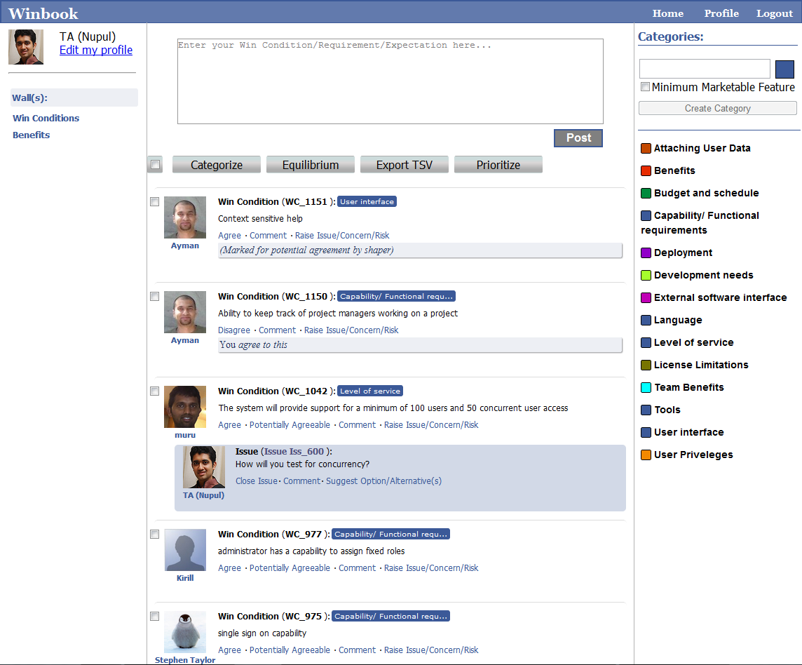

Slide 35
Show Me The Code!
Winbook is Based on Restlet –
A Restful framework for Java

Slide 36
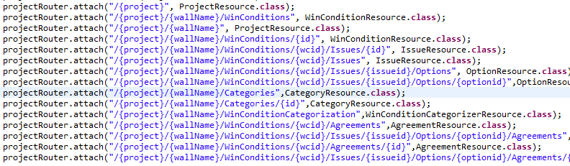
Setting-up URI Routing

Slide 37
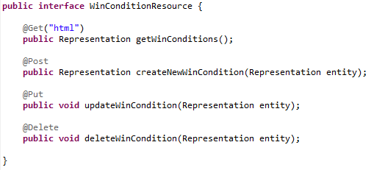
Create ‘Resource Interfaces’

Slide 38
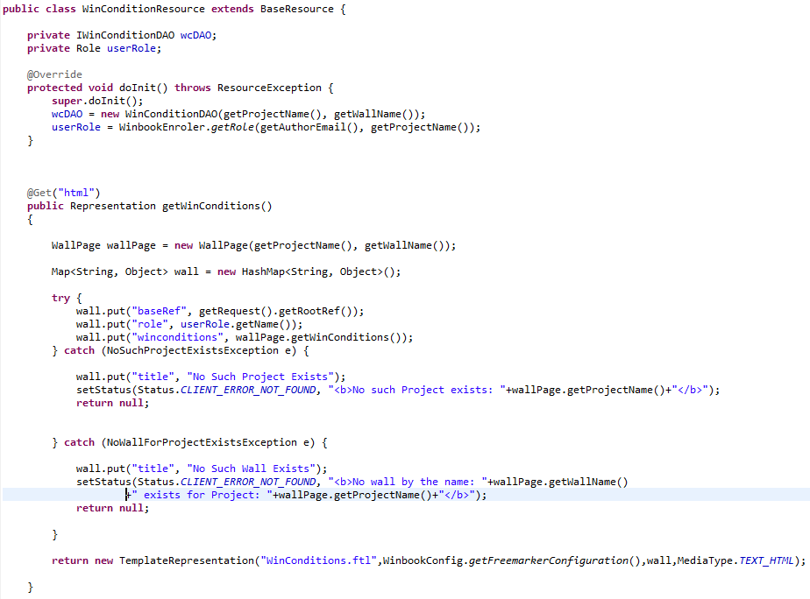

Slide 39
RESTful Frameworks
Almost all frameworks allow you to:
  Specify URI Patterns for routing HTTP requests
  Set allowable HTTP Methods on resources
  Return various different representations (JSON, XML, HTML most popular)
  Support content negotiation
  Implement/follow the studied REST principles
Restlet is ONE of the many frameworks…

Slide 40
List of REST Frameworks
Rails Framework for Ruby (Ruby on Rails)
Django (Python)
Jersey /JAX-RS (Java)
Restlet (Java)
Sinatra (Ruby)
Express.js (JavaScript/Node.js)
…and many others: View complete list at: http://code.google.com/p/implementing-rest/wiki/RESTFrameworks

Slide 41
Architectural Styles Encountered With REST
REST isn’t alone ☺

Slide 42
Model-View-Controller (MVC)
Most commonly employed style with frameworks:
  Model: Classes responsible for talking to the DB and fetching/populating objects for the application
  Controller: Acts as URI Router i.e. routes calls to specific resources and invokes actions based on the corresponding HTTP Method
  View: Usually the resource itself that returns the content/representation as requested by the client
May/may-not be true MVC but parts of application usually split as such – leading to clean code organization/separation of concerns

Slide 43
Client-Side MVC
JS heavy pages lead to spaghetti code
Frameworks like Backbone.js, Ember.js implement MVC paradigm on web page itself making code easier to manage/maintain
  Models: Data that is fetched/saved from/to the server
  Views: HTML elements that display the data and change if the data is updated
  Controller: Intercepts user-events and sends appropriate messages to model/views
JS Models communicate with server (controller) to update themselves
Client-side MVC becoming very popular and critical for ‘front-heavy’/smart-client web-apps based on Ajax
Notes:
Various frameworks are available for JS MVC. Backbone.js is the most prevalent. However there are various other and a good listing/comparison can be found on: http://addyosmani.github.com/todomvc/

Slide 44
Event-Based Architectures
Exclusively client-side:
  Required for communicating between various parts of the JS application/elements
  Based on the Observer pattern – an event bus is used for sending/receiving messages across components
Exclusively server-side:
  For implementing asynchronous communications between different process (e.g.: sending email after a particular action)
  Communicating with other processes on the network via a Message oriented Middleware (MoM) (e.g.: RabbitMQ, WebSphereMQ etc.)
  Communicating with client-side apps – using Node.js or Pub/Sub web services like PubNub.com or Pusher.com
Notes:
As per the HTTP standard server cannot send a message to the client. But seeing how the web is evolving for collaborative applications, WebSockets has been introduced as a standard to support full-duplex communication over HTTP; So that a server may send a message to the client. There are some ‘hacks’ to have it work without websockets:
Polling – the client keeps polling the server for updates; quite inefficient and waste of server’s resources
Long polling/reverse ajax – the server sleeps on receiving a request and if something interesting happens in the meanwhile sends to client else sends empty response. Client reinitiates the request and the process repeats. Used for facebook’s event updates at one point (may still be true)

Slide 45
Data Access
The final nail in the coffin ☺

Slide 46
3-Tier Architecture
Most commonly encountered when designing web-based systems
  Layer 1: Presentation
    HTML/CSS + JS (MVC)
  Layer 2: Business Logic
    RESTful framework (usually MVC)
  Layer 3: Data Access
    ORM tools – Hibernate, Spring JDBC, iBatis, Ruby’s ActiveRecord & DataMapper etc.,
    May already be integrated with RESTful framework and represented as ‘Models’ in the MVC
Notes:
ORM = Object-Relational-Mapping

Slide 47
Conclusion
Just REST isn’t enough
100% REST isn’t the goal either
Various architectural styles work together in tandem for creating distributed web-based systems
MVC on client-side is gaining high momentum
Event-based communication exceedingly important for near-real-time/asynchronous applications (reason for Node.js popularity)
You can learn the REST by reading a few books and designing/implementing a few systems ☺

