Slide 1
TCP Congestion Control for Data Centers
(DCTCP)
Bilal Siddiqui and Yahya Javed
^{Purdue University}

Slide 2
Implementation Challenges
Ns3 is still in development phase.
Why ns3: Lack of access to data centers.
Holistically, there were two challenging tasks at hand in ns3.
Implementation of ECN in switch and TCP layer. And implementation of DCTCP on top of it. Hard because of changing the source code.
Generation and collection of results for verification of our DCTCP implementation on custom made fat tree data center topology (Scalability).

Slide 3
Implementation of ECN and DCTCP
Building handshake mechanism between Sender and Receiver.
Sender: SYN+CWR+ECE
Receiver : SYN-ACK-ECE
Sender: ACK
When Congestion Experienced: (Mark CE bit in IP header)
Receiver Sends: ECN Echo in TCP header with CE marked.
Sender Sends: CWR (Congestion Window Reduced) and reduces Congestion Window
DCTCP on top of it:
Marking of ECN at Switch when threshold value “K” crossed.
Maintain fraction of packets “Acked” With ECN in one RTT
Decrease Congestion Window according to Alpha within one RTT.

Slide 4
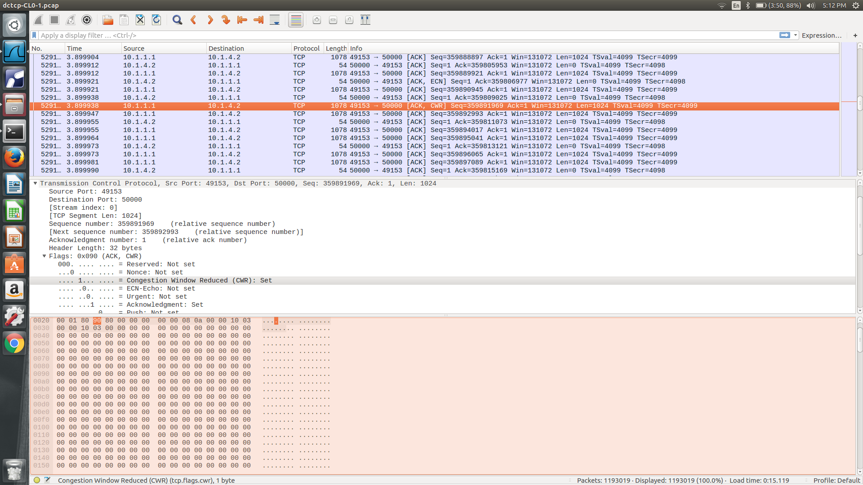
ECN Working + Congestion Window Halved Demo

Slide 5
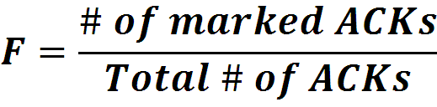

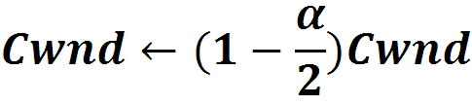
Data Center TCP Algorithm
B
K
Don’t
Mark
Switch side:
Mark packets when Queue Length > K.
Mark
Sender side:
Maintain running average of fraction of packets marked (α).
In each RTT:
Receiver Sends ECN ECHO to sender when senses congestion.
Sender Reacts before packet is dropped.
Notes:
Copyright: Slide taken from Alizadeh et.al. Sigcomm Talk. Modified a little

Slide 6
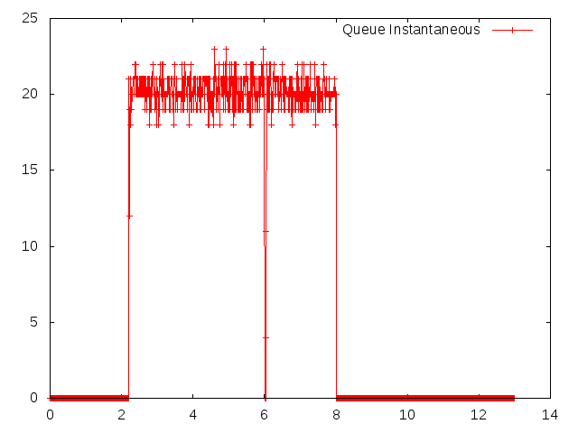
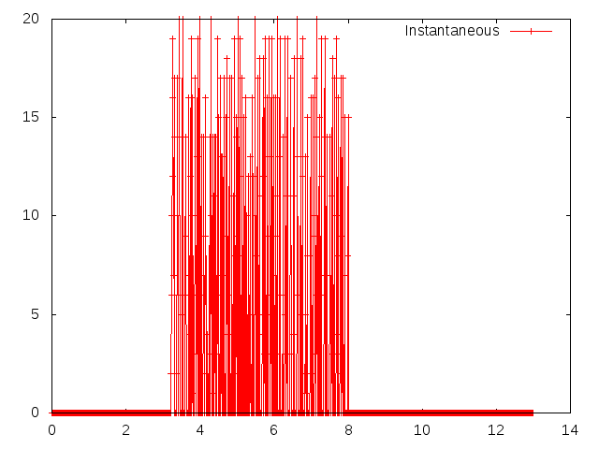
DCTCP Evaluation on a simple two sender+ switch and a receiver: Demo
Instantaneous Queue Lengths: K = 20
DCTCP
TCP

Slide 7
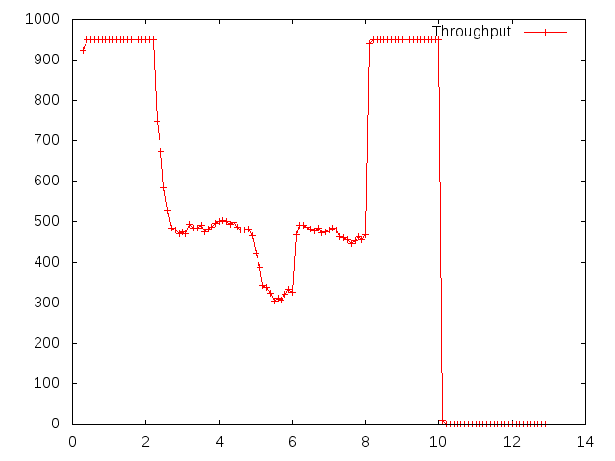
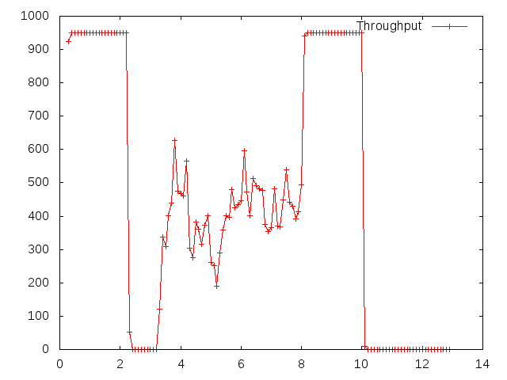
DCTCP Evaluation: Congestion Window + Throughput Demo
Throughput : Link of 1 Gbps
DCTCP
TCP

Slide 8
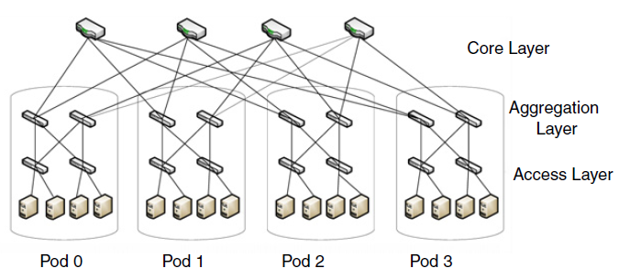
Evaluation Methodology
Used ns3 simulation environment
Implementation of fat-tree data center topology
Different experiments highlighting performance enhancements promised by DCTCP for the three performance impairments mentioned in the paper
Experiments showing DCTCP impact on overall system throughput and queue length of network switches
Experiments characterized by
Applications (traffic sources): query traffic (short flows), short messages (medium-sized), background traffic (large bandwidth hungry flows)
Total number of servers; number of senders and receivers
Which server is transmitting what kind of traffic at what time

Slide 9
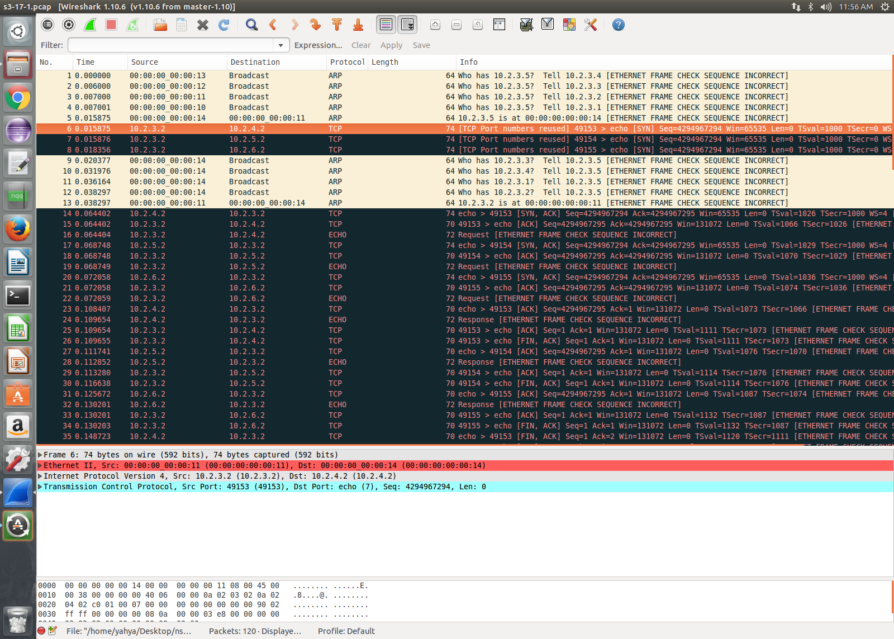
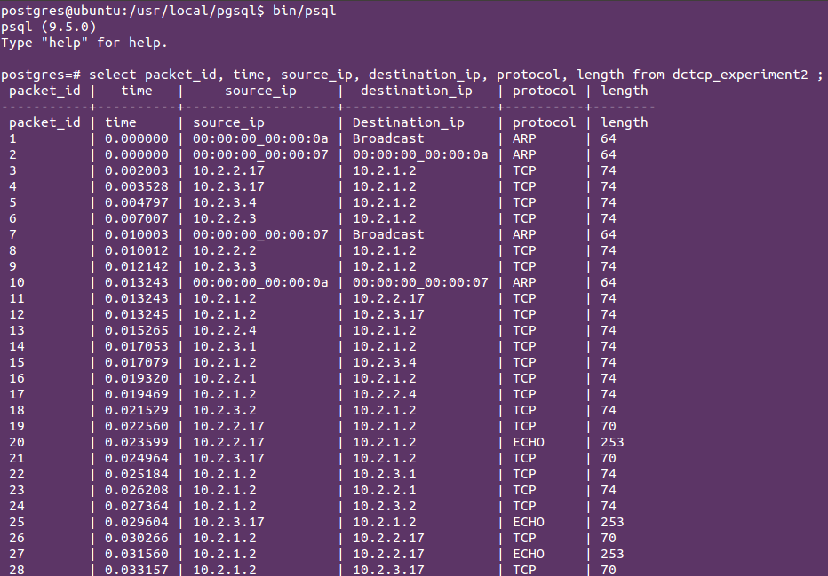
Evaluation Methodology (continued)
Implemented extensive tracing framework, that produces three different kinds of files
Pcap: Packets transmitted and received by each sender and receiver
Flowmonitor: Number of bytes sent, number of packets lost, start and stop time with nanoseconds accuracy for each flow generated in the experiment
Trace sources: Trace for specific purpose like queue length, congestion window size for nodes of interest
Extracting data in the form of CSV data files from the experiments
Export of data in PostgreSQL database system for analysis of the data
Generation of graphs corresponding to different experiments in accordance analysis presented in the paper

Slide 10
Experiment 1: Throughput and Queue Length
Servers connected to access switches using 1Gbps links, switches connect to each other using 10Gbps links
One server is receiver while others are senders that establish long lived connections and send data as fast as they can
Instantaneous queue length measured after every enqueue and dequeue operation, value of K set to 20 for DCTCP
It can be seen that DCTCP keeps the queue length of receivers switch stable around 20, while throughput is equal to that of TCP for higher values of K

Slide 11
Experiment 2: Incast Performance
One server sends query requests to other servers which provide response back to the server making the request, the pattern is repeated for roughly 50 times
Query completion time is calculated by taking the difference between the time query request was made and the last response that the requesting server gets
It is observed that the query completion time is always less in case of DCTCP (K=20) and this difference grows with the increase in the number of worker servers

Slide 12
Experiment 3: Queue Buildup Performance
One server acts as receiver, 2 servers establish long-lived TCP background flows with the receiver while the receiver server requests short message transfer data (20KB data chunks) from a fourth server simultaneously
The fourth server sends data immediately and all communication is over long lived TCP connection, 50 such requests are made by the receiver
Almost all of the short message transfers complete before 60ms for DCTCP (K=20, RTO_{min}=300ms), while for TCP this value is 140ms

Slide 13
Experiment 4: Buffer Pressure Performance
One server acts as receiver, 2 servers establish long-lived TCP background flow connection with the receiver while at the same time receiver sends query requests to 10 other servers (workers) creating a 10-1 incast pattern
100 query requests are made with and without background traffic by the receiver server
The average query completion time for DCTCP both in case of with and without background traffic is around 48ms, while for TCP the value is 116.021ms in case of without background traffic and 199.371ms in case of with background traffic

Slide 14
Analysis and Comparison
In DCTCP paper, the implementation is on a real test bed, but there is only one switch involved for every experiment
In real data center networks there are multiple switches connected in different configurations, our simulation environment emulates that using fat-tree topology
When servers are spread across multiple racks then high delays are observed especially for incast traffic pattern, in our simulation when we tried to run experiments for 16-rack, 64 server scenario we find unexpected delays
The results we obtain are consistent with the paper, with DCTCP outperforming TCP for every experiment but overall delay values are higher than the ones in the paper

Slide 15
Contribution
Bilal
Implementation of ECN at Switch Level:
Implementation of ECN at TCP layer utilizing switches:
Building Handshake mechanism
Reducing Congestion Window in response to ECN
Implementation of DCTCP algorithm at Switch, Sender and Receiver:
Testing DCTCP validity on a very simple topology.
Yahya
Implementation of data center topology
16-server, 4-rack simulation topology
Query traffic, short message traffic and background traffic generation
Testing of DCTCP implementation
Queue size, congestion window size tracing
Design and implementation of experiments
Multiple experiments corresponding to different performance impairments discussed in the paper
Data collection and results
Implementation of tracing and data collection framework
Export of data to PostgreSQL database for analysis
Marking packets with CE bit when ECT bits set.
Source Code Related Changes:

Slide 16
References
[1] Implementing explicit congestion notification in ns-3
[2] Design and Implementation of the Traffic Control Module in ns-3
[3] DCTCP Sigcomm 2010.

Slide 17
Old Slide: DCTCP implementation in NS3
NS3 is still in development phase. We are using ns 3.26 released in March 2017.
One of the Key challenges in implementing DCTCP relies on the implementation of Explicit Congestion Notification (ECN) on Switch and TCP layers.
Previously a workaround for ECN from GaTech was implemented in ns3 without the support of traffic control layer in ns3.[1]
Last year in June 2016 [2] traffic control module was implemented in ns3 similar to that of Linux. We want to build upon that.

