Slide 1
Signals and Systems ENGR 3323
Dr. Mohamed Bingabr
University of Central Oklahoma

Slide 2
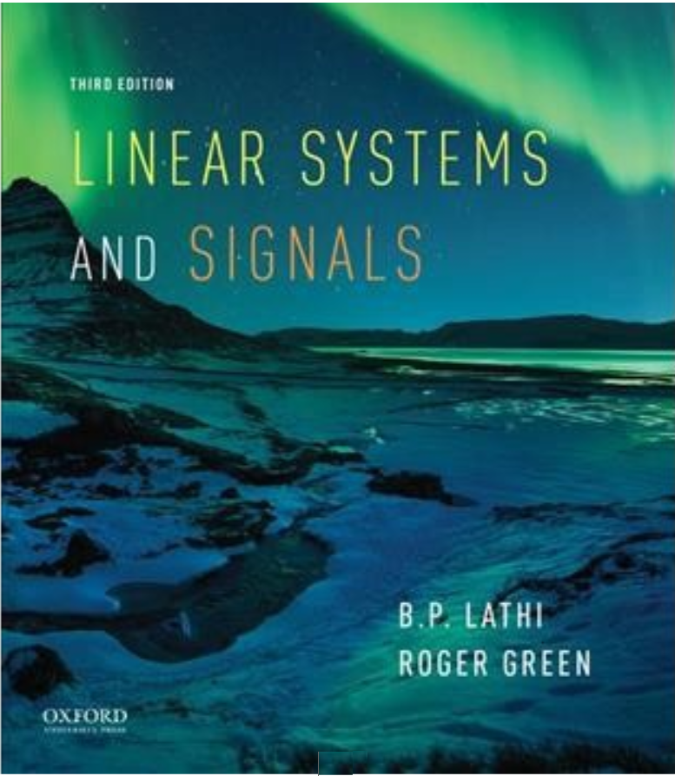
Course Materials
Textbook: “Linear Systems and Signals”, 3rd edition by B. P. Lathi. ISBN: 978-0190200176
Course Website and Videos: http://www.engineering.uco.edu/~mbingabr

Slide 3
Course Information
Instructor: Mohamed Bingabr, Professor of Engineering
Office Location: Howell Hall 221C
Phone: (405) 974 5718
Email: mbingabr@uco.edu
Course Meeting Time: MTWR 11:00 – 12:15
Course Meeting Location: STEM 102
Office Hours: MW 12:15 – 1:30, and by appointment.

Slide 4
Grading Policy
Grading Distribution:
Attendance 10 %
Homework 10 %
Quizzes 30 %
2 Tests 30 %
Final Exam 20 %
Grading Scale:
A: 90-100
B: 80-89
C: 70-79
D: 60-69
F: 0-59

Slide 5
Course Expectations & Conducts
Spend a total of 8 to 10 hours a week.
Ask for help for homework but don’t copy.
You can not seek help from your neighbor during quizzes and tests.
You are allowed to have formula sheets and your homework solutions for quizzes and tests.
Makeup test will be given for emergency situation.
Please no phone or internet use during lecture.
Be on time for the lecture and do your best to stay focus.

Slide 6
Course Topics
• Signals and Systems Characterization
- Linear, Causal, Time-invariant, Stability, Digital
• System Modeling (Elect., Mech., or Biological)
- Differential Equation
• System Analysis
- Impulse response h(t)
• Time-domain Analysis
- zero-input and zero-state responses
• Laplace Transform and Analysis
- Transfer function H(s)
• Fourier Series Analysis of Periodic Signal
• Fourier Transform Analysis of Aperiodic Signal
- Frequency response H(ω)
• Sampling Theorem and Signal Reconstructions

Slide 7
To Do Well in This Course
Focus on lectures & problems solved in the lecture.
Do and understand the homework problems.
Use the video resources
Enjoy and reflect on the physical meaning of the equations.

