Slide 1
Time Domain Analysis of Linear Systems Ch2
University of Central Oklahoma
Dr. Mohamed Bingabr

Slide 2
Outline
Zero-input Response
Impulse Response h(t)
Convolution
Zero-State Response
System Stability

Slide 3
System Response
System
Initial Conditions
are not zeros
(stored energy)
y(t) = zero input response
x(t) = 0
System
Initial Conditions
are zeros
(No stored energy)
y(t) = zero state response
x(t)
Total response = Zero input response + Zero state response

Slide 4
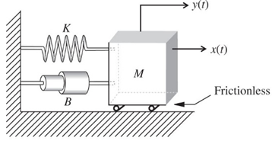
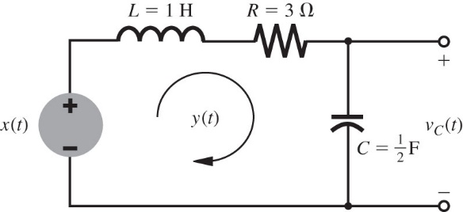
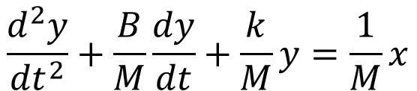
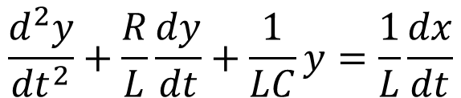
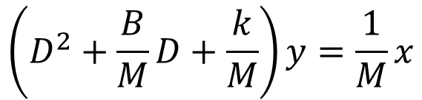
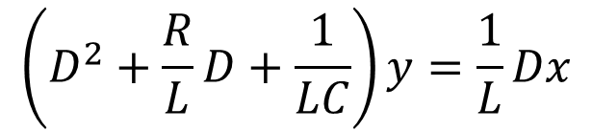
System Response
$$\frac{d^{2}y}{{dt}^{2}}+\frac{R}{L}\frac{dy}{dt}+\frac{1}{LC}y=\frac{1}{L}\frac{dx}{dt}$$
$$\frac{d^{2}y}{{dt}^{2}}+\frac{B}{M}\frac{dy}{dt}+\frac{k}{M}y=\frac{1}{M}x$$
$$\left(D^{2}+\frac{R}{L}D+\frac{1}{LC}\right)y=\frac{1}{L}Dx$$
$$\left(D^{2}+\frac{B}{M}D+\frac{k}{M}\right)y=\frac{1}{M}x$$
For N order system
$$\left(D^{N}+a_{1}D^{N−1}+a_{2}D^{N−2}+…+a_{N}\right)y(t)=$$
$$\left({b_{0}D}^{M}+b_{1}D^{M−1}+b_{2}D^{M−2}+…+b_{M}\right)x(t)$$
What is the zero-input response?

Slide 5
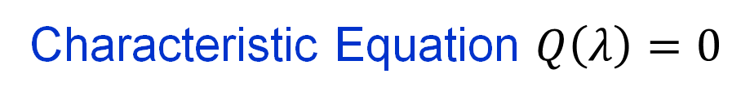



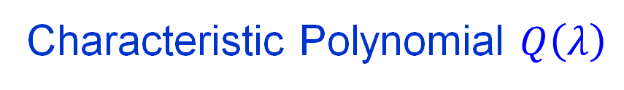
Zero-Input Response
$$\left(D^{N}+a_{1}D^{N−1}+a_{2}D^{N−2}+…+a_{N}\right)y(t)=0$$
A solution to the above differential equation is $y\left(t\right)=ce^{λt}$
$$Dy=λce^{λt}$$
$$D^{2}y=λ^{2}ce^{λt}$$
$$D^{N}y=λ^{N}ce^{λt}$$
$$\left(λ^{N}+a_{1}λ^{N−1}+a_{2}λ^{N−2}+…+a_{N}\right)ce^{λt}=0$$
Characteristic Polynomial $Q\left(λ\right)$
Characteristic Equation $Q\left(λ\right)=0$
$$λ^{N}+a_{1}λ^{N−1}+a_{2}λ^{N−2}+…+a_{N}=0$$

Slide 6



Zero-Input Response
Next step is to solve the characteristic equation
$$λ^{N}+a_{1}λ^{N−1}+a_{2}λ^{N−2}+…+a_{N}=0$$
$$\left(λ−λ_{1}\right)\left(λ−λ_{2}\right)…\left(λ−λ_{N}\right)=0$$
If the characteristic roots λs are distinct real, then possible solutions to the differential equation are
$$c_{1}e^{λ_{1}t}$$
$$c_{2}e^{λ_{2}t}$$
$$c_{N}e^{λ_{N}t}$$
A general solution of the zero-input response is
$${y\left(t\right)=c}_{1}e^{λ_{1}t}+c_{2}e^{λ_{2}t}+…+c_{N}e^{λ_{N}t}$$

Slide 7
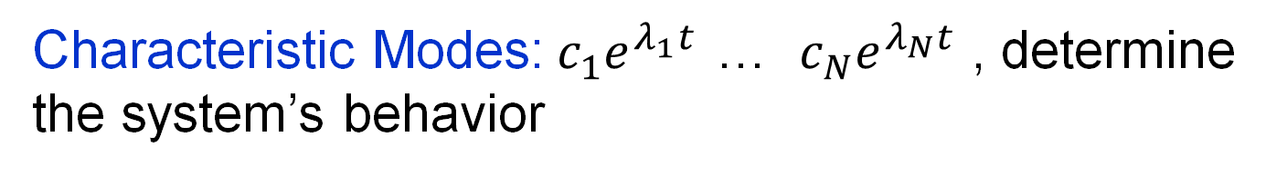
Zero-Input Response
The zero-input response is
$${y\left(t\right)=c}_{1}e^{λ_{1}t}+c_{2}e^{λ_{2}t}+…+c_{N}e^{λ_{N}t}$$
Characteristic Roots: λ₁ … λ_{N}
- Also called the natural frequencies or eigenvalues
- For stable system all λ ≤ 0
- Can be real distinct, repeated roots, and/or complex roots
Characteristic Modes:$c_{1}e^{λ_{1}t}$ … $c_{N}e^{λ_{N}t}$ , determine the system’s behavior
The constants c₁, …, c_{n} are arbitrary constants that will be determined by the initial conditions (initial states of the system)

Slide 8
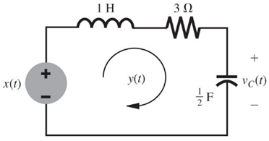
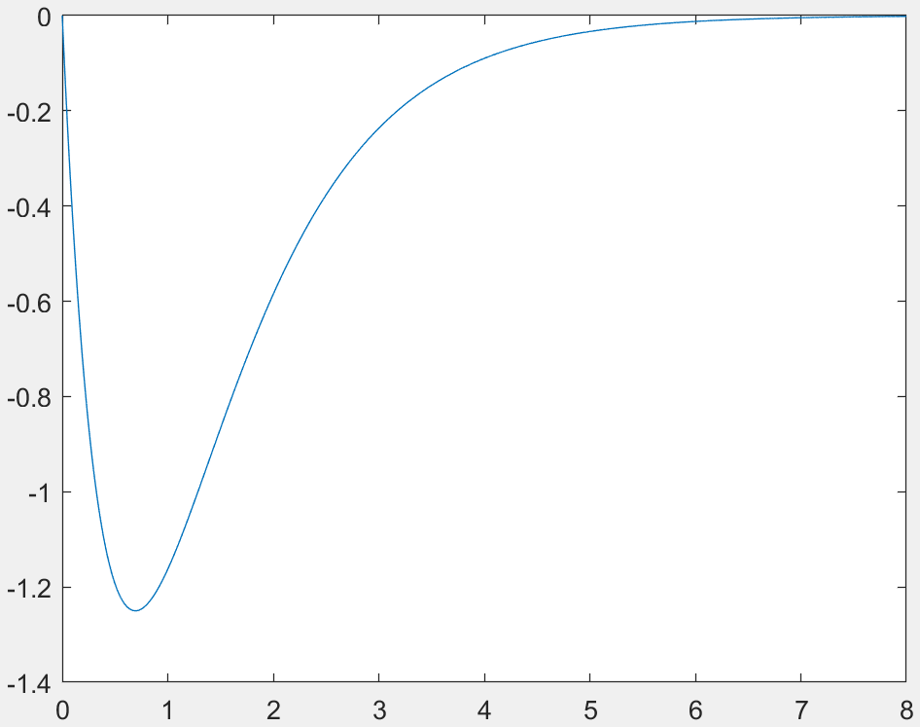
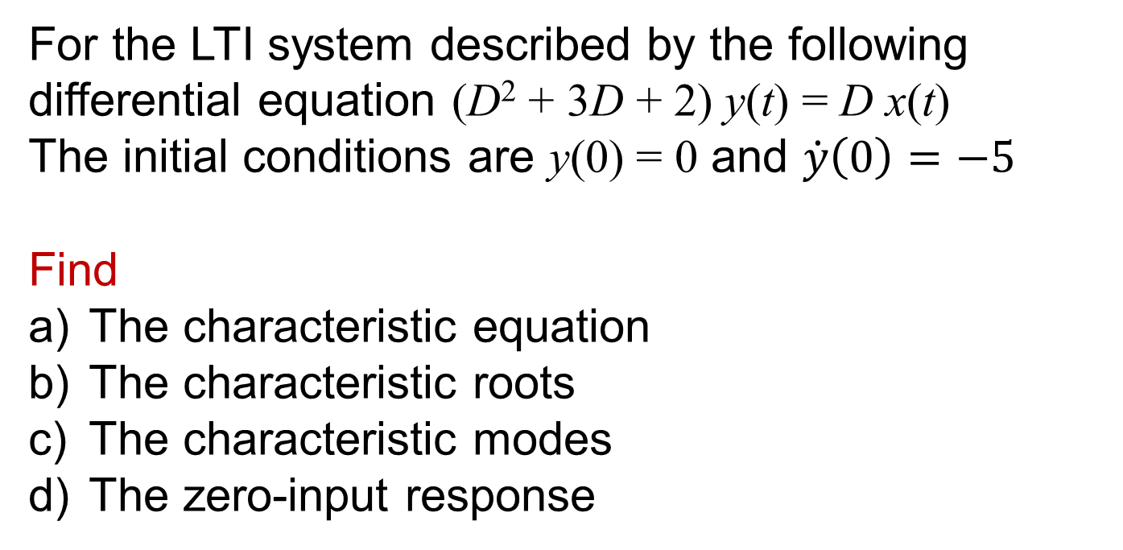
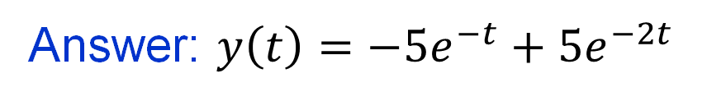
Example
For the LTI system described by the following differential equation (D² + 3D + 2) y(t) = D x(t)
The initial conditions are y(0) = 0 and $\dot{y}\left(0\right)=−5$
Find
The characteristic equation
The characteristic roots
The characteristic modes
The zero-input response
Answer: $y\left(t\right)=−5e^{−t}+5e^{−2t}$

Slide 9
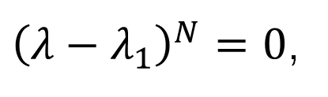
Repeated Characteristic Roots
If the characteristic equation
$$\left(λ−λ_{1}\right)\left(λ−λ_{2}\right)…\left(λ−λ_{N}\right)=0$$
has this form
${\left(λ−λ_{1}\right)}^{N}=0$,
then the N characteristic roots has the same value λ₁.
The zero-input solution will be
$${y\left(t\right)=c}_{1}e^{λ_{1}t}+c_{2}te^{λ_{1}t}+c_{3}t^{2}e^{λ_{1}t}+…+c_{N}{t^{N−1}e}^{λ_{1}t}$$

Slide 10

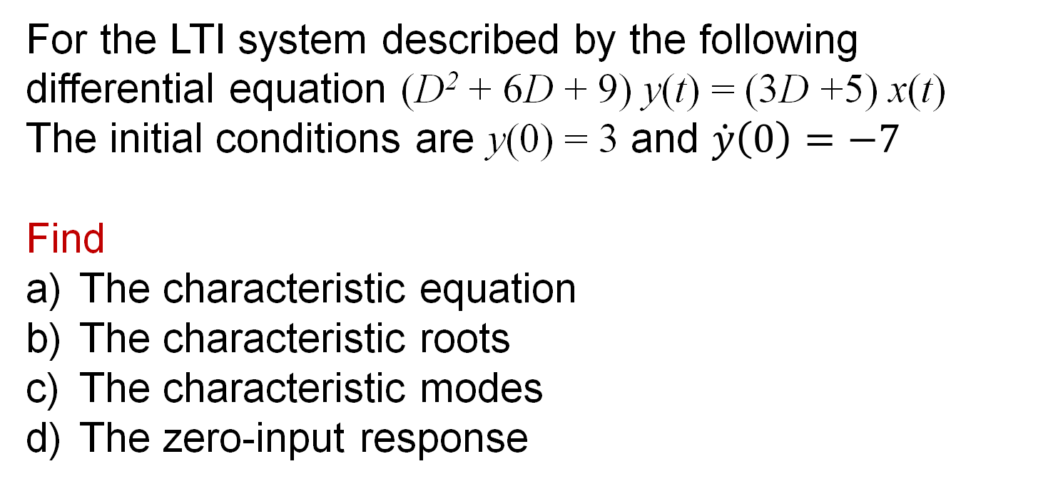
Example
For the LTI system described by the following differential equation (D² + 6D + 9) y(t) = (3D +5) x(t)
The initial conditions are y(0) = 3 and $\dot{y}\left(0\right)=−7$
Find
The characteristic equation
The characteristic roots
The characteristic modes
The zero-input response
Answer: $y\left(t\right)=3e^{−3t}+2{te}^{−3t}$

Slide 11


Complex Characteristic Roots
If the characteristic equation
$$\left(λ−λ_{1}\right)\left(λ−λ_{2}\right)…\left(λ−λ_{N}\right)=0$$
has a complex characteristic root σ + jω then its conjugate σ - jω is also a characteristic root. This is necessary for the system to be physically realizable.
The zero-input solution for a pair of conjugate roots is
$${y\left(t\right)=c}_{1}e^{\left(σ+jω\right)t}+c_{2}e^{\left(σ−jω\right)t}$$
If c₁ and c₂ are complex, then c₂ is conjugate of c₁.
$$y\left(t\right)=ce^{jθ}e^{\left(σ+jω\right)t}+ce^{−jθ}e^{\left(σ−jω\right)t}$$
$$y\left(t\right)=2ce^{σt}cos\left(ωt+θ\right)$$

Slide 12

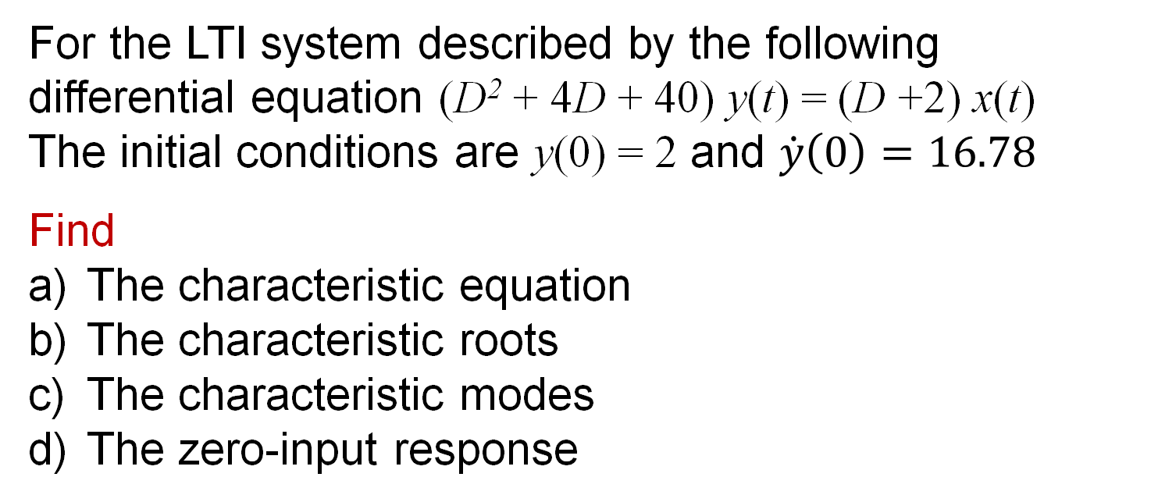
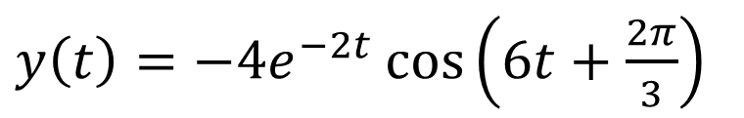
Example
For the LTI system described by the following differential equation (D² + 4D + 40) y(t) = (D +2) x(t)
The initial conditions are y(0) = 2 and $\dot{y}\left(0\right)=16.78$
Find
The characteristic equation
The characteristic roots
The characteristic modes
The zero-input response
Answer: $y\left(t\right)=4e^{−2t}\cos\left(6t−\frac{π}{3}\right)$ or
$y\left(t\right)=−4e^{−2t}\cos\left(6t+\frac{2π}{3}\right)$

Slide 13
The Meaning of t = 0⁻ and t = 0⁺
t = 0
x(t)
System
y(t)
y(0⁻): At t = 0⁻ the input is not applied to the system yet so the output is due only to the initial conditions.
y(0⁺): At t = 0⁺ the input is applied to the system, so the output is due the input and the initial conditions.

Slide 14
Impulse Response h(t)
x(t) = δ(t)
y(t) = h(t)
LTI
System

Slide 15
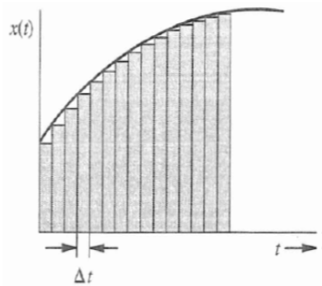
Unit Impulse Response h(t)
Reveal system behavior
Depends on the system internal characteristic modes
Helps in finding system response to any input x(t)

Slide 16




Derivation of Impulse Response h(t)
1- Find the differential equation of the system
$$\left(D^{N}+a_{1}D^{N−1}+…+a_{N}\right)y=\left({b_{0}D}^{M}+b_{1}D^{M−1}+…+b_{M}\right)x$$
$$y_{n}$$
$$Q\left(D\right)y\left(t\right)=P\left(D\right)x(t)$$
x(t)
Q(D)
P(D)
h(t)
2- Find the natural response y_{n}(t) using the same steps used to find the zero-input response.
$${y_{n}\left(t\right)=c}_{1}e^{λ_{1}t}+c_{2}e^{λ_{2}t}+…+c_{N}e^{λ_{N}t}$$
3- To find the constants c, set all initial conditions to zeros except N-1 derivative, set it to equal 1.
$$y_{n}\left(0\right)={\dot{y}}_{n}\left(0\right)={\ddot{y}}_{n}\left(0\right)=…=y_{n}^{N−2}\left(0\right)=0$$
$$y_{n}^{N−1}\left(0\right)=1$$
4-
$$h\left(t\right)=\left[P\left(D\right)y_{n}\left(t\right)\right]u(t)$$
If M = N then h(t) = [P(D) y_{n}(t)] u(t) + b₀ δ(t)

Slide 17
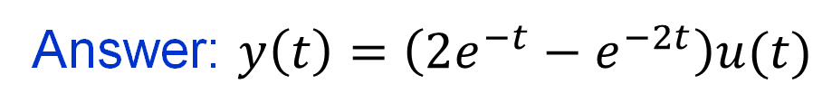
Example
Determine the impulse response h(t) for the system
(D² + 3D + 2) y(t) = (D +3) x(t)
Answer: $y\left(t\right)=\left(2e^{−t}−e^{−2t}\right)u(t)$
HW3_Ch2

Slide 18
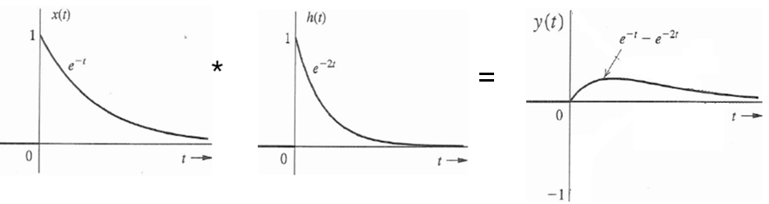
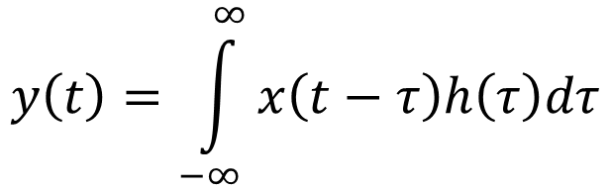
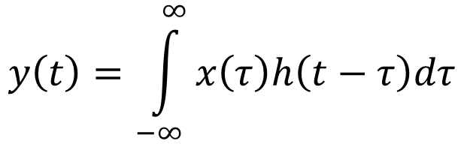
Zero-State Response
LTI
h(t)
x(t)
y(t) = x(t) * h(t)
convolution
$$y\left(t\right)=\int_{−∞}^{∞}{x\left(t−τ\right)h\left(τ\right)dτ}$$
$$y\left(t\right)=\int_{−∞}^{∞}{x\left(τ\right)h\left(t−τ\right)dτ}$$

Slide 19
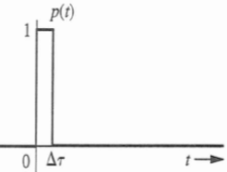
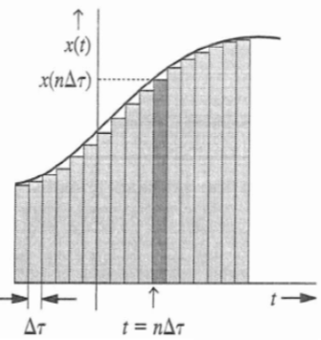
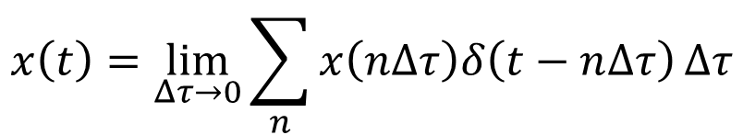
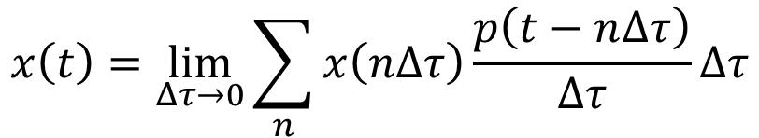
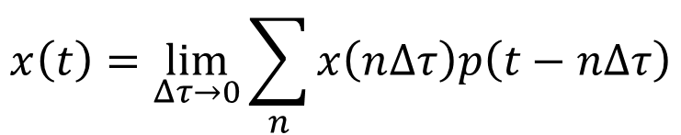
Zero-State Response
Any signal can be represented as a train of pulses of different amplitudes and at different locations
$$x\left(t\right)=\lim_{Δτ→0}{\sum_{n}{x\left(n∆τ\right)p\left(t−n∆τ\right)}}$$
$$x\left(t\right)=\lim_{Δτ→0}{\sum_{n}{x\left(n∆τ\right)\frac{p\left(t−n∆τ\right)}{∆τ}}}∆τ$$
$$x\left(t\right)=\lim_{Δτ→0}{\sum_{n}{x\left(n∆τ\right)δ\left(t−n∆τ\right)}}∆τ$$

Slide 20
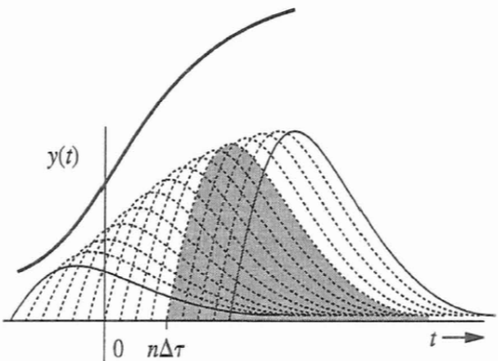
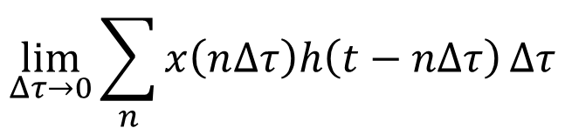
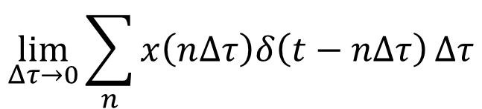
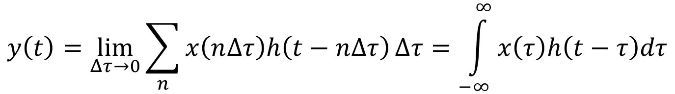
Zero-State Response
x(t)
y(t)
$$\lim_{Δτ→0}{\sum_{n}{x\left(n∆τ\right)δ\left(t−n∆τ\right)}}∆τ$$
$$\lim_{Δτ→0}{\sum_{n}{x\left(n∆τ\right)h\left(t−n∆τ\right)}}∆τ$$
y(t) is the sum of all curves.
Each curve represents the output for impulse input at nΔt
Input x(t)
$$y\left(t\right)=\lim_{Δτ→0}{\sum_{n}{x\left(n∆τ\right)h\left(t−n∆τ\right)}}∆τ=\int_{−∞}^{∞}{x\left(τ\right)h\left(t−τ\right)dτ}$$

Slide 21
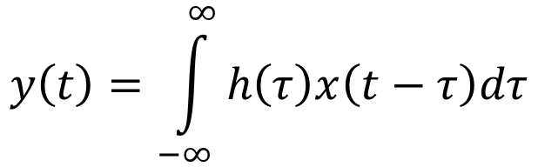
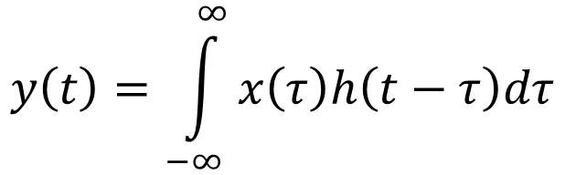
Zero-State Response
The Convolution Integral
y(t) = x(t) * h(t)
$$y\left(t\right)=\int_{−∞}^{∞}{x\left(τ\right)h\left(t−τ\right)dτ}$$
x(t)
h(t)
y(t) = h(t) * x(t)
$$y\left(t\right)=\int_{−∞}^{∞}{h\left(τ\right)x\left(t−τ\right)dτ}$$

Slide 22
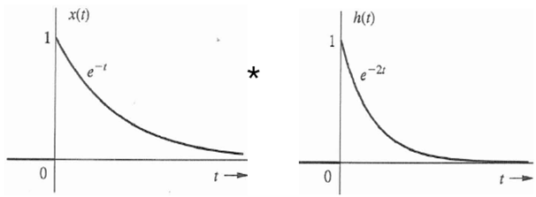
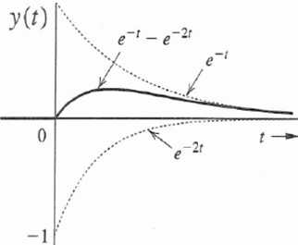

Example
For a LTI system with impulse response h(t) = e^{-2t} u(t), determine the response y(t) for the input x(t) = e^{-t} u(t).
Answer: $y\left(t\right)=(e^{−t}−e^{−2t})u(t)$
=

Slide 23
The Convolution Properties
Commutative: x₁ * x₂ = x₂ * x₁
Associative: x₁ * [x₂ * x₃] = [x₁ * x₂ ] * x₃
Distributive: x₁ * [x₂ + x₃] = [x₁ * x₂ ] + [x₁ * x₃ ]
Impulse Convolution: x(t) * δ(t) = $\int{x\left(τ\right)δ\left(t−τ\right)dτ}=$ x(t)

Slide 24
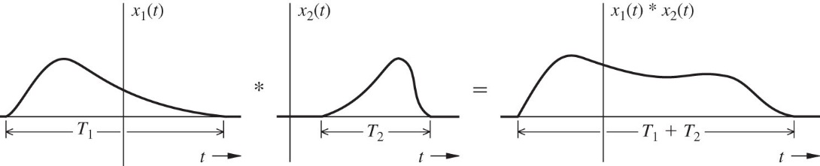
The Convolution Properties
Shift Property:
if x₁(t) * x₂(t) = c(t)
then x₁(t -T) * x₂(t) = x₁(t) * x₂(t -T) = c(t -T)
also x₁(t –T₁) * x₂(t –T₂) = c(t –T₁ –T₂)
Width Property:
If the width of x₁(t) is T₁ and the width of x₂(t) is T₂
then the width of x₁(t ) * x₂(t) is T₁ +T₂

Slide 25
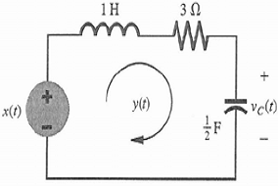
Example
Find the total response for the system D²y + 3Dy + 2y = Dx for input x(t)=10e^{-3t}u(t) with initial condition y(0) = 0 and
Answer
For t ≥ 0
Zero-input Response
Zero-state Response
Natural Response
Forced Response

Slide 26
System Stability
External Stability (BIBO)
If the input is bounded, then the output is bounded
Internal Stability (Asymptotic)
If and only if all the characteristic roots are in the LHP
Unstable if, and only if, one or both of the following conditions exist:
At least one root is in the RHP
There are repeated roots on the imaginary axis
Marginally stable if, and only if, there are no roots in the RHP, and there are some unrepeated roots on the imaginary axis.

Slide 27
Example
Investigate the asymptotic & BIBO stability of the following systems:
(D+1)(D² + 4D + 8) y(t) = (D - 3) x(t)
(D-1)(D² + 4D + 8) y(t) = (D + 2) x(t)
(D+2)(D² + 4) y(t) = (D² + D + 1) x(t)
HW4_Ch2

Slide 28
Convolution Example
Find the zero-state response y(t) of the system described by the impulse response h(t) for an input x(t), shown below.
h(t)
x(t)
4
2
2t
t
0
4
2
t

Slide 29
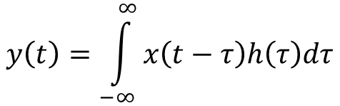
Convolution Example
Find the zero-state response y(t) of the system described by the impulse response h(t) for an input x(t), shown below.
h(t)
x(t)
4
2
2t
t
0
4
2
t
$$y\left(t\right)=\int_{−∞}^{∞}{x\left(t−τ\right)h\left(τ\right)dτ}$$
h(τ)
x(-τ)
4
x(t-τ)
2τ
2
2
τ
t - 4
t
0
2
τ
-4
0

Slide 30
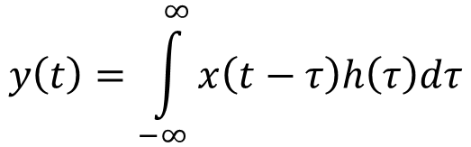
Convolution Demonstration
$$y\left(t\right)=\int_{−∞}^{∞}{x\left(t−τ\right)h\left(τ\right)dτ}$$
h(τ)
4
2τ
x(t-τ)
2
y(t) for t < 0
τ
t - 4
t
0
2

Slide 31
Convolution Demonstration
$$y\left(t\right)=\int_{−∞}^{∞}{x\left(t−τ\right)h\left(τ\right)dτ}$$
x(t-τ)
y(t) for 0 < t < 2
t - 4
0
t

Slide 32
Convolution Demonstration
$$y\left(t\right)=\int_{−∞}^{∞}{x\left(t−τ\right)h\left(τ\right)dτ}$$
h(τ)
4
2τ
x(t-τ)
2
y(t) for 2 < t < 4
τ
t - 4
0
2
t

Slide 33
Convolution Demonstration
$$y\left(t\right)=\int_{−∞}^{∞}{x\left(t−τ\right)h\left(τ\right)dτ}$$
h(τ)
4
2τ
2
x(t-τ)
y(t) for 4 < t < 6
τ
0
t - 4
2
t

Slide 34
Convolution Demonstration
$$y\left(t\right)=\int_{−∞}^{∞}{x\left(t−τ\right)h\left(τ\right)dτ}$$
h(τ)
4
2τ
2
x(t-τ)
y(t) for t > 6
τ
0
2
t - 4
t

