Slide 1
System Realization and Filter Design By Poles and Zeros Positioning
Dr. Mohamed Bingabr
University of Central Oklahoma

Slide 2
Outline
Block Diagrams and System Realization
Filter Design by Placement of Poles and Zeros of H(s)

Slide 3
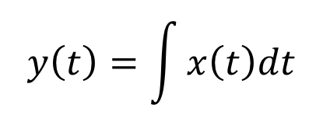
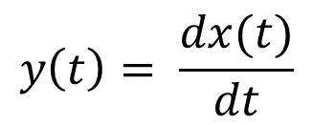
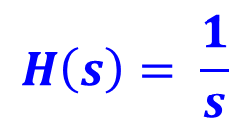
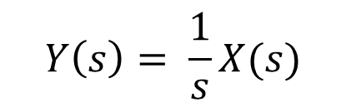
Transfer Function
Time Delay
Shifting
Property
x(t)
y(t) = x(t-τ)
Time Delay τ
H(s) = e^{-τs}
X(s)
Y(s) = X(s)e^{-τs}
Differentiator
Differentiator
Property
$$y\left(t\right)= \frac{dx(t)}{dt}$$
x(t)
Differentiator
H(s) = s
X(s)
Y(s) = s X(s)
Integrator
$$y\left(t\right)=\int{x\left(t\right)dt}$$
Integrator Property
x(t)
Integrator
$$H\left(s\right)= \frac{1}{s}$$
X(s)
$$Y\left(s\right)= \frac{1}{s}X(s)$$

Slide 4
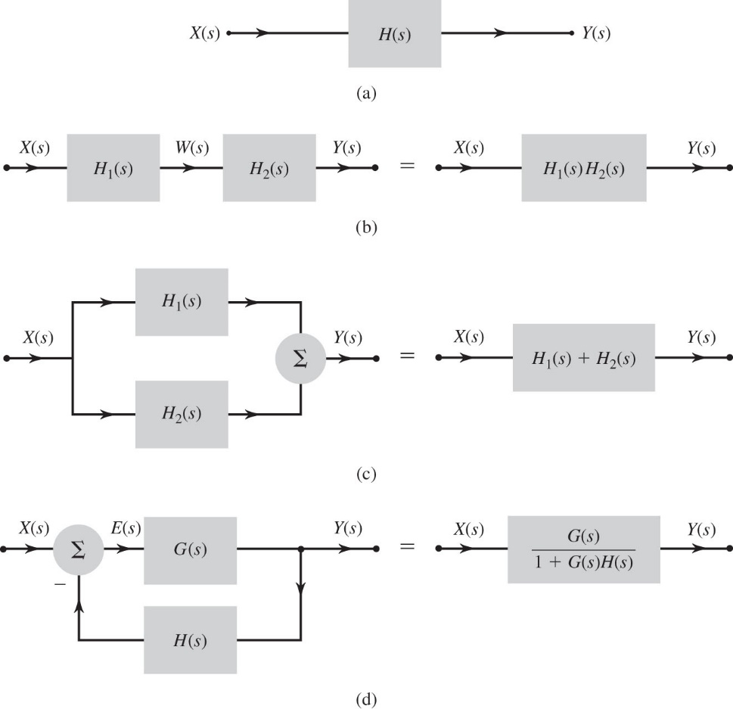

Block Diagrams
Cascade Connection
Parallel Connection
Feedback Interconnections

Slide 5
System Realization
Realization is a synthesis problem, so there is no unique way of realizing a system.
A common realization of H(s) is using
Integrator
Scalar multiplier
Adders

Slide 6
Direct Form I Realization
Divide every term by s with the highest order in the denominator, s³ .
H₂(s)
H₁(s)
H₁(s)
H₂(s)
X(s)
W(s)
Y(s)

Slide 7
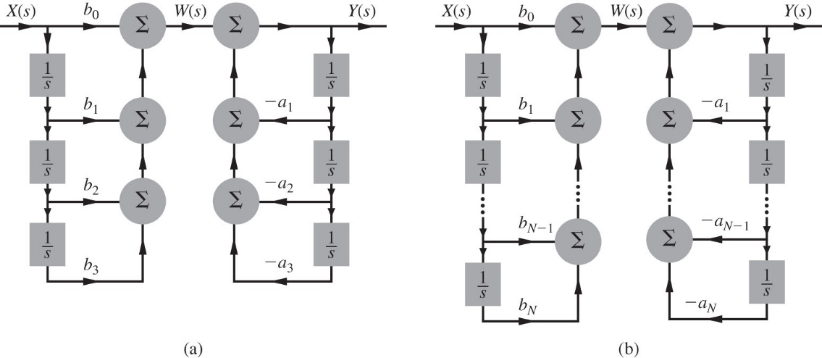
Direct Form I Realization
H₁(s)
H₂(s)
X(s)
W(s)
Y(s)

Slide 8
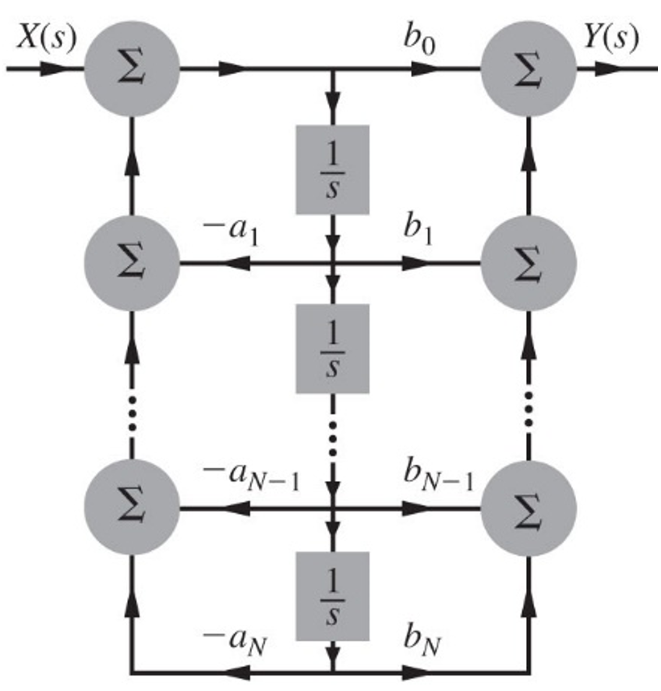
Direct Form II Realization
H₂(s)
H₁(s)
X(s)
V(s)
Y(s)

Slide 9
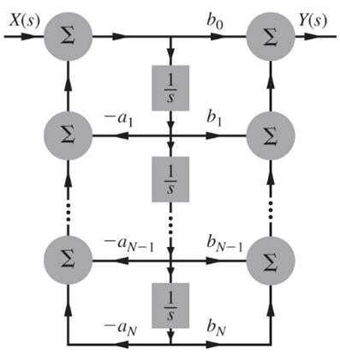
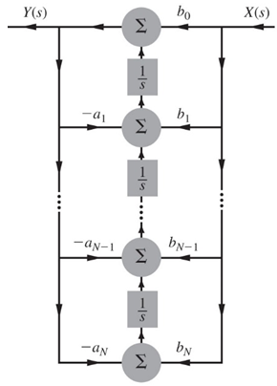
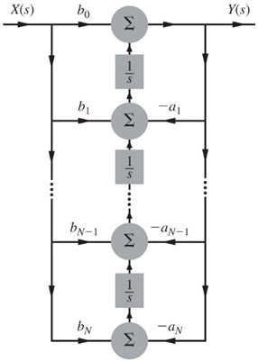
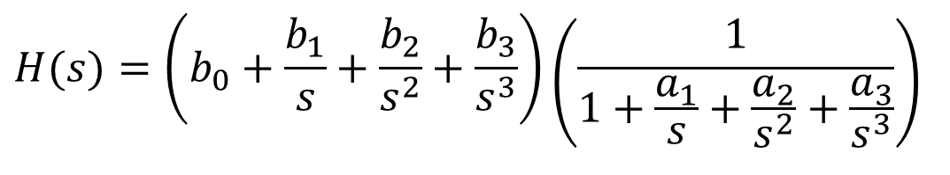
Transposed Realization
- Reverse all the arrow directions without changing the scalar multiplier values.
- Replace branch nodes by adders and vice versa.
- Replace the input X(s) with the output Y(s) and vice versa.
- To make the follow of the input from left to right rotate the diagram 180 degree.
$$H(s)=\left(b_{0}+\frac{b_{1}}{s}+\frac{b_{2}}{s^{2}}+\frac{b_{3}}{s^{3}}\right)\left(\frac{1}{1+\frac{a_{1}}{s}+\frac{a_{2}}{s^{2}}+\frac{a_{3}}{s^{3}}}\right)$$

Slide 10
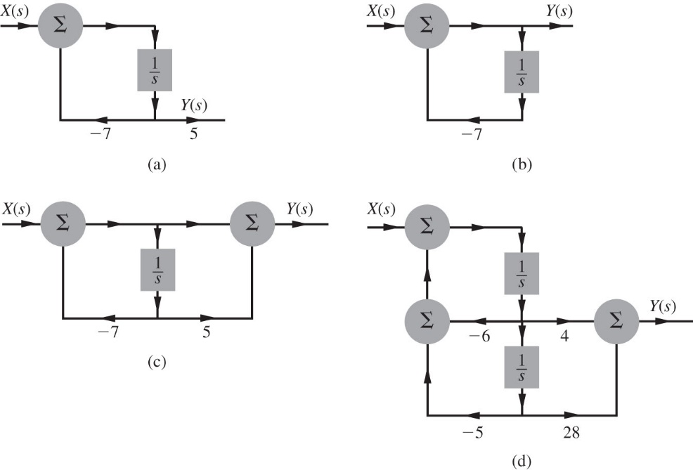
Example
Find the canonic direct form realization of the following transfer functions:

Slide 11
Cascade and Parallel Realizations
Cascade Realization
Parallel Realization
The complex poles in H(s) should be realized as a second-order system.

Slide 12
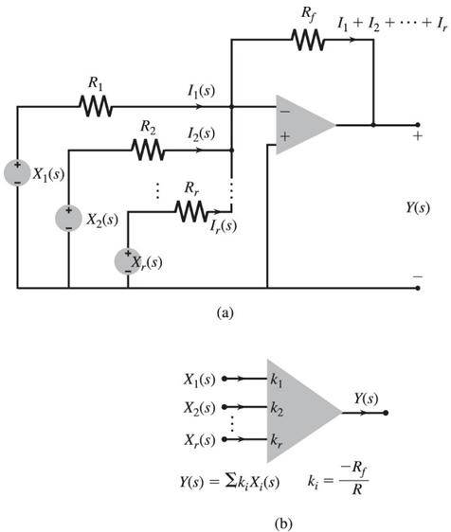
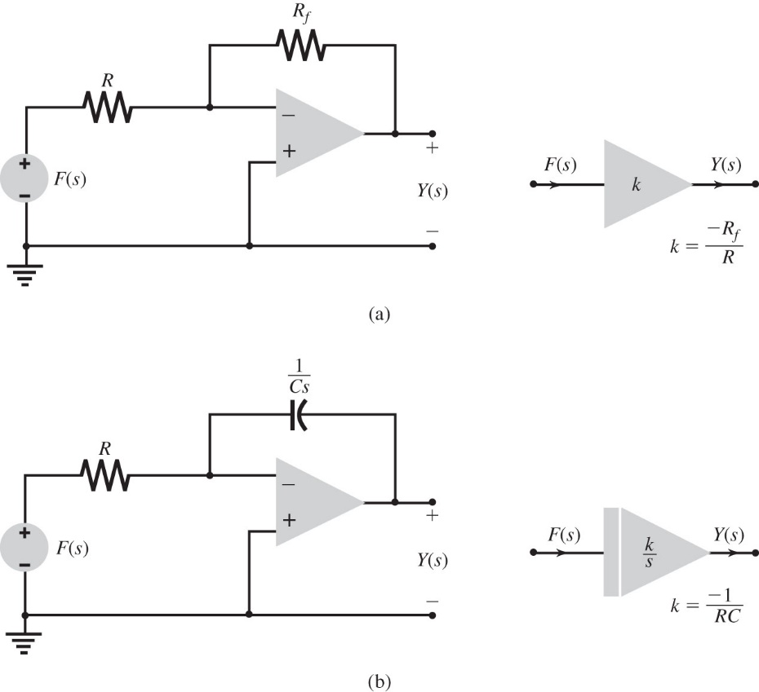
Using Operational Amplifier for System Realization

Slide 13
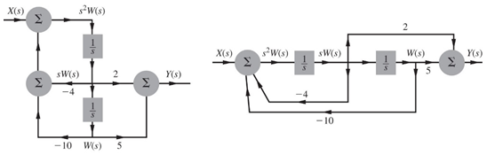
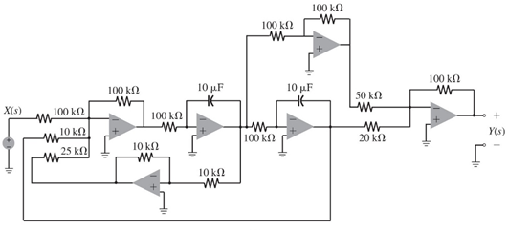
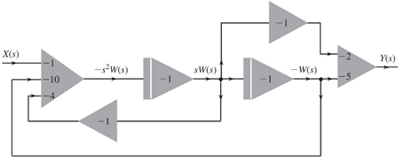
Example
Use Op-Amp circuits to realize the canonic direct form of the transfer function

Slide 14
Filter Design By Poles and Zeros Positioning

Slide 15
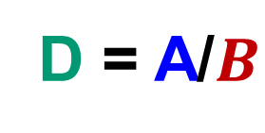

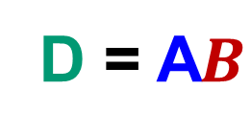
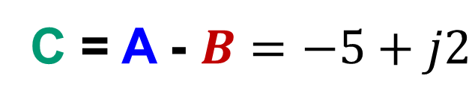
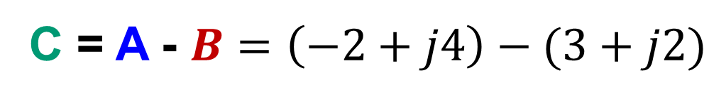

Review of Vectors Operations
$$A=−2+j4$$
Im
x
$$B=3+j2$$
x
x
Re
C = A - $B=\left(−2+j4\right)−(3+j2)$
C = A - $B=−5+j2$
D = A$B$
D = A/$B$

Slide 16
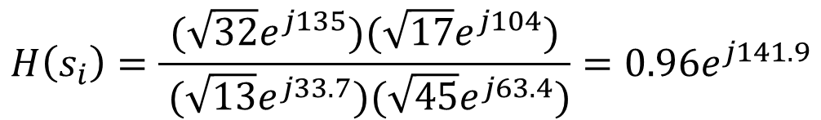
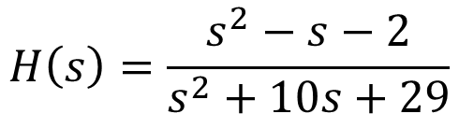


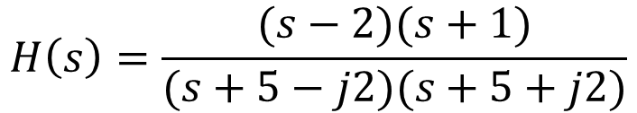

Effects of Poles & Zeros on Frequency Response
s_{i} = -2+j4
S-Plane
$$x(t)=e^{s_{i}t}$$
H(s)
$$y(t)={H(s_{i})e}^{s_{i}t}$$
s_{i}
_
4
$$H\left(s\right)=\frac{s^{2}−s−2}{s^{2}+10s+29}$$
_
X
2
|
|
-5
-2
-1
2
$$H\left(s\right)=\frac{(s−2)(s+1)}{(s+5−j2)(s+5+j2)}$$
_
X
-2
$$H\left(s_{i}\right)=\frac{(−2+j4−2)(−2+j4+1)}{(−2+j4+5−j2)(−2+j4+5+j2)}=\frac{(−4+j4)(−1+j4)}{(3+j2)(3+j6)}$$
$$H\left(s_{i}\right)=\frac{{(\sqrt{32}e}^{j135})(\sqrt{17}e^{j104})}{ (\sqrt{13}e^{j33.7})(\sqrt{45}e^{j63.4})}=0.96e^{j141.9}$$
$$y(t)={{0.96}^{j141.9}e}^{s_{i}t}$$

Slide 17
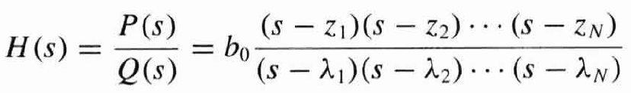


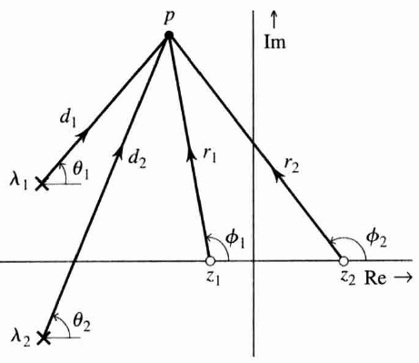


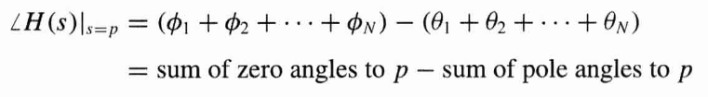
Effects of Poles & Zeros on Frequency Response
Consider a general system transfer function:
The value of the transfer function at some complex frequency s = p is:
zeros at z₁, z₂, …, z_{N}
poles at λ₁, λ₂, …, λ_{N}
j2
-5
-1
2
-j2

Slide 18
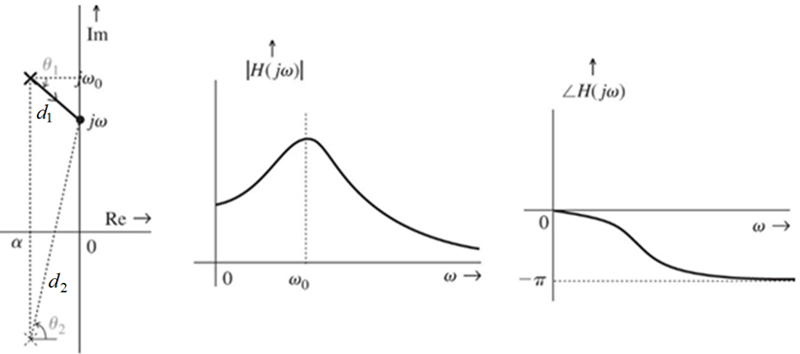


Poles Enhance Amplitude Frequency Response
- Frequency Response of a system is obtained by evaluating H(s) along the y-axis (i.e. taking all value of s = jω).
- Consider the effect of two complex system poles on the frequency response.
$$\left|H(jω)\right|=\frac{1}{d_{1}d_{2}}$$
$$∠H\left(jω\right)=−\left(θ_{1}+θ_{2}\right)$$
Systems amplify frequencies near a pole

Slide 19
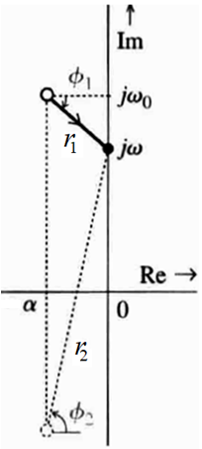
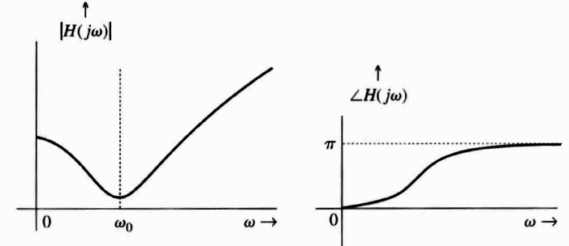


Zeros Suppresses Amplitude Frequency Response
Consider the effect of two complex system zeros on the frequency response.
$$\left|H(jω)\right|=r_{1}r_{2}$$
$$∠H\left(jω\right)=\left(∅_{1}+∅_{2}\right)$$
Systems suppress frequencies near a zero

Slide 20
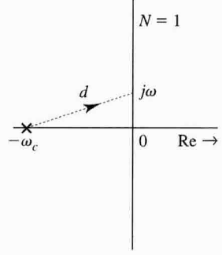
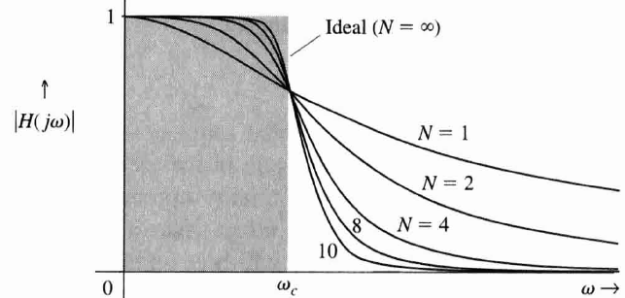
Low-pass Filters
- Use the enhancement and suppression properties of poles & zeros to design filters.
- Low-pass filter (LPF) has maximum gain at ω=0, and the gain decreases as ω increase.
- Simplest LPF has a single pole on real axis, say at (s=-ω_{c}), then
- To have an ideal LPF (i.e. very sharp cut-off at ω_{c}), we need a WALL OF POLE as
shown, the more poles we get, the sharper the cut-off.
x
jω_{c}
x
x
x
0
Re→
x
x
x
-jω_{c}
Butterworth Filter

Slide 21
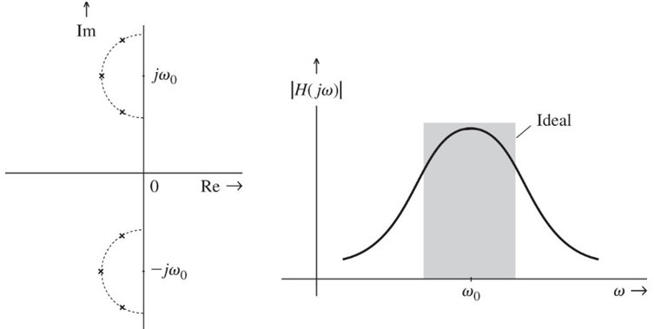
Band-pass Filter
- Band-pass filter has gain enhanced over the entire passband, but suppressed
elsewhere.
- For a passband centred around ω₀, we place many poles in a semicircle where its center is ω₀ and diameter equals the difference between the upper ω₂ and lower cutoff frequencies ω₁.
ω₂
ω₁
ω₁
ω₂

Slide 22
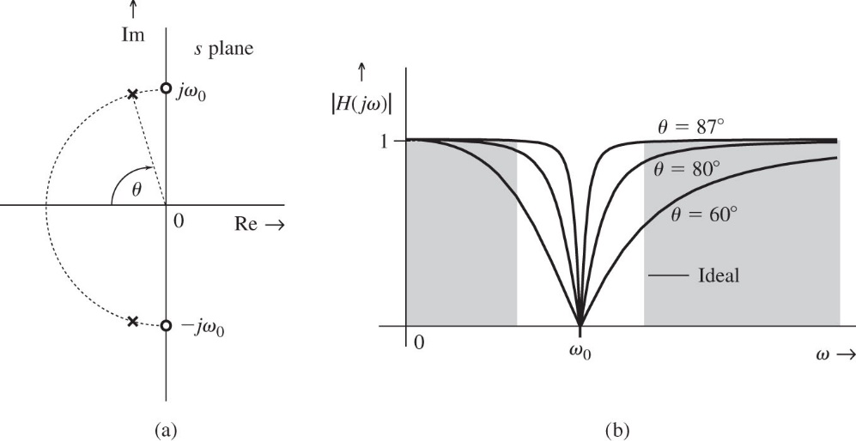
Notch Filter
A notch filter suppresses specific frequency component such as ω₀ in a signal and allows other frequencies to pass without attenuation. To suppress ω₀, two zeros are placed in ±jω₀.
To allow other frequencies to pass without attenuation two poles should be placed near the two zeros in the semicircle in left hand side plane.

Slide 23
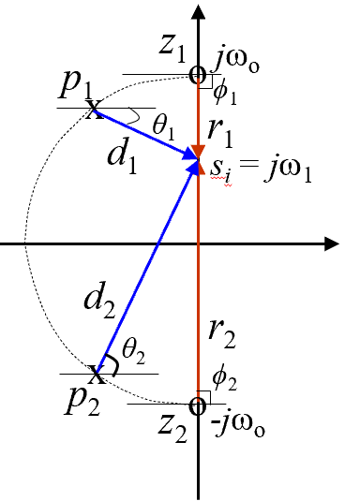
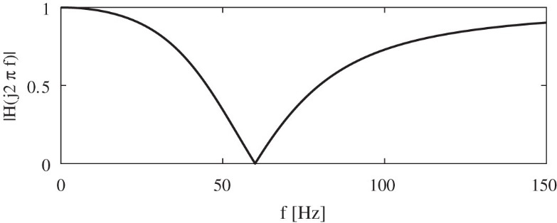
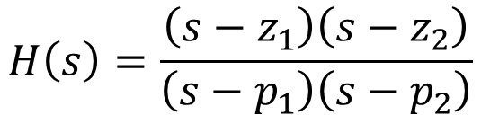
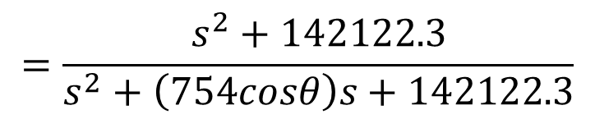
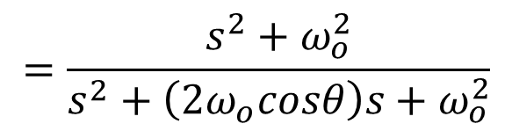
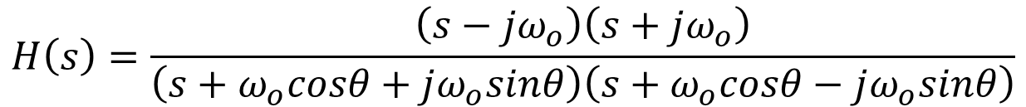
Notch Filter Design by Poles and Zeros Positioning
Design a second-order notch filter to suppress 60 Hz hum in a radio receiver.
$$H\left(s\right)=\frac{\left(s−z_{1}\right)\left(s−z_{2}\right)}{\left(s−p_{1}\right)\left(s−p_{2}\right)}$$
$$H\left(s\right)=\frac{\left(s−jω_{o}\right)\left(s+jω_{o}\right)}{\left(s+ω_{o}cosθ+jω_{o}sinθ\right)\left(s+ω_{o}cosθ−jω_{o}sinθ\right)}$$
$$=\frac{s^{2}+ω_{o}^{2}}{s^{2}+\left(2ω_{o}cosθ\right)s+ω_{o}^{2}}$$
$$=\frac{s^{2}+142122.3}{s^{2}+\left(754cosθ\right)s+142122.3}$$
θ = 60º

