Slide 1
ENGR 3323: Signals and Systems
Ch6
Continuous-Time Signal Analysis
Engineering and Physics
University of Central Oklahoma
Dr. Mohamed Bingabr

Slide 2
Outline
Introduction
Fourier Series (FS) Representation of Periodic Signals.
Trigonometric and Exponential Form of FS.
Gibbs Phenomenon.
Parseval’s Theorem.
Simplifications Through Signal Symmetry.
LTIC System Response to Periodic Inputs.

Slide 3
Sinusoidal Wave and phase
x(t) = Asin(ωt) = Asin(2π50t)
x(t)
A
t
T₀ = 20 msec
x(t-0.0025)= Asin(2π50[t - 0.0025])
= Asin(2π50t - 0.25π)= Asin(2π50t - 45º)
A
t
t_{d} = 2.5 msec
Time delay t_{d} = 2.5 msec correspond to phase shift θ = 45º

Slide 4
Representation of Quantity using Basis
Any number can be represented as a linear sum of the basis number {1, 10, 100, 1000}
Ex: 10437 =10(1000) + 4(100) + 3(10) +7(1)
Any 3-D vector can be represented as a linear sum of the basis vectors {[1 0 0], [0 1 0], [0 0 1]}
Ex: [2 4 5]= 2 [1 0 0] + 4[0 1 0]+ 5[0 0 1]

Slide 5
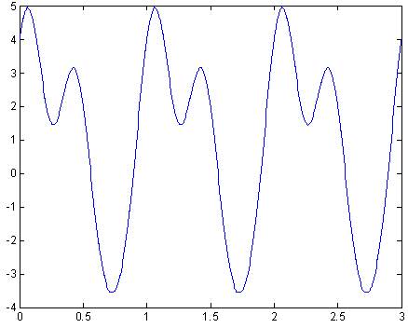
Basis Functions for Time Signal
Any periodic signal x(t) with fundamental frequency ω₀ can be represented by a linear sum of the basis functions {1, cos(ω₀t), cos(2ω₀t),…, cos(nω₀t), sin(ω₀t), sin(2ω₀t),…, sin(nω₀t)}
Ex:
x(t) =1+ cos(2πt)+ 2cos(2 π2t)+ 0.5sin(2π3t)+ 3sin(2πt)

Slide 6
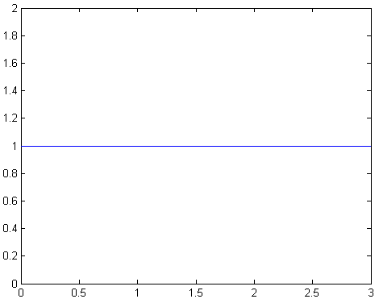
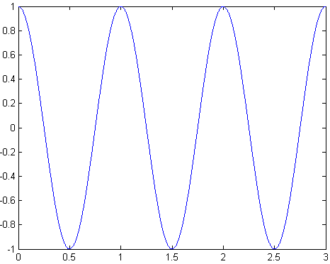
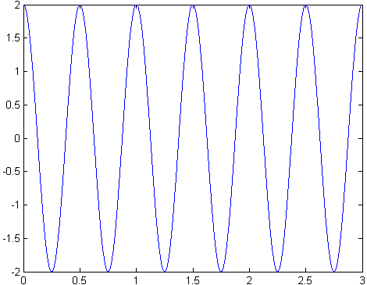
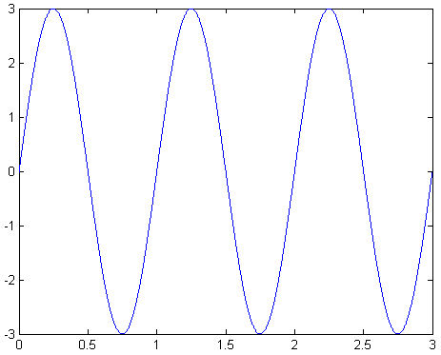
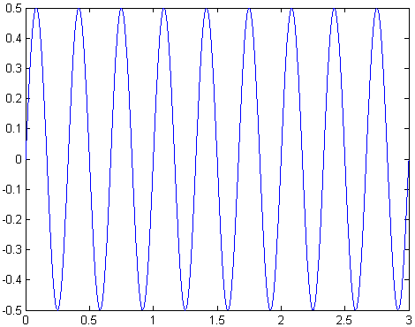
x(t) =1+ cos(2πt)+ 2cos(2 π2t)+ 3sin(2πt)+ 0.5sin(2π3t)
+
+
+
=

Slide 7
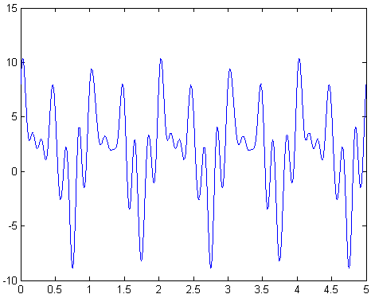
Purpose of the Fourier Series (FS)
FS is used to find the frequency components and their strengths for a given periodic signal x(t).

Slide 8
The Three forms of Fourier Series
Trigonometric Form
Compact Trigonometric (Polar) Form.
Complex Exponential Form.

Slide 9
Trigonometric Form
It is simply a linear combination of sines and cosines at multiples of its fundamental frequency, f₀=1/T.
a₀ counts for any dc offset in x(t).
a₀, a_{n}, and b_{n} are called the trigonometric Fourier Series Coefficients.
The n^{th} harmonic frequency is nf₀.

Slide 10
Trigonometric Form
How to evaluate the Fourier Series Coefficients (FSC) of x(t)?
To find a₀ integrate both side of the equation over a full period

Slide 11
Trigonometric Form
To find a_{n} multiply both side by cos(2πmf₀t) and then integrate over a full period, m =1,2,…,n,…∞
To find b_{n} multiply both side by sin(2πmf₀t) and then integrate over a full period, m =1,2,…,n,…∞

Slide 12
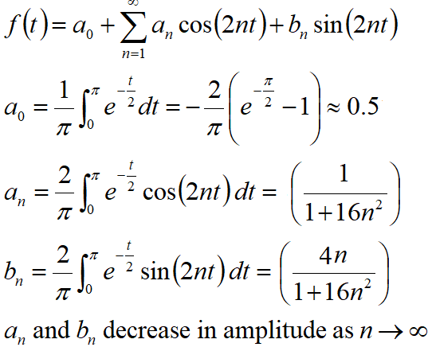
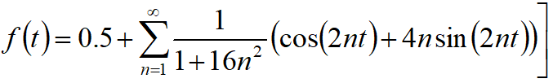
Example
f(t)
1
e^{-t/2}
−π
0
π
Fundamental period
T₀ = π
Fundamental frequency
f₀ = 1/T₀ = 1/π Hz
ω₀ = 2π/T₀ = 2 rad/s
To what value does the FS converge at the point of discontinuity?

Slide 13
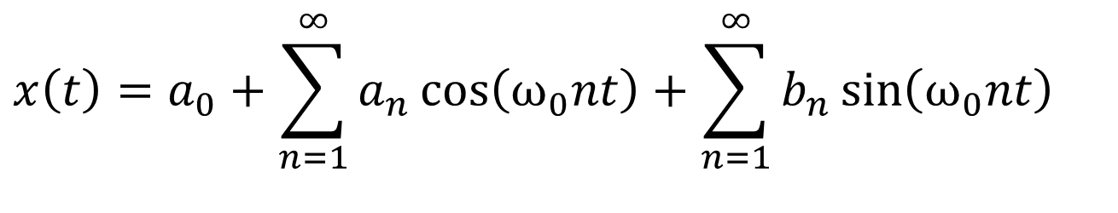
Simplifications Through Signal Symmetry
$$x\left(t\right)=a_{0}+\sum_{n=1}^{∞}{a_{n}\cos\left(ω_{0}nt\right)+\sum_{n=1}^{∞}{b_{n}\sin\left(ω_{0}nt\right)}}$$
If x (t) is EVEN: It must contain Cosine Terms and it may contain DC. Hence b_{n} = 0.
If x(t) is ODD: It must contain ONLY Sines Terms. Hence a₀ = a_{n} = 0.

Slide 14
Dirichlet Conditions
A periodic signal x(t), has a Fourier series if it satisfies the following conditions:
x(t) is absolutely integrable over any period, namely
x(t) has only a finite number of maxima and minima over any period
x(t) has only a finite number of discontinuities over any period

Slide 15
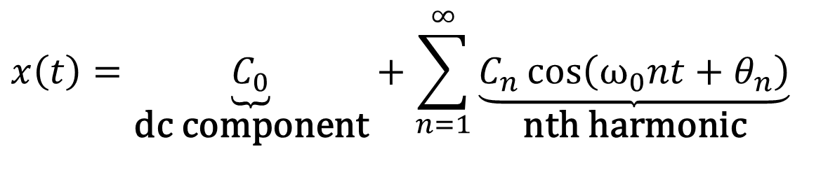
Compact Trigonometric Form
Using single sinusoid,
are related to the trigonometric coefficients a_{n} and b_{n} as:
$$x\left(t\right)=\underset{\text{dc} \text{component}}{\underbrace{C_{0}}}+\sum_{n=1}^{∞}{\underset{\text{nth} \text{harmonic}}{\underbrace{C_{n}\cos\left(ω_{0}nt+θ_{n}\right)}}}$$
and
The above relationships are obtained from the trigonometric identity
a cos(x) + b sin(x) = c cos(x + θ)

Slide 16
Compact Trigonometric Form
$$x\left(t\right)=a_{0}+\sum_{n=1}^{∞}{a_{n}\cos\left(ω_{0}nt\right)+\sum_{n=1}^{∞}{b_{n}\sin\left(ω_{0}nt\right)}}$$
a cos(x) + b sin(x) = c cos(x + θ)

Slide 17
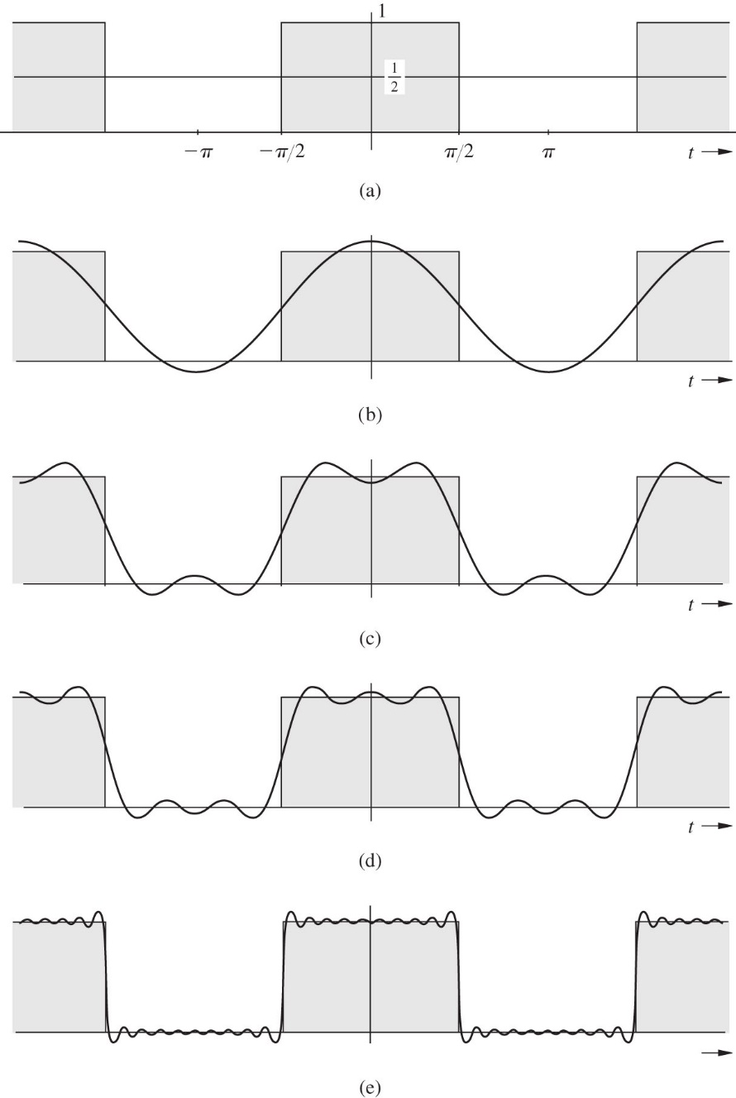
Role of Amplitude in Shaping Waveform

Slide 18
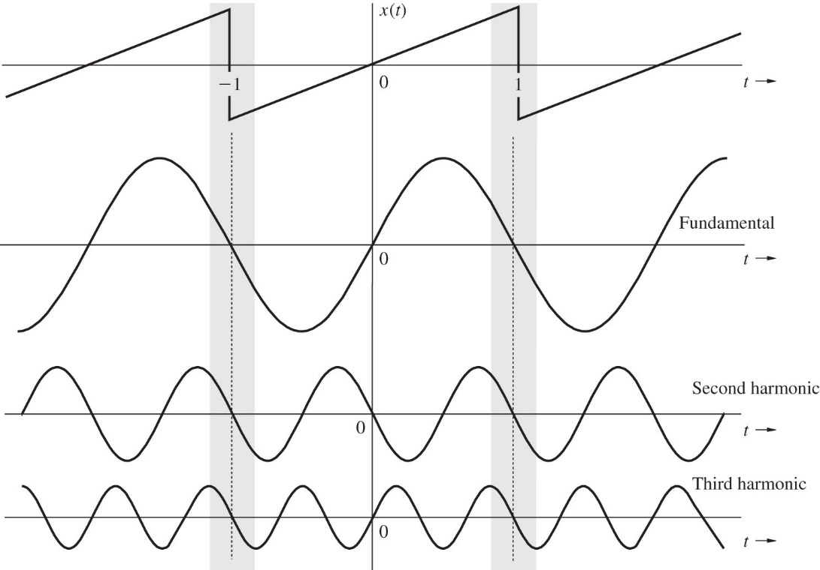
Role of the Phase in Shaping a Periodic Signal

Slide 19
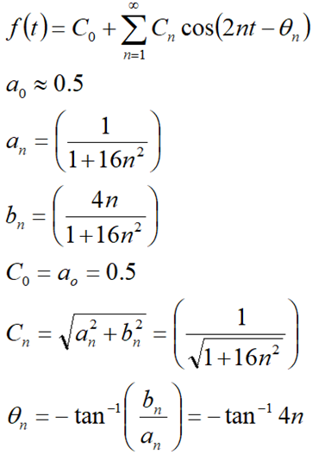

Compact Trigonometric
f(t)
1
e^{-t/2}
−π
0
π
Fundamental period
T₀ = π
Fundamental frequency
f₀ = 1/T₀ = 1/π Hz
ω₀ = 2π/T₀ = 2 rad/s

Slide 20
Line Spectra of x(t)
The amplitude spectrum of x(t) is defined as the plot of the magnitudes |C_{n}| versus ω
The phase spectrum of x(t) is defined as the plot of the angles versus ω
This results in line spectra
Bandwidth as the difference between the highest and lowest frequencies of the spectral components of a signal.

Slide 21
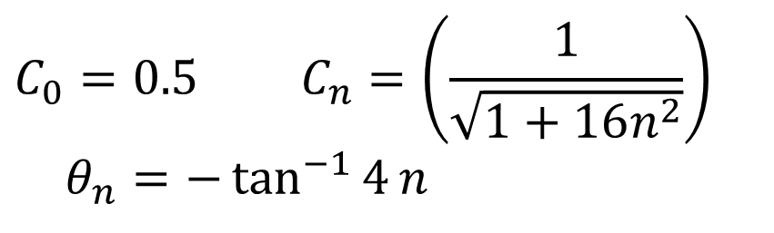
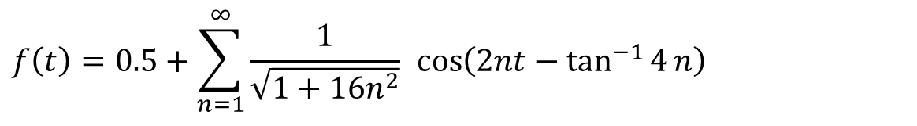
Line Spectra
f(t)
$$C_{0}=0.5 C_{n}=\left(\frac{1}{\sqrt{1+16n^{2}}}\right) \\ θ_{n}=−\tan^{−1}{4}n$$
1
e^{-t/2}
−π
0
π
$$f\left(t\right)=0.5+\sum_{n=1}^{∞}{\frac{1}{\sqrt{1+16n^{2}}} \cos\left(2nt−\tan^{−1}{4}n\right)}$$
f(t)=0.5 + 0.24 cos(2t-76º) + 0.12 cos(4t-82.9º) +
0.08 cos(6t-85.2º) + 0.06 cos(8t-86.2º) + …
C_{n}
θ_{n}
0.5
0 2 4 6
ω
0.24
0.12
0.08
-π/2
0.06
0.05
ω
0 2 4 6 8 10

Slide 22


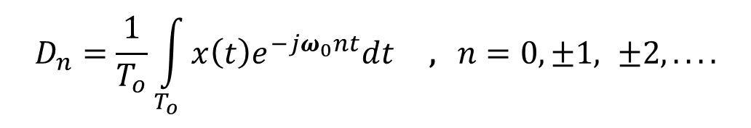
Exponential Form
x(t) can be expressed as
$$x\left(t\right)=\sum_{n=−∞}^{∞}{D_{n}e^{jω_{0}nt}}$$
$$e^{−jω_{0}nt}$$
To find D_{n} multiply both side by and then integrate over a full period, m =1,2,…,n,…∞
$$D_{n}=\frac{1}{T_{o}}\int_{T_{o}}{x\left(t\right)e^{−jω_{0}nt}dt}\text{ , }n=0,±1, ±2,....$$
D_{n} is a complex quantity in general D_{n}=|D_{n}|e^{jθ}
D_{-n} = D_{n}*
|D_{n}|=|D_{-n}|
&
D_{n} = - D_{-n}
Even
Odd
D₀ is called the constant or dc component of x(t)

Slide 23
Line Spectra of x(t) in the Exponential Form
The line spectra for the exponential form has negative frequencies because of the mathematical nature of the complex exponent.
C₀ = D₀
C_{n} = 2|D_{n}|
C_{n} = D_{n}

Slide 24
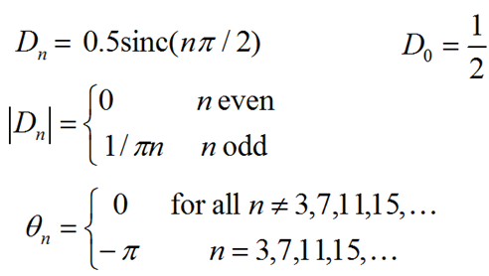
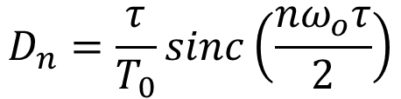
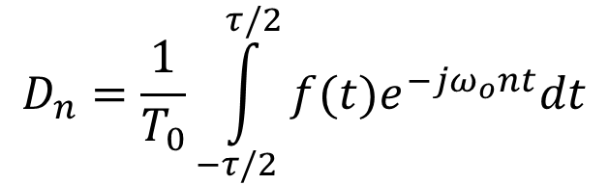
Example
Find the exponential Fourier Series for the square-pulse periodic signal.
f(t)
1
$$D_{n}=\frac{1}{T_{0}}\int_{−τ/2}^{τ/2}{f(t)e^{−jω_{o}nt}dt}$$
−Τ_{ο}
−Τ_{ο}/2
−τ/2
τ/2
Τ_{ο}
Τ_{ο}/2
$$D_{n}=\frac{τ}{T_{0}}sinc\left(\frac{{nω}_{o}τ}{2}\right)$$
If T_{o} = 2π and τ = π then

Slide 25
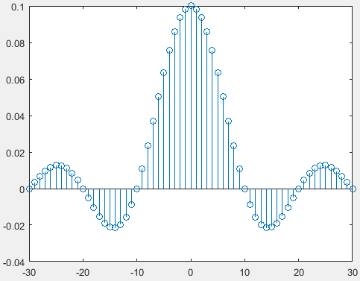
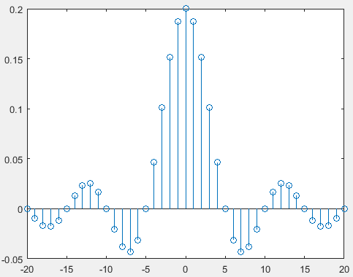
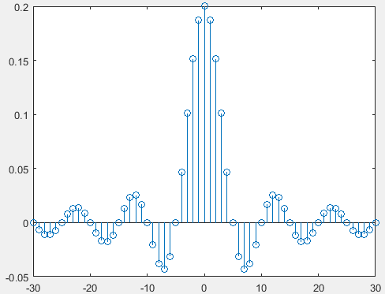

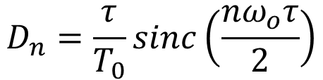





$$D_{n}=\frac{τ}{T_{0}}sinc\left(\frac{{nω}_{o}τ}{2}\right)$$
$$T0=π$$
$$τ=0.1π$$
f(t)
1
−Τ_{ο}
−Τ_{ο}/2
−τ/2
τ/2
Τ_{ο}
Τ_{ο}/2
$$T0=0.5π$$
$$T0=π$$
$$τ=0.1π$$
$$τ=0.2π$$

Slide 26
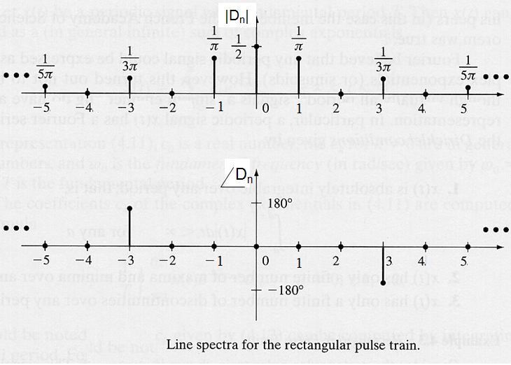
Exponential Line Spectra

Slide 27
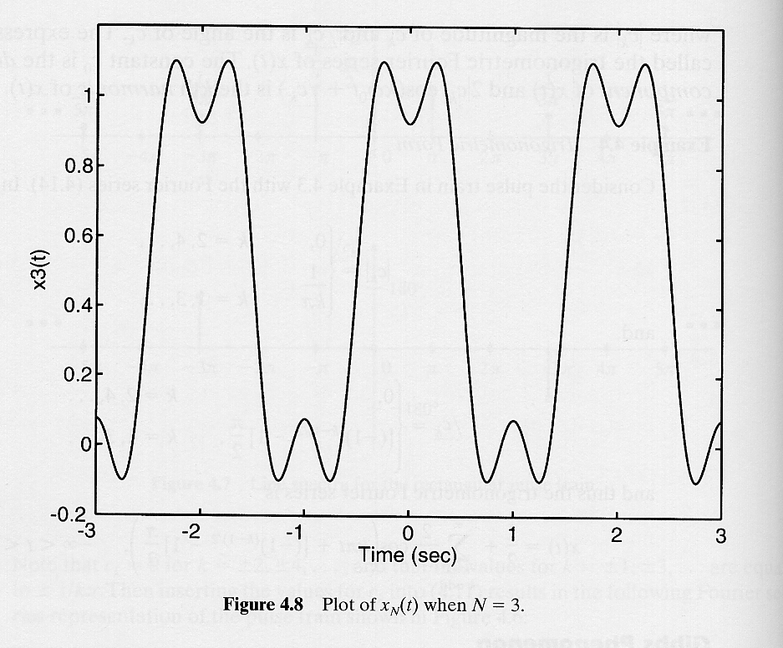
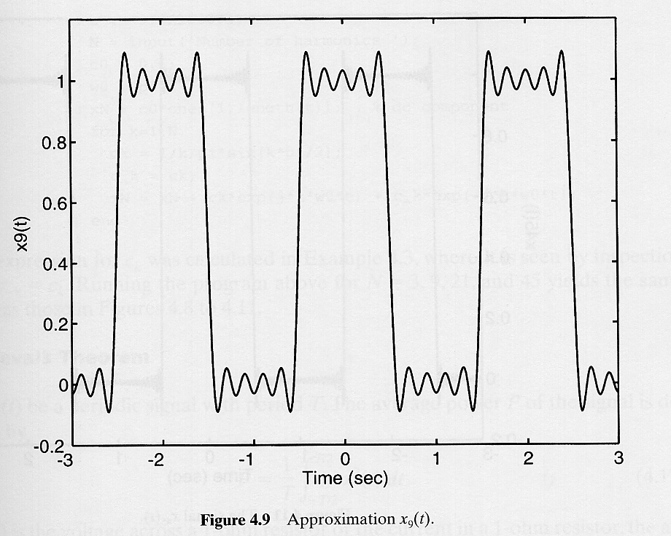
Gibbs Phenomenon

Slide 28
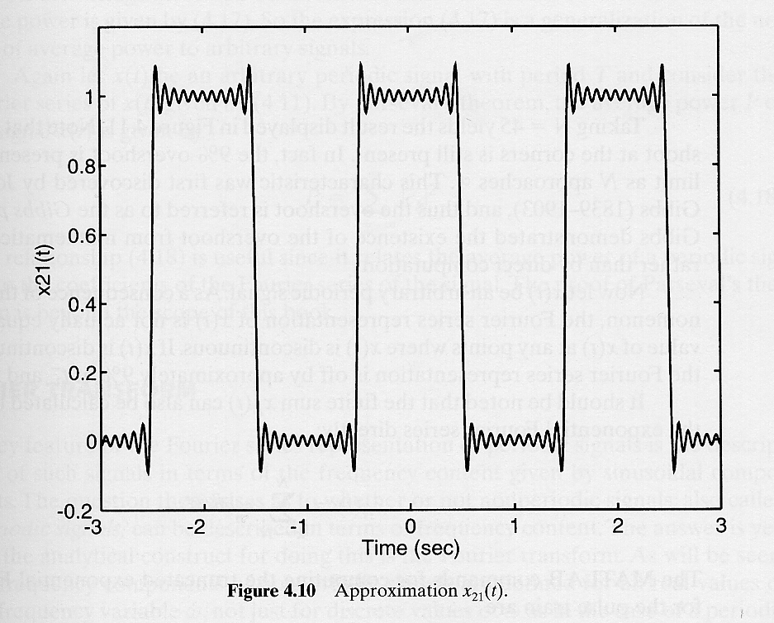
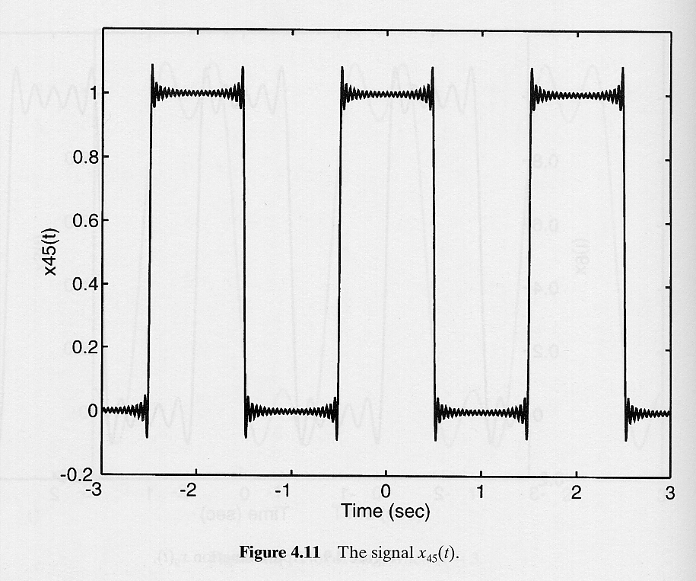
Gibbs Phenomenon – Cont’d
overshoot: about 9 % of the signal magnitude (present even if )

Slide 29
Example
Find the exponential Fourier Series and sketch the corresponding spectra for the impulse train shown below. From this result sketch the trigonometric spectrum and write the trigonometric Fourier Series.
Solution
-2T₀
-T₀
T₀
2T₀

Slide 30
Relationships between the Coefficients of the Different Forms

Slide 31
Parseval’s Theorem
Let x(t) be a periodic signal with period T
The average power P of the signal is defined as
Expressing the signal as
it is also

Slide 32
LTIC System Response to Periodic Inputs
H(s)
H(jω)
A periodic signal x(t) with period T₀ can be expressed as
For a linear system
H(s)
H(jω)

Slide 33
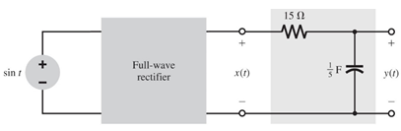

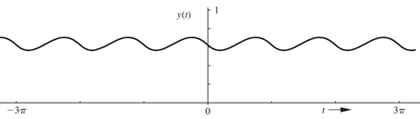
Fourier Series Analysis of DC Power Supply
A full-wave rectifier is used to obtain a dc signal from a sinusoid sin(ω₁t). The rectified signal x(t) is applied to the input of a lowpass RC filter, which suppress the time-varying component and yields a dc component with some residual ripple. Find the filter output y(t). Find also the dc output and the rms value of the ripple voltage.

Slide 34
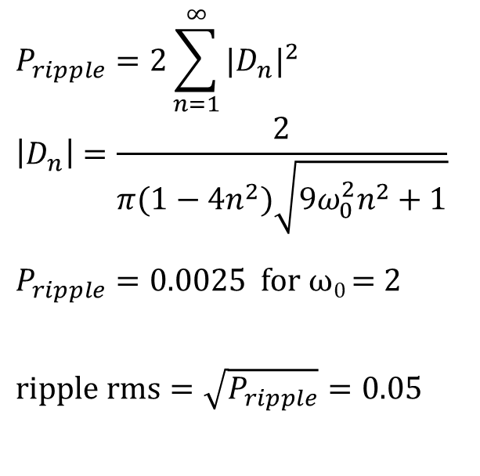
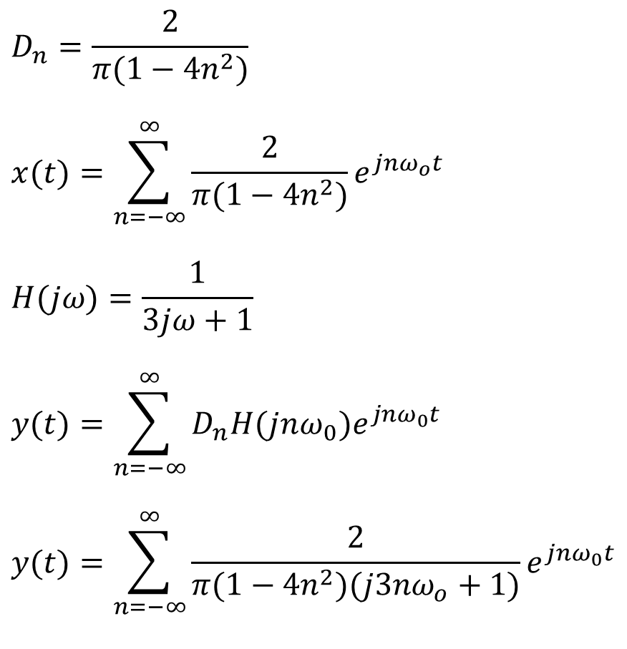

Fourier Series Analysis of DC Power Supply
$$D_{n}=\frac{2}{π(1−4n^{2})}$$
$$x(t)=\sum_{n=−∞}^{∞}{\frac{2}{π(1−4n^{2})}e^{jnω_{o}t}}$$
$$H(jω)=\frac{1}{3jω+1}$$
$$y(t)=\sum_{n=−∞}^{∞}{D_{n}H(jnω_{0})e^{jnω_{0}t}}$$
$$y(t)=\sum_{n=−∞}^{∞}{\frac{2}{π(1−4n^{2})(j3nω_{o}+1)}e^{jnω_{0}t}}$$
$$D_{0}=2/π P_{DC}=4/π^{2}$$
$$P_{ripple}=2\sum_{n=1}^{∞}{|D_{n}|^{2}} \\ \left|D_{n}\right|=\frac{2}{π(1−4n^{2})\sqrt{9ω_{0}^{2}n^{2}+1}}$$
$P_{ripple}=0.0025$ for ω₀ = 2
$$\text{ripple} \text{rms}=\sqrt{P_{ripple}}=0.05$$
Ripple rms is only 5% of the input amplitude

Slide 35
Fourier Series Analysis of DC Power Supply
clear all
t=0:1/1000:3*pi;
for i=1:100
n=i;
yp=(2*exp(j*2*n*t))/(pi*(1-4*n^2)*(j*6*n+1));
n=-i;
yn=(2*exp(j*2*n*t))/(pi*(1-4*n^2)*(j*6*n+1));
y(i,:)=yp+yn;
end
yf = 2/pi + sum(y);
plot(t,yf, t, (2/pi)*ones(1,length(yf)))
axis([0 3*pi 0 1]);
Power=0;
for n=1:50
Power(n) = abs(2/(pi*(1-4*n^2)*(j*6*n+1)));
end
TotalPower = 2*sum((Power.^2));
figure; stem( Power(1,1:20));
This Matlab code will plot y(t) for -100 ≤ n ≤ 100 and find the ripple power according to the equations below

