Slide 1
Continuous-Time Signal Analysis: The Fourier Transform
Chapter 7
Mohamed Bingabr

Slide 2
Chapter Outline
Aperiodic Signal Representation by Fourier Integral
Fourier Transform of Useful Functions
Properties of Fourier Transform
Signal Transmission Through LTIC Systems
Ideal and Practical Filters
Signal Energy
Applications to Communications
Data Truncation: Window Functions

Slide 3
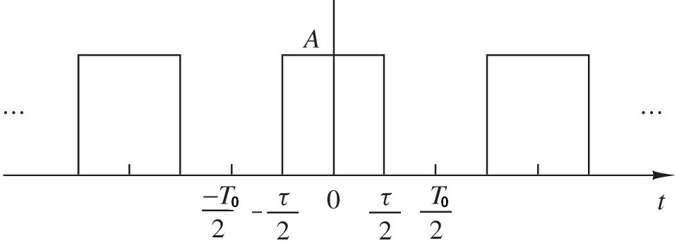
Link between FT and FS
Fourier series (FS) allows us to represent periodic signal in term of sinusoidal or exponentials e^{jnωot}.
Fourier transform (FT) allows us to represent aperiodic (not periodic) signal in term of exponentials e^{jωt}.
x_{To}(t)

Slide 4
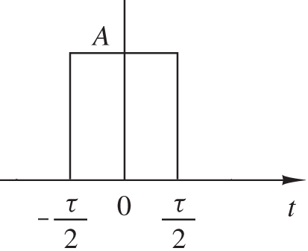
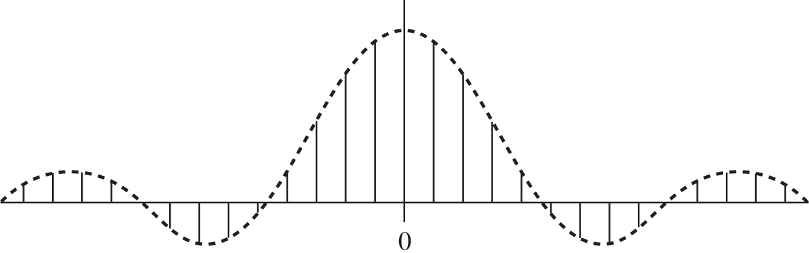
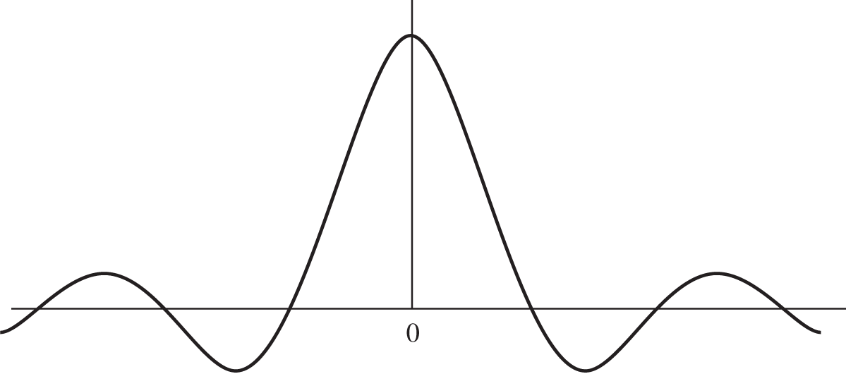
Link between FT and FS
x_{To}(t)
x(t)
As T₀ gets larger and larger the fundamental frequency ω₀ gets smaller and smaller, so the spectrum becomes continuous.
nω₀
ω

Slide 5
The Fourier Transform Spectrum
The Fourier transform:
The Amplitude (Magnitude) Spectrum
The Phase Spectrum
The amplitude spectrum is an even function and the phase is an odd function.
The Inverse Fourier transform:

Slide 6
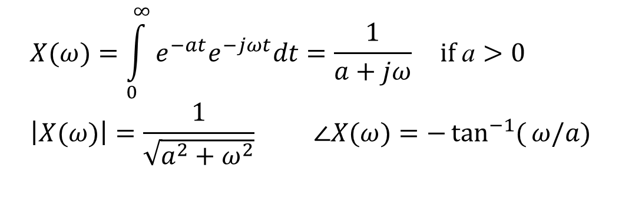
Example
Find the Fourier transform of x(t) = e^{-at}u(t), the magnitude, and the spectrum
Solution:
S-plane
s = σ + jω
$$X(ω)=\int_{0}^{∞}{e^{−at}e^{−jωt}dt}=\frac{1}{a+jω} \text{if} \text{a}>0 \\ \left|X(ω)\right|=\frac{1}{\sqrt{a^{2}+ω^{2}}} ∠X(ω)=−\tan^{−1}{(}ω/a)$$
jω
Re(s)
σ
How does X(ω) relates to X(s)?
-a
ROC
Since the jω-axis is in the region of convergence then FT exist.

Slide 7
Useful Functions
Unit Gate Function
1
x
-τ/2
τ/2
Unit Triangle Function
1
x
-τ/2
τ/2

Slide 8
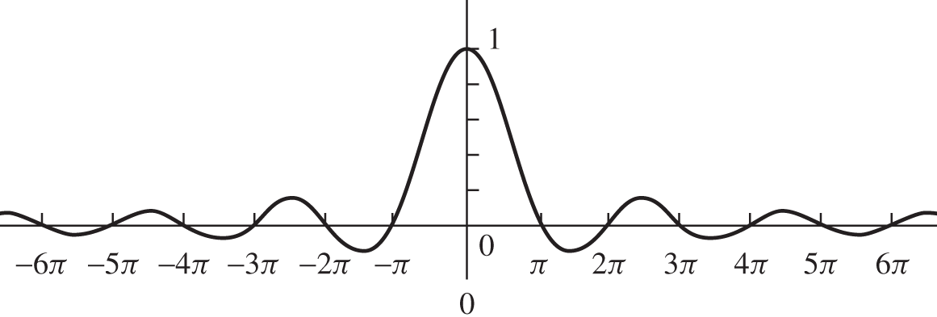
Useful Functions
Interpolation Function
sinc(x)
x

Slide 9
Example
Find the FT, the magnitude, and the phase spectrum of x(t) = rect(t/τ).
Answer
What is the bandwidth of the above pulse?
The spectrum of a pulse extend from 0 to ∞. However, much of the spectrum is concentrated within the first lobe (ω=0 to 2π/τ)

Slide 10
Examples
Find the FT of the unit impulse δ(t).
Answer
Find the inverse FT of δ(ω).
Answer

Slide 11
Examples
Find the inverse FT of δ (ω - ω₀).
Answer
Find the FT of the everlasting sinusoid cos(ω₀t).
Answer

Slide 12
Examples
Find the FT of a periodic signal.
Answer

Slide 13

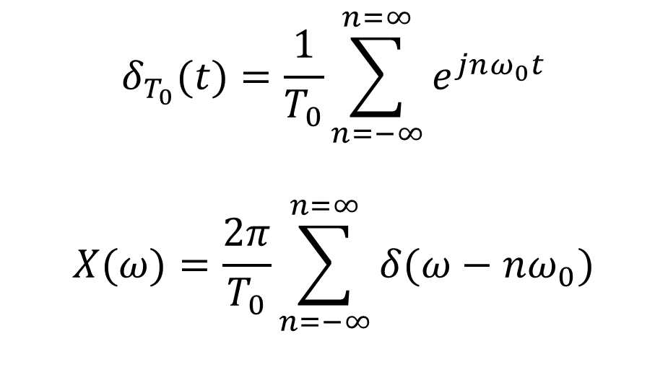
Examples
Find the FT of the unit impulse train
Answer
$$δ_{T_{0}}(t)=\frac{1}{T_{0}}\sum_{n=−∞}^{n=∞}{e^{jnω_{0}t}}$$
$$X(ω)=\frac{2π}{T_{0}}\sum_{n=−∞}^{n=∞}{δ(ω−nω_{0})}$$

Slide 14
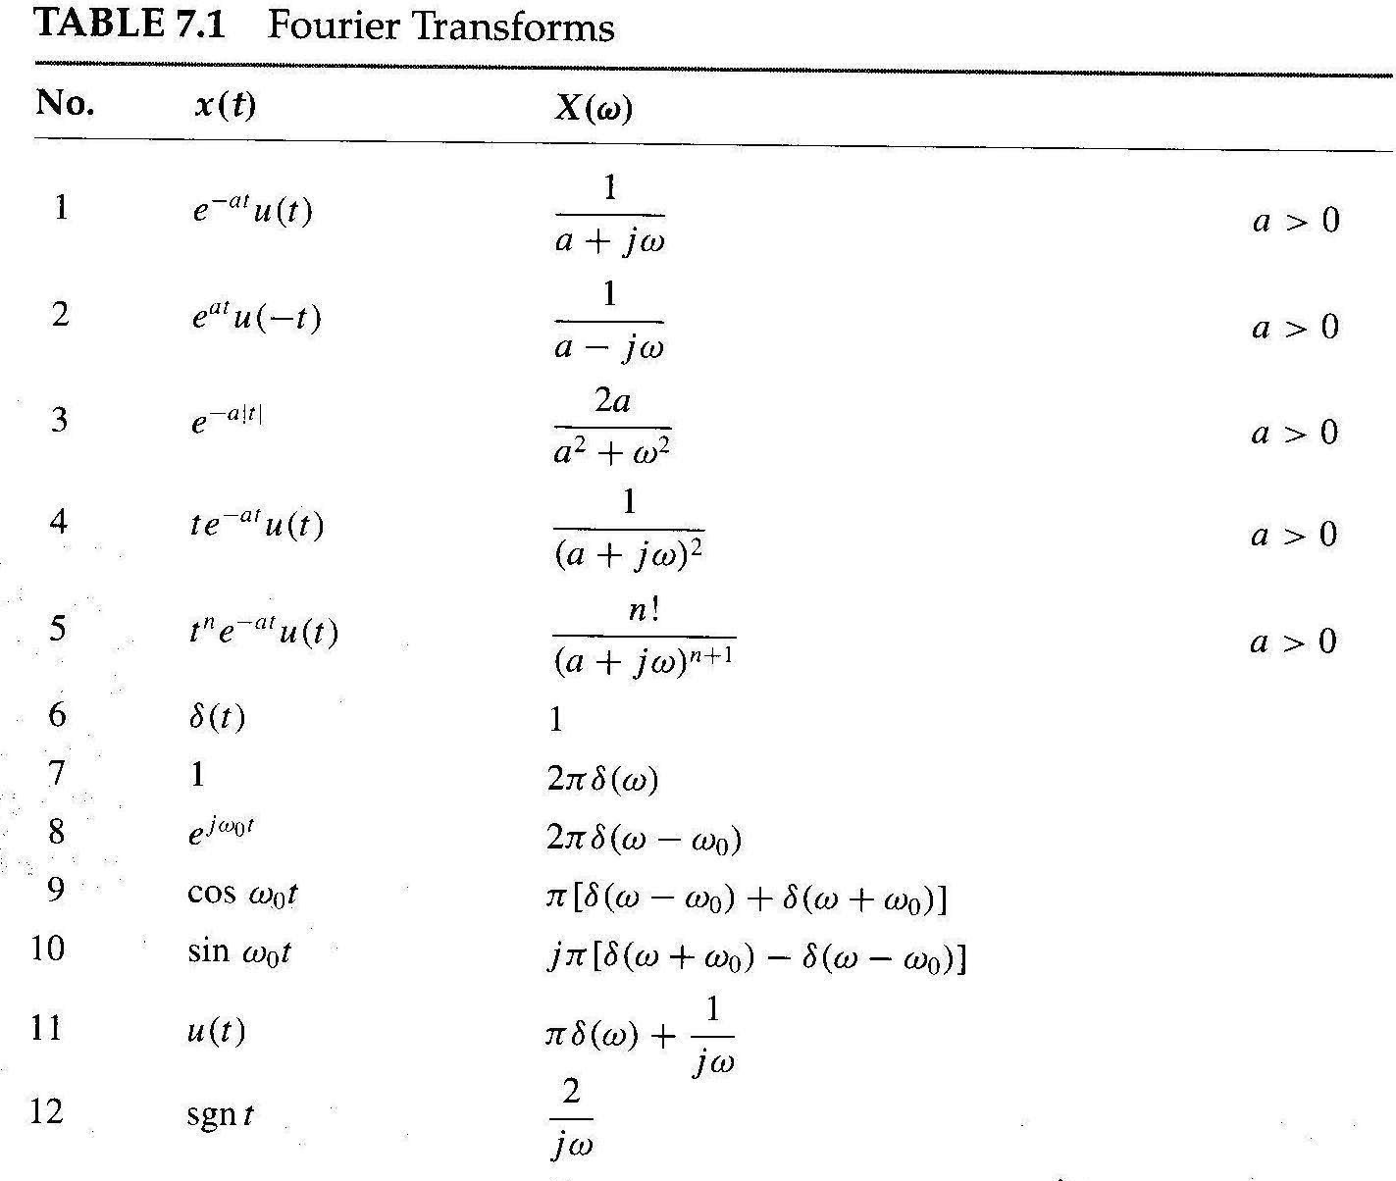

Slide 15
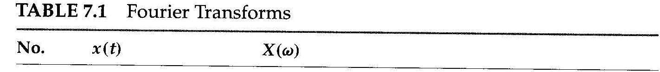
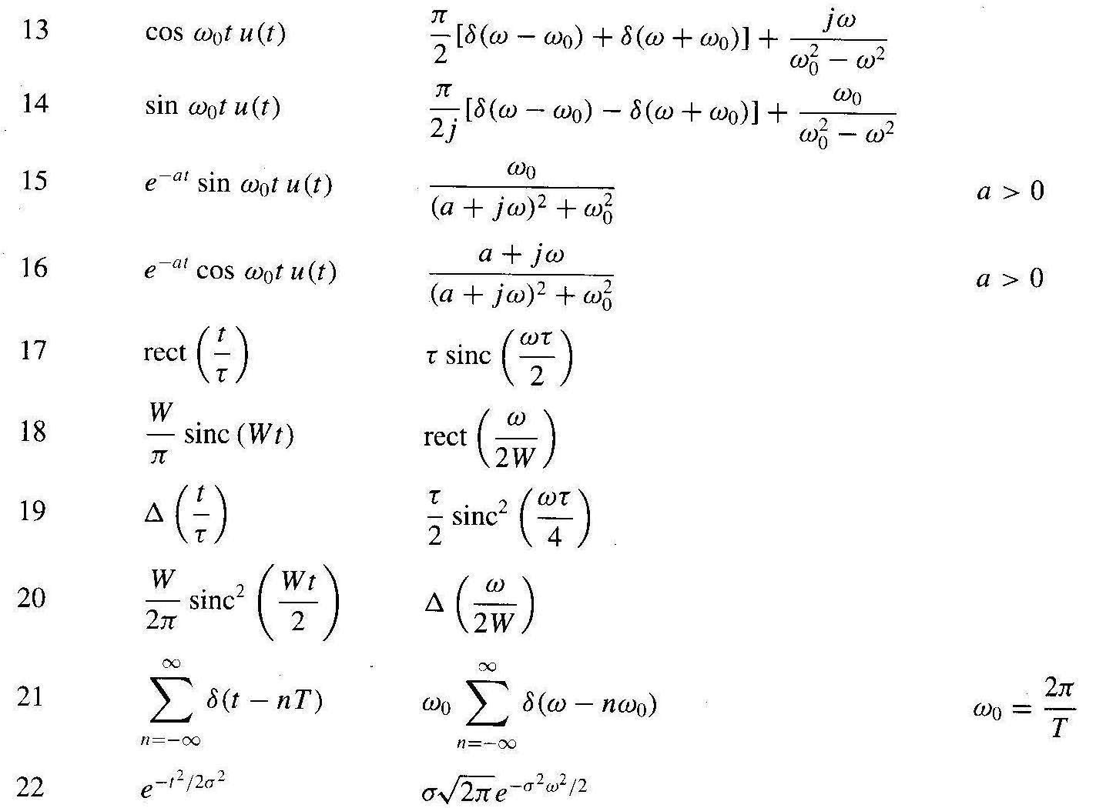

Slide 16
Properties of the Fourier Transform
Linearity
Let and
then
Time Scaling
Let
then
When a > 1 that leads to compression in the time domain which results in expansion in the frequency domain
Internet channel A can transmit 100k pulse/sec and channel B can transmit 200k pulse/sec. Which channel does require higher bandwidth?

Slide 17

Properties of the Fourier Transform
Time Reversal
Let
then
Example: Find the FT of e^{-a|t|}
Time shift effects the phase and not the magnitude.
Left or Right Shift in Time
Let
then
Example: Find the FT of and draw its magnitude and spectrum
$$e^{−a|t−t_{0}|}$$

Slide 18
Properties of the Fourier Transform
Multiplication by a Complex Exponential (Freq. Shift Property)
Let
then
Multiplication by a Sinusoid (Amplitude Modulation)
Let
then
cosω₀t is the carrier, x(t) is the modulating signal (message),
x(t) cosω₀t is the modulated signal.

Slide 19
Example: Amplitude Modulation
x(t)
Example: Find the FT for the signal
A
-2
2

Slide 20
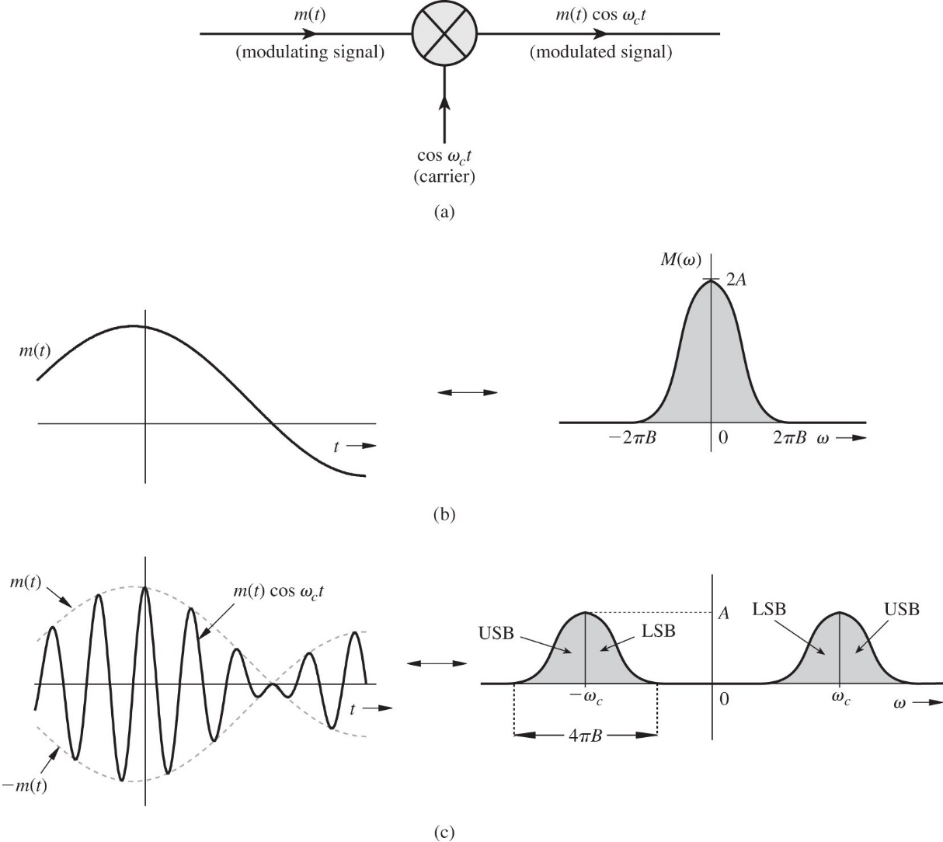
Transmitter: Amplitude Modulation
Modulation

Slide 21
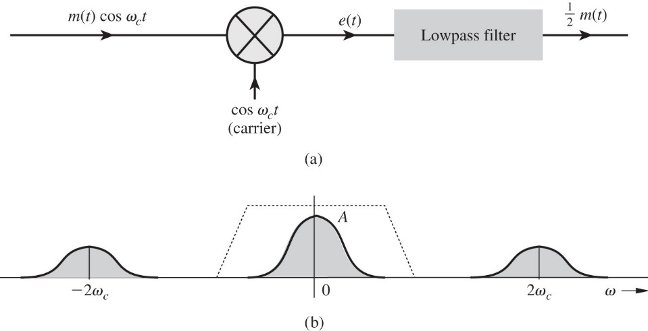
Receiver: Amplitude Demodulation
Demodulation
Then lowpass filtering

Slide 22
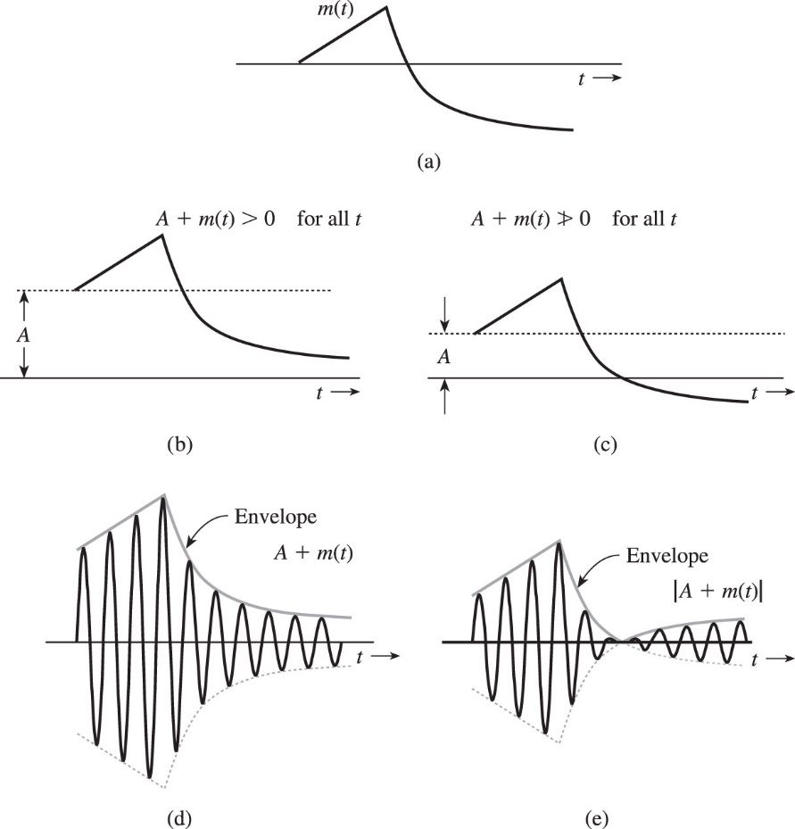
Amplitude Modulation: Envelope Detector

Slide 23
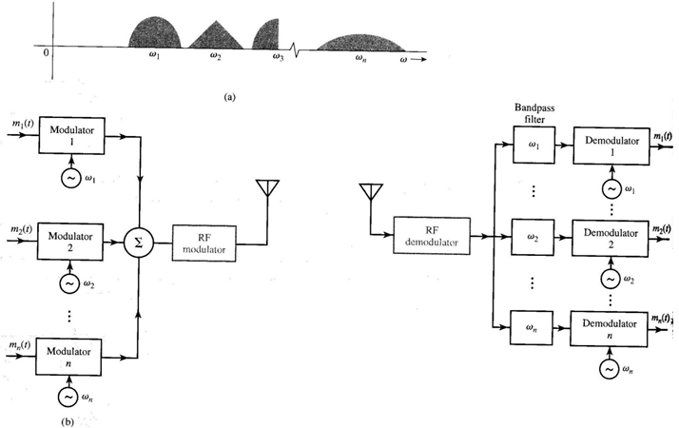
Applic. of Modulation: Frequency-Division Multiplexing
1- Transmission of different signals over different bands
2- Require smaller antenna
Transmitter
Receiver

Slide 24
Properties of the Fourier Transform
Differentiation in the Time Domain
Let
then
Convolution and Multiplication in the Time Domain
Let
then
Frequency convolution

Slide 25
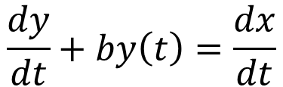
Properties of the Fourier Transform
Example
Find the system response to the input x(t) = e^{-at} u(t) if the system described by the differential equation
$$\frac{dy}{dt}+by\left(t\right)=\frac{dx}{dt}$$

Slide 26

Properties of the Fourier Transform
Duality ( Similarity)
Let
then
Example:
What is the Fourier transform of the signal x(t) = sinc(10t)?
x(t) X(ω)

Slide 27
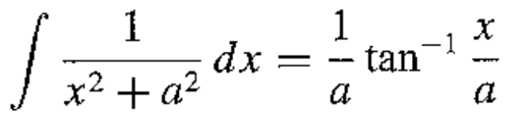
Energy of a Signal
Parseval’s Theorem
since x(t) is non-periodic and has FT X(ω), then it is an energy signals:
Real signal has even spectrum X(ω)= X(-ω),
Example
Find the energy of signal x(t) = e^{-at} u(t). Determine the frequency ω so that the energy contributed by the spectrum components of all frequencies below ω is 95% of the signal energy E_{X}.
Answer: ω = 12.7a rad/sec

Slide 28
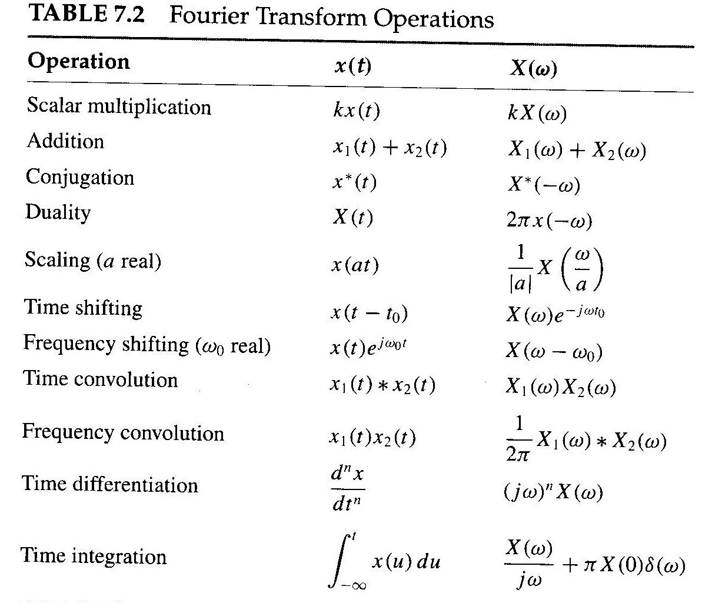

Slide 29
Data Truncation: Window Functions
1- Truncate x(t) to reduce numerical computation
2- Truncate h(t) to make the system response finite and causal
3- Truncate X(ω) to prevent aliasing in sampling the signal x(t)
4- Truncate D_{n} to synthesis the signal x(t) from few harmonics.
Truncation Window
Original Signal
Truncated Signal
What are the implications of data truncation?

Slide 30
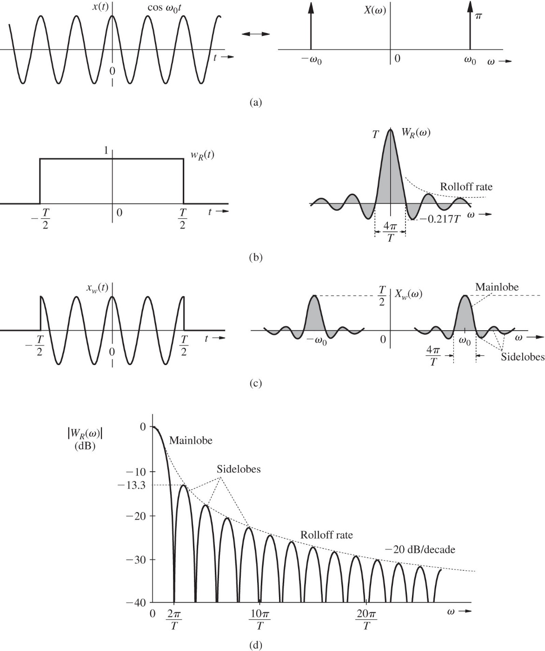
Implications of Data Truncation
1- Spectral spreading
2- Spectral leakage
3- Poor frequency resolution
What happened if x(t) has two spectral components of frequencies differing by less than 2π/T rad/s (1/T Hz)?
T > 1/f_{res}
The ideal window for truncation is the one that has
1- Smaller mainlobe width
2- Sidelobes with high rolloff rate
3- Small sidelobe peak

Slide 31
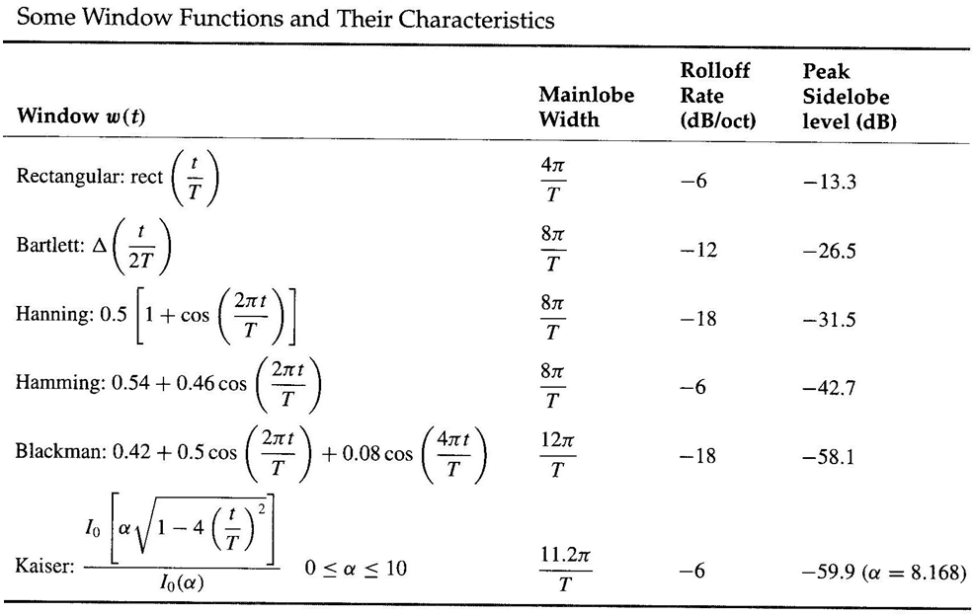
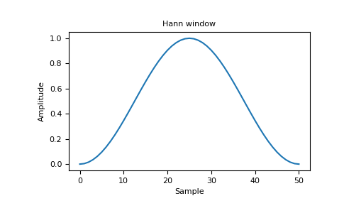
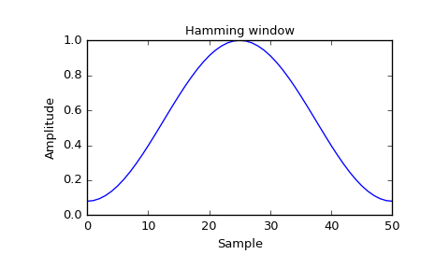
Data Truncation: Window Functions

Slide 32
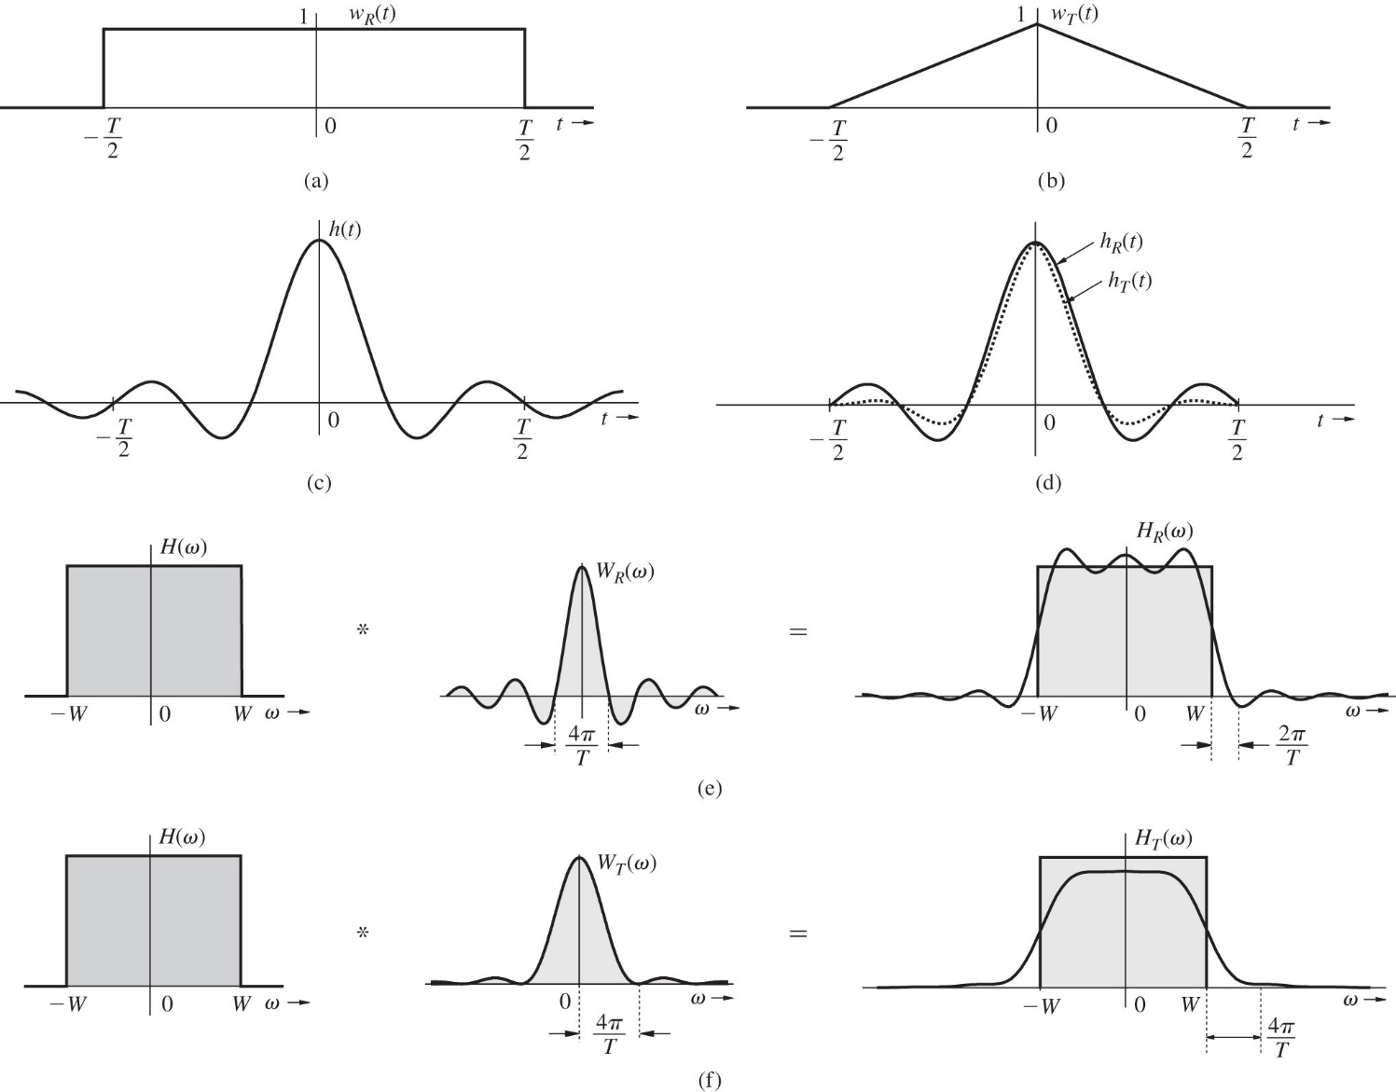
Using Windows in Filter Design
Chebyshev
Filter
Butterworth
Filter

