Slide 1
Sampling
Chapter 8
Mohamed Bingabr

Slide 2
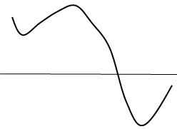
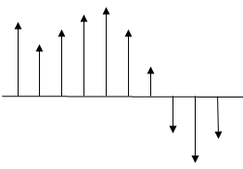
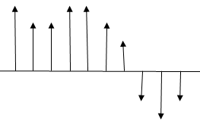
Analog to Digital Converter (ADC)
Sampling
Quantization
Binary Representation
Sampling
Quantization
Binary Coding
x(t)
x(nT)
x_{q}(nT)
x[n]
01100101 10001110

Slide 3
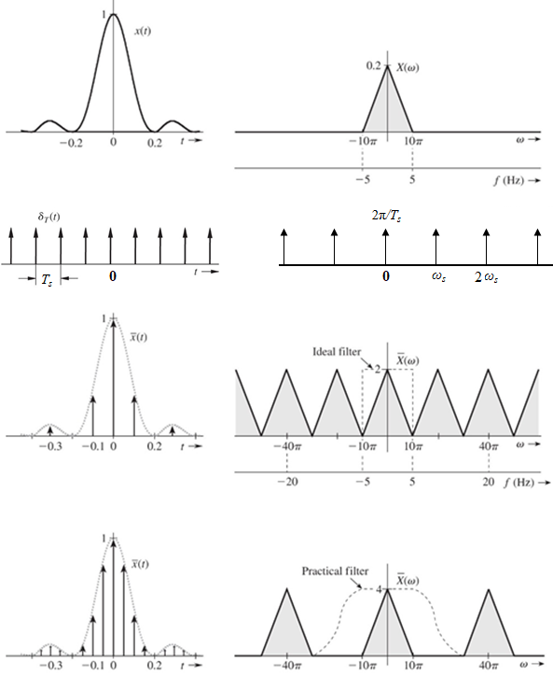
Sampling Theorem
Time Domain
Frequency Domain
Multiplication
Convolution

Slide 4
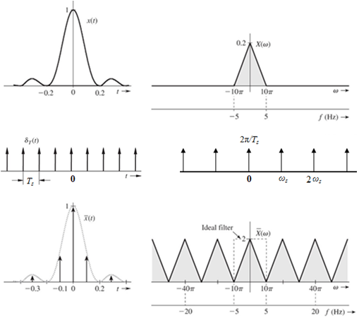



Sampling Theorem
A real signal whose spectrum is bandlimited to B Hz [X(ω) = 0 for |ω| > 2πB ] can be reconstructed exactly from its samples taken uniformly at a rate f_{s} > 2B samples per second. When f_{s}= 2B then f_{s} is the Nyquist rate.

Slide 5
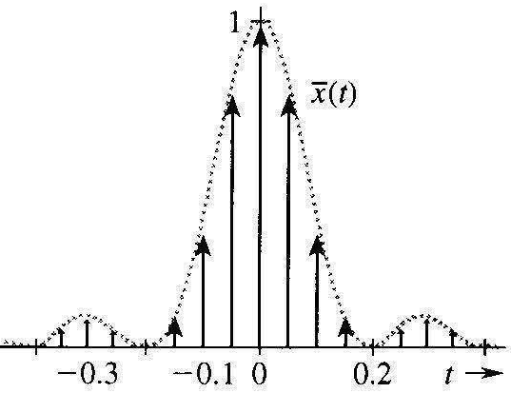
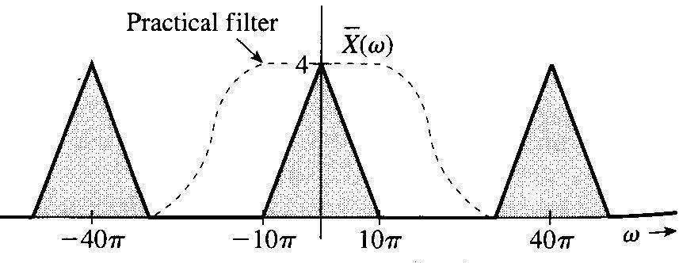

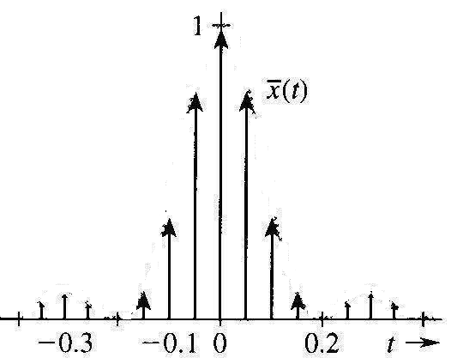

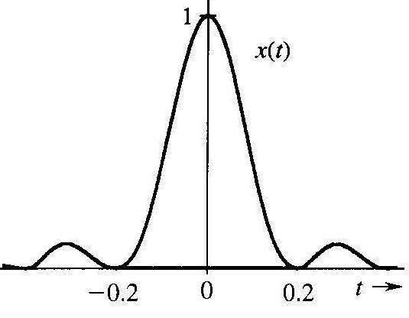
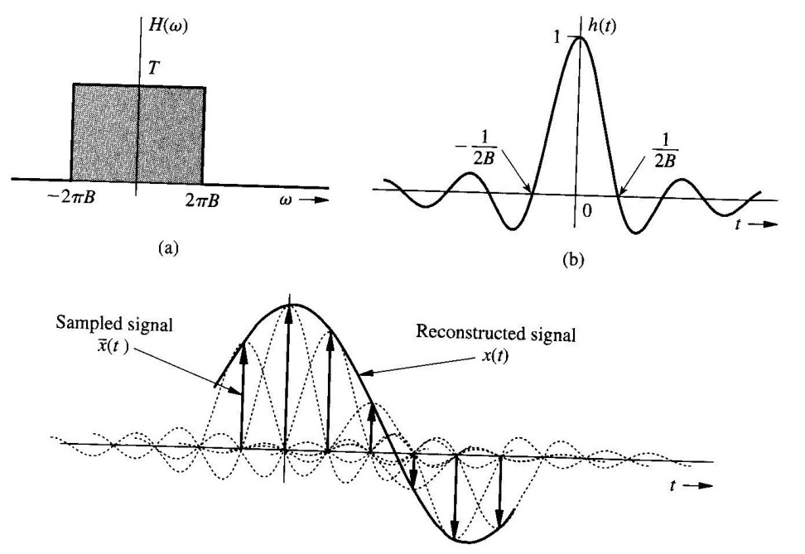


Reconstructing the Signal from the Samples
LPF

Slide 6
Example
Determine the Nyquist sampling rate for the signal
x(t) = 3 + 2 cos(10πt) + sin(30πt).
Solution
The highest frequency is f_{max} = 30π/2π = 15 Hz
The Nyquist rate = 2 f_{max} = 2*15 = 30 sample/sec

Slide 7
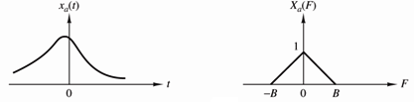
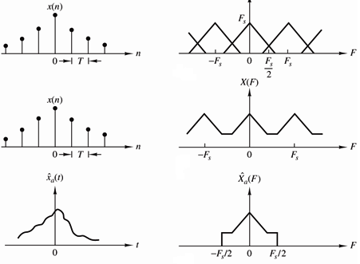
Aliasing
If a continuous time signal is sampled below the Nyquist rate then some of the high frequencies will appear as low frequencies and the original signal can not be recovered from the samples.
Frequency above f_{s}/2 will appear (aliased) as frequency below f_{s}/2
LPF
With cutoff frequency f_{s}/2
Apparent frequency
f_{a} =| f – mf_{s} | f_{a} < f_{s}/2 m =1, 2, ...
f =3100 f_{s} = 2000 f_{a} = ?

Slide 8
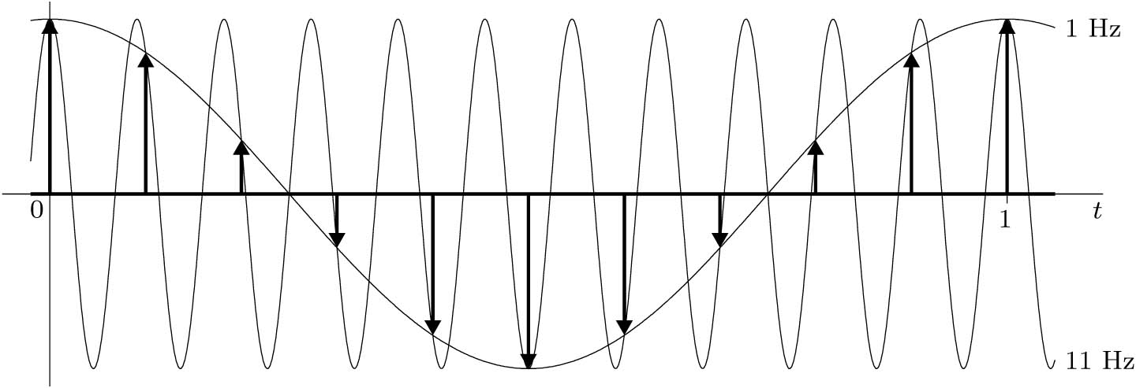
Aliasing
A sinusoid with 11 Hz frequency sampled with sampling rate f_{s} = 10 z.
f_{a} =| f – mf_{s} | f_{a} < f_{s}/2
-11
11
f =11 f_{s} = 10 f_{a} = ?
LPF with BW = 5
-21
-1
1
21

Slide 9
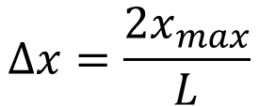
Quantization & Binary Representation
x(t)
4
3
2
1
0
-1
-2
-3
-4
Δx
L : number of levels
n : Number of bits
Quantization error = Δx/2
4
3
2
1
0
-1
-2
-3
-4
111
110
101
100
011
010
001
000
$$∆x=\frac{2x_{max}}{L}$$

Slide 10
Example
A 5 minutes segment of music sampled at 44000 samples per second. The amplitudes of the samples are quantized to 1024 levels. Determine the size of the segment in bits.
Solution
# of bits per sample = ln(1024) { remember L=2^{n} }
n = 10 bits per sample
# of bits = 5 * 60 * 44000 * 10 = 13200000 = 13.2 Mbit

Slide 11
Problem 8.3-4
Five telemetry signals, each of bandwidth 1 KHz, are quantized and binary coded, These signals are time-division multiplexed (signal bits interleaved). Choose the number of quantization levels so that the maximum error in the peak signal amplitudes is no greater than 0.2% of the peak signal amplitude. The signal must be sampled at least 20% above the Nyquist rate. Determine the data rate (bits per second) of the multiplexed signal.

Slide 12
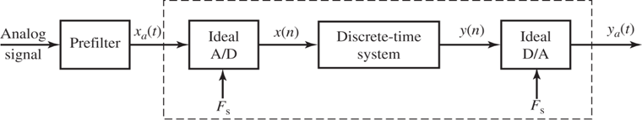
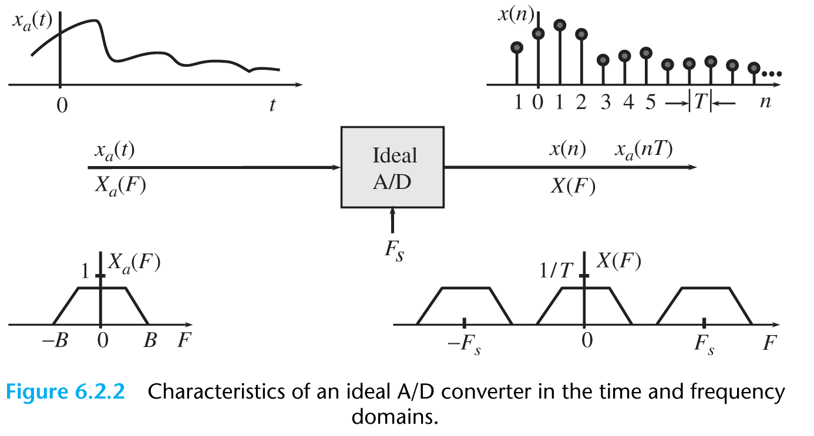
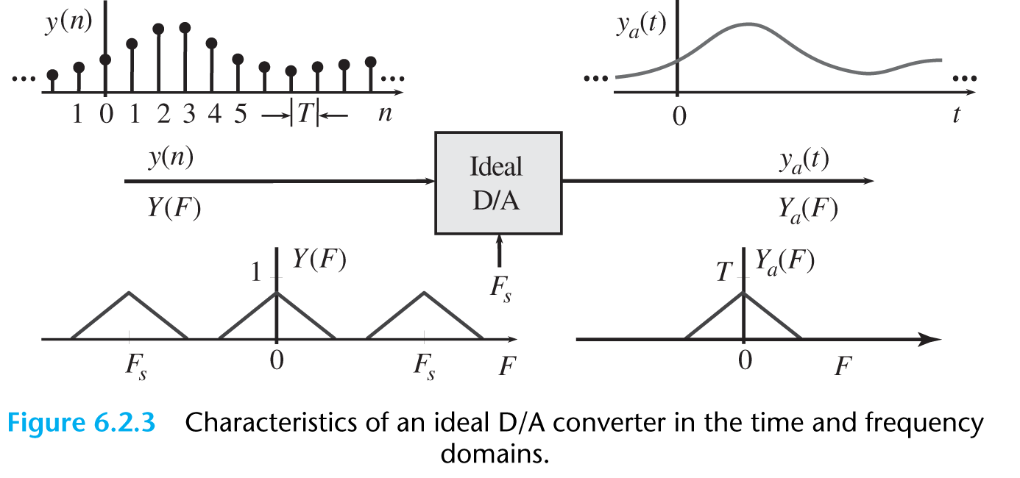
Discrete-Time Processing of Continuous-Time Signals

