Slide 1
Object Oriented Methodology Lab
Md. Mujahid Islam
Software Developer & Guest Lecturer

Slide 2
What Is an Object?
Real-world objects share two characteristics: They all have state and behavior. Dogs have state (name, color, breed, hungry) and behavior (barking, fetching, wagging tail). Bicycles also have state (current gear, current pedal cadence, current speed) and behavior (changing gear, changing pedal cadence, applying brakes).
For each object that you see, ask yourself two questions: "What possible states can this object be in?" and "What possible behavior can this object perform?".

Slide 3
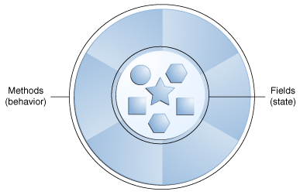
What Is an Object?

Slide 4
What is Object Oriented Methodology?
Object Oriented Methodology (OOM) is a system development approach encouraging and facilitating re-use of software components. With this methodology, a computer system can be developed on a component basis which enables the effective re-use of existing components and facilitates the sharing of its components by other systems.
By the adoption of OOM, higher productivity, lower maintenance cost and better quality can be achieved.
This methodology employs international standard Unified Modeling Language (UML) from the Object Management Group (OMG). UML is a modeling standard for OO analysis and design which has been widely adopted in the IT industry.

Slide 5
HISTORY OF OOM
The use of OOM for analysing and designing systems began to mature towards 1990 with the launch of methodologies from the three industry-leading methodologists : Ivar Jacobson, Grady Booch and James Rumbaugh.
In 1989, the Object Management Group (OMG) was founded. The mission of OMG is to establish industry guidelines, detailed object management specifications and common frameworks for application development.

Slide 6
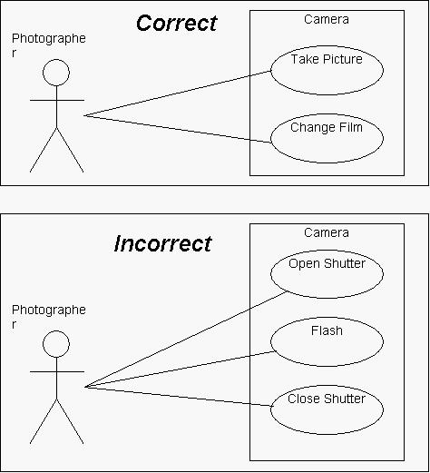
Unified Modeling Language
One of the best-known specifications maintained by OMG is the Unified Modeling Language (UML). The UML is a language for specifying, visualizing, constructing, and documenting the deliverables of software systems, as well as for business modelling and other non-software systems.

Slide 7
BENEFITS OF OOM
Improve productivity : Application development is facilitated by the reuse of existing components which can greatly improve the productivity and facilitate rapid delivery.
Deliver high quality system : The quality of the system can be improved as the system is built up in a component manner with the use of existing components which are well-tested and well-proven.
Lower maintenance cost : The associated property of traceability of OOM can help to ensure the impact of change is localised and the problem area can be easily traced. As a result, the maintenance cost can be reduced.
Facilitate reuse : With this approach, a computer system can be developed on a component basis that enables the effective re-use of existing components.
Manage complexity : The use of OOM eases the process in managing complexity. By the breaking down of a complex solution into different components and with each component encapsulated (e.g. treated as a black box) from others, complex development can be better managed.

Slide 8
The OOM life cycle
Business Planning
Business Architecture Definition
Technical Architecture Definition
Incremental Delivery Planning
Incremental Design & Build
Deployment

Slide 9
Object Oriented Language
Java
C++
Python
PHP
C#
JavaScript

Slide 10
History of Java
Java is a programming language created by James Gosling & Patrick Naughton from Sun Microsystems (Sun) in 1991.
The first publicly available version of Java (Java 1.0) was released in 1995. Sun Microsystems was acquired by the Oracle Corporation in 2010. Oracle has now the steermanship for Java.
The target of Java is to write a program once and then run this program on multiple operating systems. In 2006 Sun started to make Java available under the GNU General Public License (GPL). Oracle continues this project called OpenJDK.
The current version of Java is Java 1.8 which is also known as Java 8.

Slide 11
Working Mechanism of Java
In the Java programming language, all source code is first written in plain text files ending with the .java extension.
Those source files are then compiled into .class files by the javac compiler. A .class file does not contain code that is native to your processor; it instead contains bytecodes — the machine language of the Java Virtual Machine1(Java VM).
The java launcher tool then runs your application with an instance of the Java Virtual Machine.

Slide 12
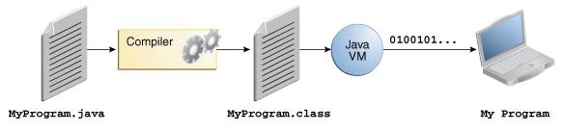
Working Mechanism of Java

Slide 13
Main Features of JAVA
Platform independent
Object-orientated programming language
Strongly-typed programming language
Simple
Robust Language
Secure
Multithreading
Portable

Slide 14
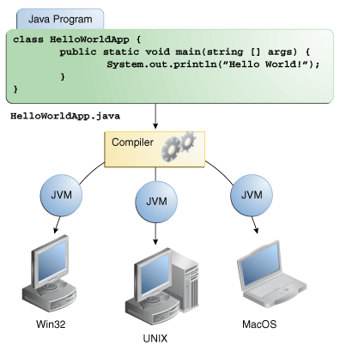
Platform independent
Java programs use the Java virtual machine as abstraction and do not access the operating system directly. So this reason Java program (which is standard-compliant and follows certain rules) can run unmodified on all supported platforms, e.g., Windows or Linux.

Slide 15
Object-orientated programming language
4 main concepts of Object Oriented programming are:
Abstraction : Abstraction is managed by well-defined objects and their hierarchical classification.
Encapsulation : Binding the data with the code that manipulates it & It keeps the data and the code safe from external interference
Inheritance : Inheritance is the mechanism by which an object acquires the some/all properties of another object.
Polymorphism : Polymorphism means to process objects differently based on their data type.

Slide 16
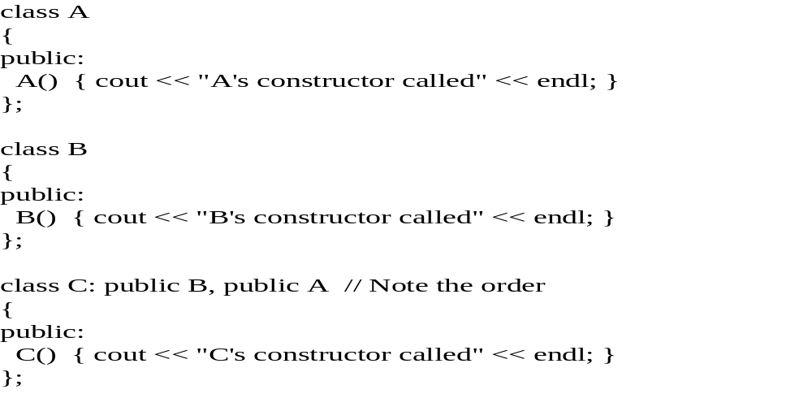
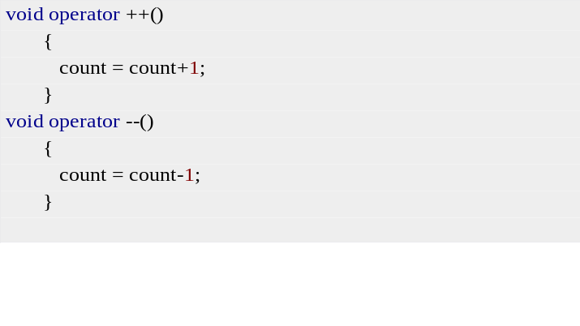
Simple
Java is considered as one of simple language because it does not have complex features like Operator overloading, Multiple inheritance, pointers and Explicit memory allocation.

Slide 17
Robust Language
Two main problems that cause program failures are memory management mistakes and mishandled runtime errors. Java handles both of them efficiently.
    1) Memory management mistakes can be overcome by garbage collection. Garbage collection is automatic de-allocation of objects which are no longer needed.
    2) Mishandled runtime errors are resolved by Exception Handling procedures.

Slide 18
Secure
It provides a virtual firewall between the application and the computer. Java codes are confined within Java Runtime Environment (JRE) thus it does not grant unauthorized access on the system resources.
Firewall
A firewall is a network security system that monitors and controls the incoming and outgoing network traffic based on predetermined security rules.A firewall typically establishes a barrier between a trusted, secure internal network and another outside network.

Slide 19
Multithreading
A thread is a light-weight smallest part of a process that can run concurrently with the other parts(other threads) of the same process.
Threads are independent because they all have separate path of execution that’s the reason if an exception occurs in one thread, it doesn’t affect the execution of other threads.
All threads of a process share the common memory. The process of executing multiple threads simultaneously is known as multithreading.

Slide 20
Java virtual machine
The Java virtual machine (JVM) is a software implementation of a computer that executes programs like a real machine.
The Java virtual machine is written specifically for a specific operating system, e.g., for Linux a special implementation is required as well as for Windows.
Java programs are compiled by the Java compiler into bytecode. The Java virtual machine interprets this bytecode and executes the Java program.

Slide 21
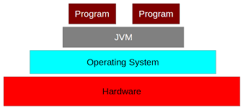
Java virtual machine

Slide 22
Environment Setup
Java Runtime Environment (JRE) and the Java Development Kit (JDK).
Eclipse or any other Integrated Development Environment (IDE).
Setting Up the Path for Windows :
  Assuming you have installed Java in c:\Program Files\java\jdk directory −
  Right-click on 'My Computer' and select 'Properties'.
  Click the 'Environment variables' button under the 'Advanced' tab.
  Now, alter the 'Path' variable so that it also contains the path to the Java executable. Example, if the path is currently set to 'C:\WINDOWS\SYSTEM32', then change your path to read 'C:\WINDOWS\SYSTEM32;c:\Program Files\java\jdk\bin'.
https://www.ntu.edu.sg/home/ehchua/programming/howto/EclipseJava_HowTo.html

Slide 23
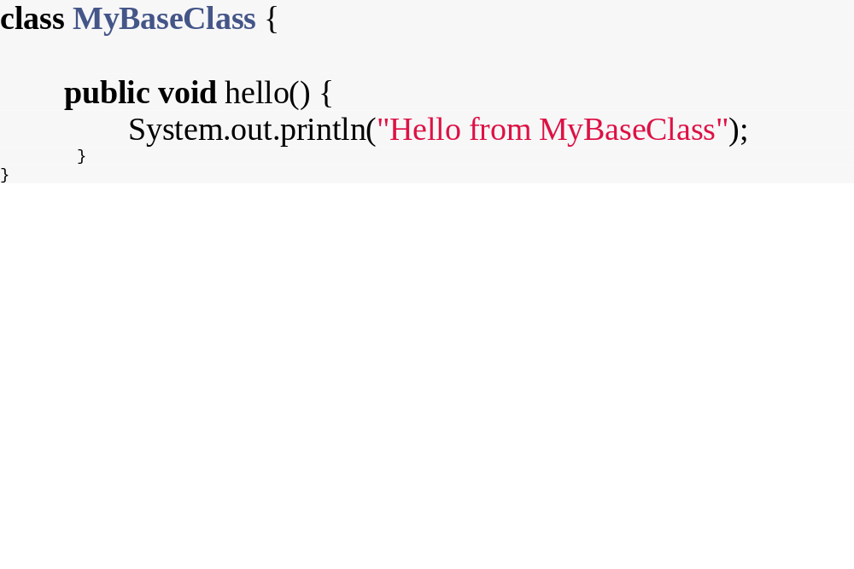
Hello World Program

Slide 24
  Questions?

