Slide 1
Object Oriented Methodology
Md. Mujahid Islam
Software Developer & Guest Lecturer

Slide 2
What Is an Object?
Real-world objects share two characteristics: They all have state and behavior. Dogs have state (name, color, breed, hungry) and behavior (barking, fetching, wagging tail). Bicycles also have state (current gear, current pedal cadence, current speed) and behavior (changing gear, changing pedal cadence, applying brakes).
For each object that you see, ask yourself two questions: "What possible states can this object be in?" and "What possible behavior can this object perform?".

Slide 3
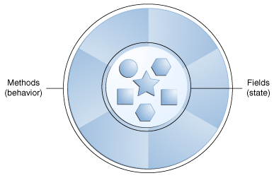
What Is an Object?

Slide 4
What is Object Oriented Methodology?
Object Oriented Methodology (OOM) is a system development approach encouraging and facilitating re-use of software components. With this methodology, a computer system can be developed on a component basis which enables the effective re-use of existing components and facilitates the sharing of its components by other systems.
By the adoption of OOM, higher productivity, lower maintenance cost and better quality can be achieved.
This methodology employs international standard Unified Modeling Language (UML) from the Object Management Group (OMG). UML is a modeling standard for OO analysis and design which has been widely adopted in the IT industry.

Slide 5
HISTORY OF OOM
The use of OOM for analysing and designing systems began to mature towards 1990 with the launch of methodologies from the three industry-leading methodologists : Ivar Jacobson, Grady Booch and James Rumbaugh.
In 1989, the Object Management Group (OMG) was founded. The mission of OMG is to establish industry guidelines, detailed object management specifications and common frameworks for application development.

Slide 6
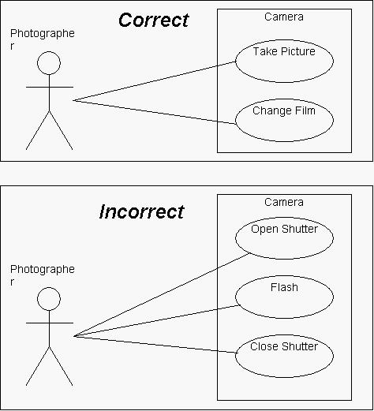
Unified Modeling Language
One of the best-known specifications maintained by OMG is the Unified Modeling Language (UML). The UML is a language for specifying, visualizing, constructing, and documenting the deliverables of software systems, as well as for business modelling and other non-software systems.

Slide 7
BENEFITS OF OOM
Improve productivity : Application development is facilitated by the reuse of existing components which can greatly improve the productivity and facilitate rapid delivery.
Deliver high quality system : The quality of the system can be improved as the system is built up in a component manner with the use of existing components which are well-tested and well-proven.
Lower maintenance cost : The associated property of traceability of OOM can help to ensure the impact of change is localised and the problem area can be easily traced. As a result, the maintenance cost can be reduced.
Facilitate reuse : With this approach, a computer system can be developed on a component basis that enables the effective re-use of existing components.
Manage complexity : The use of OOM eases the process in managing complexity. By the breaking down of a complex solution into different components and with each component encapsulated (e.g. treated as a black box) from others, complex development can be better managed.

Slide 8
  Questions?

