Slide 1
Object Oriented Methodology
Md. Mujahid Islam
Software Developer & Guest Lecturer

Slide 2
Computer
A computer is a device that can be instructed to carry out an arbitrary set of arithmetic or logical operations automatically.
A modern computer consists of at least one processing element, typically a central processing unit (CPU), and some form of memory.
Charles Babbage, an English mechanical engineer and polymath, originated the concept of a programmable computer. Considered the "father of the computer", he conceptualized and invented the first mechanical computer in the early 19th century.

Slide 3
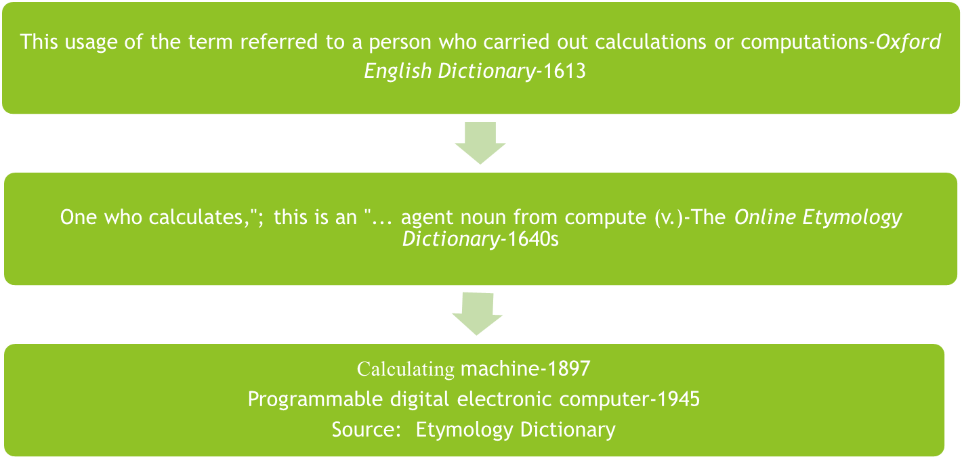
Computer Etymology

Slide 4
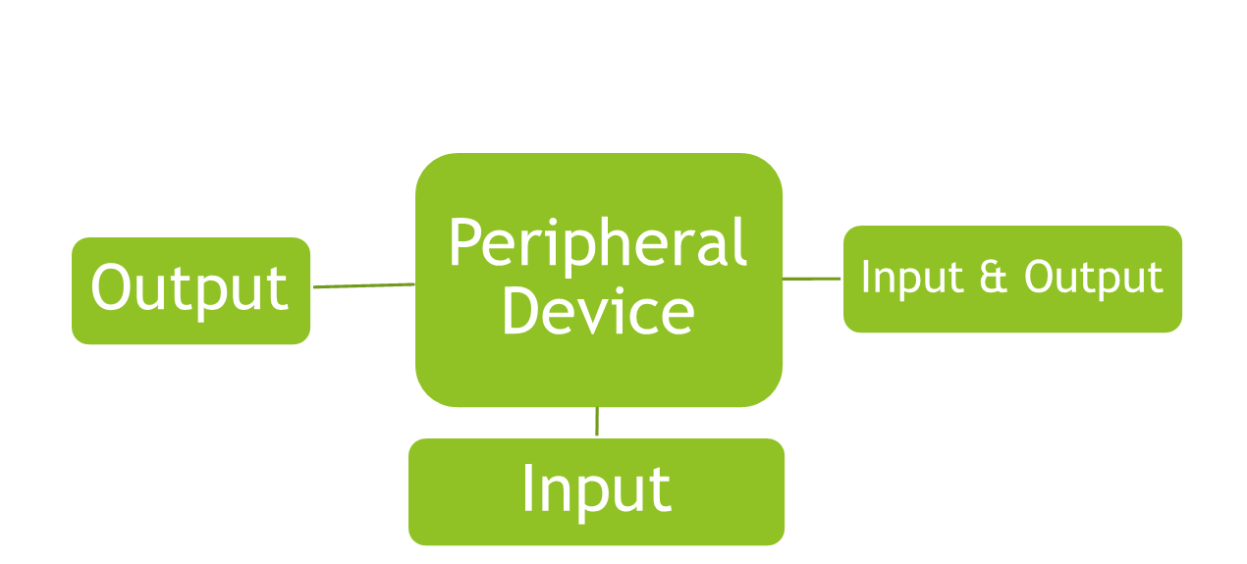
Peripheral Device
A peripheral is "an ancillary device used to put information into and get information out of the computer".

Slide 5
Memory
Memory refers to the computer hardware devices involved to store information for immediate use in a computer; it is synonymous with the term "primary storage".
Computer memory operates at a high speed, for example random-access memory (RAM), as a distinction from storage that provides slow-to-access program and data storage but offers higher capacities.
If needed, contents of the computer memory can be transferred to secondary storage, through a memory management technique called "virtual memory". An archaic synonym for memory is store.

Slide 6
Computer Multitasking
In computing, multitasking is a concept of performing multiple tasks (also known as processes) over a certain period of time by executing them concurrently.
New tasks start and interrupt already started ones before they have reached completion, instead of executing the tasks sequentially so each started task needs to reach its end before a new one is started. As a result, a computer executes segments of multiple tasks in an interleaved manner, while the tasks share common processing resources such as central processing units (CPUs) and main memory.
Multitasking does not necessarily mean that multiple tasks are executing at exactly the same time (simultaneously). In other words, multitasking does not imply parallel execution, but it does mean that more than one task can be part-way through execution at the same time, and that more than one task is advancing over a given period of time

Slide 7
Multiprocessing
Multiprocessing is the use of two or more central processing units (CPUs) within a single computer system.
The term also refers to the ability of a system to support more than one processor or the ability to allocate tasks between them.
According to some on-line dictionaries, a multiprocessor is a computer system having two or more processing units (multiple processors) each sharing main memory and peripherals, in order to simultaneously process programs.

Slide 8
Multiprocessing
Multiprocessing is the use of two or more central processing units (CPUs) within a single computer system.
The term also refers to the ability of a system to support more than one processor or the ability to allocate tasks between them.
According to some on-line dictionaries, a multiprocessor is a computer system having two or more processing units (multiple processors) each sharing main memory and peripherals, in order to simultaneously process programs.

Slide 9
Basic Term
Data
Information
Program
Hardware
System S/W & Application Software
Algorithm
Pseudo Code
Arithmetic & Logical Operation
Computer Bus : Control bus, Address bus, memory bus

Slide 10
Software
SW and S/W, software is a collection of instructions that enable the user to interact with a computer, its hardware, or perform tasks. Without software, most computers would be useless. According to some on-line dictionaries, a multiprocessor is a computer system having two or more processing units (multiple processors) each sharing main memory and peripherals, in order to simultaneously process programs.
There are three type of S/W :
  Application Software
  System Software: Operating Systems, Device Driver, Utilities Software
  Malware Software

Slide 11
  Questions?

