Slide 1
Object Oriented Methodology Lab
Md. Mujahid Islam
Software Developer & Guest Lecturer

Slide 2
Defining Classes for Objects
A class defines the properties and behaviors for objects.
A class is a template, blueprint,or contract that defines what an object’s data fields and methods will be. An object is an instance of a class.
An object has a unique identity, state, and behavior.
  The state of an object (also known as its properties or attributes) is represented by data fields with their current values.
  The behavior of an object (also known as its actions) is defined by methods.

Slide 3
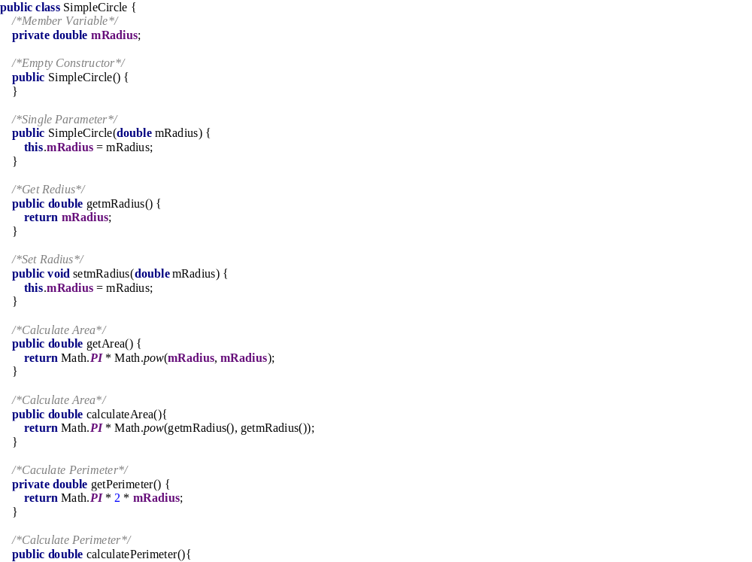
Define Class

Slide 4
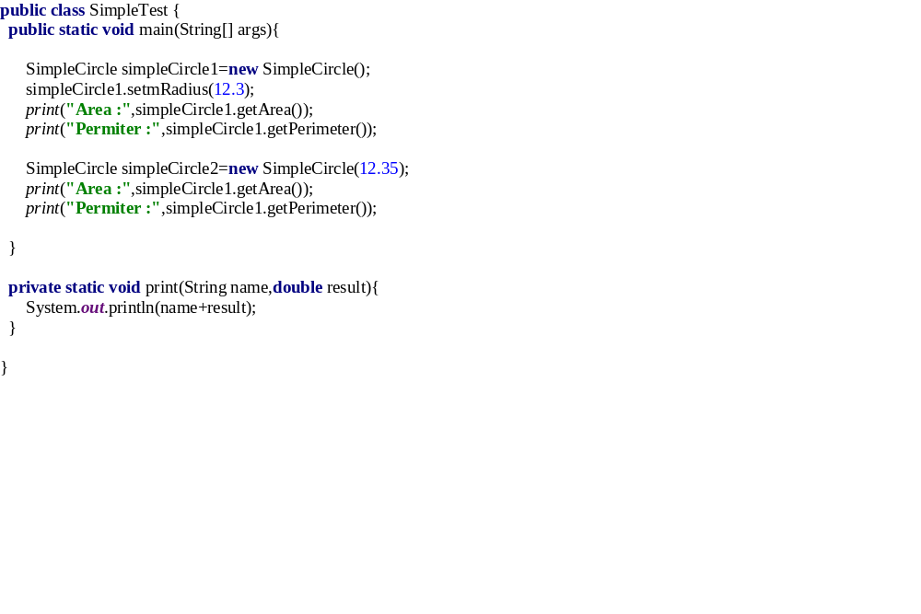
Define Object

Slide 5

Constructing Objects Using Constructors
Constructors are a special kind of method. They have three peculiarities:
  A constructor must have the same name as the class itself.
  Constructors do not have a return type—not even void.
  Constructors are invoked using the new operator when an object is created. Constructors play the role of initializing objects.

Slide 6
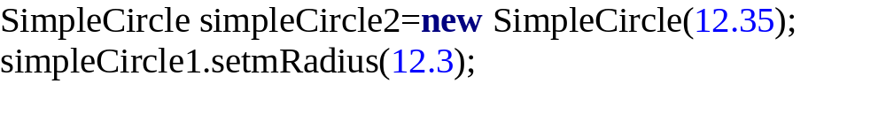
Accessing an Object’s Data and Methods
After an object is created, its data can be accessed and its methods invoked using the dot operator (.), also known as the object member access operator:
  objectRefVar.dataField references a data field in the object.
  objectRefVar.method(arguments) invokes a method on the object.

Slide 7
  Questions?

