Slide 1
Object Oriented Methodology Lab
Md. Mujahid Islam
Software Developer & Guest Lecturer

Slide 2
Iteration Statements
Java’s iteration statements are for, while, and do-while. These statements create what we commonly call loops.
As you probably know, a loop repeatedly executes the same set of instructions until a termination condition is met.

Slide 3
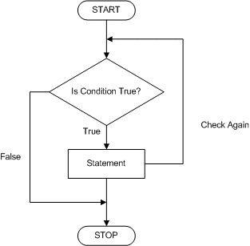
While Loop Flowchart

Slide 4
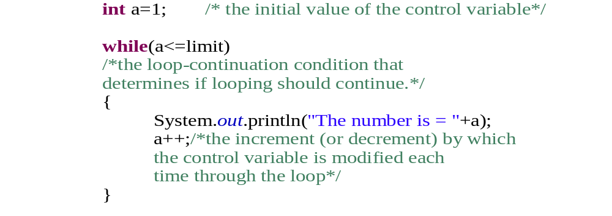
While Loop

Slide 5
For Loop Flowchart

Slide 6
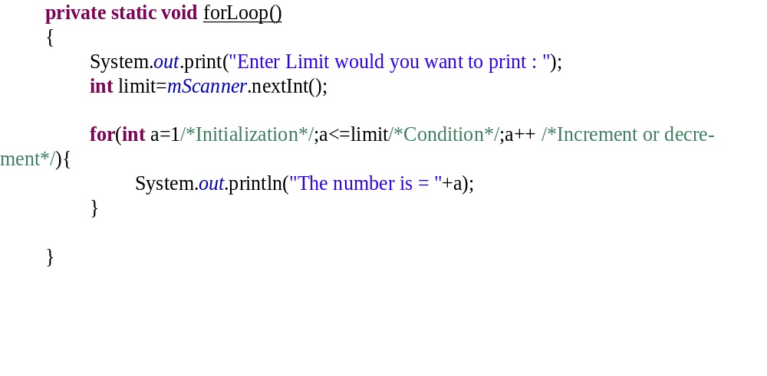
For Loop

Slide 7
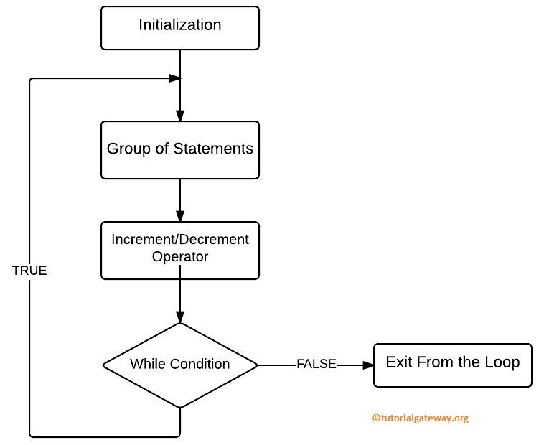
Do-While loop

Slide 8
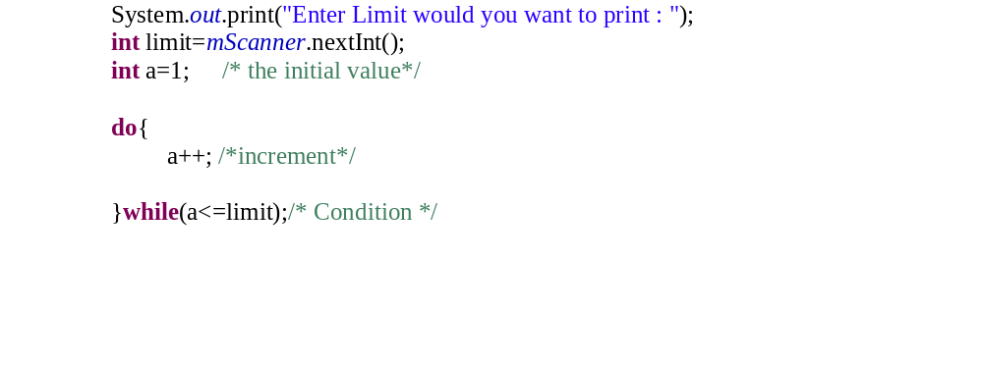
Do-While loop

Slide 9
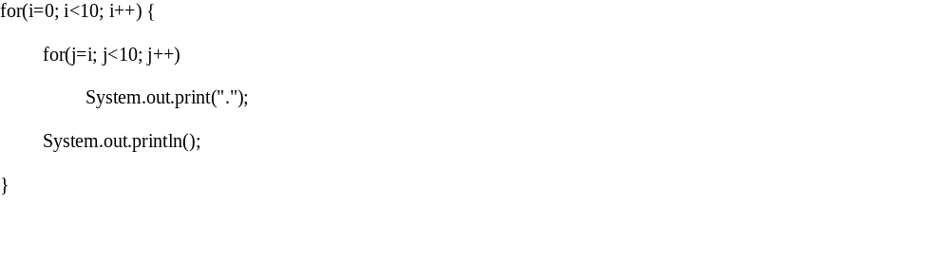
Nested Loop

Slide 10
  Source Code
  Variable Naming convention

Slide 11
  Questions?

