Slide 1
Object Oriented Methodology Lab
Md. Mujahid Islam
Software Developer & Guest Lecturer

Slide 2
Jump Statements
Java supports three jump statements: break, continue, and return.
These statements transfer control to another part of your program. Each is examined here.

Slide 3
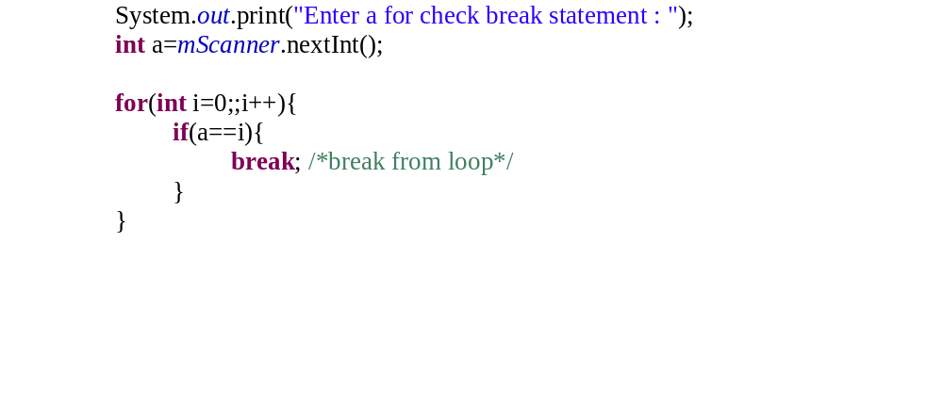
Break Statement

Slide 4
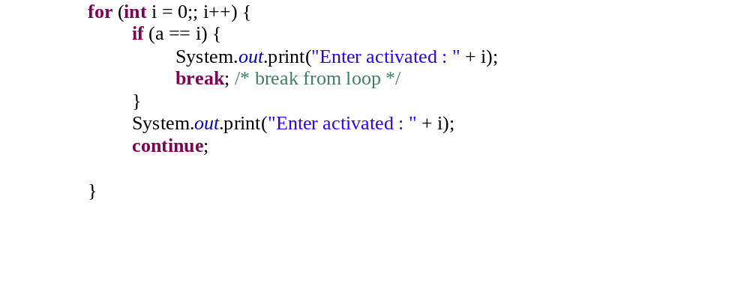
Continue Statement

Slide 5
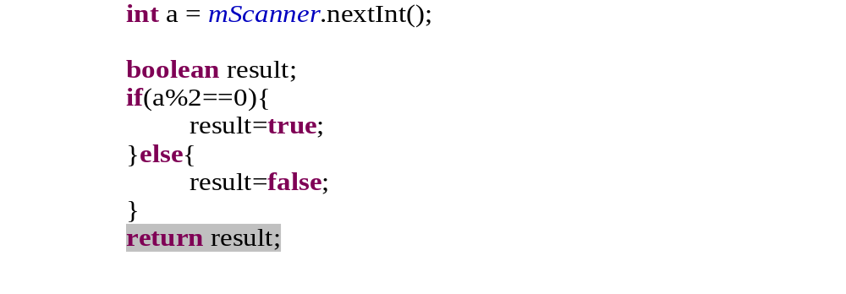
Return Statement

Slide 6
  Source Code
  Variable Naming convention

Slide 7
  Questions?

