Slide 1
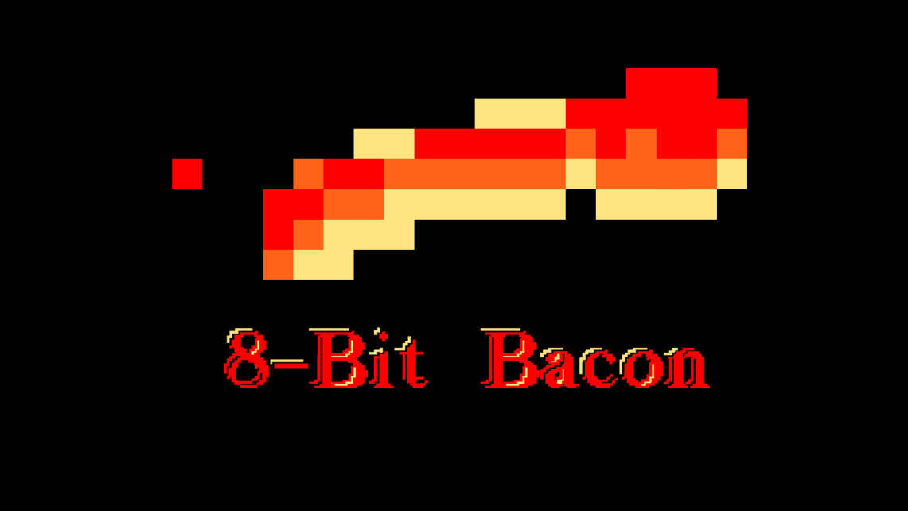
Programmers:
Sean Welch
CJ Meade
Matthew Birky
Daniel Lima
Roberto Rubiano
Anton Lopez
Justin Maza
Artists:
Oscar Valera
Santiago Hoyos
Team Members:

Slide 2
Brainstorm 1 (WIP) Hack-n-Slash RPG

Slide 3
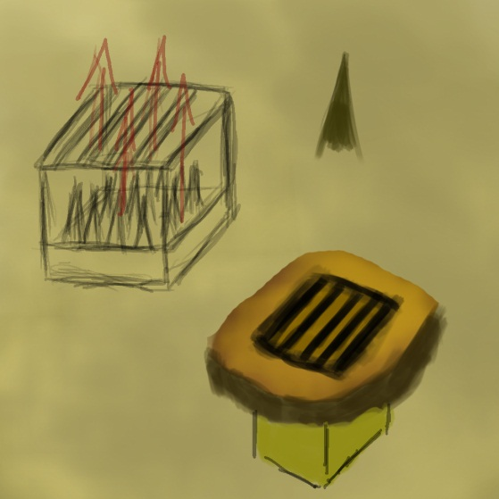
Game Mood and Pace
Intense
Constant waves of enemies
Environment keeps you moving
Fast-paced
Won’t die from getting hit a few times
Any environmental effects won’t kill the player instantly

Slide 4
Player Actions
Dash – 25%
Dodge enemy attacks and environmental effects
Close distance to ranged enemies
Manipulate the environment(pushing boxes, buttons, etc)
Attack – 75%
Damage Enemies
Destroy Environment
Deflect Ranged attacks

Slide 5
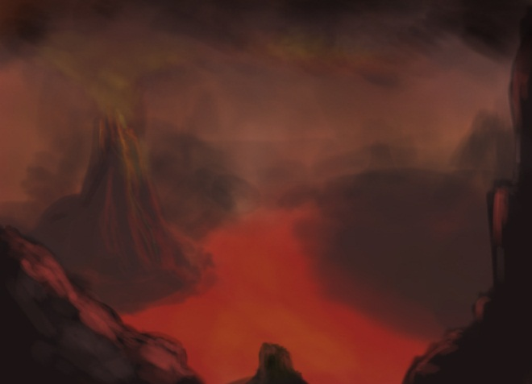
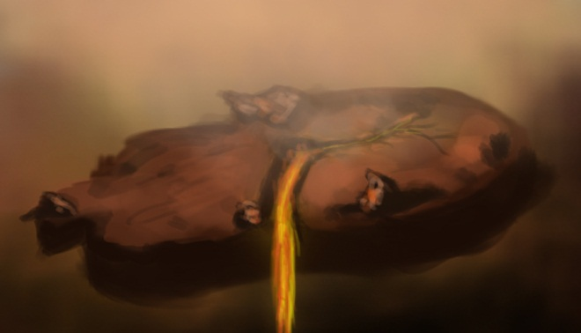
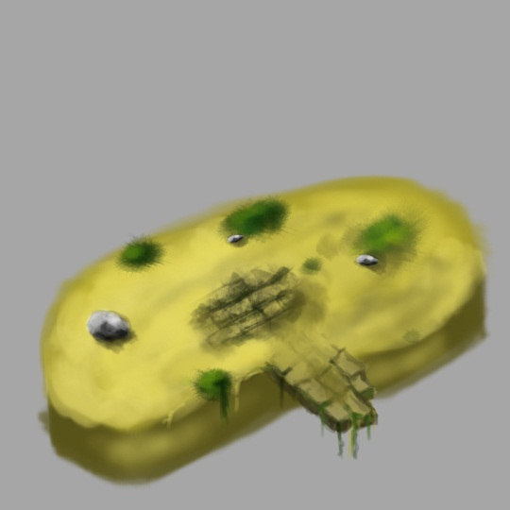
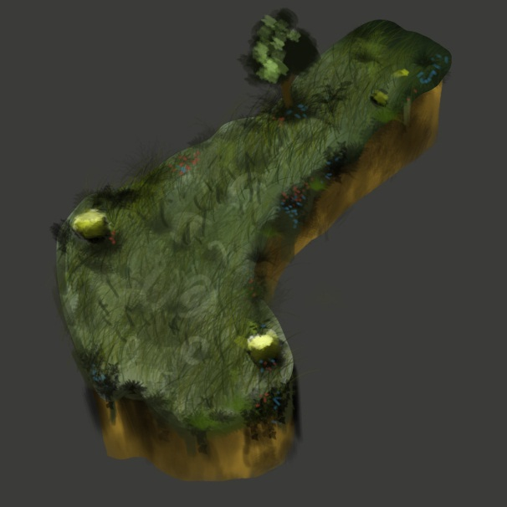
Where
Alternate fantasy realm

Slide 6
Game Structure

Slide 7
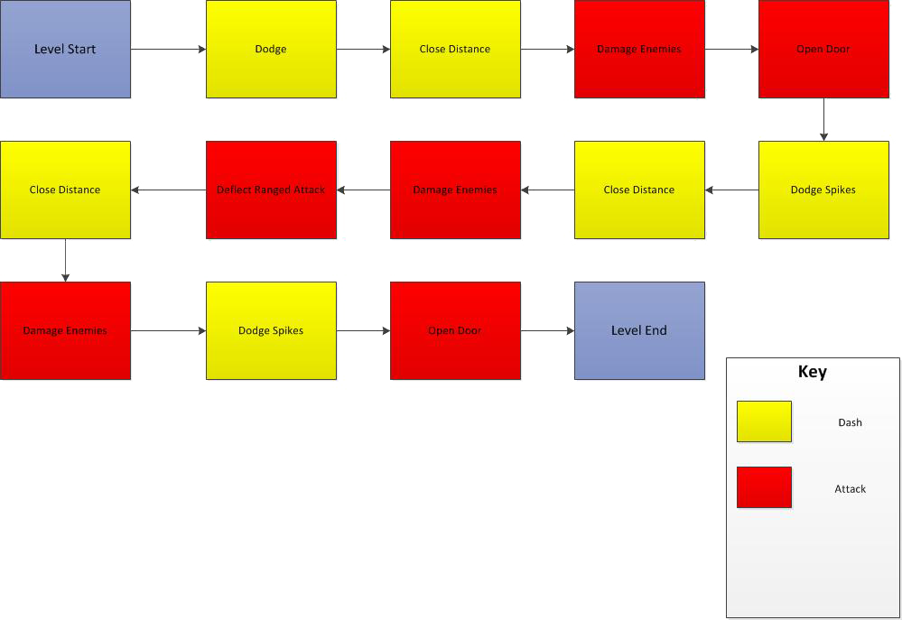
Level Flow

Slide 8
Questions?

Slide 9
Brainstorm 2 (WIP) First-Person Shooter

Slide 10
Game Mood and Pace
Intense
Possibility of enemies appearing spontaneously
Moderate
Taking a few hits from enemies will kill the player
Environment can shield you

Slide 11
Player Actions
Shoot – 50%
Kill Enemies
Manipulate Environment
Sprint – 30%
Run Away
Get To Cover
Collect Items
Crouch – 20%
Hide Behind Cover
Increase Accuracy
Smaller Target

Slide 12
Where
Modern day urban environment

Slide 13
Game Structure

Slide 14
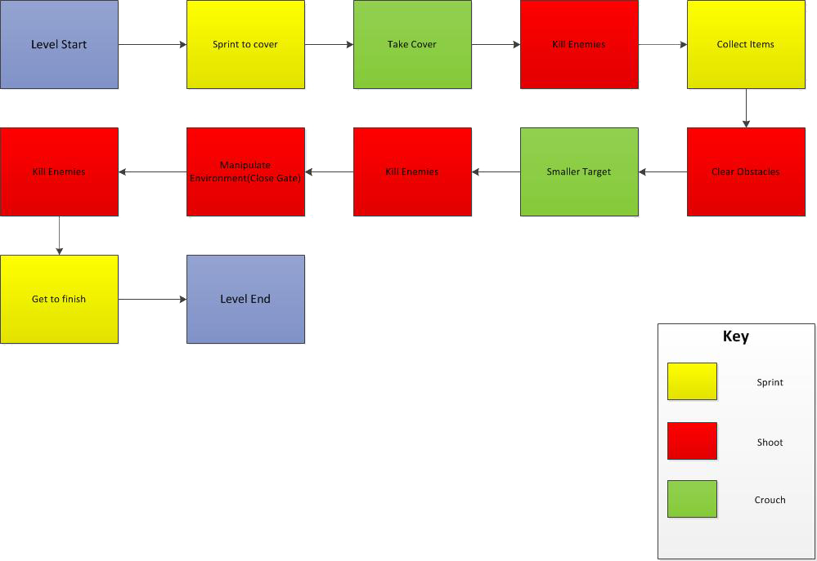
Level Flow

Slide 15
Questions?

