Slide 1
Inf-Sem-MathMed: Mathematische Methoden in der Informatik
First-Order Theorem
Proving
Vampire
19.06.2015
Maximilian Reinhart, Martin Bittermann
Notes:
name, datum, etc

Slide 2
Background information
First implementation 1993
v 2.6 started in 2009
~ 152k SLOC
developed at University of Manchester
multi-platform (Linux, Win, Mac)
multi-threaded
won many CASC trophies
integrated in Sledgehammer/Isabelle/HOL
Notes:
-behauptet "very simple way of use" -> dem ist nicht so
-schnell

Slide 3
CASC Comparison
 | THF | FOF | CNF | SAT | EPR
CASC‑J7 (2014) | Satallax‑MaLeS 1.3 | Vampire 2.6 | - | - | iProver 0.9
CASC‑24 (2013) | Satallax‑MaLeS 1.2 | Vampire 2.6 | - | - | iProver 0.9
CASC‑J6 (2012) | Isabelle 2012 | Vampire 2.6 | - | - | iProver 0.9
CASC‑23 (2011) | Satallax 2.1 | Vampire 0.6 | E 1.4pre | - | iProver 0.9
CASC‑J5 (2010) | LEO‑II 1.2 | Vampire 0.6 (A&P) | Vampire 0.6 | - | iProver 0.8
CASC‑22 (2009) | TPS 3.080227G1d | Vampire 11.0 (A&P) | Vampire 10.0 | Paradox 3.0 | iProver 0.7
CASC‑J4 (2008) | - | Vampire 10.0 (A&P) | Vampire 10.0 | MetaProver 1.0 | iProver 0.5
CASC‑21 (2007) | - | Vampire 9.0 (A&P) | Vampire 8.1 (A&P) | Paradox 1.3 (A&M) | Darwin 1.3
CASC‑J3 (2006) | - | Vampire 8.1 (A&P) | Vampire 8.1 (A&P) | Paradox 1.3 (A&M) | Darwin 1.3
CASC‑20 (2005) | - | Vampire 8.0 (A&P) | Vampire 8.0 (A&P) | Paradox 1.3 (A&M) | DCTP 10.21p
CASC‑J2 (2004) | - | Vampire 7.0 (A&P) | Vampire 7.0 (A&P) | Gandalf c‑2.6‑SAT (A) Paradox 1.0‑casc (M) | DCTP 10.21p

Slide 4
Features
can prove (typed) first-order theorems
can reason about integers, reals, arrays, strings
limited resource strategy
CASC mode
can answer queries to large knowledge databases

Slide 5
Proving strategy
Vampire's algorithm
read the problem
determine proof-search options to be used for this problem
preprocess the problem
convert it into conjunctive normal form (cnf)
run a saturation algorithm on it
report the result, maybe including a refutation.

Slide 6
Basic principle: Proof by refutation
Negate the conjecture
Add it to the axioms and assumptions
Try to infer $false
  Refutation found (clause set is unsatisfiable)
  ==> Conjecture proven
  Satisfiable
  ==> Conjecture disproved
  Terminated by user or time or memory limit
  ==> Undecided
Notes:
Satisfiable: Was das bedeutet erklären wir später (Punkt 3.4 Saturation im paper)
->mbit

Slide 7
Saturation algorithm
Saturated set of S: Contains S,
no more formulas can be inferred under the inference system
Infers formulas from the given clause set, S
Each iteration, select an inference rule, apply it to formulas from S, add conclusion to S.
S is unsatisfiable <=> smallest saturated set containing S contains $false
S is satisfiable <=> smallest saturated set containing S does not contain $false

Slide 8

TPTP
Problem language accepted by Vampire
Used by the
Thousands of Problems for Theorem Provers (TPTP) library
There is also a corresponding Thousands of Solutions for Theorem Provers (TSTP) library
TPTP supported formula types:
FOF (first order formula)
TFF (typed first order formula)
CNF (clause normal form)
TPI (TPTP Process Instruction Language)
THF (typed higher order form)
Notes:
Klammermenge aus Lisp (lost of irritating superfluous parentheses)
Logik recht Prolog ähnlich
CNF!=CNF
(Vampire: conjunctive normal form,
TPTP: Clause Normal form)
->mbit

Slide 9
TPTP syntax guide
Notes:
TPTP Syntax mit Prover9 vergleichen
->mrei

Slide 10
TPTP syntax guide
(writing a formula)
fof(sum, axiom, ( ! [X,A] :
( member(X,sum(A)) <=> ? [Y] : ( member(Y,A) & member(X,Y))))).
problem_syntax (name, role, formula)
axiom
hypothesis
conjecture
...
fof(...)
tff(...)
cnf(...)
...
Notes:
TPTP Syntax mit Prover9 vergleichen
->mrei

Slide 11
Example 1: Trivial set problem
Notes:
->mbit

Slide 12
Required axioms:
fof(intersection,axiom,
( ! [X,A,B] :
( member(X,intersection(A,B))
<=> ( member(X,A)
& member(X,B) ) ) )).
fof(union,axiom,
( ! [X,A,B] :
( member(X,union(A,B))
<=> ( member(X,A)
| member(X,B) ) ) )).
fof(subset,axiom,
( ! [A,B] :
( subset(A,B)
<=> ! [X] :
( member(X,A)
=> member(X,B) ) ) )).
(from the TPTP problem library)
Notes:
Erklären!
Prologähnlichkeit

Slide 13
TPTP input file for Vampire
%----Include set theory definitions
include('Axioms/SET006+0.ax').
%----Conjecture to prove
fof(intInUnion, conjecture,
( ! [A,B] : (subset(intersection(A,B), union(A,B))))).
Notes:
erklärung...
include bindet datei ein, die alle mengenaxiome definiert

Slide 14
Vampire's output (pt. 1)
Refutation found. Thanks to Tanya!
1452. $false (3:0) [resolution 355,74]
74. ~subset(intersection(sK3,sK4),union(sK3,sK4)) (0:7) [cnf transformation 47]
47. ~subset(intersection(sK3,sK4),union(sK3,sK4)) [skolemisation 27]
27. ? [X0,X1] : ~subset(intersection(X0,X1),union(X0,X1)) [ennf transformation 13]
13. ~! [X0,X1] : subset(intersection(X0,X1),union(X0,X1)) [negated conjecture 12]
12. ! [X0,X1] : subset(intersection(X0,X1),union(X0,X1)) [input]
355. subset(intersection(X5,X6),union(X5,X7)) (2:7) [duplicate literal removal 340]
340. subset(intersection(X5,X6),union(X5,X7)) | subset(intersection(X5,X6),union(X5,X7)) (2:14) [resolution 86,84]
84. member(sK0(X0,intersection(X1,X2)),X1) | subset(intersection(X1,X2),X0) (1:12) [resolution 53,49]
49. member(sK0(X1,X0),X0) | subset(X0,X1) (0:8) [cnf transformation 30]
30. ! [X0,X1] : ((~subset(X0,X1) | ! [X3] : (~member(X3,X0) | member(X3,X1))) & ((member(sK0(X1,X0),X0) & ~member(sK0(X1,X0),X1)) | subset(X0,X1))) [skolemisation 29]
29. ! [X0,X1] : ((~subset(X0,X1) | ! [X3] : (~member(X3,X0) | member(X3,X1))) & (? [X2] : (member(X2,X0) & ~member(X2,X1)) | subset(X0,X1))) [rectify 28]
28. ! [X0,X1] : ((~subset(X0,X1) | ! [X2] : (~member(X2,X0) | member(X2,X1))) & (? [X2] : (member(X2,X0) & ~member(X2,X1)) | subset(X0,X1))) [nnf transformation 25]
25. ! [X0,X1] : (subset(X0,X1) <=> ! [X2] : (~member(X2,X0) | member(X2,X1))) [ennf transformation 1]
1. ! [X0,X1] : (subset(X0,X1) <=> ! [X2] : (member(X2,X0) => member(X2,X1))) [input]
53. ~member(X0,intersection(X1,X2)) | member(X0,X1) (0:8) [cnf transformation 33]
33. ! [X0,X1,X2] : ((~member(X0,intersection(X1,X2)) | (member(X0,X1) & member(X0,X2))) & (~member(X0,X1) | ~member(X0,X2) | member(X0,intersection(X1,X2)))) [flattening 32]
32. ! [X0,X1,X2] : ((~member(X0,intersection(X1,X2)) | (member(X0,X1) & member(X0,X2))) & ((~member(X0,X1) | ~member(X0,X2)) | member(X0,intersection(X1,X2)))) [nnf transformation 15]
15. ! [X0,X1,X2] : (member(X0,intersection(X1,X2)) <=> (member(X0,X1) & member(X0,X2))) [rectify 4]
4. ! [X2,X0,X1] : (member(X2,intersection(X0,X1)) <=> (member(X2,X0) & member(X2,X1))) [input]
86. ~member(sK0(union(X0,X1),X2),X0) | subset(X2,union(X0,X1)) (1:12) [resolution 57,50]
50. ~member(sK0(X1,X0),X1) | subset(X0,X1) (0:8) [cnf transformation 30]
57. member(X0,union(X1,X2)) | ~member(X0,X1) (0:8) [cnf transformation 35]
35. ! [X0,X1,X2] : ((~member(X0,union(X1,X2)) | member(X0,X1) | member(X0,X2)) & ((~member(X0,X1) & ~member(X0,X2)) | member(X0,union(X1,X2)))) [flattening 34]
34. ! [X0,X1,X2] : ((~member(X0,union(X1,X2)) | (member(X0,X1) | member(X0,X2))) & ((~member(X0,X1) & ~member(X0,X2)) | member(X0,union(X1,X2)))) [nnf transformation 16]
16. ! [X0,X1,X2] : (member(X0,union(X1,X2)) <=> (member(X0,X1) | member(X0,X2))) [rectify 5]
5. ! [X2,X0,X1] : (member(X2,union(X0,X1)) <=> (member(X2,X0) | member(X2,X1))) [input]
Notes:
unübersichtlich!

Slide 15
Output explained
DAG of inferences
Only shows formulas relevant to proof, internally generated many more
Vampire implements 79 inference rules
86. ~member(sK0(union(X0,X1),X2),X0) | subset(X2,union(X0,X1)) (1:12) [resolution 57,50]
Formula
number
Inferred formula
?
inference
rule
formulas used
in inference

Slide 16
Vampire's output (pt. 2)
[...]
16. ! [X0,X1,X2] : (member(X0,union(X1,X2)) <=> (member(X0,X1) | member(X0,X2))) [rectify 5]
5. ! [X2,X0,X1] : (member(X2,union(X0,X1)) <=> (member(X2,X0) | member(X2,X1))) [input]
------------------------------
Version: Vampire 3.0 (commit unknown)
Termination reason: Refutation
Active clauses: 141
Passive clauses: 1174
Generated clauses: 1406
Final active clauses: 141
Final passive clauses: 1029
Input formulas: 12
Initial clauses: 27
Unused predicate definitions: 1
Duplicate literals: 49
Simple tautologies: 13
Equational tautologies: 3
Forward subsumptions: 165
Backward subsumptions: 4
Binary resolution: 1324
Factoring: 3
Equality resolution: 3
Memory used [KB]: 1407
Time elapsed: 0.033 s
------------------------------
------------------------------
Statistics about:
Input and generated formulas
Termination reason
Memory and time (performance)
Notes:
unübersichtlich!

Slide 17
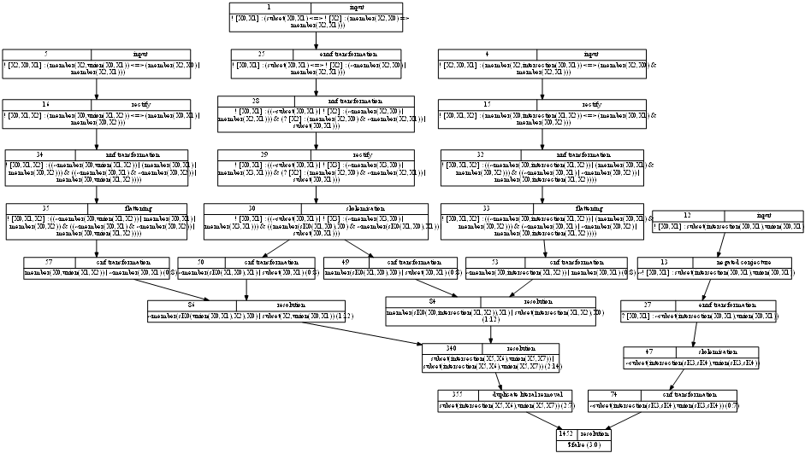
Output visualization
Notes:
aber so sieht es aus wenn man es aufarbeitet!

Slide 18
Example 2: Group theory
All order-2 groups are commutative
%---- 1*x = x
fof(left_identity, axiom, ! [X] : mult(e,X) = X).
%---- i(x)*x = 1
fof(left_inverse, axiom, ! [X] : mult(inverse(X),X) = e).
%---- (x*y)*z = x*(y*z)
fof(associativity, axiom, ! [X,Y,Z] : mult(mult(X,Y),Z) = mult(X,mult(Y,Z))).
%---- For all group elem.: x*x = 1 (order-2 group)
fof(group_of_order_2, hypothesis, ! [X] : mult(X,X) = e).
%---- prove x*y = y*x (commutativity)
fof(commutativity, conjecture, ! [X] : mult(X,Y) = mult(Y,X)).
Taken from the CAV 2003 Paper
First-Order Theorem Proving and VAMPIRE
Notes:
Gruppenaxiome erklären
Hypothese erklären->
Sei a Gruppenelement, x nat. Zahl
Ordnung x bedeutet :
x ist die kleinste nat. Zahl sodass a^{x} = e (neutr. Elem)

Slide 19
Example 2: Group theory
Example 3: Yesterday's group's group proofs
Example 4: Primitive Pythagorean triples
Example 5: COM003_1(The halting problem)
Example 6: ANA002-1 (Intermediate value theorem)
Example 7: ANA001-1 (Extreme value theorem)
All order-2 groups are commutative
Taken from the CAV 2003 Paper
First-Order Theorem Proving and VAMPIRE
Notes:
Gruppenaxiome erklären
Hypothese erklären->
Sei a Gruppenelement, x nat. Zahl
Ordnung x bedeutet :
x ist die kleinste nat. Zahl sodass a^{x} = e (neutr. Elem)

Slide 20
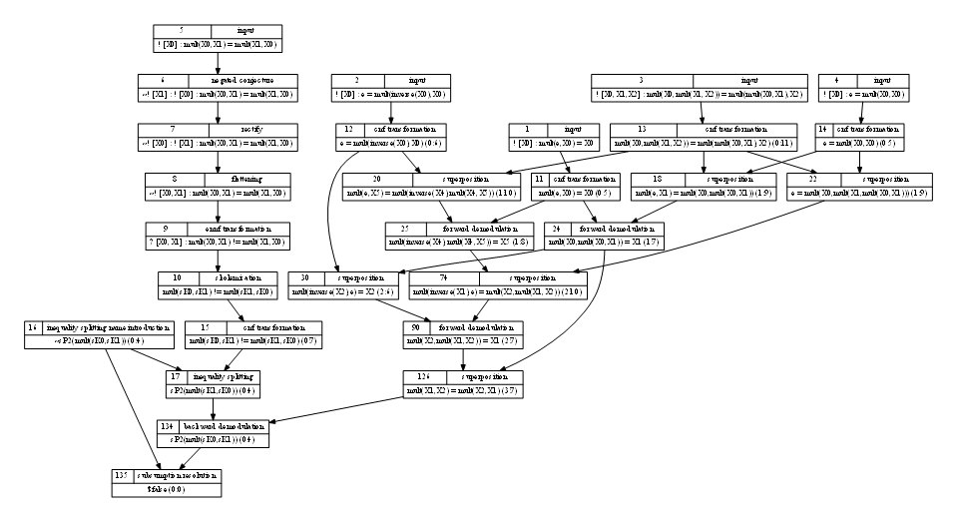
Output visualization

Slide 21
Performance comparison

Slide 22
Drawbacks
Documentation
  There is no manual
  No command line help (!) although there are many switches
  Getting-started and specific information found across various papers and slides
Distributed only in binary form
Currently not available through download
Closed development
Non-agile development cycle
Proprietary license

